Slide 1
TCAD simulation I
E. Giulio Villani
Instrumentation Training Lectures, Oxford 30/05/2023

Slide 2
Overview
Introduction, needs for TCAD simulations
Transport regimes and related equations
Discretization techniques: meshing
Discretization of semiconductor equations: Scharfetter-Gummel technique
Examples
Instrumentation Training Lectures, Oxford 30/05/2023

Slide 3




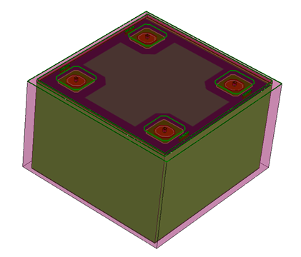
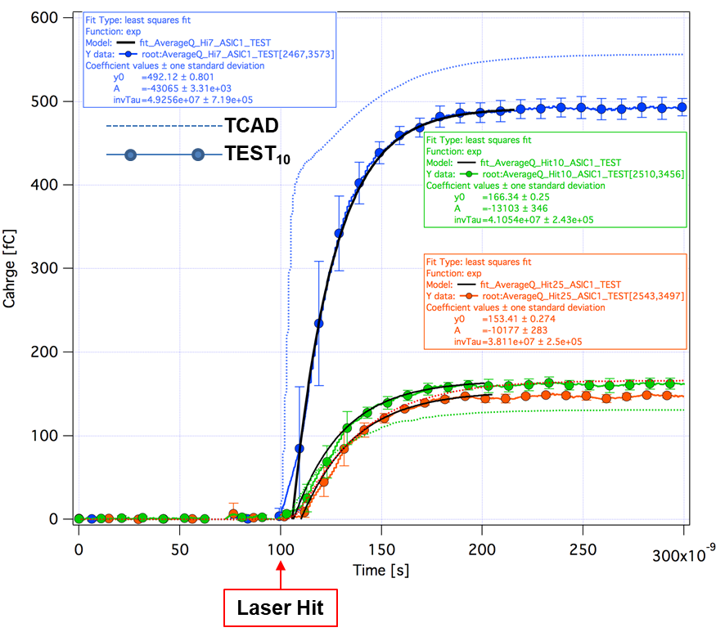
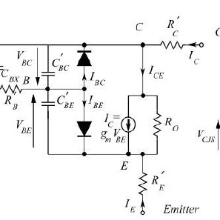
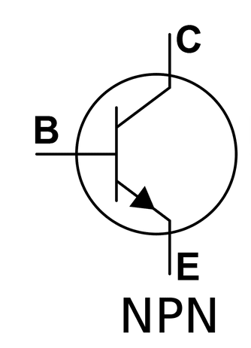

Introduction
Epitax growth
SiO₂ etch
N⁺⁺ implant
P⁺⁺ implant
TCAD (Technology Computer Aided Design) divides into three groups:
  Process simulation, i.e. simulation of fabrication process steps (oxidation, implantation, diffusion…)
  Device simulation, i.e. simulation of the thermal/electrical/optical behavior of electronic devices,(IV,CV, frequency response…)
  Device modeling, i.e. creating compact behavioral models for devices for circuit simulation (SPICE, Cadence…)
1
Instrumentation Training Lectures, Oxford 30/05/2023

Slide 4
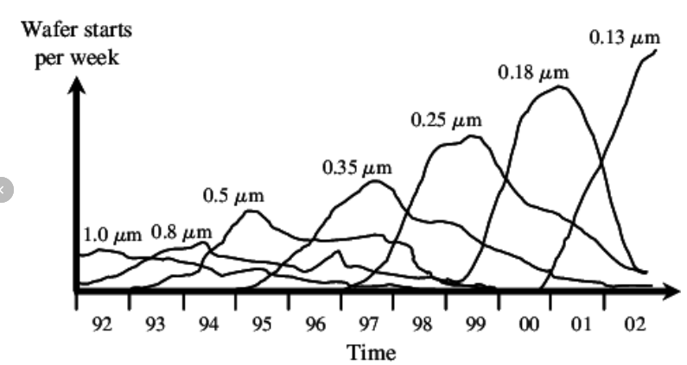
Introduction
  Reasons why TCAD simulations are needed:
    Market demands cycle of design to production of 18 months or less. Typically 2-3 months required for wafer tape out implies short time for development
    Reduce cost to run experiments on new devices and circuits
Shrinking product life cycles in semiconductor industry over time
2
Instrumentation Training Lectures, Oxford 30/05/2023

Slide 5
Introduction
Electronic structure/lattice dynamics
  Main components of semiconductor device simulation include description of electronic structure, driving forces and transport phenomena
  The two kernels of semiconductor transport equations and fields that drive charge flow are coupled to each other and needs solving self-consistently
Transport equations
Electromagnetic Fields
Device simulation
3
Instrumentation Training Lectures, Oxford 30/05/2023

Slide 6
Transport regimes
Usually only the quasi-static electric fields from the solution of Poisson’s equation are necessary for EM solutions
Transport regime in semiconductors depends on length scale
Modern Silicon technology already requires tools to describe transport in quantum regime [D. K. Ferry and S. M. Goodnick, Transport in Nanostructures, 1997]
L: device length
l_{e-e}: electron-electron scattering length
l_{e-ph}: electron-phonon scattering length
λ: electron wavelength
4
Instrumentation Training Lectures, Oxford 30/05/2023

Slide 7

Transport regimes
$R\sim \frac{h}{2π}\frac{γv}{<I>}\sim 1.2 \left[nm\right] Ionization radius for MIP in Si$ (Segre’, Nuclei and Particles, Vol. II)
$$n=\frac{dE}{dx}ρ\frac{L}{E_{th}}\frac{1}{πR^{2}L}\sim 2∙{10}^{19} charge density within Ionization radius and$$
$$n^{−1/3}\sim 3.6\left[nm\right]$$
$$λ≤\frac{h}{\sqrt{2meV_{b}}}\sim \left\{\begin{aligned}0.38 \left[nm\right]@10 V \\ 0.12 \left[nm\right]@100 V\end{aligned}\right.De Broglie wavelength of carriers$$
$@ full depletion$
Charge carrier dynamics in Si detectors usually does not require QM
Semiclassical laws of motions apply
Drift-diffusion equations are valid, provided the electron gas is in thermal equilibrium with lattice temperature (T_{n} = T_{L})
5
Instrumentation Training Lectures, Oxford 30/05/2023

Slide 8







Drift diffusion model
$$BTE$$
The semiconductor equations derived from 1st moment of BTE are referred to as Drift Diffusion model
The model consists of Poisson's equation, continuity and current density equations for electrons and holes
They express charge and momentum conservation
Their self-consistent solutions are obtained via discretization, using finite element methods (FEM)
$$Poisson$$
$$Continuity$$
$$Current density$$
6
Instrumentation Training Lectures, Oxford 30/05/2023

Slide 9
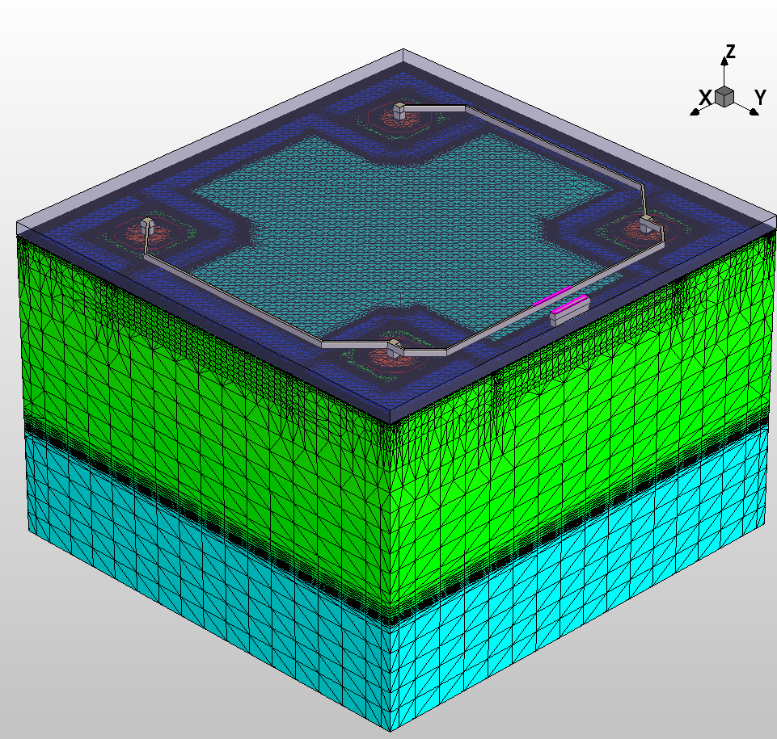
Discretization and meshing
The device simulations process consists of two steps:
1: The test volume is obtained through grid generation (‘mesh generation’ )
2: Solve the discretized differential equations using Finite-Boxes method (box integration method) . This method integrates PDEs over the test volume.
7
Instrumentation Training Lectures, Oxford 30/05/2023

Slide 10
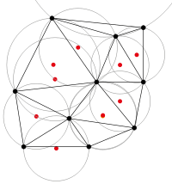
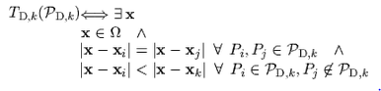
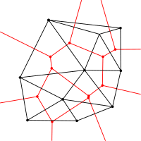
Discretization and meshing
The Delaunay triangulation with all the circumcircles and their centres
The meshing used in most finite elements methods (FEM) relies on Delaunay triangulations:
the interior of the circumsphere of each element contains no mesh vertices.
The Delaunay triangulation of a discrete point set P in general corresponds to the dual graph of the Voronoi diagram for P
the set of all locations x closest to P_{i} than to any other point of the grid
Connecting the centres of the circumcircles produces the Voronoi diagram (in red).
8
Instrumentation Training Lectures, Oxford 30/05/2023

Slide 11
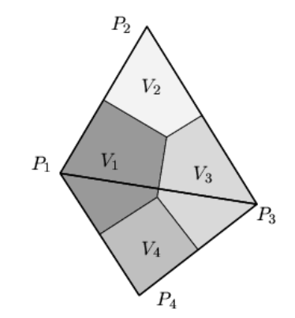
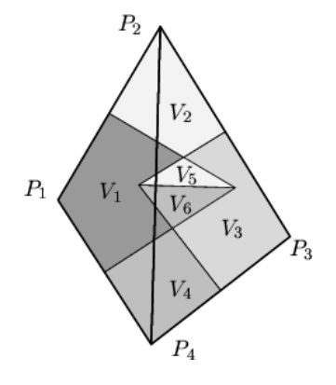
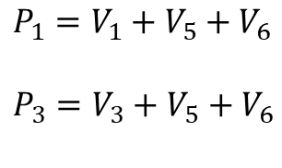

Discretization and meshing
Voronoi boxes do not overlap (each circumcircle does not include a point of another triangle). Each can be uniquely assigned to its corresponding grid points.
$$P_{i}=V_{i}$$
Correct Delaunay triangulation guarantees element-volume conservation, important in many problems (diffusion, charge generation, et cetera)
Delaunay triangulation maximizes the minimum angle.
Voronoi boxes do overlap (each circumcircle does include a point of another triangle). Each cannot be uniquely assigned to its corresponding grid points. Wrong volumes calculated
$P_{1}=V_{1}+$ $V_{5}+V_{6}$
$P_{3}=V_{3}+$ $V_{5}+V_{6}$
9
Instrumentation Training Lectures, Oxford 30/05/2023

Slide 12
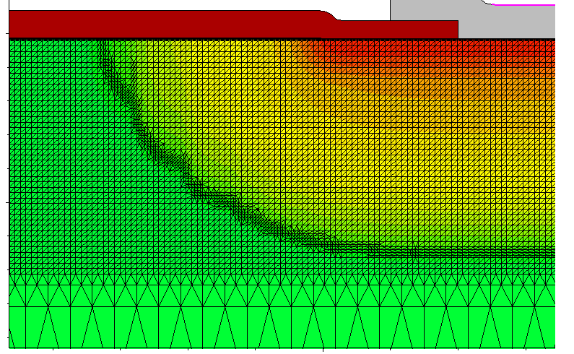

Discretization and meshing
Discretization of equations imposes some constraints on spatial and temporal mesh size
Mesh size should be smaller than Debye length (i.e. the characteristic length for screening of field by charges) where charge variations in space have to be resolved
$$L_{D}=\sqrt{\frac{{ε_{s}k}_{B}T}{e^{2}N}} Debye length$$
$$N={10}^{13}{[cm}^{−3}]:L_{D}≈1.3 \left[um\right]@T=300 \left[K\right] \\ N={10}^{17}{[cm}^{−3}]:L_{D}≈13 \left[nm\right]@T=300 \left[K\right] \\ N={10}^{19}{[cm}^{−3}]:L_{D}≈1.3 \left[nm\right]@T=300 [K]$$
10
Instrumentation Training Lectures, Oxford 30/05/2023

Slide 13
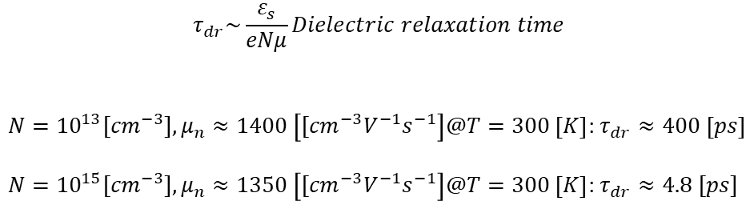


Discretization and meshing
$$τ_{dr}\sim \frac{ε_{s}}{eNμ}Dielectric relaxation time$$
$N={10}^{13}{[cm}^{−3}],μ_{n}≈1400 \left[{[cm}^{−3}V^{−1}s^{−1}\right]@T=300 \left[K\right]$: $τ_{dr}≈400 \left[ps\right]$
$N={10}^{15}{[cm}^{−3}],μ_{n}≈1350 \left[{[cm}^{−3}V^{−1}s^{−1}\right]@T=300 \left[K\right]$: $τ_{dr}≈4.8 [ps]$
Also temporal ‘mesh’ size should be smaller than the dielectric relaxation time t_{dr} (i.e. time it takes to charge fluctuations to decay under the field they produce)
Time interval $Δt$ bigger than t_{dr} might give unrealistic transient results (‘oscillations’ in estimated transient currents)
$$\frac{∂Δn}{∂t} =\frac{Δn(t=0)}{t_{dr}}$$
$$Δn \left(Δt\right)=Δn \left(0\right)−Δt\frac{Δn(0)}{t_{dr}}$$
11
Instrumentation Training Lectures, Oxford 30/05/2023

Slide 14
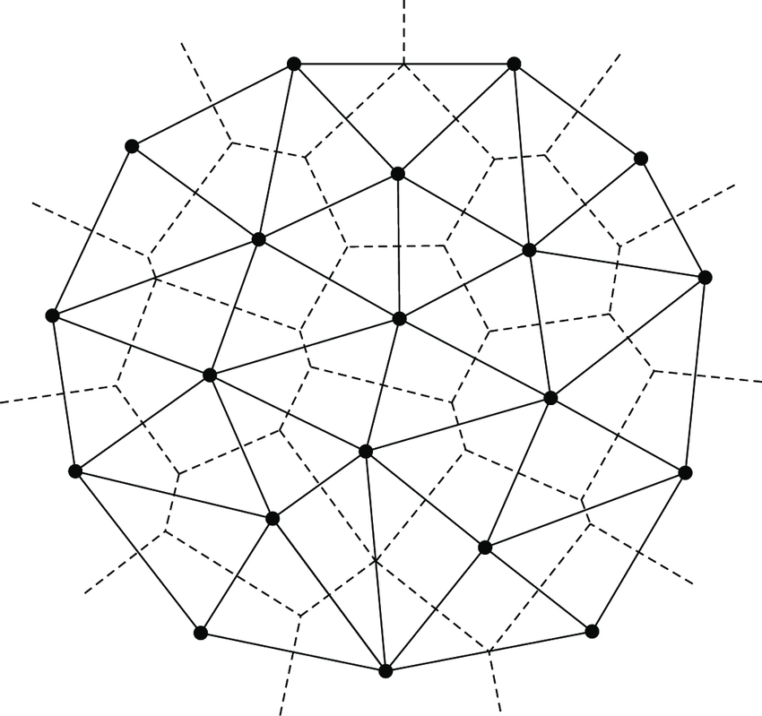

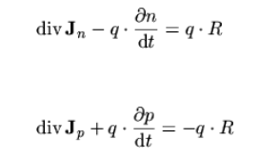




Box integration method
$$k$$
$$j$$
Discretization of Poisson’s and continuity equations is done via Box Integration method
The LHS of equations is transformed via Gauss’ theorem and integrated over a Voronoi box Ω_{k} of point P_{k}
$$i$$
$$≡\int{D∙dS=\int{ρdV}}$$
12
Instrumentation Training Lectures, Oxford 30/05/2023

Slide 15













Box integration method
$$k$$
$$L_{j}$$
$$L_{i}$$
Example of Poisson’s discretization
Assume that the electric potential is linearly varying over each elementary domain
$$d_{j}$$
$$d_{i}$$
$$d_{k}$$
$$i$$
$$L_{k}$$
$$j$$
$$i,j,k:nodal indices$$
$L_{i},L_{j}$, $L_{k}:side vectors$
$L_{i},L_{j}$, $L_{k}:magnitude side vectors$
$$u≔\frac{e}{k_{B}T}φ:normalized potential$$
13
Instrumentation Training Lectures, Oxford 30/05/2023

Slide 16


Box integration method
$$k$$
$$L_{j}$$
$$L_{i}$$
Components of D vector along sides L_{i,j,k}
Flux of D vector associated to node k:
Discretization of RHS is obtained by multiplying the node value of charge by the area of the portion of the Voronoi box
$$d_{j}$$
$$d_{i}$$
$$d_{k}$$
$$i$$
$$L_{k}$$
$$j$$
$$\frac{k_{B}T}{e}ε_{s}\frac{1}{L_{i}}\left(u_{j}−u_{k}\right) \\ \frac{k_{B}T}{e}ε_{s}\frac{1}{L_{j}}\left(u_{k}−u_{i}\right) \\ \frac{k_{B}T}{e}ε_{s}\frac{1}{L_{k}}(u_{i}−u_{j})$$
$\frac{k_{B}T}{e}ε_{s}[\frac{d_{i}}{L_{i}}\left(u_{j}−u_{k}\right)$+ $\frac{d_{j}}{L_{j}}\left(u_{i}−u_{k}\right)$] $Flux of D$
14
Instrumentation Training Lectures, Oxford 30/05/2023

Slide 17



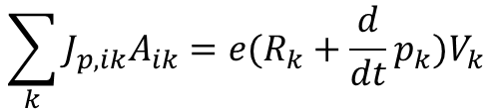

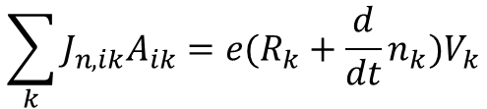

Box integration method
$$k$$
$$j$$
$$i$$
Summing over all points P_{k} of Voronoi boxes
Same approach to discretize continuity equations for electrons and holes
$$\sum_{k}{D_{ik}A_{ik}=ρ_{k}V_{k}}$$
$$A_{ik}:area of K −Vbox \\ D_{ik}:projection along grid line$$
$$\sum_{k}{J_{n,ik}A_{ik}=e(R_{k}+\frac{d}{dt}n_{k})V_{k}}$$
$$\sum_{k}{J_{p,ik}A_{ik}=e(R_{k}+\frac{d}{dt}p_{k})V_{k}}$$
15
Instrumentation Training Lectures, Oxford 30/05/2023

Slide 18
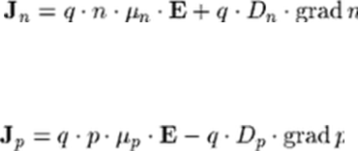














$$k$$
Scharfetter-Gummel discretization
$$L_{j}$$
$$L_{i}$$
$$d_{j}$$
$$d_{i}$$
$$d_{k}$$
In case of no strong generation-recombination current density varies little within each domain
Still this implies an exponential dependence of electron / hole density with position along grid’s edge
Using previous discretization method would require very dense mesh: Scharfetter-Gummel technique includes such dependence, requiring less grid points [D. L. Scharfetter and H. K. Gummel, “Large-signal analysis of a silicon read diode oscillator,” IEEE Trans. Electron Devices, vol. ED-16, pp. 64–77, Jan. 1969].
$$i$$
$$L_{k}$$
$$j$$
$$u≔\frac{e}{k_{B}T}φ$$
$$D_{n}≔\frac{k_{B}T}{e}μ_{n}$$
$$J_{n}≔eD_{n}[∇n−n∇u]$$
from $J_{n}$
$projection along L_{k}\sim constant$
$$J_{nk}≔eD_{n}[\frac{dn}{dl_{k}}−n\frac{du}{dl_{k}}]$$
16
Instrumentation Training Lectures, Oxford 30/05/2023

Slide 19



$$k$$
Scharfetter-Gummel discretization
$$L_{j}$$
$$L_{i}$$
$$d_{j}$$
$$d_{i}$$
$$d_{k}$$
Assume u varies linearly along the edge and current density ≃ constant over the domain
Define reduced current and assume and average diffusion along the edge
Obtain first order equation in n along the edge
$$i$$
$$L_{k}$$
$$j$$
$$u=\frac{u_{j}−u_{i}}{L_{k}}l_{k}+u_{i}=a_{k}l_{k}+u_{i}$$
$j_{nk}:=\frac{J_{nk}}{{eD}_{nk}},{ D}_{nk}≔<D_{ni},$ $D_{nj}>$
$$j_{nk}= \frac{dn}{dl_{k}}−na_{k}$$
17
Instrumentation Training Lectures, Oxford 30/05/2023

Slide 20

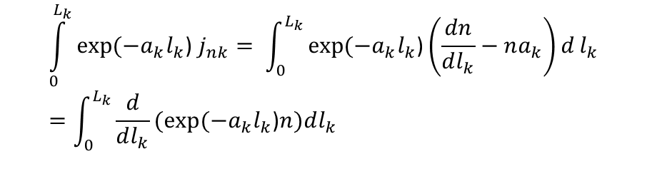


$$k$$
Scharfetter-Gummel discretization
$$L_{j}$$
$$L_{i}$$
$$d_{j}$$
$$d_{i}$$
$$d_{k}$$
Integrate from node i to node j, i.e. for l_{k}=[0, L_{k}]
Obtain expression relating potential and carriers concentration
$$i$$
$$L_{k}$$
$$j$$
$$\int_{0}^{L_{k}}{exp⁡(−a_{k}l_{k}\text{) }j_{nk}}= \int_{0}^{L_{k}}{exp⁡(−a_{k}l_{k}\text{)}\left(\frac{dn}{dl_{k}}−na_{k}\right)d}l_{k}=\int_{0}^{L_{k}}{\frac{d}{dl_{k}}(exp⁡(−a_{k}l_{k}\text{)}n)dl_{k}}$$
$j_{nk}\frac{1}{a_{k}}(1−exp(⁡−u_{ji}\text{)}=$ $exp⁡(−u_{ji}\text{)}n_{j}−n_{i }$
$${,u}_{ji}=u_{j}−u_{i }$$
$$j_{nk}=a_{k}(\frac{n_{j}}{exp⁡(u_{ji}\text{)}\text{−1}}+\frac{n_{i}}{exp⁡(−u_{ji}\text{)−1}})$$
18
Instrumentation Training Lectures, Oxford 30/05/2023

Slide 21



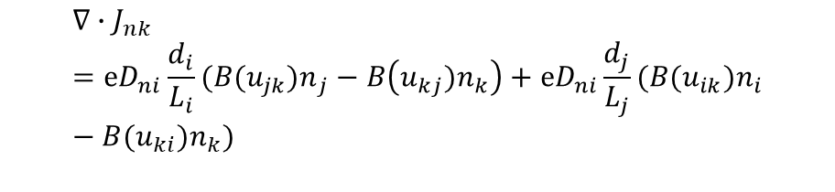
$$k$$
Scharfetter-Gummel discretization
$$L_{j}$$
$$L_{i}$$
$$d_{j}$$
$$d_{i}$$
$$d_{k}$$
Obtain the flux of current density relative to node k
Scharfetter –Gummel discretization requires less fine mesh as the exponential dependence of carriers concentration is included in the discretization scheme
It also depends on boundary values, i.e. 2D and 3D cases can be reduced to local 1D cases
$$i$$
$$L_{k}$$
$$j$$
$$j_{nk}=\frac{1}{L_{k}}(\frac{{u_{ji}n}_{j}}{exp⁡(u_{ji}\text{)}\text{−1}}−\frac{u_{ij}n_{i}}{exp⁡(u_{ij}\text{)−1}})$$
$$j_{nk}=\frac{1}{L_{k}}(B({u_{ji})n}_{j}−B({u_{ij})n}_{i})$$
$$Bernoulli function B\left(x\right):=\frac{x}{\exp\left(x\right)−1}$$
$$∇∙J_{nk}=eD_{ni}\frac{d_{i}}{L_{i}}(B({u_{jk})n}_{j}−B\left({u_{kj})n}_{k}\right)+eD_{ni}\frac{d_{j}}{L_{j}}(B({u_{ik})n}_{i}−B({u_{ki})n}_{k})$$
19
Instrumentation Training Lectures, Oxford 30/05/2023

Slide 22
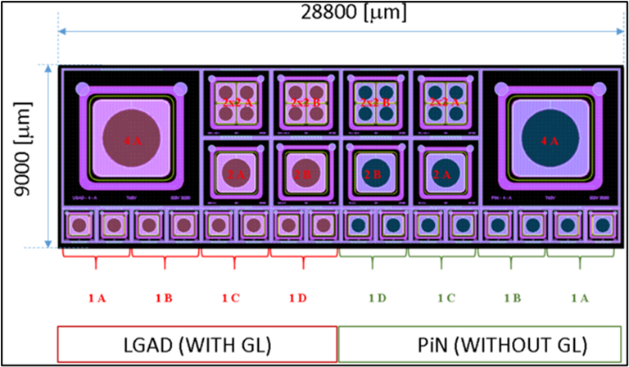
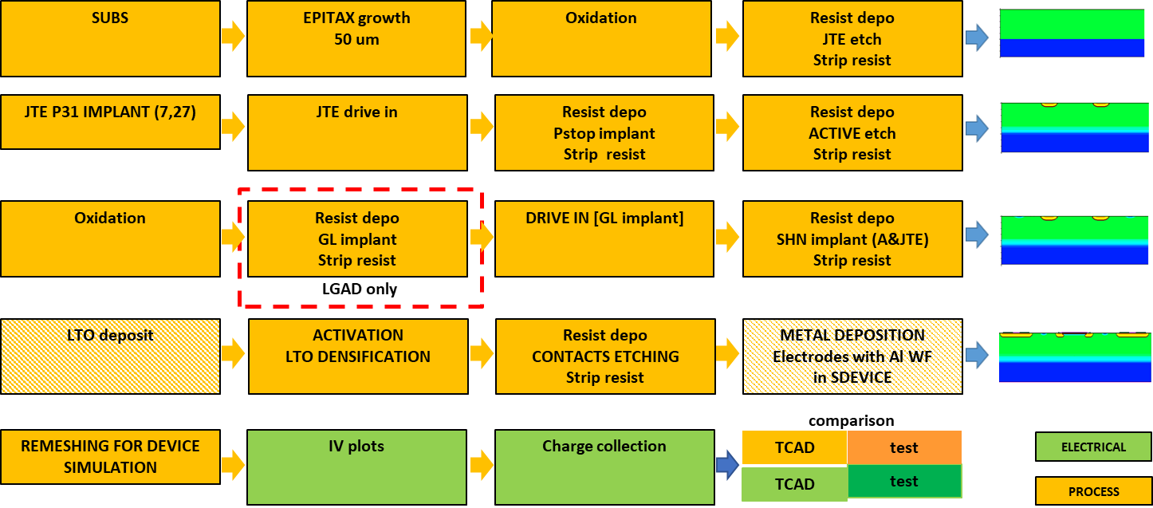
Simulation examples
Examples from Synopsys TCAD (more on this from N. Owen lectures)
Beside electrical simulations, simulation of processes of device fabrication is possible
Most of the typical fabrication process steps can be simulated
Simulated process steps for LGAD fabrication
Nwell-GR
Nwell
P-epi
p⁺⁺
20
Instrumentation Training Lectures, Oxford 30/05/2023

Slide 23
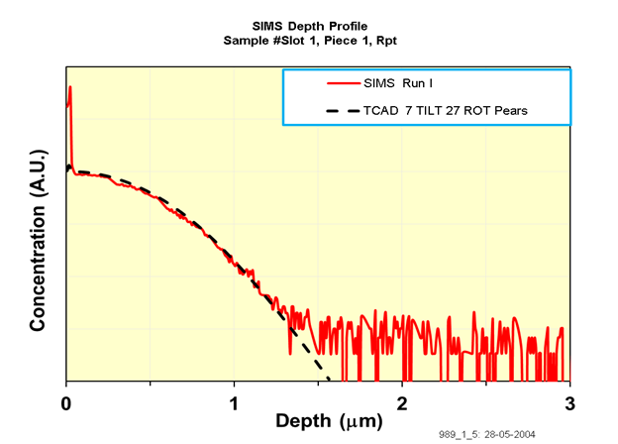
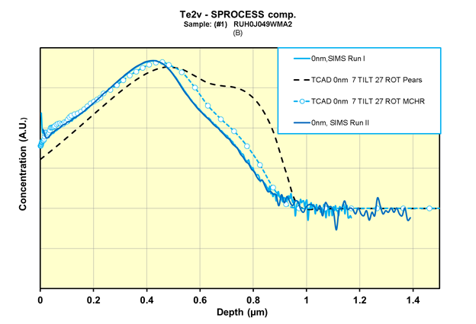
Simulation examples
High energy implants of ions can be simulated, either analytically or via MC
Creation of defects following implantation can be simulated
SIMS and Pearson IV distribution – 31P
SIMS, Pearson IV distribution and MC run – 11B
21
Instrumentation Training Lectures, Oxford 30/05/2023

Slide 24
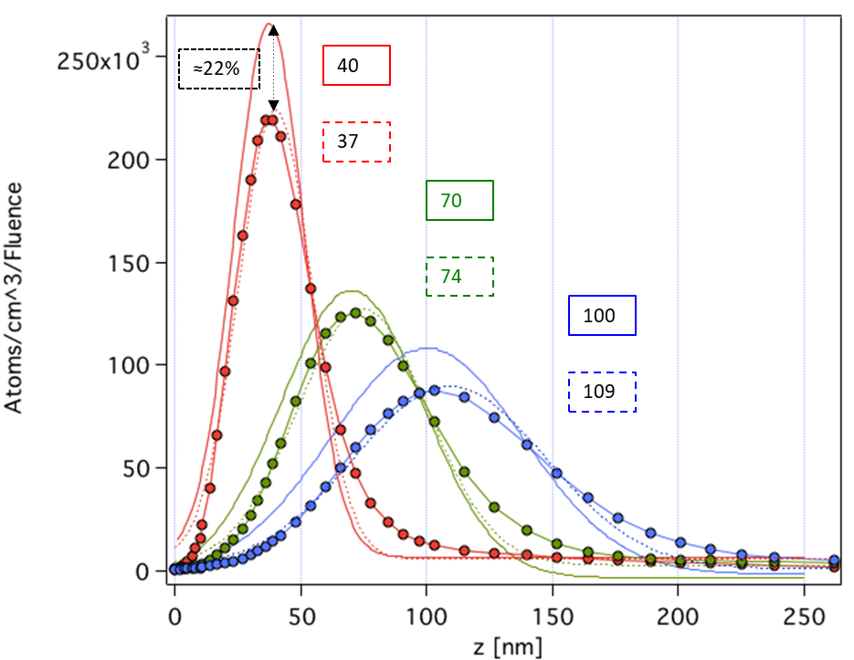
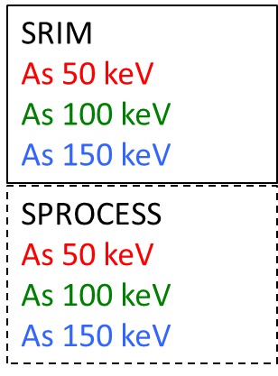
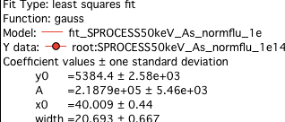
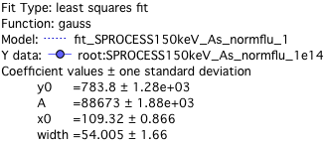
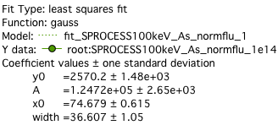
Simulation examples
At least with As, MC (SRIM) and SPROCESS predictions on doping seem to agree within ≈ 20%
Note: SRIM assumes amorphous Si, <100> used for SPROCESS, but 1D
SRIM (Stopping and Range of Ions in Matter, http://www.srim.org/)
22
Instrumentation Training Lectures, Oxford 30/05/2023

Slide 25
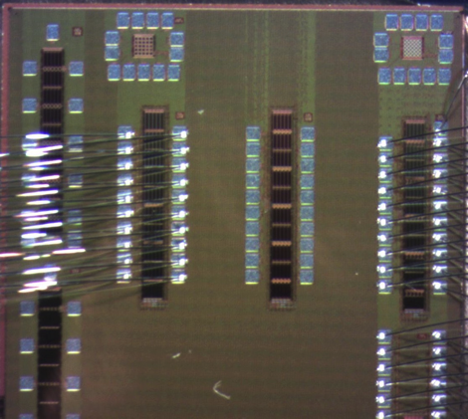
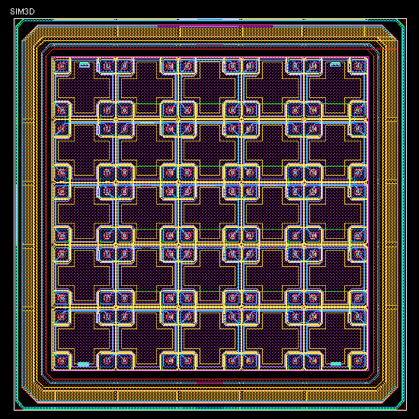
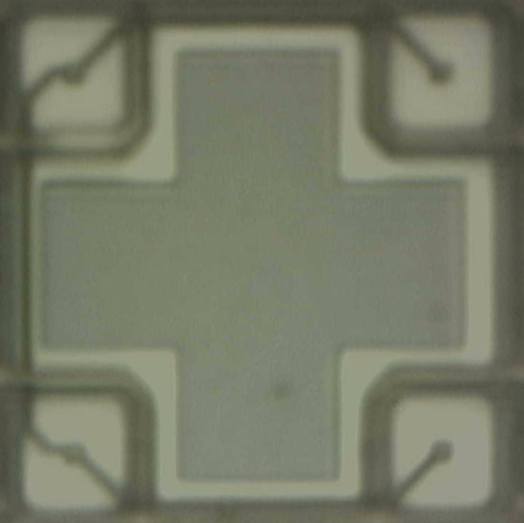
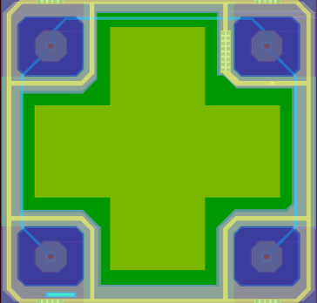
Simulation examples
Electrical simulation of a CMOS sensors (OVERMOS)
A TCAD model of fabrication process of OVERMOS has been developed to investigate and predict the performances of the sensor
Photograph of OVERMOS test structure and simulated cell
40um
40um
Photograph of OVERMOS cell and .gds layout
23
Instrumentation Training Lectures, Oxford 30/05/2023

Slide 26

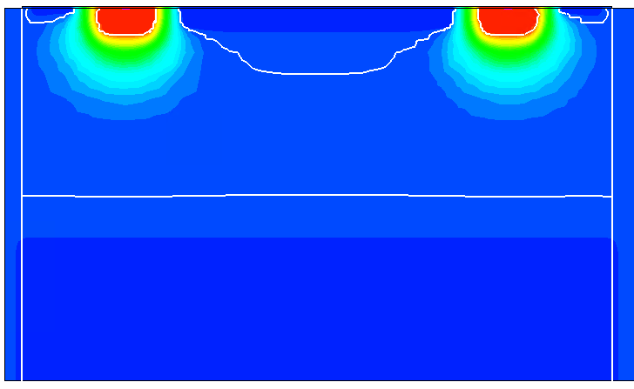
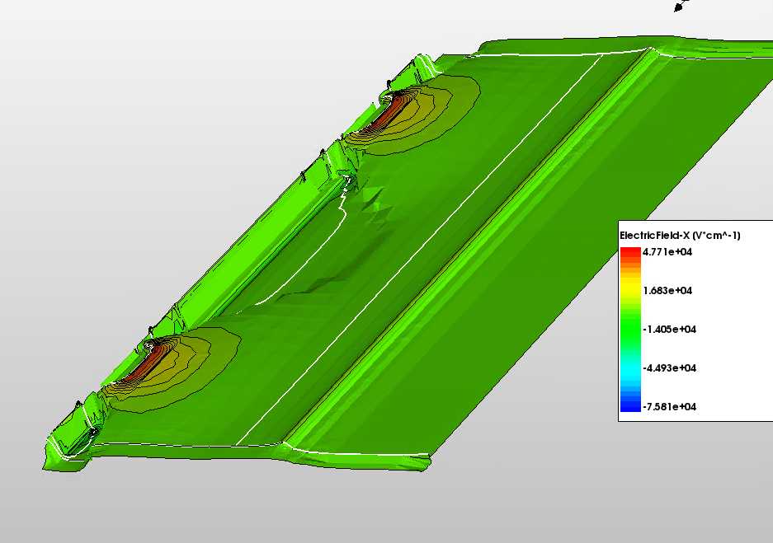
Simulation examples
SiPoly to simulate non reflective BC
Vbias
Internal field configuration vs. bias and temperature
DC and AC characteristics can be obtained from the simulated model
T = 300 K
3D simulated cell
GND
Xsection showing potential and depletion Vbias = 10 V
Surface plot of x-field and depletion Vbias = 10 V
24
Instrumentation Training Lectures, Oxford 30/05/2023

Slide 27
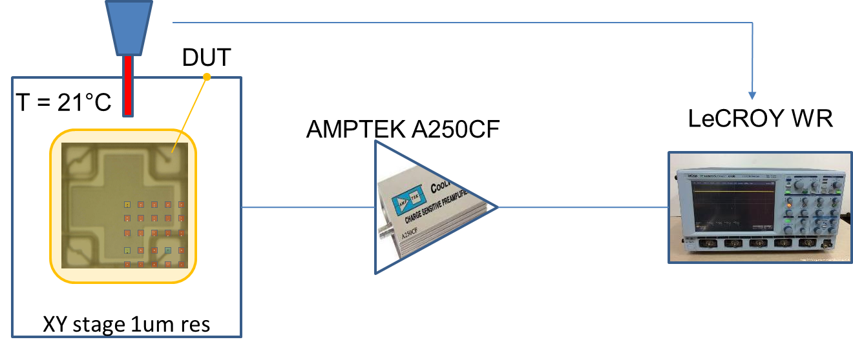
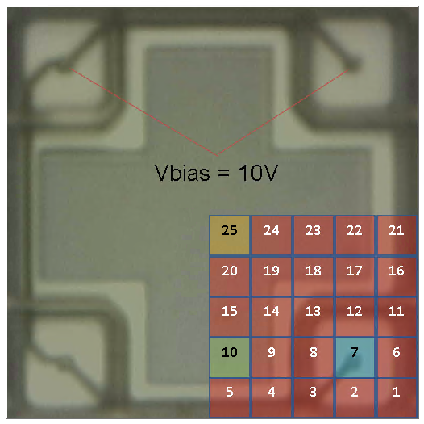
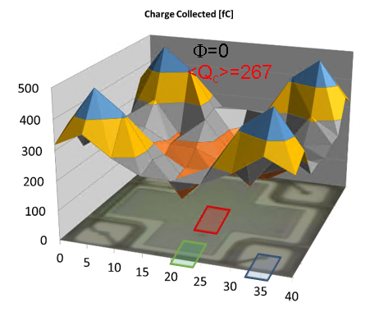

Simulation examples
Charge collection is simulated using laser light injection and compared with test results
Laser beam is 5 x 5 um2 around 4.5 ns pulse width, 1064 nm wavelength, $\sim 10 pJ$
These values are introduced in the simulator
Test setup for charge collection measurement
Charge is injected via laser at three different locations on cell. Results are mirrored to obtain a map of collected charge vs. position
25
Instrumentation Training Lectures, Oxford 30/05/2023

Slide 28
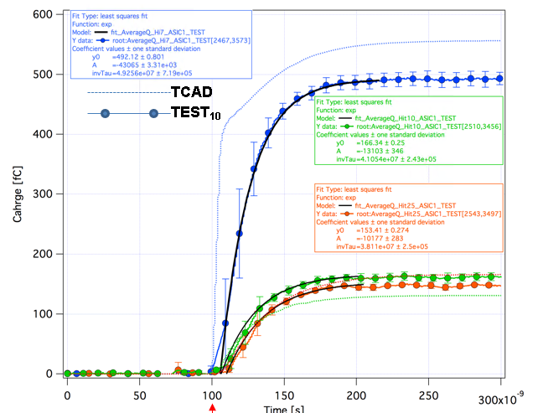
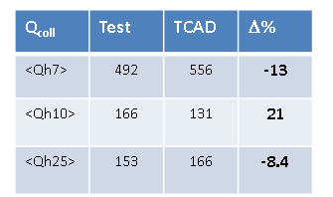
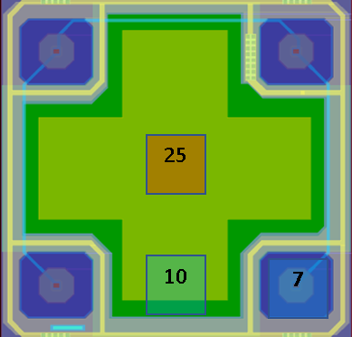
Simulation examples
Effects of SiO₂ reflection and attenuation of IR light can be implemented
Quantum yield of optical generation, polarization, tilting, pulse width et cetera can all be included in the simulation
TCAD simulations of non-irradiated OVERMOS reproduce experimental results, both in DC and in CC, with maximum discrepancy of the order of ∼20%
Transient of charge collection measurement and simulation
26
Instrumentation Training Lectures, Oxford 30/05/2023

Slide 29
TCAD and simulation I
Introduction to simulation
Needs and transport regimes
Meshing and discretization. Intro to DD model discretization. SG method
Some examples of TCAD simulations: process and electrical device simulations, charge collection
    Thank you
    giulio.villani@stfc.ac.uk
27
Instrumentation Training Lectures, Oxford 30/05/2023

