Slide 1

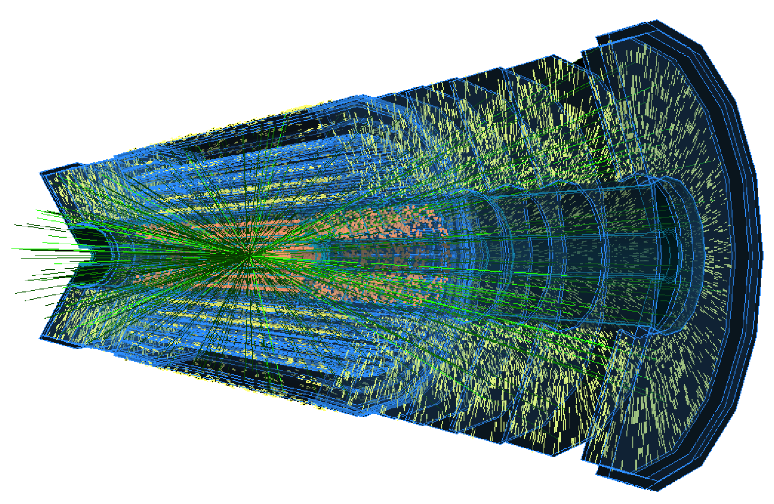
Kenneth Wraight
Testbeam Reconstruction
  Testbeam re-cap
  Generic steps
  Corryvreckan
  23/06/22

Slide 2
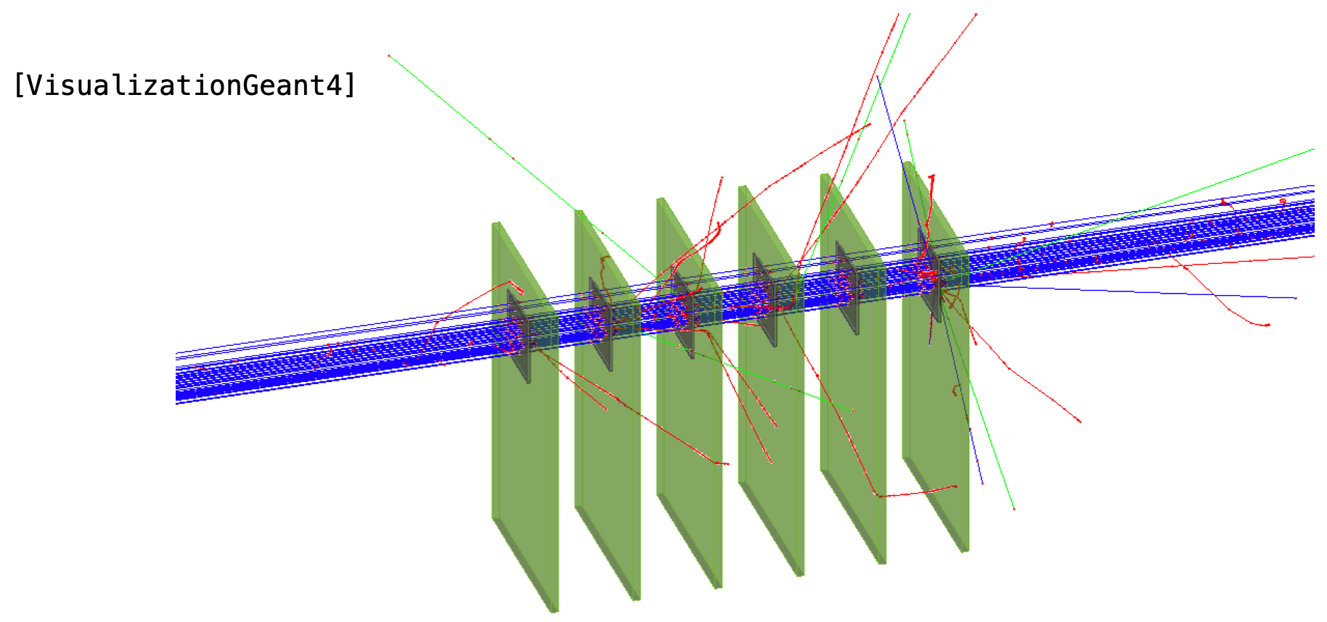
2
Coming from
This section leads on from previous Instrumentation topics
Testbeams: link
Part1 - concepts: efficiency & purity
Part2 - practice: facilities & activities
Allpix**2
Part1 – setting up simulation geometry, beam & detectors
Part2 – detector details and charge transport
Building on concepts introduced, we will look at a tool for reconstruction of testbeam data.
Credit: Jaap Velthuis
Credit:
Daniel Hynds

Slide 3
3
Overview
Part I: Testbeam re-cap
Why bother?
Set-up
S/N
Multiple scattering
Part II: Generic reconstruction
Goal: data → determination
Steps
  Hits, Clusters, Correlations, Alignment, Tracking
Output metrics: efficiencies, etc.
Part III: Corryvreckan
Overview
Reconstruction steps
Example using allpix**2 input
Motivations
Common concepts
Specific tool
NB often I write pixels when I mean pixels or strips

Slide 4
4
Part I
Testbeam Re-cap

Slide 5
5
Re-cap: TB Motivation
Goal: Quantitative characterisation of detector properties
What can you get in the lab?
Cosmics
  Free source of high energy particles
  But beam parameters not well defined: energy, direction, rate
Laser
  Well defined beam parameters: energy, direction, rate
  But:
    Limits on beam spot precision
    Not appropriate if sensor is metallised
Radioactive sources
  Well defined beam energy
  But not defined direction or rate (even if columnated)
Test charges/pulses
  Only appropriate for electronics
What you get at testbeam
Well defined radiation source: energy, direction, rate, beam spot

Slide 6
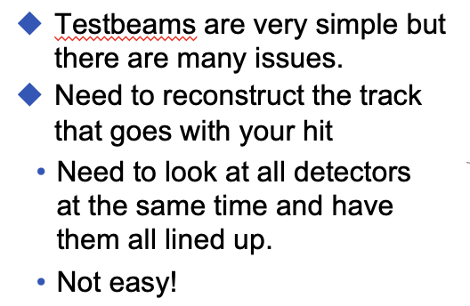
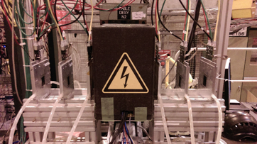
6
Re-cap: Set-up
Ugly Truth: complex, multi-detector set-up
“all the detectors”
Multiple detector planes
  Perhaps multiple readout formats
“at the same time”
Coordinate readout: synchronise or associate
  Triggers or timestamps
“all lined up”
Make sure beam passes through detector planes
Understand the relative positions of detector planes
Credit: Jaap Velthuis

Slide 7
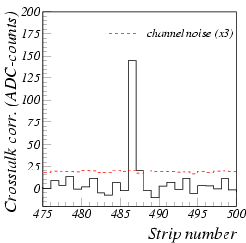
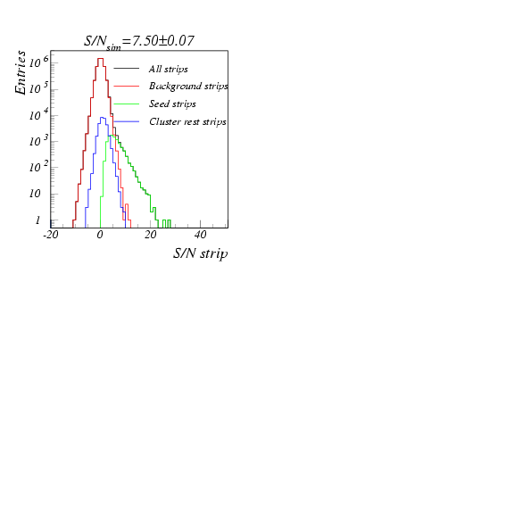
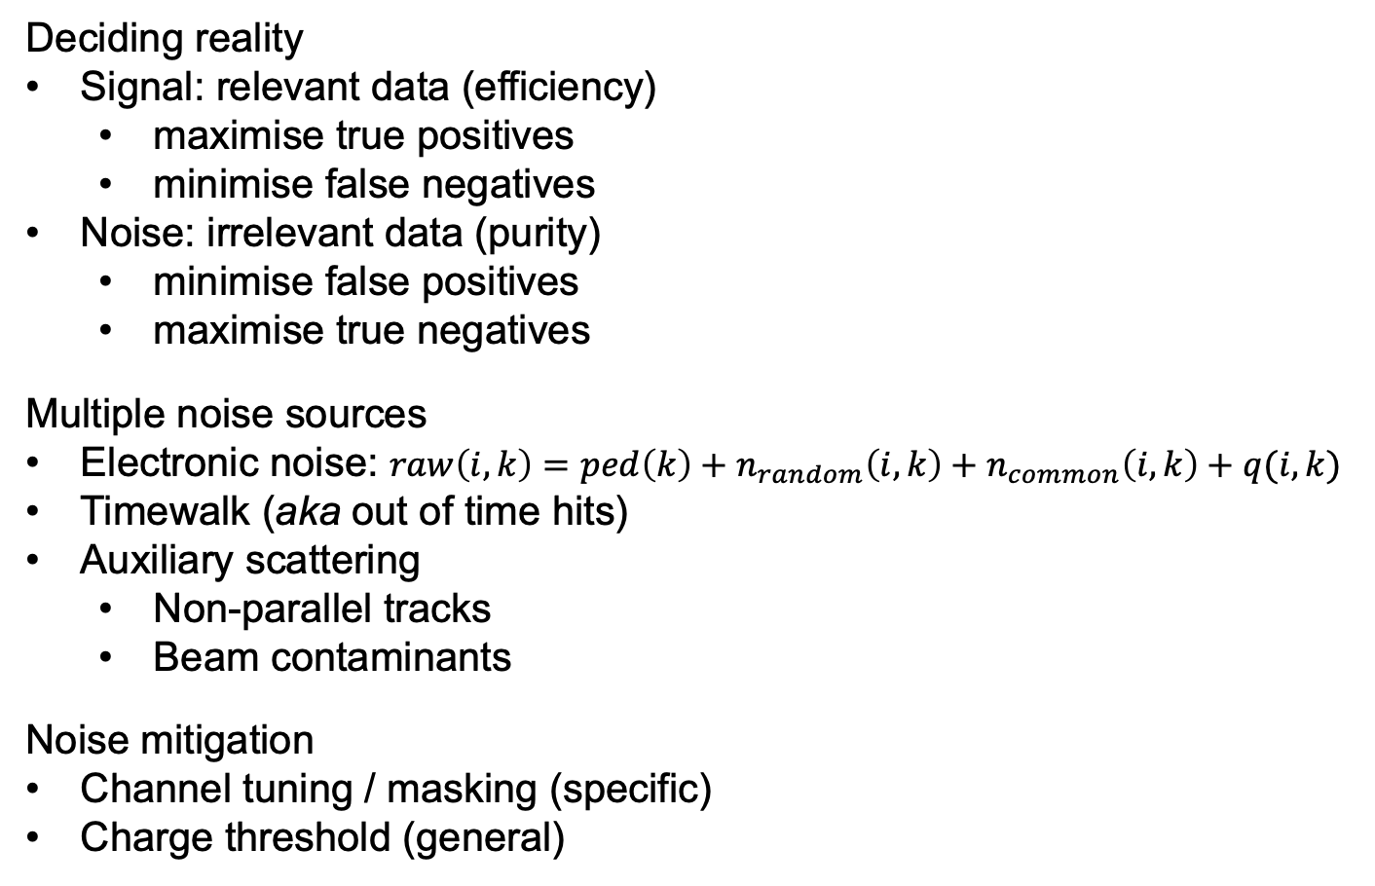
7
Re-cap: Signal & Noise
Deciding reality
Signal: relevant data (efficiency)
  maximise true positives
  minimise false negatives
Noise: irrelevant data (purity)
  minimise false positives
  maximise true negatives
Multiple noise sources
Electronic noise: $raw\left(i,k\right)=ped\left(k\right)+n_{random}\left(i,k\right)+n_{common}\left(i,k\right)+q(i,k)$
Timewalk (aka out of time hits)
Auxiliary scattering
  Non-parallel tracks
  Beam contaminants
Noise mitigation
Channel tuning / masking (specific)
Charge threshold (general)
timewalk
Credit: Jaap Velthuis
THL
Credit: Jaap Velthuis

Slide 8
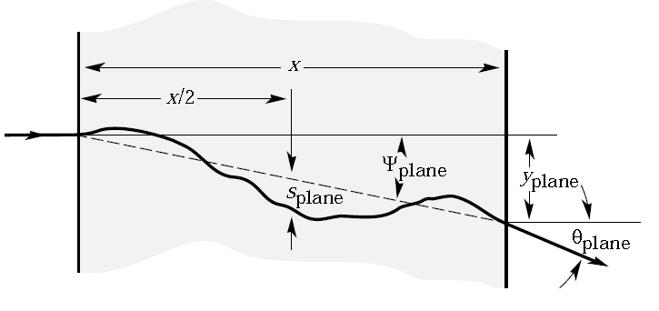
8
Re-cap: Multiple Scattering
Building a straight (?) track
Standard method of fitting a straight line to coincident hits across detector planes
Works best for high/hard p_{t} beam
Particles are deflected in lower energy beams
Thin scattering: angle of deflection
Thick scattering: angle of deflections and orthogonal offset
Example:
With AIDA telescope
Low energy:
5GeV e
High energy:
120GeV π

Slide 9
9
Part II
Generic Construction

Slide 10
10
Generic (Re-)Construction
Goal: Quantitative characterisation of detector properties
Use data collections recorded while detectors operated in the presence of a well-understood particle beam
Hope detectors were functioning properly
  Measured: detector environment: temp, humidity, current stability
  But: What if detector bumps were broken?
Hope the beam was as expected
  Measured: flux, scintillator triggers, magnet settings
  But: What if extra scattering from unexpected material?
Hope combined system worked together
  Measure: quantity of data recorded
  But: Maybe it’s junk?
Suspicions only settled by reconstruction output

Slide 11
11
Generic (Re-)Construction
Goal: Quantitative characterisation of detector properties
Task is broken into successive intermediate steps:
Raw data interpretation
  Goal: read information from data sources to common format
Hit definitions
  Goal: select data from well-functioning pixels exposed to radiation from known source
Clustering
  Goal: gather pixels from common incident particle into single object
Correlations & alignment
  Goal: associate clusters across detectors from common particle trajectory
  Goal: position detector local planes to global layout
Metrics – compare DUT response to tracks

Slide 12
12
Generic: Raw data
Goal: Read information from data sources to common format
Multiple data sources
Telescope – usually multiple planes of one or two detector types
DUT (detector under test) – whatever is of interest
TLU (trigger logic unit) & scintillators– controlling event structure, timestamps
DCS (detector control system) – relevant environment and operational parameters (e.g. T, RH, I)
More than enough information
Need to separate useful from the rest
Keep enough information to interpret spatial coordinates per detector
  Possibly charge and timing information as well
Need to translate to single format for analysis
Timing may come from detectors or TLU/scintillators

Slide 13
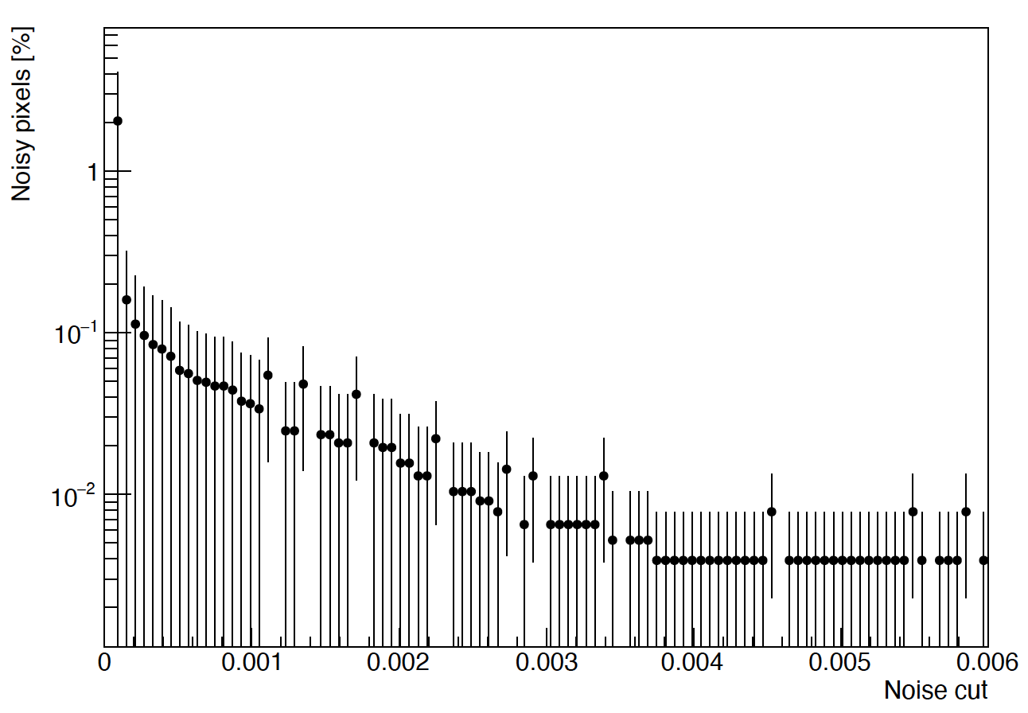
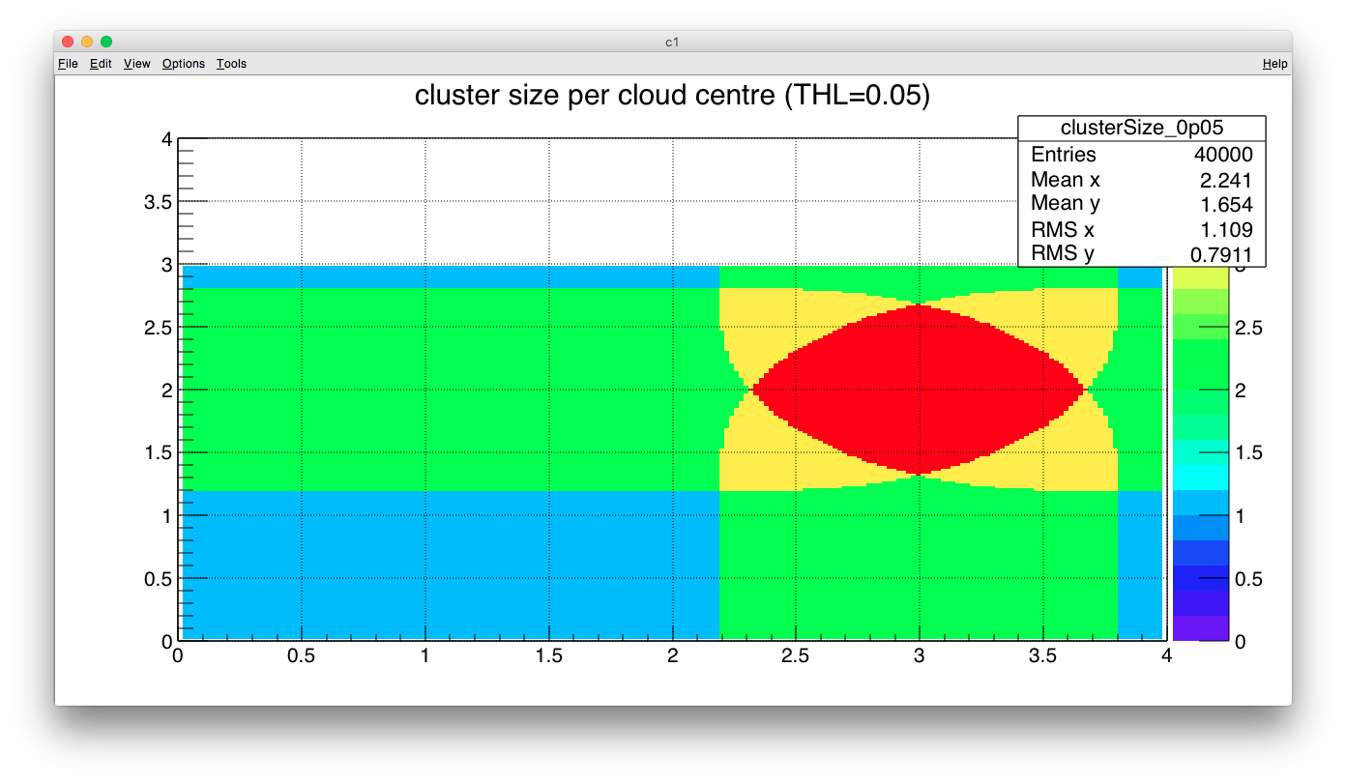
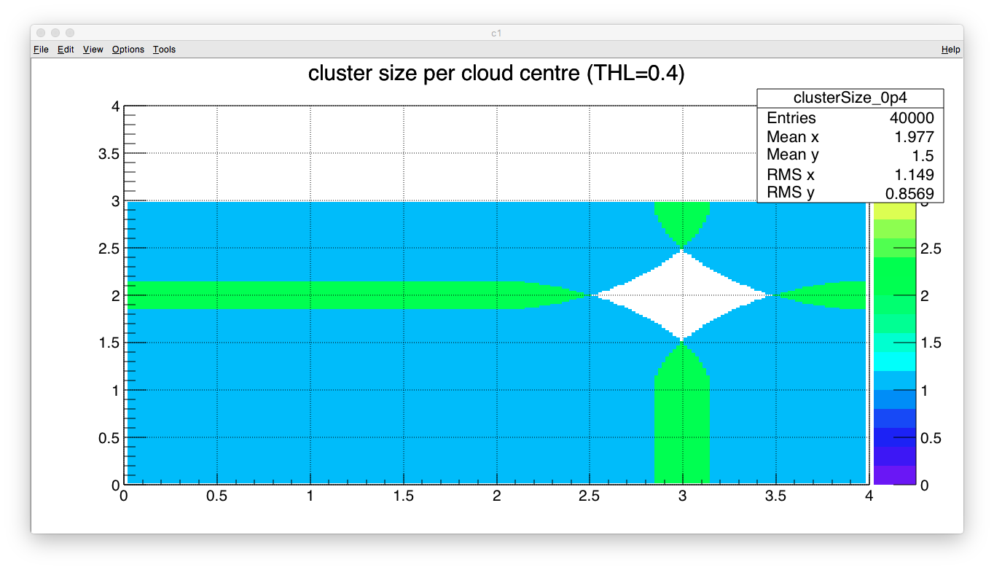
13
Generic: Hits
Goal: Select data from well-functioning pixels exposed to radiation from known source
Pixel is well-functioning
Not firing constantly or intermittently without radiation
Filter out pixels with excessive firing frequency
  Compare to distribution of pixel frequencies
Source of pixel response is from the known source
  Not electronic noise in ASICs
  Not external contaminant sources
  Not secondary beam components
Threshold charge deposition using
Time Over Threshold (ToT) information
  Given the expected beam
  composition/kinematics/profile
  what is the expected signal?
  Balance efficiency & purity
Firing freq.
Increase ToT THL

Slide 14
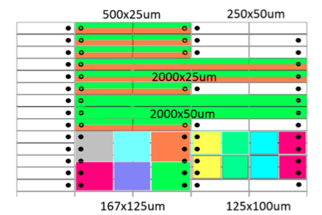
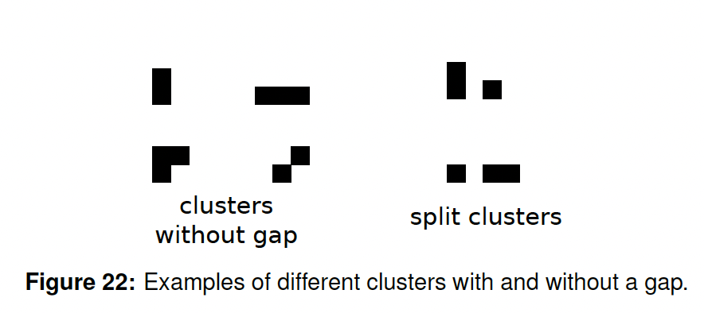
14
Generic: Clusters I
Goal: Gather pixels from common incident particle into single object
Building cluster
Intuitively charge deposited in local area of particle track
Common → locally close pixels → neighbouring
Acceptable neighbours?
4 nearest pixels on square matrix
  8 if include diagonals (expect lower ToT)
What about rectangular/hexagonal matrices?
next-to-nearest neighbours?
Let an algorithm decide based on continuity of cluster?
Split clusters? – e.g from masked pixel
Merged/overlapping clusters? – e.g. coincidence
Credit: Marko Milovanovic
Credit: Jens Kröger

Slide 15
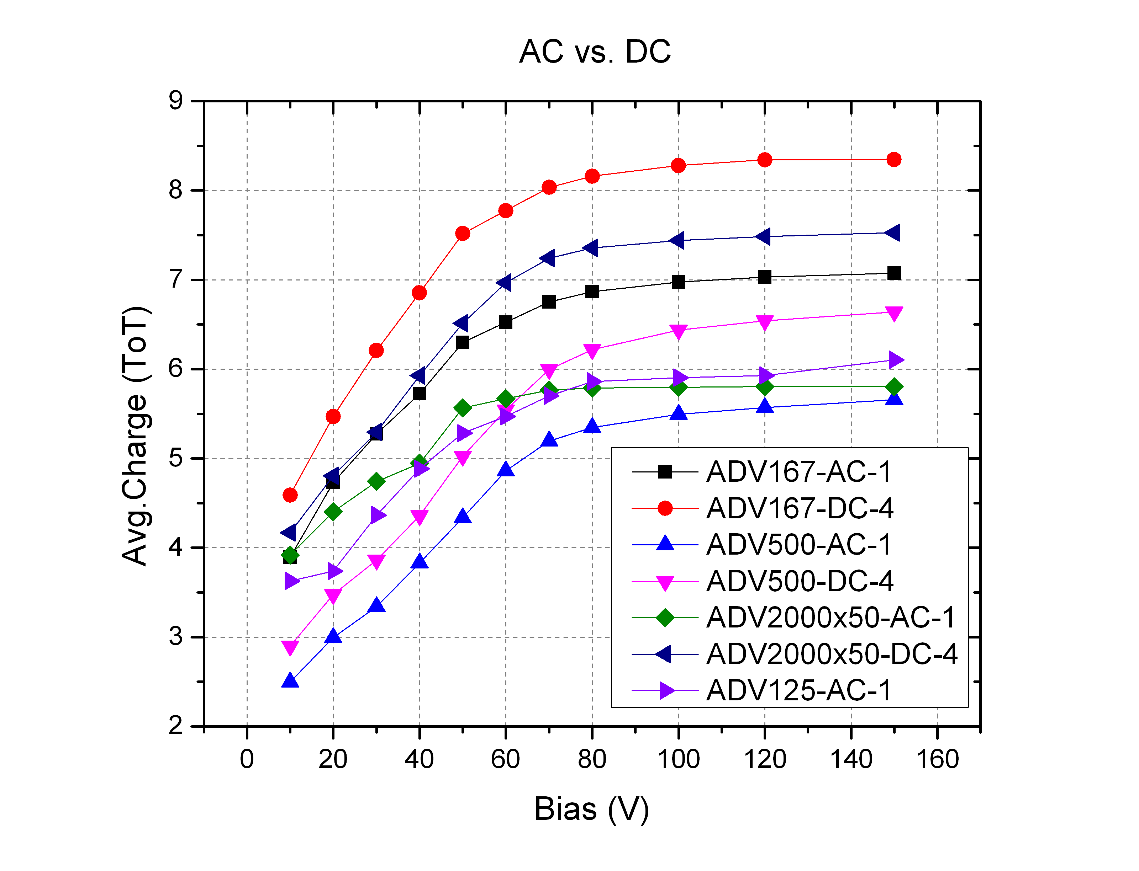
15
Generic: Clusters II
Goal: Gather pixels from common incident particle into single object
Derived cluster parameters – a matter of counting
Cluster size (in pixels)
Cluster width in X (in pixels)
Cluster width in Y (in pixels)
Cluster charge (sum of pixels)
Seed/highest/hottest pixel, i.e. greatest ToT
Can be useful parameters themselves: – reflects pitch, depth, charge, V, THL
Defined parameters – a decision
Cluster position X
Cluster position Y
Common options
Average
Weighted mean – weighted by pixel charge
  AKA centre-of-mass, barycentre, Newton centre
Credit: Marko Milovanovic

Slide 16
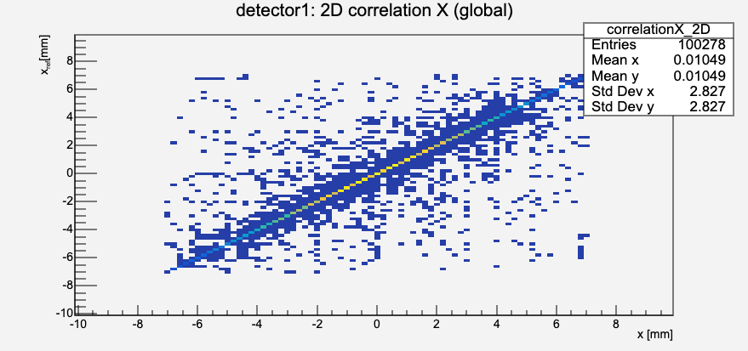
16
Generic: Correlations
Goal: Associate clusters across detectors
Assuming trajectory of incident particle is straight(ish) between planes, clusters can be associated by means of correlation
Compare hits in detector pairs in each dimension
detector A profile in X/Y Vs detector B profile in X/Y
Straight line shows correlation
Positive (negative) gradient for (anti-)correlation
No line → no correlation
  → Mis-orientation or de-synchronisation
Displacement of (anti-)correlation intersection with origin (LHS lower corner)
Relative misalignment of planes

Slide 17
17
Generic: Alignment
Goal: Position & orient detector local planes in global layout
Use single plane as reference to align all others
Adjust positions based on misalignment wrt reference plane
Reference coordinates global coordinate frame
Misalignments minimised assuming track trajectory between planes is understood
NB Important distinction:
xcorrelation = xcluster on reference detector − xcluster on this detector
biased: xresidual = xtrack intercept on this plane − xtrack cluster on this plane
  Choice of cluster is biased
unbiased: xresidual = xtrack intercept on this plane − xassociated cluster on this plane
  Choice of cluster is unbiased

Slide 18
18
Generic: Track building
Goal: Build global track trajectory from local cluster positions in planes
Track defined by minimised misalignments of telescope planes
DUTs not used in track building → track definition unbiased wrt DUT
Metrics give quantitative characterisation of DUT properties by comparing interpolated track position with DUT response
Residual: distance
DUT
track
Telescope planes
with hits

Slide 19
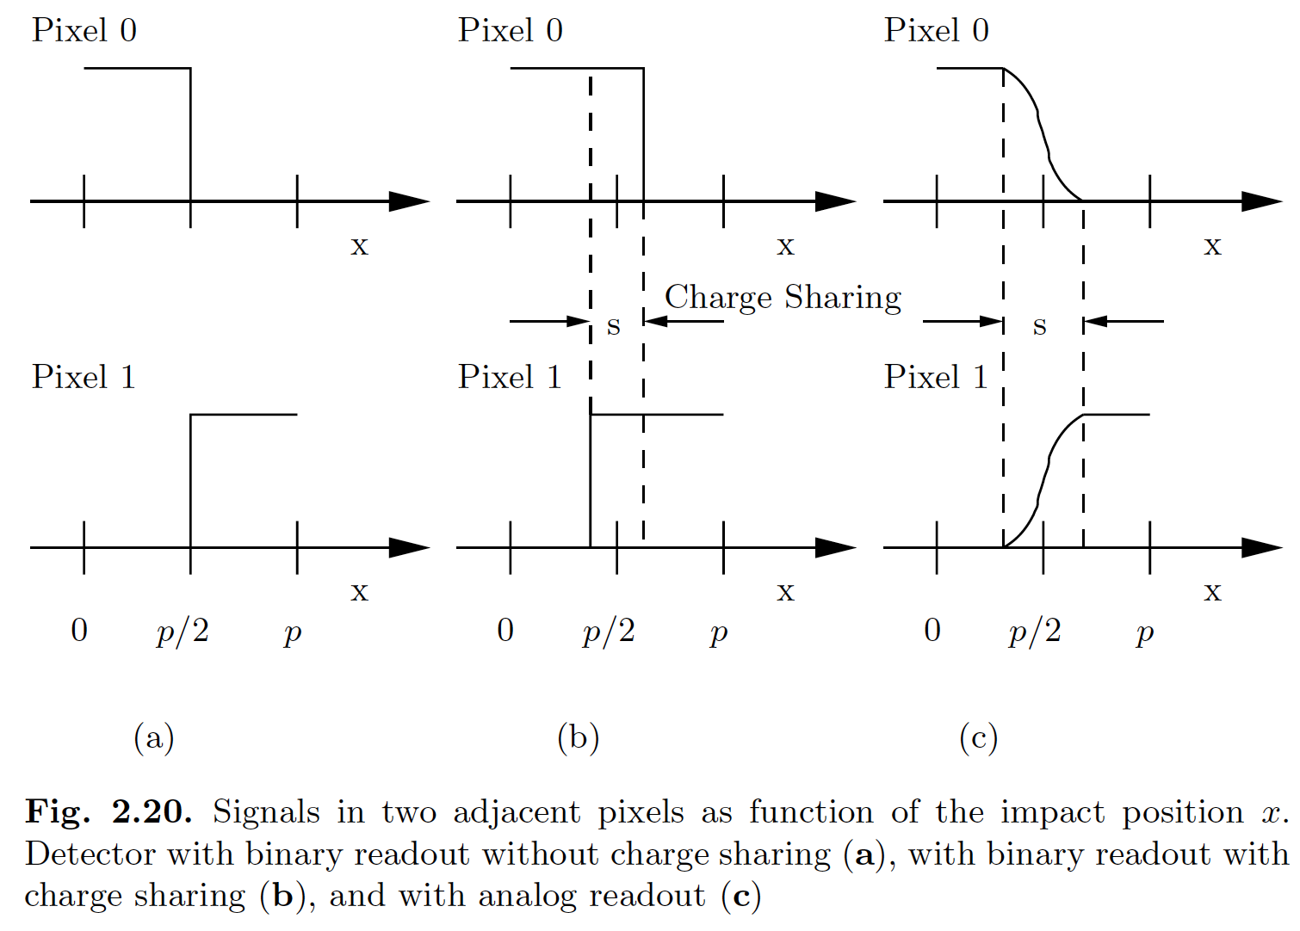
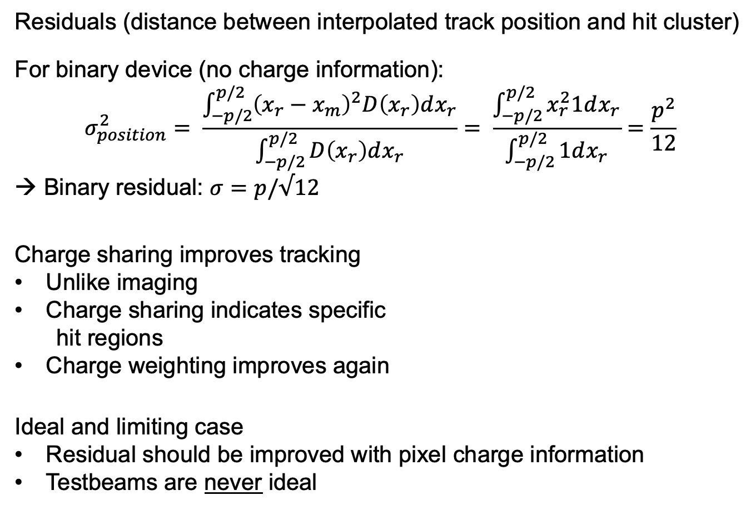
19
Generic: Metrics
Residuals (distance between interpolated track position and hit cluster)
For binary device (no charge information):
$$σ_{position}^{2}= \frac{\int_{−p/2}^{p/2}{{\left(x_{r}−x_{m}\right)}^{2}D\left(x_{r}\right)dx_{r}}}{\int_{−p/2}^{p/2}{D\left(x_{r}\right)dx_{r}}}= \frac{\int_{−p/2}^{p/2}{x_{r}^{2}1dx_{r}}}{\int_{−p/2}^{p/2}{1dx_{r}}}=\frac{p^{2}}{12}$$
→ Binary residual: $σ=p/√12$
Charge sharing improves tracking
Unlike imaging
Charge sharing indicates specific
hit regions
Charge weighting improves again
Ideal and limiting case
Residual should be improved with pixel charge information
Testbeams are never ideal
Credit: L. Rossi et al.

Slide 20

20
Generic: Metrics
Efficiency (whole detector)
$$ε = \frac{N_{matched hits} }{N_{expected hits}}$$
Regions of Interest (RoIs) can be used to focus metric on appropriate areas
E.g. avoid poor bump-bonding, malfunctioning channels
DUT
?
track
Telescope planes
with hits

Slide 21
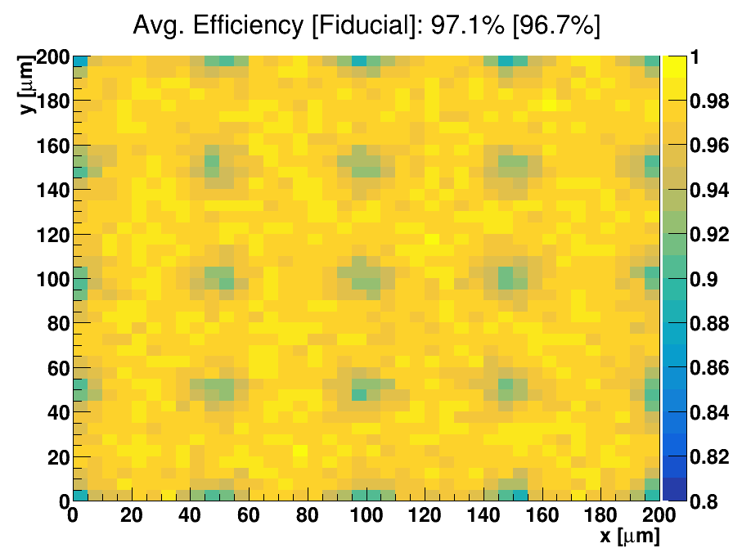
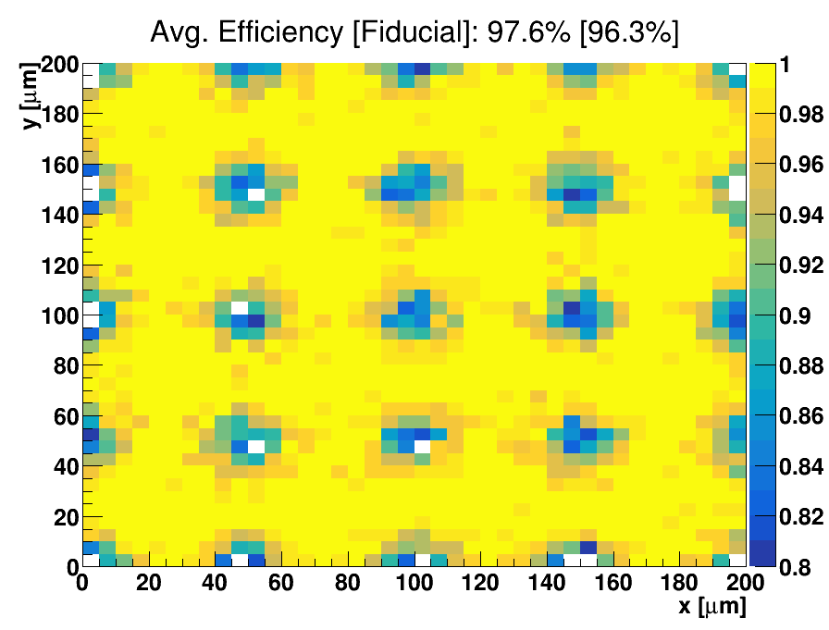
21
Generic: Metrics
In-pixel Efficiency (specific region)
Sub-pixel resolution
Need high statistics over small region
Focus the beam on single pixel
Overlap pixel information from across matrix
  Average pixel response across the detector
Lower THL
Higher THL
Credit: Kenneth Wraight et al.

Slide 22
22
Part III
Corryvreckan

Slide 23
23
Corry: Overview
Testbeams have been around a while; reconstruction almost as long
In the LHC era (my experience) effort was made to standardise software
EUTelescope: https://eutelescope.github.io
Judith: https://github.com/gmcgoldr/judith
Kepler: https://gitlab.cern.ch/lhcb/Kepler
Aimed to be modular and adaptable to various testbeam setups
Use EUDAQ: Generic Multi-platform Data Acquisition Framework
  Used by DESY, SPS and other testbeam facilities
Corryvreckan is the most modern reconstruction framework
Compatible with EUDAQ
Uses modern modular code base
Flexible to various testbeam devices and timing
  Building on the ad hoc solutions in previous frameworks
Well documented and supported
(Compatible with Allpix**2)

Slide 24

24
Corry: Documentation
Useful documents
Website:
https://project-corryvreckan.web.cern.ch/project-corryvreckan/
Gitlab repository:
https://gitlab.cern.ch/corryvreckan/corryvreckan
Modules include description, parameters and usage
Also, for reconstruction:
  Maintainer, module type, detector type, status
Presentations and tutorials:
https://project-corryvreckan.web.cern.ch/project-corryvreckan/page/publications/
  BTTB9 workshop tutorial (Feb 2021):
  https://indico.cern.ch/event/945675/contributions/4184960/
  Si Pixel Characterisation (July 2020):
  https://www.physi.uni-heidelberg.de/Einrichtungen/FP/anleitungen/F96.pdf

Slide 25
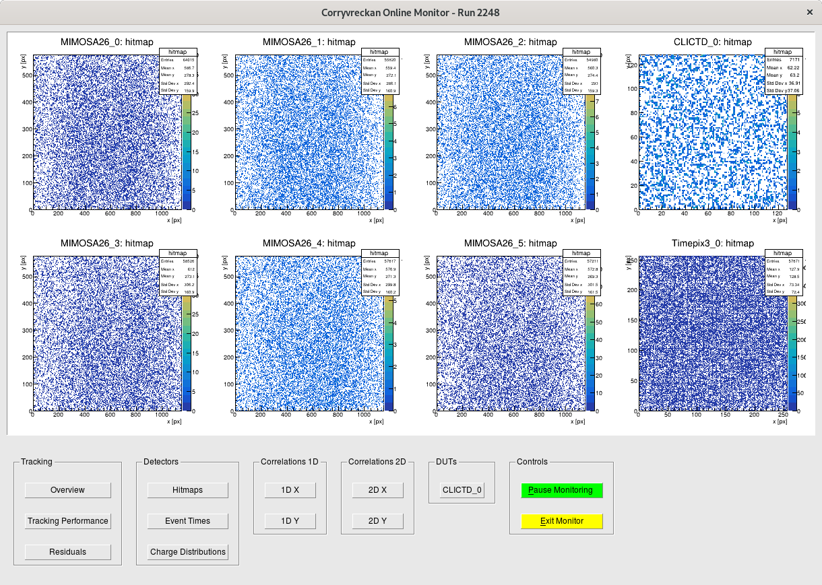
25
Corry: Functionality
Reconstruction
Offline data analysis – post-testbeam data taking
On-line monitoring
On-line data quality check – during data taking
Looking for
  Populated plots
    → Data exists
  Reasonable clusters dist’ns
    → Devices functioning well
  Correlations!
  → synchronised planes

Slide 26
26
Corry: Files
Necessary input to run the software
Global configuration file
File paths: [corryvreckan] module
  e.g. geometry file, output histograms
Reconstruction modules, e.g.
  Timing: [Metronome], Clustering: [Clustering4D]
  Find modules: corryvreckan/src/modules
Any detector type/name specific configuration
Geometry file
Plane positions
  Positions on beam axis (z), x-y plane, rotations (orientations)
Type of detector
Find detector scripts: corryvreckan/src/core/detector
Run reconstruction chain:
> corry –c CONFIGFILE –o OPTION

Slide 27
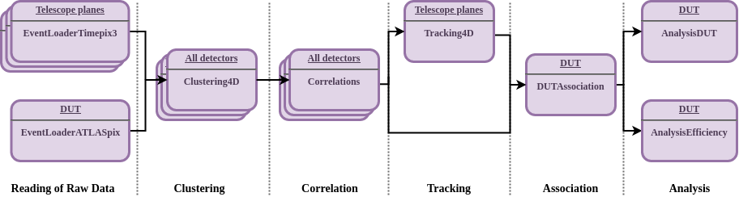
27
Corry: Steps
Reconstruction chain is configurable to particular case
Typical example:
Metronome – construct common timing (if necessary)
EventLoader(s) – reading raw data per detector type
Clustering – collect pixels into clusters
Correlations – check relative offsets of detector planes
Tracking – build track trajectory from subset of planes
Association – comparison of DUT hits with estimated track position
Analysis – additional metrics

Slide 28
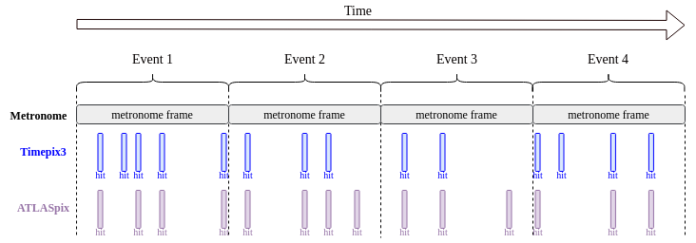
28
Corry: Metronome
Goal: Common timing across planes → event definition
Define modules
Metronome: set event duration
Timestamps from raw data will be mapped onto metronome “event rhythm”

Slide 29
29
Corry: EventLoading
Goal: Read information from data sources to common format
Multiple data sources
Telescope – usually multiple planes of one or two detector types
DUT – whatever is of interest
TLU (& scintillators) – controlling event structure, timestamps
DCS – relevant environment and operational parameters (e.g. T, RH, I)
Define modules, e.g.
EventLoaderTimepix3: timepix3 detectors
EventLoaderATLASpix: prototype atlas ITk detector
Set type/name value to specify which detectors should be read by the module
Outputs (per plane)
2D hit position maps
Pixel ToT distribution

Slide 30
30
Corry: Clustering
Goal: Gather pixels from common incident particle into single object
Define modules, e.g.
ClusteringSpatial: use position information for clustering
Clustering4D: use position and time information for clustering
Set distance/time vicinity to gather pixels into clusters
Outputs (per plane)
Cluster parameters per plane: cluster size, cluster size X&Y, multiplicity, cluster charge
Cluster seed charge
Pixel time distributions (if appropriate)
2D cluster position maps

Slide 31
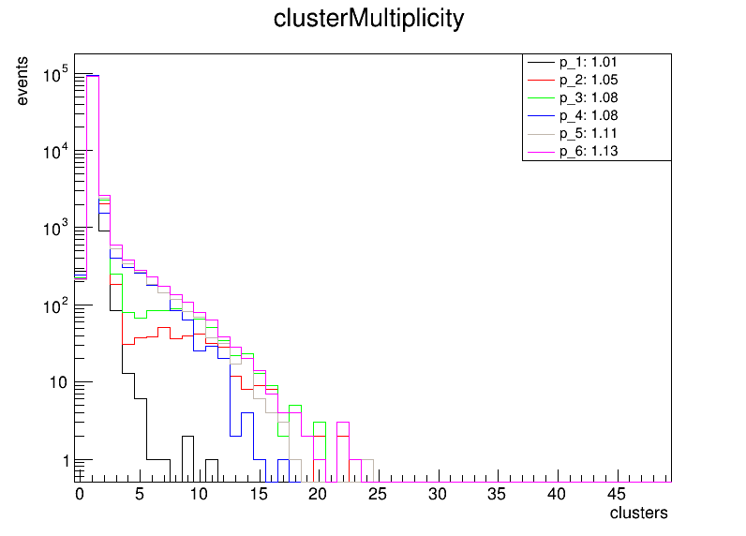
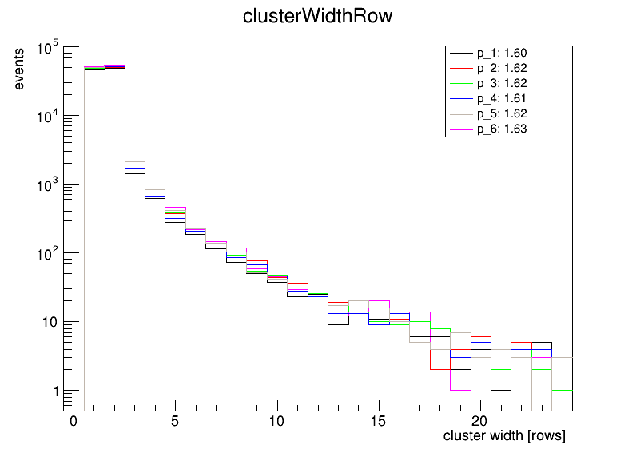
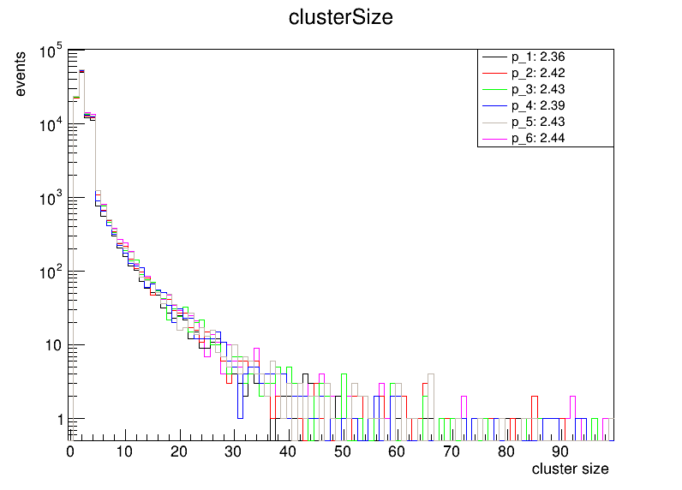
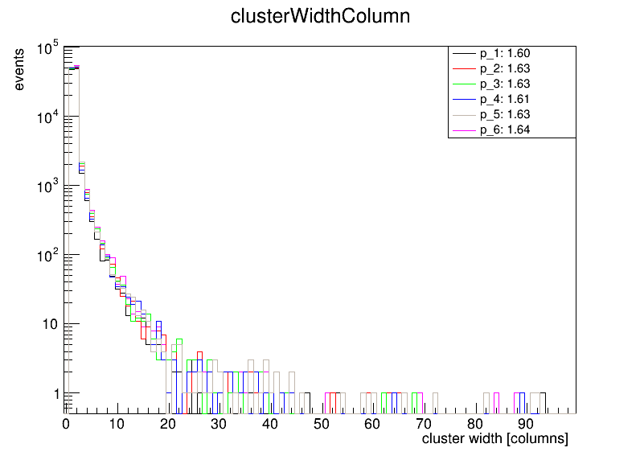
31
Corry: Clustering II
Sample:
100k events
120GeV π+
Telescope only
NB
Cluster sizes increase down stream
Multiplicity increases downstream

Slide 32
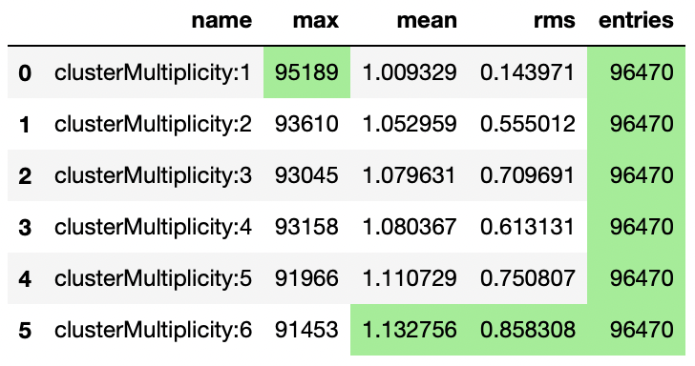
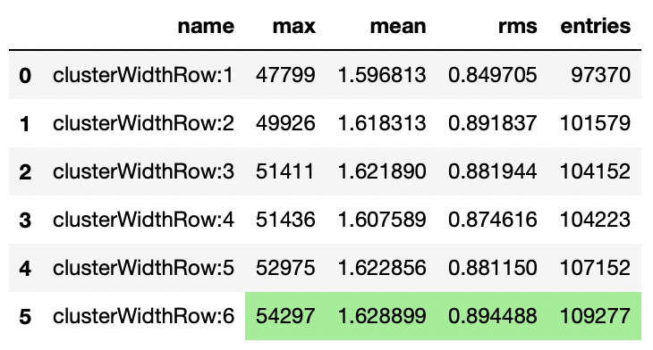
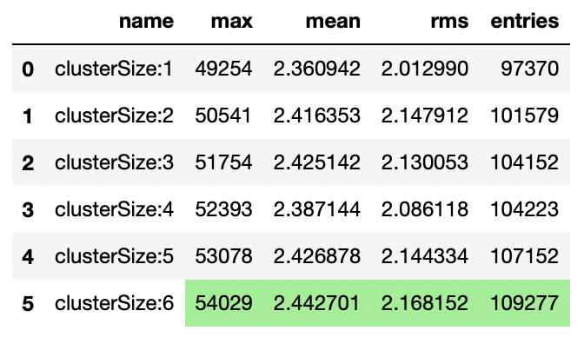
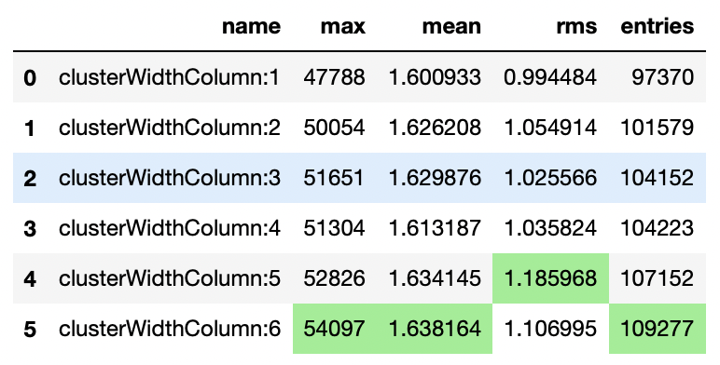
32
Corry: Clustering III
Highest value in column highlighted
Sample:
100k events
120GeV π+
Telescope only
NB
Cluster sizes increase down stream
Multiplicity increase downstream

Slide 33
33
Corry: Correlations
Goal: Associate clusters across detectors
Define modules, e.g.
Correlations: correlation and timing plots
Reference detector flagged in geometry file using role parameter
Outputs (per plane)
Col/row to col/row 2D correlation maps
Time 2D correlation maps (if appropriate)
X/Y to X/Y 2D correlation maps
Pixel/cluster hit maps
X/Y correlation profiles
Computationally intensive step
Not required every for reconstruction iteration or all events
  Can be neglected when satisfied with orientations

Slide 34
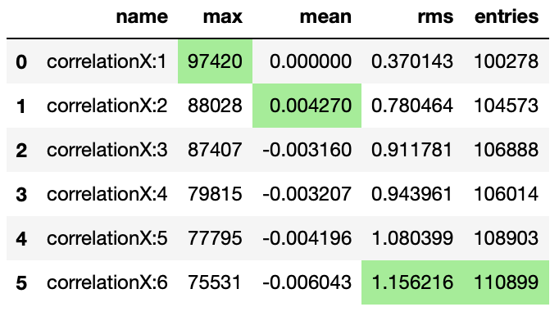
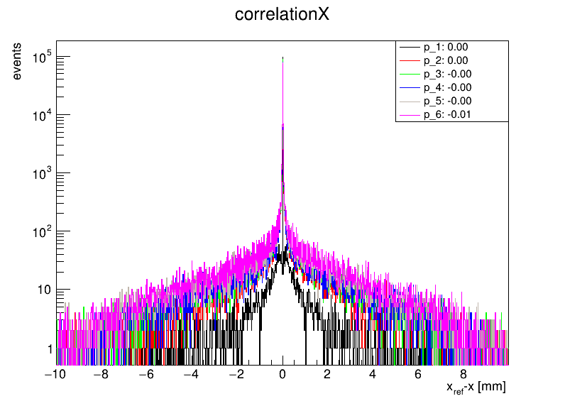
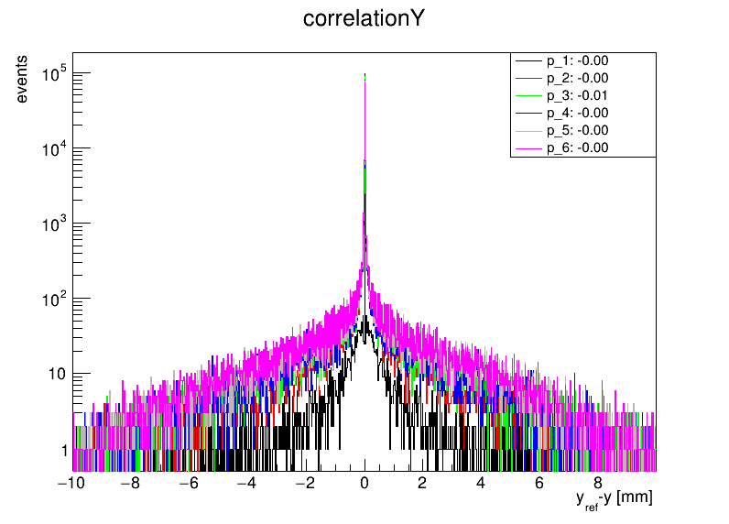
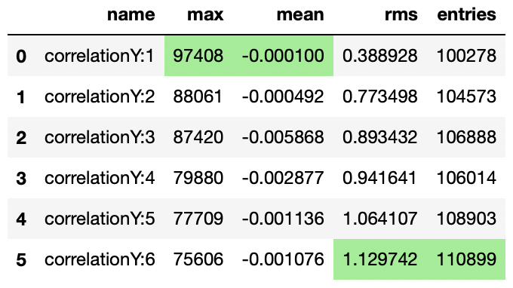
34
Corry: Correlations II
Sample:
100k events
120GeV π+
Telescope only
NB
Multiplicity increases downstream
RMS increases downstream
Means ~0.0
→ well aligned

Slide 35
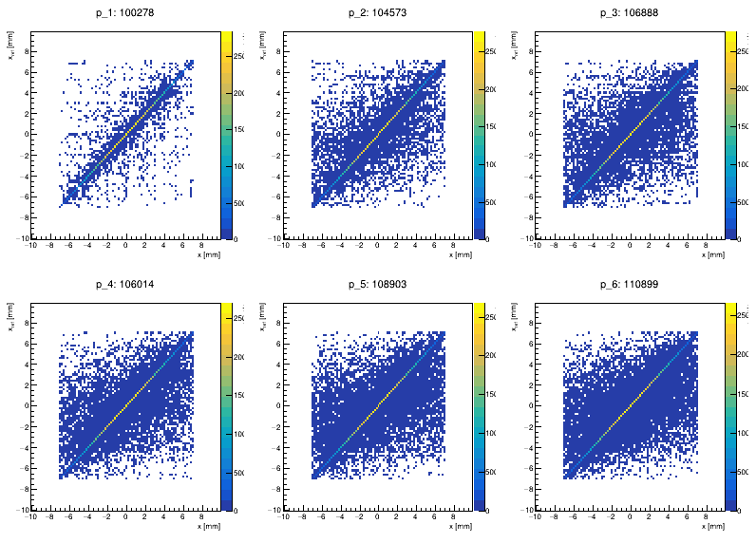
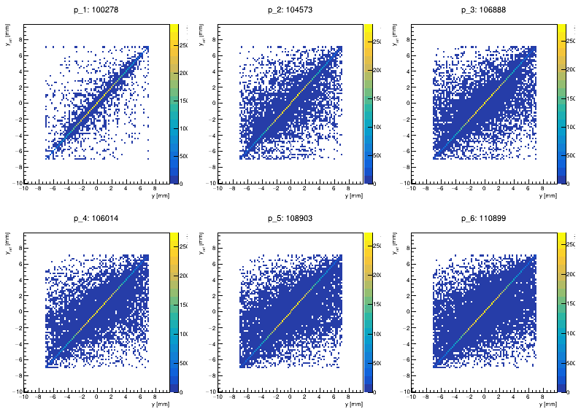
35
Corry: Correlations II
Sample:
100k events
120GeV π+
Telescope only
NB
Correlations BL to TR
→ good orientation
Origin offset ~0.0
→ well aligned
Multiplicity increases downstream
Correlations “spread” moving downstream
X correlations
Y correlations

Slide 36
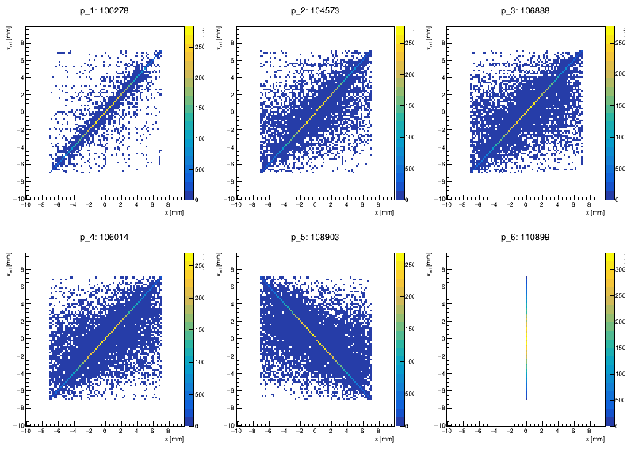
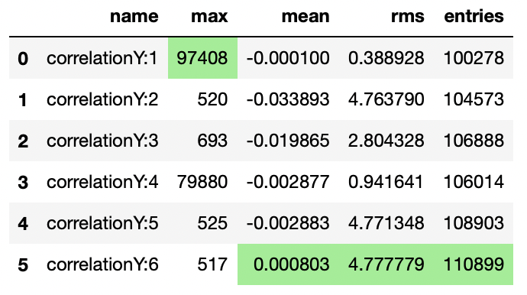
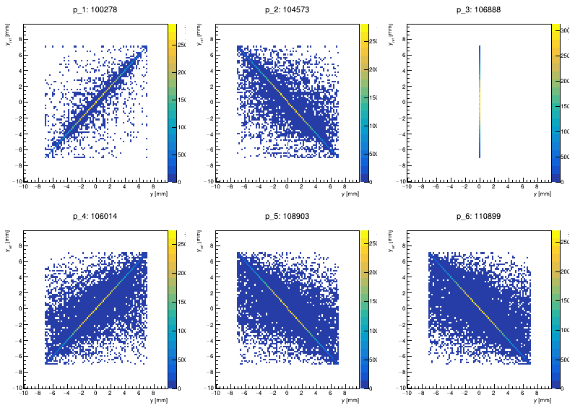
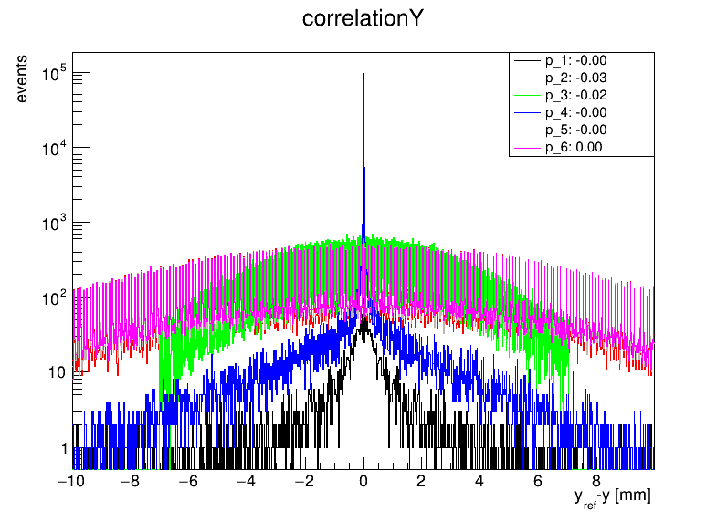
36
Corry: Correlations IV
BAD geometry file
180º rotation
  Reverse correlation (TL to BR) in map
  Peak lost in profile
    Low max value
    Large RMS
90º rotation
→ Lost correlation (2D) & peak (1D)
X correlations
Y correlations

Slide 37
37
Corry: (Pre-)Alignment
Goal: Position & orient detector local planes to global layout
Define modules, e.g.
Prealignment: translational plane alignment (not rotations)
AlignmentMillepede: implementation of the Millepede module
Reference detector flagged in geometry file using role parameter
Outputs
Updated geometry file
  Limit to what can be automated
    Won’t flip orientations
    Can get stuck in local 𝜒² minima

Slide 38
38
Corry: Track Finding
Goal: Build global track trajectory from local cluster positions in planes
Track Finding
Define modules, e.g.
Tracking4D: using position and time from tracking planes
TrackingMultiplet: build from upstream and downstream tracklets
Reference detector flagged in geometry file using role parameter
Then add Track Association
Define modules, e.g.
DUTAssiciation: establish association between DUT clusters and tracks

Slide 39
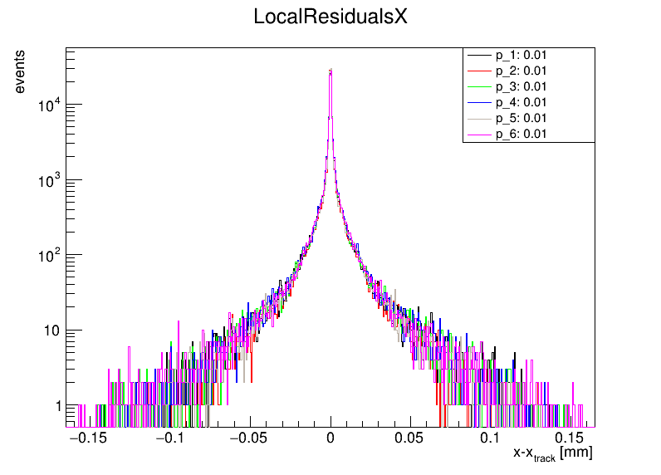
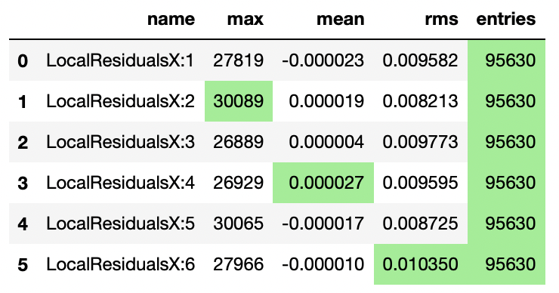
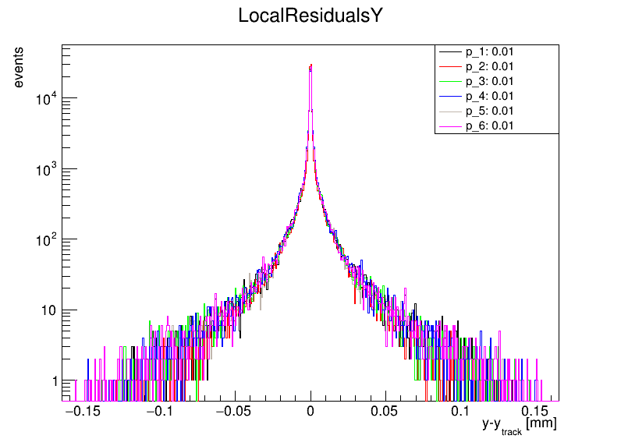
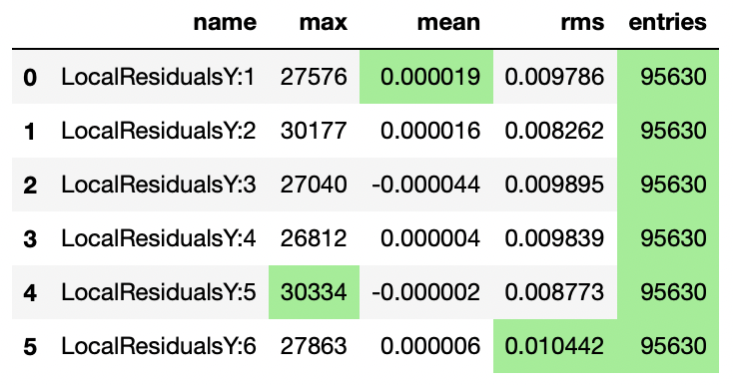
39
Corry: Track Finding II
Telescope planes
Residuals are biased
Planes are used in track fitting
→ σ << pitch/√12
Distributions very close to zero

Slide 40
40
Corry: Metrics
Goal: Quantitative characterisation of detector properties
Analysis examples:
AnalysisDUT: generic analysis module for all types of detectors
  Including residuals
AnalysisEfficiency: comparing cluster positions with the interpolated track position
  Including in-pixel efficiencies
AnalysisTimingATLASpix: in-depth timing analysis of the ATLASpix
  Specific to detector type

Slide 41
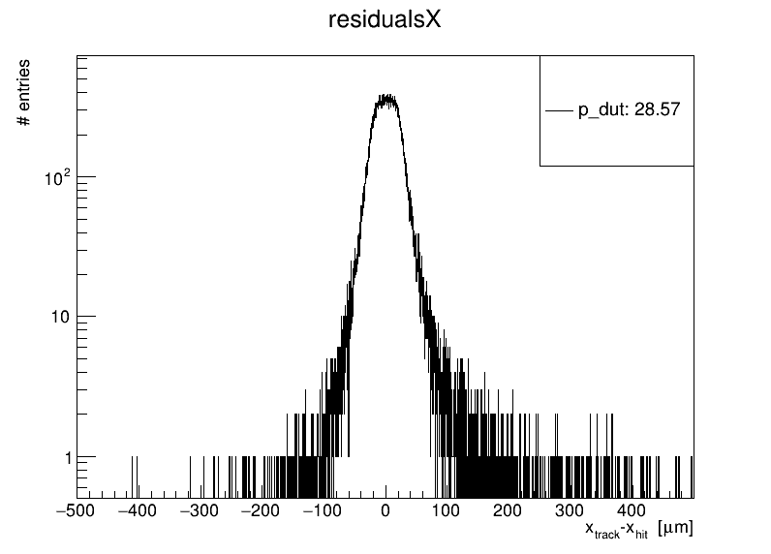
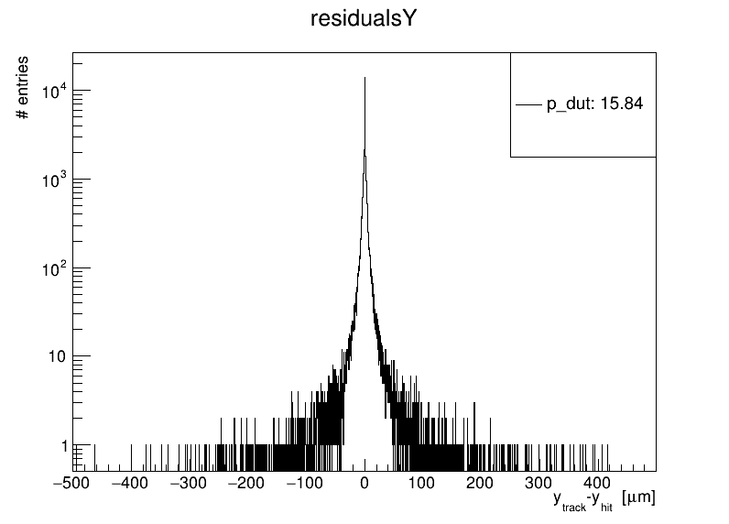
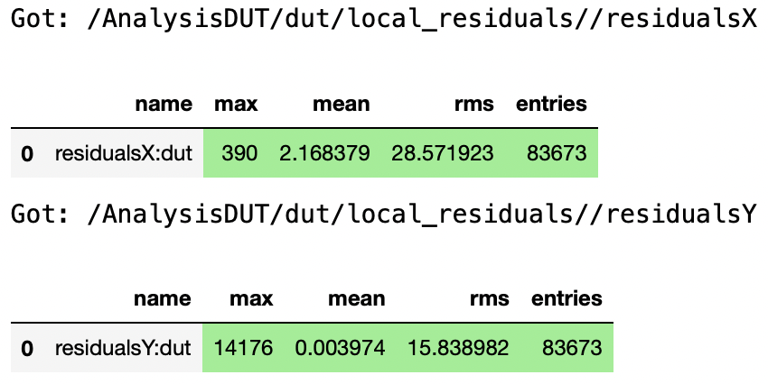
41
Corry: Metrics
Residuals
Lower population in DUT than in telescope planes (~95k)
Matching not always successful (less than required planes hit)
Detector not always efficient
Residuals much wider than telescope (X:~0.01, Y: ~0.01)
DUT planes not used in track fitting (i.e. unbiased residuals)

Slide 42
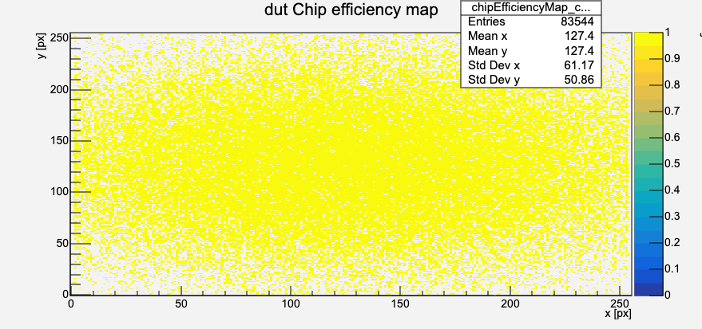
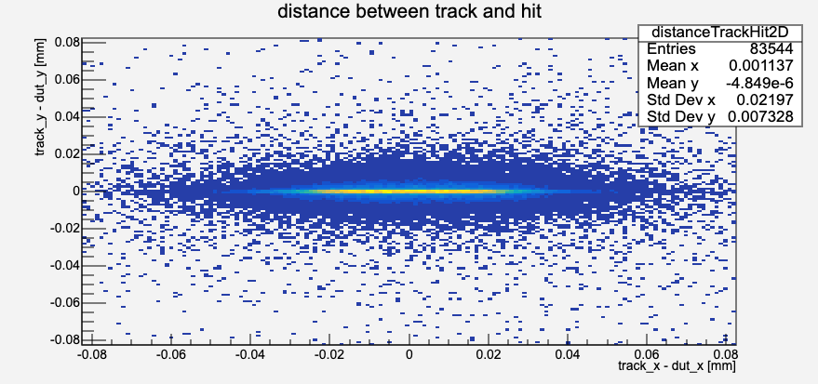

42
Corry: Metrics II
Efficiency
Map of efficiency across pixel matrix
Excellent efficiency in simulation
  Uniform colour → consistent matrix
  High value → efficient device
Distribution of pixel efficiencies
Excellent efficiency in simulation
Entries = number of pixels
Distance between track and hit ≈ 2D residual plot

Slide 43

43
Corry: Metrics III
In-pixel efficiency
Map of efficiency across pixel matrix
Excellent efficiency in simulation
  Uniform colour → consistent matrix
  High value → efficient device
Lower THL
Higher THL

Slide 44
44
Corry: Allpix**2
Allpix**2 generates corryvreckan output
Module: CorryvreckanWriter - documentation
Corryvreckan can read in file
Module: FileReader – documentation
Allpix**2 contains event and detectors hit info formation
Replaces Metronome and EventLoader modules
More Generally…
Corryvreckan can also read in part completed analysis
Don’t need to run all steps in one go
  Can focus on single step
  Split alternative analysis options
    e.g. clustering
      binary/analog
      Neighbour definition

Slide 45
45
Summary
Part I: Testbeam re-cap
Testbeams offer unique tests based on control of radiation source
  Complex logistics & data gathering
  Complex data interpretation
Part II: Generic reconstruction
Common reco. steps: Hits, Clusters, Correlations, Alignment, Tracking
Qualitative characterisation via metrics via tracks comparison to DUT
Part III: Corryvreckan
Modern, well-documented, free reconstruction framework
Compatible with Allpix**2 simulation framework

Slide 46
46
Back-up
Setting up tutorial

Slide 47
47
Set-up repos
Clone repositories
Pick your favourite directory
Clone corryvreckan repo.
  git clone https://gitlab.cern.ch/corryvreckan/corryvreckan.git
Go into repository
  cd corryvreckan
Build local docker image (optional)
  docker build -f etc/docker/Dockerfile -t corry .
Back to your favourite directory
Clone tutorial repo.
  git clone https://gitlab.cern.ch/jekroege/fp_pixel_sensor_characterisation.git
Go into repository
  cd fp_pixel_sensor_characterisation/scripts/
Download data
  ./download_data.sh

Slide 48
48
Running corry
Run corryvreckan container
From top directory of corryvreckan repo.
docker run --interactive --tty --volume "$(pwd)":/data -v $(pwd)/../fp_pixel_sensor_characterisation/:/examples --name=corryvreckan gitlab-registry.cern.ch/corryvreckan/corryvreckan bash
Running interactively with bash and local volumes mounted for output data and examples
For Windows users: $(pwd) → $PWD
If using (optional) local image:
  gitlab-registry.cern.ch/corryvreckan/corryvreckan → corry
Run corryvreckan package
Inside container
corry -c /examples/01_example.conf
You can find the output file (01_example.root) in the output directory
This can be viewed locally (i.e. outside container)
root 01_example.root
TBrowser a

