Slide 1
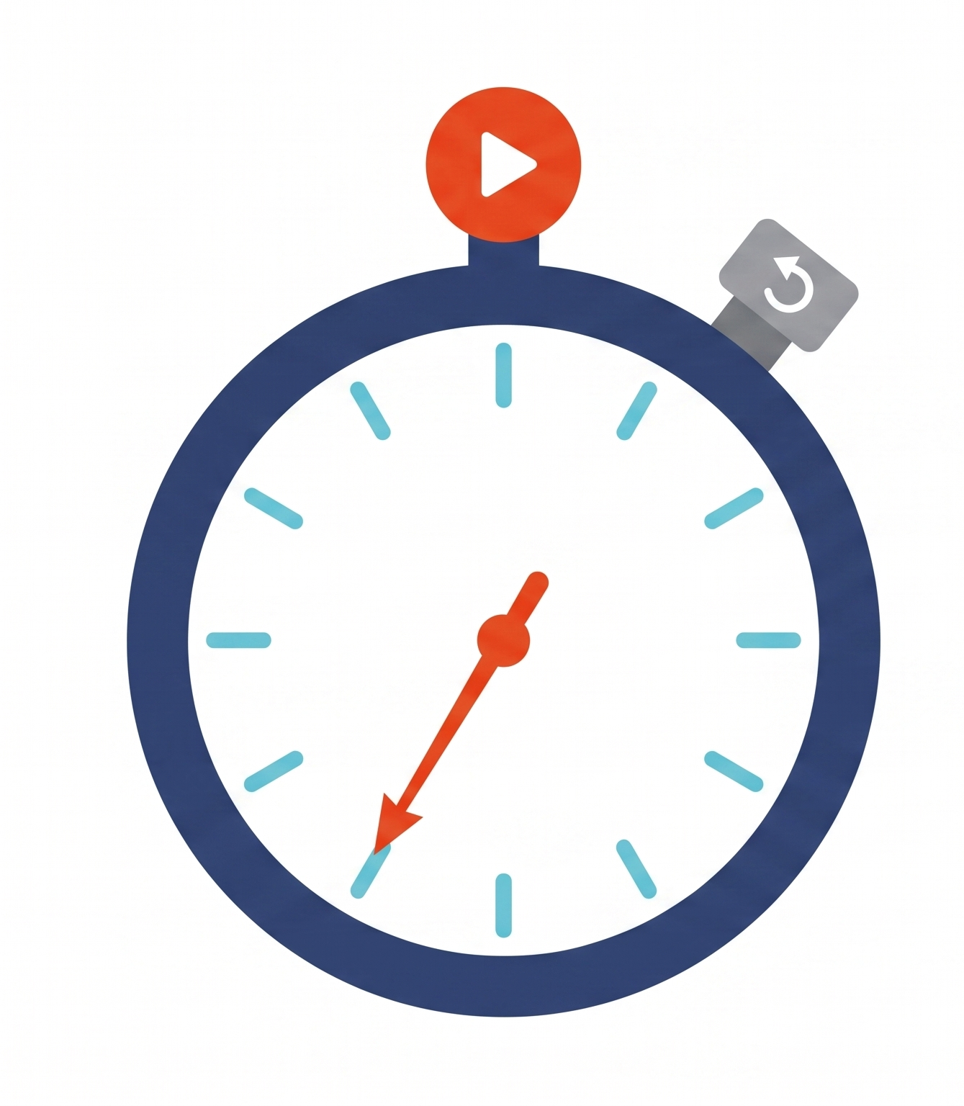
It’s About Time:
4D Tracking in Modern Detectors
Luca Menzio – CERN’s Solid State Detectors group

Slide 2
Content
Disclaimer:
I took inspiration from Nicolò Cartiglia and Frank Hartmann’s lectures at the 2026 EDIT school for parts of this seminar
4D tracking
Timing measurements
Some valid candidates
Resistive Silicon Detector(s)

Slide 3
Content
4D tracking
Timing measurements
Some valid candidates
Resistive Silicon Detector(s)

Slide 4
Did not pay the ticket

Slide 9
What is 4D Tracking
The classic picture: 3D
A tracker rebuilds particle trajectories from position “hits” in successive layers → coordinates (x, y, z)
Excellent spatial precision (~µm), if the number of hits is low reconstructing the track is feasible

Slide 10
What is 4D Tracking
The classic picture: 3D
A tracker rebuilds particle trajectories from position “hits” in successive layers → coordinates (x, y, z)
Excellent spatial precision (~µm), if the number of hits is low reconstructing the track is feasible
But if the number of hits increases → problems in the reconstruction

Slide 11
What is 4D Tracking
The classic picture: 3D
A tracker rebuilds particle trajectories from position “hits” in successive layers → coordinates (x, y, z)
Excellent spatial precision (~µm), if the number of hits is low reconstructing the track is feasible
But if the number of hits increases → problems in the reconstruction
4D tracking
If we add “stopwatches” each hit has its own timestamp
4D tracking adds a precise timestamp to the spatial information
t₁
t₂
t₃

Slide 12
What is 4D Tracking
(3+1)D Tracking
A timing layer added to an existing tracker
One or two layers time-stamp the whole track
Far from the interaction point: lower rates, less radiation
The choice of CMS and ATLAS at the HL-LHC
t₁
t₂
t₃

Slide 13
Why 4D Tracking
The next generation of colliders pushes pile-up, rates and radiation beyond what position-only tracking can resolve — time becomes the essential coordinate.
HL-LHC
FCC
The high-luminosity upgrade of the LHC — many more proton collisions, from ~2029.
A proposed ~90 km circular collider at CERN, with electrons first and protons later.
Muon Collider
EIC
A future collider of muons, reaching the energy frontier in a compact machine.
A new US collider of electrons with protons and ions, probing their inner structure.

Slide 14
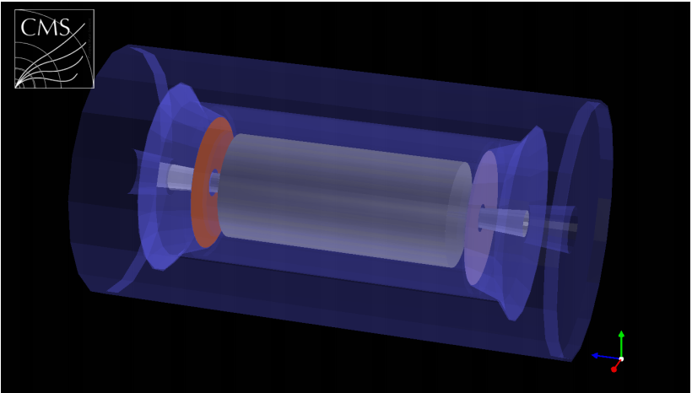
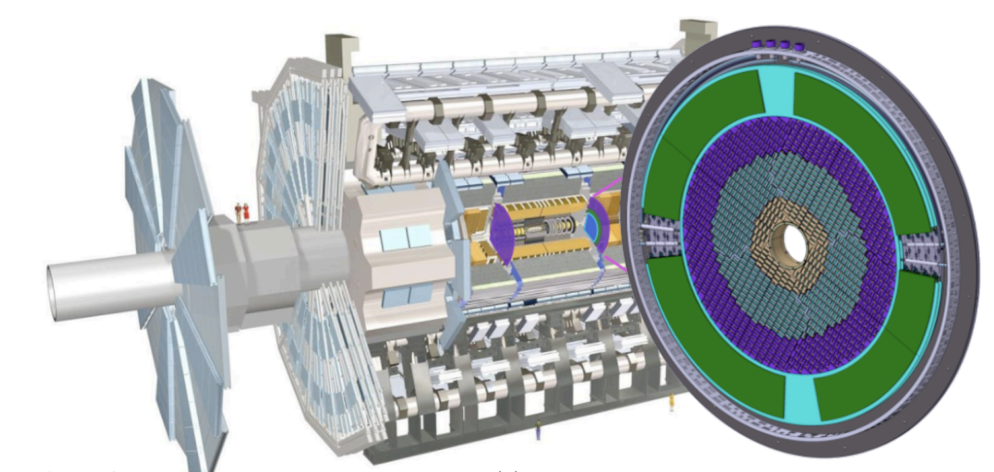
Why 4D Tracking
The next generation of colliders pushes pile-up, rates and radiation beyond what position-only tracking can resolve — time becomes the essential coordinate.
HL-LHC
CMS
MIP Timing Detector
The high-luminosity upgrade of the LHC — many more proton collisions, from ~2029.
Newest instances of tracking layers dedicated to timing!
Will be assembled soon
ATLAS
High Granularity Timing Detector

Slide 15
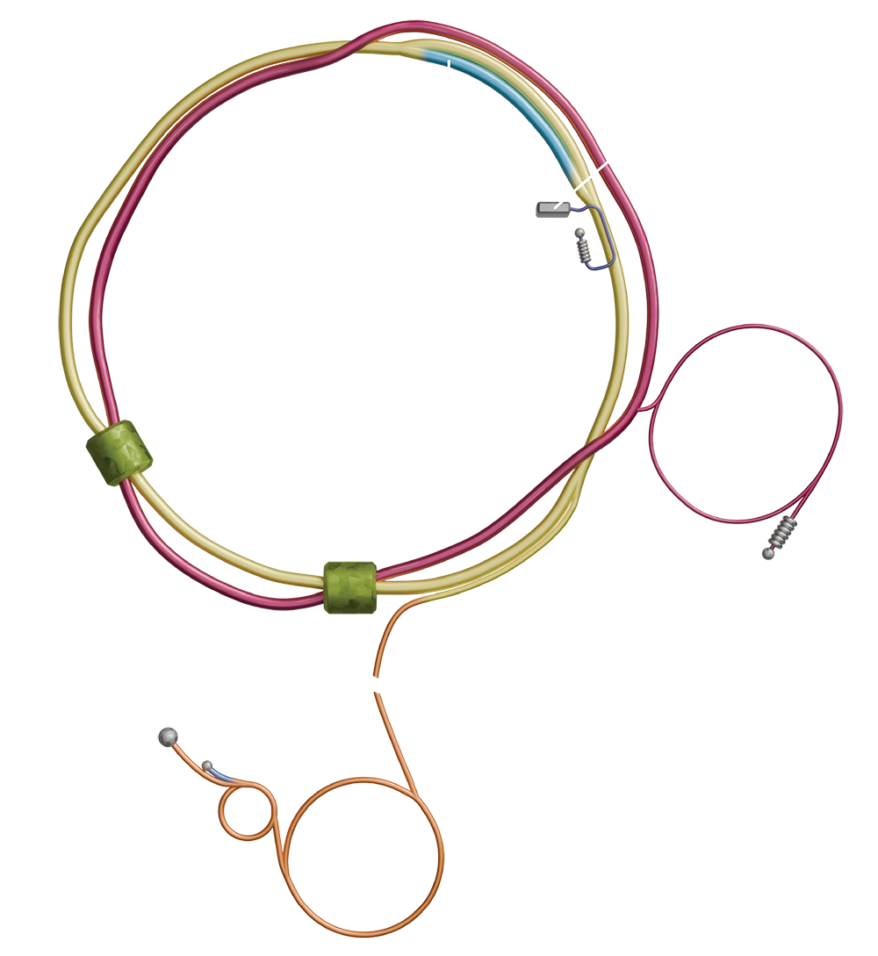
Why 4D Tracking
The next generation of colliders pushes pile-up, rates and radiation beyond what position-only tracking can resolve — time becomes the essential coordinate.
At Brookhaven Lab (US), from ~2032
First high-energy electron–ion collider
Collision energy √s up to ~140 GeV
Dedicated to nuclear structure studies
4D tracking detector in ePIC
Time-of-Flight layers
Barrel + endcaps
~30 ps per hit
Separates π, K and p
EIC
A new US collider of electrons with protons and ions, probing their inner structure.

Slide 16
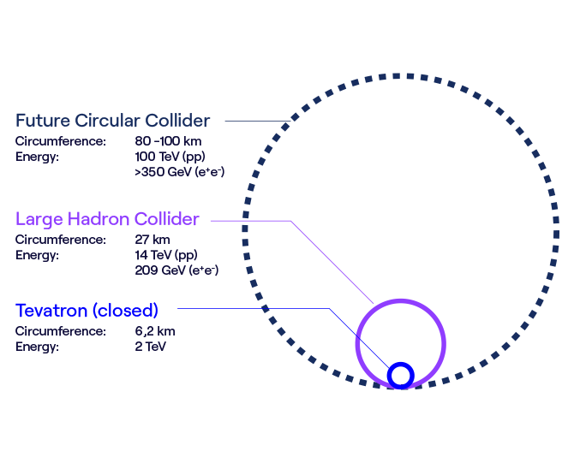
Why 4D Tracking
The next generation of colliders pushes pile-up, rates and radiation beyond what position-only tracking can resolve — time becomes the essential coordinate.
FCC
A proposed ~90 km circular collider at CERN, with electrons first and protons later.
Two possible stages: FCC-ee, then FCC-hh
FCC-ee: √s ~90–365 GeV — Higgs & EW factory
FCC-hh: pp collisions up to ~100 TeV
Final CERN decision ~2028
First beams targeted for the ~2045–2048

Slide 17
In summary: why 4D tracking
A new generation of experiments
HL-LHC, FCC, a muon collider and the EIC are being built.
1
The conditions get much harsher
Higher rates and pile-up: current position-only trackers can't cope.
2
Add the time coordinate
A timestamp on every hit — 4D tracking — separates overlapping events
3
We need timing detectors that can also do tracking
This seminar (and my job)
4

Slide 18
Content
4D tracking
Timing measurements
Some valid candidates
Resistive Silicon Detector(s)

Slide 19
Measuring Time
A crossing particle releases charge in the sensor → fast electrical pulse
The electronics record when the pulse crosses a set threshold — that instant is the arrival time t
t is always measured against a reference (the collision, or a ‘start’ detector)
Its spread is the time resolution σ_{t} — 4D tracking aims for at least σ_{t} ≈ 30 ps
particle
sensor
electronics
signal
threshold
t
time

Slide 20
Measuring Time
In all time measurement systems, there are always at least two equally important components
Detector
Electronics
Practically, the time coordinate is extracted by the electronics from the signal provided by the detector.
Faster (shorter) signals are better
Large signals help the electronics
They must be able to fulfill the experiment requirements together
particle
sensor
Today
electronics
signal
threshold
t
time

Slide 21
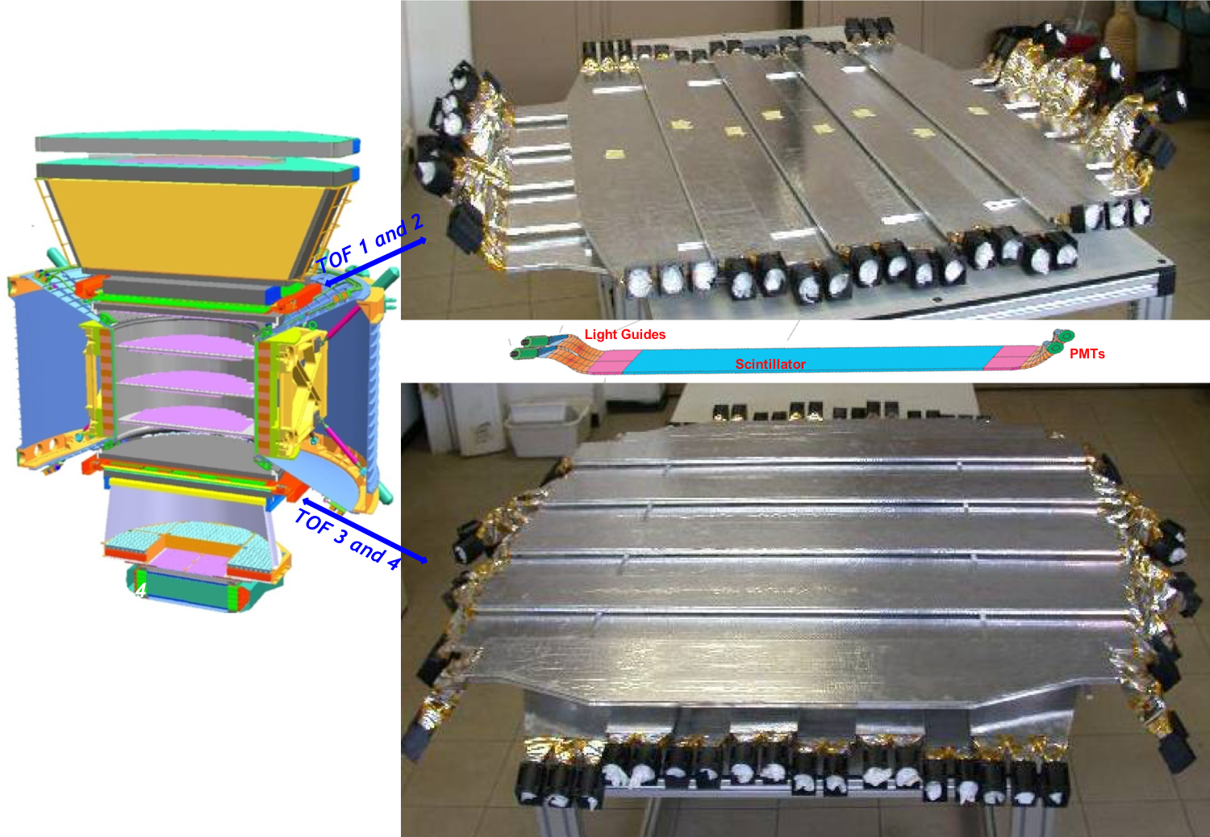
Measuring Time – Detectors: a bit of history
Timing is not new: for decades time-of-flight systems were built with scintillators read out by photodetectors.
Scintillator + PMT
Since the 1950s: the workhorse of time-of-flight
A charged particle makes light in the scintillator; a photomultiplier turns it into a fast pulse
σ_{t} ≈ 50–100 ps for a whole counter
Big, no position information and sensitive to magnetic fields
The ams-02 time of flight. Image taken from here

Slide 22
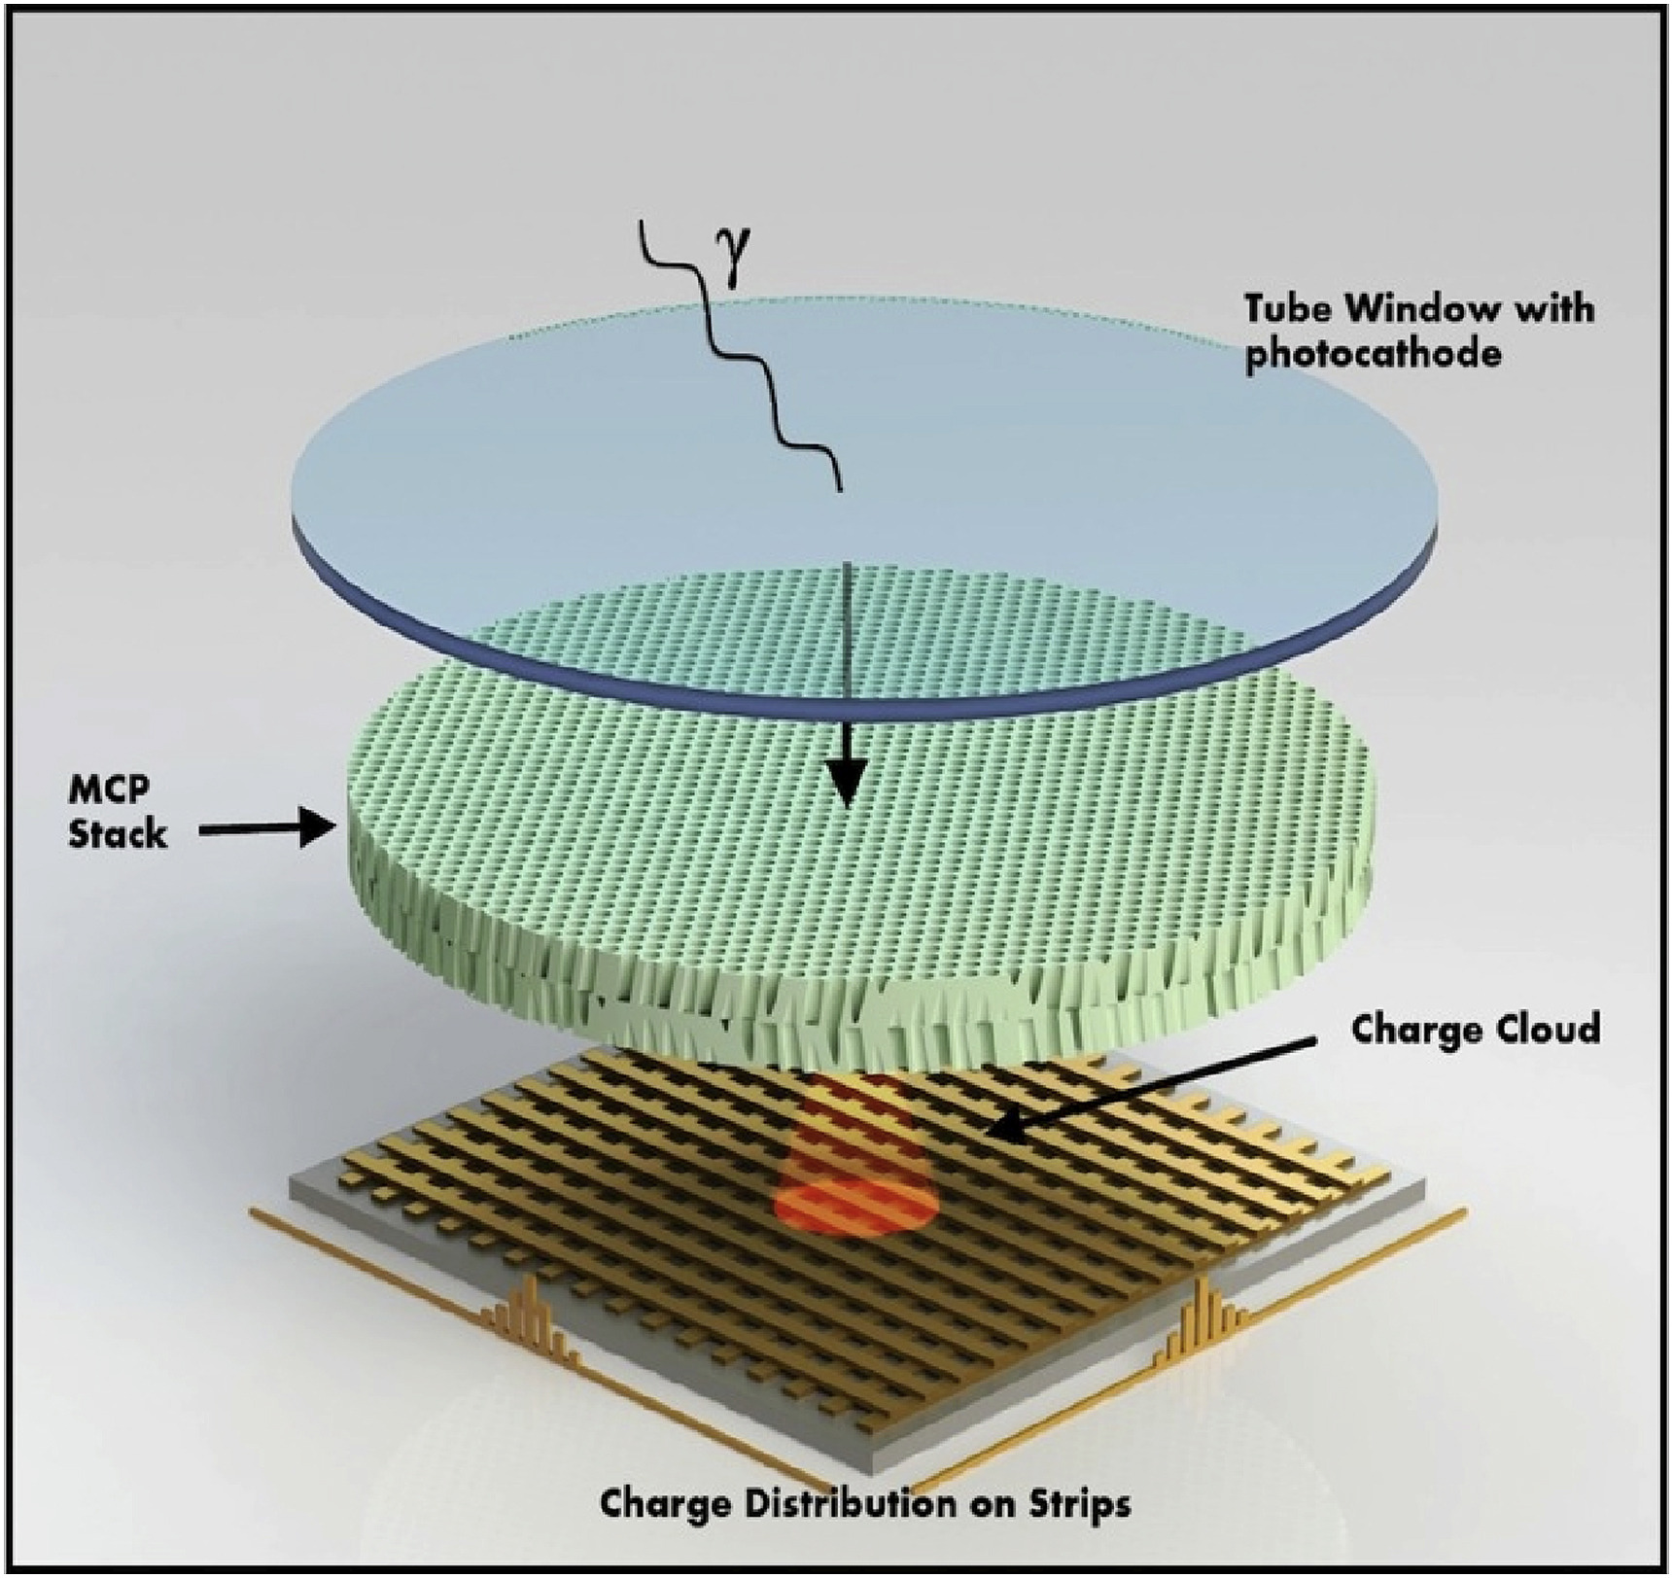
Measuring Time – Detectors: a bit of history
Timing is not new: for decades time-of-flight systems were built with scintillators read out by photodetectors.
Micro-Channel Plate PMT
A thin plate of micro-tubes multiplies the photoelectrons over a very short path
σ_{t} of a few ps to ~10 ps — some of the best timing available
Used in Cherenkov timing (e.g. Belle II TOP)
Fragile, expensive, needs light — hard to build a large tracker with it
Image taken from here

Slide 23
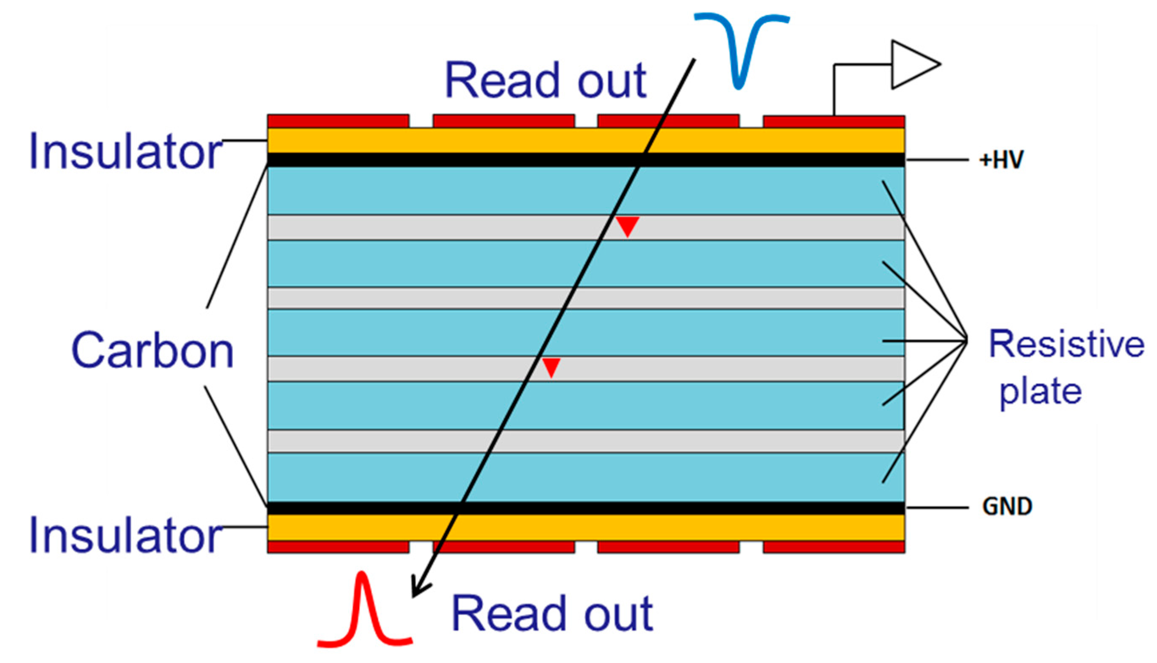
Measuring Time – Detectors: gas and the limits
Gaseous detectors brought precise timing over very large areas — but not the tracking performance we now need.
Multigap Resistive Plate Chambers
A stack of thin gas gaps between resistive plates: the avalanche starts immediately, everywhere
σ_{t} ≈ 60–80 ps over ~150 m² — the ALICE TOF wall at the LHC
Cheap per unit area, ideal for particle identification
Coarse granularity (cm-size pads) and slow rate capability

Slide 24
Measuring Time – Detectors: gas and the limits
Gaseous detectors brought precise timing over very large areas — but not the tracking performance we now need.
Multigap Resistive Plate Chambers
A stack of thin gas gaps between resistive plates: the avalanche starts immediately, everywhere
σ_{t} ≈ 60–80 ps over ~150 m² — the ALICE TOF wall at the LHC
Cheap per unit area, ideal for particle identification
Coarse granularity (cm-size pads) and slow rate capability
What these detectors cannot do
No µm-level position measurement:
they time, they do not track well
Large volumes and high voltages — heavy material budget, little space in a modern tracker
Rate and radiation tolerance far below HL-LHC or FCC conditions
Since ~10 years → silicon devices

Slide 25
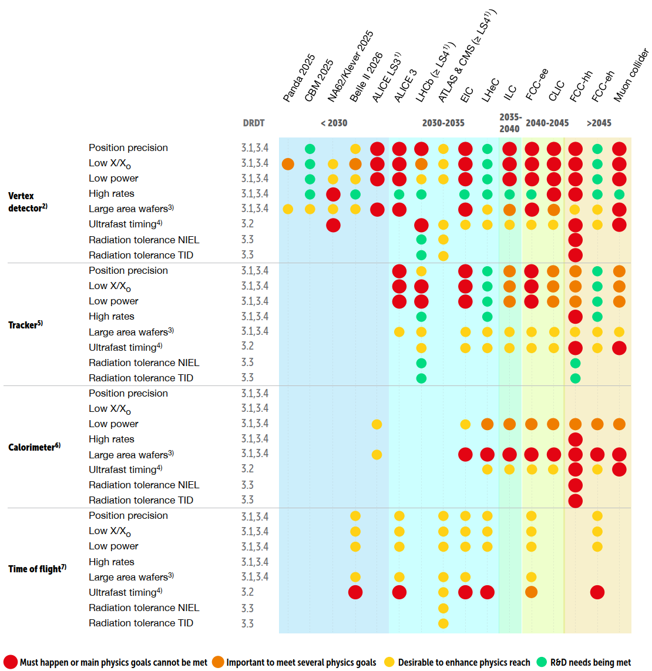
Measuring Time – Requirements
The experiment requirements are what we follow for detectors R&D. Some of the most important are:
Space resolution | Power consumption
Time resolution | Material budget
Radiation tolerance | Particle rate
Luckily, experts draw documents that summarize all that we need in a simple(r) way
There are also international collaborations such as CERN’s DRD program that found, collect and steer R&D in this field.
There’s a lot to do and plenty of room for improvement → great field?

Slide 26
Why silicon?
A reverse-biased diode: the depleted volume is the detector itself.
Great precision in manufacturing
High density of electron-hole pairs per unit length
High charge carrier mobility
Compatible with industrial fabrication processes
Good radiation resistance can be achieved
Very small pixels are feasible
Large signals ,
Fast signals
Relatively cheap ,
It “ages” well in the experiments

Slide 27
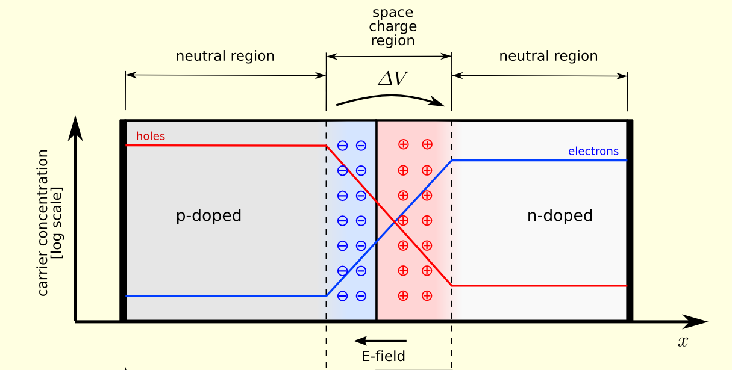
How silicon (diode)?
To summarize (very quickly) how a diode works:
if a certain voltage is applied to the sensor, the charges are free to move

Slide 28

How silicon (diode)?
To summarize (very quickly) how a diode works:
if a certain voltage is applied to the sensor, the charges are free to move
when a particle hits the diode volume, electron-hole pairs are created
Electron-hole pairs migrate towards the electrodes
an electrical signal is induced on the electrodes
Impinging particle
n++
e⁻
h⁺
e⁻
h⁺
Silicon Diode
p
e⁻
h⁺
e⁻
h⁺
p++
For (way) more about this topic see F. Hartmann’s lecture at the 2026 EDIT school
-ΔV

Slide 29
Why silicon?
Such devices have been employed in trackers (3D) for decades now.
Traditionally, though, they do not provide good timing performances
Silicon started becoming interesting for timing measurements in recent years
Device engineering (or re-engineering)
Impinging particle
n++
e⁻
h⁺
e⁻
h⁺
Silicon Diode
p
e⁻
h⁺
e⁻
h⁺
p++
-ΔV

Slide 30
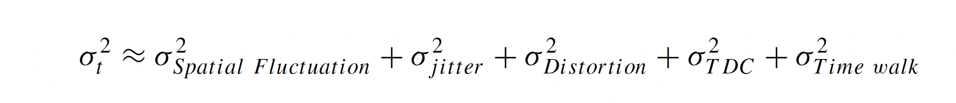
Measuring Time – Some Theory
Sensor
Electronics
Again, for an in-deep lecture about timing see N. Cartiglia’s talk at the 2026 EDIT school

Slide 31
Measuring Time – Some Theory
Go thin
Due to non-uniform energy deposition
Someone calls it also “Landau contribution”
Becomes more relevant with larger distance in between the electrodes (i.e. thickness for a standard diode)

Slide 32
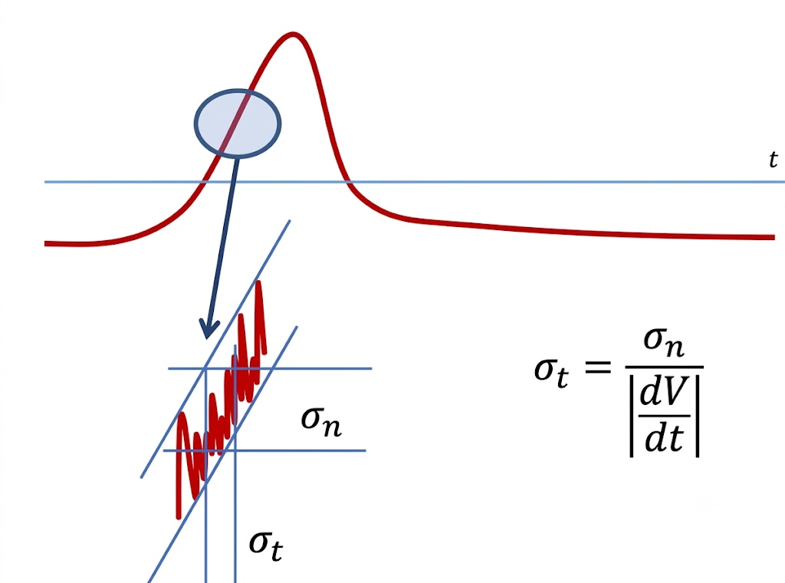

Measuring Time – Some Theory
Go thin
Increase S/N
Jitter contribution
Due to interplay between noise and signal shape.
In principle, one needs
fast and large signal
low noise.
→ large signal/noise (S/N)
$$σ_{t}=\frac{noise}{dV/dt}$$

Slide 33

Measuring Time – Some Theory
Go thin
Increase S/N
Be uniform
Distortion Contribution
It comes from Shockley-Ramo’s theorem
Due to a position-dependent coupling of the drifting charges to the electrode (non-uniform weighting field)
Parallel plate geometry
Saturated drift velocities
Signal shape is determined by it
$$i∝qvE_{w}$$
Weighting field
Drift velocity

Slide 34
Content
4D tracking
Timing measurements
Some valid candidates
Resistive Silicon Detector(s)

Slide 35
From Theory to practice
Go thin
Increase S/N
Be uniform
There are various strategies to decrease the time resolution. Some examples are:
3D sensors – (very) short drift of charges + great S/N thanks to the diode being “vertical”
SiPM – normally coupled with scintillators. Exploit the Gaiger Mode S/N
Sensors with internal gain – they device engineering to achieve signal multiplication

Slide 36
Requirements
Before jumping into the technologies, it is important to keep in mind the objectives:
each machine sets its own targets in time, space, radiation hardness and material budget.
No single sensor wins everywhere
Experiment (timing detector) | Time res. / hit | Spatial res. | Fluence [n_eq/cm²]
HL-LHC | 30–50 ps | ~1 mm pads | up to 2.5×10¹⁵
FCC-ee — full-Si vertex/tracker | 10–30 ps | 5–10 µm | < 10¹⁴
EIC — ePIC ToF | ~25–30 ps | 20–30 µm | ~10¹³
Muon collider — tracker | ~30 ps | 5–25 µm | ~10¹⁵

Slide 37
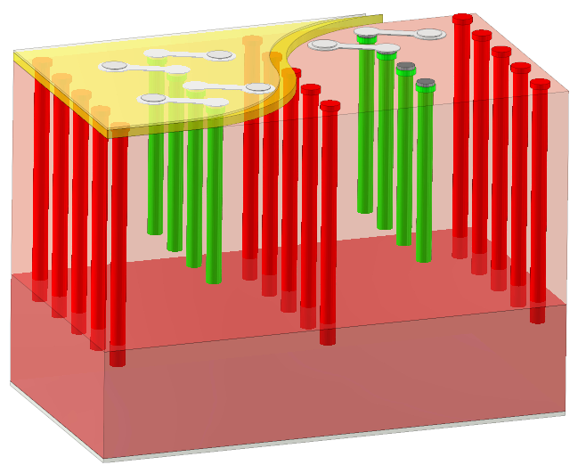
3D detectors
3Ds minimize drift path by “rotating” the diode with respect to the particle path → the particle is parallel to the junction
They were adopted at the High-Luminosity LHC
Longer ionization path – More charge
Shorter drift path
  Radiation resistance – above Φ = 10¹⁶ n_{eq}/cm² (very good)
  Less power – goes with (electrode distance)²
  Time resolution – the jitter contribution is very low
But the columnar configuration is not ideal for the distortion term
Dalla Betta G-F and Povoli M (2022) Progress in 3D Silicon Radiation Detectors. Front. Phys. 10:927690. doi: 10.3389/fphy.2022.927690

Slide 38
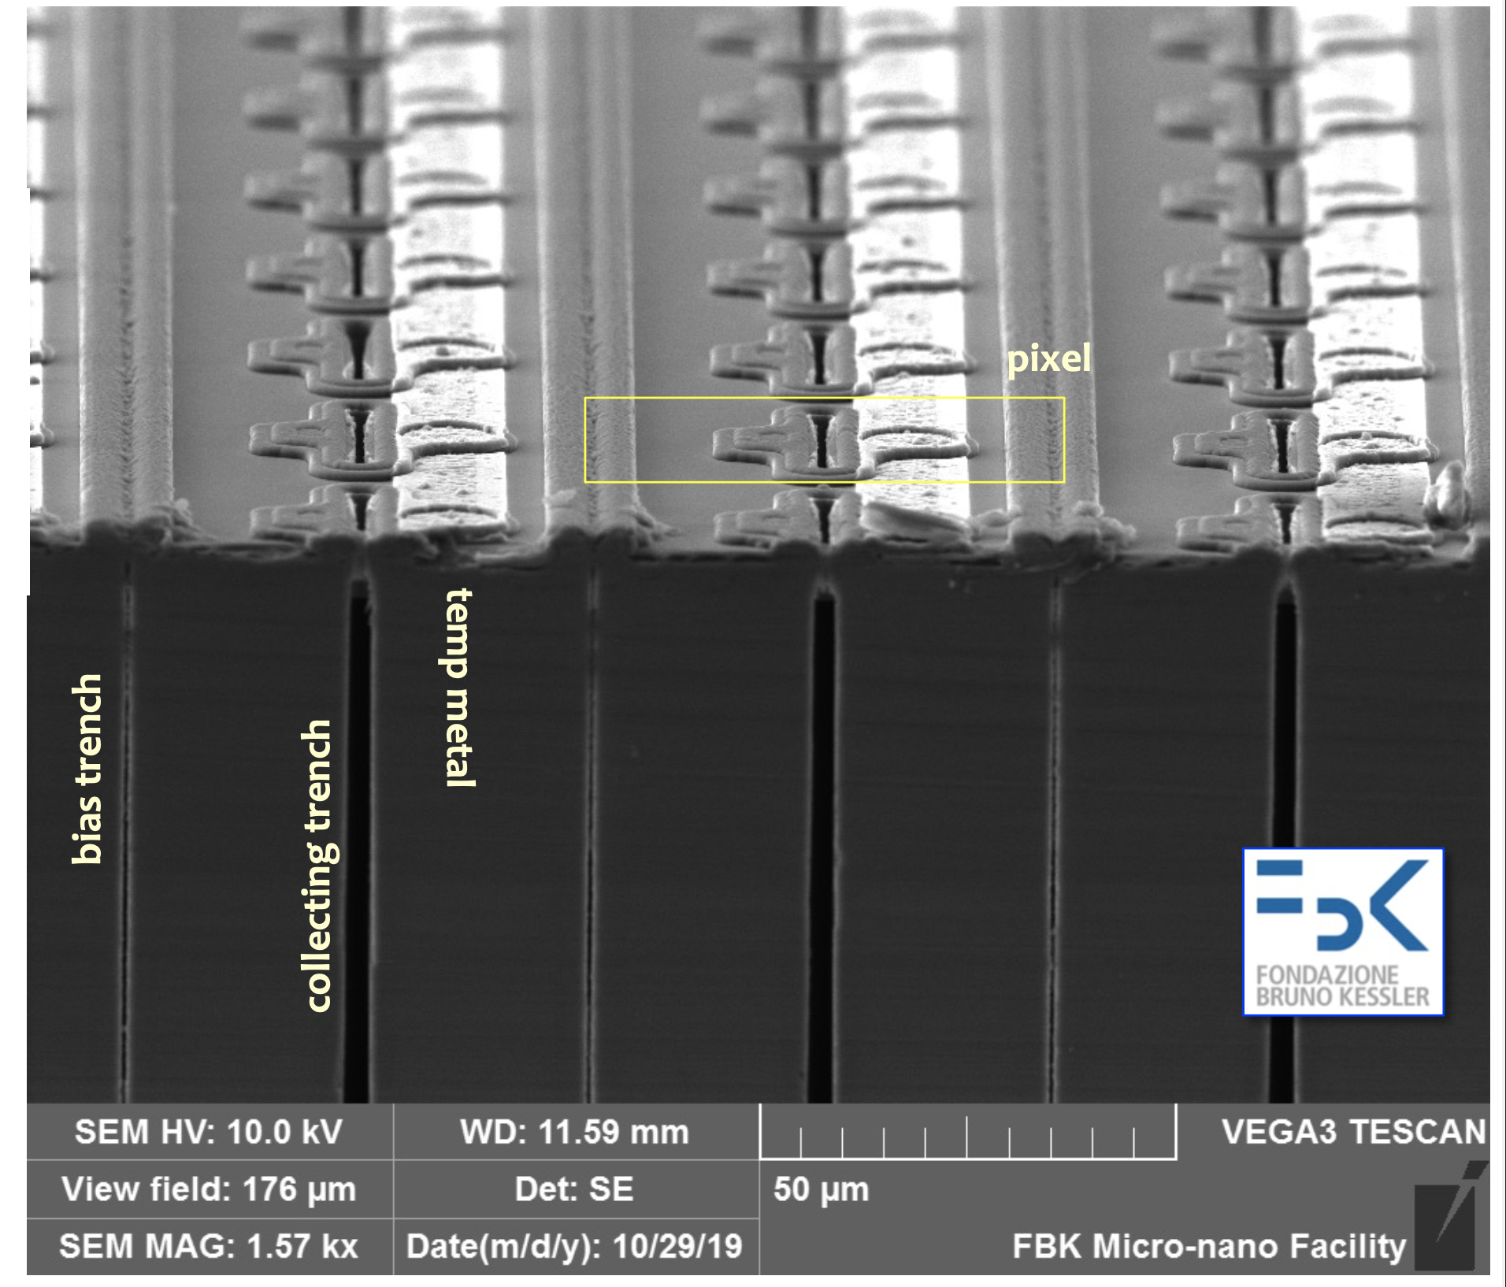
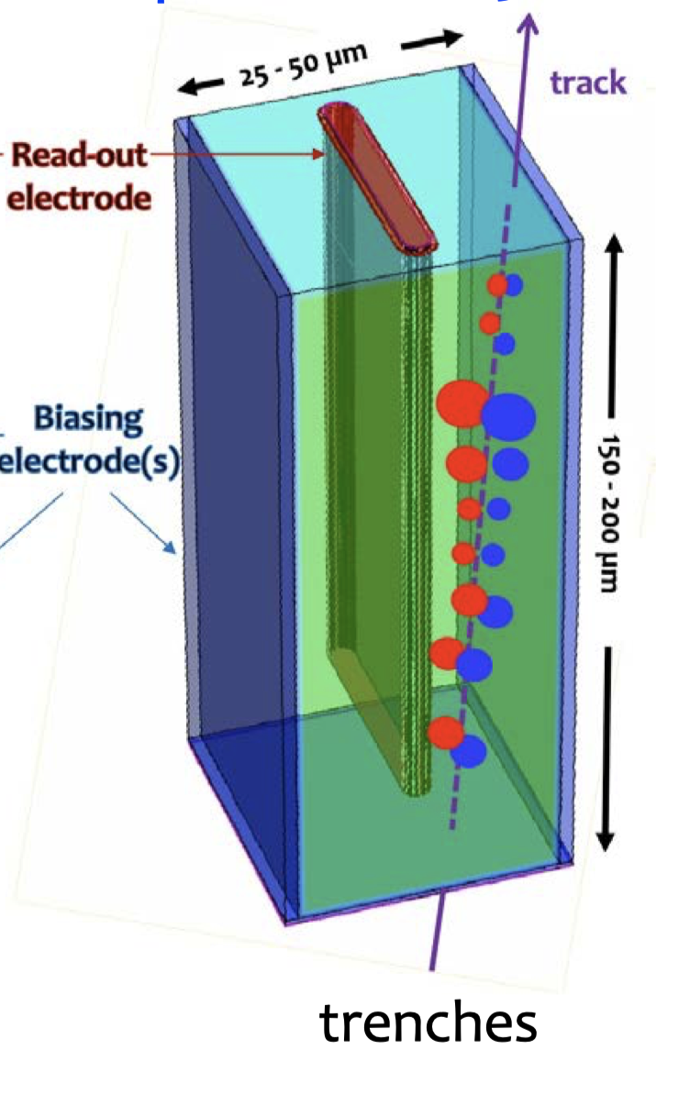
3D detectors
Trenches
Trenches instead of columns!
Parallel plate geometry is restored – distortion term becomes small again
Very impressive results achieved:
10 ps time resolution
10 µm space resolution
Very high efficiency at >> 10¹⁶ n_{eq}/cm²
Small cells = a lot of channels
Ideal where the radiation resistance is fundamental and the power budget is not an issue
TimeSPOT results – A. Lai – Vertex 2022
TIME and SPace real-time Operating Tracker

Slide 39

Sensors with Internal Gain
Internal multiplication can be achieved when the electric field is high enough
l = distance
α_{e} ~ 0.7/μm for electrons,
α_{h} ~ 0.1/um for holes
Charge Multiplication: $G= e^{αl}$
Two multiplication regimes: electrons-only, or electrons-holes
Electrons-holes tends to be more unstable and is closer to an avalanche mode.
Most gain-based silicon detectors operate ΔV ~ 300 kV/cm → electrons-only
Use external bias - V_{bias} ~ 1500 V in a 50 µm-thick sensor
almost impossible to achieve
Use doping in silicon

Slide 40
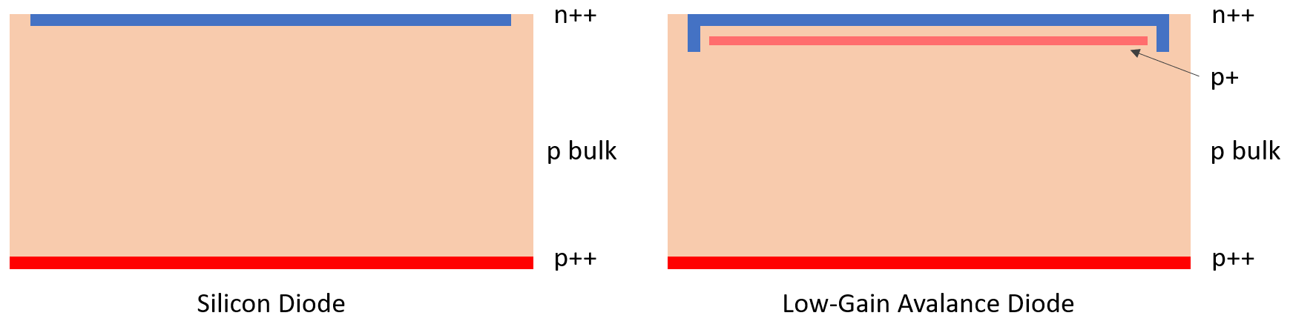
LGADs
Electric Field
Electric Field
Low-Gain Avalanche Diodes (LGADs) exploit a p++ doping layer to create high field
The low gain (10-30) allows for:
Thinner devices – better spatial fluctuation term
Larger Signal/Noise – better jitter term
The parallel plate geometry is maintained – good distortion term
Ultra Fast Silicon Detectors (UFSDs)

Slide 41
LGADs
The LGAD is a mature technology
They can provide 20-40 ps time resolution and ~100% efficiency up to
Baseline technology of ATLAS HGTD and CMS MTD at the High-Luminosity LHC
The electronics side is also mature: ALTIROC and ETROC provide exceptional results with low power budget
The couple Detector + Electronics are ready for HL-LHC (after 10+ years of R&D)
Drawbacks
radiation resistance is limited to ~2.5×10¹⁵ n_{eq}/cm²
no-gain region between pads limits segmentation → Resistive Silicon Detectors (aka AC-LGAD), TI-LGAD

Slide 42
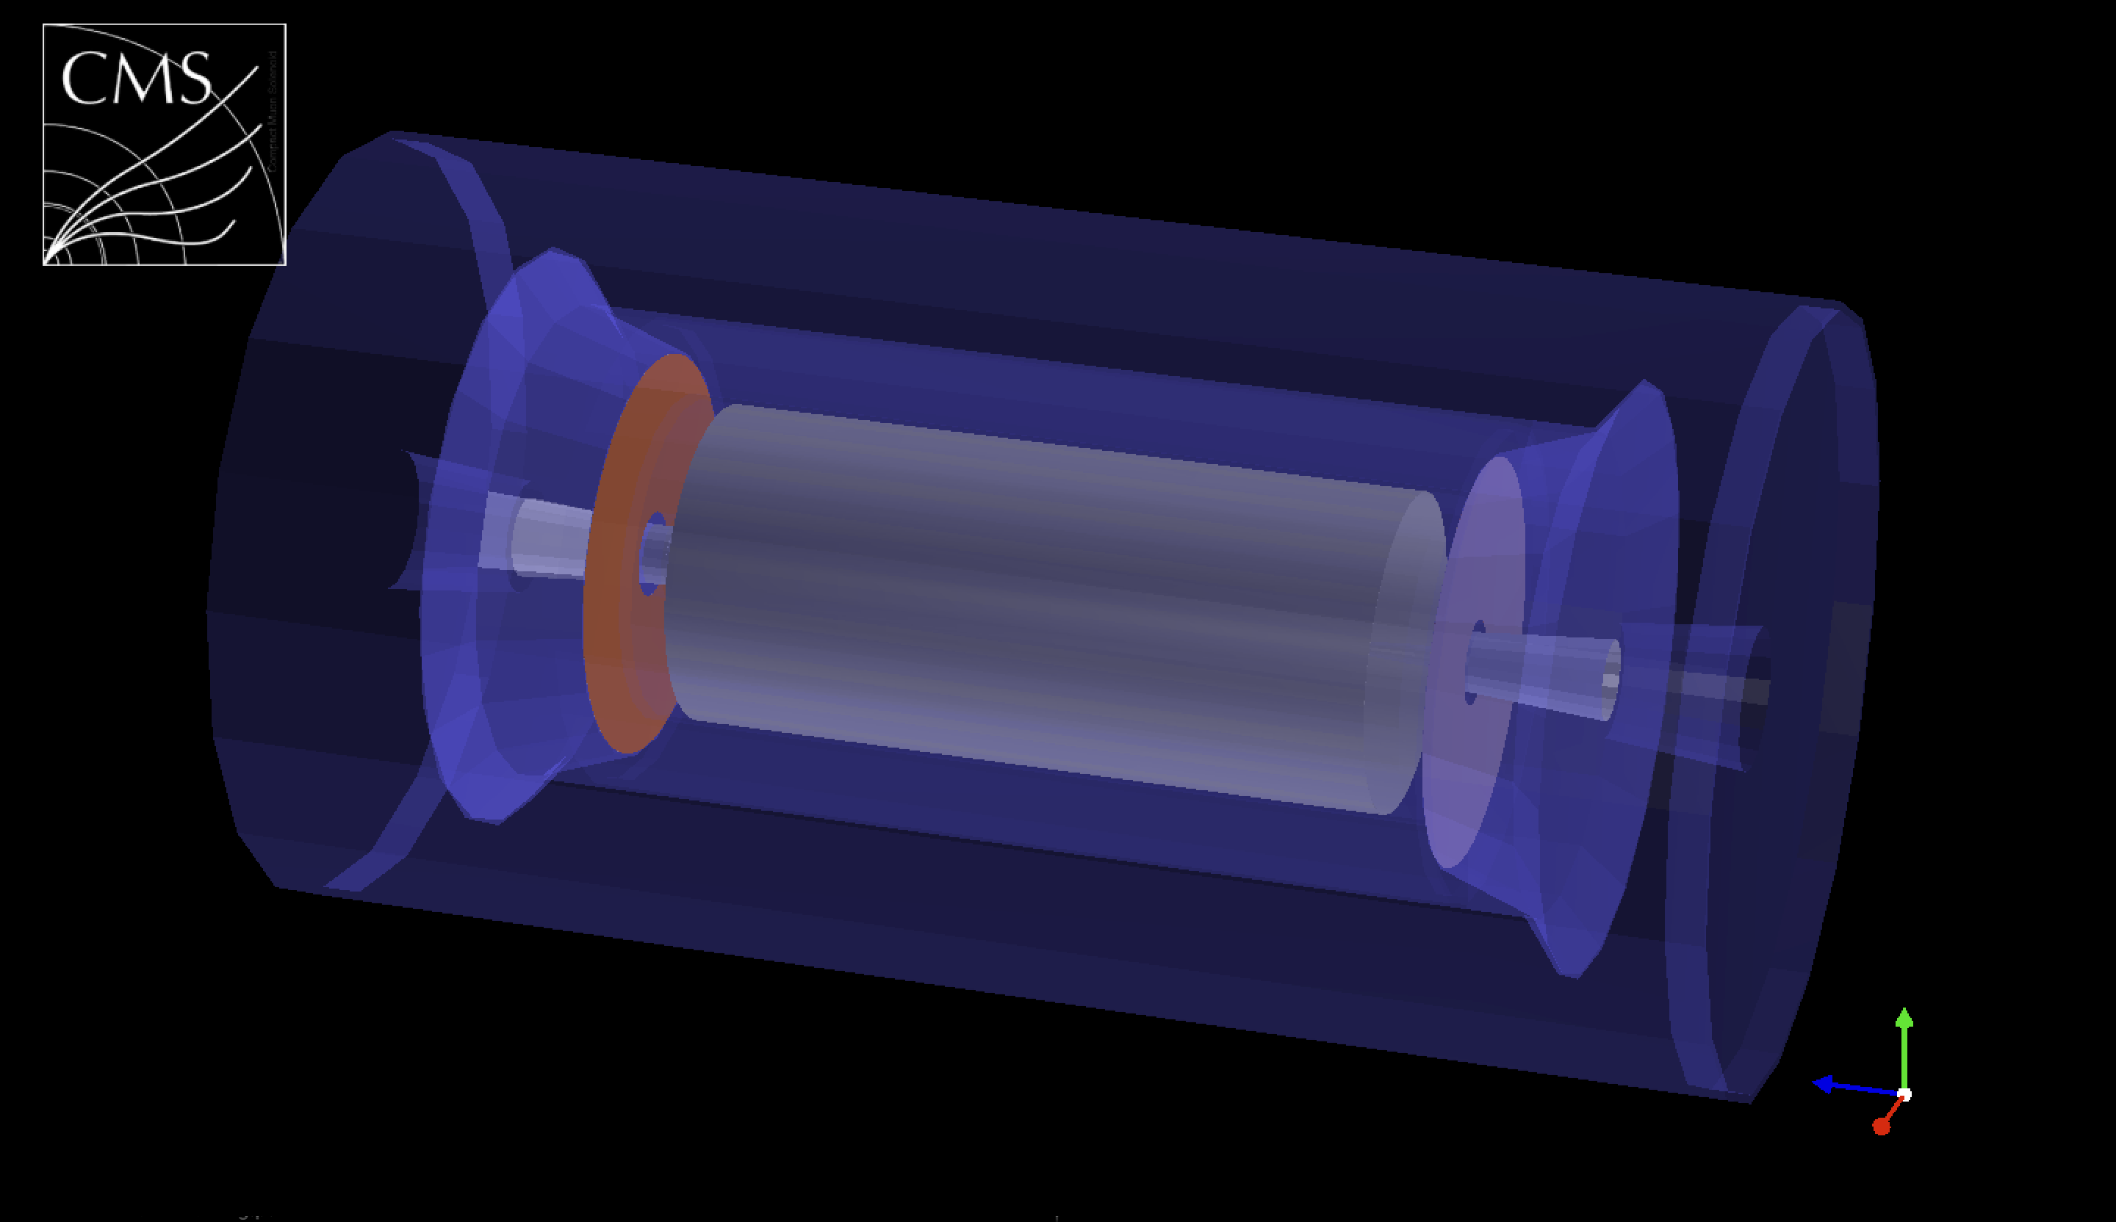

CMS & ATLAS timing layers
CMS MTD
Barrel: LYSO:Ce + SiPMs, 38 m²
Endcap: LGADs, 14 m², 8.5 M ch.
ETROC ASIC, 65 nm
ATLAS HGTD
Endcap: LGADs, 6.4 m², 3.5 M ch.
ALTIROC ASIC, 130 nm
Both: 1.3 × 1.3 mm² pads
Both timing layers will drastically improve the reconstruction efficiency during HL-LHC operations
BTL: L(Y)SO bars + SiPM readout:
Total thickness: ~ 45 mm thick; |η|<1.45
Inner Radius: 1148 mm
Area: ~38 m² and ~332 kchannels
Fluence: up to 2x10¹⁴ n_{eq}/cm²
ETL: Si with internal gain (LGAD)
Total thickness: ~ 100 mm thick; 1.6<|η|<3.0
Radius: 315< R < 1200 mm
Position: = $±$ 3 m from the interaction point
Area: ~14 m² and ~8.5 M channels
Fluence: up to 2x10¹⁵ n_{eq}/cm²

Slide 43
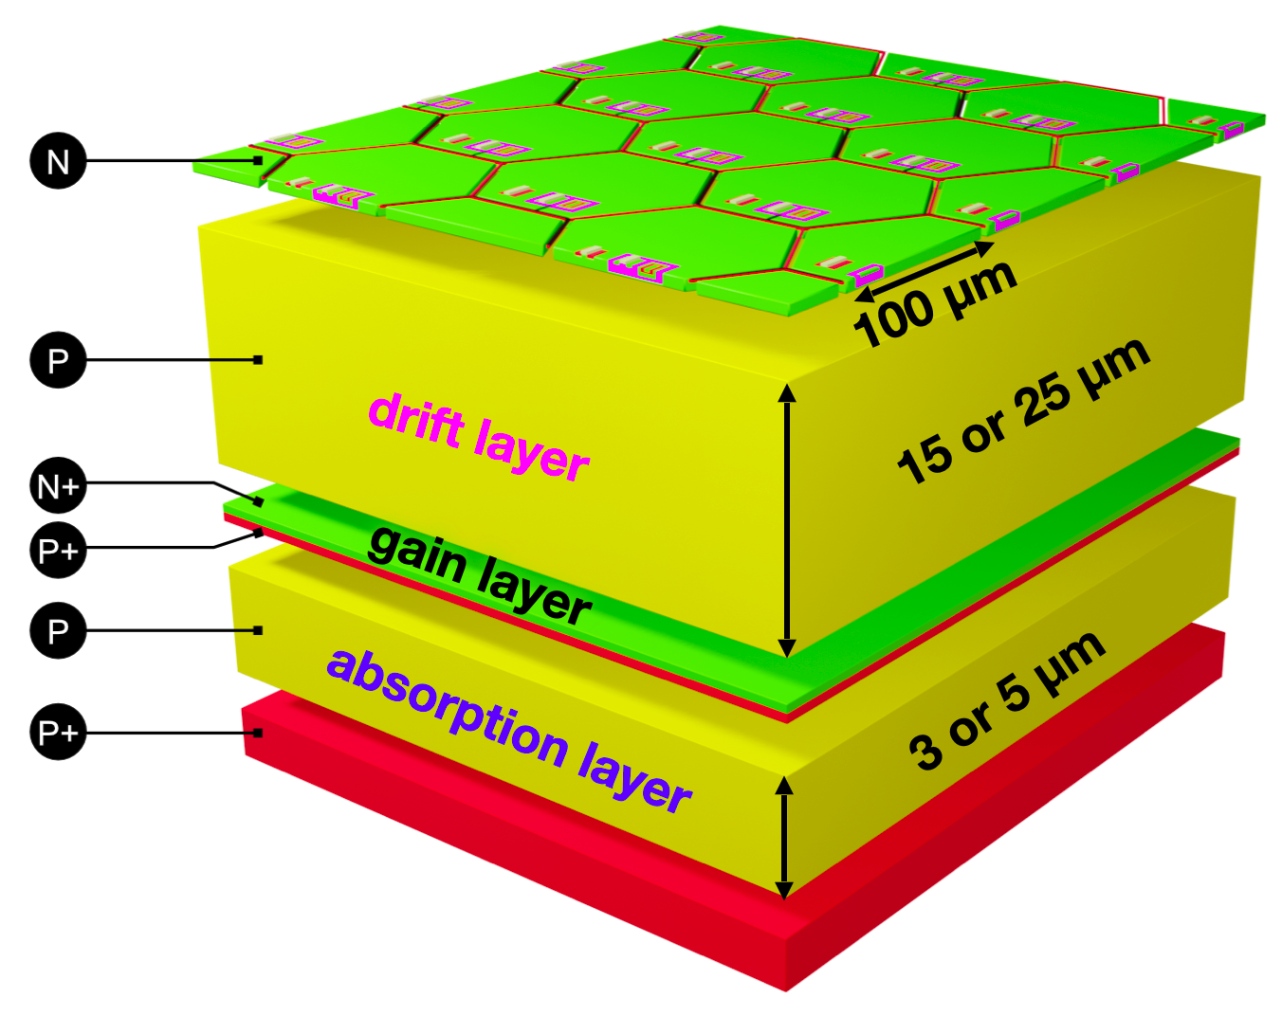
Monolith and PicoAD
MONOLITH: sensor and fast SiGe BiCMOS front-end on the same chip → no bump bonding, low capacitance, very fast rise time
~20 ps per hit already without internal gain
~13 ps adding the PicoAD gain layer
PicoAD = a continuous, buried gain layer under the whole pixel matrix → uniform gain and 100% fill factor, with ~100 µm pixels
But still R&D: small prototypes, power density can be an issue

Slide 44
Content
4D tracking
Timing measurements
Some valid candidates
Resistive Silicon Detector(s)
Disclosure: what I do, I am biased
Open collaboration with a group here in KIT

Slide 45
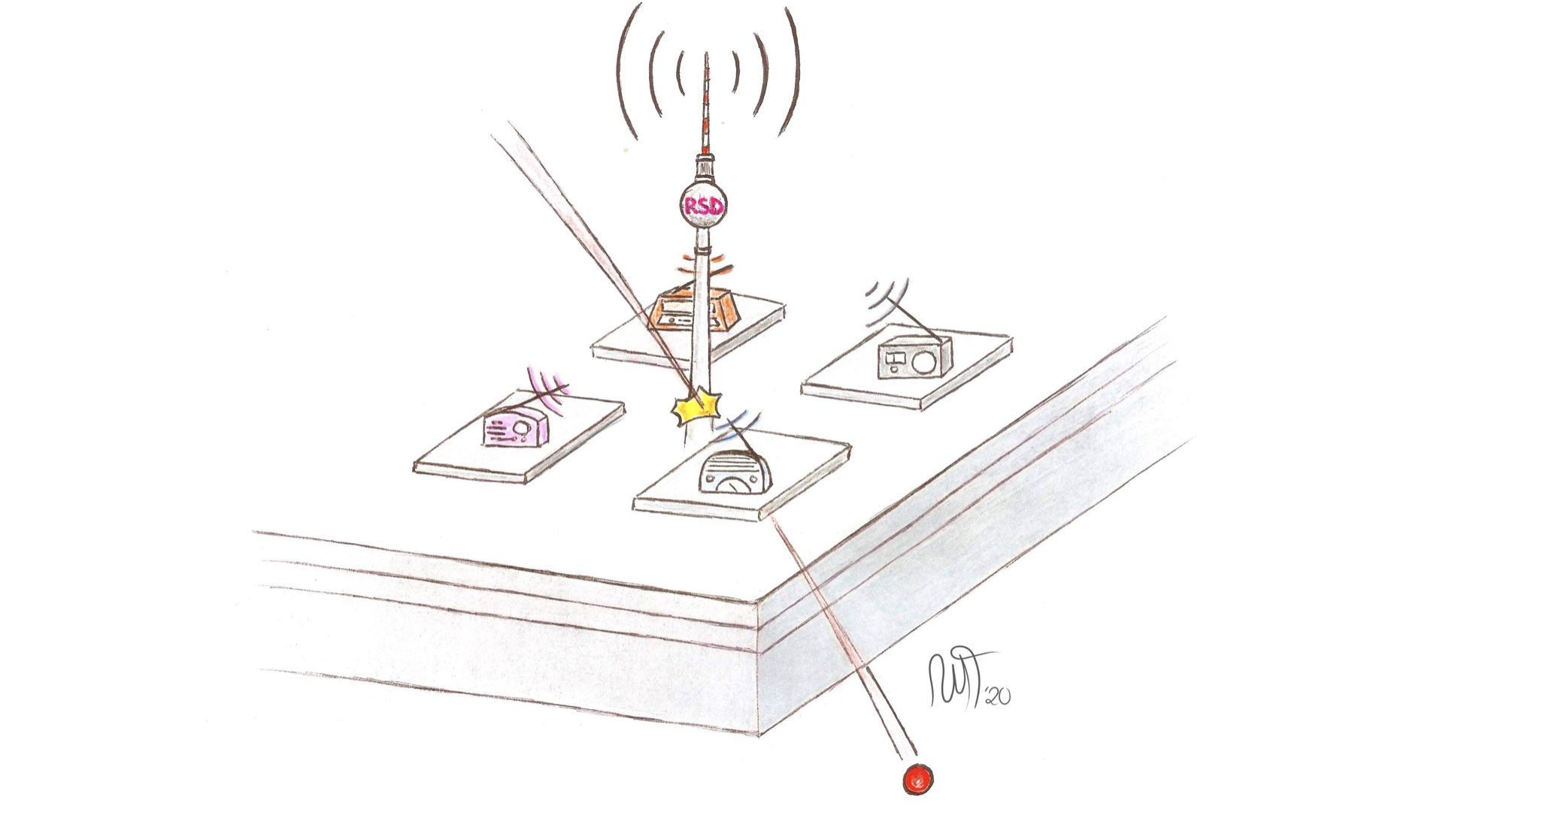
Content
4D tracking
Timing measurements
Some valid candidates
Resistive Silicon Detector(s)

Slide 46
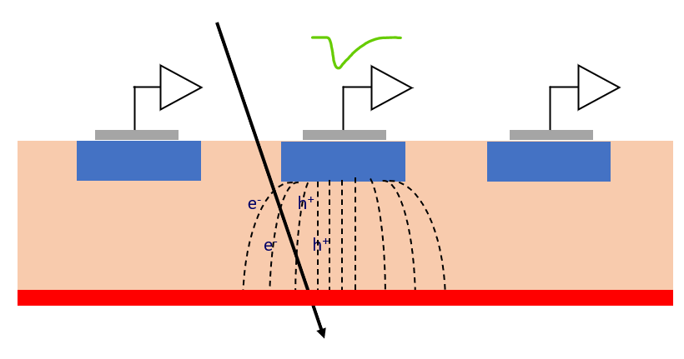
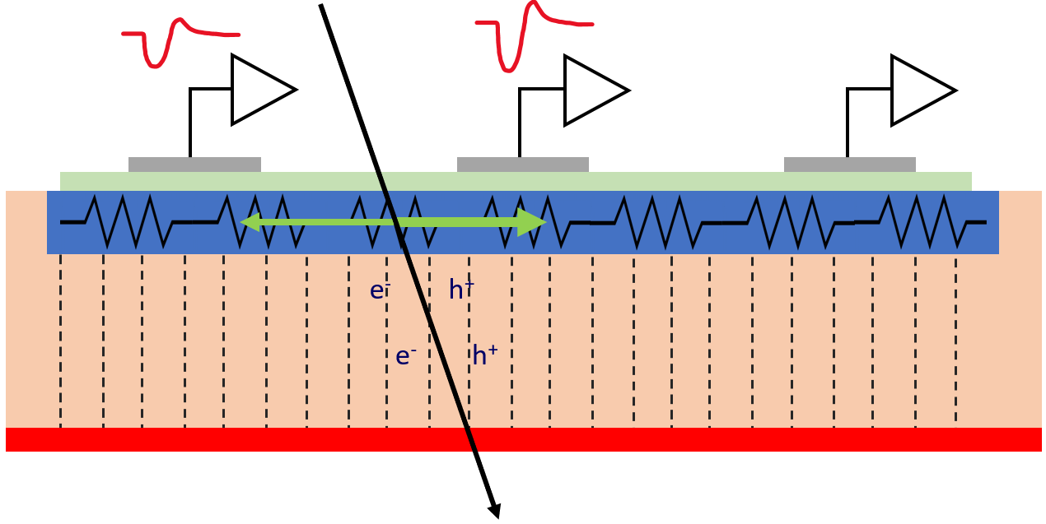
Resistive Read-out
In resistive read-out, instead of many p-n diodes, there is a single diode
The n-doped implant is resistive and acts as a signal divider
The LGAD gain layer provides large signals
Very uniform weighting field: perfect geometry for timing

Slide 47
Standard pixels vs Resistive Readout
Standard Silicon Detector
Resistive Read-out Detector
Pixel size
~ 25 x 25 μm²
Electronics
Pixel size
~ 250 x 250 μm²
~ 150 μm
Contacts
~ 50 μm
--
---
- --
+
++
+++
---
- --
++
+++
Resistive implant
Silicon bulk
Gain implant
Pros
Low channel density
Thin sensors
Low power consumption
Low material budget
Notes:
Parametrizzazioni prossima

Slide 48
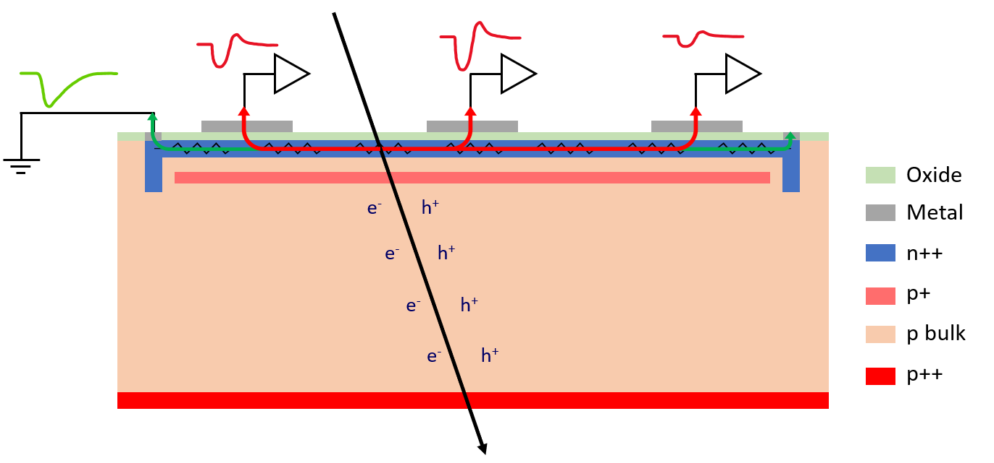
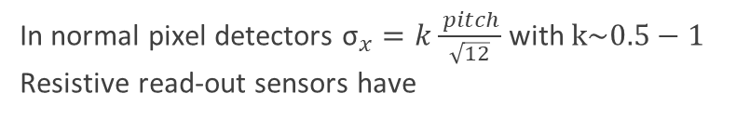
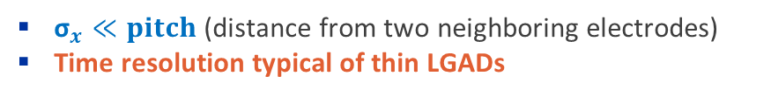
RSDs Principles of Operation
Electrons are multiplied (LGAD)
Charge is induced in the n+ layer
(resistive layer)
Nearby electrodes see a fast signal
Charges in the n+ flow to ground
50 μm
Signal sharing
In normal pixel detectors ${\text{σ}}_{x}=k\frac{ pitch}{\sqrt{12}}$ with $k\sim 0.5−1$
Resistive read-out sensors have
${\text{σ}}_{x}≪pitch$ (distance from two neighboring electrodes)
Time resolution typical of thin LGADs

Slide 49
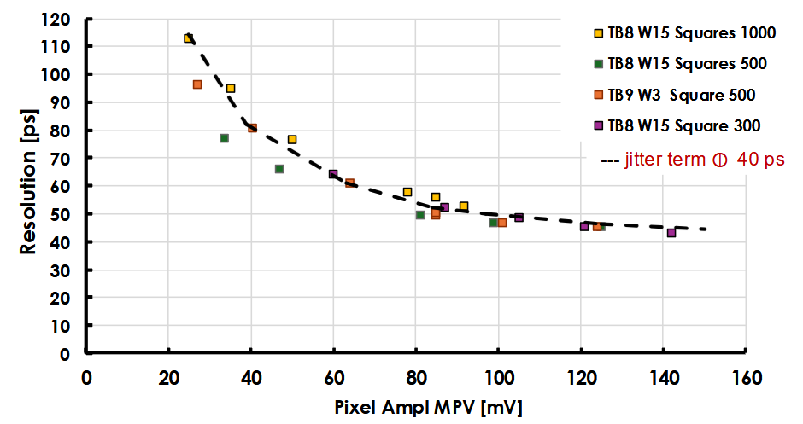
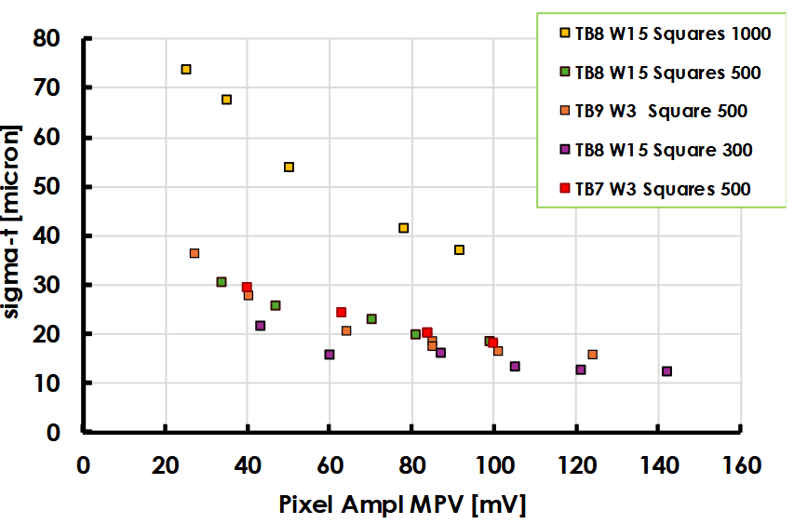
RSDs – Some Results
The RSDs have been studied for 4 years now.
2 different types, AC- and DC- coupled
They have proven to provide:
Exceptional spatial resolution
  about x10 better than traditional pixelated sensors
  Fewer pixels – less power consumption
Time resolution comparable to the one of LGADs (very good)
A lot of different groups started fabricating these detectors, probably the idea is a good one!

Slide 50
Content
4D tracking
Timing measurements
Some valid candidates
Resistive Silicon Detector(s)
Be optimistic about the future

Slide 51
Time is the new coordinate
We need new detectors to enable future high physics experiments
Many technologies, no winner(s) yet — a lot to do in this field
10–30 ps and tens of µm are already on the table
RSDs and 4D Tracking at KIT: there is room for you in this story

Slide 52
Questions?

