Slide 1

Circuits and layouts I
E. Giulio Villani
Instrumentation Training Lectures, Oxford 02/05/2022

Slide 2
Overview
Introduction, definitions
Hybrid and Monolithic Sensors
Example of Monolithic CMOS Sensors layout and fabrication
Isolation techniques
HV biasing

Slide 3
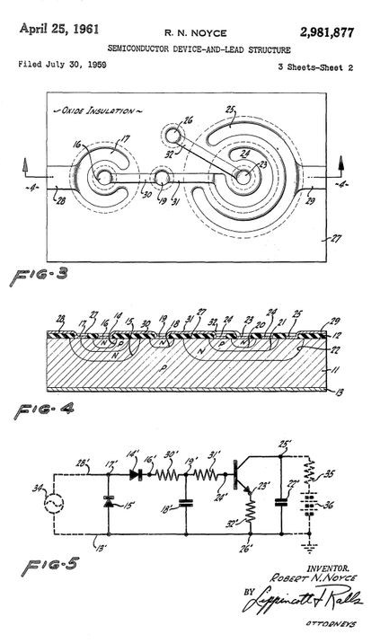
Introduction
IC (integrated circuit) single silicon chip that includes active and passive interconnected devices to implement complex operations (analogue, digital)
Planar technology: the processing steps are implemented in a thin layer of the surface of the chip
Semiconductor device-and-lead structure US2981877A
First planar IC patent, 1961
1
Instrumentation Training Lectures, Oxford 02/05/2022

Slide 4

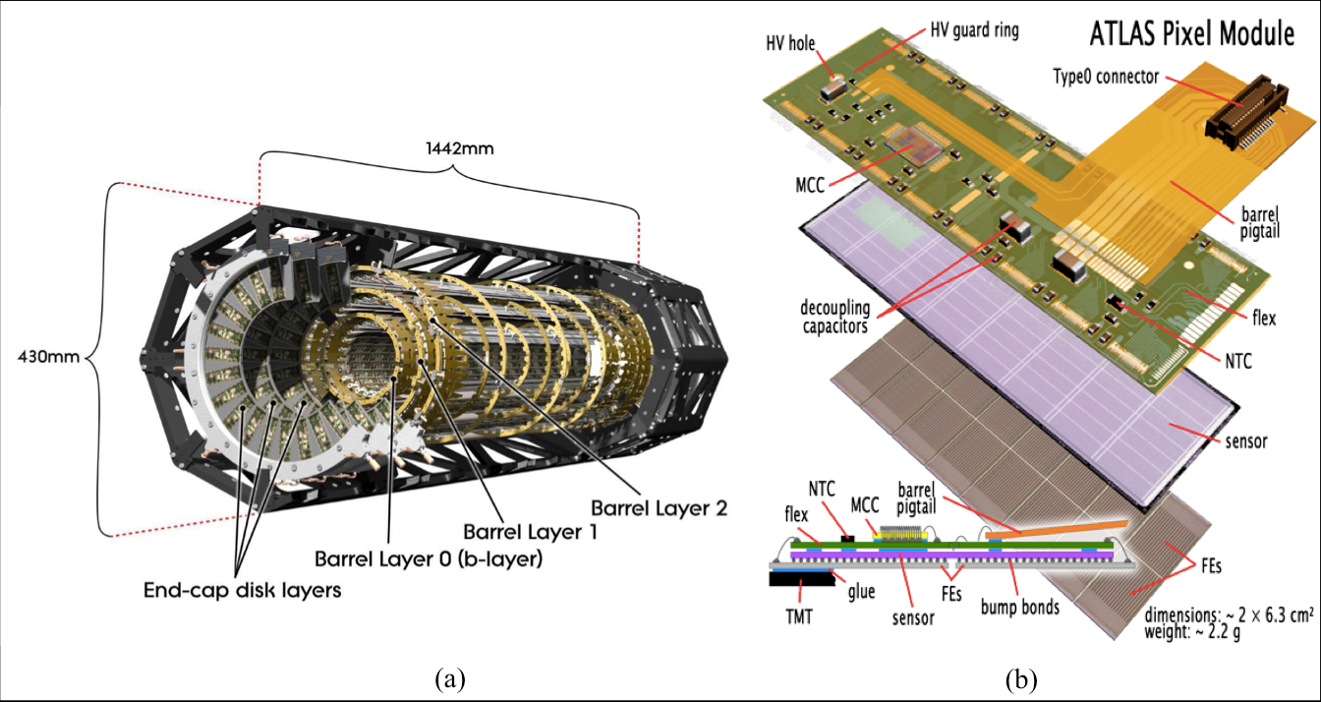
Introduction
Planar technology used also for detector technology
Remarkable evolution in planar technologies impacted on detector technology as well
Historically used ‘hybrid’ approach
2
Instrumentation Training Lectures, Oxford 02/05/2022

Slide 5
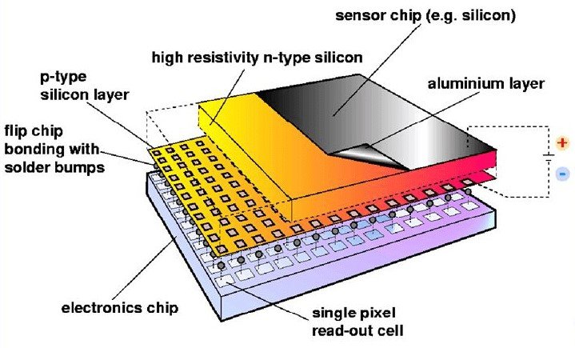
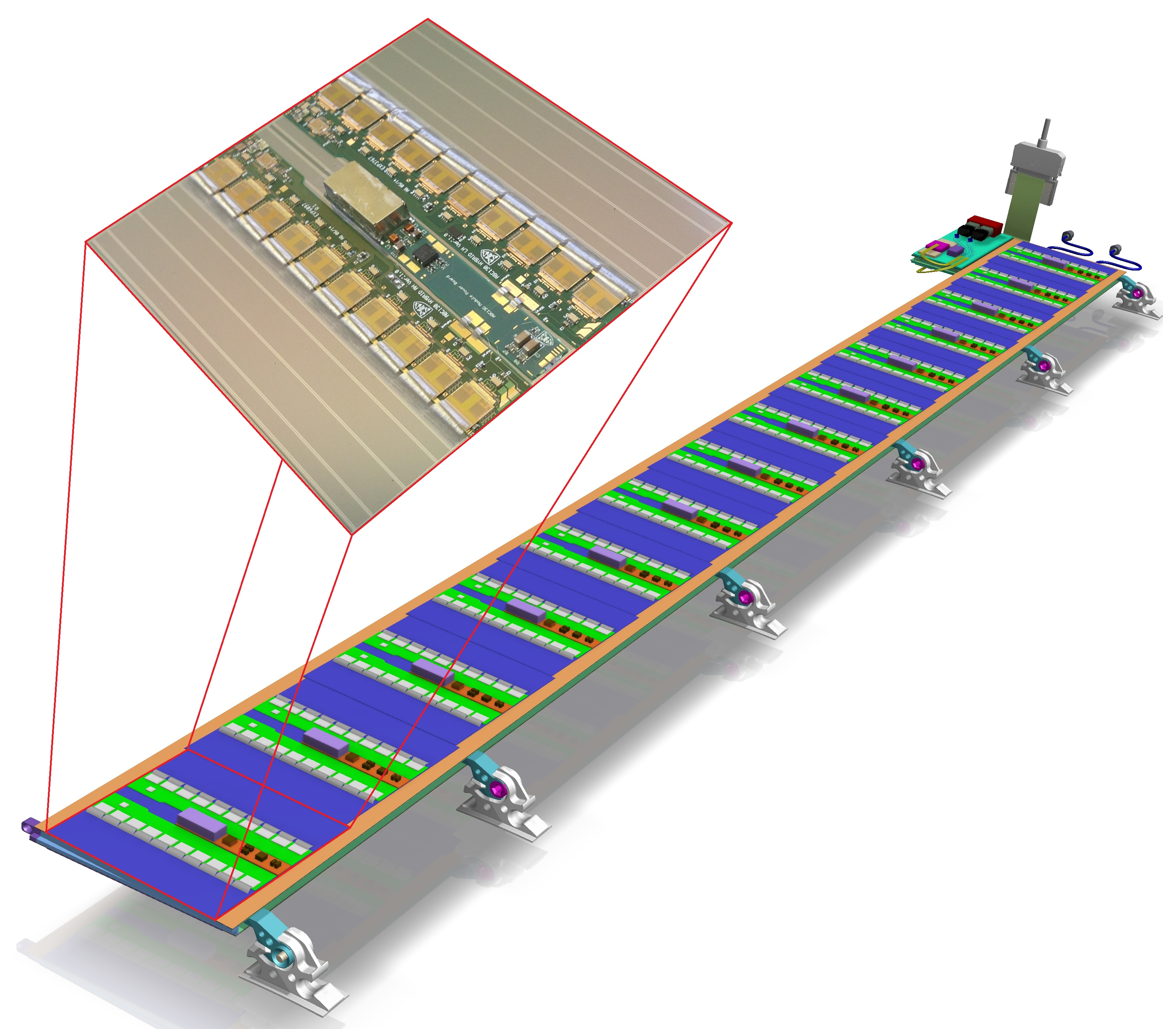
Hybrid solution
Hybrid: different operations are implemented on different silicon chips (like sensing and read out on separate carriers)
    HR substrate for the sensor optimize the charge collection efficiency and speed
    It requires complex bonding, affecting reliability, costs
    Extra material due to the various layers
ATLAS Inner Tracker Upgrade (ITk) silicon strip module on barrel stave
3
Instrumentation Training Lectures, Oxford 02/05/2022

Slide 6
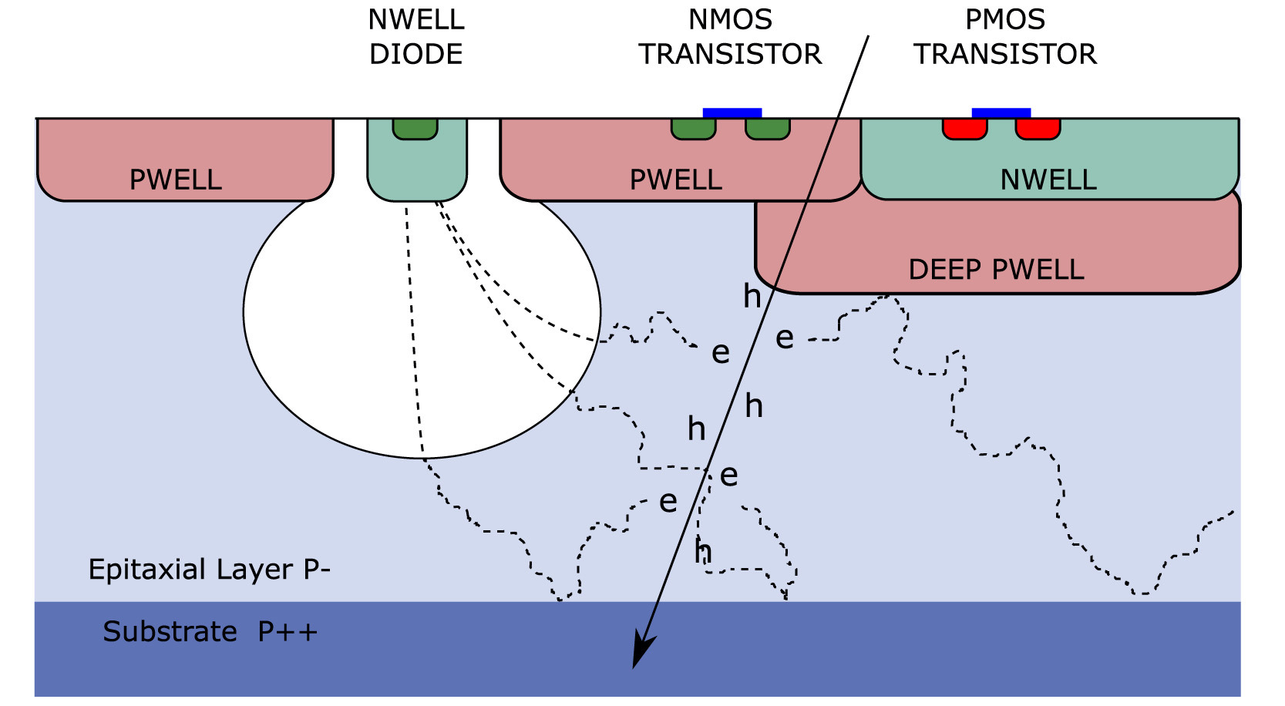
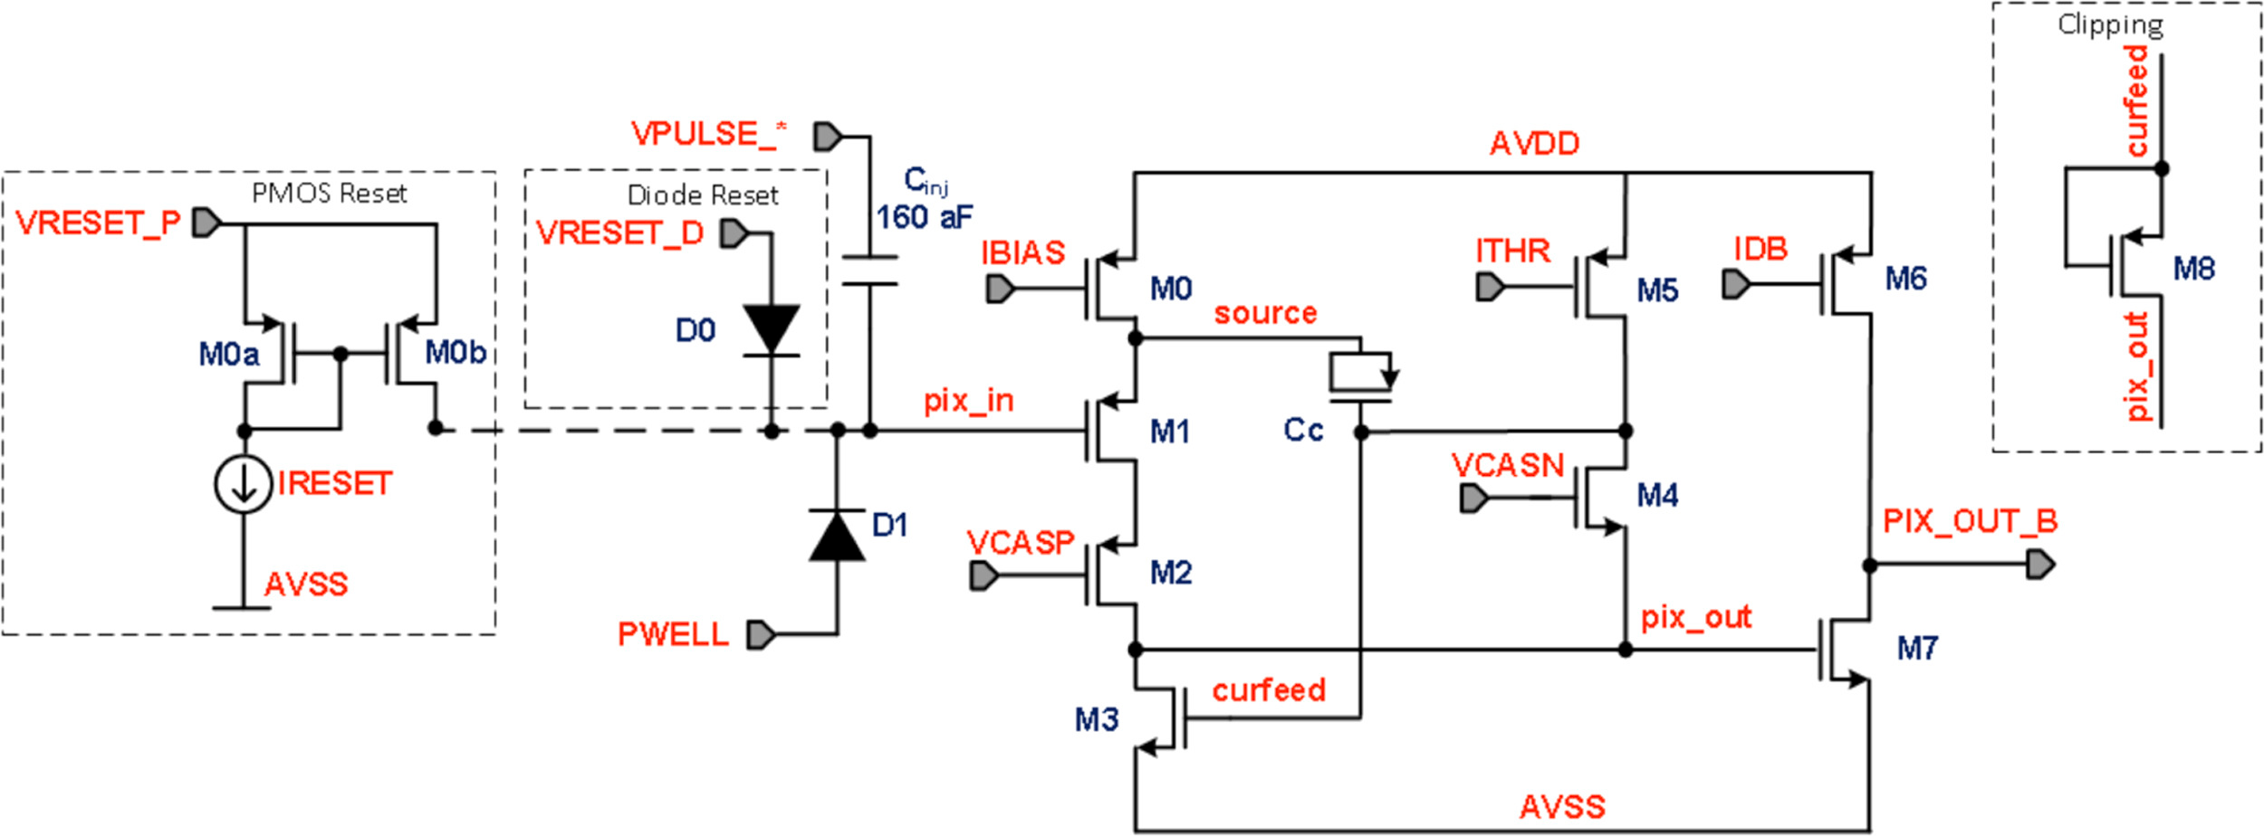
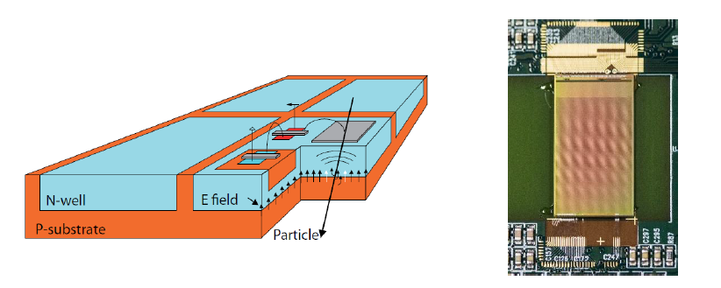
Monolithic solution
Monolithic: sensing and read out are implemented on the same silicon chip
    In-pixel processing possible: amplification and digitization integrated in the same chip
    Small pixels ( ‘10’s x 10’s um )
    Low noise, due to small pixel, low leakage, low capacitance
    Good S/N
    Sensitive region 10’us um, backthinning possible to reduce mass
The vertex detector of the STAR experiment, the first to use CMOS MAPS
MAPS used for ALICE ITS upgrade, with in-pixel FE circuitry
HV MAPS used for Mu3e
4
Instrumentation Training Lectures, Oxford 02/05/2022

Slide 7
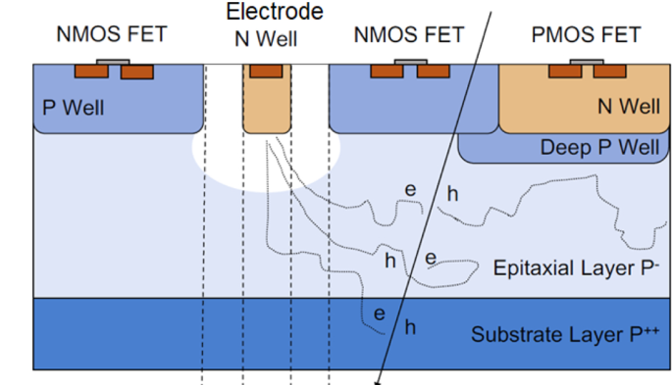

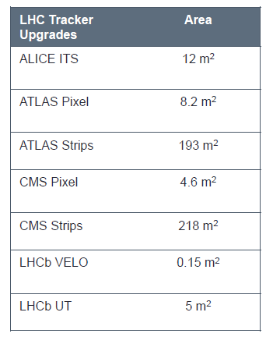
Monolithic Solution
Monolithic: sensing and read out are implemented on the same silicon chip
  Mostly use commercial CMOS process
    Redundancies of foundries
    Potentially low cost, large area cover possible
    High yield
  Reliability, no need for wire/bump bonding
Deep N Well
Deep P Well
Monolithic approach is an interesting option for most HEP experiments
5
Instrumentation Training Lectures, Oxford 02/05/2022

Slide 8
Pros and Cons of Hybrid and Monolithic
Monolithic Layout, mostly focusing on Sensor part (monolithic RO will be covered by others)
Hybrid and Monolithic approach: conceptually similar ‘layouts issues’:
  Guard rings, barrier stops to avoid surface currents required in both solutions
  Usually high voltage (100’s V)are needed for biasing of sensors in hybrid approach: HV biasing technique present additional challenges
  Lower voltages (10’s V) are needed for monolithic: small signals call for optimized S/N from RO electronics
Hybrid Layout, mostly focusing on sensor HV biasing
6
Instrumentation Training Lectures, Oxford 02/05/2022

Slide 9
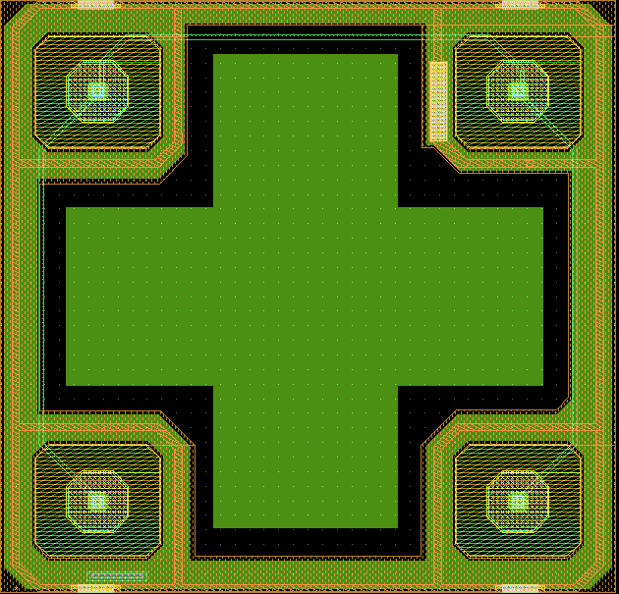
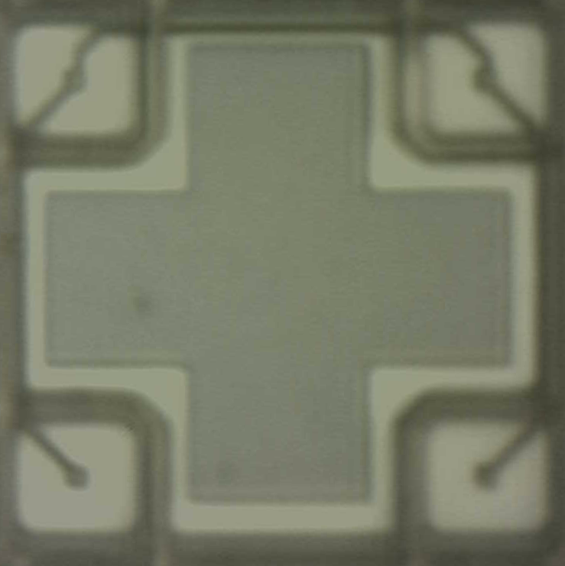
Example: Monolithic CMOS sensor Layout and fabrication
  40 um
  Collecting nodes
Example of fabrication process of a monolithic devices (OVERMOS) using a (simplified) CMOS process
Sensor implemented in p-type Silicon epi 18 um thick
Layout of the cell includes 4 collecting diodes isolated by a p-well
Only ¼ layout is processed, at the end it will be mirrored and reflected to obtain the full cell
  40 um
Pixel Layout
Picture of real cell
7
Instrumentation Training Lectures, Oxford 02/05/2022

Slide 10
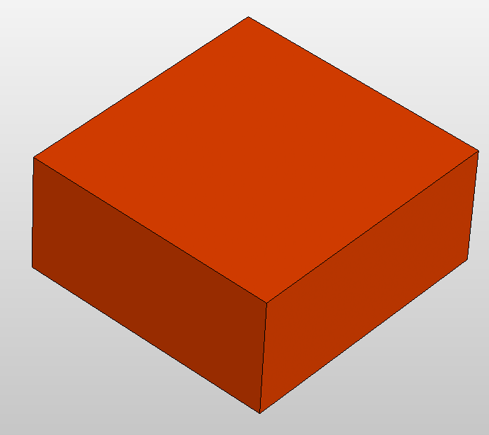
Example: Monolithic CMOS sensor Layout and fabrication
Silicon substrate P-type CZ NA ~ 5•10¹⁸ cm⁻³
Typical doping > 10¹⁸ cm⁻³
P-substrate
8
Instrumentation Training Lectures, Oxford 02/05/2022

Slide 11
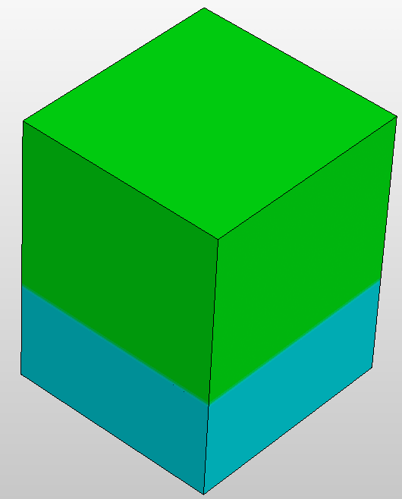
Example: Monolithic CMOS sensor Layout and fabrication
Epitaxial silicon growth 18 um thick <100> doping ~ 10¹³ cm⁻³
Temperature 1000 C, 600 sec anneal
P-epitaxial
P-substrate
9
Instrumentation Training Lectures, Oxford 02/05/2022

Slide 12
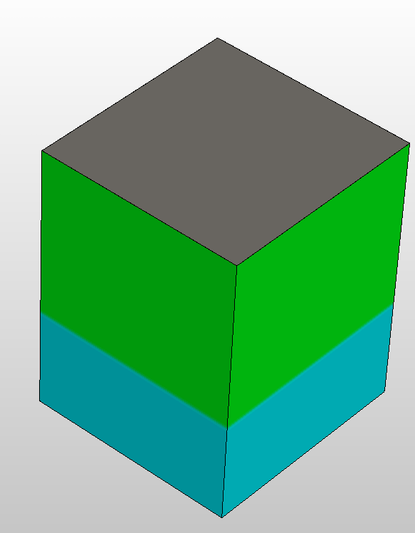
Example: Monolithic CMOS sensor Layout and fabrication
SiO₂
Thermal oxide growth 8 nm
Si+O₂ @ 1000 C P = 1 atm
P-epitaxial
P-substrate
10
Instrumentation Training Lectures, Oxford 02/05/2022

Slide 13
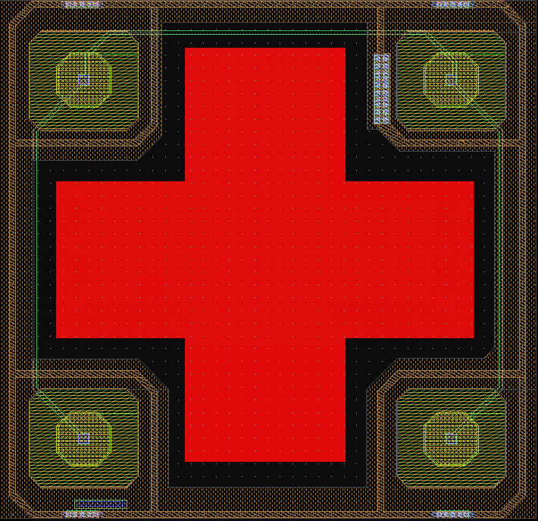
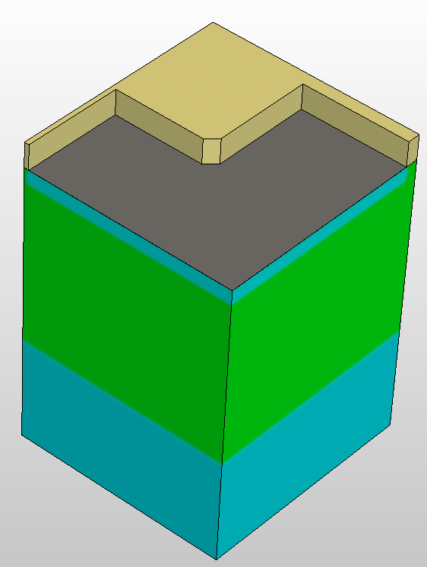
Example: Monolithic CMOS sensor Layout and fabrication
Resist
SiO₂
Resist deposition >1 µm
Patterning via mask
Resist development
Strip resist
B¹¹ implantation (PW well)
Strip residual resist
P-epitaxial
P-substrate
11
Instrumentation Training Lectures, Oxford 02/05/2022

Slide 14
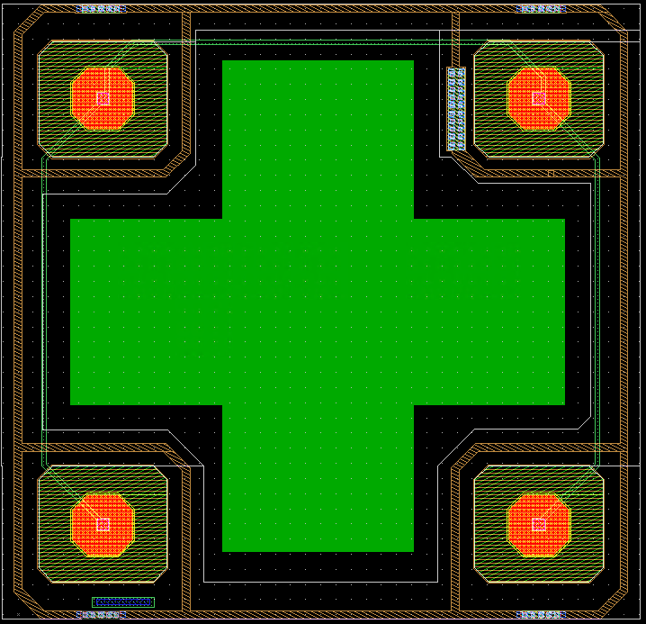
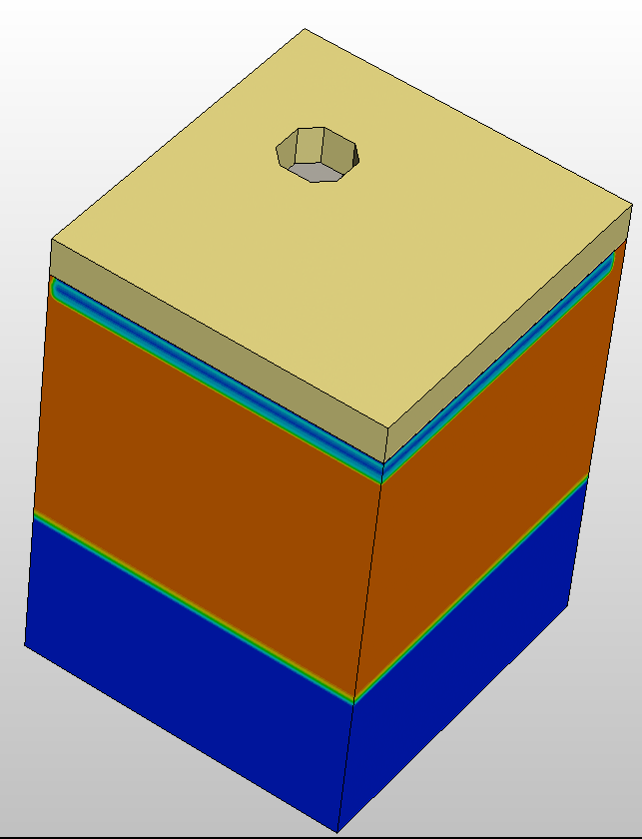
Example: Monolithic CMOS sensor Layout and fabrication
Resist
SiO₂
Resist deposition >1 µm
Patterning via mask
Resist development
Strip resist
P³¹ implantation (NW well)
Strip residual resist
P-epitaxial
P-substrate
12
Instrumentation Training Lectures, Oxford 02/05/2022

Slide 15
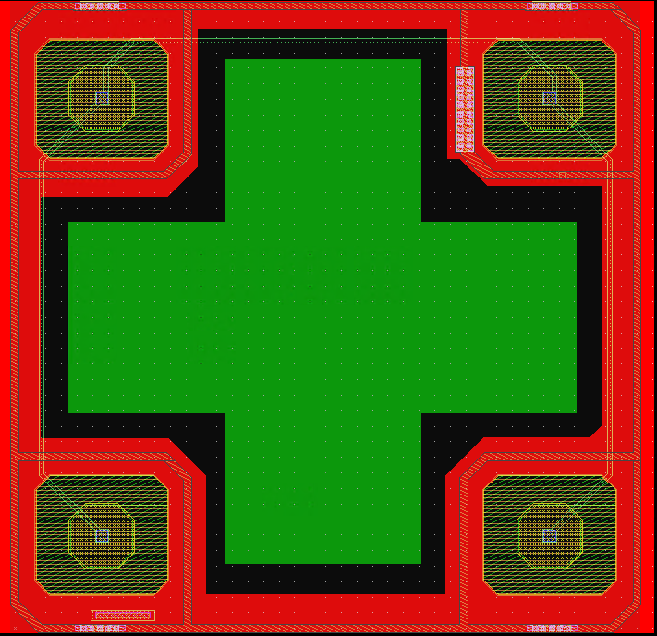
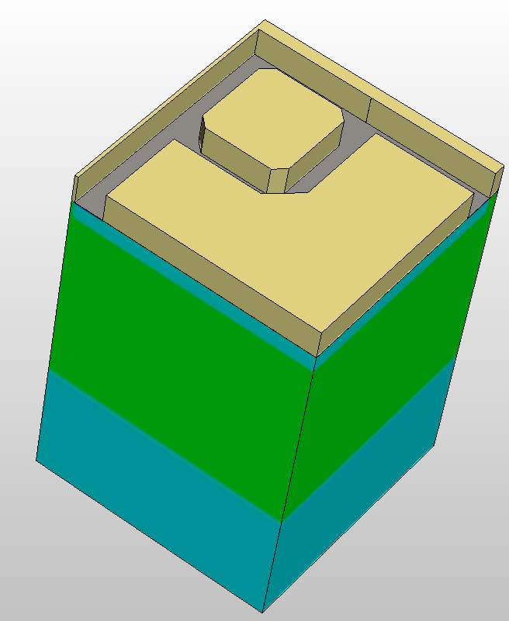
Example: Monolithic CMOS sensor Layout and fabrication
Resist
SiO₂
Resist deposition >1 µm
Patterning via mask
Resist development
Strip resist
B¹¹ implantation (XP well)
Strip residual resist
P-epitaxial
P-substrate
13
Instrumentation Training Lectures, Oxford 02/05/2022

Slide 16
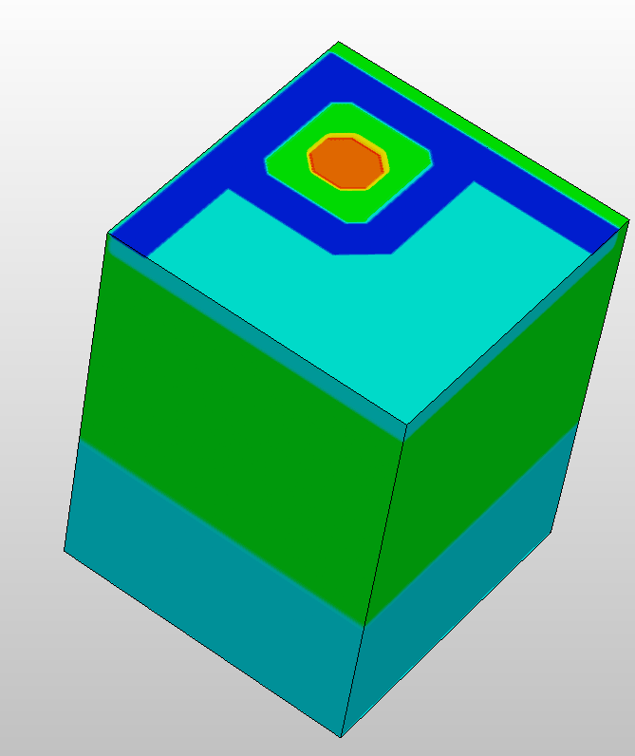
N Well
Example: Monolithic CMOS sensor Layout and fabrication
XP (P⁺⁺) Well
RTA temperature up to 1022 C, 20 secs. max
Strip residual resist
WP (P⁺) Well
P-epitaxial
P-substrate
14
Instrumentation Training Lectures, Oxford 02/05/2022

Slide 17
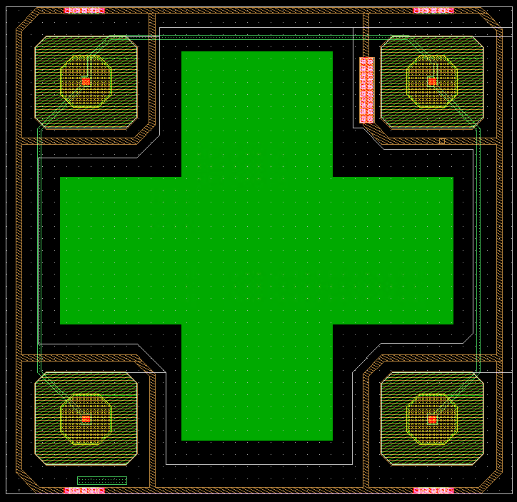
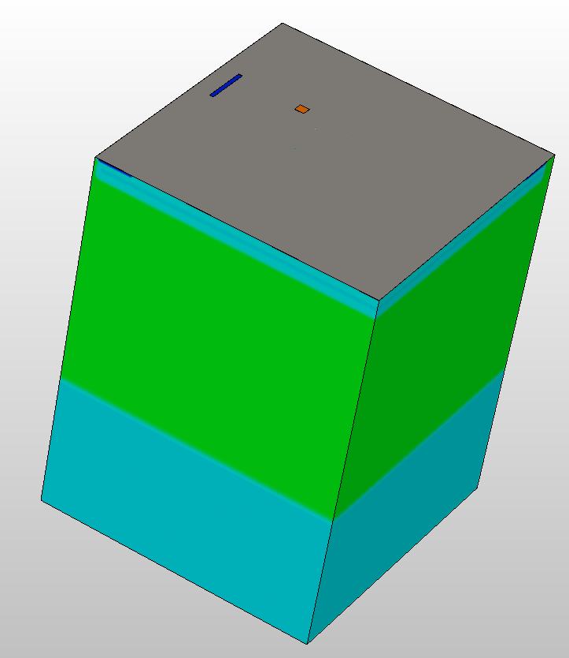
Example: Monolithic CMOS sensor Layout and fabrication
SiO₂
SiO₂ anisotropic (dry) etching for VIAs and contacts placement
P-epitaxial
P-substrate
15
Instrumentation Training Lectures, Oxford 02/05/2022

Slide 18
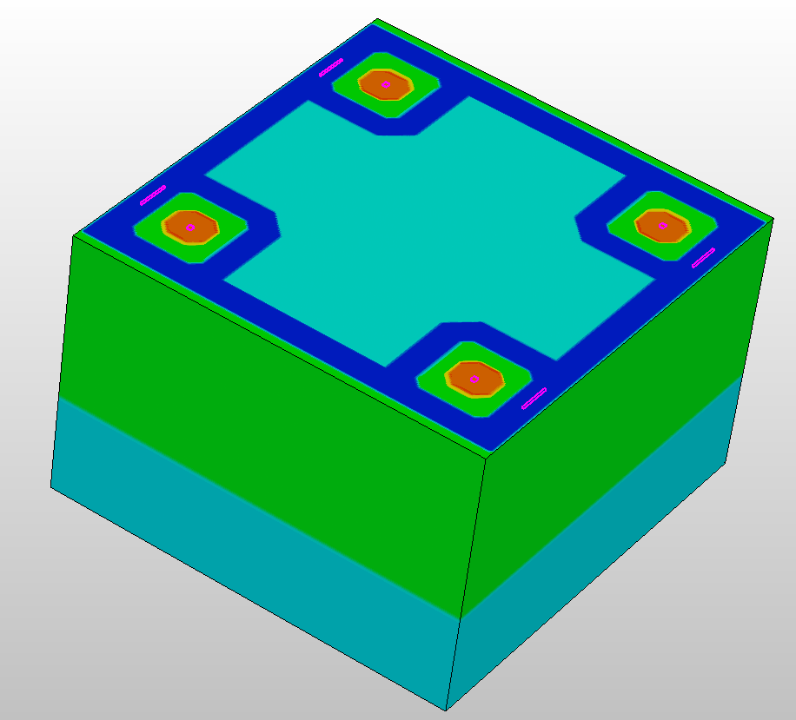
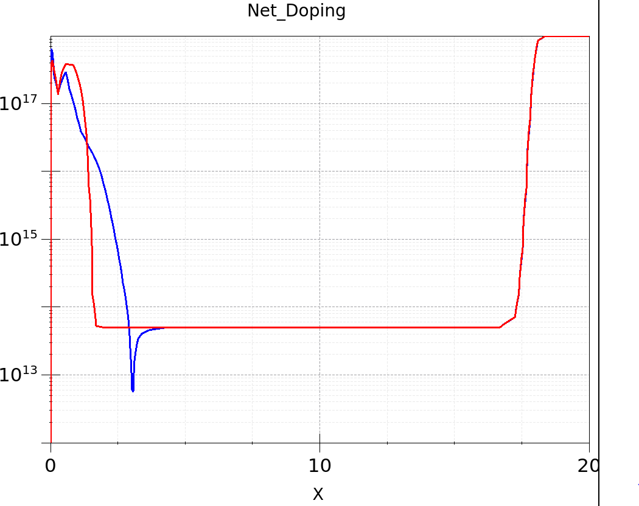
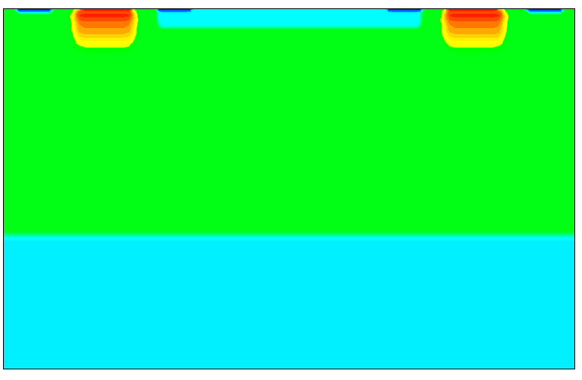
N Well (Cathode)
Example: Monolithic CMOS sensor Layout and fabrication
SiO₂
The simulated model is reflected and mirrored to get a full realistic device
Around 10,000 secs to ‘build’ a simulated model cell on a 4-core 3.6GHz machine 16 GB
Resolution to < nm (fraction of Debye length) in some regions (Si-SiO₂ interface, PN junctions)
P-epitaxial
1
2
2
P-substrate
1
16
Instrumentation Training Lectures, Oxford 02/05/2022

Slide 19
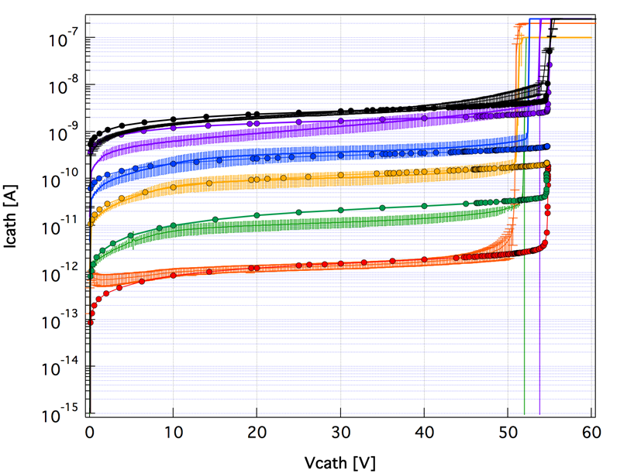
Example: Monolithic CMOS sensor Layout and fabrication
TCAD
TEST
1e15 Φ
Simulated devices compare reasonably well with real devices in DC
Also including radiation damage effects (neutron bulk damage up to 10¹⁵ 1 MeV n-eqv fluence – Penta traps Hamburg model)
1e14 Φ
5e13 Φ
1e13 Φ
0 Φ
T = 21 C
Aval model: UNIBO
17
Instrumentation Training Lectures, Oxford 02/05/2022

Slide 20
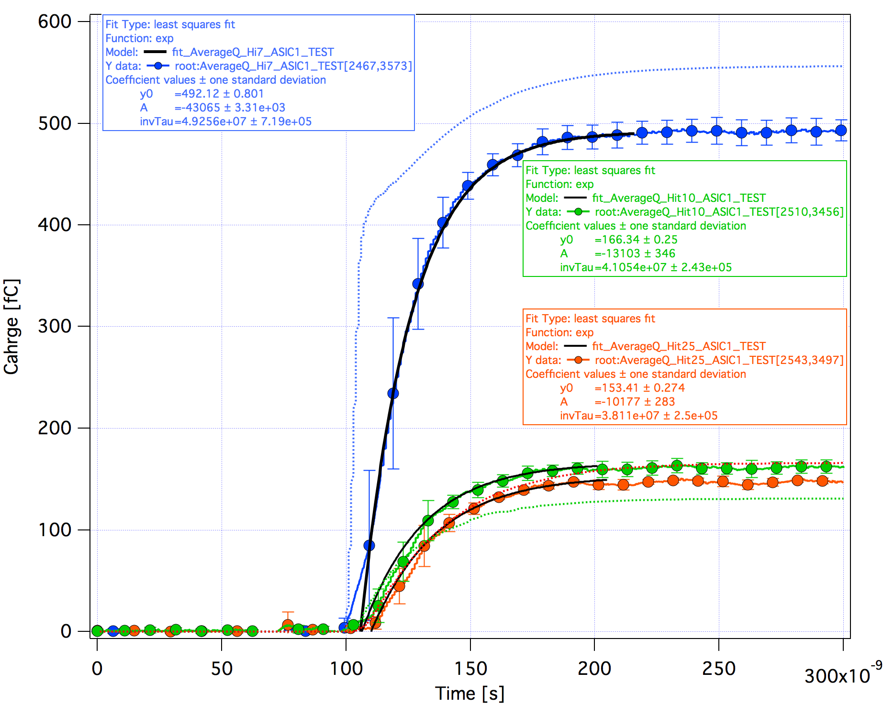
Example: Monolithic CMOS sensor Layout and fabrication
Simulated devices compare less well with real devices in charge collection estimation (Laser injection)
TCAD
TEST₁₀
T = 21 C
Aval model: UNIBO
Laser Hit
18
Instrumentation Training Lectures, Oxford 02/05/2022

Slide 21
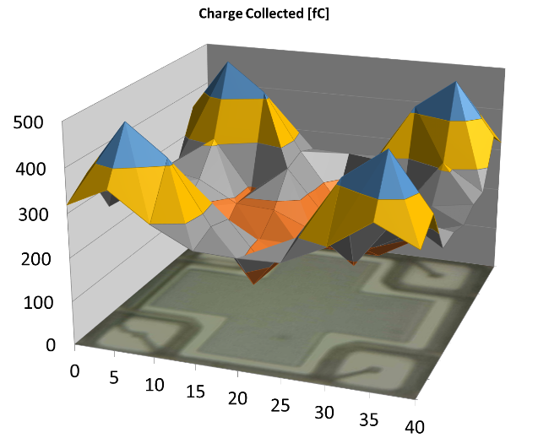
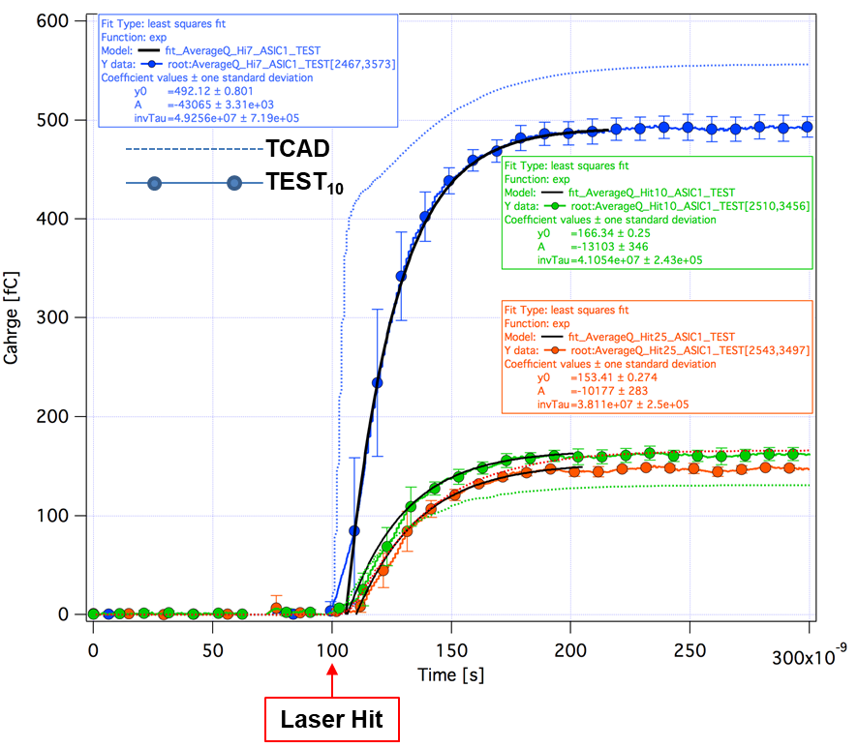
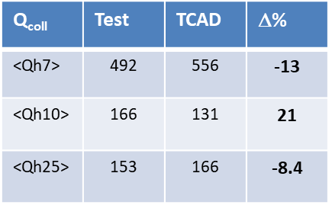
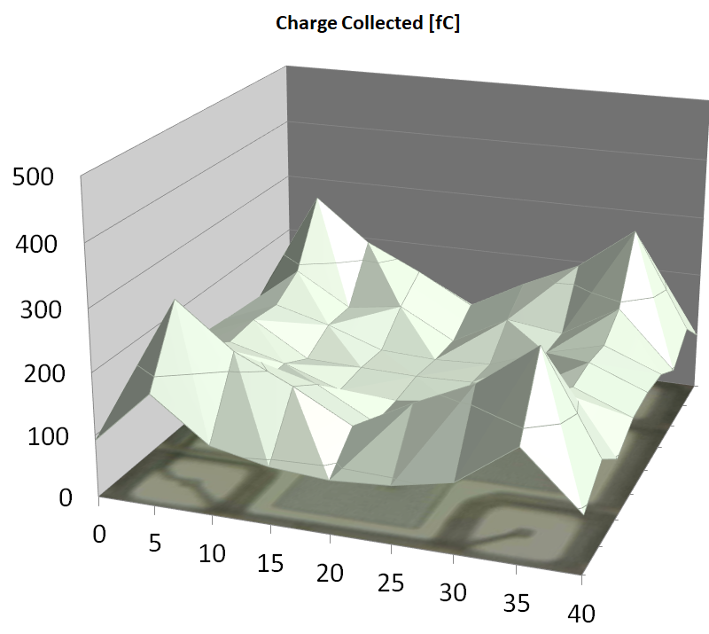
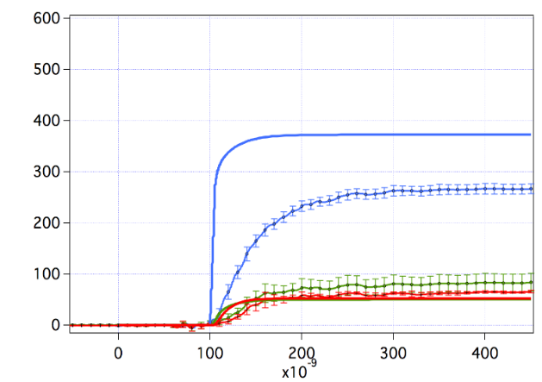
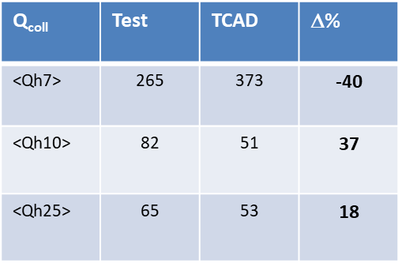
<Q_{c}>=267 ∫time = 200 ns
Example: Monolithic CMOS sensor Layout and fabrication
Φ=0
Approximately 15% overestimate in Charge Collection when non-irradiated, up to 70% for neutron irradiated devices (depending on fluence)
<Q_{c}>=109 ∫time = 200 ns
Φ=1e14
Q [fC]
1e14
19
Instrumentation Training Lectures, Oxford 02/05/2022

Slide 22
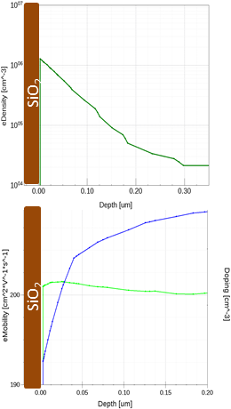
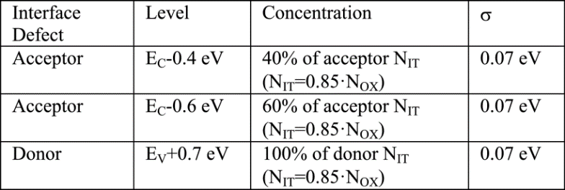
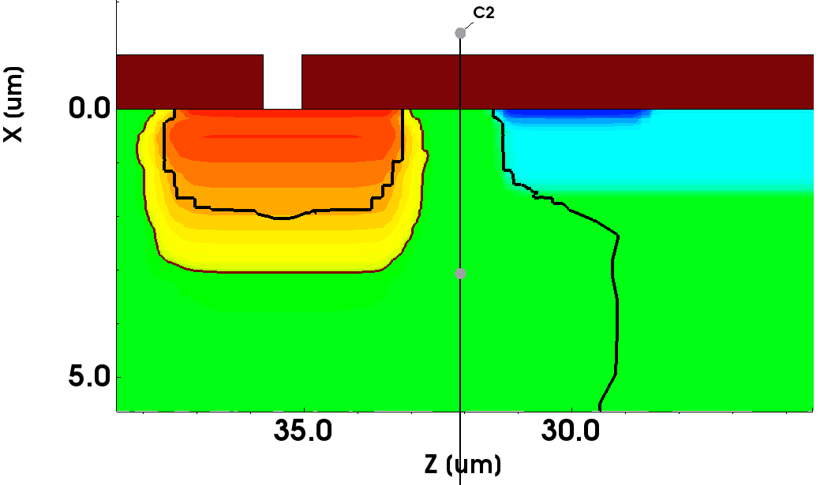
P⁺⁺ Well
N Well
Example: Monolithic CMOS sensor Layout and fabrication
The presence of XP region helps isolate the collecting wells
At interface of SiO₂/Si interface states usually positive charged
An inversion channel is created, especially important in low doped substrate
* Effects of Interface Donor Trap States on Isolation Properties of Detectors Operating at High-Luminosity LHC, DOI: 10.1109/TNS.2017.2709815
20
Instrumentation Training Lectures, Oxford 02/05/2022

Slide 23
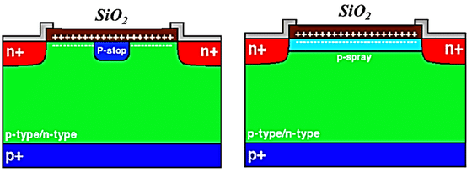
Isolation techniques
Non-irradiated sensors, fixed positive charge around 2e11 cm-2
Values up to > 1e12 cm-2 following irradiation
Good isolation among n collecting wells is needed
P-stop and p-spray isolation techniques
The floating p+ stop method consists of placing a p+ implant in between two adjacent n+ strips
It requires an additional mask
The p-spray method consists of having uniform p+ layer
beneath the Si/SiO2 interface.
It requires careful dose of doping (too low does increase BV but does not isolate, too high isolate but decreases BV)
21
Instrumentation Training Lectures, Oxford 02/05/2022

Slide 24
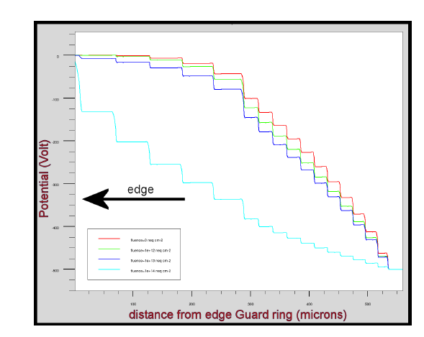
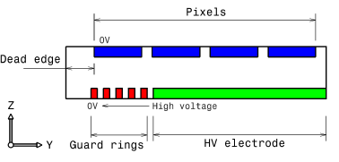
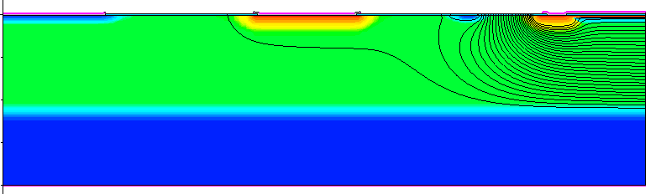
Isolation techniques
The biasing of sensors with High voltage is required to guarantee good charge collection efficiency and short collection time
The biasing voltage is usually increased following sensors irradiation, due to loss of charge collection efficiency
Techniques are needed to suppress the likelihood of breakdown
Multi guard rings improve the high voltage operation, by decreasing the electric field at the sensor edge
Simulation of guard ring influence on the performance of ATLAS pixel
detectors for inner layer replacement DOI: 10.1088/1748-0221/4/03/P03025
Guard ring
P-stop
JTE
Cathode
P-epi
P⁺⁺
The use of junction termination extension (JTE) reduces gradually the potential from the edge of the sensor, decreasing the field
22
Instrumentation Training Lectures, Oxford 02/05/2022

Slide 25

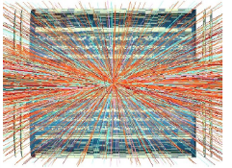

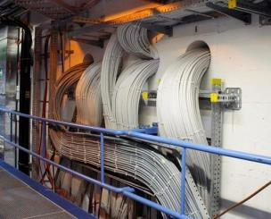
HV biasing
LHC
HL-LHC
Current SCT uses independent powering for the 4088 detector modules. Each sensor has its own independent HV bias line.
‘ideal’ solution:
  High Redundancy
  Individual enabling or disabling of sensors and current monitoring
The increased number of sensors in the Upgraded Tracker (>10 k modules in barrel upgrade vs. ∼2 k in present barrel) implies a trade off among material budget, complexity of power distribution and number of HV bias lines.
From 1E33 cm⁻² s⁻¹
…to 7.5E34 cm⁻² s⁻¹
23
Instrumentation Training Lectures, Oxford 02/05/2022

Slide 26
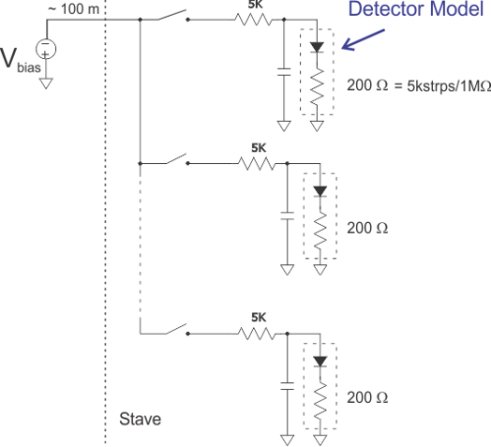
HV biasing
HV (-500V)
Use single (or more) HV bus to bias in parallel all sensors and use one HV switch for each sensor to disable malfunctioning sensors: High Voltage Multiplexing ‘HVMUX’
The HV switch is DCS controlled, with control signals provided by custom ASIC
DCS controlled HV switch
24
Instrumentation Training Lectures, Oxford 02/05/2022

Slide 27
HV biasing
Partial list of investigated HV devices
FAILED
FAILED
FAILED
High Voltage switches strip detector requirements:
Rated to 500V plus a safety margin
Must be radiation hard, nominal maximum expected ∼1x10¹⁵ n_{eq}/cm² , ∼ 30Mrad (Si) for strip end cap. Multiply by 1.5 to include safety margin
On-state impedance R_{on} << 1kΩ // I_{on} ∼ 10mA (for irradiated strip sensors)
Off-state impedance R_{off} >> 1GΩ // I_{lkg} << I_{sens}
Must be unaffected by magnetic field
Must maintain satisfactory performance at -30° C
Must be small (mass/area constraint) and cheap (around 1E4 needed)
FAILED
FAILED
PASS – N.A.
FAILED
FAILED
FAILED
FAILED
FAILED
FAILED
PASS
GS66502B | GaNFET | 650V | PASS
PGA26E19BV | GaNFET | 600V | PASS
25
Instrumentation Training Lectures, Oxford 02/05/2022

Slide 28
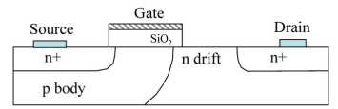
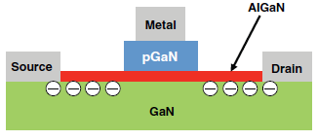
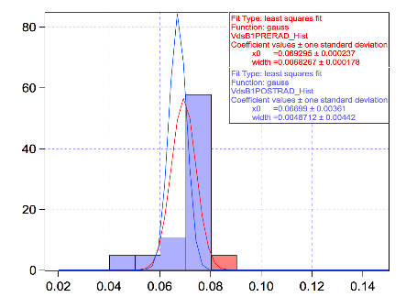
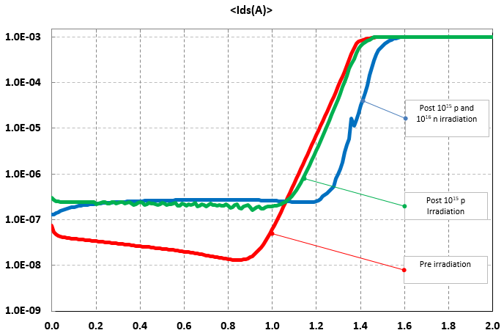
HV biasing
A Lateral Double-Diffused MOS (LDMOS). A long drift region of lower doping reduces the electric field
Example Xsection of a HEMT E. GaN FET. Strain-induced polarization at interface forms a 2DEG
Typical Si HV MOSFET use regions of low doping to increase high voltage capabilities: this affects their radiation hardness
Non-ionizing and ionizing irradiation test results of GaN FET devices indicate very high radiation hardness
Ids [A]
Vds = 550V, T = 21C
Board1 Vds
<Φ> = 9.05E14
TID = 207 [Mrad]
GaN Vds shift with irradiation
Vds [V]
Vgs [V]
Additional test performed on 18 devices Total p fluence 1.0E15, ~TID 200Mrad(GaN) Total n fluence 1.0E16
26
Instrumentation Training Lectures, Oxford 02/05/2022

Slide 29
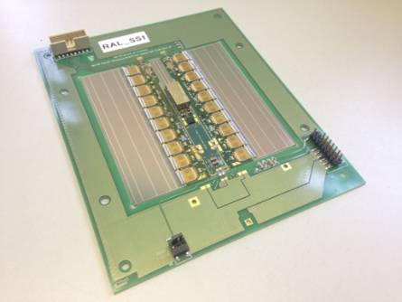
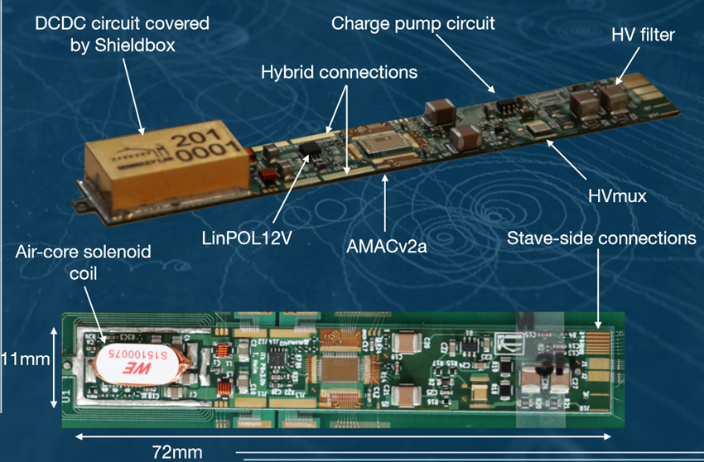
Strips power Board
HV biasing
HV area
The HVMUX sits on the lower side of a flexi power board (PB).
The PB final version incorporates power control and HVMUX elements in the AMAC (Autonomous Monitor And Control) ASIC.
A barrel short strip module with
two hybrids and one powerboard with HVMUX
Power board v3.0b
27
Instrumentation Training Lectures, Oxford 02/05/2022

Slide 30


LBNL V3 PowerBoard with HV Mux
HV biasing
AMAC
Sensor
A charge pump voltage multiplier driven by AC drives the gate of a GaN FET, rated for HV
Investigated stacked solutions demonstrated switching voltages > 1kV
Up to 600V with the implemented ItK solution
Baseline solution for HV bias of ItK strips
RC Filters
HV GaNFET
From Bustape
Schottky Diode Charge Pump
for Gate Bias
From Bustape
Gate Overvoltage
Protection Zener
Villani, E.G., and ATLAS Collaboration. HVMUX, a High Voltage Multiplexing for the ATLAS Tracker Upgrade. United States: N. p., 2016.
28
Instrumentation Training Lectures, Oxford 02/05/2022

Slide 31
Circuits and Layouts I
Summary
  Hybrid and Monolithic technology pros and cons
    From layout to device example of CMOS sensor fabrication
    Isolation techniques
    HV biasing
    Thank you
    giulio.villani@stfc.ac.uk
29
Instrumentation Training Lectures, Oxford 02/05/2022

