Slide 1
TCAD simulation I
E. Giulio Villani
UK HEP Instrumentation Summer School, Oxford 10-20 Aug 2026

Slide 2
Overview
Introduction
  needs for TCAD simulations
  Transport regimes and related equations
  Discretization techniques: meshing
  Discretization of semiconductor equations: Scharfetter-Gummel technique
Synopsys TCAD intro
Synopsys TCAD simulation: Structure Editor (SDE)
  2D simulation of PN junction
UK HEP Instrumentation Summer School, Oxford 10-20 Aug 2026

Slide 3




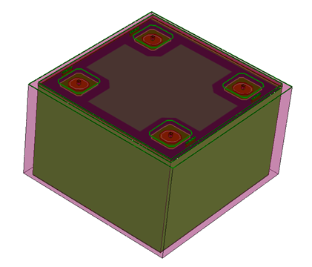
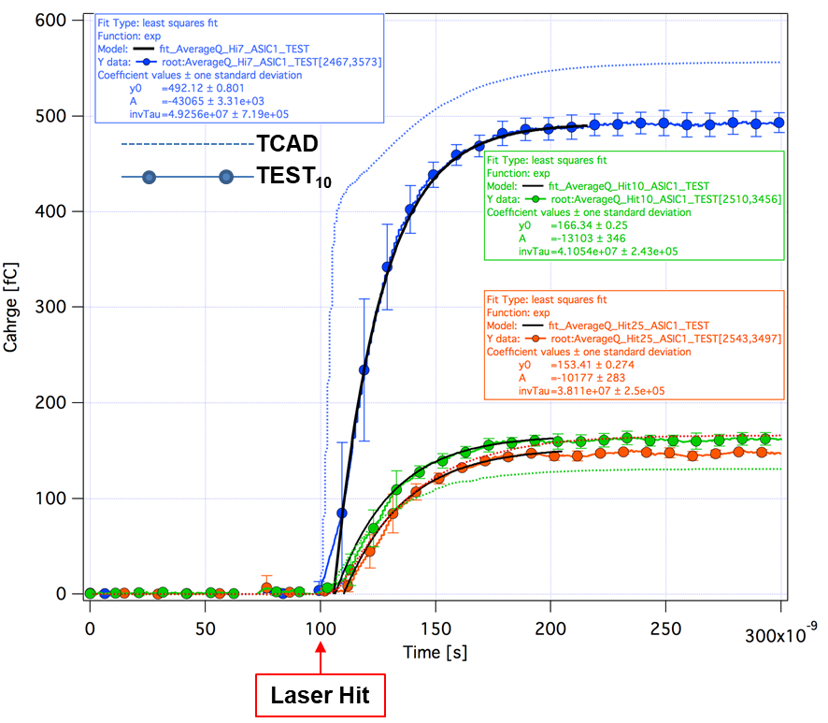
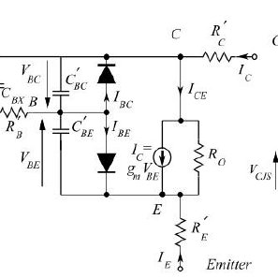
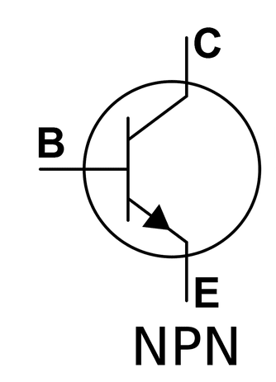

Introduction
Epitax growth
SiO₂ etch
N⁺⁺ implant
P⁺⁺ implant
TCAD (Technology Computer Aided Design) divides into three groups:
  Process simulation, i.e. simulation of fabrication process steps (oxidation, implantation, diffusion…)
  Device simulation, i.e. simulation of the thermal/electrical/optical behavior of electronic devices,(IV,CV, frequency response…)
  Device modeling, i.e. creating compact behavioral models for devices for circuit simulation (SPICE, Cadence…)
1
UK HEP Instrumentation Summer School, Oxford 10-20 Aug 2026

Slide 4
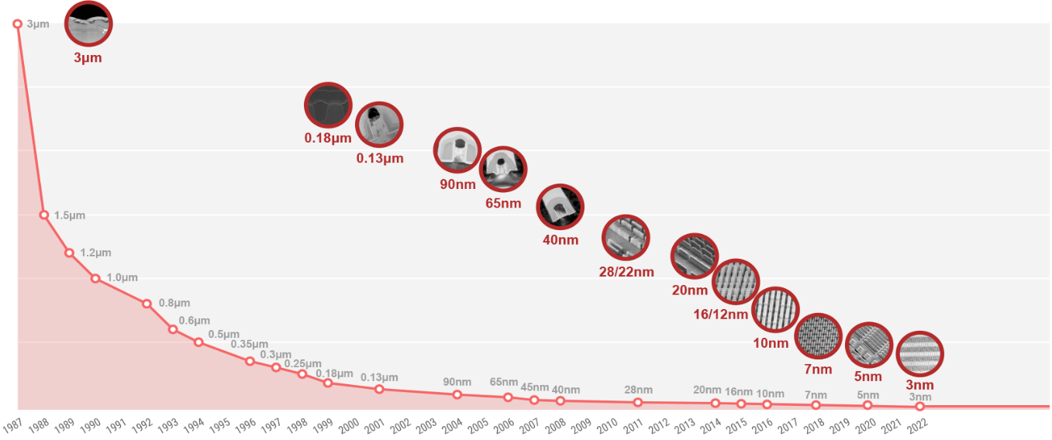
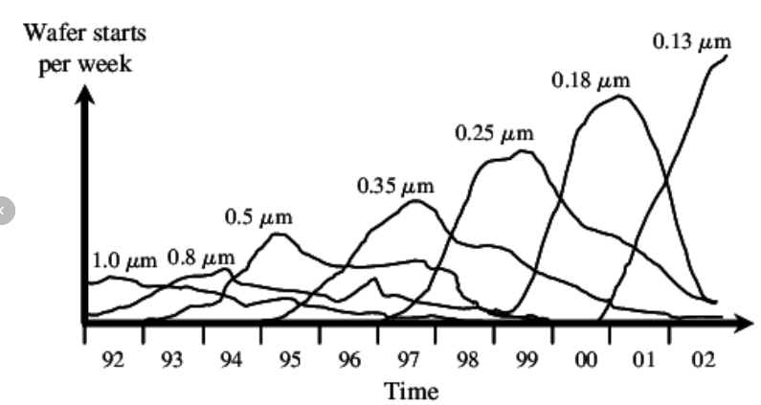
Introduction
  Reasons why TCAD simulations are needed:
    Market demands cycle of design to production of 18 months or less. Typically 2-3 months required for wafer tape out implies short time for development
    Reduce cost to run experiments on new devices and circuits
evolution of TSMC's semiconductor process nodes from its founding in 1987 through 2022.
from https://orbitskyline.com/ The Evolution of Semiconductor Technology Nodes:
Shrinking product life cycles in semiconductor industry over time
Hochbaum, Dorit S. et al., Rating Customers According to Their Promptness to Adopt
New Products., Operations Research, vol. 59, no. 5, p. 1171–83, 2011.
2
UK HEP Instrumentation Summer School, Oxford 10-20 Aug 2026

Slide 5
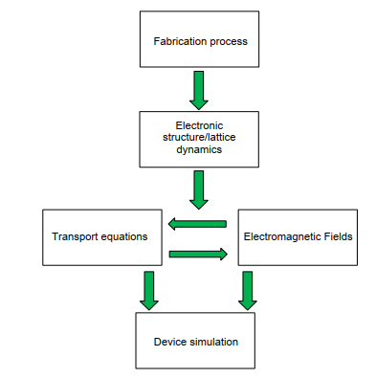
Introduction
  Main components of semiconductor device simulation include fabrication process, description of electronic structure, driving forces and transport phenomena
  The two kernels of semiconductor transport equations and fields that drive charge flow are coupled to each other and needs solving self-consistently
3
UK HEP Instrumentation Summer School, Oxford 10-20 Aug 2026

Slide 6
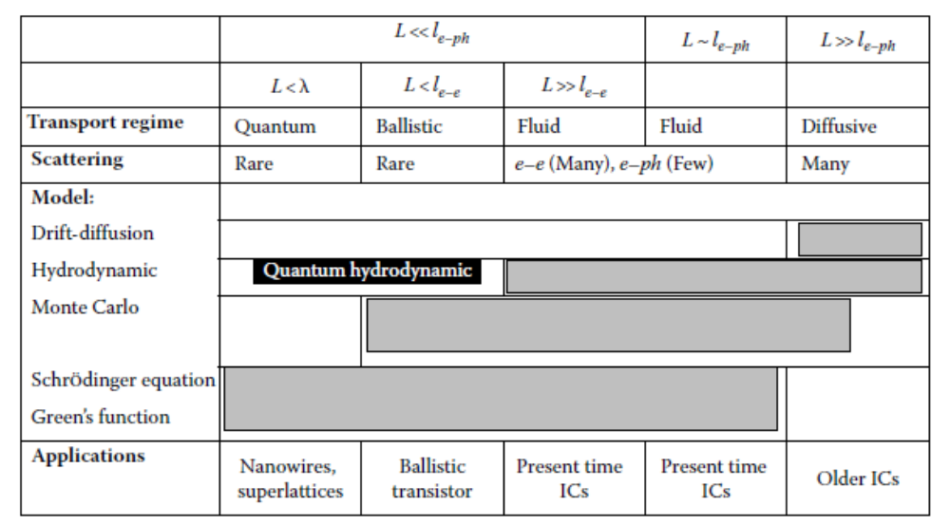
Transport regimes
Usually only the quasi-static electric fields from the solution of Poisson’s equation are necessary
Transport regime in semiconductors depends on length scale
Modern Silicon technology already requires tools to describe transport in quantum regime [D. K. Ferry and S. M. Goodnick, Transport in Nanostructures, 1997]
L: device length
l_{e-e}: electron-electron scattering length
l_{e-ph}: electron-phonon scattering length
λ: electron wavelength
D. Vasileska, et al., Computational Electronics: Semiclassical and Quantum Device Modelling and Simulation, RC press, 2010,ISBN-13: 978-1-4200-6484-1.
4
UK HEP Instrumentation Summer School, Oxford 10-20 Aug 2026

Slide 7
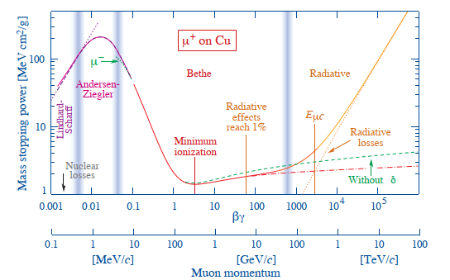
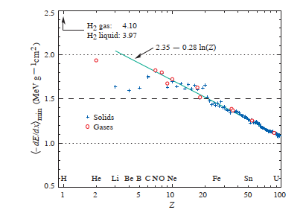
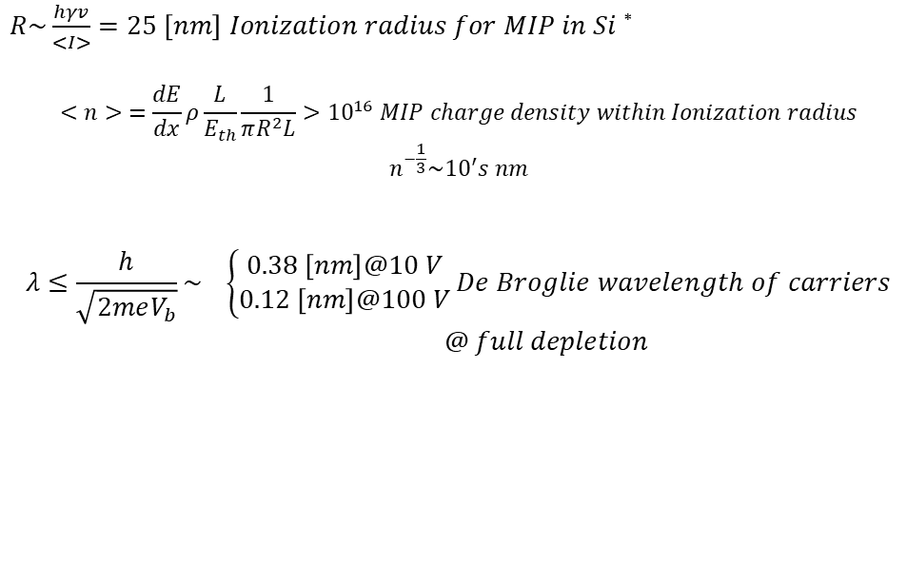
Transport regimes
Charge carrier dynamics in Si detectors usually does not require QM
Semiclassical laws of motions apply
Drift-diffusion (DD) equations are often valid, i.e. provided the electron gas is in thermal equilibrium with lattice temperature (T_{n} = T_{L})
Mass stopping power (= −dE/dx) for positive muons in copper as a function of βγ = p/Mc
Mass stopping power at minimum ionization for the chemical elements.
$R\sim \frac{hγv}{<I>}=25 \left[nm\right] Ionization radius for MIP in Si$ *
$$<n> =\frac{dE}{dx}ρ\frac{L}{E_{th}}\frac{1}{πR^{2}L}>{10}^{16} MIP charge density within Ionization radius$$
$$n^{−\frac{1}{3}}\sim {10}^{′}s nm$$
$$λ≤\frac{h}{\sqrt{2meV_{b}}}\sim \left\{\begin{aligned}0.38 \left[nm\right]@10 V \\ 0.12 \left[nm\right]@100 V\end{aligned}\right.De Broglie wavelength of carriers$$
$@ full depletion$
* Nuclei And Particles, Emilio Segre Published by W.A. Benjamin, Inc, New York, 1965
5
UK HEP Instrumentation Summer School, Oxford 10-20 Aug 2026

Slide 8



Drift diffusion model
BTE
The semiconductor equations derived from 1st and 2nd moment of Boltzmann Transport Equation (BTE) are referred to as Drift Diffusion (DD) model (see the notes)
The model consists of Poisson's equation and PDE: continuity and current density equations for electrons and holes
They express charge and momentum conservation
Their self-consistent solutions are obtained via discretization, using finite element methods FEM
For first-principle derivation of DD model:
https://www.oghma-nano.com/manual/drift-diffusion-derivation.html
6
UK HEP Instrumentation Summer School, Oxford 10-20 Aug 2026

Slide 9
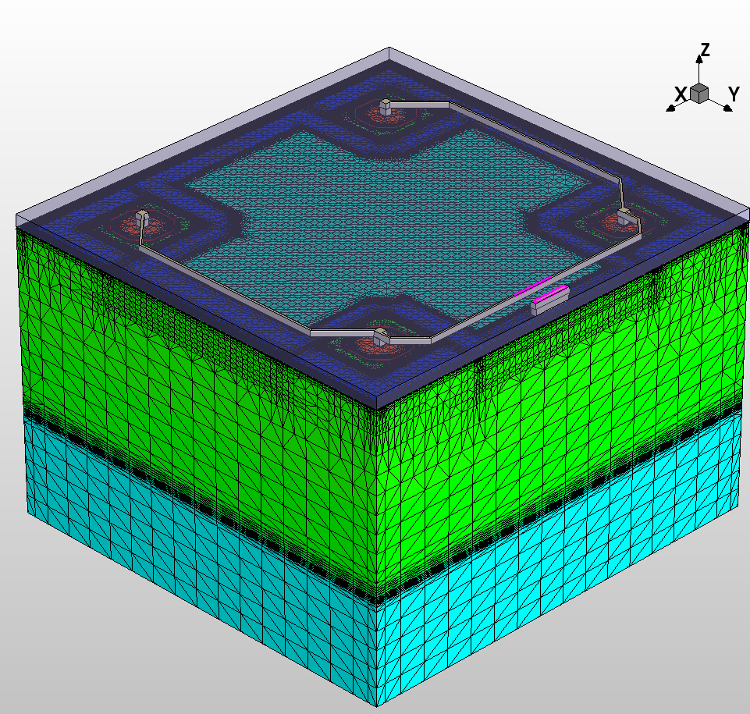
Discretization and meshing
The (electrical *) device simulation process consists of two steps:
The test volume is obtained through grid generation (‘mesh generation’ )
Solving the discretised differential equations using the Finite-Boxes method (box integration method). This method integrates PDEs over a test volume.
* the fabrication process simulation might use different meshing approaches, for dynamic meshing of moving boundaries, i.e. oxide growth, etching. A widely used method is the Level Set Method:
(https://math.berkeley.edu/~sethian/2006/Semiconductors/ieee_overview.html)
7
UK HEP Instrumentation Summer School, Oxford 10-20 Aug 2026

Slide 10
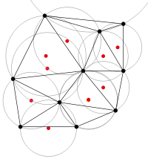
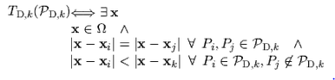
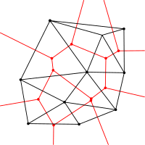
Discretization and meshing
The Delaunay triangulation with all the circumcircles and their centres
The meshing used in most finite elements methods (FEM) relies on Delaunay triangulations:
the interior of the circumsphere of each element contains no mesh vertices.
The Delaunay triangulation of a discrete point set P in general corresponds to the dual graph of the Voronoi diagram for P
the set of all locations x closest to P_{i} than to any other point of the grid
Connecting the centres of the circumcircles produces the Voronoi diagram (in red).
8
UK HEP Instrumentation Summer School, Oxford 10-20 Aug 2026

Slide 11
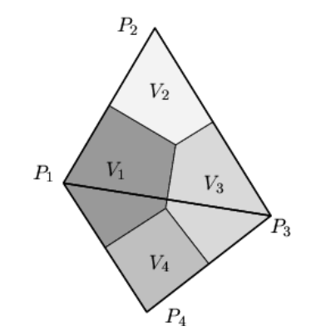
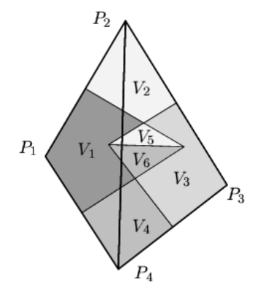
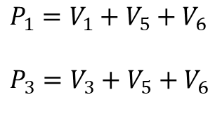

Discretization and meshing
Voronoi boxes do not overlap (each circumcircle does not include a point of another triangle). Each can be uniquely assigned to its corresponding grid points.
$$P_{i}=V_{i}$$
Correct Delaunay triangulation* guarantees element-volume conservation, important in many problems (diffusion, charge generation, et cetera)
Delaunay triangulation maximizes the minimum angle of the triangle
*A. Okabe, B. Boots, and K. Sugihara, Spatial Tessellations, John Wiley and Sons Ltd, 1992.
Voronoi boxes do overlap (each circumcircle does include a point of another triangle). Each cannot be uniquely assigned to its corresponding grid points. Wrong volumes calculated
$P_{1}=V_{1}+$ $V_{5}+V_{6}$
$P_{3}=V_{3}+$ $V_{5}+V_{6}$
9
UK HEP Instrumentation Summer School, Oxford 10-20 Aug 2026

Slide 12
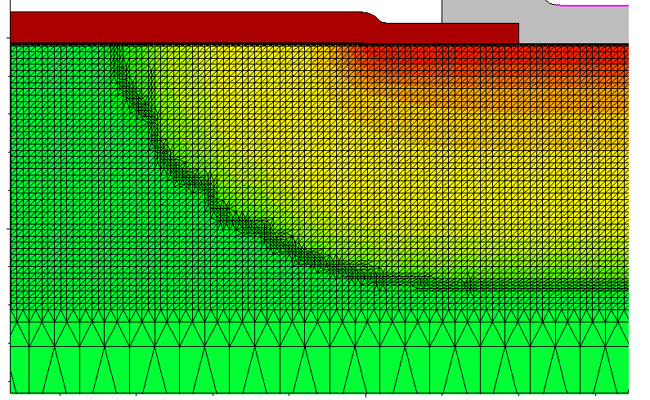
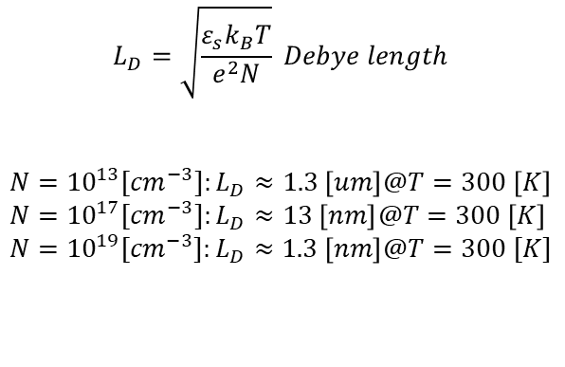
Discretization and meshing
nwell
HR p
Discretization of equations imposes some constraints on spatial and temporal mesh size
Mesh size should be smaller than Debye length (i.e. the characteristic length for screening of field by charges) where charge variations in space have to be resolved
$$L_{D}=\sqrt{\frac{{ε_{s}k}_{B}T}{e^{2}N}} Debye length$$
$$N={10}^{13}{[cm}^{−3}]:L_{D}≈1.3 \left[um\right]@T=300 \left[K\right] \\ N={10}^{17}{[cm}^{−3}]:L_{D}≈13 \left[nm\right]@T=300 \left[K\right] \\ N={10}^{19}{[cm}^{−3}]:L_{D}≈1.3 \left[nm\right]@T=300 [K]$$
10
UK HEP Instrumentation Summer School, Oxford 10-20 Aug 2026

Slide 13

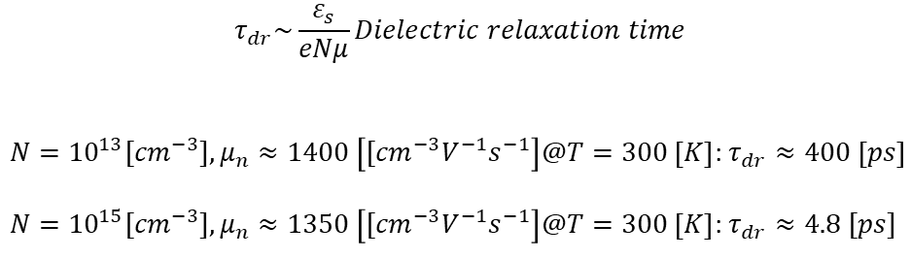
Discretization and meshing
$$τ_{dr}\sim \frac{ε_{s}}{eNμ}Dielectric relaxation time$$
$N={10}^{13}{[cm}^{−3}],μ_{n}≈1400 \left[{[cm}^{−3}V^{−1}s^{−1}\right]@T=300 \left[K\right]$: $τ_{dr}≈400 \left[ps\right]$
$N={10}^{15}{[cm}^{−3}],μ_{n}≈1350 \left[{[cm}^{−3}V^{−1}s^{−1}\right]@T=300 \left[K\right]$: $τ_{dr}≈4.8 [ps]$
Also temporal ‘mesh’ size should be smaller than the dielectric relaxation time t_{dr} (i.e. time it takes to charge fluctuations to decay under the field they produce)
Time interval smaller than t_{dr} might give unrealistic transient results (‘oscillations’ in estimated transient currents)
$$\frac{∂Δn}{∂t} =−\frac{Δn(t=0)}{t_{dr}}$$
$$Δn \left(Δt\right)=Δn \left(0\right)−Δt\frac{Δn(0)}{t_{dr}}$$
11
UK HEP Instrumentation Summer School, Oxford 10-20 Aug 2026

Slide 14
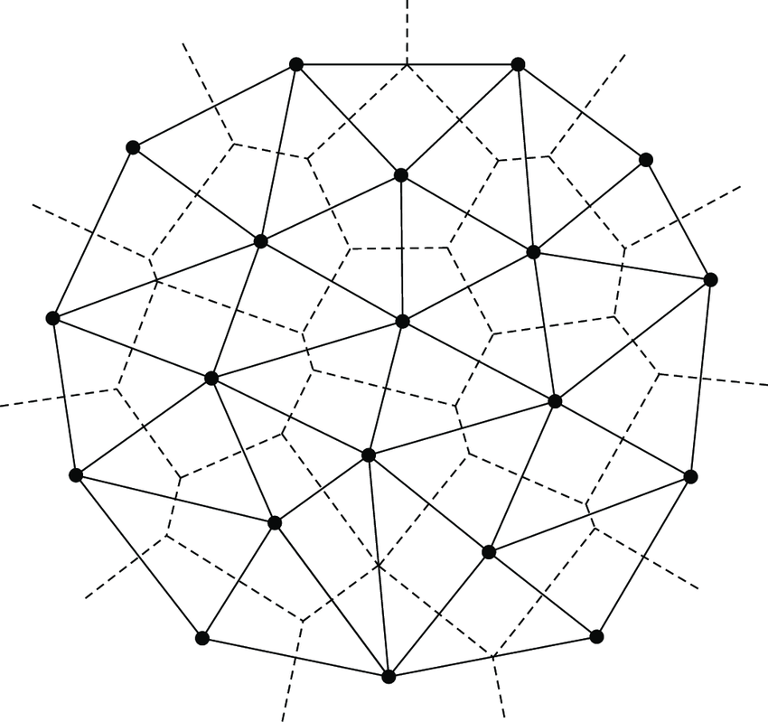






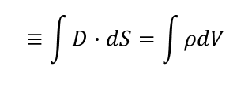
Box integration method
$$k$$
$$j$$
Discretization of Poisson’s and continuity equations is done via Box Integration method
The LHS of equations is transformed via Gauss’ theorem and integrated over a Voronoi box Ω_{k} of point P_{k}
$$i$$
$$≡\int{D∙dS=\int{ρdV}}$$
$$∇∙ε_{S}∇φ=e(n−p−N_{D}+N_{A})$$
$$∇∙J_{n} −q\frac{∂n}{∂t}=qR$$
$$∇∙J_{p}+q\frac{∂p}{∂t}=−qR$$
12
UK HEP Instrumentation Summer School, Oxford 10-20 Aug 2026

Slide 15







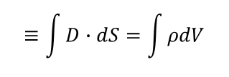







Box integration method
$$k$$
$$L_{j}$$
$$L_{i}$$
Example of Poisson’s equation discretization
Assume that the electric potential is linearly varying over each elementary domain
$$d_{j}$$
$$d_{i}$$
$$d_{k}$$
$$i$$
$$L_{k}$$
$$j$$
$$≡\int{D∙dS=\int{ρdV}}$$
$$∇∙ε_{S}∇φ=e(n−p−N_{D}+N_{A})$$
$$i,j,k:nodal indices$$
$L_{i},L_{j}$, $L_{k}:side vectors$
$L_{i},L_{j}$, $L_{k}:magnitude side vectors$
$$u≔\frac{e}{k_{B}T}φ:normalized potential$$
13
UK HEP Instrumentation Summer School, Oxford 10-20 Aug 2026

Slide 16

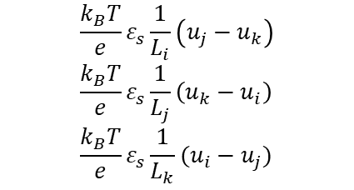
Box integration method
$$k$$
$$L_{j}$$
$$L_{i}$$
Components of D vector along sides L_{i,j,k}
Flux of D vector associated to node k:
Discretization of RHS is obtained by multiplying the node value of charge by the area of the portion of the Voronoi box
$$d_{j}$$
$$d_{i}$$
$$d_{k}$$
$$i$$
$$L_{k}$$
$$j$$
$$\frac{k_{B}T}{e}ε_{s}\frac{1}{L_{i}}\left(u_{j}−u_{k}\right) \\ \frac{k_{B}T}{e}ε_{s}\frac{1}{L_{j}}\left(u_{k}−u_{i}\right) \\ \frac{k_{B}T}{e}ε_{s}\frac{1}{L_{k}}(u_{i}−u_{j})$$
$\frac{k_{B}T}{e}ε_{s}[\frac{d_{i}}{L_{i}}\left(u_{j}−u_{k}\right)$+ $\frac{d_{j}}{L_{j}}\left(u_{i}−u_{k}\right)$] $Flux of D$
14
UK HEP Instrumentation Summer School, Oxford 10-20 Aug 2026

Slide 17
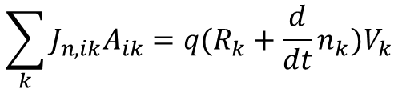
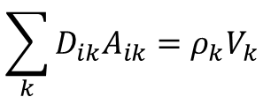



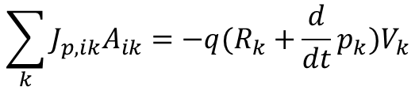

Box integration method
$$k$$
$$j$$
$$i$$
Summing over all points P_{k} of Voronoi boxes
Same approach to discretize the continuity equations for electrons and holes
$$\sum_{k}{D_{ik}A_{ik}=ρ_{k}V_{k}}$$
$$A_{ik}:area of K −Vbox \\ D_{ik}:projection along grid line$$
$$\sum_{k}{J_{n,ik}A_{ik}=q(R_{k}+\frac{d}{dt}n_{k})V_{k}}$$
$$\sum_{k}{J_{p,ik}A_{ik}=−q(R_{k}+\frac{d}{dt}p_{k})V_{k}}$$
15
UK HEP Instrumentation Summer School, Oxford 10-20 Aug 2026

Slide 18
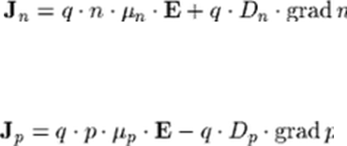






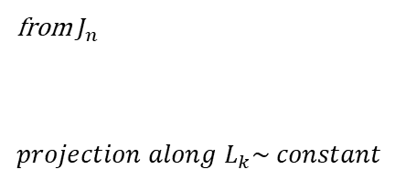







$$k$$
Scharfetter-Gummel discretization
$$L_{j}$$
$$L_{i}$$
$$d_{j}$$
$$d_{i}$$
$$d_{k}$$
In case of no strong generation-recombination the current density varies little within each domain
Even so, this implies an exponential dependence of electron / hole density n/p with position along grid’s edge
Using previous discretization method would require very dense mesh: the Scharfetter-Gummel technique* includes such dependence, requiring less grid points
*D. L. Scharfetter and H. K. Gummel, “Large-signal analysis of a silicon read diode oscillator,” IEEE Trans. Electron Devices, vol. ED-16, pp. 64–77, Jan. 1969
$$i$$
$$L_{k}$$
$$j$$
$$u≔\frac{e}{k_{B}T}φ$$
$$D_{n}≔\frac{k_{B}T}{e}μ_{n}$$
$$J_{n}≔qD_{n}[∇n−n∇u]$$
from $J_{n}$
$projection along L_{k}\sim constant$
$$J_{nk}≔qD_{n}[\frac{dn}{dl_{k}}−n\frac{du}{dl_{k}}]$$
16
UK HEP Instrumentation Summer School, Oxford 10-20 Aug 2026

Slide 19

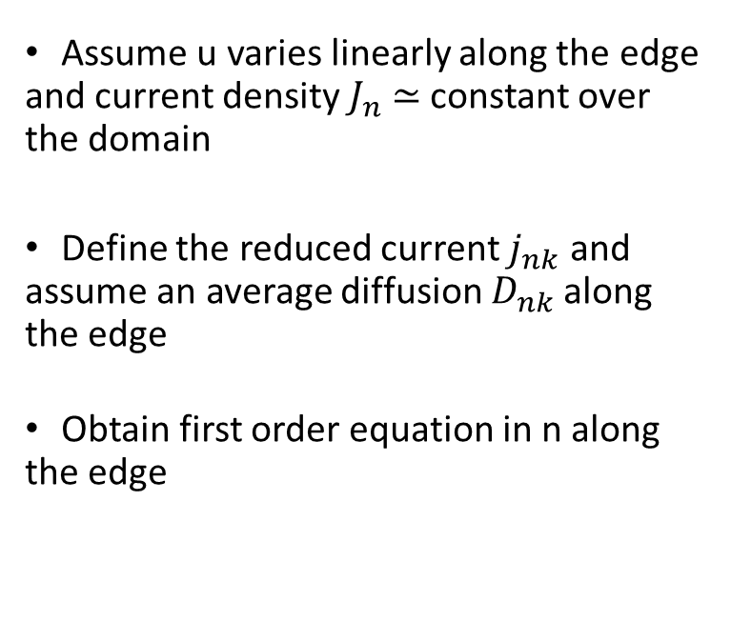


$$k$$
Scharfetter-Gummel discretization
$$L_{j}$$
$$L_{i}$$
$$d_{j}$$
$$d_{i}$$
$$d_{k}$$
Assume u varies linearly along the edge and current density $J_{n}$ ≃ constant over the domain
Define the reduced current $j_{nk}$ and assume an average diffusion $D_{nk}$along the edge
Obtain first order equation in n along the edge
$$i$$
$$L_{k}$$
$$j$$
$$u=\frac{u_{j}−u_{i}}{L_{k}}l_{k}+u_{i}=a_{k}l_{k}+u_{i}$$
$j_{nk}:=\frac{J_{nk}}{{qD}_{nk}},{ D}_{nk}≔<D_{ni},$ $D_{nj}>$
$$j_{nk}= \frac{dn}{dl_{k}}−na_{k}$$
17
UK HEP Instrumentation Summer School, Oxford 10-20 Aug 2026

Slide 20

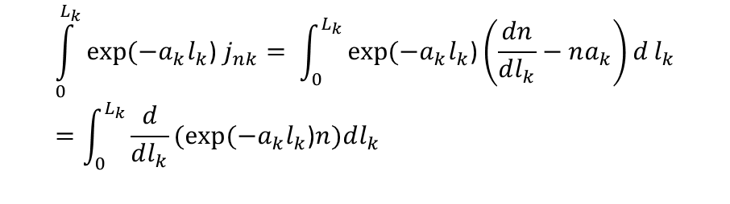

$$k$$
Scharfetter-Gummel discretization
$$L_{j}$$
$$L_{i}$$
$$d_{j}$$
$$d_{i}$$
$$d_{k}$$
Integrate from node i to node j, i.e. for l_{k}=[0, L_{k}]
Obtain expression relating potential and carriers concentration
$$i$$
$$L_{k}$$
$$j$$
$$\int_{0}^{L_{k}}{exp⁡(−a_{k}l_{k}\text{) }j_{nk}}= \int_{0}^{L_{k}}{exp⁡(−a_{k}l_{k}\text{)}\left(\frac{dn}{dl_{k}}−na_{k}\right)d}l_{k}=\int_{0}^{L_{k}}{\frac{d}{dl_{k}}(exp⁡(−a_{k}l_{k}\text{)}n)dl_{k}}$$
$j_{nk}\frac{1}{a_{k}}(1−exp(⁡−u_{ji}\text{)}=$ $exp⁡(−u_{ji}\text{)}n_{j}−n_{i}$
$$j_{nk}=a_{k}(\frac{n_{j}}{exp⁡(u_{ji}\text{)}\text{−1}}+\frac{n_{i}}{exp⁡(−u_{ji}\text{)−1}})$$
18
UK HEP Instrumentation Summer School, Oxford 10-20 Aug 2026

Slide 21

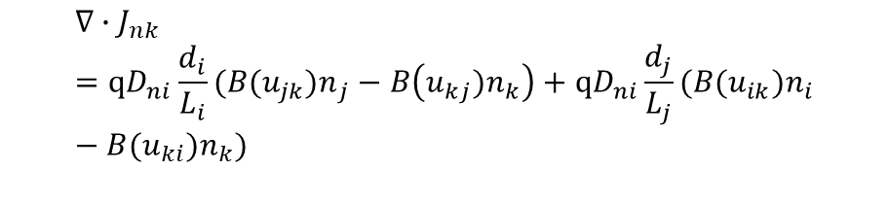


$$k$$
Scharfetter-Gummel discretization
$$L_{j}$$
$$L_{i}$$
$$d_{j}$$
$$d_{i}$$
$$d_{k}$$
Obtain the flux of current density relative to node k
Scharfetter –Gummel discretization requires less fine mesh as the exponential dependence of carriers concentration is included in the discretization scheme
It also depends on boundary values, i.e. 2D and 3D cases can be reduced to local 1D cases
$$i$$
$$L_{k}$$
$$j$$
$$j_{nk}=\frac{1}{L_{k}}(\frac{{u_{ji}n}_{j}}{exp⁡(u_{ji}\text{)}\text{−1}}−\frac{u_{ij}n_{i}}{exp⁡(u_{ij}\text{)−1}})$$
$$j_{nk}=\frac{1}{L_{k}}(B({u_{ji})n}_{j}−B({u_{ij})n}_{i})$$
$$Bernoulli function B\left(x\right)=\frac{x}{\exp\left(x\right)−1}$$
$$calculate the flux of j_{nk}to get the charge at k$$
$$∇∙J_{nk}=qD_{ni}\frac{d_{i}}{L_{i}}(B({u_{jk})n}_{j}−B\left({u_{kj})n}_{k}\right)+qD_{ni}\frac{d_{j}}{L_{j}}(B({u_{ik})n}_{i}−B({u_{ki})n}_{k})$$
19
UK HEP Instrumentation Summer School, Oxford 10-20 Aug 2026

Slide 22
Synopsys TCAD
E. Giulio Villani
UK HEP Instrumentation Summer School, Oxford 10-20 Aug 2026

Slide 23
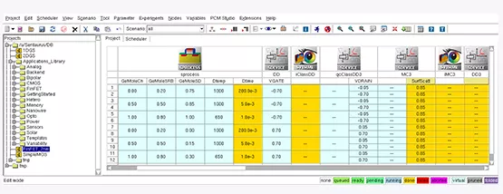
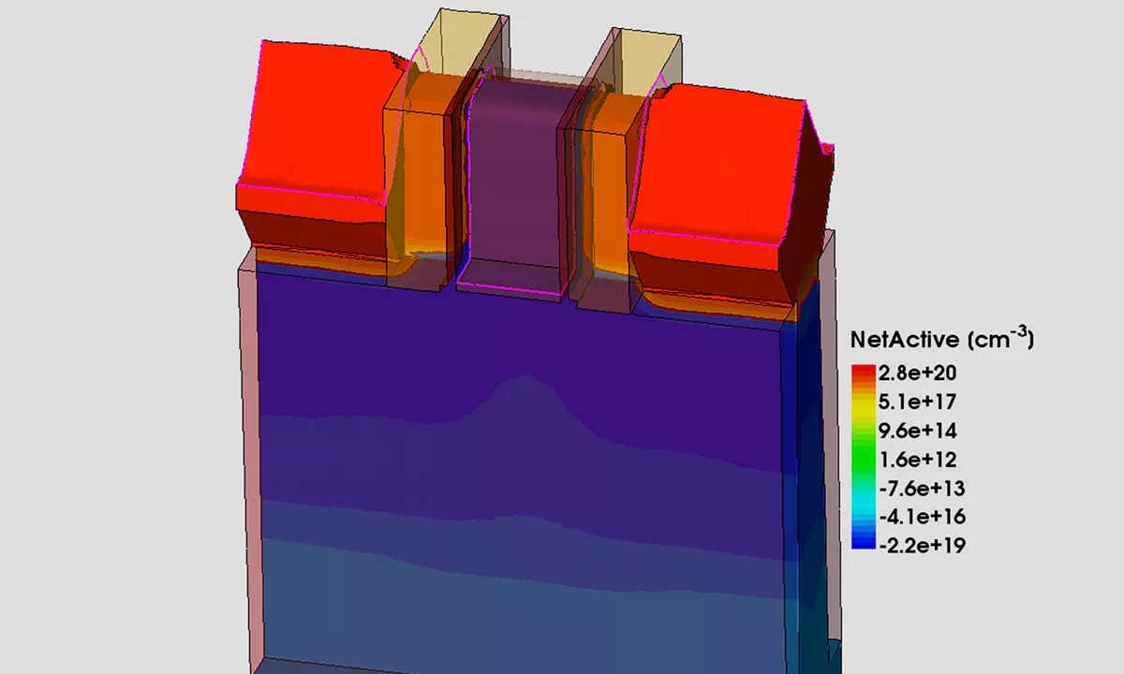
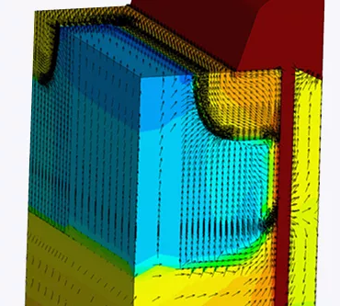
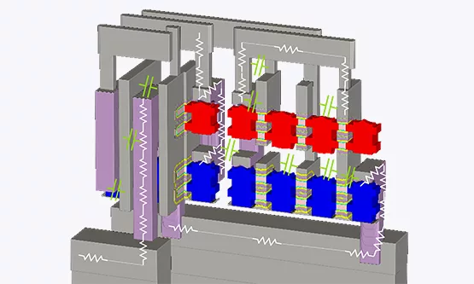
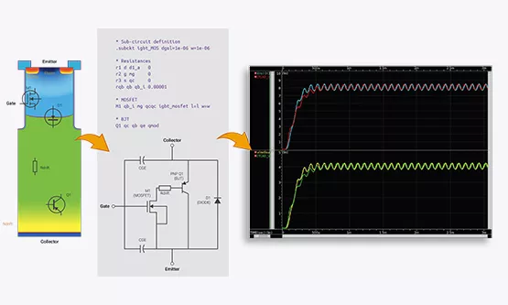
TCAD Synopsys Simulation
Synopsys Sentaurus TCAD [*] allows the complete simulation of semiconductor devices
Fabrication process, including epitaxial growth, oxidation, implantation, etching, diffusion, metallisation can be simulated
Full electrical, thermal and optical simulations are possible, including IV/CV/noise, Charge transport and response to radiation
Process simulation
Device simulation
Device interconnect simulation
SPICE parameters extraction
[*] https://www.synopsys.com/manufacturing/tcad.html
20
UK HEP Instrumentation Summer School, Oxford 10-20 Aug 2026

Slide 24
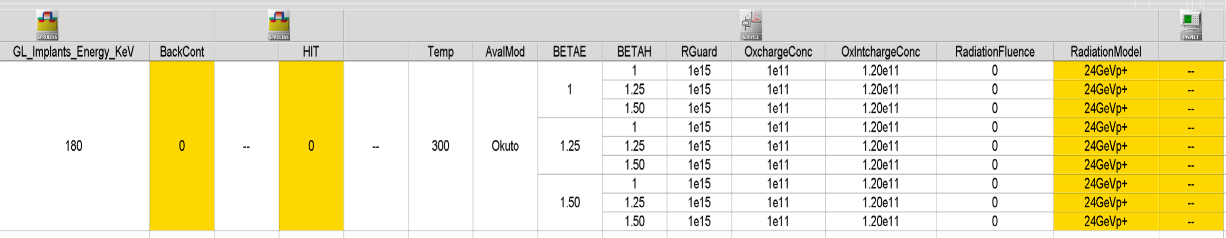
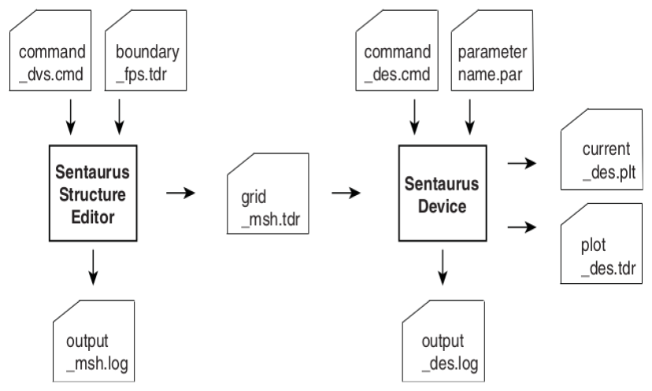
TCAD Synopsys Simulation
The description of the devices can be done either graphically or via scripts, using code compatible with Tool Command Language [TCL]
The various individual simulation tools are arranged on a Workbench (SWB) in a pipeline fashion
Default models and parameters for fabrication and physics of most semiconductor devices are available and can be fully customised by the user
Cross section of simulated LGAD (top) and PIN diode (bottom)
21
UK HEP Instrumentation Summer School, Oxford 10-20 Aug 2026

Slide 25
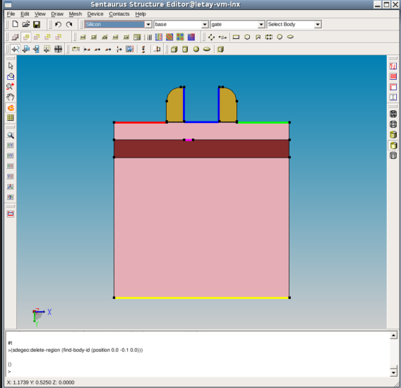
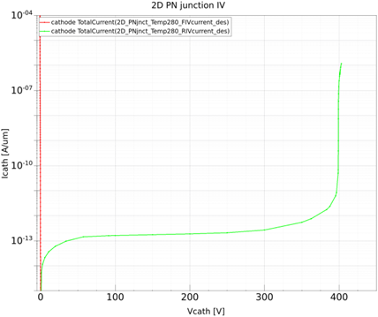
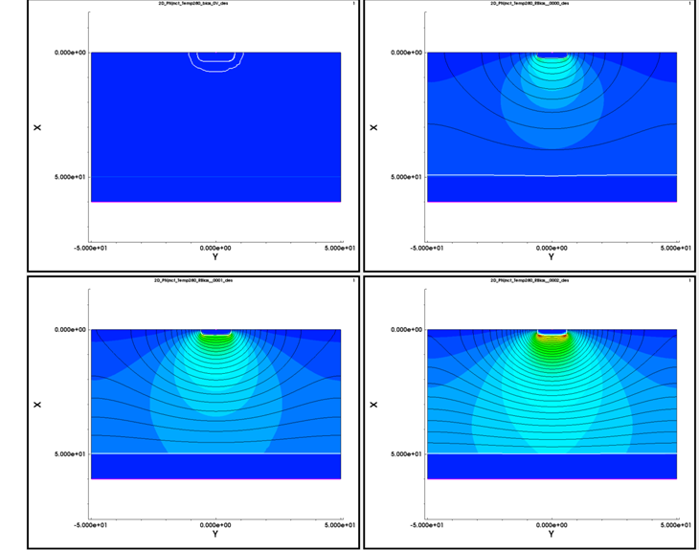
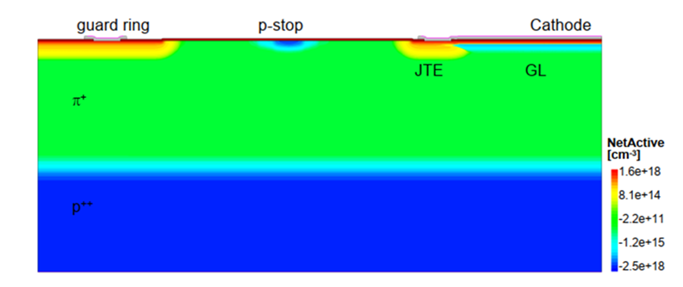
TCAD Synopsys Simulation
The simulation tools we’ll use are:
  Sentaurus Device Editor (SDE) ~ 900 pages
    structure definition
  Sentaurus Device (SDEVICE) ~ 1800 pages
    device electrical simulation
  Sentaurus Visual (SVISUAL) ) ~ 600 pages
    visualisation tool
  Sentaurus Process (SPROCESS) ) ~ 1400 pages
    fabrication process simulation
    SDE GUI
    SDEVICE results (.plt) plotted with SVISUAL
    SPROCESS device
    SDEVICE results (.tdr) plotted with SVISUAL
22
UK HEP Instrumentation Summer School, Oxford 10-20 Aug 2026

Slide 26
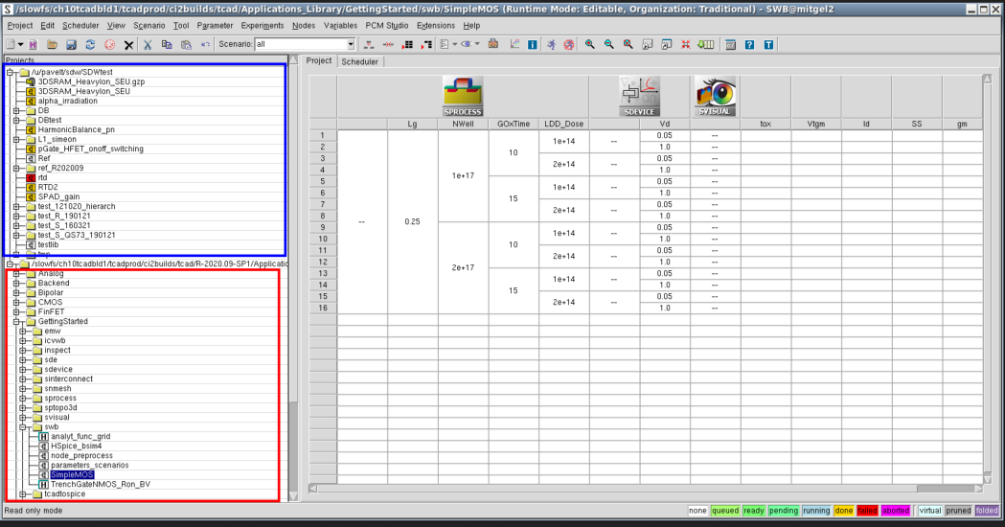
TCAD Synopsys Simulation
Sentaurus Workbench (SWB) is the graphical front end that integrates TCAD Sentaurus simulation tools into one environment.
Simulations are organized comprehensively into projects. SWB automatically manages the information flow, which includes preprocessing user input files, parameterizing projects, setting up and executing tool instances, and visualizing results.
SWB allows you to define parameters and variables to run comprehensive parametric analyses. The resulting data can be used with statistical and spreadsheet applications.
To start SWB:
swb &
23
UK HEP Instrumentation Summer School, Oxford 10-20 Aug 2026

Slide 27

TCAD Synopsys Simulation
Sentaurus Structure Editor (SDE) is a structure editor for 2D and 3D device structures. Its operational modes are 2D structure editing and 3D structure editing.
From the user interface, 2D and 3D device models are created geometrically, using 2D or 3D primitives such as rectangles, polygons, cuboids, cylinders, and spheres. Rounded edges are generated by filleting, 3D edge blending, and chamfering. Complex shapes are generated by intersecting primitive elements.
The user interface of SDE features a command-line window, in which SDE prints script commands corresponding to the user interface operations.
To start SDE:
sde –openGL &
24
UK HEP Instrumentation Summer School, Oxford 10-20 Aug 2026

Slide 28

1 File Section: input/output files
2 Electrode Section: electrode definition, matching those in the input grid
3 Physics Section: physics models to use in the simulation
4 Plot Section: variables to plot
5 Math Section: solvers
6 Solve Section: what to solve (IV,CV, Charge injection)
TCAD Synopsys Simulation
Sentaurus Device is a numeric semiconductor device simulator, capable of simulating the electrical, thermal, and optical characteristics of various semiconductor devices.
It simulates 1D, 2D, and 3D device behaviour over a wide range of operating conditions, including mixed-mode circuit simulation, combining numerically simulated devices with their compact modelling, which is performed on a SPICE-based circuit simulation level.
A typical command file of Sentaurus Device consists of several sections (or statement blocks), with each section executing a relatively independent function. The default extension of the command file is _des.cmd, for example, pp1_des.cmd. To start: sdevice
25
UK HEP Instrumentation Summer School, Oxford 10-20 Aug 2026

Slide 29

Command file (*.cmd)
This is the main input file for Sentaurus Process. It contains all the process steps and can be edited.
Log file (*.log and *.out)
Sentaurus Process generates a log file when it is run. Both files contain information about each processing step.
TDR boundary file (*_bnd.tdr)
This file stores the boundaries of the structure without the bulk mesh or fields.
TDR grid and doping file (*_fps.tdr)
This file stores the boundaries of the structure with the bulk mesh or fields
XGRAPH file (*.plx)
This file saves the 1D distributions of the doping concentration or other fields in a specified cross section.
To start: sprocess
TCAD Synopsys Simulation
Sentaurus Process is a highly flexible multidimensional process modelling environment. It constitutes a solid base for process simulation.
Calibrated to a wide range of the latest experimental data using proven calibration methodology, Sentaurus Process offers predictive capabilities for modern silicon and non-silicon technologies.
26
UK HEP Instrumentation Summer School, Oxford 10-20 Aug 2026

Slide 30

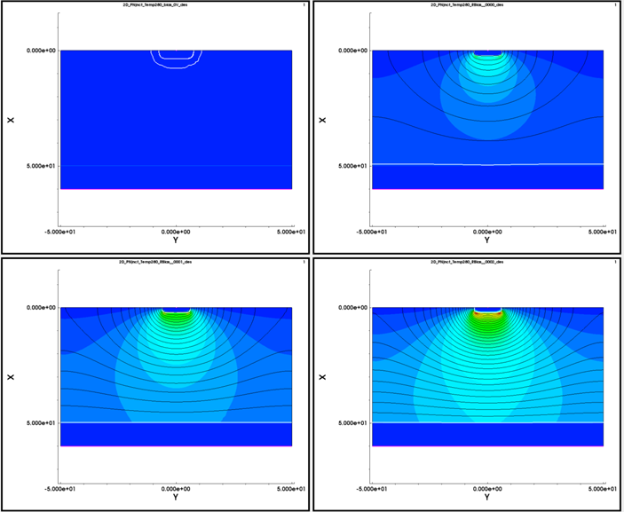
TCAD Synopsys Simulation
Sentaurus Visual is advanced visualization software developed by Synopsys based on the Visualization Toolkit.
Sentaurus Visual is used to visualize results created by TCAD simulation tools in one, two, and three dimensions.
Sentaurus Visual provides tools to probe data fields, to make cutlines and cut planes, to perform analysis on data fields, and to export data in ASCII format for further analysis by third-party software.
Two file types can be loaded into Sentaurus Visual:
Files with the *.tdr extension describe a device structure, its mesh, and data fields stored on the mesh.
Files with the *.plt extension store terminal characteristics produced by the device simulator and are used to create I–V curve plots. To start: svisual &
27
UK HEP Instrumentation Summer School, Oxford 10-20 Aug 2026

Slide 31
TCAD simulation
Structure Editor (SDE)
UK HEP Instrumentation Summer School, Oxford 10-20 Aug 2026

Slide 32
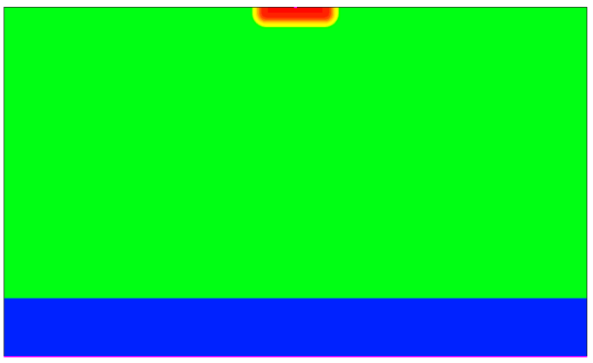
TCAD Synopsys Simulation
N-well cathode
100 um
10 um
First example: 2D pn junction using SDE: 2D_PNjnct_SDE
  INTERACTIVE using the GUI
  BATCH using the script mode: the scripting language of SDE is based on Scheme, a LISP-like programming language that differs significantly from most widely used programming languages. A working knowledge of Scheme is needed to create SDE scripts for parameterized devices.
  https://docs.scheme.org/
P - HR
60 um
P++
anode
28
UK HEP Instrumentation Summer School, Oxford 10-20 Aug 2026

Slide 33
(sde:clear)
;DEFINES THE GEOMETRY OF THE DEVICE
(sdegeo:create-rectangle (position 0 -50 0) (position 60 50 0) "Silicon" "bulk")
(sdedr:define-refeval-window "substrate" "Rectangle" (position 50 -50 0) (position 60 50 0))
(sdedr:define-refeval-window "nwell_central" "Rectangle" (position 0 -5 0) (position 1 5 0))
;DEFINES THE DOPING PROFILES
(sdedr:define-constant-profile "ConstantProfileDefinition_subs" "BoronActiveConcentration" 5e18)
(sdedr:define-constant-profile-placement "ConstantProfilePlacement_subs" "ConstantProfileDefinition_subs" "substrate")
(sdedr:define-constant-profile "ConstantProfileDefinition_bulk" "BoronActiveConcentration" 1e+13)
(sdedr:define-constant-profile-region "ConstantProfilePlacement_bulk" "ConstantProfileDefinition_bulk" "bulk")
(sdedr:define-analytical-profile-placement "AnalyticalProfilePlacement_Cath" "AnalyticalProfileDefinition_nwell" "nwell_central" "Positive" "NoReplace" "Eval")
(sdedr:define-gaussian-profile "AnalyticalProfileDefinition_nwell" "PhosphorusActiveConcentration" "PeakPos" 0 "PeakVal" 1e17 "Length" 1 "Gauss" "Factor" 0.8)
TCAD Synopsys Simulation
First example: 2D pn junction using SDE: 2D_PNjnct_SDE
29
UK HEP Instrumentation Summer School, Oxford 10-20 Aug 2026

Slide 34
;DEFINES THE REFINEMENTS FOR EACH REGION
(sdedr:define-refinement-size "RefinementDefinition_1" 1 1 1 0.1 0.1 0.1 )
(sdedr:define-refinement-placement "RefinementPlacement_bulk" "RefinementDefinition_1" (list "region" "bulk" ) )
(sdedr:define-refinement-function "RefinementDefinition_1" "DopingConcentration" "MaxTransDiff" 1)
(sdedr:define-refinement-size "RefinementDefinition_1" 1 1 1 0.1 0.1 0.1 )
(sdedr:define-refinement-placement "RefinementPlacement_bulk" "RefinementDefinition_1" (list "region" "bulk" ) )
(sdedr:define-refinement-function "RefinementDefinition_1" "DopingConcentration" "MaxTransDiff" 1)
;DEFINES THE CONTACTS
(sdegeo:define-contact-set "cathode" 4 (color:rgb 1 0 0 ) "##")
(sdegeo:define-contact-set "substrate" 4 (color:rgb 1 0 0 ) "##")
(sdegeo:set-contact (list (car (find-edge-id (position 60 -50 0)))) "substrate")
(sdegeo:insert-vertex (position 0 -0.25 0))
(sdegeo:insert-vertex (position 0 0.25 0))
(sdegeo:set-contact (list (car (find-edge-id (position 0.0 0 0)))) "cathode")
TCAD Synopsys Simulation
First example: 2D pn junction using SDE: 2D_PNjnct_SDE
30
UK HEP Instrumentation Summer School, Oxford 10-20 Aug 2026

Slide 35
;SAVES THE MODEL
(sde:save-model "/opt/ppd/fullcad/egv73/heplnm093/STDB/Lectures/2D_PNjnct_SDE/2D_PNjnct")
(sde:set-project-name "/opt/ppd/fullcad/egv73/heplnm093/STDB/Lectures/2D_PNjnct_SDE/2D_PNjnct")
(sdesnmesh:iocontrols "outputFile" "/opt/ppd/fullcad/egv73/heplnm093/STDB/Lectures/2D_PNjnct_SDE/2D_PNjnct")
; MAKES THE MESH
(sde:build-mesh "" "/opt/ppd/fullcad/egv73/heplnm093/STDB/Lectures/2D_PNjnct_SDE/2D_PNjnct")
TCAD Synopsys Simulation
First example: 2D pn junction using SDE: 2D_PNjnct_SDE
31
UK HEP Instrumentation Summer School, Oxford 10-20 Aug 2026

Slide 36
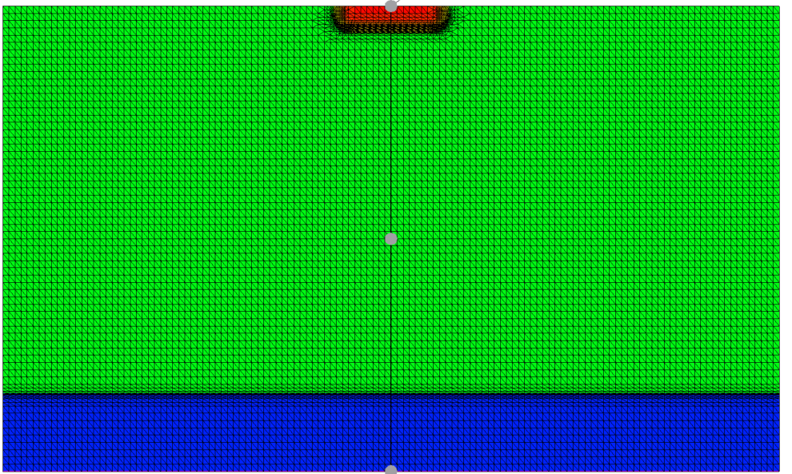
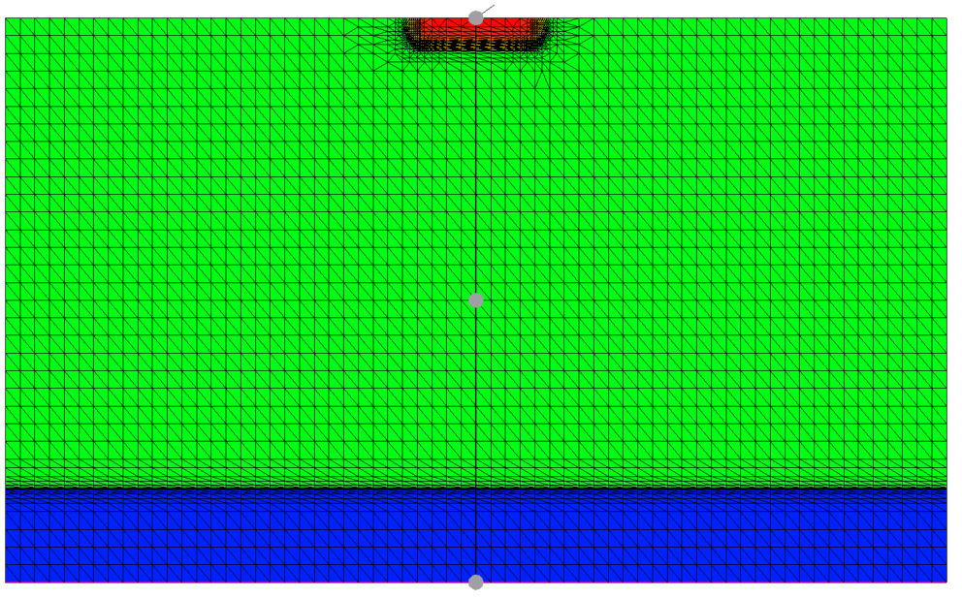
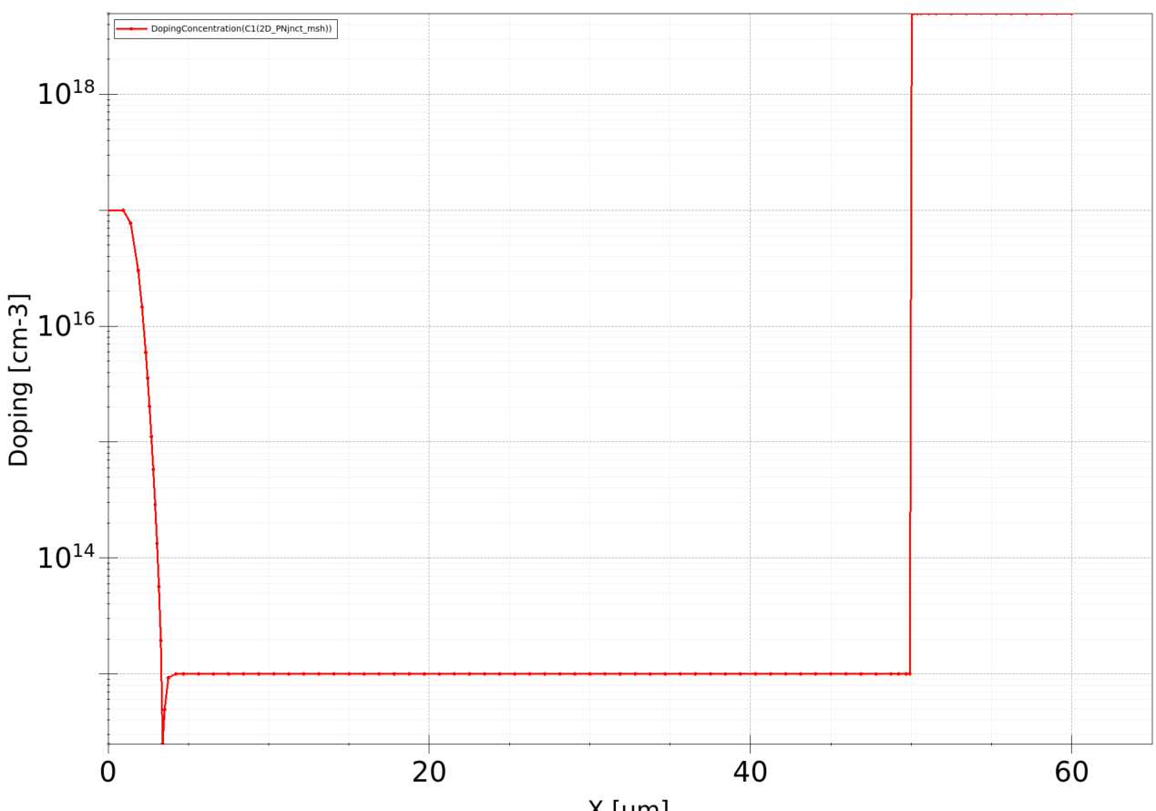
TCAD Synopsys Simulation
Visualize the resulting mesh using SVISUAL
  Re-mesh the structure changing the p – doping
  Visualise the meshing
32

Slide 37
TCAD and simulation I
Introduction to simulation
Needs and transport regimes
Meshing and discretization. Intro to DD model discretization. SG method
example of TCAD simulations: SDE in interactive and batch mode, 2D PN junction
    Thank you
    giulio.villani@stfc.ac.uk
33
UK HEP Instrumentation Summer School, Oxford 10-20 Aug 2026

