Slide 1
TCAD simulation III
E. Giulio Villani
UK HEP Instrumentation Summer School, Oxford 10-20 Aug 2026

Slide 2
Overview
Simulation example of 2D PN junction using SDEVICE
CV
UK HEP Instrumentation Summer School, Oxford 10-20 Aug 2026

Slide 3
TCAD simulation
SDEVICE
UK HEP Instrumentation Summer School, Oxford 10-20 Aug 2026

Slide 4


1 File Section: input/output files
2 Electrode Section: electrode definition, matching those in the input grid
3 Physics Section: physics models to use in the simulation
4 Plot Section: variables to plot
5 Math Section: solvers
6 Solve Section: what to solve (IV,CV, Charge injection)
TCAD Synopsys Simulation
Sentaurus Device is a numeric semiconductor device simulator, capable of simulating the electrical, thermal, and optical characteristics of various semiconductor devices.
It simulates 1D, 2D, and 3D device behaviour over a wide range of operating conditions, including mixed-mode circuit simulation, combining numerically simulated devices with their compact modeling, which is performed on a SPICE-based circuit simulation level.
A typical command file of Sentaurus Device consists of several sections (or statement blocks), with each section executing a relatively independent function. The default extension of the command file is _des.cmd, for example, pp1_des.cmd. To start: sdevice
1
UK HEP Instrumentation Summer School, Oxford 10-20 Aug 2026

Slide 5

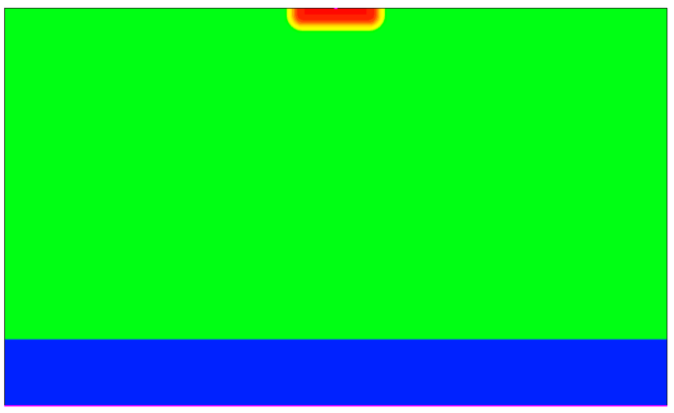
TCAD Synopsys Simulation
N-well cathode
SDEVICE simulation of 2D pn junction
  CV
The CV analysis is performed by applying a DC bias to the cathode and injecting a small AC signal into it
100 um
10 um
P - HR
δI = YδV
δI = current vector
δV = voltage vector
Y = admittance matrix
Y = A + i2πν C
P++
2
UK HEP Instrumentation Summer School, Oxford 10-20 Aug 2026

Slide 6
TCAD Synopsys Simulation
### System definition
System {
PNjnct PNjnctDUTA (
"cathode" = SENS_CTH
"substrate" = SENS_SUB
)
Vsource_pset vc ( SENS_CTH 0 ){ dc = 0 }
Vsource_pset vs ( SENS_SUB 0 ){ dc = 0 }
}
SDEVICE command file: almost the same as for the DC analysis
  File Section: input/output files
  Electrode Section: electrode definition, matching those in the input grid
  Physics Section: physics models to use in the simulation
  System: defines a mixed mode setup consisting of the device(s) and sources attached to it
  Plot Section: variables to plot
  Math Section: solvers to use
3
UK HEP Instrumentation Summer School, Oxford 10-20 Aug 2026

Slide 7
TCAD Synopsys Simulation
### Solve procedure
Solve {
Coupled(Iterations= 500 LineSearchDamping= 1e-4){ Poisson }
Coupled(Iterations= 50 LineSearchDamping= 1e-4){ Poisson Electron Hole }
Plot (FilePrefix = "2D_PNjnct_Temp@Temp@_bias_0V")
NewCurrentPrefix="2D_PNjnct_Temp@Temp@_CV_REV"
### ramps up the cathode voltage up to the maximum set value
Quasistationary (
InitialStep=0.01 Increment=1.3
MaxStep=0.025 Minstep=1.e-5
Goal { Parameter=vc.dc Voltage=Vdd}
) {
ACCoupled (
StartFrequency=1e4 EndFrequency=1e4 NumberOfPoints=1 Decade
Node(SENS_CTH SENS_SUB) Exclude(vc vs)
ACCompute (Time = (Range = (0 1) Intervals = 100))
) { Poisson Electron Hole }
}
}
SDEVICE command file
  Solve Section: what to solve (IV,CV, Charge injection…)
    For the CV, a small-signal analysis is performed, i.e. response of the device to small sinusoidal signals superimposed onto the DC bias
    The Exclude list is used to remove a set of circuit or physical devices from the AC analysis (usually the power supply, to avoid short-circuit the AC analysis)
4
UK HEP Instrumentation Summer School, Oxford 10-20 Aug 2026

Slide 8
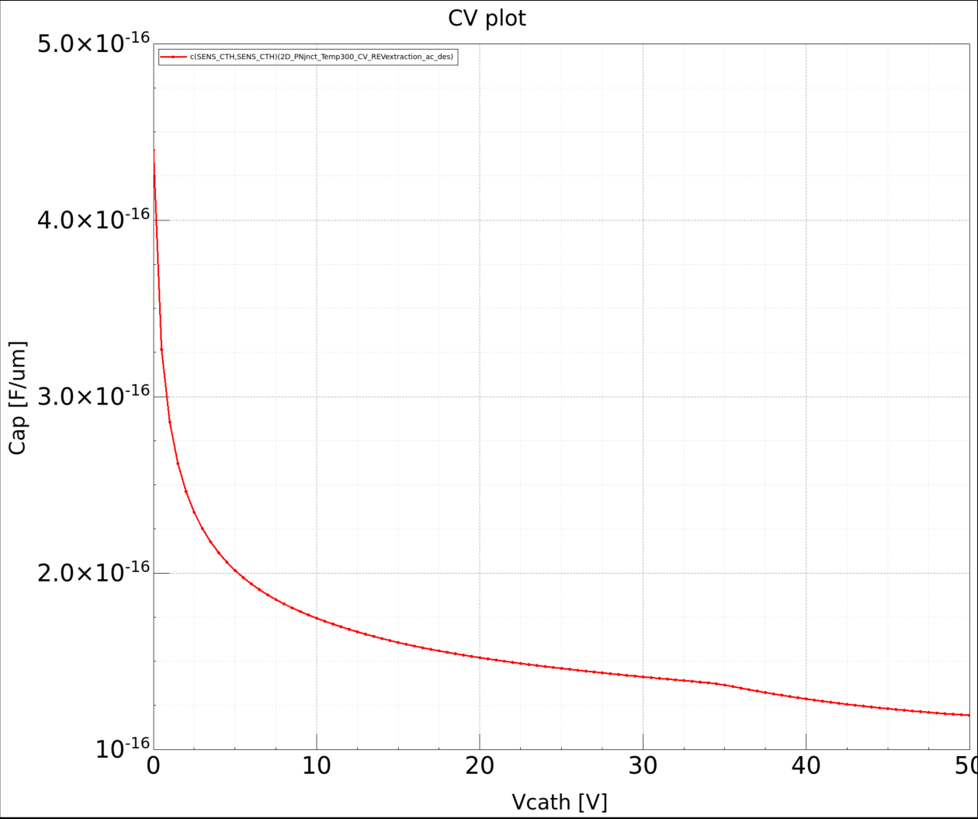


TCAD Synopsys Simulation
Visualize the resulting mesh using SVISUAL
  Re-mesh the structure changing the p – doping
  Visualise the meshing
  CV vs. bias/ cmp with formula
  Doping from CV profile
CV plot example – doping 1e13
5
UK HEP Instrumentation Summer School, Oxford 10-20 Aug 2026

Slide 9
TCAD and simulation I
Simulation example : 2D pn using SDEVICE
CV / doping from CV
    Thank you
    giulio.villani@stfc.ac.uk
6
UK HEP Instrumentation Summer School, Oxford 10-20 Aug 2026

