Slide 1
TCAD simulation II
E. Giulio Villani
UK HEP Instrumentation Summer School, Oxford 10-20 Aug 2026

Slide 2
Overview
Simulation example of 2D PN junction using SDEVICE
IV and CV
UK HEP Instrumentation Summer School, Oxford 10-20 Aug 2026

Slide 3
TCAD simulation
SDEVICE
UK HEP Instrumentation Summer School, Oxford 10-20 Aug 2026

Slide 4


1 File Section: input/output files
2 Electrode Section: electrode definition, matching those in the input grid
3 Physics Section: physics models to use in the simulation
4 Plot Section: variables to plot
5 Math Section: solvers
6 Solve Section: what to solve (IV,CV, Charge injection)
TCAD Synopsys Simulation
Sentaurus Device is a numeric semiconductor device simulator, capable of simulating the electrical, thermal, and optical characteristics of various semiconductor devices.
It simulates 1D, 2D, and 3D device behaviour over a wide range of operating conditions, including mixed-mode circuit simulation, combining numerically simulated devices with their compact modeling, which is performed on a SPICE-based circuit simulation level.
A typical command file of Sentaurus Device consists of several sections (or statement blocks), with each section executing a relatively independent function. The default extension of the command file is _des.cmd, for example, pp1_des.cmd. To start: sdevice
1
UK HEP Instrumentation Summer School, Oxford 10-20 Aug 2026

Slide 5

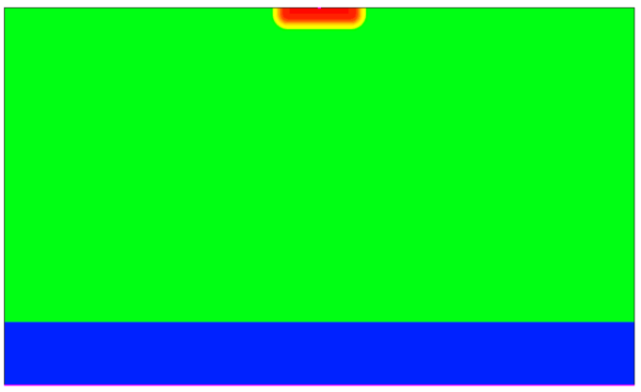
TCAD Synopsys Simulation
N-well cathode
SDEVICE simulation of 2D pn junction
  IV
  SC/Depletion region visualisation
  Breakdown voltage
The DC analysis is performed by sweeping the voltage across the cathode, keeping the substrate contact grounded
100 um
10 um
P - HR
P++
2
UK HEP Instrumentation Summer School, Oxford 10-20 Aug 2026

Slide 6
##### 2D PN junction DC bias analysis ######
#define Vdd 1000.
## Input and Output Files
File {
grid = "2D_PNjnct_msh.tdr"
}
### Electrode definition
Electrode {
##$ By default Ohmic contact
{ Name="cathode" Voltage= 0.0 }
{ Name="substrate" Voltage= 0.0 }
}
TCAD Synopsys Simulation
SDEVICE command file:
  File Section: input/output files
  Electrode Section: electrode definition, matching those in the input grid
3
UK HEP Instrumentation Summer School, Oxford 10-20 Aug 2026

Slide 7
### Physics models
Physics {
Fermi
Temperature = @Temp@
Mobility(
DopingDep
PhuMob Enormal (Lombardi PosInterfaceCharge)
HighFieldSaturation(GradQuasiFermi)
)
Recombination(
SRH( DopingDep TempDependence ElectricField (Lifetime = Hurkx ) )
Auger
Avalanche(Okuto EParallel BandgapDependence )
##Avalanche(Unibo EParallel BandgapDependence )
)
EffectiveIntrinsicDensity(BandGapNarrowing (OldSlotboom) )
}
### Plots definition
Plot
{
eDensity hDensity
TotalCurrent/Vector eCurrent/Vector hCurrent/Vector ….
eMobility hMobility….
}
TCAD Synopsys Simulation
SDEVICE command file
  Physics Section: physics models to use in the simulation
  Plot Section: variables to plot
4
UK HEP Instrumentation Summer School, Oxford 10-20 Aug 2026

Slide 8
### Math definition
Math {
BreakCriteria{ Current(Contact="cathode" AbsVal=1e-6) }
extrapolate
digits= 4
##ExtendedPrecision
numberOfThreads= maximum
Derivatives
Avalderivatives
RelErrControl
method=blocked
submethod=pardiso(iterativeRefinement)
Iterations=20
Rhsmin = 1e-20
ParallelToInterfaceInBoundaryLayer(FullLayer -ExternalBoundary)
GeometricDistances
eMobilityAveraging=ElementEdge
hMobilityAveraging=ElementEdge
##AvalDensGradQF
ErrRef(electron)=1e8
ErrRef(hole)=1e8
RefDens_eEparallel_ElectricField_HFS= 1e17
RefDens_hEparallel_ElectricField_HFS= 1e17
RefDens_eEparallel_ElectricField_Aval= 1e17
RefDens_hEparallel_ElectricField_Aval= 1e17
}
TCAD Synopsys Simulation
SDEVICE command file
Math Section: solvers to use
5
UK HEP Instrumentation Summer School, Oxford 10-20 Aug 2026

Slide 9
TCAD Synopsys Simulation
### Solve procedure
Solve {
Coupled(Iterations= 500 LineSearchDamping= 1e-4){ Poisson }
Coupled(Iterations= 50 LineSearchDamping= 1e-4){ Poisson Electron Hole }
Plot (FilePrefix = "2D_PNjnct_Temp@Temp@_bias_0V")
NewCurrentPrefix="2D_PNjnct_Temp@Temp@_RIV"
Quasistationary (
InitialStep=0.001 Increment=2.0 decrement=4.0
MaxStep=0.05 Minstep=1.e-15
Goal { name="cathode" Voltage= Vdd}
) { Coupled { Poisson Electron Hole }
Plot(FilePrefix="2D_PNjnct_Temp@Temp@_RBias_" Time=(0.1;0.2;0.3;0.4;0.5) NoOverWrite)
### fixed plot interval
### CurrentPlot( Time=(Range=(0 1) Intervals= 200 ) )
}
}
SDEVICE command file
  Solve Section: what to solve (IV,CV, Charge injection…)
6
UK HEP Instrumentation Summer School, Oxford 10-20 Aug 2026

Slide 10
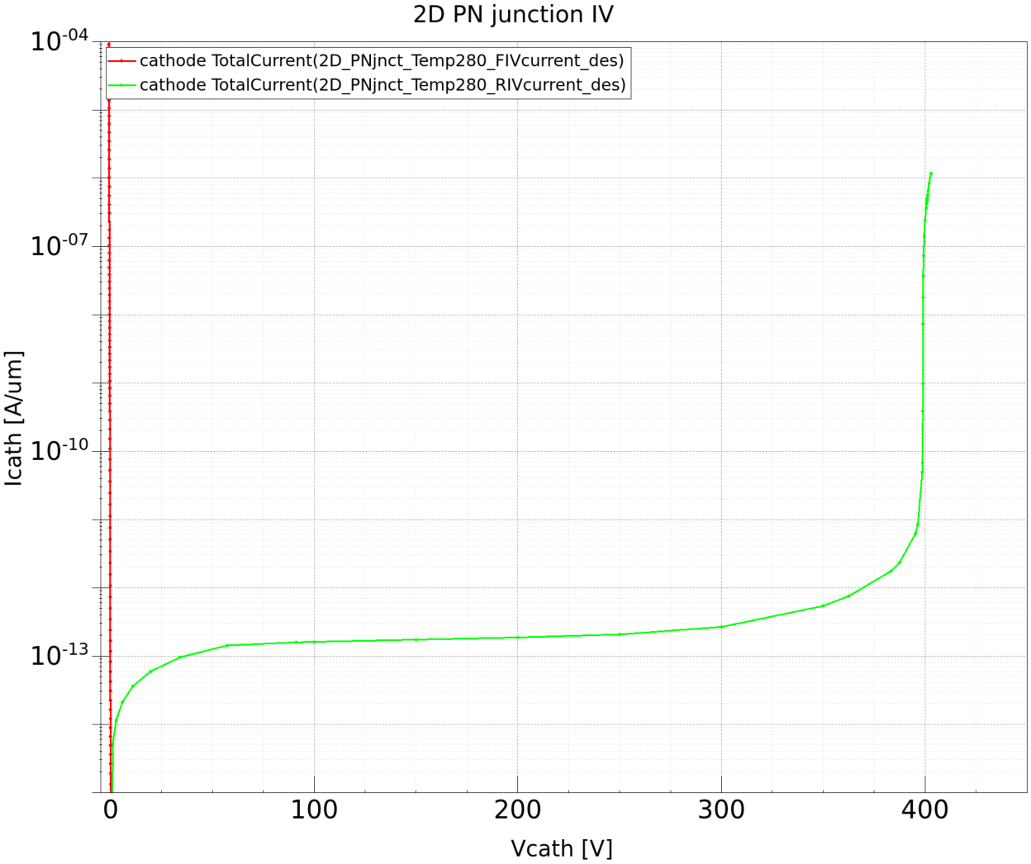
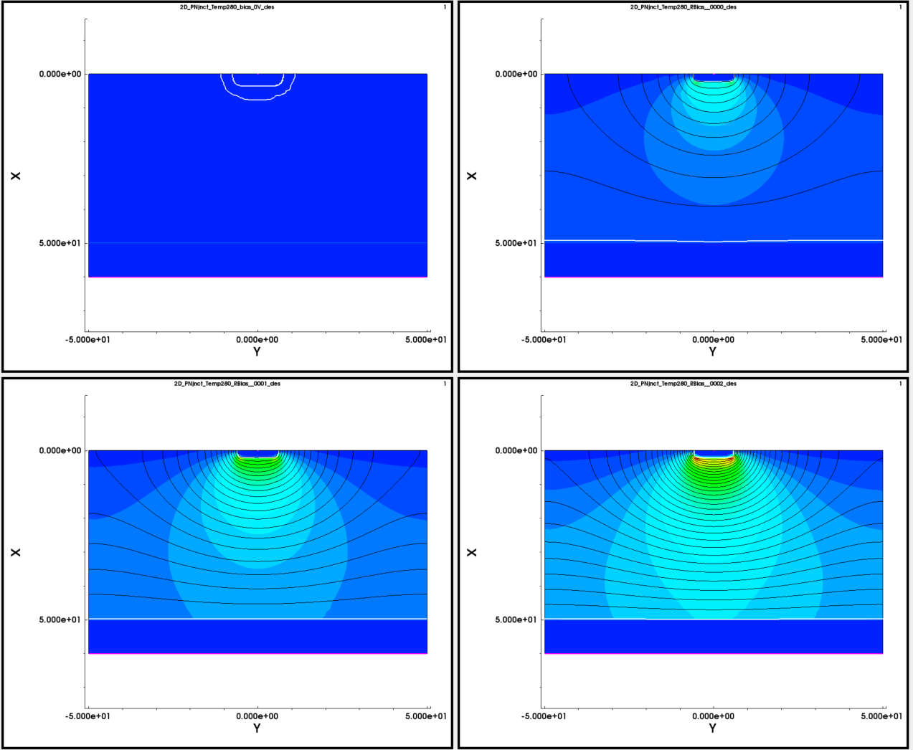

FWD and REV IV @ 280 K vs. Vbias
TCAD Synopsys Simulation
Visualize the resulting mesh using SVISUAL
  Re-mesh the structure changing the p – doping
  Visualise the meshing Investigate the extension of depletion vs. bias/doping/temperature
Depletion and x-Field
vs. Vbias
7
UK HEP Instrumentation Summer School, Oxford 10-20 Aug 2026

Slide 11
TCAD and simulation I
Simulation example : 2D pn using SDEVICE
IV (FWD/REV), SC, Depletion region
    Thank you
    giulio.villani@stfc.ac.uk
8
UK HEP Instrumentation Summer School, Oxford 10-20 Aug 2026

