Slide 1
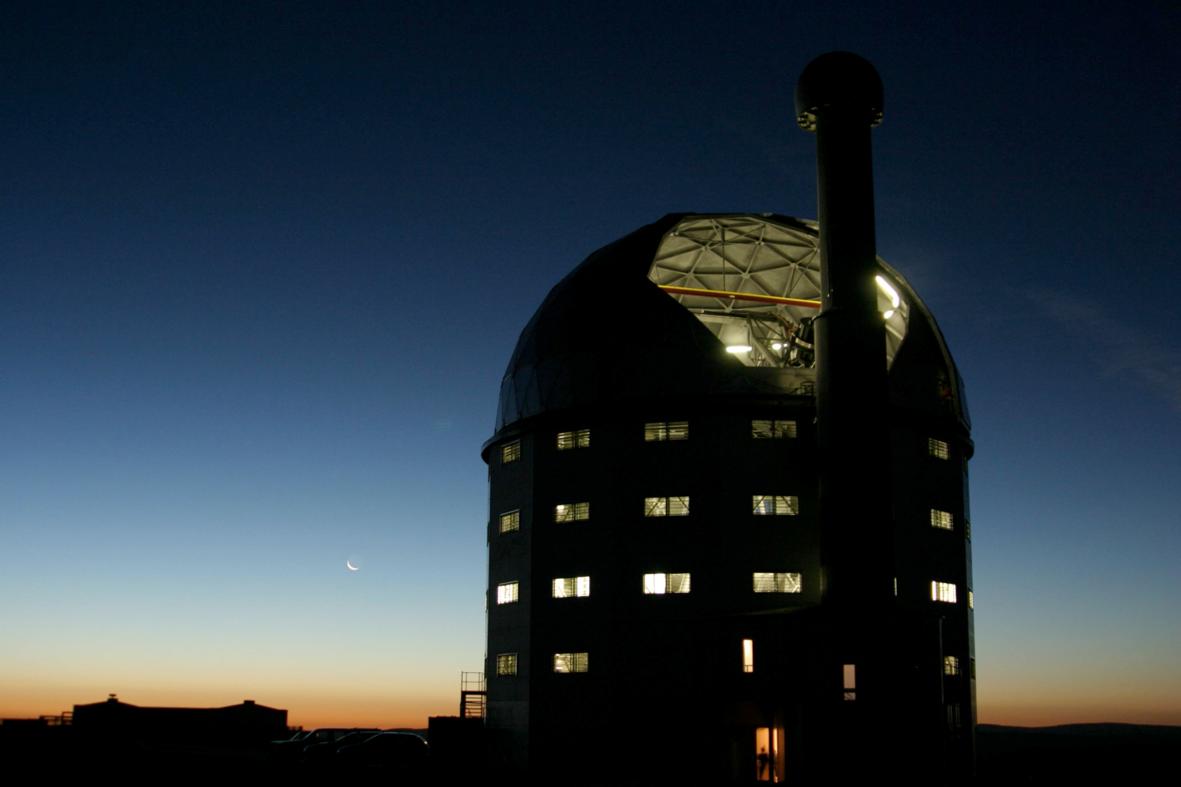


Spectro-Polarimetric Observations of TeV Sources (SPOTS): Results and updates
I.P. van der Westhuizen, J. Barnard, B. van Soelen, M. Böttcher, D.A.H. Buckley, A. Martin-Carrillo, S. Mukherjee, H.M. Schutte,, M. Zacharias
| E: vanderwesthuizenip@ufs.ac.za |

Slide 2
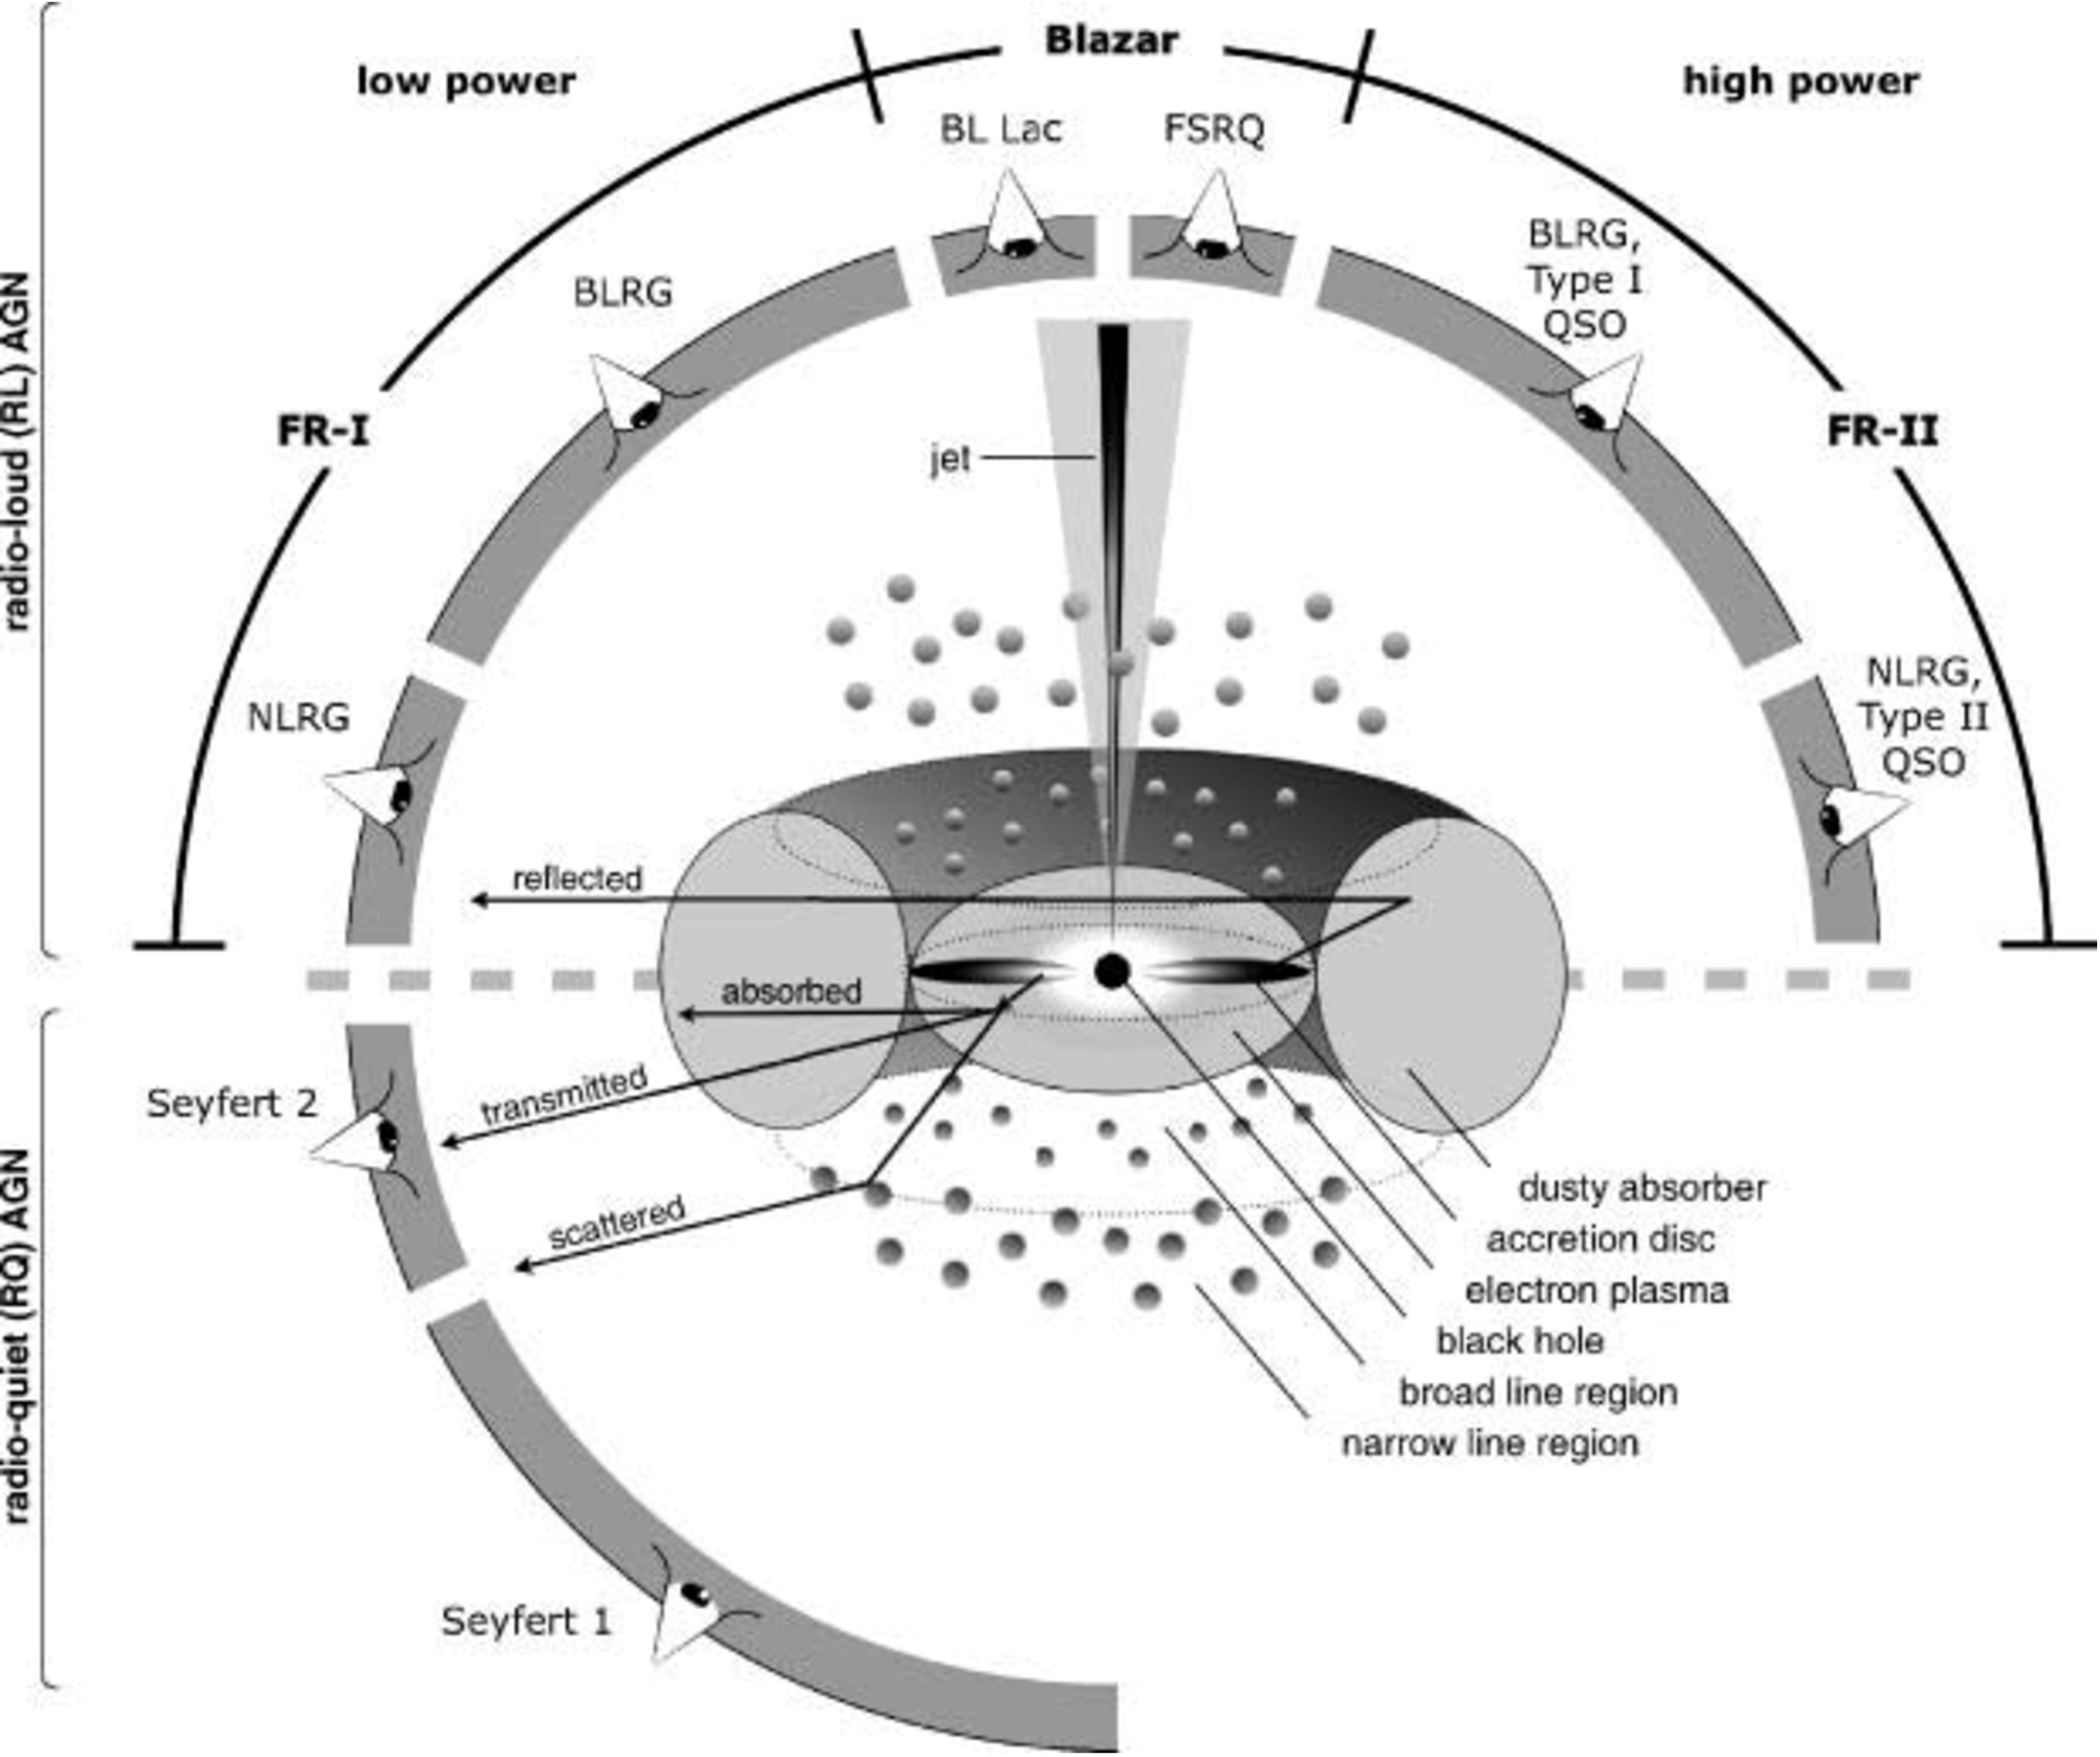
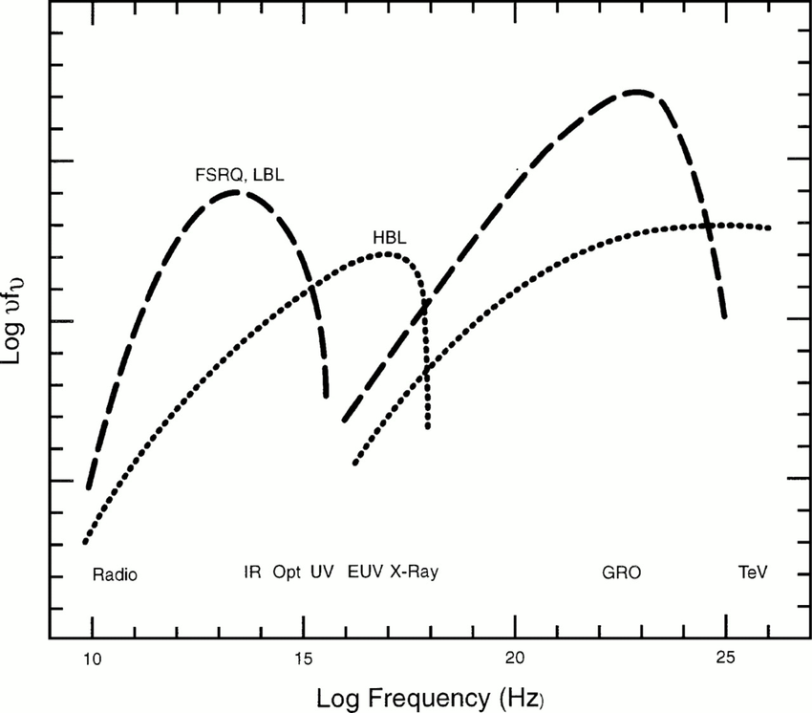
Unified AGN model
Leptonic processes
(inverse-Compton: EC+SSC)
OR
hadronic processes
(proton-synchrotron/photo-pion production)
Leptonic processes
(Synchrotron)
(radio to UV/X-ray)
Beckmann and Shrader, 2012
Blazar SED’s

Slide 3
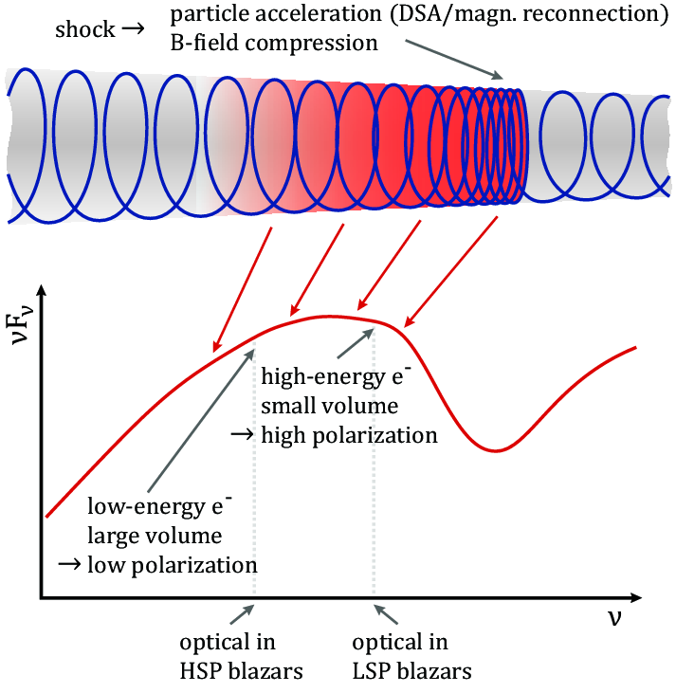
Unified AGN model
Beckmann and Shrader, 2012
Angelakis et al. 2016, MNRAS 463, 3365–3380

Slide 4
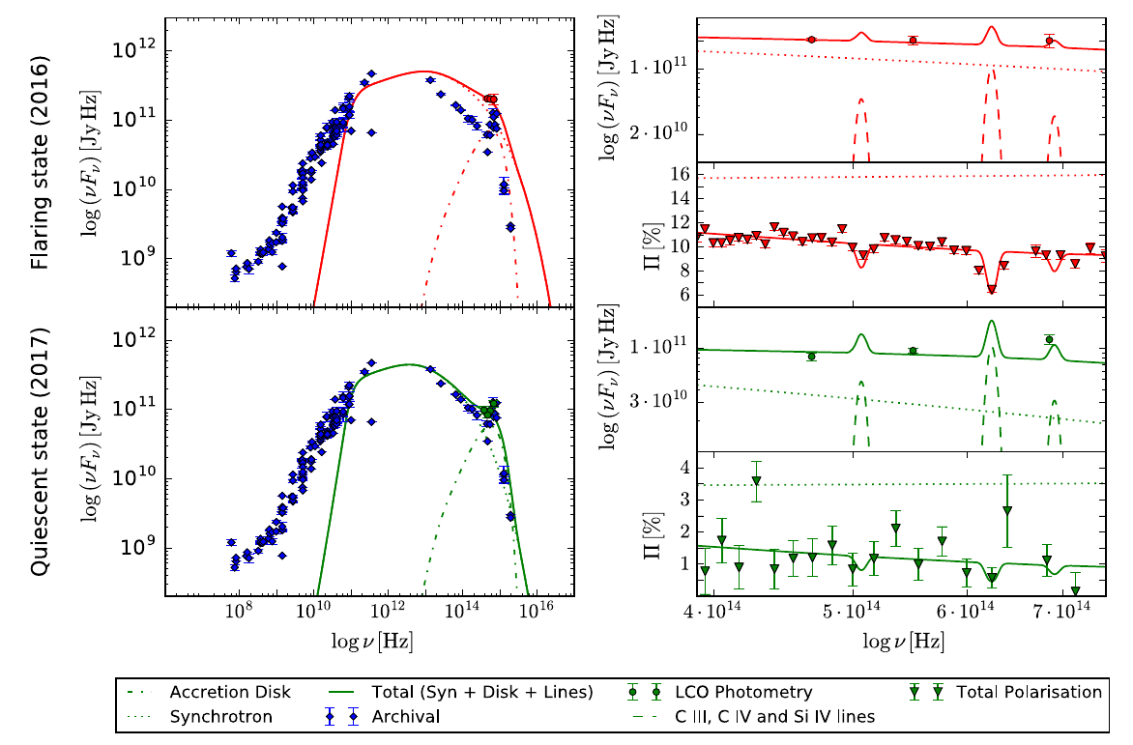
AGN Polarization
4C +01.02 in 2016-2017
FSRQ, z = 2.099
Observed with SALT during the (at the time) brightest gamma-ray flare in 2016 July–August (Verrecchia et al. 2016)
Observed it again in 2017 July-August to during a low state.
Constrain the underlying electron population
Mass for the SMBH of 3e9 Msolar
Degree of ordering
  FB=0.188 (flare)
  FB=0.040 (quiescence)
Schutte et al. 2022

Slide 5
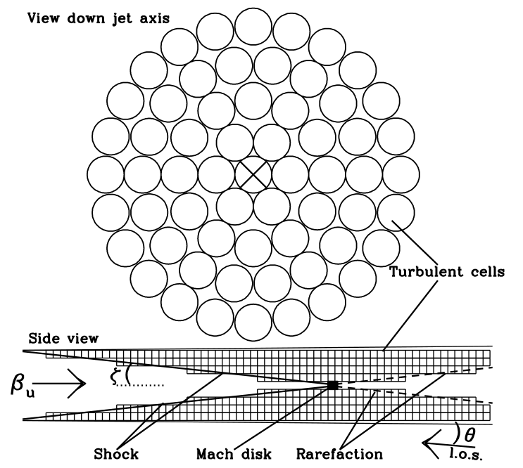
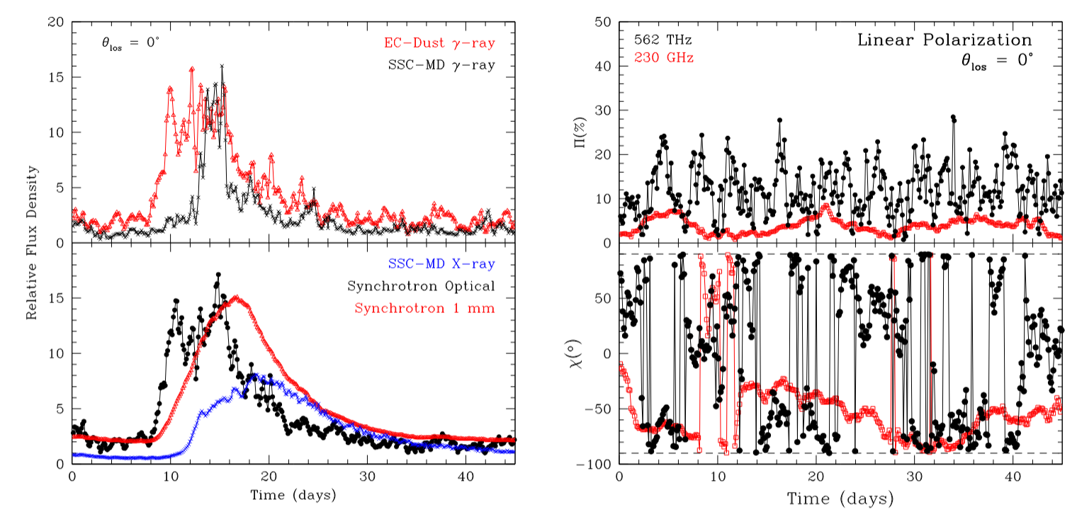
AGN Polarization - Models
Marscher 2014: ApJ, 780, 87

Slide 6
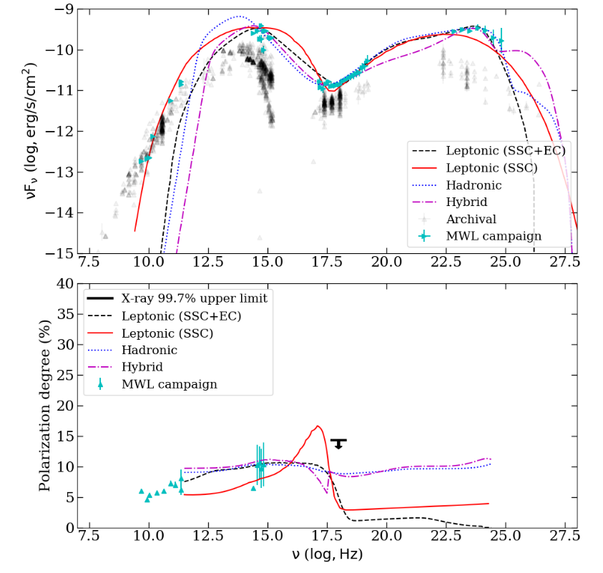
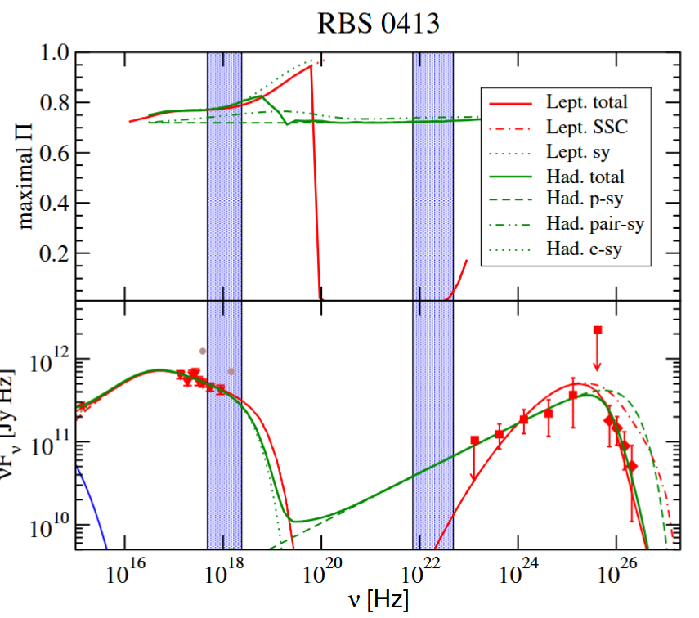
AGN Polarization - Models
Zhang and Böttcher, 2013
Liodakis, et al. 2025

Slide 7
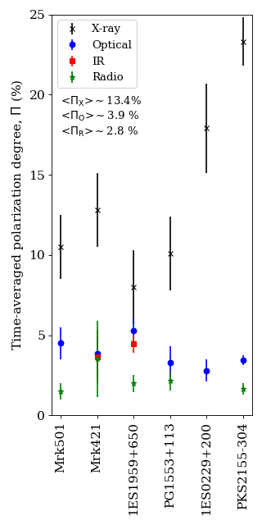
MWL Polarization:
IXPE/Optical Observational Findings
Leans toward leptonic high-energy emission (but some exceptions)
Optical/X-ray polarization strongly chromatic (1.7 ≤ ΠX/ΠO ≤ 7.5)
Polarization angle aligned with jet direction; similar at optical & X-ray
Polarization angle swings correlated with ɣ-ray activity
Behaviour naturally explained by shock-in-jet model
Kouch, P. M., et al.: A&A, 689, A119 (2024)

Slide 8
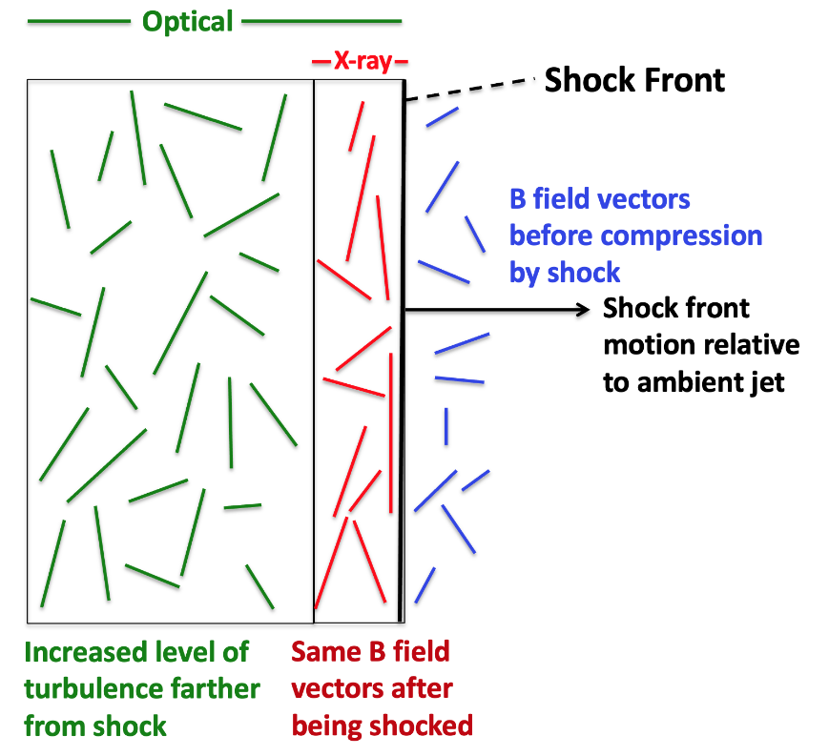
MWL Polarization:
IXPE/Optical Observational Findings
Leans toward leptonic high-energy emission (but some exceptions)
Optical/X-ray polarization strongly chromatic (1.7 ≤ ΠX/ΠO ≤ 7.5)
Polarization angle aligned with jet direction; similar at optical & X-ray
Polarization angle swings correlated with ɣ-ray activity
Behaviour naturally explained by shock-in-jet model
Marscher, A. P., et al. (2024).

Slide 9
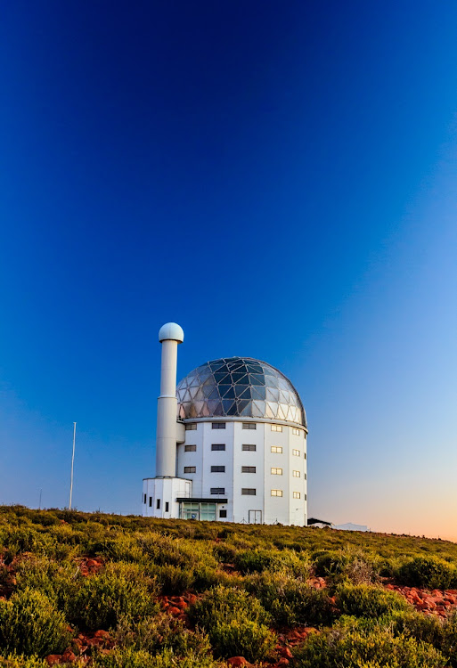

Spectro-Polarimetric Observations of TeV Sources (SPOTS):
Since 2016, as part of the Observing the Transient Universe programme (PI D.A.H. Buckley) and a few dedicated programmes we’ve been observing flaring gamma-ray bright blazars with SALT (Barnard, et al. 2024)
SPOTS Campaign: 2023 November and 2025 August (Barnard, et al. 2026)
Observations with RSS in Linear Spectropolarimetry mode, using (the now removed) pg0300 grating, which covered the full optical range or pg0900 (sometimes at two grating angles).
Data was reduced using IRAF and the polsalt package. (Crawford et al. 2010, Cooper, van Soelen & Britto 2022)

Slide 10
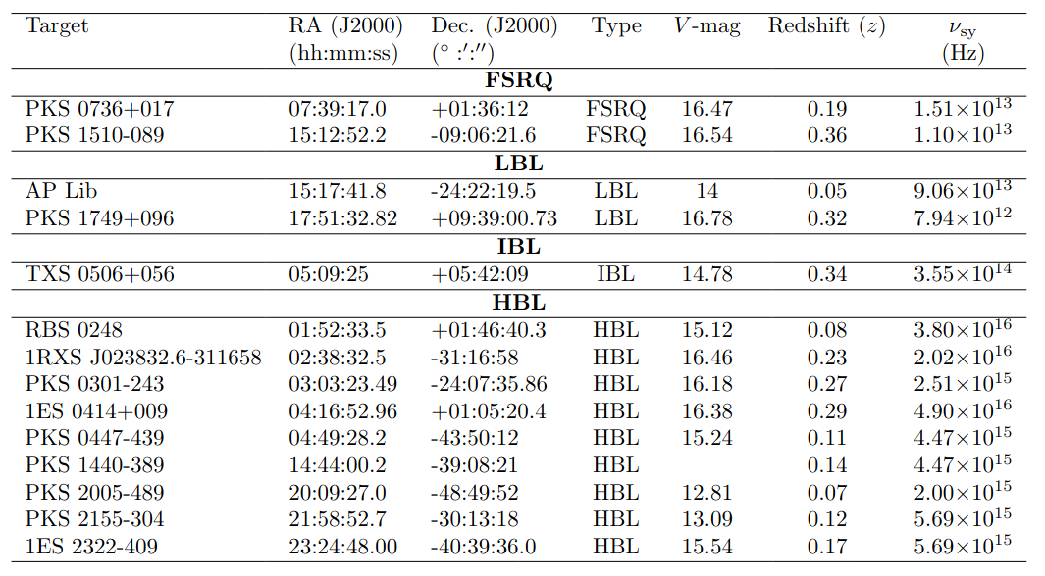
SPOTS: Source list
Selection Criteria:
TeV emitting Blazars
High Fermi-LAT variability
Observable with SALT
  Dec < 11°
  V < 17 mag
Availability of archival data

Slide 11
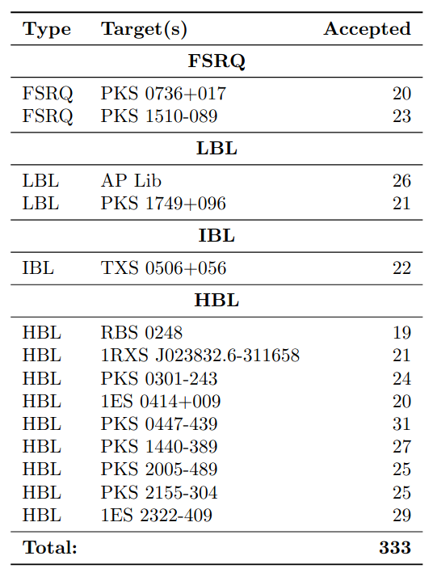
SPOTS: Observations
Observations:
  SALT:
    >333 Observations completed to date
    ~2 week cadence
  LCO: >
    1300 Observations completed to date
    ~2-3 day cadence
  Results (Barnard, et al. 2026):
  No significant gamma-ray flares (GeV) during the observation period, but some variability.
  Both correlation and no correlation was found between polarization and optical flux, depending on the source
  Both smooth, long-term rotations and stochastic variations in polarization angle

Slide 12
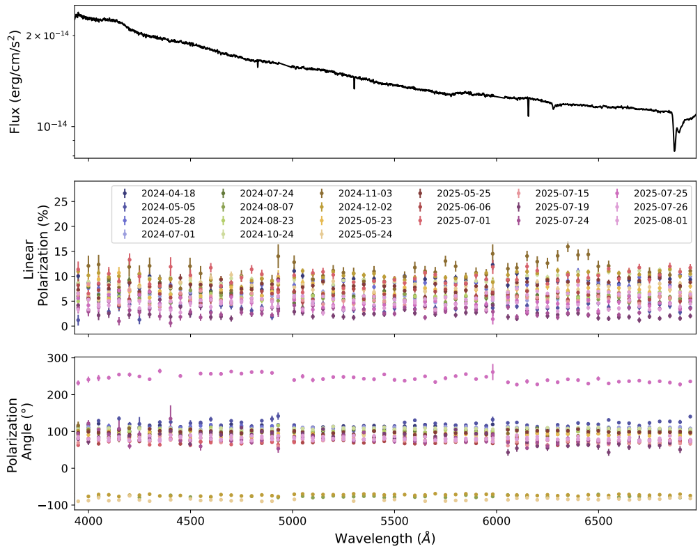
Spectro-polarimetric data
Data - Single setup for all observations
  PG0900 grating
  Wavelength ~4000 -7000 Angstroms
Data reduction polsalt / python pipeline
  Basic CCD reduction
  Wavelength calibration
  O&E extraction
  Polarization calculation
  Spectra flux calibrated
  Host galaxy correction applied where possible
  Assume elliptical galaxy + log parabola contribution in flux
  Correction applied to polarization

Slide 13
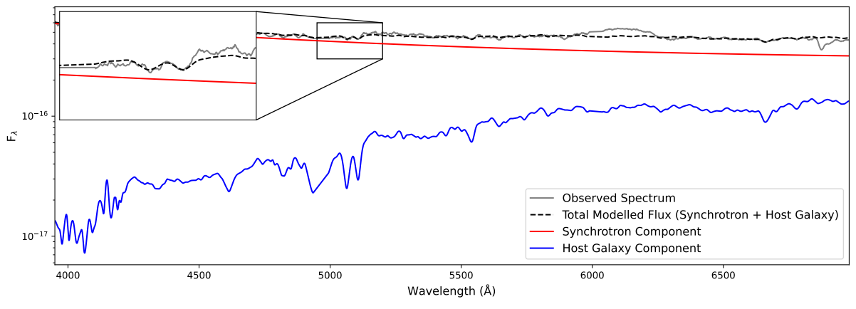
Spectro-polarimetric data
HBL 1ES 0414 + 009
Data - Single setup for all observations
  PG0900 grating
  Wavelength ~4000 -7000 Angstroms
Data reduction polsalt / python pipeline
  Basic CCD reduction
  Wavelength calibration
  O&E extraction
  Polarization calculation
  Spectra flux calibrated
  Host galaxy correction applied where possible (HBL sources)
  Assume elliptical galaxy (Kinney et al. 1996) + log parabola contribution in flux
  Correction applied to polarization

Slide 14
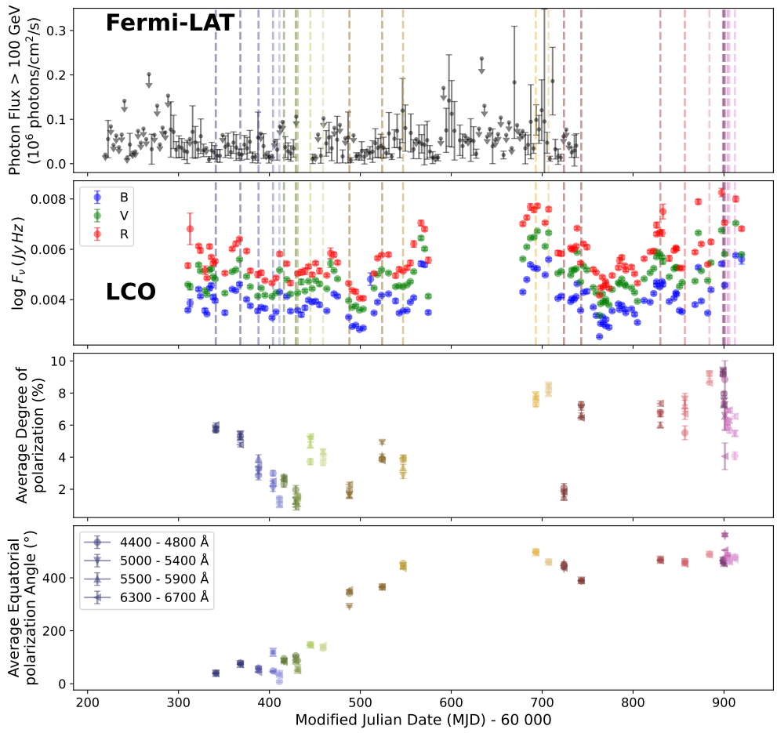
SPOTS: Results - light curves
Example: PKS 1440-389
Slow, smooth polarization angle rotations

Slide 15
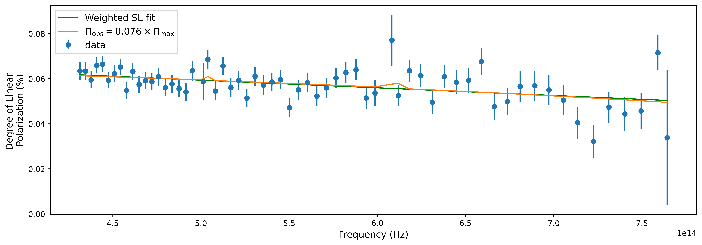
SPOTS: Results – Polarization slope
Example: PKS 1440-389
Slow, smooth polarization angle rotations
Switch in the polarization slope over the observations

Slide 16
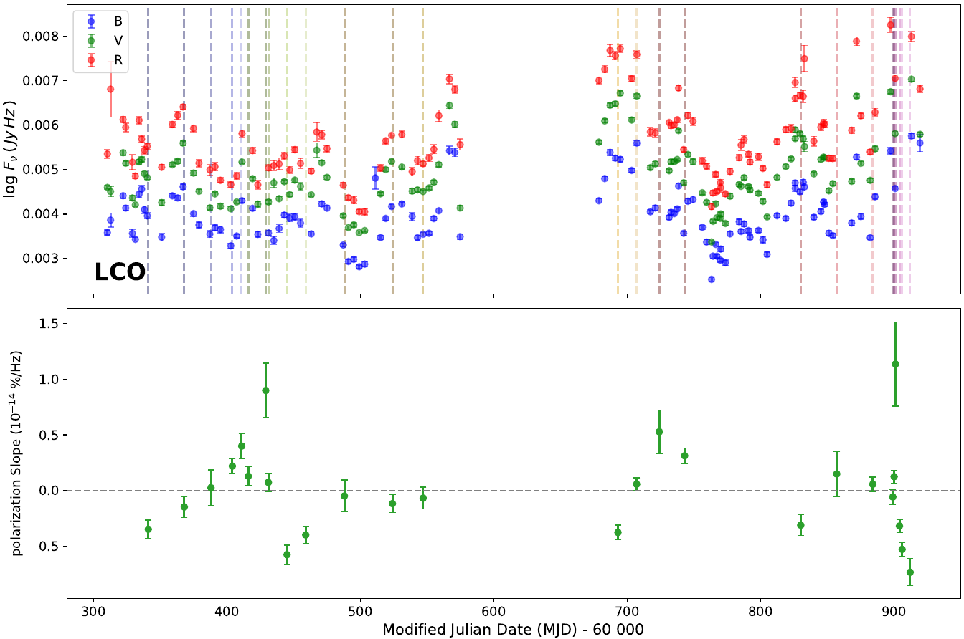
SPOTS: Results - Polarization slope
Example: PKS 1440-389
Slow, smooth polarization angle rotations
Switch in the polarization slope over the observations

Slide 17
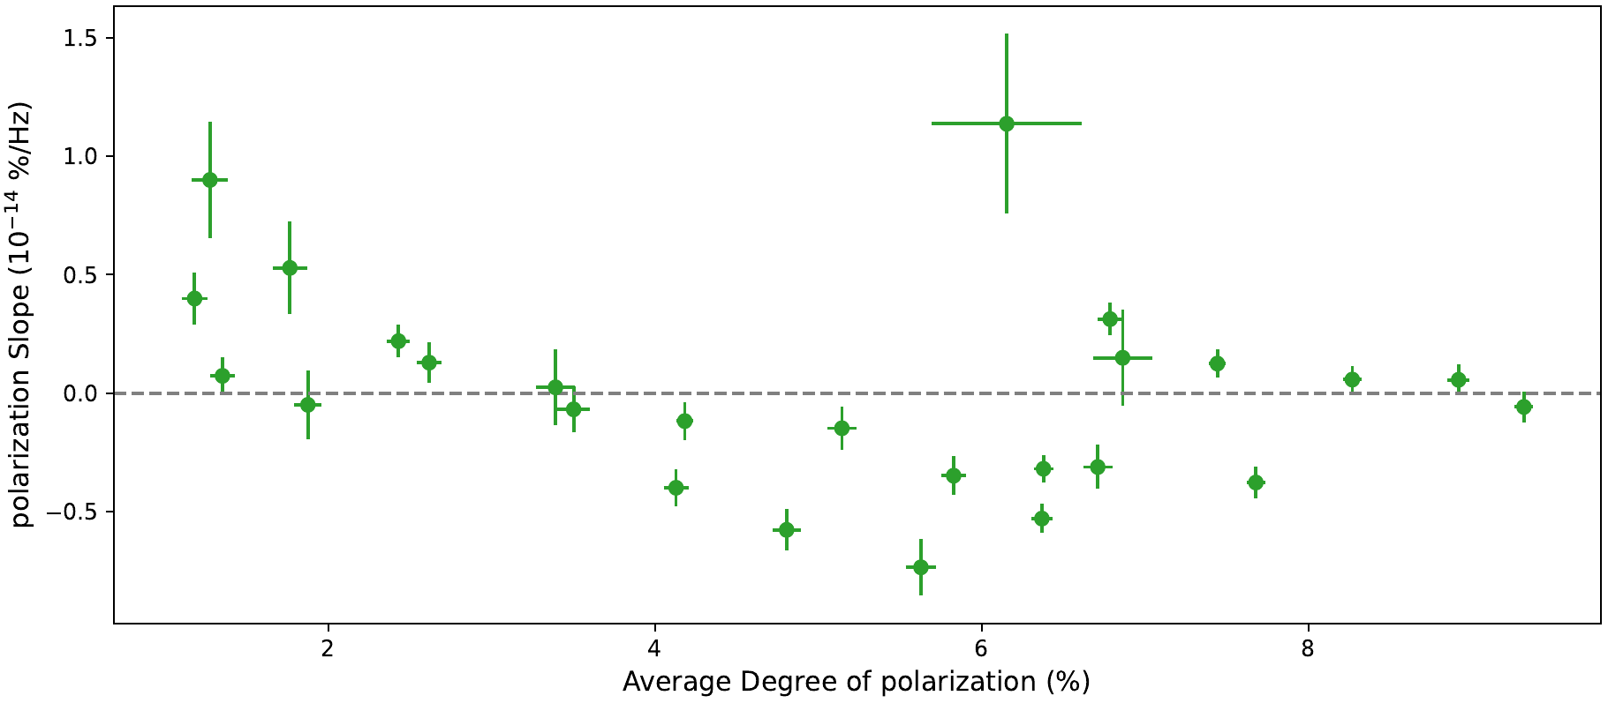
SPOTS: Results - Polarization slope
Example: PKS 1440-389
Slow, smooth polarization angle rotations
Switch in the polarization slope over the observations
Increase with frequency
Decrease with frequency

Slide 18
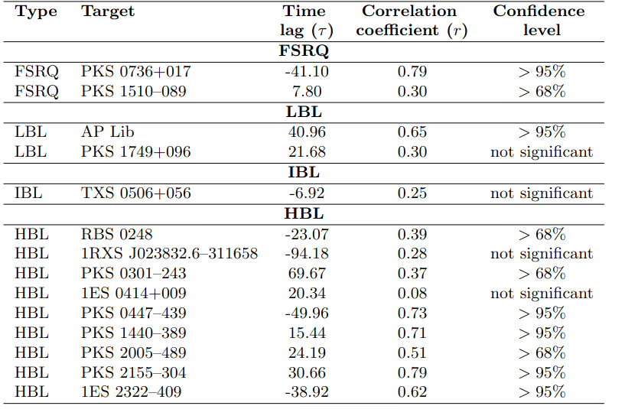
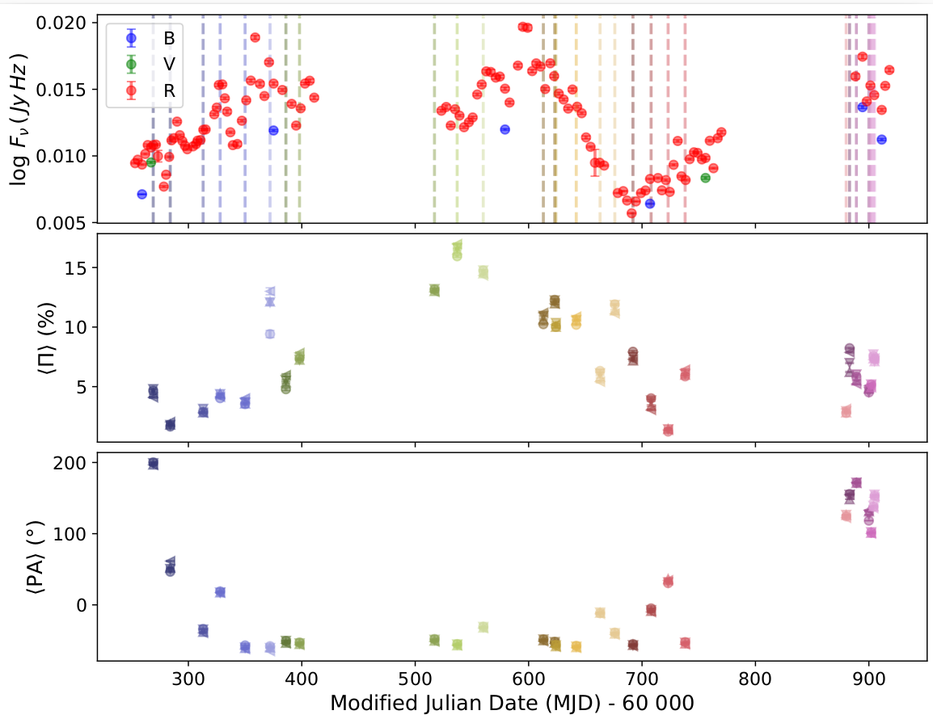
Optical flux - polarization correlation
Correlations between the optical polarization and photometric variability was tested with a ZDCF
The significance was assessed through a Monte-Carlo bootstrap procedure
PKS 0447-439

Slide 19
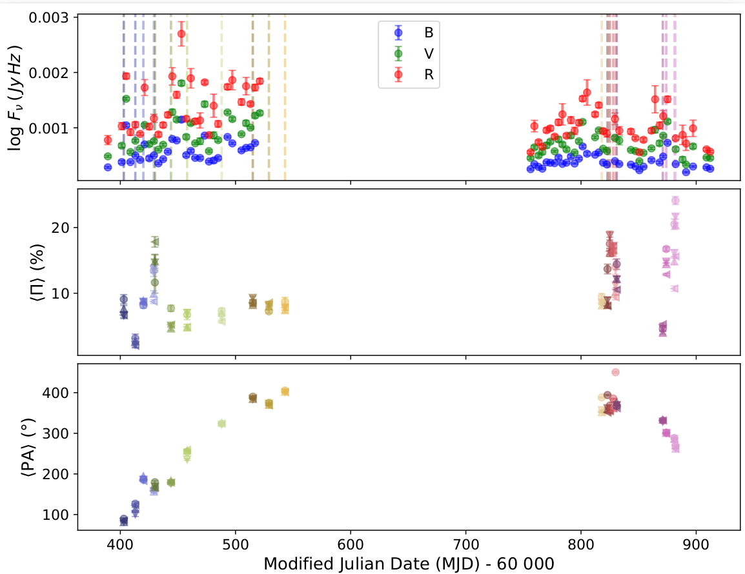
Optical flux - polarization correlation
Correlations between the optical polarization and photometric variability was tested with a ZDCF
The significance was assessed through a Monte-Carlo bootstrap procedure
PKS 1749+096

Slide 20
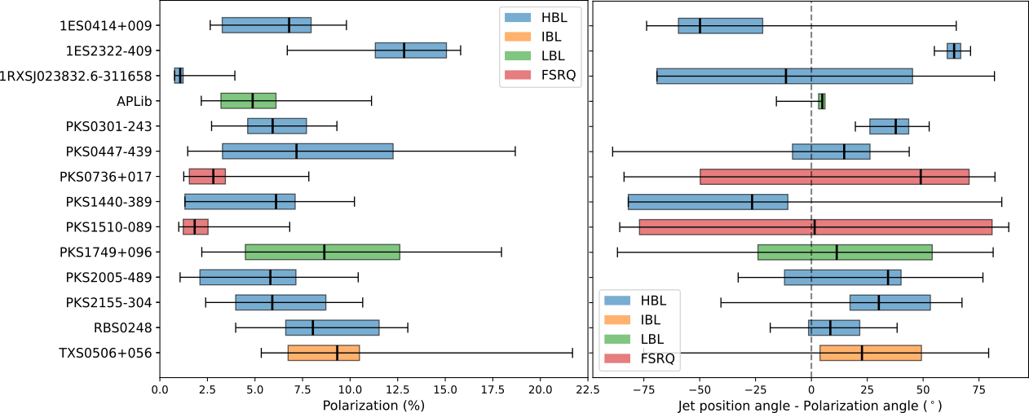
SPOTS: Population statistics
Low level of polarization for observations
larger distribution for HBLs
Polarization angle is compatible with the jet direction for most of the sources

Slide 21
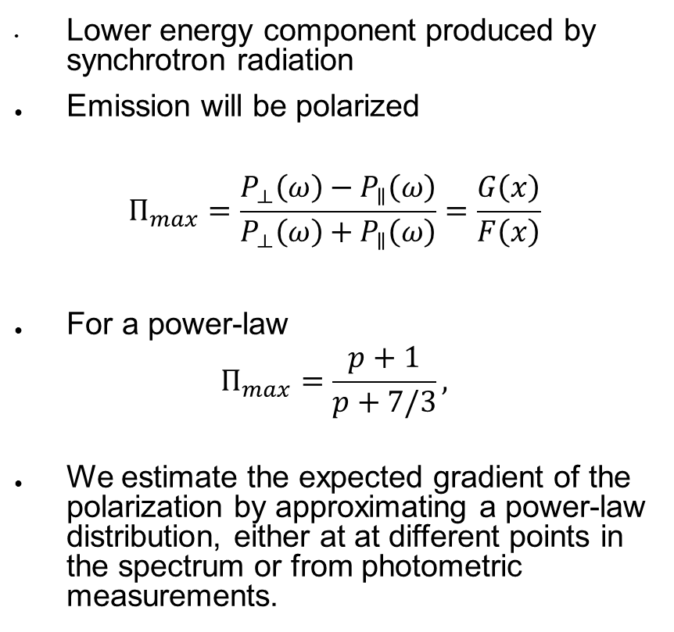
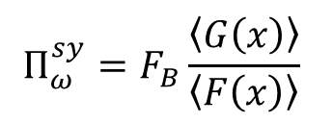
Ordering of the magnetic field
Lower energy component produced by synchrotron radiation
Emission will be polarized
$$Π_{max}=\frac{P_{⟂}\left(ω\right)−P_{∥}\left(ω\right)}{P_{⟂}\left(ω\right)+P_{∥}\left(ω\right)}=\frac{G\left(x\right)}{F\left(x\right)}$$
For a power-law
$$Π_{max}=\frac{p+1}{p+7/3},$$
We estimate the expected gradient of the polarization by approximating a power-law distribution, either at at different points in the spectrum or from photometric measurements.
The ordering factor is then
$$Π_{ω}^{sy}=F_{B}\frac{\left\langle G\left(x\right)\right\rangle }{\left\langle F\left(x\right)\right\rangle }$$

Slide 22
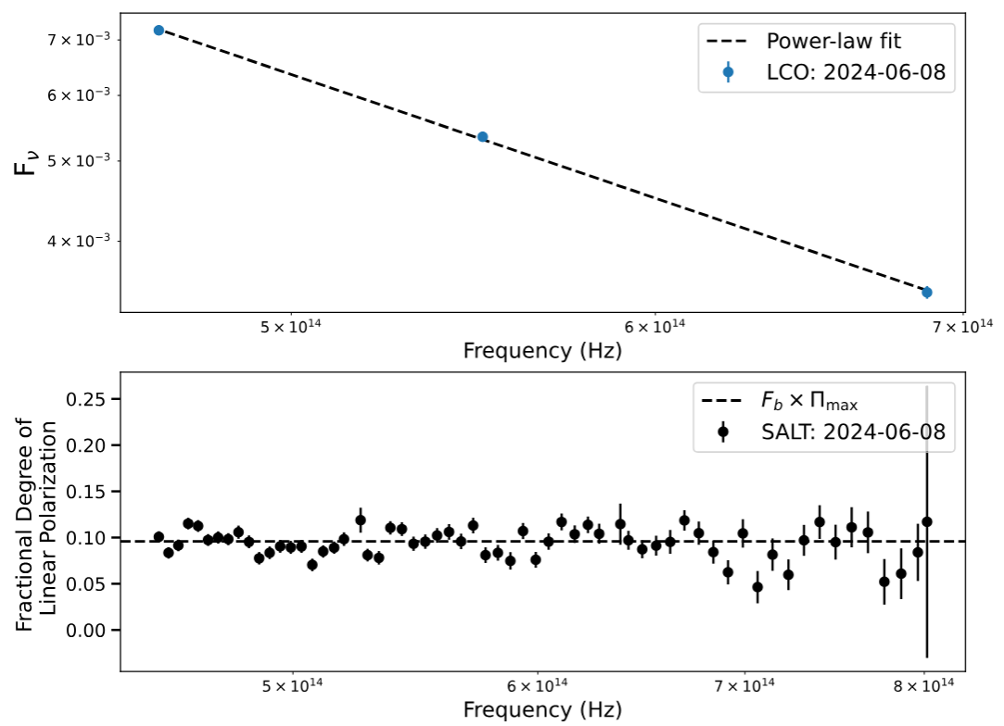
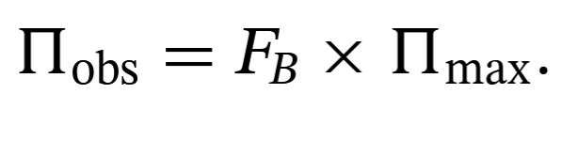
Ordering of the magnetic field
AP Librae
Lower energy component produced by synchrotron radiation
Emission will be polarized
$$Π_{max}=\frac{P_{⟂}\left(ω\right)−P_{∥}\left(ω\right)}{P_{⟂}\left(ω\right)+P_{∥}\left(ω\right)}=\frac{G\left(x\right)}{F\left(x\right)}$$
For a power-law
$$Π_{max}=\frac{p+1}{p+7/3},$$
We estimate the expected gradient of the polarization by approximating a power-law distribution, either at at different points in the spectrum or from photometric measurements.

Slide 23
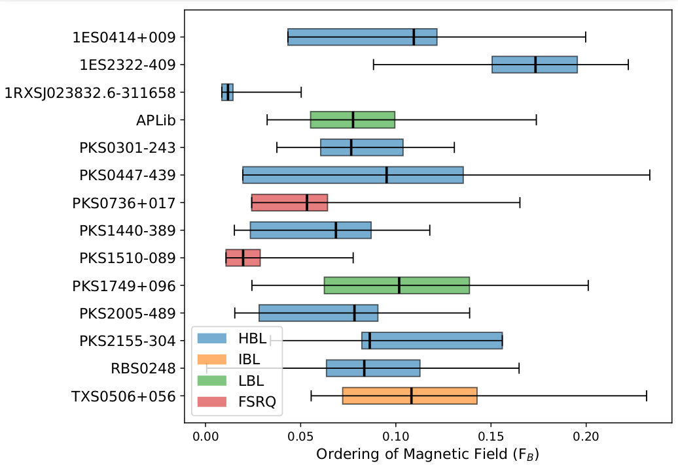
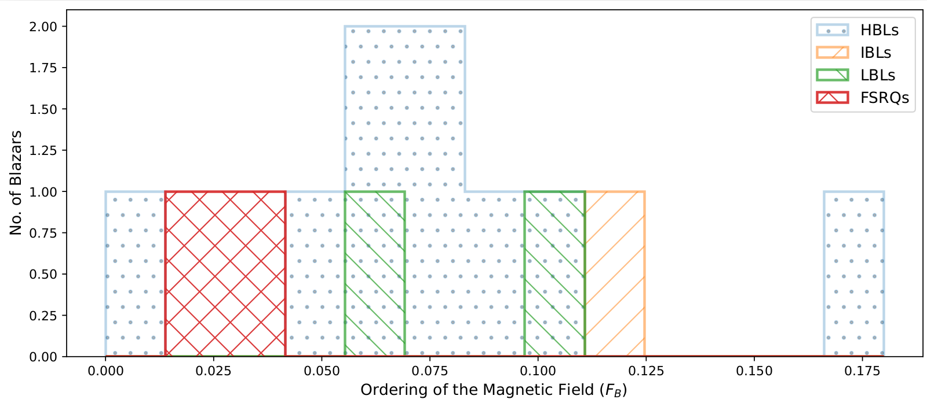
Ordering of the magnetic field
Ordering of the magnetic field below 20%
FSRQs showed a smaller distribution in the ordering
HBLs the highest – but more HBLs in the sample

Slide 24
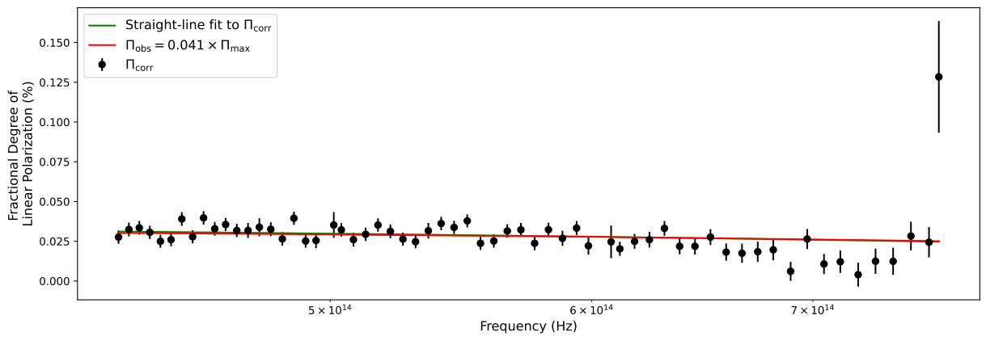
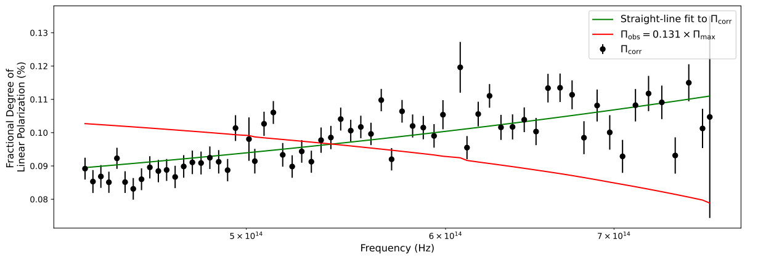
Polarization wavelength dependence
PKS 0301-243
2024-02-04
Frequency dependence of polarization due to particle spectrum only
2024-08-08
Prediction from particle spectrum approximation is not the same as the observed slope

Slide 25
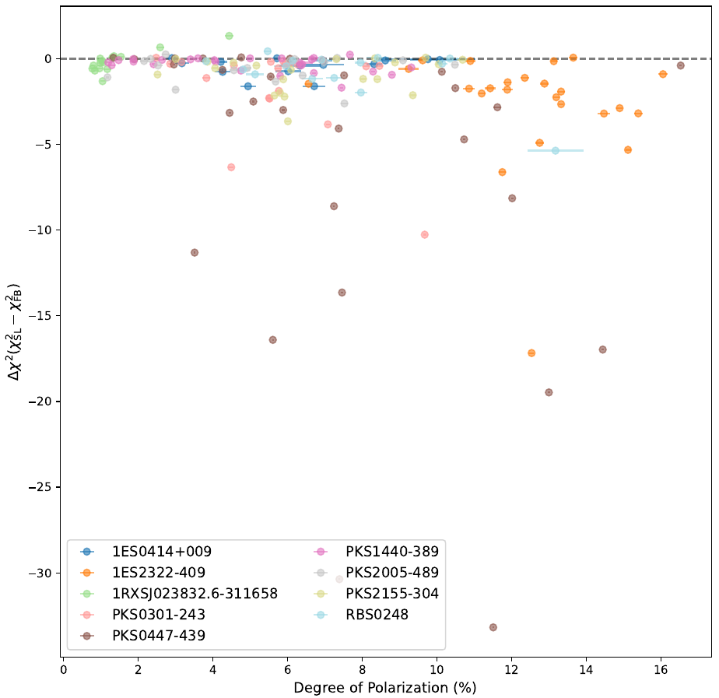
Polarization wavelength dependence
Compare the estimated polarization slope to a straight line fit
For most the slopes give a reasonable match.
For some sources, there are large deviations.
    Multiple emission regions.
    Additional non-thermal contribution
  Caveat:
      Systematics in the flux calibration

Slide 26
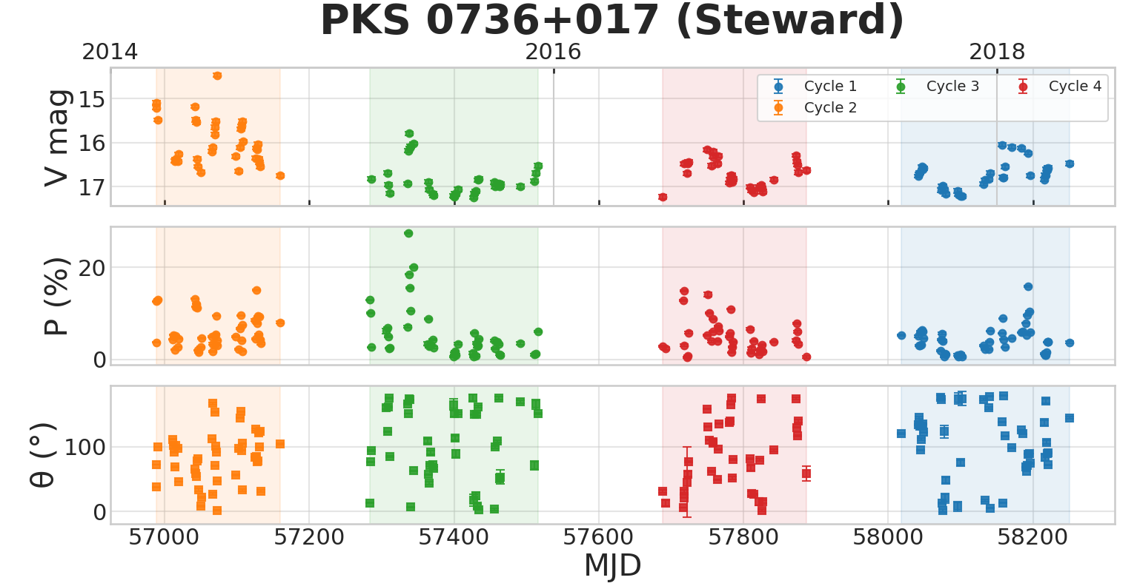
Next steps
Modelling of individual sources:
  Adding archival data

Slide 27
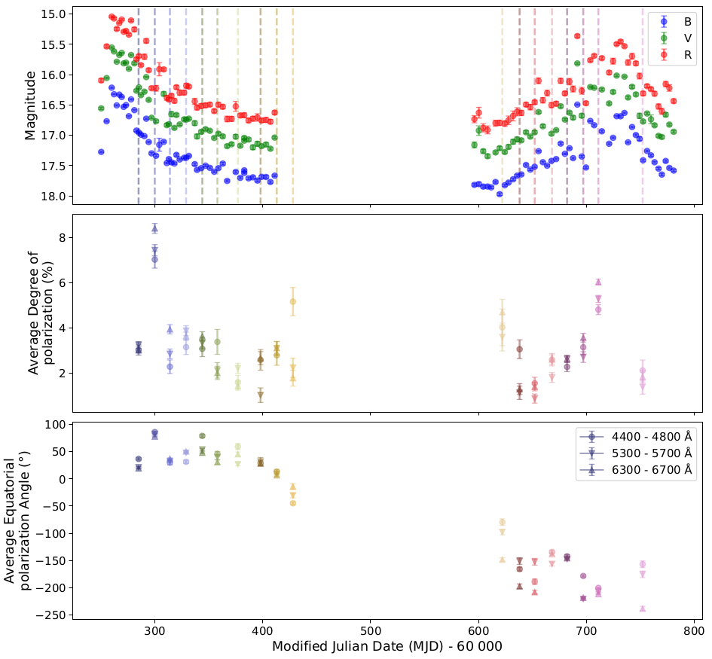
Next steps
Modelling of individual sources:
  Adding archival data

Slide 28
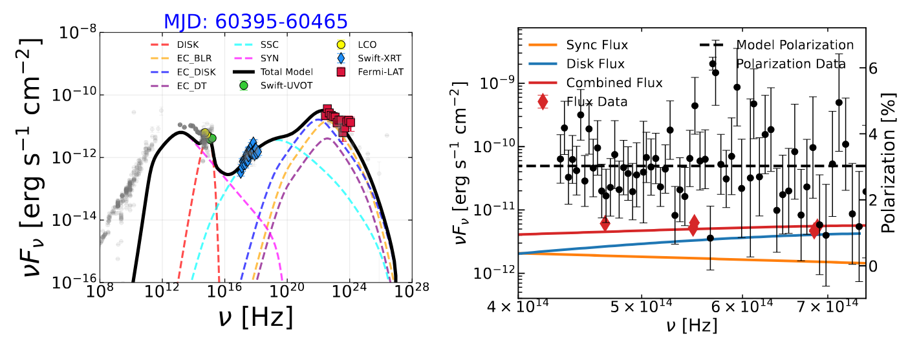
Next steps
Modelling of individual sources:
  Adding archival data
Chaudhary in prep.

Slide 29
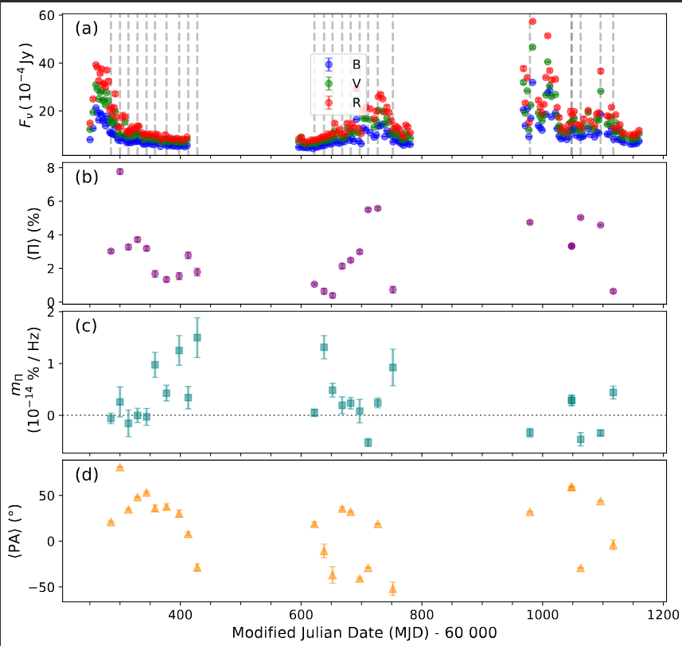
Next steps
PKS 0736+017
Modelling of individual sources:
  Adding archival data
Continuous monitoring
  Build a larger dataset
  Looking for changes
  Waiting for flares
Expanding on source list

Slide 30

Conclusions
SALT is a great instrument for obtaining medium to long term monitoring of sources
Optical results provide important constraints that we need when we try to interpret the non-thermal emission we see from different sources
SPOTS:
    Provide better constraints on the electron population, on the order of the magnetic field structures, and potential the structure of the magnetic field.
    First preliminary results find:
      Polarization which is chromatically dependent & variable
      In most cases alignment with the jet axis – but show large swings
      No universal correlation between the flux and correlations.
      Starting more detailed modelling of individual sources.
Izak van der Westhuizen
vanderwesthuizenip@ufs.ac.za
Brian van Soelen
vansoelenb@ufs.ac.za

Slide 31
Conclusions
SALT is a great instrument for obtaining medium to long term monitoring of sources
Optical results provide important constraints that we need when we try to interpret the non-thermal emission we see from different sources
SPOTS:
    Provide better constraints on the electron population, on the order of the magnetic field structures, and potential the structure of the magnetic field.
    First preliminary results find:
      Polarization which is chromatically dependent & variable
      In most cases alignment with the jet axis – but show large swings
      No universal correlation between the flux and correlations.
      Starting more detailed modelling of individual sources.
Thank you!
Izak van der Westhuizen
vanderwesthuizenip@ufs.ac.za
Brian van Soelen
vansoelenb@ufs.ac.za

