Slide 1
RADIO AND GAMMA-RAY VARIABILITY STUDY OF A SAMPLE OF BLAZARS
  Daniel Nghinyekwa¹, Dr. Eli Kasai¹, Dr. Nadeem Oozeer²
¹University of Namibia
² South African Radio Astronomy Observatory

Slide 2
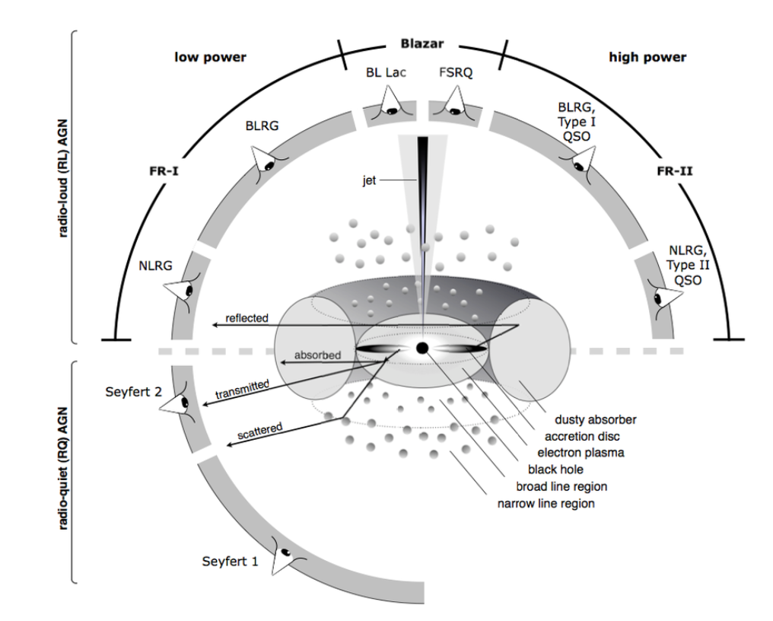
Background
Blazars are AGNs with relativistic jets oriented at a very small angle to the line of sight of the observer.
This class includes Flat-Spectrum Radio Quasars (FSRQs) and BL Lacertae objects (BL Lacs).
They are characterized by rapid variability and strong radio emission, and dominate the bright radio and gamma-ray sky.
Figure adapted from Christopher Reynolds et al.

Slide 3
Research Problem
Despite the commissioning of major astronomical instruments in the southern hemisphere, particularly H.E.S.S. and MeerKAT, dedicated multi-wavelength studies of blazars in the southern sky are limited.
This research project aimed to fill that gap by
  Reviewing and adapting the analysis techniques established for northern hemisphere multi-wavelength campaigns.
  Formulating an analysis strategy tailored for future southern hemisphere monitoring campaigns of blazars with H.E.S.S. and MeerKAT.

Slide 4
Objectives
The main objectives of this study were the following:
Assess existing multiwavelength analysis techniques applied to blazars and identify variability metrics that yield temporal variability results.
Propose a multiwavelength analysis workflow on analogous published datasets to establish a baseline on variability.
Establish a standardized data processing framework that covers sample selection, data mining, light curve generation, statistical measures, variability metrics and correlation analysis to be used for future multiwavelength campaigns in the southern hemisphere.

Slide 5
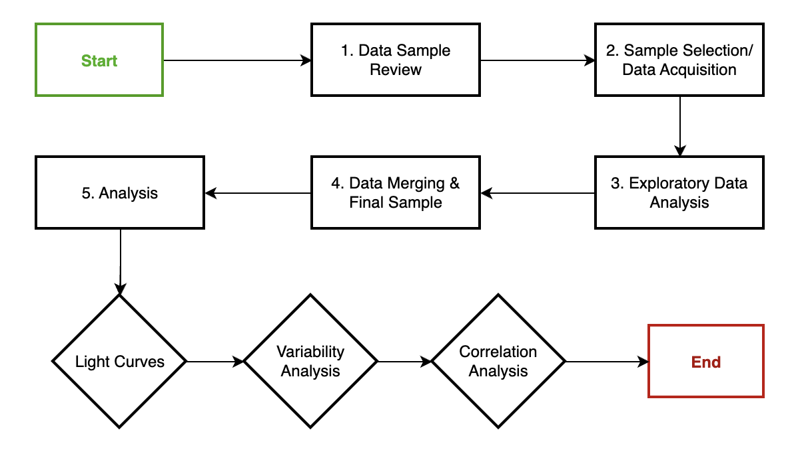
Data Sampling and Research Methodology
To build a good sample of data for our research, we looked at archival data accessed via VizieR, a widely used library of published astronomical data.
VLBA data: 10.5 years (June 2007 to December 2018) utilizing the VLBA-BU-BLAZAR monitoring program, which observed a sample of 38 AGN (including 22 flat-spectrum radio quasars, 13 BL Lac objects, and 3 radio galaxies)
Effelsberg data: F-GAMMA programme, which executed nearly monthly observations of Fermi detected blazars from January 2007 to January 2015. The campaign monitored 155 sources.
Fermi-LAT data: Consists of 106 AGN during an initial 11-month all-sky survey period (August 4, 2008 to July 4, 2009).
Basic information about selected source, such as sky coordinates, redshift values, and object classifications was gathered from well established astronomical databases, including SIMBAD and NED.

Slide 6
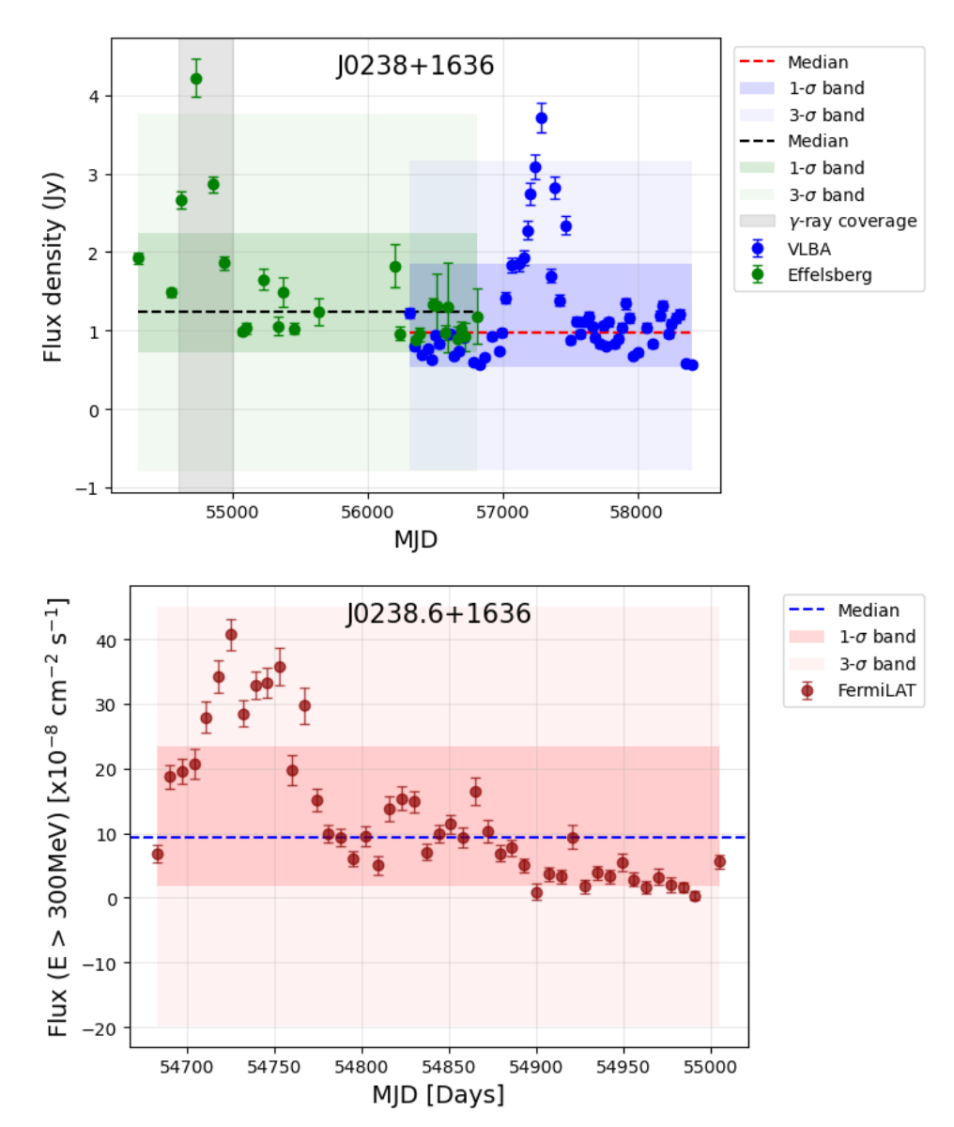
J0238+1636 (PKS 0235+164)
At redshift of z ∼ 0.940, this BL Lacertae object exhibits rapid radio spectral variability, with flares repeating about once per year, and shows a positive correlation between radio core flux and gamma-ray brightness.
Both radio and gamma -ray observations show variability patterns.
The radio data display flaring activities with flux densities peaking above 3σ at ∼ 4.3 Jy (Effelsberg) and ∼ 3.8 Jy (VLBA)
The gamma-ray curve presents periods of enhanced activity between MJD 54700 and MJD 54750.
The temporal structure suggests more likely a source variability rather than random scatter.

Slide 7
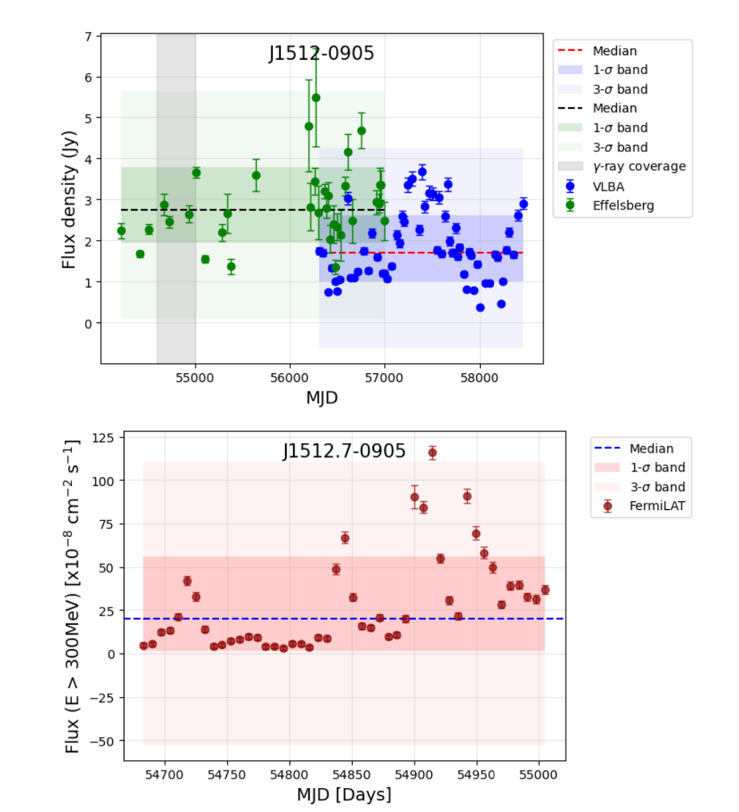
J1512.7–0905 (PKS 1510-089 )
At a redshift of z ∼ 0.360.
It is a strong radio emitting flat-spectrum radio quasar and highly variable across the radio to gamma-ray bands with multiple prominent flares and quasi-stationary features present within a few parsecs.
The radio and gamma-ray light curves display significant variability.
The radio observations show flaring activities with substantial amplitude changes beyond 1σ.
Gamma-ray data exhibit periods of enhanced emission above the median, especially 54900 – 54950 MJD.
This source represents the brightest gamma-ray source in our sample.

Slide 8
Variability Metrics
Variability in AGNs can be quantified through parameters such as;
Variability Index (VI): Quantifies the largest observed fractional change in flux. It provides a limited view of variability, as it relies only the maximum and minimum flux densities of a source over the full observation period and disregards the rest of the dataset and is sensitive to outliers.
Modulation Index (MI): Provides the most direct indication of the variability characteristics of a source at a given frequency. We use the modulation index to measure the degree of variability.
Debiased Modulation Index (M_{d}): Accounts for the uncertainties in the flux measurements, avoiding bias in which sources with larger errors (or lower signal-to-noise ratios) tend to have higher modulation indices.
Fractional Index (FI): Used to quantify the intrinsic variability of AGN and blazars. It provides a normalized measure of the variability strength after accounting for measurement uncertainties.

Slide 9
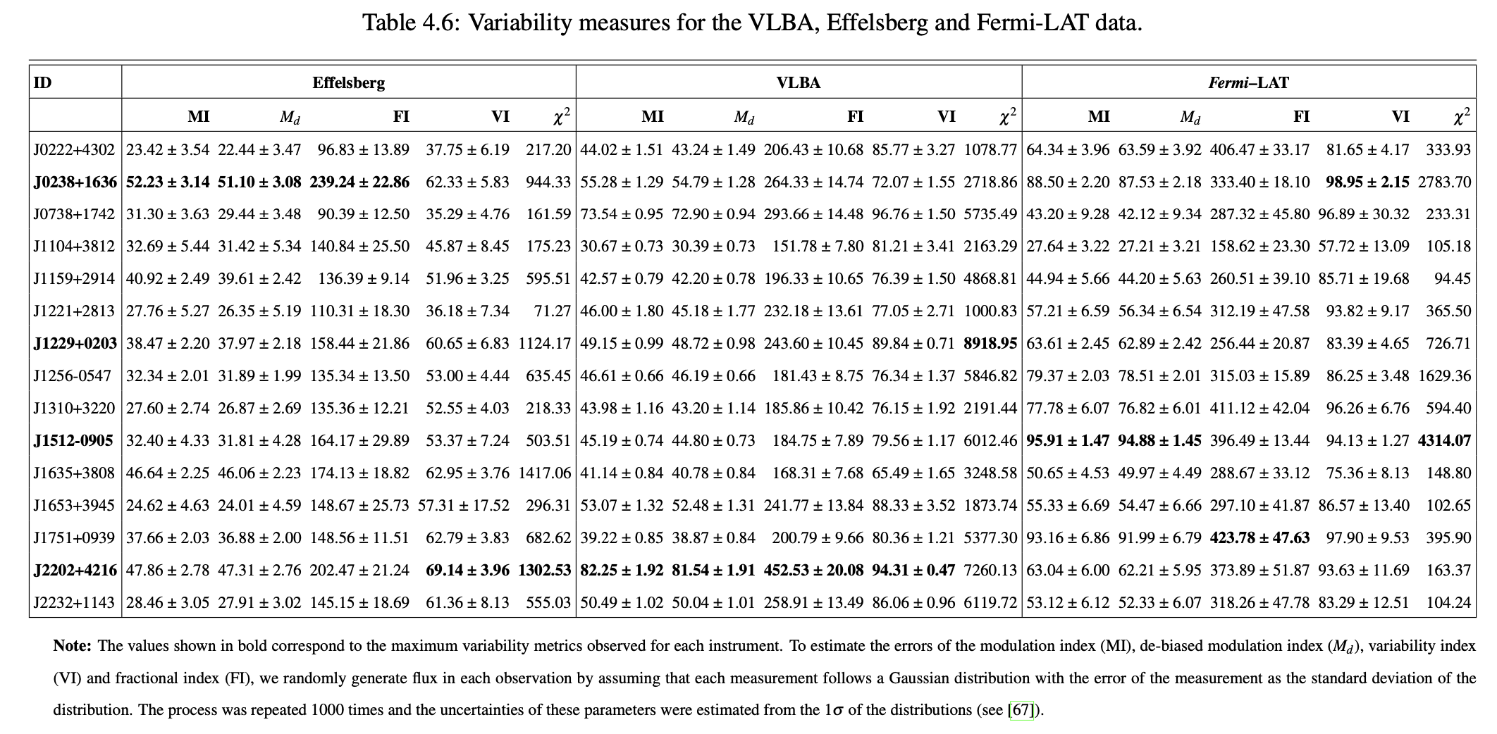
Results - Variability

Slide 10
Summary of Variability Metrics
J1512−0905 - strong Fermi variability
J2202+4216 - strong VLBA variability
J0238+1636 – strong Effelsberg variability

Slide 11
Correlation Analysis
In this study, we applied regression analysis using the LINMIX statistical package to investigate the correlation and relationship between our calculated variability matrices.
Traditional regression techniques such as ordinary least squares are inappropriate for data in which both the independent and dependent variables are subject to measurement error.
The LINMIX model extends linear regression to account for measurement errors in both x and y variables, as well as intrinsic variability not explained by the regression.

Slide 12
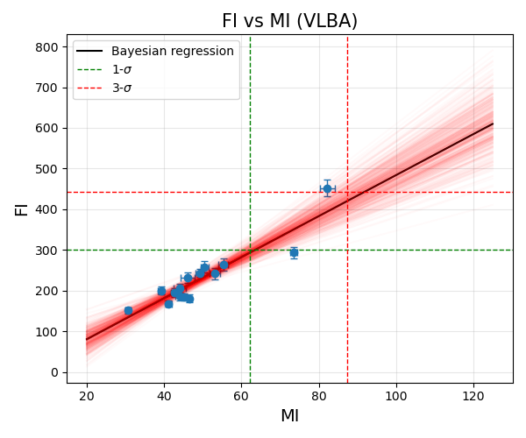
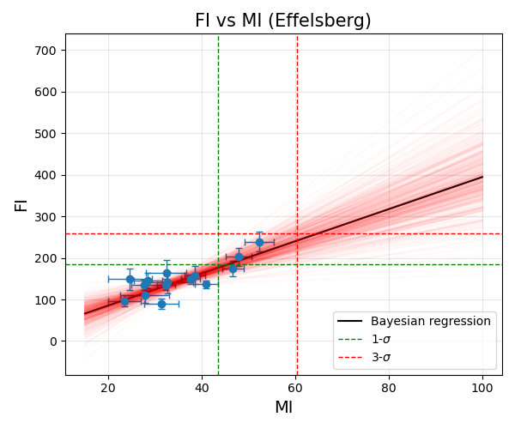
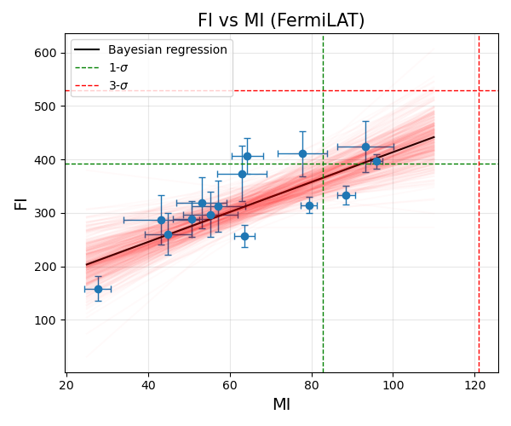
Results - Correlation
The VLBA correlation analysis shows the strongest linear relationships.
  Reflects the superior angular resolution and sensitivity of the VLBA observations, which better resolve intrinsic source variability from systematic effects.
The Fermi-LAT correlation matrix shows the most variability relationships, with increased scatter.
  Reflects the challenges of gamma-ray variability detection and the distinct physical processes that govern high-energy emission.

Slide 13
Summary
The examination of individual light curves shows differences in variability patterns, ranging from sources with minimal flux variations to highly active objects showing high flaring behaviours.
The variability analysis using multiple metrics reveals differences in observational techniques, with VLBA observations consistently showing higher variability measures compared to single-dish Effelsberg data as expected.
Similarly, Fermi–LAT observations show variability amplitudes comparable to VLBA measurements, suggesting that high-energy emission processes are more variable than the extended radio emission detected by single-dish telescopes.
The radio observations show stronger linear relationships than gamma-ray measurements.

