Slide 1


HEASA 2026
Assessing the Fringe Detectability of the Africa Millimetre Telescope for Event Horizon Telescope Observations
Hiiko I. Katjaita¹, Michael Backes^{1,2}, Michael Janssen³, Christiaan Brinkerink³, James O. Chibueze^{4,1,2}, Lott Frans¹
¹ University of Namibia ² North-West University ³ Radboud University ⁴ University of South Africa
October 2026

Slide 2
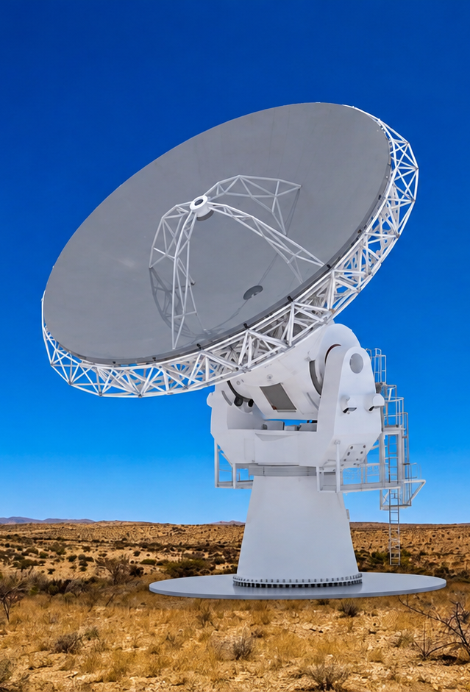
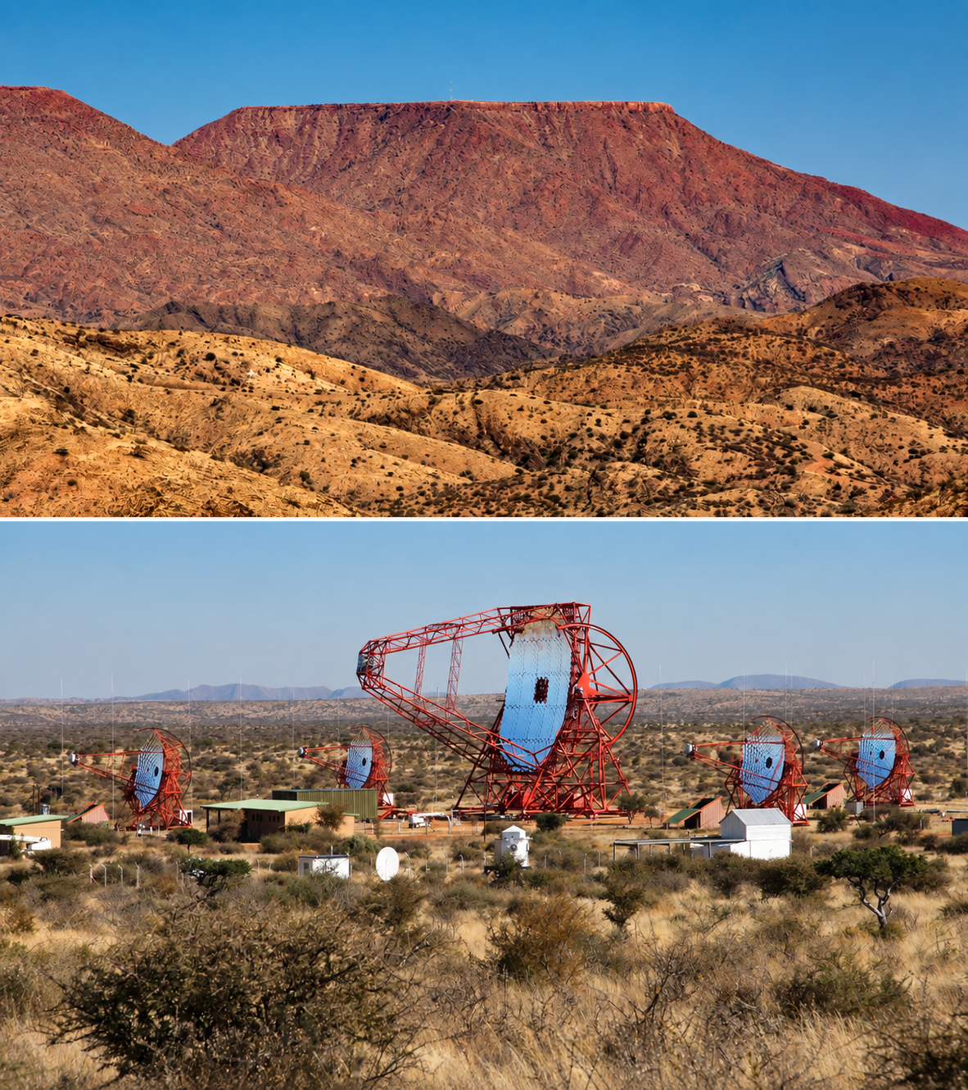
The AMT and the Fringe-Detectability Question
A 14 m-class millimetre telescope planned for Namibia, designed to join the EHT at 230 GHz.
Two candidate sites are being characterised: the H.E.S.S. site and Gamsberg Mountain.
We test when the AMT–ALMA and AMT–NOEMA baselines can detect useful fringes from Sgr A* and M87*.
Main question: How often can these AMT baselines detect useful fringes from these sources?
Gamsberg Mountain (top) and H.E.S.S. observatory (bottom)
HEASA 2026
H. Katjaita: AMT fringe detectability

Slide 3


What do we mean by “fringe detectable”?
Two stations see the same source
AMT
ALMA /
NOEMA
A useful fringe needs:
Useful fringe: SNR ≥ 4 ⇔ correlated signal ≥ detection limit
• simultaneous visibility
• low enough SEFD at both stations
• enough coherent integration time
• enough correlated source flux
Lower SEFD and longer coherence time reduce the minimum correlated signal that can be detected.
HEASA 2026
H. Katjaita: AMT fringe detectability

Slide 4
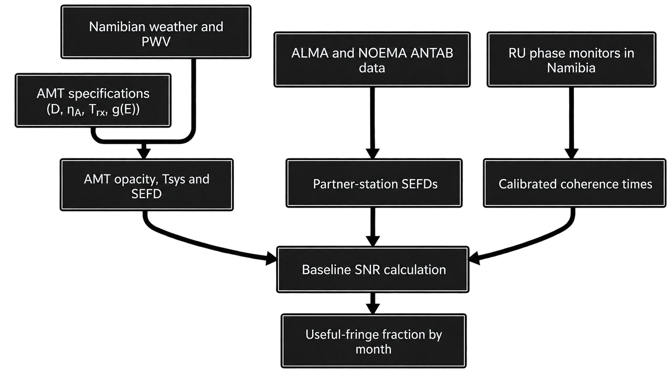
From site measurements to a useful-fringe fraction
HEASA 2026
H. Katjaita: AMT fringe detectability

Slide 5
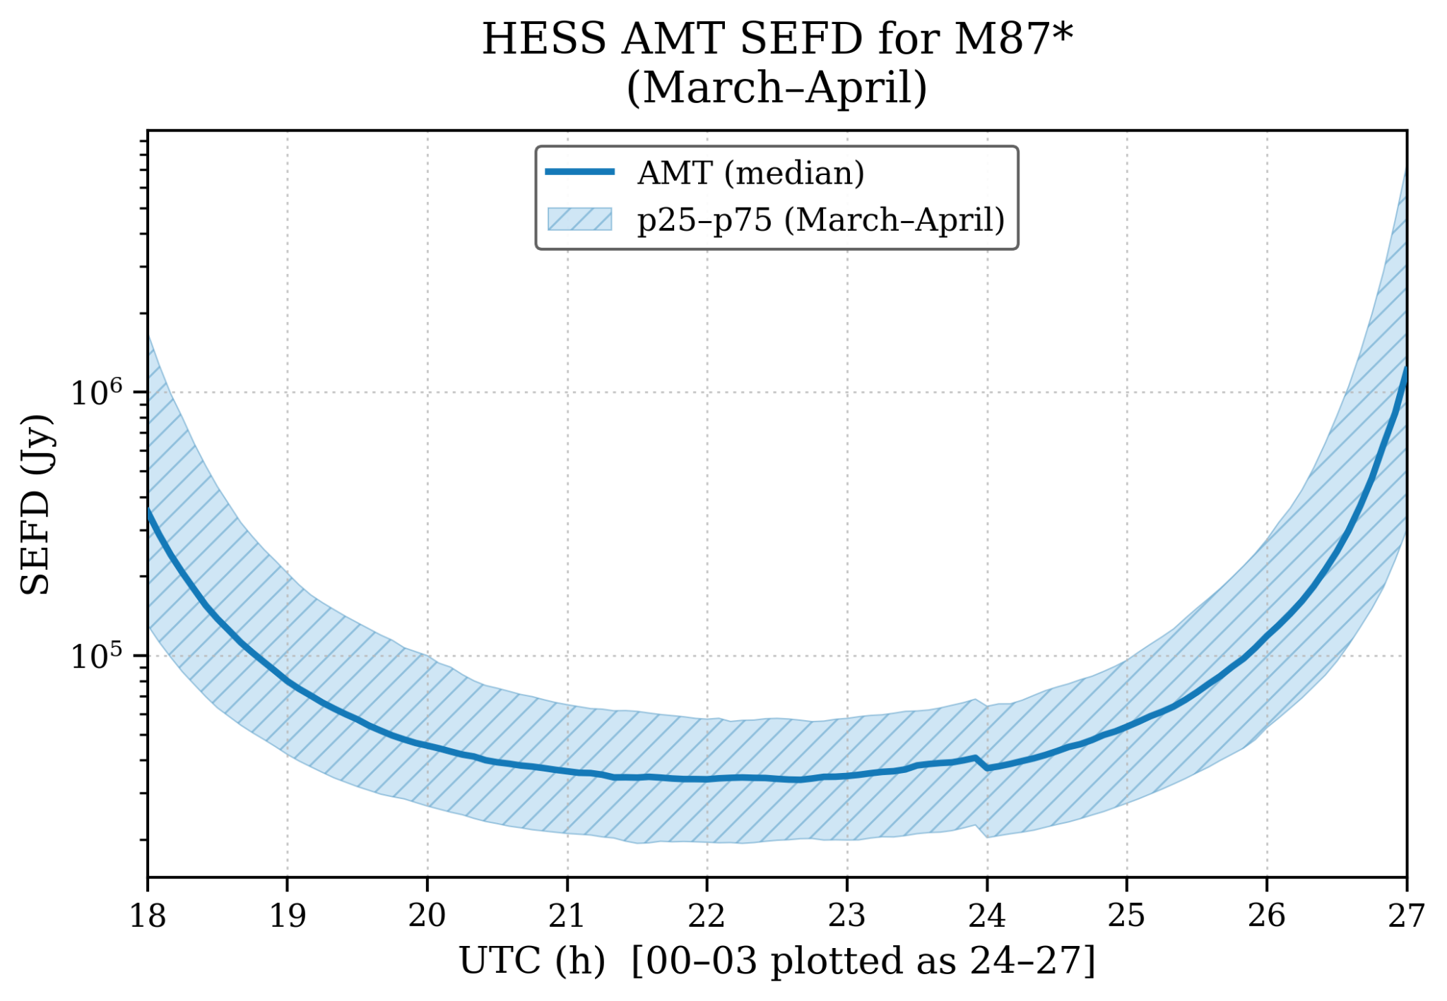
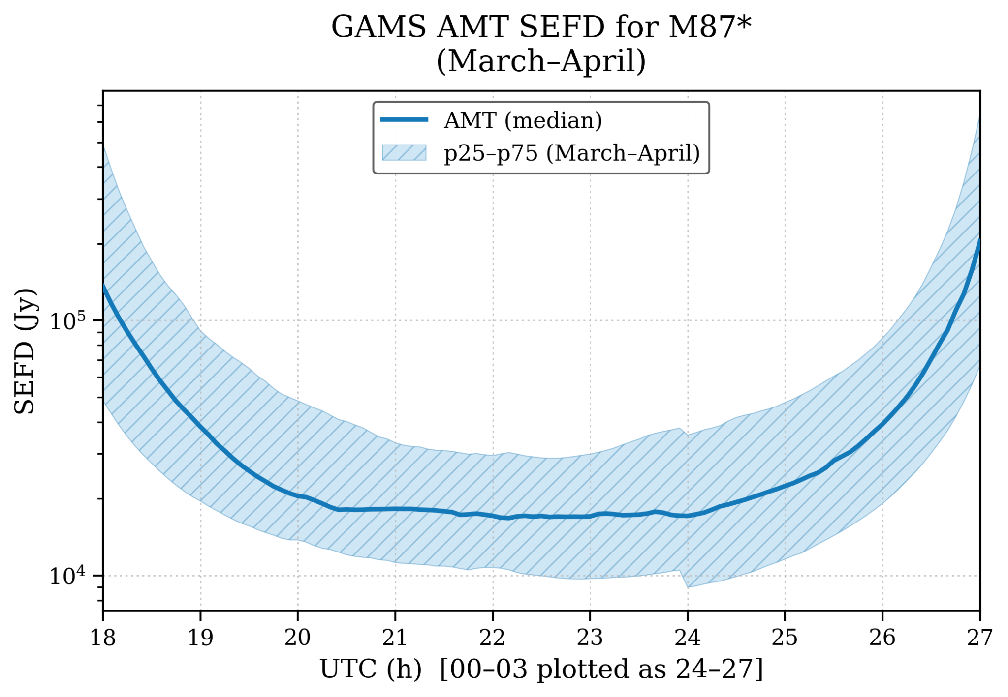
PWV → τ₀(230 GHz) → τₗₒₛ(E) → Tₛᵧₛ → SEFD
GNSS PWV + ground temperature are converted to 230 GHz opacity, then to a source-elevation-dependent AMT SEFD.
H.E.S.S. median SEFD ≈ 44.9 kJy
Gamsberg median SEFD ≈ 20.3 kJy

Slide 6
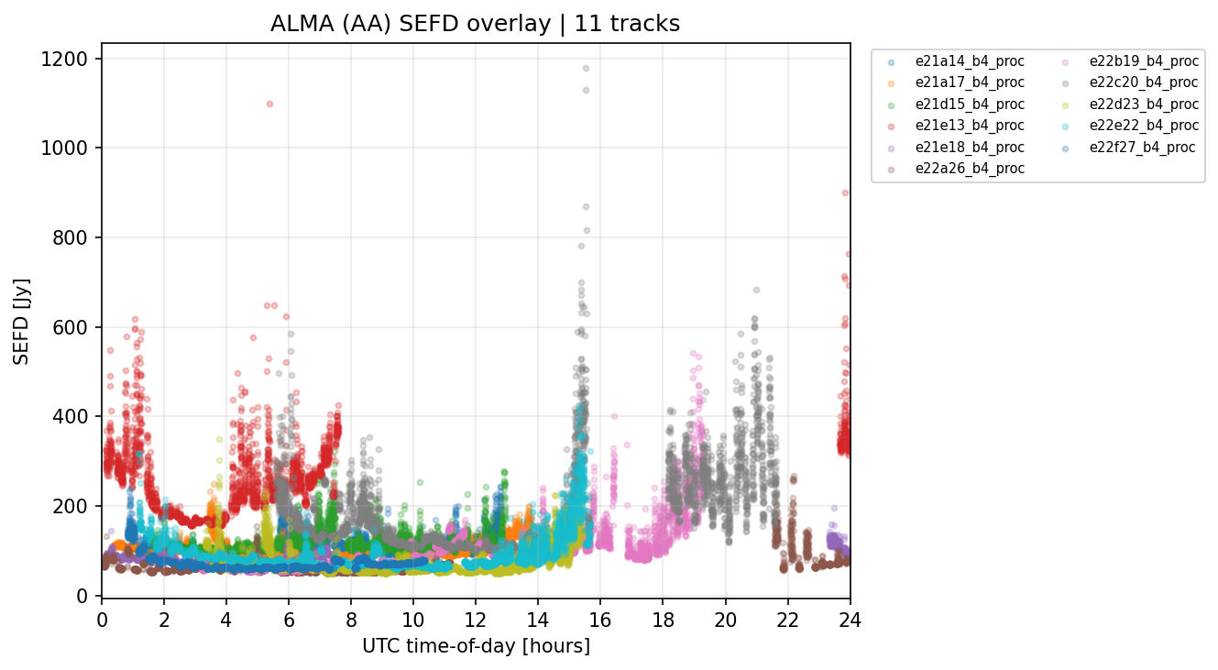
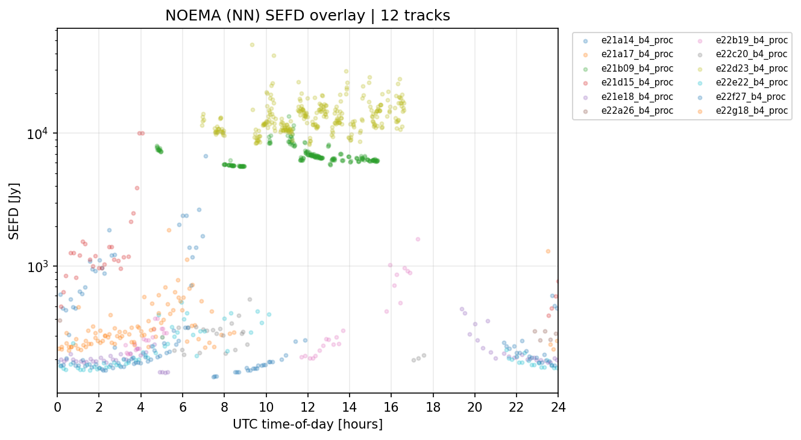
Partner-station SEFDs from real EHT ANTAB data
Observed partner-station sensitivity distributions used in the AMT fringe simulations
ALMA (AA) • 11 independent tracks
NOEMA (NN) • 12 independent tracks
ALMA: SEFD = ⟨Tsys⟩ / DPFU
NOEMA: processed TSYS_NN values are already SEFD-equivalent
Monte Carlo sampling: track first → measurement second, so a densely sampled day does not receive extra weight.
HEASA 2026
H. Katjaita: AMT fringe detectability

Slide 7
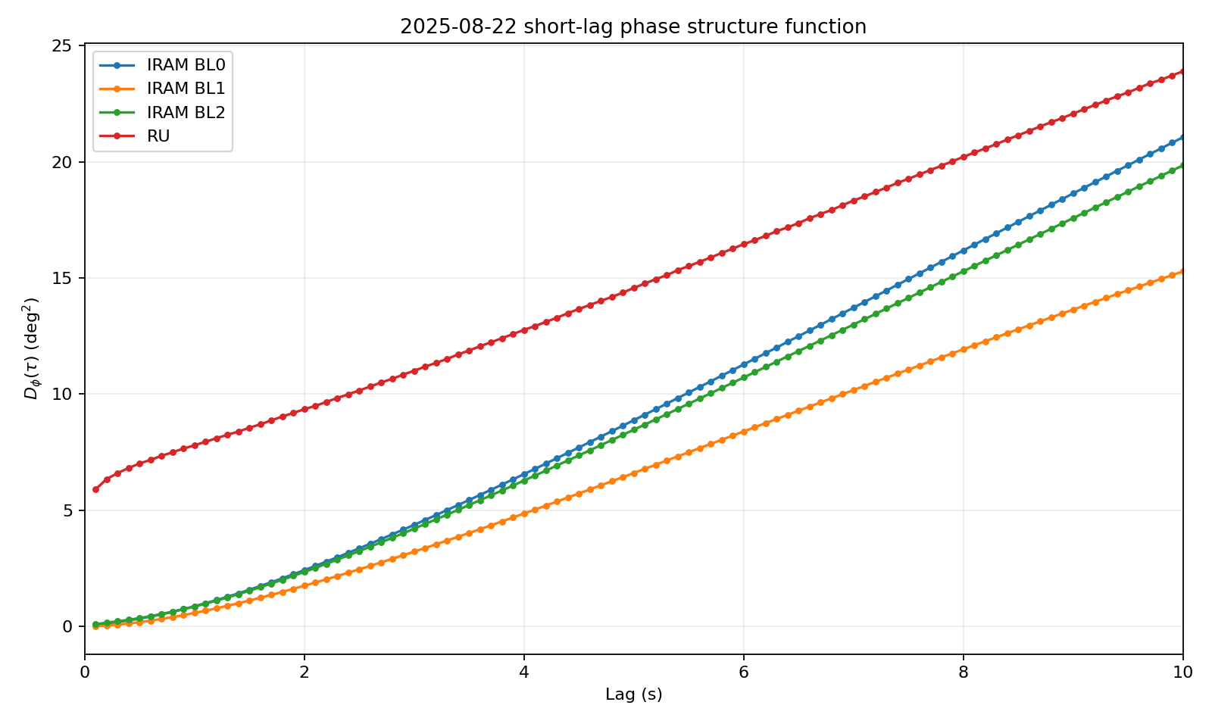
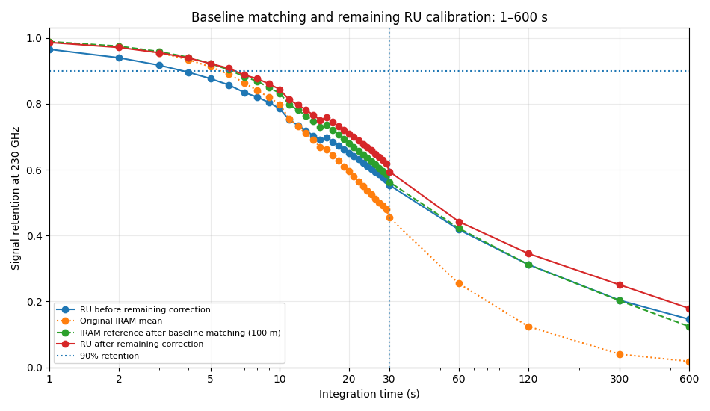
Calibrating the low-cost RU phase monitor against IRAM
1 Noise floor
2 Baseline length
3 Remaining factor
RU has a non-zero short-lag floor; subtract instrumental variance.
Match IRAM to the ~100 m RU baseline; baseline effects grow at long T.
Transfer the residual 1–30 s correction to Namibia; validated with held-out dates.
HEASA 2026
H. Katjaita: AMT fringe detectability

Slide 8

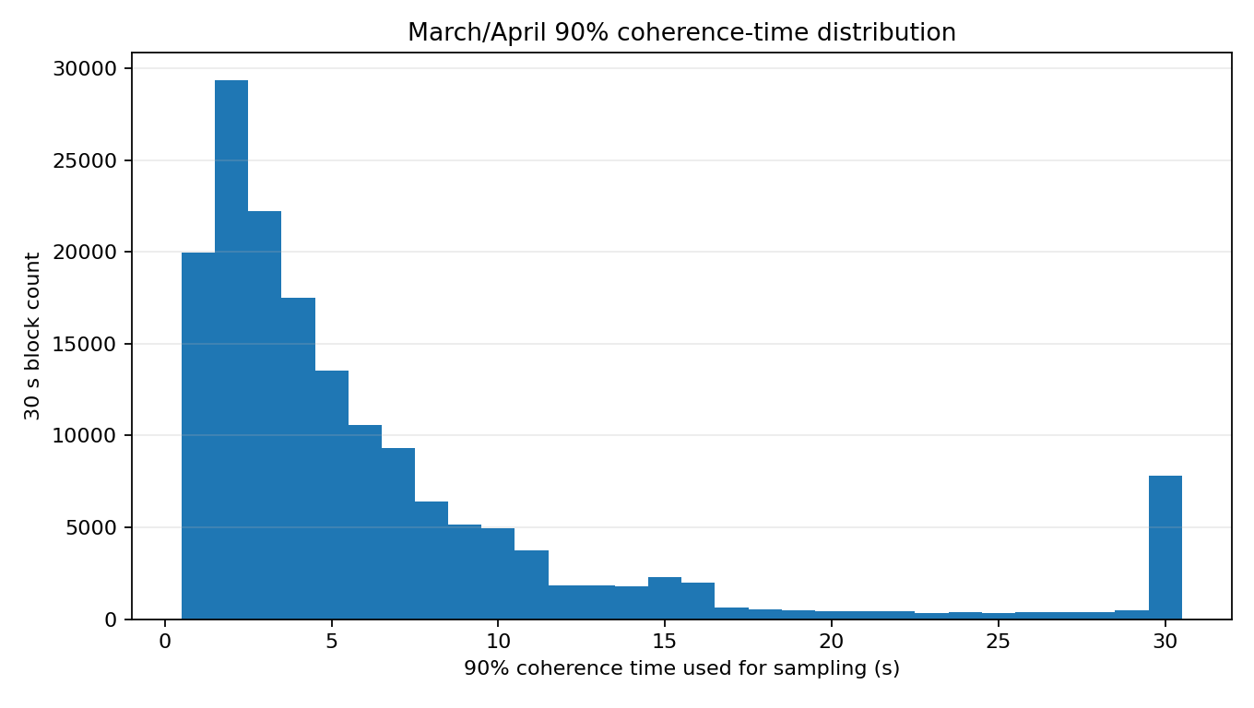
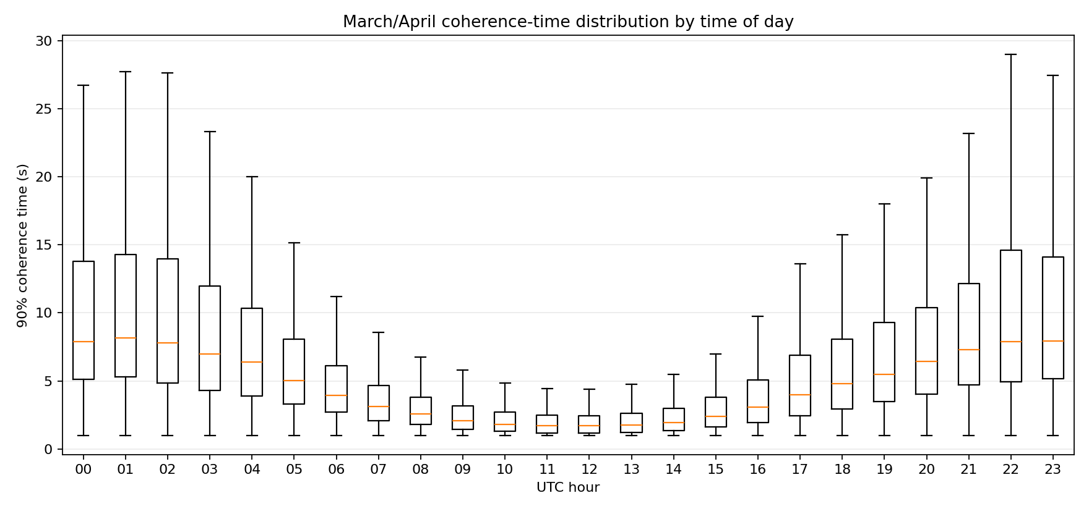
165,692
60
accepted 30 s
atmospheric blocks
independent observing
dates
4.1 s
1.7–10.5 s
Monte Carlo sampling follows the measured τ₉₀ distribution for the current UTC hour, not one fixed coherence time.
overall median τ₉₀
middle 68%

Slide 9
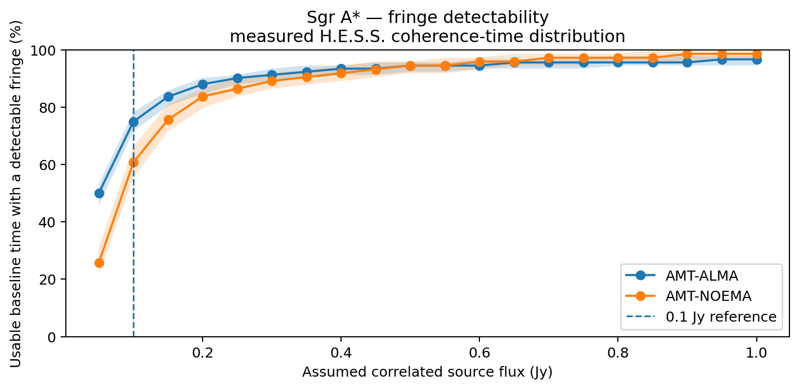
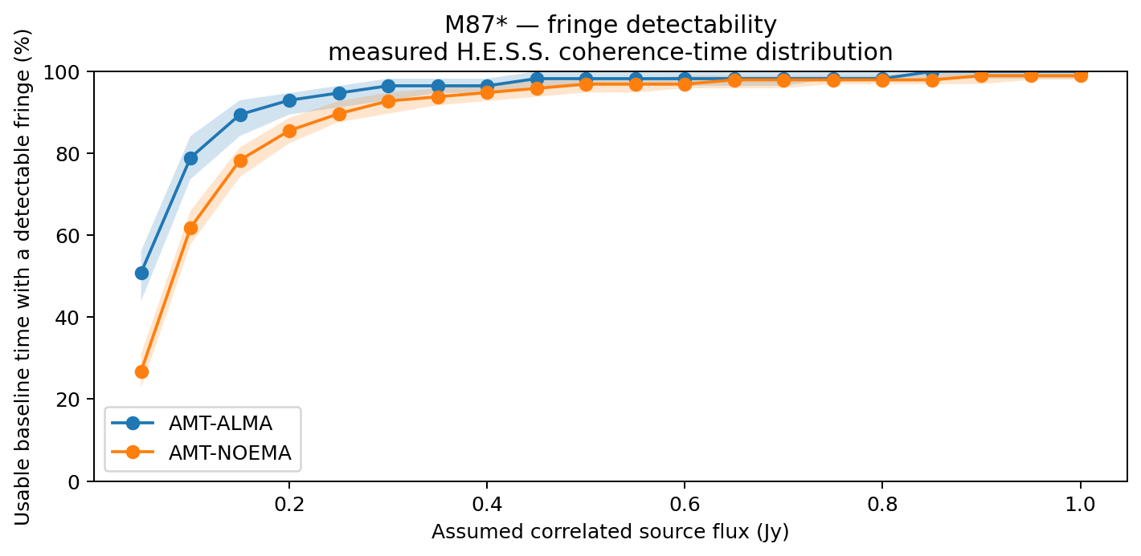
Preliminary fringe detectability with measured H.E.S.S. coherence times
5,000 Monte Carlo realisations per source–baseline combination.
Reference case for the percentages below: 0.1 Jy correlated signal
73.8%
68.7%
71.4%
57.6%
Sgr A* · AMT–ALMA
16–84 percentile: 70.2–77.4%
Sgr A* · AMT–NOEMA
16–84 percentile: 62.8–73.1%
M87* · AMT–ALMA
16–84 percentile: 66.1–76.8%
M87* · AMT–NOEMA
16–84 percentile: 53.8–61.3%
HEASA 2026
H. Katjaita: AMT fringe detectability

Slide 10
What we can say now — and what comes next
Preliminary takeaways
Next steps
1
Apply the calibrated coherence-time method to Gamsberg and the remaining Namibia phase monitors.
Measured atmosphere matters
The H.E.S.S. median t₉₀ is ~4.1 s, but the distribution changes strongly with UTC time.
2
Replace the fixed 0.1 Jy reference with source-model correlated flux as a function of baseline and time.
AMT–ALMA is more sensitive
For the 0.1 Jy reference, AMT–ALMA gives median detection fractions of 73.8% for Sgr A and 71.4% for M87, compared with 68.7% and 57.6% for AMT–NOEMA.
3
Apply the same fringe-detectability analysis to selected existing EHT baselines to provide a direct benchmark for the AMT results.
Gamsberg looks promising
Its weather-based AMT SEFD is lower than H.E.S.S., but Gamsberg coherence times are not yet included.
HEASA 2026
H. Katjaita: AMT fringe detectability

Slide 11

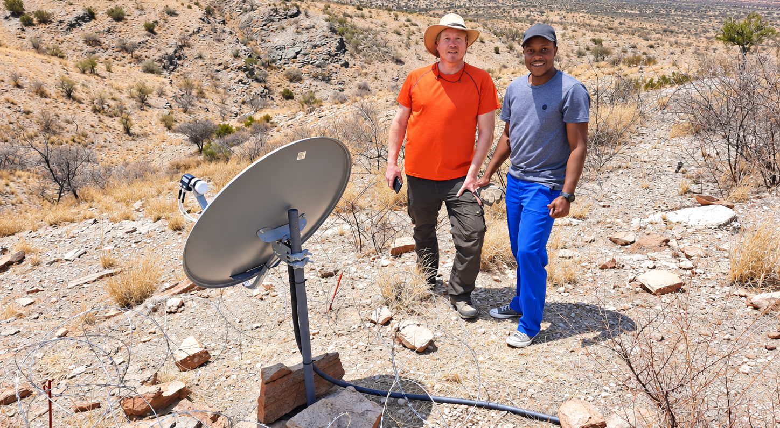
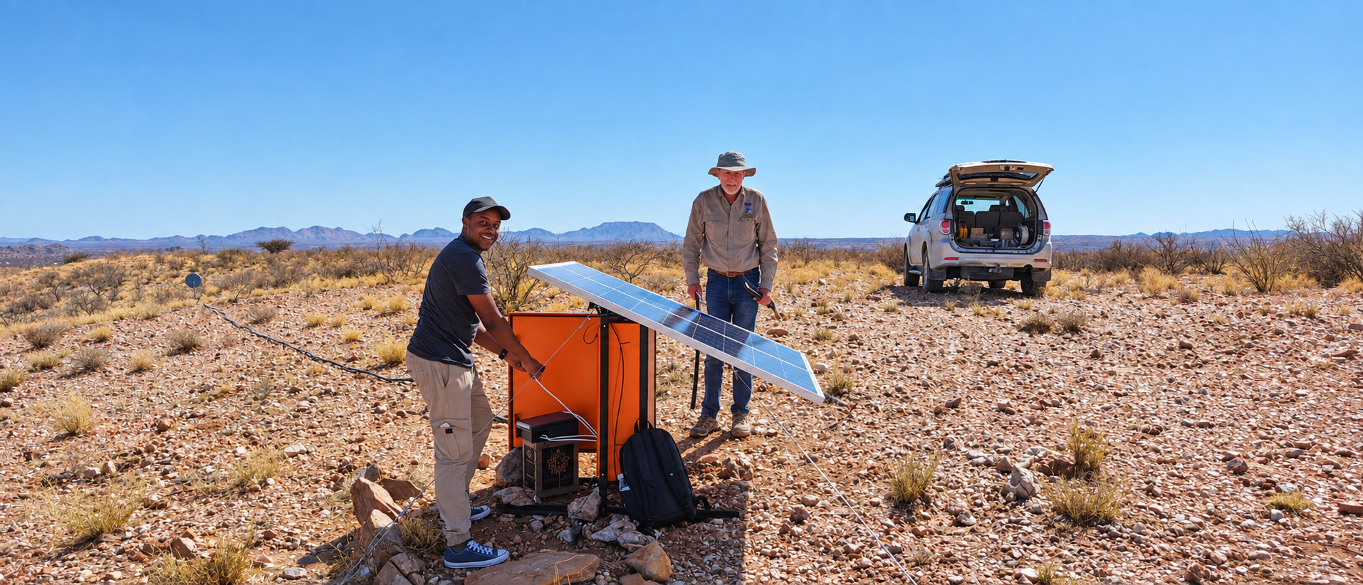
Thank you
Questions and discussion
Hiiko Katjaita
University of Namibia
Acknowledgements
Radboud University / Radboud Radio Lab
Institut de Radioastronomie Millimétrique (IRAM), Plateau de Bure
Africa Millimetre Telescope (AMT)
Partial support: ERC Synergy Grant BlackHolistic, ERC-2022-SYG 101071643

Slide 12
Backup — key simulation assumptions
4 GHz
0.88
SNR ≥ 4
0.90
Bandwidth
Quantisation efficiency
Fringe threshold
Retention at t₉₀
5,000 / combination
14 m / 0.55
7°
≥ 3 locations
Monte Carlo
AMT dish / ηA
Minimum elevation cut
Network requirement
Network-constrained baseline windows
Sgr A* — AMT–ALMA:
03:00–10:00 UTC
M87* — AMT–ALMA:
22:50–03:30 UTC
Sgr A* — AMT–NOEMA:
01:35–07:10 UTC
M87* — AMT–NOEMA:
17:40–03:30 UTC
Windows are defined where the source is above 7° at both baseline stations and at least 3 independent EHT locations are simultaneously above 7°.
HEASA 2026
H. Katjaita: AMT fringe detectability · backup

Slide 13
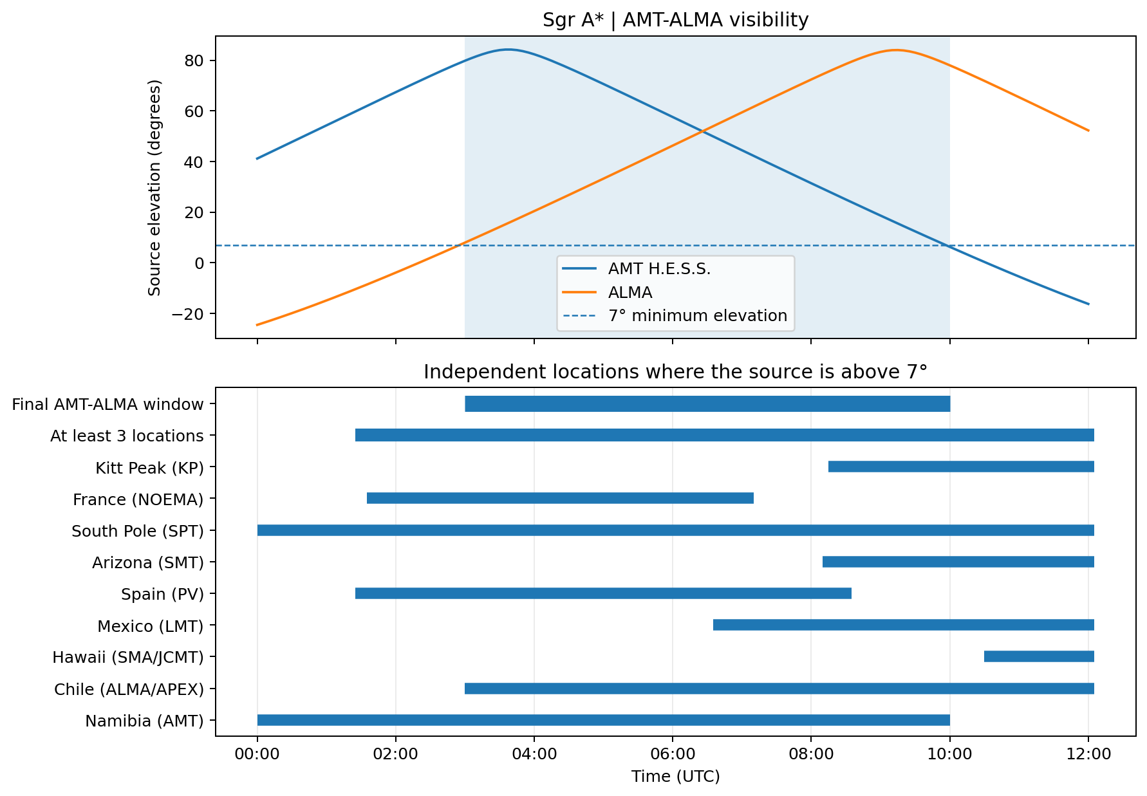
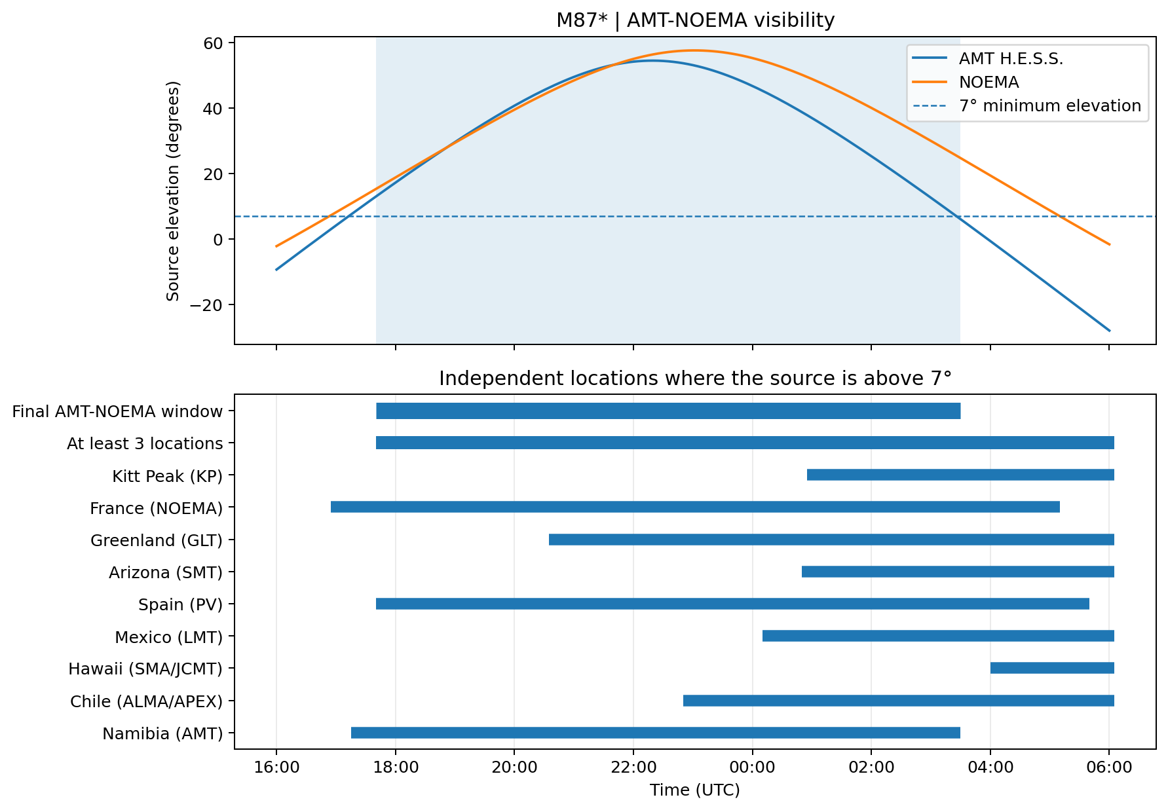
Backup — visibility windows and baseline overlap
Baseline windows use the ≥3 independent-location network criterion and a 7° minimum elevation cut.
AMT–ALMA window (Sgr A*)
AMT–NOEMA window (M87*)
03:00–10:00 UTC (7.00 h)
17:40–03:30 UTC (9.83 h)
A time step is kept only when both stations see the source and at least 3 independent EHT locations are above 7°.
HEASA 2026
H. Katjaita: AMT fringe detectability · backup

Slide 14
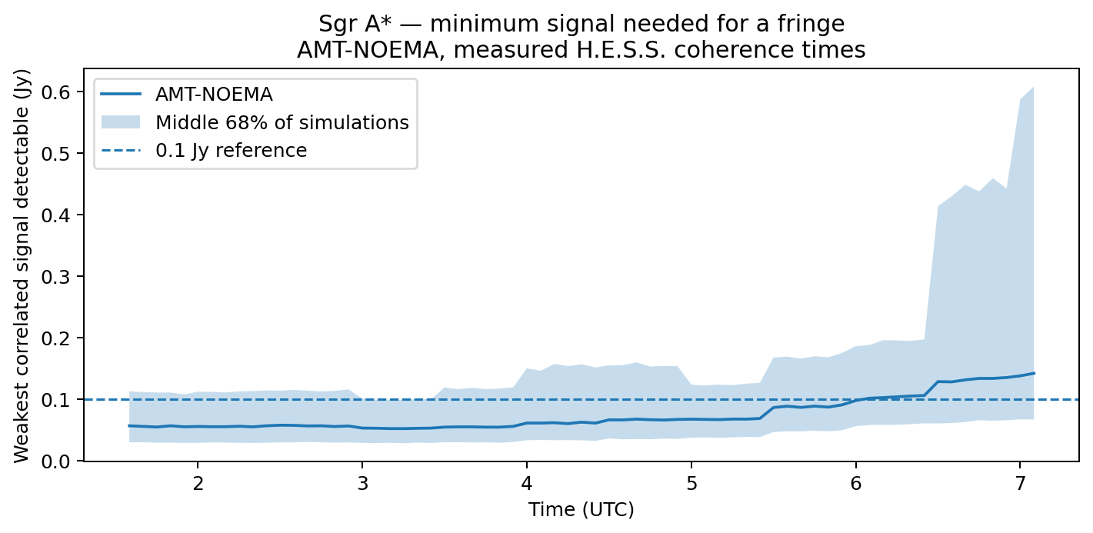
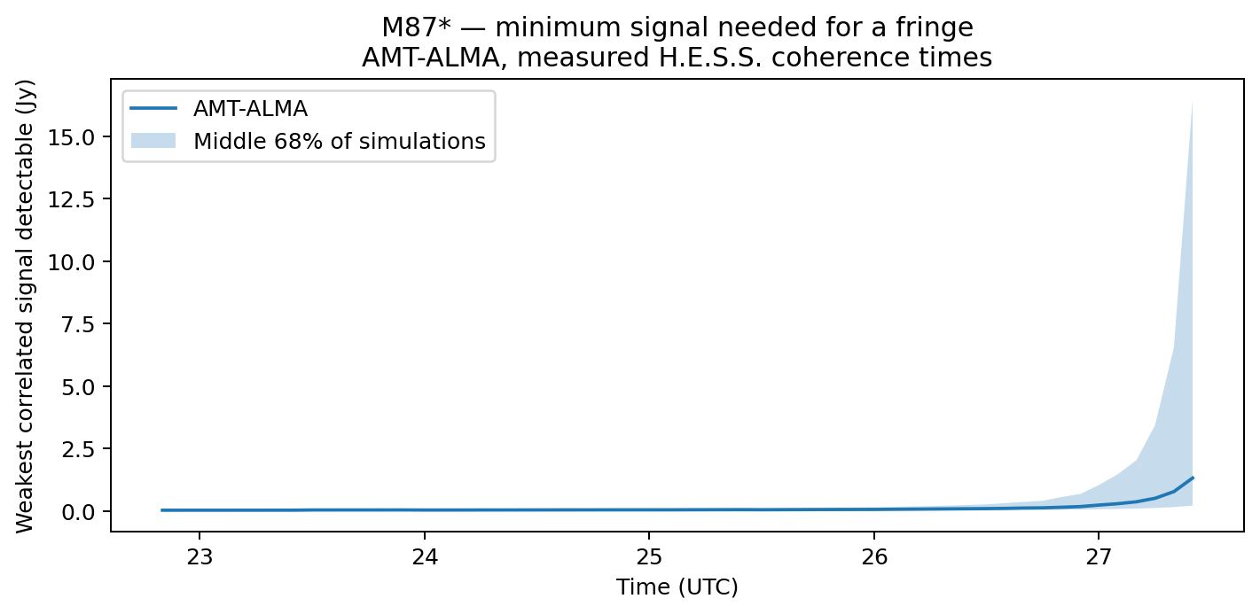
Backup — minimum correlated signal needed for a fringe
Median detection limit over usable simulated points
Sgr A*
AMT–ALMA
0.053 Jy
Sgr A*
AMT–NOEMA
0.070 Jy
M87*
AMT–ALMA
0.057 Jy
M87*
AMT–NOEMA
0.085 Jy
Smaller detection limit = better baseline sensitivity.
HEASA 2026
H. Katjaita: AMT fringe detectability · backup

Slide 15
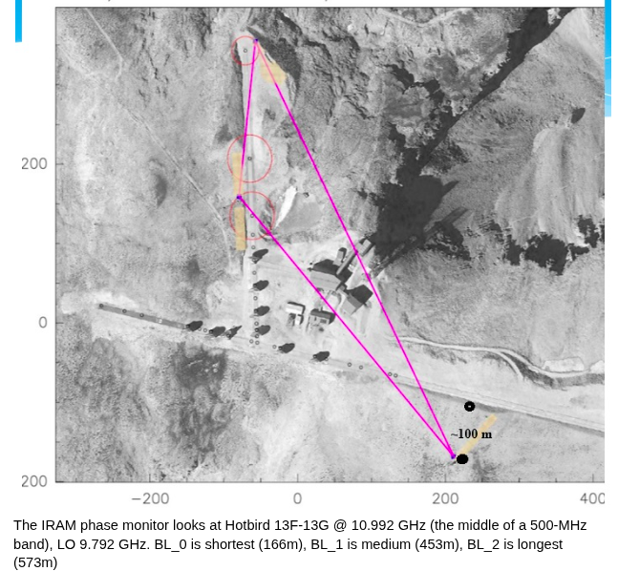
Backup — what drives the RU–IRAM difference?
We corrected the known baseline-length difference first, then tested other possible causes of the remaining offset.
Different physical
baselines
Baseline length is the dominant long-timescale effect
Baseline matching matters most at long integration times (≳30 s).
RU ≈100 m
IRAM ≈166–591 m
Weather variables
Different satellites
Baseline orientation
Longer baselines sample larger atmospheric phase differences.
No clear correlation
No convincing effect
No convincing effect
Residual offset is strongest at short integration times → treated as an empirical instrument correction.
HEASA 2026
H. Katjaita: AMT fringe detectability · backup

Slide 16
Backup — current AMT site characterisation
Current EHT window: March–April · 230 GHz
H.E.S.S. site
1,859 m a.s.l.
Gamsberg Mountain
2,377 m a.s.l.
≈518 m higher
Median PWV
230 GHz transmission
Weather-based SEFD
Median PWV
230 GHz transmission
Weather-based SEFD
16.62 mm
40%
44.9 kJy
11.20 mm
55%
20.3 kJy
Mar–Apr
median
M87* median
Mar–Apr
median
M87* median
Phase / coherence status
Phase / coherence status
Calibrated H.E.S.S. coherence-time data are already available and used in the preliminary fringe simulation.
165,692 accepted 30 s blocks · 60 dates · median t₉₀ ≈ 4.1 s
The Gamsberg phase monitor is part of the Namibia monitoring programme, but its calibrated coherence-time distribution is not yet included in the current fringe Monte Carlo.
Next step: apply the RU→IRAM calibration and derive the Gamsberg t₉₀ distribution.
Current picture
Gamsberg is drier and gives a lower weather-based AMT SEFD, while H.E.S.S. currently provides the mature coherence-time data used for the preliminary fringe-detectability result.
Atmospheric site results: Frans et al. (2025) · SEFD and coherence-time results: this work
HEASA 2026
H. Katjaita: AMT fringe detectability · backup

