Slide 1

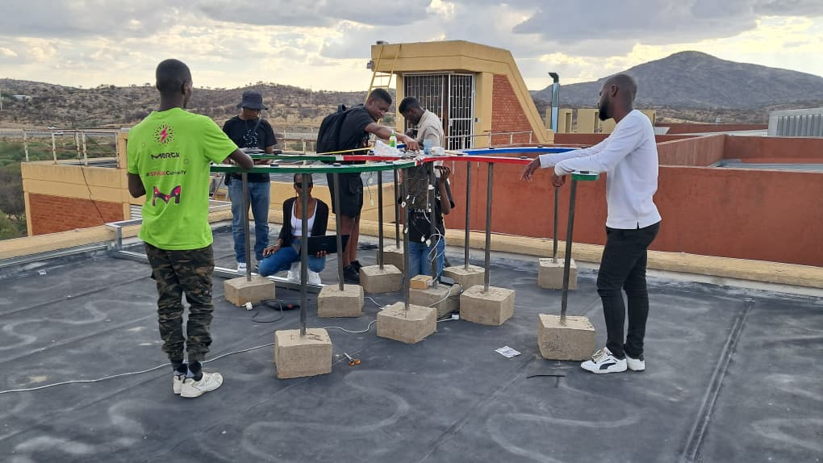

Detecting a solar radio burst with the TART
S. K. Mukungu¹, E. Kasai¹, B. Hugo²
¹Department of Physics, Chemistry and Material Science, University of Namibia
²South African Radio Astronomy Observatory, South Africa
HEASA 2026
TART, University of Namibia
S. K. Mukungu · MPhil Physics, University of Namibia

Slide 2
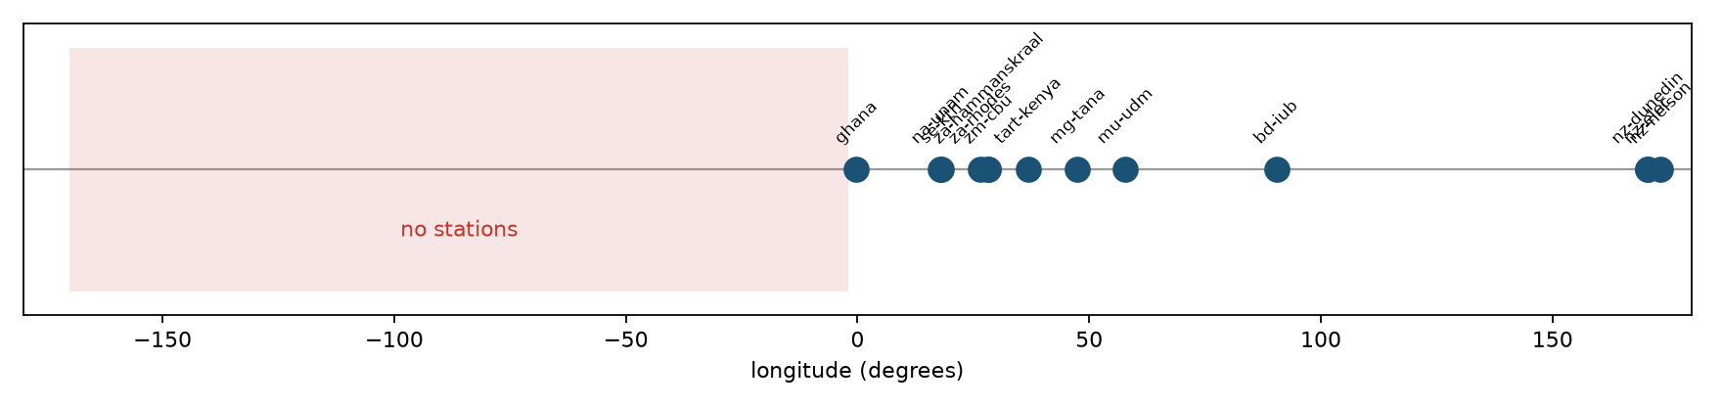
TART
The instrument
24
1575.42 MHz
3.23 m
3.38°
antennas, 276 baselines
2.5 MHz bandwidth
maximum baseline
synthesised beam
One-bit correlator · single polarisation · 1 s integrations · ~170° field · 13 stations
TART station longitudes.
1
S. K. Mukungu · MPhil Physics, University of Namibia

Slide 3
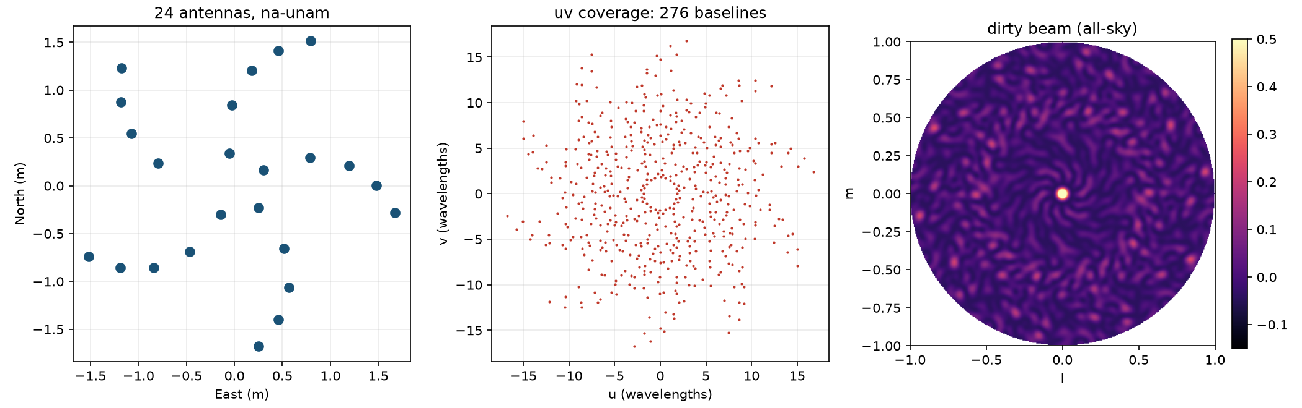
INSTRUMENT
Point spread function
Array layout, uv coverage, all-sky point spread function.
3.38°
20%
2.8%
synthesised beam
peak sidelobe
of sky above 10% of peak
2
S. K. Mukungu · MPhil Physics, University of Namibia

Slide 4
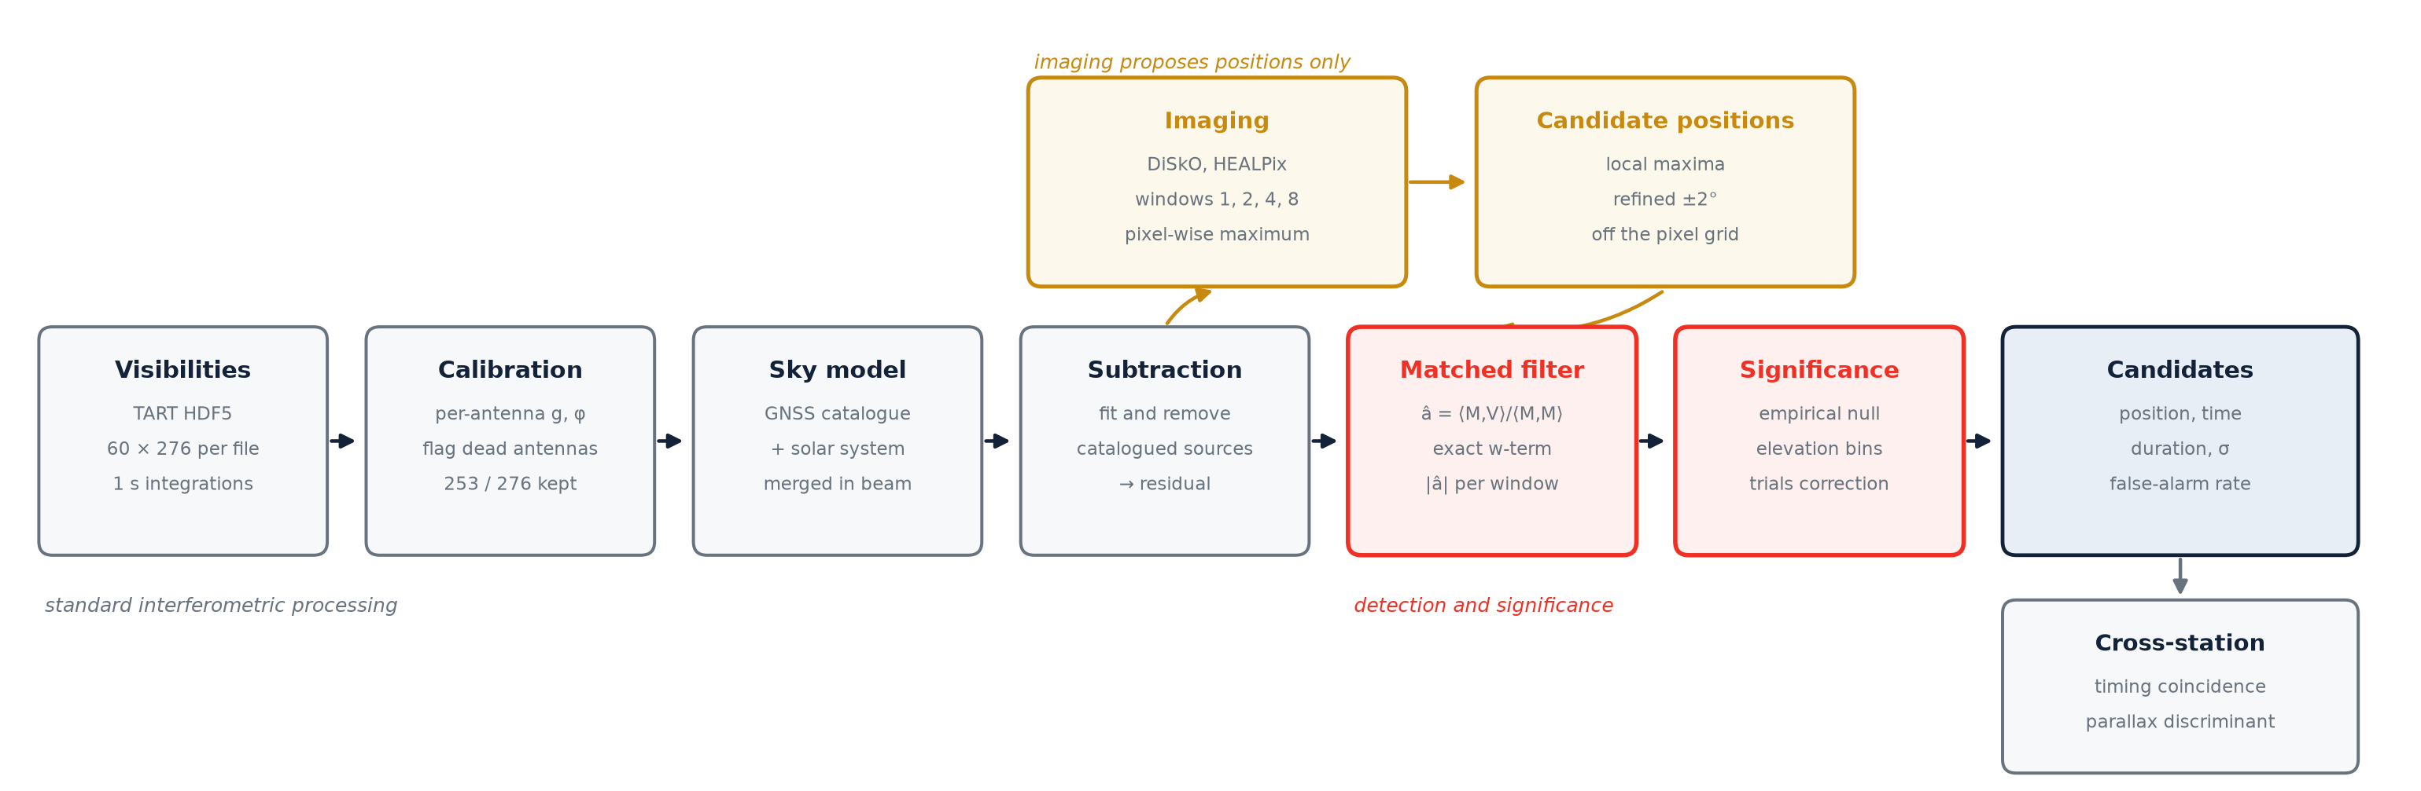
METHOD
The pipeline
Raw visibilities to candidates with calibrated significance.
3
S. K. Mukungu · MPhil Physics, University of Namibia

Slide 5
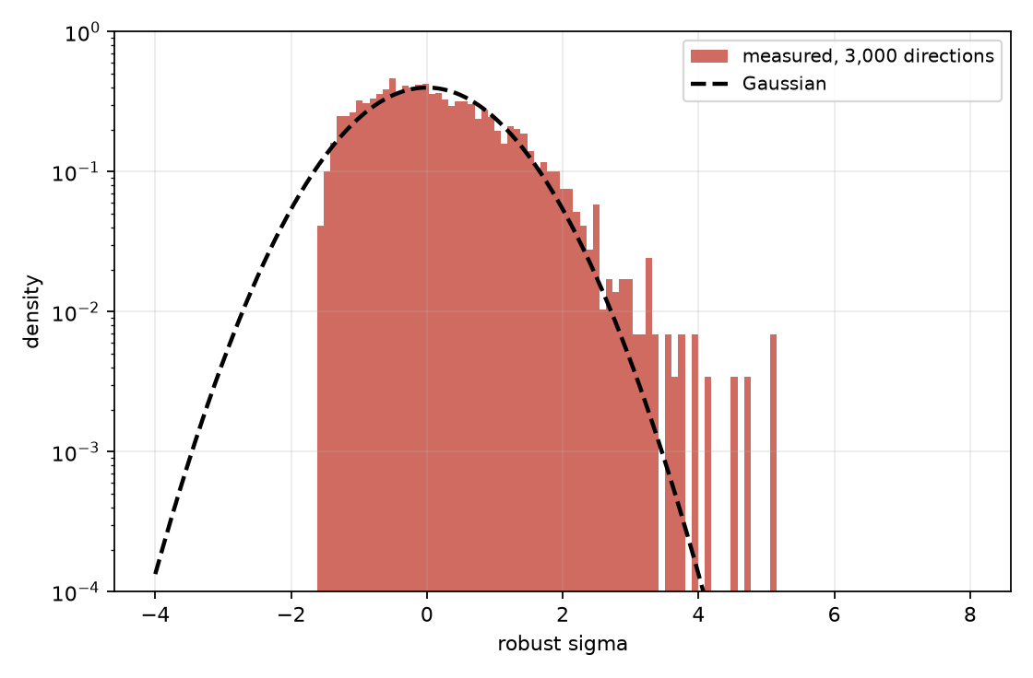
STATISTICS
Measured thresholds
Empirical null
Thresholds from 20,000 random sky directions.
Elevation bins
Tail ~35% heavier below 20°. Scaled at 99th percentile.
Trials correction
Null distribution, 3,000 directions (red), and Gaussian (dashed).
N(≥ρ) = N̂ exp(−ρ/ρ̂), solved for target false alarms.
4
S. K. Mukungu · MPhil Physics, University of Namibia

Slide 6
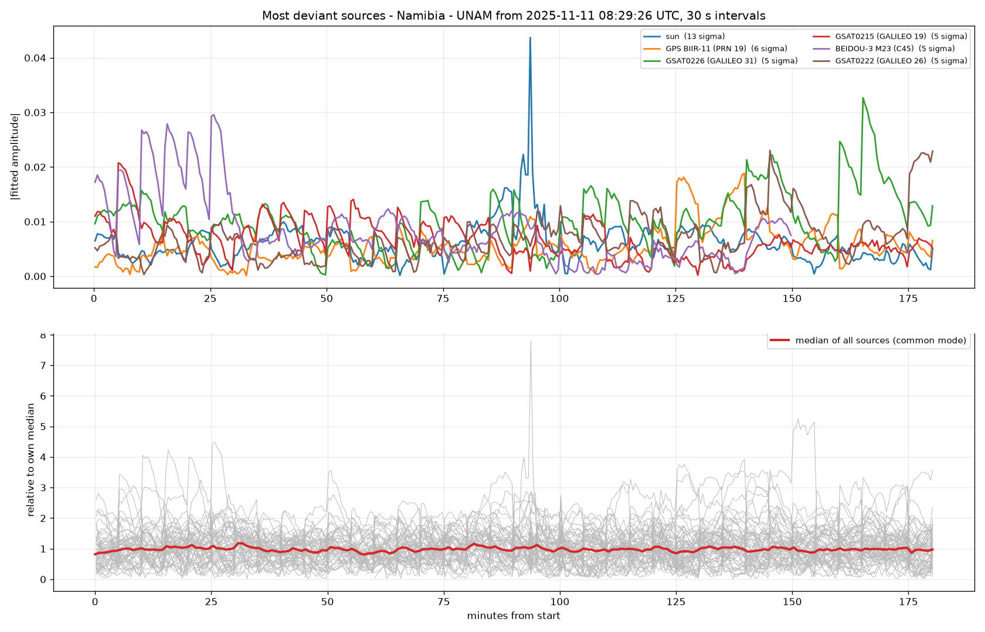
RESULT
Blind detection: 2025 November 11
na-unam, 3 h, 30 s sampling. Sun 13.3σ; next source 5.7σ. Onset 10:01:11, peak 10:03:11 UT; above threshold ~150 s.
5
S. K. Mukungu · MPhil Physics, University of Namibia

Slide 7
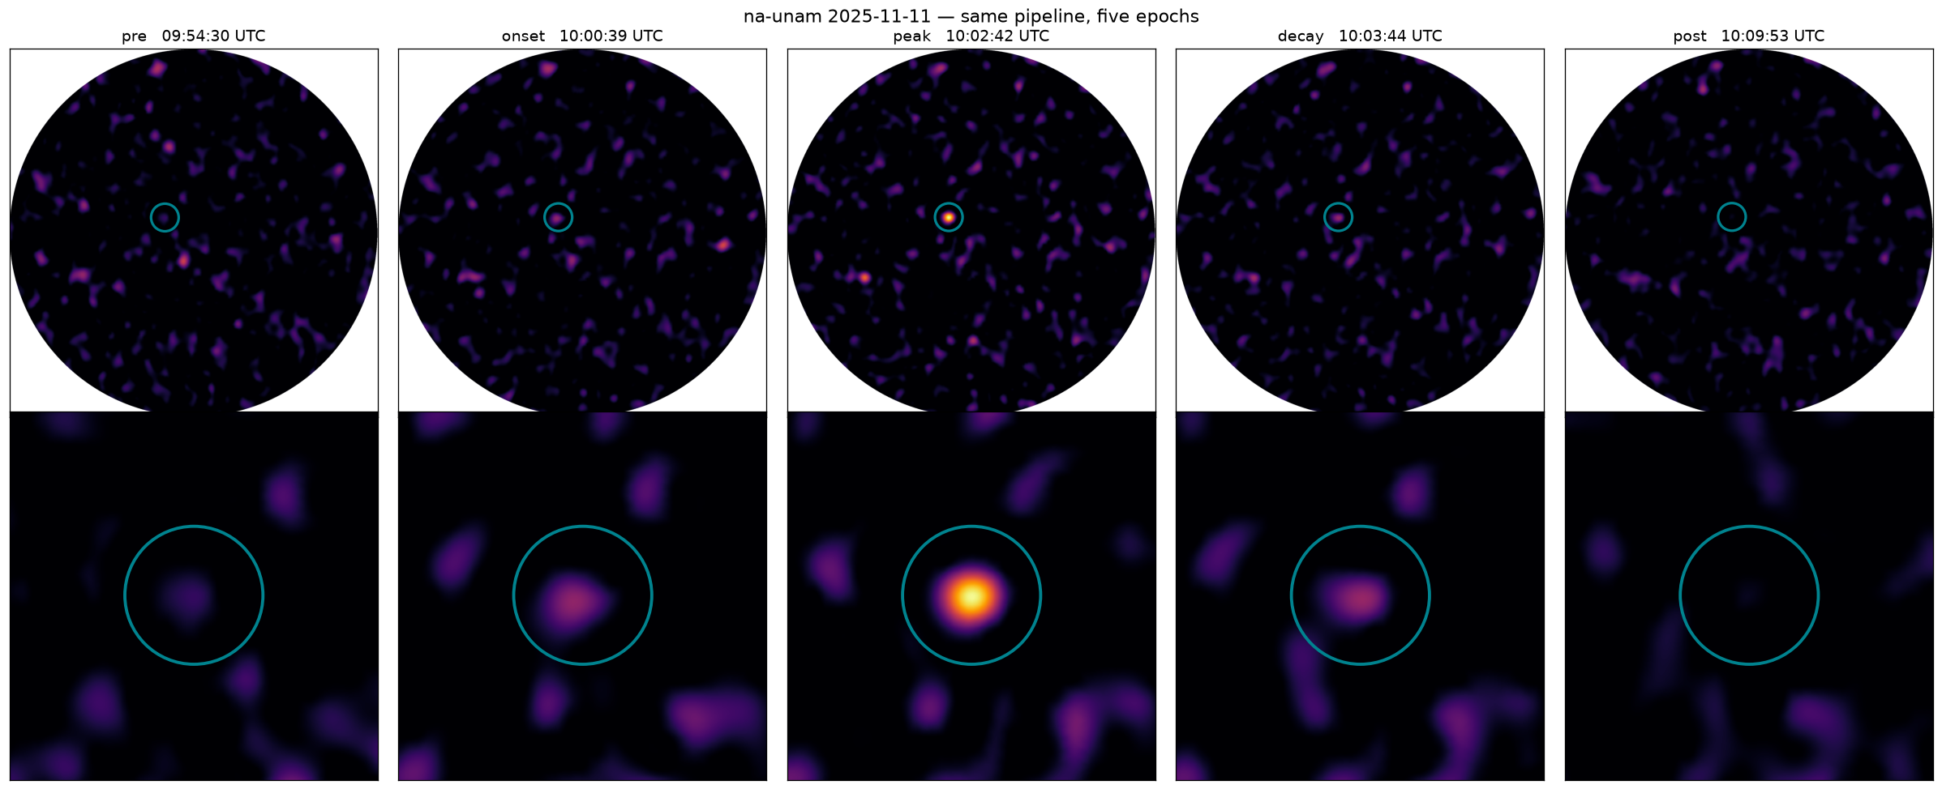
RESULT
Independent confirmation
Five calibrated and imaged epochs.
Three stations
USAF RSTN
Astrometry
Peak times agree to 0.01 min.
53,000 sfu at 1415 MHz.
0.00° from ephemeris, all epochs.
6
S. K. Mukungu · MPhil Physics, University of Namibia

Slide 8
VALIDATION
Unattended search over archival data
12 station-days, no prior on position or time.
ghana
za-rhodes
controls
10:03:12 UT
same second
no alarms > 5σ
31.3σ, 0.3° from the Sun
16.8σ, 3,000 km away
~330,000 s, limit ~10⁻⁵ s⁻¹
7
S. K. Mukungu · MPhil Physics, University of Namibia

Slide 9
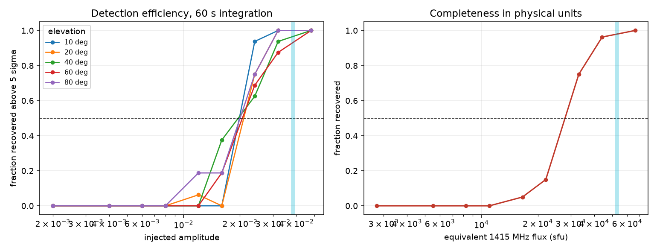
RESULT
Sensitivity by injection
Detection floor
41,800 sfu
extrapolated
28,400 sfu
injection-measured
22,700 sfu
720 synthetic sources, known amplitude, recovered through the full pipeline.
after track subtraction
8
S. K. Mukungu · MPhil Physics, University of Namibia

Slide 10
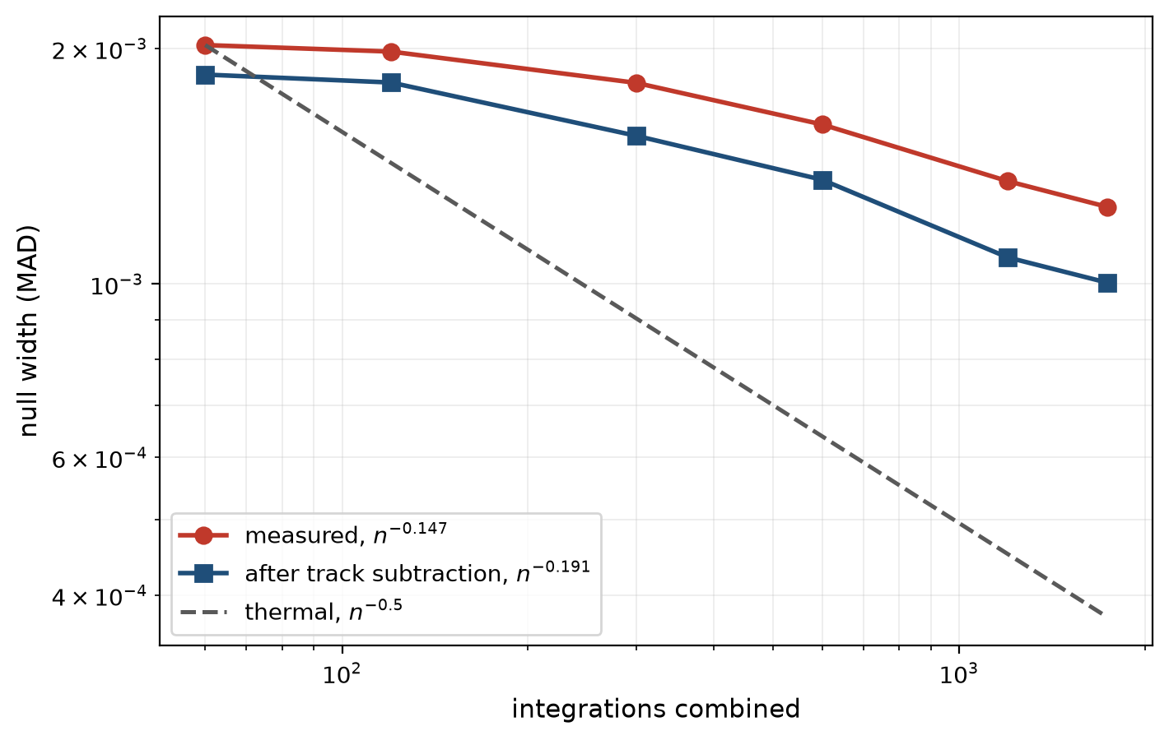
KEY FINDING
Integration scaling
n⁻⁰·¹⁴⁷ measured
Thermal expectation n⁻⁰·⁵. 29× more data gives 1.6×, not 5.4×.
Sidelobe-limited
Bright GNSS sources through 20% PSF sidelobes, not thermal noise.
After track subtraction
Null width against integrations combined.
Moving sources fitted and removed, no gain solution. n⁻⁰·¹⁹¹; floor 28,400 → 22,700 sfu.
9
S. K. Mukungu · MPhil Physics, University of Namibia

Slide 11
LIMITS
Detection limits
FRB 20251229A, recorded at three stations. Not detected.
Storage
1 s integrations
No archived data below 1 s. A 1 ms burst is averaged with 999 ms.
Geometry
below every horizon
CHIME transits over Canada; no TART station within ~90° longitude.
Sensitivity
2.8 × 10⁶
Single-second threshold 4.5 × 10⁸ Jy·ms against 160 Jy·ms.
10
S. K. Mukungu · MPhil Physics, University of Namibia

Slide 12
CONCLUSION
Summary
Blind detection and localisation
solar radio burst, 13.3σ, calibrated false-alarm rate
Sensitivity by injection
floor 28,400 sfu, 22,700 sfu after track subtraction
Sidelobe-limited
n⁻⁰·¹⁴⁷ against thermal n⁻⁰·⁵
Transferable methods
empirical nulls, tail-fitted trials, windowed search, multi-site parallax
github.com/shecode-hue/tart-transient-search
11
S. K. Mukungu · MPhil Physics, University of Namibia

Slide 13
BIBLIOGRAPHY
References
Thompson, Moran & Swenson (2017)
Interferometry and Synthesis in Radio Astronomy, 3rd ed.
Alard & Lupton (1998)
ApJ 503, 325
Fridman (2010)
MNRAS 409, 808
Law & Bower (2012)
ApJ 749, 143
Anderson et al. (2019)
OVRO-LWA all-sky search. ApJ
Murphy et al. (2017)
Dawes Review 13. PASA
Scheel (2019)
PhD thesis, University of Otago
Molteno & Scheel (2019)
ICEAA
Mtetho (2021)
MSc thesis, Stellenbosch University
Mutula & Dusabe
Kenya Space Agency
NOAA / SWPC
USAF RSTN 1415 MHz records
12
S. K. Mukungu · MPhil Physics, University of Namibia

Slide 14
HELD BACK
Detection requirements
1. Notice
2. Localise
3. Exclude
a change, in data where satellites rise, transit and set
the change on the sky
interference, satellites, calibration failure
13
S. K. Mukungu · MPhil Physics, University of Namibia

Slide 15
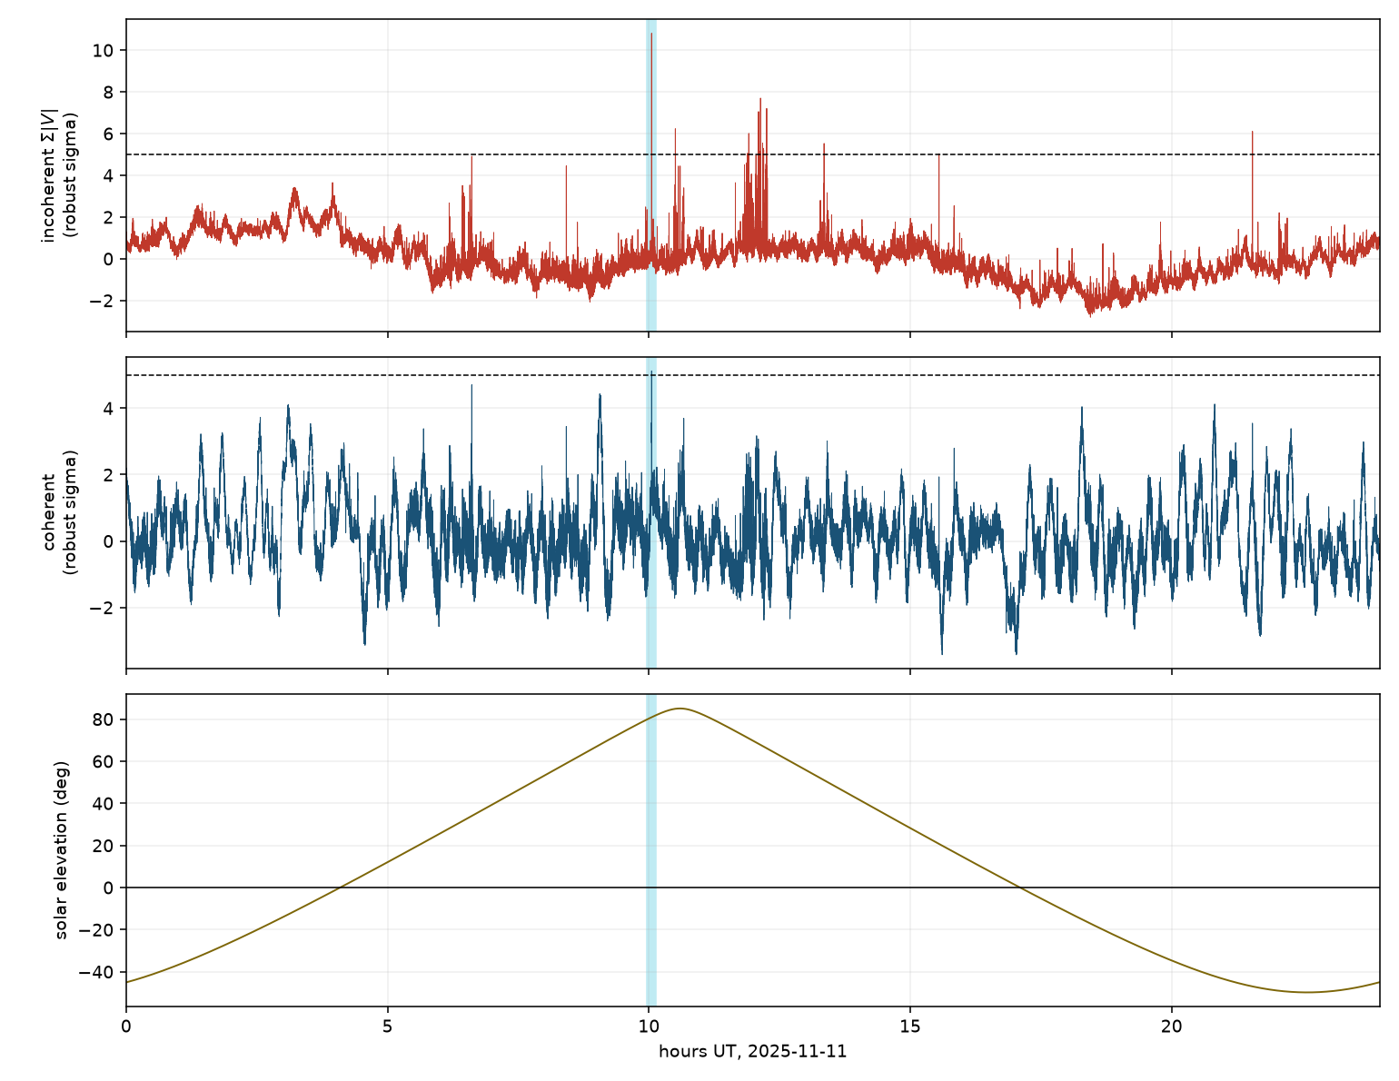
HELD BACK
Coherent and incoherent statistics
Peaks above 5σ
9
incoherent Σ|V|
1
coherent matched filter
One incoherent peak with the Sun 47° below the horizon.
Same station-day, both statistics, 5σ threshold.
14
S. K. Mukungu · MPhil Physics, University of Namibia

Slide 16
BACKUP
Unidentified event
2025 November 11, 21:32:48 UT, na-unam. 43.8σ, 5 s duration.
static to 0.25° / 5 s
not LEO or aircraft
absent at za-rhodes, mu-udm
not celestial
Sun 47° below horizon
not solar
above geostationary arc
not GEO
cloud-free, 0 mm (ERA5)
not lightning
no fireball or GRB match
catalogues checked
112 GNSS satellites
nearest 17.6°
15
S. K. Mukungu · MPhil Physics, University of Namibia

Slide 17
BACKUP
Reproducibility
Before refinement
After refinement
31.0σ and 15.9σ
38.1σ twice
Same input file. ~1° pixels, random visibility subsampling.
Coarse-to-fine local maximisation, ±2°.
16
S. K. Mukungu · MPhil Physics, University of Namibia

Slide 18
BACKUP
Toolchain patches
tart2ms elevation cut
Solar-system positions
Satellite catalogue filtered at 45°, not configurable. Field extends to ~5°.
Catalogue position differs from the ephemeris by 9.3°. Cause not identified.
17
S. K. Mukungu · MPhil Physics, University of Namibia

