Slide 1
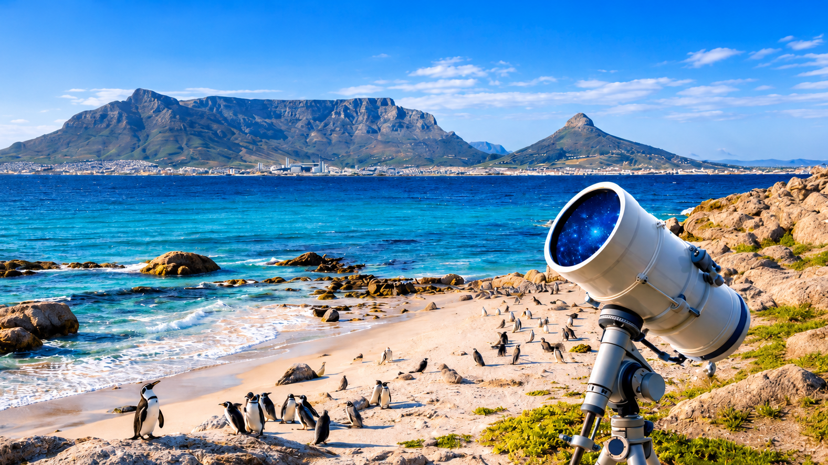


Extending the Cosmic Distance
Ladder to High Redshifts with Gamma-Ray Bursts
Tamador Aldowma
Soebur Razzaque, Saeeda Sajjad, Adrita Khan, Maria Dainotti , and Ankur Gosh
HEASA 2026 (29 Sep – 02 Oct)

Slide 2
Outline
Brief Introduction
The LADDER Framework
GRB Calibration and Extension to High Redshift
Updated Datasets
Redshift Estimation through Correlation Inversion
Preliminary Results
Summary
1

Slide 3
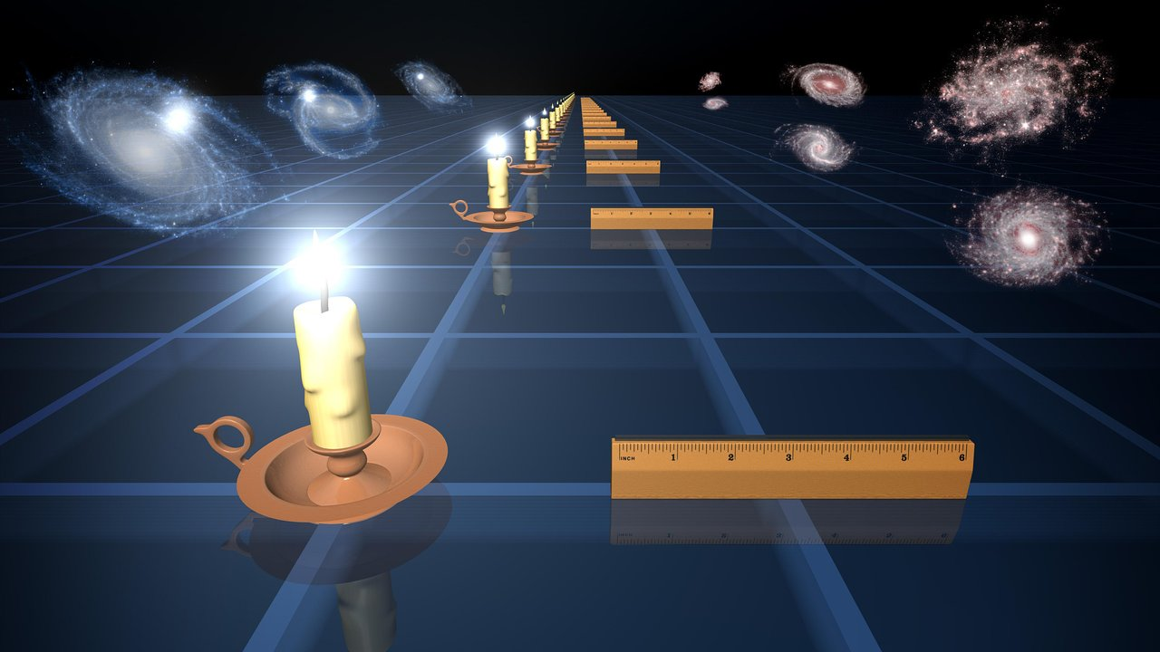
Introduction
Type Ia supernovae (SNe Ia) act as standardizable candles to measure cosmic distances.
Their Hubble diagram shows how distance changes with redshift.
(Scolnic et al., 2022).
GRBs reach higher redshifts, potentially extending this diagram into the early Universe (Cucchiara et al., 2011; Liang et al., 2008).
The circularity problem:
Calibrating GRB energy and luminosity correlations, such as Amati and Yonetoku, requires luminosity distances. If these distances are calculated using an assumed cosmology, subsequently using the calibrated correlations to constrain cosmology introduces circularity (Liang et al., 2008).
Credit: NASA/JPL-Caltech
2

Slide 4
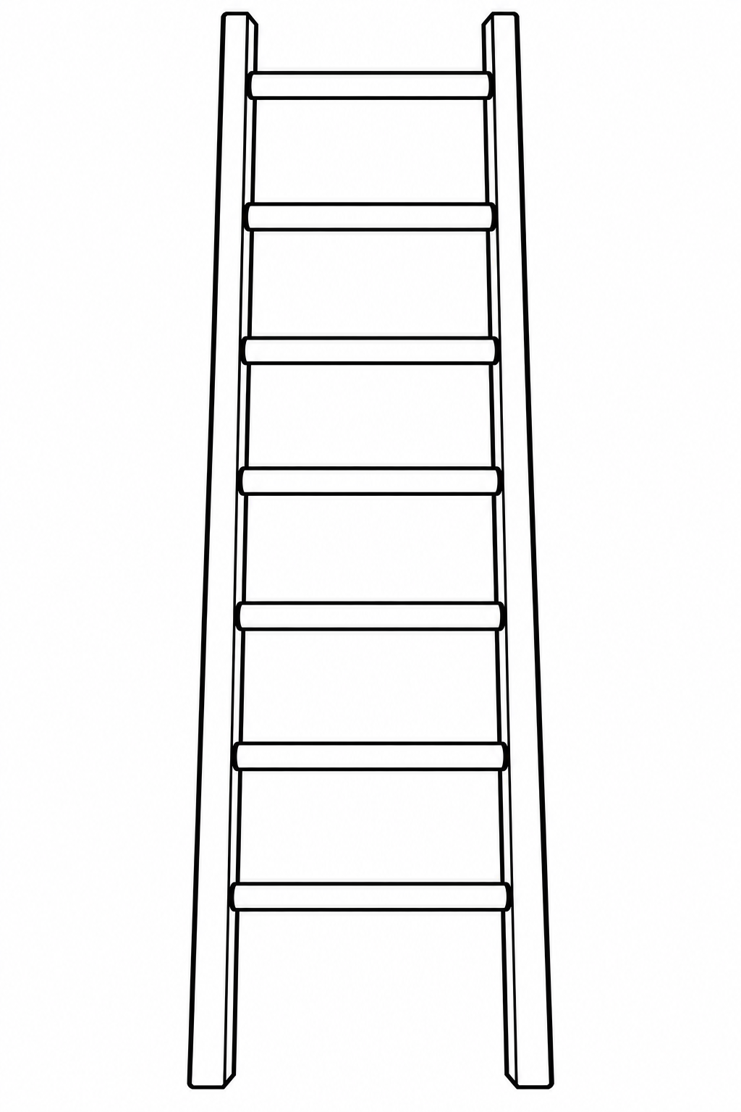
Introduction
Addressing the GRB Circularity Problem
SNe interpolation: Calibrate GRBs using SNe Ia distances (Liang et al., 2008).
Gaussian processes: Reconstruct SNe distances to calibrate Amati (Liang et al., 2022).
Joint fitting: Fit GRB correlations and cosmology simultaneously (Cao, Dainotti & Ratra, 2022; Aldowma, Razzaque, Martinelli et al., 2026).
Cosmic chronometers: Calibrate the Dainotti relation using chronometers and Gaussian processes (Favale et al., 2024).
Another approach, introduced by Shah et al. (2024), uses deep learning to reconstruct the supernova distance–redshift relation
Learning Algorithm for Deep Distance Estimation and Reconstruction
LADDER
3

Slide 5
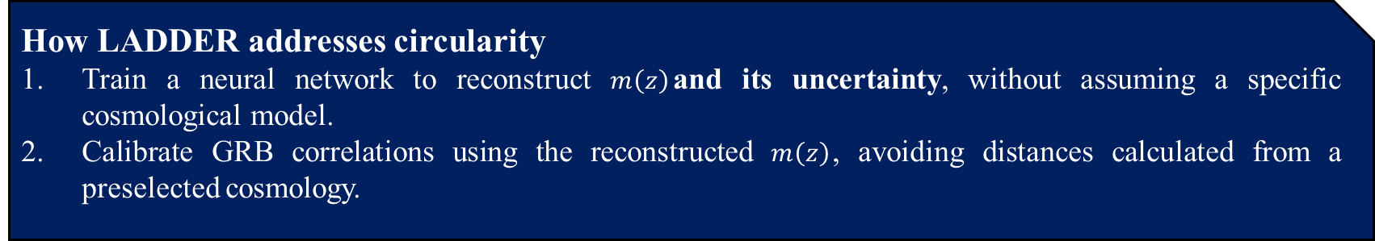

LADDER
From SNe to GRBs
The central idea of the LADDER approach (Shah et al., 2024) is to:
Reconstruct the apparent-magnitude–redshift relation directly from the observed SNe Ia Hubble diagram.
Transfer this information to GRBs with measured redshifts within the SNe calibration range.
Calibrate GRB correlations and apply them to higher-redshift GRBs to extend the Hubble diagram.
How LADDER addresses circularity
Train a neural network to reconstruct $m\left(z\right)$and its uncertainty, without assuming a specific cosmological model.
Calibrate GRB correlations using the reconstructed $m\left(z\right)$, avoiding distances calculated from a preselected cosmology.
$$z →[m_{LADDER}\left(z\right), σ_{LADDER}\left(z\right)]$$
4

Slide 6
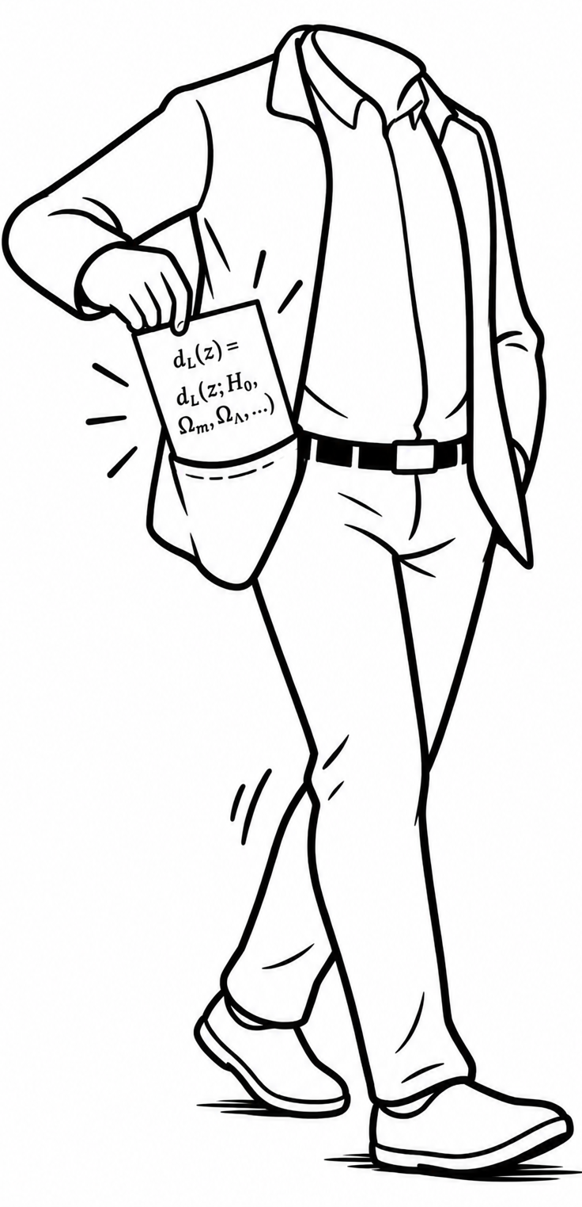
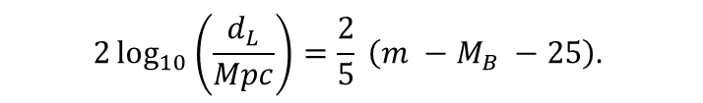
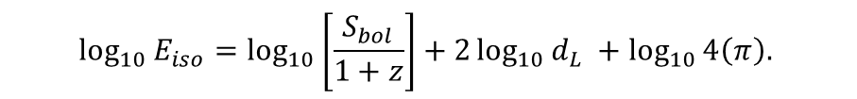
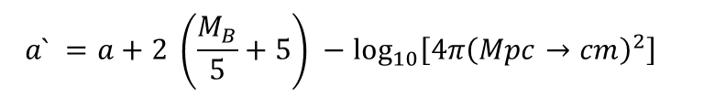
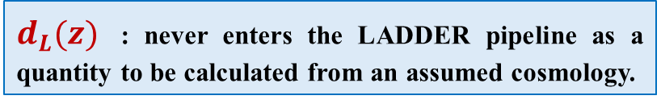
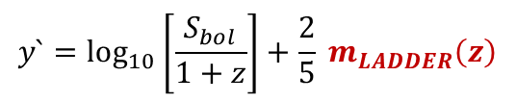


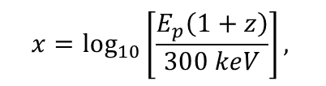
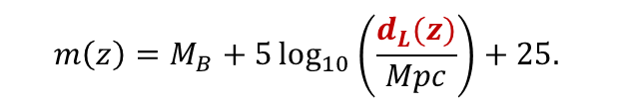

LADDER
To calibrate GRB using Amati relation
$$2\log_{10}\left(\frac{d_{L}}{Mpc}\right)=\frac{2}{5} \left(m −M_{B} −25\right).$$
$$μ\left(z\right)=m\left(z\right) −M_{B} ,$$
$μ\left(z\right)=5\log_{10}\left(\frac{d_{L}}{Mpc}\right)+25,$
$$\log_{10}{E_{iso}=\log_{10}\left[\frac{S_{bol}}{1+z}\right]+2\log_{10}{d_{L} }+\log_{10}{4\left(π\right).} }$$
$$m\left(z\right)=M_{B}+5\log_{10}\left(\frac{d_{L}(z)}{Mpc}\right)+25.$$
$$d_{L}\left(z\right)=d_{L}\left(z;H_{0}, Ω_{m}, Ω_{Λ}, …\right),$$
The Amati relation can consequently be rearranged into:
$d_{L}(z)$ : never enters the LADDER pipeline as a quantity to be calculated from an assumed cosmology.
$$y`=a`+bx$$
$$x=\log_{10}\left[\frac{E_{p}\left(1+z\right)}{300 keV}\right],$$
LADDER uses a recurrent neural-network architecture based on Long Short-Term Memory (LSTM) units to learn the statistical relation between redshift and apparent magnitude.
$$y`=\log_{10}\left[\frac{S_{bol}}{1+z}\right]+\frac{2}{5} m_{LADDER}\left(z\right)$$
SNe Ia data $P\left(m \right| z)$ $m_{LADDER}\left(z\right)$
$$a` =a+2 \left(\frac{M_{B}}{5}+5\right) −\log_{10}\left[4π{\left(Mpc→cm\right)}^{2}\right]$$
No GRB data are required to train the SNe reconstruction itself.
5

Slide 7
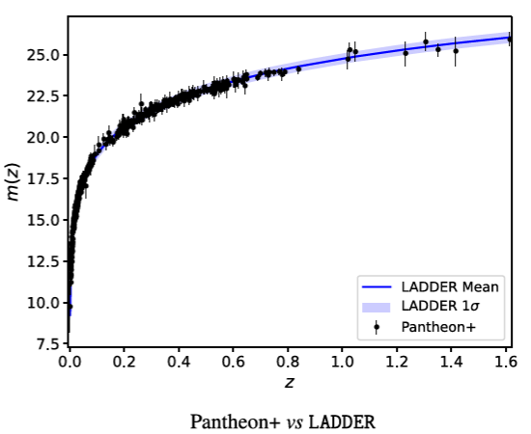
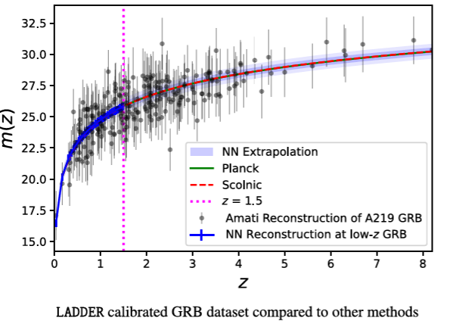
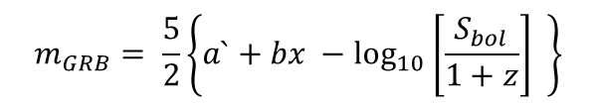
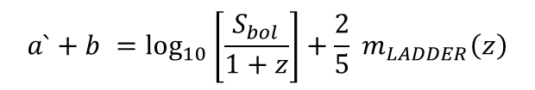
GRB Calibration and Extension to High Redshift
The calibration problem transformed into
$$z, E_{p}, S_{bol} +m_{LADDER\left(z\right)} →x, y` →a`, b, σ_{int}$$
then fit via Reichart (2001)
$$a`+b =\log_{10}\left[\frac{S_{bol}}{1+z}\right]+\frac{2}{5} m_{LADDER}\left(z\right)$$
$$m_{GRB}= \frac{5}{2}\left\{a`+bx −\log_{10}\left[\frac{S_{bol}}{1+z}\right] \right\}$$
140 GRBs (Liang et al. 2022)
Pantheon SNe Ia (Scolnic et al. 2018)
6
Shah et al., 2024

Slide 8
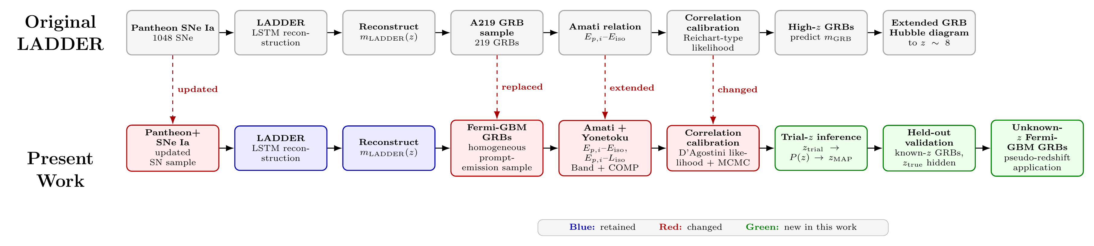
Updated Datasets
7

Slide 9
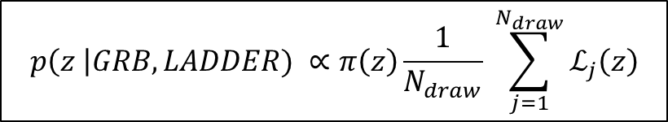
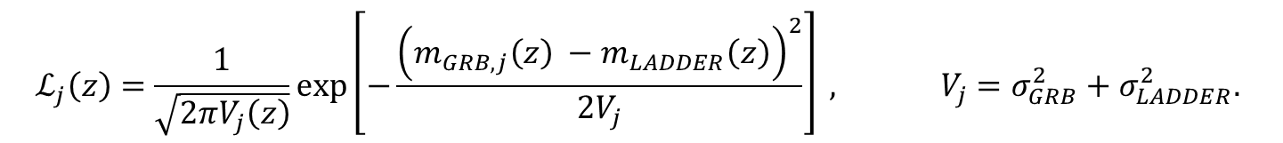

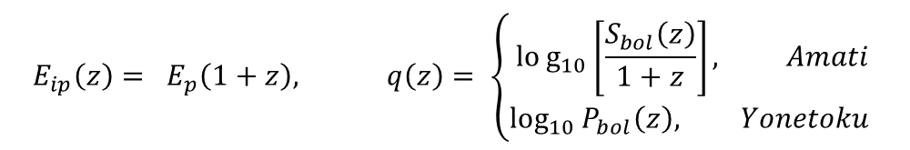
Redshift Estimation through Correlation Inversion
1. Recalculate the GRB quantities at each trial redshift ${z_{trial} ∈[z}_{min}, z_{max}]$
$$E_{ip}\left(z\right)= E_{p}\left(1+z\right), q\left(z\right)= \left\{\begin{aligned}log_{10}\left[\frac{S_{bol}\left(z\right)}{1+z}\right], Amati \\ \log_{10}{P_{bol}\left(z\right), Yonetoku }\end{aligned}\right.$$
2. Predict the magnitude using each calibration-posterior draw
$$m_{GRB_{j}}\left(z\right)= 2.5 [a_{j}`+b_{j}x\left(z\right) −q\left(z\right)$$
3. Compare the prediction with LADDER
$$ℒ_{j}\left(z\right)=\frac{1}{\sqrt{2πV_{j}\left(z\right)}}\exp\left[−\frac{{\left(m_{GRB,j}\left(z\right) −m_{LADDER}\left(z\right)\right)}^{2}}{2V_{j}}\right] , V_{j}=σ_{GRB}^{2}+σ_{LADDER}^{2}.$$
4. Average over calibration uncertainty to obtain the redshift posterior
$$p\left(z \right|GRB, LADDER) ∝π\left(z\right)\frac{1}{N_{draw}} \sum_{j=1}^{N_{draw}}{ℒ_{j}\left(z\right)}$$
8

Slide 10
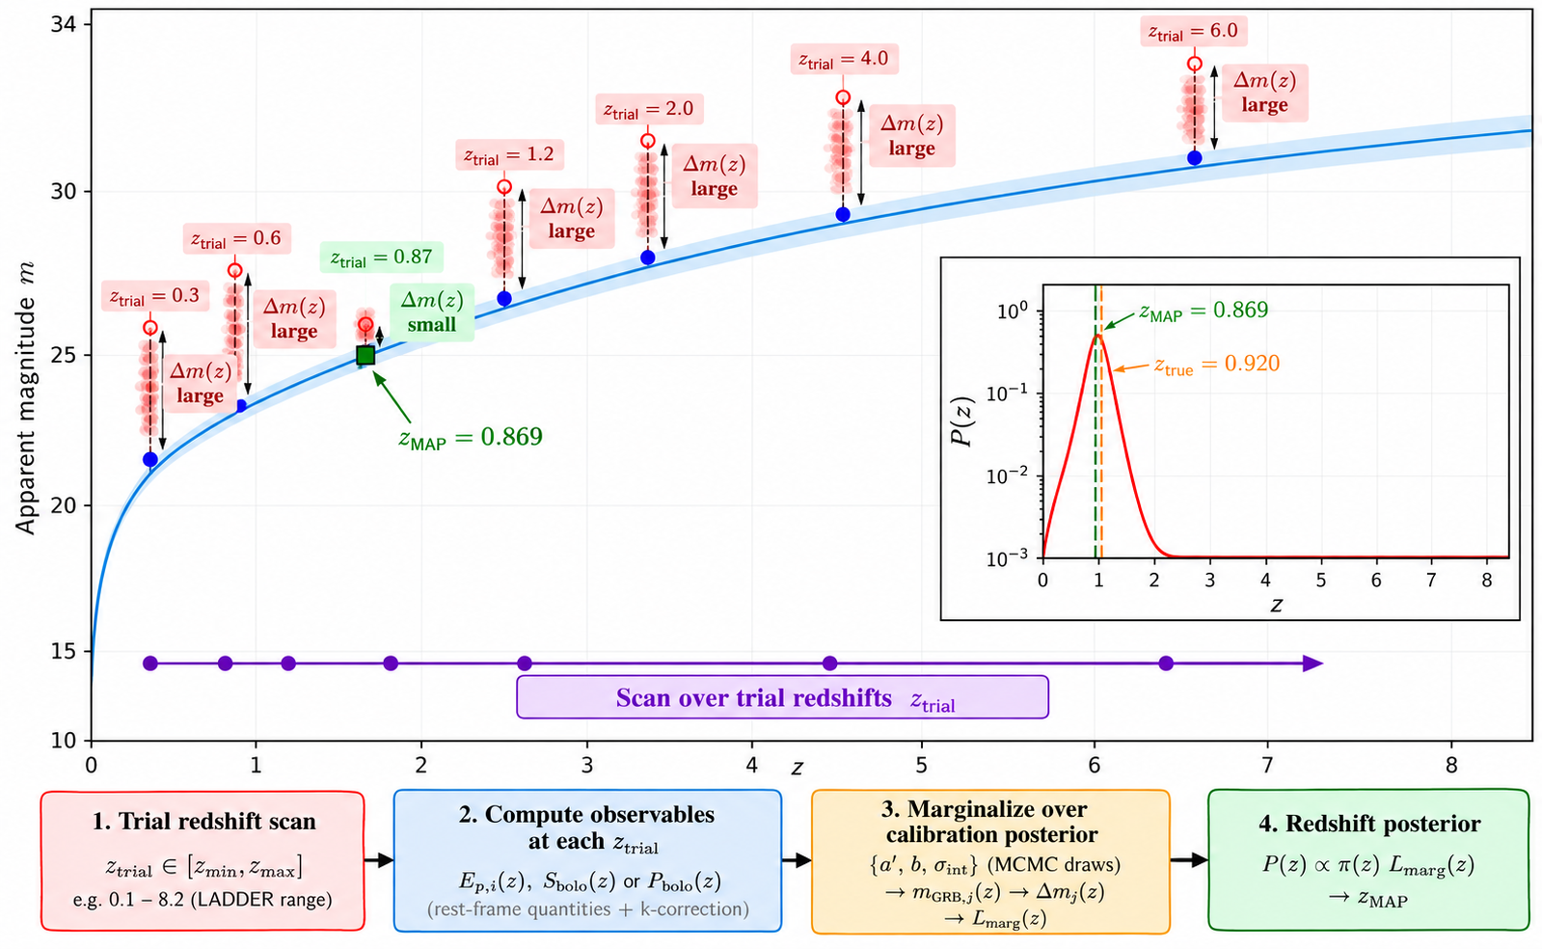
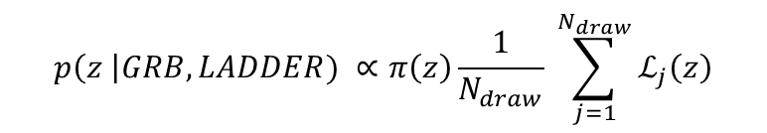
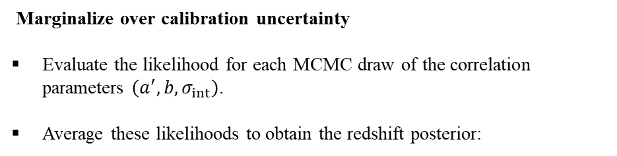
Redshift Estimation through Correlation Inversion
Marginalize over calibration uncertainty
Evaluate the likelihood for each MCMC draw of the correlation parameters $\left(a^{′} , b , σ_{int}\right)$.
Average these likelihoods to obtain the redshift posterior:
$$p\left(z \right|GRB, LADDER) ∝π\left(z\right)\frac{1}{N_{draw}} \sum_{j=1}^{N_{draw}}{ℒ_{j}\left(z\right)}$$
average over calibration uncertainty
9

Slide 11
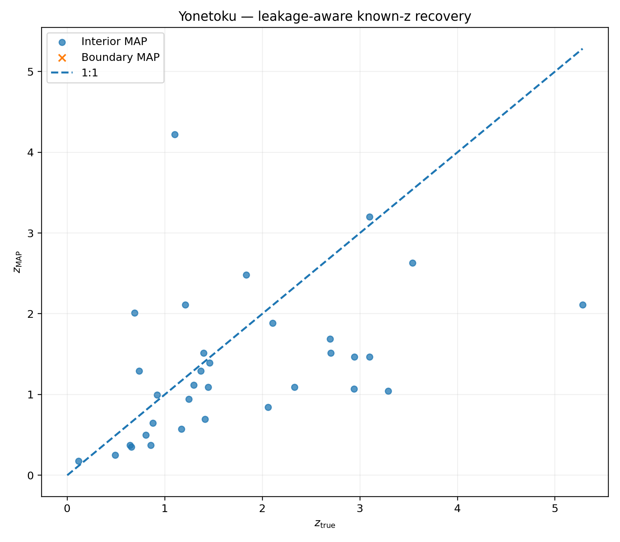
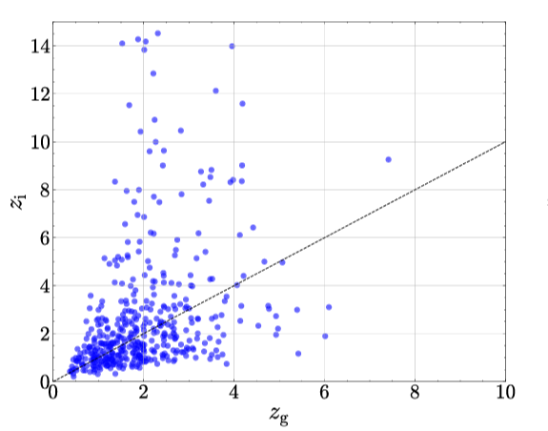
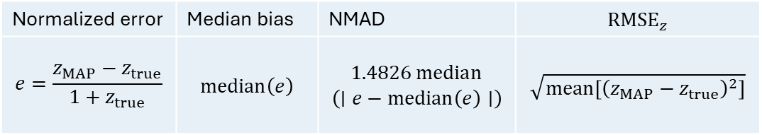
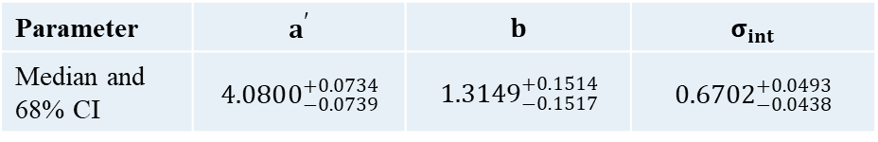
Preliminary results: Validation
Sample: Fermi-GBM
This work
Yonetoku – Comp
For each model, we repeated the train–validation split 20 times with different random seeds.
1
Calibration GRBs | 124
Held-out validation GRBs | 33
Parameter | $$a^{′}$$ | $$b$$ | $$σ_{int}$$
Median and 68% CI | $$4.0800_{−0.0739}^{+0.0734}$$ | $$1.3149_{−0.1517}^{+0.1514}$$ | $$0.6702_{−0.0438}^{+0.0493}$$
2
Normalized error | Median bias | NMAD | $${RMSE}_{z}$$
$$e=\frac{z_{MAP}−z_{true}}{1+z_{true}}$$ | $$median\left(e\right)$$ | $$1.4826 median$$ $$\left(∣e−median\left(e\right)∣\right)$$ | $$\sqrt{mean\left[{\left(z_{MAP}−z_{true}\right)}^{2}\right]}$$
3
4
Well-constrained | Narrow, informative redshift posterior
Weakly constrained | Broad or prior-sensitive redshift posterior
Emre S. Yorgancioglu et, al 2025
10

Slide 12
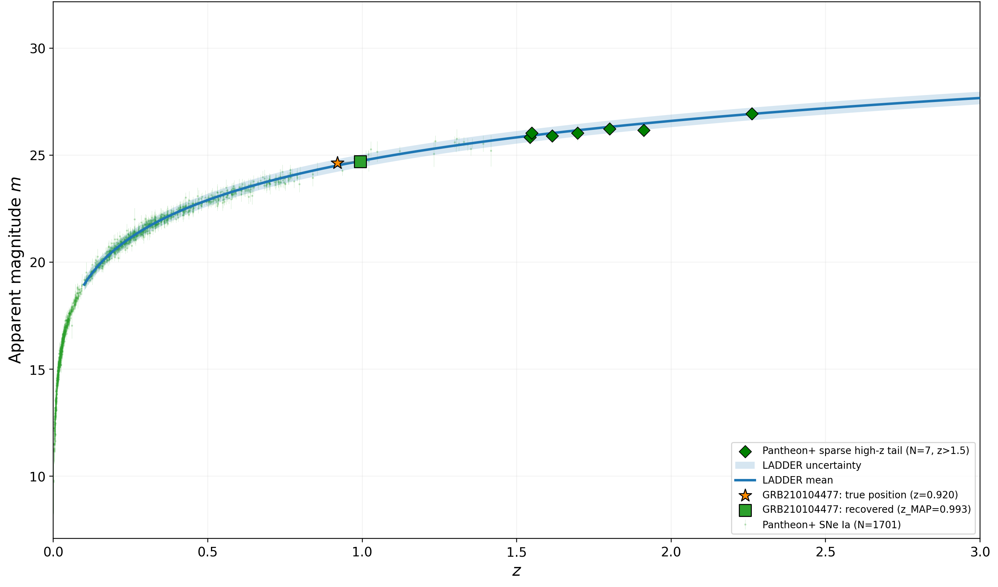
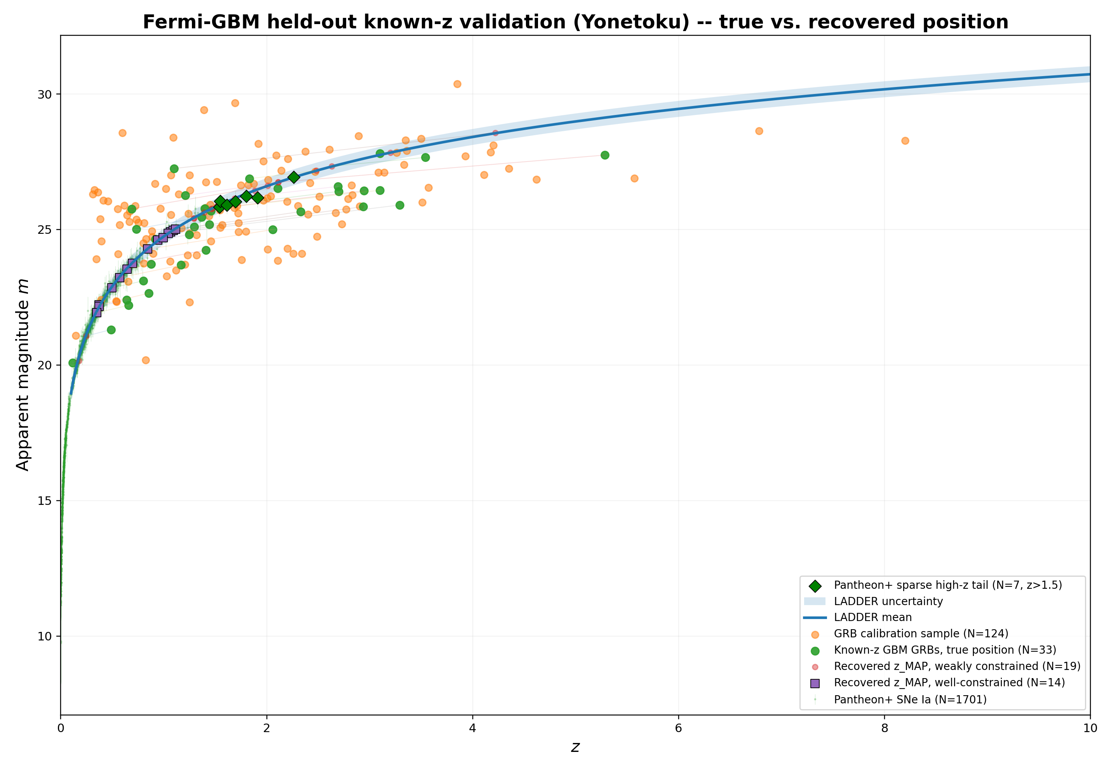
Preliminary results: Yonetoku relation - Band Model
This work
Yonetoku – Band
11

Slide 13
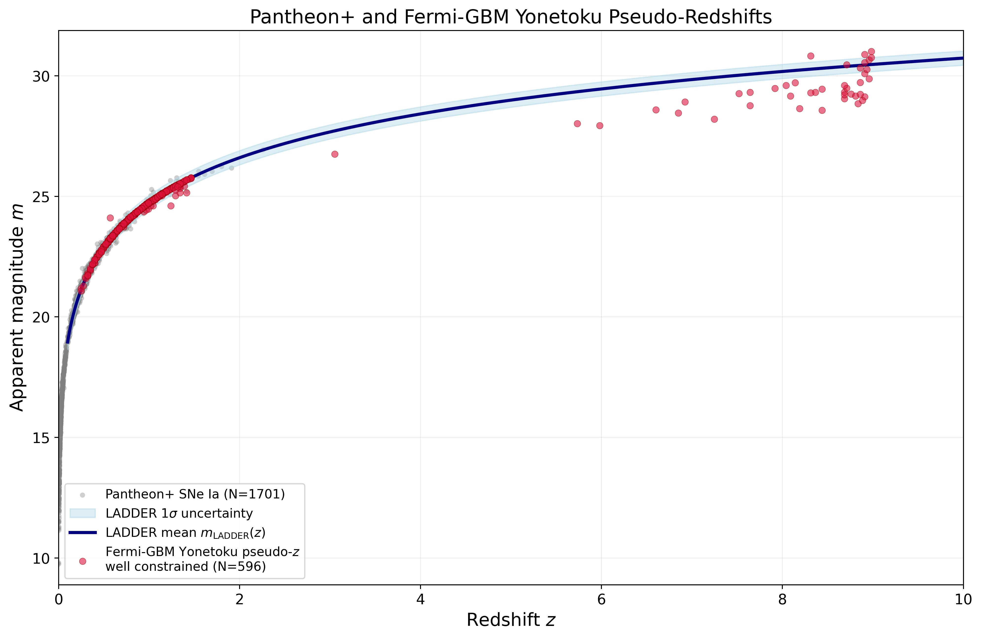
Summary
Yonetoku – Band
Following validation, apply the method to the full Fermi-GBM sample that meets our selection criteria.
Preliminary validation results favour Yonetoku for redshift estimation.
Amati provides weaker redshift constraints in our analysis.
Next steps: Retrain LADDER using alternative SNe Ia datasets (DES5Y, JLA, and the MASTER) sample and assess the impact on calibration and redshift estimates.
Preliminary results
12

Slide 14


Slide 15

Backup Slides

Slide 16
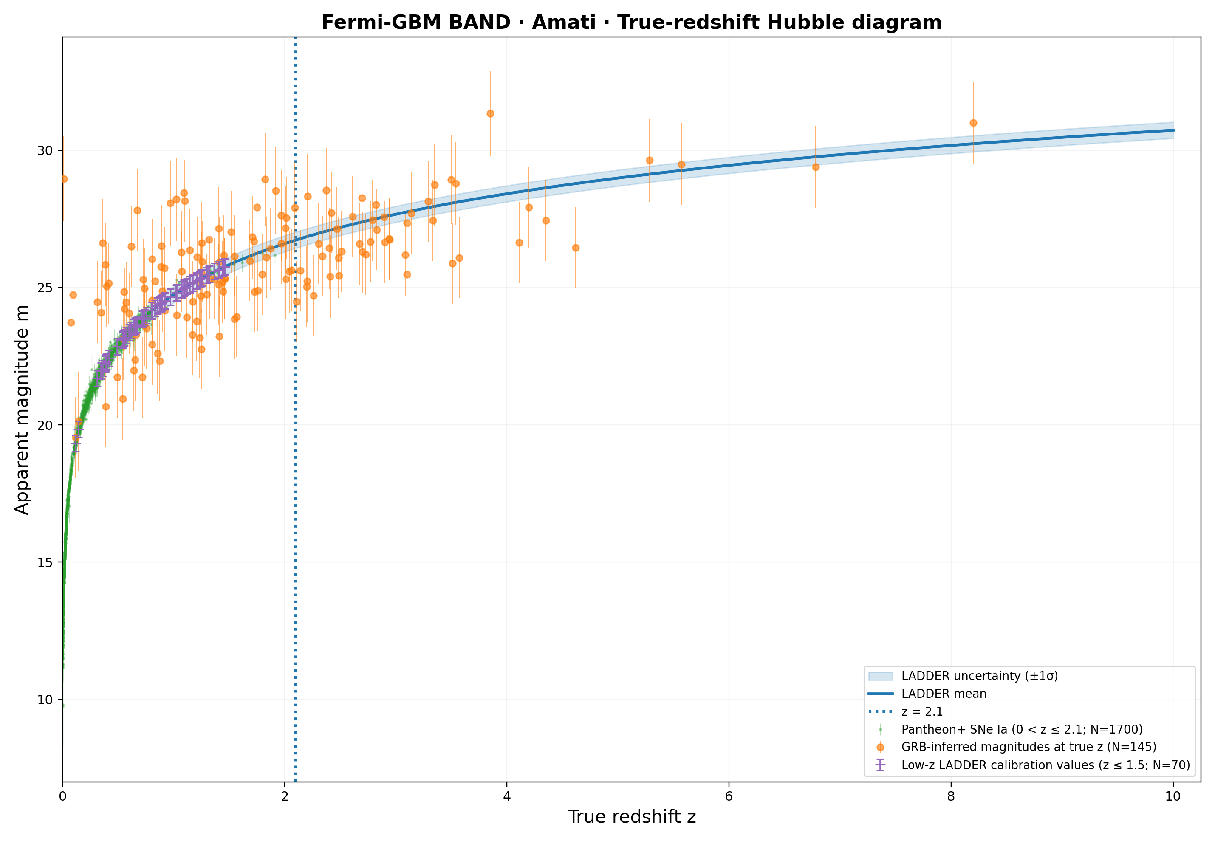
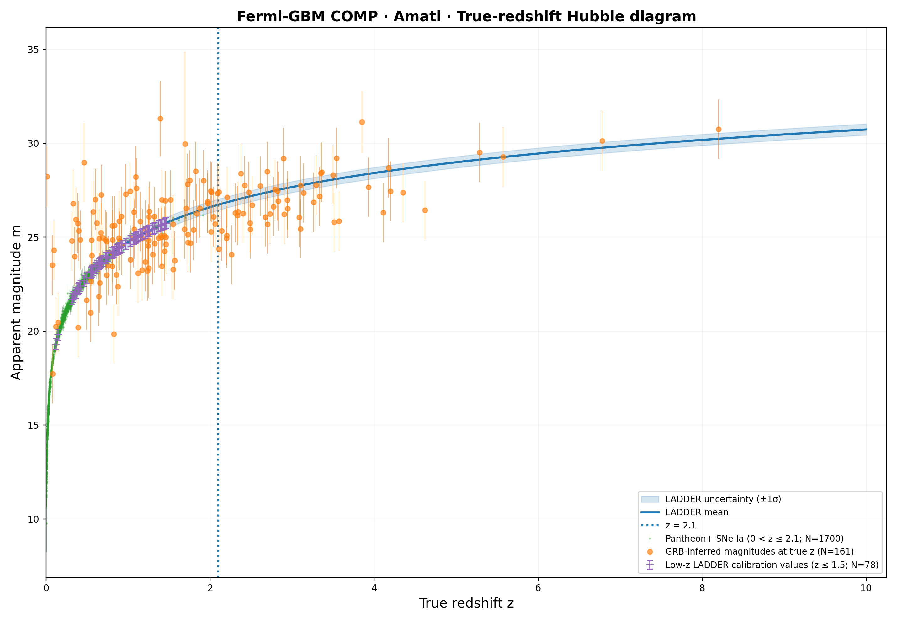
Backup
Preliminary results: Amati Relation - Band & Comp model
15

Slide 17
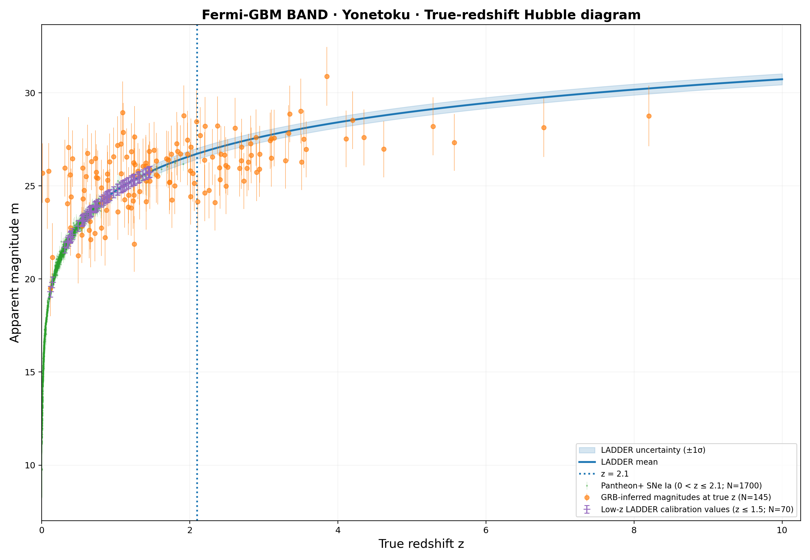
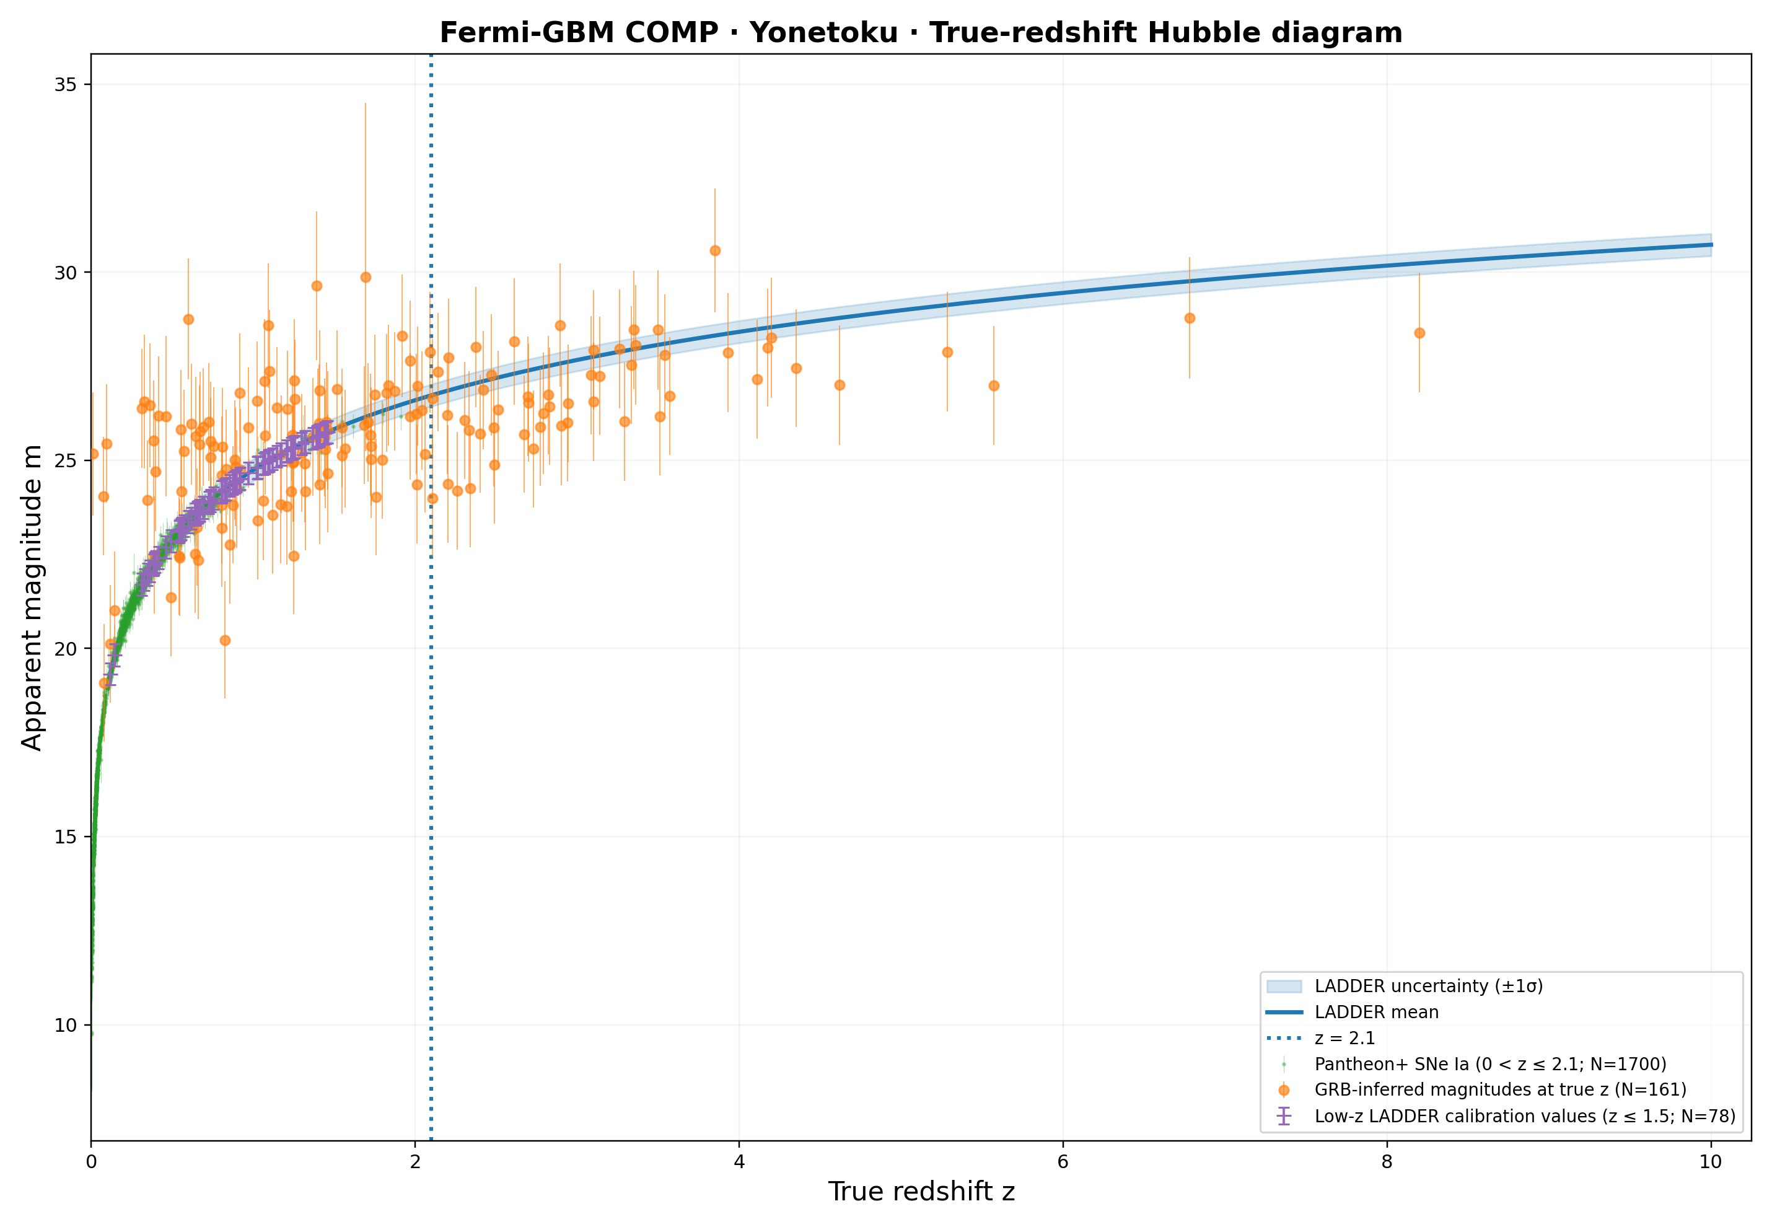
Backup
Preliminary results: Yonetoku Relation - Band & Comp model
16

Slide 18
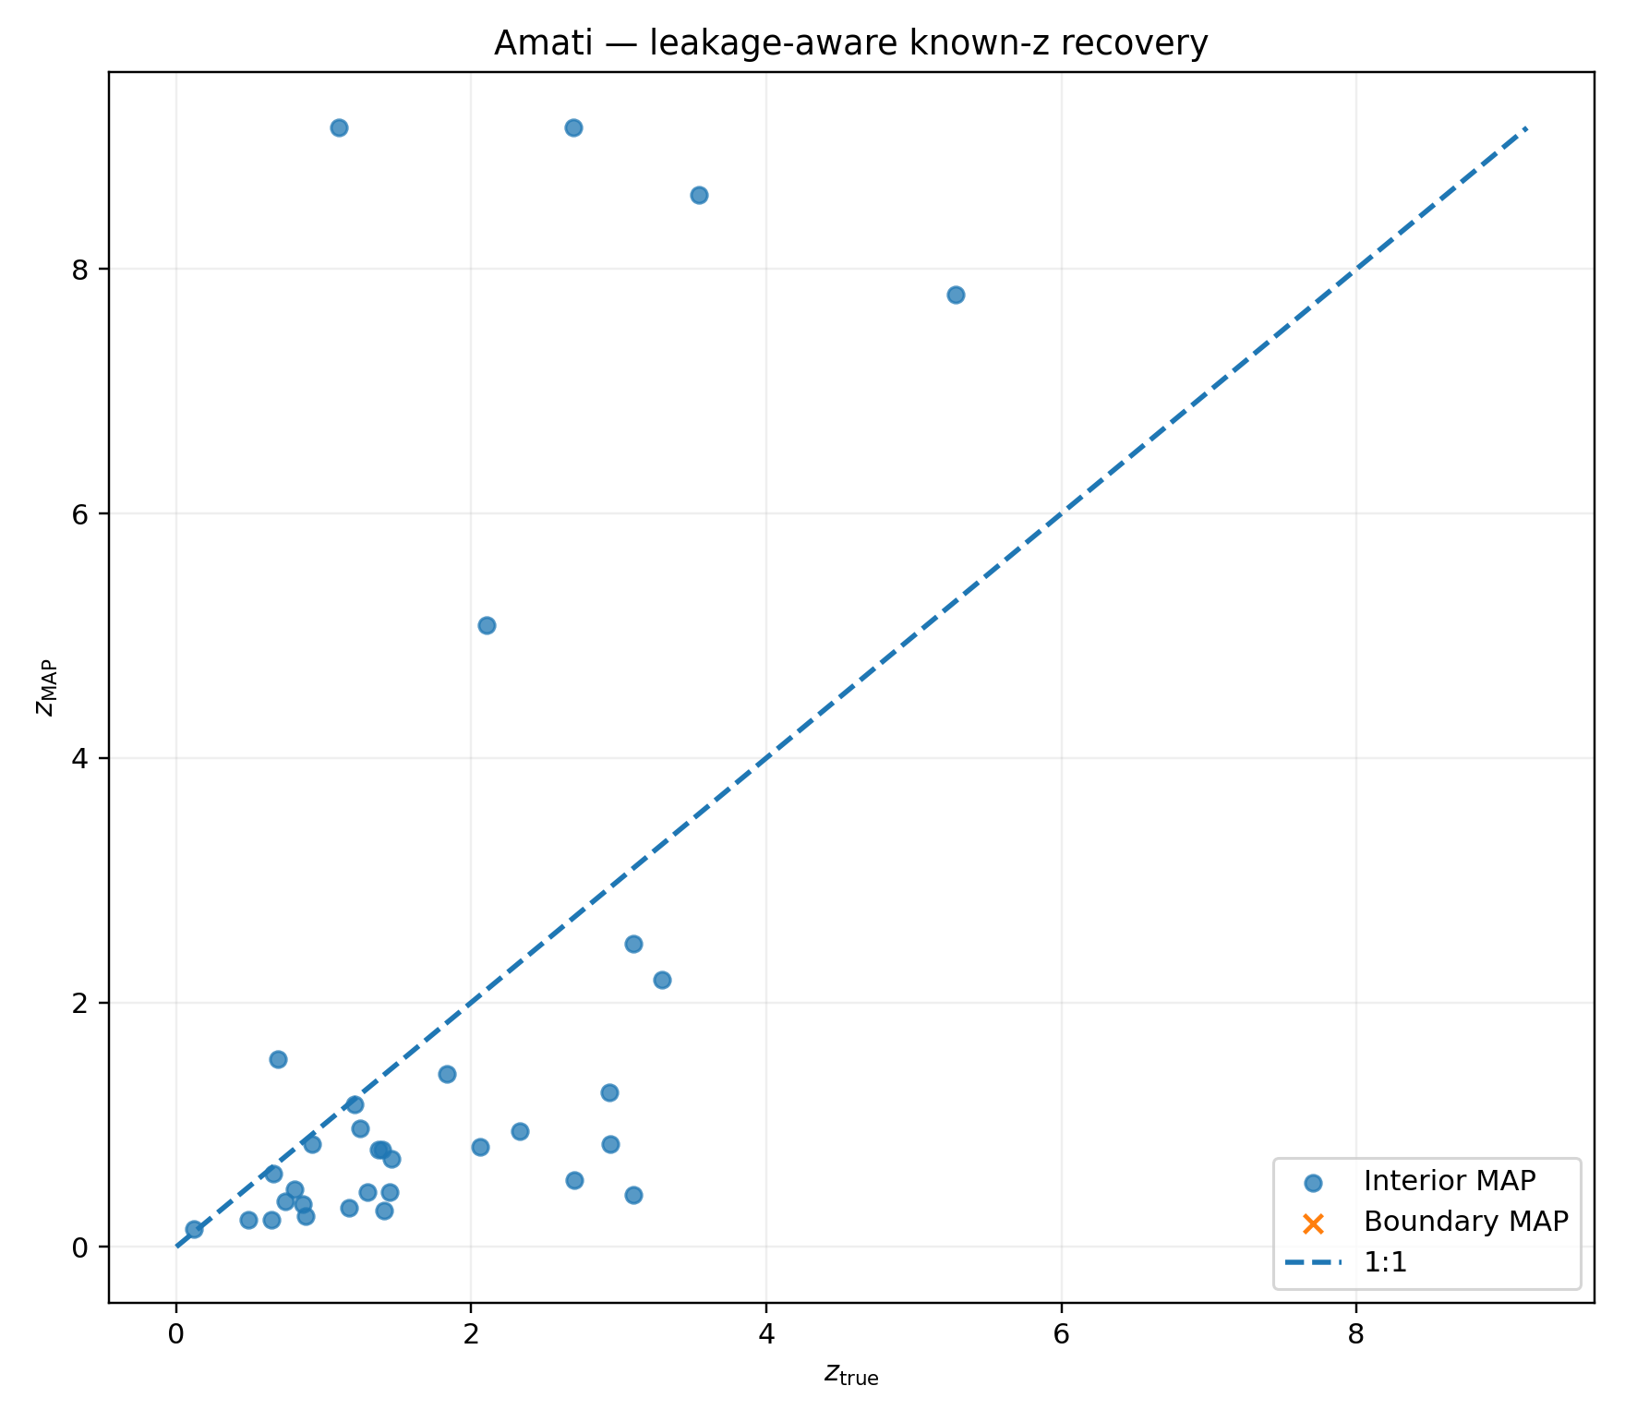
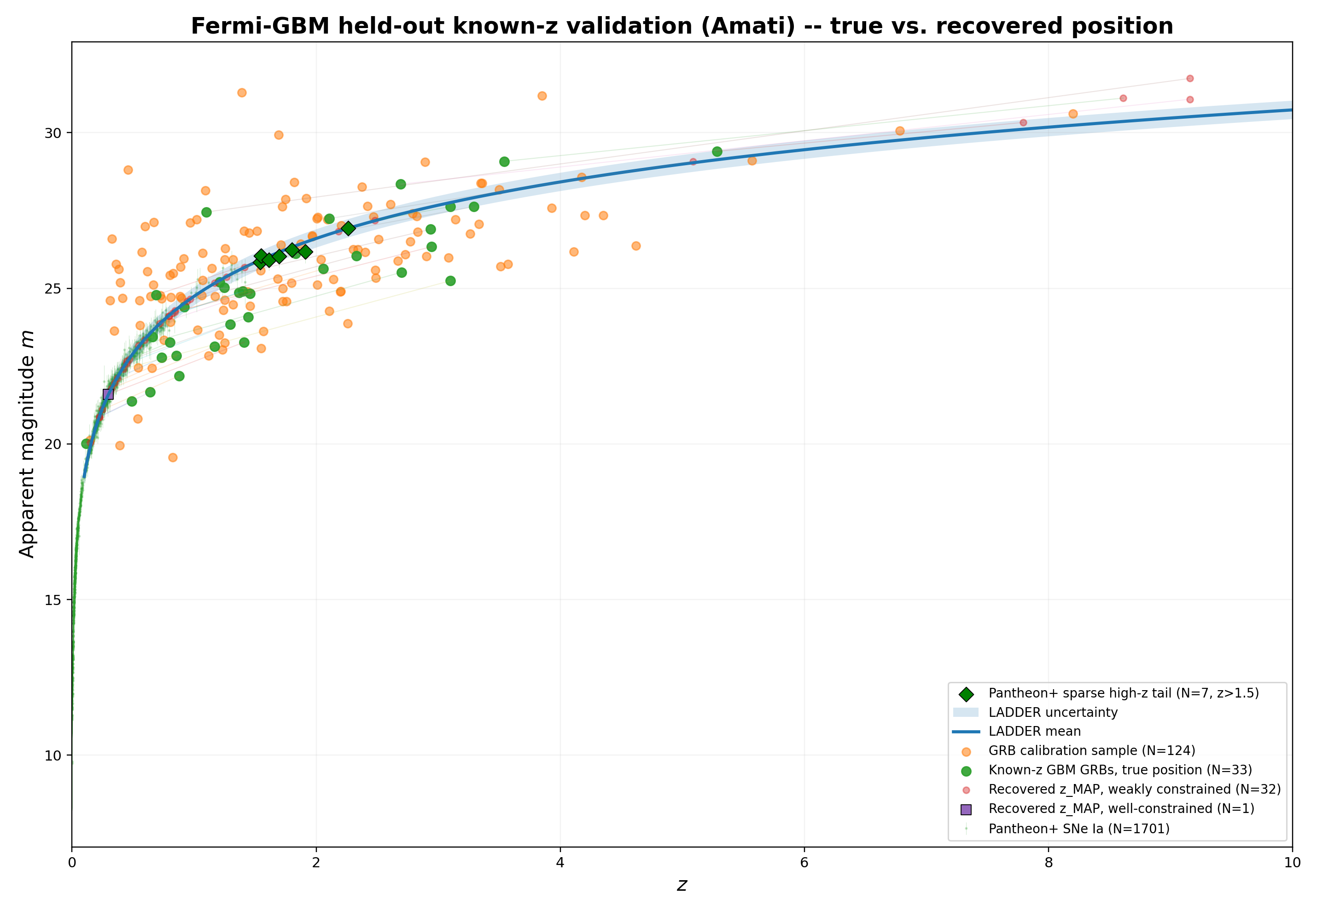
Backup
Preliminary results: Amati Relation - Band model
17

Slide 19
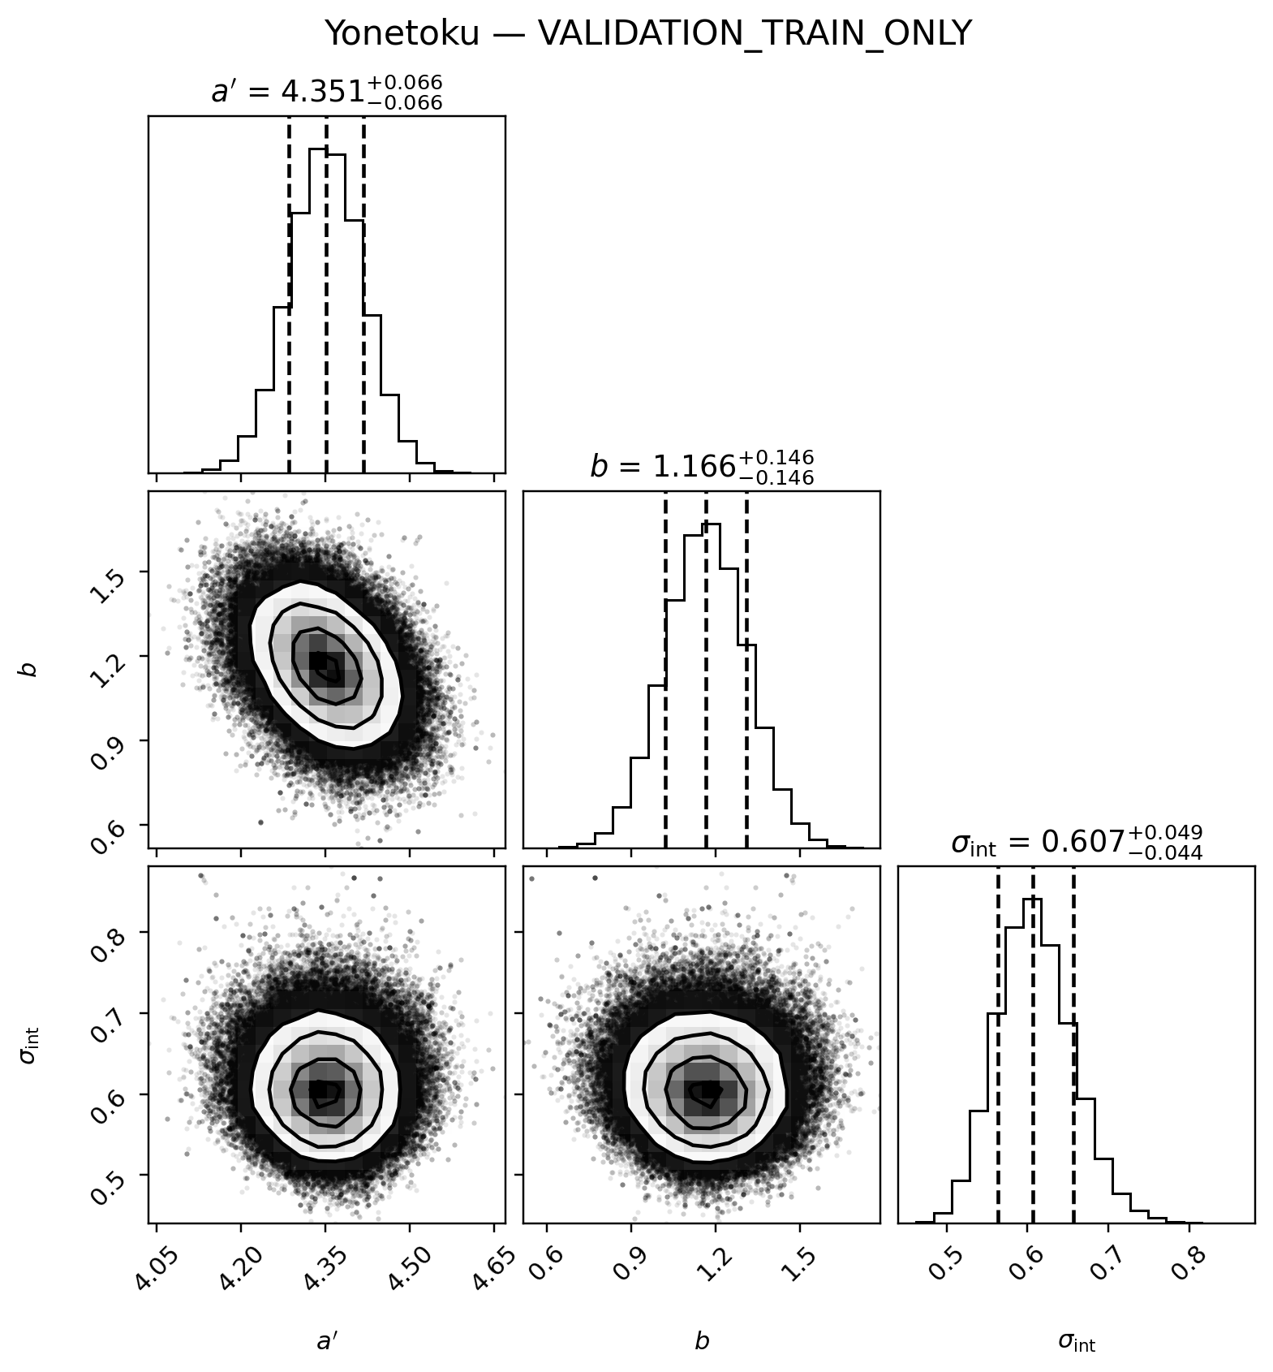
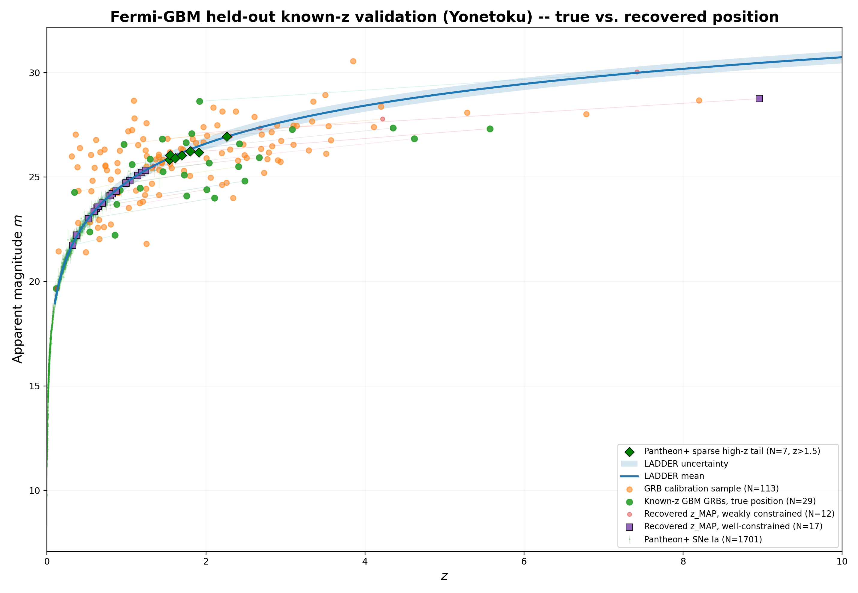
Backup
Corner Plot: Yonetoku relation – Band
18

