Slide 1

Probing Dark Matter-Photon Interactions with High Energy Gamma-Ray Observations
Khushboo Dixit
(kdixit@uj.ac.za)
HEASA, 30 Sep - 2 Oct 2026
with
Soebur Razzaque (CAPP, University of Johannesburg)
Nina Bavdaz, Gabrijela Zaharijas, Judit Perez (University of Nova Gorica, Slovenia)

Slide 2
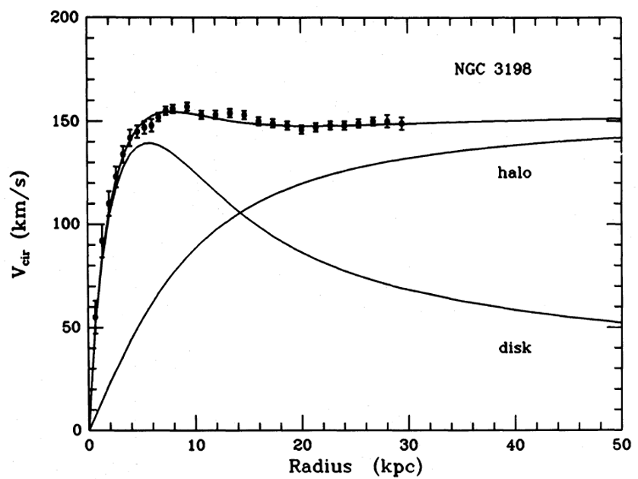
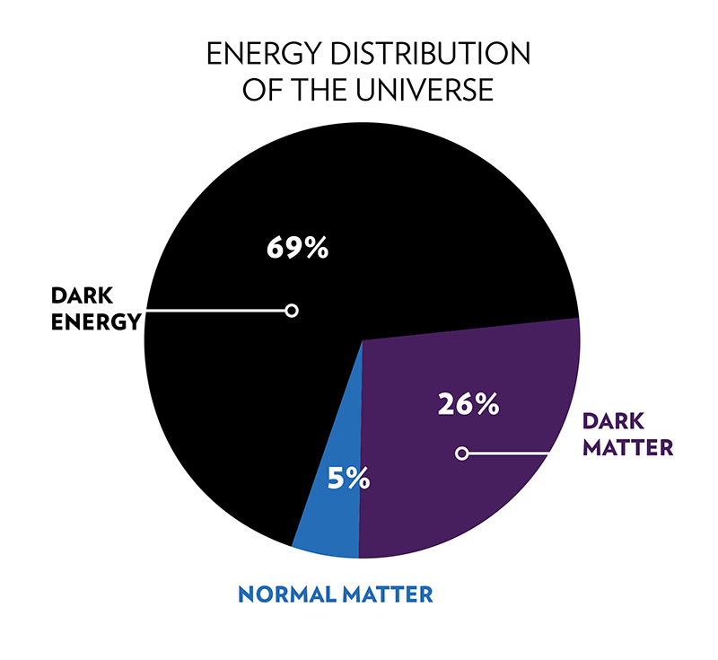
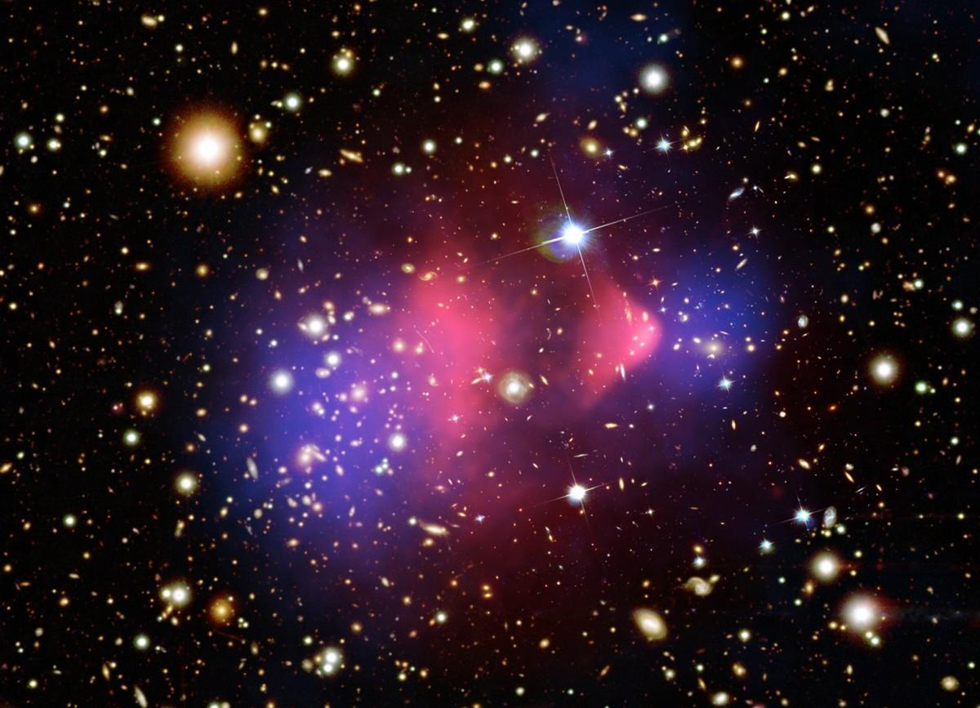
Dark Matter
Rotational curves of galaxies
Weak lensing effect in Bullet Clusters
Khushboo Dixit University of Johannesburg

Slide 3
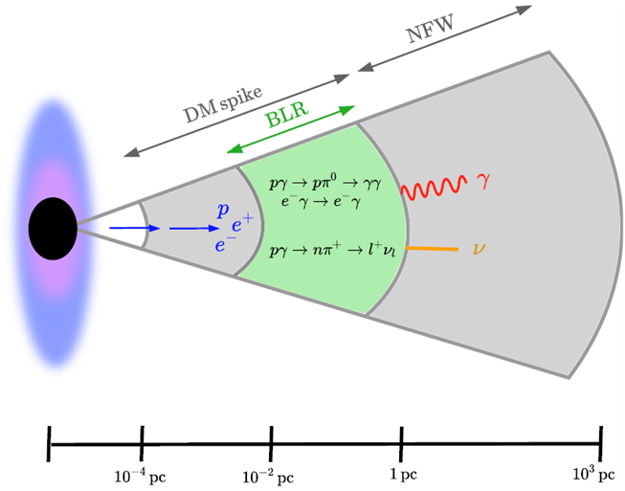
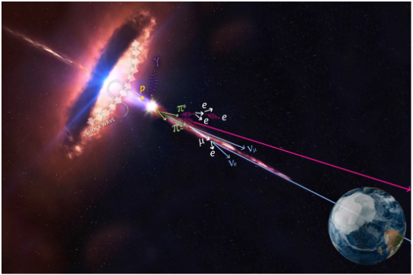
The dark matter profile in AGNs around blackhole
Credit: IceCube/NASA
Khushboo Dixit University of Johannesburg

Slide 4
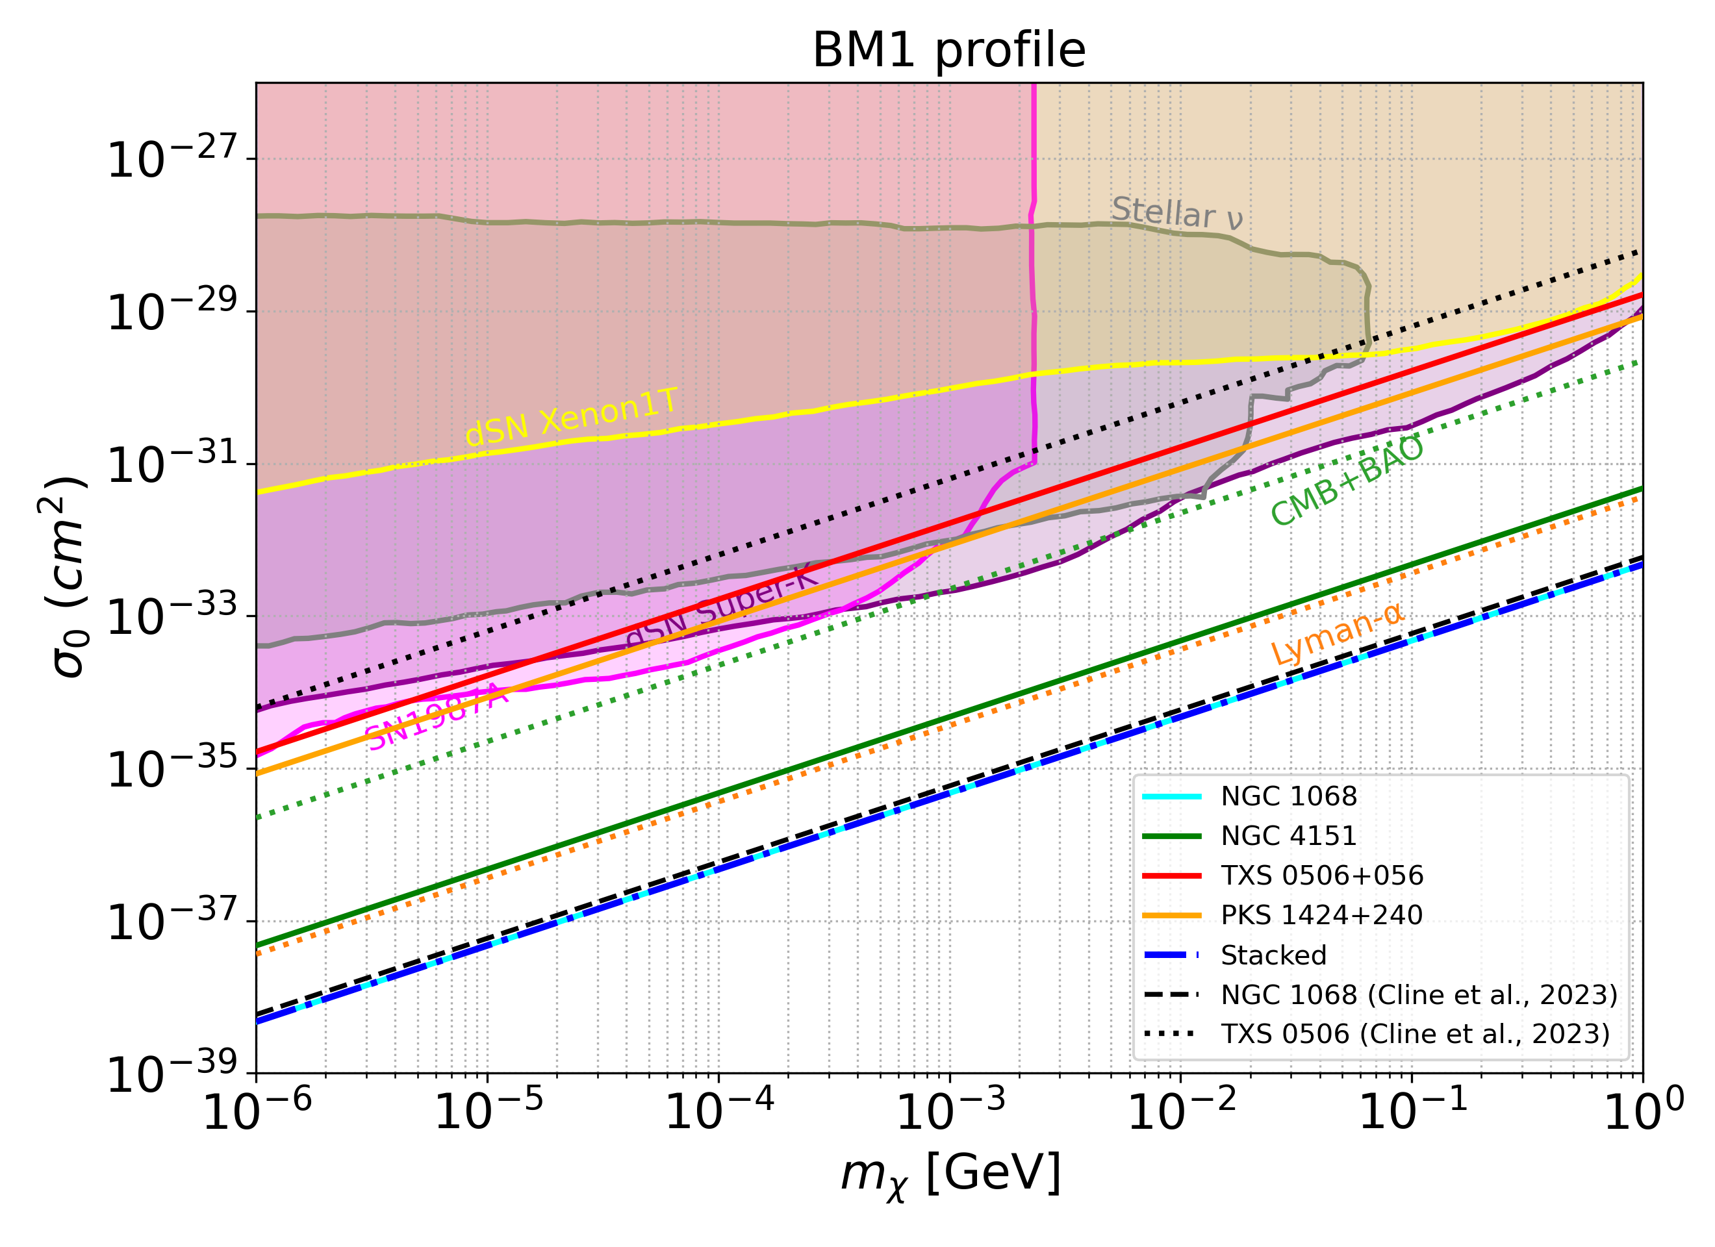
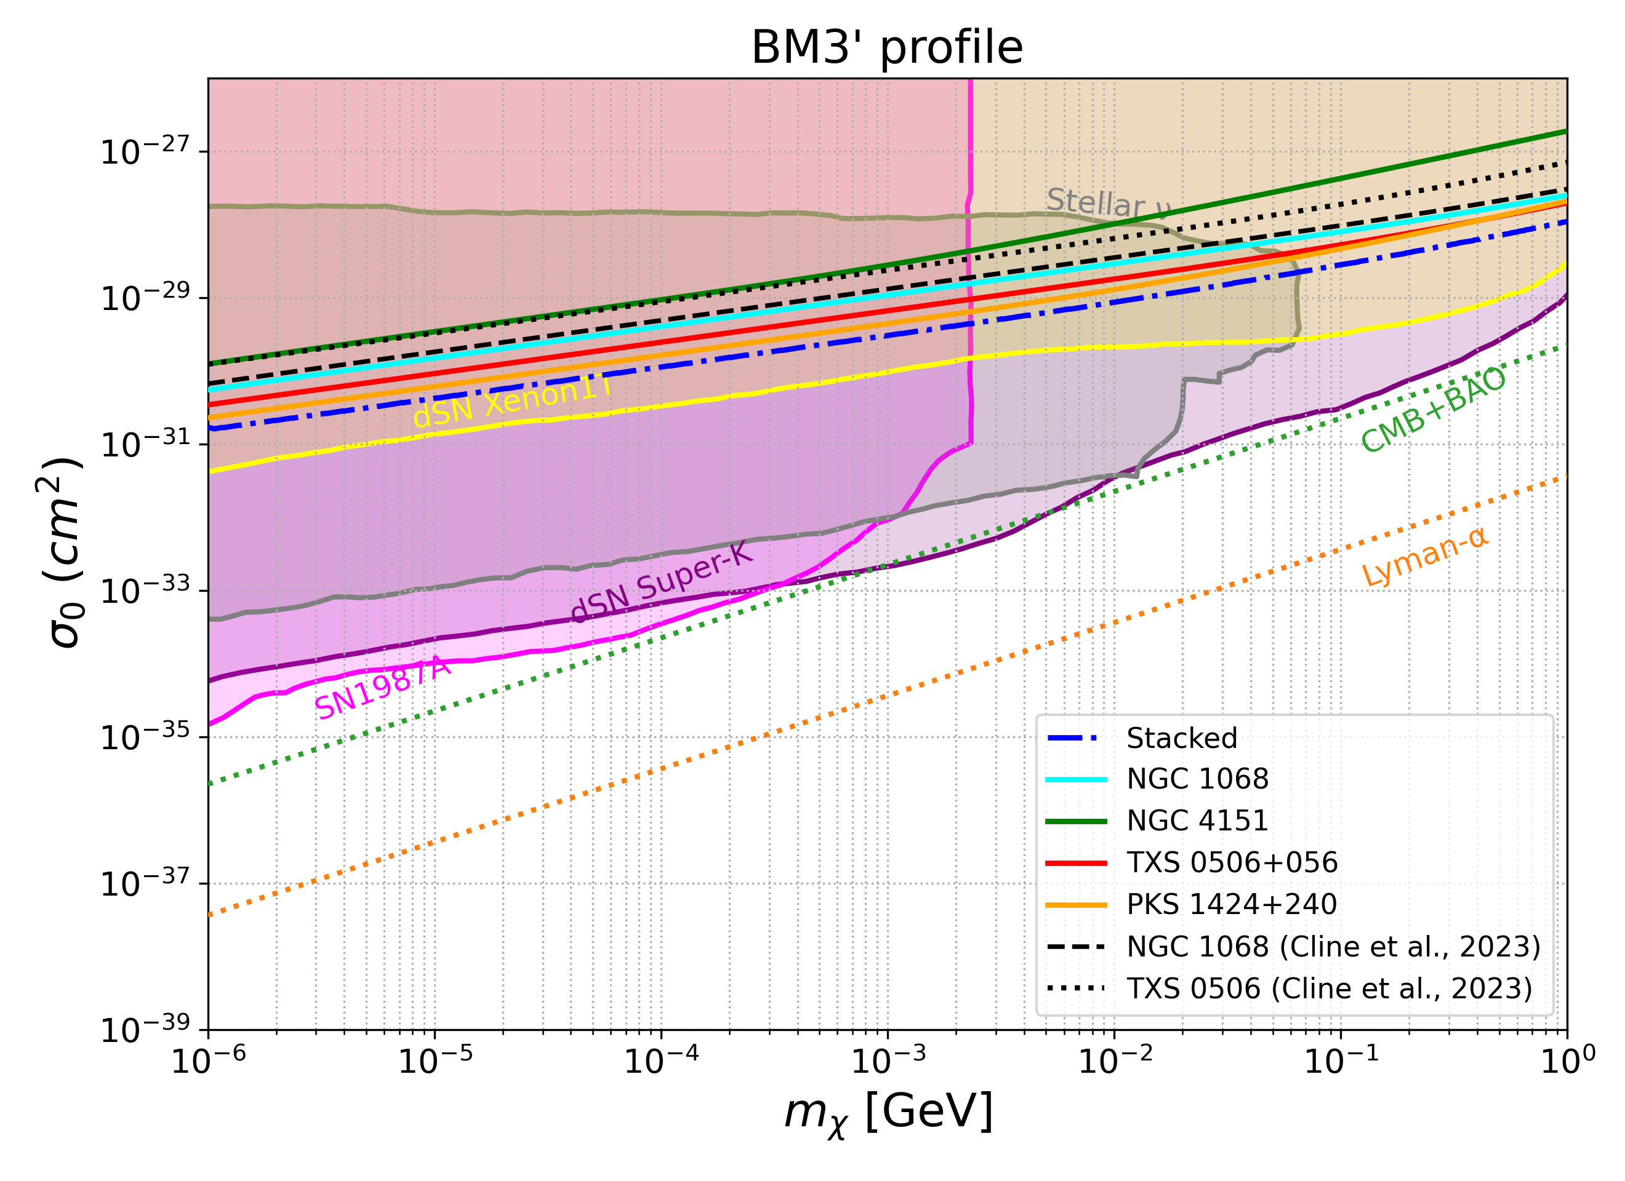
Previous DM-neutrino scattering results
K.D., Mohlabeng, Razzaque, PRD 2026.
Bounds from “NGC 1068, TXS 0506+056, PKS 1424+240” (3.3σ CL), NGC 4151 (2.9σ CL) (IceCube, 22’ 24’)
Khushboo Dixit University of Johannesburg
Notes:
Based on this idea, we have obtained constraints on the DM-neutrino scattering cross section in a previous work, where we analysed the IceCube public data observed from 4 high energy neutrino candidates, namely ….. We found results stronger than several previous analyses including CMB+BAO, Lyman \alpha and also previous astrophysical bounds.

Slide 5
Gamma ray photon counts at Fermi-LAT
Gamma ray photon counts at Fermi-LAT
4FGL-DR4 catalog: 14 years all-sky survey, Aug 2008 – Aug 2022; 50 MeV – 1 TeV catalog energy range
Source | Type | Spectral model | N_{pred} | Significance
NGC 1068 | Seyfert 2 galaxy | Power law, Γ = 2.35 | 1416 | 19.7σ
NGC 4151* | Seyfert 1.5 galaxy | Power law, Γ = 2.11 | 227 | 6.0σ
TXS 0506+056 | Blazar (BL Lac) | Log-parabola, α = 2.03, β = 0.053 | 9906 | 118.6σ
PKS 1424+240 | Blazar (BL Lac) | Log-parabola, α = 1.70, β = 0.057 | 11083 | 171.1σ
NGC 4151 has no catalog association: we use 4FGL J1210.3+3928 (~5′ away), attributed to NGC 4151 (Peretti et al., JCAP 2025)
(Abdollahi et al., ApJS 2022 [4FGL-DR3]; Ballet et al., arXiv:2307.12546 [4FGL-DR4])
Khushboo Dixit University of Johannesburg
Khushboo Dixit University of Johannesburg
4

Slide 6
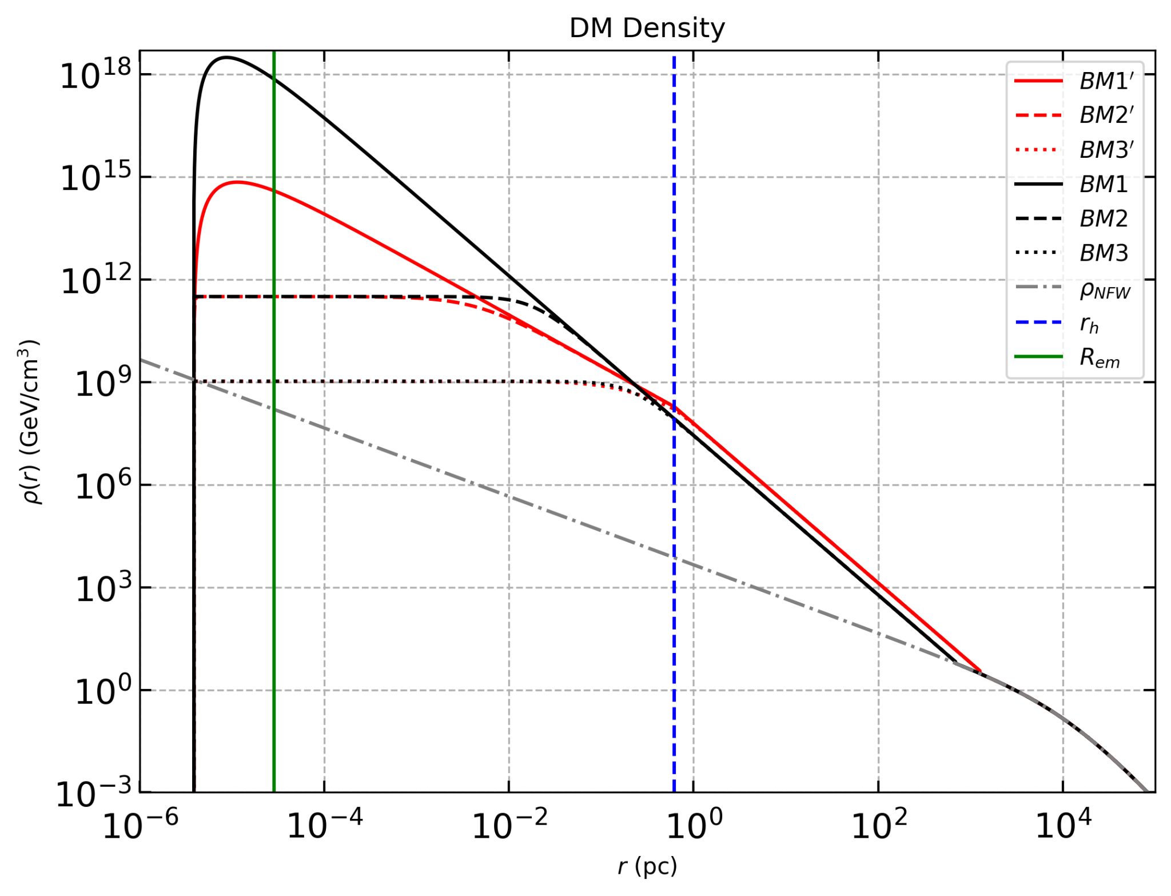
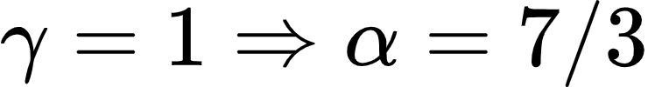
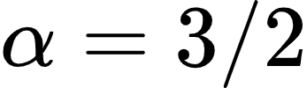

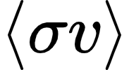
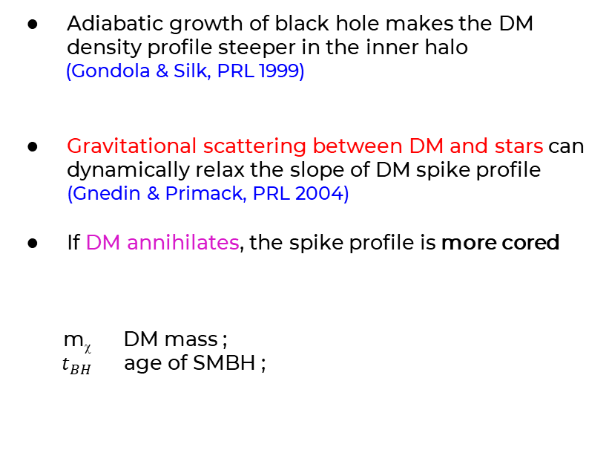

Dark Matter Density Profile
Adiabatic growth of black hole makes the DM density profile steeper in the inner halo
(Gondola & Silk, PRL 1999)
Gravitational scattering between DM and stars can dynamically relax the slope of DM spike profile (Gnedin & Primack, PRL 2004)
If DM annihilates, the spike profile is more cored
m_{ꭓ} DM mass ;
$t_{BH}$ age of SMBH ;
$$ρ_{NFW}$$
velocity average annihilation cross section (${10}^{−26}{ cm}^{3}/s$)
Khushboo Dixit University of Johannesburg

Slide 7
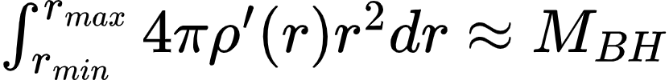
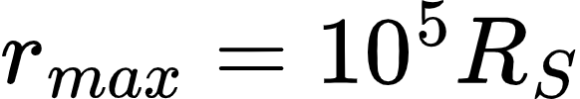
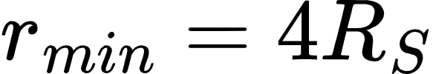
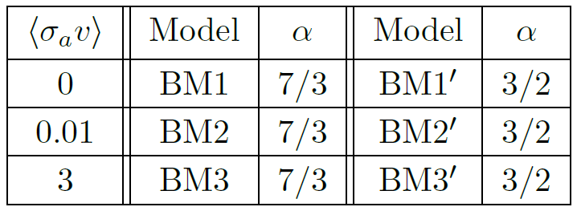
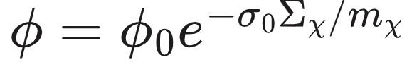

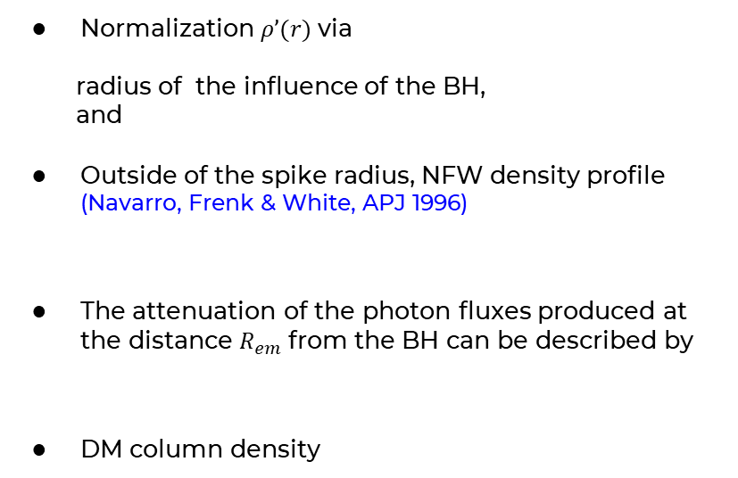
Dark Matter Density Profile
Normalization $ρ’(r)$ via
radius of the influence of the BH,
and
Outside of the spike radius, NFW density profile (Navarro, Frenk & White, APJ 1996)
The attenuation of the photon fluxes produced at the distance $R_{em}$ from the BH can be described by
DM column density
$$ρ_{NFW}$$
Khushboo Dixit University of Johannesburg

Slide 8

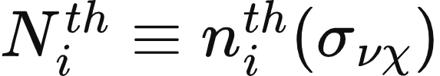



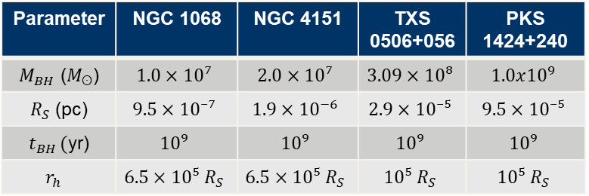
Methodology
We define a Poisson likelihood χ²
where and , for and for
For stacking analysis:
Parameter | NGC 1068 | NGC 4151 | TXS 0506+056 | PKS 1424+240
$M_{BH}$ ($M_{ʘ}$) | $$1.0×10⁷$$ | $$2.0×10⁷$$ | $$3.09×10⁸$$ | $$1.0x{10}^{9}$$
$R_{S}$ (pc) | $$9.5×10⁻⁷$$ | $$1.9×{10}^{−6}$$ | $$2.9×10⁻⁵$$ | $$9.5×10⁻⁵$$
$t_{BH }($yr) | $$10⁹$$ | $$10⁹$$ | $$10⁹$$ | $$10⁹$$
$$r_{h}$$ | $$6.5×10⁵{ R}_{S}$$ | $$6.5×10⁵{ R}_{S}$$ | $$10⁵{ R}_{S}$$ | $$10⁵{ R}_{S}$$
$$R_{em}$$ | 30$R_{S}$ | $$\text{30}R_{S}$$ | $$2×{{10}^{3}R}_{S}$$ | $$6.5×{{10}^{2}R}_{S}$$
Khushboo Dixit University of Johannesburg

Slide 9
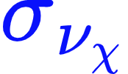

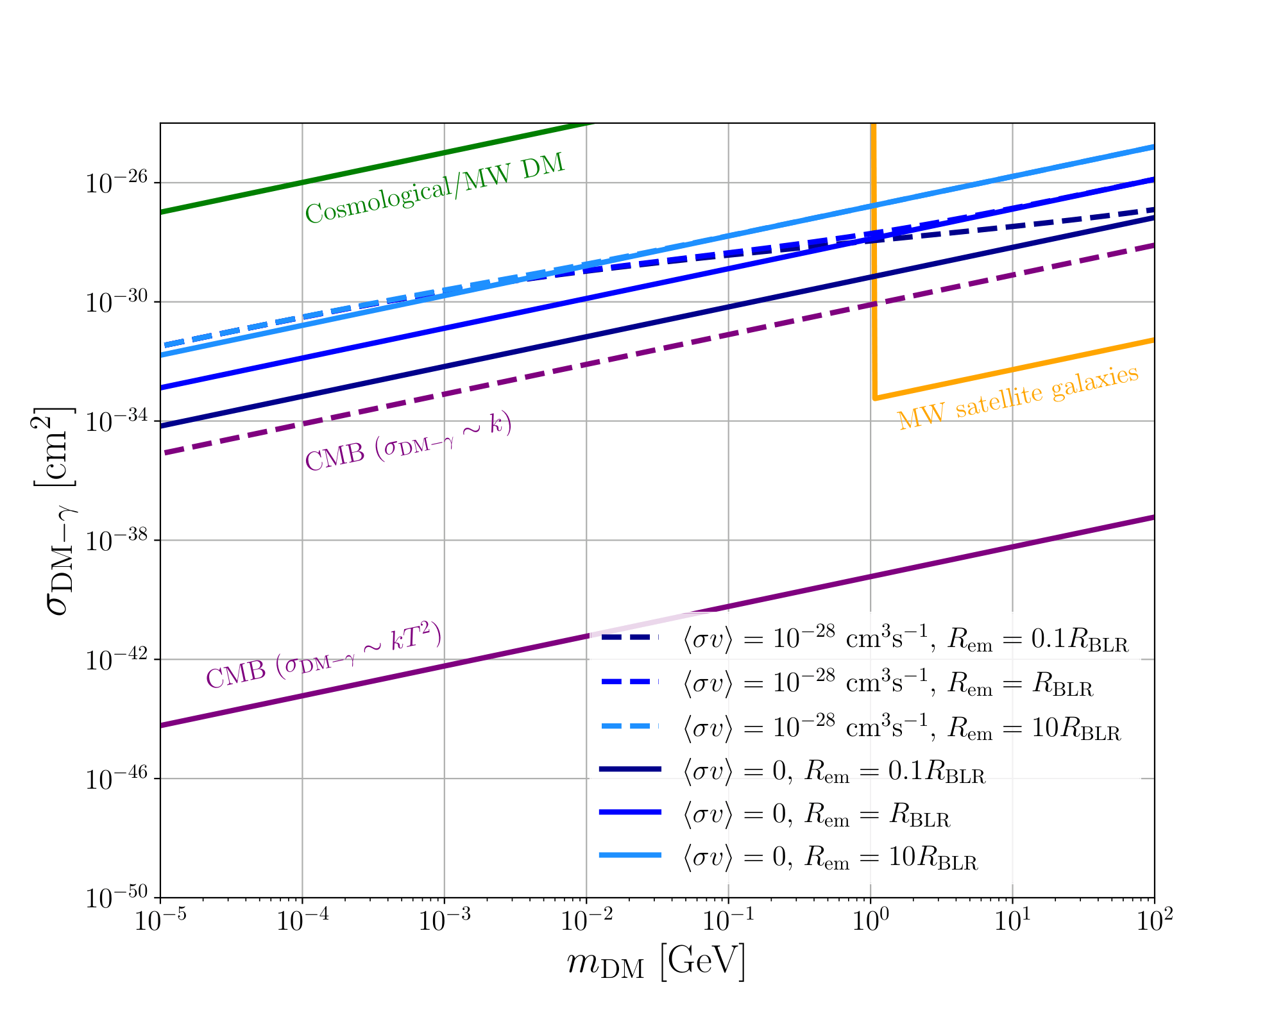
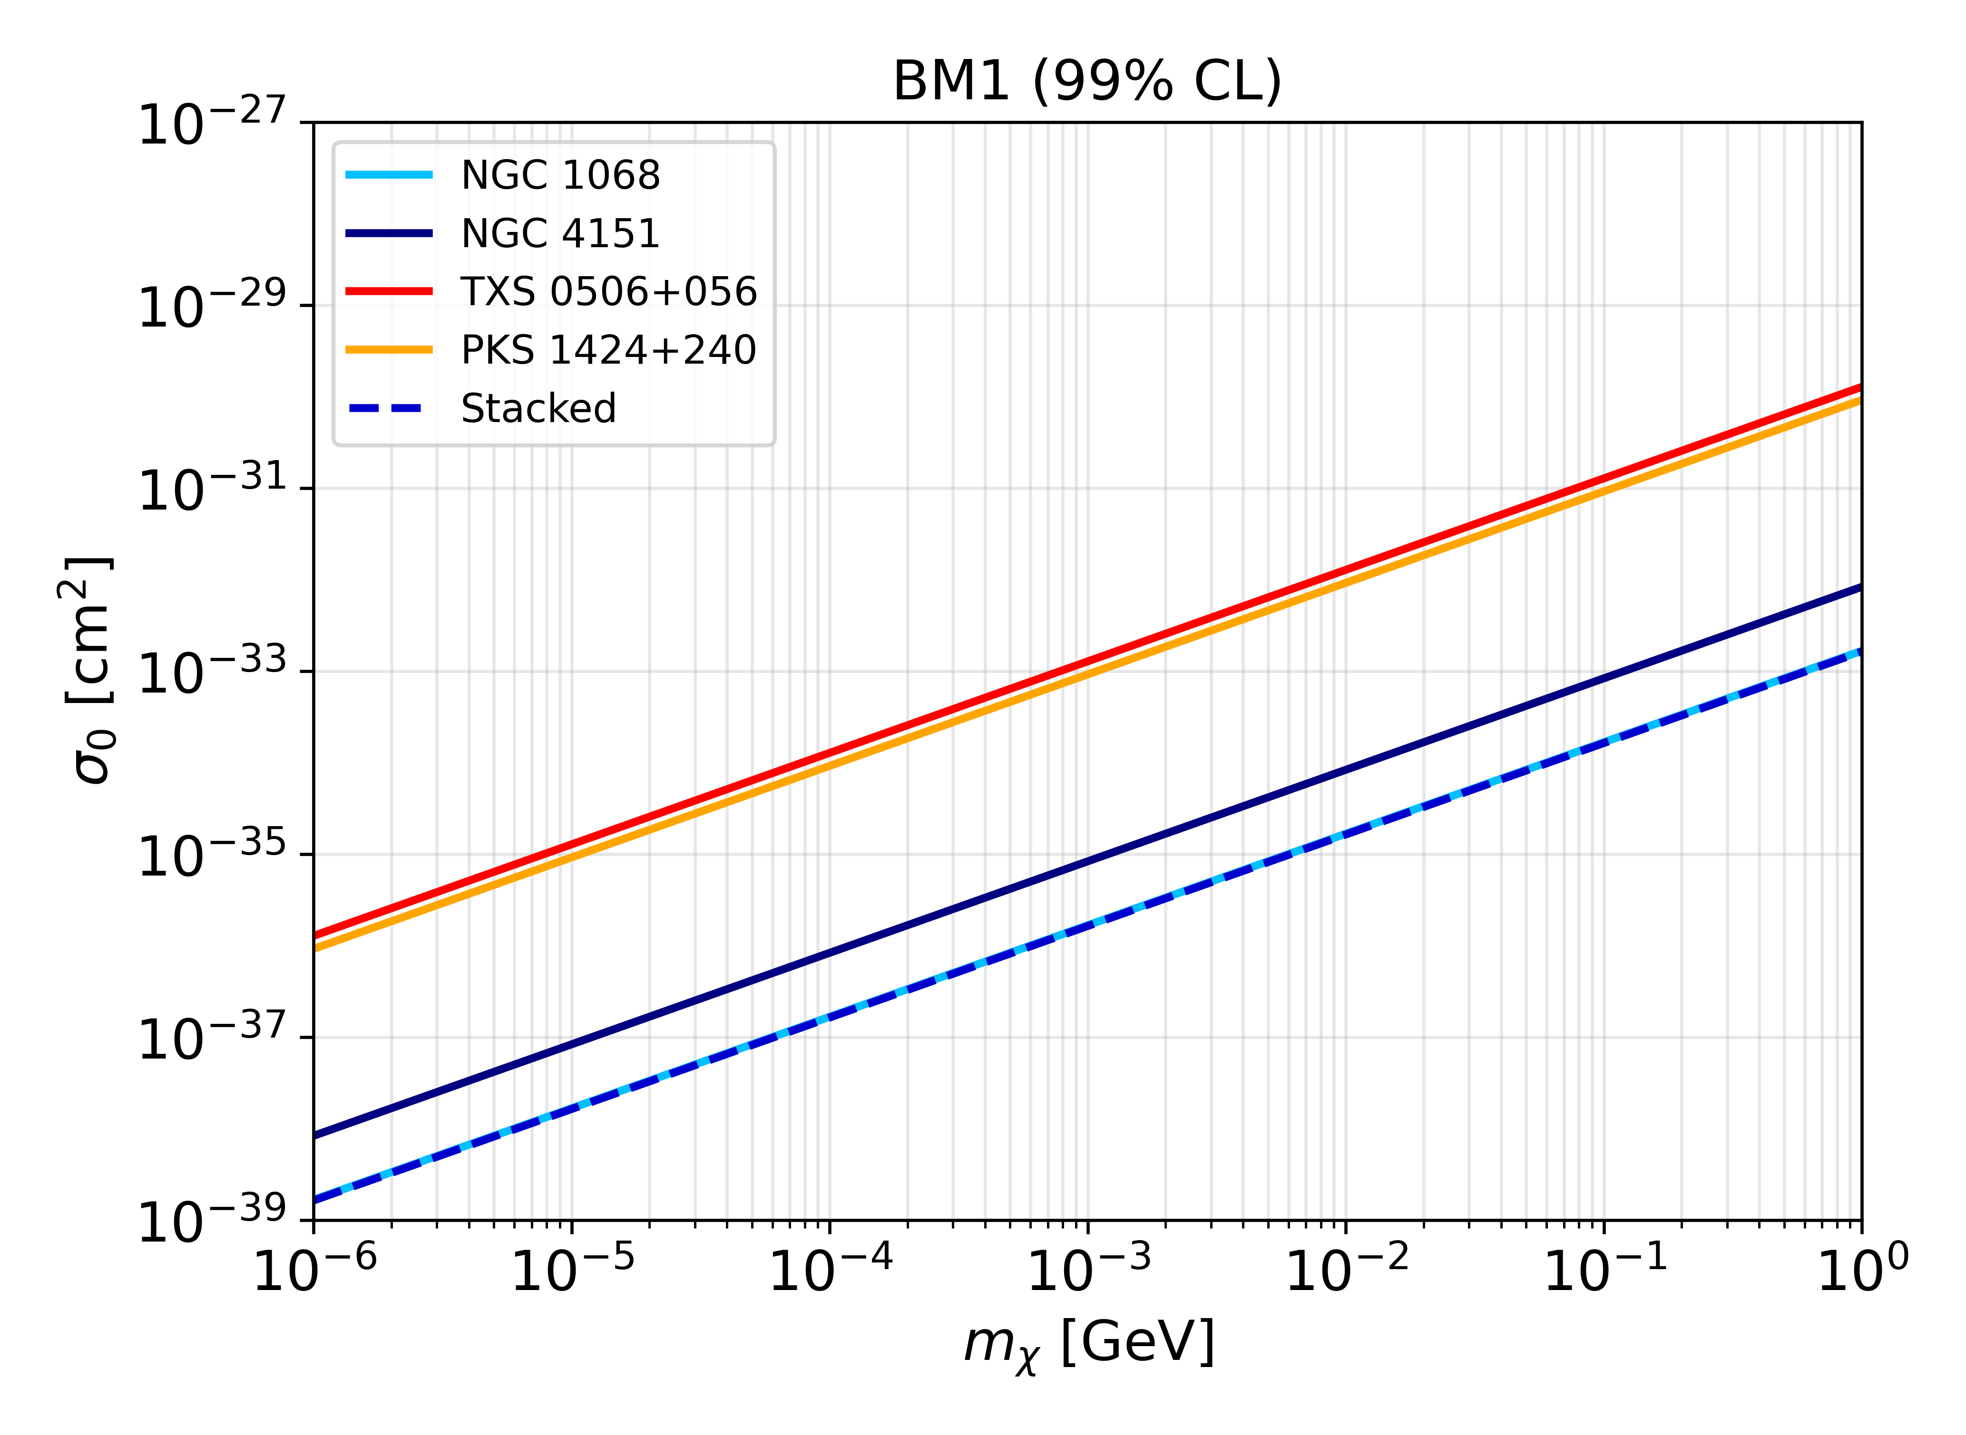

Constraint on DM-photon Cross-Section
Constant : For benchmark models where $=0$ ; NGC 1068 dominates the stacking analysis.
TXS 0506+056
(Ferrer et al., 2023)
for SMBH with lighter mass, peaks at smaller distance with higher amplitude, hence larger (Gondolo & Silk 1999)
(Bavdaz, KD, Perez, Razzaque, Zaharijas in prep).
Khushboo Dixit University of Johannesburg

Slide 10
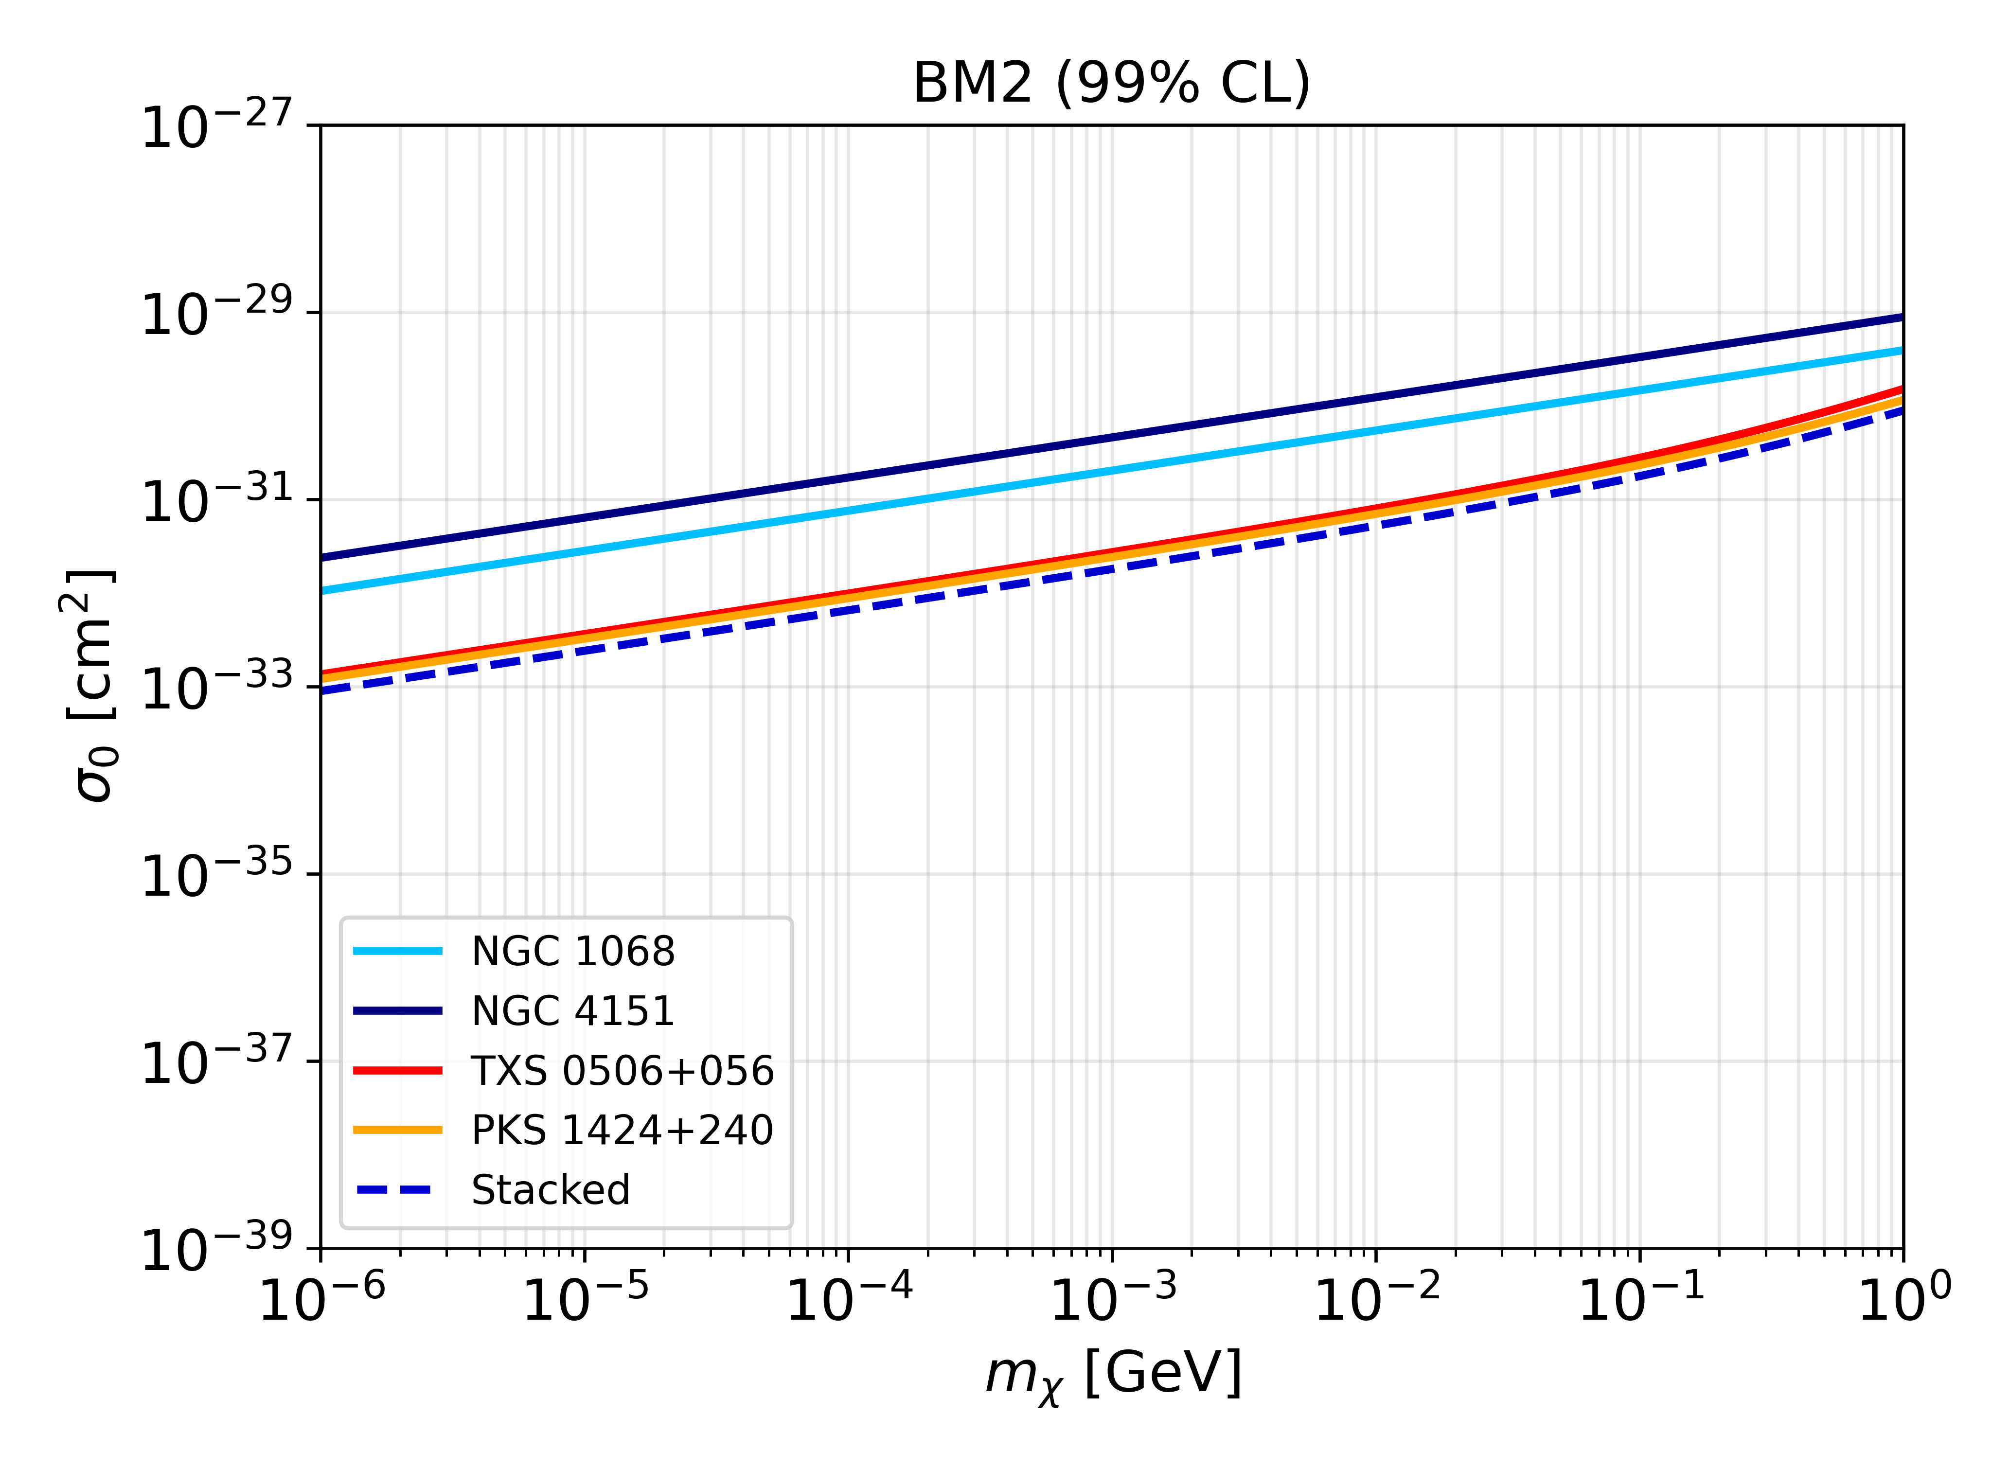
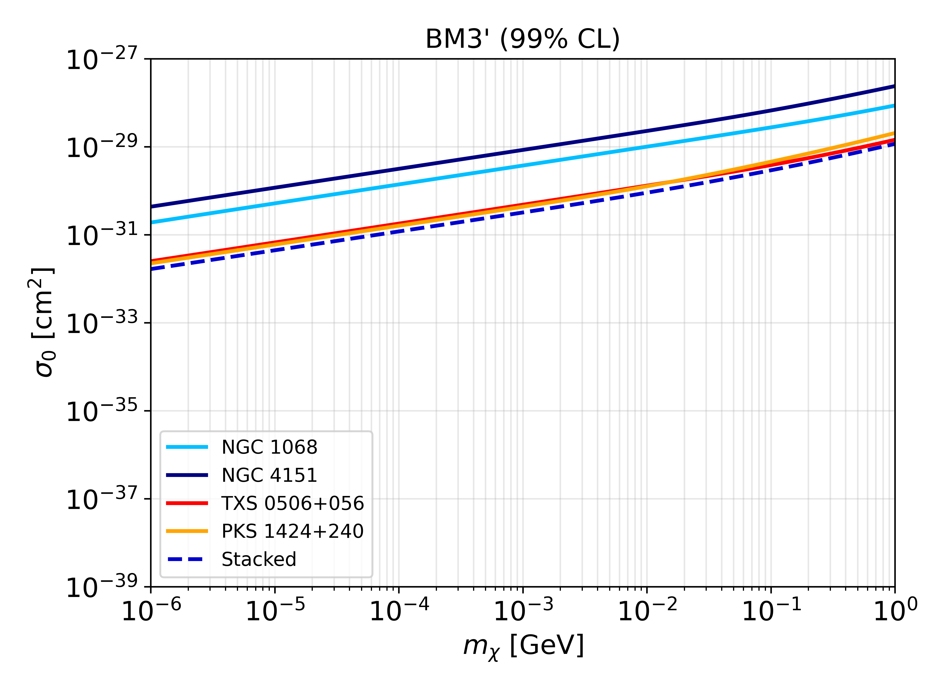
Constraint on DM-photon Cross-Section
Constant :
For benchmark profiles with $≠0,$ , PKS 1424+240 dominates the stacking analysis.
The denser the dark matter spike, the stronger the depletion due to self-annihilations, the weaker the constraints.
(Bavdaz, KD, Perez, Razzaque, Zaharijas in prep.)
Khushboo Dixit University of Johannesburg

Slide 11
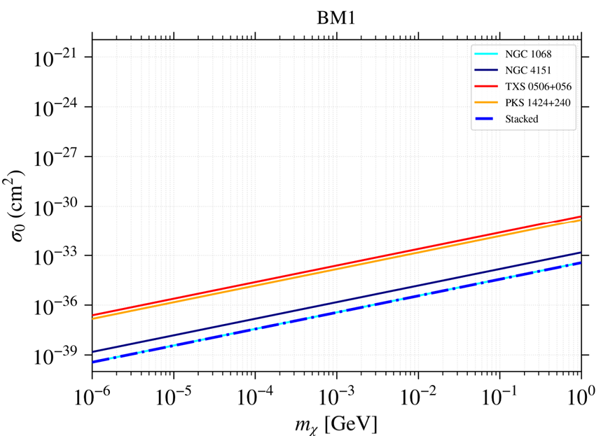
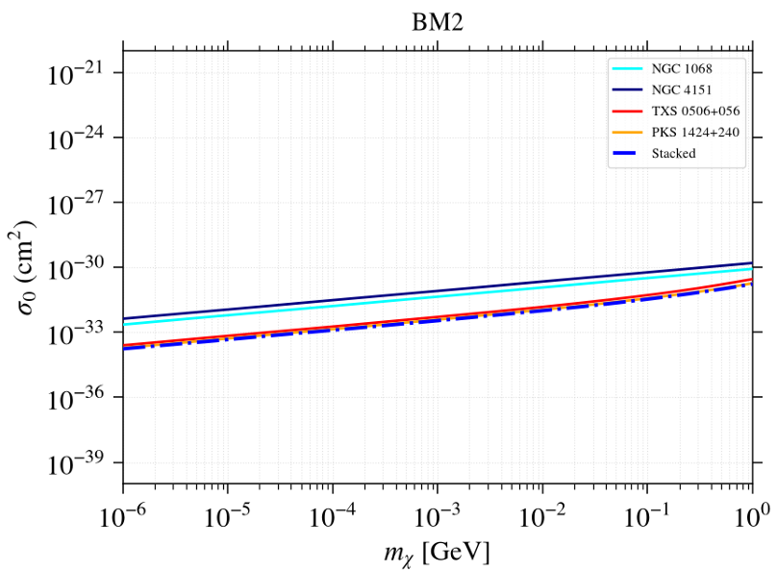
Constraint on DM-photon Cross-Section
Energy dependent :
Similar qualitative features to the constant-cross-section case, but with stronger constraints.
(Bavdaz, KD, Perez, Razzaque, Zaharijas in prep.)
Khushboo Dixit University of Johannesburg

Slide 12


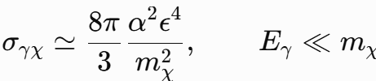




Possible model interpretation
Millicharged DM
for the low-energy photon–DM scattering reducing to the Thomson limit (Kouvaris, PRD 2013;
Bélanger, EPJC 2021)
Scalar Rayleigh dark matter
In relativistic regime
For low energy )
(Barducci et al., JHEP 2025)
Khushboo Dixit University of Johannesburg

Slide 13
Summary
The observation of gamma-rays from AGNs and Blazars can be used to constrain the dark matter scattering cross section with photons, since these need to traverse the dark matter spike around the black hole and the halo of the host galaxy.
We obtained the bounds one order of magnitude stronger than the previous analysis done without a proper statistical analysis. EBL inclusion in future for energy dependent DM-photon scattering.
The constraints are subject to uncertainties from the flux modelling, the emitting region of neutrinos and gamma-rays, and from the dark matter profile.
Future Fermi-LAT or MAGIC observations can improve results in this line.
Khushboo Dixit University of Johannesburg

Slide 14
Thank you for attention!
(kdixit@uj.ac.za)
Khushboo Dixit University of Johannesburg
Notes:
(In the last) —> Identification of more sources in future may improve this bound further.

Slide 15
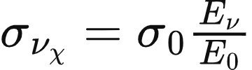




Constraint on DM-neutrino Cross-Section
Energy-dependent :
Linear energy dependence, i.e.,
where,
and,
Assuming approximately isotropic centre-of-mass scattering and
K.D., Mohlabeng, Razzaque, PRD 2026.
Khushboo Dixit University of Johannesburg
Notes:
there’s no simple analytic solution

Slide 16
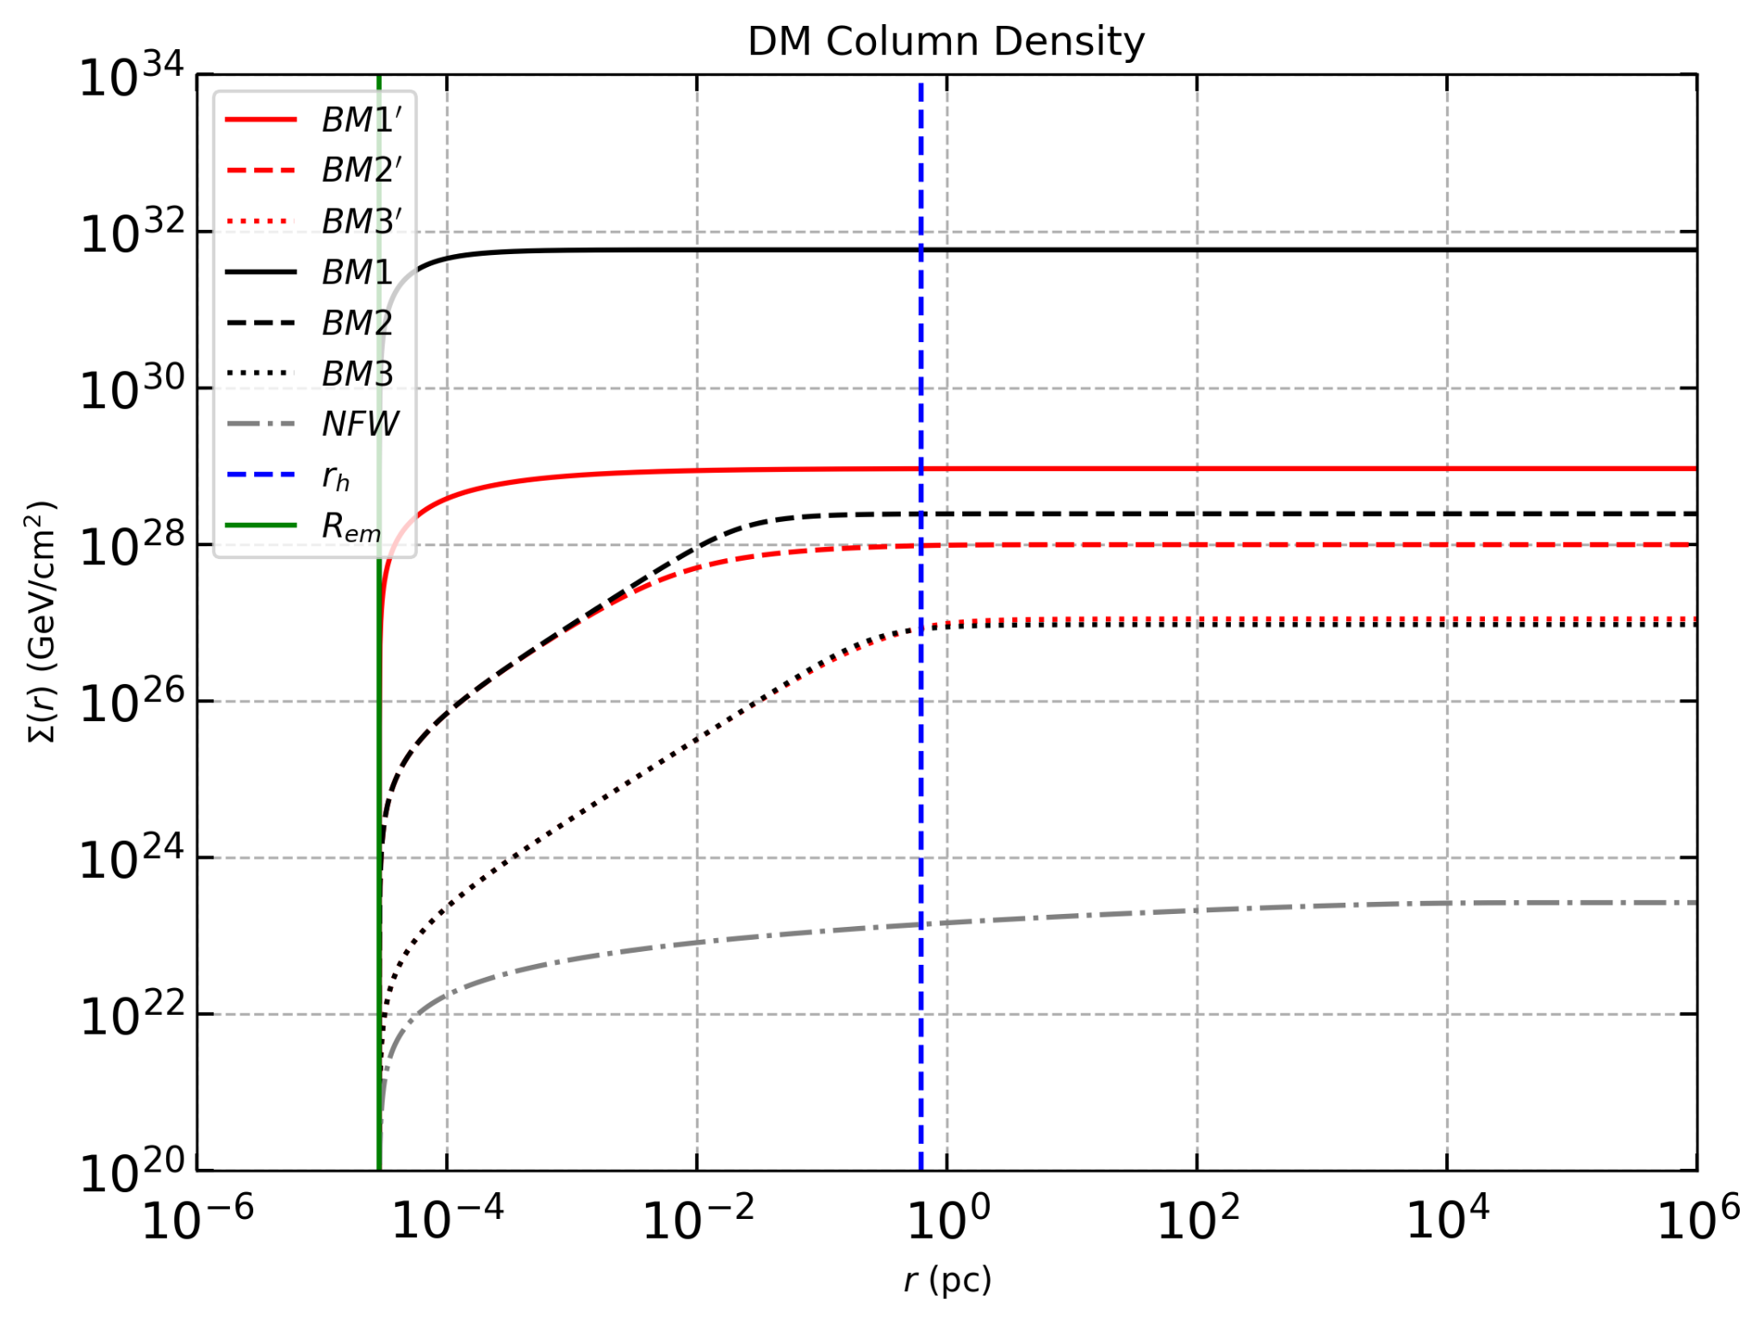
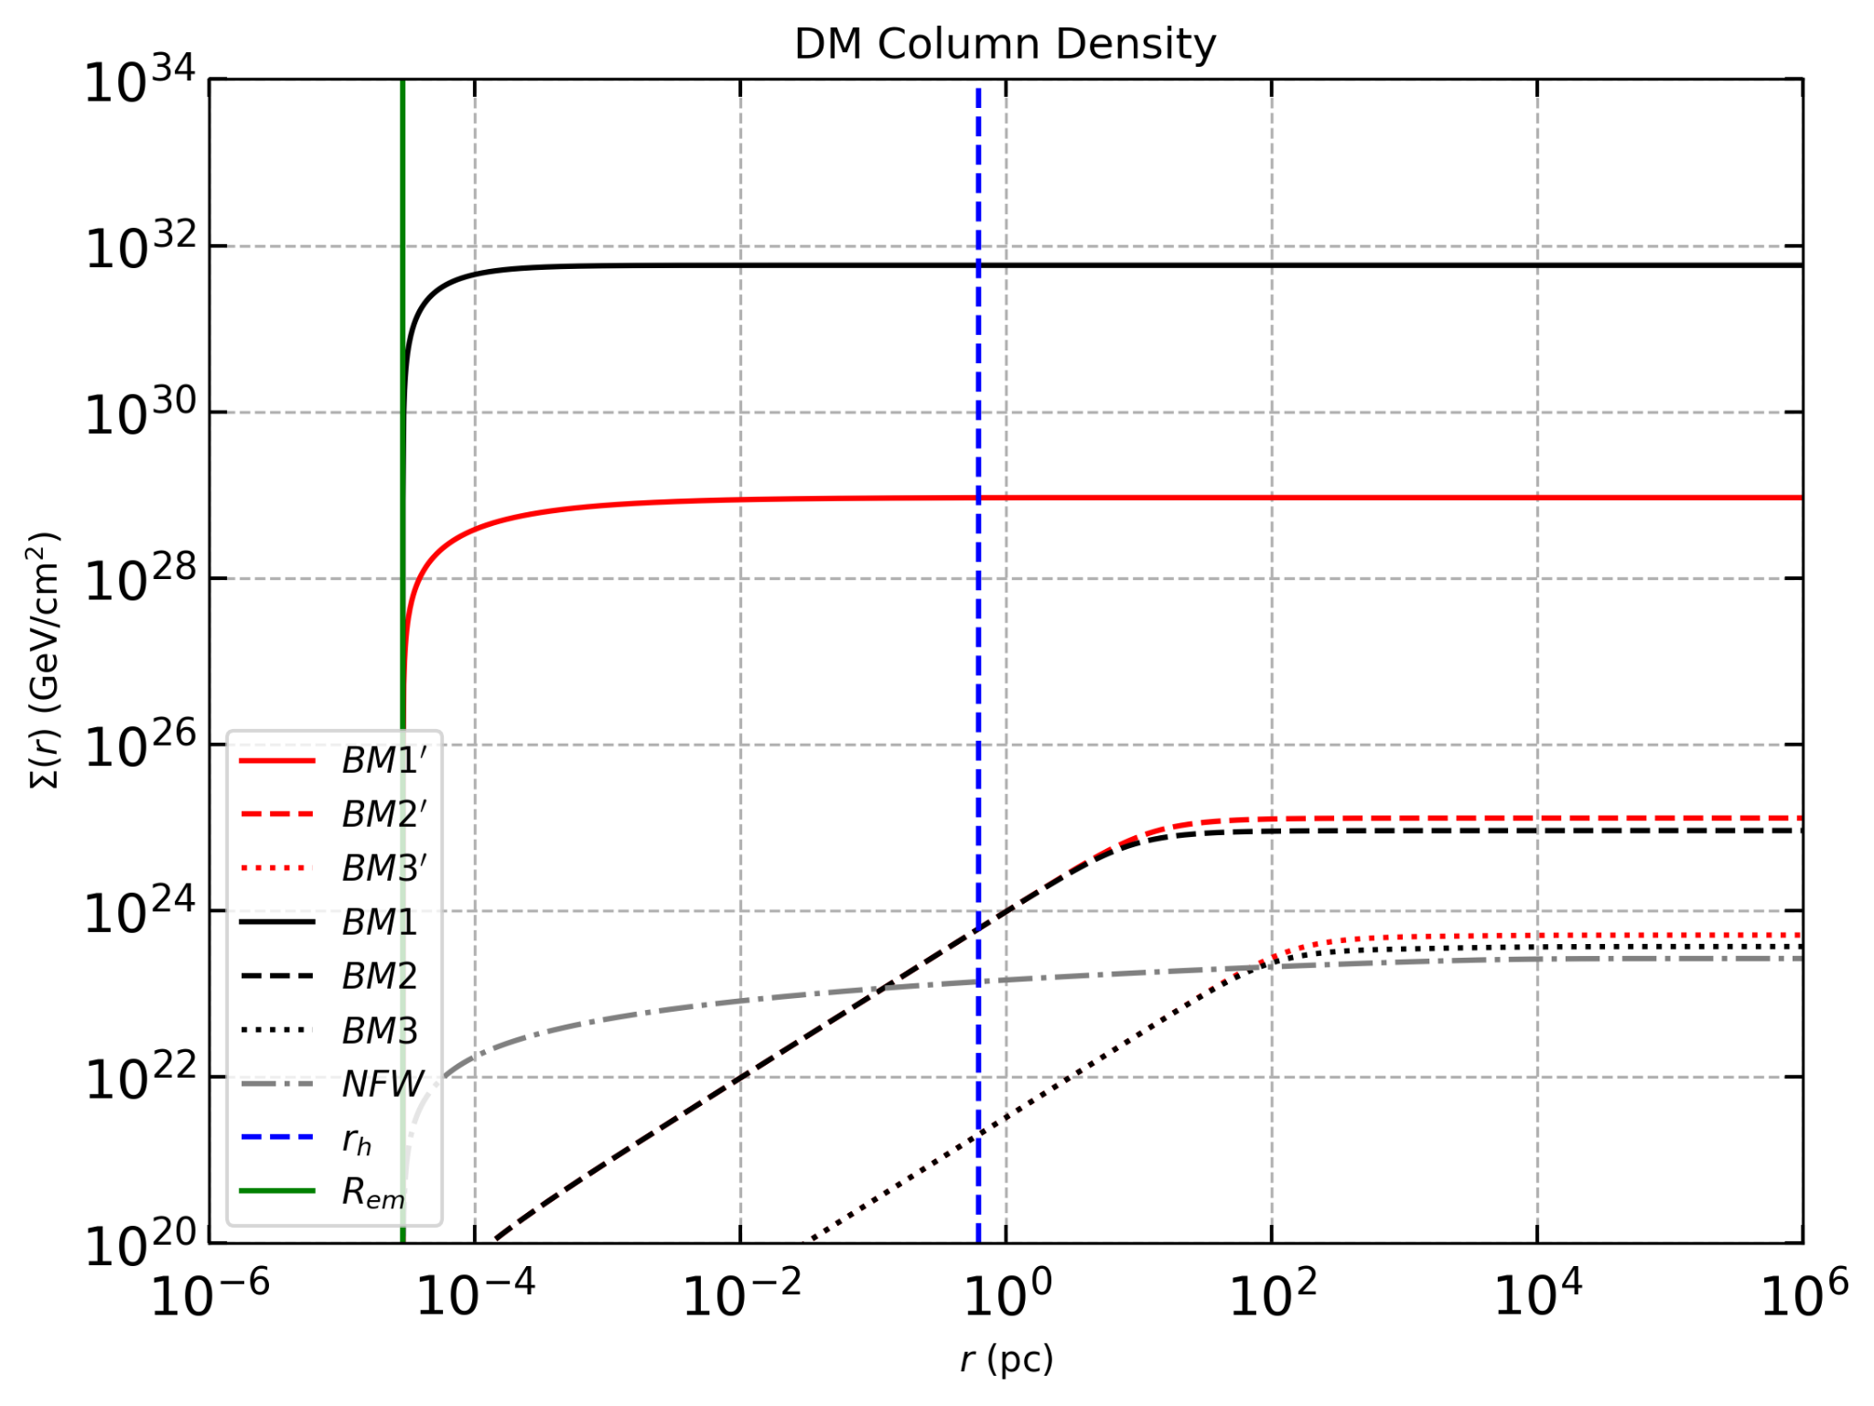


BACKUP: Dark Matter Column Density Profile
NGC 1068
$$m_{ꭓ}=1 GeV$$
$$m_{ꭓ}=0.001 MeV$$
K.D., Mohlabeng, Razzaque, PRD 2026.
Khushboo Dixit University of Johannesburg
Notes:
(In the last) —> Identification of more sources in future may improve this bound further.

Slide 17
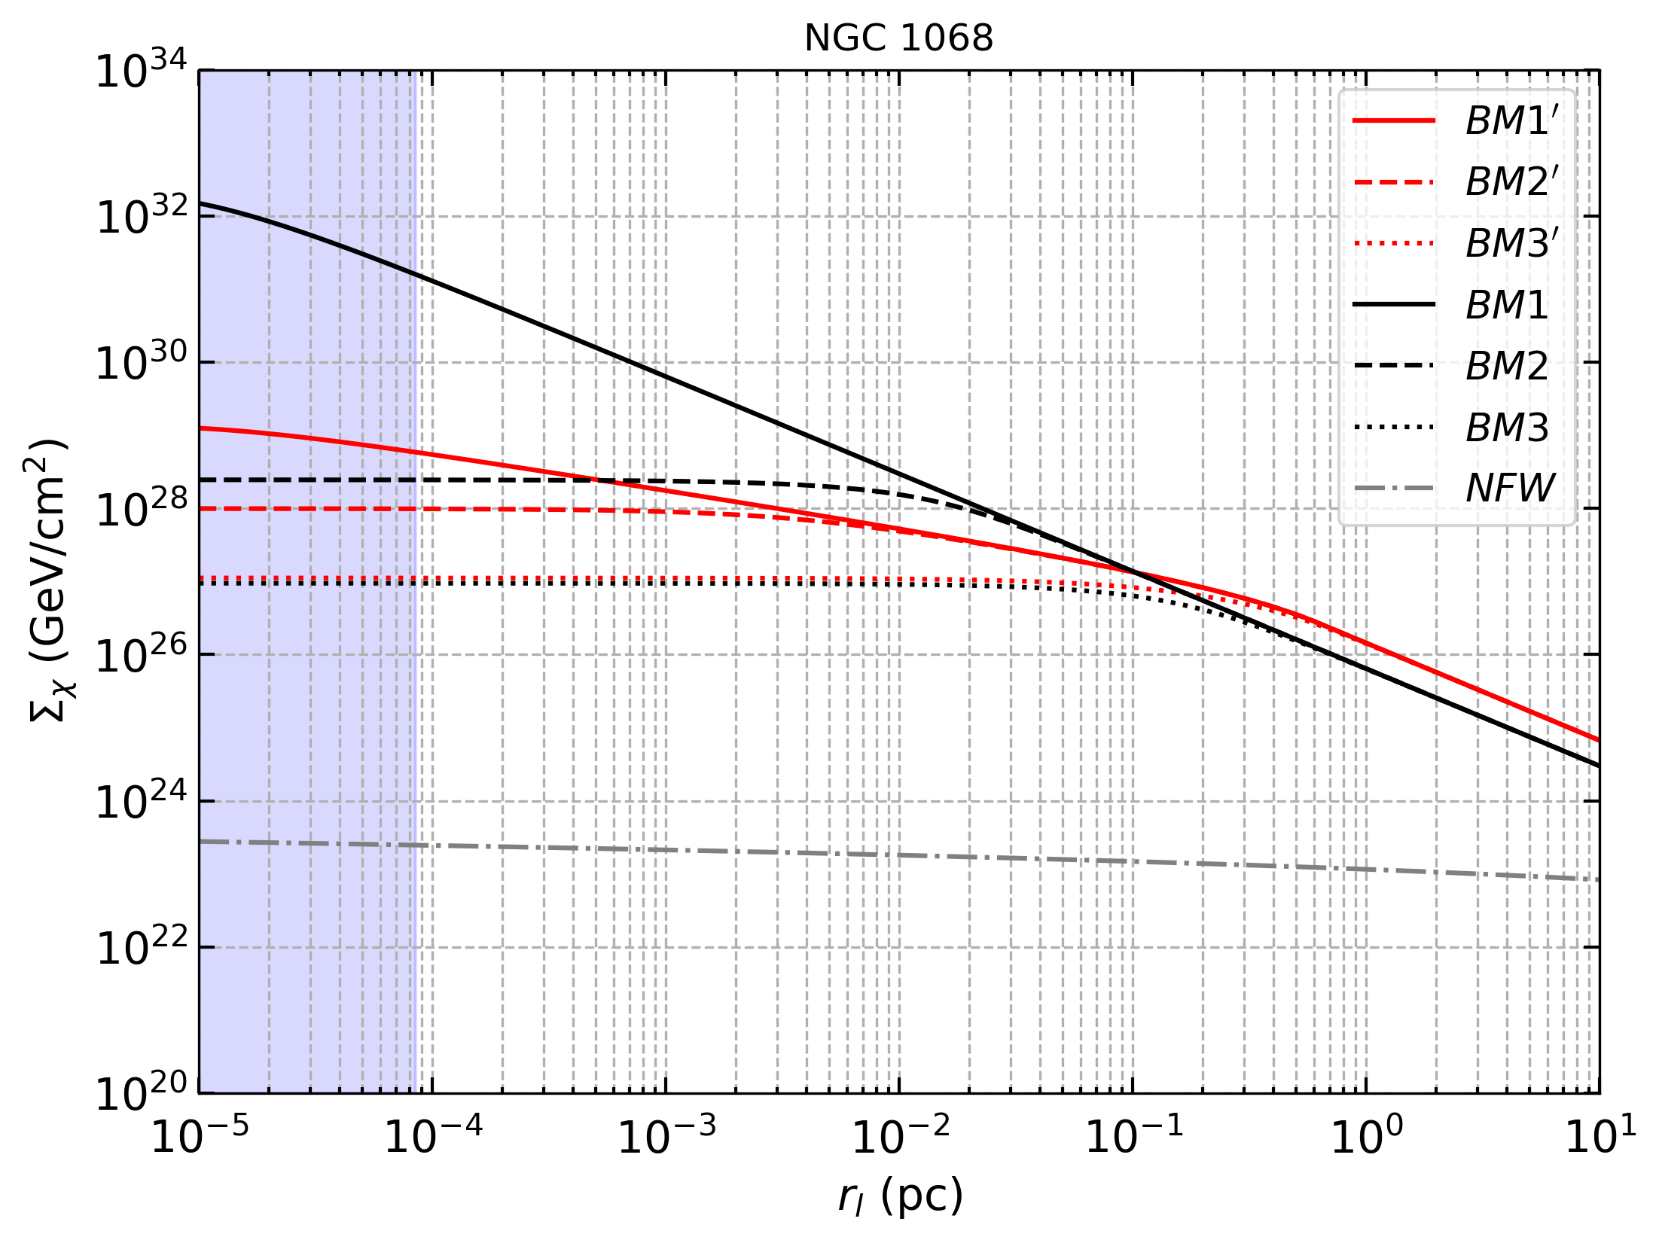
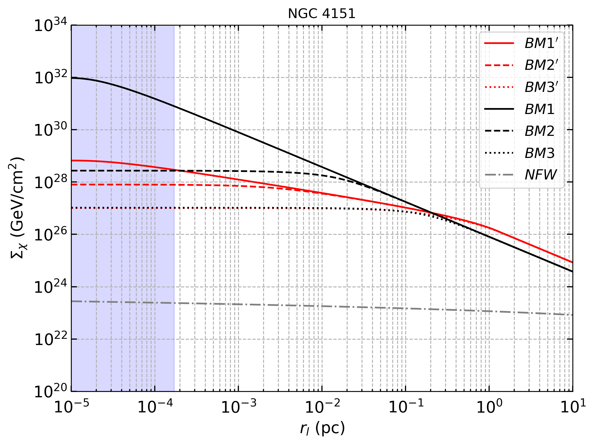
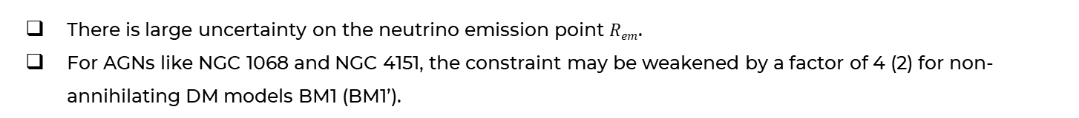
BACKUP: Astrophysical Uncertainty
There is large uncertainty on the neutrino emission point $Rem$.
For AGNs like NGC 1068 and NGC 4151, the constraint may be weakened by a factor of 4 (2) for non-annihilating DM models BM1 (BM1’).
K.D., Mohlabeng, Razzaque, PRD 2026.
Khushboo Dixit University of Johannesburg
Notes:
The results derived in this analysis are subject to astrophysical uncertainties. I have already talked about a range of possible values of the profile exponent α and DM annihilation cross section ⟨σav⟩. Another parameter is the size of the emission region, characterized by the radial distance Rem from the central black hole beyond which neutrinos are likely to be produced. Allowing for Rem ≃ 100RS, the value of Σ(r) implied by eq. (3.12) would decrease by a factor of ∼ 4 (2) for the non-annihilation DM model BM1 (BM1′), weakening the corresponding constraints on σ0 by the same factor.

Slide 18
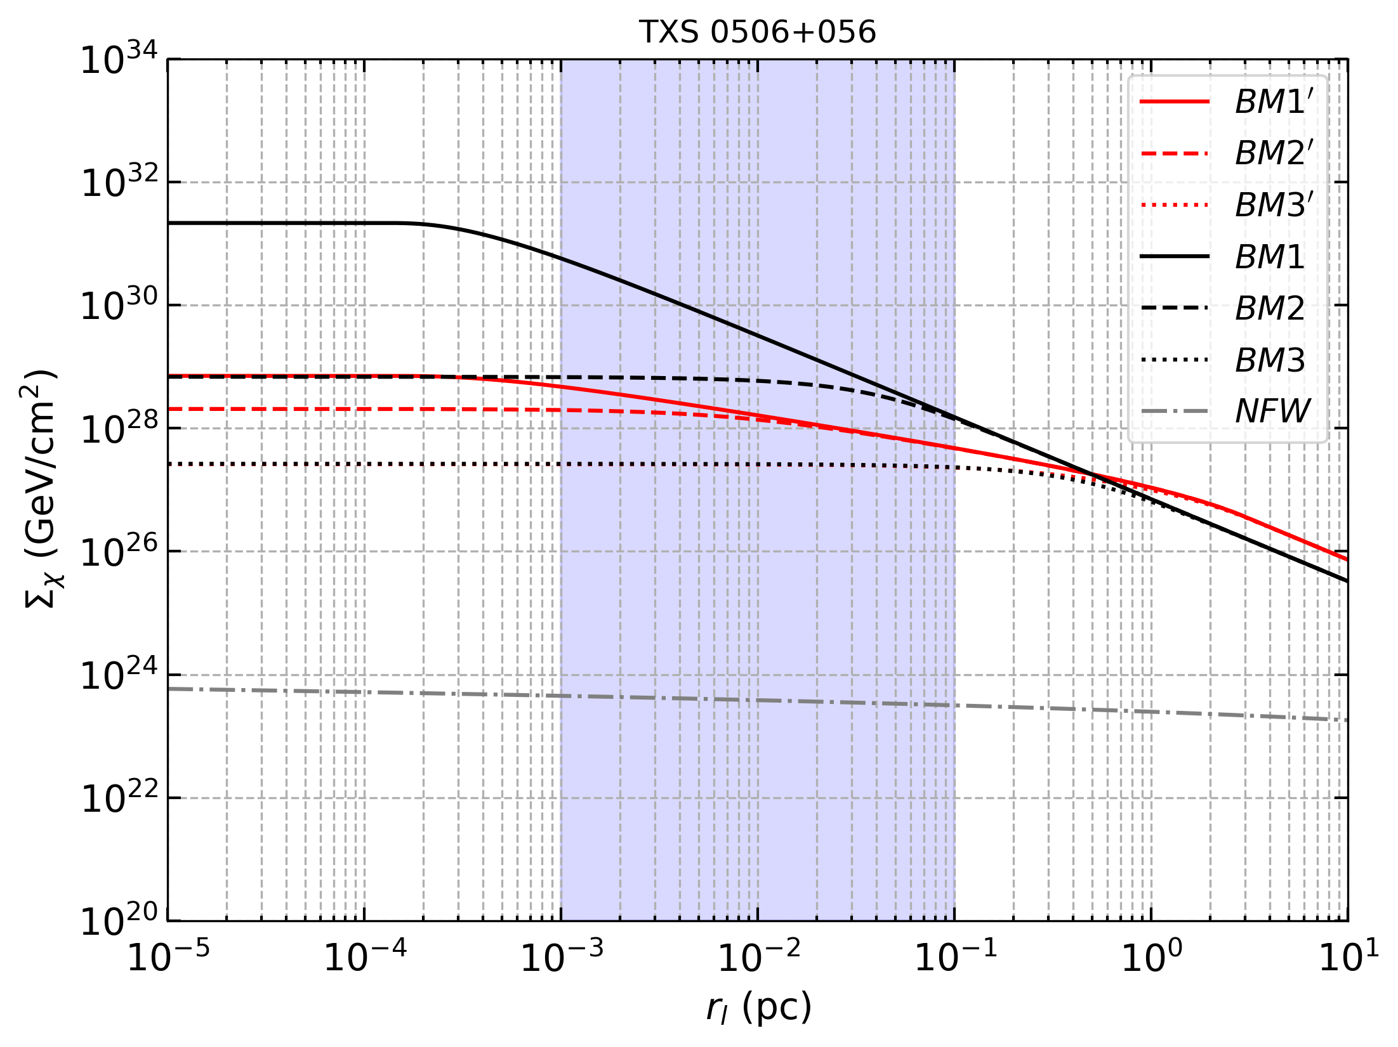
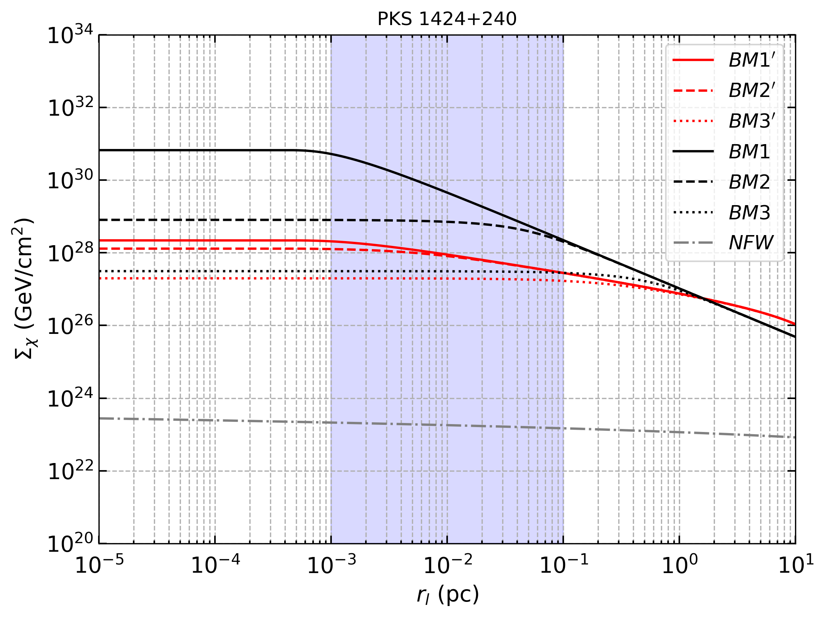
BACKUP: Astrophysical Uncertainty
For blazars TXS 0506+056 and PKS 1424+240, the emission region is likely to be farther from the central BH.
The constraint may get weakened by a factor of 2 for BM1, BM1’, BM2 and BM2’.
K.D., Mohlabeng, Razzaque, PRD 2026.
Khushboo Dixit University of Johannesburg
Notes:
Once you allow $\left\langle σv\right\rangle >0$, the inner spike can’t keep rising forever. It saturates at the annihilation plateau

Slide 19
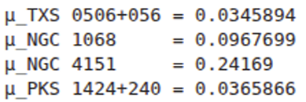
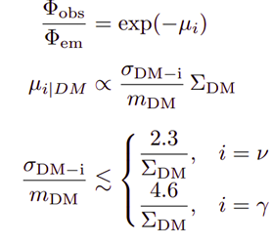
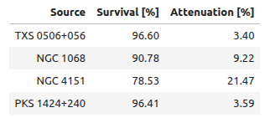
BACKUP: Previous analyses
(Ferrer et al., 2023)
K.D., Mohlabeng, Razzaque, PRD 2026.
Khushboo Dixit University of Johannesburg
Notes:
Once you allow $\left\langle σv\right\rangle >0$, the inner spike can’t keep rising forever. It saturates at the annihilation plateau

Slide 20
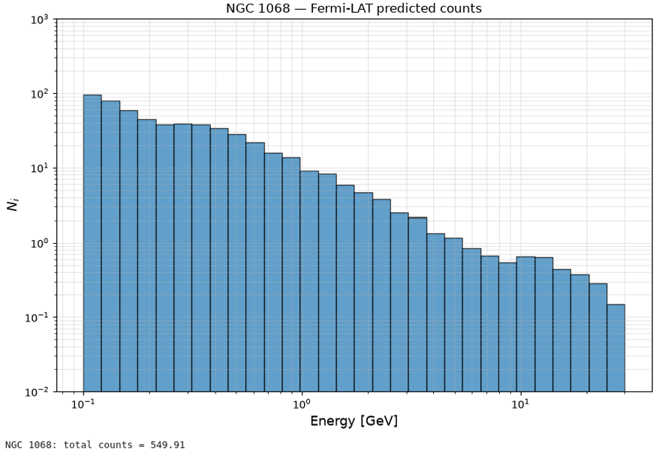
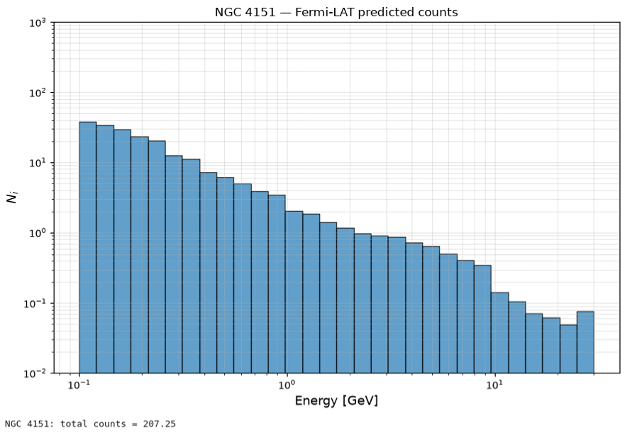
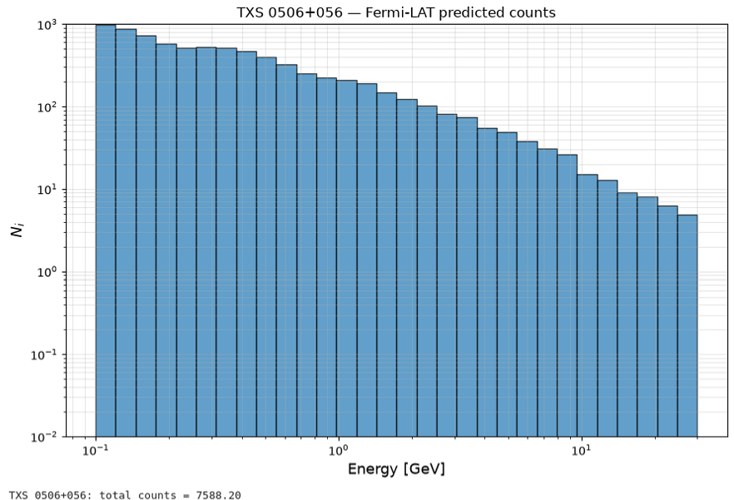
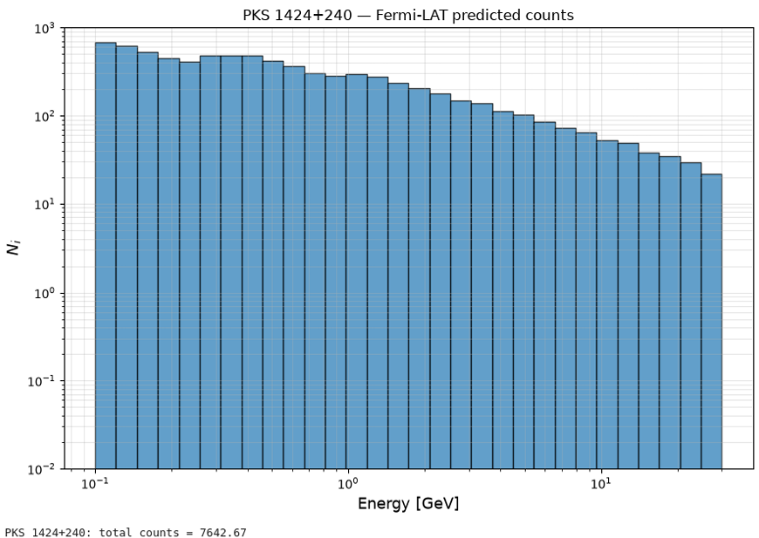
BACKUP: Predicted counts by Fermi-LAT
Khushboo Dixit University of Johannesburg
Notes:
Once you allow $\left\langle σv\right\rangle >0$, the inner spike can’t keep rising forever. It saturates at the annihilation plateau

