Slide 1



Multiwavelength studies of Be X-ray binaries
Caption
Itumeleng Monageng
et al.

Slide 2
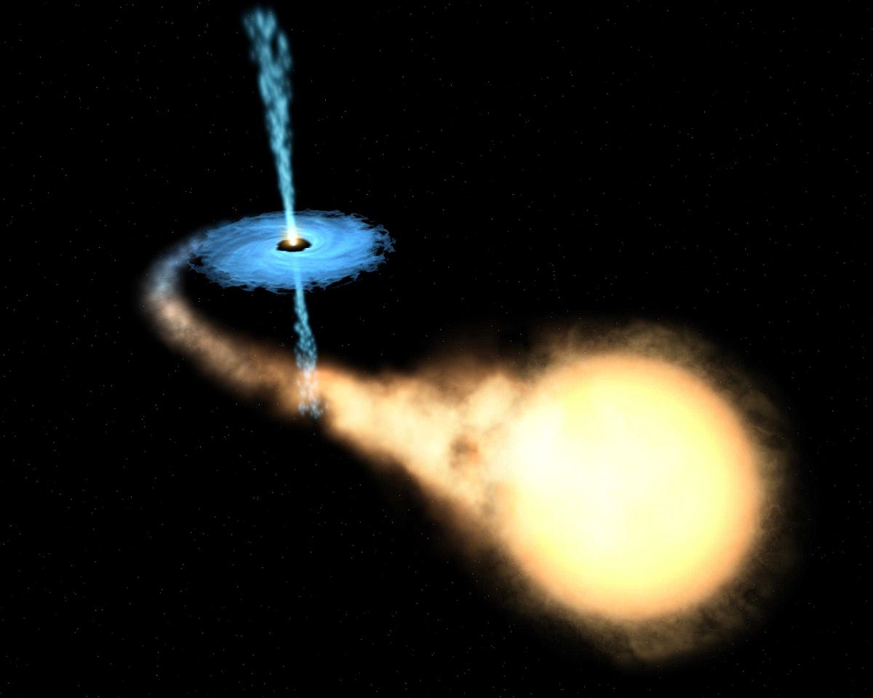
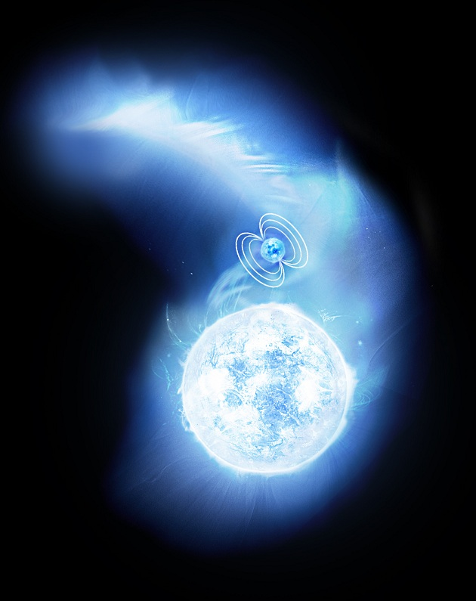
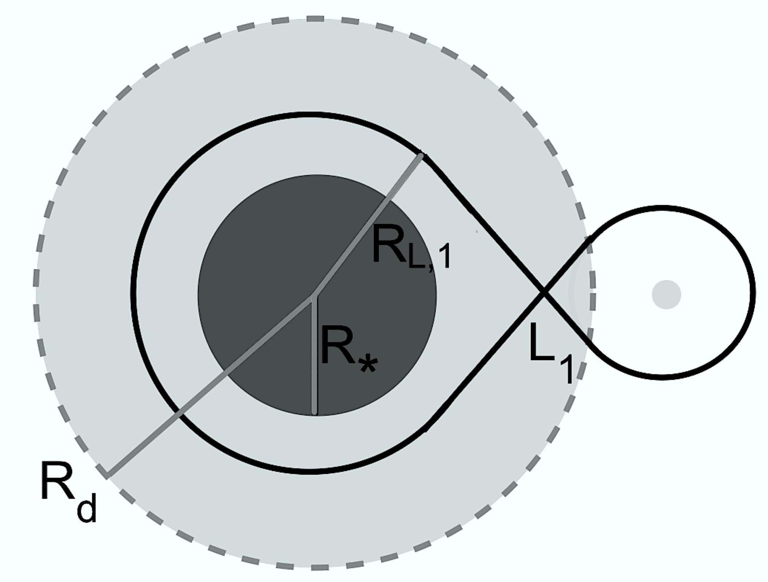
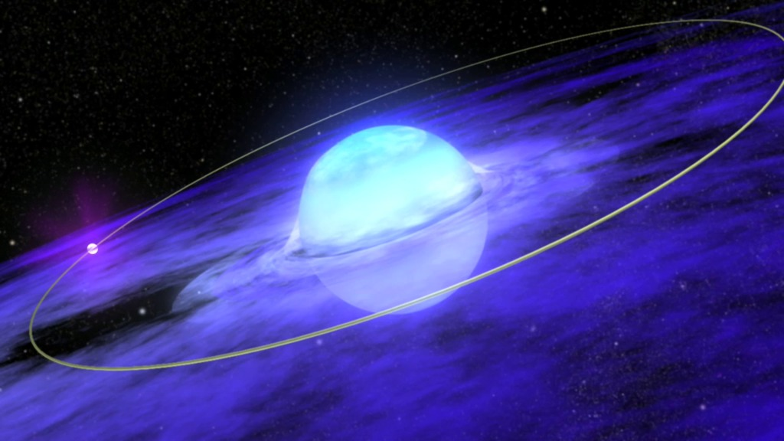
Mass transfer in X-ray binaries
Roche lobe overflow
Wind accretion
Wind-Roche lobe overflow
Disc accretion

Slide 3
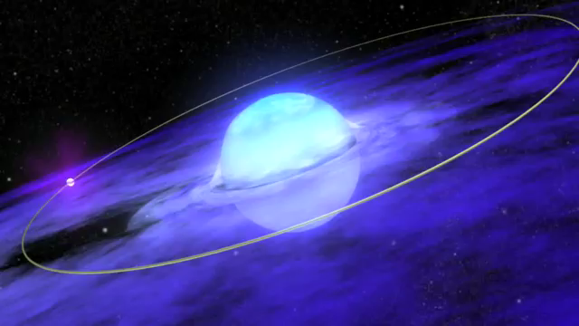
Be X-ray binaries

Slide 4
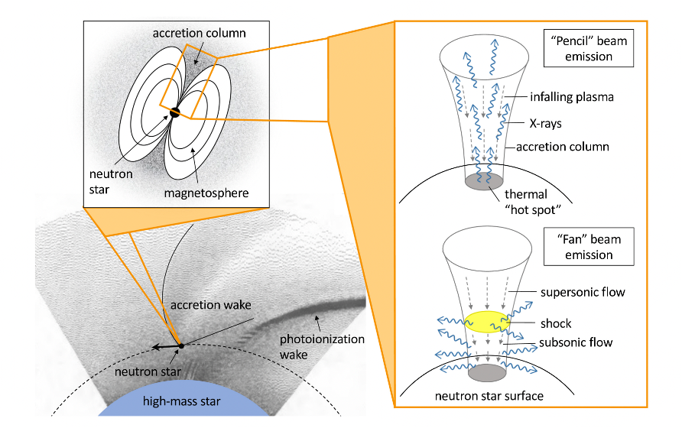
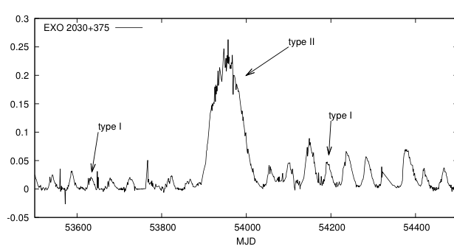
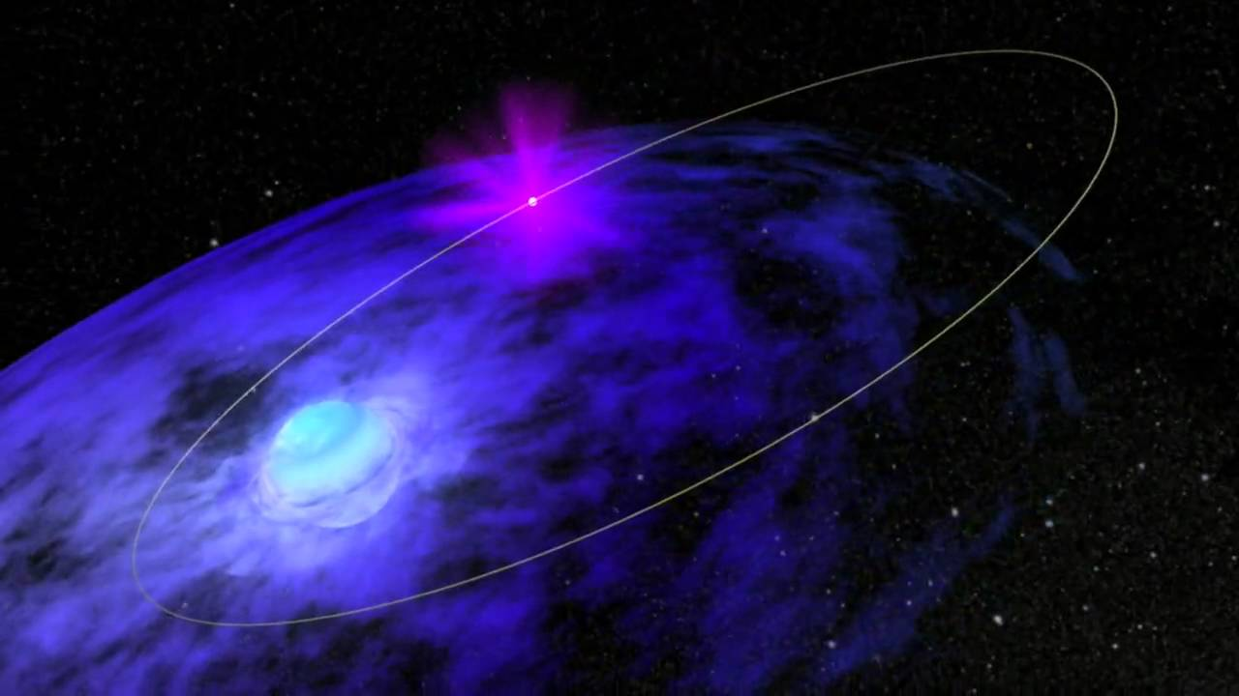
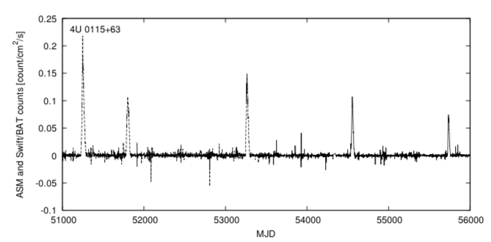
X-ray emission
Type I (normal) outbursts:
- regular in occurrence and
generally associated with periastron passage of neutron
star.
- X-ray luminosity below 10³⁷ erg/s
Type II (giant) outbursts:
- appear less frequently and not associated with any
particular orbital phase.
X-ray luminosity > 10³⁷ erg/s
Last longer
Type II
Type II
Type II
Type II
Notes:
X-ray outbursts come in 2 flavours: type I and type II. Two example lightcurves from well-studied Galactic sources showing them:
Type I: - lower luminosities (order of 10^37 erg/s)
Regular in occurrence (typically on the timescales of the P_orb), so they’re associated with the periastron passage of the NS
Type II: - larger luminosities (> 10^37 erg/s)
They last longer as well, sometimes even last for several orbits of the NS and aren’t necessarily associated with any specific orbital phase
Different systems exhibit different behaviour when it comes to the occurrence of these outbursts – they depend on different factors (intrinsic Be disc properties and orbital parameters). These are two extreme examples here, where the 1 system shows regular occurrences of T1 outbursts with rare T2 outbursts and the other one does vice-versa (more T2 than T1s). Can get anything in between.

Slide 5
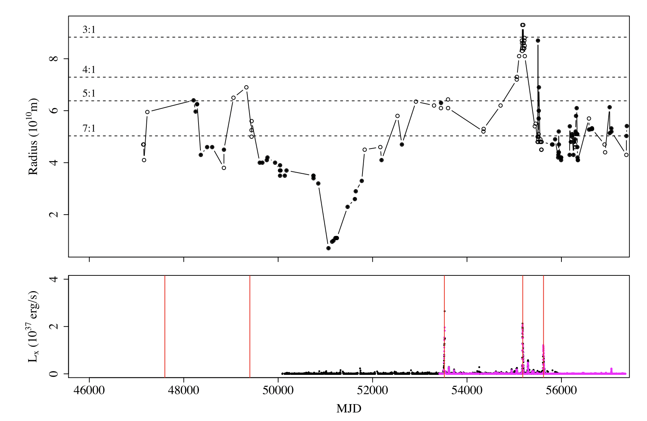
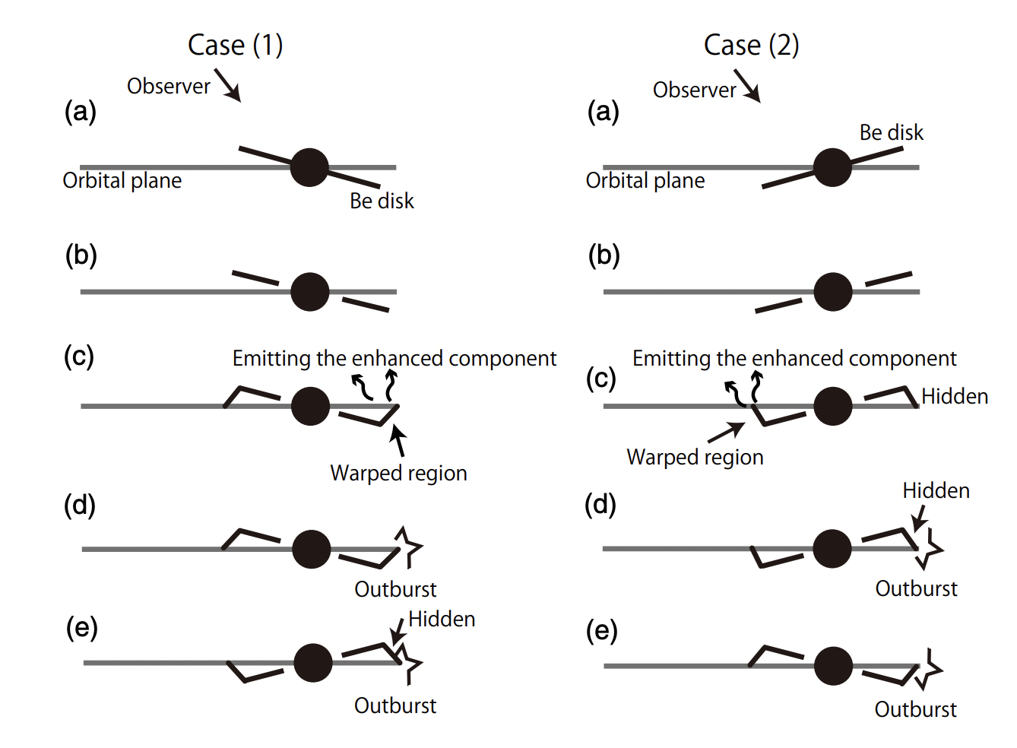
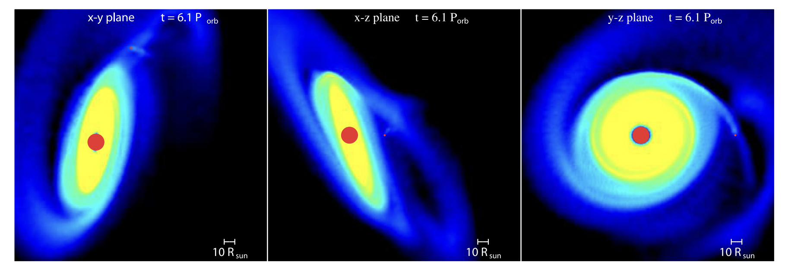
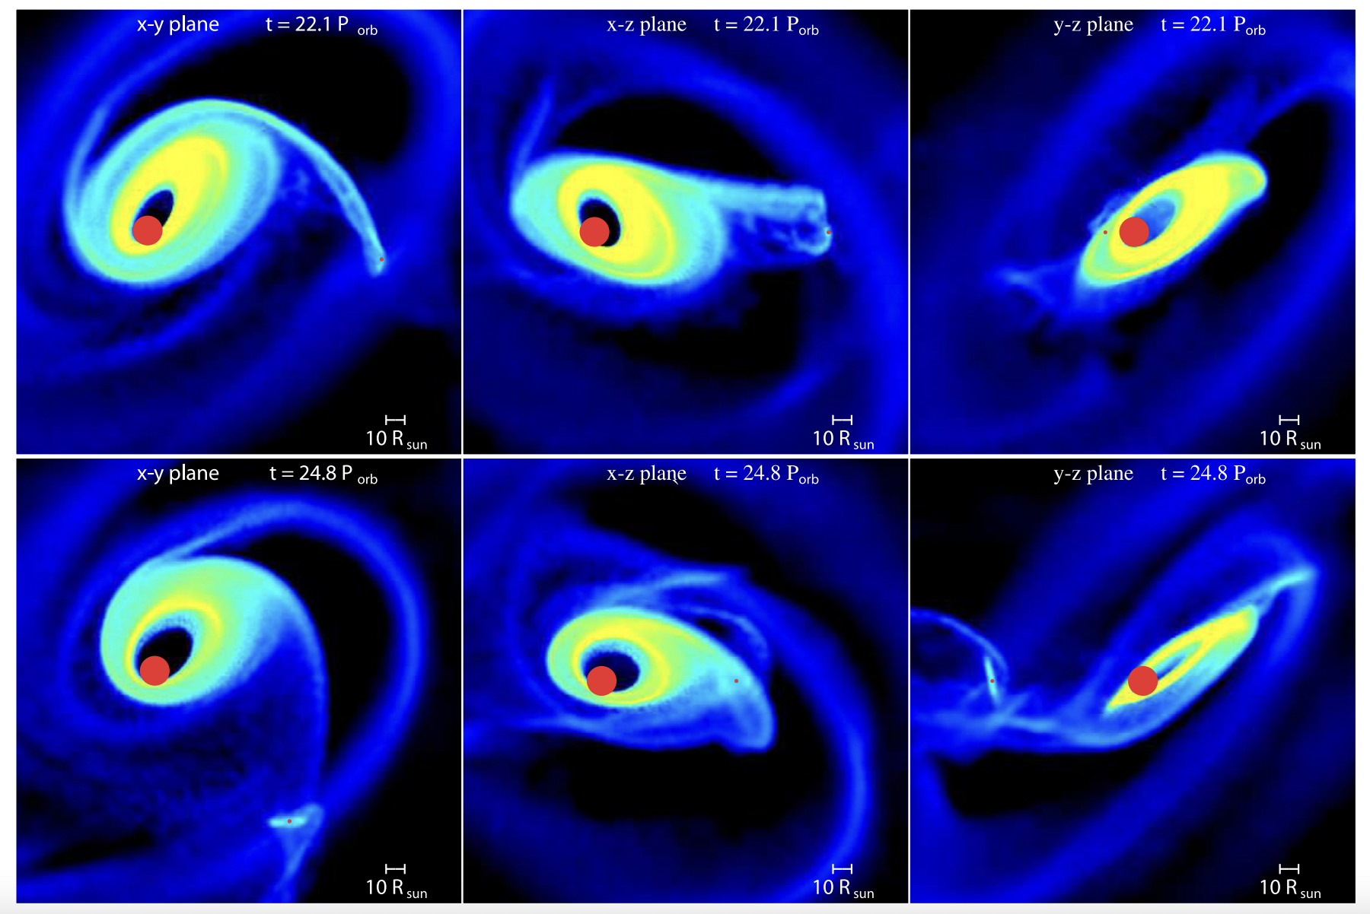
Origin of Type II/Giant outbursts?
Monageng et al. (2017)
Moritani et al. (2013)
Warped Be disc?
Eccentric Be disc?
Martin et al. (2014)

Slide 6
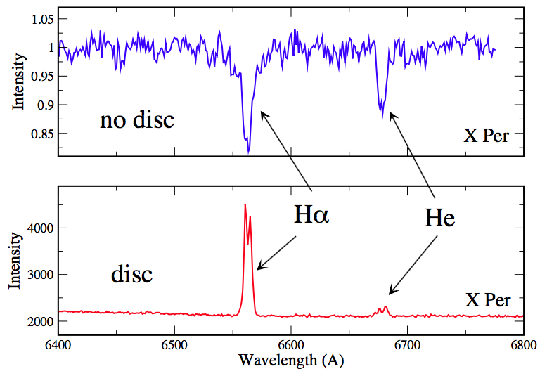
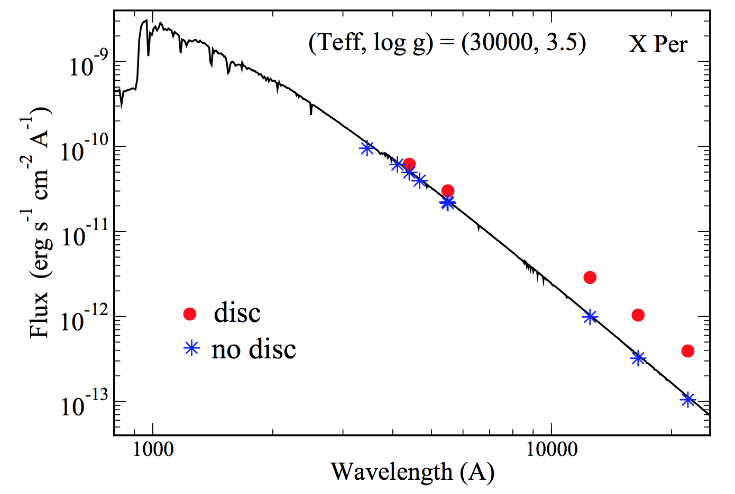
      Optical/Infrared emission

Slide 7
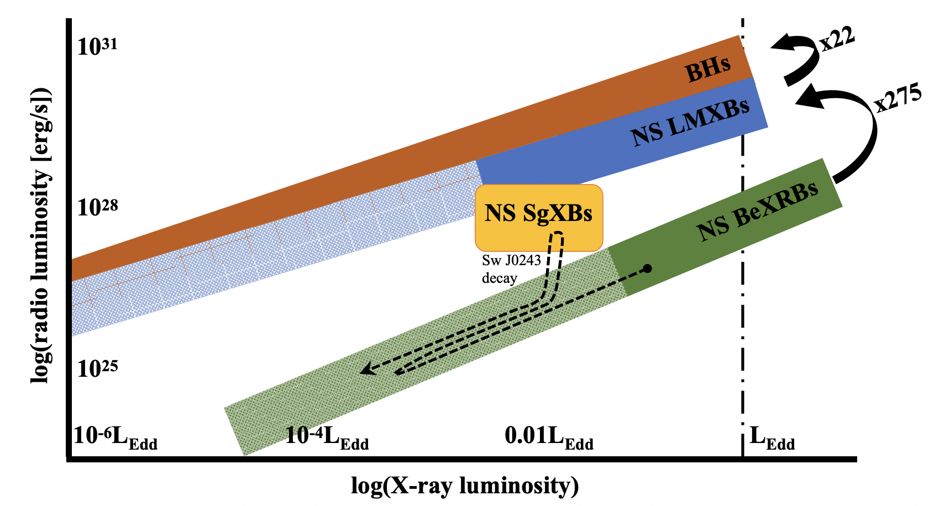
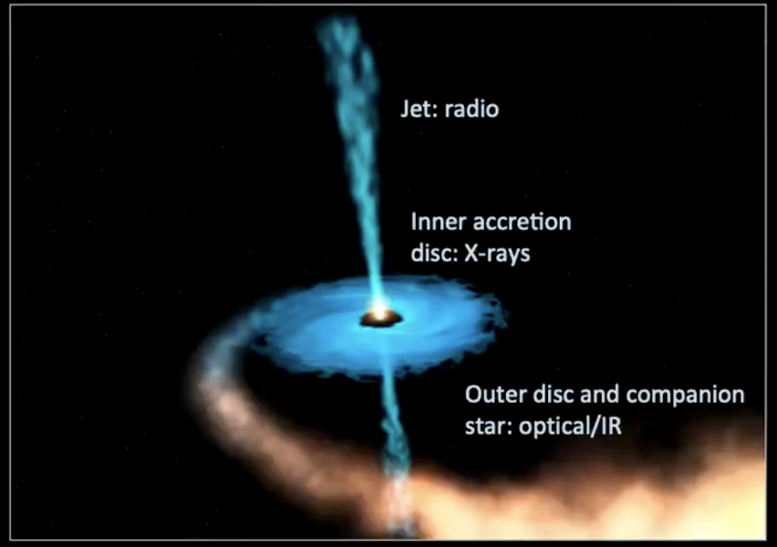
Radio emission from Be X-ray binaries
Radio detections from Galactic objects undergoing Type II outbursts
  Quasi-simultaneous radio and X-ray observations show a consistent luminosity correlation
  Similar to BH and NS LMXBs: coupling between inflow (X-ray) and jet outflow (radio).
  Radio luminosity observed during Type II outbursts is weaker at the same X-ray luminosity than in LMXBs.
  Radio emission interpreted as jet emission (alternative models proposed)
van den Eijnden et al. (2022)

Slide 8
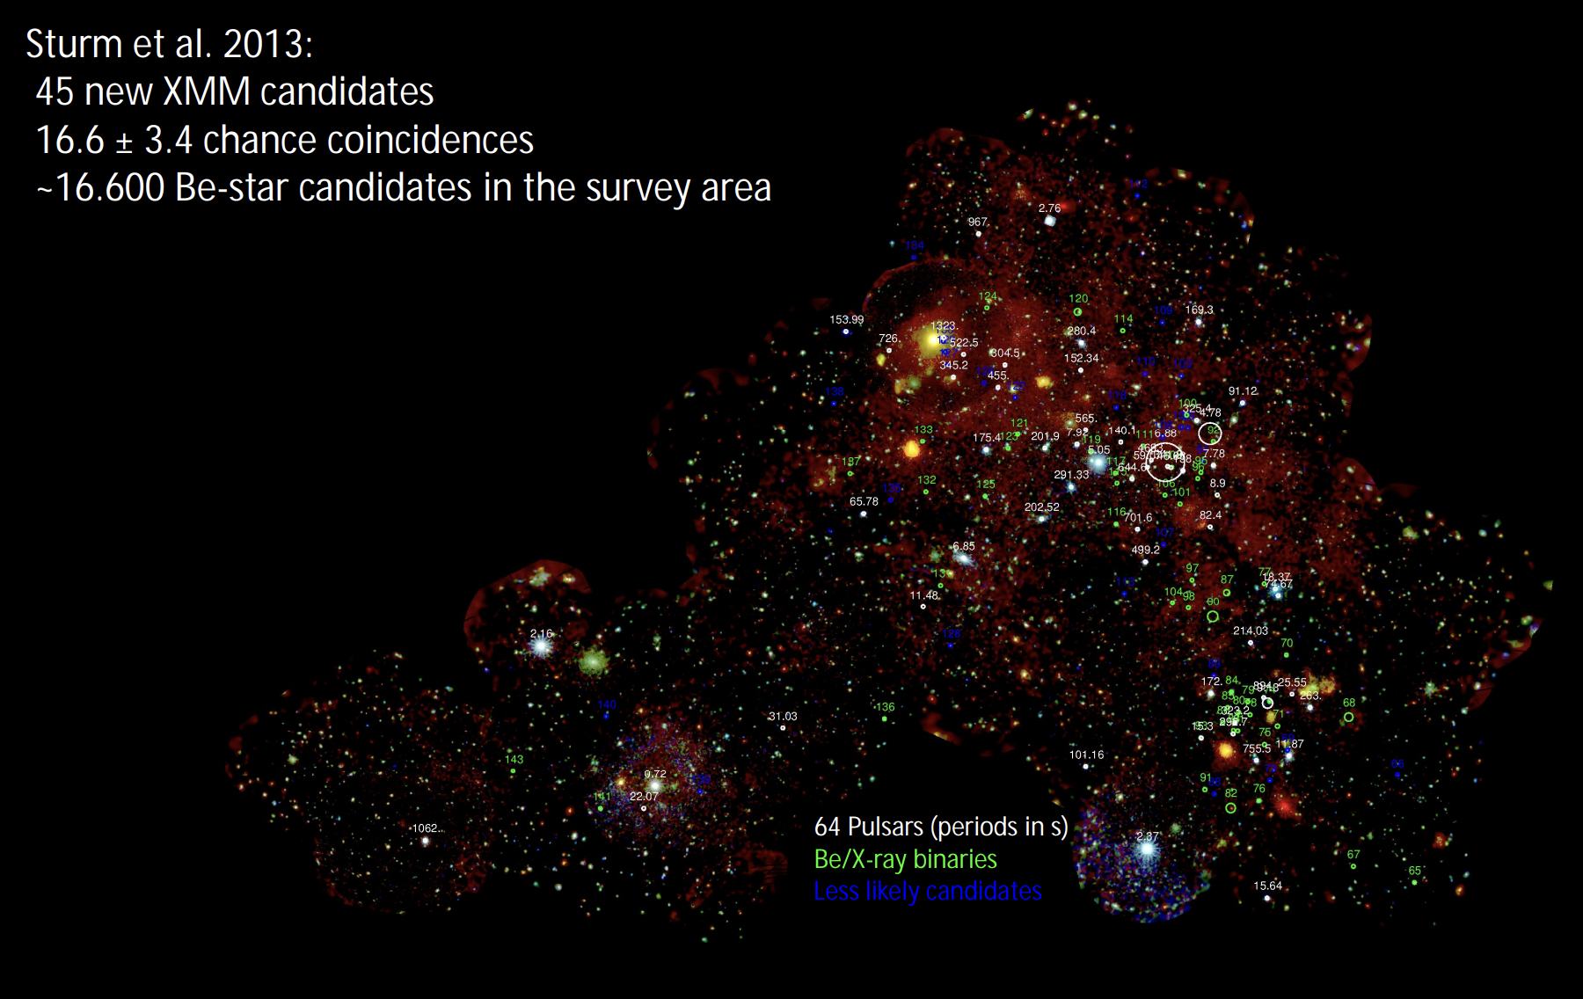
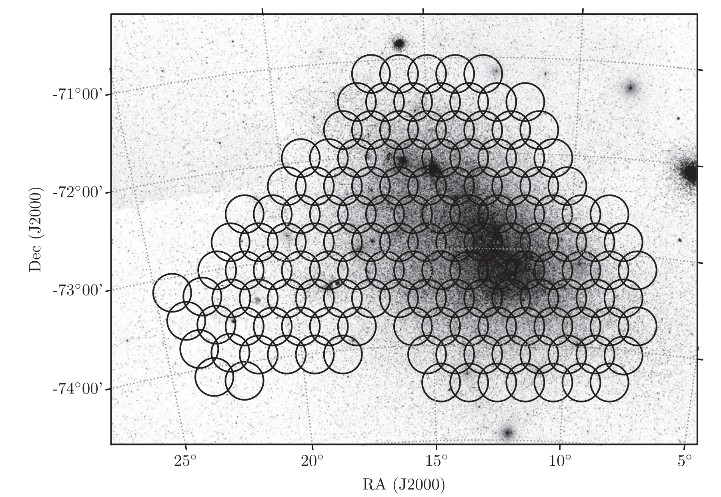
Be X-ray binaries in the SMC: S-CUBED
High-cadence, shallow X-ray survey.
142 tiles every week (60 s exposures per tile).
Discovery and monitoring of X-ray outbursts.
Kennea et al. 2018

Slide 9
Be X-ray binaries in the SMC: S-CUBED
The 2022 super-Eddington outburst of the source SMC X-2; Monthly Notices of the Royal Astronomical Society; M J Coe, J A, Kennea, I M Monageng, L J Townsend, D A H Buckley, M Williams, A Udalski, P A Evans
Discovery of a Rare Eclipsing Be/X-Ray Binary System, Swift J010902.6-723710 = SXP 182; Astrophysical Journal Letters; Thomas M. Gaudin, Jamie A. Kennea, M. J. Coe, I. M. Monageng, Andrzej Udalski, L. J. Townsend, David A. H. Buckley, Phil A. Evans
CXOU J005245.0-722844: discovery of a Be star/white dwarf binary system in the SMC via a very fast, super-Eddington X-ray outburst event; Monthly Notices of the Royal Astronomical Society; T M Gaudin, M J Coe, J A Kennea, I M Monageng, D A H Buckley, A Udalski, P A Evans
A rare outburst from the stealthy BeXRB system Swift J0549.7−6812; Monthly Notices of the Royal Astronomical Society; M J Coe, J A Kennea, I M Monageng, D A H Buckley, A Udalski, P A Evans
SXP 15.6 - an accreting pulsar close to spin equilibrium?; Monthly Notices of the Royal Astronomical Society; M J Coe, I M Monageng, J A Kennea, D A H Buckley, P A Evans, A Udalski, Paul Groot, Steven Bloemen, Paul Vreeswijk, Vanessa McBride, Marc Klein-Wolt, Patrick Woudt, Elmar Körding, Rudolf Le Poole, Danielle Pieterse
Disentangling the neighbouring pulsars SXP 15.3 and SXP 305; Monthly Notices of the Royal Astronomical Society; I M Monageng, M J Coe, L J Townsend, S G T Laycock, J A Kennea, A Roy, A Udalski, S Bhattacharya, D M Christodoulou, D A H Buckley, P A Evans
SXP 31.0 - the 2025 near-Eddington double X-ray outburst after 26 years of quiescence; Monthly Notices of the Royal Astronomical Society; M J Coe, Gaudin T, I M Monageng, Kennea, J. A.; Buckley, D. A. H.; Udalski, A.; Evans, P. A.; Chattopadhyay, S
The Be/neutron star system Swift J004929.5-733107 in the Small Magellanic Cloud - X-ray characteristics and optical counterpart candidates; Monthly Notices of the Royal Astronomical Society; Coe, M. J.; Kennea, J. A.; Evans, P. A.; Townsend, L. J.; Udalski, A.; Monageng, I. M.; Buckley, D. A. H.
The newly discovered Be/X-ray binary Swift J004516.6-734703 in the SMC: witnessing the emergence of a circumstellar disc; Monthly Notices of the Royal Astronomical Society; Kennea, J. A.; Coe, M. J.; Evans, P. A.; Monageng, I. M.; Townsend, L. J.; Siegel, M. H.; Udalski, A.; Buckley, D. A. H.
Optical and X-ray study of the peculiar high mass X-ray binary XMMU J010331.7-730144; Monthly Notices of the Royal Astronomical Society; Monageng, I. M.; Coe, M. J.; Buckley, D. A. H.; McBride, V. A.; Kennea, J. A.; Udalski, A.; Evans, P. A.; Clark, J. S.; Negueruela, I.
A major optical and X-ray outburst from the Magellanic Bridge source RX J0209.6-7427; Monthly Notices of the Royal Astronomical Society; Coe, M. J.; Monageng, I. M.; Bartlett, E. S.; Buckley, D. A. H.; Udalski, A.
An X-ray and optical study of the outbursting behavior of the SMC Be X-ray binary SXP 91.1; Monthly Notices of the Royal Astronomical Society; Monageng, I. M.; Coe, M. J.; Kennea, J. A.; Townsend, L. J.; Buckley, D. A. H.; McBride, V. A.; Udalski, A.; Evans, P. A.; Roche, P. D.
The SMC X-ray binary SXP4.78: a new Type II outburst and the identification and study of the optical counterpart; Monthly Notices of the Royal Astronomical Society; Monageng, I. M.; Coe, M. J.; Townsend, L. J.; Buckley, D. A. H.; McBride, V. A.; Roche, P. D.; Kennea, J. A.; Udalski, A.; Evans, P. A.

Slide 10
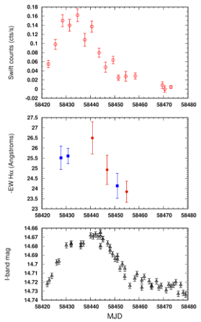
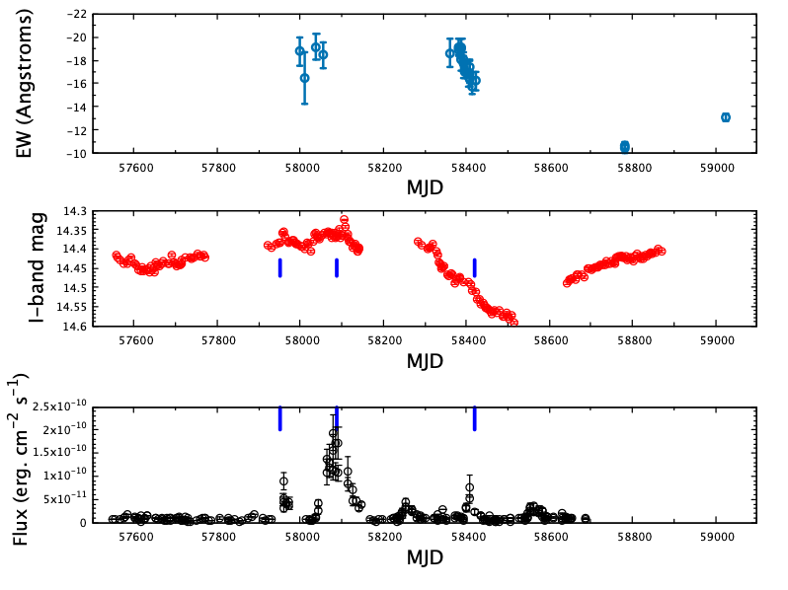
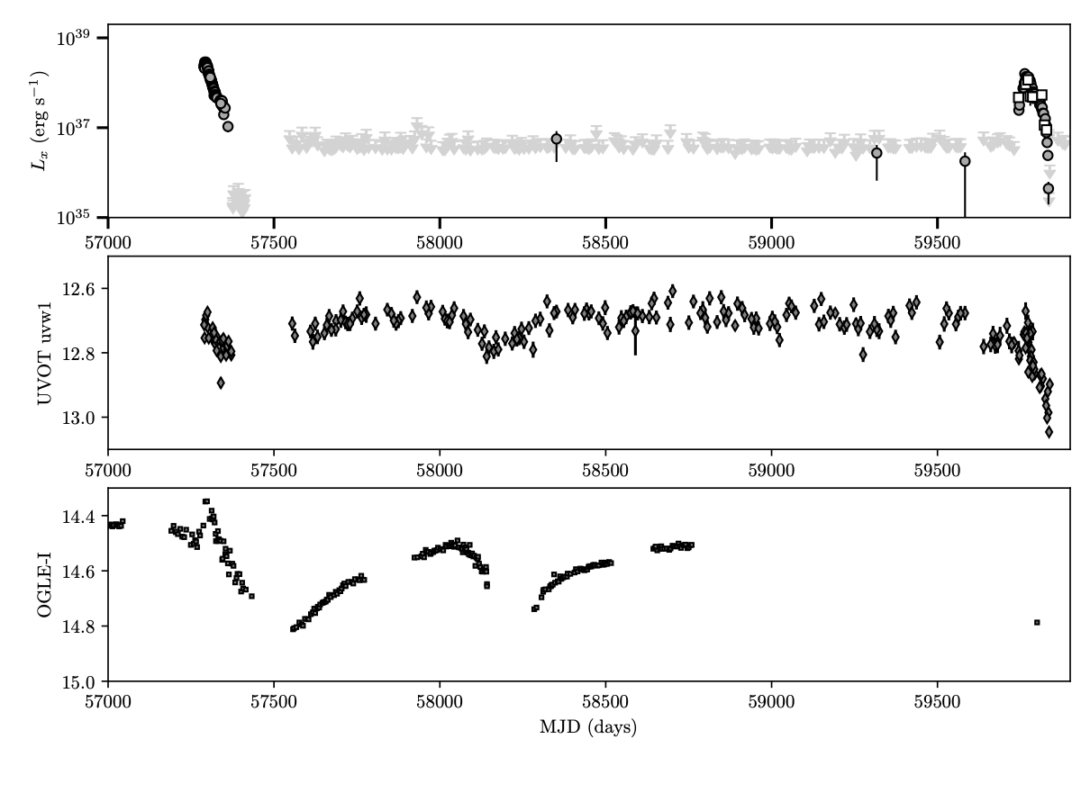
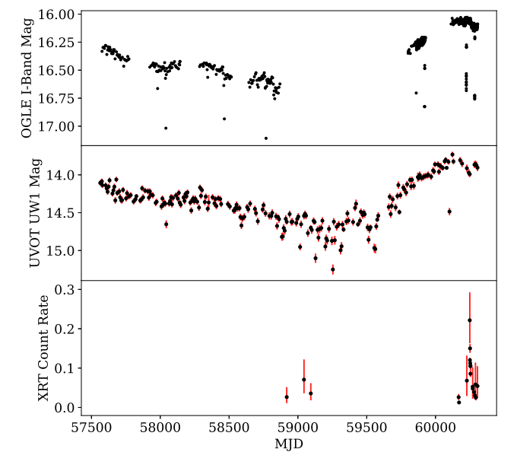
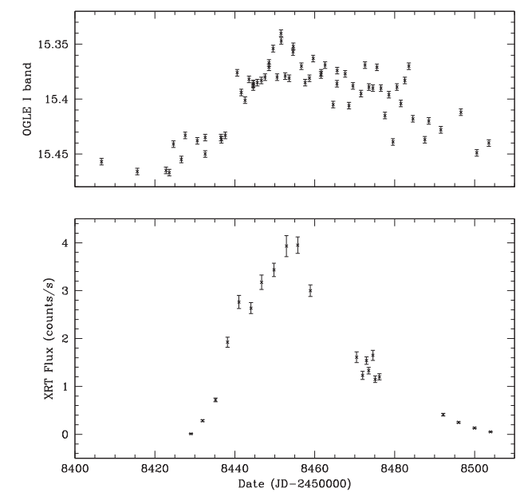
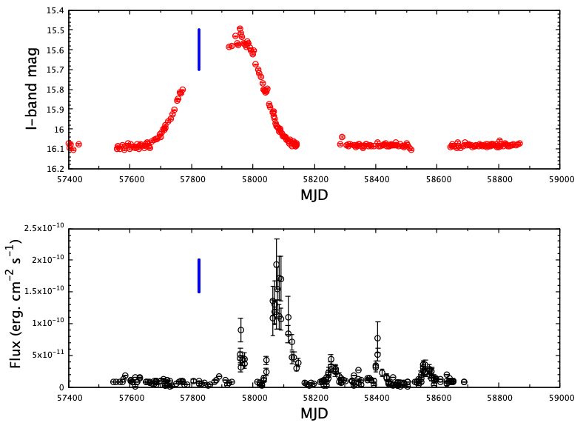
      Be X-ray binaries in the SMC: S-CUBED
Title
SXP 91.1
SMC X-2
SXP 15.3
Swift J010902.6
Caption
SXP 305
SXP 4.78
Caption
Caption

Slide 11
  The 2025 near-Eddington double X-ray outburst of SXP 31.0
Orbital period of 90.53±0.07 days and unknown eccentricity.
Pulse period of 31.0 s
Discovered in 1998 using RXTE during a Type II outburst.
Optical counterpart identified as a B0.5V – B1Ve star with IR excess.
H-alpha images revealed extended structure:
  Supernova remnant?
  Bow shock?
  Ionised HII region?
Multiwavelength campaign using Swift XRT, UVOT, OGLE and SALT during a period of X-ray activity

Slide 12
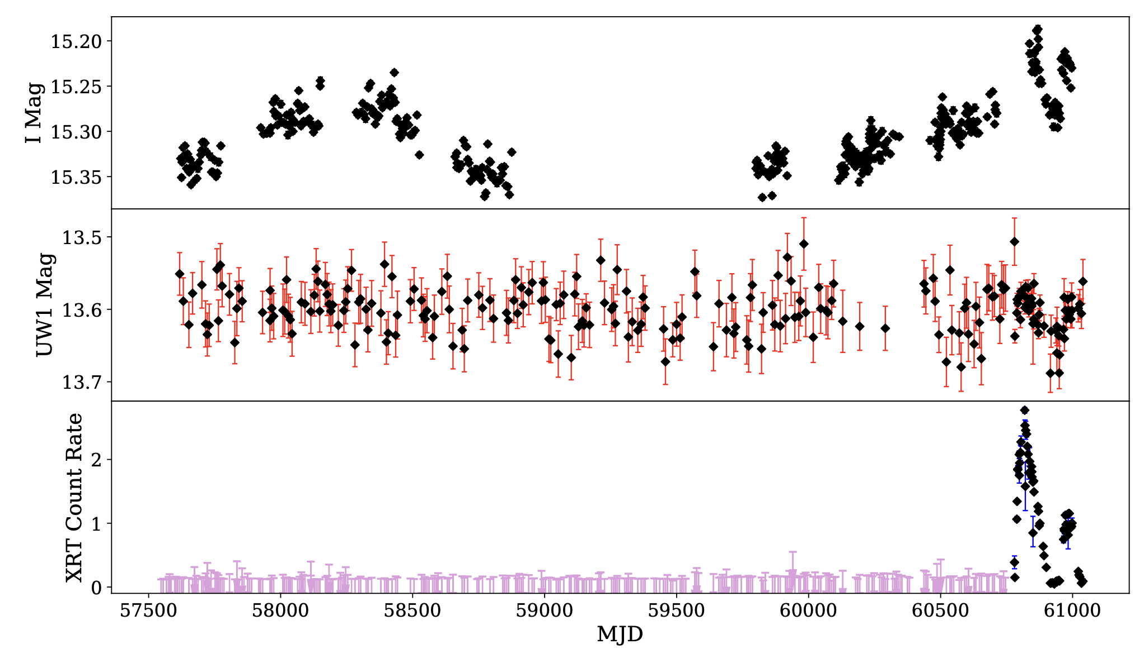
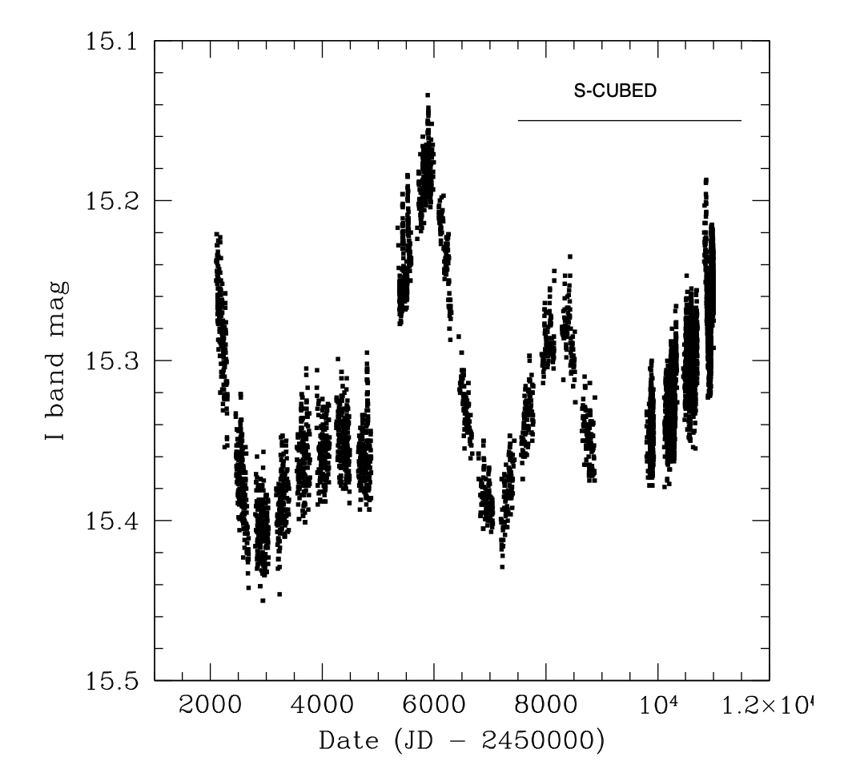
X-ray/UV/Optical photometric variability
Detected for the first time with SCUBED monitoring (after 9 years of monitoring). ToO requests followed with exposure times 1ks – 5ks.
UV and IR/optical brightness trace structural changes in the inner and outer regions of the Be disc.
24 years of monitoring with OGLE I-band:
  Long-term variability on timescales of years
Surprising lack of UV variability:
  Non-global disc variability.

Slide 13
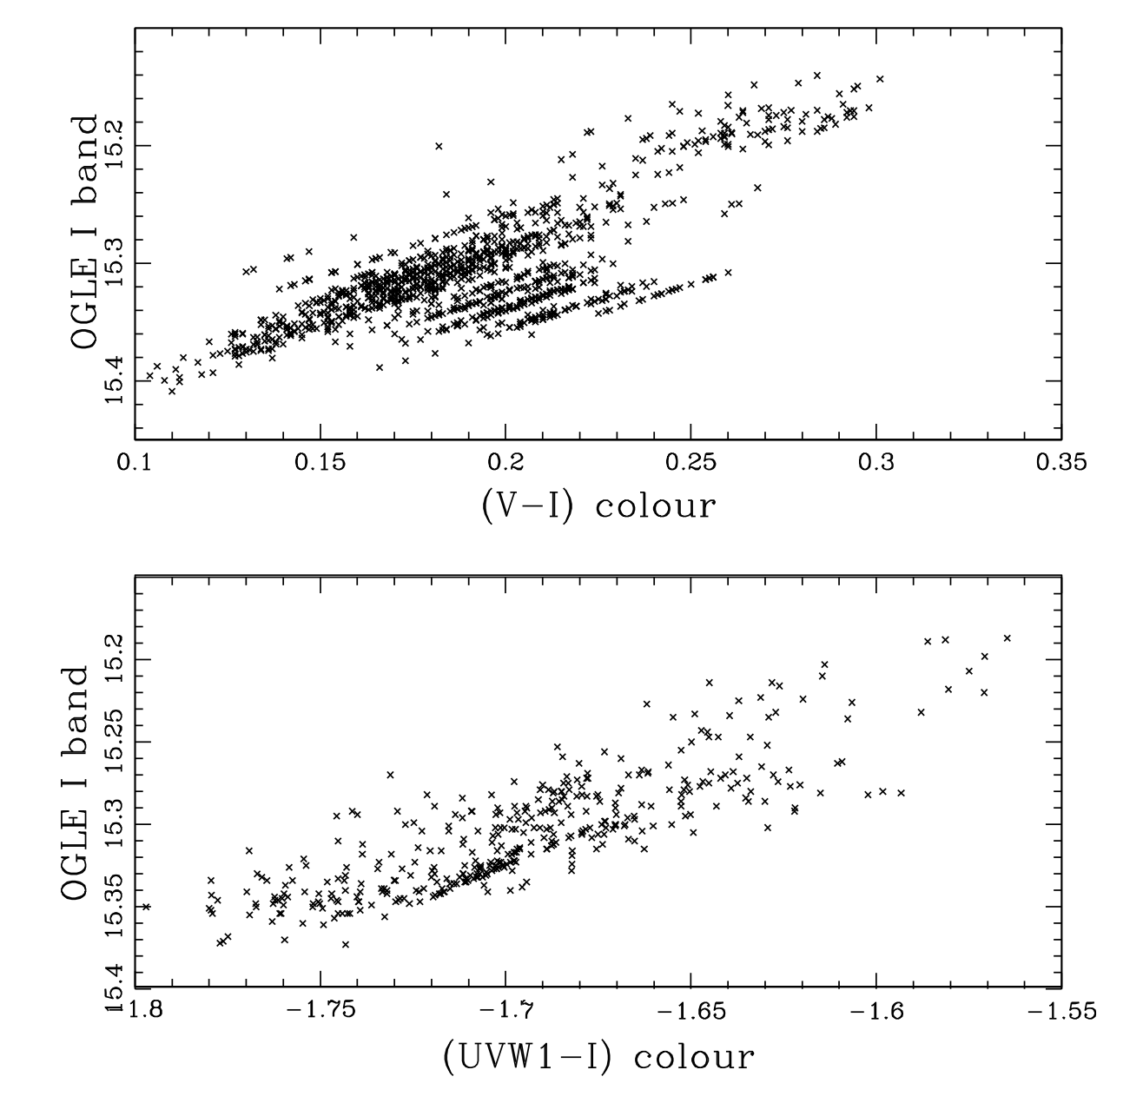
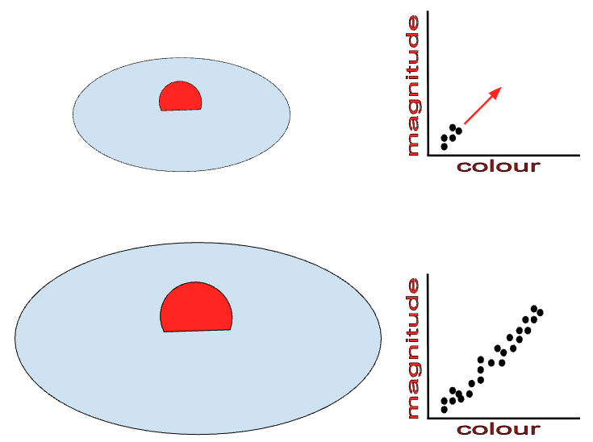
UV/Optical photometric variability
Long-term colour changes over time → Be disc temperature profile changes.
Strong correlation between colour and magnitude → intermediate/low inclination angle of the Be disc
Steeper rate of change of colour in (UVW1-I) than in (V-I) plot.
Caption

Slide 14
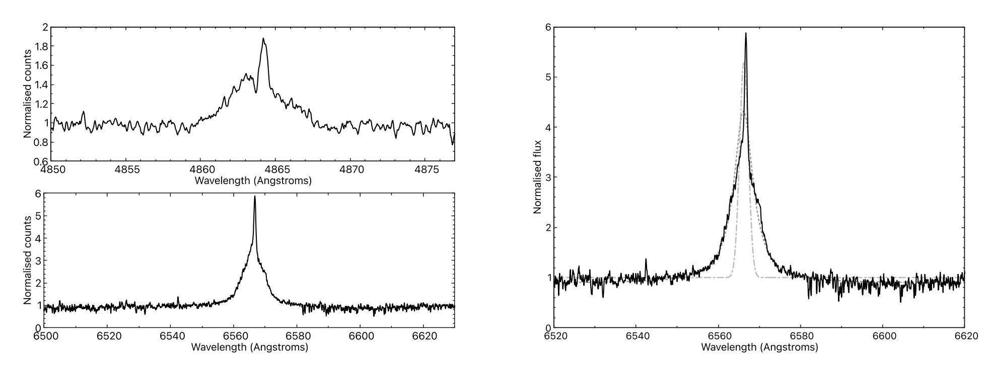
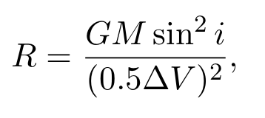
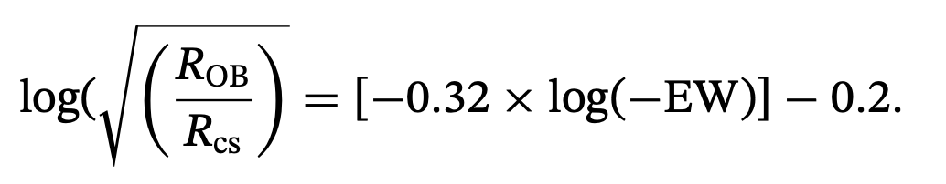
Spectroscopic variability (SALT)
Multicomponent emission line :
  Narrow emission superimposed on broader component
  Narrow emission likely originates from surrounding extended emission while the broad component is likely from the Be disc.
Disc size is comparable to neutron star semi-major axis:
  Direct physical interaction between NS and Be disc
  Tidal interaction temporarily enhances the disc surface area

Slide 15
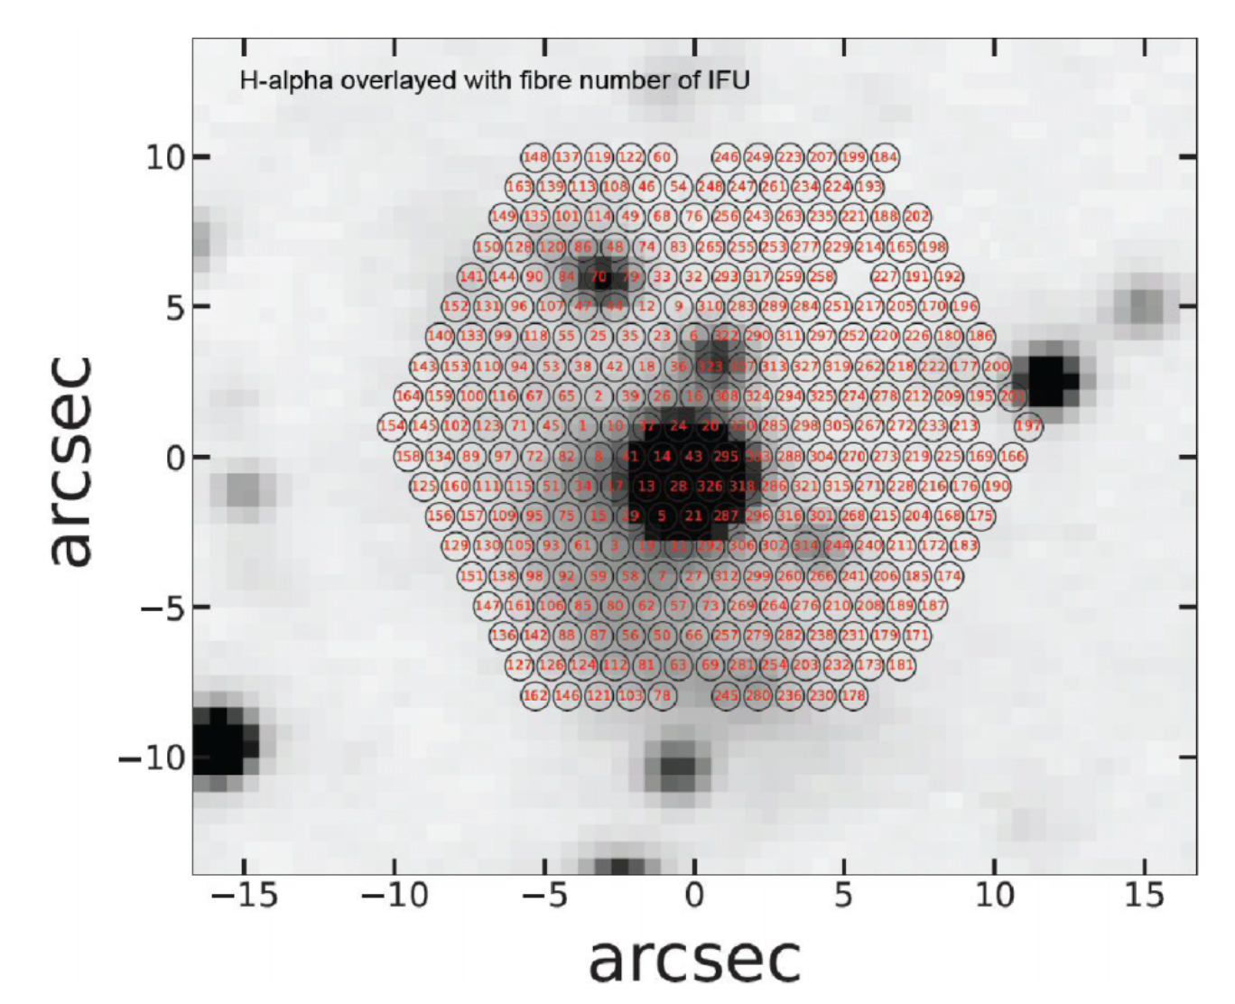
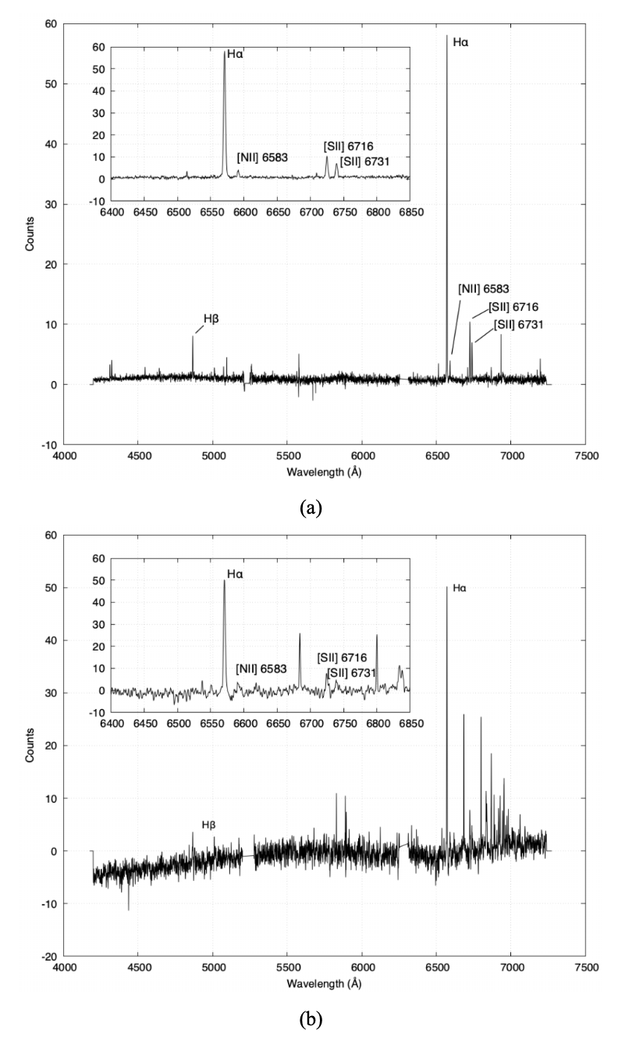
SALT imaging
Extended halo that dominates the SW of SXP 31.0
Slit Mask Integral Field Unit observations to investigate the nature of the extended halo:
  Comparison of the [S II] and H-alpha emission lines.
  [S II]/H-alpha ratio of 0.2 – 0.3, which strongly indicates that the emission is from an HII region (photoionisation) instead of supernova remnant or bow shock (shock excitation).

Slide 16
Summary
Enhanced X-ray activity of the SMC Be X-ray binary, SXP 31.0, for the first time in 26 years!
Unusual back-to-back Type II outbursts:
  Possible multiple epochs of mass outflow from the Be star.
  Accretion from an eccentric Be disc due to Kozai-Lidov oscillations?
Nature of the extended surrounding halo:
  Chance coincidence with HII region (not due to SNR or bow shock)

