Slide 1


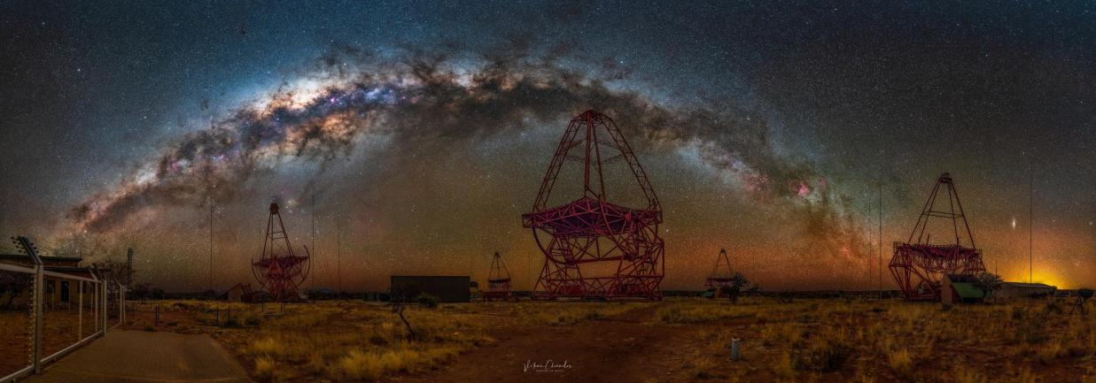
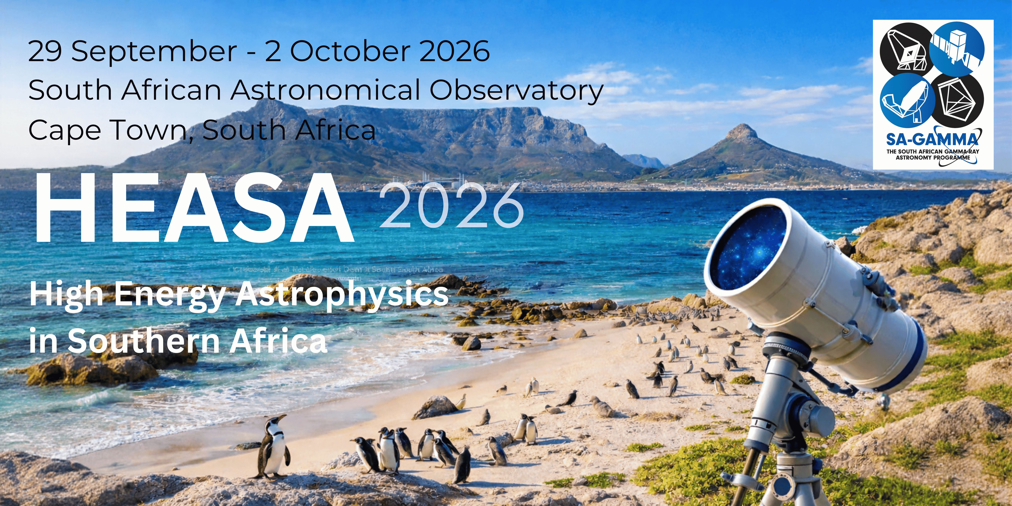
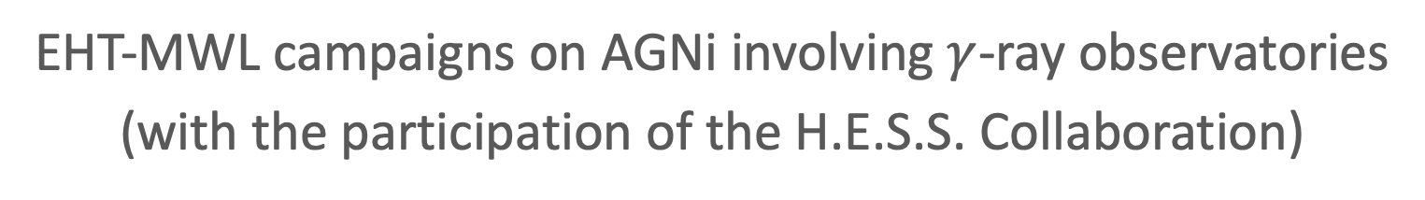
EHT-MWL campaigns on AGNi involving $γ$-ray observatories
(with the participation of the H.E.S.S. Collaboration)
Anna Luashvili
Credit: Vikas Chander

Slide 2
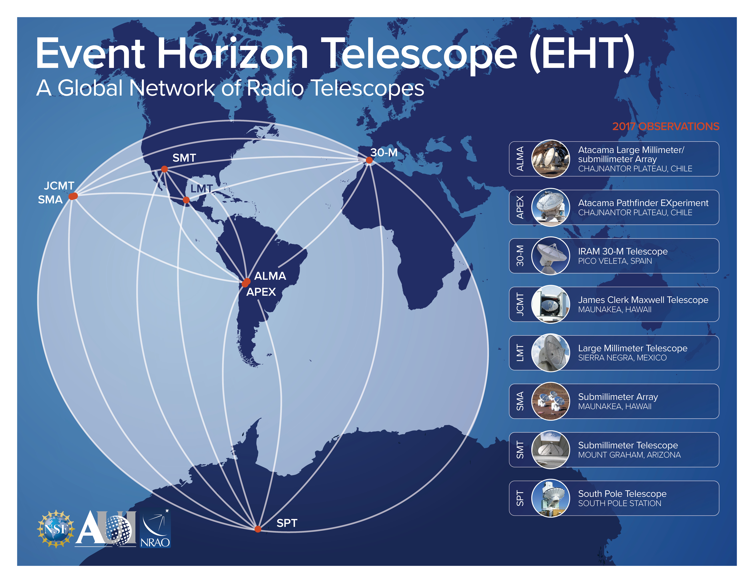
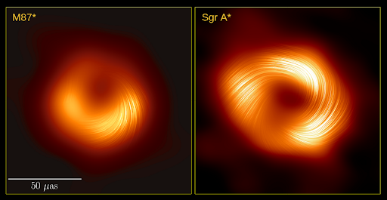
Credit: EHT Collaboration
M87* and Sgr A*: only two targets resolved at event horizon scales.
+ very high resolution images of innermost jet regions of other sources (e.g. Röder et al. 2025)
Credit: NRAO
  HEASA 2026 (SAAO, Cape Town, 30 September 2026) Anna Luashvili 1

Slide 3
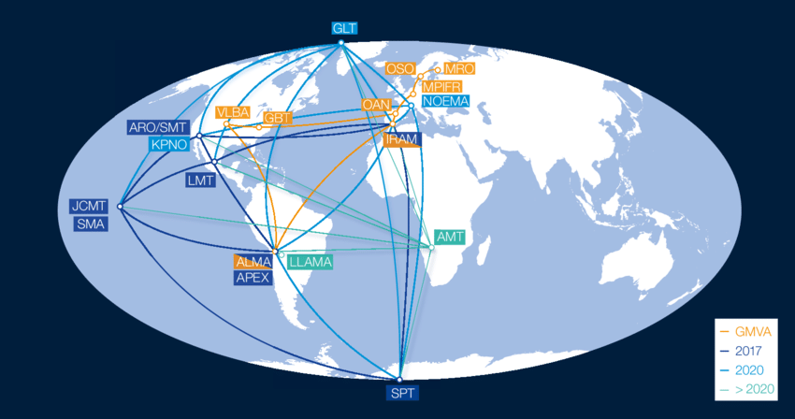
Credit: EHT Collaboration
M87* and Sgr A*: only two targets resolved at event horizon scales.
+ very high resolution images of innermost jet regions of other sources (e.g. Röder et al. 2025)
From Goddi+2019
Credit: NRAO
  HEASA 2026 (SAAO, Cape Town, 30 September 2026) Anna Luashvili 1

Slide 4
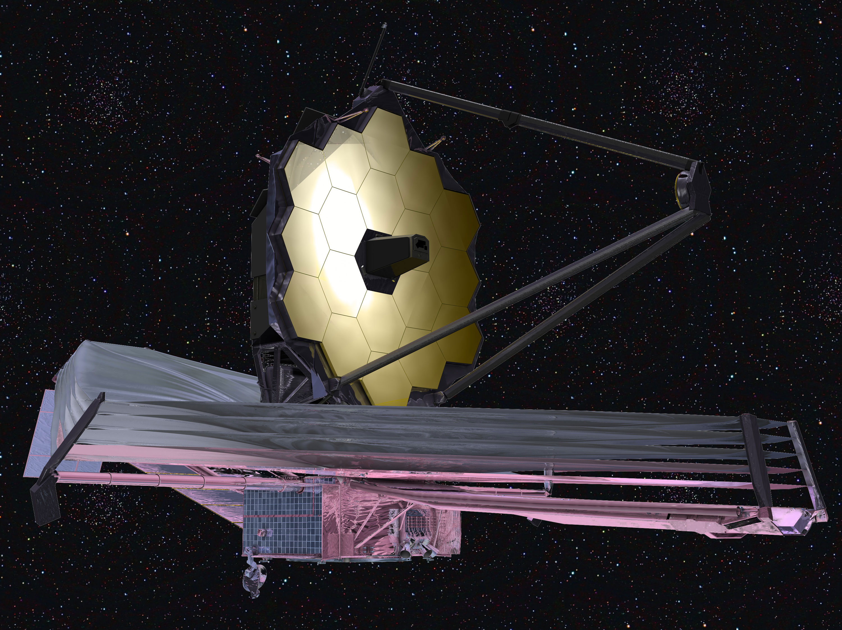
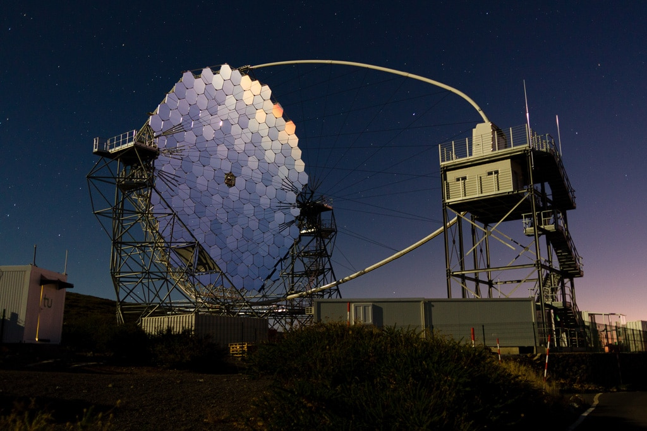

JWST (IR)
+
LST-1 (VHE $γ$-rays)
Credits: EHT Collaboration, Fermi-LAT Collaboration, H.E.S.S. Collaboration, MAGIC Collaboration, VERITAS Collaboration, EAVN Collaboration, NASA/JSWT, O. Ballester/LST-CTAO
  HEASA 2026 (SAAO, Cape Town, 30 September 2026) Anna Luashvili 2

Slide 5
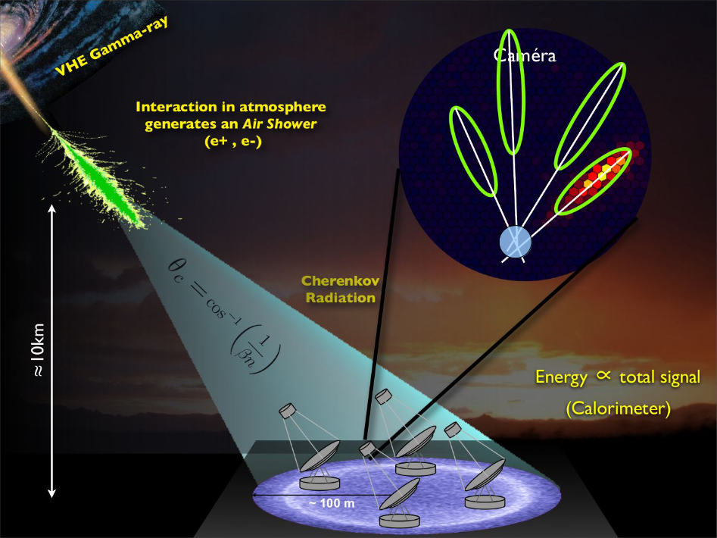
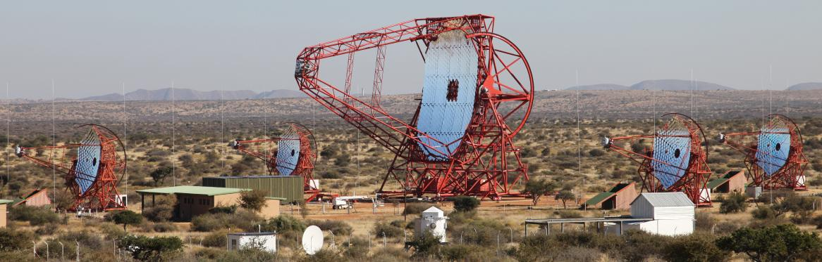
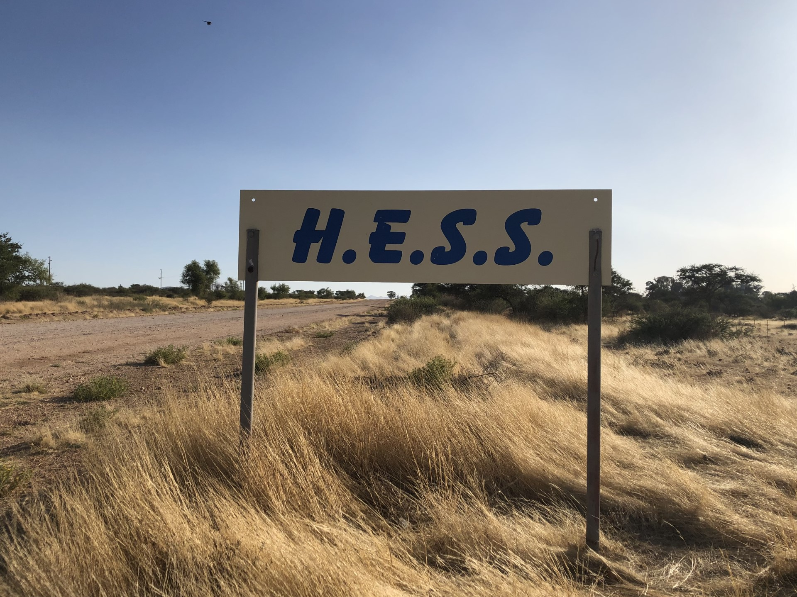
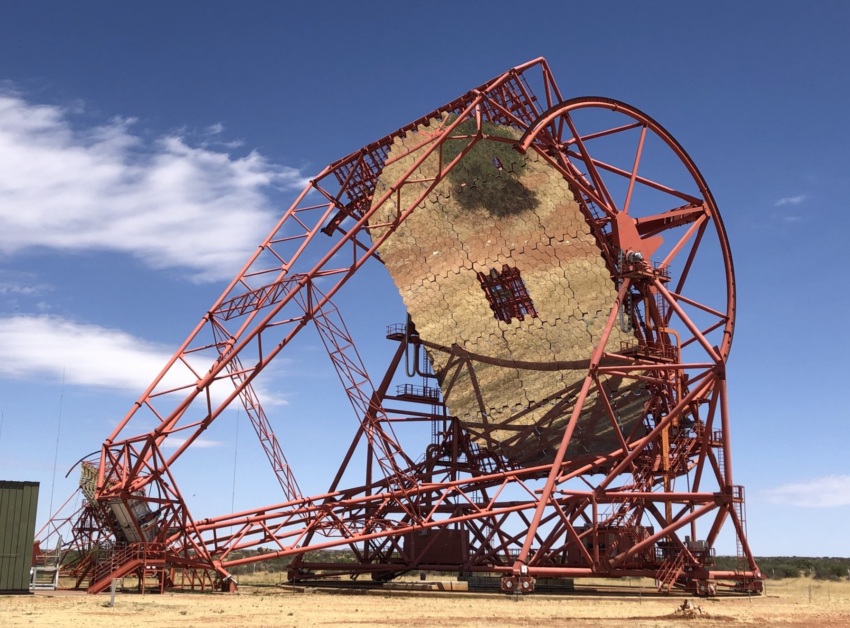
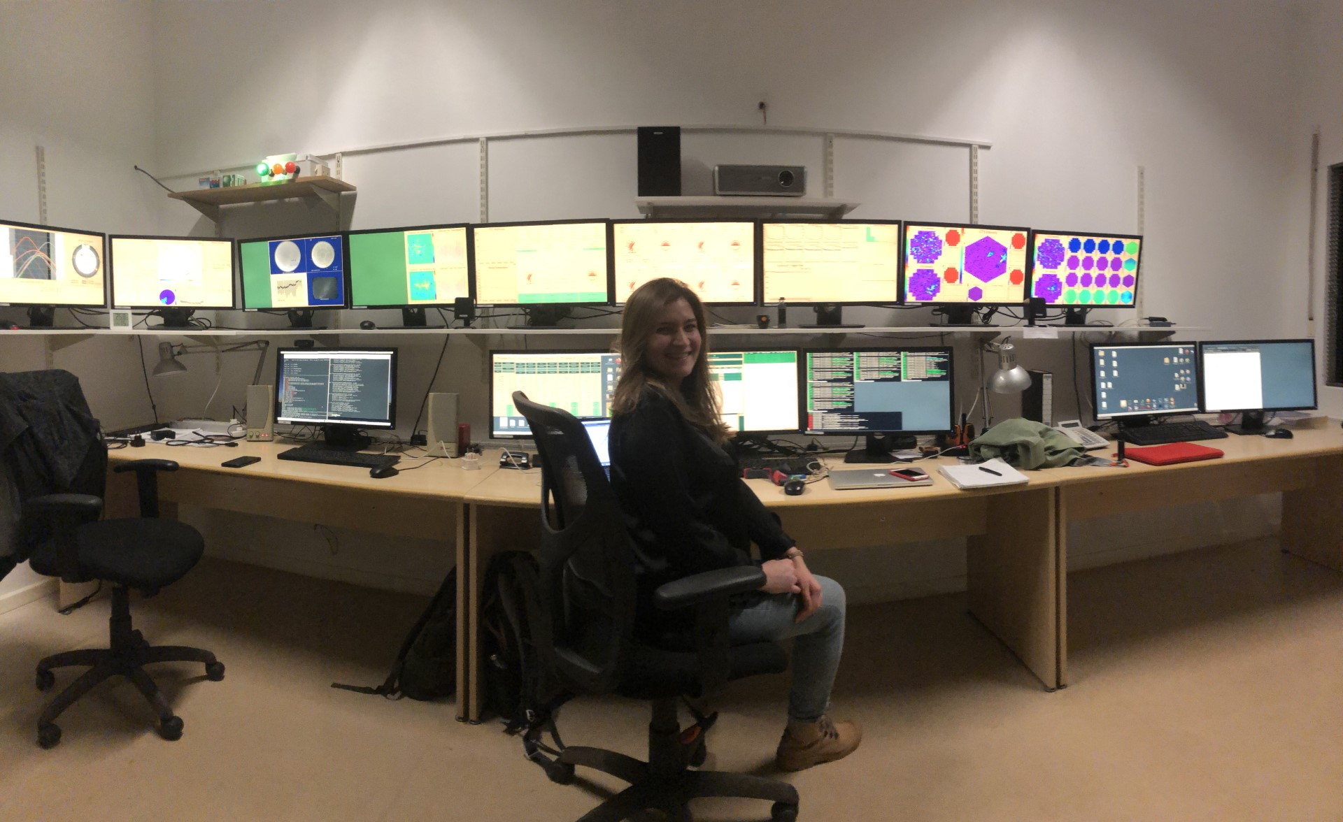
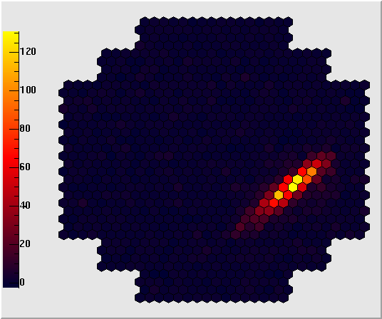
  High Energy Stereoscopic System (H.E.S.S.)
Credit: Vikas Chander
Credit: Karl Kosack
Credit: H.E.S.S. collaboration
  HEASA 2026 (SAAO, Cape Town, 30 September 2026) Anna Luashvili 3

Slide 6
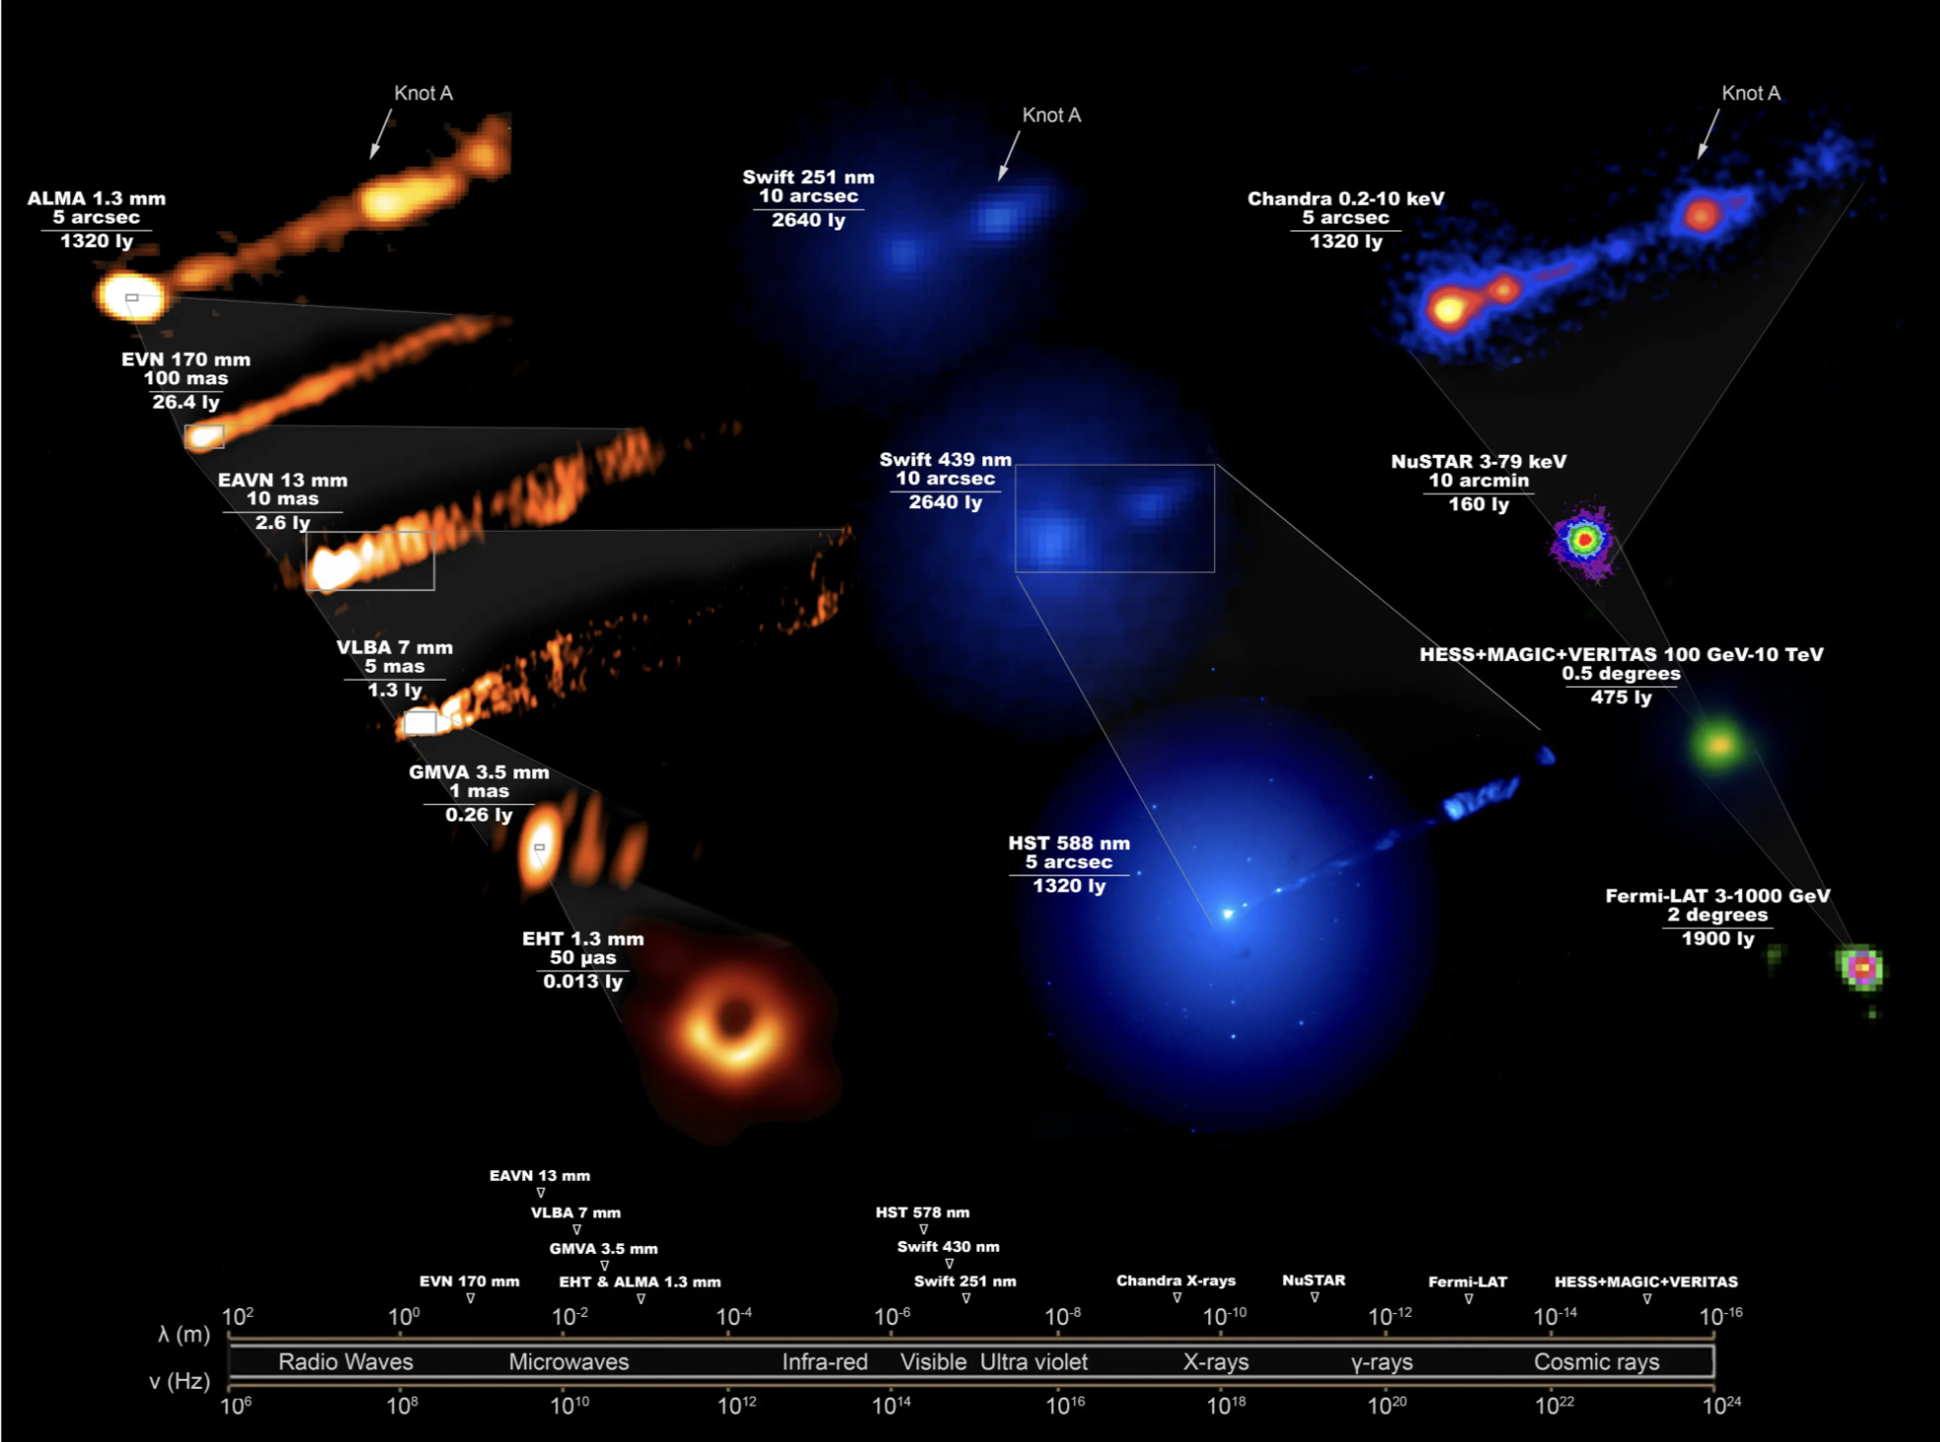
  M87 – complex jet structure
Credit: The EHT Multi-wavelength Science Working Group; the EHT Collaboration; ALMA (ESO/NAOJ/NRAO); the EVN; the EAVN Collaboration; VLBA (NRAO); the GMVA; the Hubble Space Telescope; the Neil Gehrels Swift Observatory; the Chandra X-ray Observatory; the Nuclear Spectroscopic Telescope Array; the Fermi-LAT Collaboration; the H.E.S.S collaboration; the MAGIC collaboration; the VERITAS collaboration; NASA and ESA. Composition by J. C. Algaba.
  HEASA 2026 (SAAO, Cape Town, 30 September 2026) Anna Luashvili 4

Slide 7
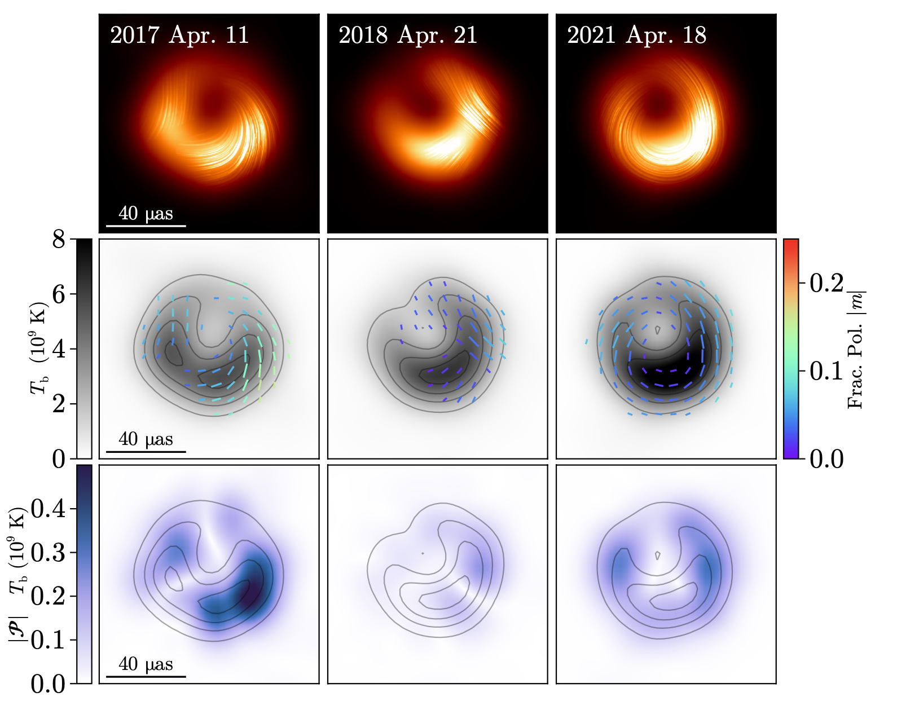
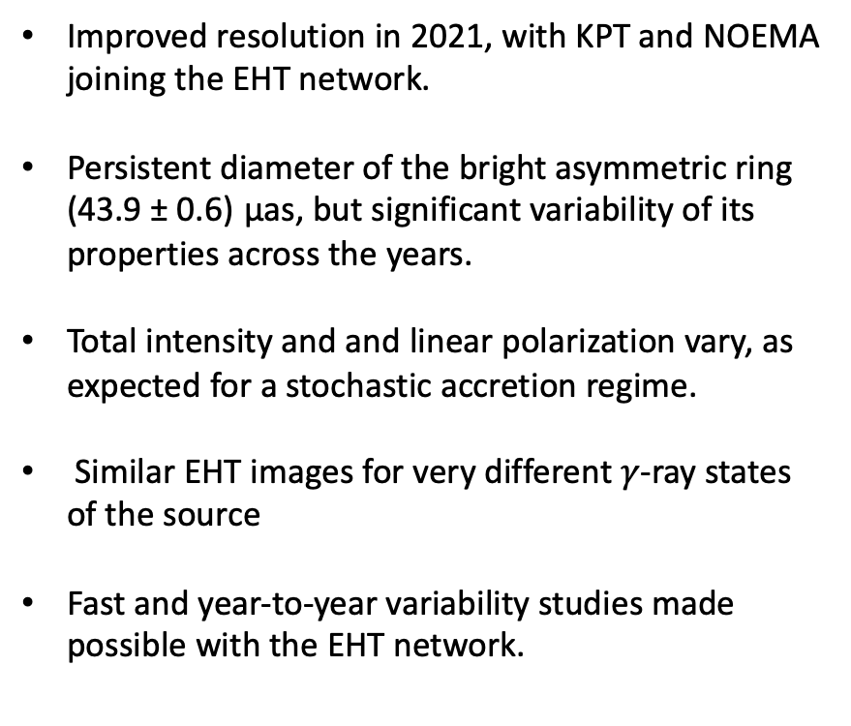
  M87* multi-year variability
Improved resolution in 2021, with KPT and NOEMA joining the EHT network.
Persistent diameter of the bright asymmetric ring (43.9 ± 0.6) µas, but significant variability of its properties across the years.
Total intensity and and linear polarization vary, as expected for a stochastic accretion regime.
Similar EHT images for very different $γ$-ray states of the source
Fast and year-to-year variability studies made possible with the EHT network.
Event Horizon Telescope Collaboration (2025)
  HEASA 2026 (SAAO, Cape Town, 30 September 2026) Anna Luashvili 5

Slide 8
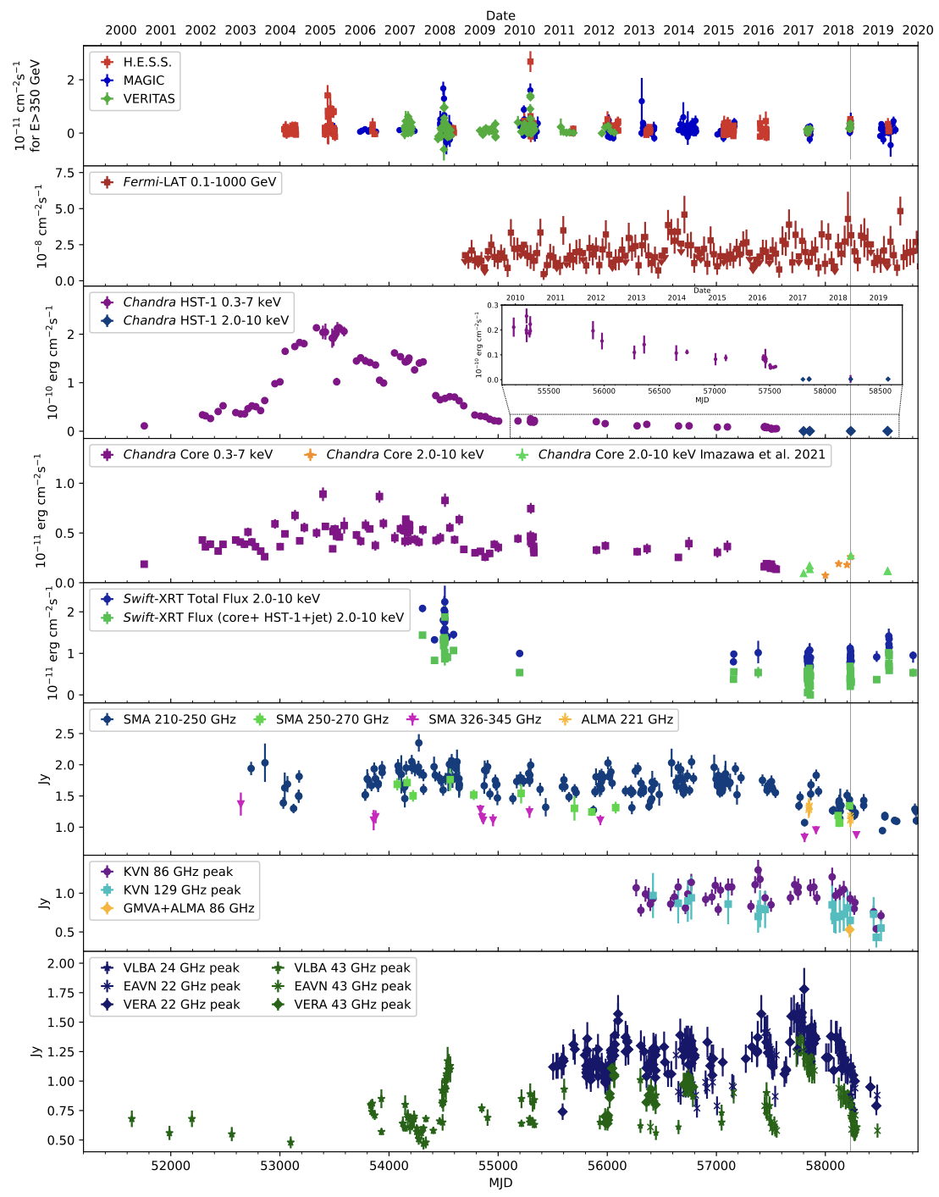
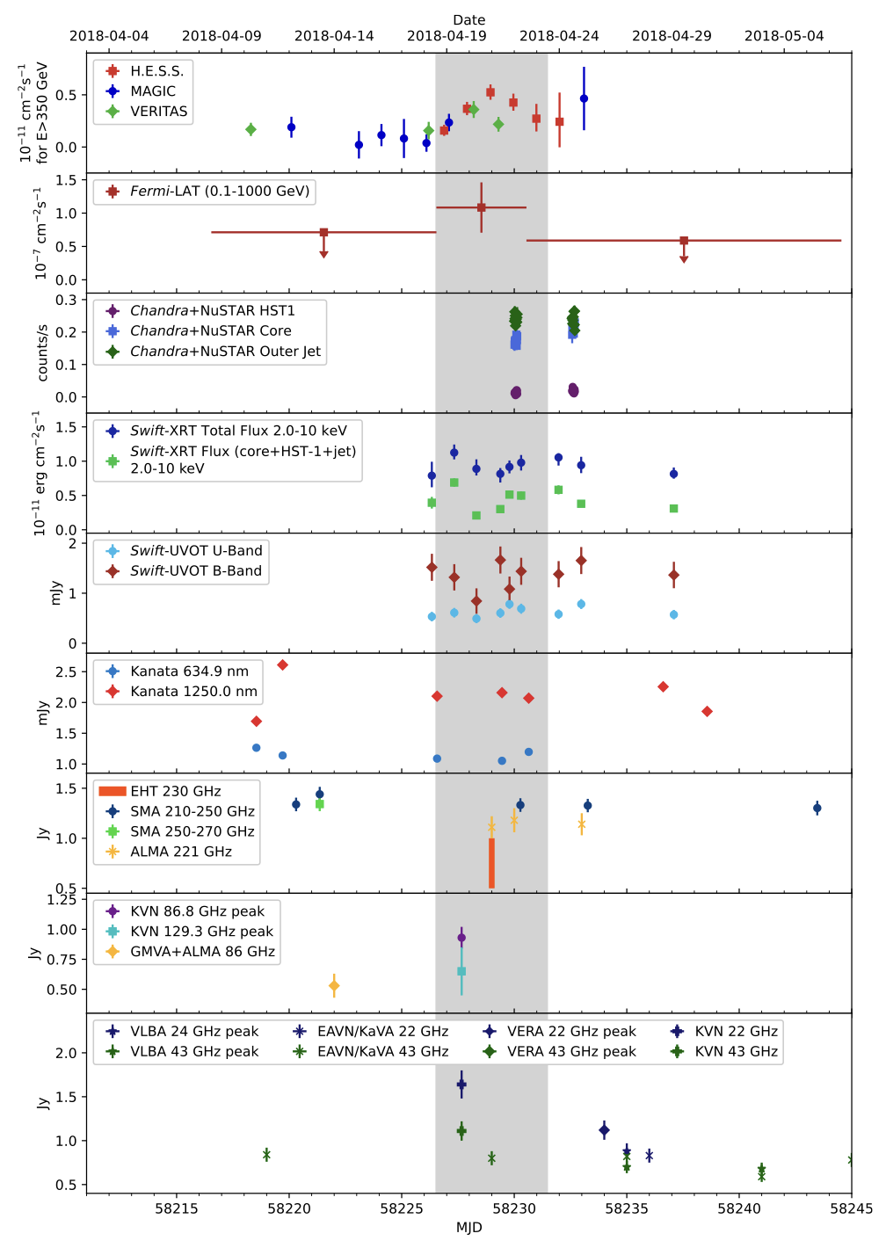
  M87 – complex MWL variability
EHT MWL Science WG (2021) – low state (2017)
EHT MWL Science WG (2024) – high state (2018)
  HEASA 2026 (SAAO, Cape Town, 30 September 2026) 6

Slide 9
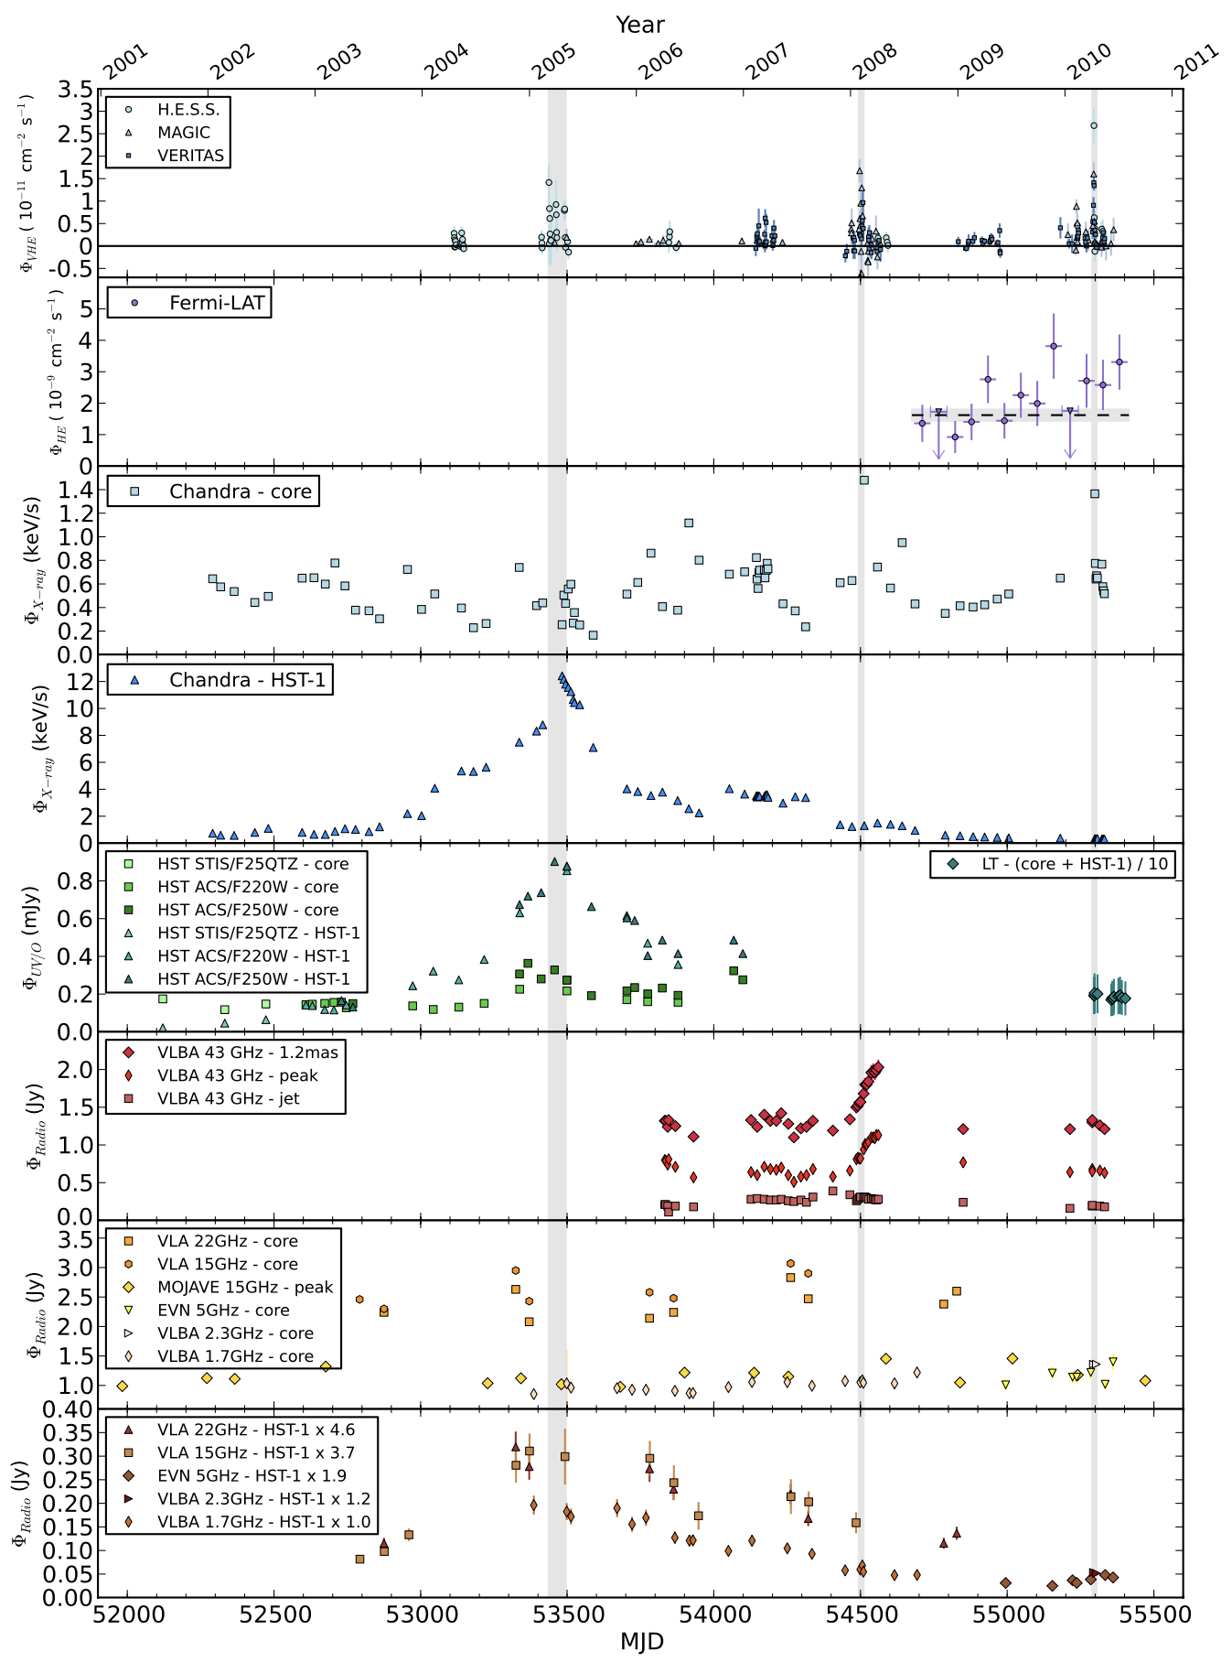
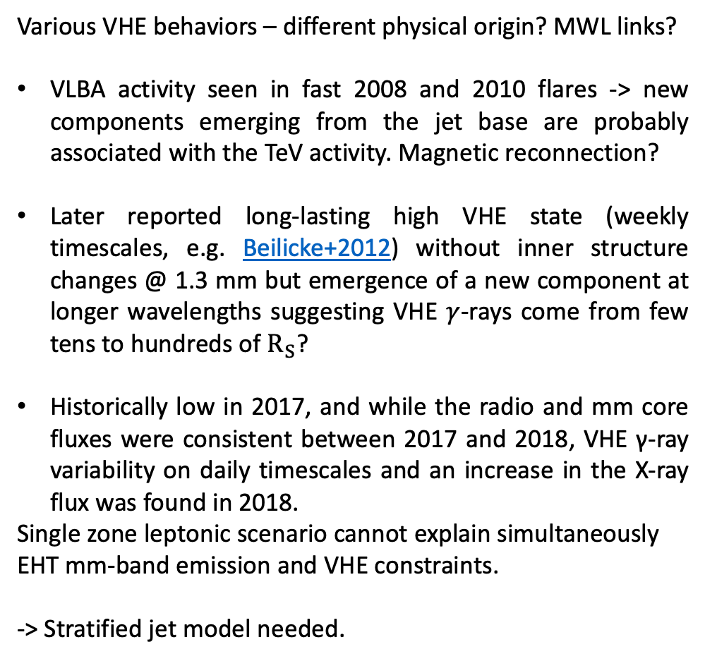
  What are we (still) trying to understand?
Various VHE behaviors – different physical origin? MWL links?
VLBA activity seen in fast 2008 and 2010 flares -> new components emerging from the jet base are probably associated with the TeV activity. Magnetic reconnection?
Later reported long-lasting high VHE state (weekly timescales, e.g. Beilicke+2012) without inner structure changes @ 1.3 mm but emergence of a new component at longer wavelengths suggesting VHE $γ$-rays come from few tens to hundreds of $R_{S}$?
Historically low in 2017, and while the radio and mm core fluxes were consistent between 2017 and 2018, VHE γ-ray variability on daily timescales and an increase in the X-ray flux was found in 2018.
Single zone leptonic scenario cannot explain simultaneously EHT mm-band emission and VHE constraints.
-> Stratified jet model needed.
Abramowski et al., 2012
  HEASA 2026 (SAAO, Cape Town, 30 September 2026) 7

Slide 10
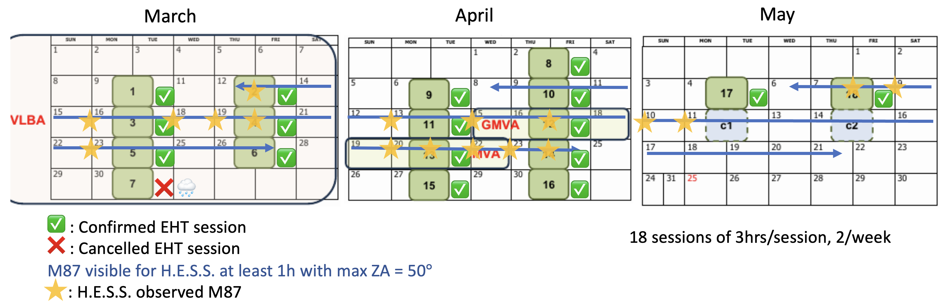
  M 87 movie campaign – VHE coverage with H.E.S.S.
High cadence EHT and MWL observations during 2 – 3 months, instead of 1 – 2 weeks.
Cross-correlate VHE/multi-band variability with structural changes in the horizon scales.
PRELIMINARY
  HEASA 2026 (SAAO, Cape Town, 30 September 2026) Anna Luashvili 8

Slide 11
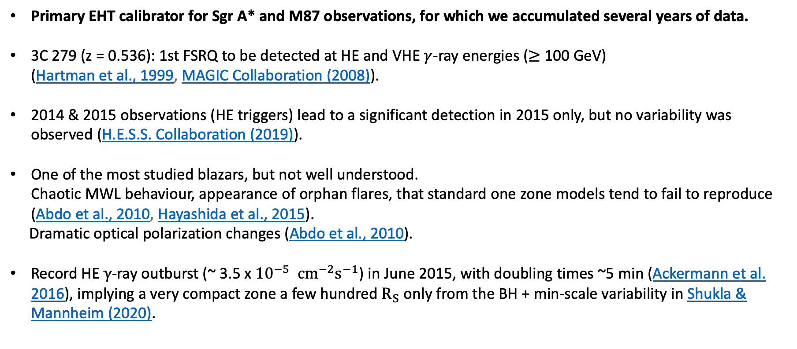
  3C 279 – intriguing blazar
Primary EHT calibrator for Sgr A* and M87 observations, for which we accumulated several years of data.
3C 279 (z = 0.536): 1st FSRQ to be detected at HE and VHE $γ$-ray energies ($≥$ 100 GeV)
(Hartman et al., 1999, MAGIC Collaboration (2008)).
2014 & 2015 observations (HE triggers) lead to a significant detection in 2015 only, but no variability was observed (H.E.S.S. Collaboration (2019)).
One of the most studied blazars, but not well understood.
Chaotic MWL behaviour, appearance of orphan flares, that standard one zone models tend to fail to reproduce (Abdo et al., 2010, Hayashida et al., 2015).
Dramatic optical polarization changes (Abdo et al., 2010).
Record HE $γ$-ray outburst (~ 3.5 x ${10}^{−5} {cm}^{−2}s^{−1}$) in June 2015, with doubling times ~5 min (Ackermann et al. 2016), implying a very compact zone a few hundred $R_{S}$ only from the BH + min-scale variability in Shukla & Mannheim (2020).
  HEASA 2026 (SAAO, Cape Town, 30 September 2026) Anna Luashvili 9

Slide 12
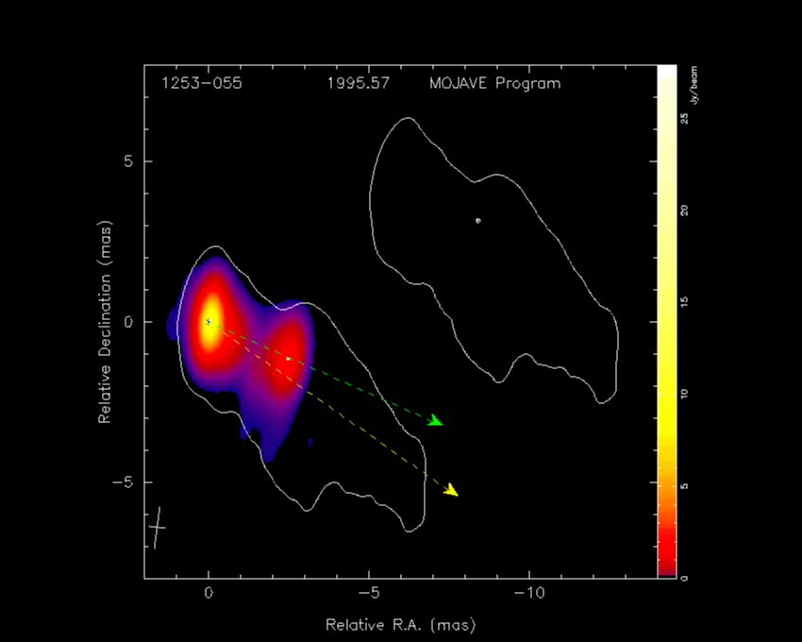
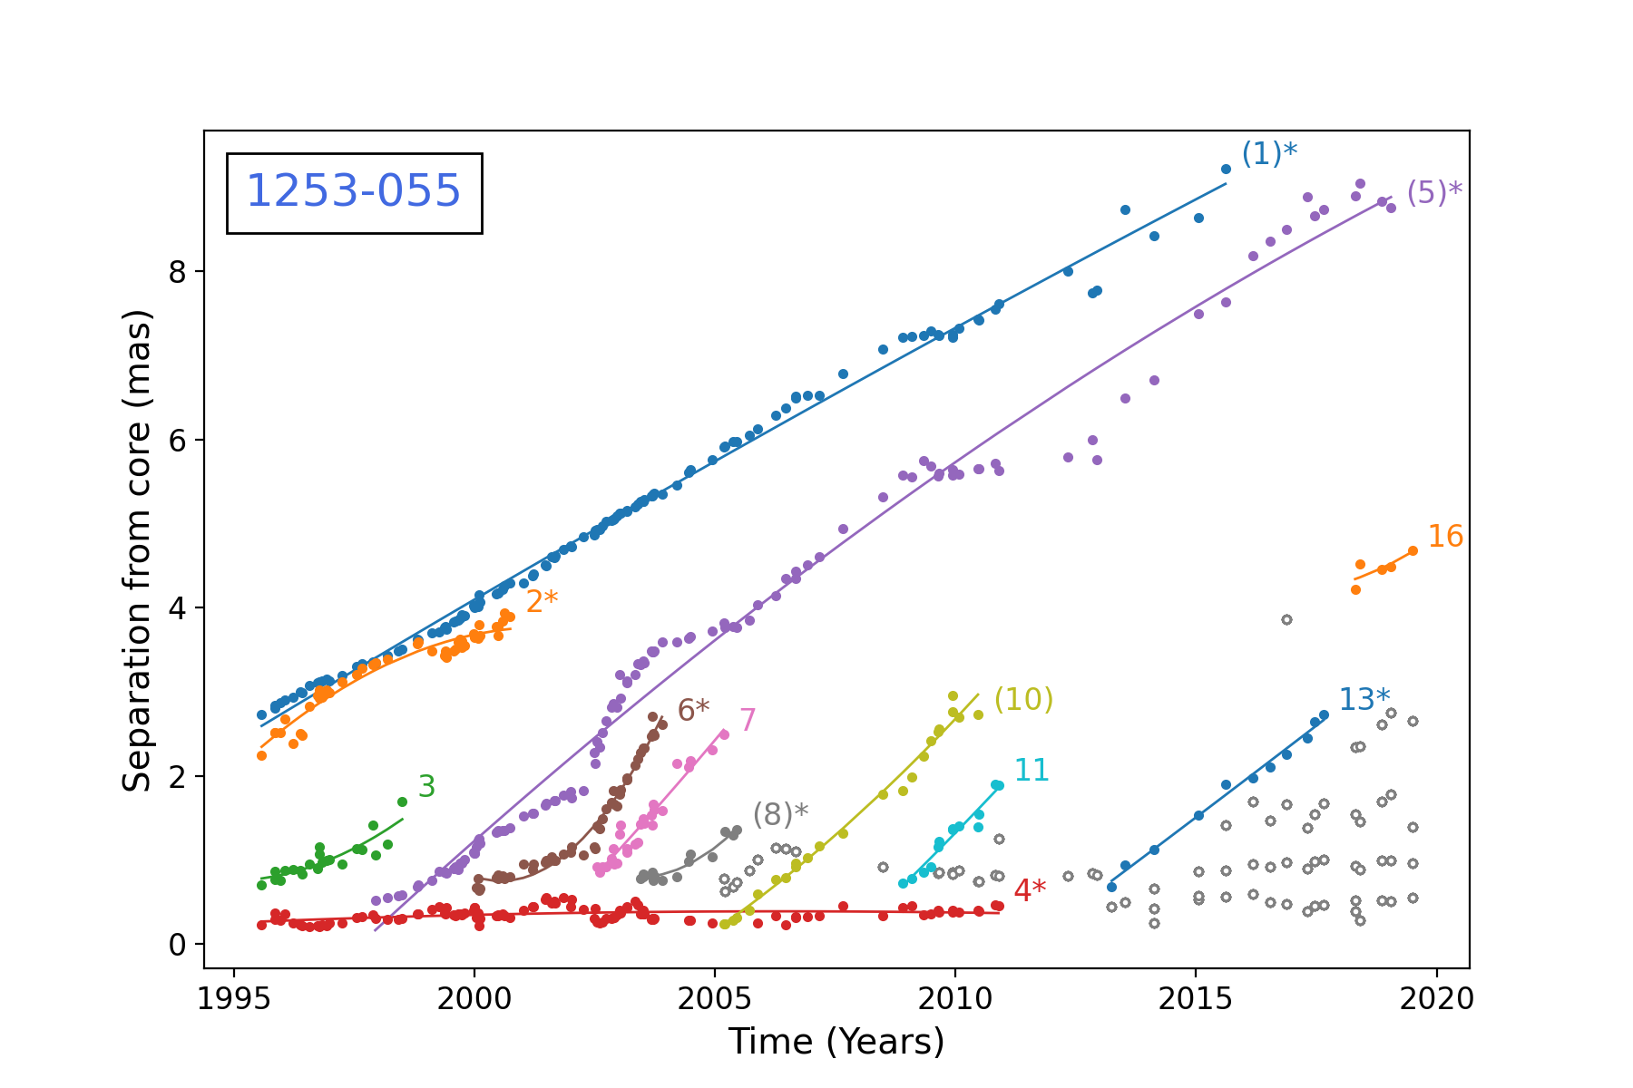
  3C 279 – intriguing blazar
Characterised by several radio components moving at relativistic speeds, whose relation, if any, with the observed high energy emission remains unclear.
MOJAVE program
Lister et al., 2019 & 2021
MOJAVE program
Homan et al. 2003
  HEASA 2026 (SAAO, Cape Town, 30 September 2026) Anna Luashvili 10

Slide 13
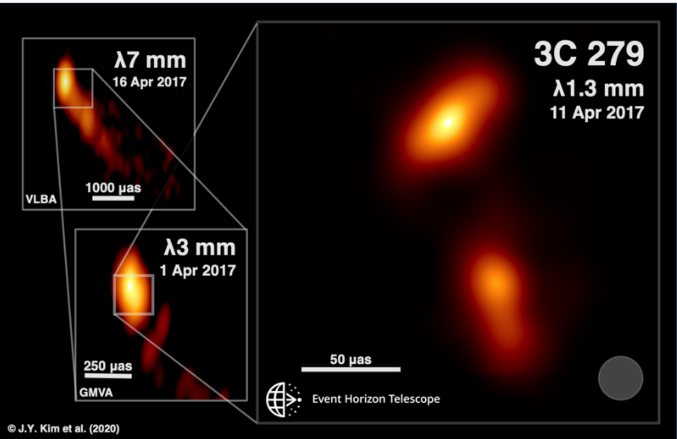
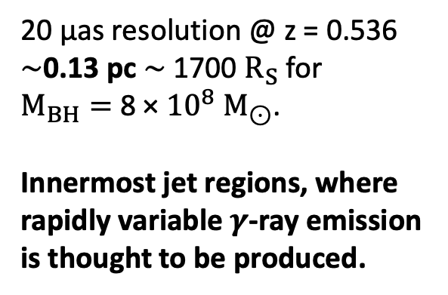
  3C 279 2017 EHT observations
Kim et al., 2020
20 μas resolution @ z = 0.536
∼0.13 pc ∼ 1700 $R_{S}$ for
$M_{BH}=$ 8 × ${10}^{8}$ $M_{⊙}$.
Innermost jet regions, where rapidly variable $γ$-ray emission is thought to be produced.
  HEASA 2026 (SAAO, Cape Town, 30 September 2026) Anna Luashvili 11

Slide 14
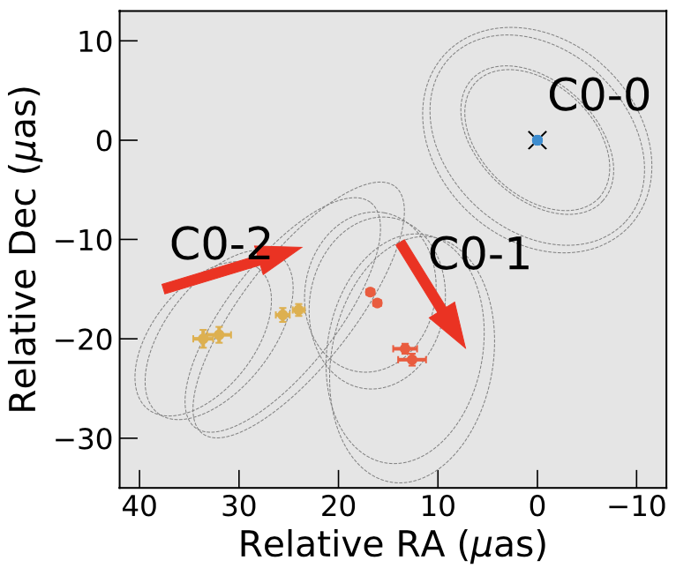
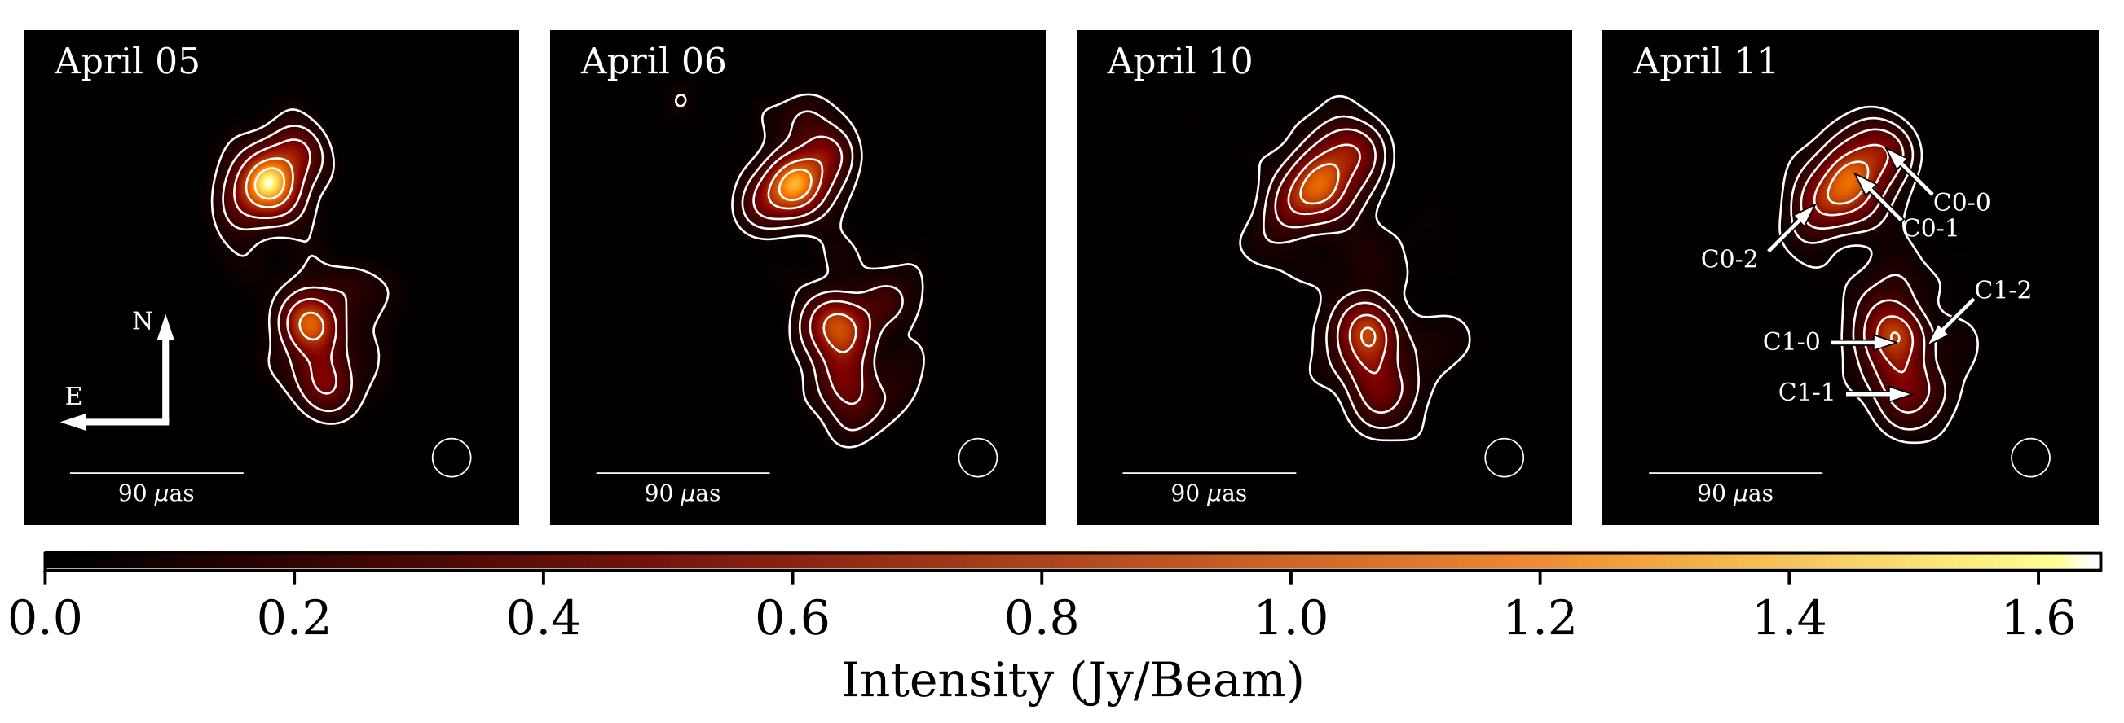
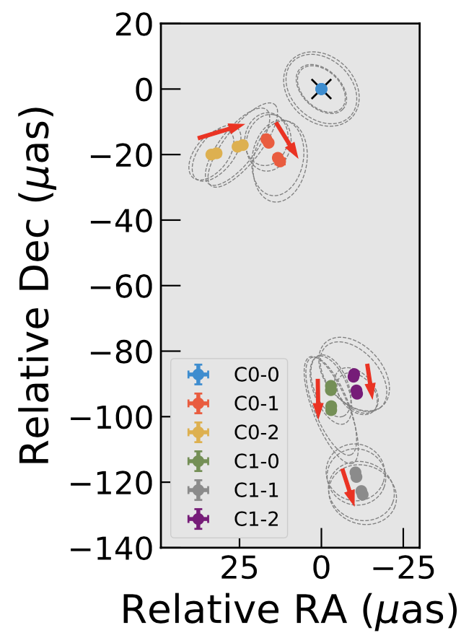
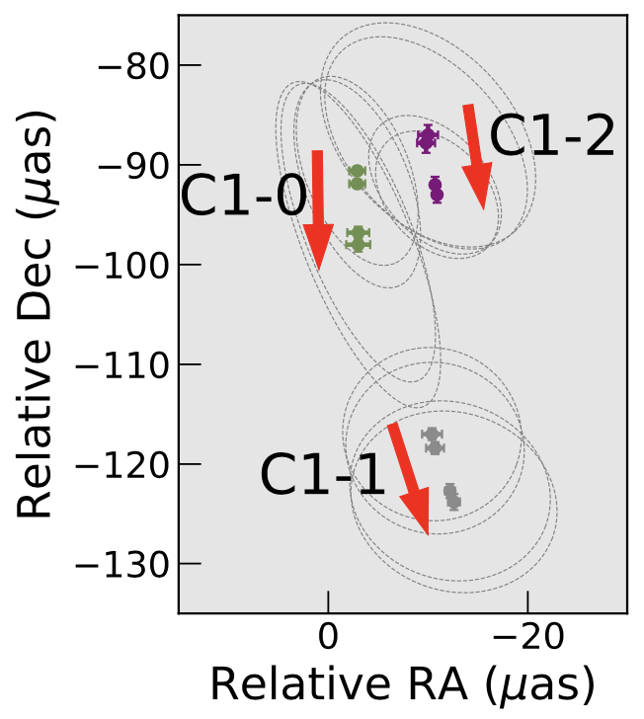
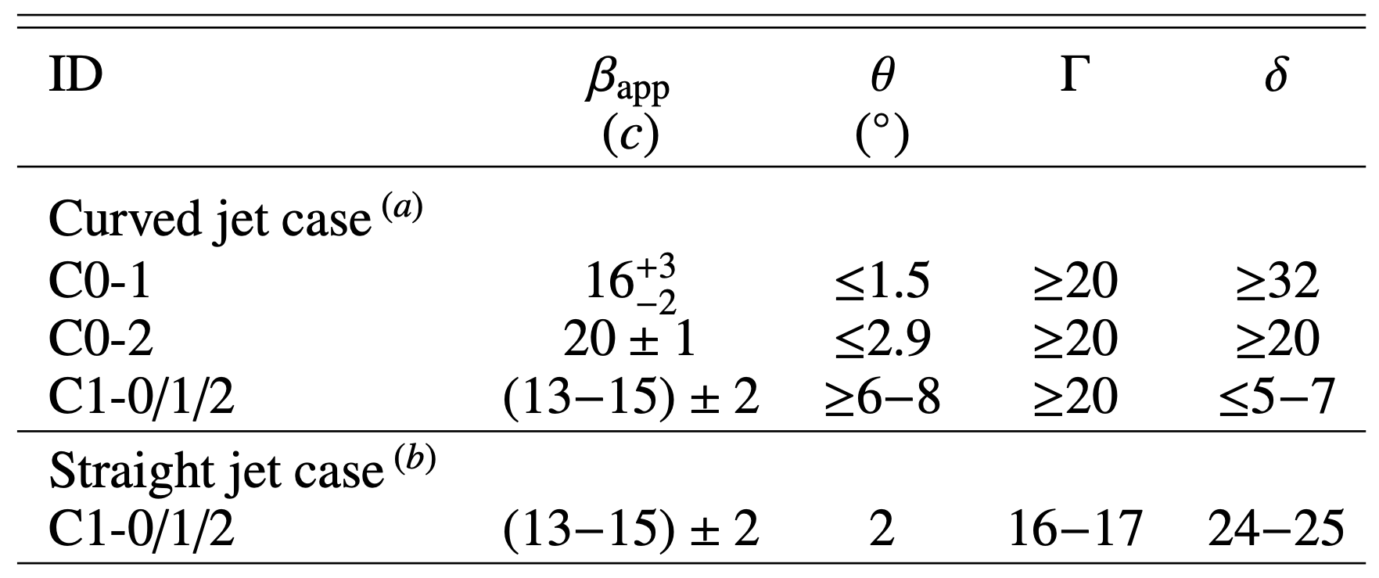
  3C 279 2017 EHT observations
Kim et al., 2020
Multicomponent morphology of the inner jet, with two perpendicular components moving at apparent speeds ~15c and 20c, sign of “traveling shocks or instabilities in a bent, possibly rotating jet.”
  HEASA 2026 (SAAO, Cape Town, 30 September 2026) Anna Luashvili 12

Slide 15
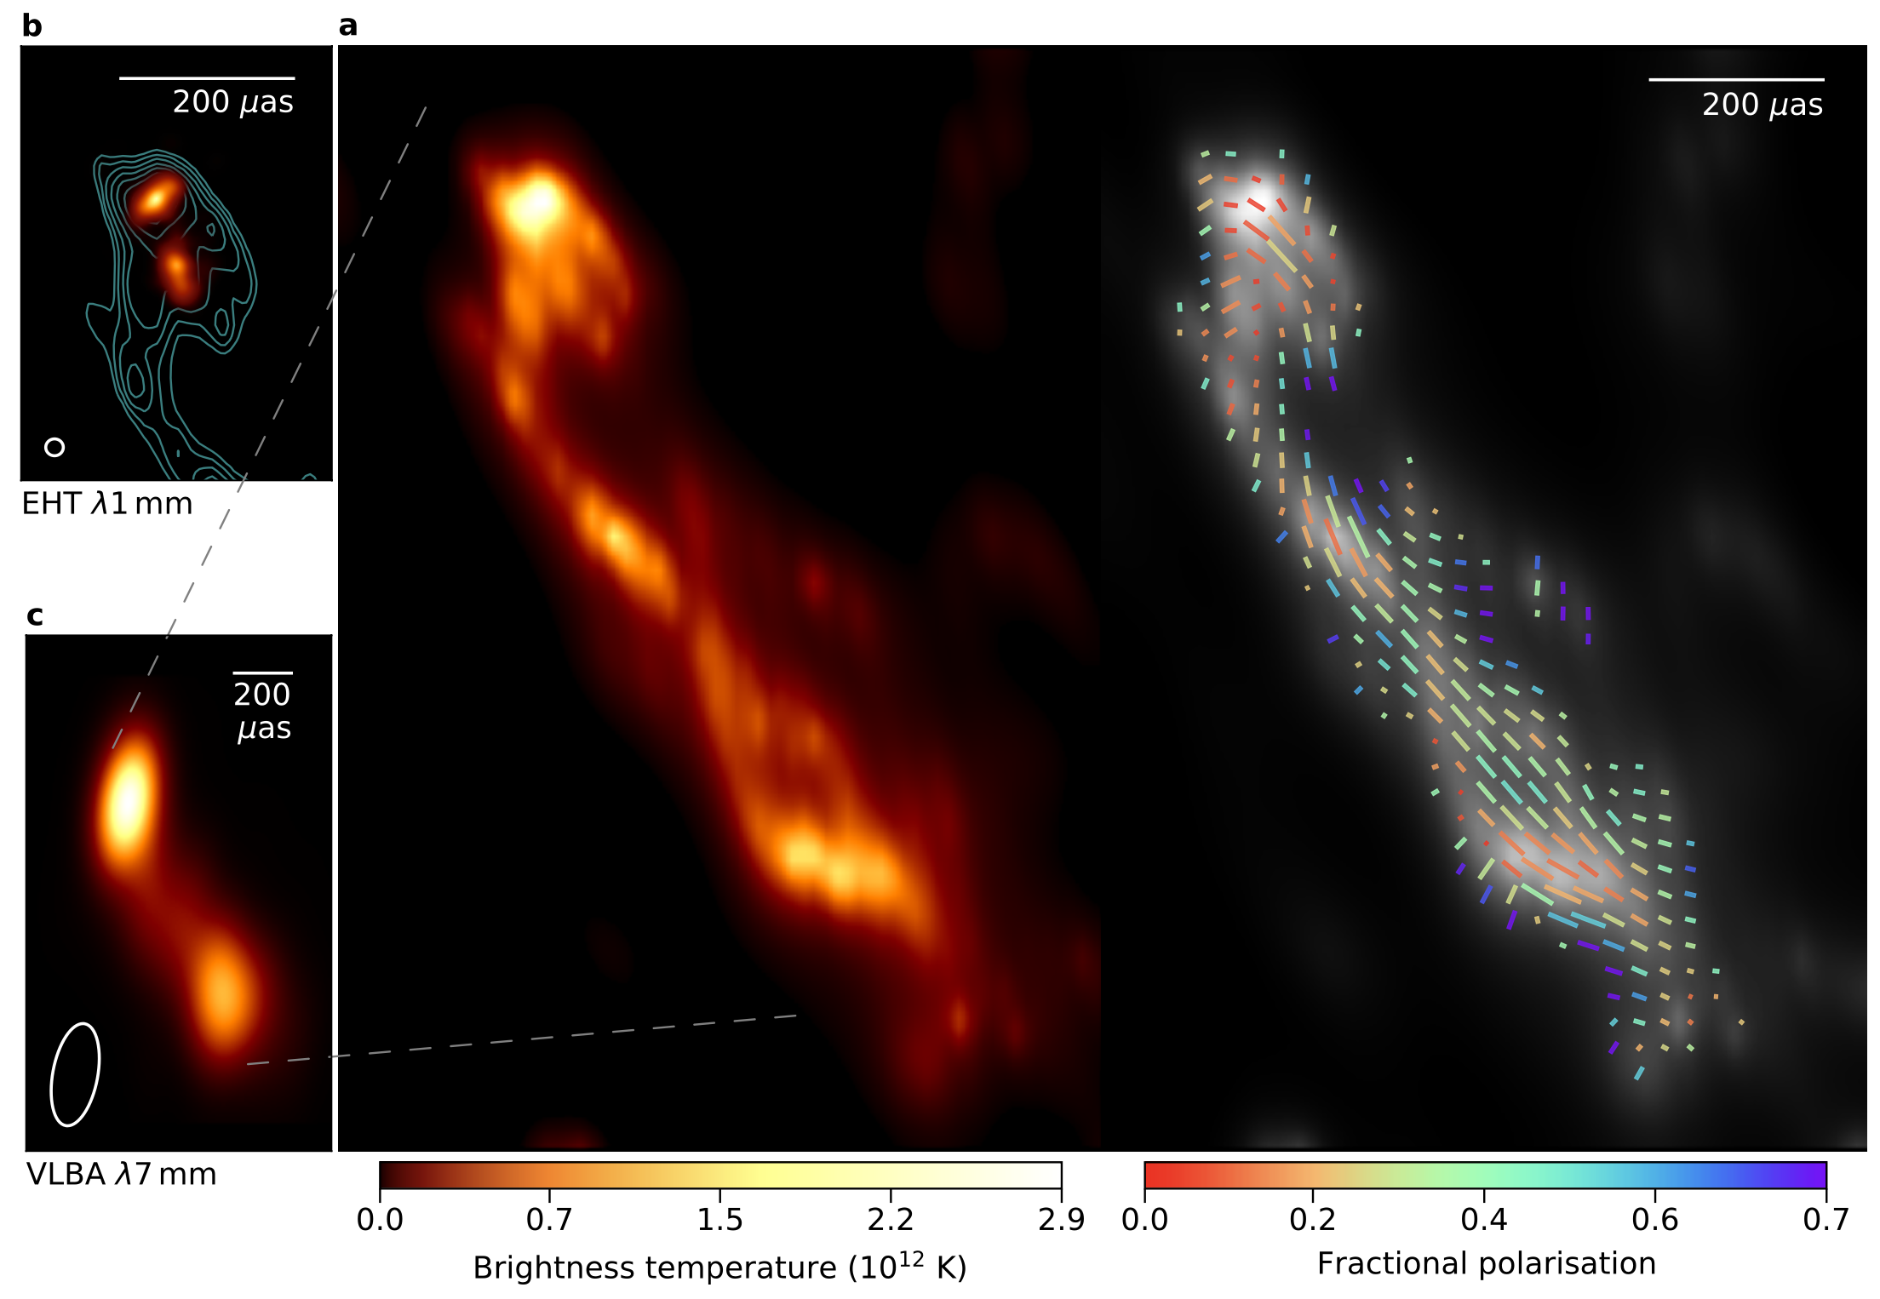
  RadioAstron observations of 3C 279
Space VLBI mission RadioAstron, a 10m Space Radio Telescope +23 ground based telescopes; Projected baseline distance of up to 8 Earth diameters, probing a large range of spatial frequencies perpendicular to the jet propagation axis.
10 March 2014 observations @ 22 GHz (1.3 cm) with a resolution power of ~27 μas, similar to that of the EHT network @ 230 GHz.
Filamentary structure suggesting instabilities in a kinetically dominated jet.
Fuentes et al., (2023)
a) Total intensity and linearly polarized RadioAstron image maps @ 1.3 cm.
EVPA in ticks where the length and colour are proportional to the level of linearly polarized intensity and fractional polarization, respectively.
b) The 1:1 scale 1.3 mm EHT image obtained in April 2017, with RadioAstron contours
c) The 7 mm VLBA-BU-BLAZAR program image, obtained on the 25 February 2014 with RadioAstron
  HEASA 2026 (SAAO, Cape Town, 30 September 2026) Anna Luashvili 13

Slide 16
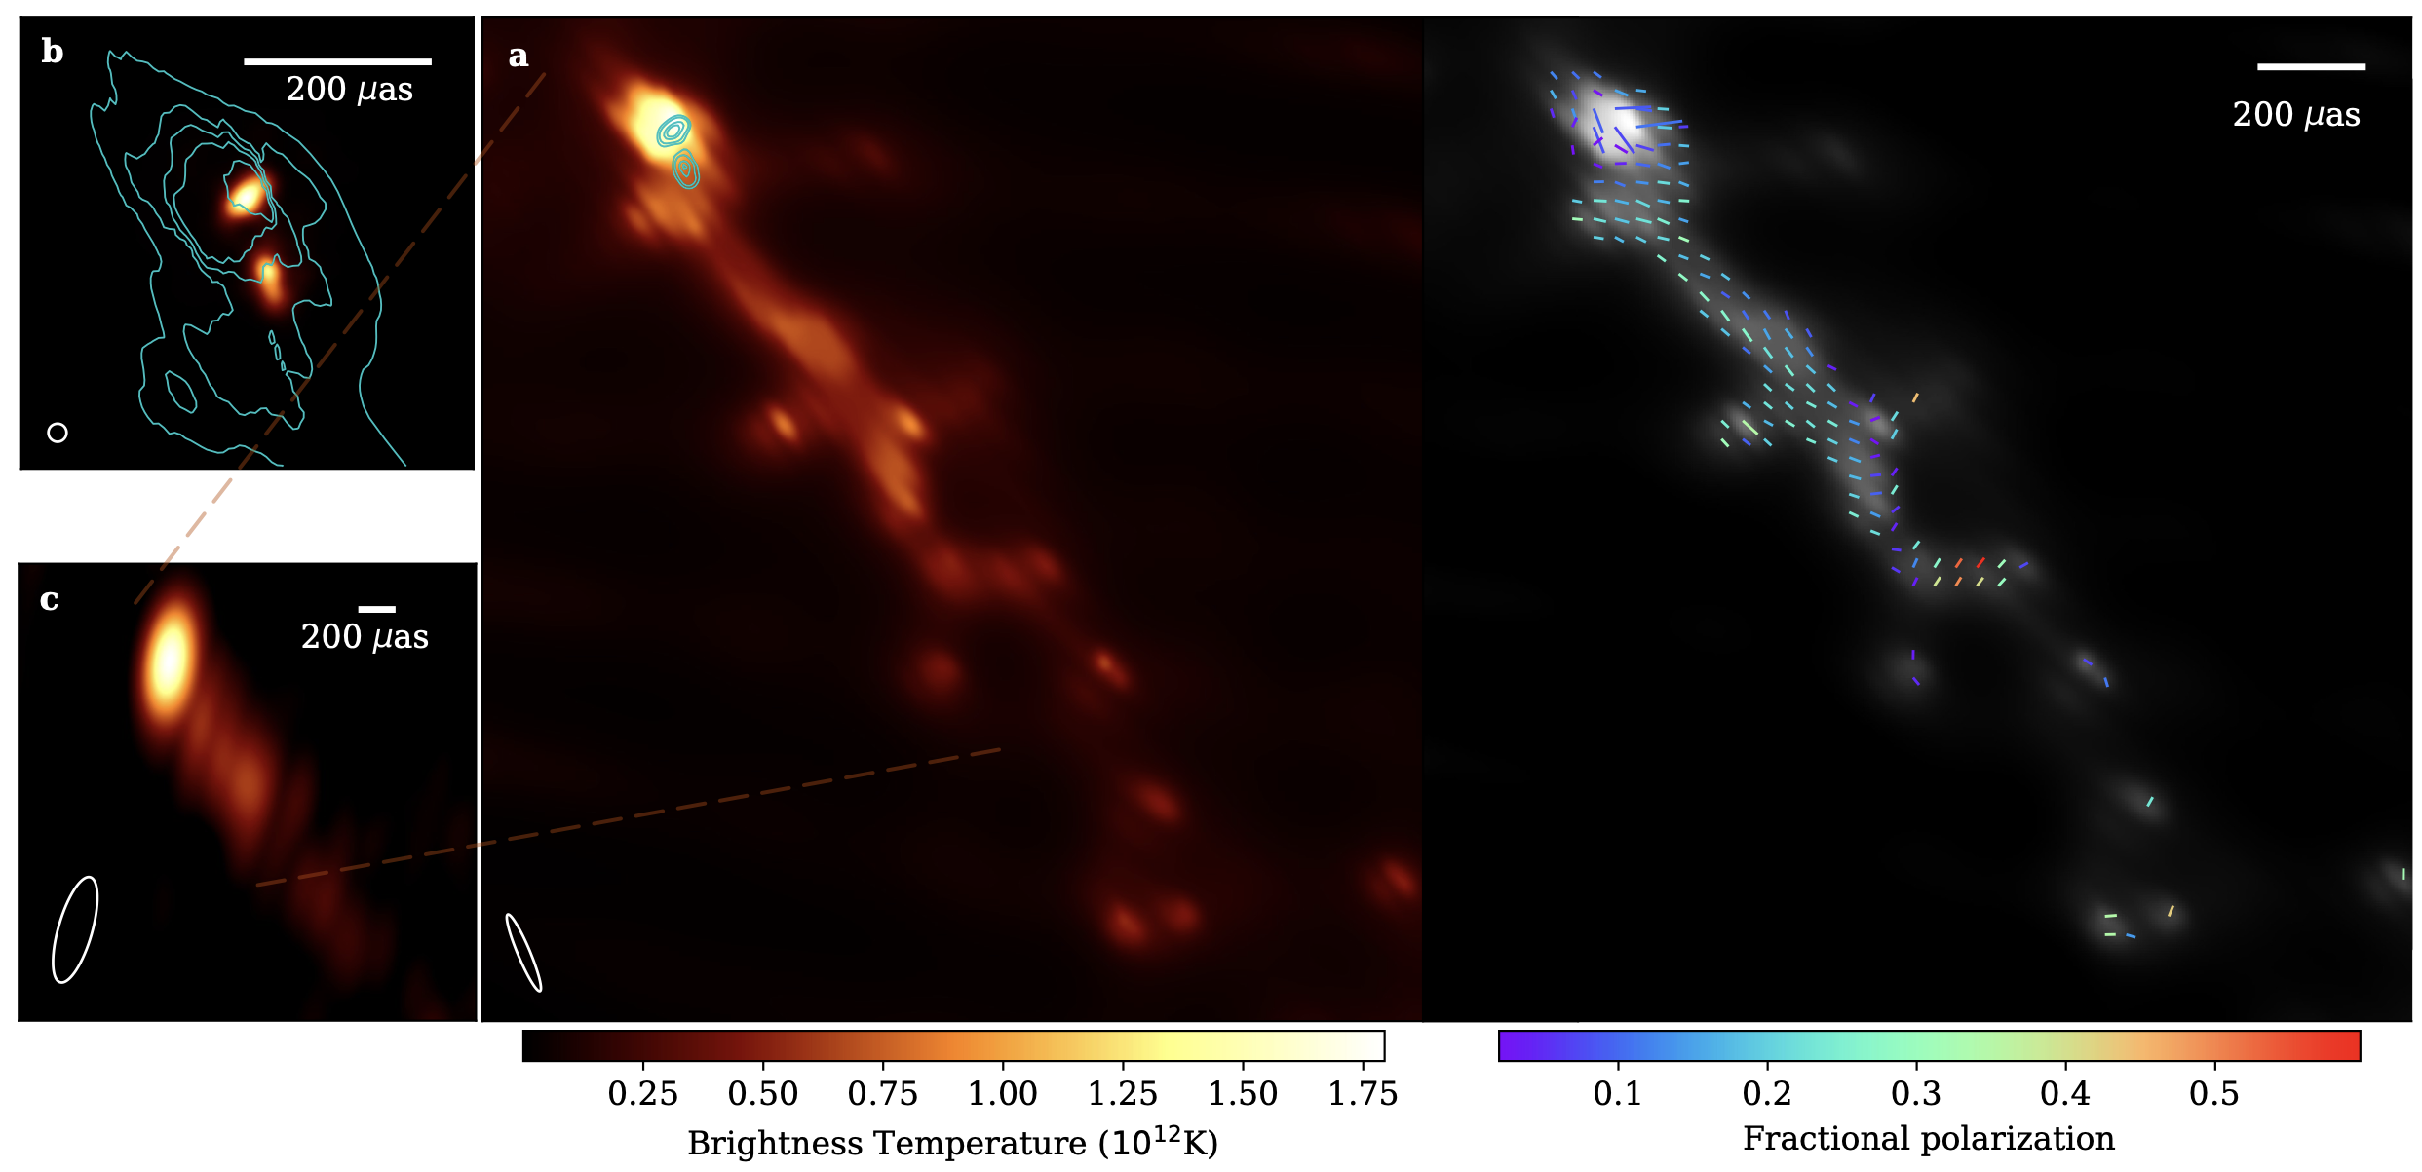
  RadioAstron observations of 3C 279
Space VLBI mission RadioAstron, a 10m Space Radio Telescope +23 ground based telescopes; Projected baseline distance of up to 8 Earth diameters, probing a large range of spatial frequencies perpendicular to the jet propagation axis.
10 March 2014 observations @ 22 GHz (1.3 cm) with a resolution power of ~27 μas, similar to that of the EHT network @ 230 GHz.
Filamentary structure suggesting instabilities in a kinetically dominated jet.
Toscano et al., 2025
RadioAstron (15 January 2018)
Fuentes et al., (2023)
a) Total intensity and linearly polarized RadioAstron image maps @ 1.3 cm.
EVPA in ticks where the length and colour are proportional to the level of linearly polarized intensity and fractional polarization, respectively.
b) The 1:1 scale 1.3 mm EHT image obtained in April 2017, with RadioAstron contours
c) The 7 mm VLBA-BU-BLAZAR program image, obtained on the 25 February 2014 with RadioAstron
  HEASA 2026 (SAAO, Cape Town, 30 September 2026) Anna Luashvili 13

Slide 17
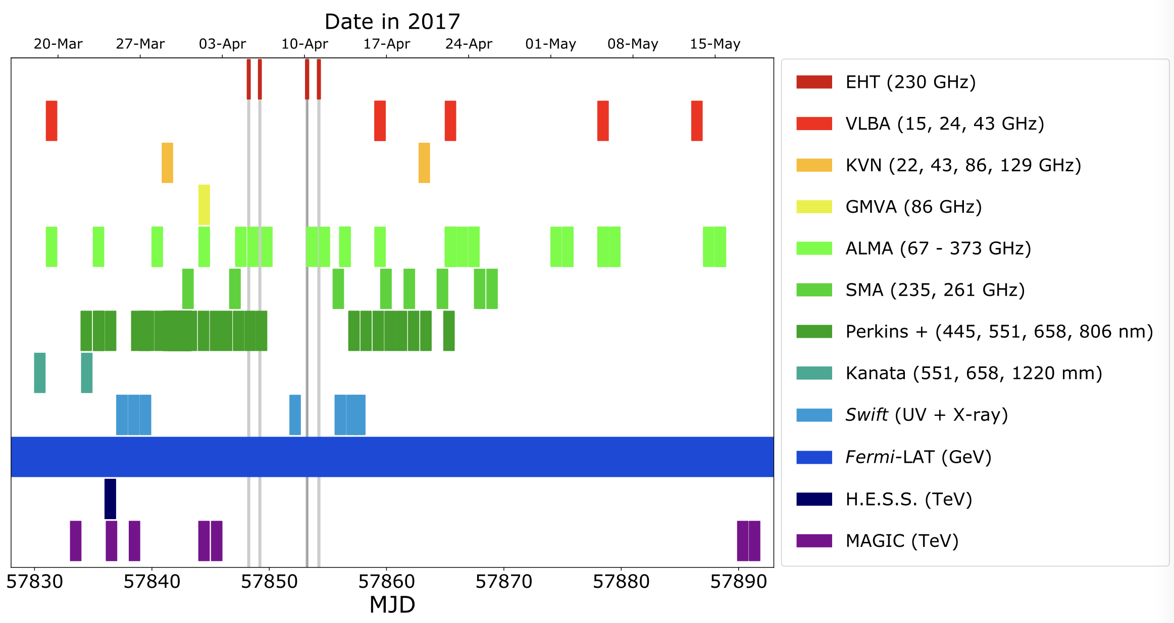
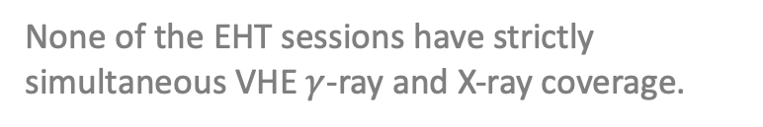
  3C 279 2017 EHT-MWL campaign
First extensive MWL campaign for 3C 279!
None of the EHT sessions have strictly simultaneous VHE $γ$-ray and X-ray coverage.
EHT-MWL Science WG (2026)
  HEASA 2026 (SAAO, Cape Town, 30 September 2026) Anna Luashvili 14

Slide 18
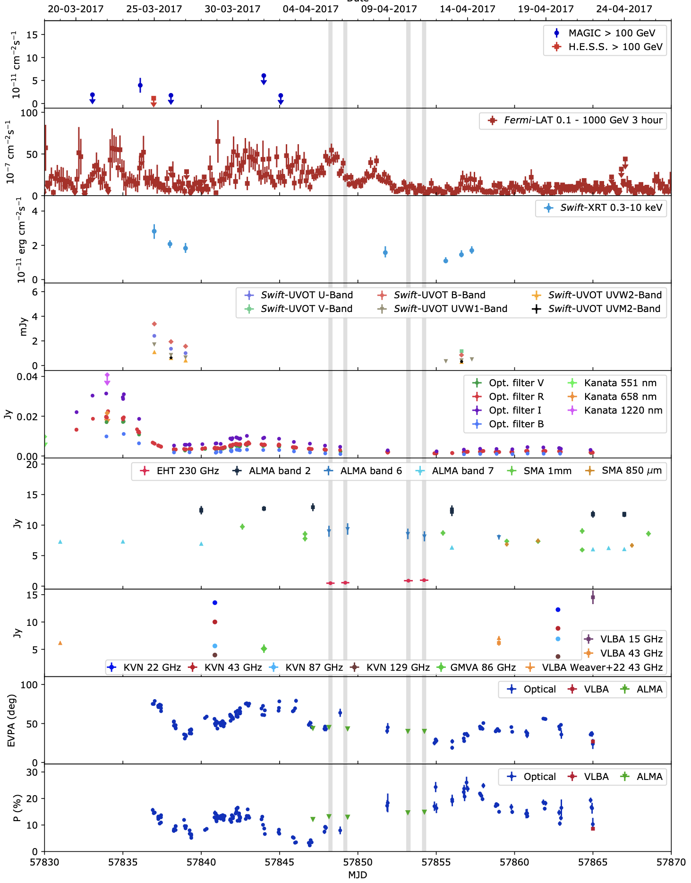
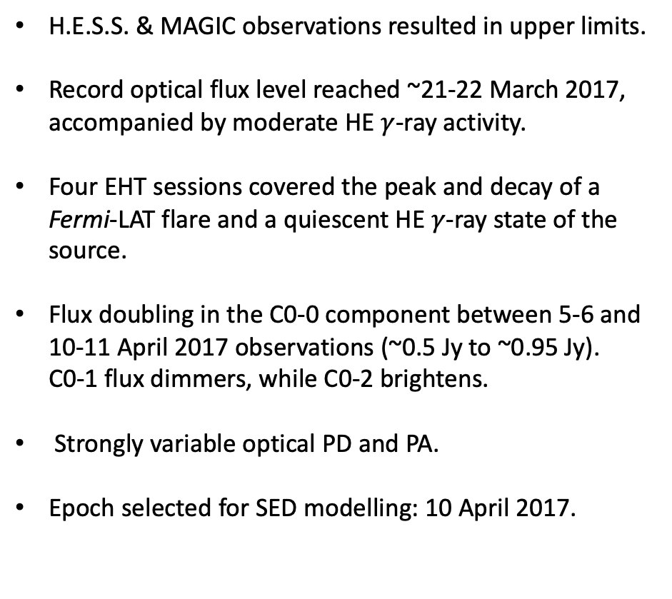
  3C 279 2017 EHT-MWL campaign
EHT-MWL Science WG (2026)
H.E.S.S. & MAGIC observations resulted in upper limits.
Record optical flux level reached ~21-22 March 2017, accompanied by moderate HE $γ$-ray activity.
Four EHT sessions covered the peak and decay of a Fermi-LAT flare and a quiescent HE $γ$-ray state of the source.
Flux doubling in the C0-0 component between 5-6 and 10-11 April 2017 observations (~0.5 Jy to ~0.95 Jy).
C0-1 flux dimmers, while C0-2 brightens.
Strongly variable optical PD and PA.
Epoch selected for SED modelling: 10 April 2017.
  HEASA 2026 (SAAO, Cape Town, 30 September 2026) 15

Slide 19
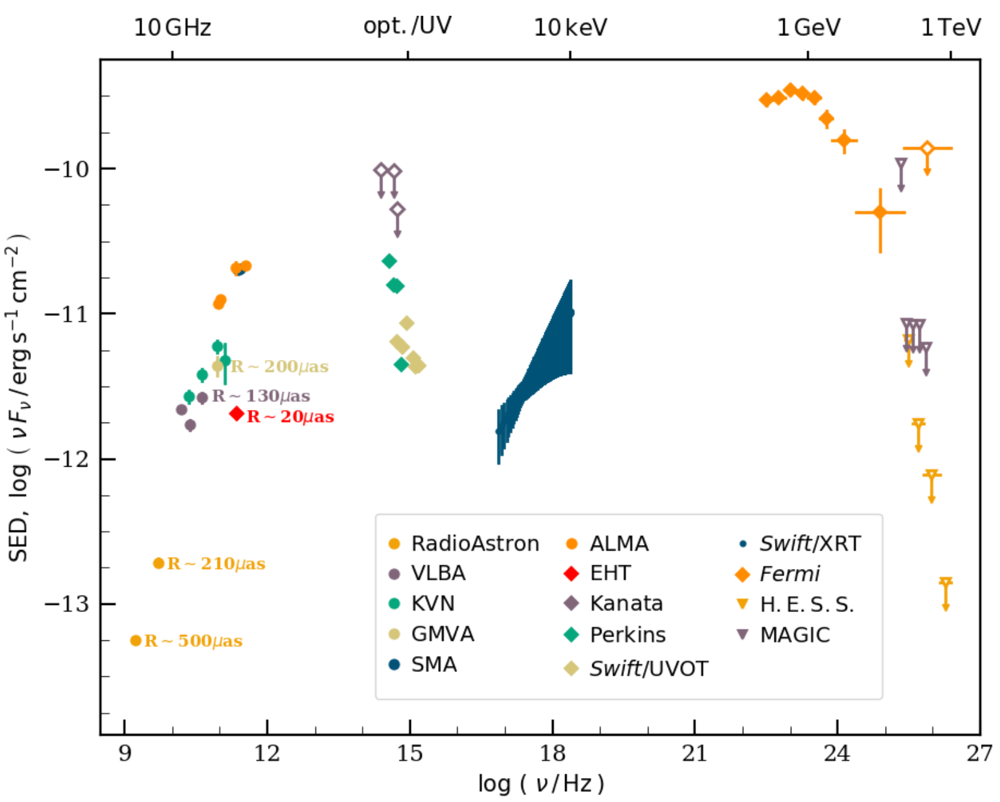
  3C 279 2017 EHT-MWL campaign
EHT-MWL Science WG (2026)
H.E.S.S. & MAGIC observations resulted in upper limits.
Record optical flux level reached ~21-22 March 2017, accompanied by moderate HE $γ$-ray activity.
Four EHT sessions covered the peak and decay of a Fermi-LAT flare and a quiescent HE $γ$-ray state of the source.
Flux doubling in the C0-0 component between 5-6 and 10-11 April 2017 observations (~0.5 Jy to ~0.95 Jy).
C0-1 flux dimmers, while C0-2 brightens.
Strongly variable optical PD and PA.
Epoch selected for SED modelling: 10 April 2017.
EHT-MWL Science WG (2026)
  HEASA 2026 (SAAO, Cape Town, 30 September 2026) 15

Slide 20
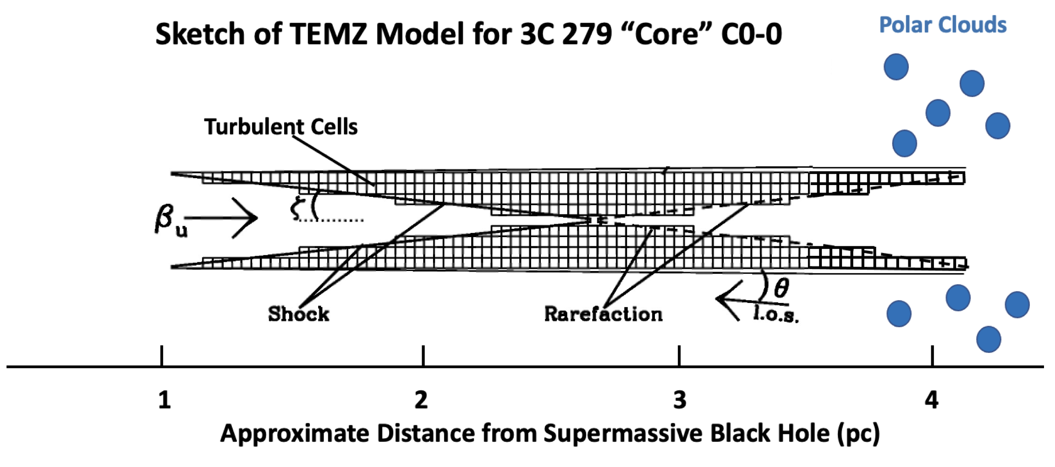
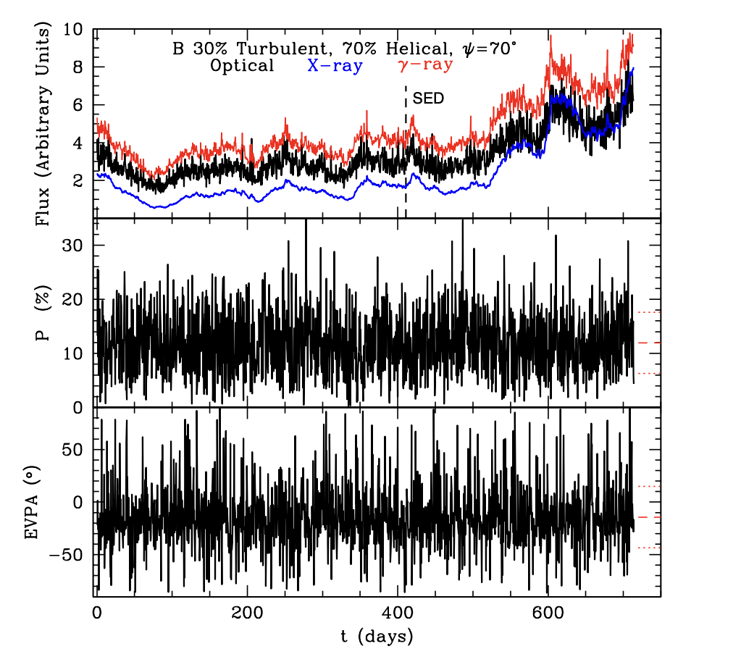
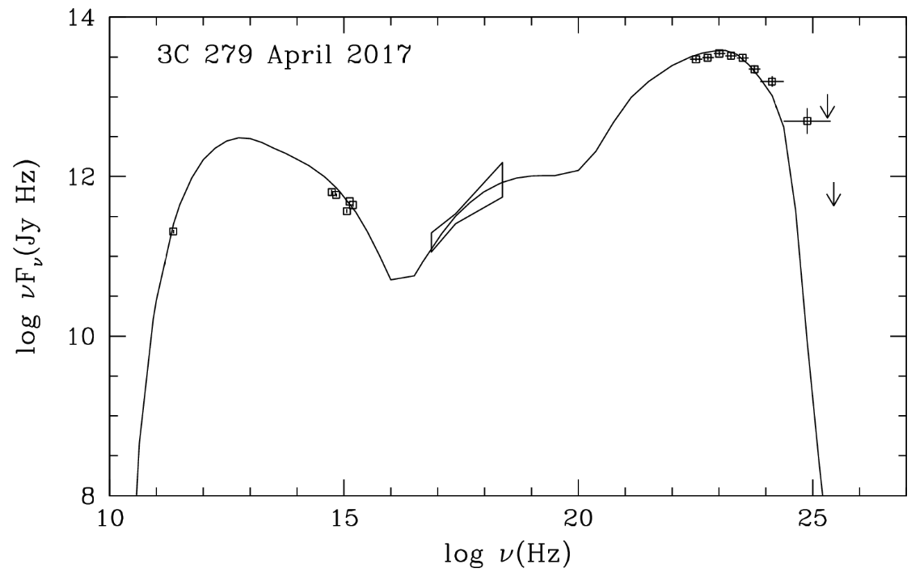
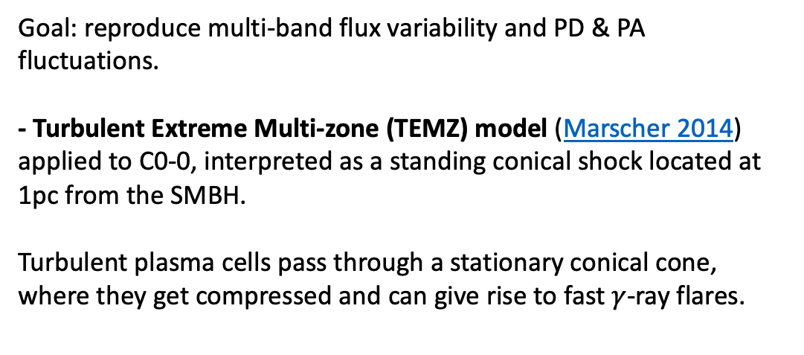
  3C 279 2017 MWL dataset - modelling
Goal: reproduce multi-band flux variability and PD & PA fluctuations.
- Turbulent Extreme Multi-zone (TEMZ) model (Marscher 2014) applied to C0-0, interpreted as a standing conical shock located at 1pc from the SMBH.
Turbulent plasma cells pass through a stationary conical cone,
where they get compressed and can give rise to fast $γ$-ray flares.
  HEASA 2026 (SAAO, Cape Town, 30 September 2026) Anna Luashvili 16

Slide 21
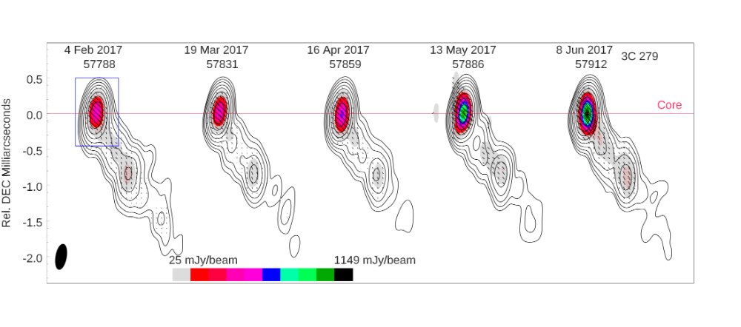
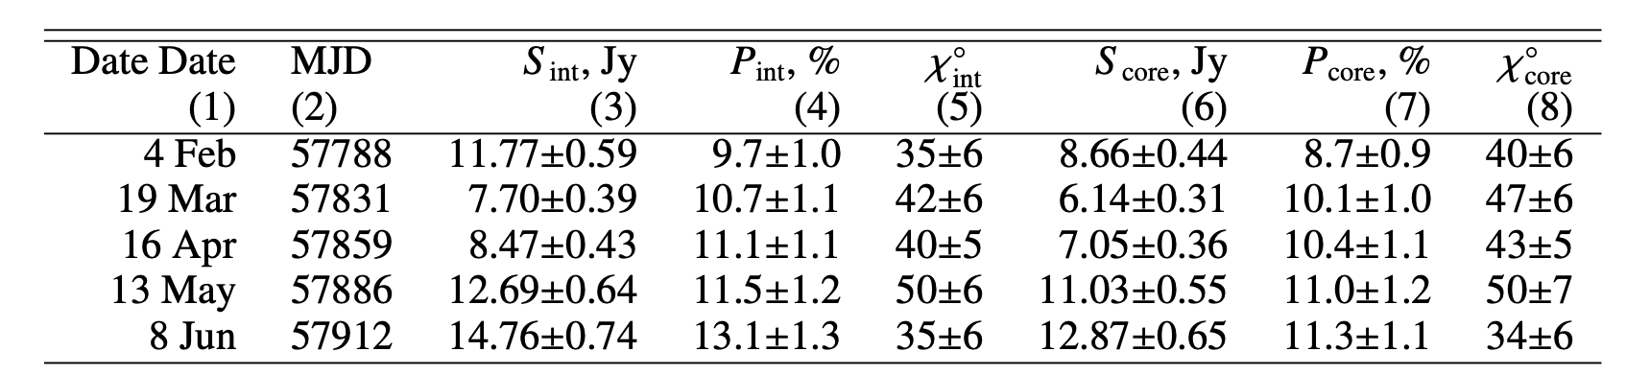
  Alternative scenarios
Shock-in-jet scenario
VLBA observations @ 43 GHz
with a monthly cadence
Ejection of a superluminal plasma knot on 2 April 2017 (± 12 days) with apparent speed of (25 ± 2)c
-> Triggered an increase in the total and polarized flux.
Magnetic reconnection (see 2018 behavior)…
  HEASA 2026 (SAAO, Cape Town, 30 September 2026) Anna Luashvili 17

Slide 22
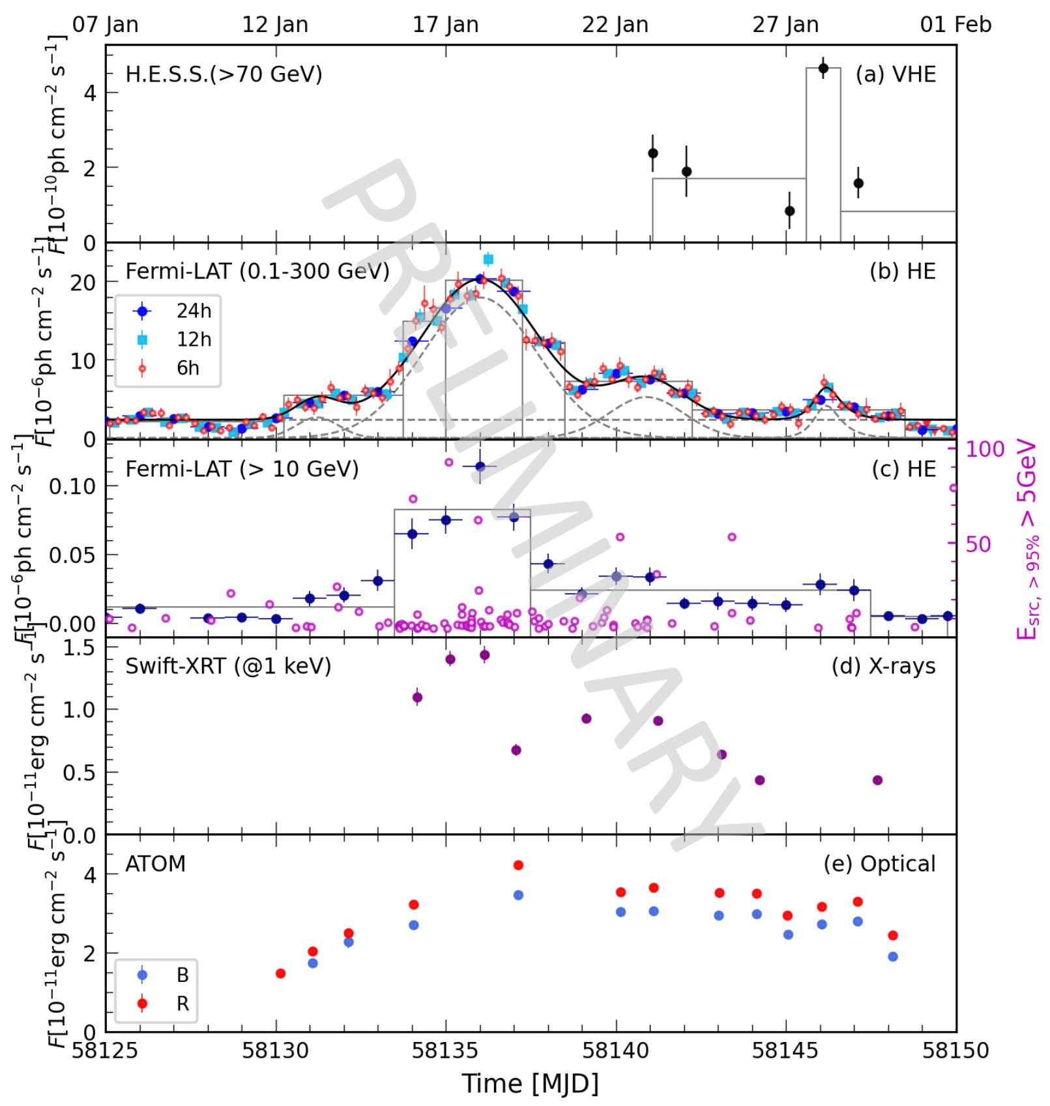
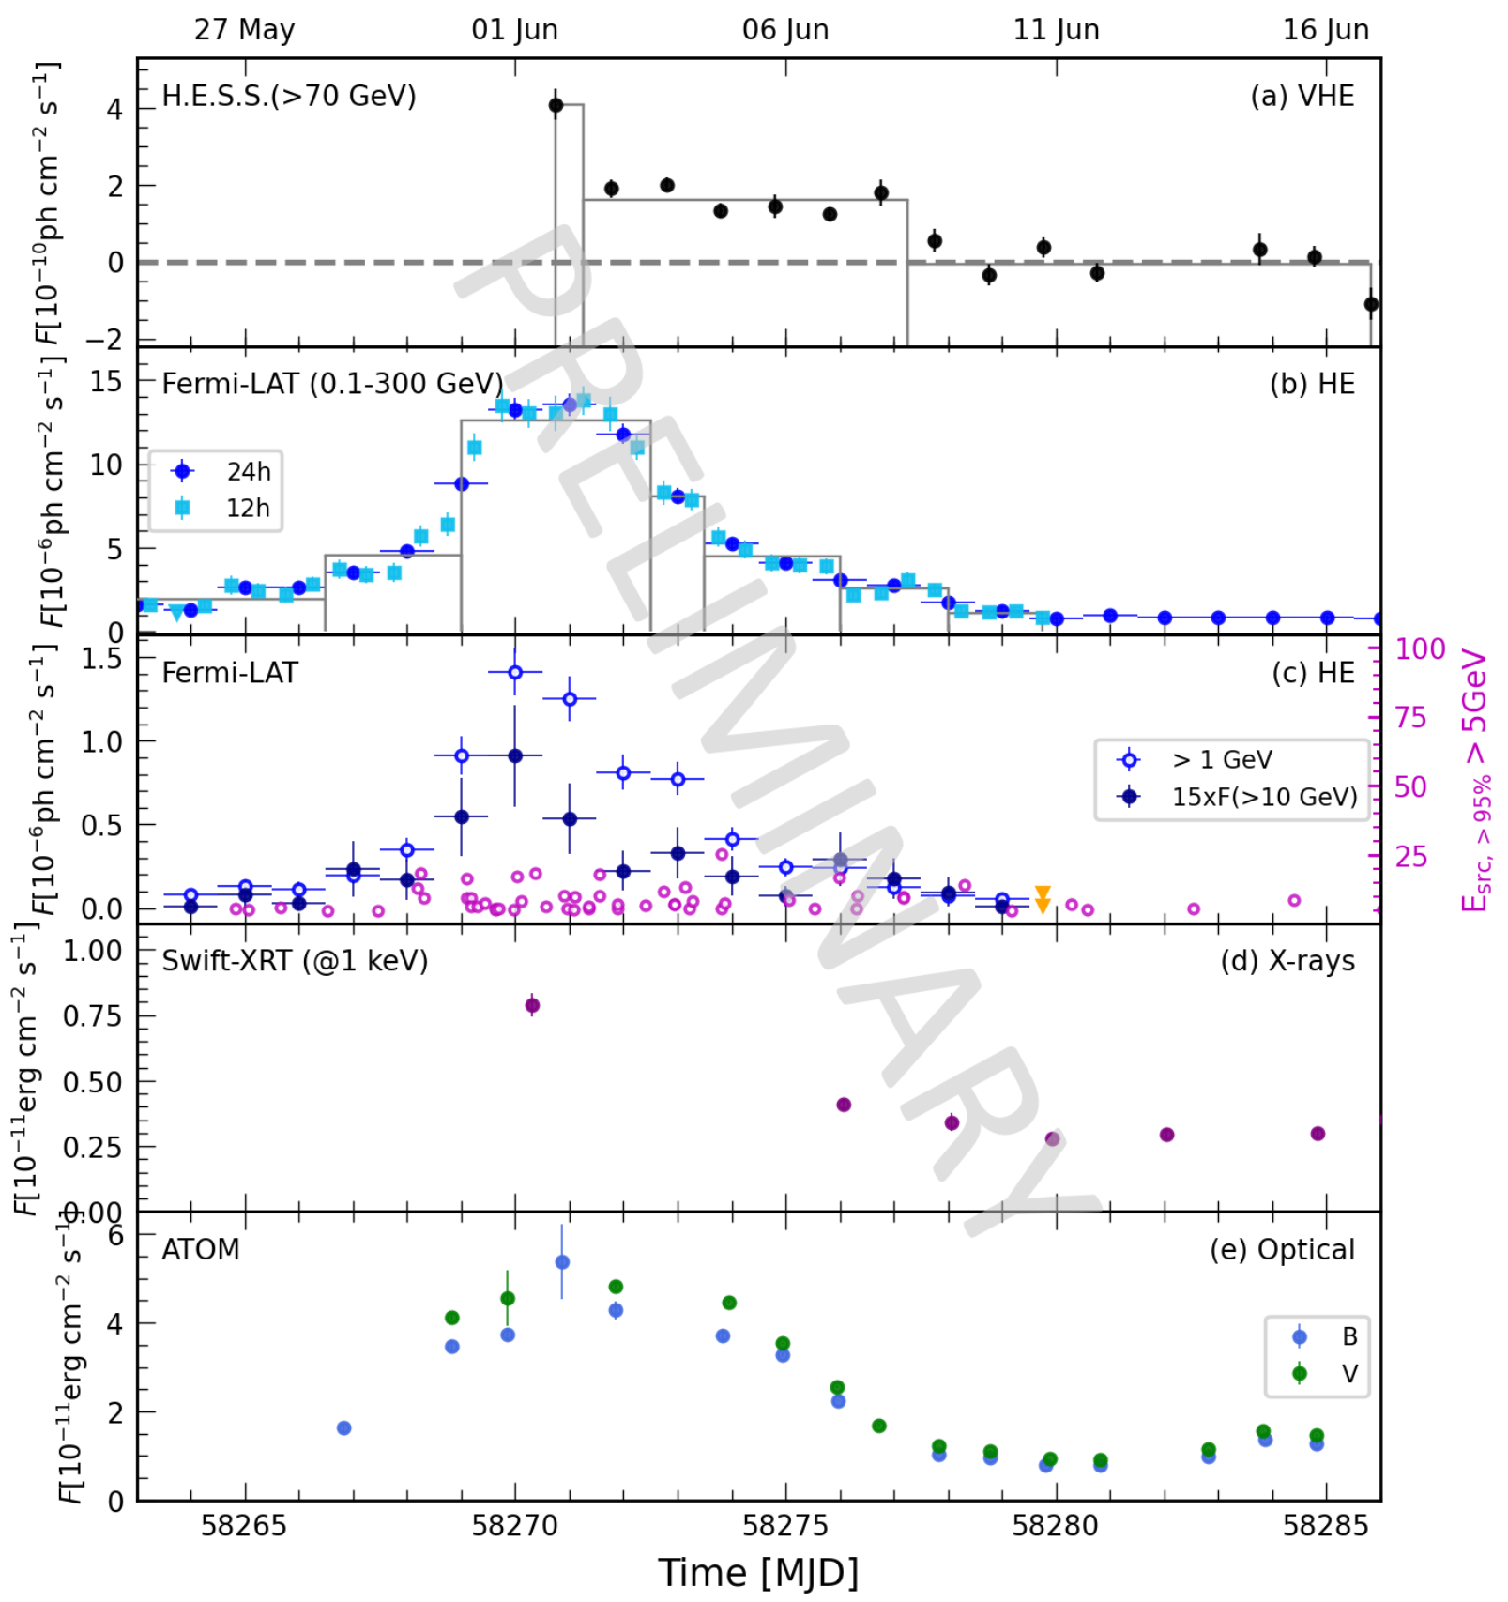
  3C 279 very active in 2018 (January & June)
Luashvili et al. (2026)
  HEASA 2026 (SAAO, Cape Town, 30 September 2026) Anna Luashvili 18

Slide 23
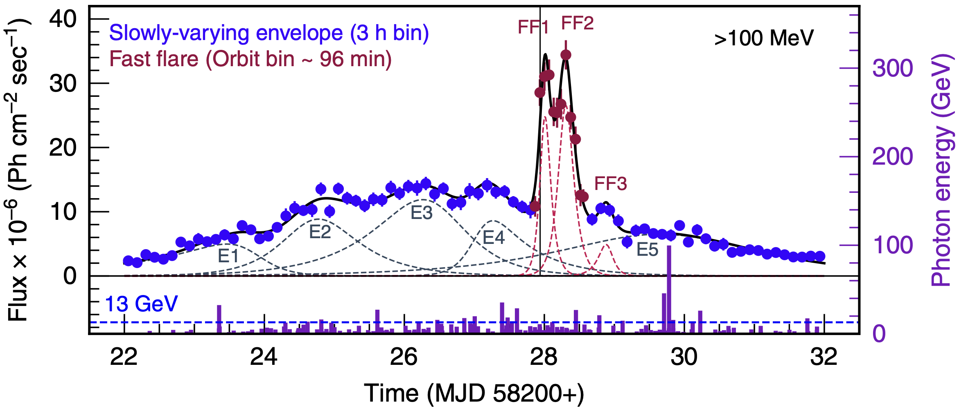
  3C 279 during 2018 EHT-MWL campaign
Major flare detected by Fermi-LAT in April 2018, with ”peak-in-peak” structure and minimal flux doubling time ~8 min.
Reconnection-driven mini-jets model (Giannios (2013)) favored and shock-in-jet scenario rejected.
Shukla & Mannheim (2020)
  HEASA 2026 (SAAO, Cape Town, 30 September 2026) Anna Luashvili 19

Slide 24
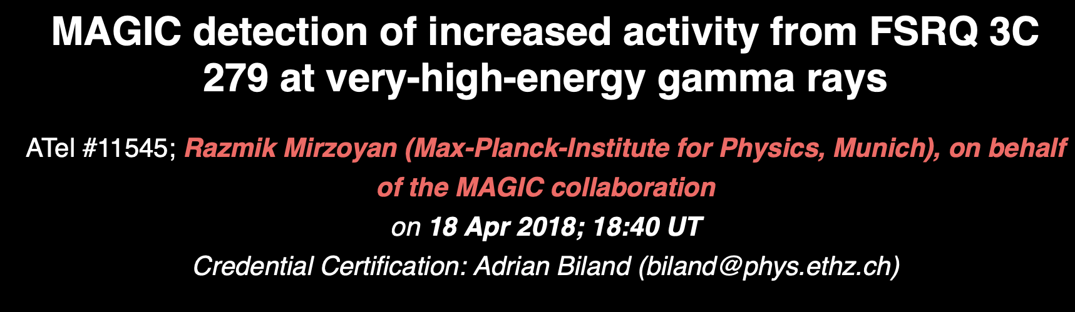
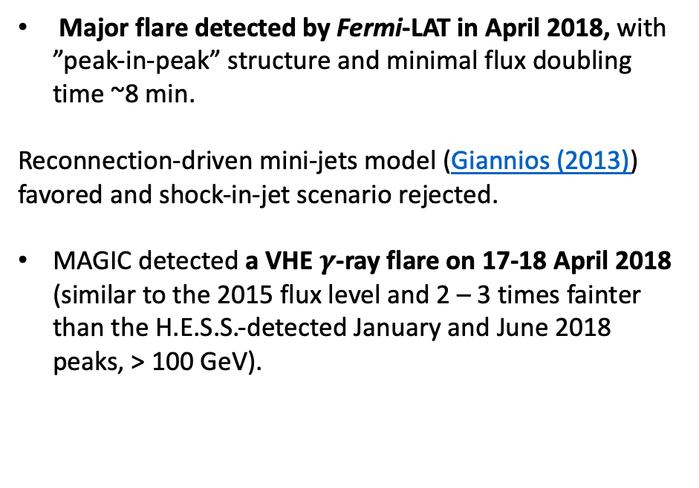
  3C 279 during 2018 EHT-MWL campaign
Major flare detected by Fermi-LAT in April 2018, with ”peak-in-peak” structure and minimal flux doubling time ~8 min.
Reconnection-driven mini-jets model (Giannios (2013)) favored and shock-in-jet scenario rejected.
MAGIC detected a VHE $γ$-ray flare on 17-18 April 2018 (similar to the 2015 flux level and 2 – 3 times fainter than the H.E.S.S.-detected January and June 2018 peaks, > 100 GeV).
Shukla & Mannheim (2020)
  HEASA 2026 (SAAO, Cape Town, 30 September 2026) Anna Luashvili 19

Slide 25

  3C 279 during 2018 EHT-MWL campaign
Major flare detected by Fermi-LAT in April 2018, with ”peak-in-peak” structure and minimal flux doubling time ~8 min.
Reconnection-driven mini-jets model (Giannios (2013)) favored and shock-in-jet scenario rejected.
MAGIC detected a VHE $γ$-ray flare on 17-18 April 2018 (similar to the 2015 flux level and 2 – 3 times fainter than the H.E.S.S.-detected January and June 2018 peaks, > 100 GeV).
Unfortunately, no H.E.S.S. observations (colliding with M87 2018 campaign).
EHT observations: 21 - 25 April 2018 (Principe et al. 2025), only a few days after the major HE and bright VHE $γ$-ray outbursts.
Looking forward to the EHT results (analysis ongoing)!
Shukla & Mannheim (2020)
  HEASA 2026 (SAAO, Cape Town, 30 September 2026) Anna Luashvili 19

Slide 26



  3C 279 in April 2021
2021 EHT observations of 3C 279 just published (with the largest EHT
configuration published to date)!
Compact features ~orthogonal to the large-scale jet axis, consistent with earlier EHT results from 2017.
$Γ≥$ 10 within the inner ~ 5000 $R_{G}$ from the kinematic origin – acceleration occurs near the core.
The 1st downstream structure much brighter than the core (master recollimation shock).
Very small $θ$ values and jet bending towards the observer on sub-pc scales (can be caused by the jet – ISM interactions, instabilities, magnetic reconnection near the horizon, precession induced by a binary system).
Müller et al. 2026
  HEASA 2026 (SAAO, Cape Town, 30 September 2026) Anna Luashvili 20

Slide 27




  3C 279 in April 2021
3C 279 seems in a low $γ$-ray flux state during the EHT-MWL campaign in April 2021.
Cannot comment on the VHE observations yet (stay tunned).
Fermi LCR, weekly
Optical flares reported, but in January 2021 (ATel#14310, ATel#14353).
Flare in polarized flux, with biggest EVPA jump (~${90}^{∘})$ of ALMA history, reported in February 2021 (ATel#14385).
Interesting dataset to explore for a new EHT-MWL project!
Fermi LCR, 3 day-binned
  HEASA 2026 (SAAO, Cape Town, 30 September 2026) Anna Luashvili 21

Slide 28


  What’s next?
  Cen A
Janssen et al., 2021
H.E.S.S. Collaboration (2020)
  HEASA 2026 (SAAO, Cape Town, 30 September 2026) Anna Luashvili 22

Slide 29



  What’s next?
  PG 1553+113
HESS Collaboration (2015)
HBL blazar (z~0.43), known for MWL variability and strong VHE flares
SMBH binary system <–> long-term quasi-periodic variability
2012 VHE flare HESS Collaboration (2015)
Fermi-LAT LC: ~2.2 yr periodicity (>4$σ)$ (Penil+2020), probably closely correlated with lower energy emission (Ackermann+2015).
One of the EHT targets
+ also observed by other IACTs.
MAGIC Collaboration (2012)
  HEASA 2026 (SAAO, Cape Town, 30 September 2026) Anna Luashvili 23

Slide 30

  What’s next?
  PG 1553+113 – similar to OJ 278?
Gomez+2026
  HEASA 2026 (SAAO, Cape Town, 30 September 2026) Anna Luashvili 24

Slide 31


  What’s next?
  PKS 1510-089
H.E.S.S. Collaboration (2023)
Can EHT resolve any of those zones (overlap in 2022)?
  HEASA 2026 (SAAO, Cape Town, 30 September 2026) Anna Luashvili 25

Slide 32
  Conclusions / Outlook
Three exceptionally dense EHT-MWL campaigns with the involvement of H.E.S.S. published:
quiescence (2017) and high state M87 (2018), 3C 279 campaign (2017).
More to come… Moving towards multi-year projects and movie campaign(s)!
  HEASA 2026 (SAAO, Cape Town, 30 September 2026) Anna Luashvili 26

Slide 33
  Conclusions / Outlook
Three exceptionally dense EHT-MWL campaigns with the involvement of H.E.S.S. published:
quiescence (2017) and high state M87 (2018), 3C 279 campaign (2017).
More to come… Moving towards multi-year projects and movie campaign(s)!
Need to be watching during low and flaring states as well (before and beyond CTAO-South)…
Extensive data sets from EHT-MWL campaigns become available to the community.
- Test a variety of models incorporating both EHT & high-energy constraints (not straightforward even for quiescent states).
  HEASA 2026 (SAAO, Cape Town, 30 September 2026) Anna Luashvili 26

Slide 34
  Conclusions / Outlook
Three exceptionally dense EHT-MWL campaigns with the involvement of H.E.S.S. published:
quiescence (2017) and high state M87 (2018), 3C 279 campaign (2017).
More to come… Moving towards multi-year projects and movie campaign(s)!
Need to be watching during low and flaring states as well (before and beyond CTAO-South)…
Extensive data sets from EHT-MWL campaigns become available to the community.
- Test a variety of models incorporating both EHT & high-energy constraints (not straightforward even for quiescent states).
H.E.S.S. has a major role in Sgr A* observations, one of the primary EHT targets.
  HEASA 2026 (SAAO, Cape Town, 30 September 2026) Anna Luashvili 26

Slide 35
  Conclusions / Outlook
Three exceptionally dense EHT-MWL campaigns with the involvement of H.E.S.S. published:
quiescence (2017) and high state M87 (2018), 3C 279 campaign (2017).
More to come… Moving towards multi-year projects and movie campaign(s)!
Need to be watching during low and flaring states as well (before and beyond CTAO-South (hopefully))…
Extensive data sets from EHT-MWL campaigns become available to the community.
- Test a variety of models incorporating both EHT & high-energy constraints (not straightforward even for quiescent states).
H.E.S.S. has a major role in Sgr A* observations, one of the primary EHT targets.
Exciting times for EHT-MWL activities!
Expanding EHT network, VHE – high-frequency radio monitoring, growing number of EHT-targets (population studies?)…
  HEASA 2026 (SAAO, Cape Town, 30 September 2026) Anna Luashvili 26

Slide 36






Thank you!

