Slide 1

The X-ray and optical emission of the intermediate polar Swift J0614.0+1709
Nikita Rawat (rawatn@saao.ac.za)
Collaborators: Domitilla De Martino, David Buckley, Koji Mukai, Martina Veresvarska, Zackery Irving, Simone Scaringi, and Nicola Masetti
High Energy Astrophysics in Southern Africa (HEASA 2026)
02 October 2026

Slide 2
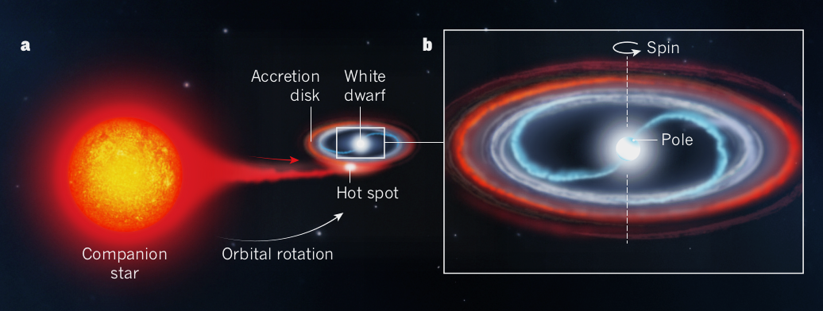
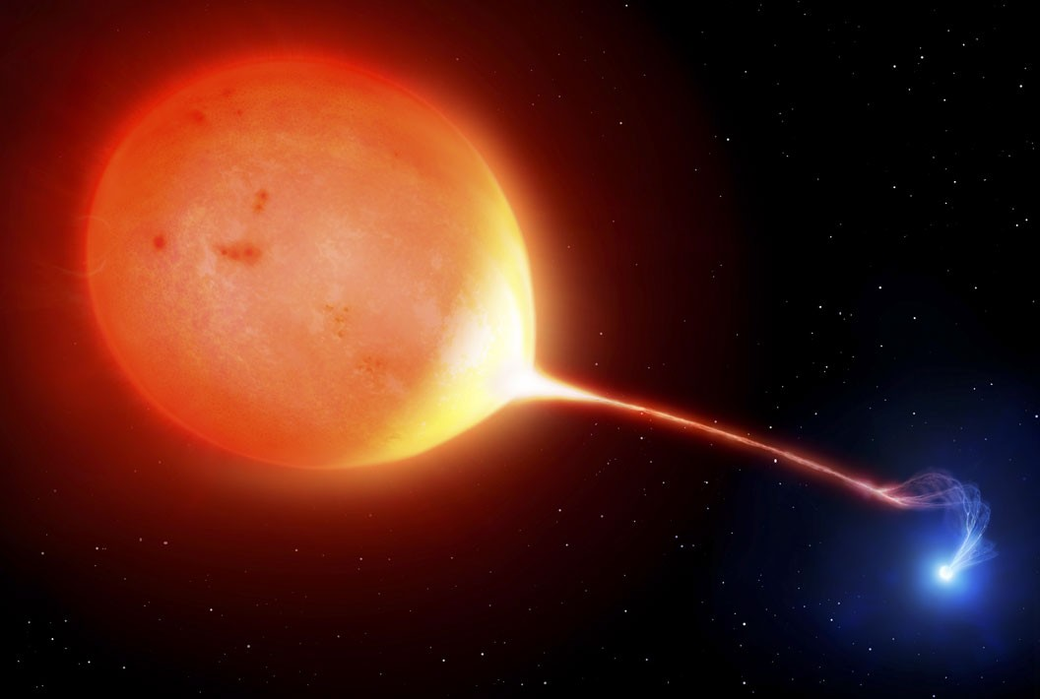
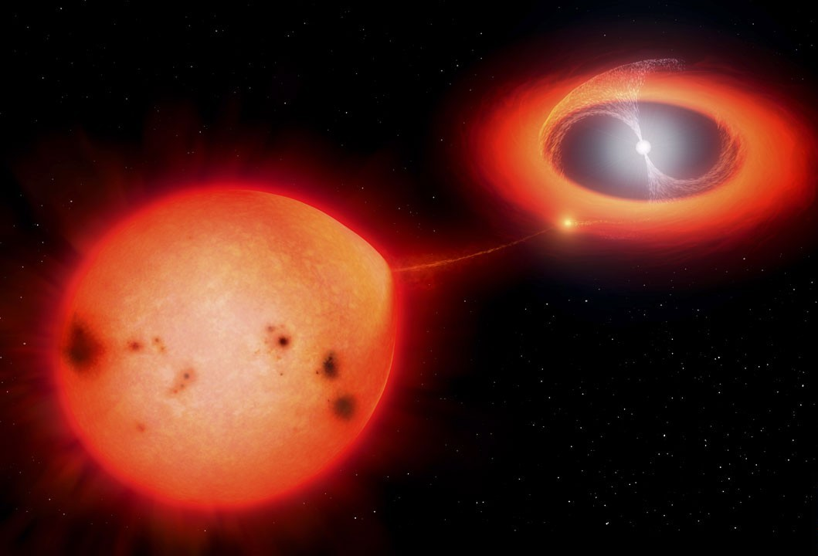
Magnetic Cataclysmic Variables (MCVs)
Semi-detached binary systems.
Two components: magnetic white dwarf (B>1MG) and a Roche-lobe filling star.
X-rays to radio wavelengths.
Accretion discs??
Shore (2017)
Polar
Intermediate Polar
Artistic illustration by Mark Garlick

Slide 3
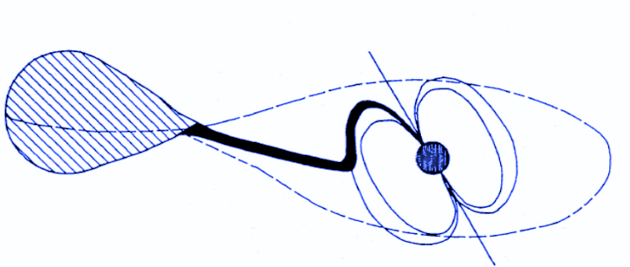
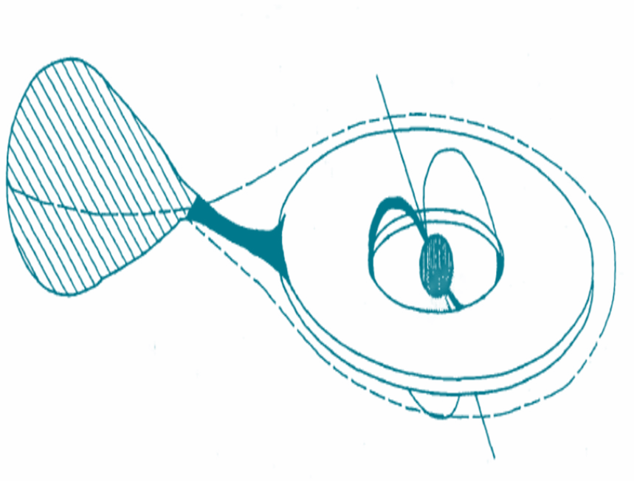

Accretion scenarios for intermediate polars (IPs)
Stream-fed (disc-less) accretion: (Hameury et al. 1986)
  Modulation at beat frequency (ω-Ω)
Disc-fed accretion: (Rosen et al., 1988)
  Modulation at spin frequency (ω)
Disc-overflow accretion: (Lubow 1989, Hellier et al. 1989)
  Simultaneous modulations at spin and beat frequencies
Norton et al. (1993)

Slide 4
A Timeline of Swift J0614.0+1709
Halpern & Thorstensen (2015): properties suggestive of a magnetic CV based on optical dataset.
Hou et al. 2023: LAMOST spectroscopy and TESS data, obtained results consistent with those of Halpern & Thorstensen (2015).
Bruch 2025: Variations in the accretion flow structure inferred from changes in the relative power of the spin and beat frequencies.
Many aspects of its X-ray behaviour remain
poorly characterised, leaving a key aspect of the system unexplored.

Slide 5
Data Sourcing
XMM-Newton: 2019 September 29 for ~29 ks.
EPIC-MOS, EPIC-PN, and OM.
Standard XMM-Newton SCIENCE ANALYSIS SYSTEM (SAS) software package (version 22.1.0).
Temporal and spectral analyses were done using HEASOFT version 6.35.1.
TESS: Sectors 33, 43, 44, 45, 71, and 72.

Slide 6
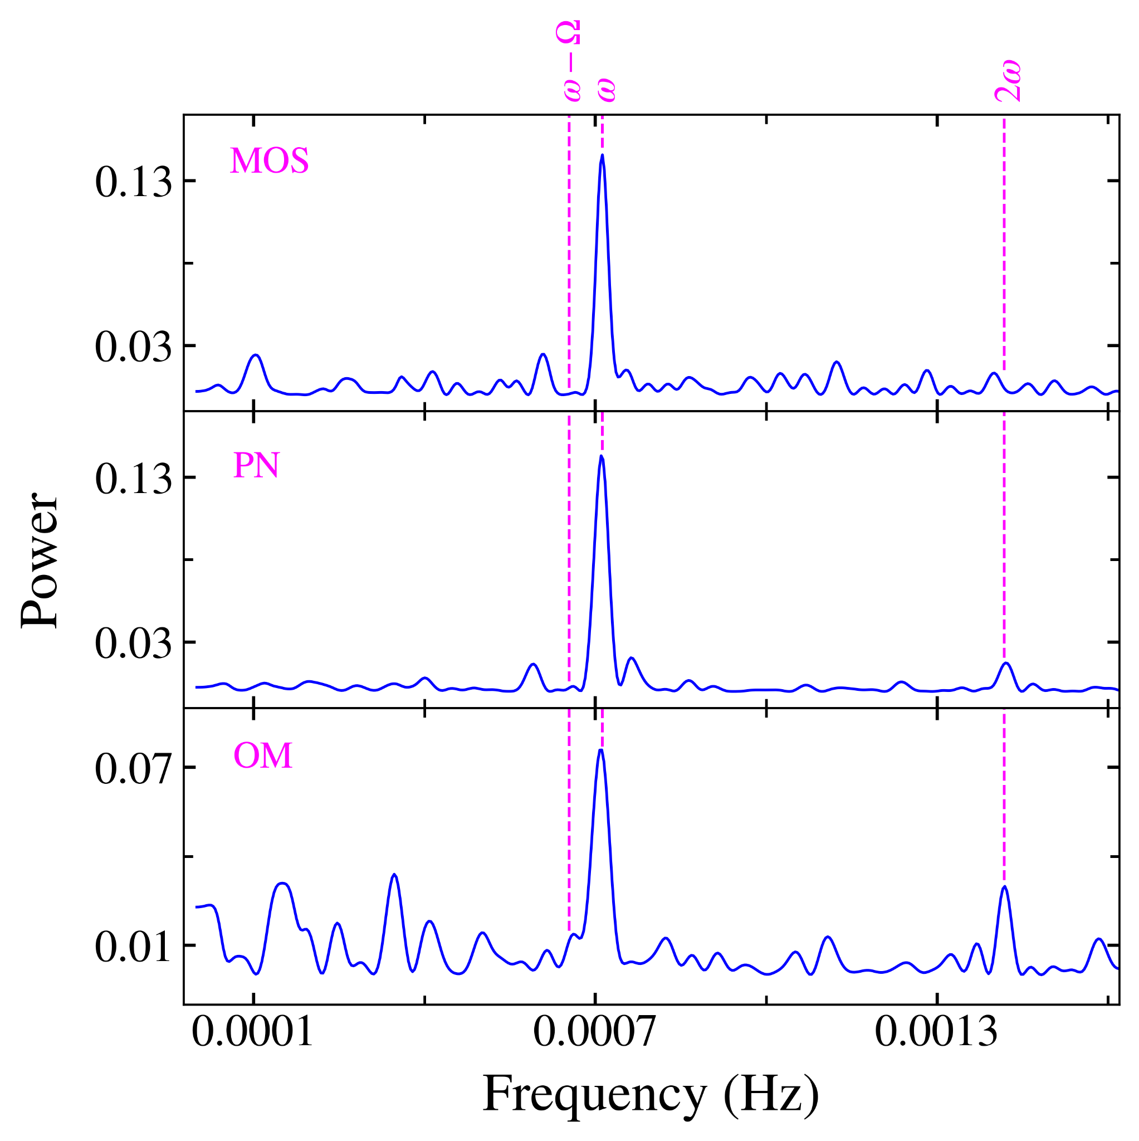
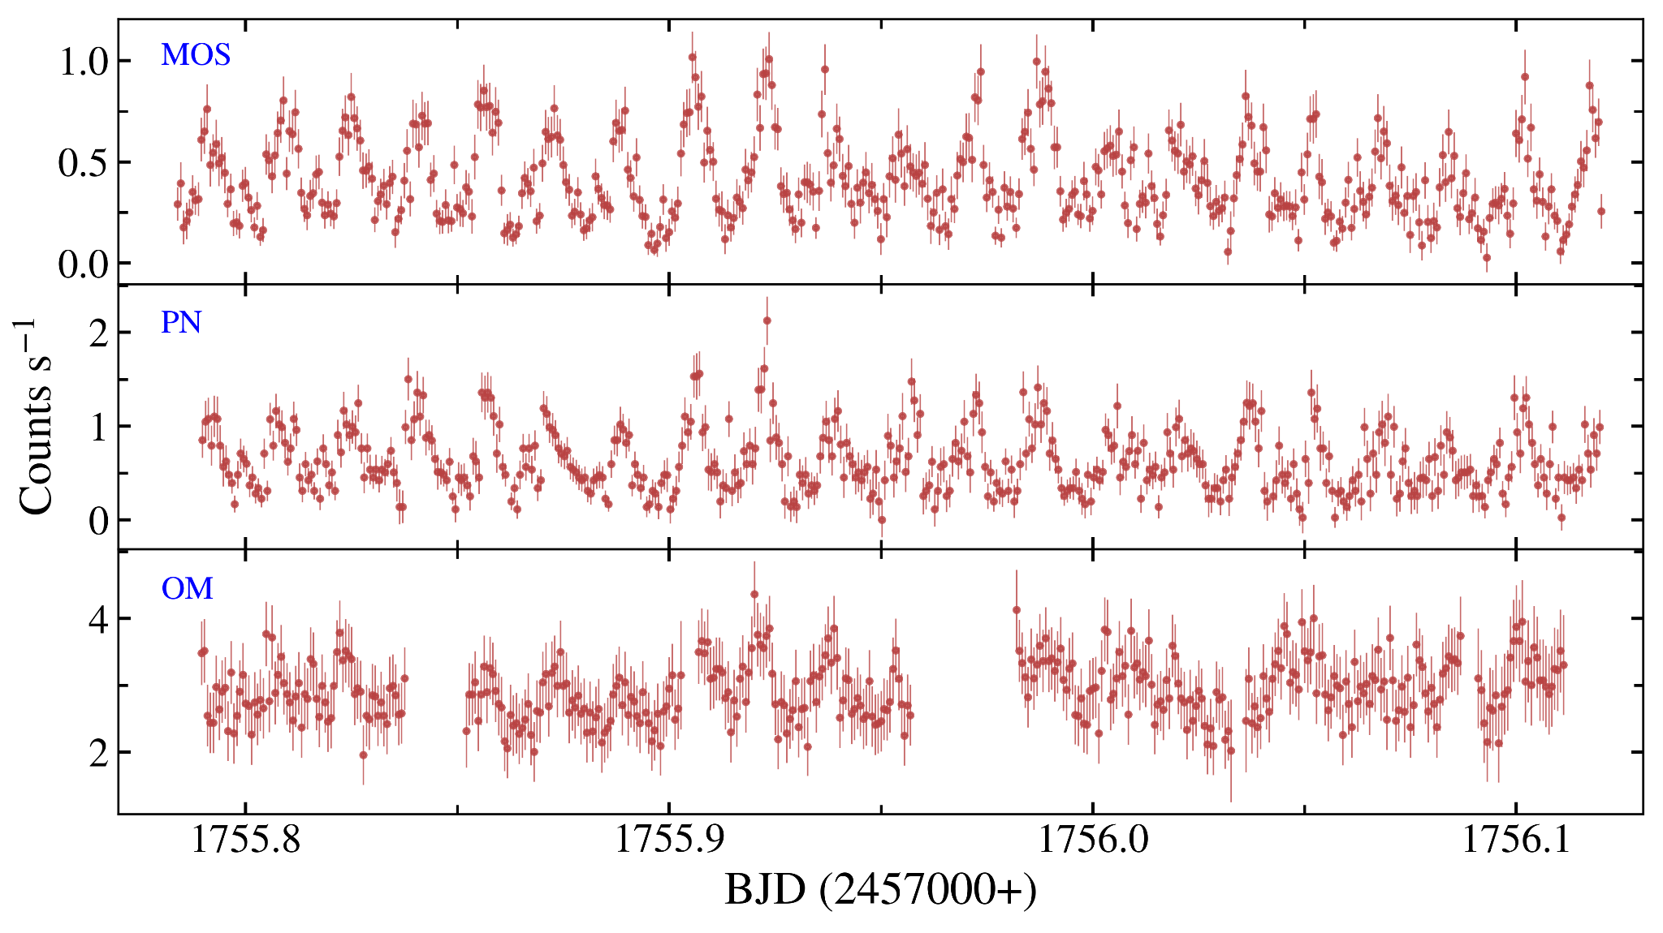
Timing Analysis
X-ray and optical light curves of J0614 obtained from XMM-Newton
Disc-fed accretor

Slide 7
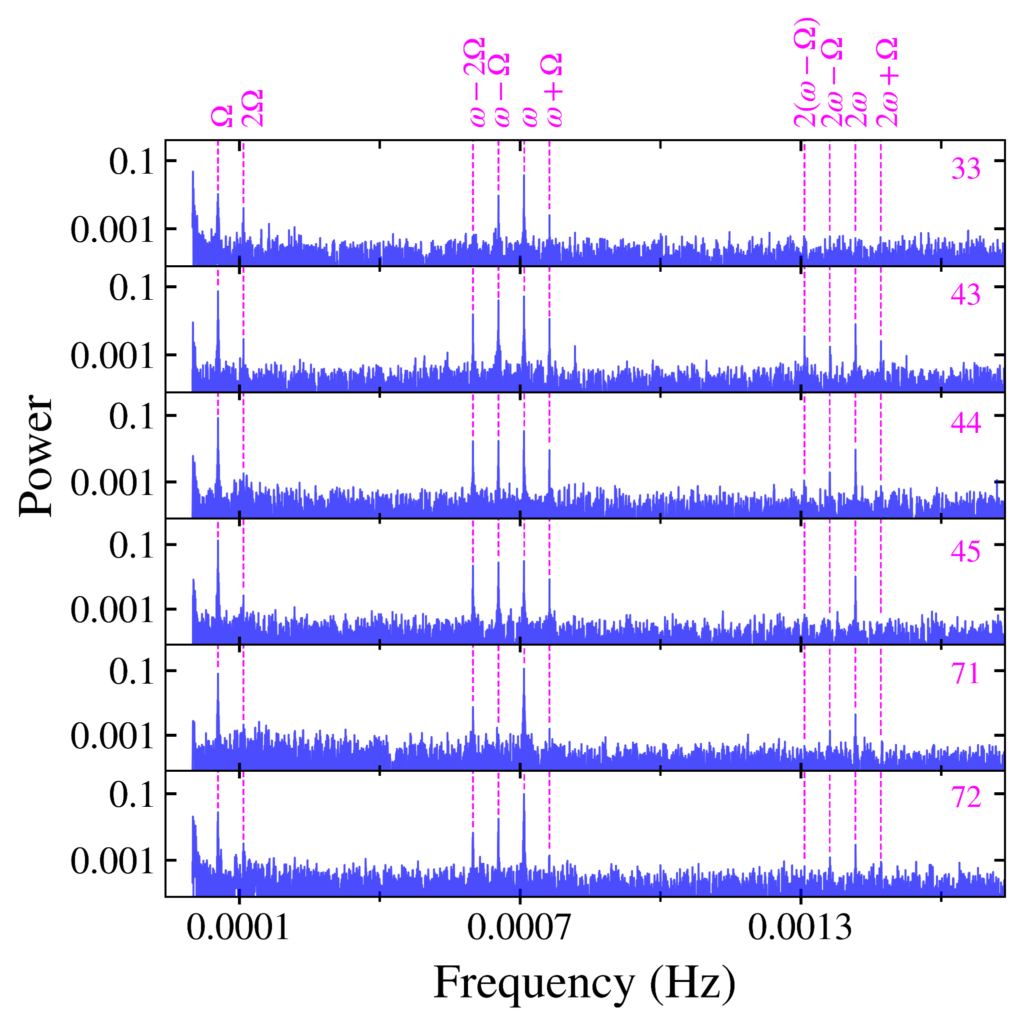
Timing Analysis
Spin period ~1411.7 s
Orbital period ~5.10 h
Beat period ~1529.4 s

Slide 8
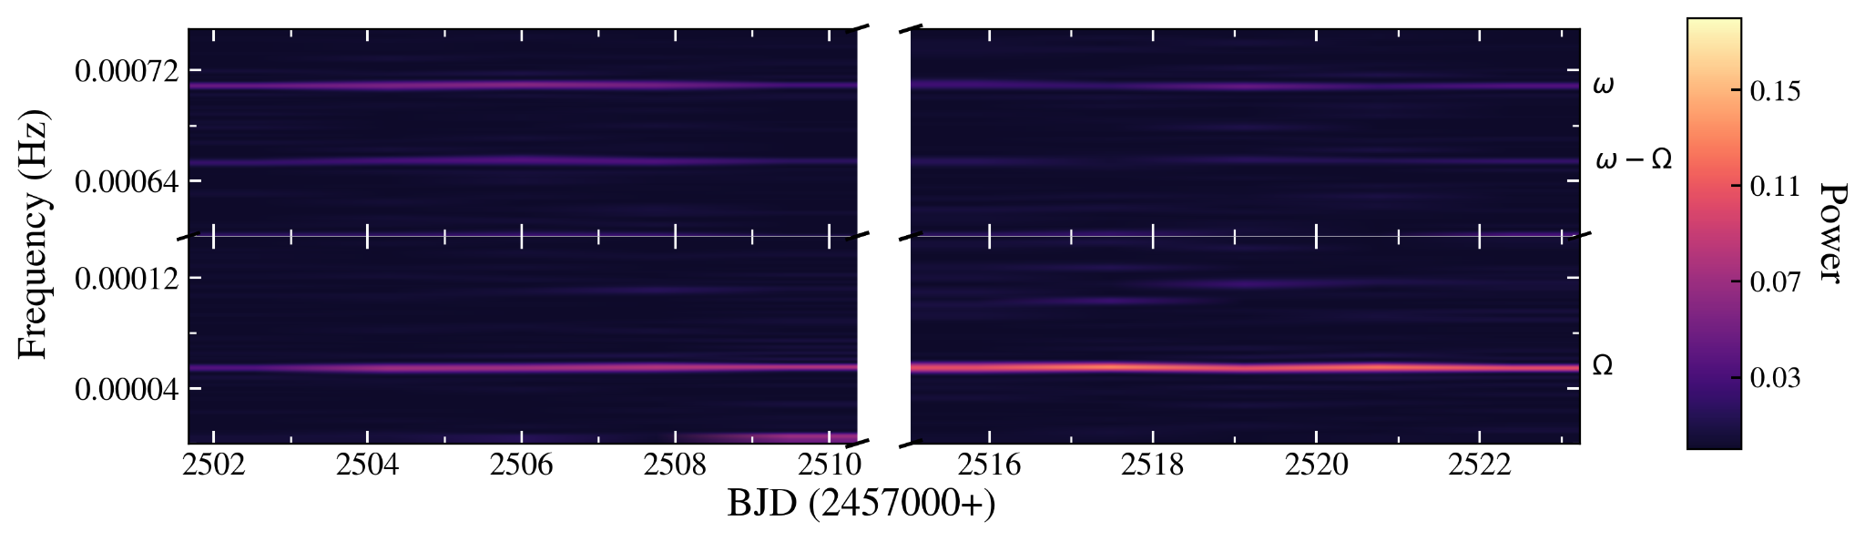
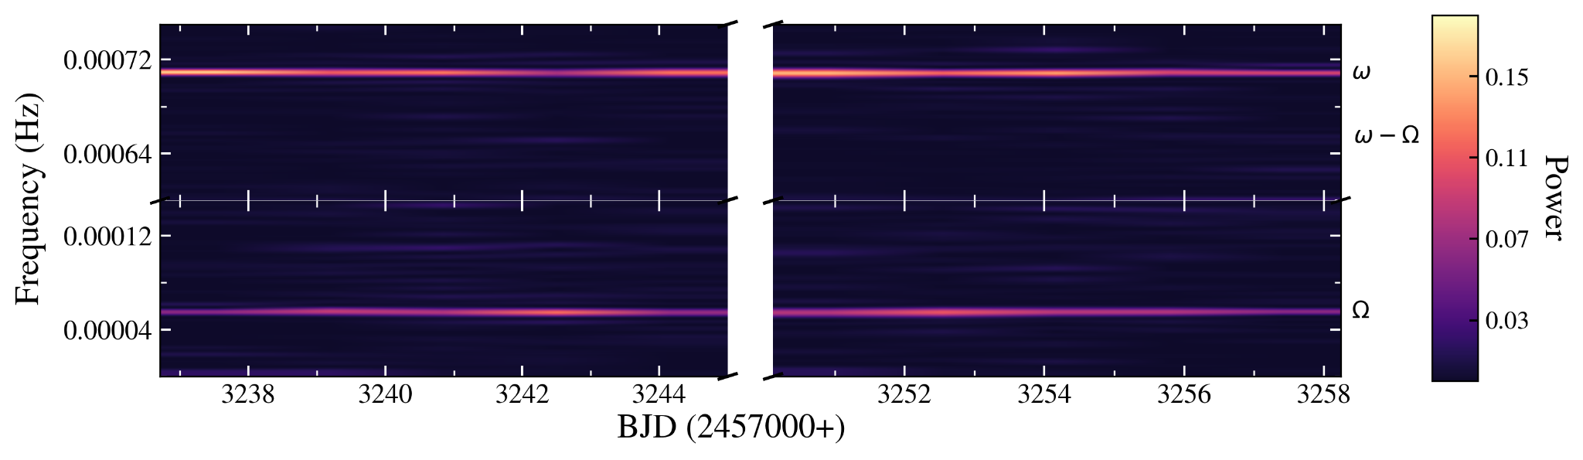
Time-resolved Power Spectral Analysis
Sector 44
Sector 71

Slide 9
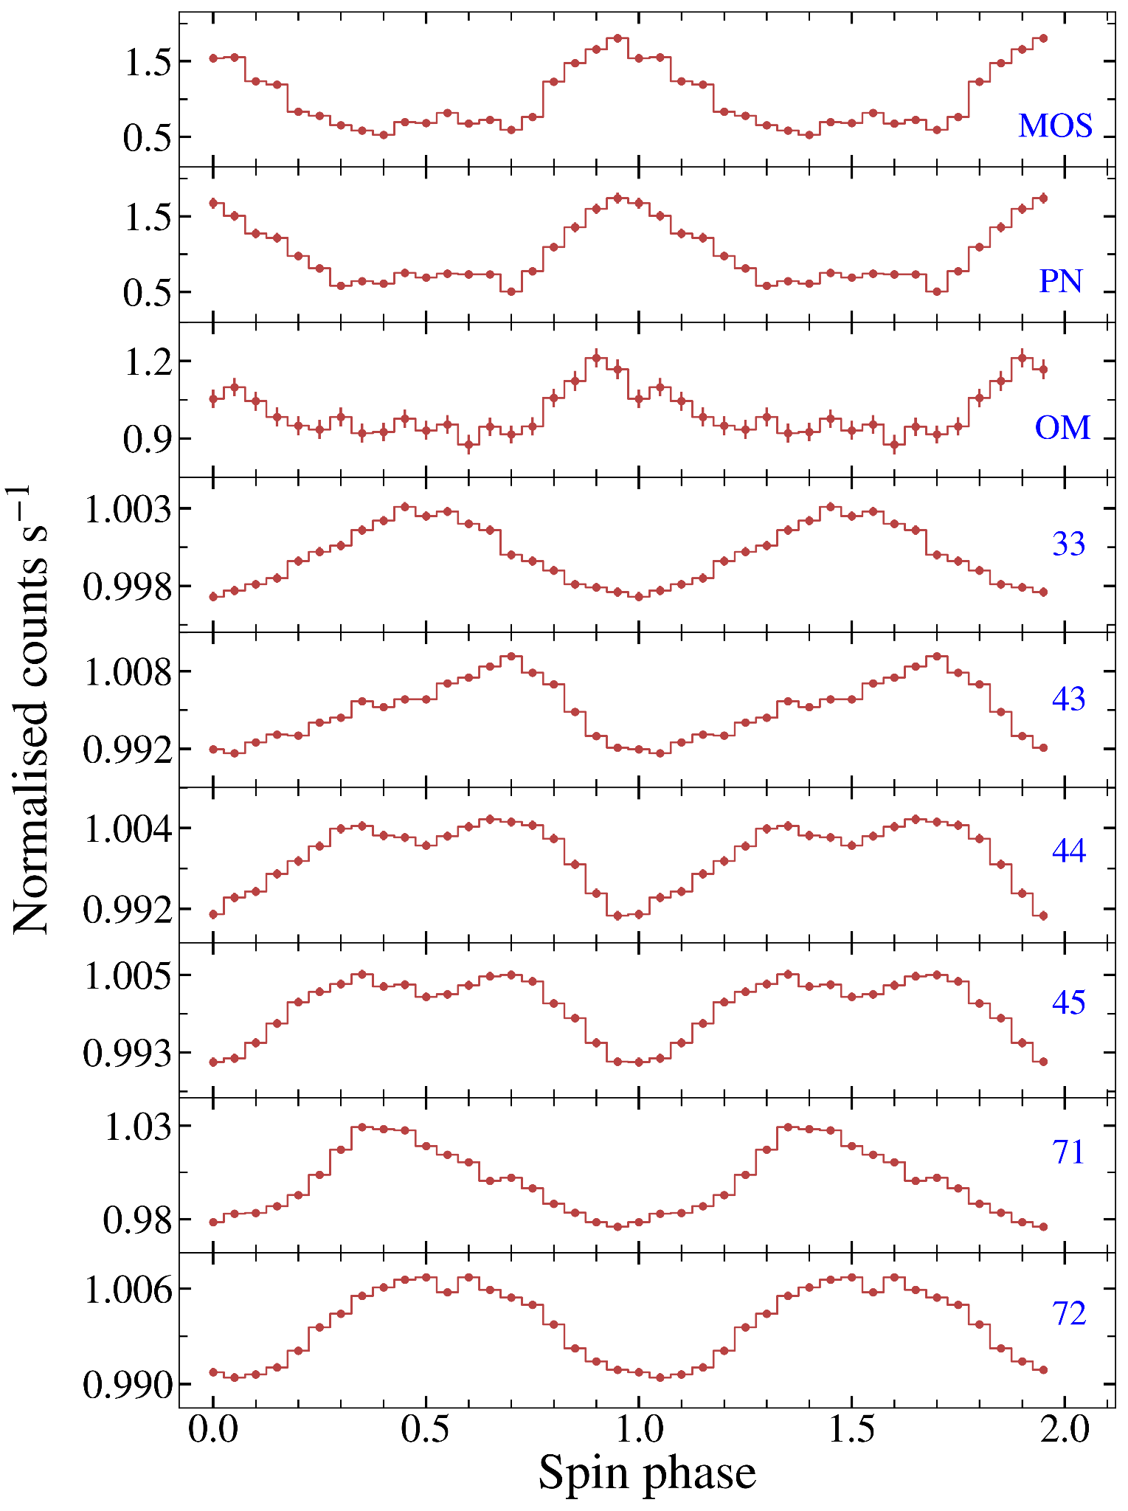
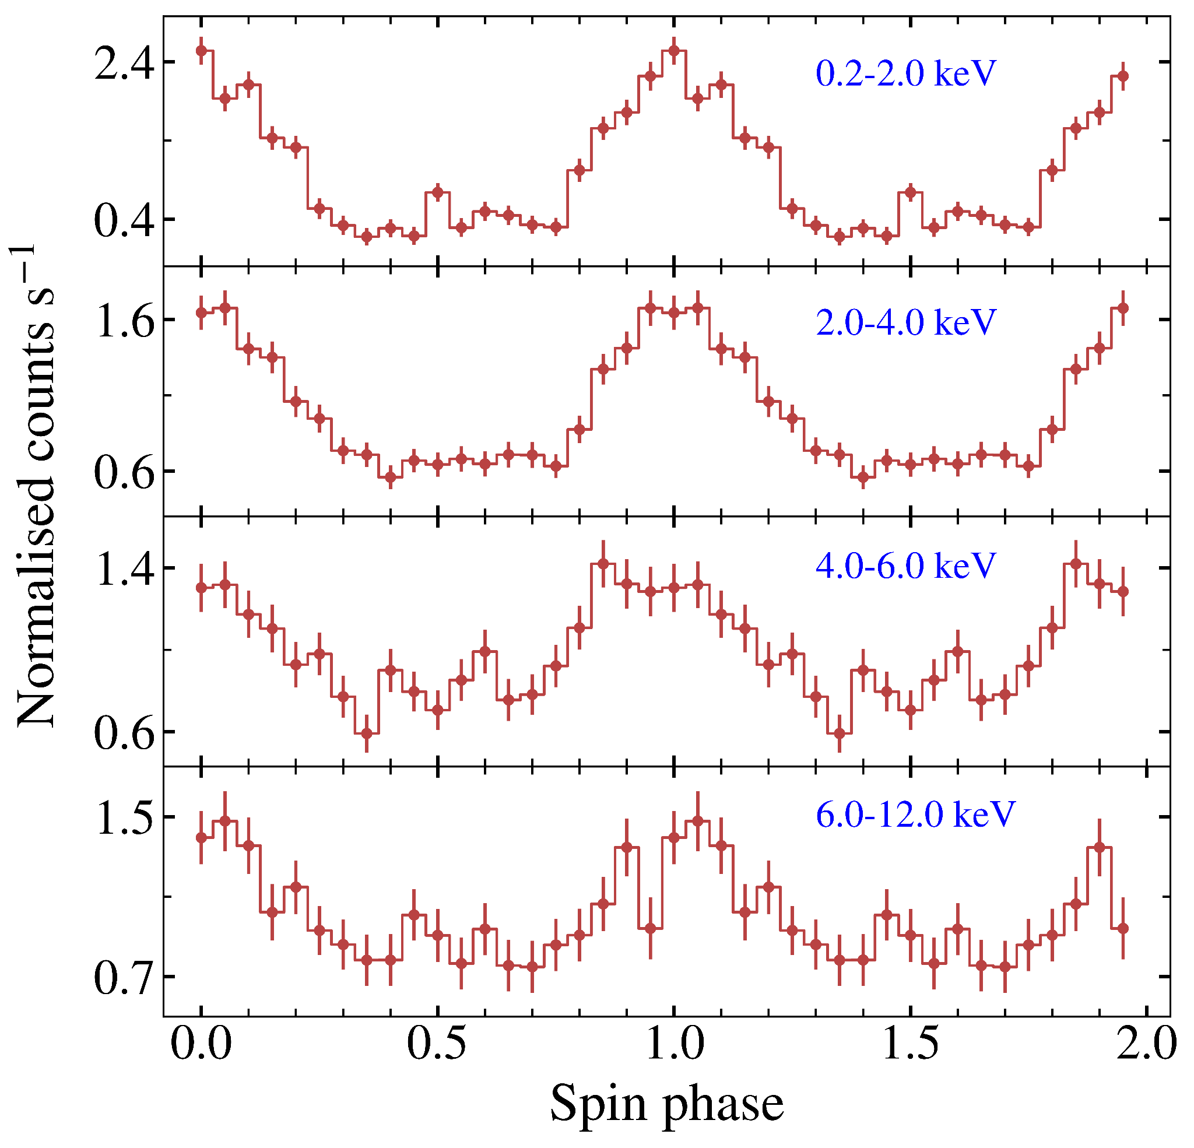
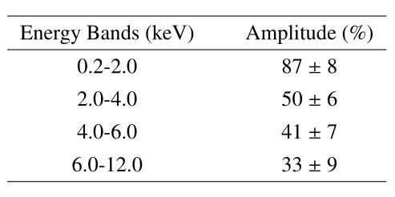
Folded Light Curve Analysis
Origin of the spin variability in X-rays: photoelectric absorption in the accretion flow

Slide 10
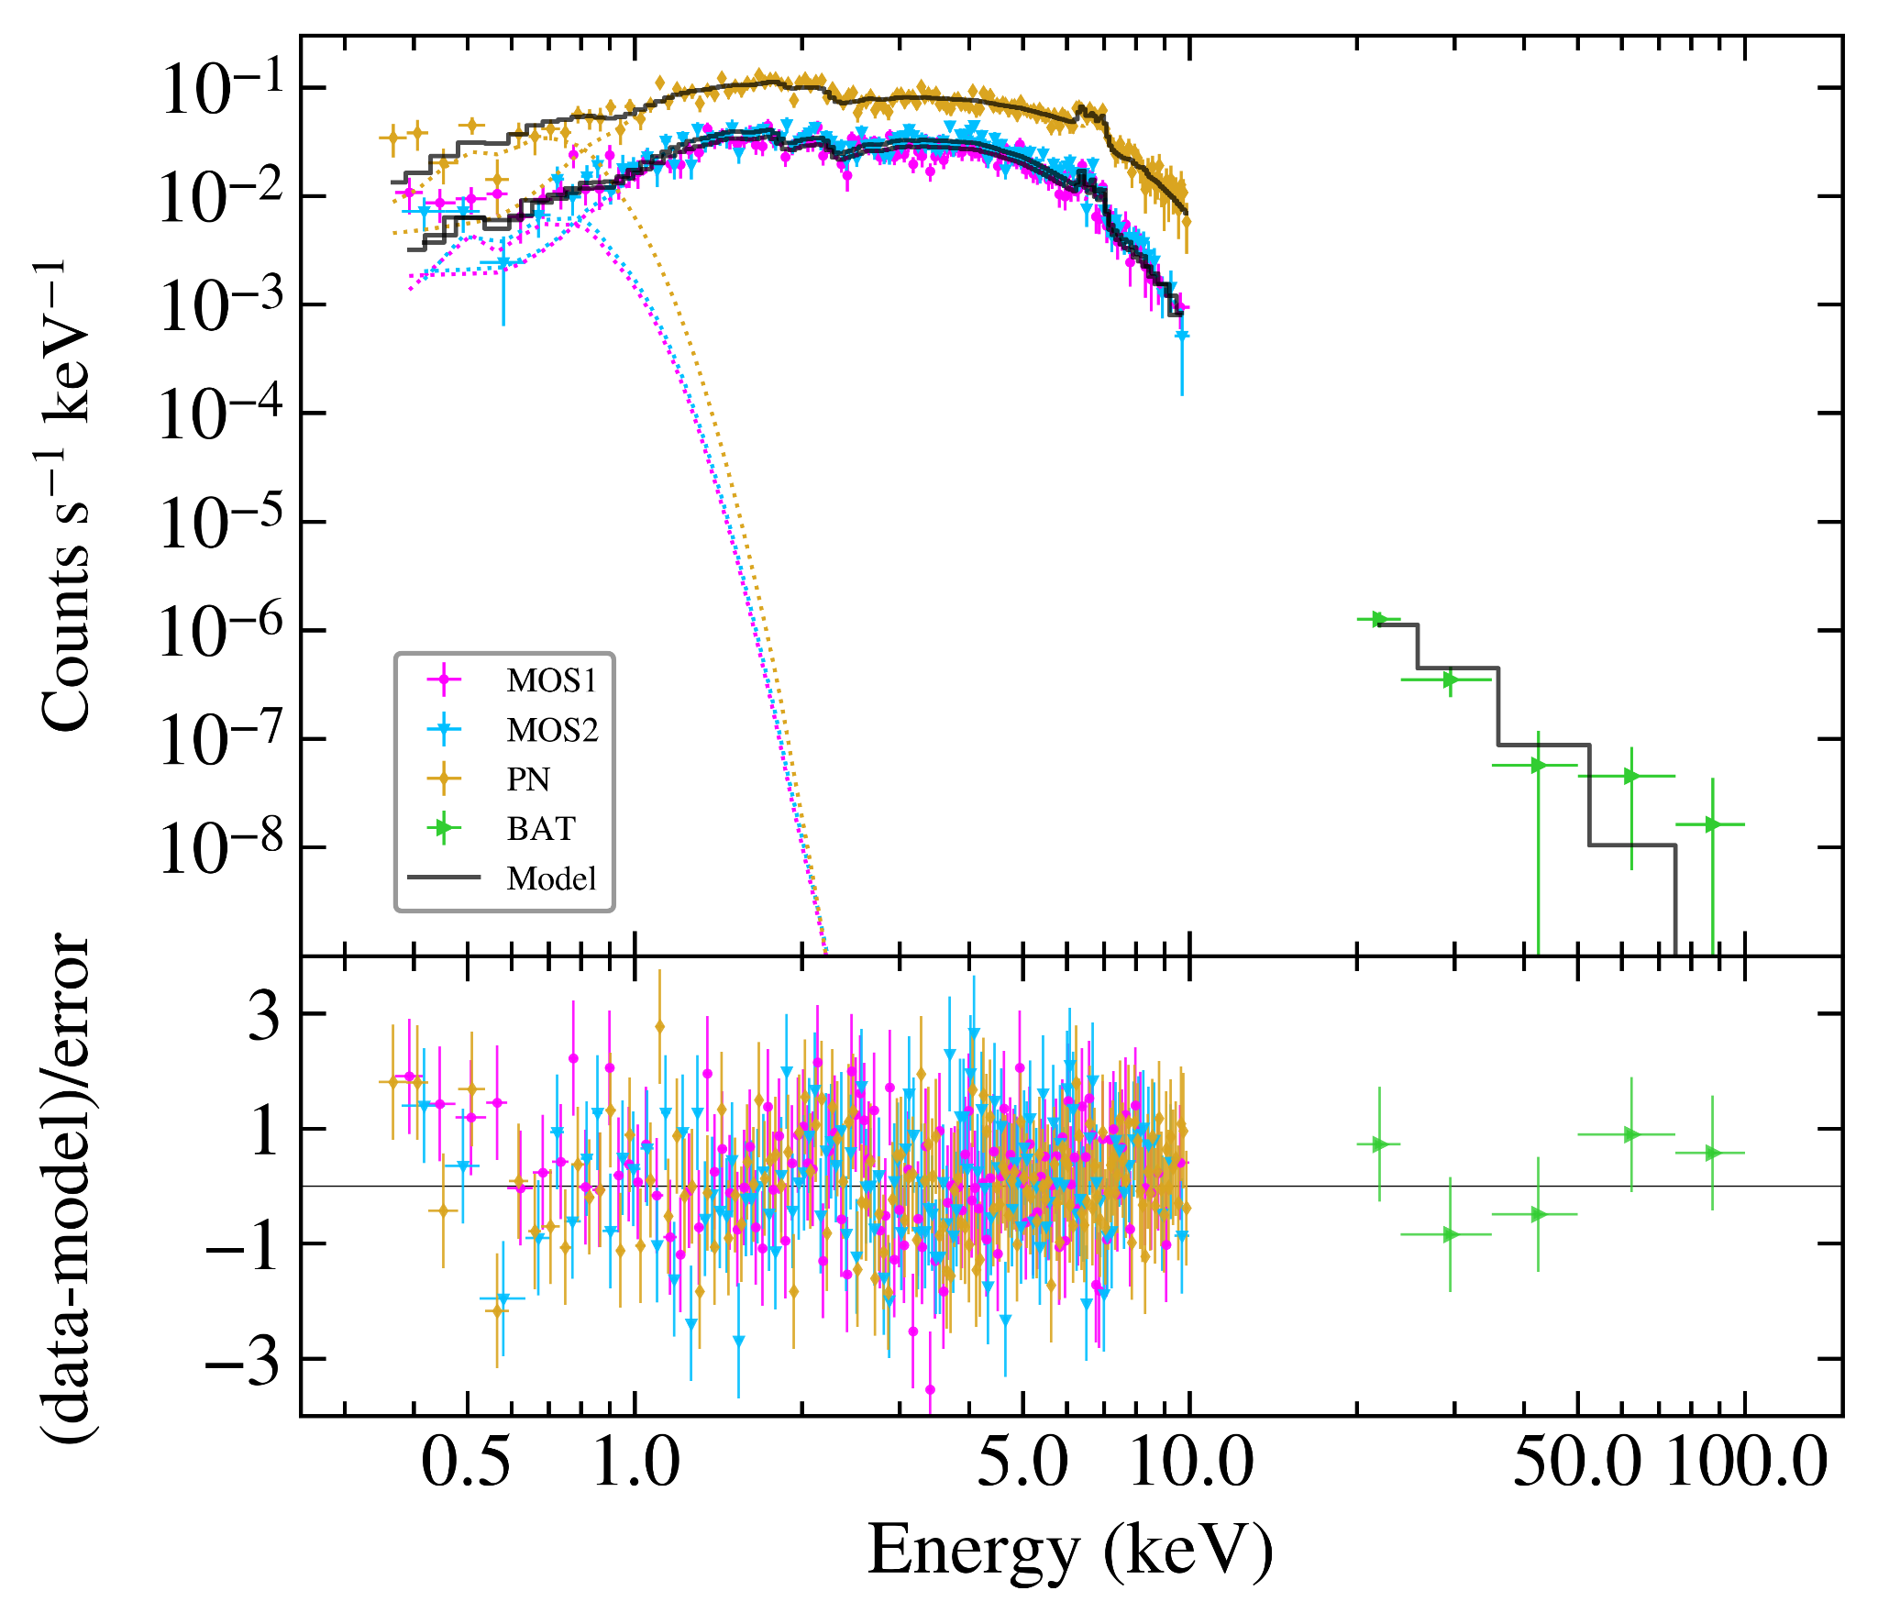
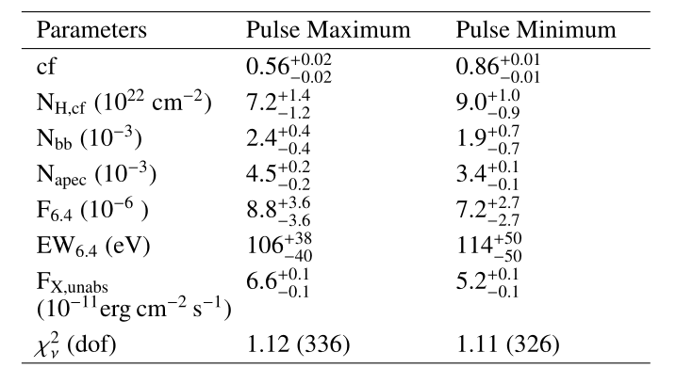
Spectral Analysis
tbabs × (partcov × tbabs) × (bb+ reflect x apec + gauss)
Covering fraction ~0.73
T_{bb} ~63 eV (soft IPs ~30%)
T_{apec} ~12 keV
L_{X,bol} ~10³⁴ erg s⁻¹

Slide 11
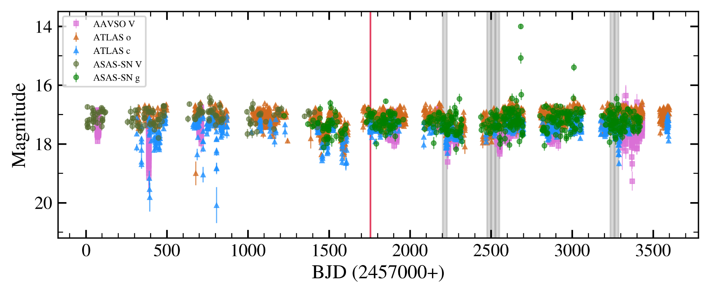
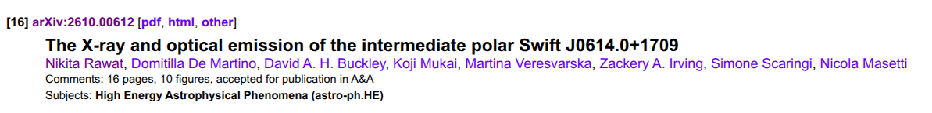

Summary
The spin periodicity found in X-ray data gives independent confirmation of J0614 belonging to IP subclass of MCVs.
The spin modulation shows a strong energy dependence and the phase-resolved spectroscopy shows significant changes in the covering fraction of the partial absorber across the spin cycle, indicating that the X-ray variability is primarily driven by absorption in the accretion curtains.
The optical spin modulation exhibits an approximately 0.5-cycle phase offset between the TESS and XMM-Newton epochs, suggesting temporal changes in the dominant accreting magnetic pole and/or in the relative contributions of the associated reprocessing regions.

Slide 12
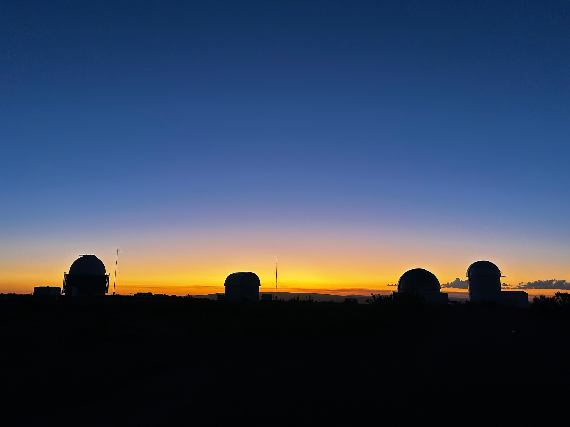
Thank you for your attention :)
ध्यान देने के लिए आपका धन्यवाद :)

Slide 13
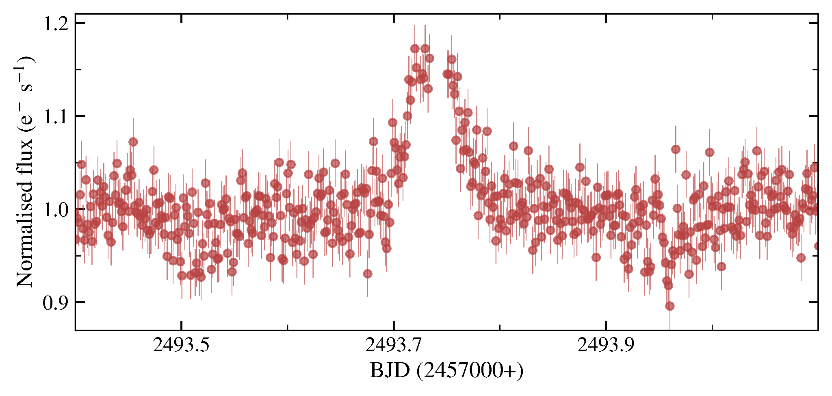
Back-up Slides

Slide 14
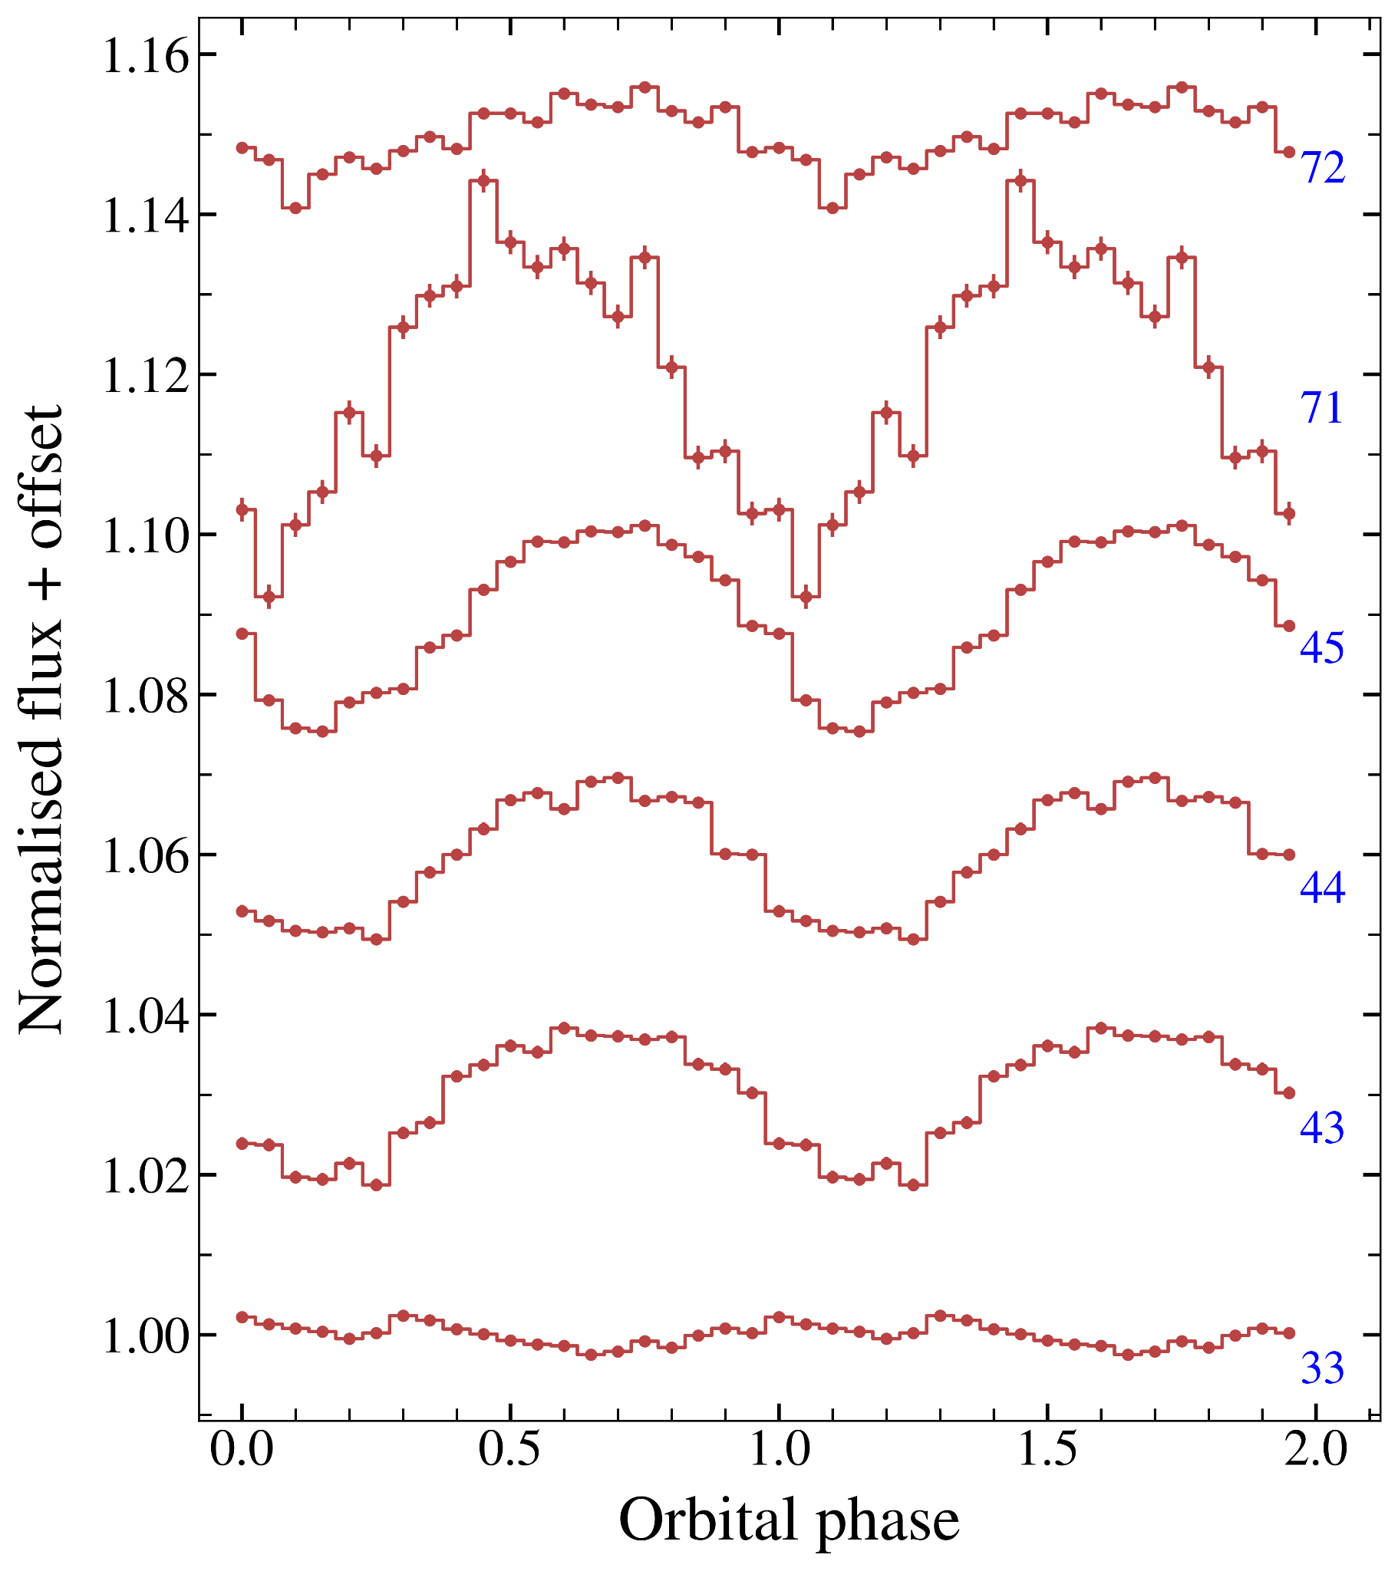
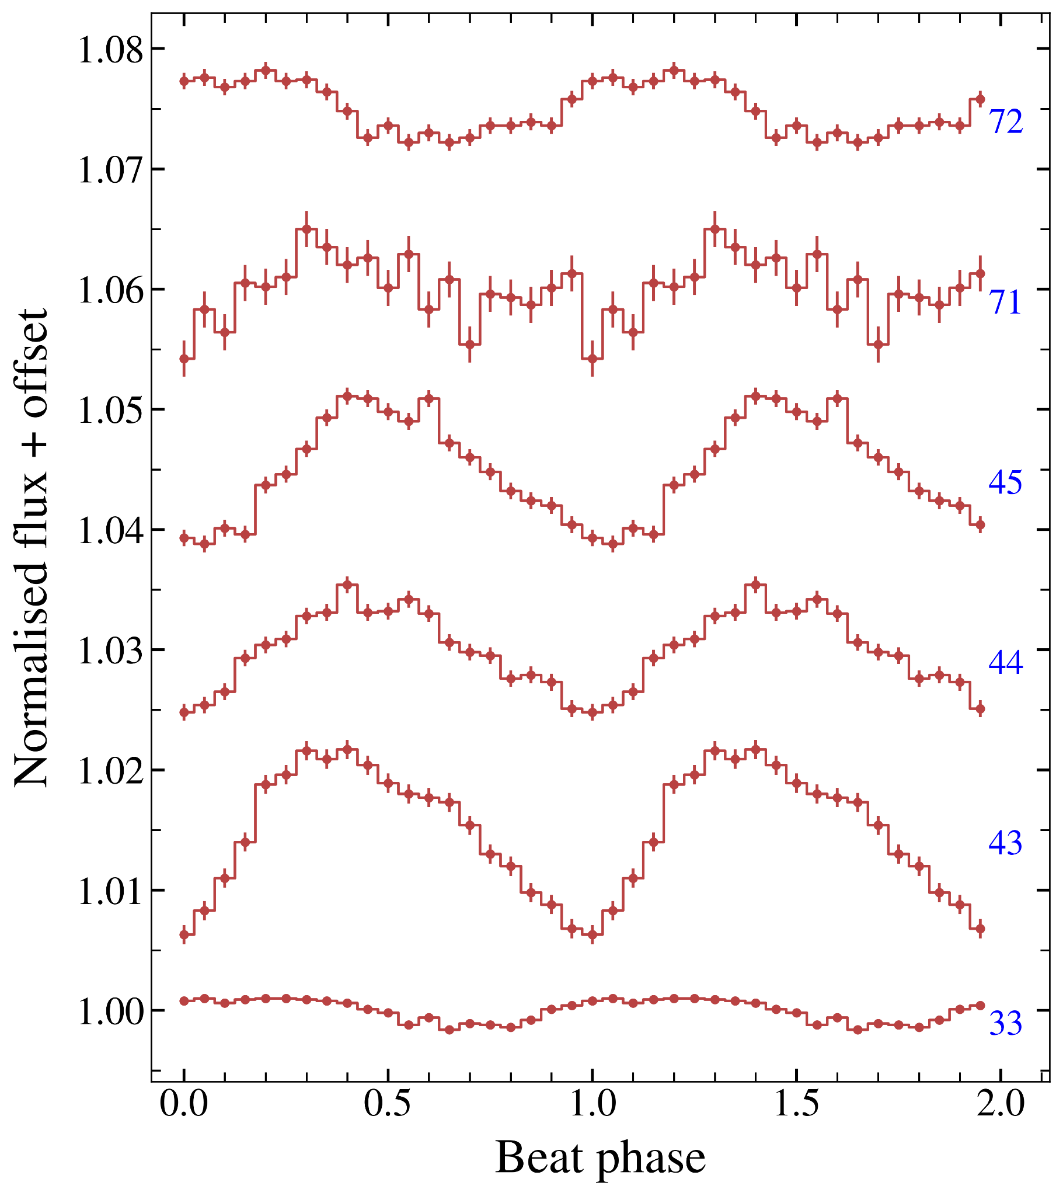
Back-up Slides

Slide 15
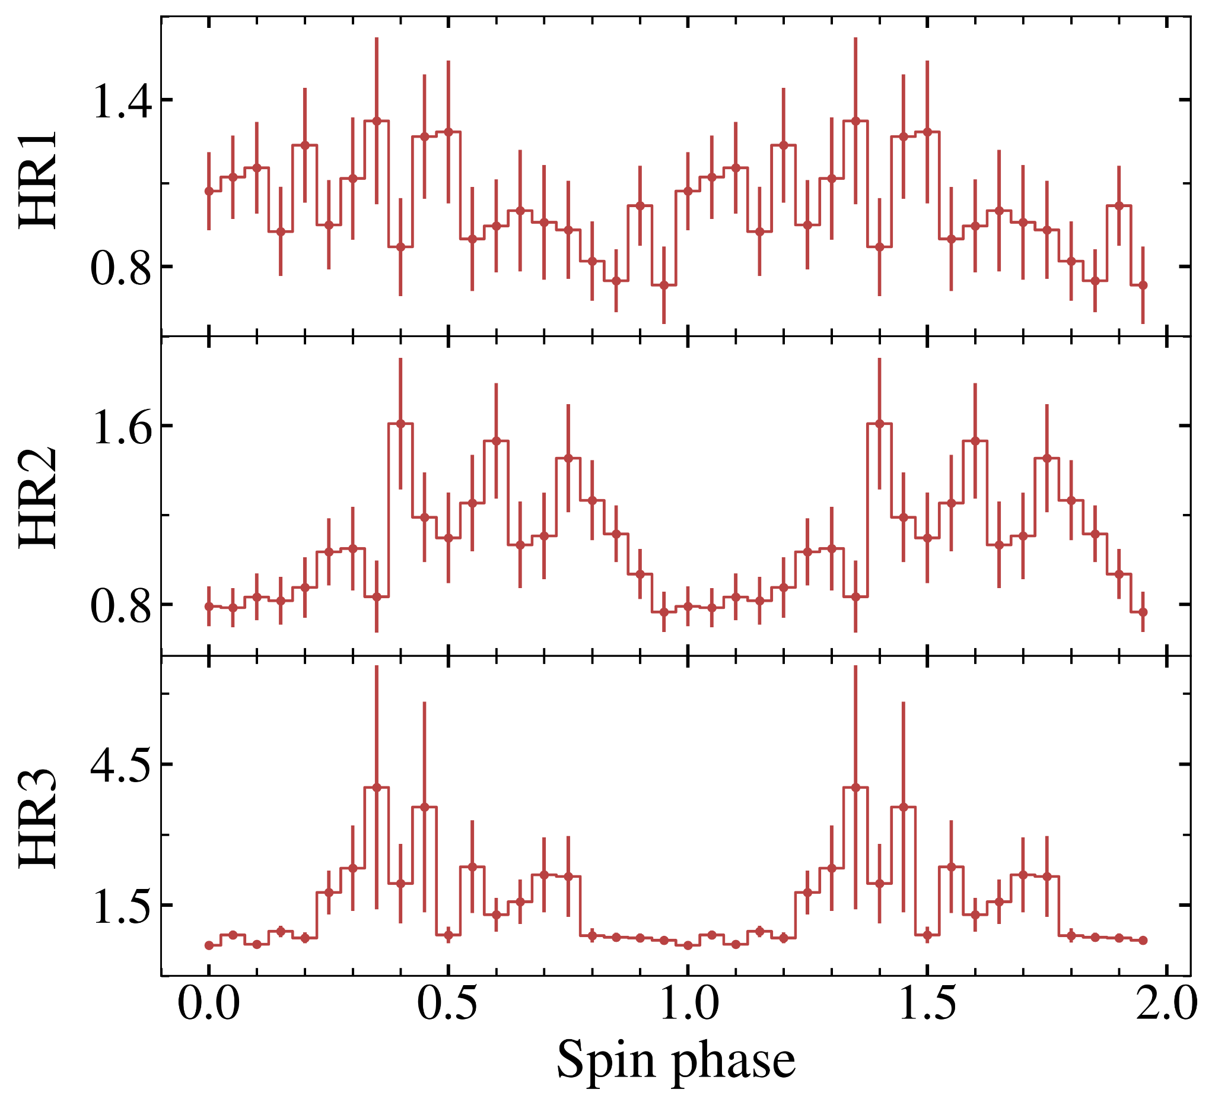
Back-up Slides

Slide 16
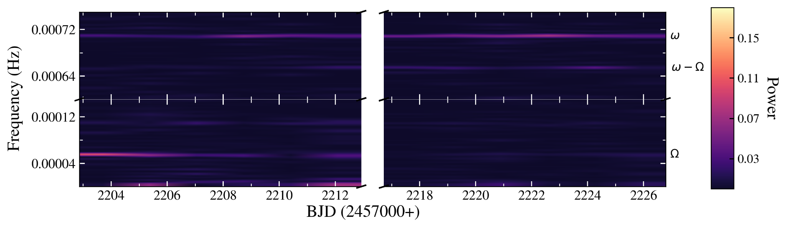
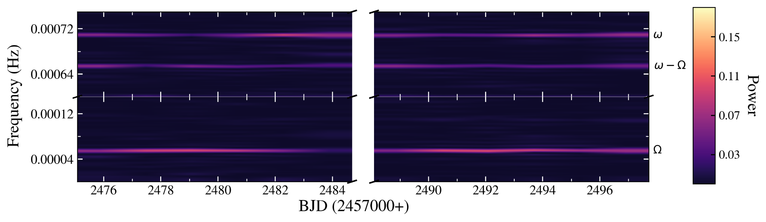
Back-up Slides

Slide 17

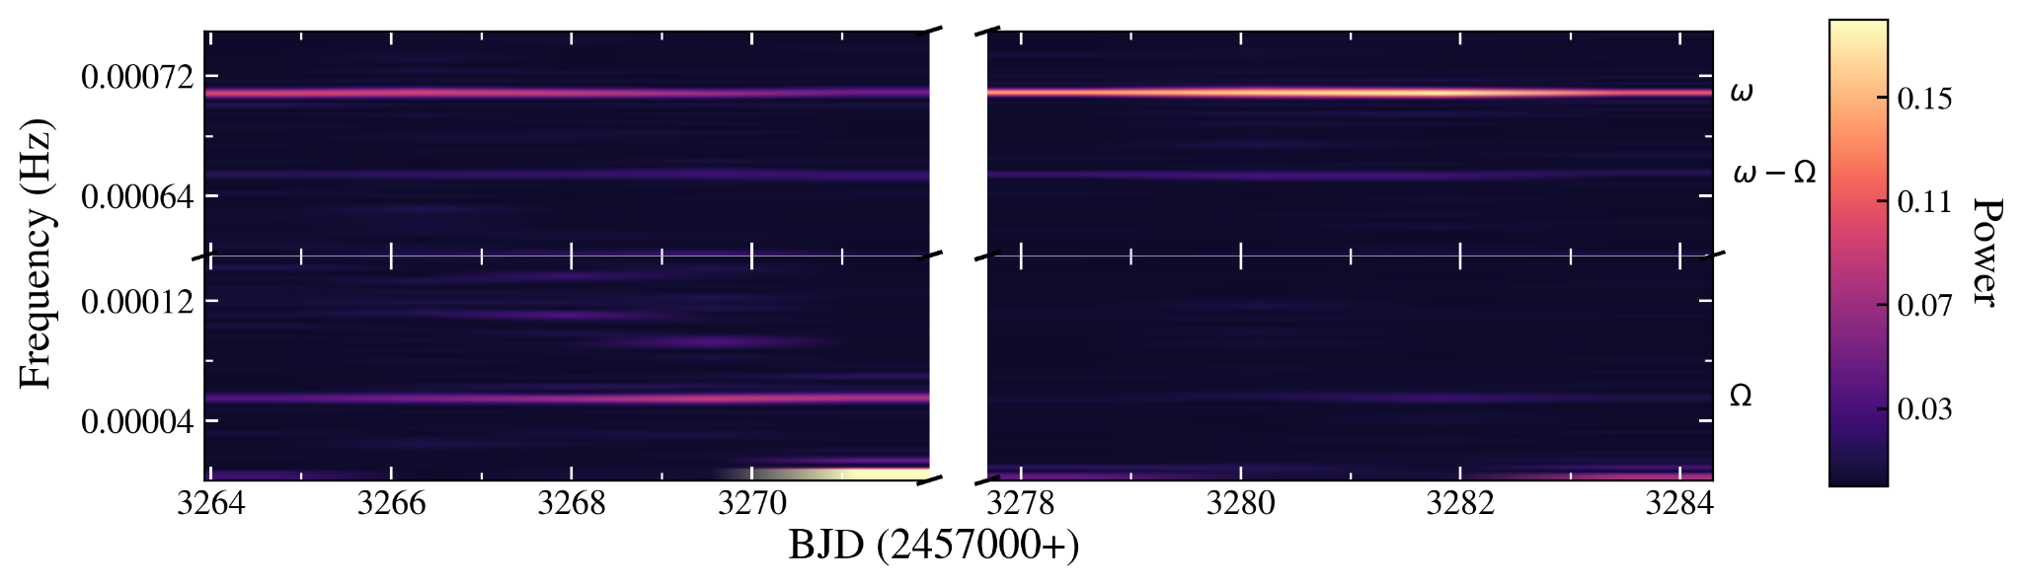
Back-up Slides

