Slide 1
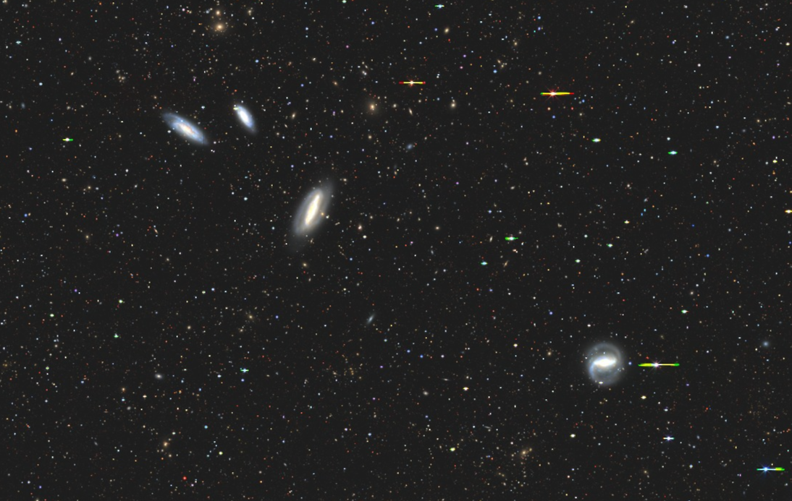



Associated HI absorption in the Grus Quartet
Mikhail de Villiers
PhD student
Collaborators: Prof DJ Pisano and Dr Moses Mogotsi
University of Cape Town/ South African Astronomical Observatory

Slide 2
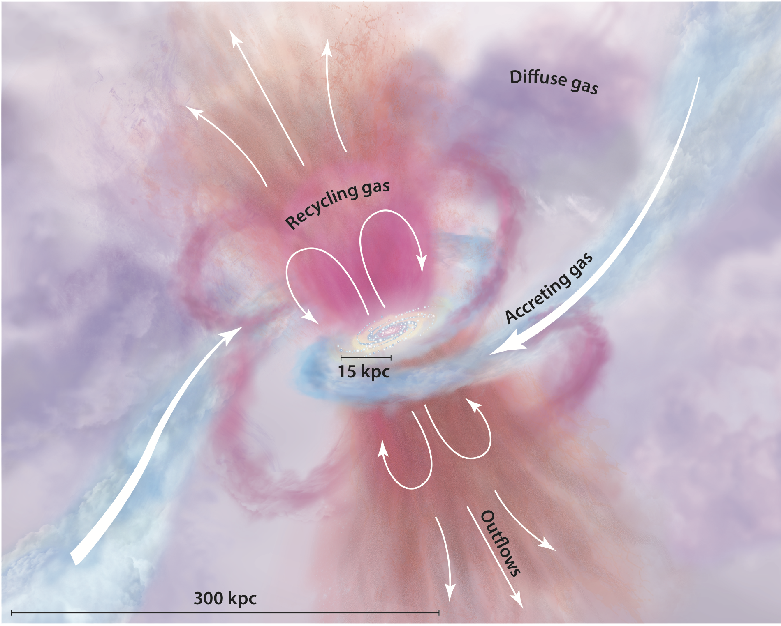
Gas in galaxies
Serves as the fuel for star formation
AGN in HI- another slide. Abs and link to AGN observations. AGN and cold gas. Fate and role of cold gas. Typically majority mass removed
The baryon cycle depicts the flow of gas in and around galaxies
HI – typically extends further, raw fuel for star-formation
HI absorption is particularly powerful:
  Investigate processes in ISM on much different scales
  Interplay between AGN and host ISM
  Push out to further z and higher spatial resolution
(Tumlinson et al 2017)

Slide 3
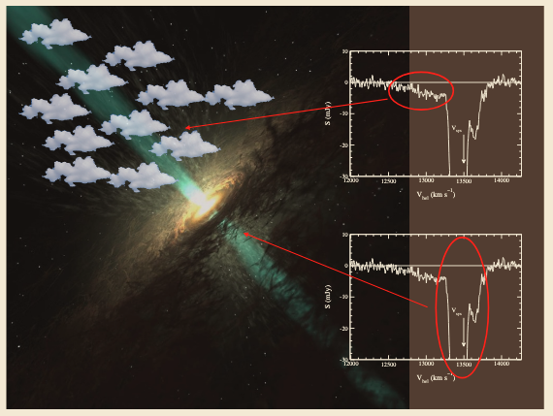
Associated and Intervening absorption
Absorption relies on gas absorbing radiation
Intervening absorption – gas absorbs radiation from some distant continuum source
Associated absorption – gas and continuum source are located in same object

Slide 4
Associated and Intervening absorption
AGN drives gas via outflows – HI is most massive comp
HI absorption is particularly powerful:
  Investigate cold gas around AGN
  Interplay between AGN and host ISM
  Push out to further z and higher spatial resolution

Slide 5
The Grus Quartet
D ~ 23 Mpc
V_disp ~ 40 km/s

Slide 6
The Grus Quartet
NGC 7590
D ~ 23 Mpc
V_disp ~ 40 km/s
NGC 7599
NGC 7582
NGC 7552

Slide 7
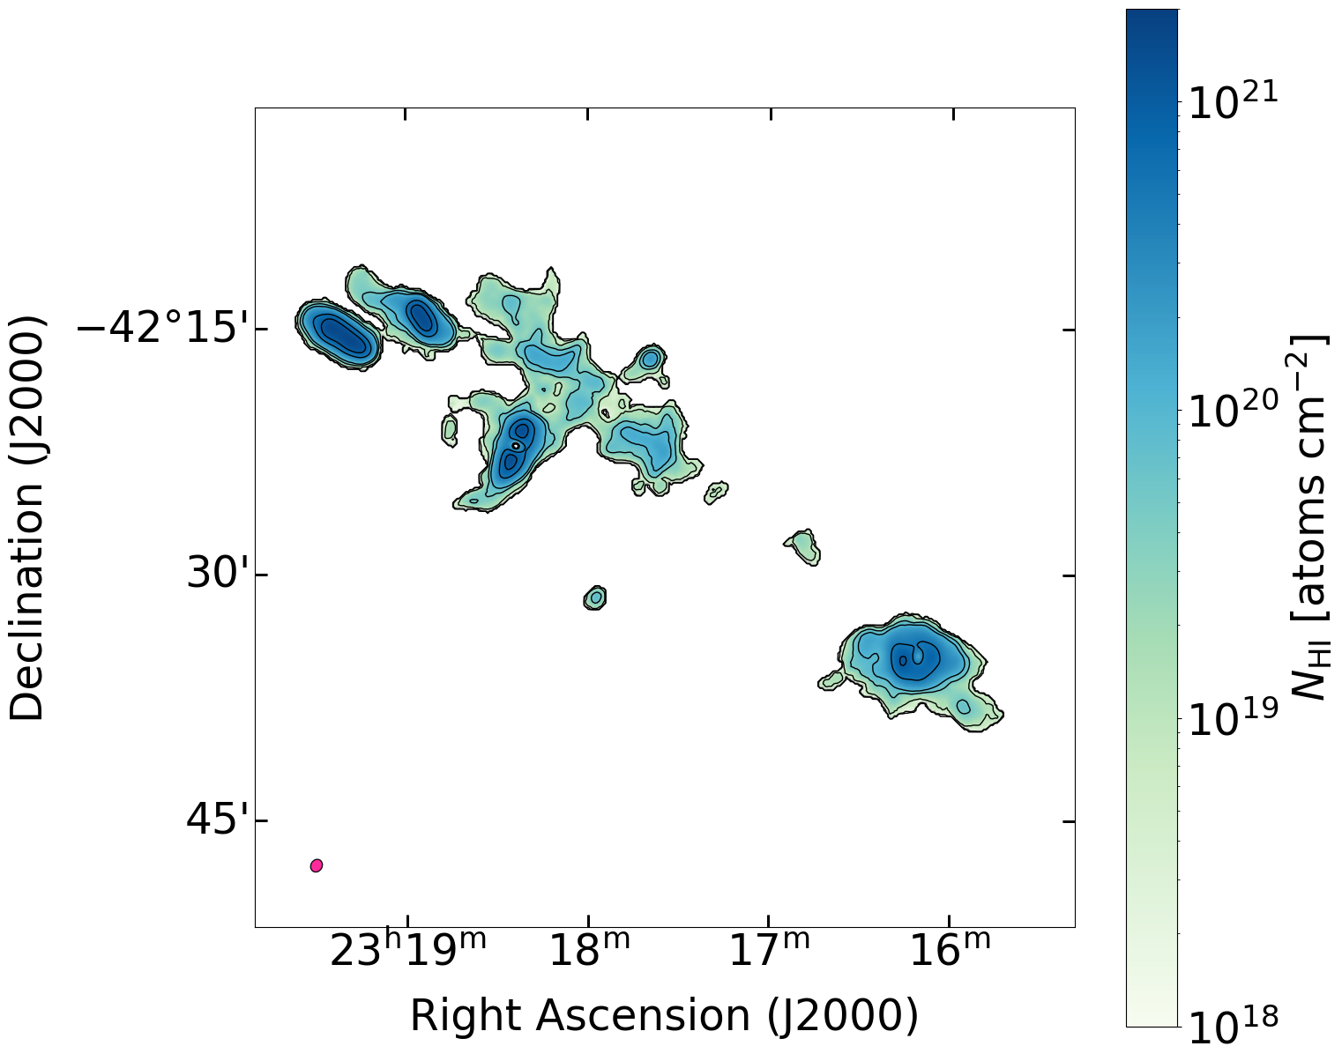
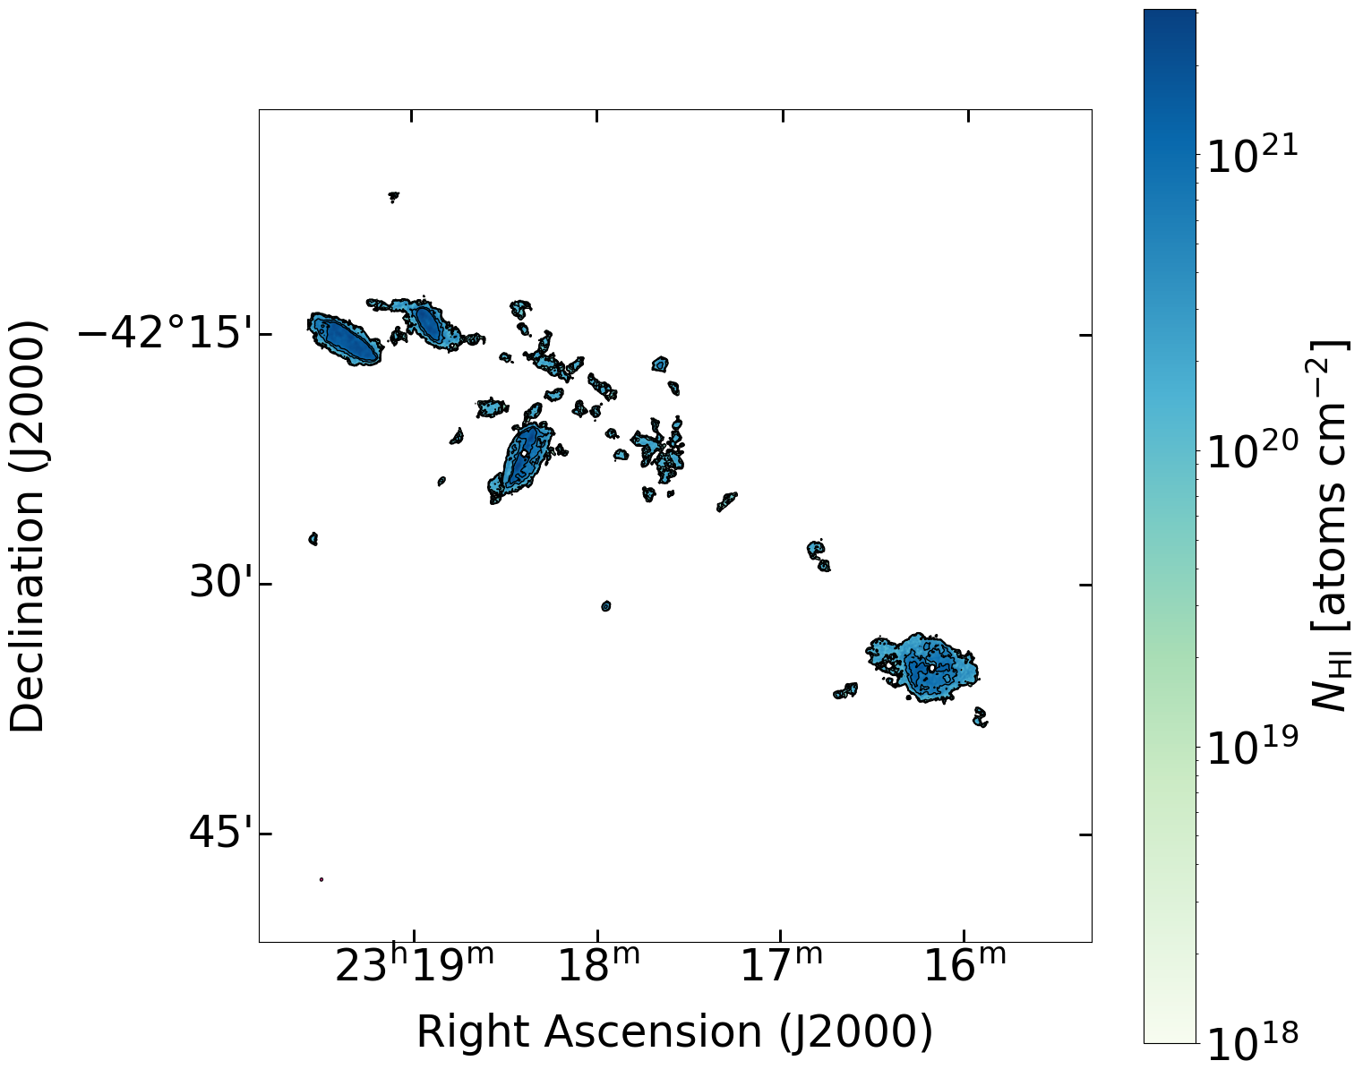
MeerKAT HI data (MeerChoirs)
48” x 41”
11” x 9”

Slide 8
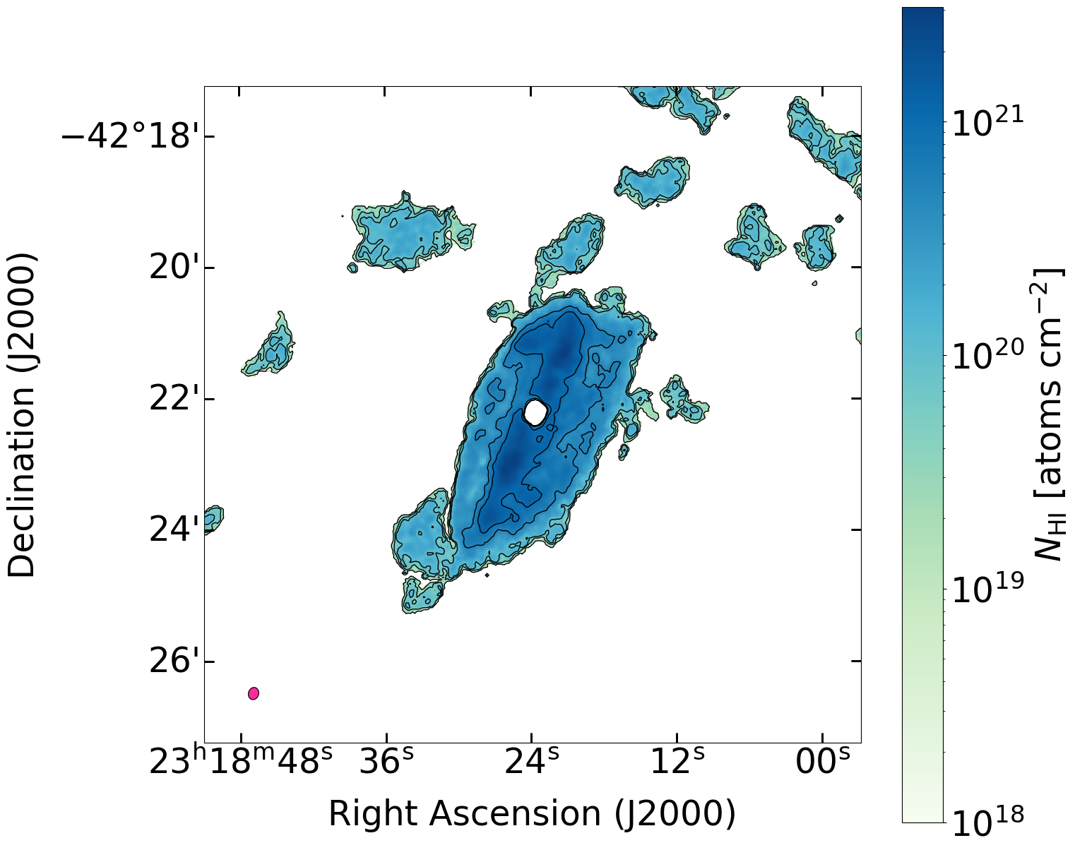
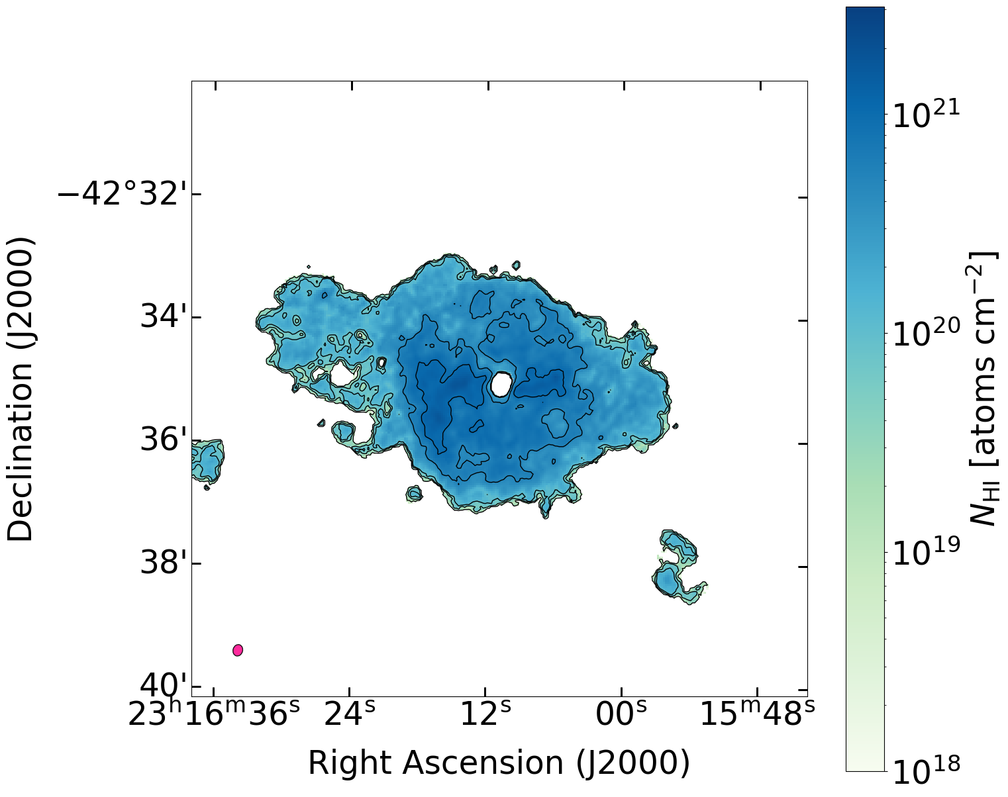
NGC 7582
NGC 7552
Notes:
Make sure that maps are of the emission ad ot get cofused with absorption.

Slide 9
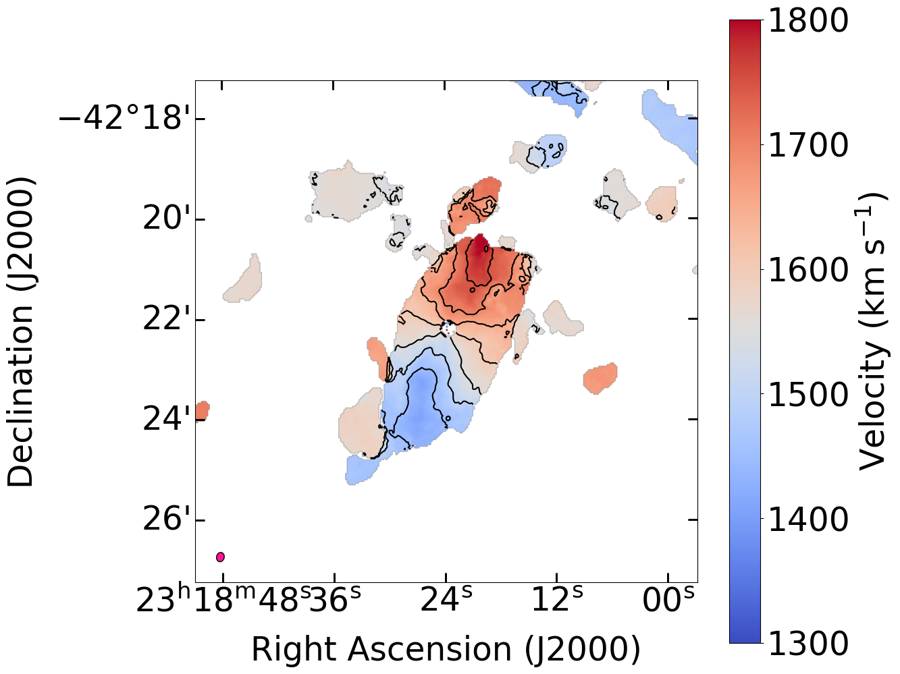
HI absorption in NGC 7582

Slide 10
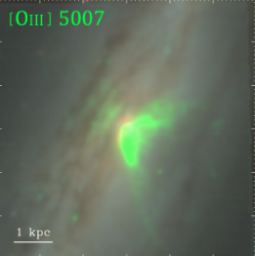
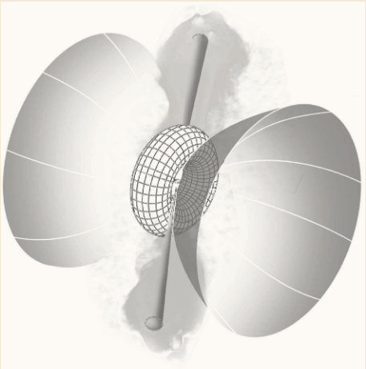
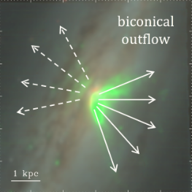
NGC 7582: State of play
Ricci et al 2018
Seyfert II
Compton-thick AGN at its centre.
M_BH = 5.5 x 10^7 M⊙
200 pc circumnuclear ring
Jet+ionization cone model
[OIII] tracing the biconical outflow
Jet+cone model projected onto the sky as seen by observer

Slide 11
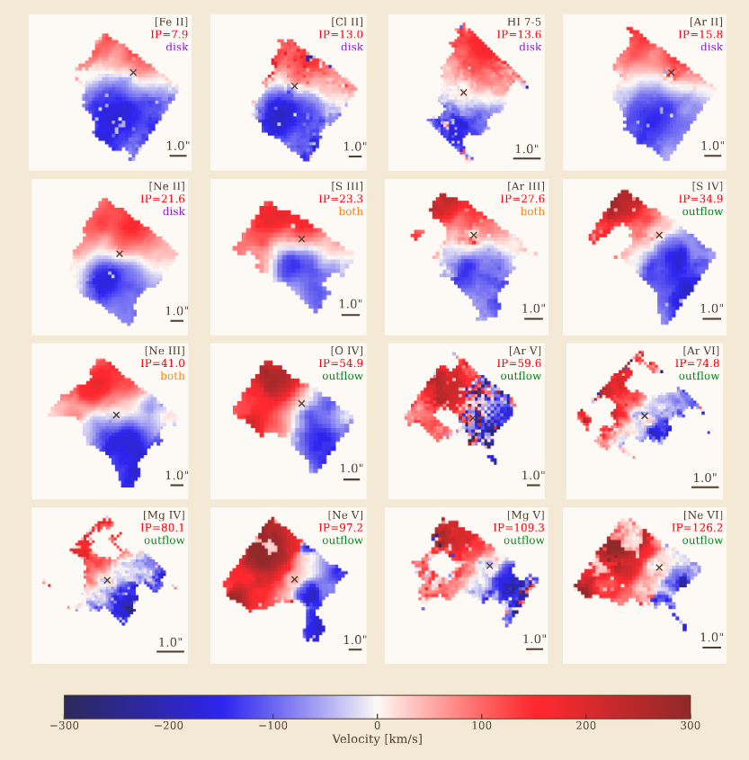
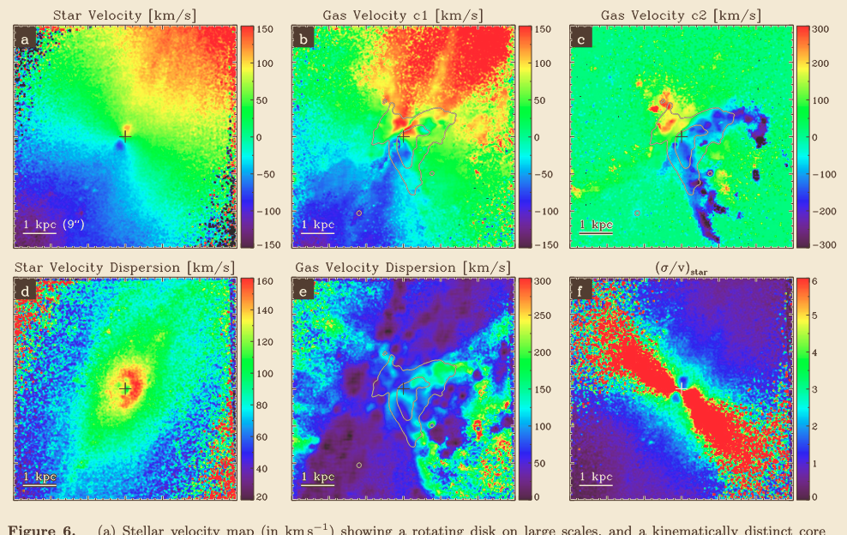
NGC 7582: State of play
Veenema et al 2026
Evidence for a KDC (kinematically distinct core) rotating faster than the galaxy disk
Central region is kinematically stratified
Juneau et al 2022

Slide 12
NGC 7582 and NGC 7552

Slide 13
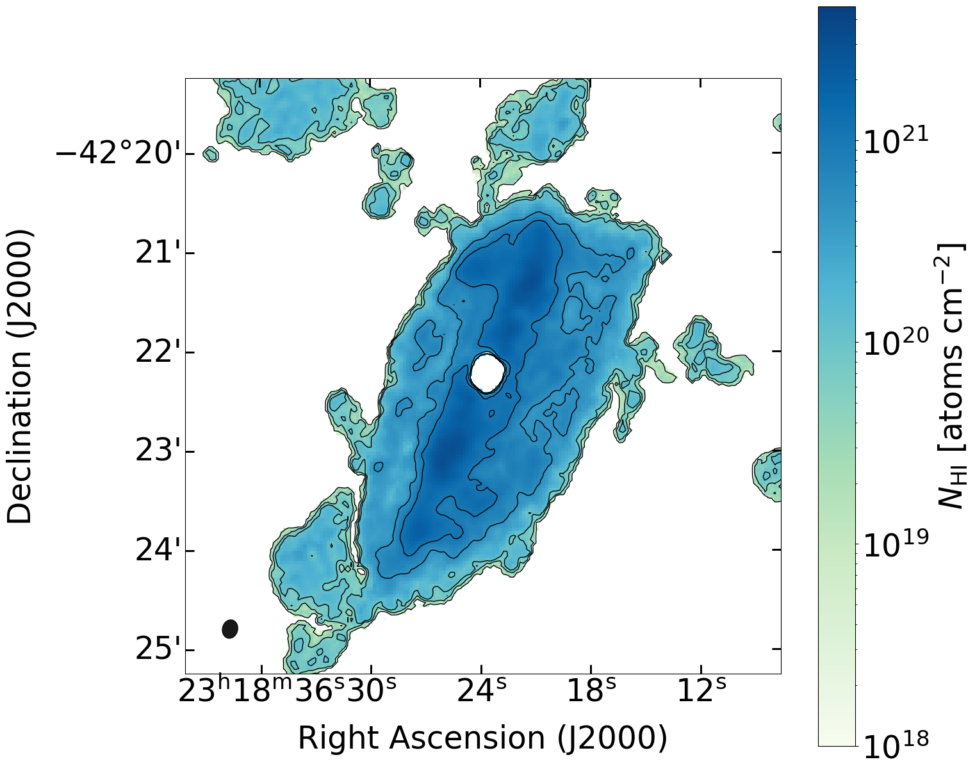
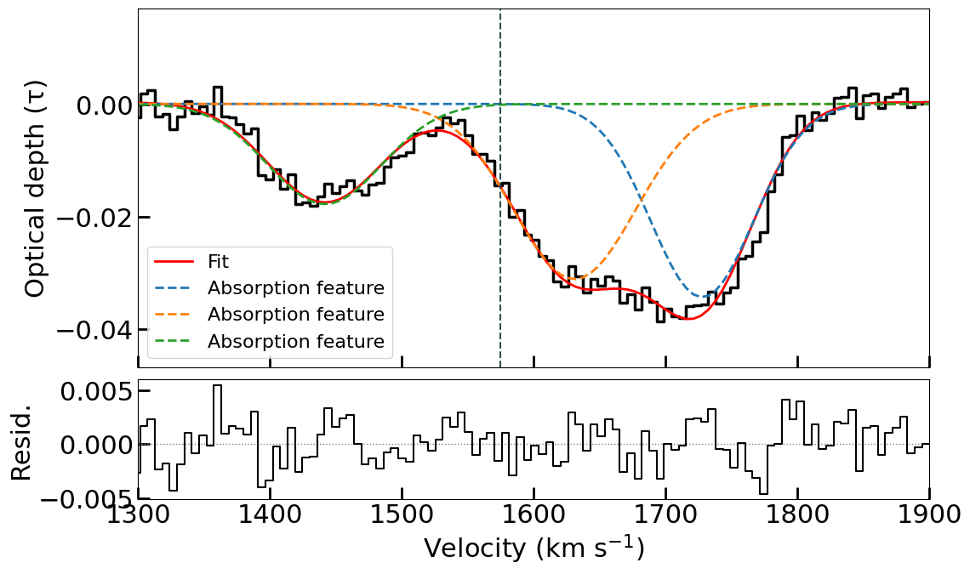
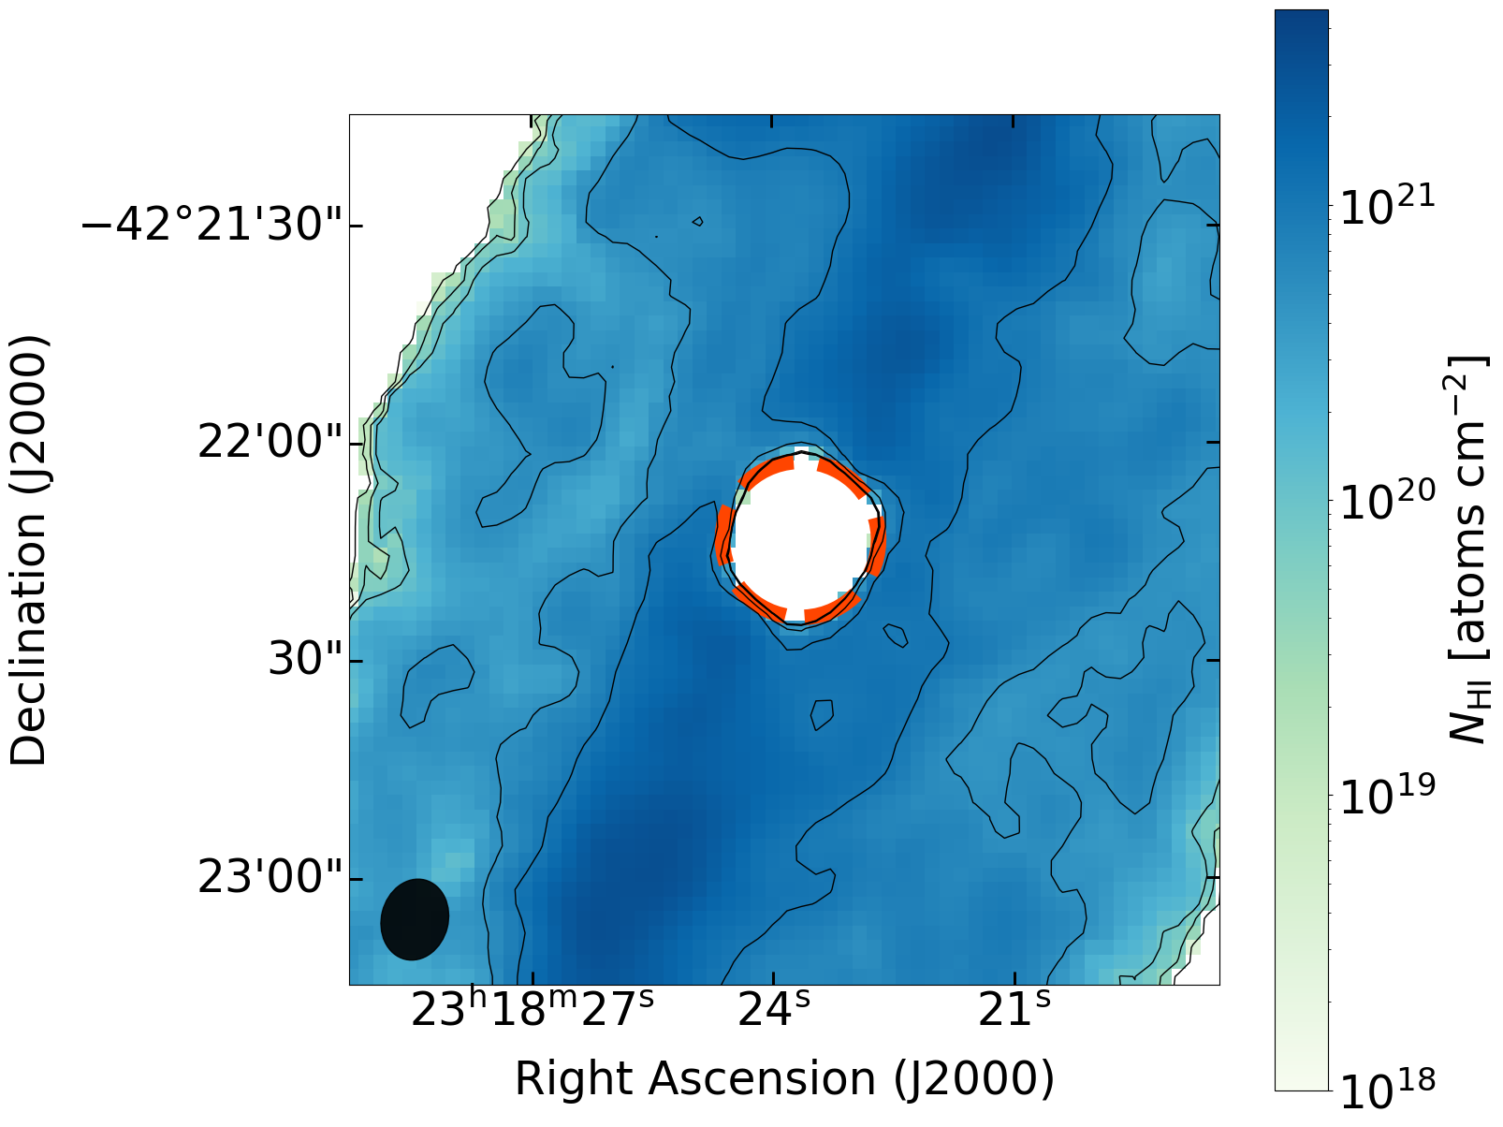

HI absorption in NGC 7582

Slide 14
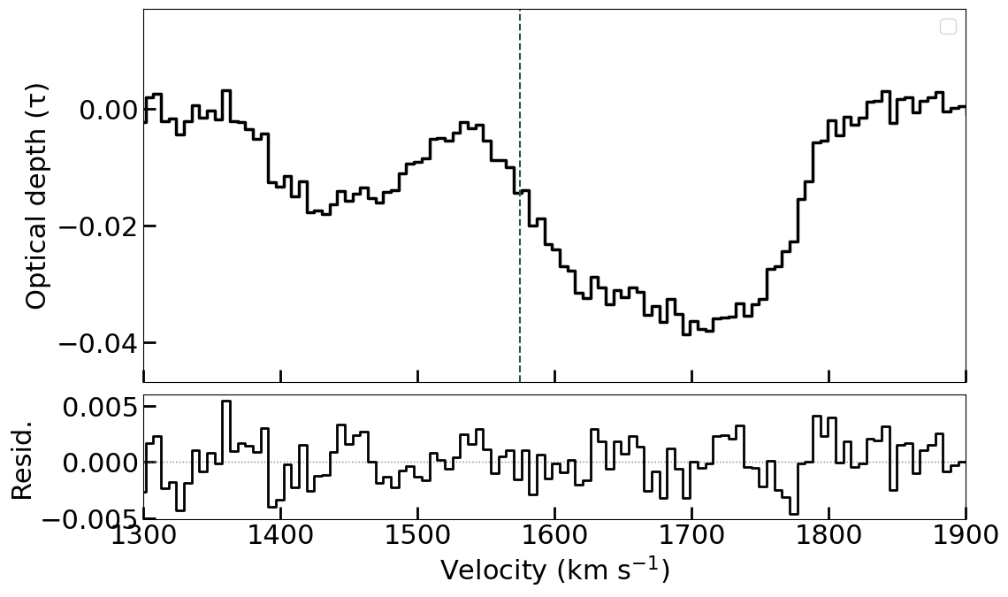
HI absorption in NGC 7582

Slide 15
HI absorption in NGC 7582

Slide 16
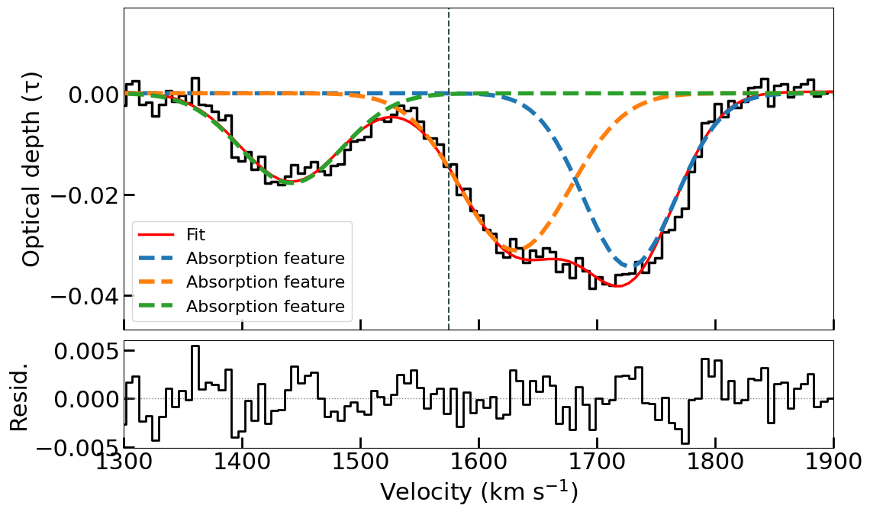
HI absorption in NGC 7582

Slide 17
HI absorption in NGC 7582
133 km/s
153 km/s
56 km/s
Vsys

Slide 18
HI absorption in NGC 7582
Component masses (x10^7 M⊙)
1.25
2.17
2.33
Adopting a spin Temp = 100 K

Slide 19
HI absorption in NGC 7582
Adopting a spin Temp = 100K:

Slide 20
HI absorption in NGC 7582

Slide 21
HI absorption in NGC 7582
Redshifted comp (56 km/s) peaks close to Vsys
Likely tracing a circumnuclear ring
Juneau et al 2022 show that the gas is rotating faster than the stars by ~50 km/s in the inner region

Slide 22
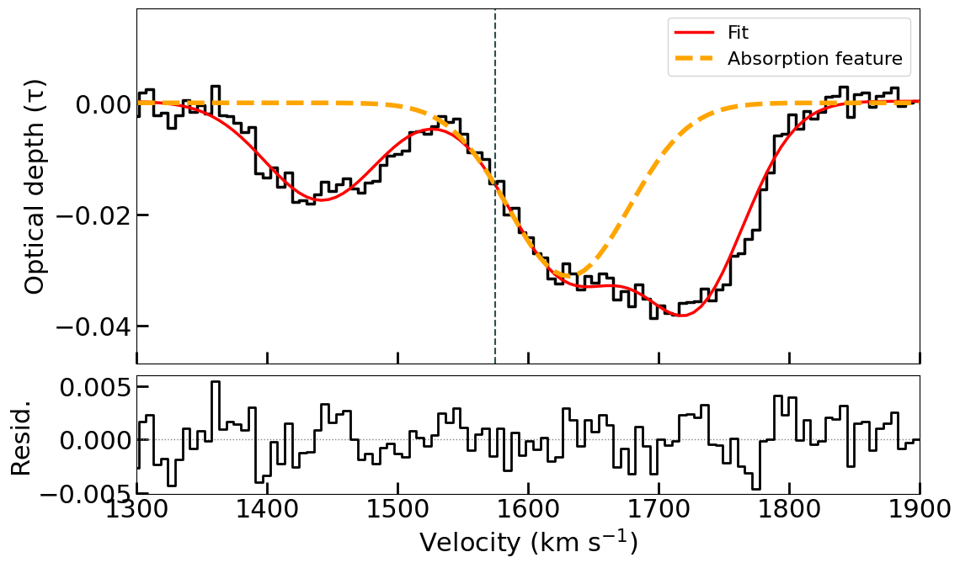
HI absorption in NGC 7582
Redshifted comp (56 km/s) peaks close to Vsys
Likely tracing a circumnuclear ring
Juneau et al 2022 show that the gas is rotating faster than the stars by ~50 km/s in the inner region

Slide 23
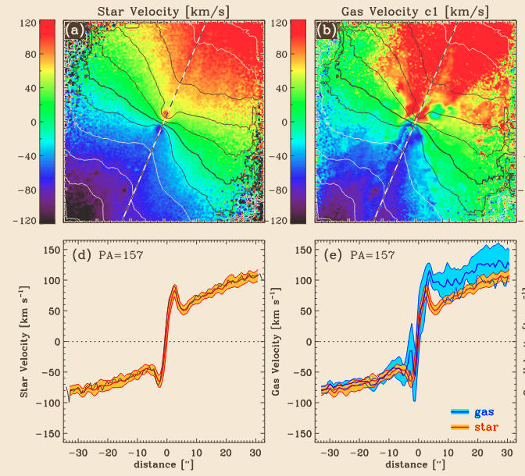
HI absorption in NGC 7582

Slide 24
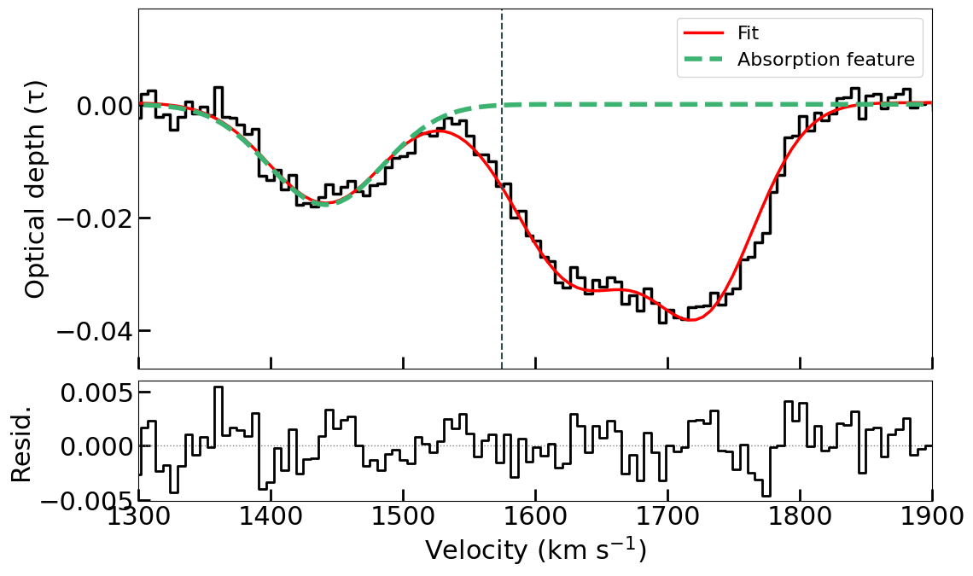
HI absorption in NGC 7582
Blueshifted comp has consistent velocities with outflows in other wavelengths
Typical optical depth for outflows
Peak V ~ 133 km/s
Ionised outflow exceeds V_esc of 580 km/s

Slide 25
HI absorption in NGC 7582
Assume that gas has same origins (200 pc)
Adopt spin Temp = 1000 K
HI mass outflow rate ~ 2.35 M⊙/yr
Ionised gas mass outflow rate ~ 0.05 M⊙/yr

Slide 26
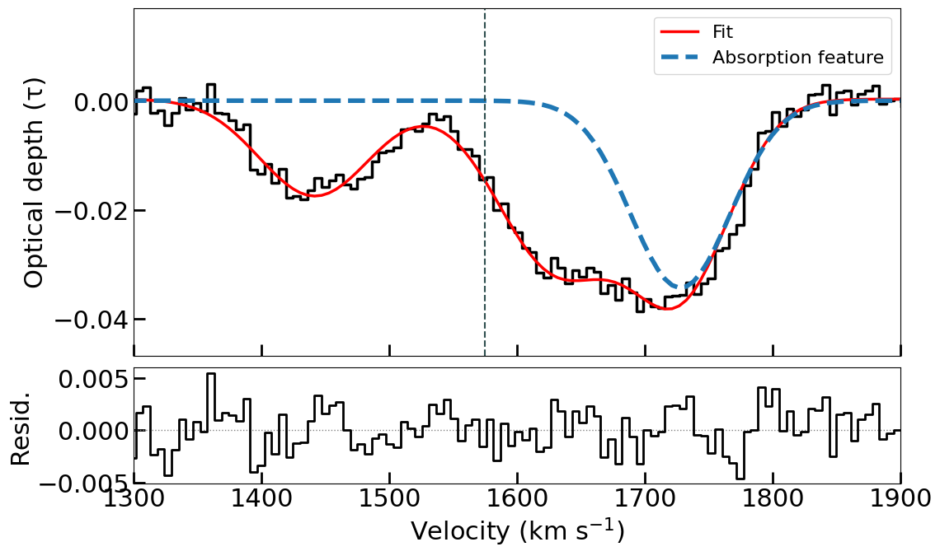
HI absorption in NGC 7582
2nd redshifted comp (153 km/s) likely tracing infalling clouds
Required accretion rate to sustain luminosity: 2.6 x 10^-3 M⊙/yr
Assuming the gas lies at 200 pc SF disk: 16.95 M⊙/yr. Cloud infall rate onto galaxy
Gas can be as far as 1300 kpc along LOS to match required rate

Slide 27
Impact of outflow/ AGN feedback/ Link to high energy

Slide 28
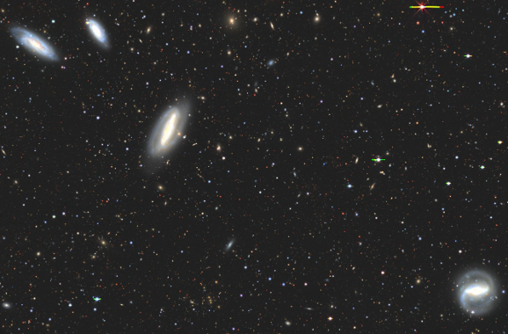
Summary
MeerChoirs MeerKAT HI data reveals the presence of HI absorption in NGC 7582
The absorption profile is complex with multiple gas components along the LOS
Evidence for both an outflow and infalling clouds
A fraction of the HI in outflow may be launched into the CGM or even IGM
The infalling HI could feed the AGN
The AGN may ‘loosen up’ the disk H, making it more susceptible to tidal stripping from group members.
  It is vital to assist the relative importance of internal factors compared to external factors in shaping the HI morphology of a galaxy

Slide 29
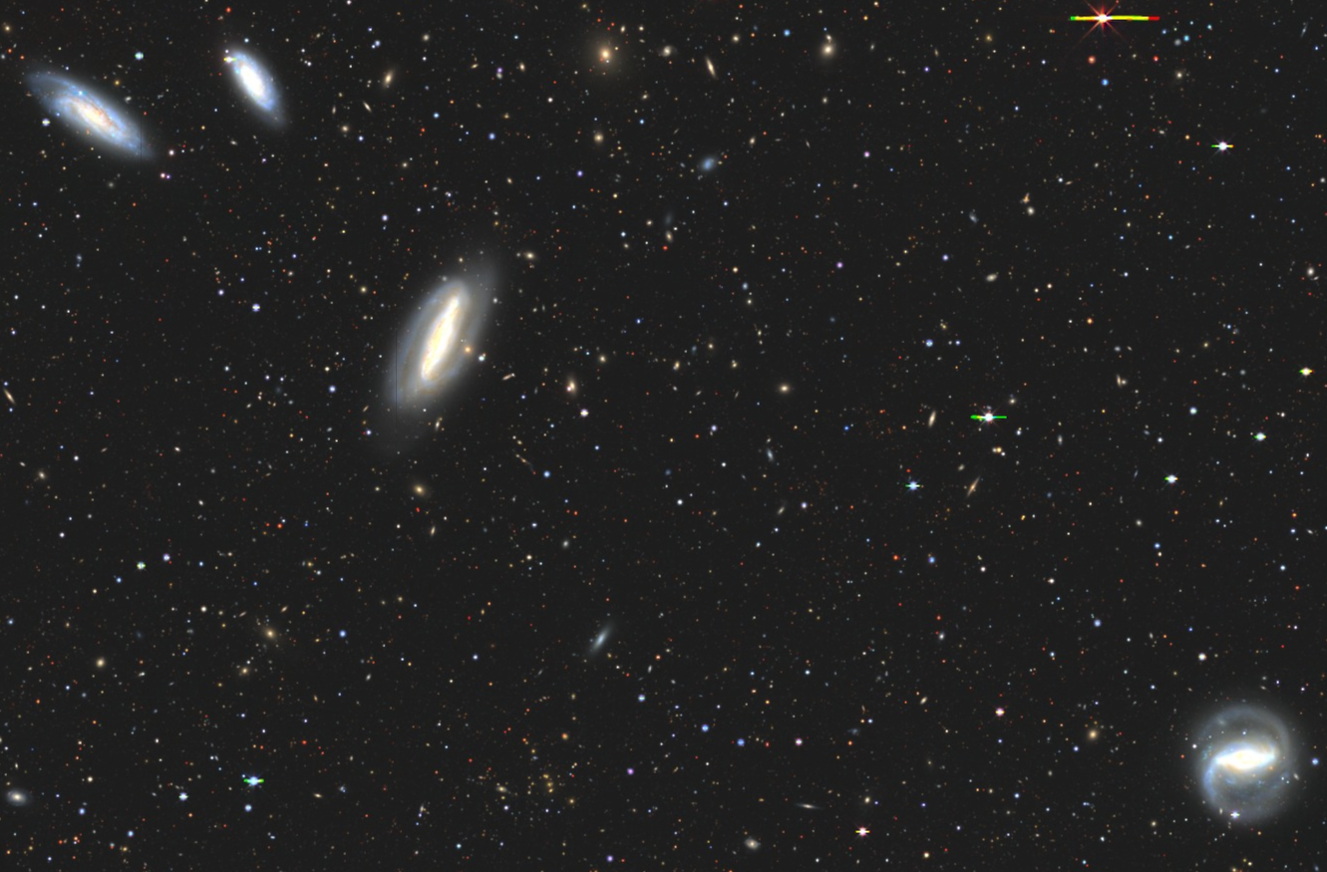
THANK YOU!

Slide 30
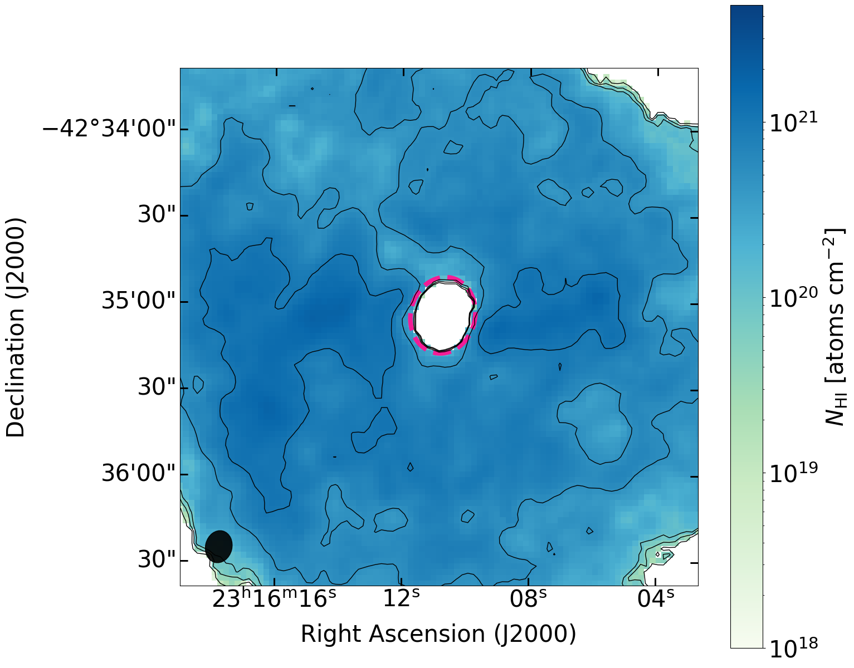
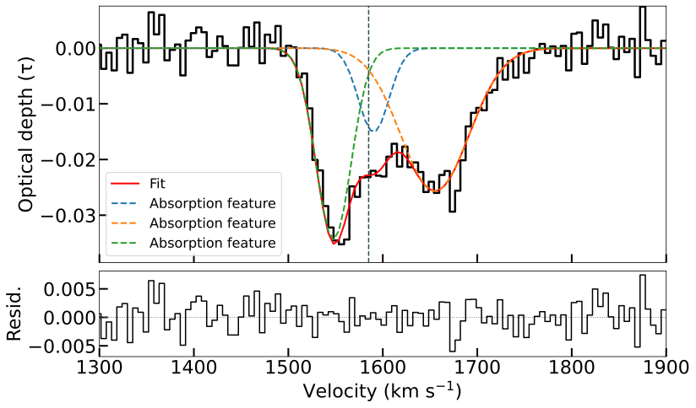
NGC 7552 is also here

Slide 31
HI absorption in NGC 7582

Slide 32

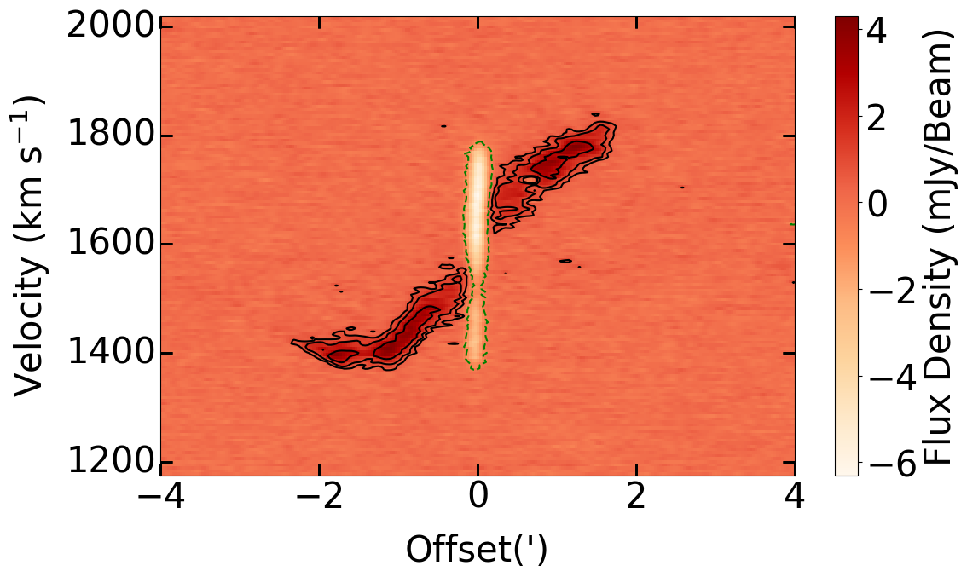
HI absorption in NGC 7582

Slide 33
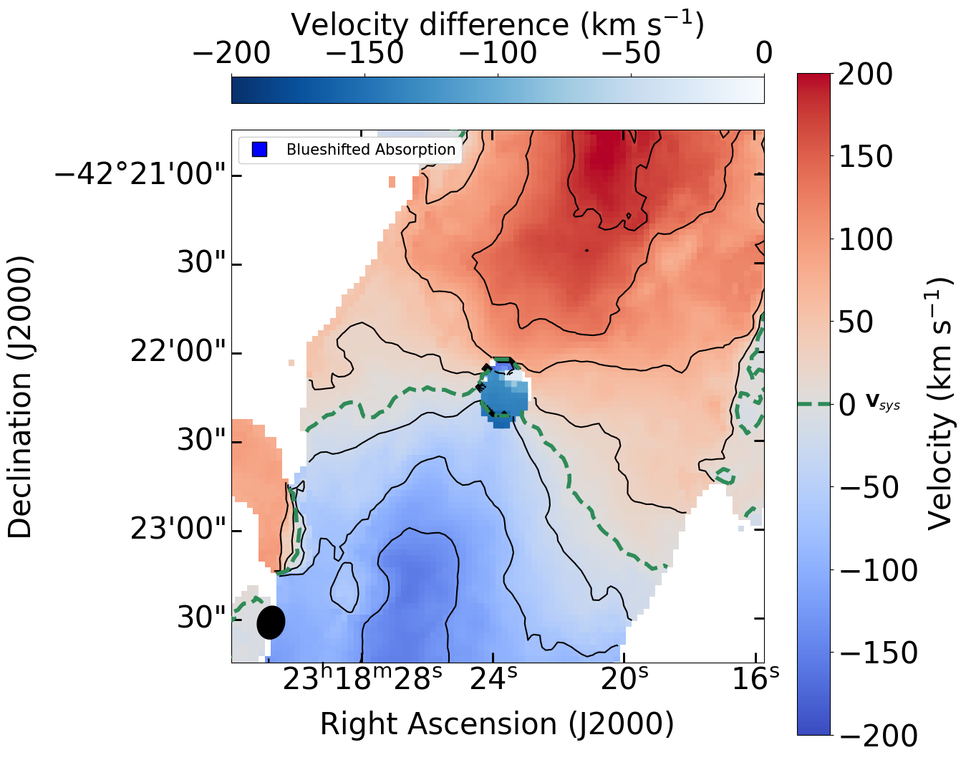
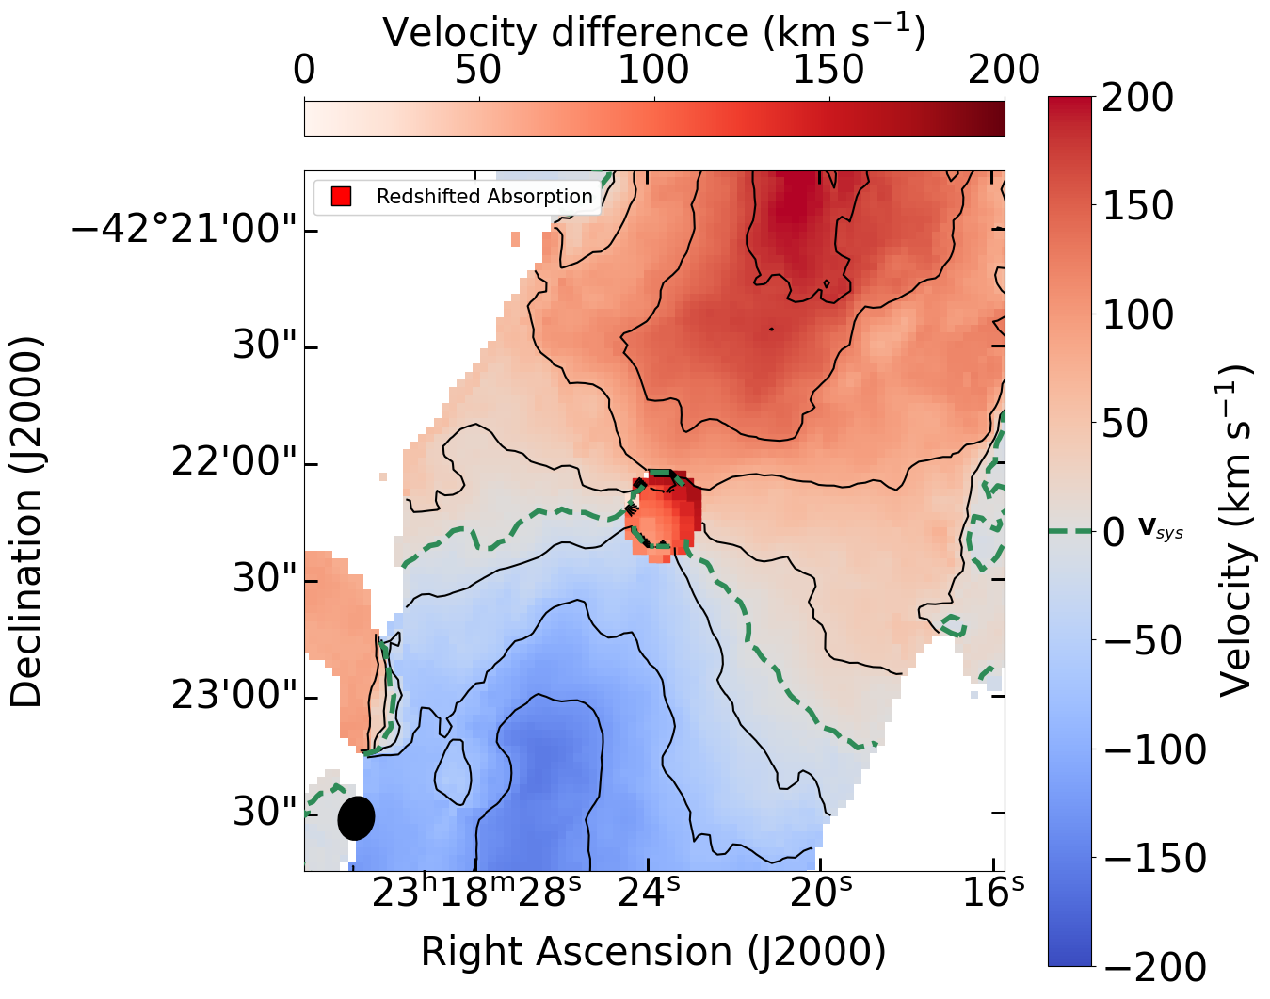
HI absorption in NGC 7582

Slide 34
