Slide 1
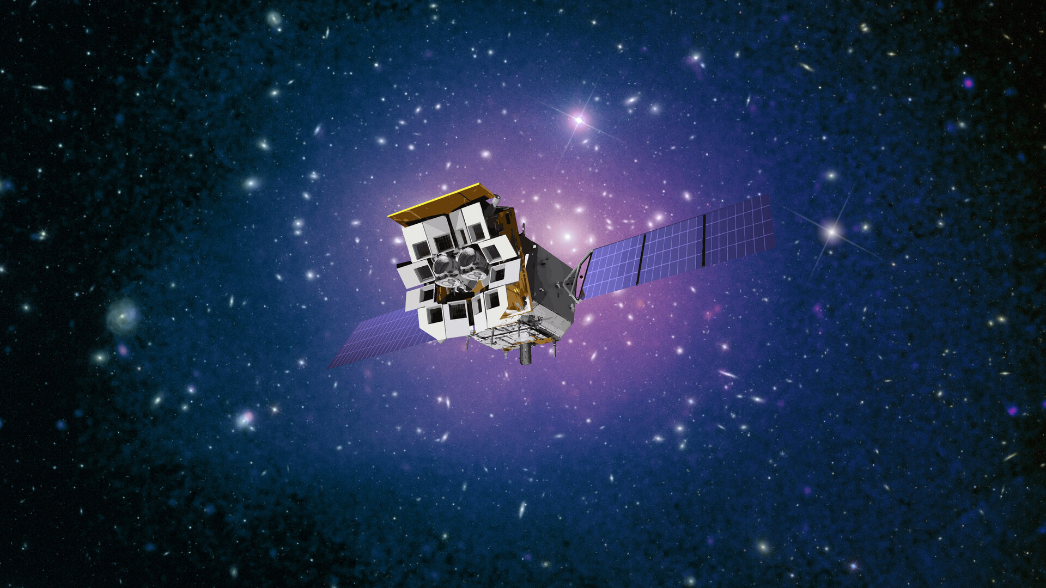



Einstein Probe: Exploring the dynamic X-ray universe
David Buckley & Weimin Yuan
National Astro. Obs.，CAS
Image credit CAS/ESA
1
Notes:
EP is a space mission to monitor and explore the X-ray sky.
It is led by CAS, in collaboration with ESA, MPE and CNES.
The satellite is complicated as there are 14 telescopes onboard,
12 X-ray monitors (WXT) to make a large FoV, and 2 telescopes for deep observations.
EP was launched in January 2024, and started science operations from July the same year.

Slide 2
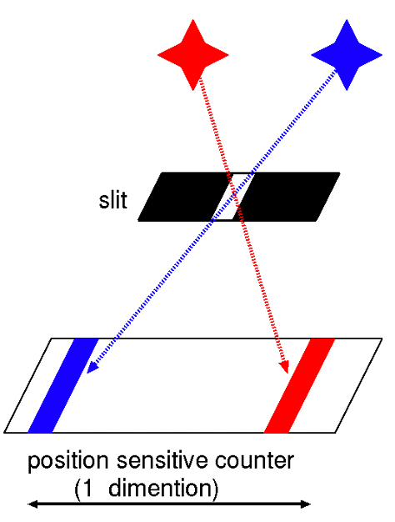
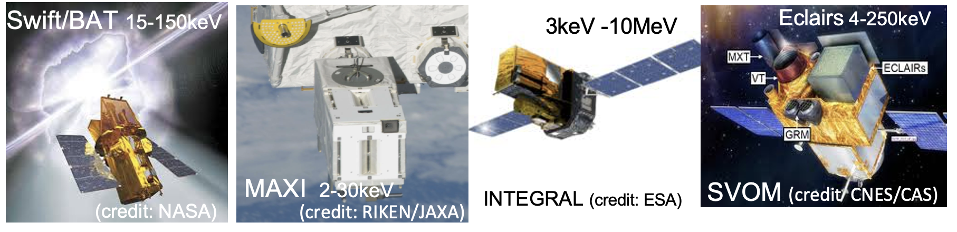

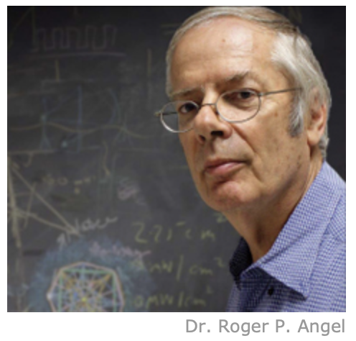
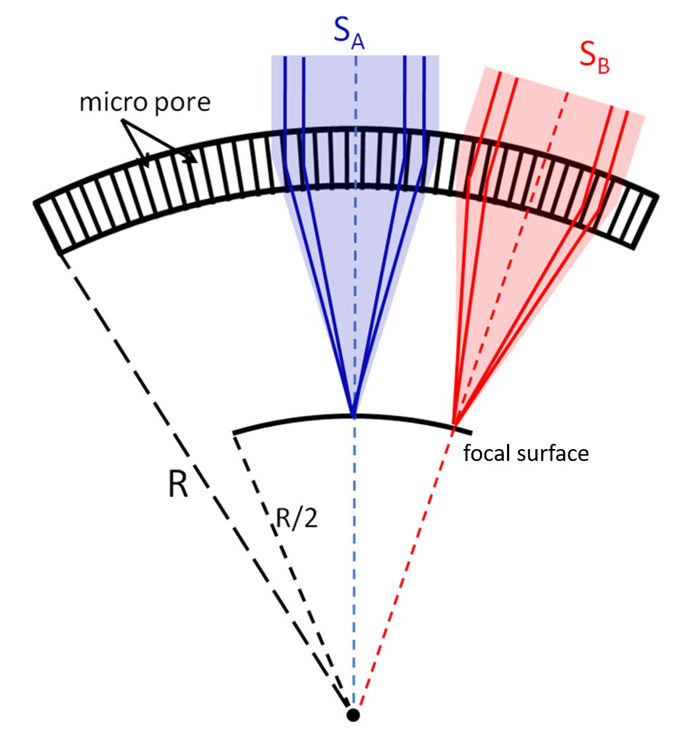
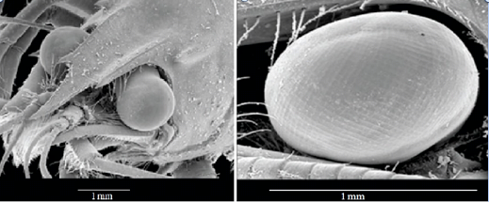
Operative X-ray all-sky monitors before EP
Conventional X-ray ASMs
  non-focusing (coded mask, slit camera)
  bottleneck in sensitivity & resolution
  no soft X-ray coverage (E < a few keV)
Lobster-eye Micro-Pore Optics (MPO) (Angel R. 1979)
  Focusing imaging while keeping large FoV
Dr. Roger Angel
FoV
grazing incidence reflection
Notes:
Currently we have several ASMs operating, Swift/BAT, MAXI, INTEGRAL, all in hard X-ray and gamma-ray.
These instruments use the technologies of either coded-mask, or pin-hole or slit camera,
which cannot focus the incoming X-ray light.
The current instruments almost reach the maximum performance that the conventional technology can possibly offer.
It is difficult to further improve sensitivity dramatically.
New technology …

Slide 3

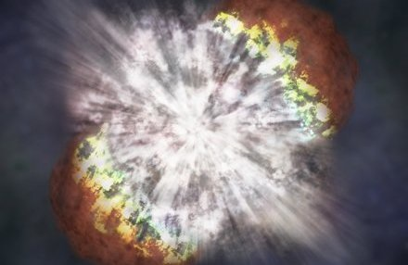
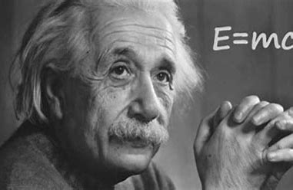
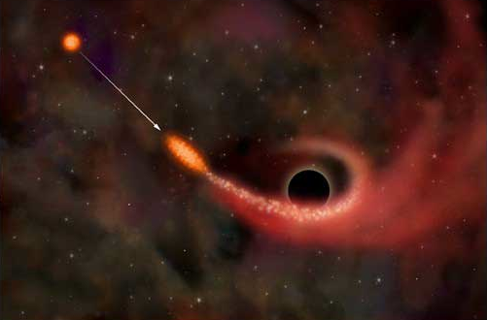
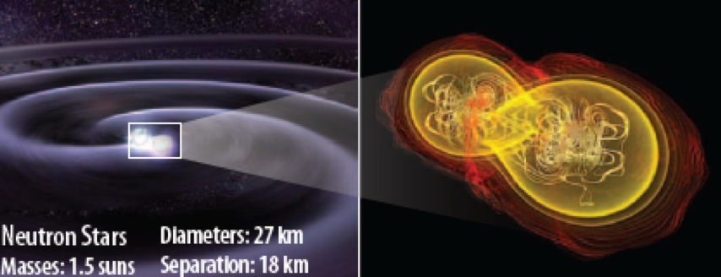
Core science objectives of EP
Systematic survey of transients and source variability in the soft X-ray band with unprecedented combination of sensitivity and cadence
Discover normally quiescent black holes and other compact objects by capturing their transient X-ray flares
Detect and localise the potential X-ray sources of gravitational wave events

Slide 4
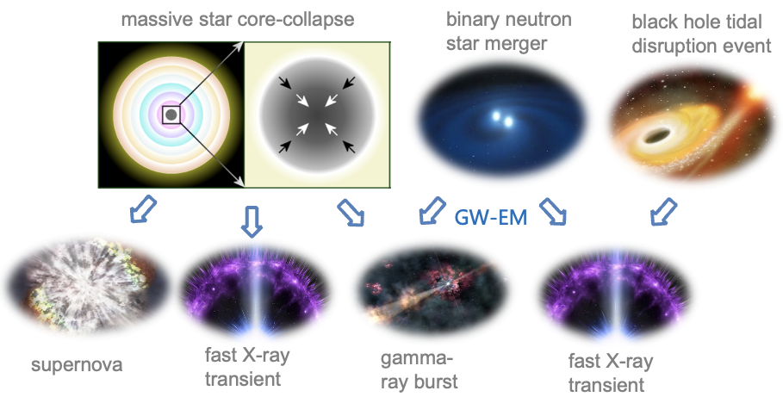
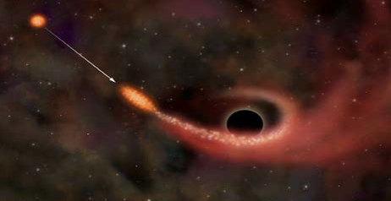
X-ray is important for observations of transients
reprocessing & kinetic E
non-relativistic
optical
jetted
normal star -TDE
WD-TDE
X-ray
optical
X-ray
gamma-ray
IR/optical/UV
kilonova
long X-ray transients
radio-active decay & kinetic E
non-relativistic
in-between?
choked jet?
weak jet?
shock breakout
powered by jet, extreme relativistic
powered by central engine?
powered by
central engine

Slide 5
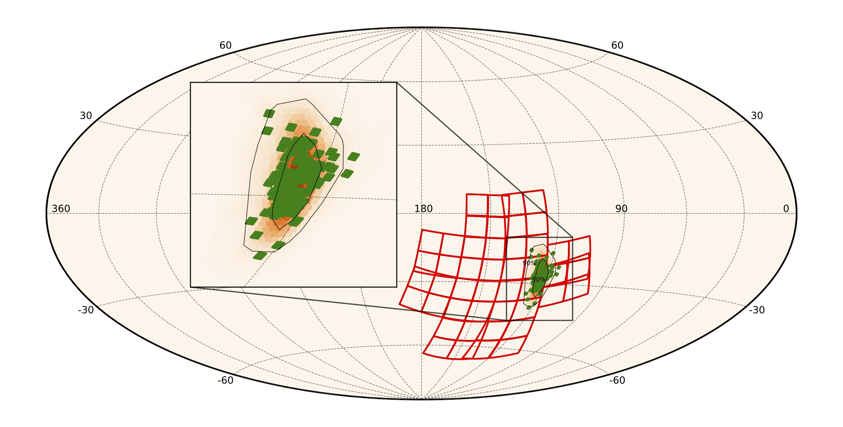
Search for X-ray counterparts to GW events
Search for X-ray counterparts to GW events
  Only GW170817 so far
  Counterparts of NS-BH never detected
Advantages of EP
  X-rays from newly formed magnetar
  WXT: large FoV, good sensitivity
  FXT: rapid/flexible response, 1deg FoV
Provide precise time/position for off-line search of weak GW signals

Slide 6
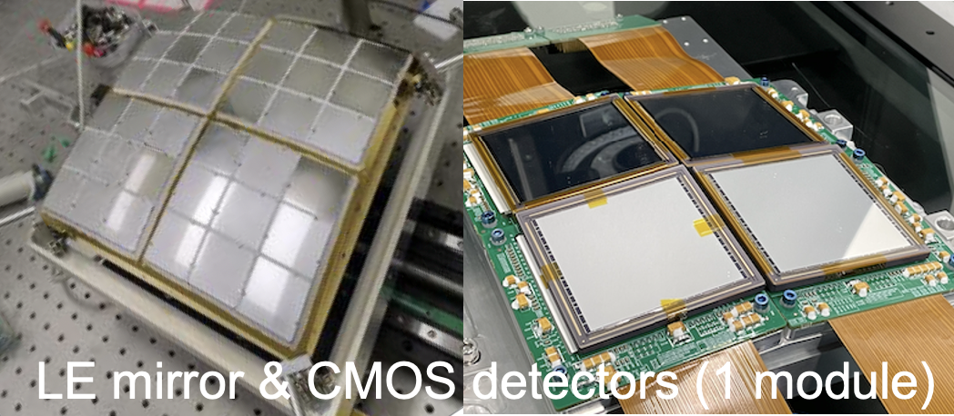

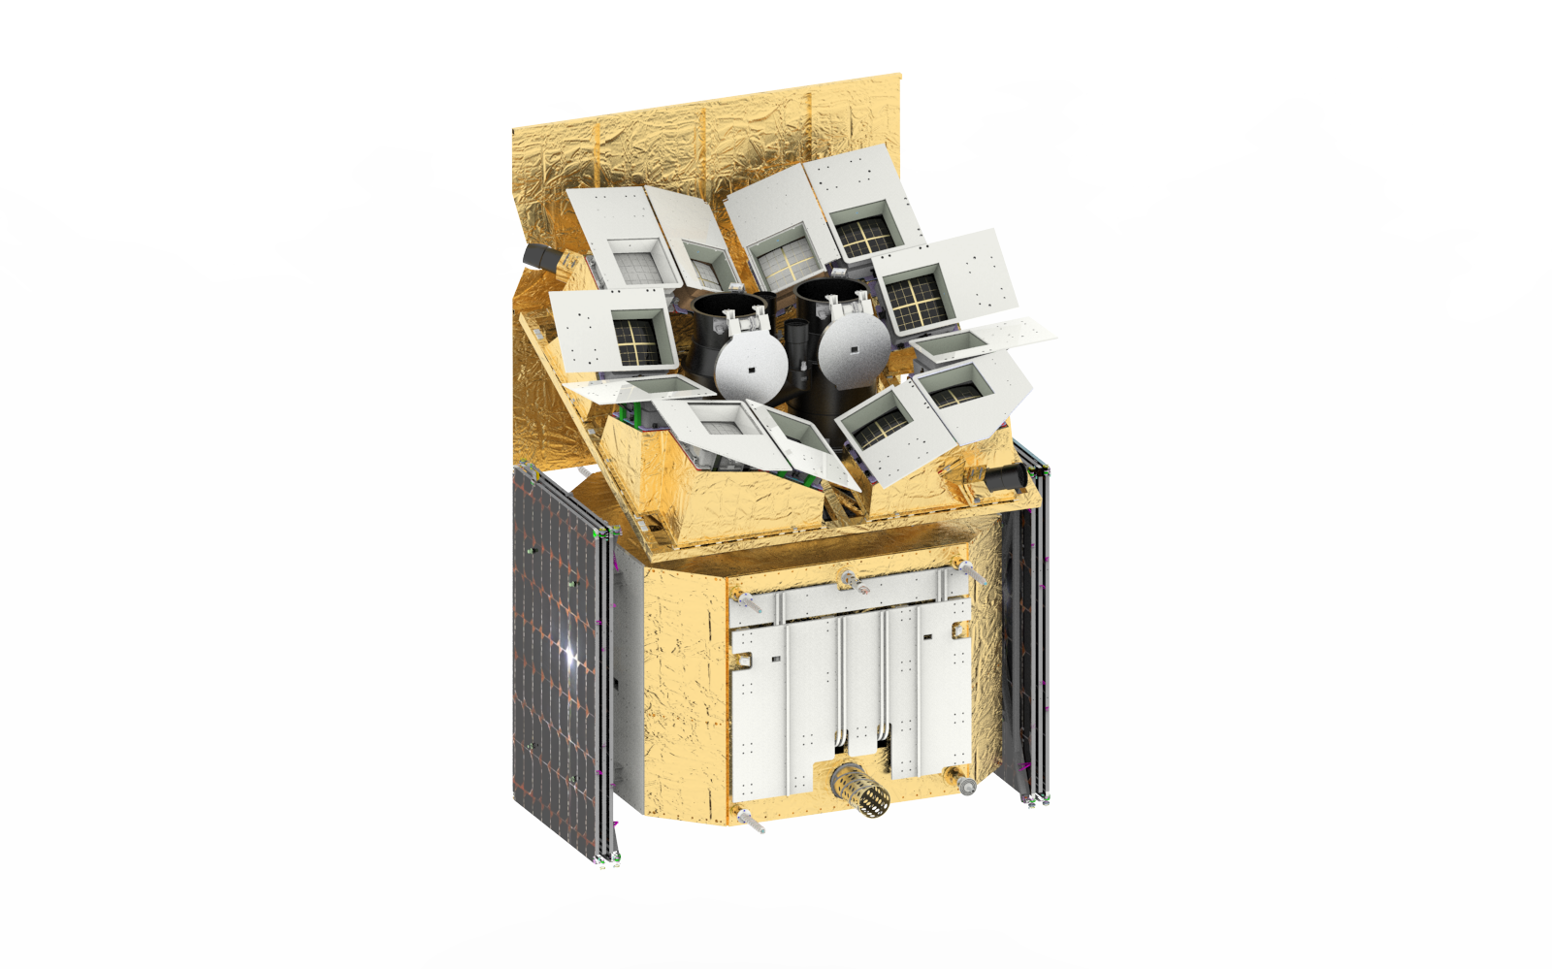

Einstein Probe: instruments & key features
Wide-field X-ray Telescope
WXT (12 modules)
LE MPO focusing imaging optics + CMOS
0.5 – 4 keV
large FoV: 3800 sq. deg. (9.2% all-sky)
unprecedented sensitivity
source localization: 2-3 arcmin
Fast satellite-ground 2-way communications in minutes
Fast alert dissemination
Fast ToO observations
Follow-up X-ray Telescope
FXT (2 units)
Chinese Beidou system
VHF network
Science data telemetry (hours)
Wolter-1 telescope (2/7 eROSITA)
0.3 -10keV
FoV: ~1 deg
effective area: : ~300 cm² @1keV (x 2)
source localization: 5-8 arcsec

Slide 7
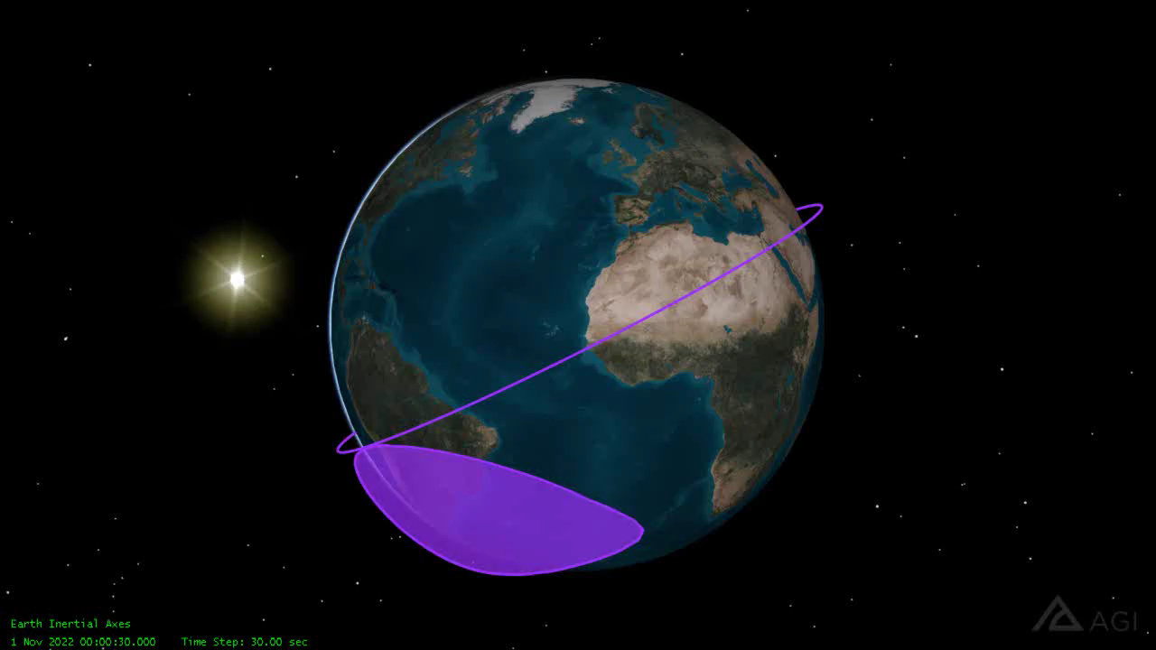
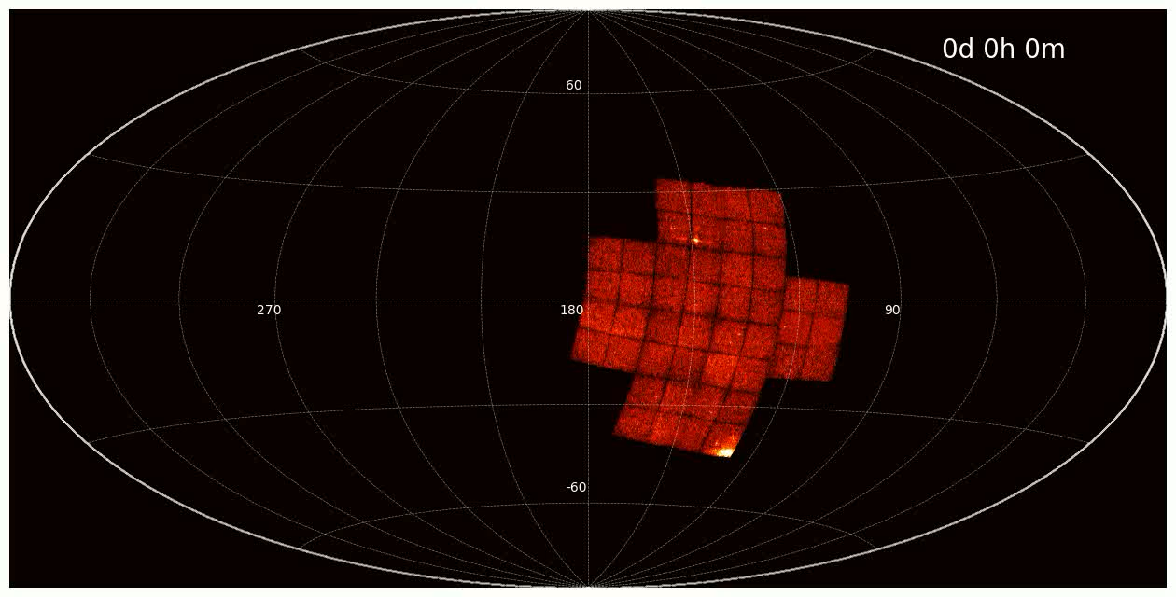
Complicated operations, satellite-ground 2-way communications
Observation modes
  Survey (WXT)
  Autonomous follow-up (FXT)
  quick alert downlink (minutes)
  ToO – quick upload (<10min)
WXT survey
  3 pointings per orbit, ~1000s each
  Night sky covered in 3 orbits (~ 5 hr)
  Whole sky in ½ year
  FXT pointed to pre-selected targets
orbit: 570 km
96 min
WXT 1-day
data taking
Equatorial coordinates
Notes:
~ 45 snapshots per day
FXT survey target observation (FSTO)

Slide 8
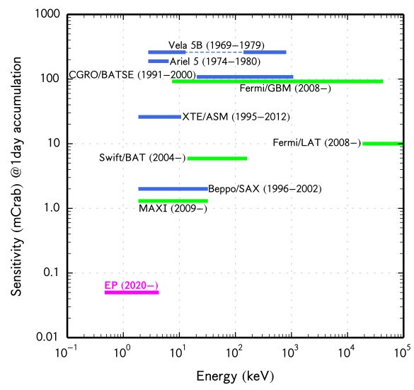
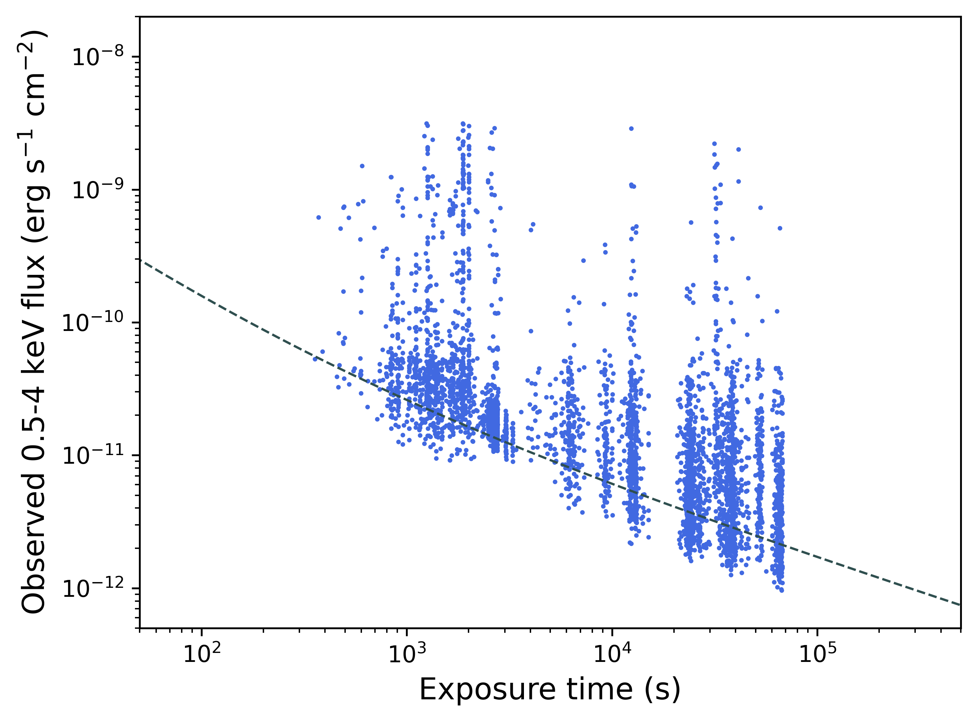
Sensitivity of WXT
snapshot
survey
mode
EP(2024-)
1 orbit pointing

Slide 9
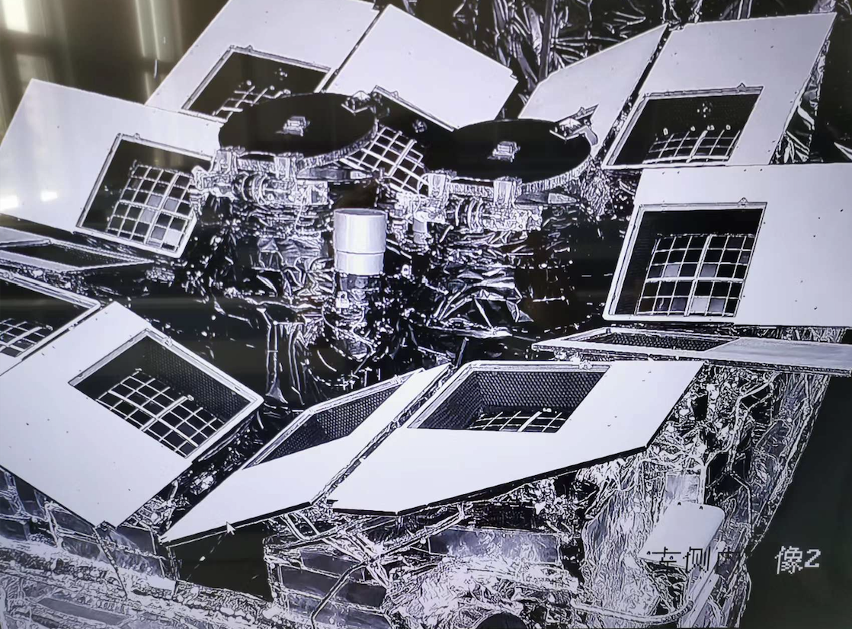
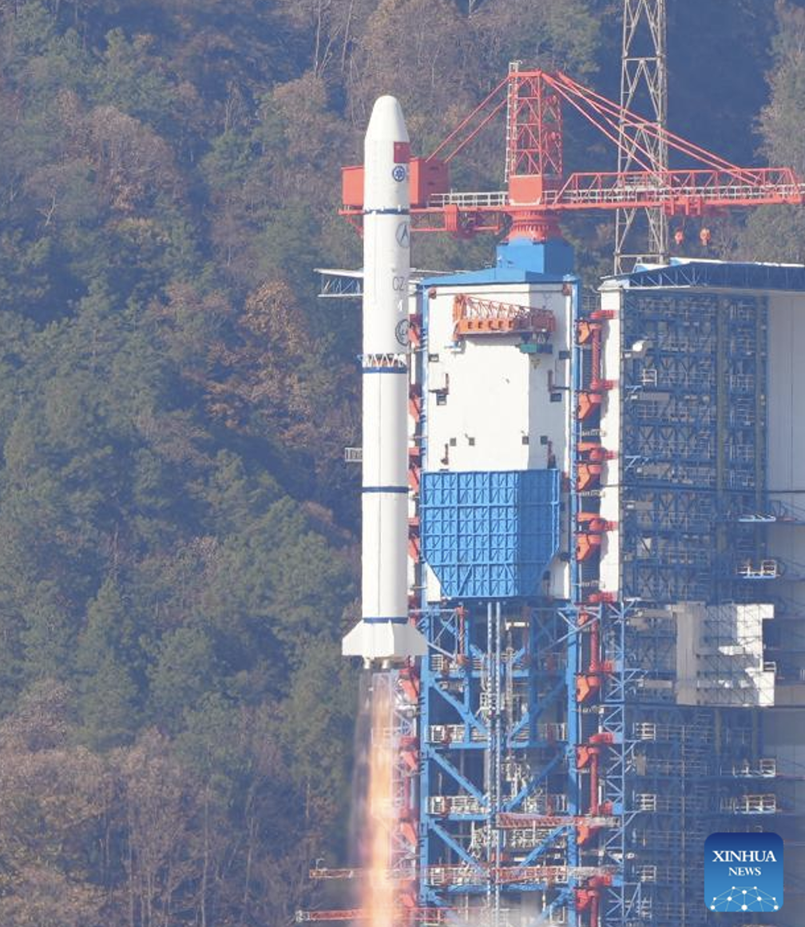
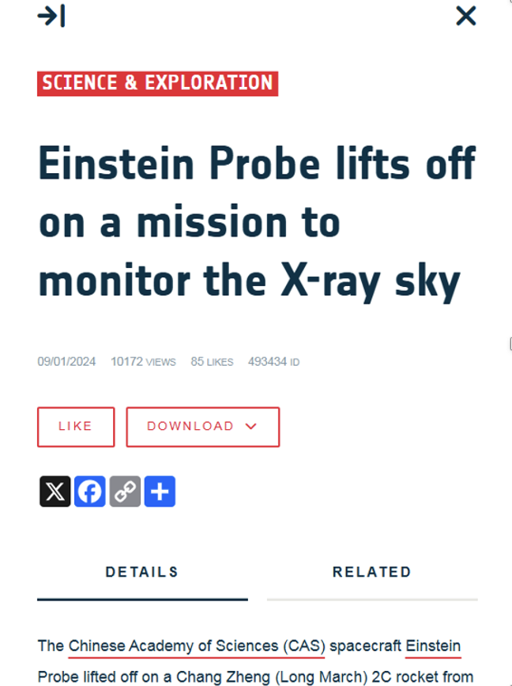
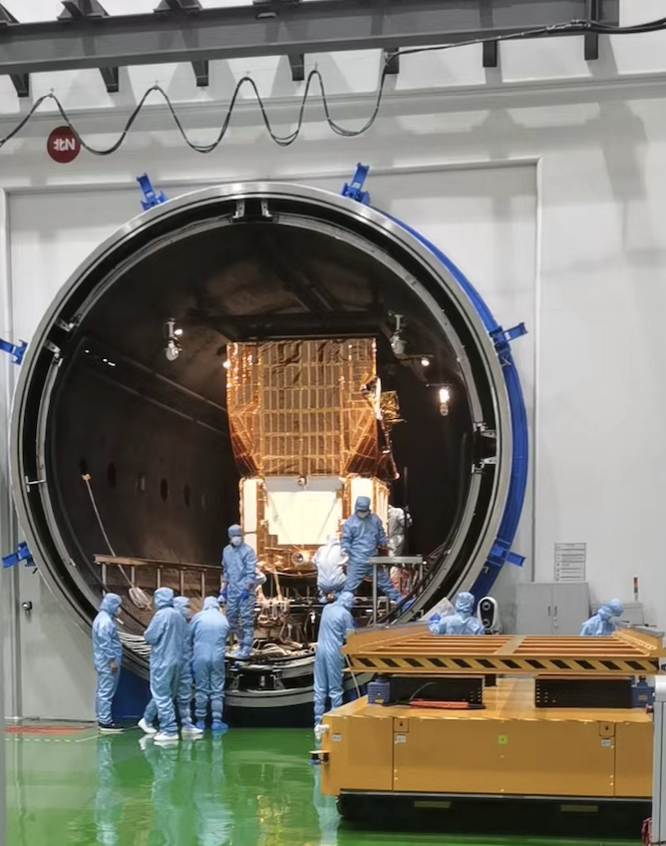
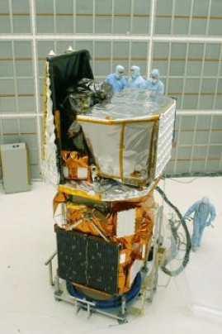
Einstein Probe: instruments & key features
launch: 2024/1/9 @Xichang
operations: 2024/7
(credit: CAS)
Swift 1,470kg
EP 1,435kg
(credit: CAS)
(credit: NASA)

Slide 10
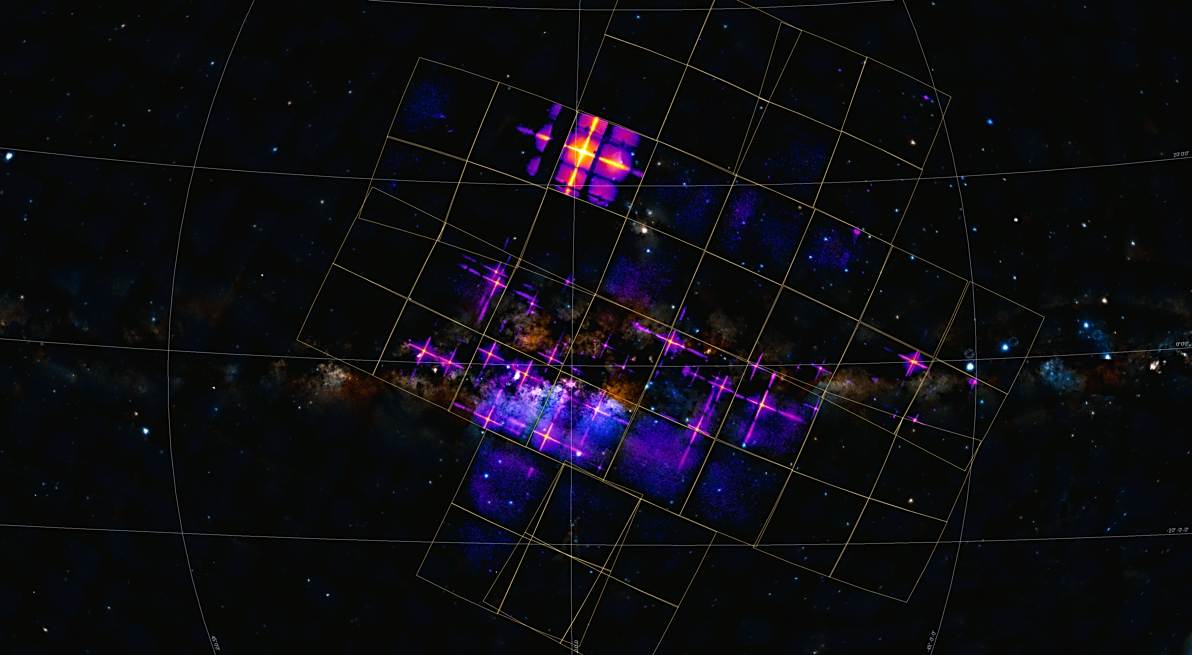
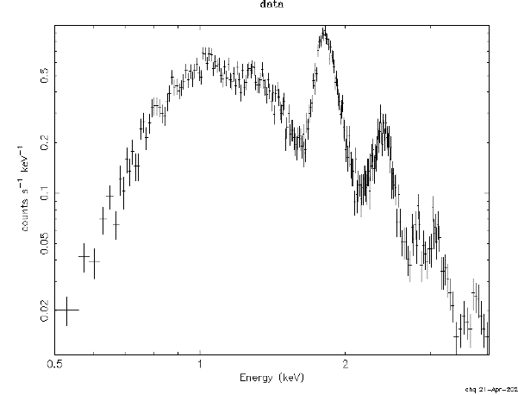

WXT first-light image (0.5-4keV) – first focusing imaging with very large FoV ever achieved
Galactic centre region (purple, red, yellow)
WXT FoV 3850 sq. deg.
exposure 40 kilo-seconds
9.3°
2
9
3
6
4
1
10
1: Cir x-1 and Swift J151857.0-572147
2: Sco X-1
3: V2216 Oph
4: V1101 Sco
5: V821 Ara
6: NP Ser
7: V4134 Sgr
8: Sgr X-4
9: Lupus SN
10: SNR RCW 86
Si He 1.83
7
5
S He 2.41
8
Counts/sec/keV
X-ray spectrum of Cas A (SNR)
$Δ$E ~ 122eV @1.25keV
Energy (keV)
credit: EPSC

Slide 11
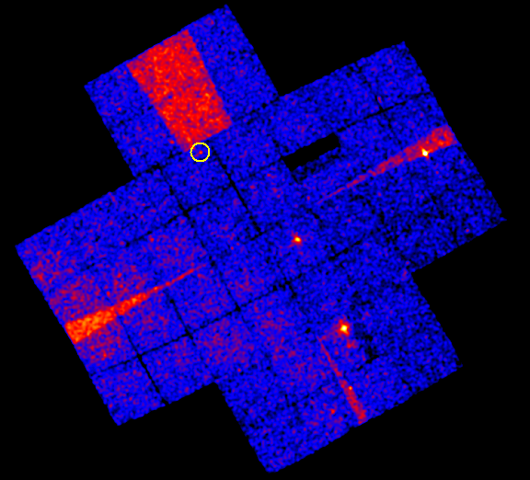
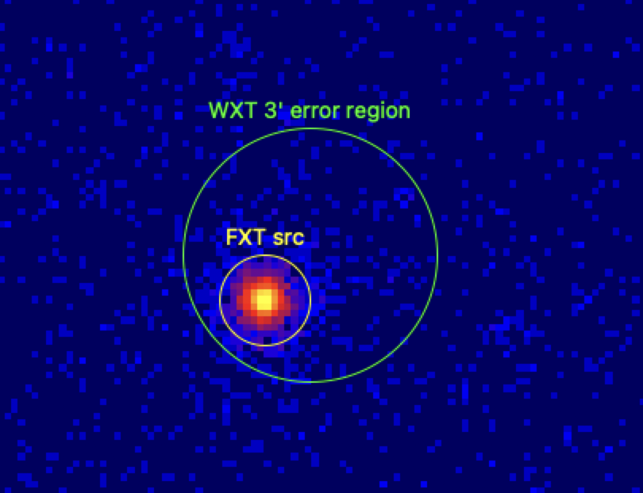
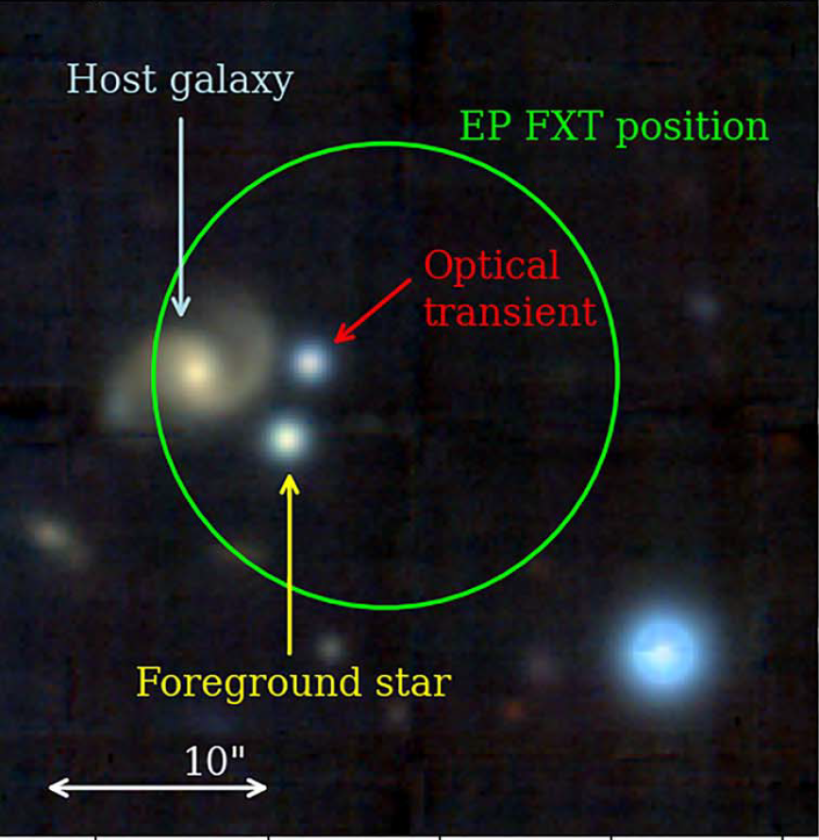
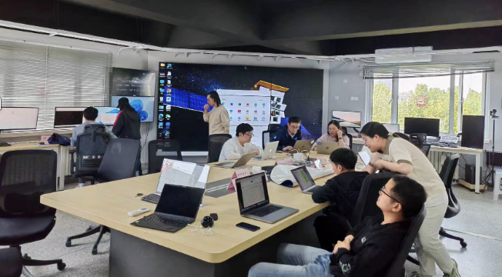
WXT monitoring survey + FXT automated follow-up
WXT obs. and onboard search
FXT automated follow-up
multi-waveband follow-ups
WXT X-ray image. 3600 sqr. deg.
FXT X-ray image
identification of optical/IR counterpart
expo 3.6 ks
WXT position error 2’-3’
FXT error radius: 5-8 arcsec
several minutes
EPSC @ NAOC/CAS
van Dalen et al. 2025
transient alert downlinked to EPSC and
automatically disseminated via GCN/notices
in minutes

Slide 12
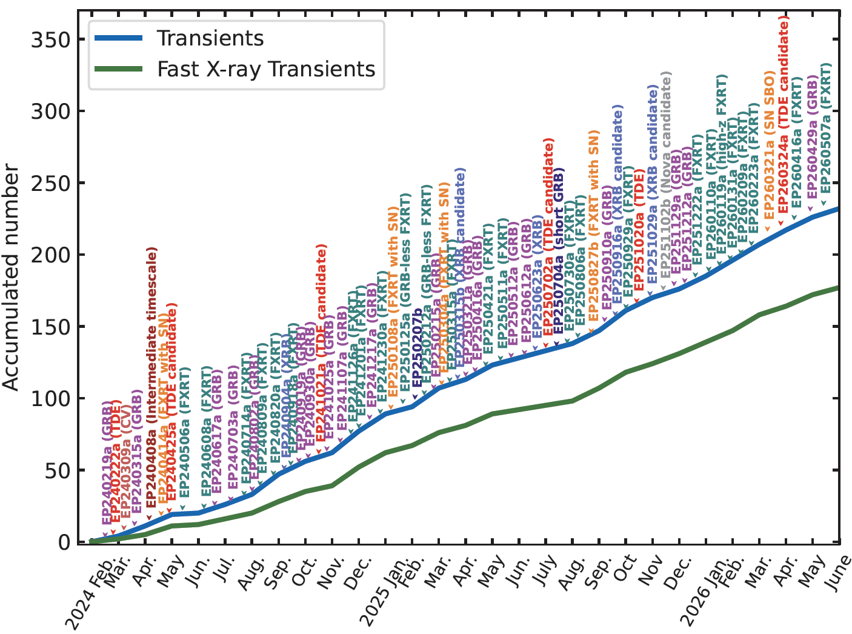
EP transients in 1st two years
X-ray transients: >270
  > 500 GCN/ATel
  follow-ups by multi-W telescopes worldwide
  ~100 /year (highest rate)
Fast X-ray Transients > 200
the rest: ~ 70
  FXRTs with long afterglow
  TDEs
  compact object flares
  unknown classes

Slide 13
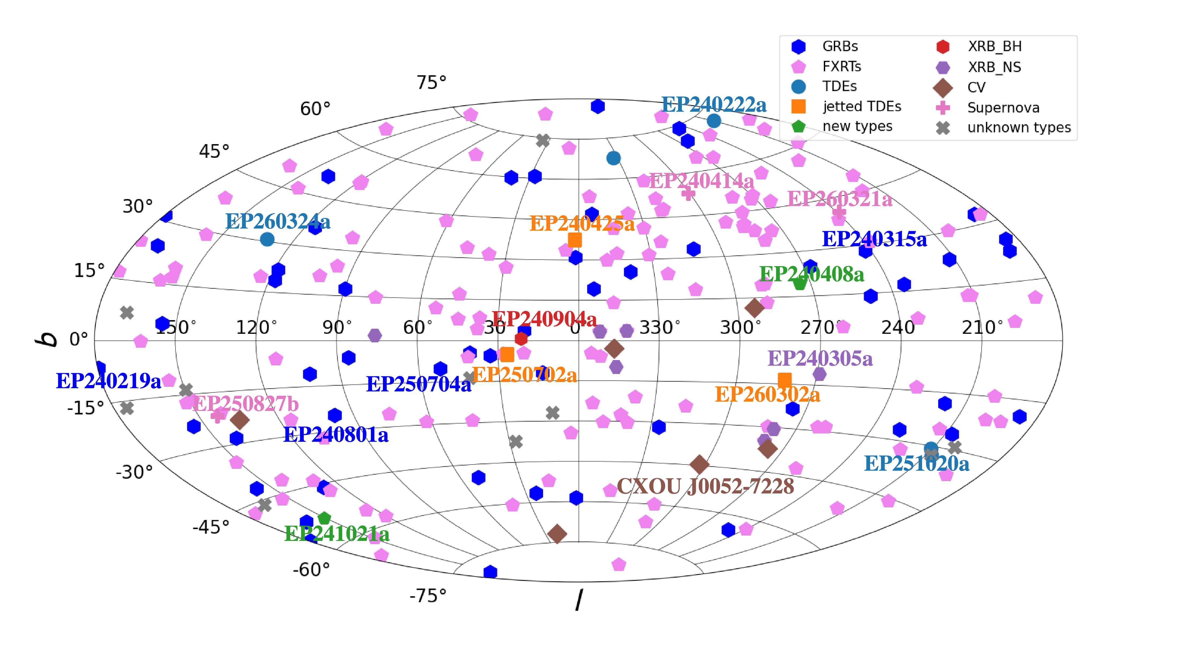
Some of the EP transients
Transients: >270
EP detection rate ~ 100/year
(Gal. coordinates)

Slide 14
EP transients in 1st two years
Catastrophic processes
  Fast X-ray transients (FXT): stellar core collapse, compact object mergers
  TDEs (IMBH)
Non-catastrophic processes
  22 new X-ray binaries (5 BH candidates, 5 NS, 8 WD, 4 unclassified)
Main advancements
  enlarging samples of rare types:
  e.g. X-ray flashes, FXT with SN associations
  new insight into well-studied transients, e.g. GRBs
  theoretical predicted but hitherto no clear evidence
    e.g. dirty fireballs, X-rays from binary NS mergers, thermal SN-SBO
  new phenomena or types of transients

Slide 15
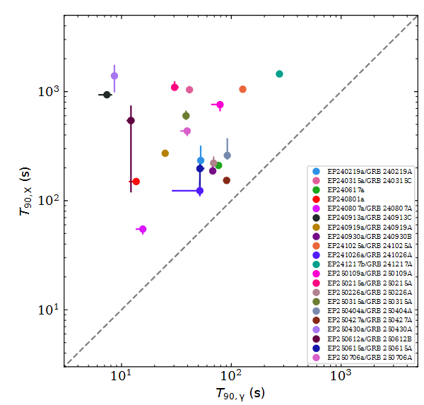
Extragalactic Fast X-ray Transients (FXT)
Fast X-ray transient mysteries
  bursts lasting seconds - hours, since 1970s
>200 FXT
  ~1/3 X-ray flashes: several tens before EP
  ~1/3 GRBs in soft X-ray: a new window
  9 SN associations: 3 before EP
Starting to
  find previously predicted or unknown phenomena
  revealing diversity of collapsars & compact binary mergers
GRB: distinct prompt emission in soft X-ray and gamma-ray
X-ray durations are much longer
Wu et al. in prep.

Slide 16
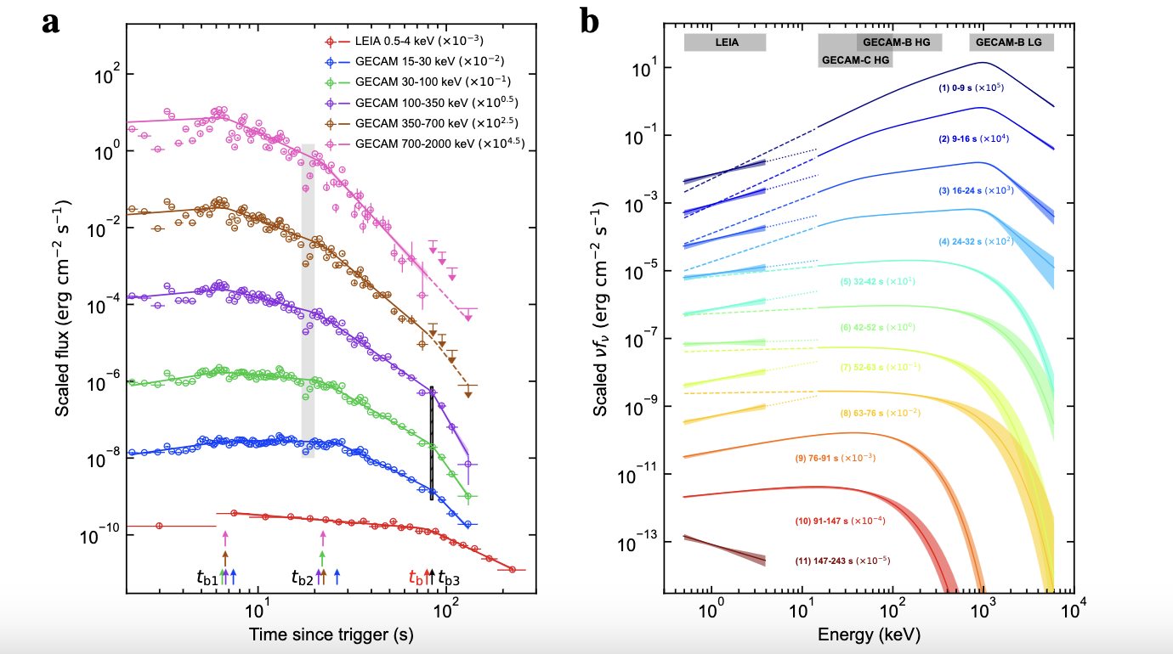
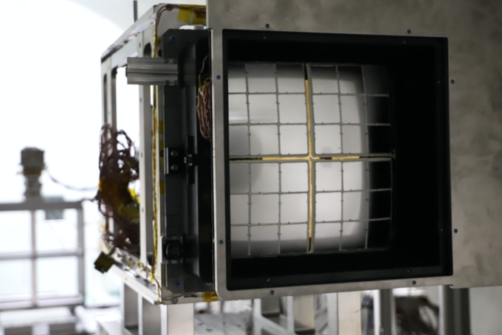
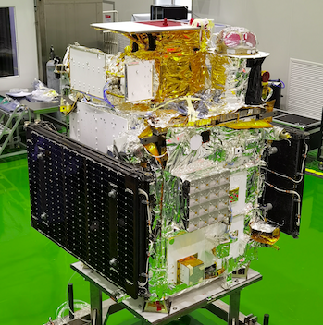
LXT 230307A: X-ray transient likely powered by BNS merger
GRB-jet
LEIA: EP-pathfinder
2022/07 – 2024/02
LEIA 0.5 – 4 keV
GRB-jet
magnetar-powered
Sun H. et al. 2025
National Science Review
magnetar-powered
credit: CAS
Soft X-ray likely powered by a magnetar, emerging from burst onset
Consistent with the association of kilonova signature found by JWST
other FXTs of possible merger origin: LXT 240402a, EP250207b, EP250704a
Becerra et al. 2026, Jonker P. et al. 2025, Li A. et al. arXiv/2601.14137
CAS’s SATech-01 experiment satellite

Slide 17
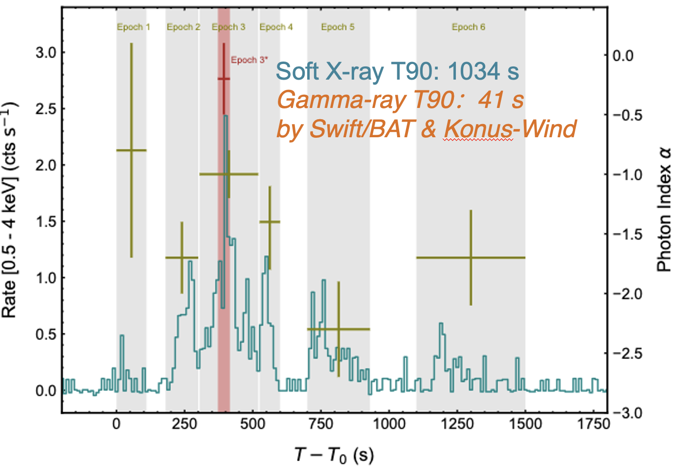
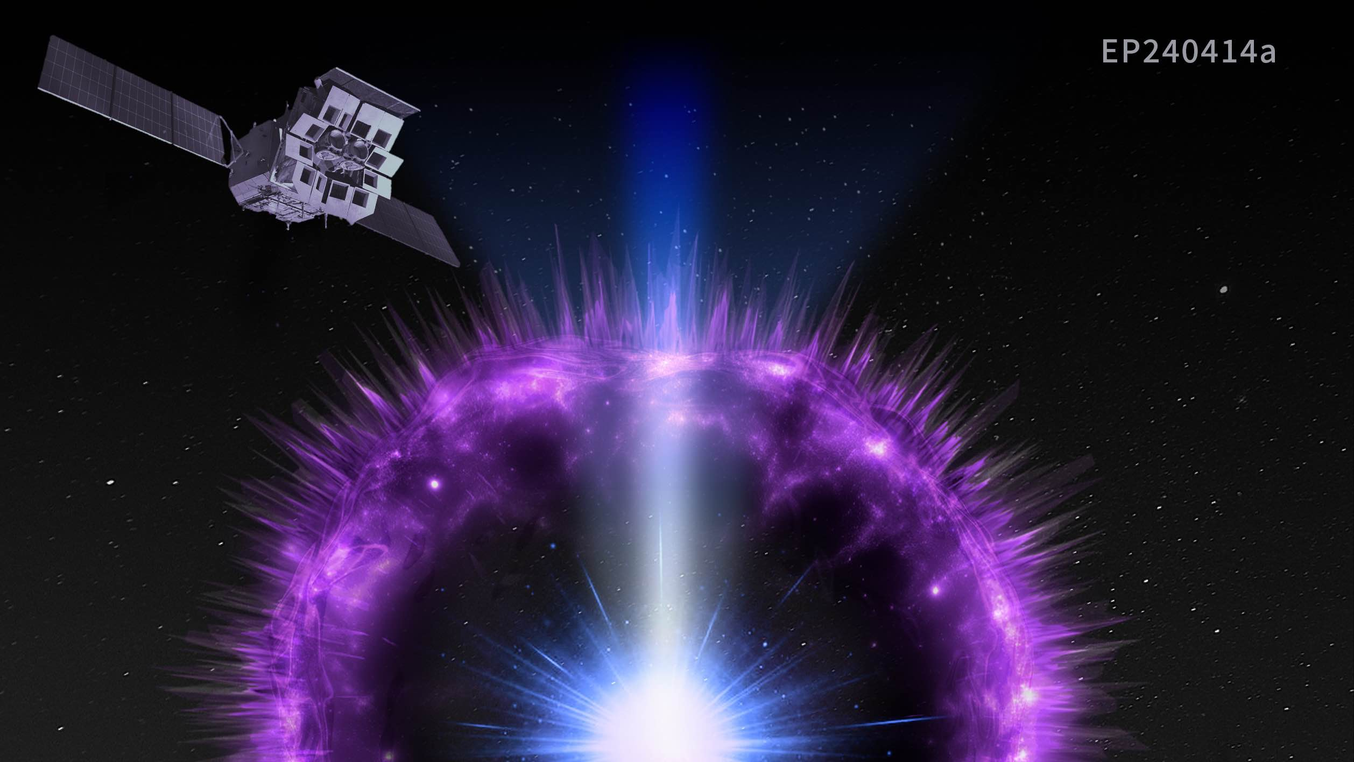
Highlights: fast X-ray transients (FXRT)
first evidence for weak relativistic jet associated with supernova
marked difference in prompt X-ray/γ-rays of GRB
A weak relativistic jet
interacting with an extended shell surrounding progenitor star
likely partly powered the supernova
soft X-ray burst leads hard X/γ ray and lasted longer
z=4.9, demonstrated potential of detecting high-z GRB
Liu Y., et al. 2025 Nature Astronomy
Levan A., et al. 2025 Nature Astronomy
Sun H. et al. 2025 Nature Astronomy

Slide 18
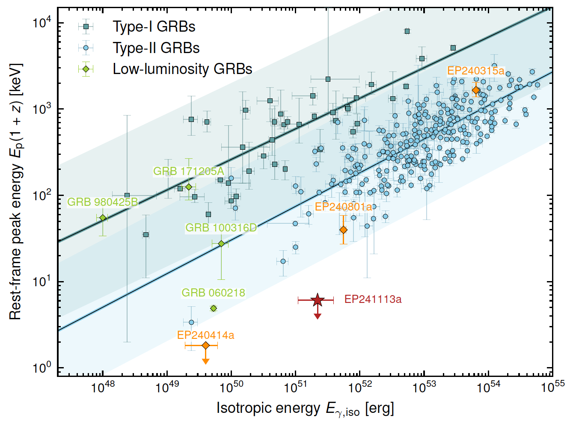
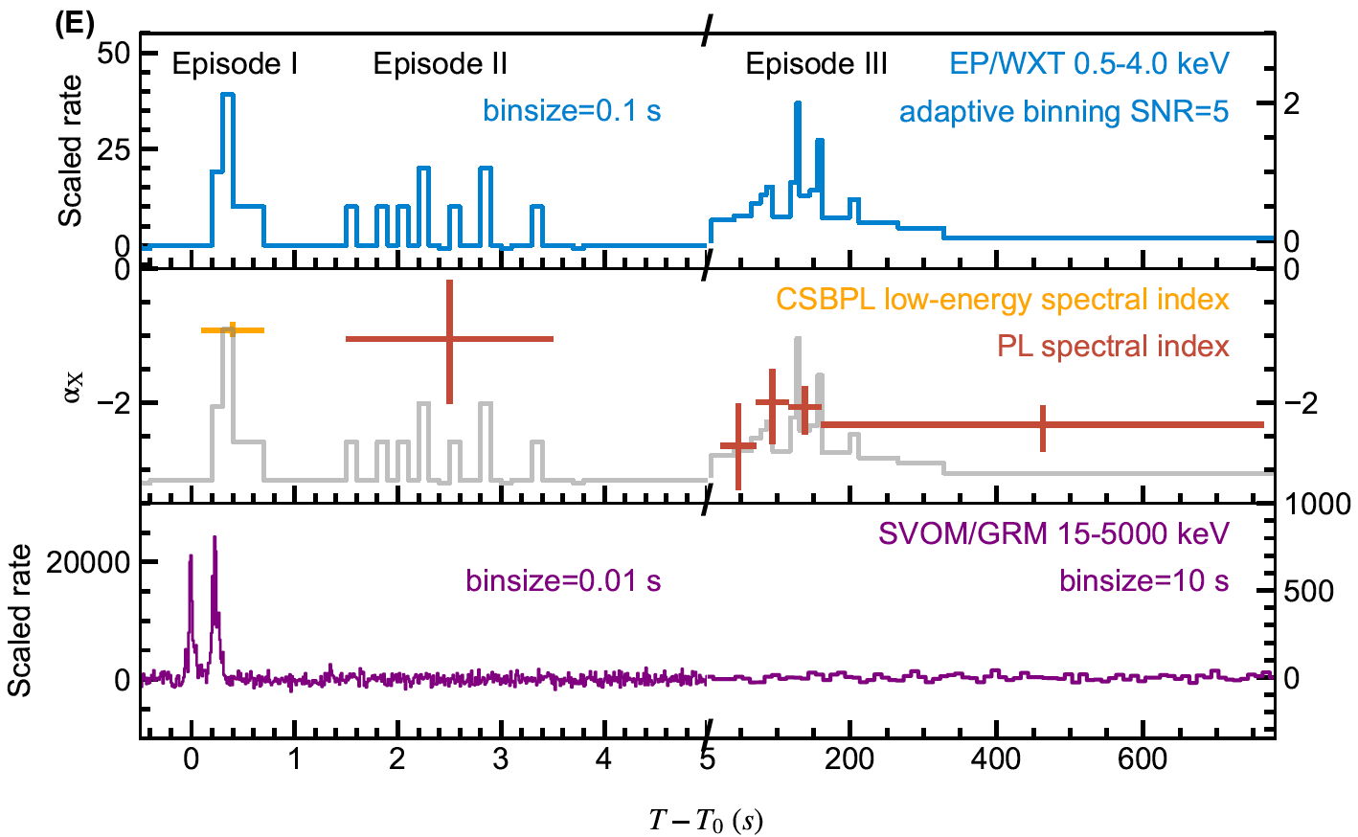
Highlights: Fast X-ray transients (FXRT)
first evidence for “dirty fireball”
long prompt soft X-ray emission in BNS merger
dirty fireball
The first clear evidence for the long-predicted “dirty fireball”--- relativistic jet largely contaminated by baryons
Discovered long-lasting soft X-ray prompt emission in a typical short gamma-ray burst, likely a common feature in merger-driven burst, and an X-ray counterpart of GW events
Dai C., et al. arXiv/2603.26213, Science, under review
Li, et al. 2026, Science Bulletin in press. arXiv:2601.14137

Slide 19
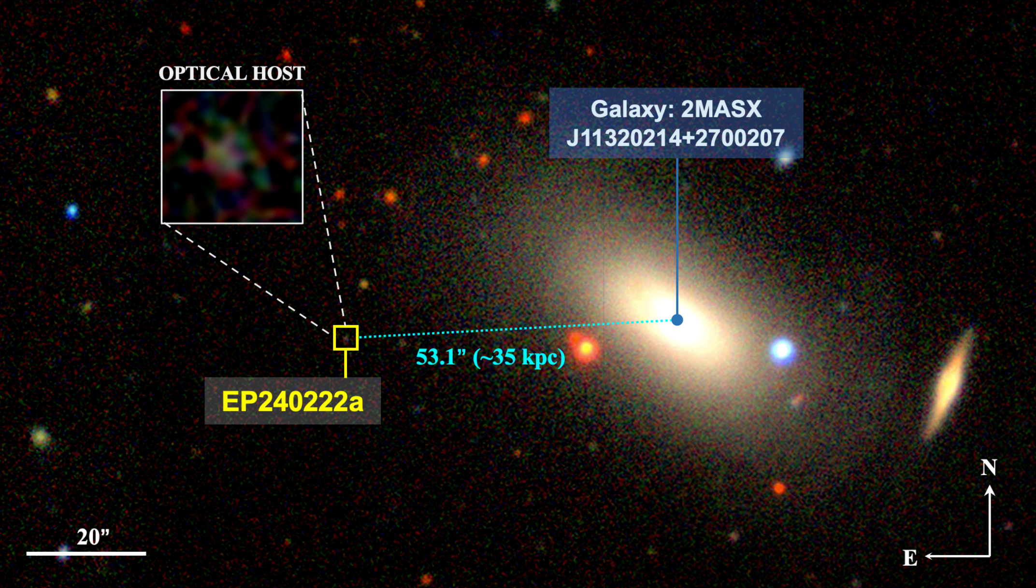
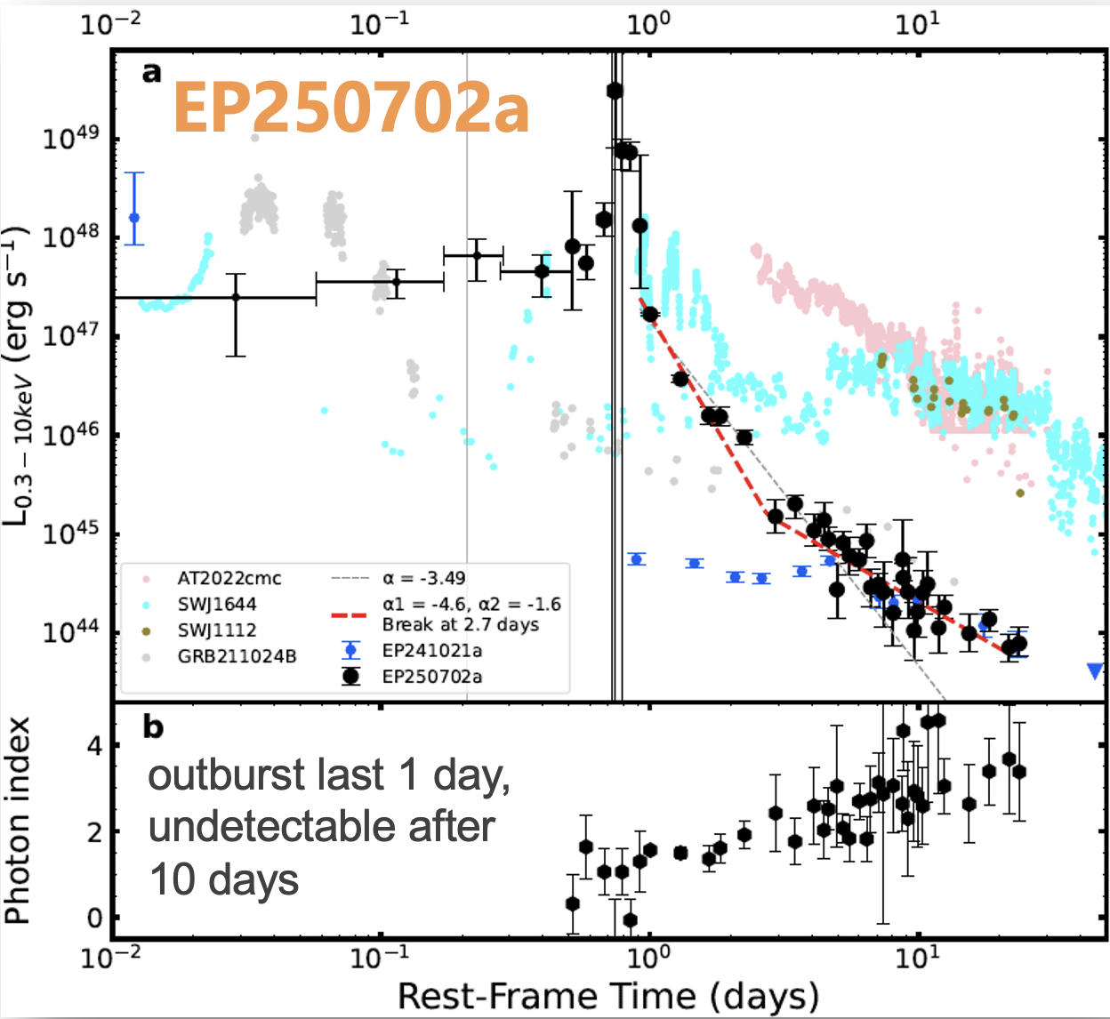
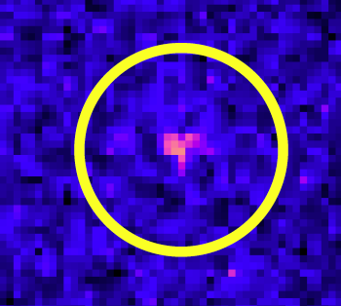
Highlights: intermediate-mass black holes (IMBH)
An intermediate-mass black hole TDE caught live
The first clear evidence for tidal disruption of a white dwarf
EP240222a
EP-WXT detection
IMBH (10²⁻⁵ M⊙) very difficult to find
discovered an on-going tidal disruption event (TDE) by an IMBH of 5x10⁴ M⊙
demonstrate TDE as an efficient way to detect IMBH
Unprecedented event consistent with prediction of a white dwarf TDE by an IMBH of ~ 10⁴ M⊙
Jin, et al., Science, under review arXiv/2501.09580
Li D., et al. 2026 Science Bulletin
Eyles-Ferris R., et al. 2026 MNRAS

Slide 20
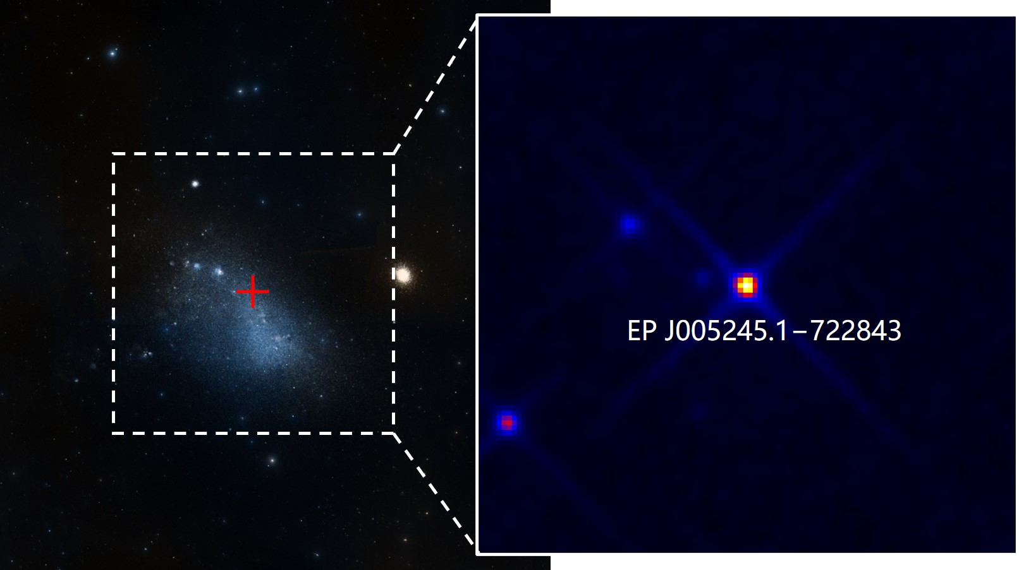
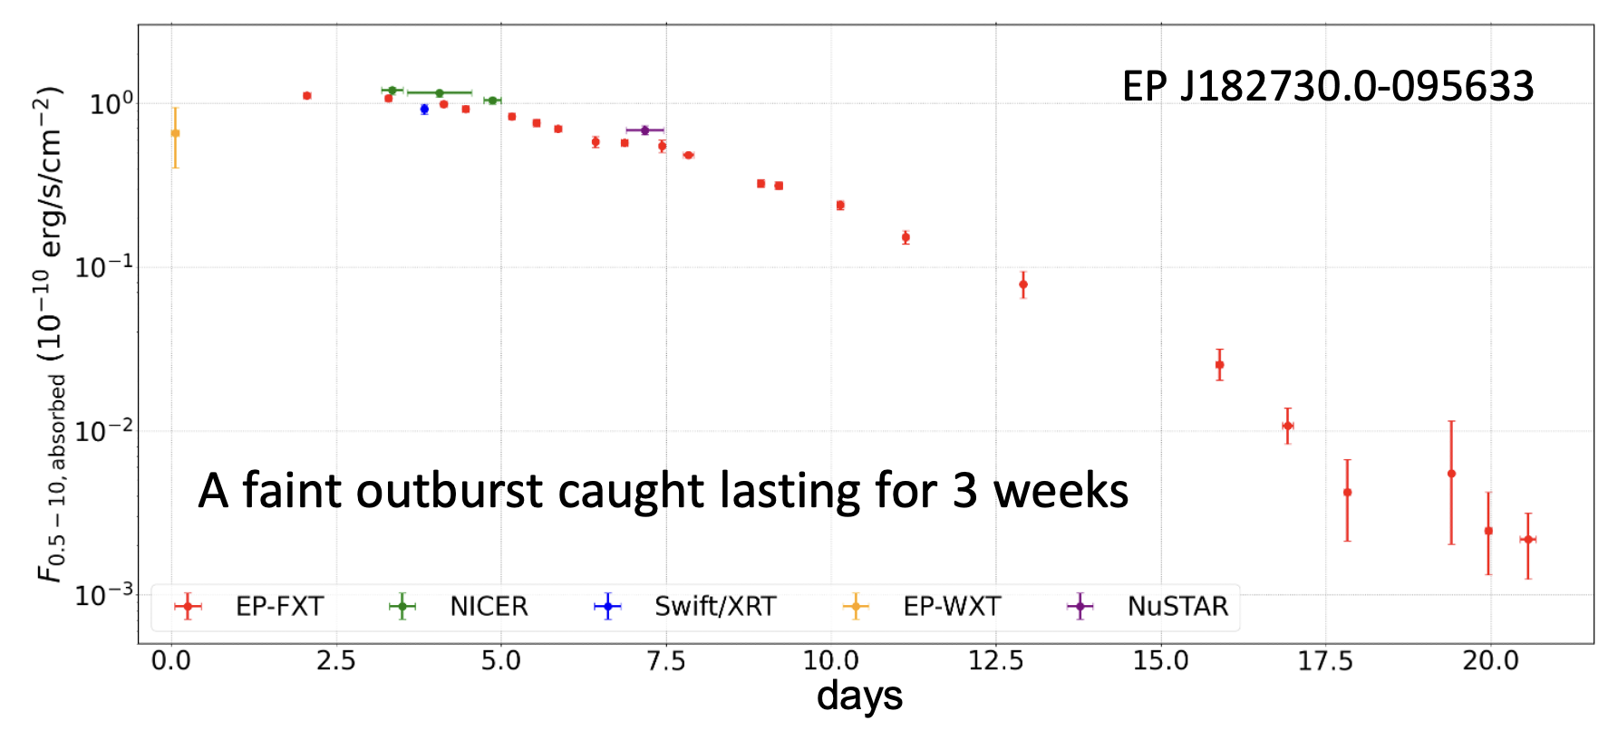
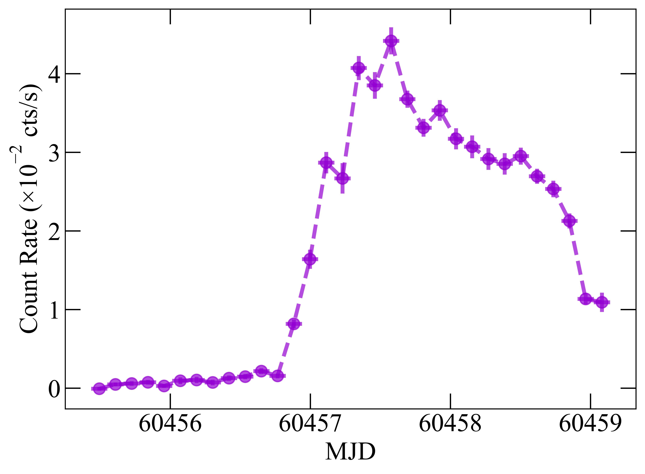
Finding hiding stellar-mass BH & compact objects
Where are the hiding BH XRB in Galaxy? predicted 10³ vs. < 100
Most in quiescent or faint activities, important to constrain stellar evolution, accretion
EP has found 22 new XRB candidates 5 BH, 5 NS, 8 WD, 4 unknown)
Very faint X-ray transients: ~ 5 /year
expected: magnetars, fireball phase of novae, …
a rare Be+WD
binary in SMC
WXT lightcurve
0.5-4 keV
a new BH binary candidate found by detecting its faint outburst
Cheng et al 2025 ApJL
Gaudin, et al. 2024 MNRAS, Marino, et al. 2024 ApJL

Slide 21
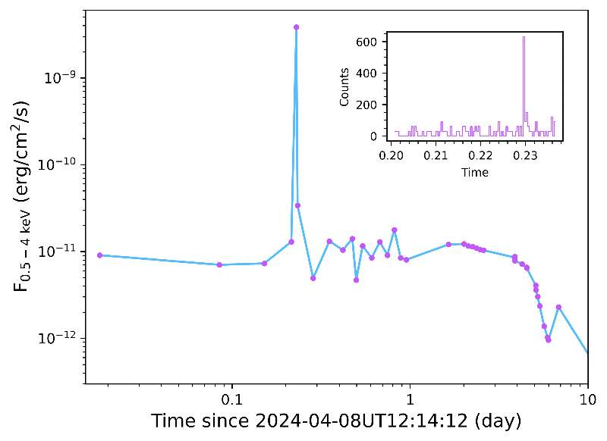
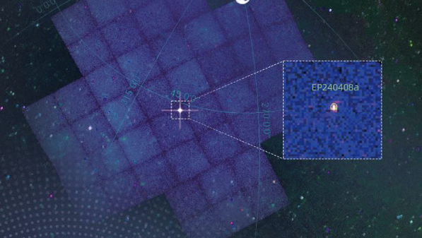
Highlights: likely a new transient class
EP240408a
A 12s-long X-ray burst
Spectral and temporal properties inconsistent with any known transient types
Likely a new class of transients
Zhang W., et al. 2025 Science China
O'Connor B., et al. 2025 ApJL
Notes:
unusual transient, previously unknown type

Slide 22
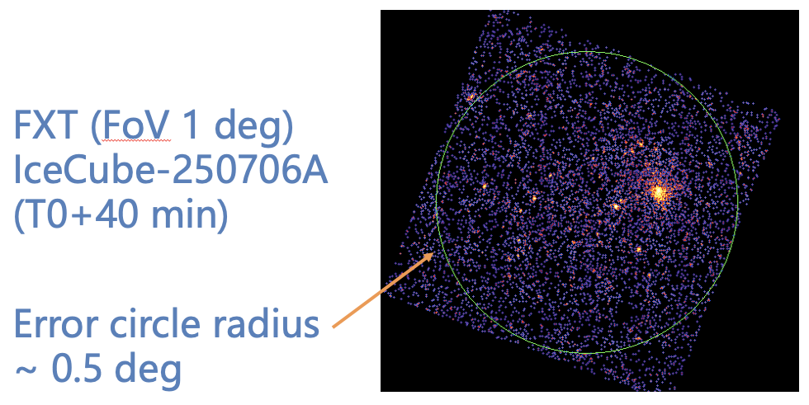
Search for X-ray counterparts to neutrino events
Questions:
  origin of high-E neutrinos
  acceleration of hadronic cosmic rays
Possible sources ?
  blazars/jets/TDE
  low-luminosity GRB
Why EP?
  WXT: large FoV, high X-ray sensitivity, high cadence
  FXT: rapid response (matching FoV 1deg)
Provide precise time/position for off-line search of weak neutrino signals
EP-FXT follow-up of an ICE-Cube neutrino event in 2025

Slide 23
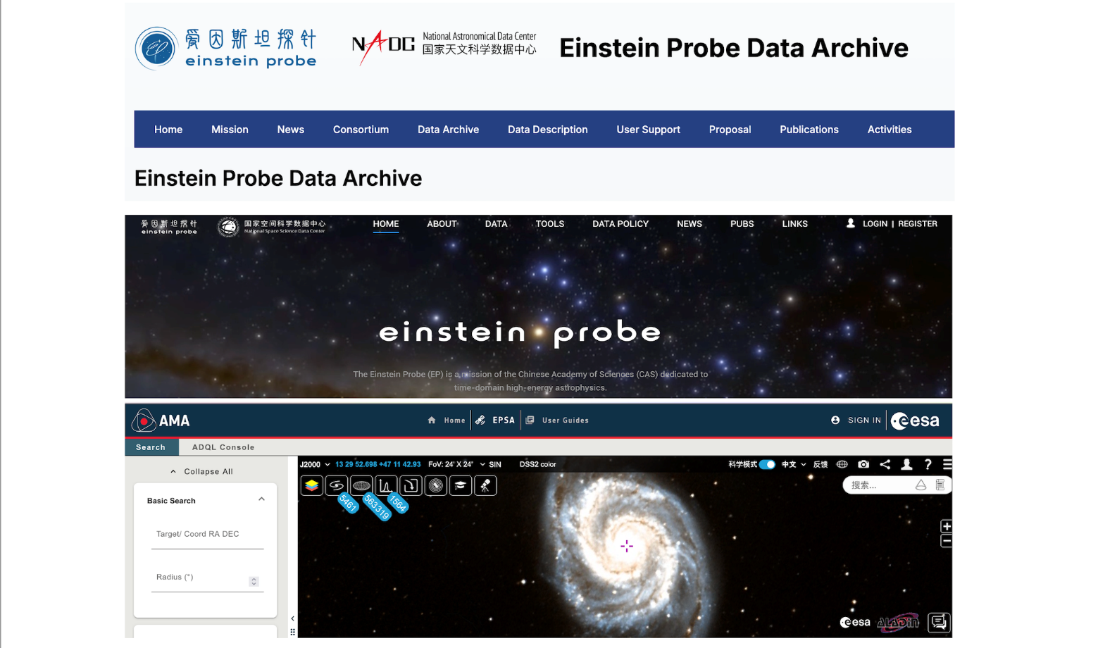


Release of 1st batch of EP science data
National Astronomical Data Centre (NADC)
National Space Science Data Centre (NSSDC)
23
ESA's Einstein Probe Science Archive (EPSA)

Slide 24
How EP observations fit into the future landscape of transients?
Unique mission in ~10 years to come
Deliver to the community discoveries of transients inaccessible to
  gamma-ray/UV/optical/radio facilities (soft X-rays)
  other X-ray telescopes (wide FoV, high sensitivity)
Rapid X-ray characterisation of important transients
  rapid ToO response (test service started and will be available soon)
Synergies with MW & MM (GW, neutrino, CR) facilities, FRBs
  e.g. shadowing obs. by ZTF in optical
A legacy database of 3D X-ray sky (time-domain database)
  http://ep.bao.ac.cn
  https://www.esa.int/Science_Exploration/Space_Science/Einstein_Probe_factsheet

Slide 25


Thank you
SN 1053
Tian-guan guest star
25

Slide 26

EP Science Centre (EPSC)
EPSC @ NAOC/CAS
EPSC: a small team
NAOC + IHEP (CAS)
instrument calibration
observation scheduling
data reduction/analysis
transient search & disse-
mination
ToO
more …
operation support
daily on-duty
1 duty scientists
2-4 transient advocates

