Slide 1
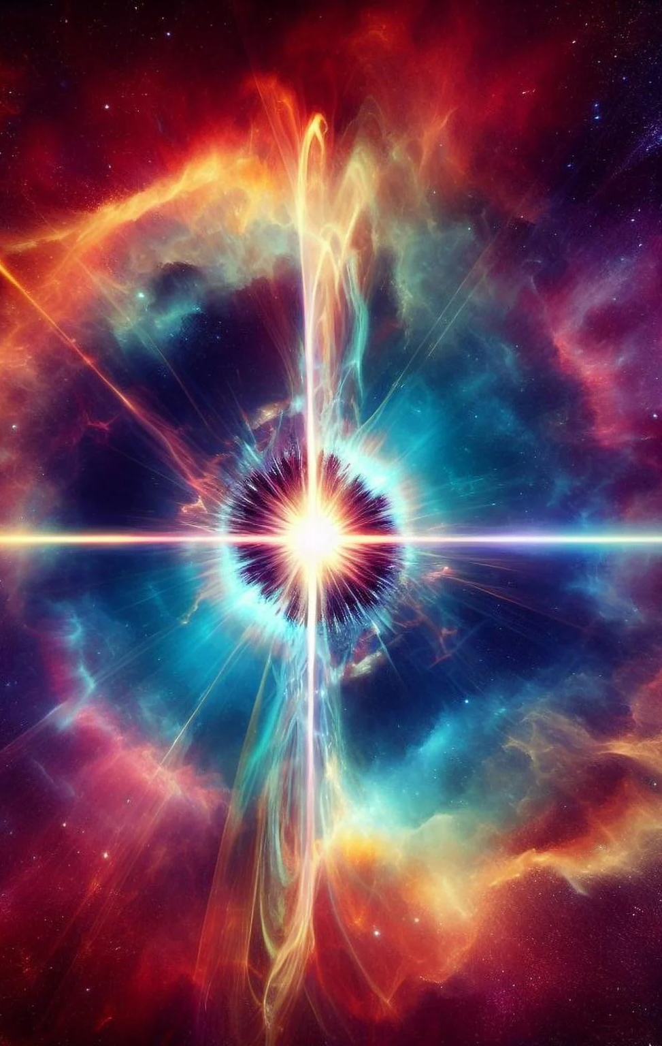

VHE Pulsar Visibility
Christo Venter^{1,2}
Alice Harding³
Constantinos Kalapotharakos⁴
¹Centre for Space Research, North-West University,
Potchefstroom, South Africa
²National Institute for Theoretical and Computational
Sciences (NITheCS), Potchefstroom, South Africa
³Theoretical Division, Los Alamos National Laboratory
⁴Astrophysics Science Division,
NASA Goddard Space Flight Center
scitechdaily.com
High Energy Astrophysics in Southern Africa (HEASA2026), Cape Town, South Africa, 29/9 – 3/10

Slide 2
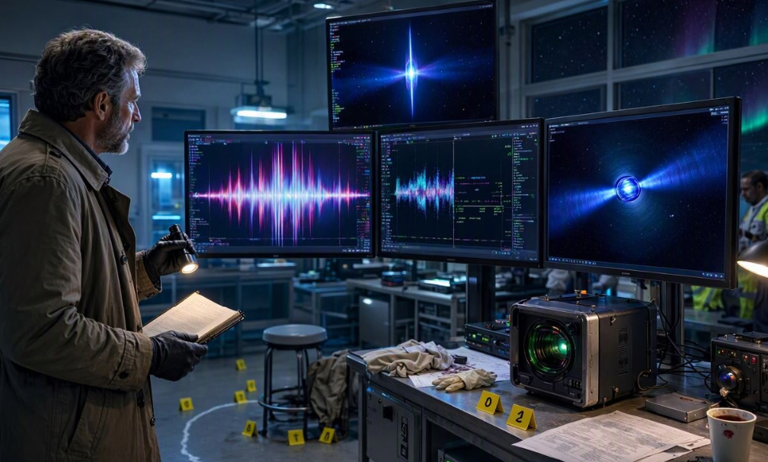
aka Pulsar Forensics
High Energy Astrophysics in Southern Africa (HEASA2026), Cape Town, South Africa, 29/9 – 3/10
www.bing.com

Slide 3
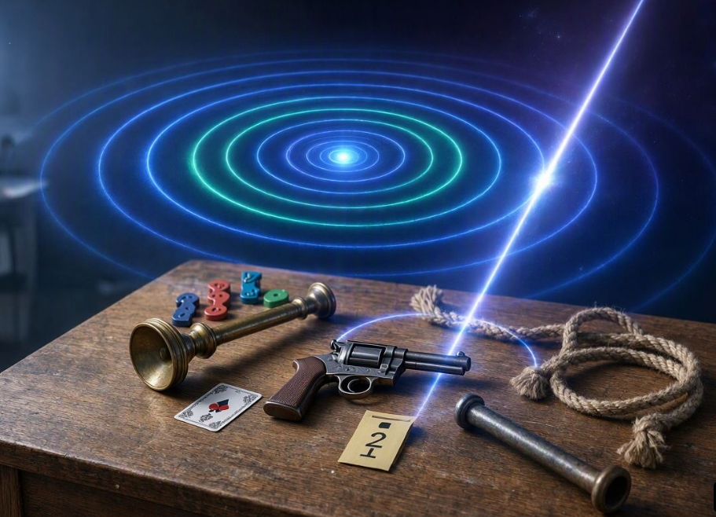
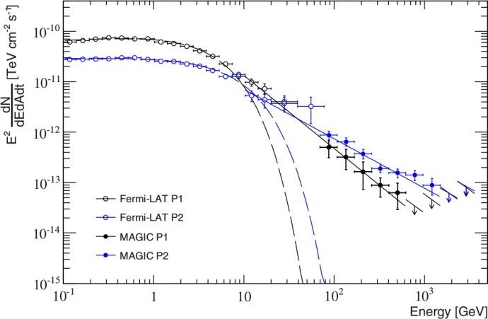
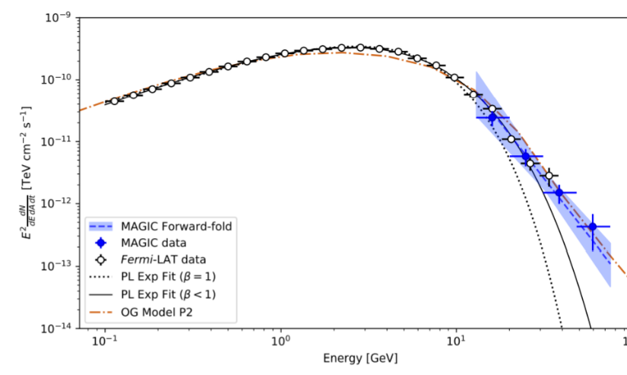
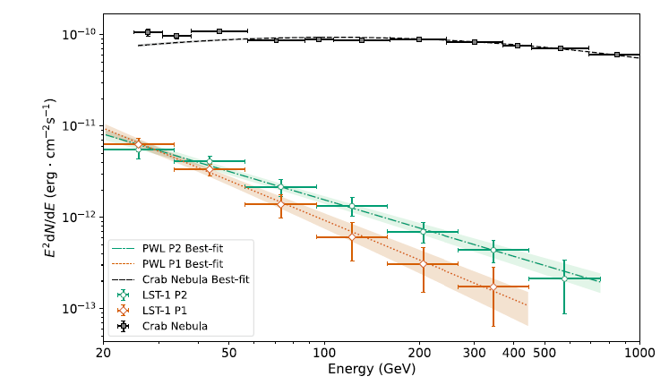
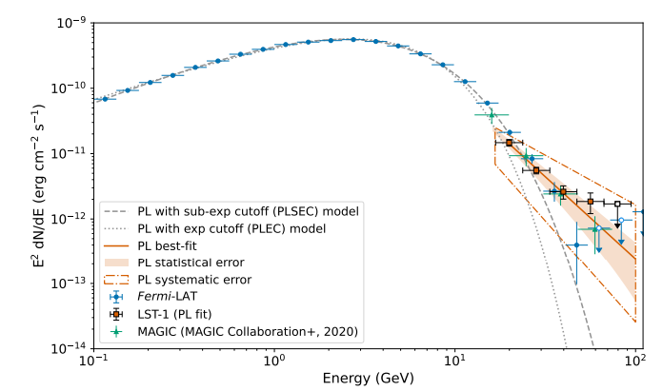
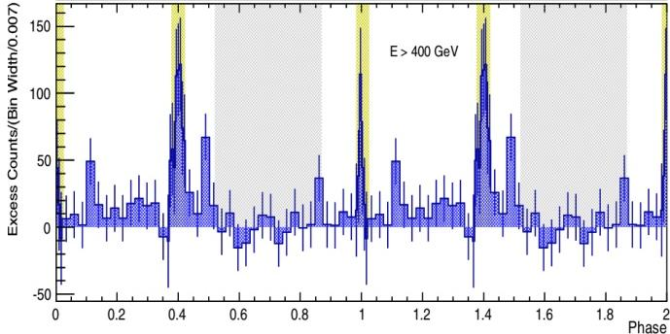
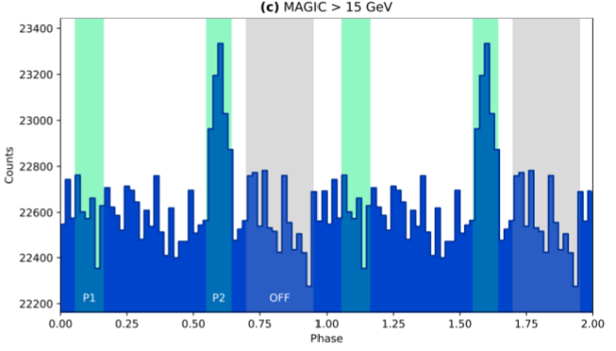
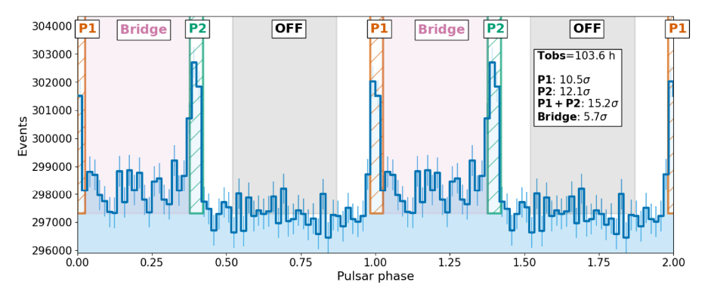
The Evidence: Crab / Geminga
Ansoldi et al. (2016)
(PSR B0531+21)
MAGIC
LST-1
(PSR B0633+17)
Abe et al. (2024)
VERITAS
P2 @ 6.3σ
LST-1 & Fermi LAT
20 – 65 GeV; P2 @ 12.2σ
Γ ~ 4.5
Sub-exponential SED
No curvature
40 GeV – 1.5 TeV
1 200 yr, E ~ 5e38 erg/s
Both P1 and P2 visible
High Energy Astrophysics in Southern Africa (HEASA2026), Cape Town, South Africa, 29/9 – 3/10

Slide 4
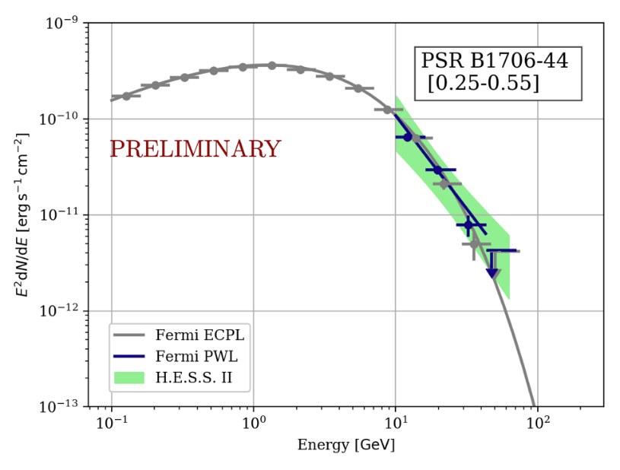
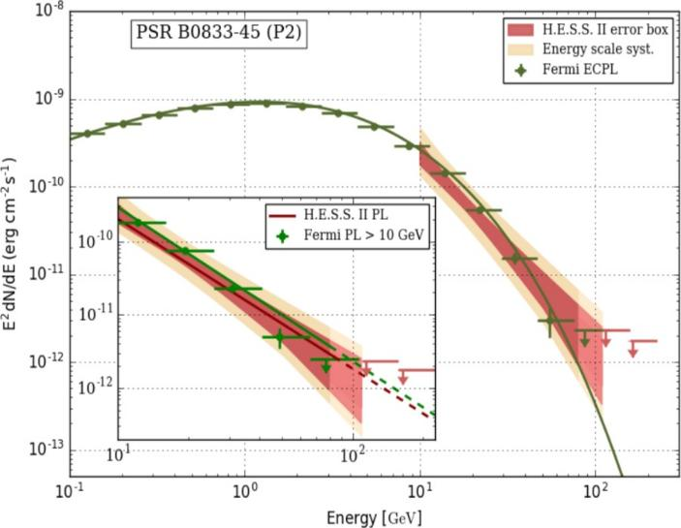
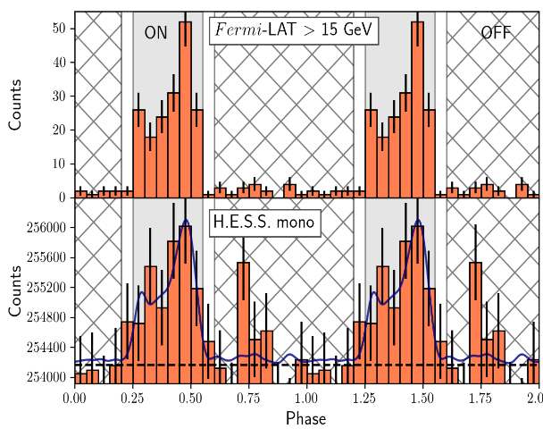
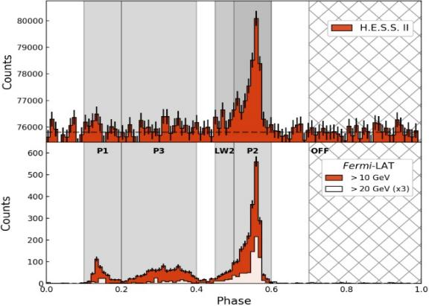
More Evidence: B1706-44 / Vela
Abdalla et al. (2018)
H.E.S.S.
H.E.S.S.
Spir-Jacob et al. (2019)
E_{γ} ~ 10 – 110 GeV
  <20 –
  100 GeV
  Curved spectrum
  > 10 GeV
<~ 60 GeV
18 kyr,
E ~ 3e36 erg/s
P2 dominates P1
High Energy Astrophysics in Southern Africa (HEASA2026), Cape Town, South Africa, 29/9 – 3/10

Slide 5
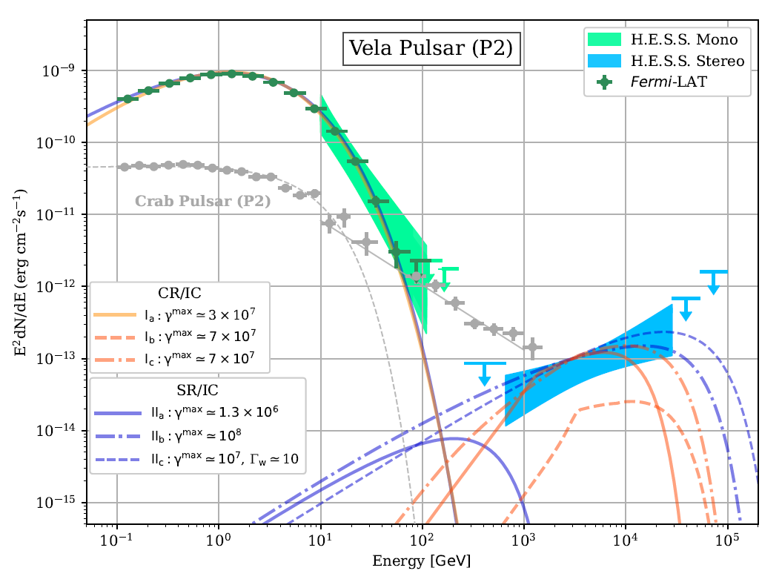
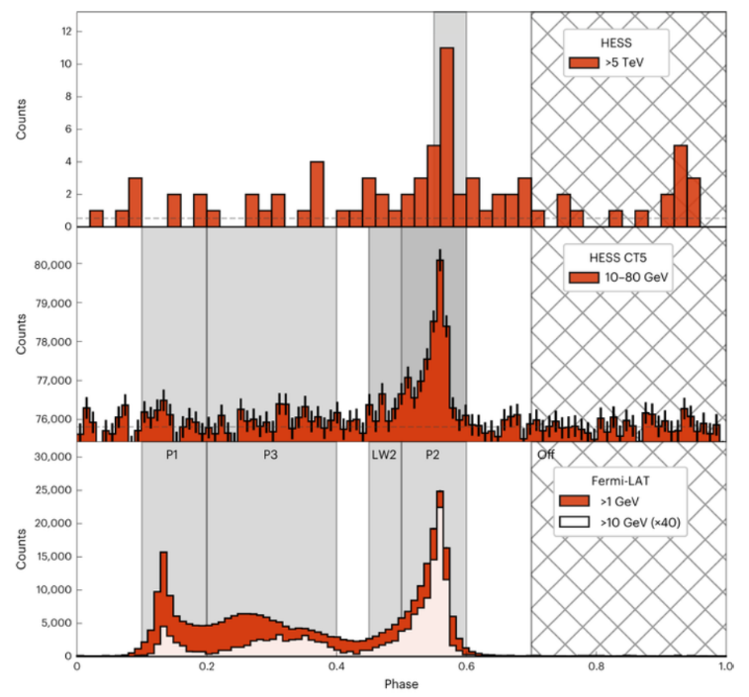
Another Clue: Vela @ 20 TeV!
H.E.S.S.
Aharonian et al. (2023)
  New spectral component
  Hard index
  P2 remains at VHE
  Similar P2 peak position & width in HE / VHE
High Energy Astrophysics in Southern Africa (HEASA2026), Cape Town, South Africa, 29/9 – 3/10

Slide 6

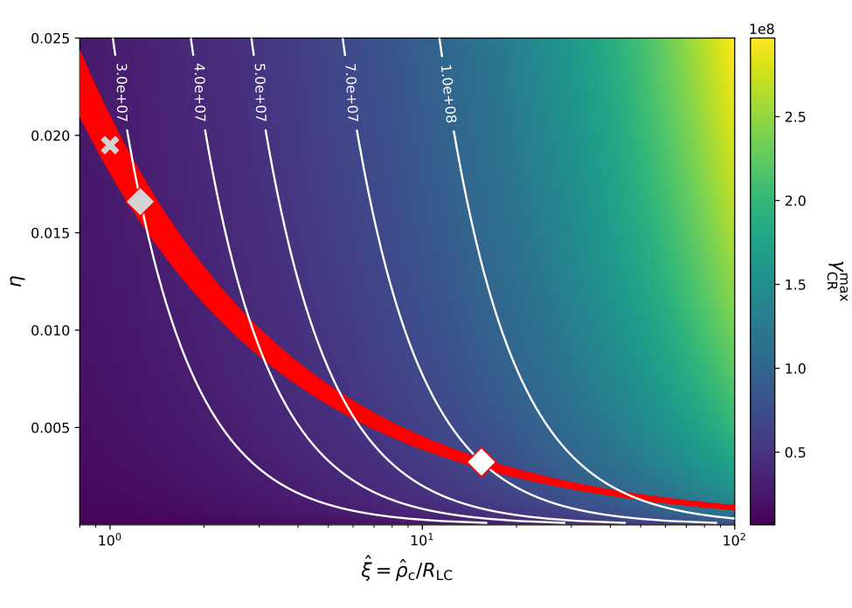
Emission Outside LC!
Aharonian et al. (2023)
  New spectral component
  Hard index
  SCR/IC: Large γ and ρ_{c} = Outside LC!
High Energy Astrophysics in Southern Africa (HEASA2026), Cape Town, South Africa, 29/9 – 3/10

Slide 7
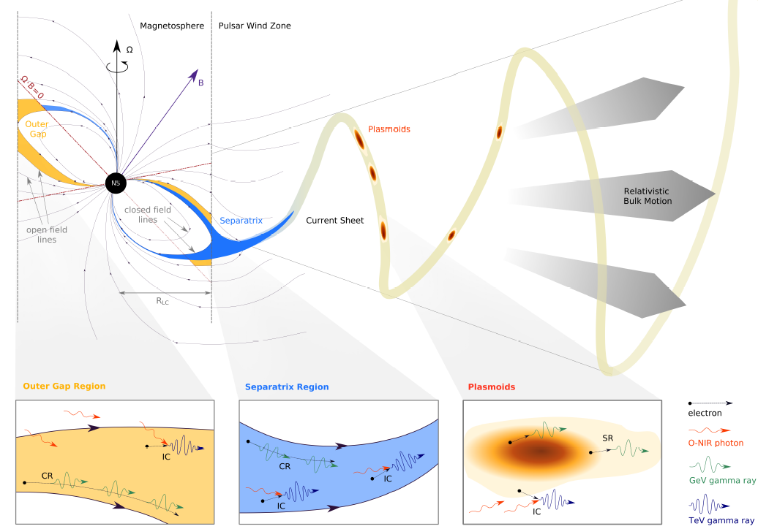
Model Frameworks
  (i) Local Models:
  Gap models (PC / OG / SG / TPC) within the light cylinder
  (ii) Global Models:
  - Separatrix / current sheet model: E||, SCR / IC
  - Magnetic reconnection in current sheet; Doppler-boosted SR / IC
  (striped wind)
Aharonian et al. (2023)

Slide 8
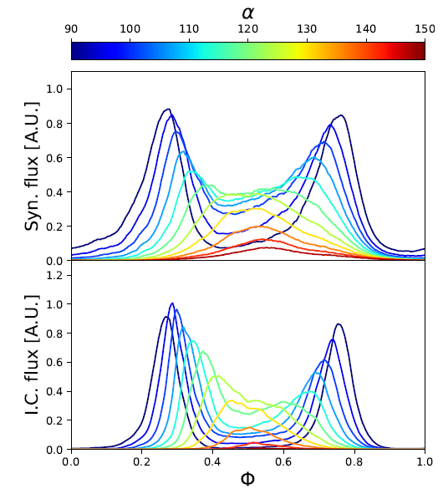
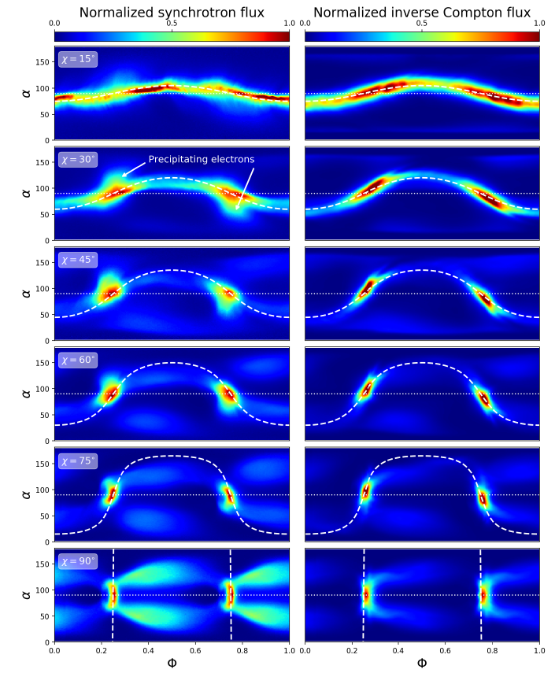
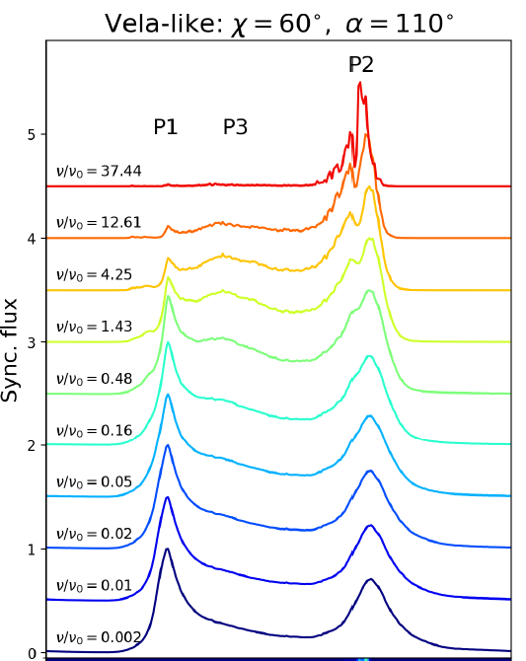
PIC Simulations: GeV / TeV Band
ζ
PIC simulations of GeV / TeV light curves
Two target fields assumed:
  Uniform CMB / diffuse emission (e.g., nebula)
  Point source at stellar centre (thermal surface hotspots)
Reconnection:
σ > 1e7!
P1/P2 & P3 vs E_{γ}
α=30^{ο}
Cerutti et al. (2025)
α=60^{ο} , ζ=110^{ο}
High Energy Astrophysics in Southern Africa (HEASA2026), Cape Town, South Africa, 29/9 – 3/10

Slide 9
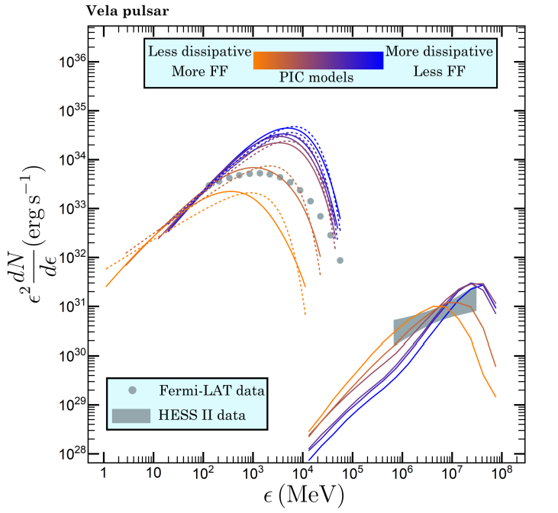
PIC Simulations: GeV / TeV Band
Assumptions:
  Power-law sub-mm to IR soft photons
  Representative P, B, Edot from PIC grid of models (injection ~ FF-ness)
  GeV normalisation fixed, TeV free (soft photon normalisation)
E|| acceleration produces γ ~ 5e7 naturally
Joint constraints (single particle population)
Kalapotharakos et al. (2026)
High Energy Astrophysics in Southern Africa (HEASA2026), Cape Town, South Africa, 29/9 – 3/10

Slide 10
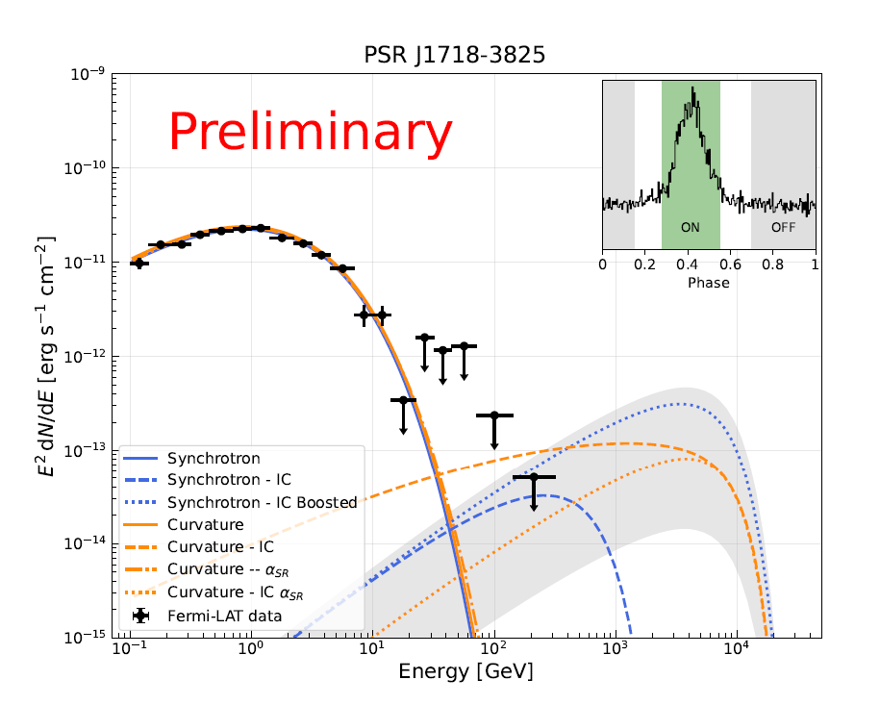
Rough Predictions
GeV bump fit by SR
(+ boosting) or CR model
Particle spectrum: PL with exp. cutoff
IC in ~KN regime
Extrapolation (and suppression) of X-ray spectrum to optical energies
List of promising targets
Regeard et al. (2025)
High Energy Astrophysics in Southern Africa (HEASA2026), Cape Town, South Africa, 29/9 – 3/10

Slide 11
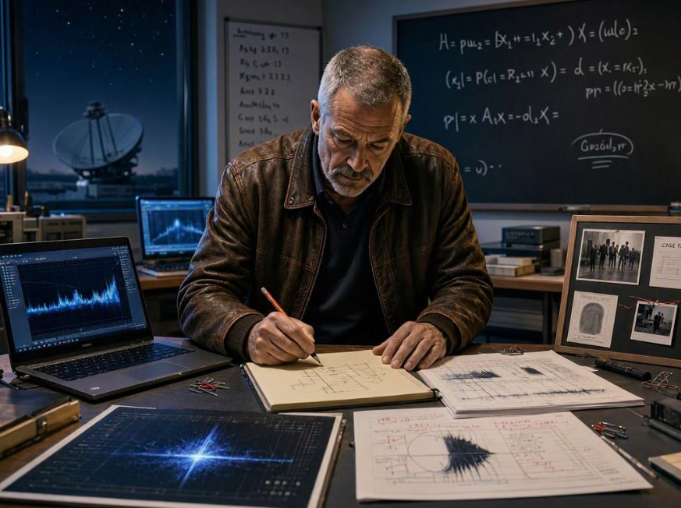





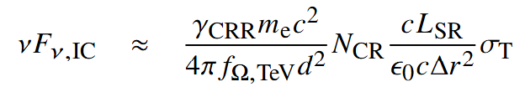
#1: Analytic Estimate
Mono-energetic
particle spectrum (CRR):
Mono-energetic
soft-photon spectrum:
IC flux
IC flux higher for:
  Smaller magnetosphere (P)
  Smaller distance
  between SR and IC
  emission regions
  Brighter SR
  Lower ε_{O} (boosts n_{ε})
  Higher L_{GeV}
Venter et al., in prep.
High Energy Astrophysics in Southern Africa (HEASA2026), Cape Town, South Africa, 29/9 – 3/10

Slide 12
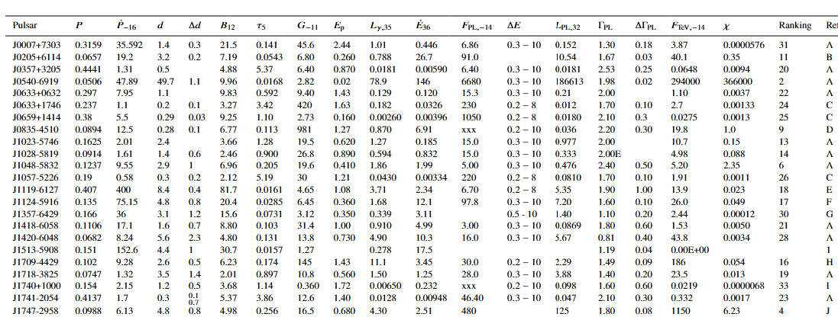

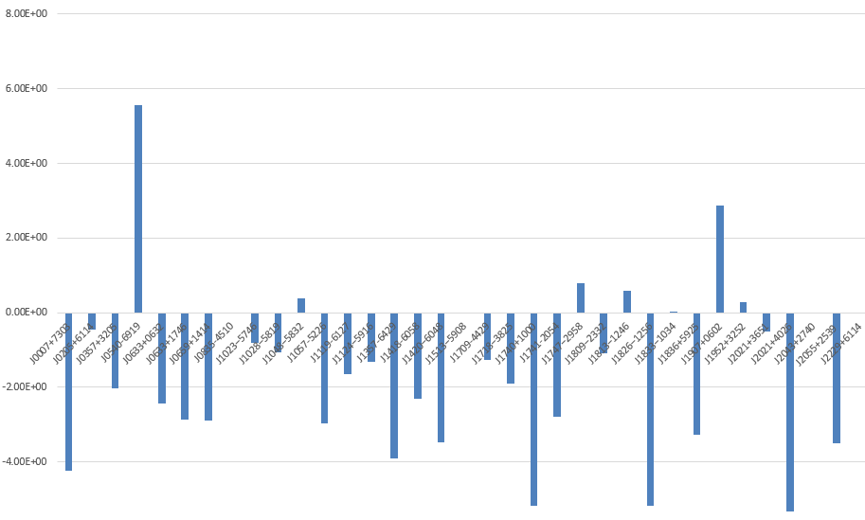
#1: Analytic Estimate
Caveat:
photon-photon pair production
Figure of merit
log₁₀(χ)
X
X
Preliminary!!
Venter et al., in prep.
PSR
High Energy Astrophysics in Southern Africa (HEASA2026), Cape Town, South Africa, 29/9 – 3/10

Slide 13
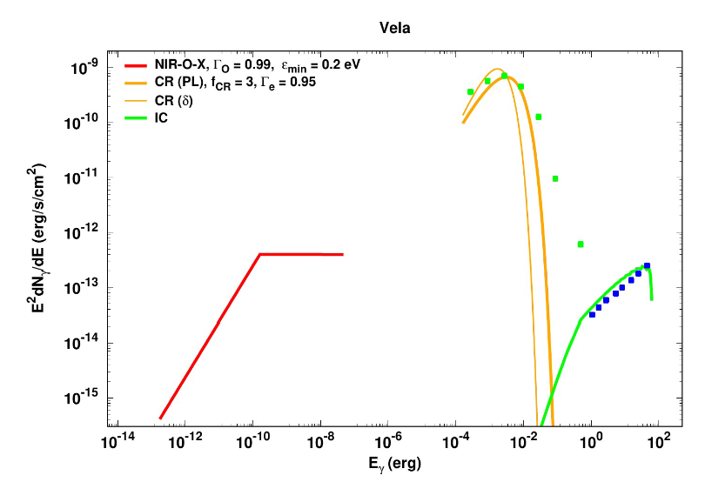
#2: Basic Spectral Code
Power-law particle spectrum (?)
(Broken) power-law
soft-photon spectrum
Full KN cross section used to calculate IC spectrum
No light curve predictions
Preliminary!!
Measured Γ_{TeV} constrains Γ_{e}
E_{e,max} determines E_{TeV}
High L_{GeV}, high IC flux
(η,ξ) limited by E_{GeV}, L_{GeV}, E_{TeV}
Lower ε_{min} boosts L_{TeV}
Softer Γ_{O} boosts L_{TeV}
Venter et al., in prep.
High Energy Astrophysics in Southern Africa (HEASA2026), Cape Town, South Africa, 29/9 – 3/10

Slide 14
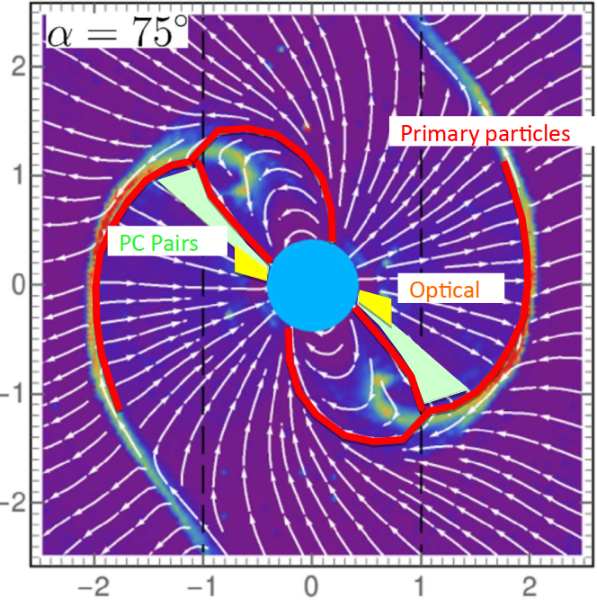
#3: Separatrix / CS Emission Model
Force-free magnetosphere.
Primaries accelerated near separatrix and predominantly in CS E-field (reaching γ_{e} ~ 5e7).
Pairs injected at above PC (J/J_{GJ} < 0).
Empirical radio core / cone model.
Solve particle dynamics in observer frame.
SC (CR+SR), ICS, SSC radiation mechanisms.
Spectra and light curves.
Radio
Harding & Kalapotharakos (2015), Harding et al. (2018, 2021)
High Energy Astrophysics in Southern Africa (HEASA2026), Cape Town, South Africa, 29/9 – 3/10

Slide 15
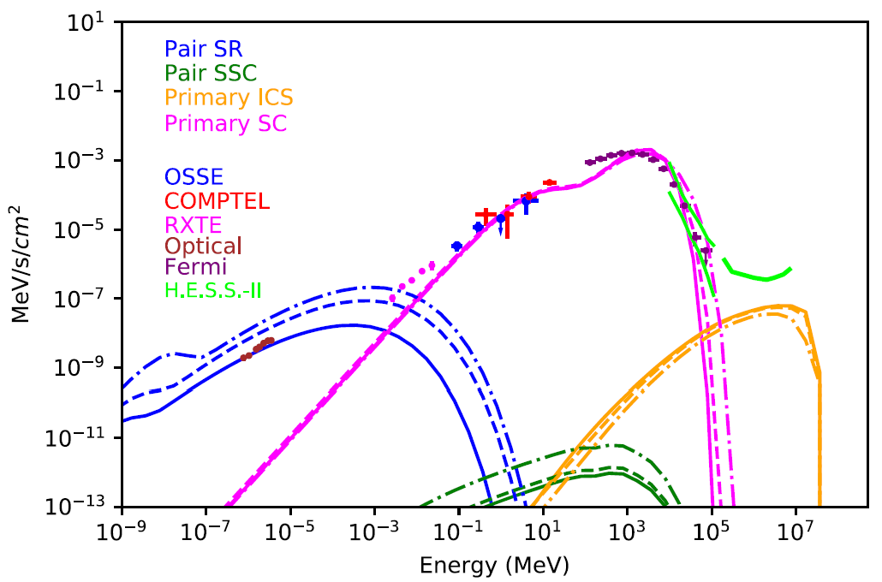
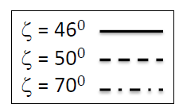
#3: Calibrate via 3D Modelling
P = 0.089 s, B0 = 4 x 10¹² G, d = 0.25 kpc
α = 75º, M₊ = 6 x 10³
Pair SR matches optical data
SCR broader GeV bump, sub-exp. tail
Primary ICS component
(primaries upscattering pair SR)
TeV emission requires γ_{max} ~5e7
e⁻
γ_{SR}
Harding et al. (2021)
High Energy Astrophysics in Southern Africa (HEASA2026), Cape Town, South Africa, 29/9 – 3/10

Slide 16
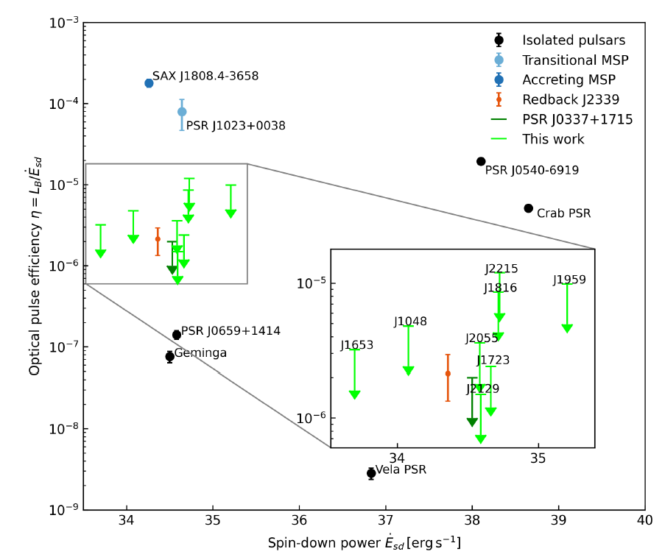
A Check: Optical
Pulsations
  Search for optical pulsations of spider binaries
  No detections
  Crab and twin η~ 1e-5
  Limits on η ~ 5e-6
  Constraints on soft-photon target field!
Malacaria et al. (2026)
High Energy Astrophysics in Southern Africa (HEASA2026), Cape Town, South Africa, 29/9 – 3/10

Slide 17
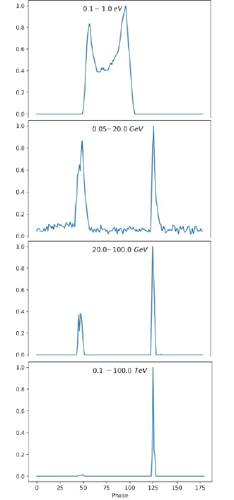
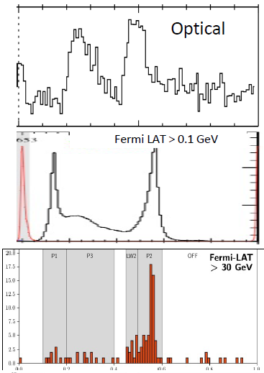
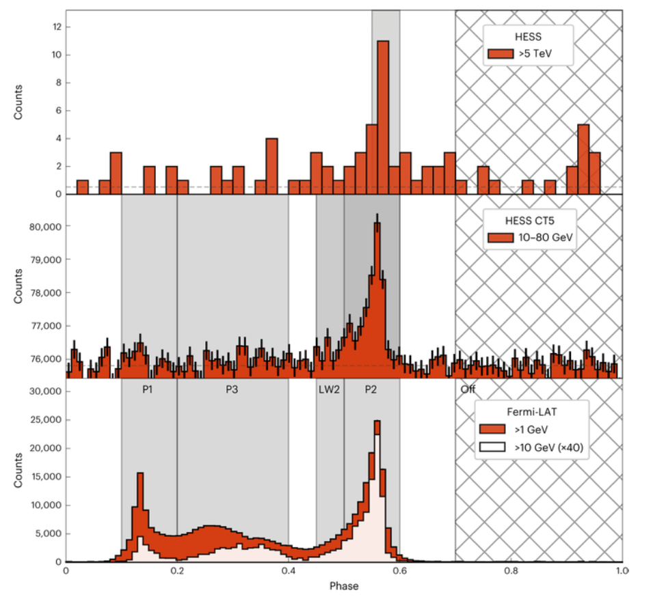
Results:
Vela LCs
Reasonable multi-wavelength LC predictions
P1/P2 vs E_{γ} effect: higher-energy photons in P2 – larger ρ_{c}
Only P2 in TeV: highest-energy particles responsible
Narrowing of peaks with energy
E||(φ) leading to azimuthally-dependent emissivity improves
radio-to-γ lags
Harding et al. (2018, 2021)
Barnard et al. (2022)
High Energy Astrophysics in Southern Africa (HEASA2026), Cape Town, South Africa, 29/9 – 3/10

Slide 18
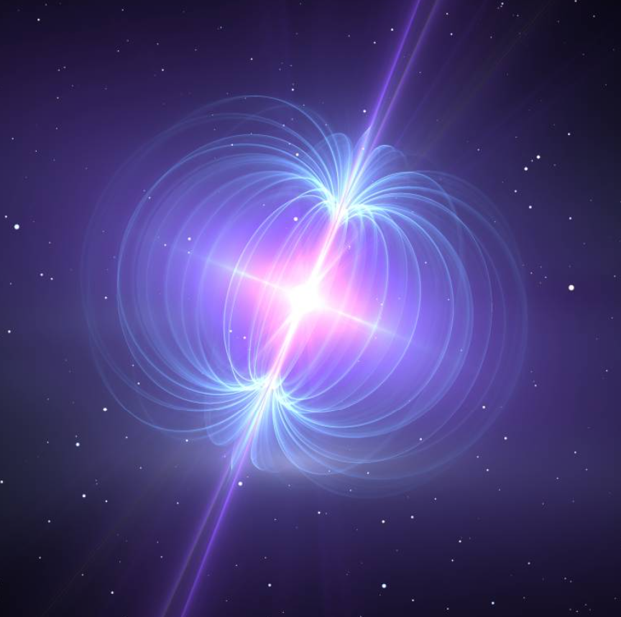
Questions...
IC implies high γ_{e}. Which framework?
Shape of GeV tail: exponential,
sub-exponential, PL?
Shape of primary particle spectrum? Range of (η,ξ)?
Do smooth particle trajectories exist in CS? Effective ρ_{c} in the CS?
Nature / spectrum of target photons?
Thermal X-rays, CMB, Nebular, SR?
Acceleration? Energetics?
Particle injection? (FF-ness)
www.astrosurf.com/luxorion/diversite-etoiles8.htm
High Energy Astrophysics in Southern Africa (HEASA2026), Cape Town, South Africa, 29/9 – 3/10

Slide 19
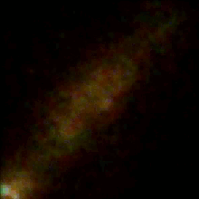
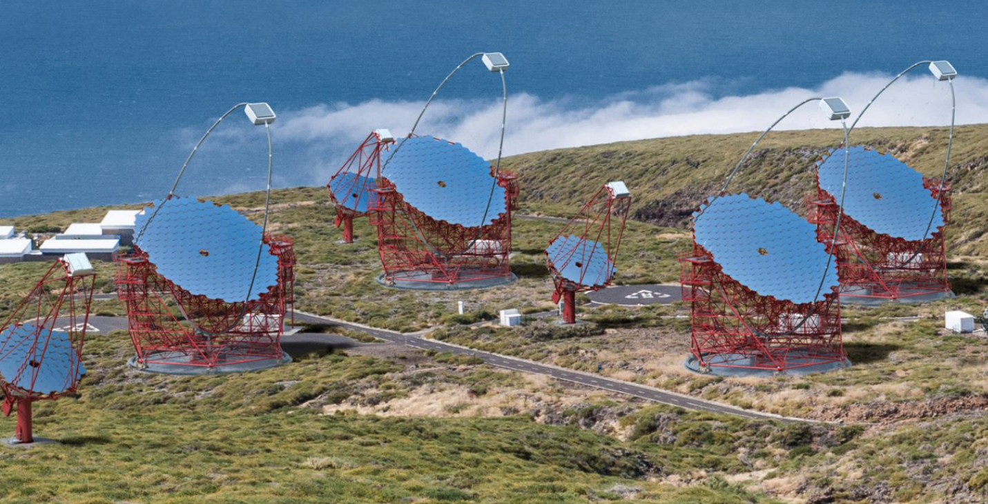
Conclusions
https://de.wikipedia.org
20 TeV pulsations from the Vela pulsar! More coming...
CTAO Pulsar Programme!
Convolution of particle dynamics & emission geometry:
imprints on light curves, spectra, polarisation
Unprecedented constraints
on models
Important to estimate
TeV pulsar visibility
High Energy Astrophysics in Southern Africa (HEASA2026), Cape Town, South Africa, 29/9 – 3/10
https://www.innovationnewsnetwork.com/cherenkov-telescope-array/973/

Slide 20
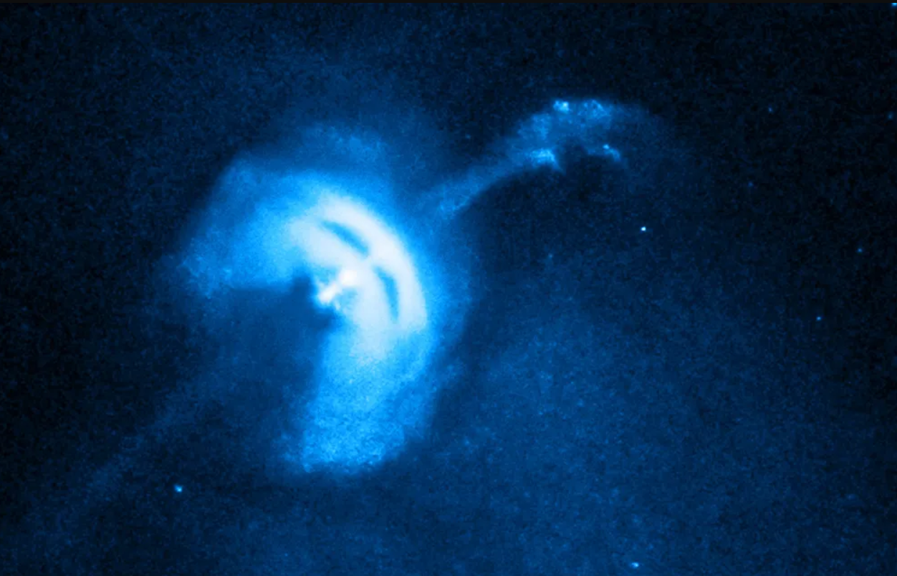


Thanks!
https://i0.wp.com/www.redorbit.com/wp-content/uploads/2016/02/vela_lg.jpg?fit=1000%2C640&ssl=1
“The heavens proclaim the glory of God. The skies display His craftsmanship.” (Ps. 19:1 NLT).

