Slide 1
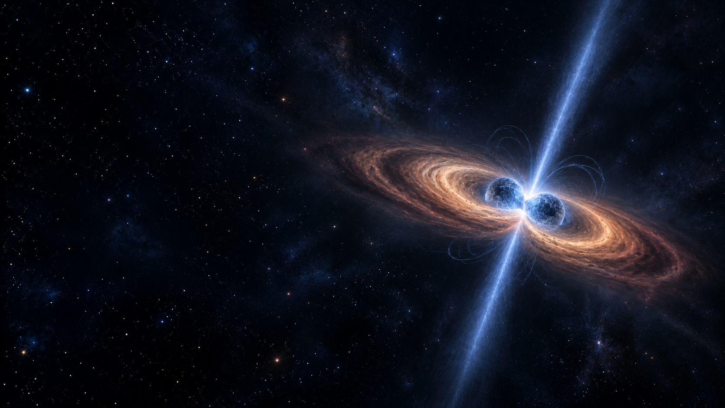



Research Presentation
Probing magnetar central engines in short GRBs
through fallback accretion and extended X-ray emission
Presented by
Ankur Ghosh
In collaboration with
Vivek Akhileshwar, Soebur Razzaque, Jagdish Joshi, Lutendo Nyadzani
Date: 01.10.2026

Slide 2

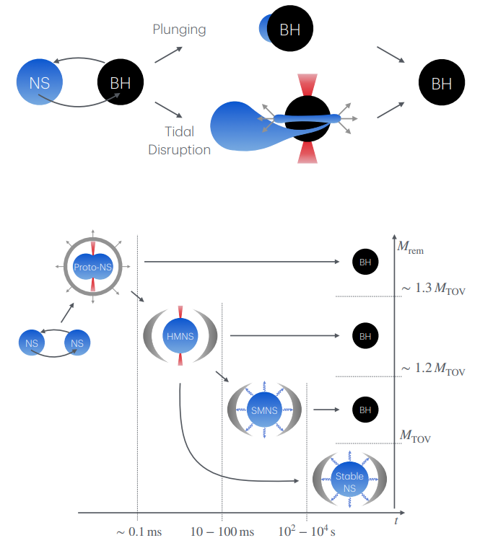
Short GRBs in a blink
Source: https://link.springer.com/article/10.1007/s41114-020-00028-7

Slide 3
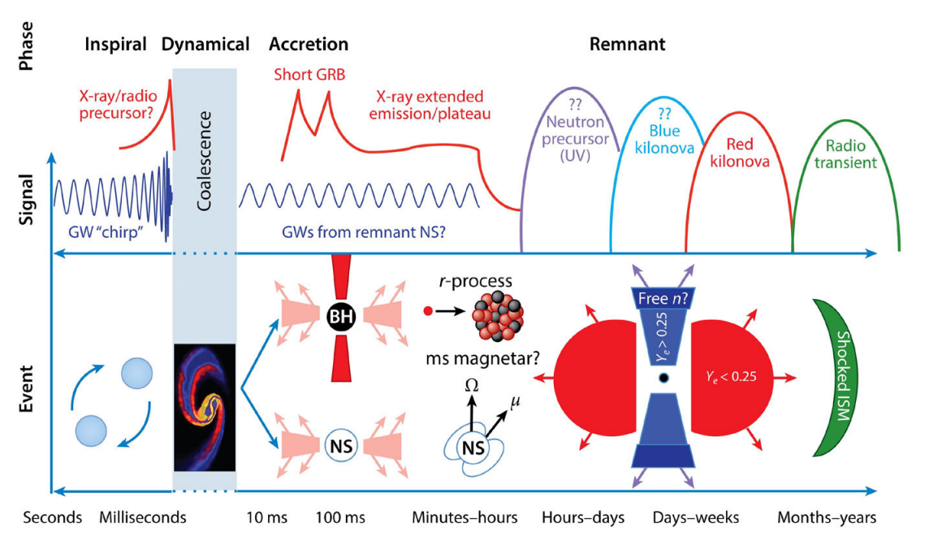
Short GRBs in a blink
Source: https://link.springer.com/article/10.1007/s41114-020-00028-7
Source: https://iopscience.iop.org/article/10.3847/1538-4357/ae5535

Slide 4
Short GRBs in a blink
Motivation of Our Study
01
Probe the presence of magnetar remnant in short GRBs with extended emission.
02
Constrain the magnetar parameters to check the correlation between the parameters and get indirect evidence for binary neutron star masses.
Source: https://link.springer.com/article/10.1007/s41114-020-00028-7
Source: https://iopscience.iop.org/article/10.3847/1538-4357/ae5535

Slide 5

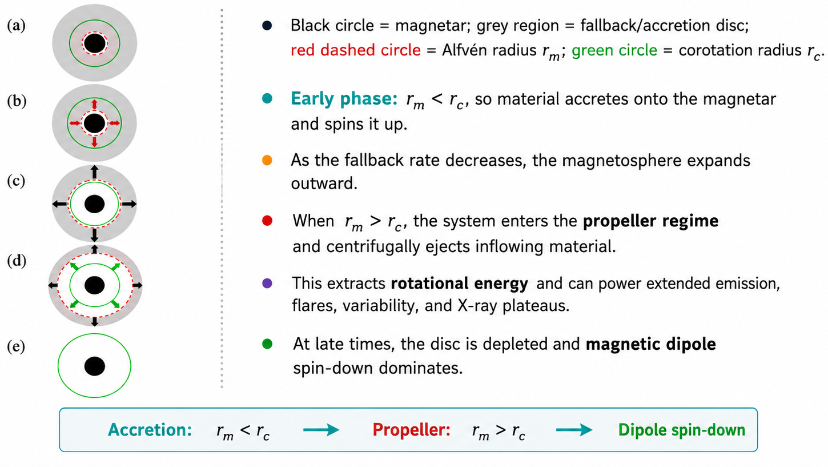
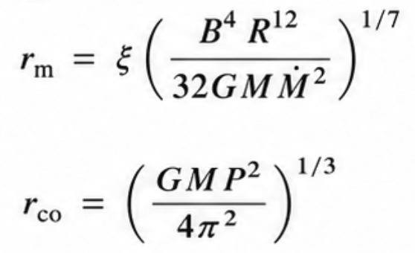
Fallback Accretion and Magnetar Propeller Model
Piro & Ott (2011) and Gompertz et al. (2014)

Slide 6
Sample Selection Criteria
STEP 01
STEP 02
STEP 03
STEP 04
TARGET SAMPLE
144
Short GRBs Detected
Years 2016 – 2025
62
Detected by XRT
Swift X-ray Telescope
22
Measured Redshift
Known redshift (z)
16
Luminosity Cut-off
Threshold applied
9
Extended Emission
Final GRB study set

Slide 7
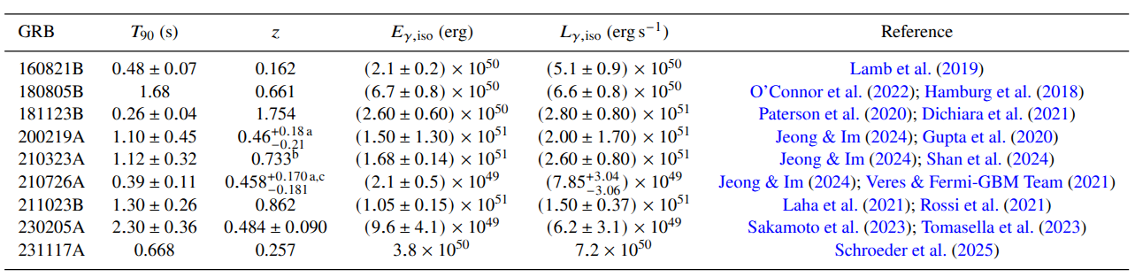
Sample Selection Criteria
STEP 01
STEP 02
STEP 03
STEP 04
TARGET SAMPLE
144
Short GRBs Detected
Years 2016 – 2025
62
Detected by XRT
Swift X-ray Telescope
22
Measured Redshift
Known redshift (z)
16
Luminosity Cut-off
Threshold applied
9
Extended Emission
Final GRB study set
short GRB SAMPLE PROPERTIES

Slide 8
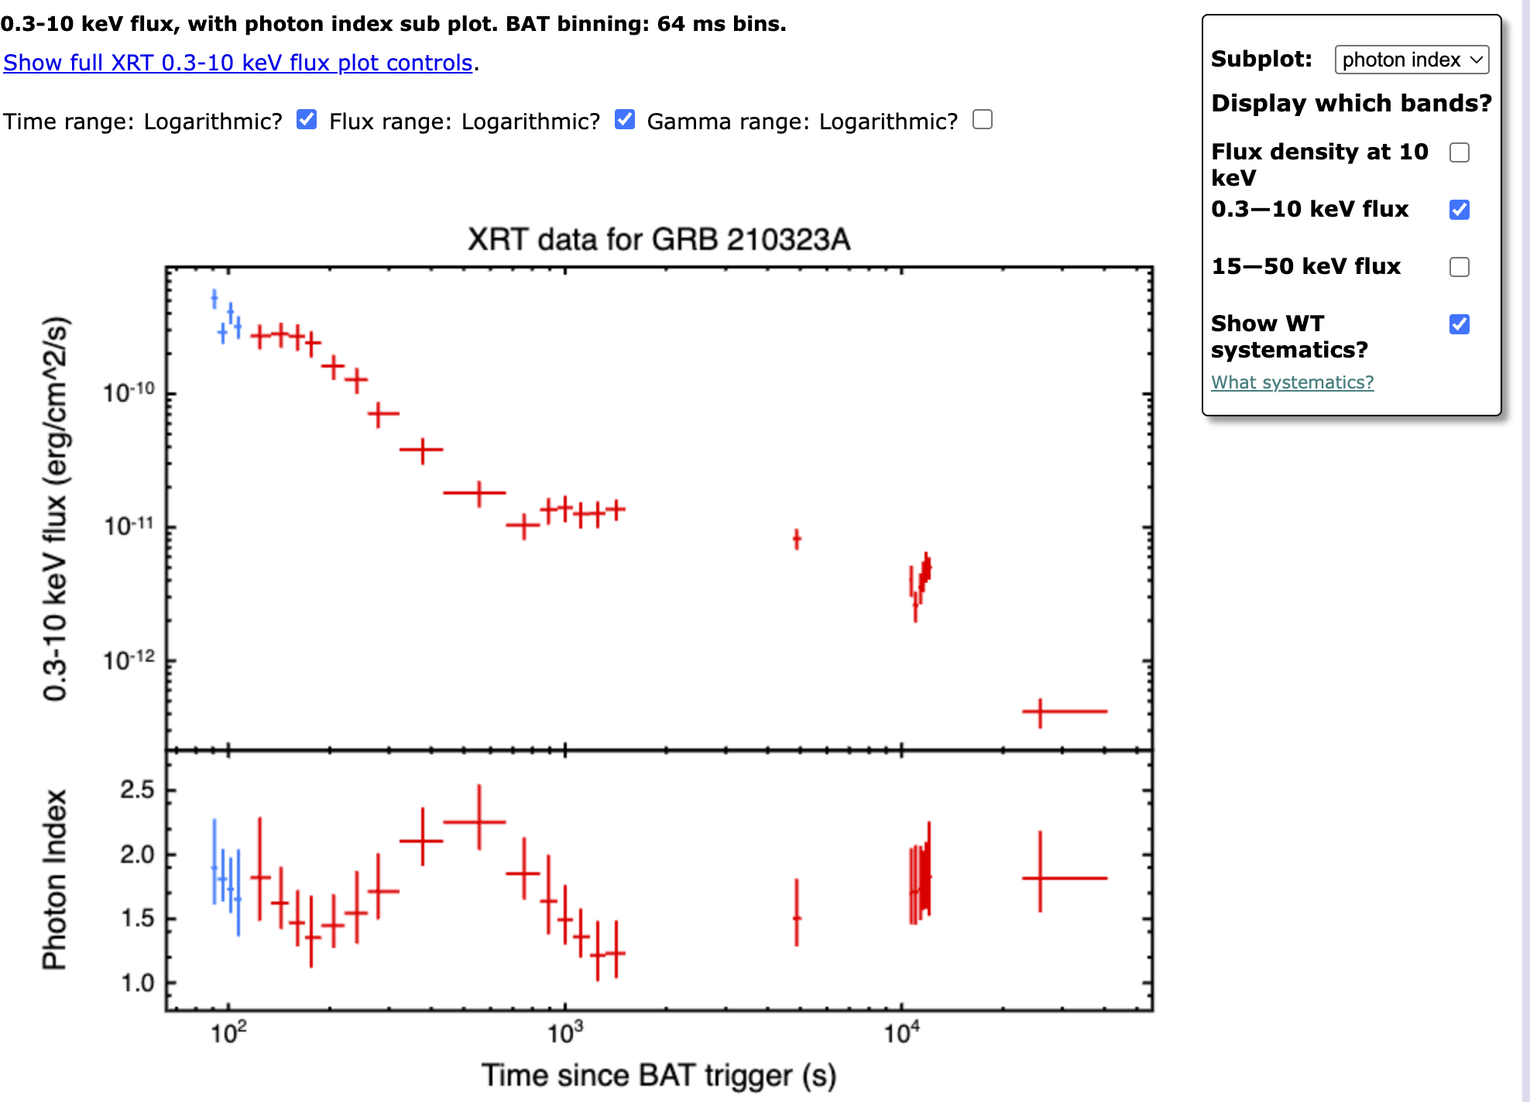
Data collection and conversion
https://www.swift.ac.uk/burst_analyser/01038247/

Slide 9
Data collection and conversion
https://www.swift.ac.uk/burst_analyser/01038247/

Slide 10
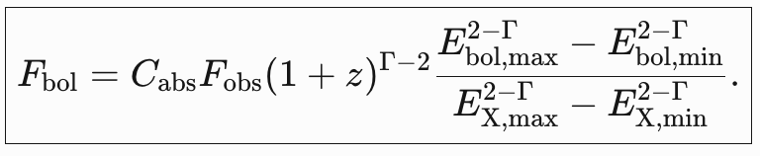

Data collection and conversion
https://www.swift.ac.uk/burst_analyser/01038247/

Slide 11
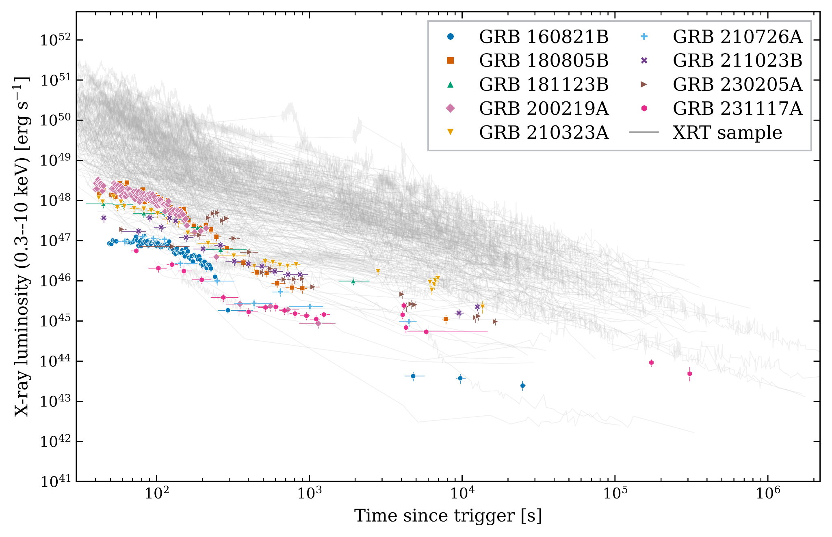
Data collection and conversion
https://www.swift.ac.uk/burst_analyser/01038247/
Luminosity of sample short GRBs in comparison to other XRT detected GRBs

Slide 12
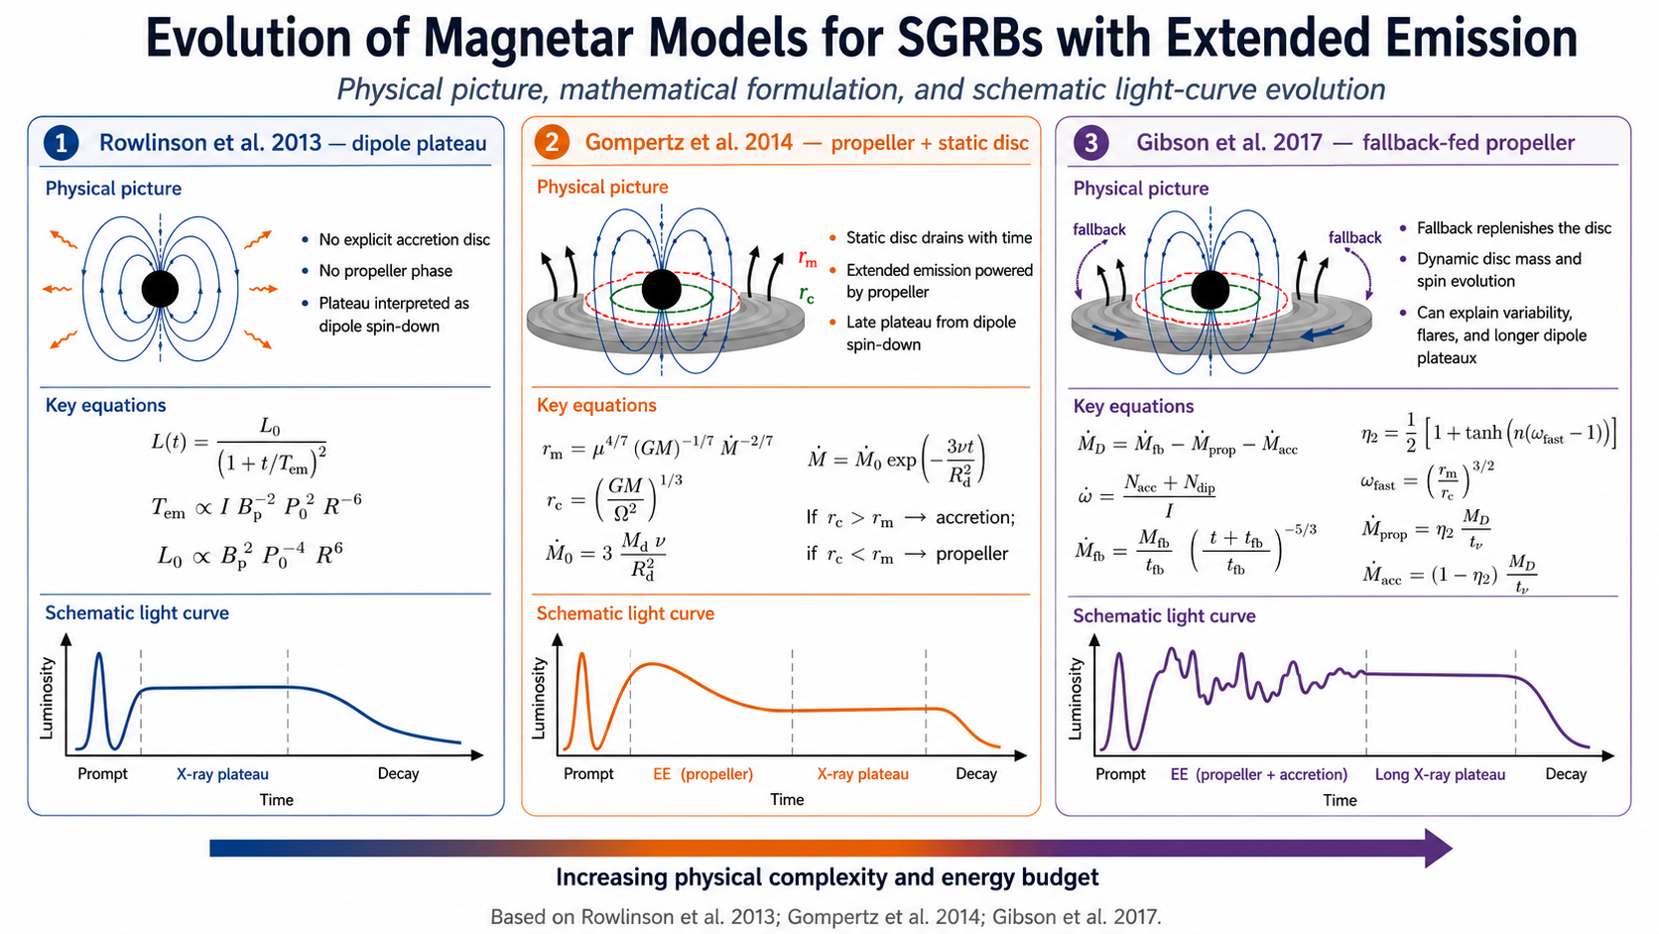

Slide 13




Magnetar central-engine luminosity model
Propeller + magnetic-dipole channels used to compare the model with bolometric luminosity data
Core equations
Physical readout
REGIME SWITCH
Magnetar spin
determines how the disc flow is divided into accretion and propeller ejection
rotational reservoir
PROPELLER LUMINOSITY
Propeller
Dipole
rotational power extracted from the magnetar minus the energy cost of ejecting matter
ejected disc material
magnetic spin-down
DIPOLE LUMINOSITY
magnetic spin-down channel; very sensitive to spin period, Ldip ∝ B²P⁻⁴
Observed model
TOTAL MODEL
beamed total luminosity
beaming-corrected luminosity fitted to the bolometric light curve
Key message
η₂ selects the accretion/propeller regime; ηprop and ηdip convert engine power into radiation; 1/fB accounts for beaming.
Definitions:
Compare Ltot(trest) with bolometric luminosity.

Slide 14
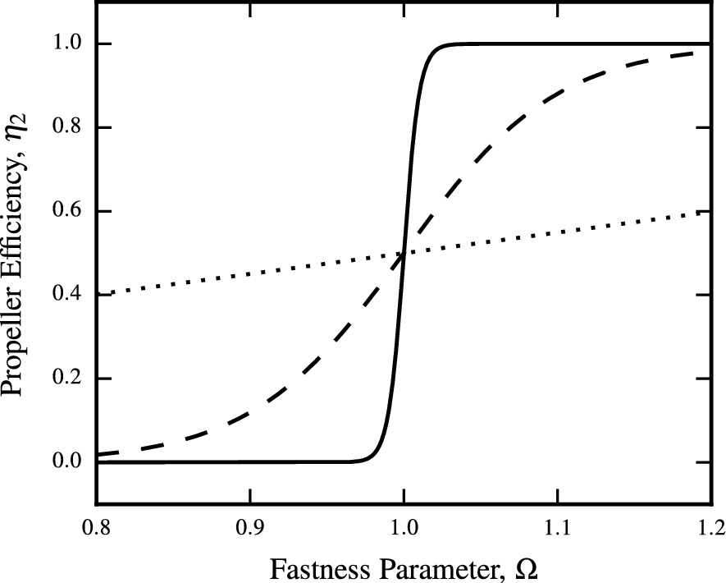
Magnetar central-engine luminosity model
Propeller + magnetic-dipole channels used to compare the model with bolometric luminosity data
Core equations
REGIME SWITCH
determines how the disc flow is divided into accretion and propeller ejection
PROPELLER LUMINOSITY
rotational power extracted from the magnetar minus the energy cost of ejecting matter
DIPOLE LUMINOSITY
magnetic spin-down channel; very sensitive to spin period, Ldip ∝ B²P⁻⁴
TOTAL MODEL
beaming-corrected luminosity fitted to the bolometric light curve
Definitions:

Slide 15
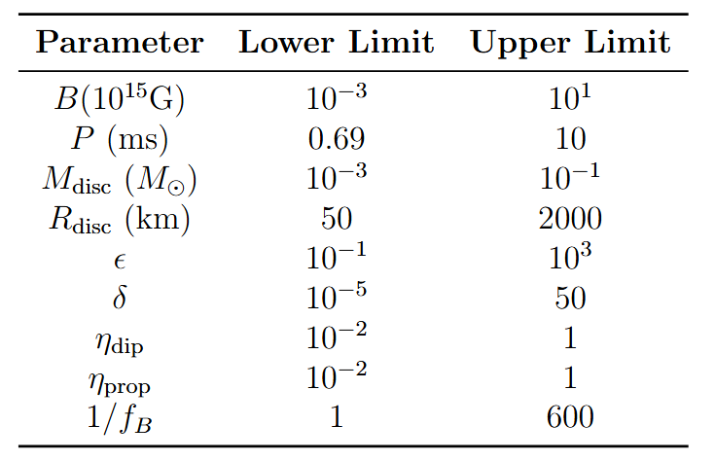
Fitting Analysis
Parameter estimation using MCMC sampling within a Bayesian framework.
Explored smoothing parameter: n = 1, 10, 100.
Models tested with 6 to 9 free parameters.
Multi-band fitting performed in:
Model performance evaluated using Reduced χ², AICc, and BIC.
Parameters | Symbol | Physical Meaning | p = 6 | p = 7 | p = 8 | p = 9
Magnetic field | (B) | Magnetar surface field strength | ✓ | ✓ | ✓ | ✓
Initial spin period | (P_i) | Initial rotation of magnetar | ✓ | ✓ | ✓ | ✓
Initial disc mass | (M_{D,i}) | Mass of accretion disc | ✓ | ✓ | ✓ | ✓
Disc radius | (R_D) | Size of accretion disc | ✓ | ✓ | ✓ | ✓
Fallback timescale ratio | (\epsilon) | Controls fallback duration | ✓ | ✓ | ✓ | ✓
Fallback mass fraction | (\delta) | Available fallback mass | ✓ | ✓ | ✓ | ✓
Beaming factor | (1/f_B) | Jet collimation (anisotropy) | ✗ | ✓ | ✗ | ✓
Dipole efficiency | (\eta_dip) | Spin-down → radiation efficiency | ✗ | ✗ | ✓ | ✓
Propeller efficiency | (\eta_prop) | Propeller → radiation efficiency | ✗ | ✗ | ✓ | ✓
0.3-10 kev
15-50 kev
Native Band

Slide 16
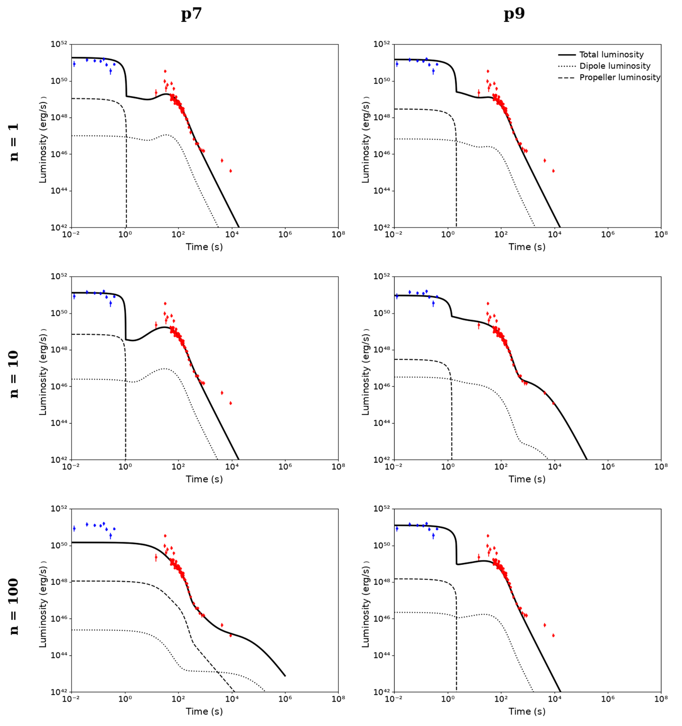
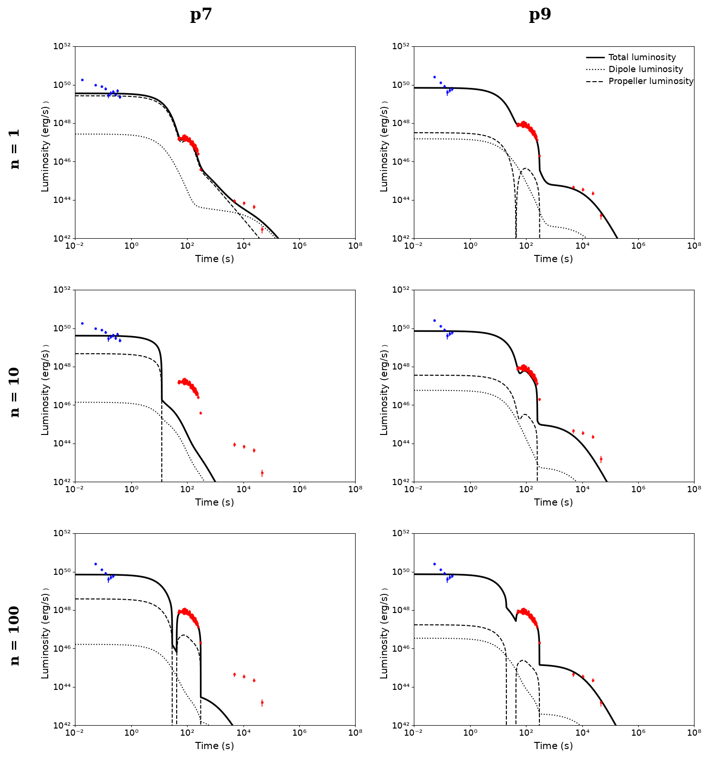
Fitting Results
GRB 160821B
GRB 180805B

Slide 17
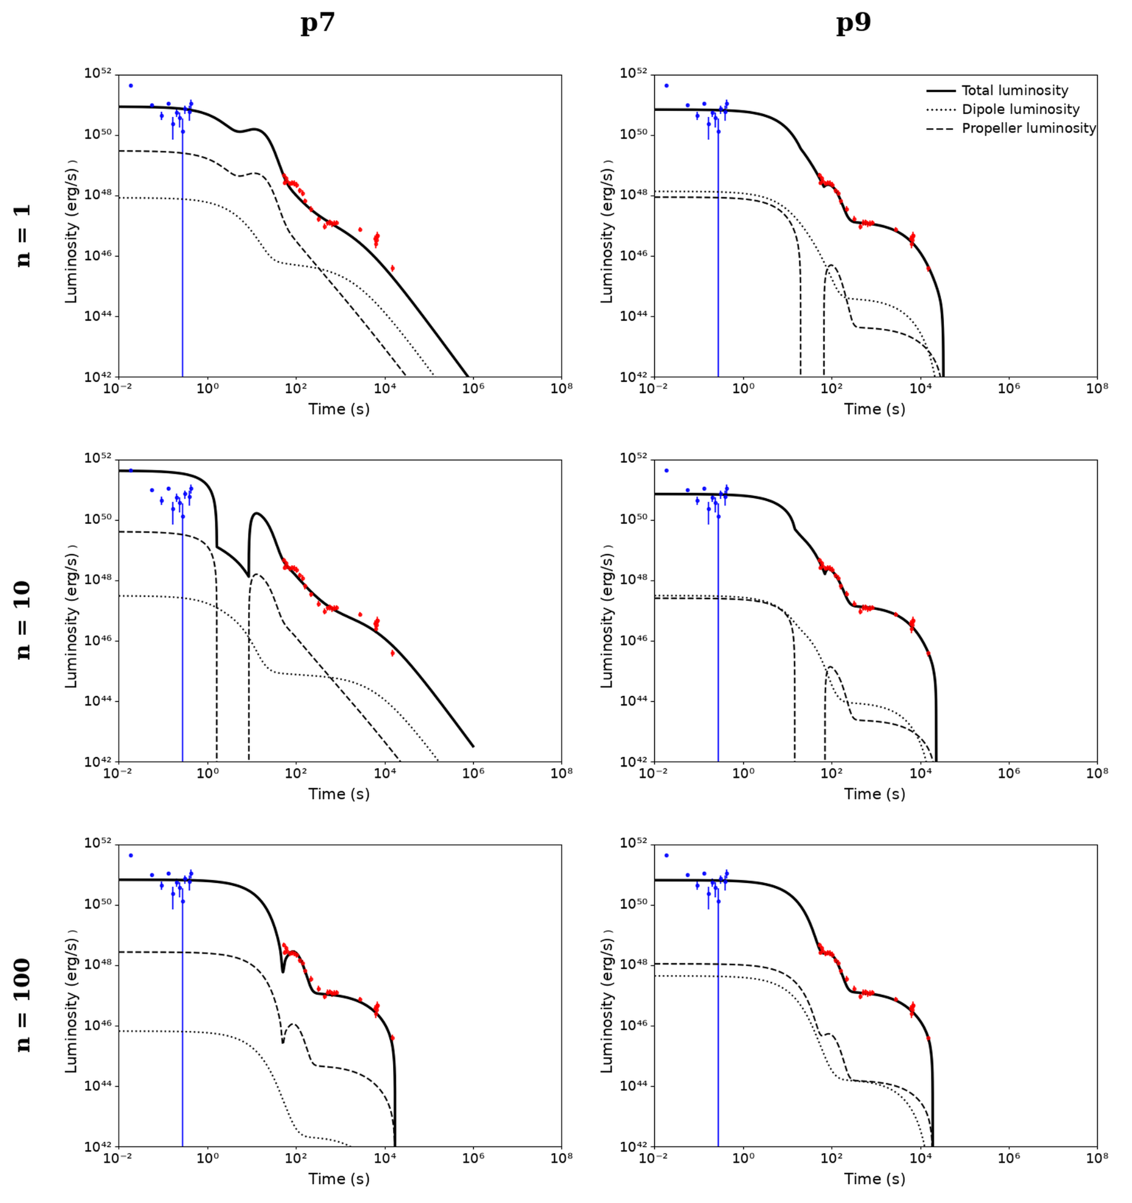
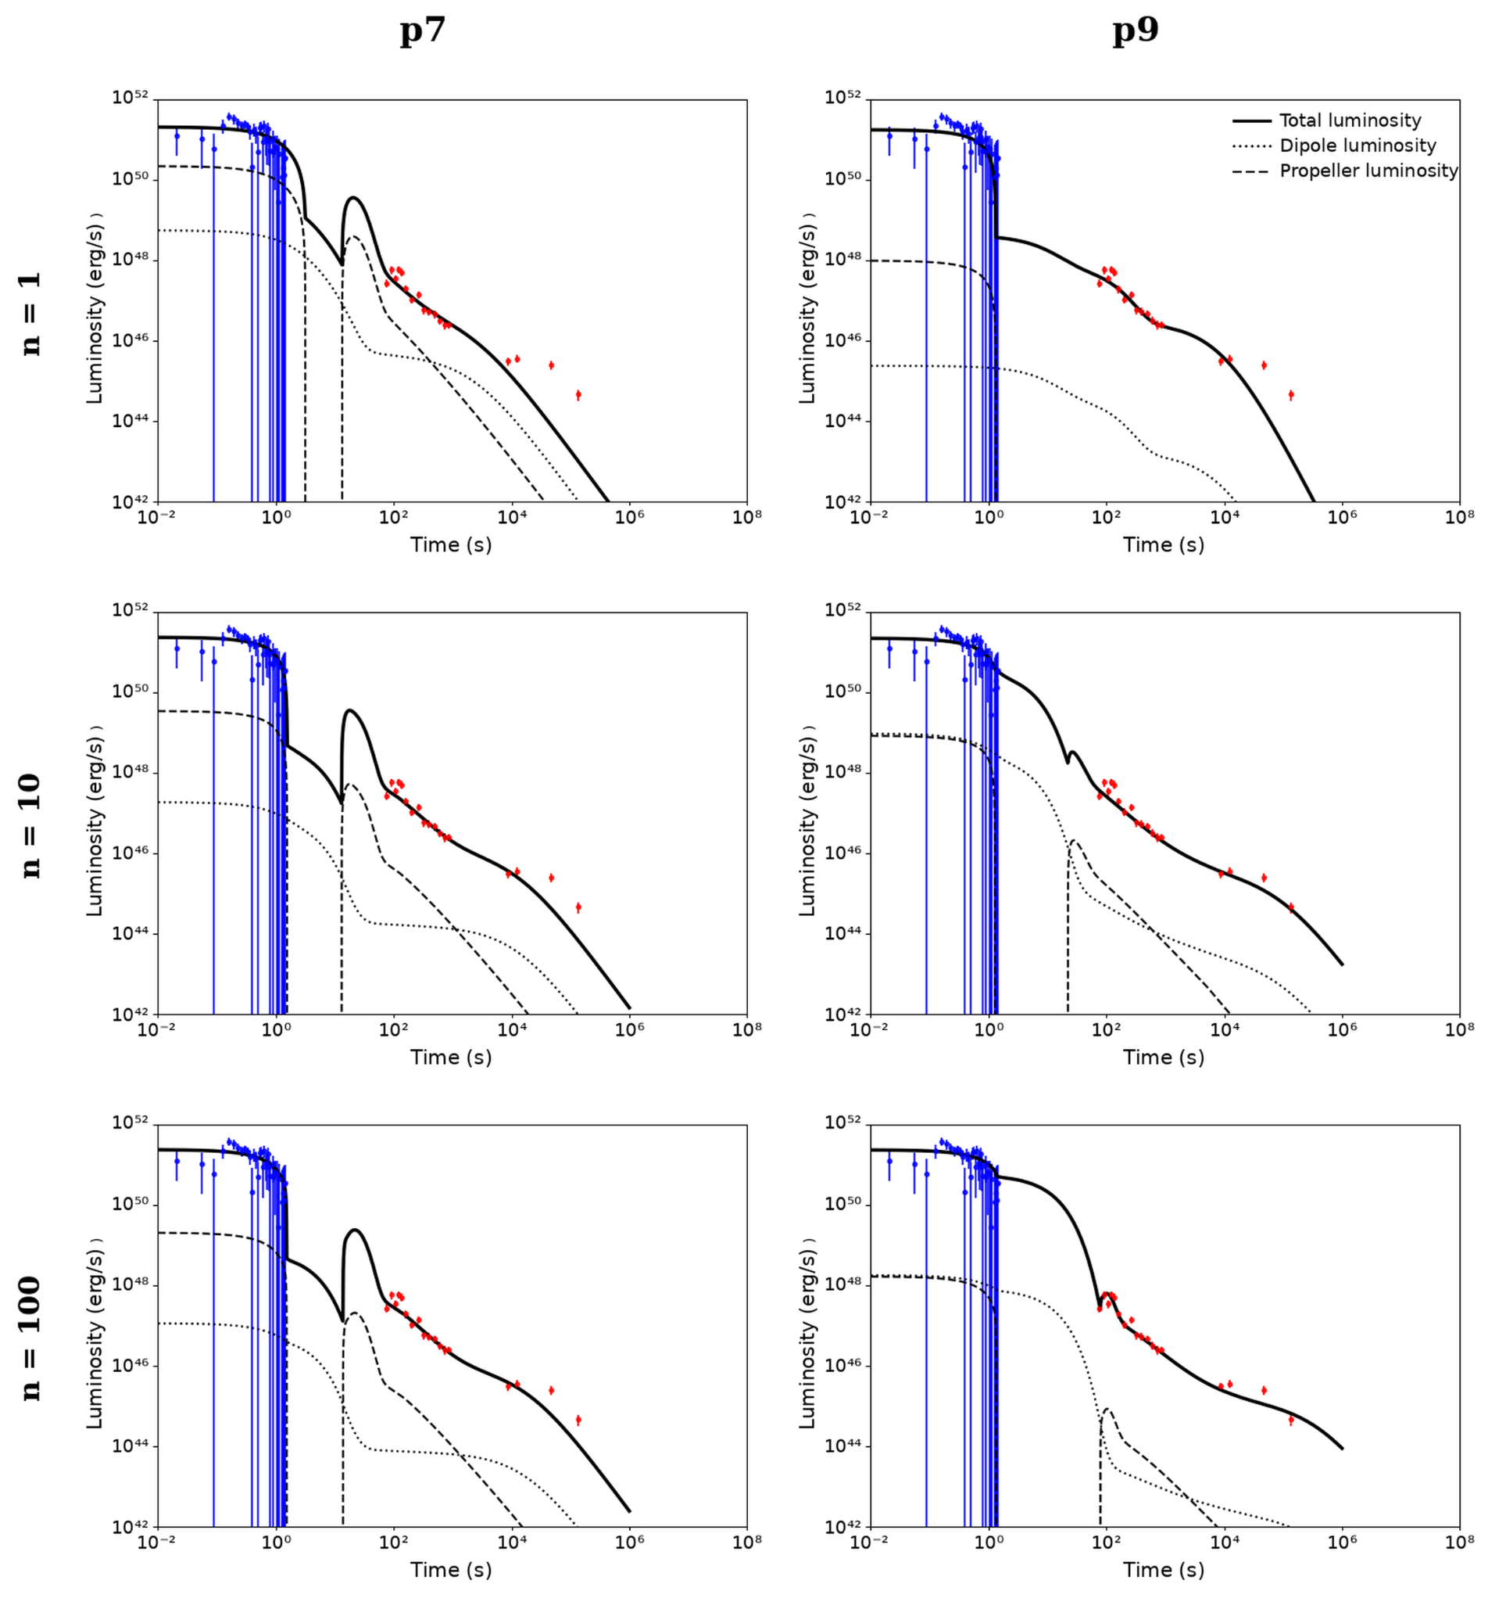
Fitting Results
GRB 210323A
GRB 211023B

Slide 18

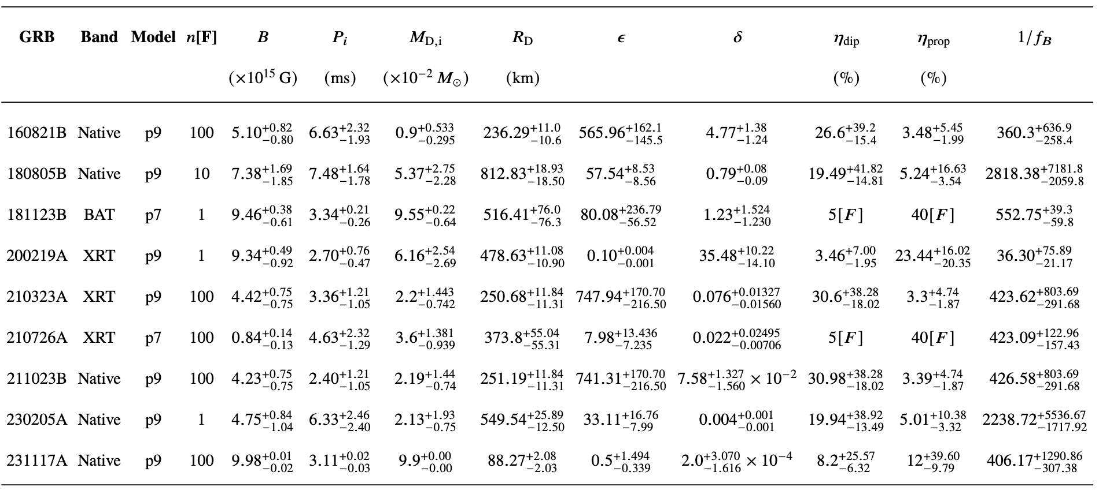
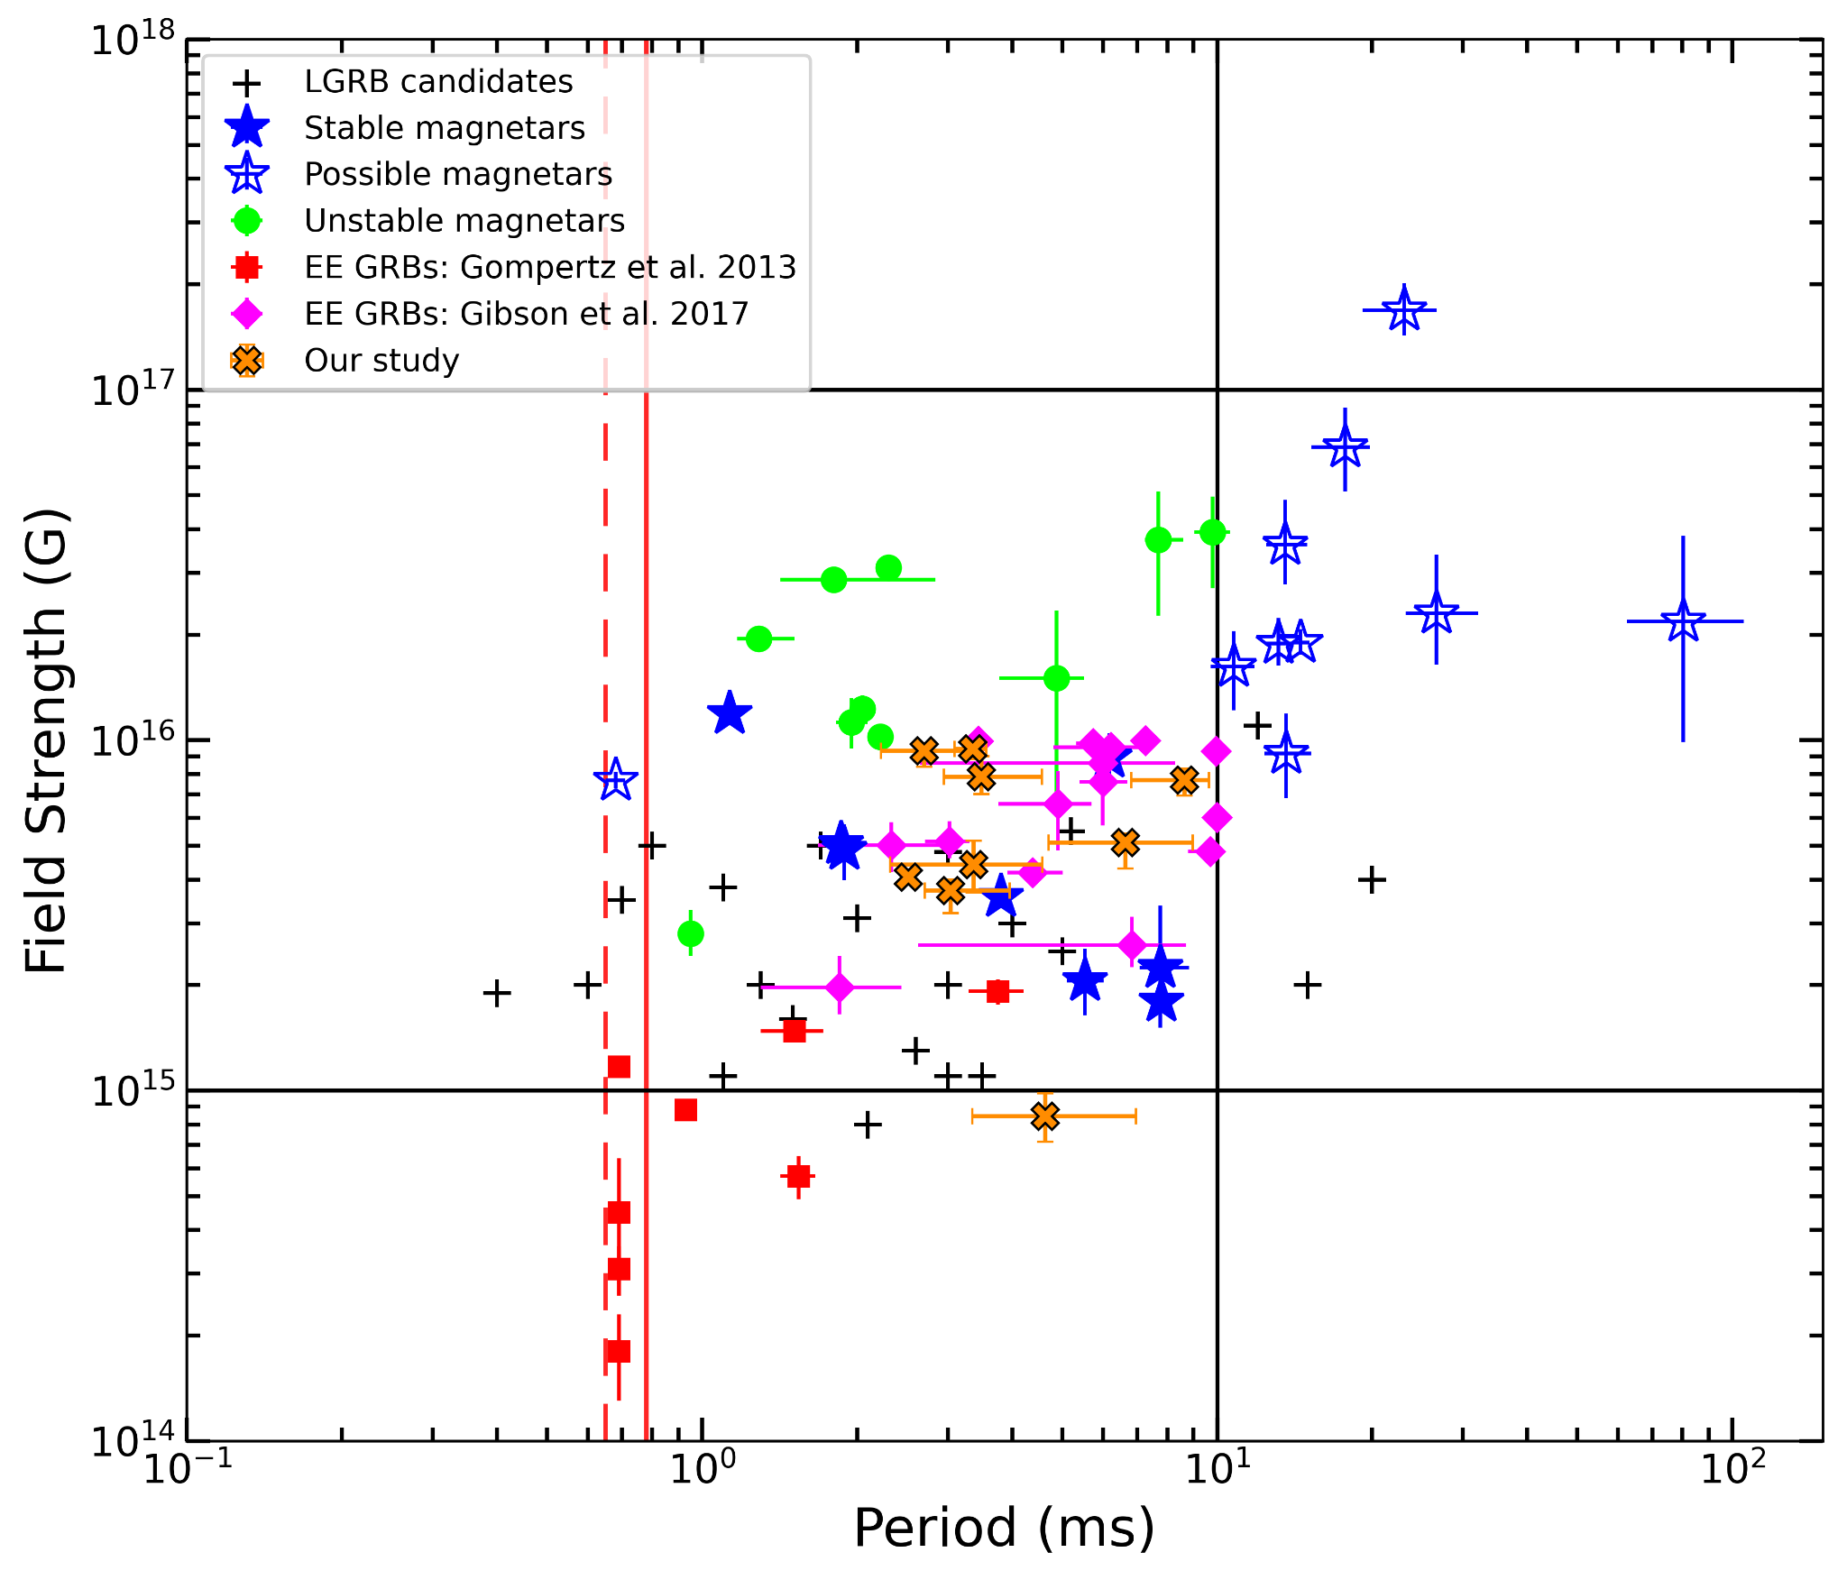
Interpretation of Results | Statistical Parameter Fitting & Sample Correlations
Summary of Derived Fit Parameters
Best-fit magnetar and accretion parameters evaluated across sample GRB events
Preliminary
Magnetic Field Strength vs. Spin Period

Slide 19
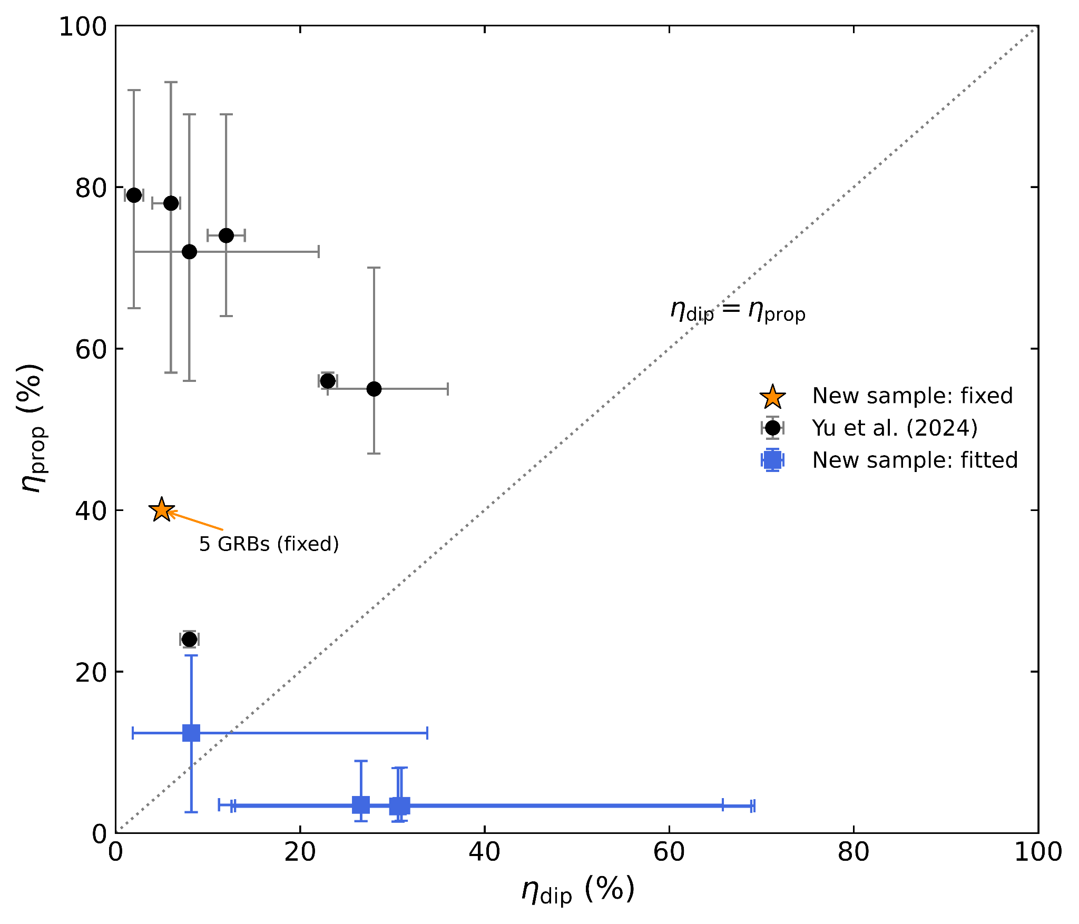
Efficiency Distribution (η_dip vs η_prop)
Interpretation of Results | Statistical Parameter Fitting & Sample Correlations
Summary of Derived Fit Parameters
Best-fit magnetar and accretion parameters evaluated across sample GRB events
Preliminary
Magnetic Field Strength vs. Spin Period

Slide 20
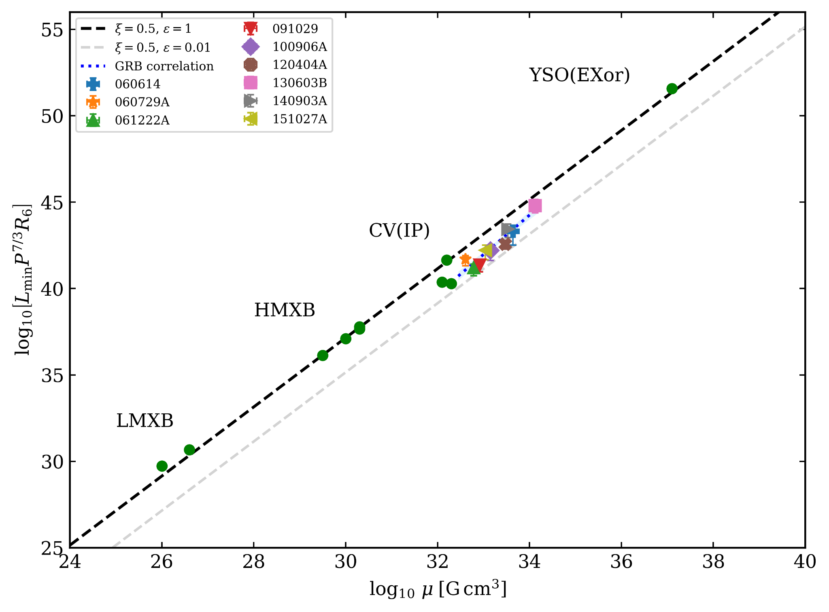
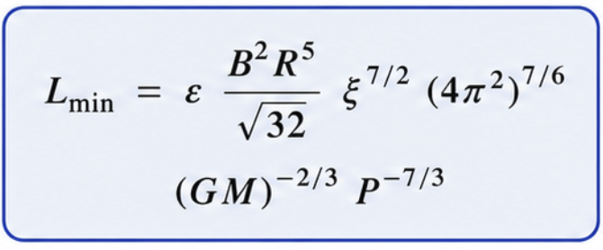
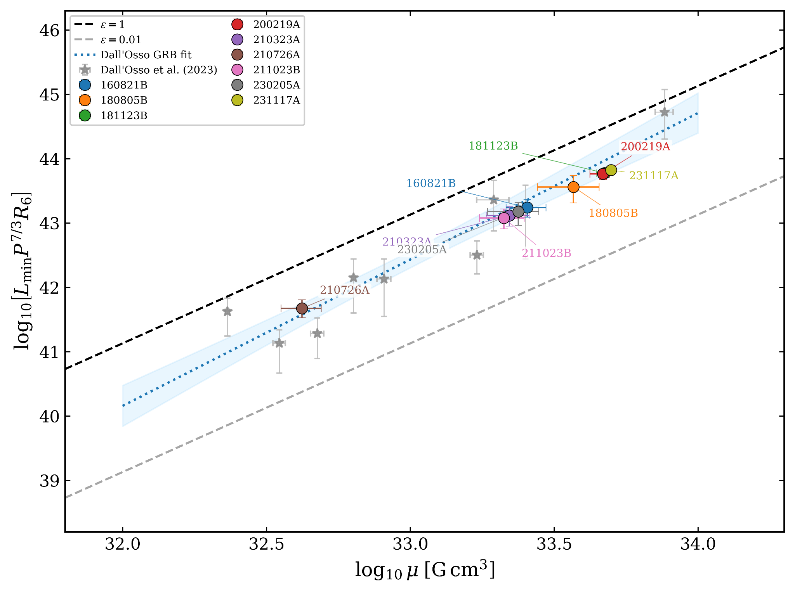
Universal Relation of Accreting Magnetic Stars
Preliminary
Preliminary
Preliminary

Slide 21
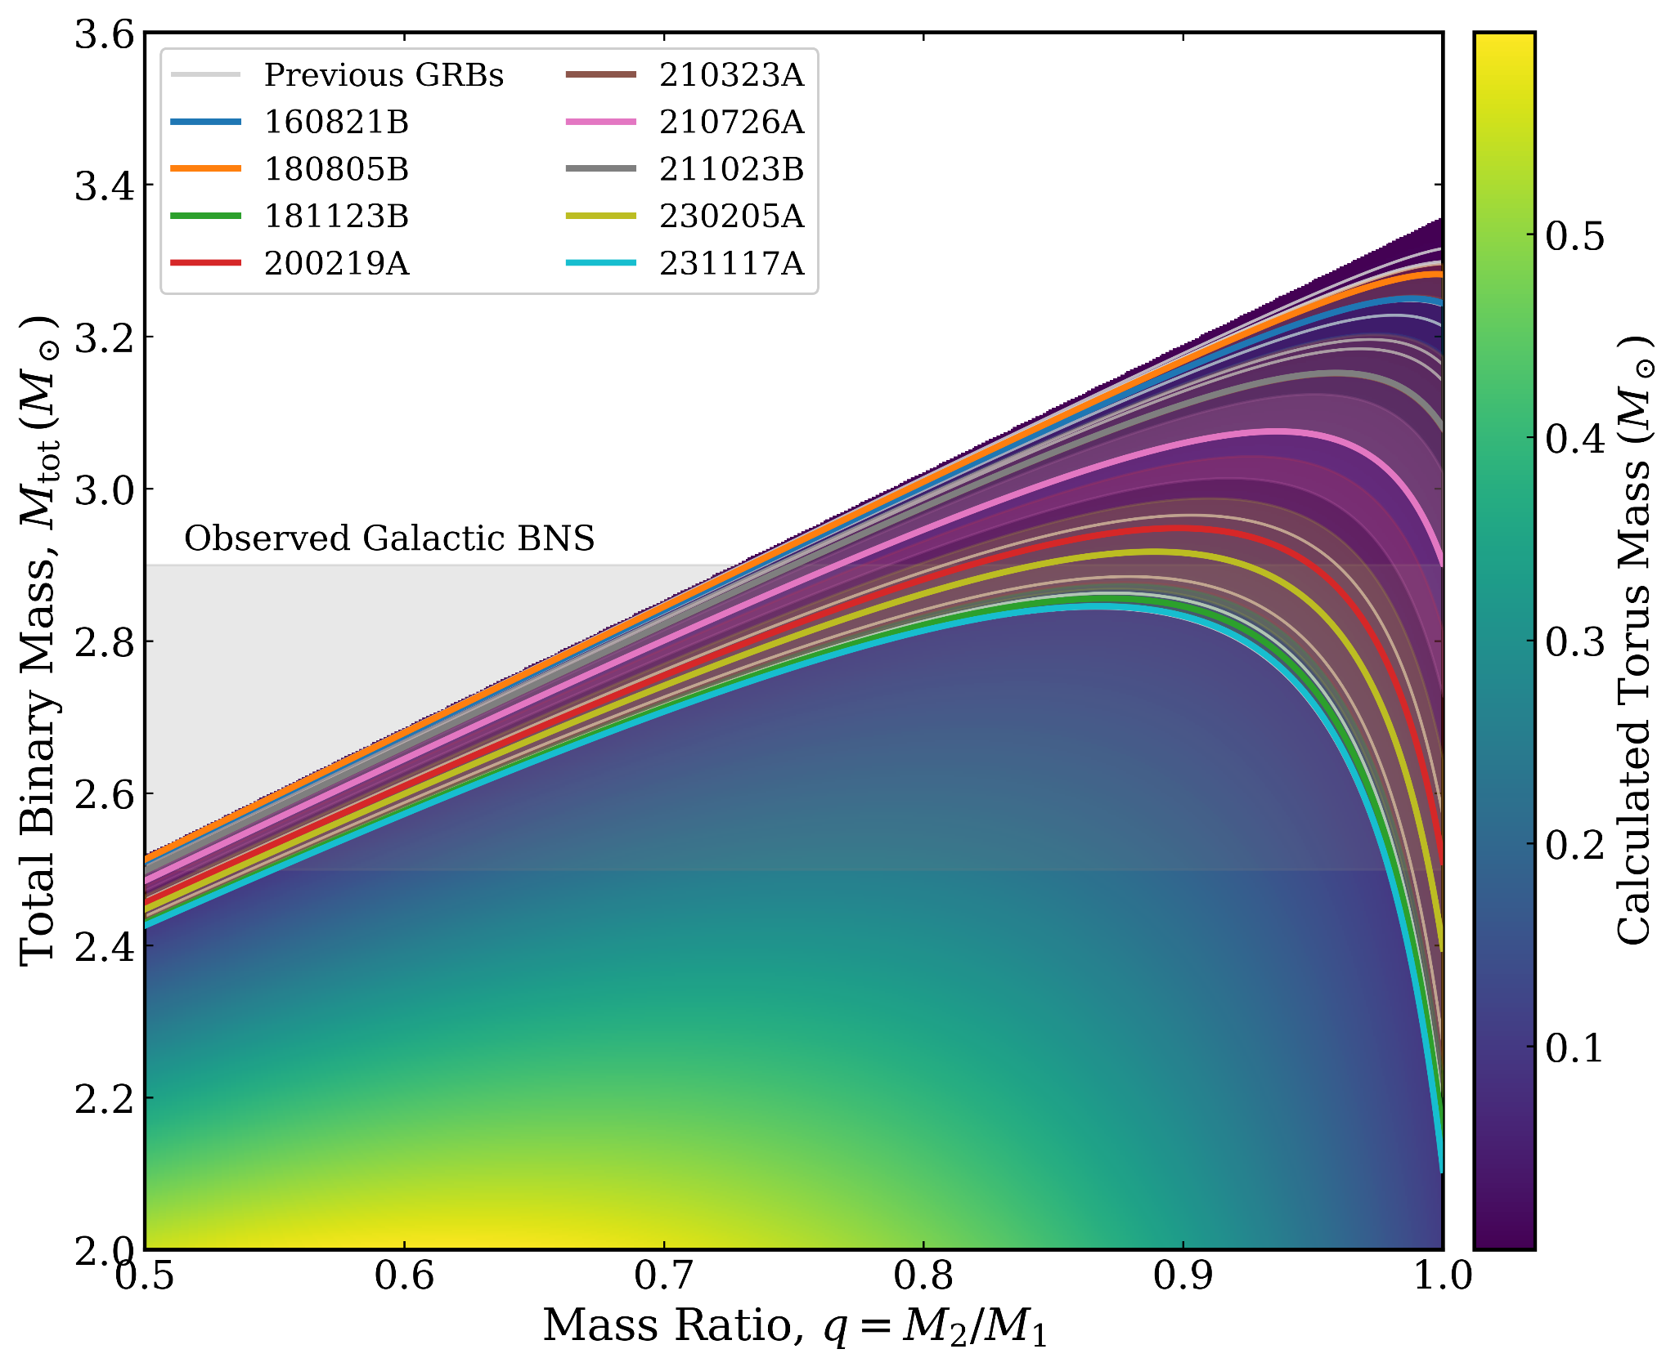
Universal Relation of Accreting Magnetic Stars
Parameter space for the binary neutron star merger
Preliminary
Preliminary
Preliminary

Slide 22
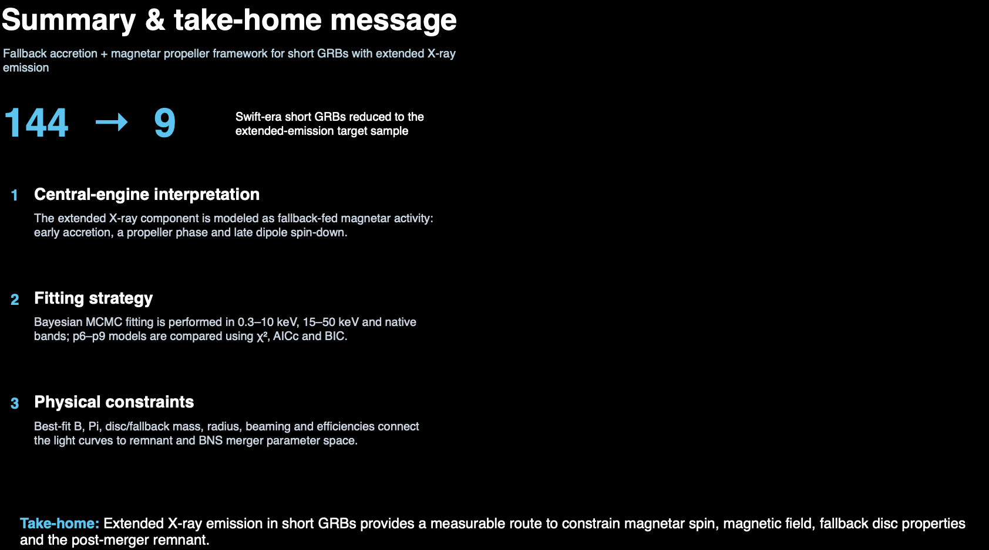

Slide 23
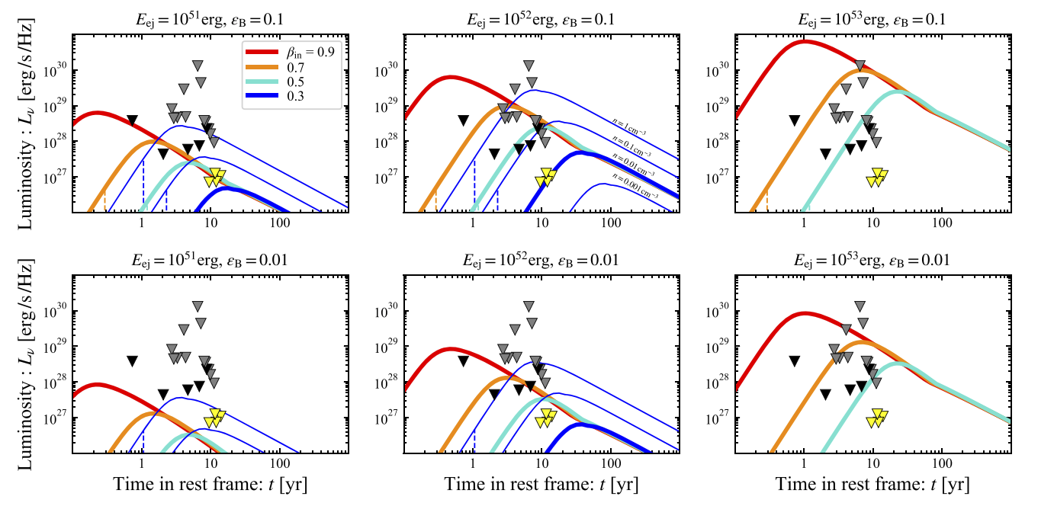
Future prospects
Magnetar driven radio emission from kilonova afterglow
Ghosh et al. 2024, Ricci et al. 2021

Slide 24

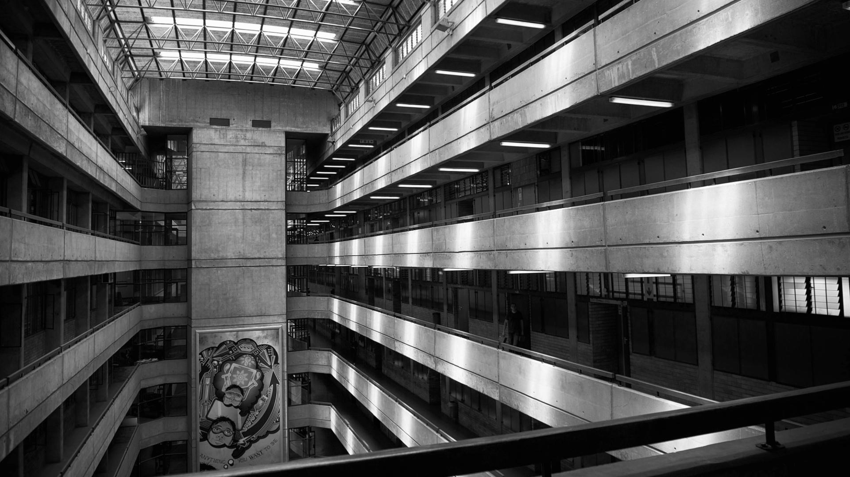
THANK YOU
THANK YOU

Slide 25
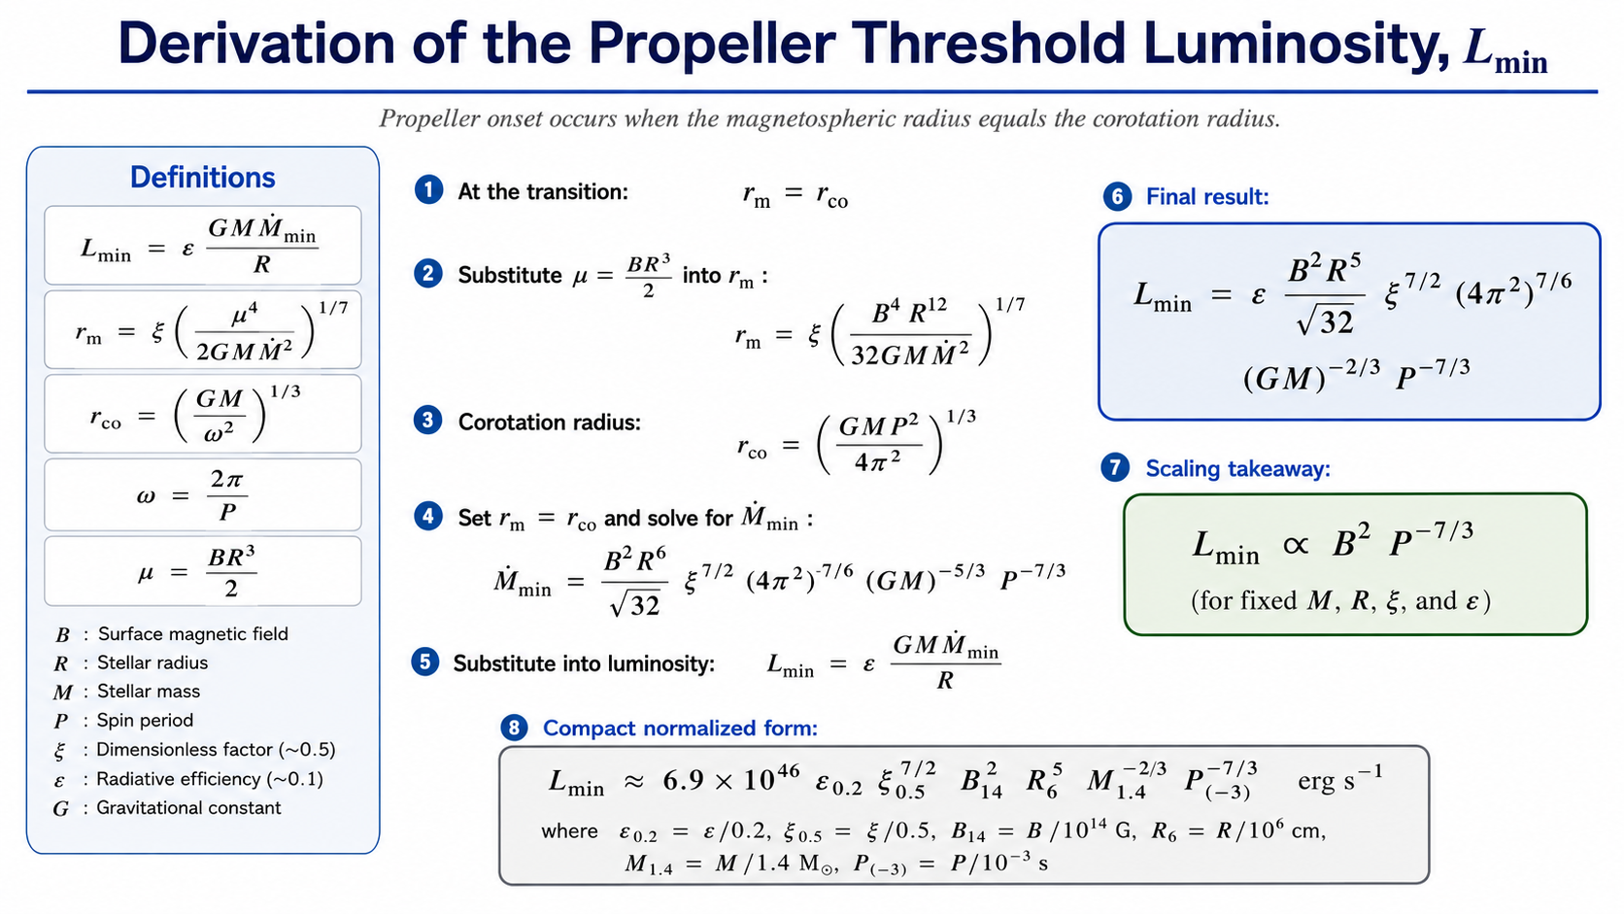
Dall’Osso et al.2023

Slide 26
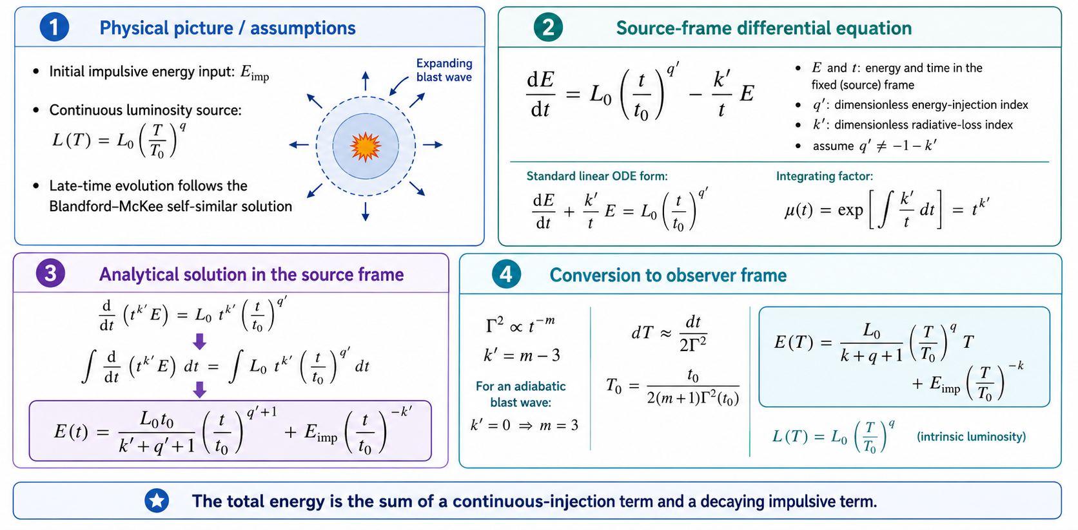
Formulations for continuous energy injection from magnetar

Slide 27
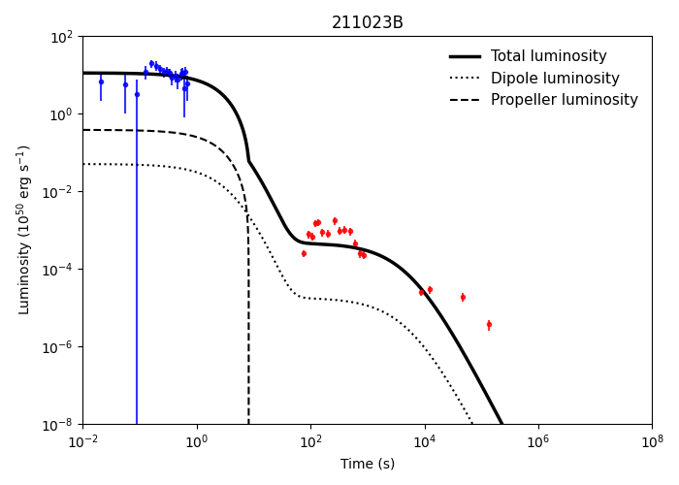
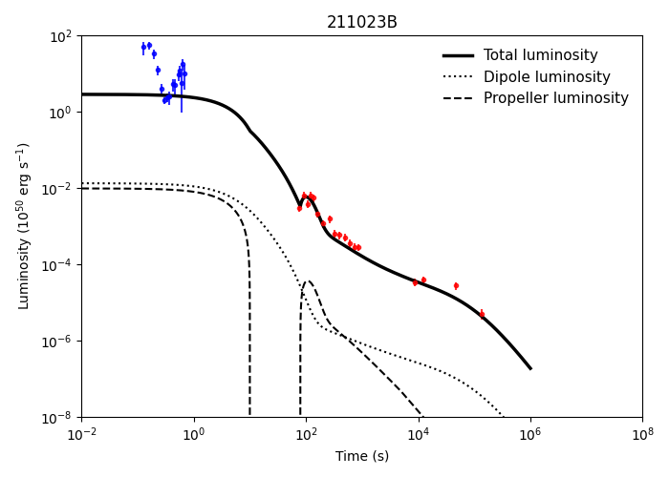
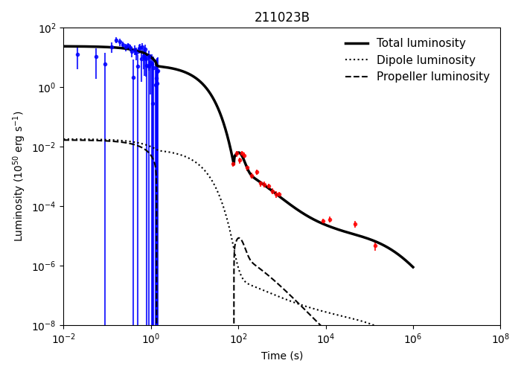
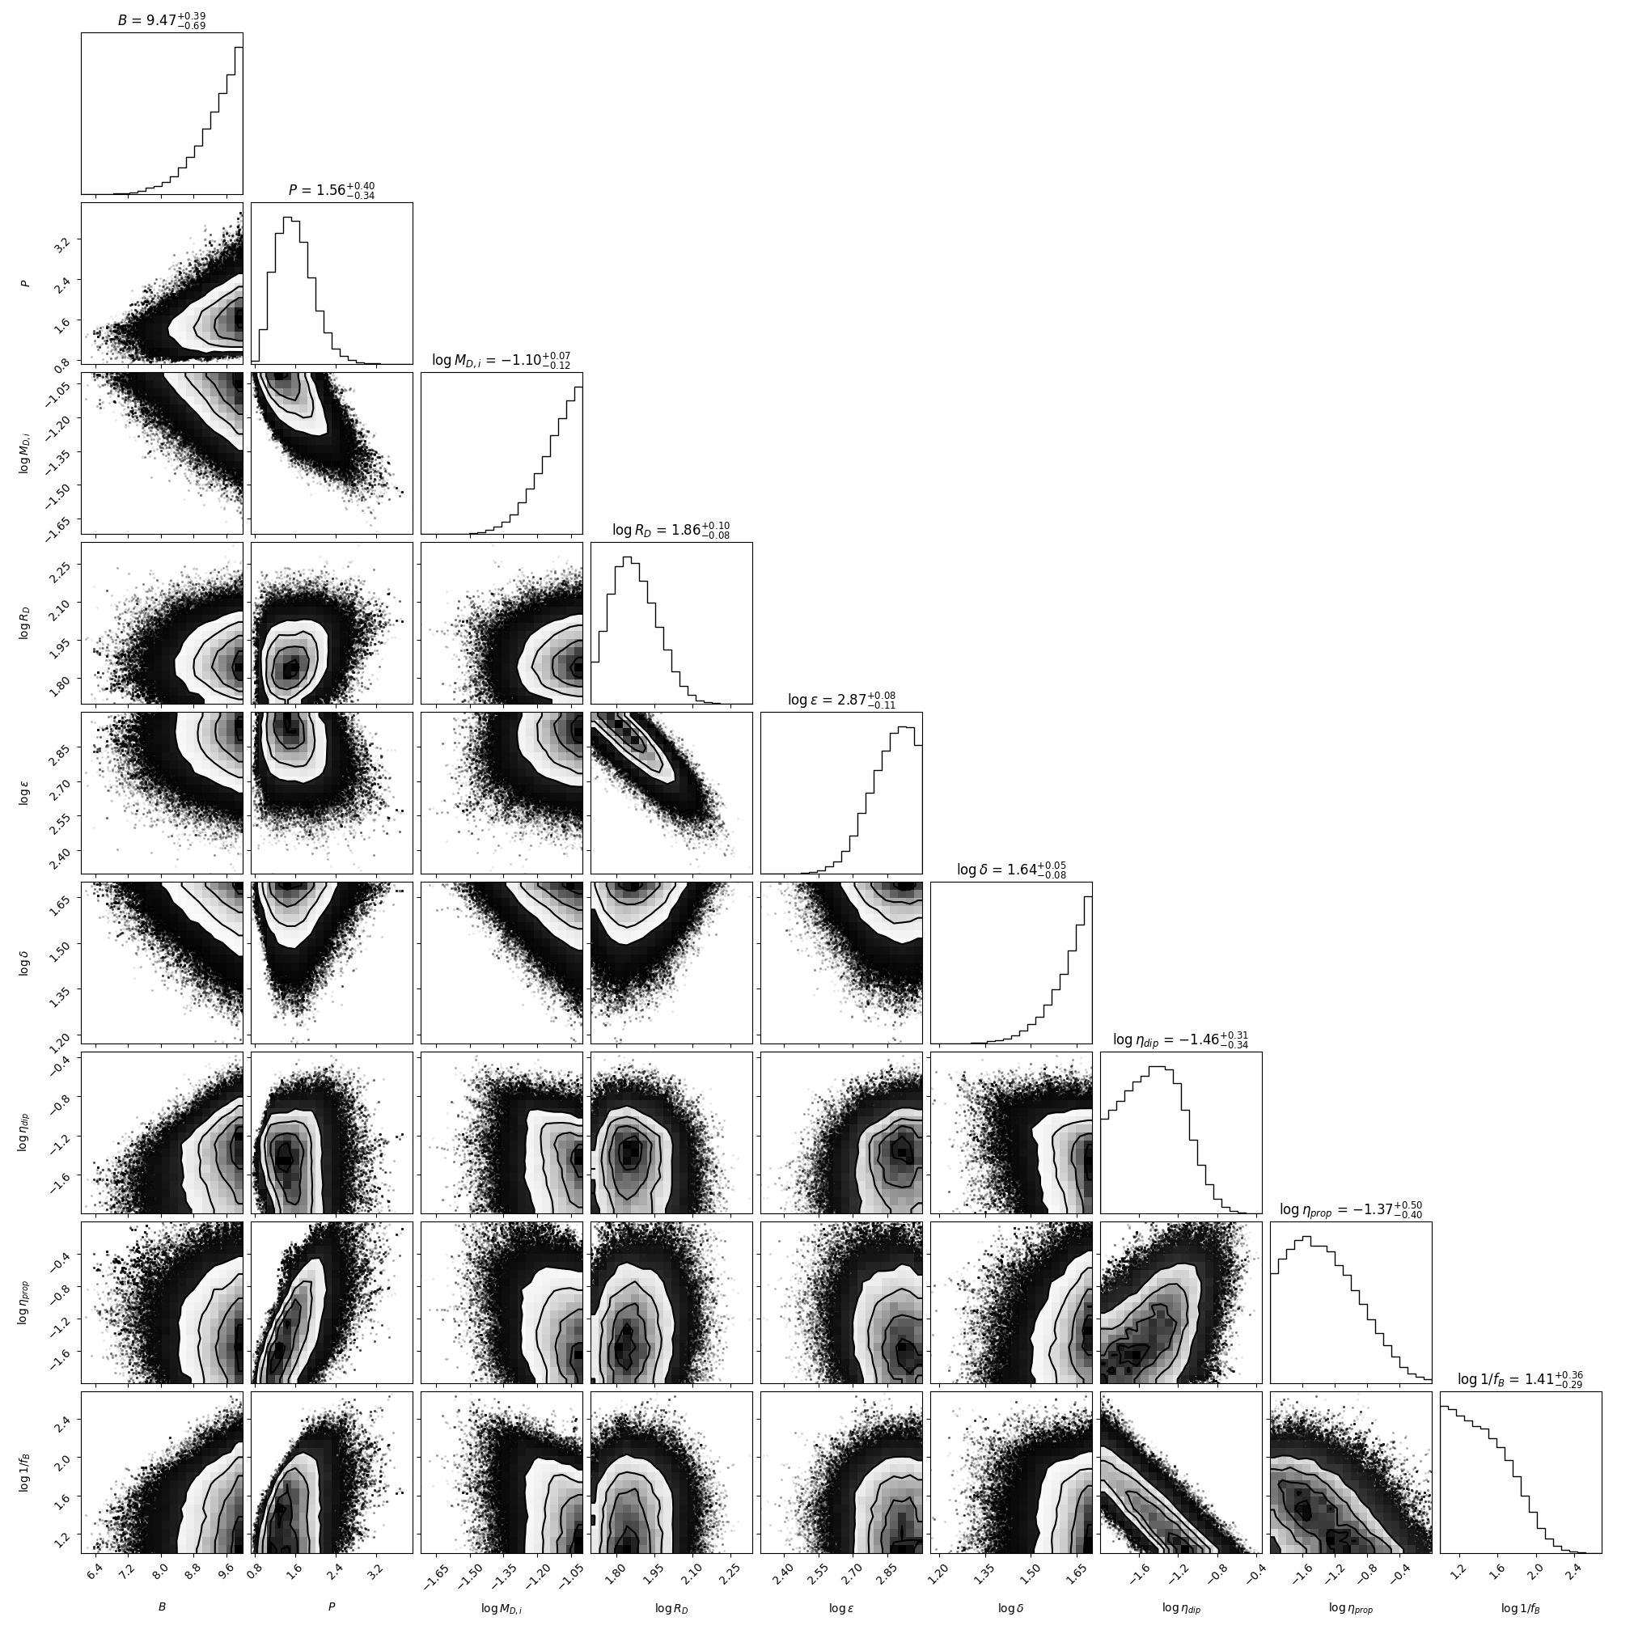
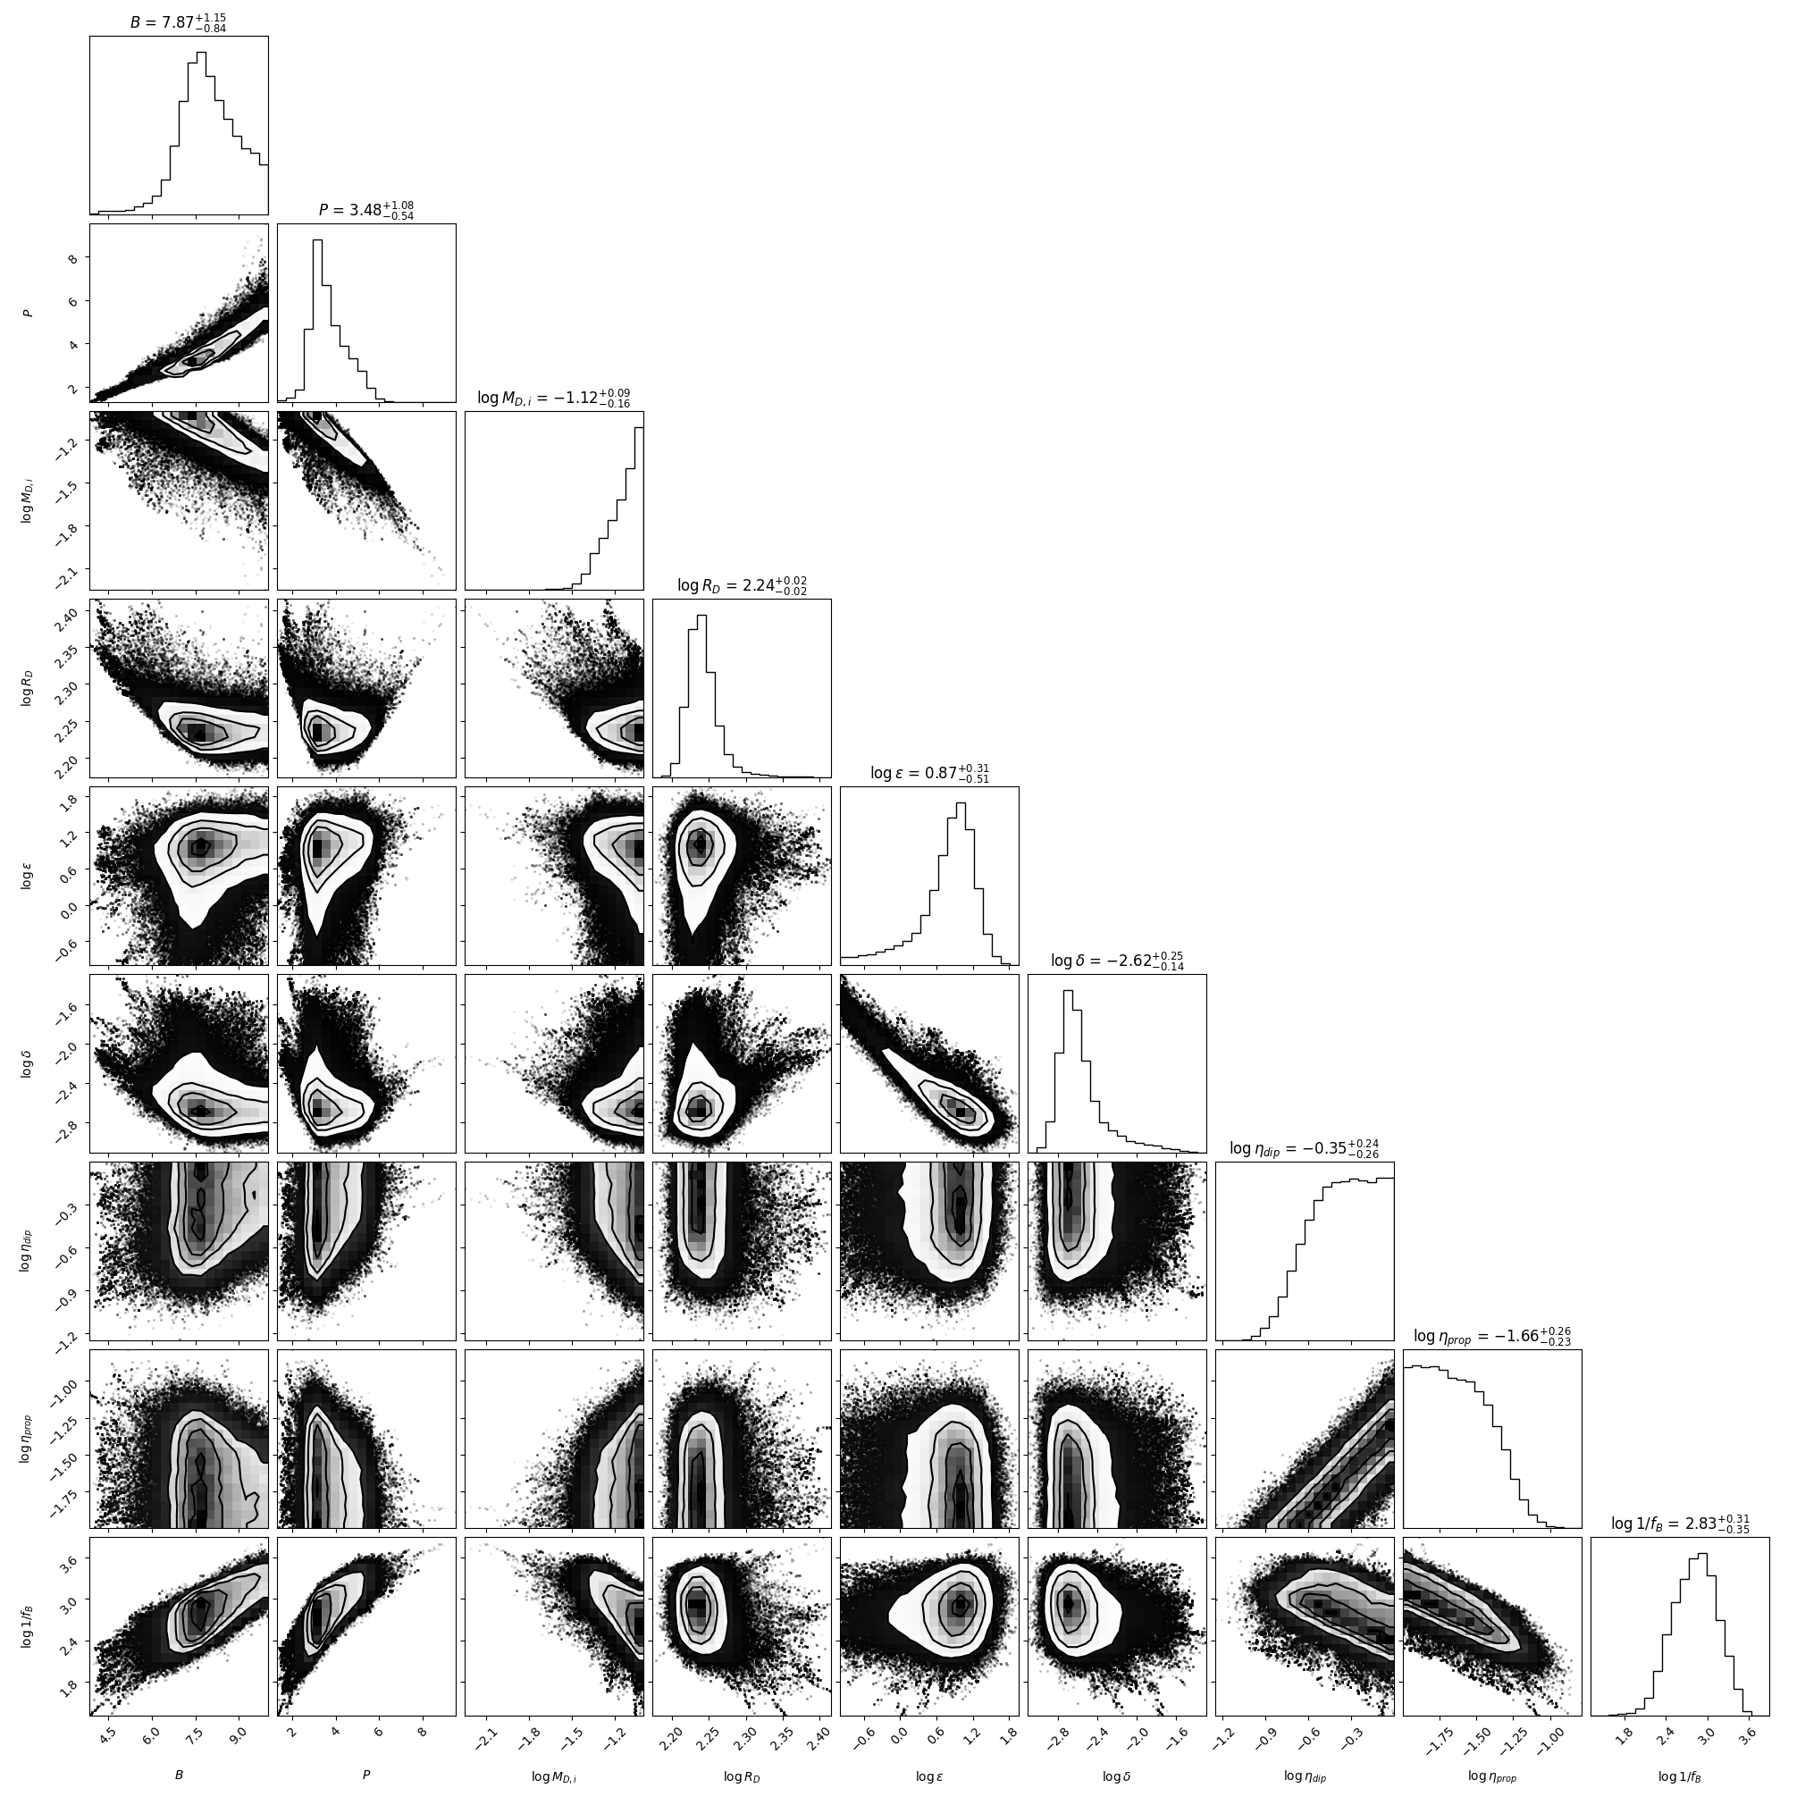
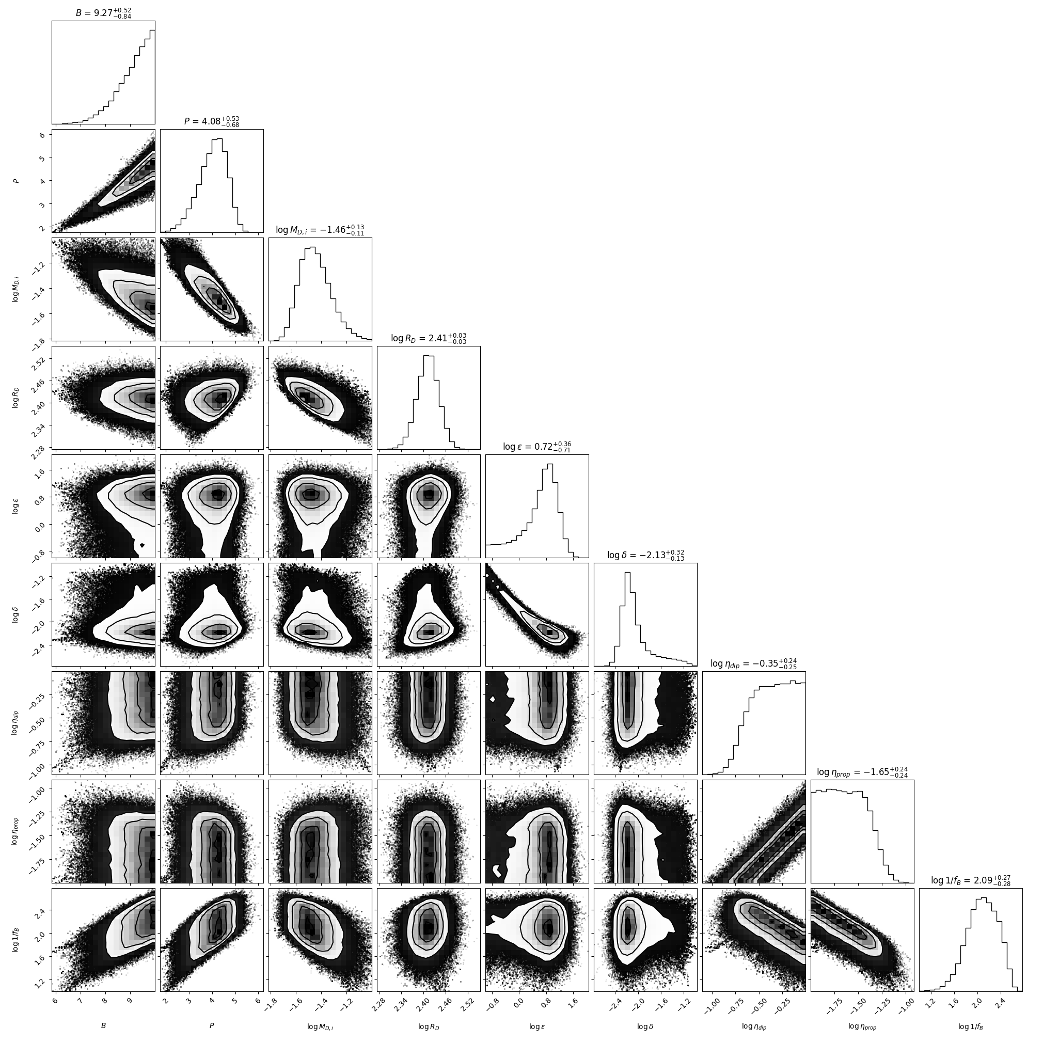
GRB 211023B
15-50 keV
0.3-10 keV
Native

Slide 28
GRB 211023B
0.3-10 keV
Reduced_chi2 = 4.681393000
AICc = 133.498125961
BIC = 139.140607057

Slide 29
GRB 211023B
15-50 keV
Reduced_chi2 = 5.555255543
AICc = 169.359721043
BIC = 176.688314566

Slide 30
GRB 211023B
Native
N = 100, p = 9
Reduced_chi2 = 1.602261483
AICc = 91.0832903
BIC = 104.629871

Slide 31
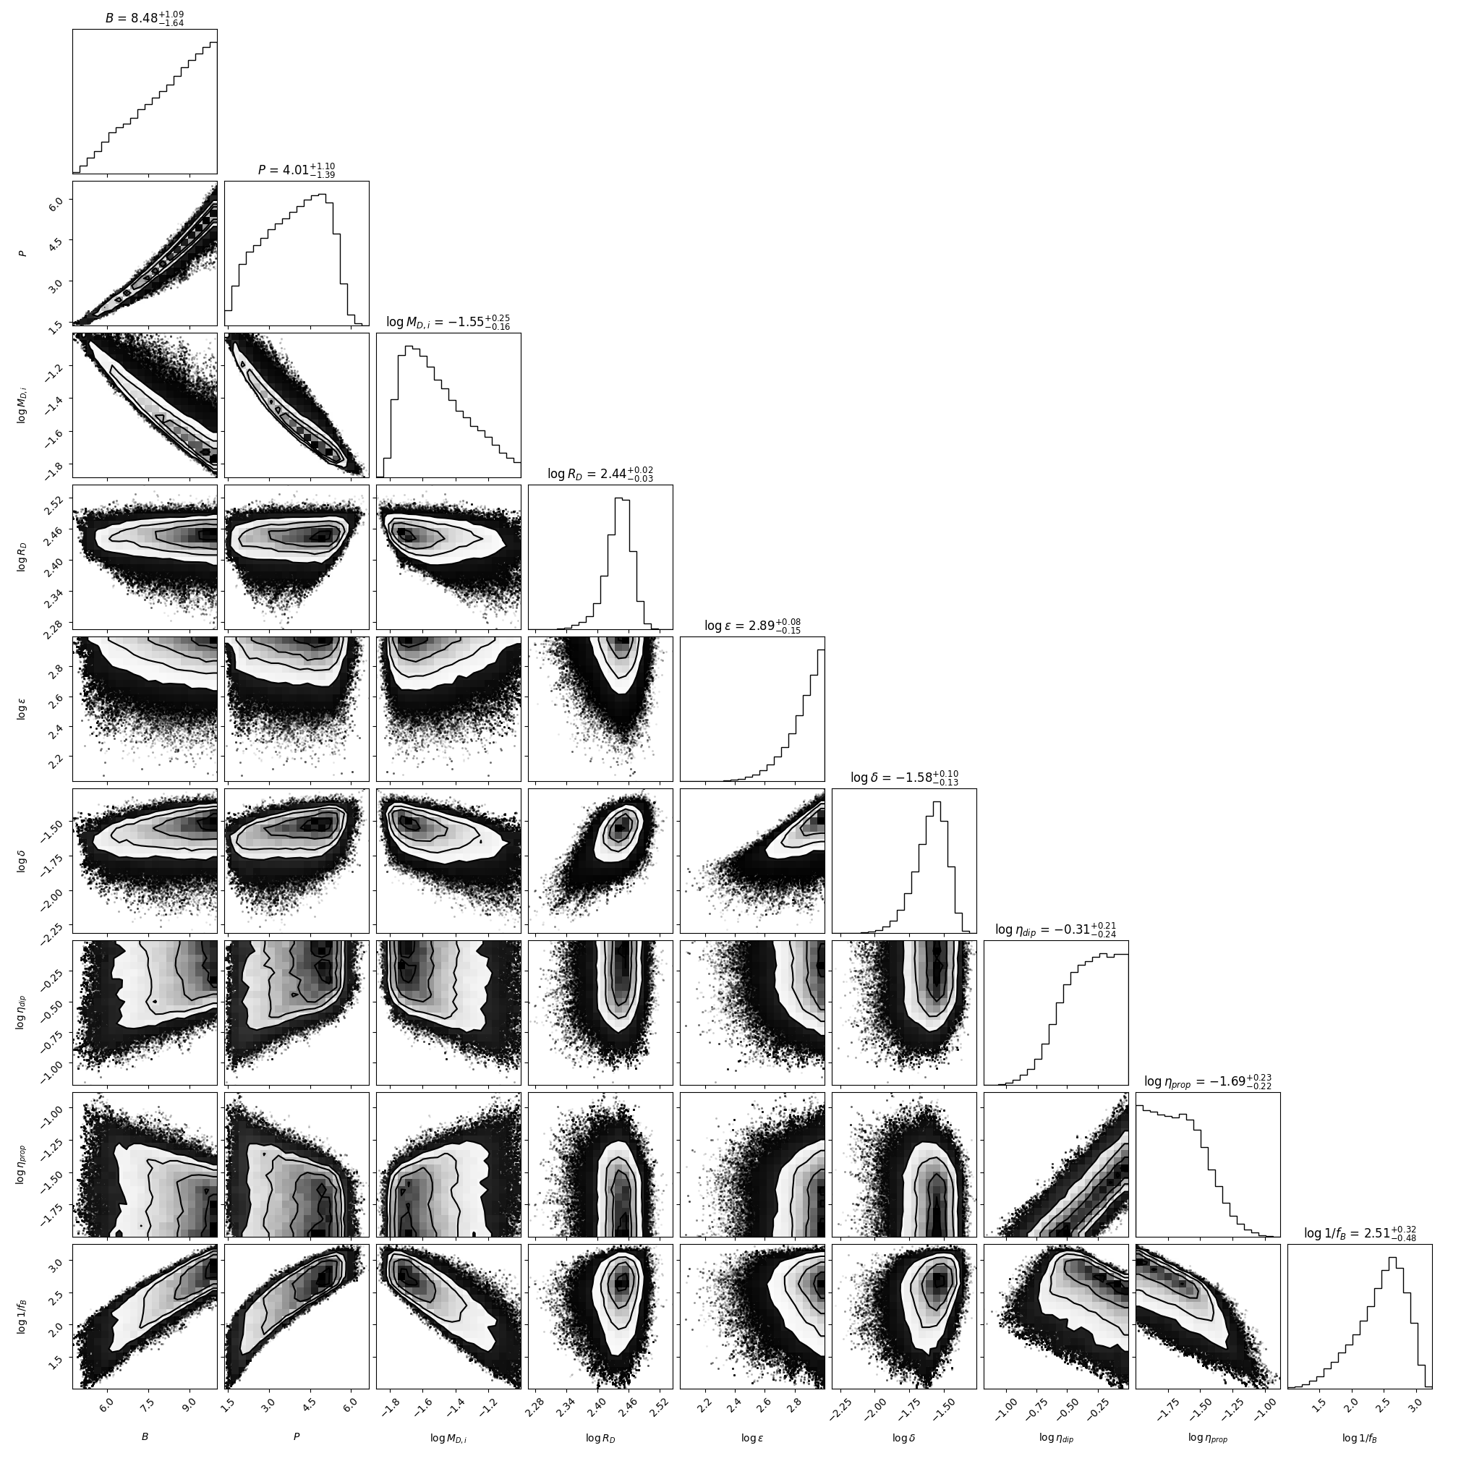
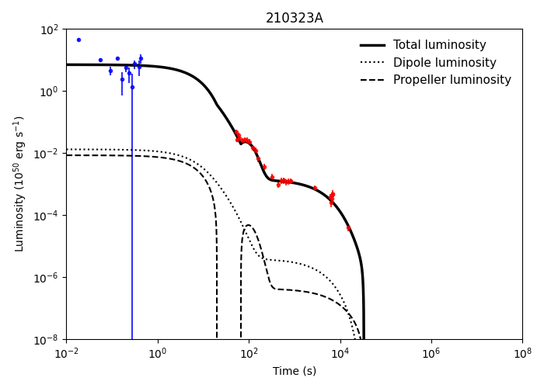
n=1
p=9
Just to check how the corner and fits are varying
Testing for different chain of MCMC
GRB 210323A (run = 10000)

Slide 32


n=1
p=9
Just to check how the corner and fits are varying
Testing for different chain of MCMC
GRB 210323A (run = 30000)

Slide 33


n=1
p=9
Just to check how the corner and fits are varying
Testing for different chain of MCMC
GRB 210323A (run = 50000)
Note that the reduced chi square, AIC and BIC values are almost same which implies the chains are saturated after a certain run

Slide 34
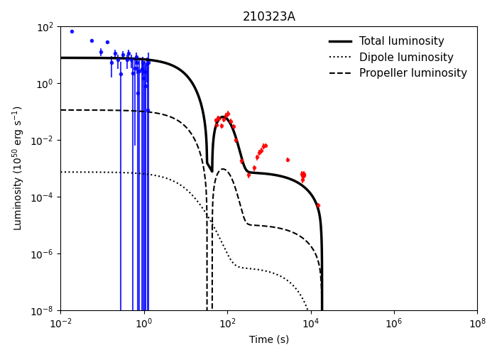

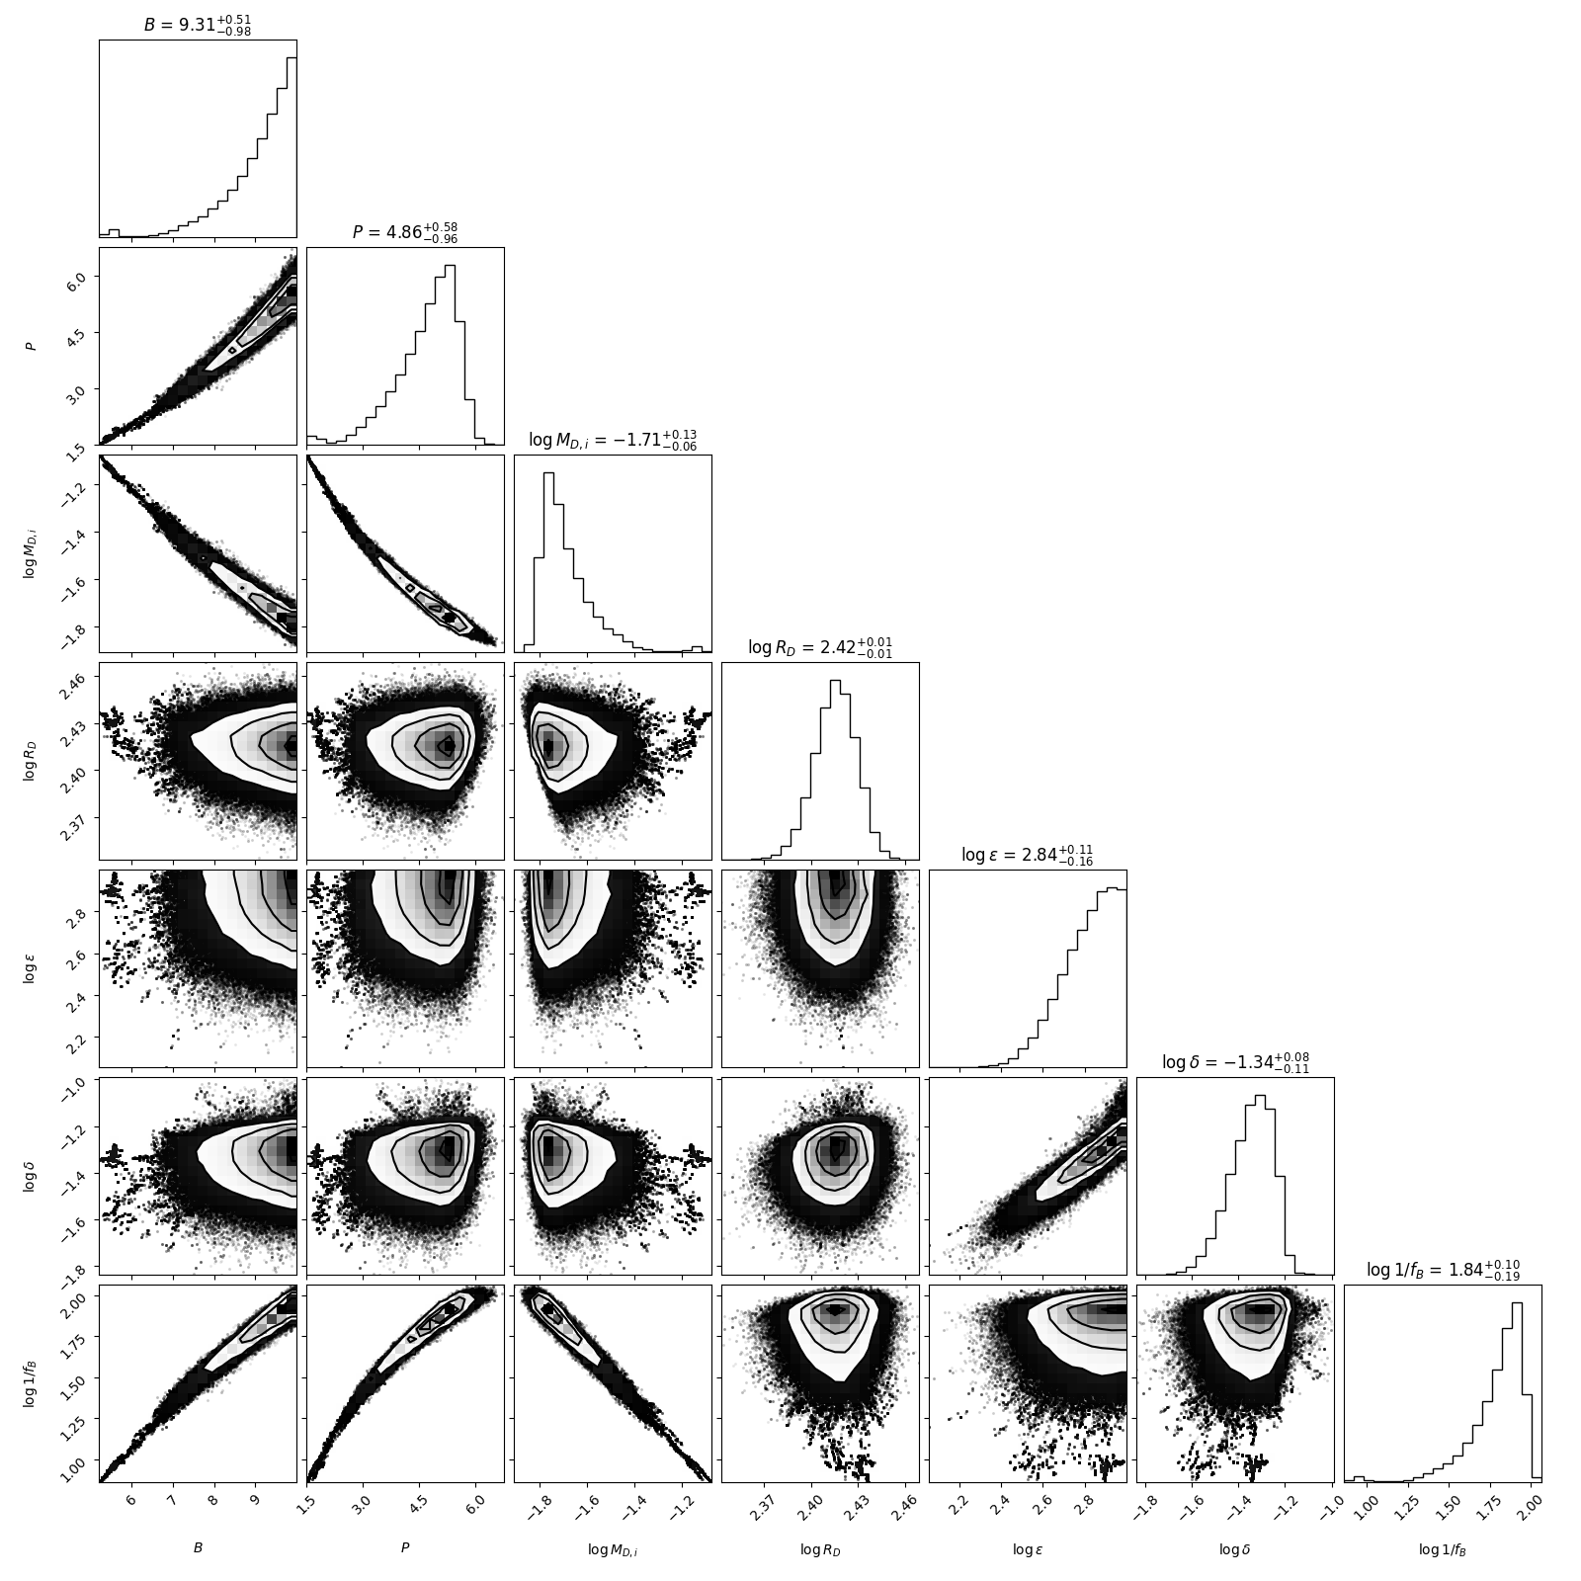

15-50 keV
GRB 210323A
0.3-10 keV
Reduced_chi2 = 5.041001405
AICc = 165.576610759
BIC = 173.886314768
Reduced_chi2 = 7.6779295
AICc = 361.9957185
BIC = 373.2988730

Slide 35
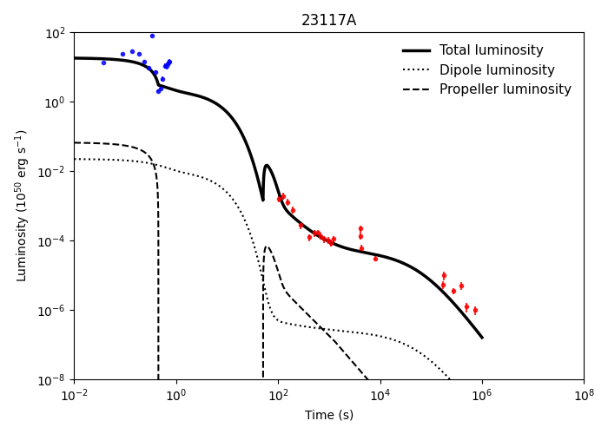
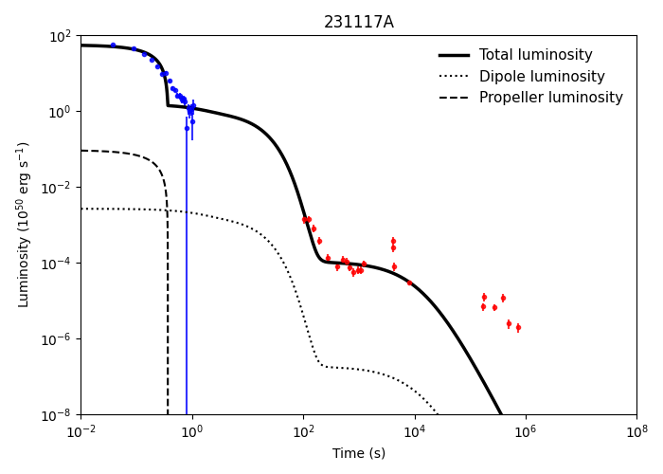
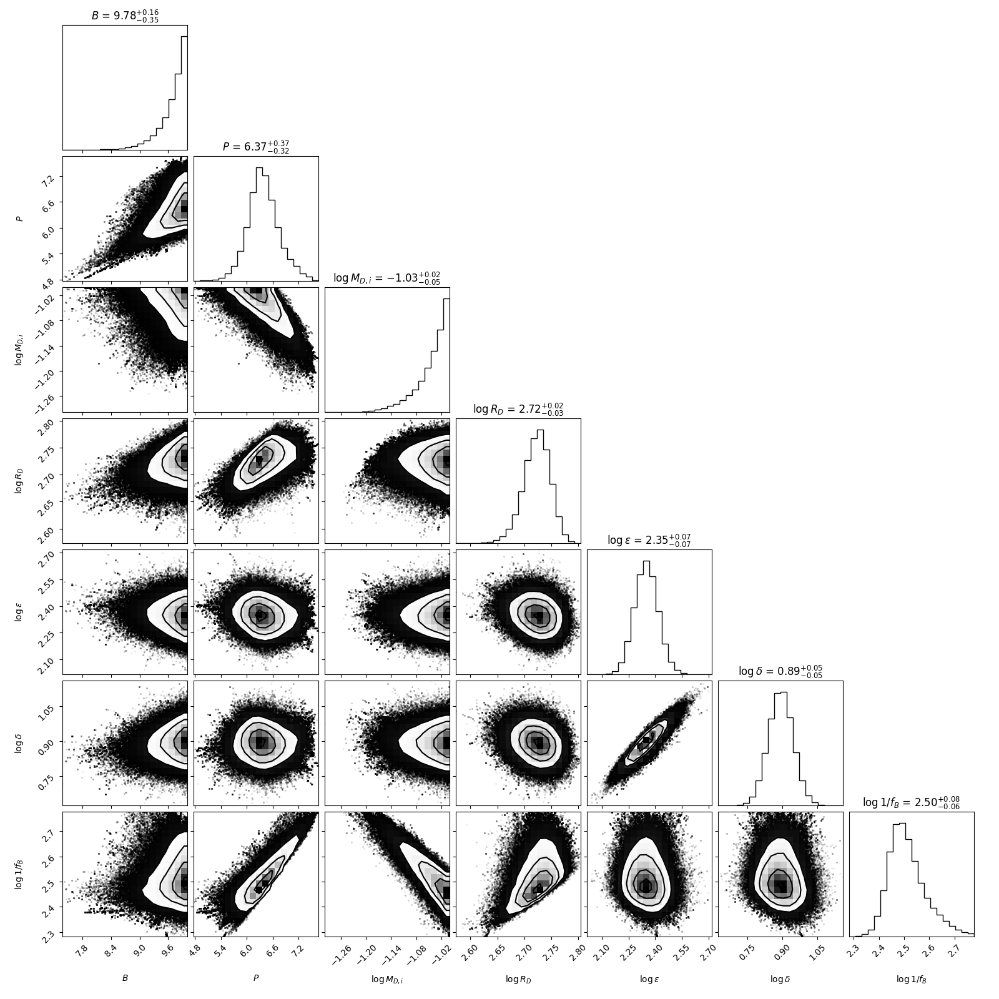
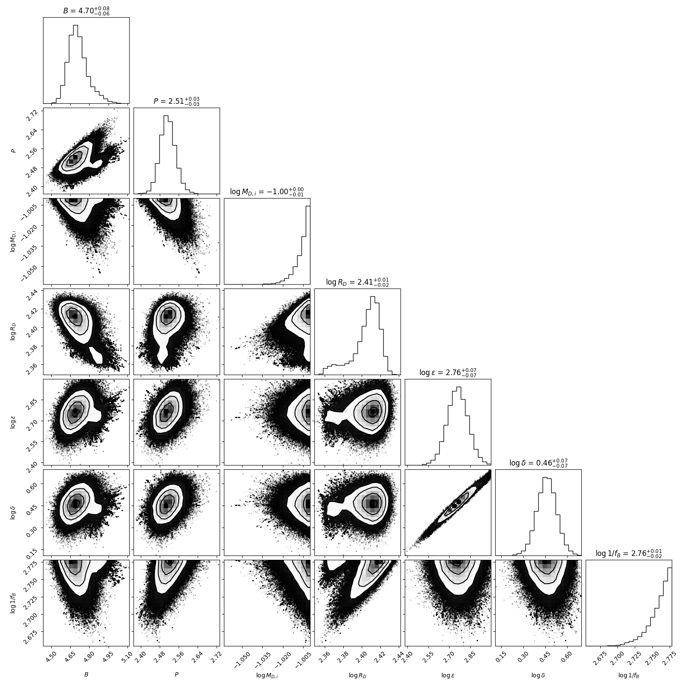
15-50 keV
GRB 231117A
0.3-10 keV
Reduced_chi2 = 41.166380135
AICc = 1177.087215222
BIC = 1185.396919231
Reduced_chi2 = 16.2551098
AICc = 602.2950642
BIC = 611.6732806

Slide 36
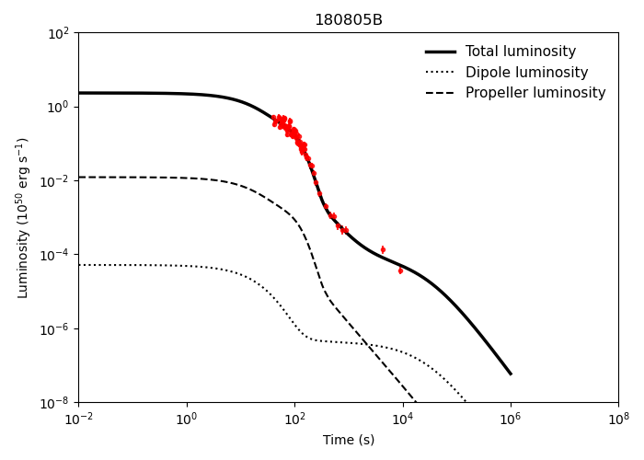
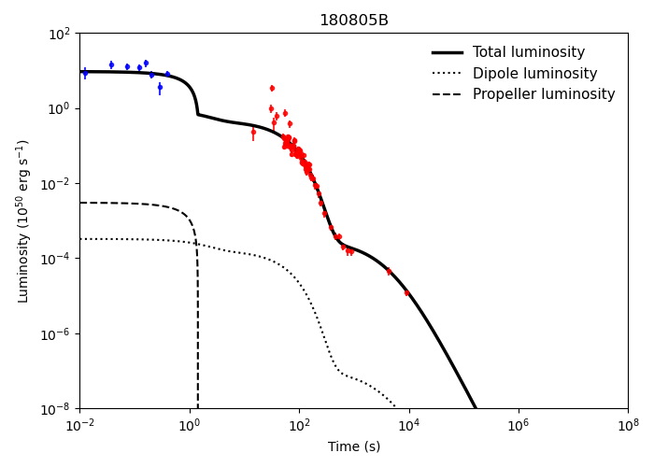
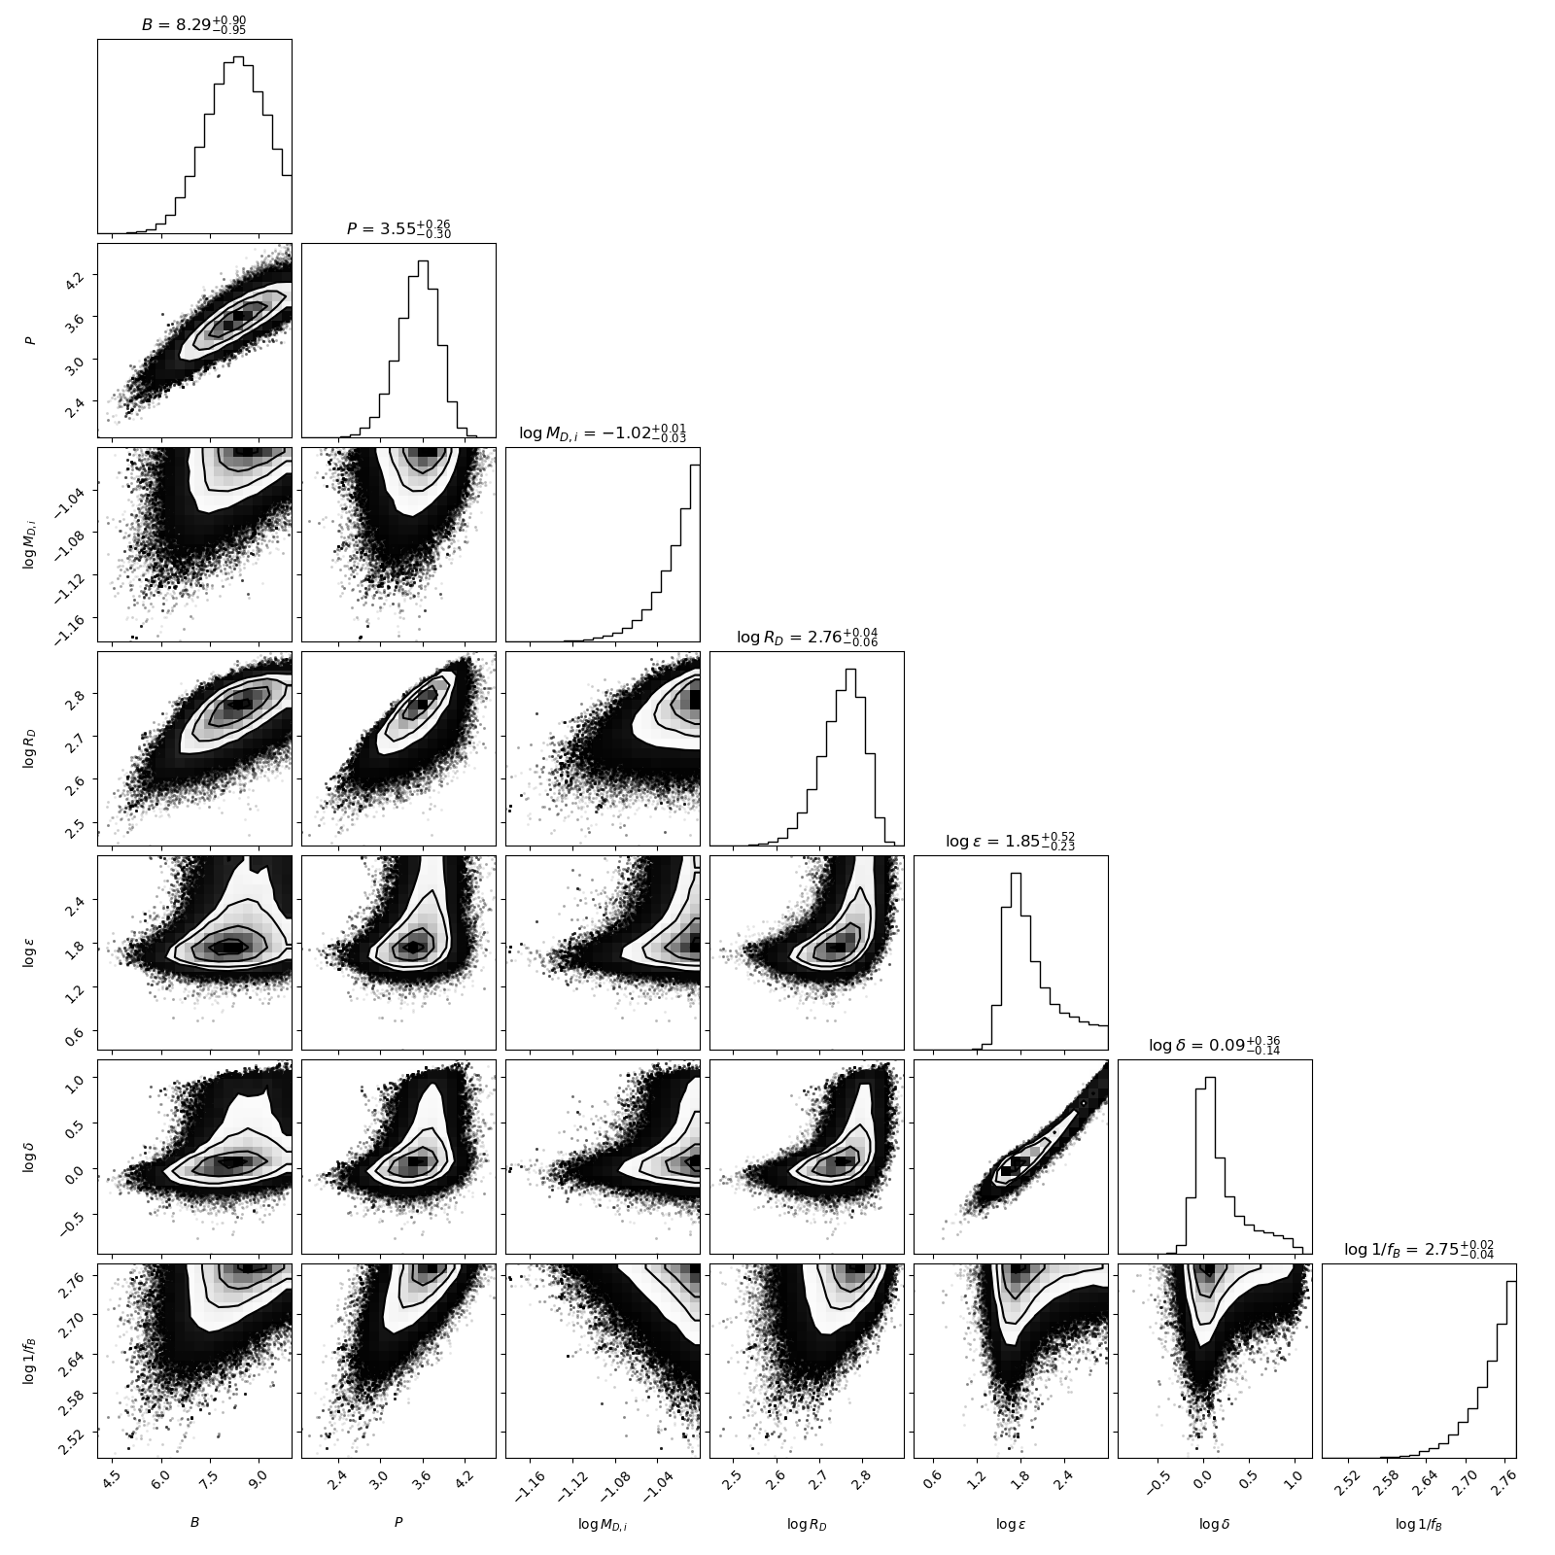
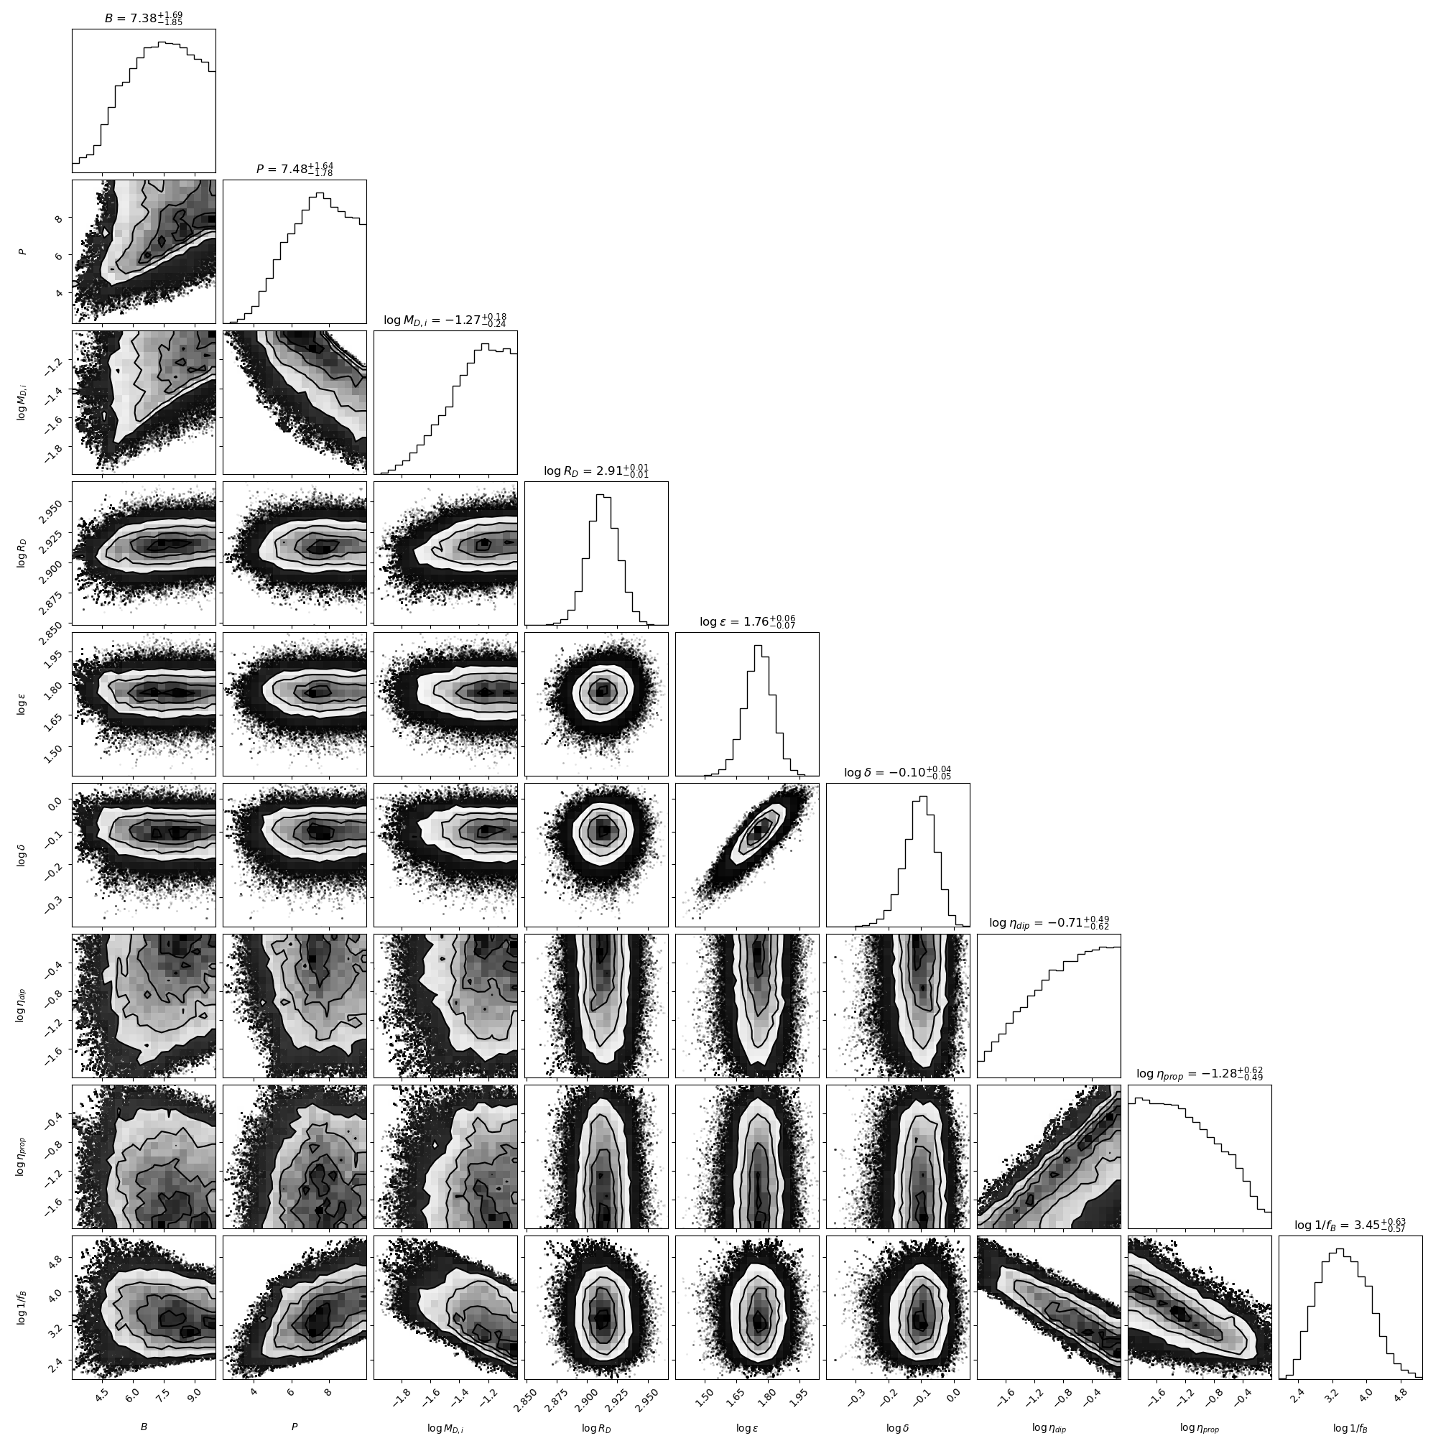
GRB 180805B
Native
p=9
Selection on the basis of BIC value
XRT
p=7

Slide 37
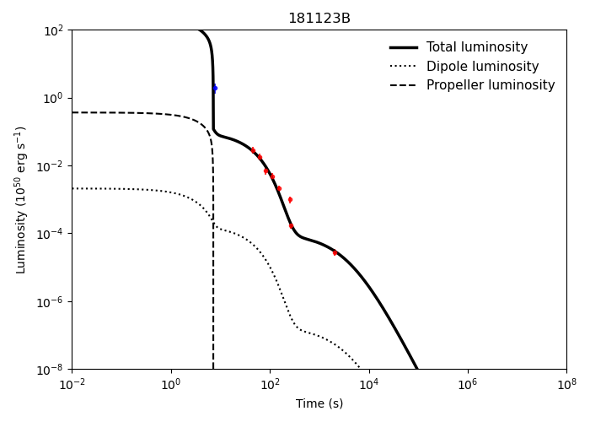
GRB 181123B

Slide 38
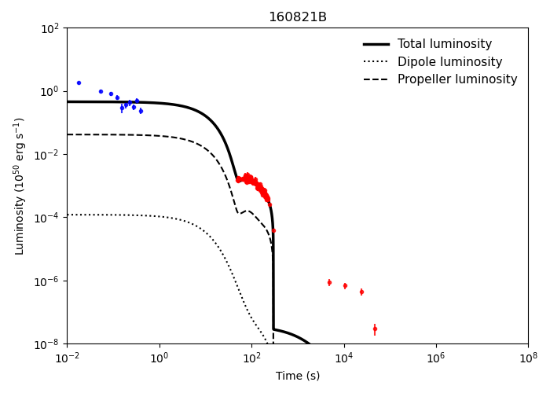
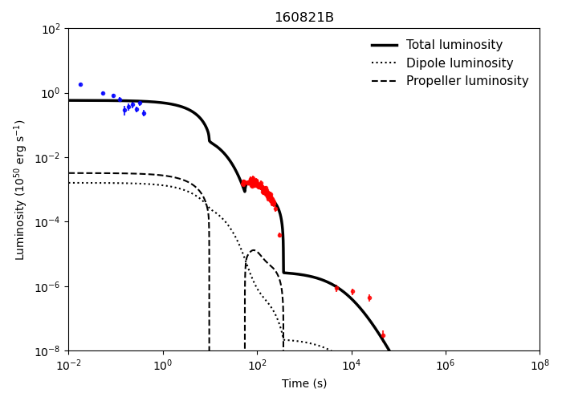
GRB160821B
P=7
P=9

Slide 39
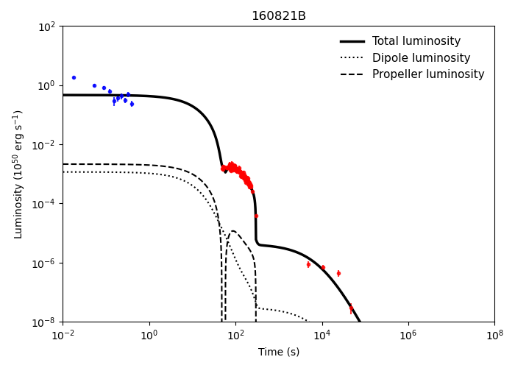

GRB160821B
n=100
n=10
n=1

Slide 40


GRB160821B
0.3-10 kev
15-50 kev
Native

Slide 41

GRB160821B
Reduced chi square:2.74
AICc:264
BIC:285

Slide 42

Final results from our sample

Slide 43

Final results from our sample

Slide 44
Magnetic field vs spin period parameter space

Slide 45


Universal Relation of Accreting Magnetic Stars

Slide 46






Magnetar Propeller Model
Toy Model (Piro and Ott 2011)

Slide 47


R. Duqué et al.: Extended emission in short gamma-ray bursts from fallback accretion

Slide 48

Final results from our sample

Slide 49

Sample Selection Criteria
Short GRBs detected between 2016 -2025: 144
2. Short GRBs detected by XRT: 62
4. Short GRBs after luminosity cut-off: 16
3. Short GRBs with measured redshift: 22
4. Short GRBs with extended emission: 9

Slide 50


Slide 51


Slide 52


Rowlinson et.al 2013
Comparison of past work
Gompertz et.al 2013

Slide 53


Slide 54

Gompertz Model
Gibson’s Model

Slide 55


Gibson’s Magnetar Model

Slide 56

GRB Classification: Long vs. Short GRBs
Progenitor Models & Physical Channels
Key Observational & Physical Differences
Property | Long GRBs | Short GRBs
Duration (T90) | > 2 Seconds | < 2 Seconds
Hardness Ratio | Soft (Lower HR) | Hard (Higher HR)
Progenitor | Core Collapse of Massive Stars (Collapsars) | Compact Object Merger (BNS / NS-BH)
Counterparts | Associated Supernovae (SNe) | Associated Kilonovae (KNe) & GWs
Spectral Lag | Significant positive spectral lag | Negligible or zero spectral lag
Host Environment | Star-forming starburst galaxies | Both elliptical & star-forming galaxies
Central Engine | Accreting Black Hole | Magnetar / Black Hole

Slide 57




Theoretical Model & Observational Signatures
Extended Emission in Short GRBs
Theoretical Framework & Fallback Accretion
Swift Observational Light Curves
1. Fallback Radiation & Kilonova Interaction
GRB 050724 — Re-brightening / Flare Component
R. Duqué et al.: Extended emission in short gamma-ray bursts from fallback accretion
https://www.swift.ac.uk/burst_analyser/
2. Central Engine Luminosity Phases (Accretor / Propeller / Ejector)
GRB 160821B — Extended X-ray Emission Feature
https://spacenews.com/evidence-suggests-grbs-are-powered-by-strongest-magnetic-fields/

