Slide 1


Modelling the High-Energy Emission of the
Vela Pulsar:
Curvature versus Synchro-Curvature
Monica Barnard¹
Alice K. Harding², Christo Venter¹, and Constantinos Kalapotharakos³
1. Centre for Space Research, North-West University, Potchefstroom 2520, South Africa
2. Theoretical Division, Los Alamos National Laboratory, Los Alamos, NM 58545, USA
3. Astrophysics Science Division, NASA Goddard Space Flight Center, Greenbelt, MD 20771, USA
HEASA 2026, 29 September – 3 October, SAAO, Cape Town

Slide 2
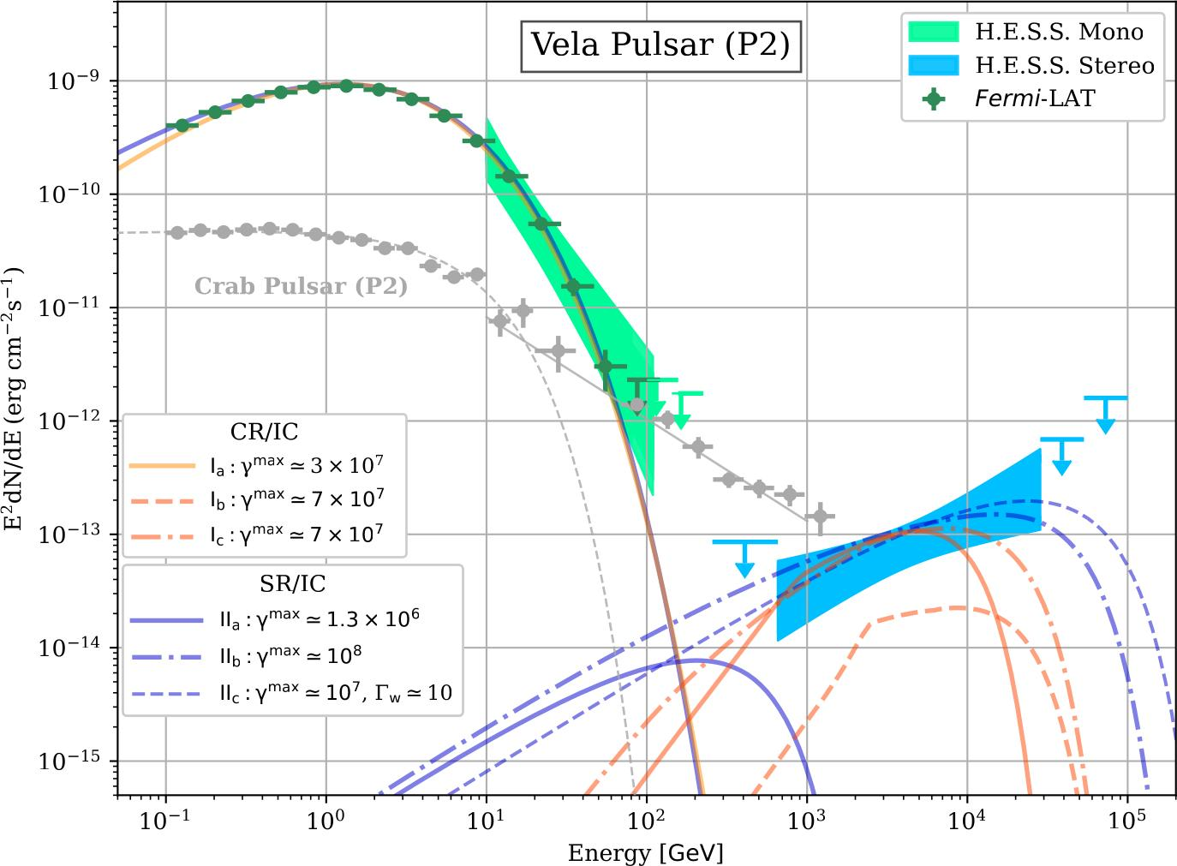
Vela pulsar HE / VHE observations
H.E.S.S. collaboration 2023
The Vela pulsar’s high-energy (HE) emission, up to 100 GeV (very high-energy, VHE) observed by H.E.S.S. II and Fermi LAT (Abdalla et al. 2018).
Continuation of Fermi spectrum (curved sub-exponential) or power law? Curved spectrum favoured by H.E.S.S. II at > 3.0σ. Additional component distinct from GeV spectrum?
Follow-up observations reported 20 TeV (H.E.S.S. collaboration 2023).
Importance of understanding the mechanisms behind the observed spectra.

Slide 3
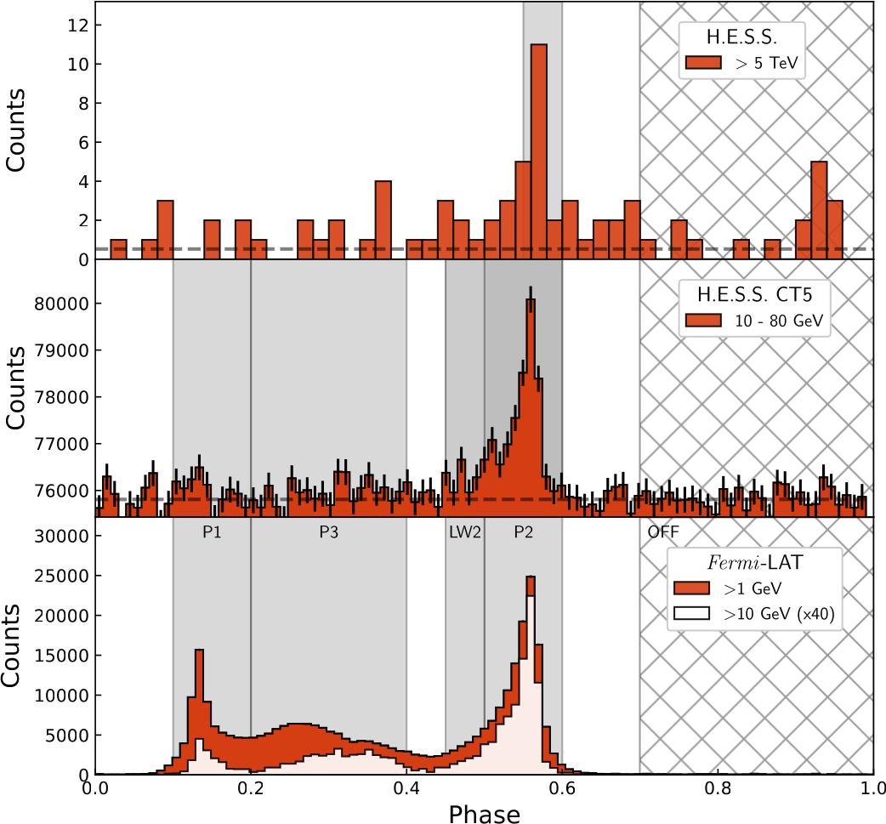
Vela pulsar HE / VHE observations
H.E.S.S. collaboration 2023
Phenomenology in observed light curves as a function of energy: (key trends to reproduce):
  Decrease in flux of the first peak relative to the second peak.
  Evolution of the bridge emission between peaks.
  Near-constant phase positions of peaks.
  Narrowing of pulses with increasing energy.

Slide 4
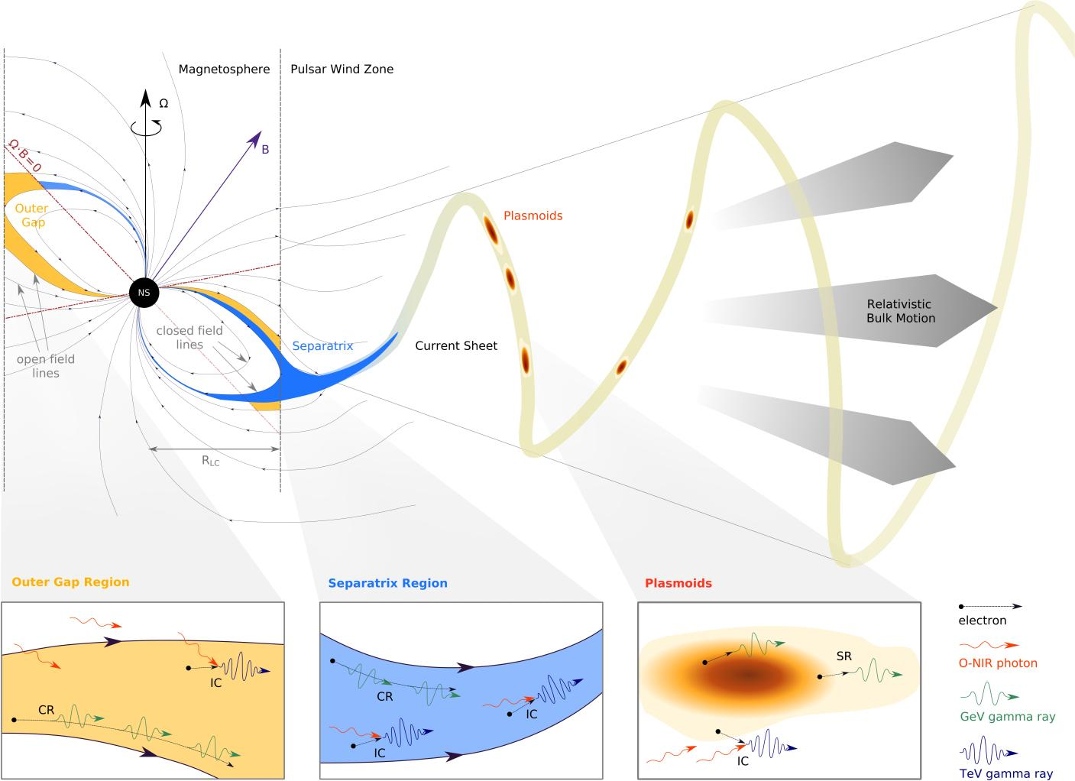
Pulsar HE emission modelling
Geometry: PSR orientation and its magnetospheric structure.
Global magnetospheric models: Retarded vacuum dipole (RVD; Deutsch 1955), Force-free Inside, Dissipative Outside (FIDO; Kalapotharakos et al. 2012, 2014), particle in cell (PIC; Philippov, Cerutti, Spitkovsky).
Particle acceleration: Gaps (constant E||) / RVD (large E||) / accelerating electric-field for FF (E||=0) and in dissipative regions (E||≠0), magnetic reconnection in current sheet.
Emission mechanisms: curvature / synchrotron / synchro-curvature / inverse Compton / synchrotron self-Compton.
H.E.S.S. collaboration 2023

Slide 5
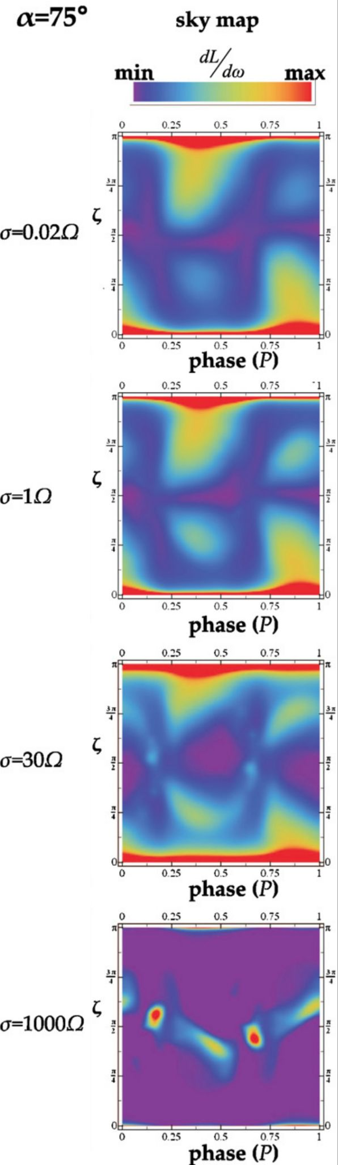
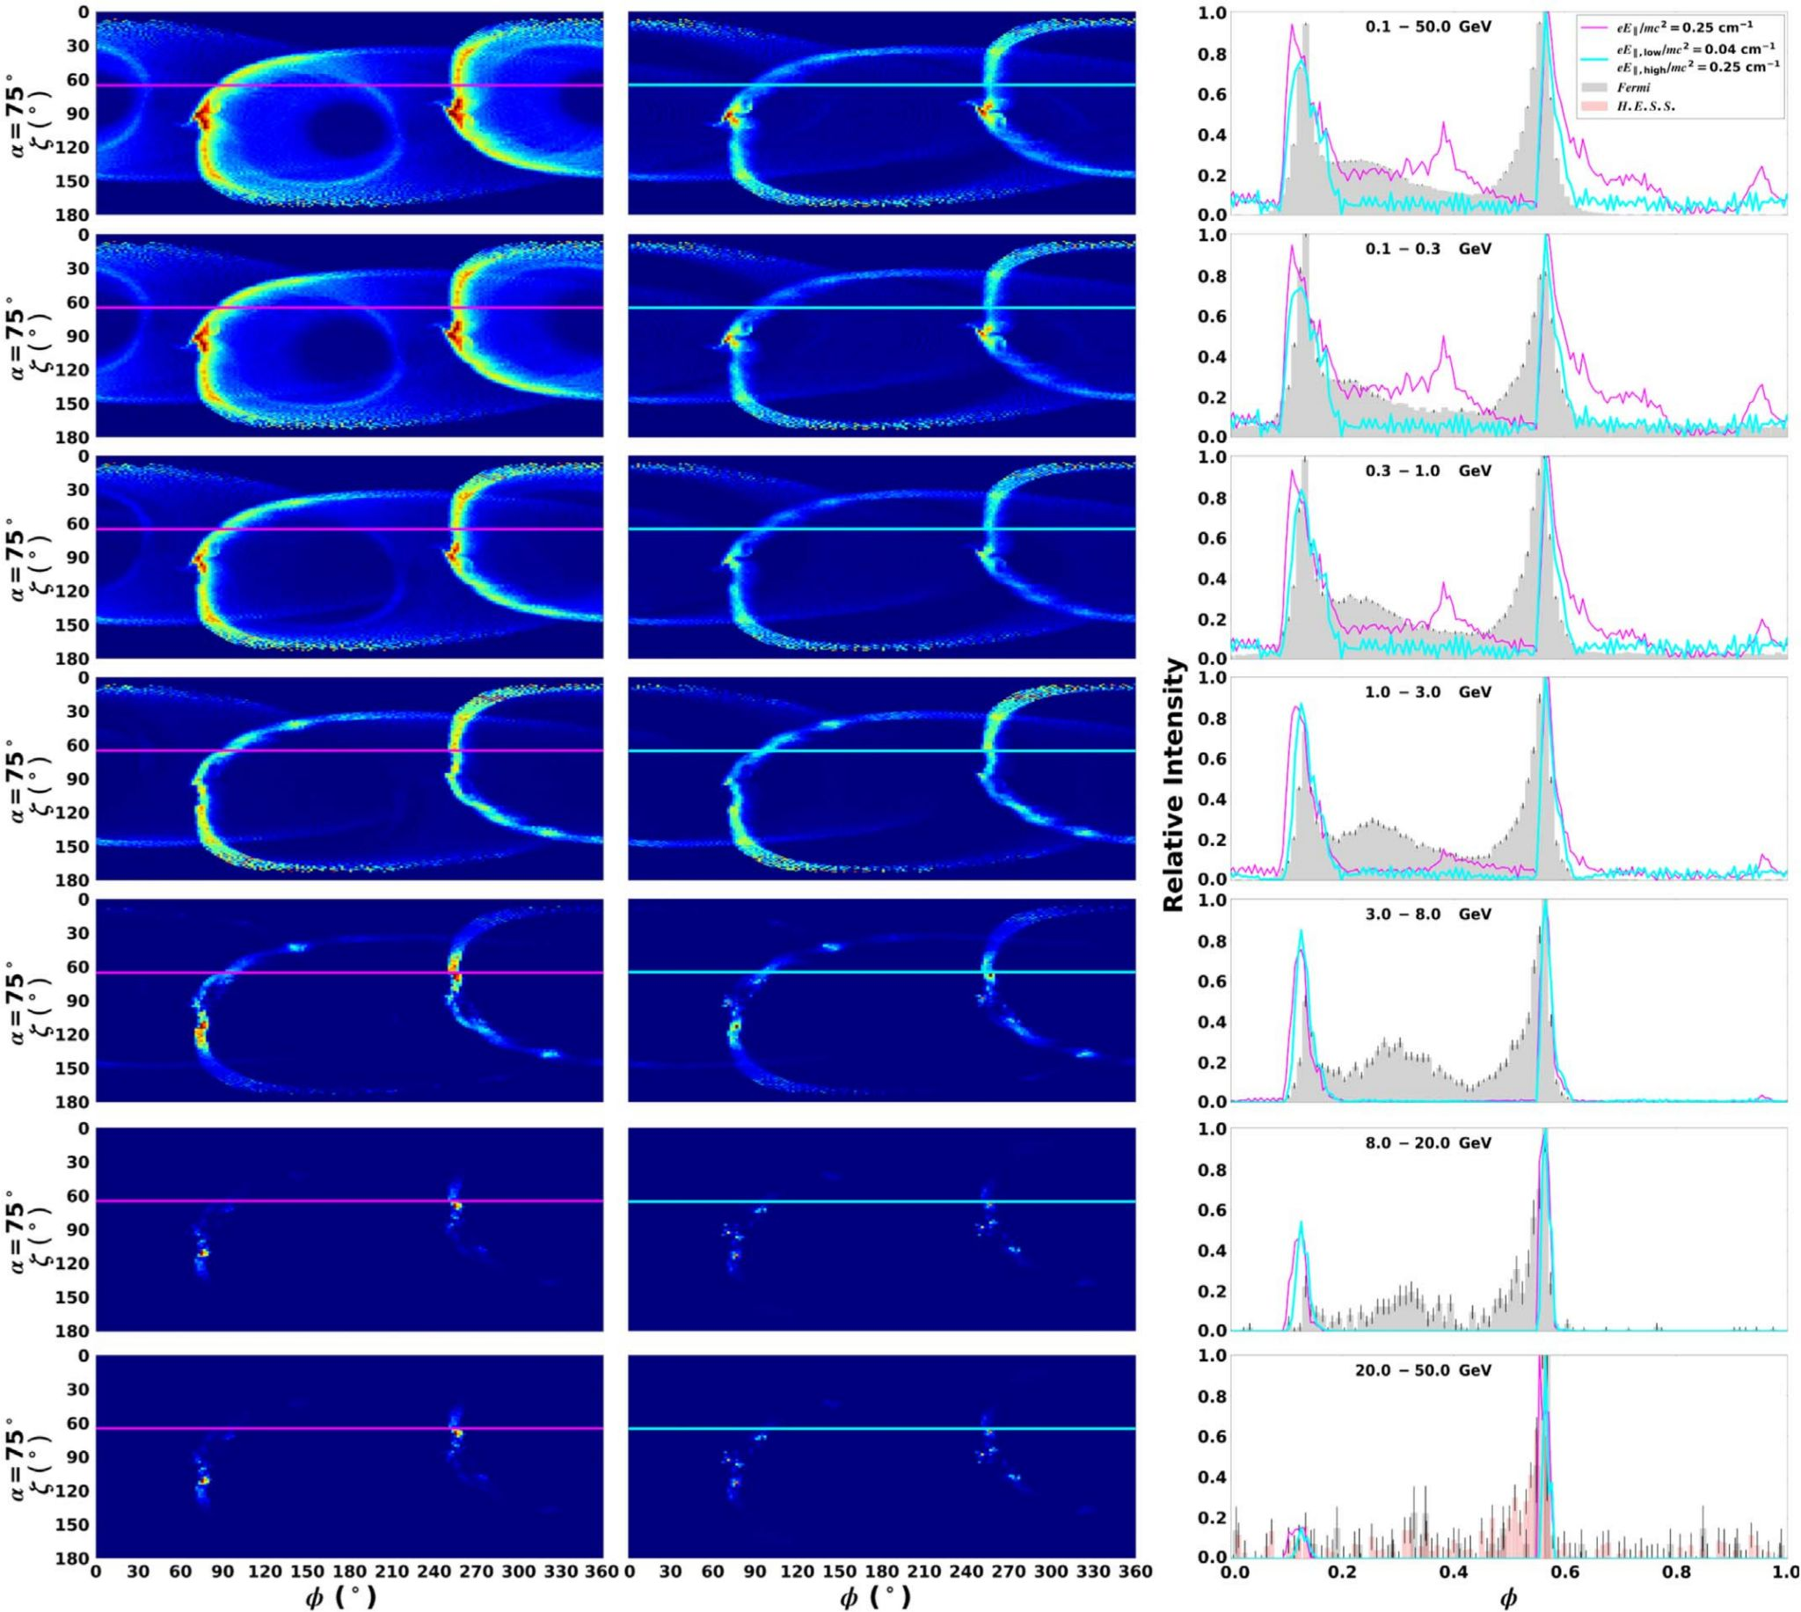
Pulsar HE emission modelling
Very high-energy from pulsars (Harding et al. 2015, 2018, 2021).
3D emission model, FIDO magnetosphere with a constant accelerating electric-field (E|| smaller inside than outside; see Kalapotharakos et al. 2014).
Includes all radiation mechanisms, with an update from curvature radiation to syncro-curvature radiation in the 2018 paper.
High-energy emission from Vela as curvature radiation (Barnard et al. 2022).
Updated particle trajectories: improved curvature radius 𝜌_{c} and Lorentz factors of the accelerating particles under influence of the accelerating E-field and curvature radiation reaction.
Case 1: R_{acc} = eE||/m_{e}c² =0.25 (everywhere) AND
Case 2: R_{acc} = eE||/m_{e}c² inside 0.04 and outside 0.25.
(values motivated by kinetic simulations).
Energy-dependent phase plots, LCs, and spectra (phase-resolved spectral modelling).
Differentiate between peak 1 and 2, and light curve trends.

Slide 6
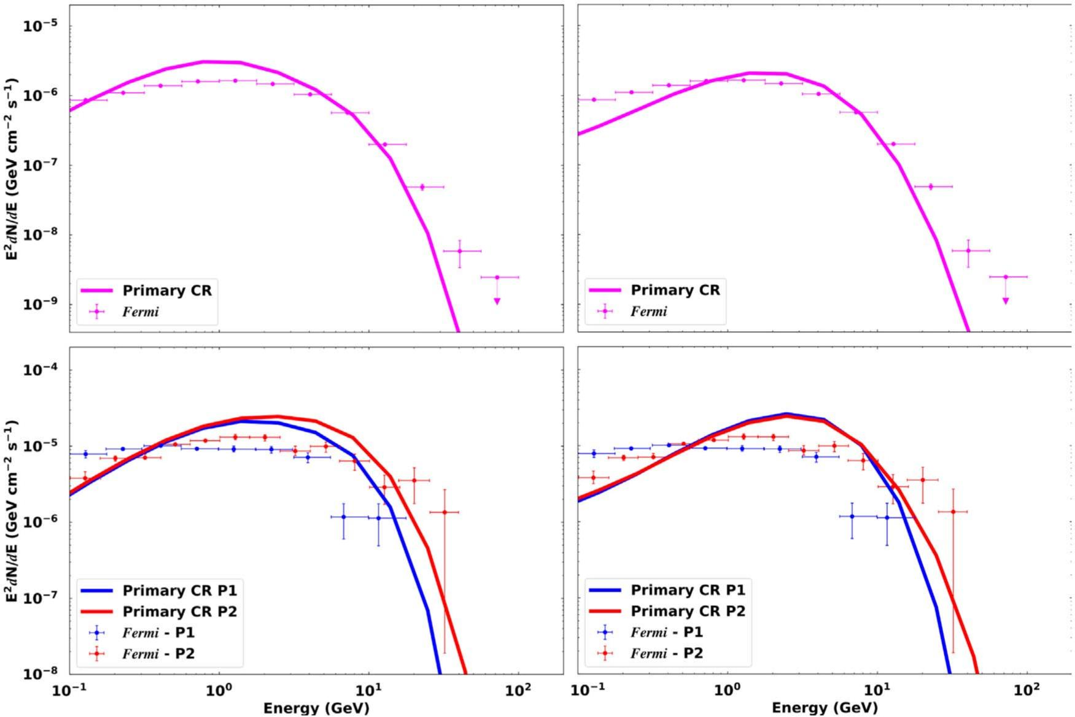
Pulsar HE emission modelling
Very high-energy from pulsars (Harding et al. 2015, 2018, 2021).
3D emission model, FIDO magnetosphere with a constant accelerating electric-field (E|| smaller inside than outside; see Kalapotharakos et al. 2014).
Includes all radiation mechanisms, with an update from curvature radiation to syncro-curvature radiation in the 2018 paper.
High-energy emission from Vela as curvature radiation (Barnard et al. 2022).
Updated particle trajectories: improved curvature radius 𝜌_{c} and Lorentz factors of the accelerating particles under influence of the accelerating E-field and curvature radiation reaction.
Case 1: R_{acc} = eE||/m_{e}c² =0.25 (everywhere) AND
Case 2: R_{acc} = eE||/m_{e}c² inside 0.04 and outside 0.25.
(values motivated by kinetic simulations).
Energy-dependent phase plots, LCs, and spectra (phase-resolved spectral modelling).
Differentiate between peak 1 and 2, and light curve trends.
Phase-averaged
Phase-resolved

Slide 7
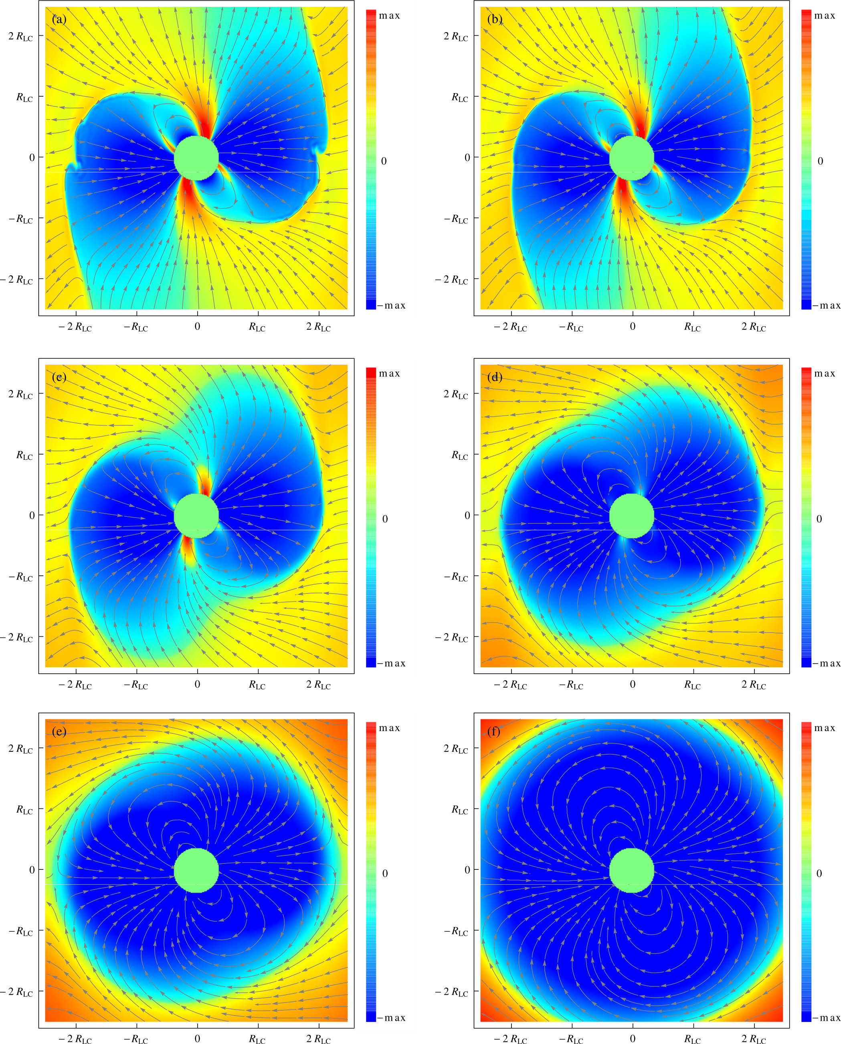

Dissipative magnetosphere
Force free
𝜎 = 6𝛺
Conductivity
Kalapotharakos et al. (2014)
𝜎 = 2𝛺
𝜎 = 0.6𝛺
An azimuthally-dependent accelerating E-field from global magnetospheric simulations (a.k.a. dissipative B-field).
Effect of the conductivity:
  Units of angular velocity 𝛺.
  Assume FIDO solution to be reasonable, therefore:
    High conductivity (large σ) → current flows more easily, resistance is low.
    Low conductivity (small σ) → current struggles to flow, resistance is high.
  Current sheet: thin layer where squeezed magnetic field lines drive strong currents, converting magnetic energy into heat (Joule heating). A magnetic field running along the sheet further boosts this heating, speeding up energy dissipation.
𝜎 = 0.2𝛺
Vacuum dipole
Li, Spitkovsky & Tchekhovskoy (2012)

Slide 8
Dissipative magnetosphere
Force free
𝜎 = 6𝛺
Radiation reaction limit reached?
Typical E||-field values outside light cylinder?
Spectral energy cutoff?
𝜎 = 2𝛺
𝜎 = 0.6𝛺
Conductivity
Kalapotharakos et al. (2014)
E_{CRR} ～ E||^{3/4} 𝜌_{c}^{1/2} ～ σ ^{-3/4} 𝜌_{c}^{1/2}
Energy cutoff in the curvature radiation reaction limit
𝜎 = 0.2𝛺
Vacuum dipole
Venter & De Jager (2010)
R_{acc} ～ eE|| /m_{e}c²
Acceleration length
Barnard et al. (2022)
Li, Spitkovsky & Tchekhovskoy (2012)

Slide 9
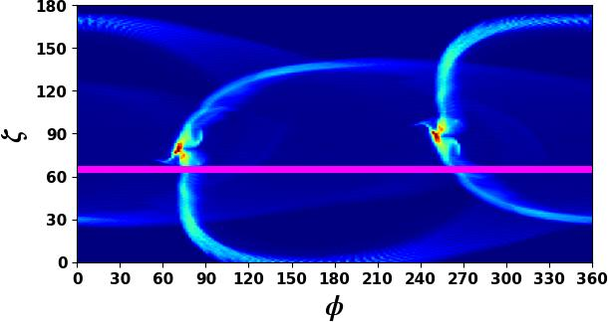
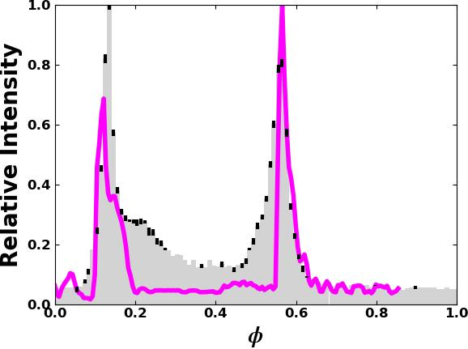
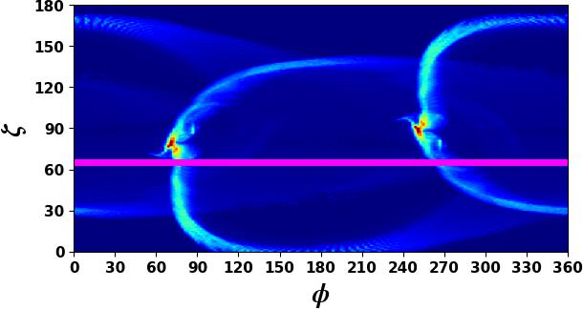
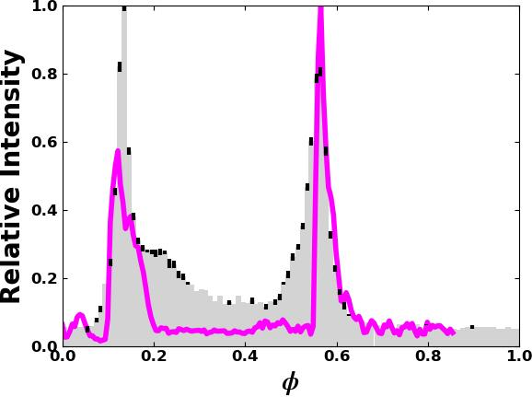
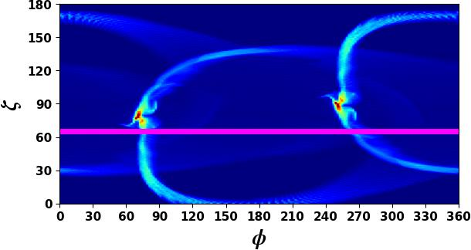
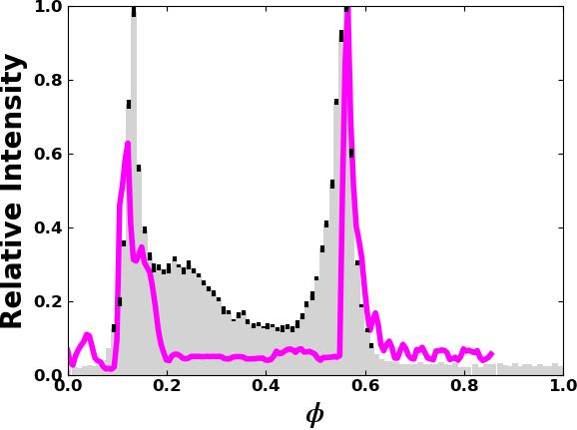
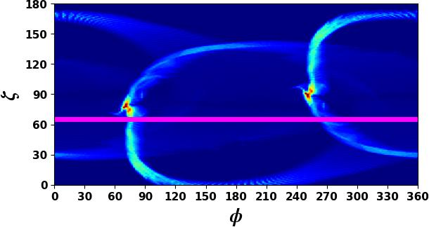
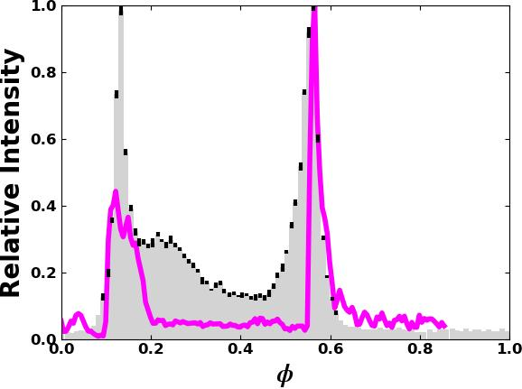


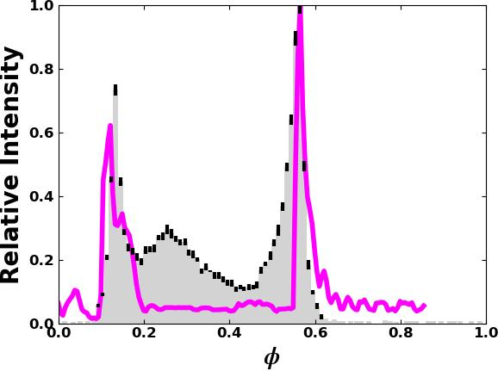
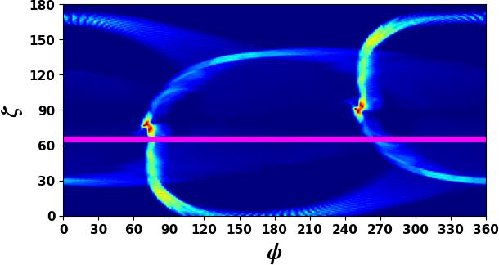
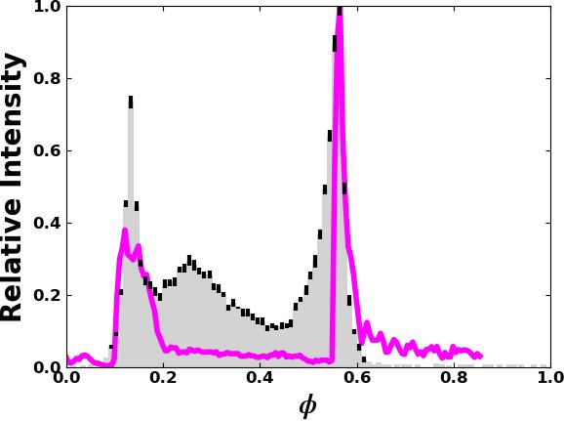


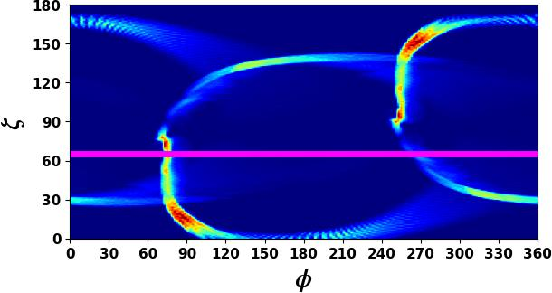
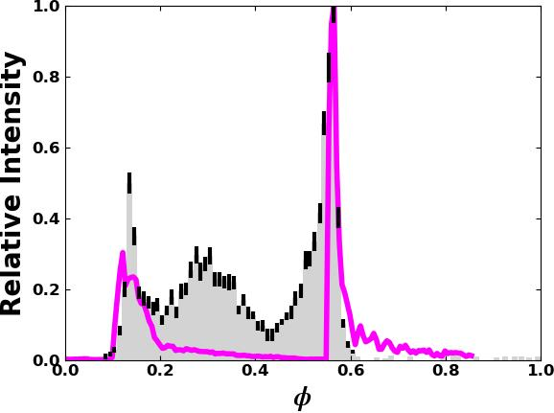
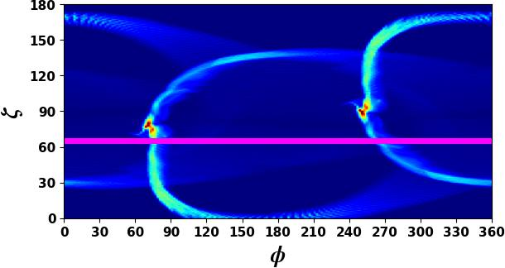
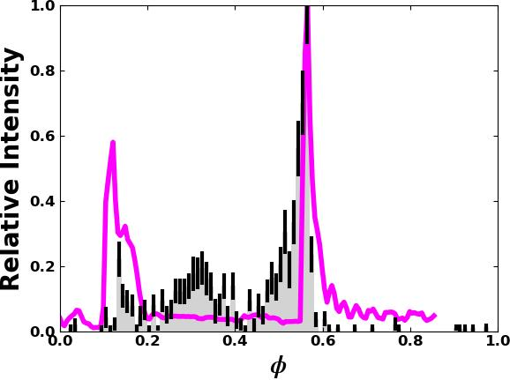
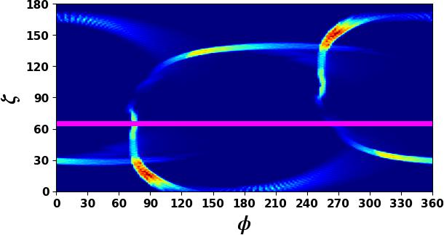
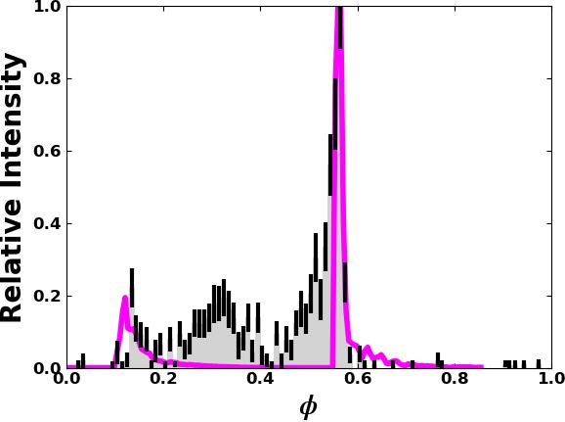
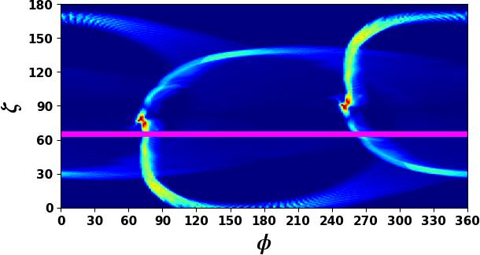
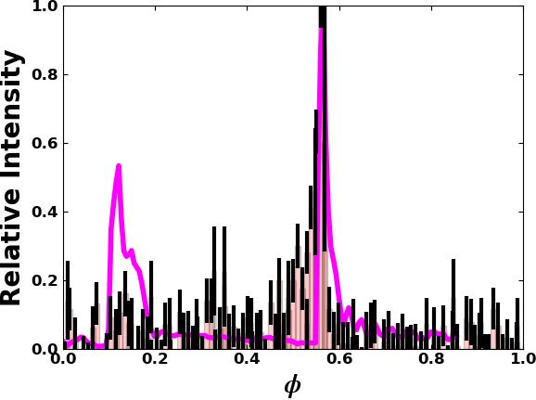
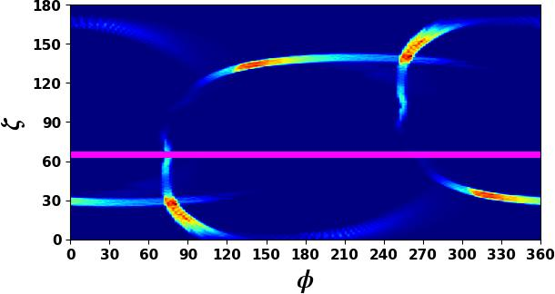
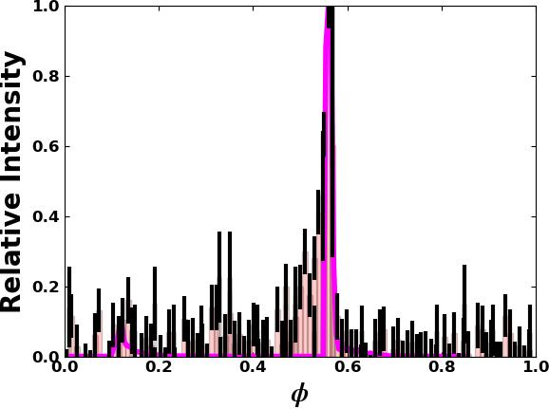
Preliminary
0.1 - 0.3 GeV
0.3 - 1 GeV
(FIDO) FF Inside + Dissipative outside
1 - 3 GeV
3 - 8 GeV
8 - 20 GeV
> 20 GeV

Slide 10
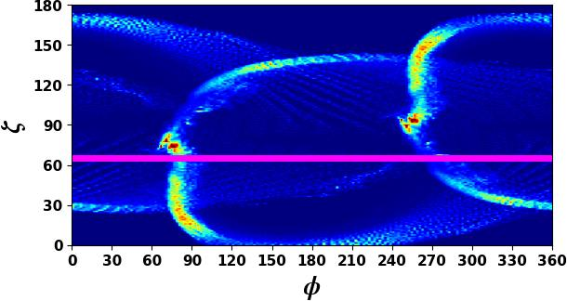
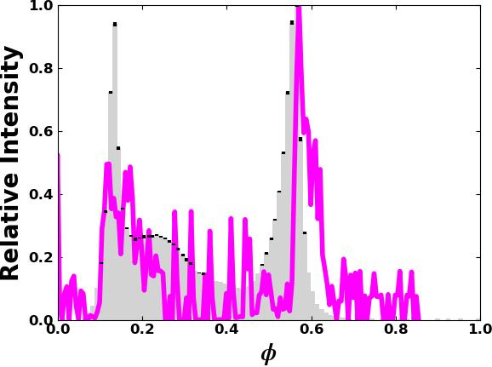
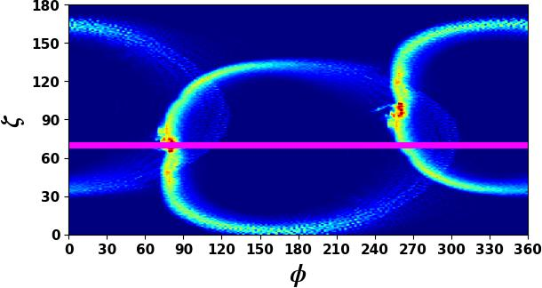
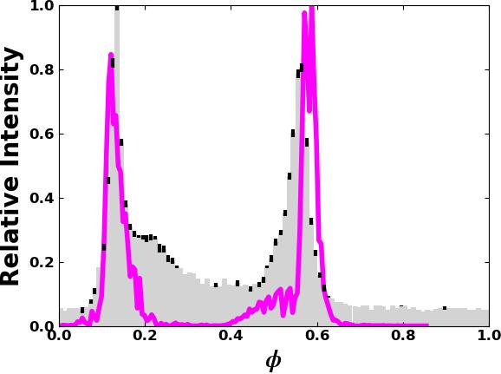
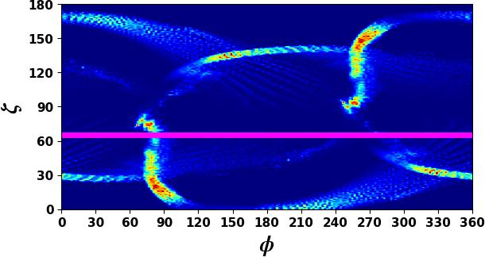
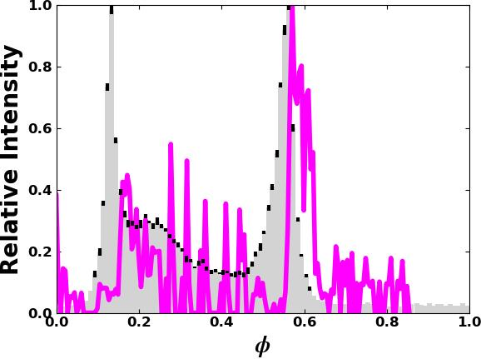
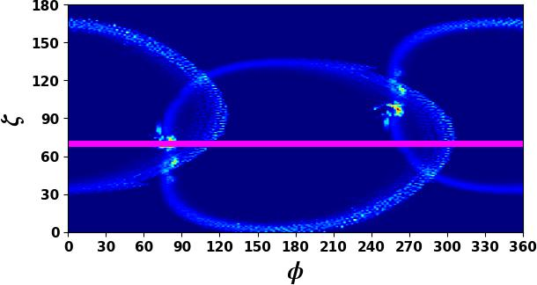
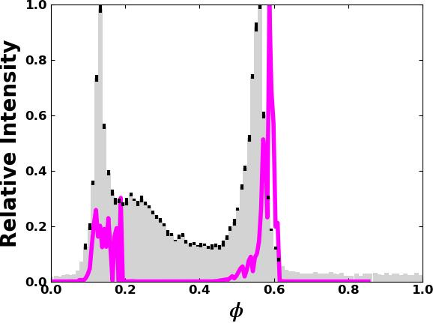
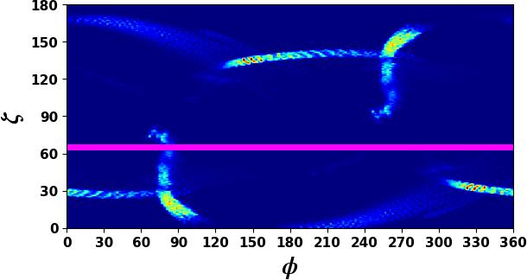
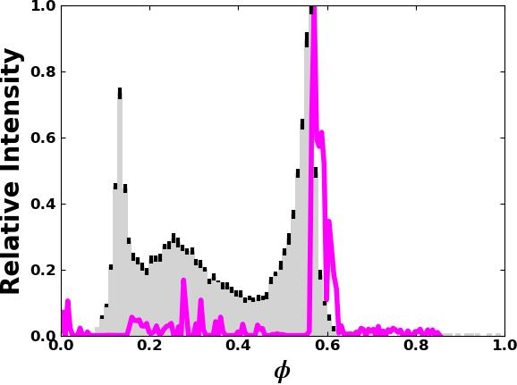
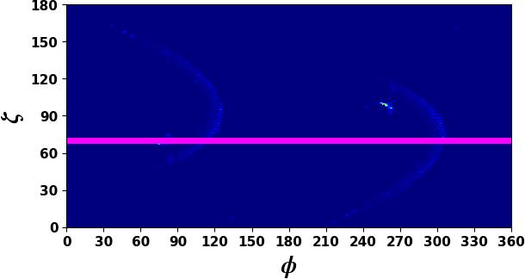
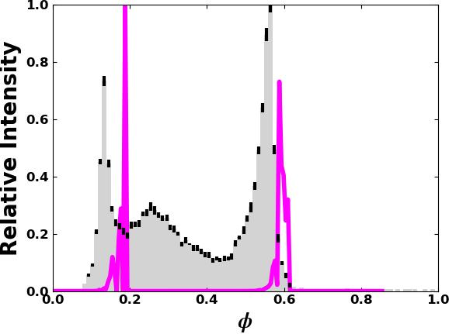
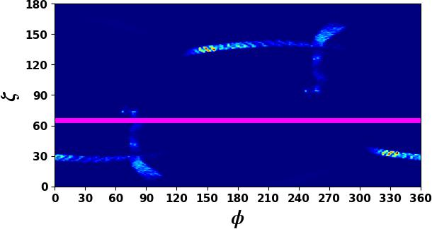
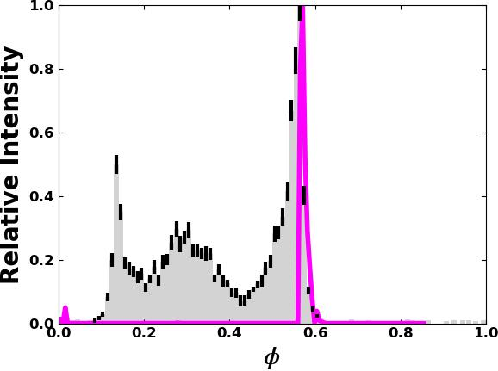
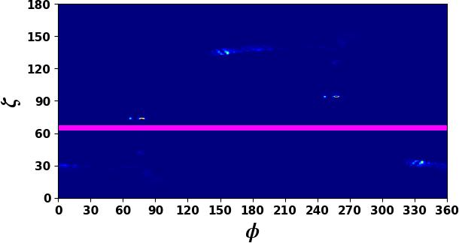
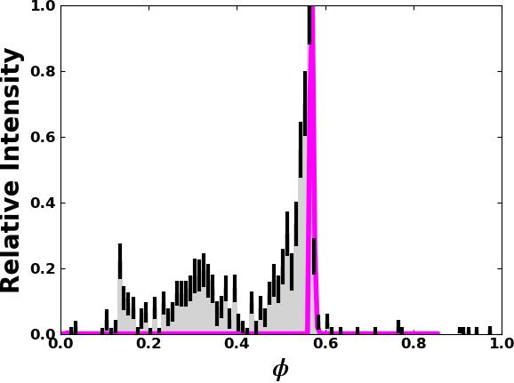

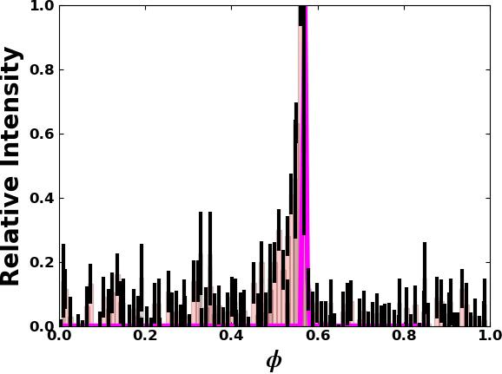
Preliminary
0.1 - 0.3 GeV
0.3 - 1 GeV
(FIDO) FF Inside + Dissipative outside
1 - 3 GeV
3 - 8 GeV
8 - 20 GeV
> 20 GeV

Slide 11
Summary
Studying the high-energy gamma-ray emission as curvature (and later the synchro-curvature radiation) in dissipative magnetospheres we found that the model captures the general trends of the light curves with increasing energy, i.e., decrease of P1/P2 (second peak leading to larger spectral cutoffs), evolution / suppression of the inter-peak bridge emission, stable peak positions and a decrease in the peak widths.
Considering our choices of conductivity, lower values are preferred to fit the H.E.S.S. and Vela data at energies >20 GeV, and this yields approximately larger energy cutoffs and larger accelerating rates.
Need to do a comparison study with previous work and current studies (see Cao and Yang 2024, and other works):
Explain the Vela pulsar’s high-energy emission as curvature in dissipative fields and also by extending the model to other radiation mechanisms, i.e., synchro-curvature radiation model (Cerutti et al. 2016, led by Hambeleleni Davids, earlier stage).
The significance of improving the phase lag between radio and gamma-ray emission to constrain the model. Does this model constrain the multi-wavelength observations? Radio model still geometric.
He determines the number of the stars; He gives to all of them their names. Psalm 147:4

