Slide 1


Multi-wavelength Behaviour and Lepto-hadronic
Modelling of PKS 0215+015
IceCube-220225A
Athira M. Bharathan · Markus Böttcher
Centre for Space Research, North-West University, Potchefstroom, South Africa
HEASA 2026 · SAAO, CAPE TOWN, SOUTH AFRICA

Slide 2
Blazars as Candidate PeV Neutrino Sources
IceCube's detection of high-energy astrophysical neutrinos opened a new window onto the most energetic particle accelerators in the Universe. The clearest evidence linking blazar jets to this flux came in 2017.
TXS 0506+056 (2017)
The open question
A 290 TeV neutrino coincided with a blazar flare, the first direct evidence that relativistic AGN jets can accelerate hadrons to photohadronic (pγ) threshold energies.
The blazar SED's high-energy hump can arise from leptonic (SSC/EC) or hadronic (p-synchrotron, pγ cascades) processes. Only hadronic channels produce neutrinos, making candidate neutrino blazars a direct test.
2

Slide 3
IceCube-220225A and PKS 0215+015
IceCube-220225A
A changing-look blazar
Detected 25 Feb 2022, 14:12 UT (GCN 31650)
PKS 0215+015 was originally classified as a featureless BL Lac (Gaskell 1982).
Later observations revealed prominent broad Lyα and C IV lines, leading to reclassification as an FSRQ (Blades et al. 1982; Foltz & Chaffee 1987).
Reconstructed energy ≈ 150 TeV
Bronze-tier alert: ~30% astrophysical purity
This BL Lac → FSRQ transition matters:
FSRQs are efficient neutrino producers precisely because the dense BLR and disc photon fields supply abundant target photons for pγ interactions.
If PKS 0215+015 was in an FSRQ-like, BLR-dominated state near the neutrino epoch, that strengthens the case for a physical association.
Best-fit position: RA ≈ 34.7°, Dec ≈ 0.0°
PKS 0215+015 (z = 1.715)
Only γ-ray source in the 90% localisation region, ~1.75 deg from best-fit position
Fermi-LAT: day-scale flux >7×, month-scale >3× the 4FGL-DR3 average at the alert epoch
3

Slide 4
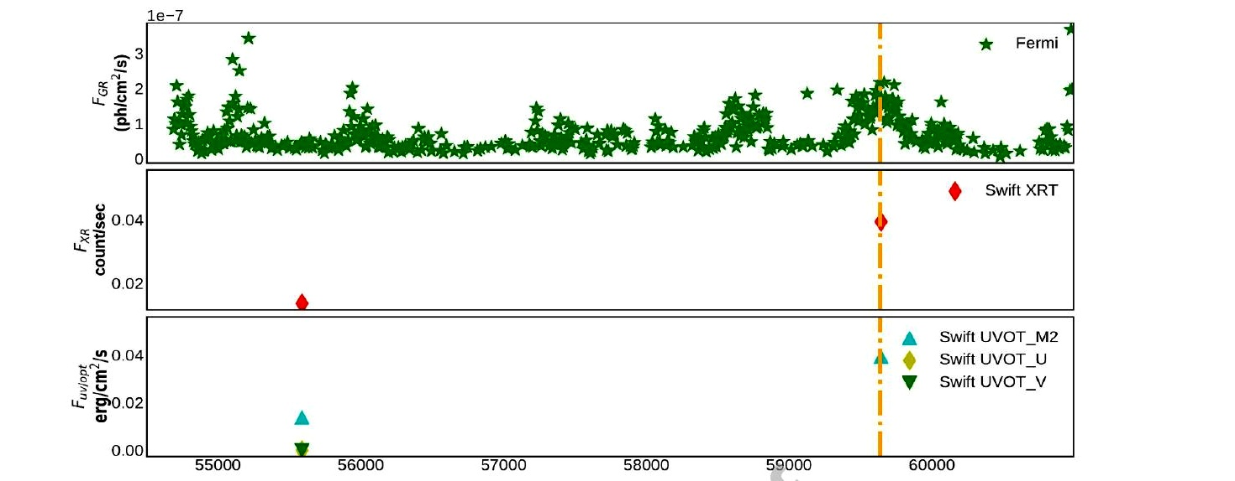
An 18-Years Light Curve Around the Neutrino Epoch
Fermi-LAT, Swift-XRT and Swift-UVOT (2008 Aug – 2026 May)
Clear γ-ray and optical/UV enhancement coincident with the IceCube-220225A epoch (dashed line, MJD 59635)
Radio: OVRO/VLBI show enhanced activity and changing polarization; a new superluminal jet component emerges close to the neutrino epoch (Eppel et al. 2026)
Independent radio monitoring recorded an outburst exceeding 3 Jy, the highest radio state for this source in over two decades (Plavin et al. 2022)
4

Slide 5
An Independent, Model-Free Size Constraint
Flux-doubling/halving timescales in the Fermi-LAT light curve give a light-crossing limit on the emission-region size, independent of any SED fit.
Shortest doubling timescale
Emission-region size limit
τ ≃ 6.61 hr
R ≲ 5.17 × 10¹⁵ cm
Flux-doubling law: F(t) = F(t₀) × 2^{-(t-t}₀^{)/τ}, requiring the flux change to exceed 3σ (Foschini et al. 2011), during the flaring interval bracketing MJD 59635.
R ≲ cδτ/(1+z)
This variability-derived limit agrees closely with the value required independently by the broadband SED fit, R = 5.0 × 10¹⁵ cm, a model-independent cross-check on the adopted jet geometry.
5

Slide 6
One-Zone Leptonic and Lepto-hadronic Framework
We model the broadband SED for the flaring interval coincident with IceCube-220225A using the time-independent, one-zone framework of Böttcher et al. (2013).
Emission region
Leptonic channel
Hadronic channel
A spherical blob of radius R, tangled magnetic field B, moving with bulk Lorentz factor Γ and Doppler factor δ along the jet.
Power law + exponential-cutoff electrons; synchrotron, SSC, and two EC channels (accretion-disc and isotropic BLR/torus fields).
A co-accelerated proton population radiating via proton synchrotron and photohadronic (pγ) interactions with jet and external photons.
Data: Fermi-LAT (MJD 59625–59645, ±10 days around the alert), Swift-XRT and Swift-UVOT.
6

Slide 7
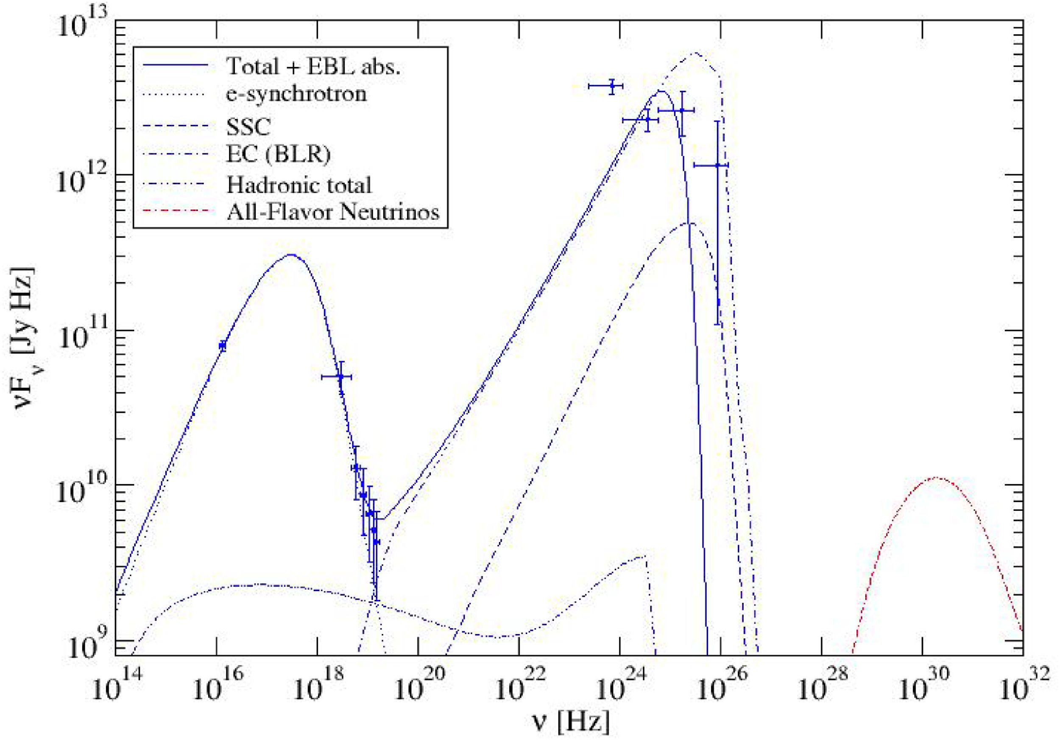
LEPTONIC FIT
A Leptonic Model Reproduces the SED, With a Caveat
Key fit parameters
Γ
20
B
1.0 G
R
5 × 10¹⁵ cm
γe,min → γe,c
1.2×10⁵ → 1×10⁶
Injection index q
5.5
LB / Le
≈ 0.65 (near equipartition)
Caveat
The fitted electron population spans less than one decade in Lorentz factor at an unusually high minimum energy, and q = 5.5 is steeper than the q ≈ 2–3 expected from standard first-order Fermi acceleration. The fit also does not fully capture the Fermi-LAT spectral shape.
We regard this as a plausible working model rather than a unique or completely satisfactory explanation
7

Slide 8
HADRONIC FIT
Maximum Hadronic Contribution: Severe Baryon Loading
A co-accelerated proton population is added to explore the maximum hadronic contribution allowed without violating the observed SED (α_{p} = 2.0, 1 GeV to 10¹⁰ GeV).
Max. proton luminosity
Proton-to-electron ratio
Proton-to-magnetic ratio
Lp = 4×10⁴⁵ erg s⁻¹
Lp / Le ≈ 69
Lp / LB ≈ 107
protons carry ~69× more power
far from equipartition
The model requires very strong baryon loading, far from equipartition
Predicted neutrino yield
Nν ≈ 1.3×10⁻⁵ (1 day) → 1.3×10⁻⁴ (10-day SED window) → 7×10⁻² (full IceCube lifetime, ~15 yr)
All three estimates are far below unity, consistent with the single, moderate-significance Bronze-tier alert observed rather than a statistically significant excess.
Despite this large reservoir of proton kinetic energy, the intrinsic inefficiency of proton-synchrotron and pγ channels keeps the hadronic emission subdominant to the leptonic component at every frequency.
8

Slide 9
DISCUSSION
Self-Consistency, and a Speculative Resolution
A model-independent cross-check
The masquerading BL Lac scenario
Emission-region size from short-term γ-ray variability: R ≲ 5.17×10¹⁵ cm
Emission-region size from the broadband SED fit: R = 5.0×10¹⁵ cm
Two entirely independent methods, a light-crossing argument versus a multi-band radiative-transfer fit, converge on the same jet geometry.
PKS 0215+015's BL Lac → FSRQ transition may reflect a Doppler-boosted jet continuum episodically outshining a genuine, persistent BLR. If enhanced accretion activity around the flare boosted the BLR photon field beyond our time-averaged treatment, pγ efficiency could rise without requiring the extreme proton luminosities implied here.
Presented as a plausible, physically motivated, but untested implication of the source's classification history, not a result demonstrated by this modelling.
9

Slide 10
Summary
1
PKS 0215+015 is the only γ-ray source in the 90% IceCube-220225A localisation region, in a substantially elevated γ-ray state, with a historic radio outburst and a new superluminal VLBI jet component near the alert epoch.
2
A leptonic model reproduces the flaring-epoch SED near equipartition (LB/Le ≈ 0.65), but requires an unusually narrow, high-energy electron distribution, a plausible working fit, not a unique one.
3
The maximum allowed hadronic contribution implies severe baryon loading (Lp/Le ≈ 69, Lp/LB ≈ 107), yet predicts a neutrino event rate well below one detection over IceCube's lifetime, consistent with the single Bronze-tier alert.
4
Emission-region sizes from independent methods, short-term variability and SED fitting, agree closely (≲ 5.17×10¹⁵ cm vs. 5.0×10¹⁵ cm), supporting the physical self-consistency of the adopted jet model.
Bharathan & Böttcher, 2026
10.1016/j.jheap.2026.100754
Thank you
Athira M. Bharathan · athirambharathan25@gmail.com
10

