Slide 1

1
Maria Giovanna Dainotti
Redshift estimator
to support GRB rate vs SFR density
Main Collaborators: Aleksander Lenart (PhD,Jagiellonian), Nagataki (Riken), Iwasaki (NAOJ), Agnieszka Pollo (NCBJ), Vahe’ Petrosian (Stanford), Fraija (UNAM), Dieter Hartmann, Nikita Khatiya, Druv Bahl (Clemson University)
1/10/2026,Cape Town, HEASA

Slide 2
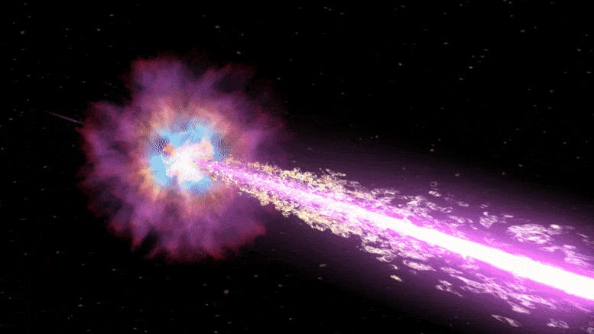
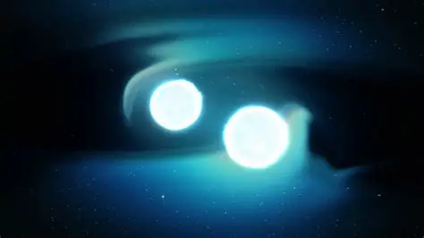
GRB and SFH connection
Traditionally
Long duration GRBs, due to massive-star deaths
Short duration GRBs, due to compact-object mergers
Both in principle they should trace the Star Formation rate density with different delays
Delay=time between star formation and GRB
(40 Myr for Long and up to Gyr for short)
We will tackle these delays
3

Slide 3
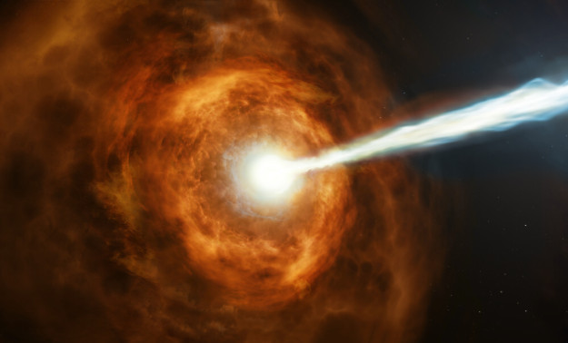
Is the GRB-SFH link so simple?
3
GRB rate deviate from the SFR Density at low-z and high-z
Key challenges
Few GRBs have observed redshifts
Non uniform (different surveys, etc) GRB host galaxy analysis
      Progenitors are mixed in terms of the long/short duration
Notes:
“Although GRBs are physically linked to star formation, the GRB–SFH connection is not settled: the GRB rate deviates from the cosmic star-formation history. The root cause is progenitor diversity — duration does not uniquely map to the physical origin.” In order to make this link clear we need to address these challenges

Slide 4
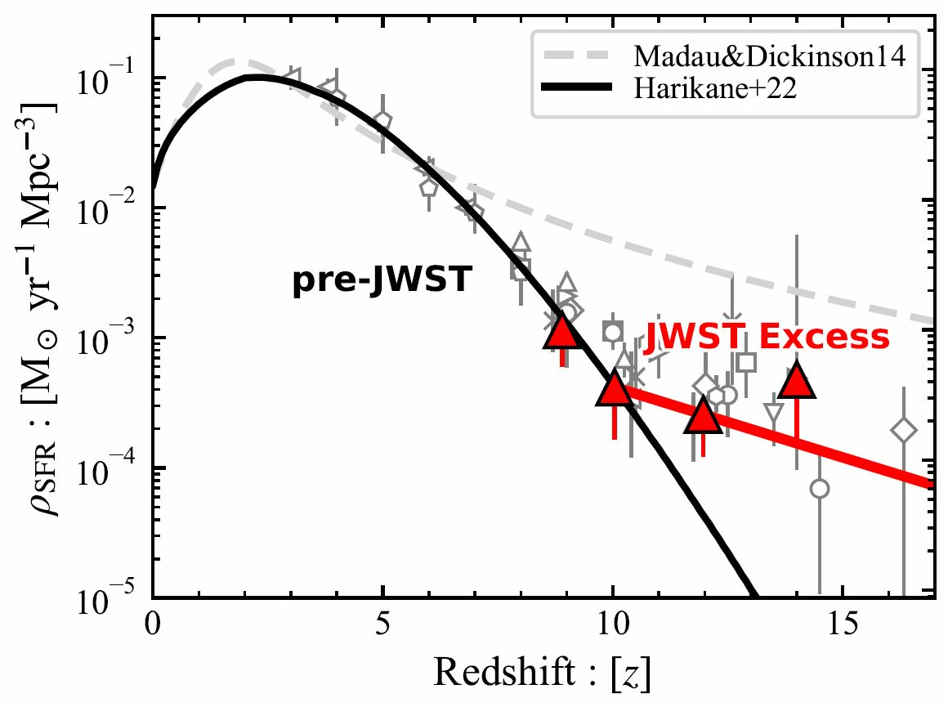
JWST galaxy excess and the GRB–SFR connection
4
JWST finds more UV-bright galaxies at z ≳ 10 than many models predict.
The inferred SFR depends on the stellar population model and AGN light: some of a galaxy’s brightness could come from gas accreting onto its central supermassive black hole.
Reduced UV suppression
Weaker UV feedback (radiation affecting the gas that form stars) may allow more SF and more GRBs, if GRB efficiency does not evolve.
Top-heavy Initial Mass Function
More UV light per stellar mass and more massive star forms altering both the inferred SFR and GRB efficiency.
AGN contribution
AGN light can yield a galaxy excess without increasing the GRB rate.
UV-inferred SFR assumes a stellar population model
Progenitor physics and selection biases affect GRB rates.
Harikane et al. (arXiv:2208.01612) Matsumoto et al. (2024, arXiv:2409.11468), Fig. 2
Notes:
JWST measures UV luminosity. Inferring SFR requires a population model. IMF means initial mass function. AGN means active galactic nucleus.
Harikane et al. propose reduced UV-background suppression before reionization as one explanation: https://arxiv.org/abs/2208.01612 .
Matsumoto et al. distinguish enhanced SFR, an IMF transition, and AGN light. In their adopted IMF model, GRB production increases. Low observed rates also require selection and progenitor checks. Their GRB suppression at z ≳ 14 is an imposed model cutoff.
Rate scenarios and Figure 2 source: Matsumoto, Harikane, Maeda & Ioka (2024), https://arxiv.org/html/2409.11468v2 , Sections II–IV and Figure 3 caption.
Spectroscopic galaxy sample: Harikane et al. (2024), https://arxiv.org/abs/2406.18352 .

Slide 5
Key Scientific Questions
5
Is GRB rate a tracer of the SFR Density?
Hence, we need to answer:
2) Host galaxy census: How do GRB host galaxies differ in their properties from the global star-forming population?
3) Progenitors: How can we understand GRB classes from the physics rather than from their duration?
Observable → Physical Classification
I will discuss the first question
5
Notes:
This diagram illustrates why duration-based classification is insufficient: overlapping progenitor signatures exist, and our catalog is designed to quantify and resolve these exceptions systematically.” Because long and short GRBs arise from different progenitors and timescales, investigating these two classes separately is essential for linking GRB rates to star formation.”

Slide 6
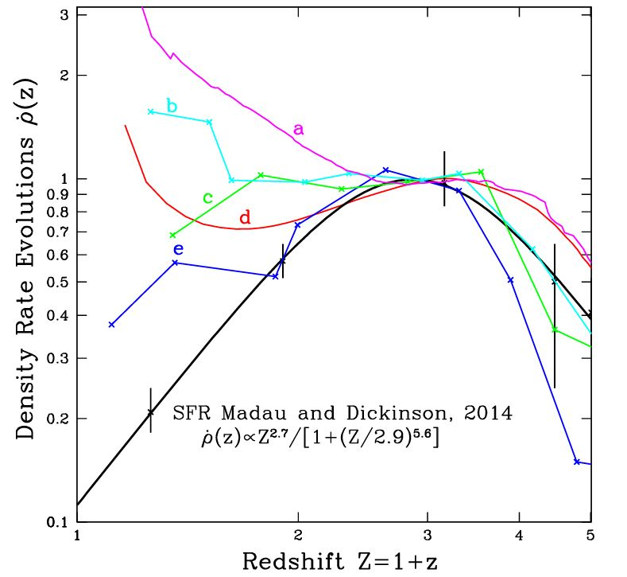

GRB deviates from the cosmic SFR
6
magenta, Lloyd-Ronning et al. (2019);
cyan, Yu et al. (2015);
(c) green, Tsvetkova et al. (2017);
(d) red, Petrosian et al. (2015);
(e) blue, Pescalli et al. (2016).
Petrosian & Dainotti, ApJL, 963, L12, 2024
Notes:
To make progress, we need to model explicitly how GRB rates are connected to the star-formation history, accounting for delays, selection effects, and evolution.” Optical (103 GRBs): Dainotti et al. 2024, ApJL, 967, L30.
• X-ray (223 GRBs): Khatiya, Dainotti et al. 2024, ApJ, 990, 69.
• Observed + inferred z (451 GRBs) – Bal, Narendra, Dainotti et al. 2026, ApJ, in press

Slide 7
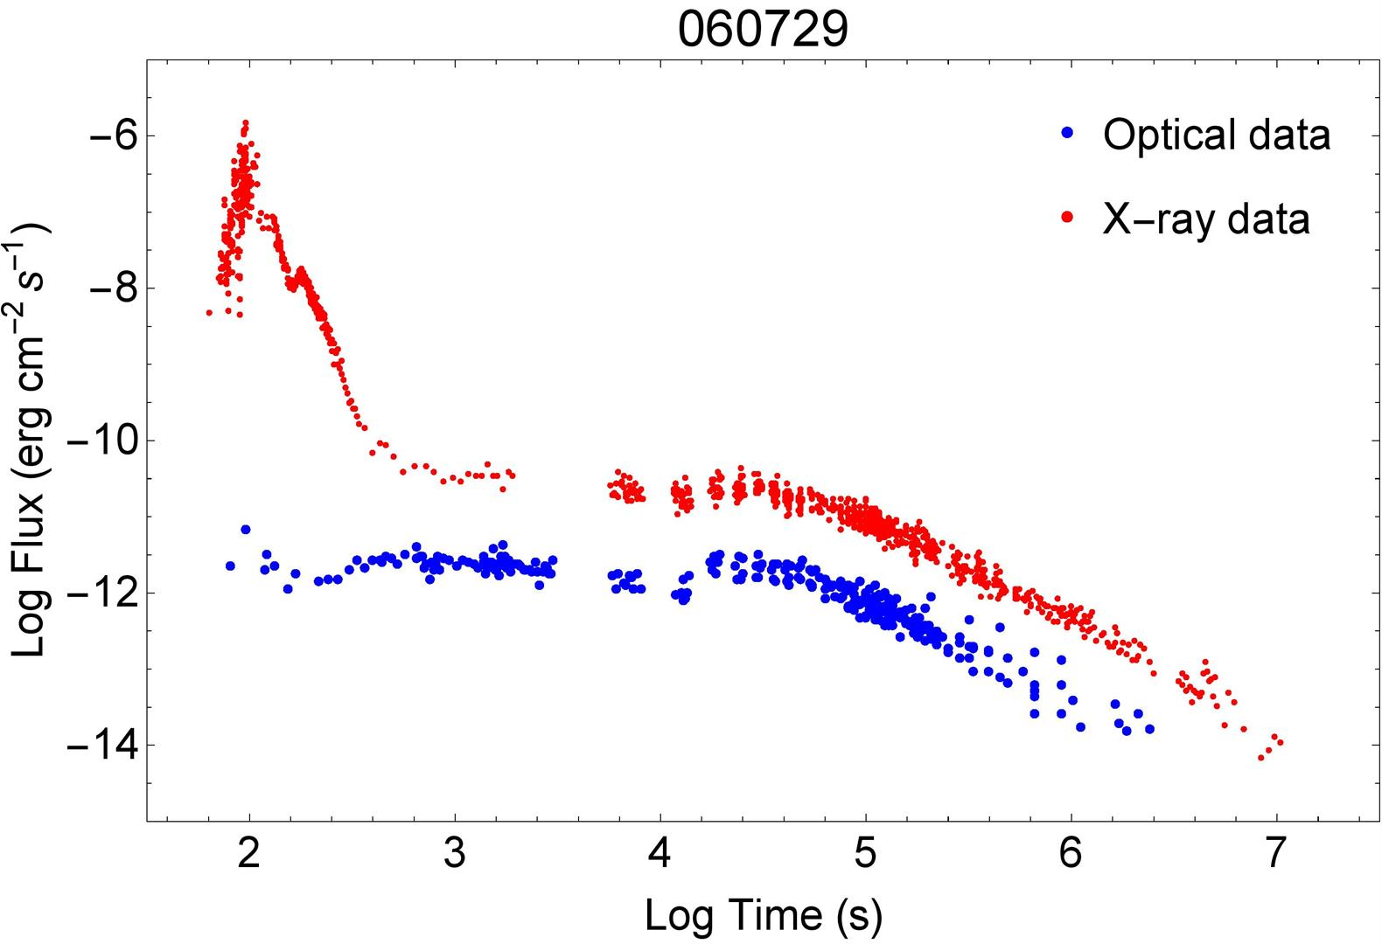



We can also use a sample with plateau features
7
Burst Alert Telescope+ X-Ray Telescope+UVOT from Swift.
The blue line is the
phenomenological Willingale model (R. Willingale et al. 2007)
Standard is good!
Dainotti, Livermore, Kann, Li, Oates, Yi, Zhang, Gendre, Cenko, Fraija 2020, ApJL, 905, 26.
The less varied properties of the plateau compared to the prompt allows an independent analysis to check the deviation.

Slide 8
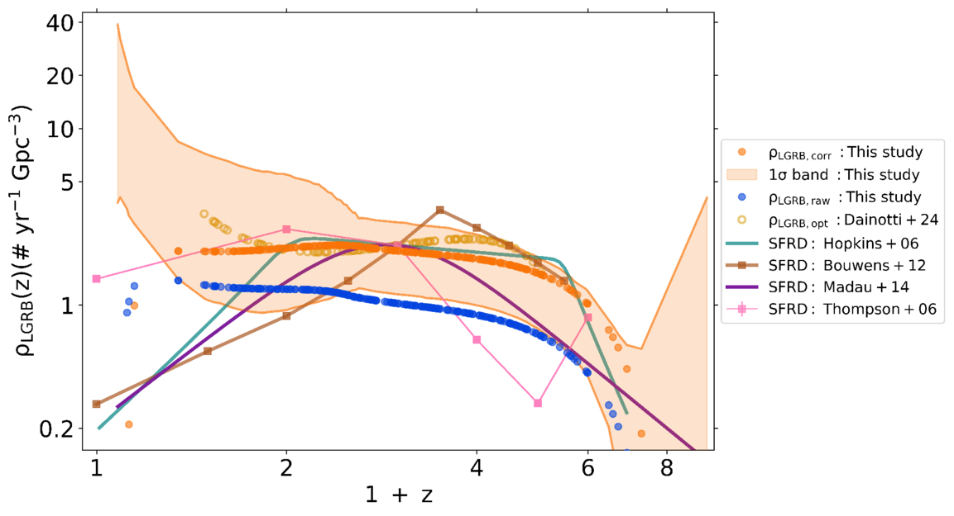
GRB rate vs. SFR with X-ray data
223 GRBs in X-rays from Narendra, Dainotti et al. 2025
SFRD=SFR density
1-σ band is obtained with bootstrap method for 1000 samples where parameter distributions reproduce the actual observations
Khatiya, Dainotti, et al. 2024, ApJ, 990, 1, id.69, 11

Slide 9
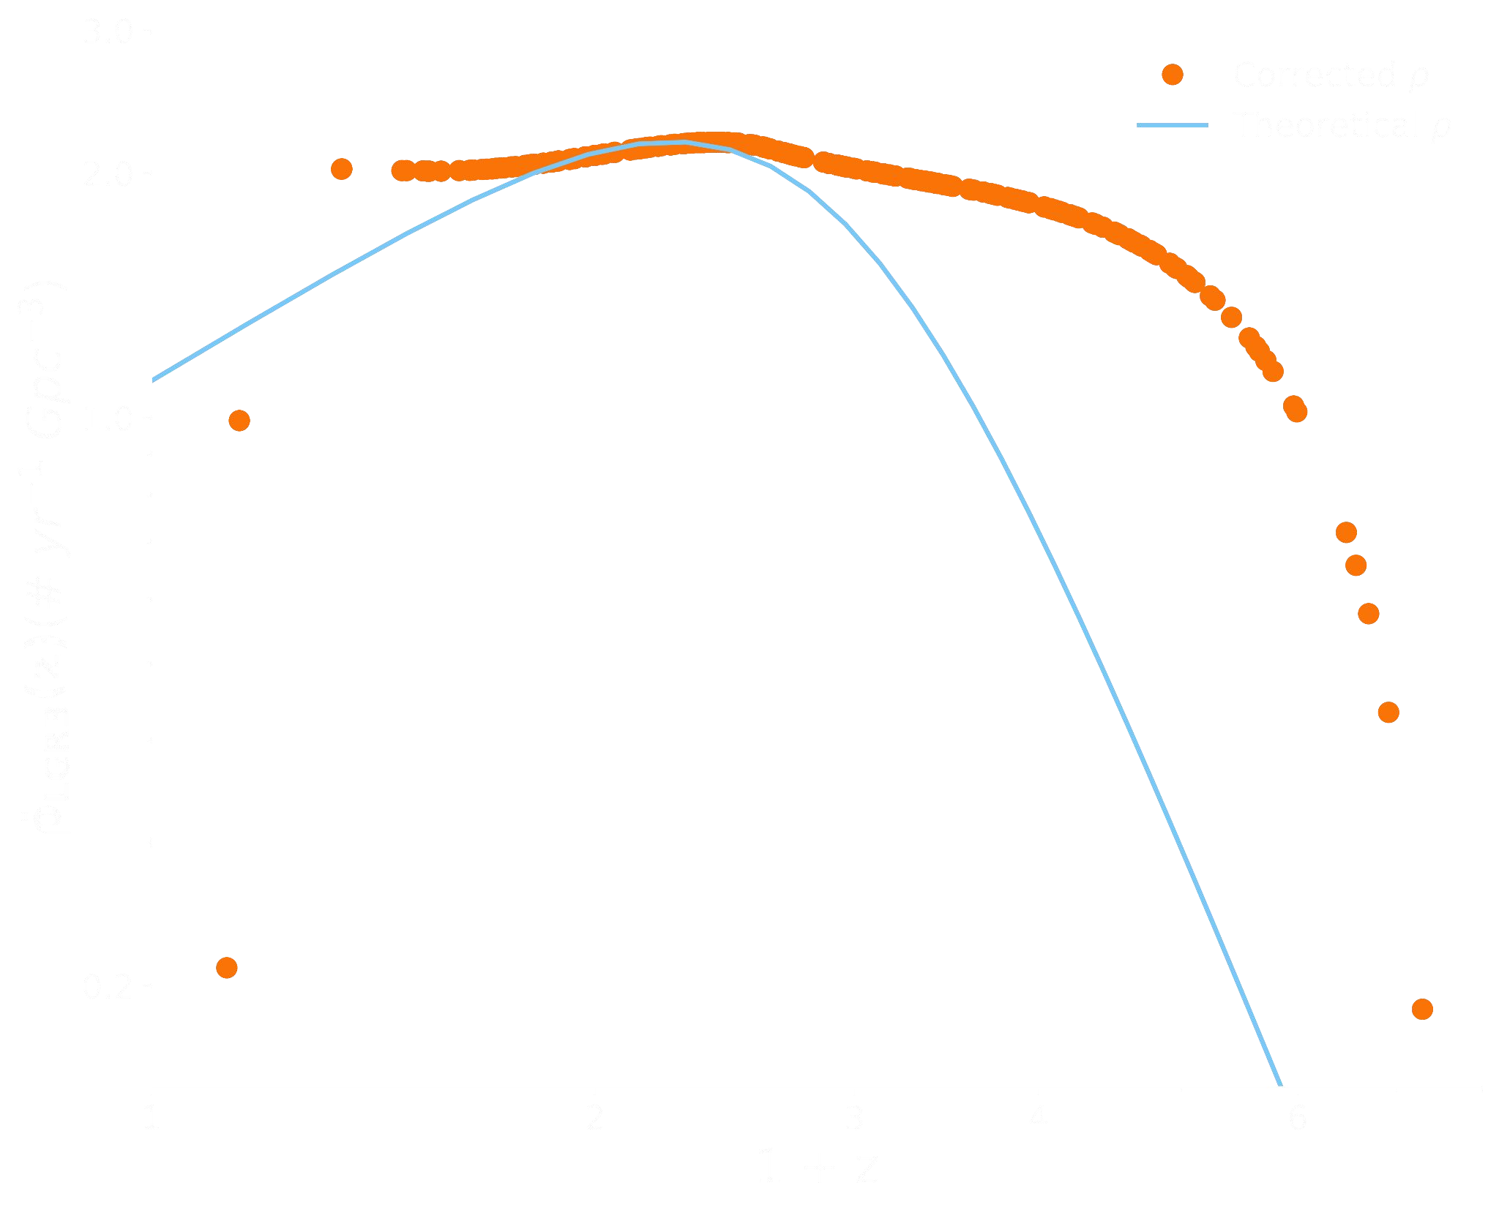

Explain mismatch-I
Beaming evolution
Low-z → Wider jets High-z → Narrower jets
f_{beam}(z) ∝ θ_{j}² ∝ (1+z)^{-1.6} [Ref: Lloyd-Ronning+19]
Instead of fixed f_{beam},
^{ρ}theory^{(z) ∝ f}beam^{(z)}
Beaming evolution with z is not sufficient to explain the ρ_{corr}
Credit from: Kathiya+25
10

Slide 10
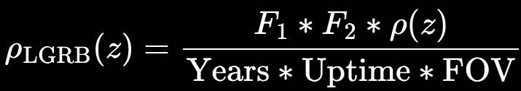
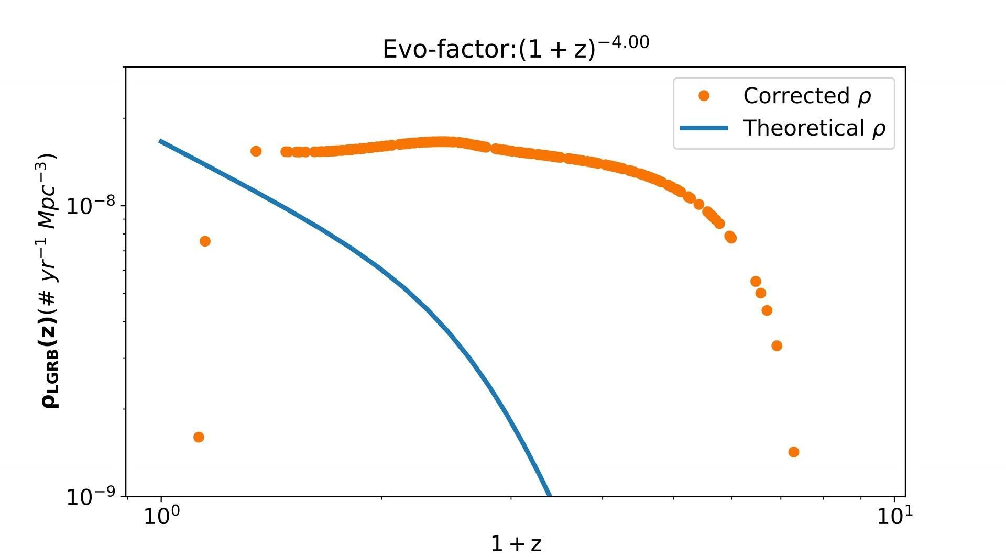
Explain mismatch-II
F1=GRBs removed by the analysis;
F2=fraction of GRBs with plateaus
Power law evolution absorbing all unresolved progenitor properties:
ρ_{theory}(z) ∝ (1+z)^{k} ; k → [-4, 4]
(1+z)^{k} factor is not sufficient to explain the ρ_{corr}
Credit from: Kathiya+25

Slide 11
To answer all these questions we need redshifts
WHAT ARE WE TRYING TO DO?
We are training a supervised machine learning model on optical photometric GRB properties to reliably predict the redshift.
Using this model, we will estimate the unknown redshift of GRBs.
WHY ARE WE DOING THIS?
Currently, the SWIFT GRB catalog only has 26% of GRBs (~400) with measured redshift.
~ 9% of GRBs have measured redshifts of the total sample.
Redshift measurements are crucial for the cosmological application of GRBs: connection between GRB rate and SFR
This highlights the difficulty of the problem and why we needed to mature the methodology
HOW ARE WE GOING DO IT?
We are applying the SuperLearner machine learning model to GRBs.
We use MICE to impute missing data
Applying Optimal Transport Bias Correction
For the first time, using optical plateau properties for GRB redshift estimation.

Slide 12
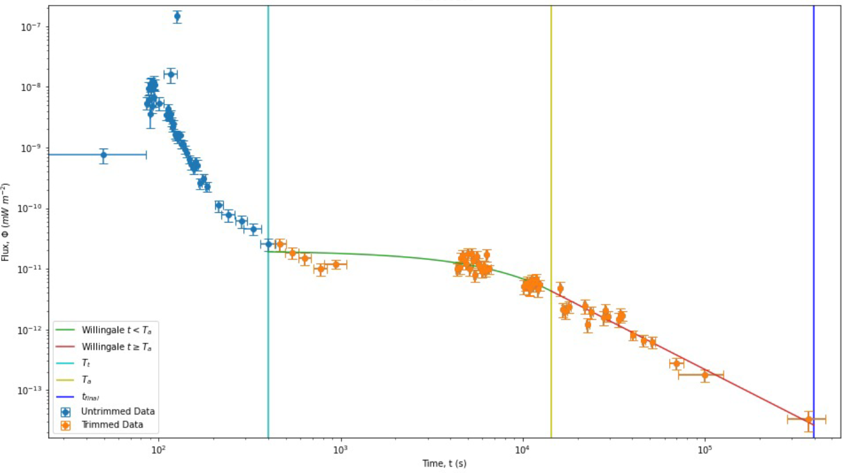
Data Sample
12
Dainotti, Narendra, 2024, ApJL, 967L,30
We are using 179 GRBs which show the optical plateau in the lightcurve.
These are taken from “The Optical Two- and Three-dimensional Fundamental Plane Correlations for Nearly 180 Gamma-Ray Burst Afterglows with Swift/UVOT, RATIR, and the Subaru Telescope” (Dainotti et al. 2022d)
The dataset contains GRBs from Swift/UVOT, RATIR and the Subaru.
We use 9 features in this analysis:
4 features from the prompt emission:
  Fluence,
  T90,
  Peak flux,
  Photon Index
5 features from the plateau emission:
  Time (Ta), Flux (Fa),
  Temporal index (α), Spectral index (β) at the end of plateau &
  Hydrogen column density (NH)

Slide 13
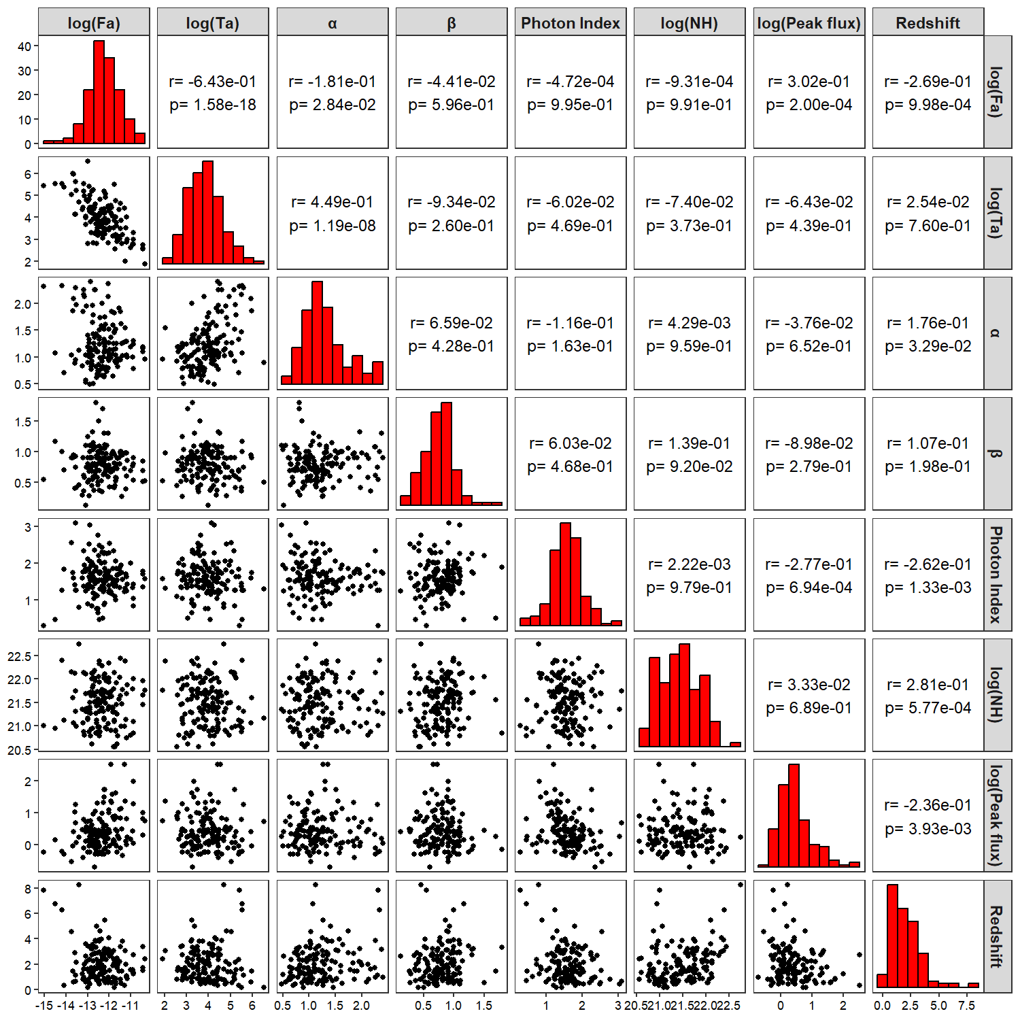
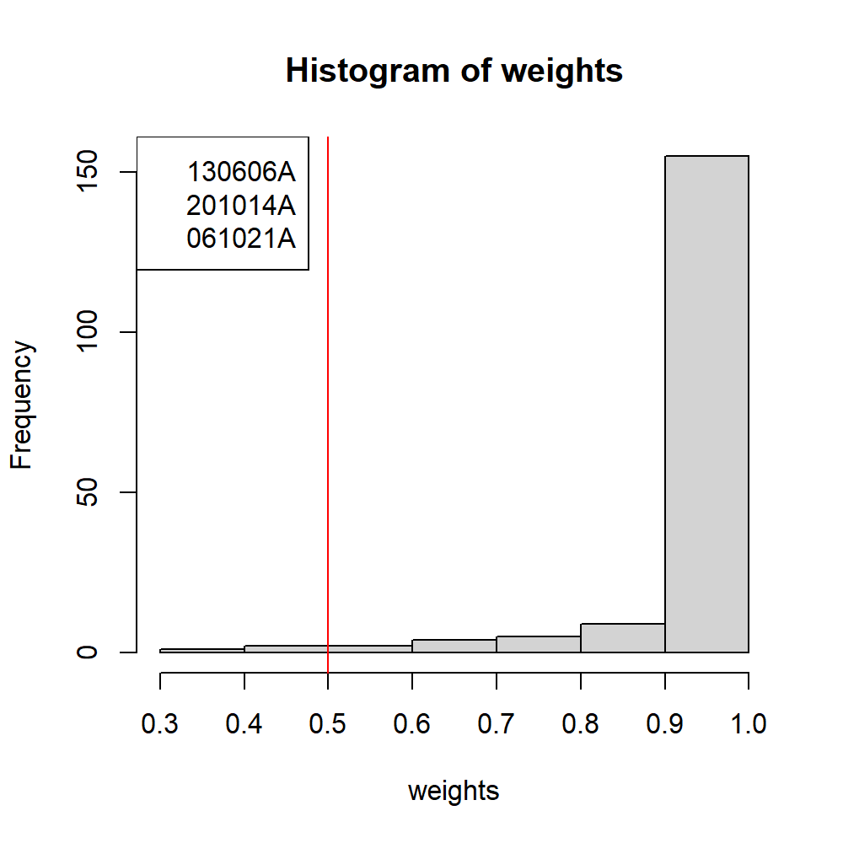
Data Sample: Outlier
13
Finally, we remove 3 GRBs as outliers using the Robust Linear Model with M-estimator, by selecting a cutoff weight of 0.5.
Training set= 176 GRBs

Slide 14
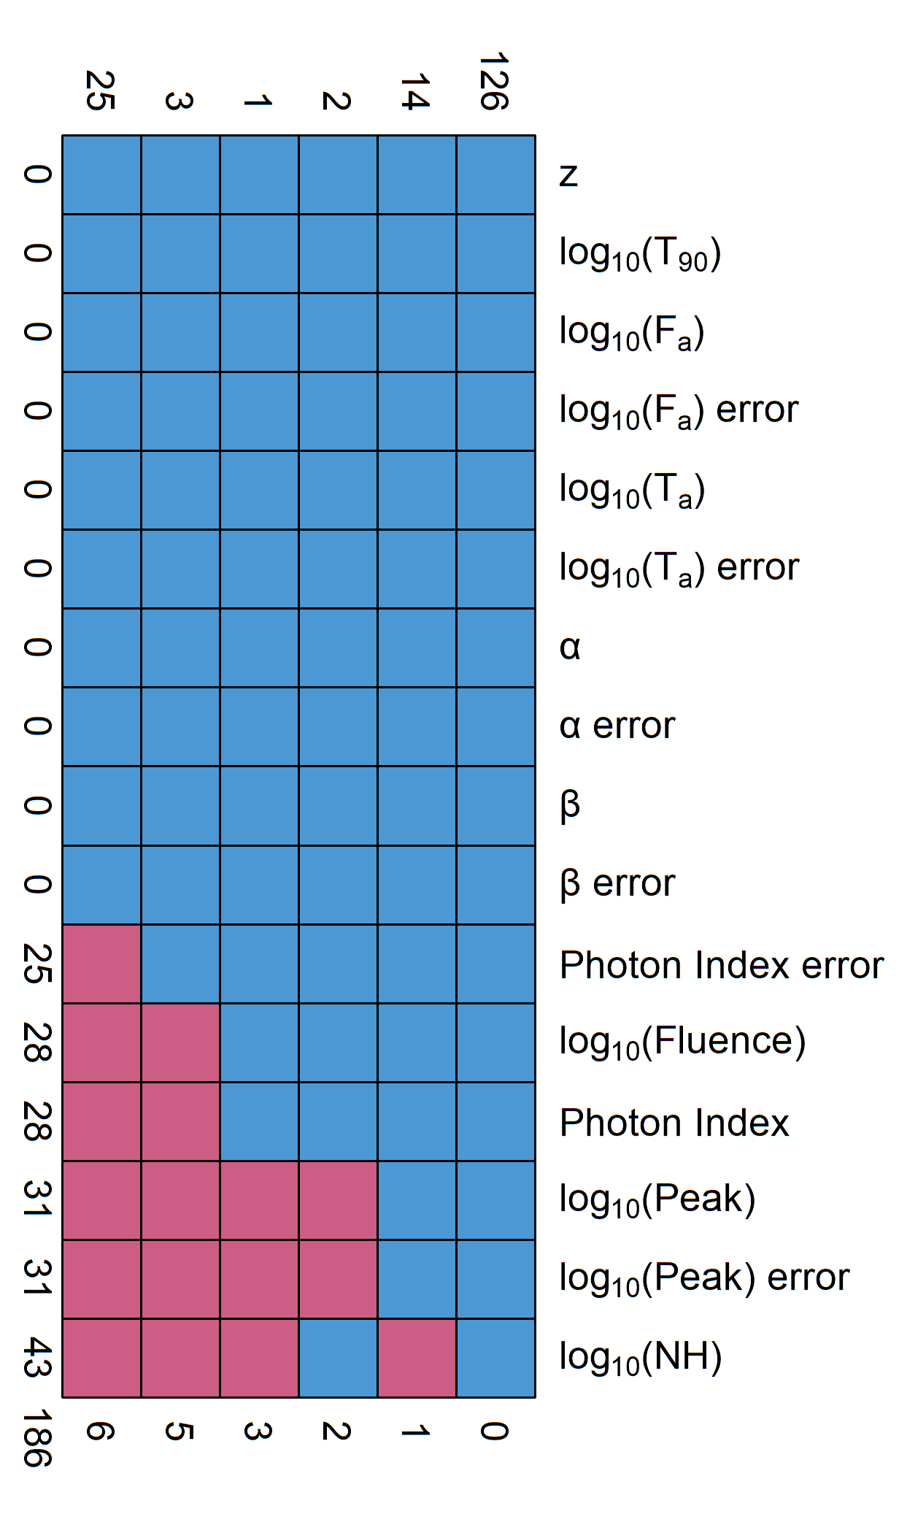
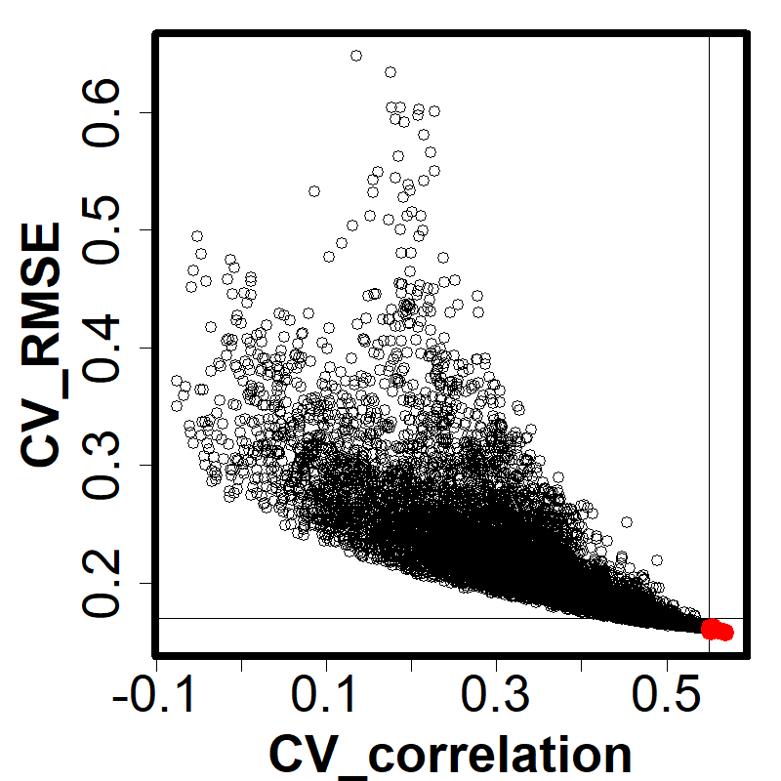
METHODOLOGY
14
MULTIVARIATE IMPUTATION BY CHAINED EQUATION (MICE)
26% of 171 (45 GRBs) have missing data.
This is a method used for imputing missing data.
MICE uses the data present to infer the missing data.
We use Predictive Mean Matching method for imputation.
Previous publications have demonstrated its effectiveness
FORMULA ESTIMATION
We combine 7 predictors to generate 16000+ formula
Select a subset of formulas based on cross-validated results
Further tested on a separate test set
Formula with best correlation, RMSE and MAD are picked.
Notes:
However, 26% of that 171 GRBs have missing data in them. So, we can either drop them, or use MICE to impute them.
MICE uses the data present to estimate what the missing values could be.
There is an assumption that the data is missing at random without any relation to eachother.
MICE supports multiple methods for imputation and the one used here is called predictive mean matching.
We have used this in our previous publications as well, and recently our very first publication using MICE won an Editor’s Choice Award for Astrostatistics from Frontiers Journal.
For the predicting the redshift we use polynomial functions created by combining the 7 predictors and their square terms. Over 16000+ formulas were tested for this.
Each of the formula’s score,based on RMSE and pearson Correlation is show in this figure. We select only a small subset that have low RMSE and high correlation.
This subset is further tested on a separate test set, and then finally we pick 3 formulas, which have the lowest RMSE & MAD and highest correlation.

Slide 15
Methodology
15
log(z+1) = (log(NH) + log(T90) + PhotonIndex + log(Fa))² + log(Ta) + α + β + log(Fluence) + log(Peakflux)
Generalized Linear Model (GLM)
Bayesian GLM
GAM
StepAIC
SuperLearner!
We did test many other ML models, but these 4 obtained the highest weights by SuperLearner consistently.
For GLM and bayes GLM to use the formula we had to develop custom functions in SuperLearner.
For the results we perform 10-fold cross validation 100 times and take their average.

Slide 16
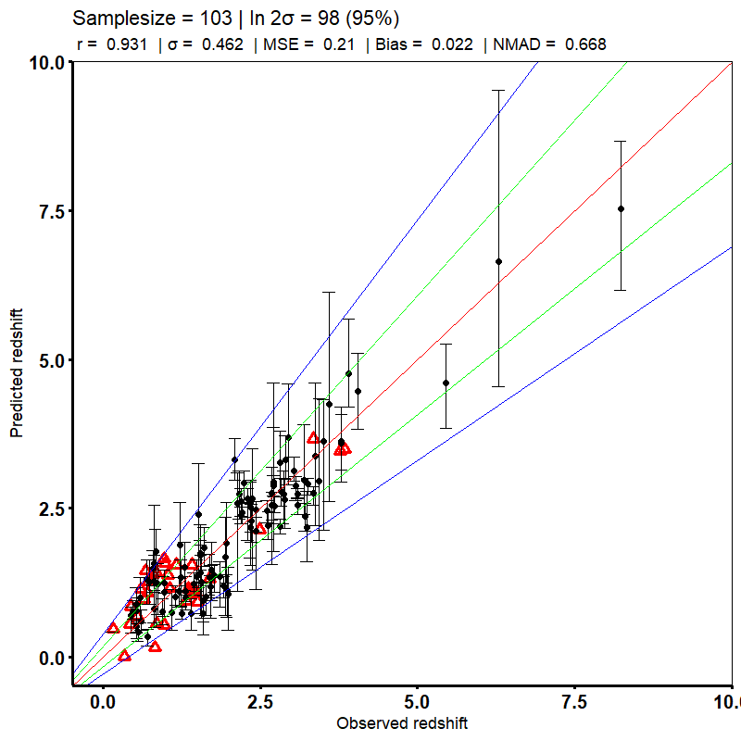
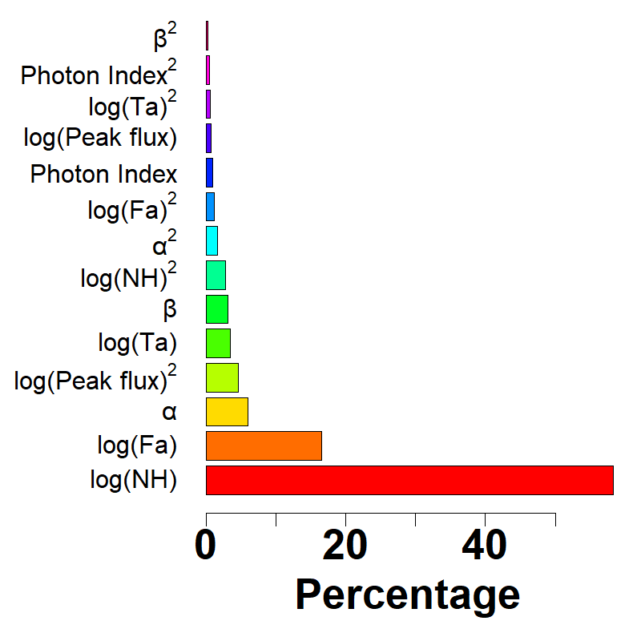
RESULTS
CV RESULTS
This is after bias correction+removing outliers
Pearson correlation 0.93
Mean square error 0.21
61% higher correlation than Ukwatta et. al 2016.
Less number of predictors (7 vs 11).
log(NH) and log(Fa) most important redshift predictors.
Two out of top 3 predictors are plateau.
103 GRBs used for LF & DRE
The optical sample and the Dainotti correlation parameters are recovered
16
Notes:
Coming to the results, here is our cross-validation result. This is obtained after applying bias correction and removing catatrophic outliers.
We achieve a correlation of 0.93 btwn obz & predz and a mean squared error of 0.21
This result is 61% higher than that achieved by Ukwatta et al. 2016 and we achieve this with 7 predictors.
Coming to the importance plot, we can see that log(NH) and log(Fa) have the highest impact on the redshift estimation. Infact two of the top 3 are plateau features, which is a really promising and encouraging sign for plateau features and warrants further research.
The 103 GRBs shown here are selected for the next steps, which is trying to obtain cosmological parameters of GRBs using these CV redshift predicitions.

Slide 17
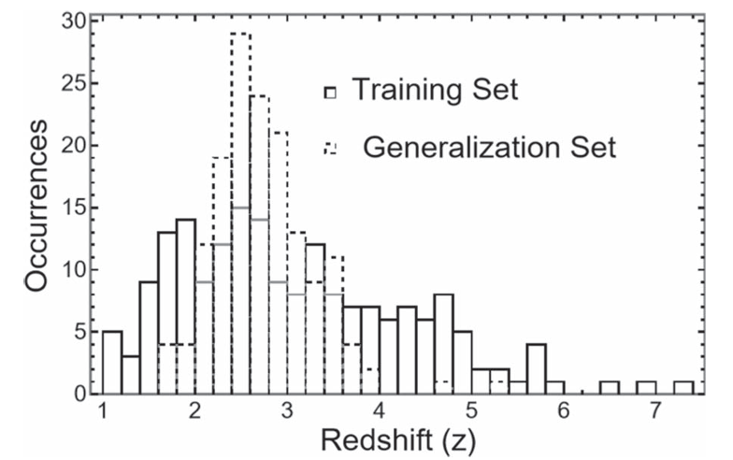
The generalization and the training set
19
Based on the X-ray redshift sample
Dainotti, … et al. 2024, ApJS, 271, 1, id.22.
Similar differences in
Aldowma & Razzaque
2024MNRAS.529.2676A
Distributions of logTa and log NH are different between the training set and the generalization set

Slide 18
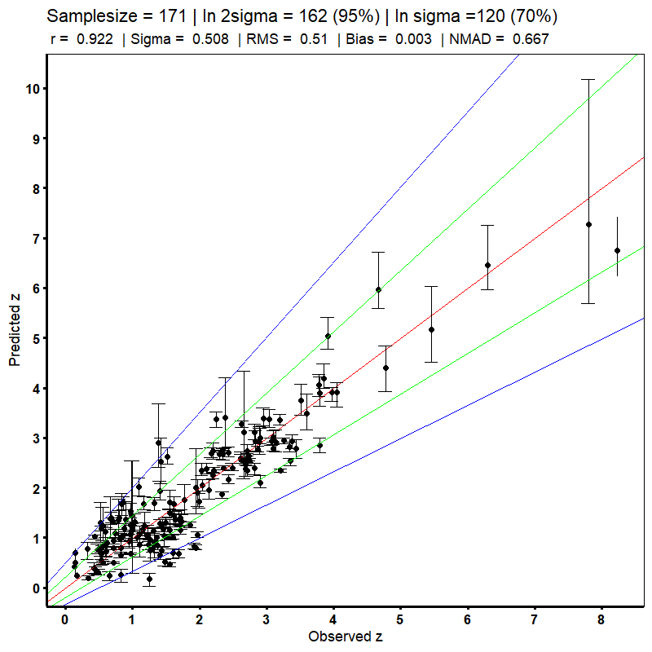
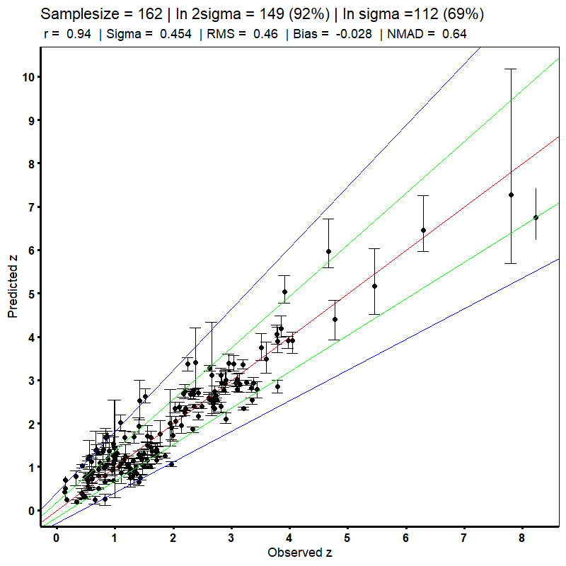
After Optimal Transport Bias Correction
(the X-ray sample)→ Dainotti, et al 2024ApJS..271...22D
18
Remove outlier
162 GRBs:
Pearson correlation,
r=0.94, RMSE =0.46
Bias =0.03
Similar results are obtained independently
Aldowma & Razzaque
2024MNRAS.529.2676A
Comparing with Ukwatta et al. 2016,
we have 56% increase of the Pearson correlation

Slide 19
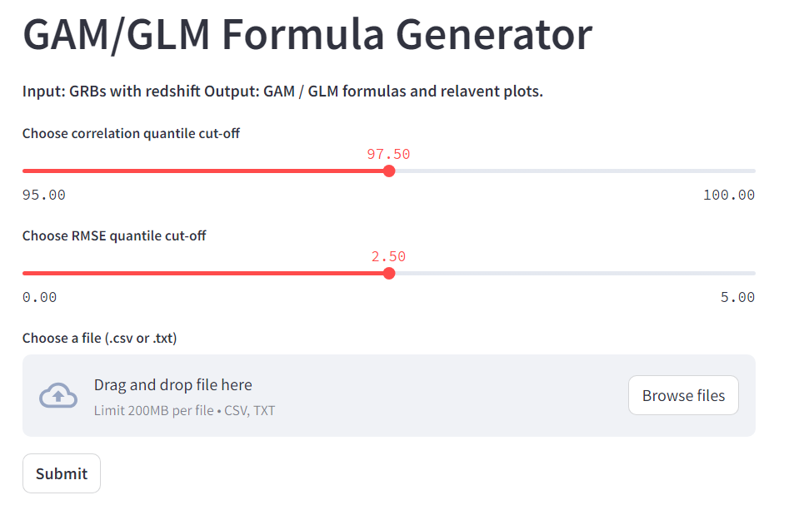
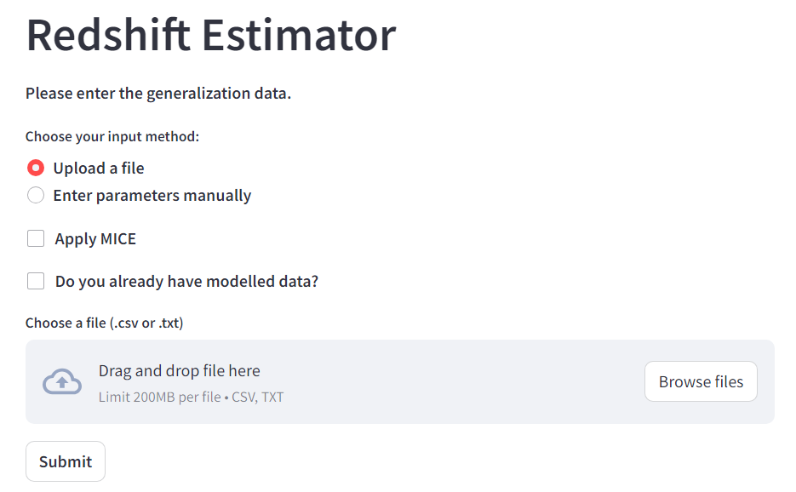
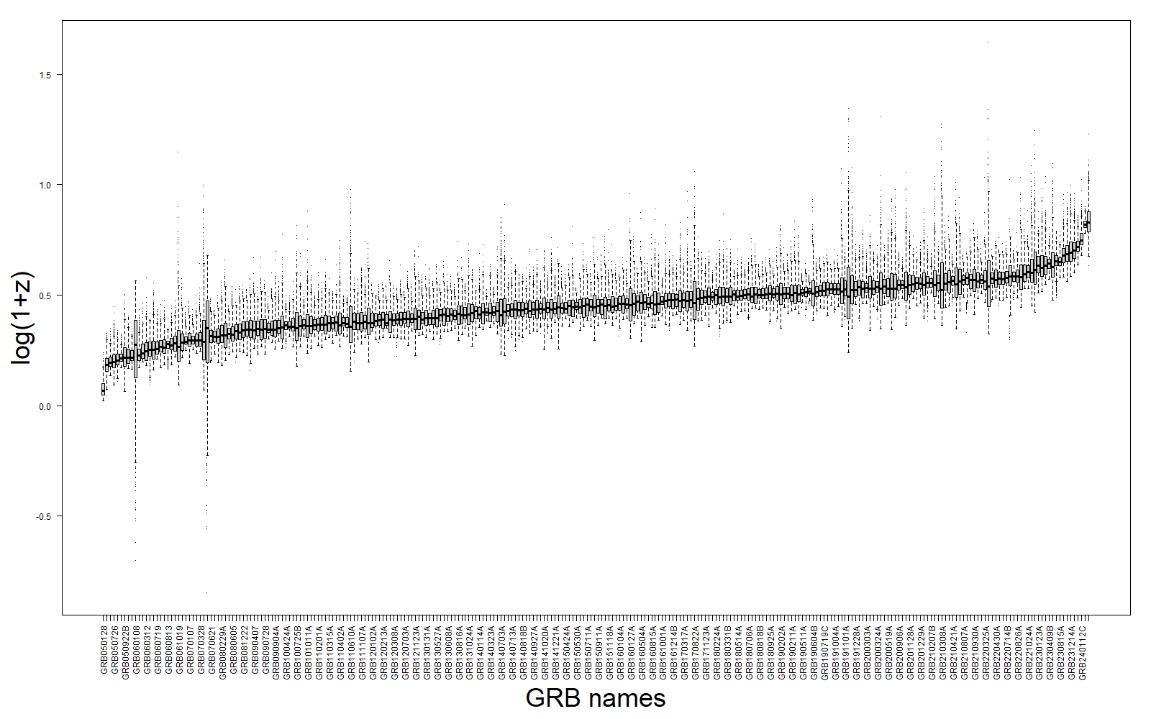
The usable Web-app
a webapp
Expanded methodology with more data
Applying to GRBs without redshift
Narendra, Dainotti, .. al. A&A,
2025A&A...698A..92N
19

Slide 20
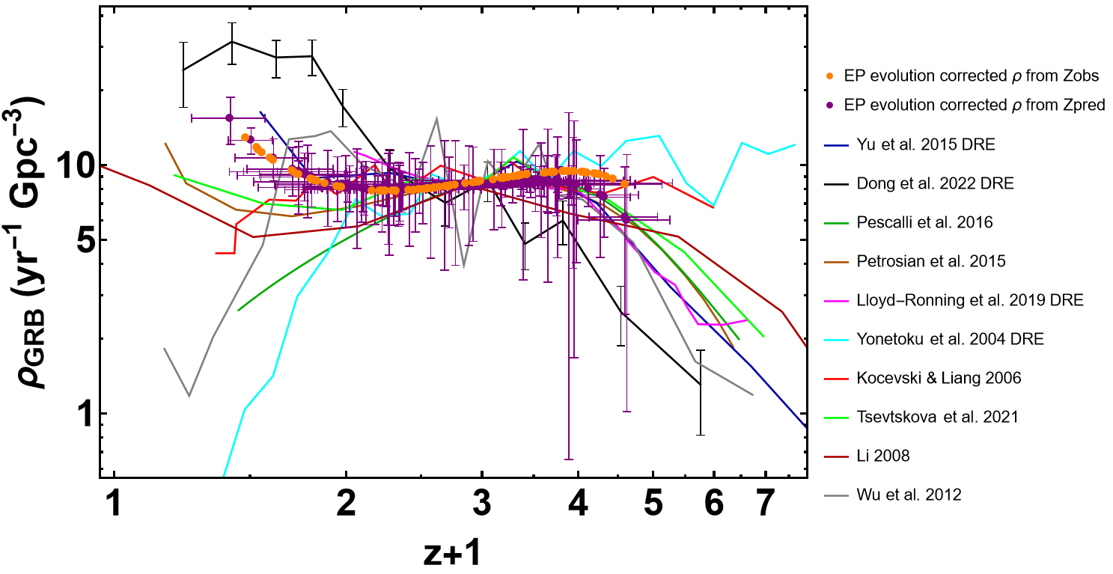
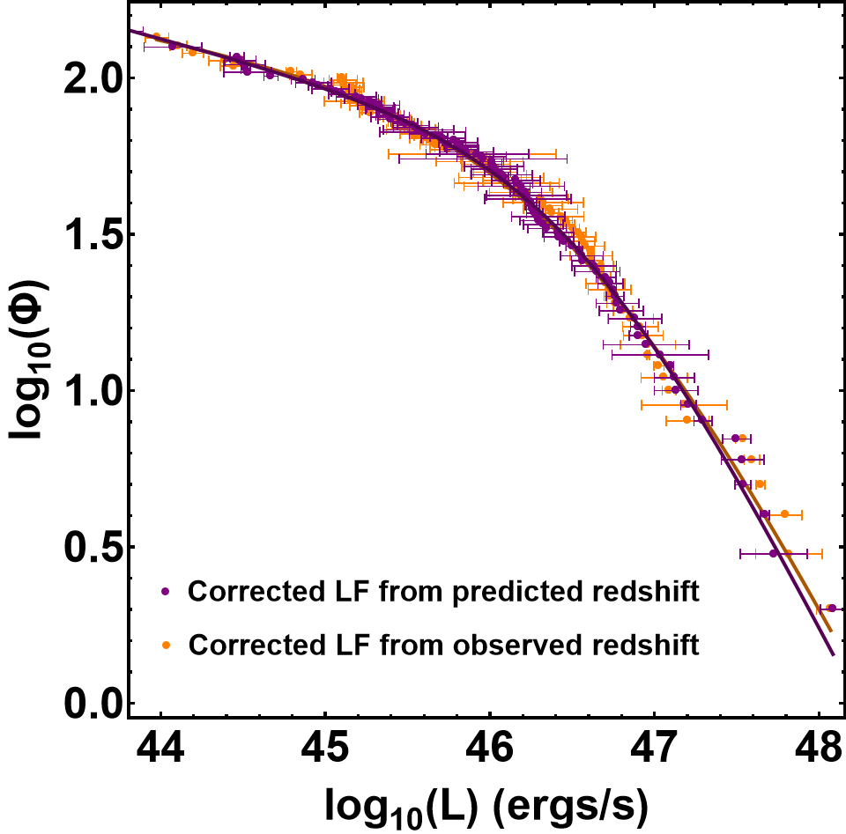
CONCLUSIONS 1
20
Using plateau features for GRB redshift prediction is effective
The LF from z_{obs} and z_{pred} are compatible in 1σ!
LGRB DRE discrepancy with SFR at low-z
THESE PREDICTIONS CAN BE USED FOR DERIVING the rates: 11 Gpc⁻³yr⁻¹ at z<1. One order of magnitude higher than the predicted values
Notes:
Coming to the conclusion, here are the 4 main points.
Most importantly, we have achieved what we set out to do, as stated in the first slide. And that is we have successfully trained a ML model that can be used for obtaining reliable redshift predictions of LGRBs and these can be used for deriving important astrophysical properties of LGRBs. To the best of our knowledge this is the first work of it kind and now the doors are open for further research and interesting results

Slide 21
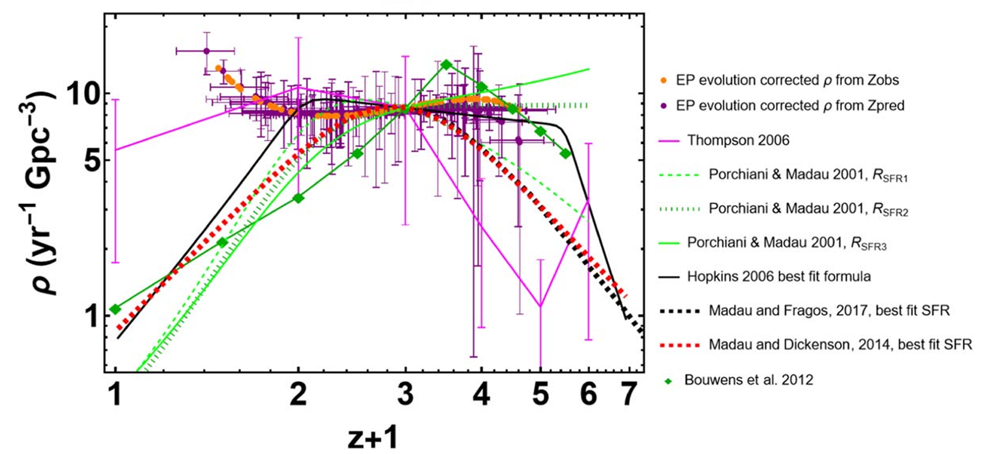
GRB rate vs. SFR with optical data
Dainotti et al. 2024, ApJL, 967, L30
Optical data=103 GRBs
21

Slide 22
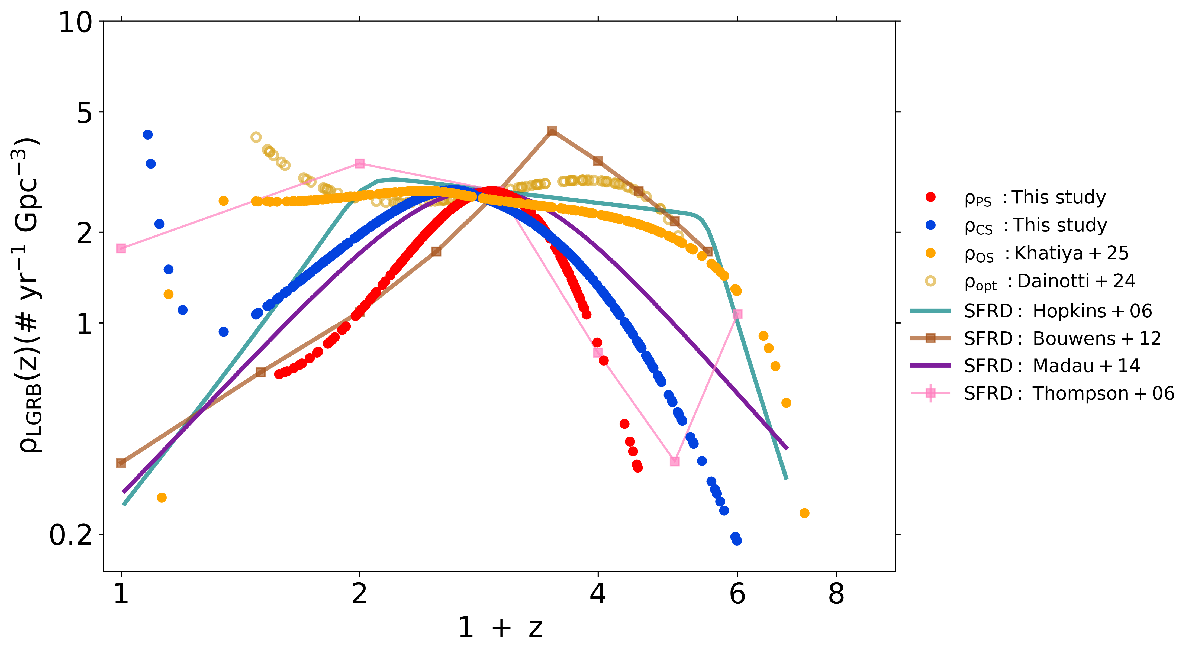
Combined data (451 GRBs)=
Observed redshifts (223 GRBs) + inferred redshifts (228 GRBs)
SFRD=SFR density
Bal, Narendra, Dainotti, et al. 2025, ApJ, 994, 185B

Slide 23
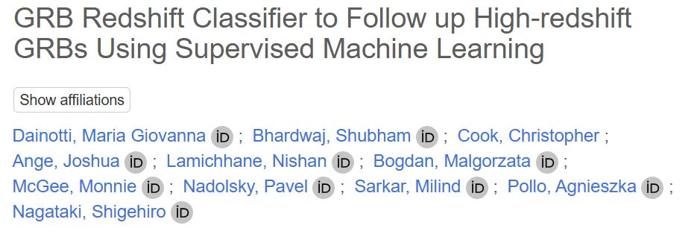
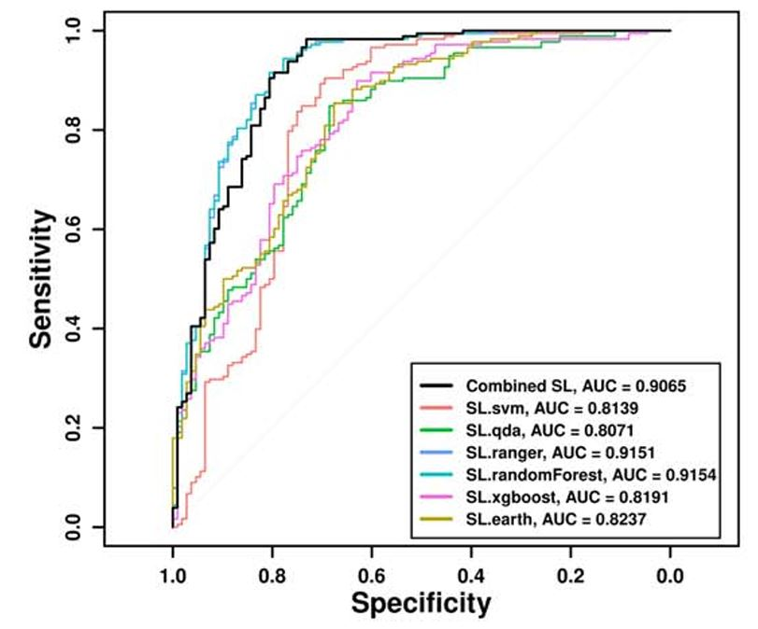
Superlearner applied for Classification
24
The Astrophysical Journal Supplement Series, Volume 277, Issue 1, id.31, 34.
Sensitivity = TP /(TP+FN),
TP=true positive, FN=false negative
A sensitivity of 87% and 89% with a balanced sampling for both z_{t} = 3.0 and z_{t} = 3.5, respectively→
9% and 11% increase in the sensitivity over random forest used alone.

Slide 24
Conclusions:
This discrepancy persists across samples and wavelengths
• Optical (103 GRBs): Dainotti et al. 2024, ApJL, 967, L30.
• X-ray (223 GRBs): Khatiya, Dainotti et al. 2024, ApJ, 990, 69.
• Observed + inferred z (451 GRBs) – Bal, Narendra, Dainotti et al. 2026, ApJ, 994, 185B,
Champati, S., Petrosian, V., & Dainotti, M. G. (2026), ApJ, 1005, 77
More data are needed: future perspective transfer learning between optical via the catalog and X-ray data
23

Slide 25
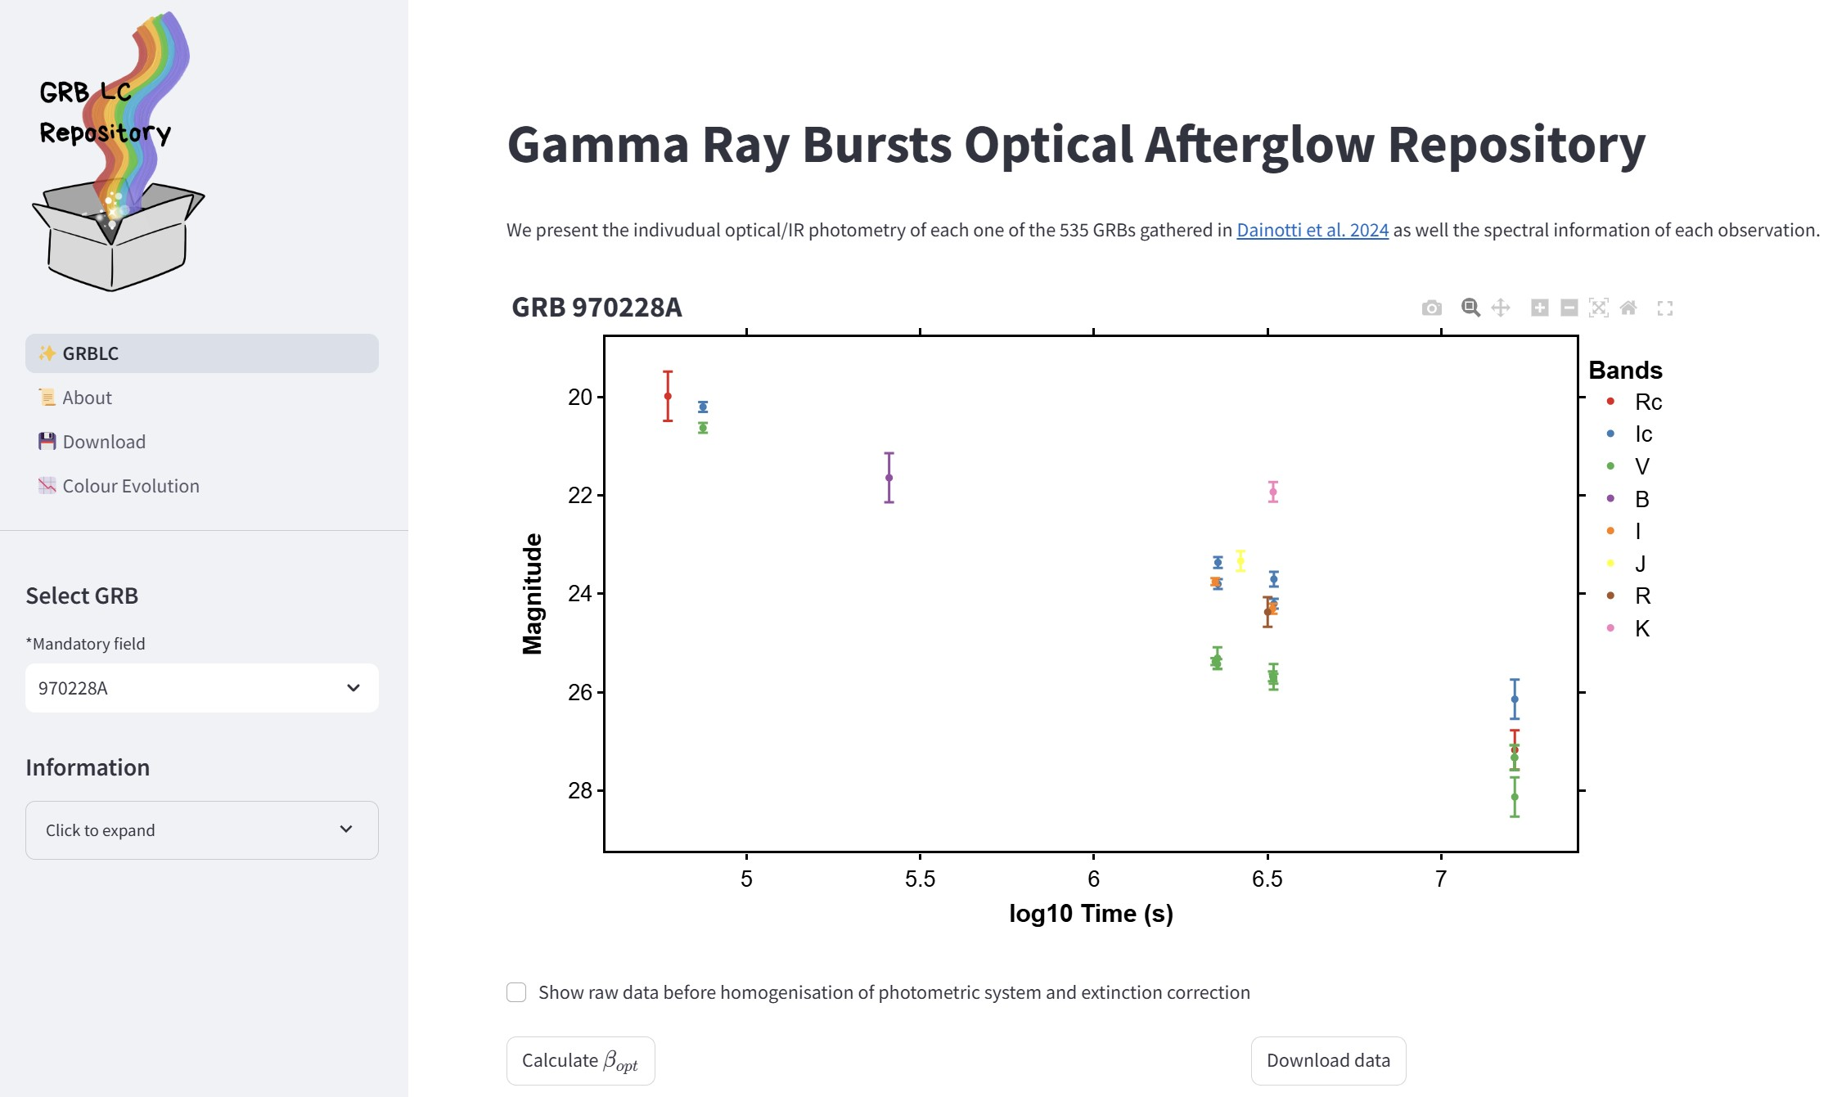
25
The largest GRB Optical Repository: GRB LC package
Dainotti et al., 2024, MNRAS, 2024, 533, 4023.
535 GRBs with redshift
Easily searchable
455 Telescopes
570 Instruments
Large to small apertures:
14 GRBs from Subaru,
1 from Kiso at z=3.6, and
other Japanese Telescopes.
Re-calibration
GRBs observed by Kiso (Dainotti, PI) since 2022.
Joint KISO and SVOM.
Product: accessible via
web-app

Slide 26
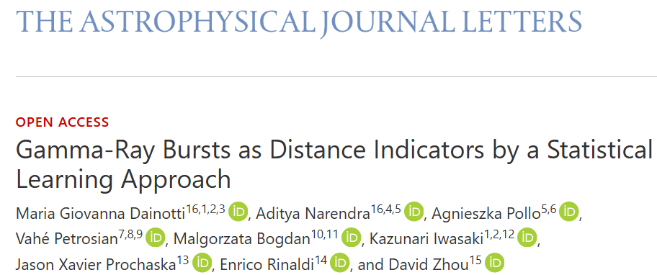

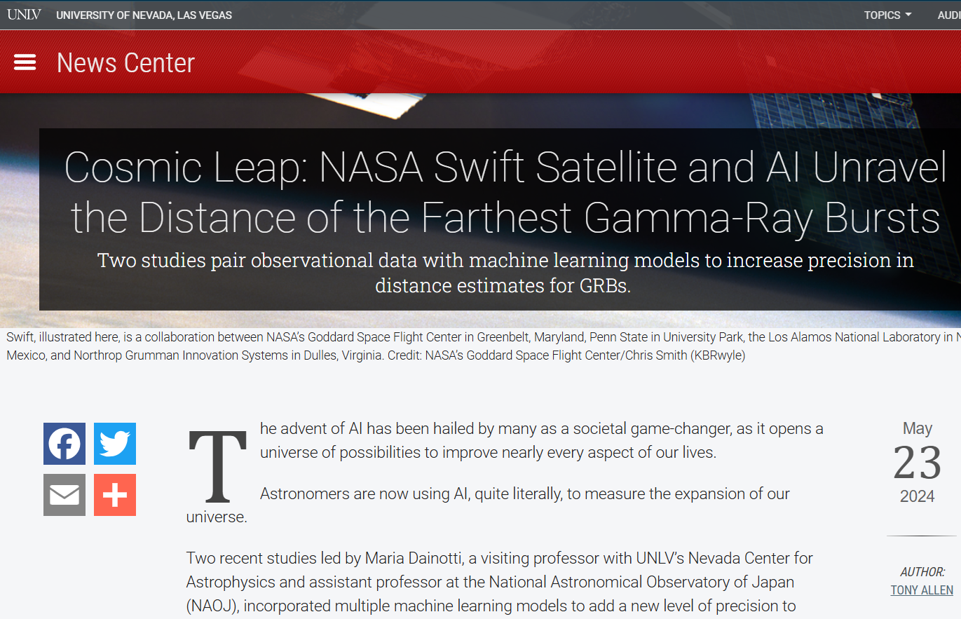
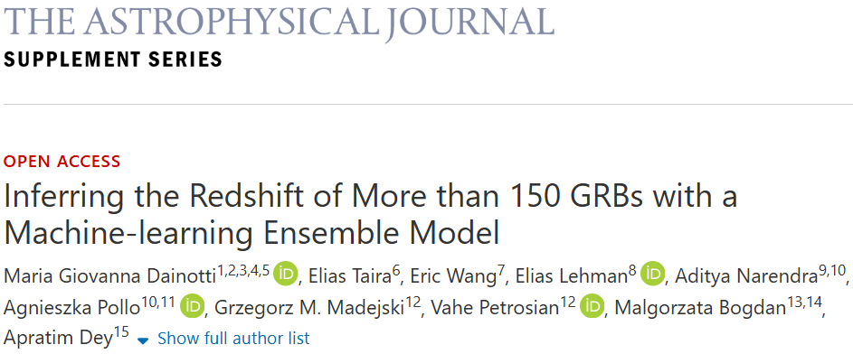

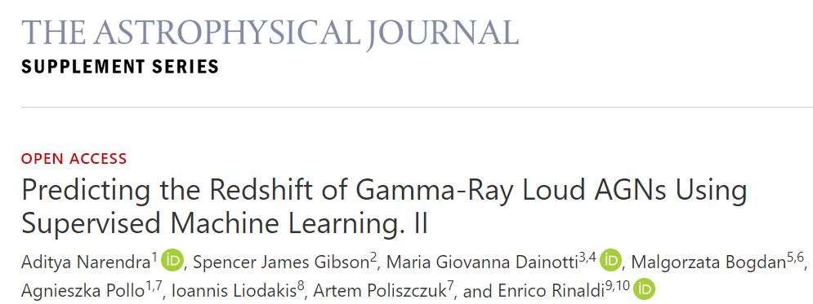


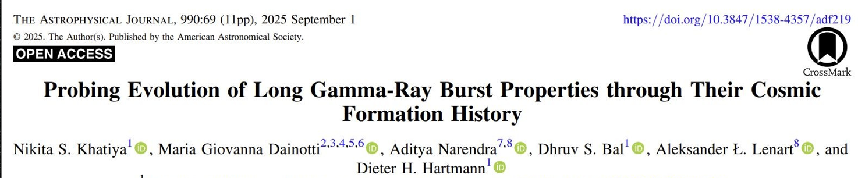
Thank you!
24

