Slide 1





Modelling the Radio Flux Densities of Dwarf Novae Outbursts Detected By MeerKAT
K. M. M. McPherson, P. J. Meintjes
T: +27 51 401 9111 | E: info@ufs.ac.za | www.ufs.ac.za
HEASA 2026
29th September – 2nd October, 2026

Slide 2
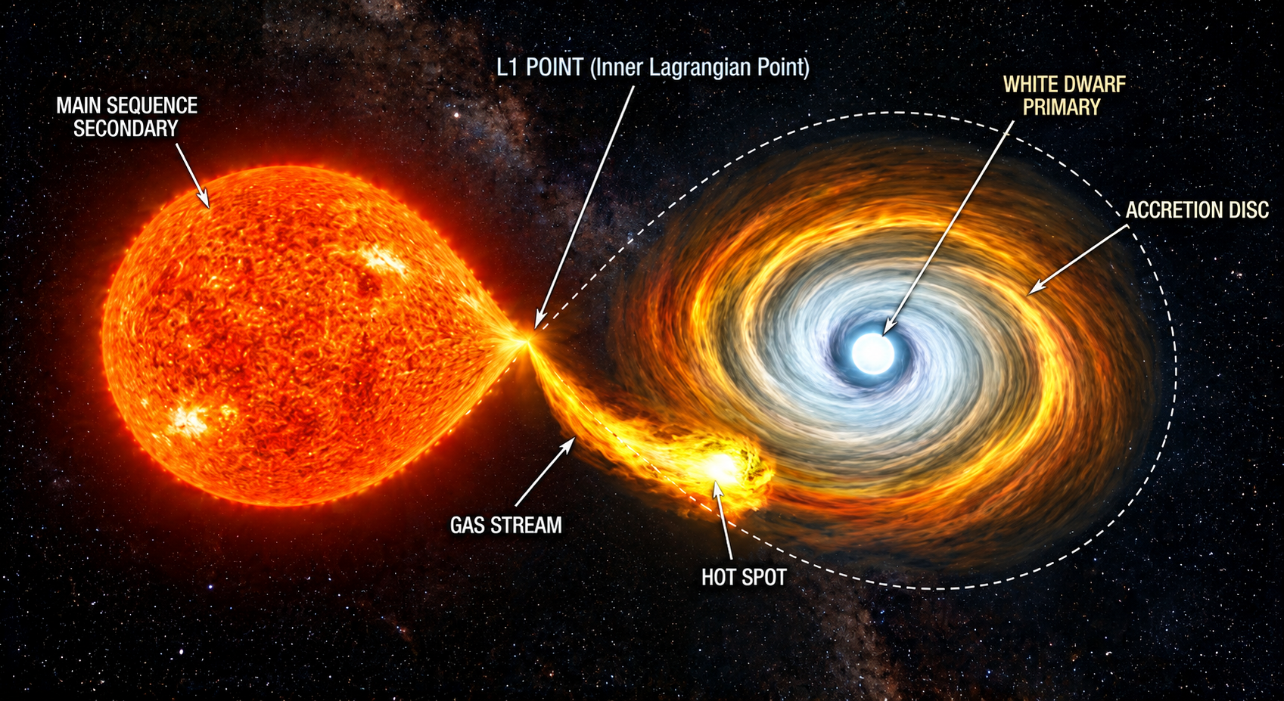
What are cataclysmic variables?
Matter accretion via Roche-lobe overflow
DNe: CV subclass with regular outbursts & super outbursts
Outbursts may be due to thermal-viscous instability (DIM)
Switching disc from cold unionised state to hot ionised state
Coppejans, 2016
HEASA 2026
Notes:
Cataclysmic variables are a type of binary system that have a white dwarf primary star, and a main sequence secondary star (typically a K- or M-type star)
In these systems, the secondary star accretes matter onto the primary star via Roche-lobe overflow
This talk will focus on a subclass of CVs known as dwarf novae, which are characterised by outbursts, which are a regular increase in the optical magnitude of the binary system. Occasionally, these sources exhibit superoutbursts, which are much brighter and last much longer than regular outbursts
It is believed that these outbursts are a result of a thermal-viscous instability caused by the build-up of matter in the accretion disc, causing the disc to switch from a cold unionised state, to a hot ionised state

Slide 3
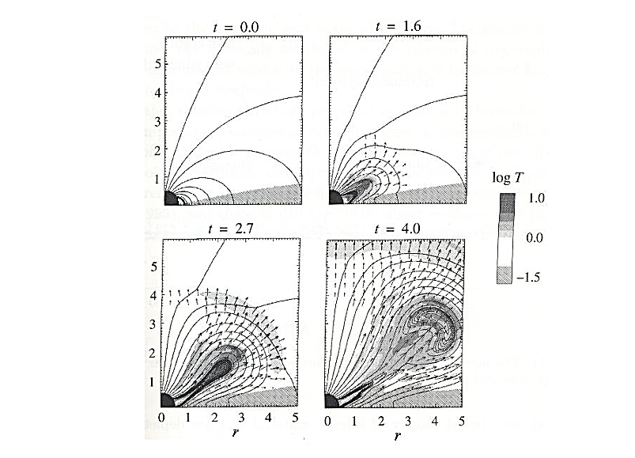
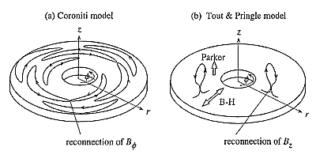
Magnetic reconnection
Believed cause of non-thermal radio synchrotron emission
Caused by two oppositely polarised magnetic fluid zones that collide.
Magnetic and gas pressure then push out the blob, resulting in reconnection
Differential rotation in disc creates instabilities e.g. tearing mode instability & Parker instability
Results in strong toroidal & vertical magnetic fields bringing about magnetorotational instabilities & reconnection
Meintjes, 2017
HEASA 2026
Notes:
For this study, we consider magnetic reconnection as the mechanism that results in the non-thermal radio synchrotron emission observed from these sources
Magnetic reconnection is a process wherein you have two oppositely polarised magnetic fluid zones that approach each other and collide. The magnetic and gas pressure then cause the magnetic field to bulge out and reconnect
Differential rotation in the disc and between the disc and WD results in an increase in the amount of toroidal fields in the disc, creating instabilities in the disc as well as strong toroidal and vertical magnetic fields that bring about magnetorotational instabilities and reconnection

Slide 4
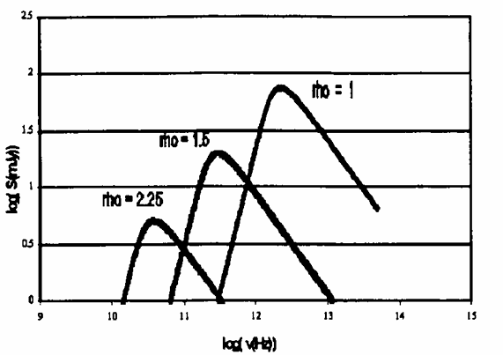
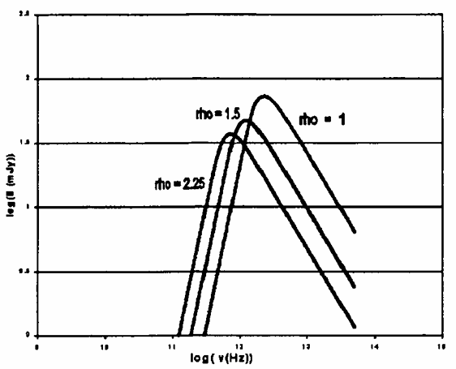
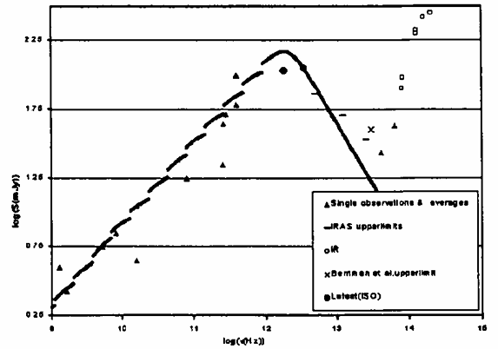
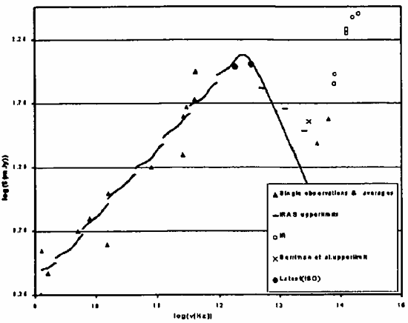
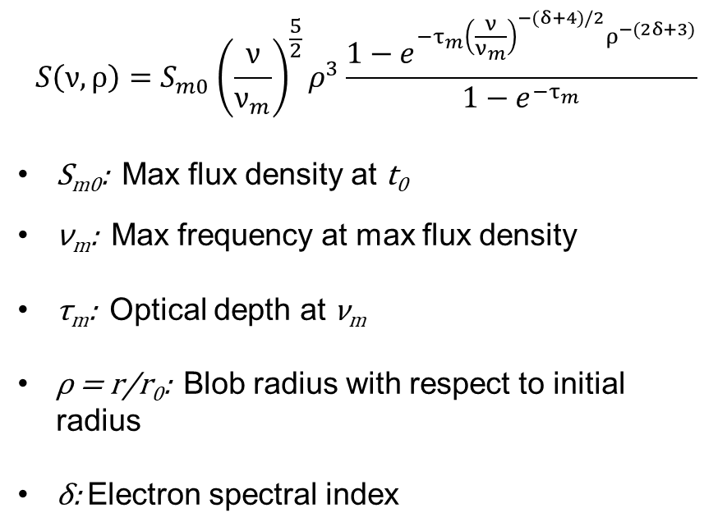
The van der Laan Model
$$S\left(ν,ρ\right)=S_{m0}{\left(\frac{ν}{ν_{m}}\right)}^{\frac{5}{2}}ρ^{3}\frac{{1−e}^{{−τ}_{m}{\left(\frac{ν}{ν_{m}}\right)}^{−(δ+4)/2}ρ^{−(2δ+3)}}}{{1−e}^{{−τ}_{m}}}$$
S_{m0}: Max flux density at t₀
ν_{m}: Max frequency at max flux density
τ_{m}: Optical depth at ν_{m}
ρ = r/r₀: Blob radius with respect to initial radius
δ: Electron spectral index
Venter & Meintjes, 2003
HEASA 2026
Notes:
We modelled the radio flares using the VDL model, given by the following equation (point to equation)
The model was previously used by Louis Venter to model the radio outbursts of AE Aqr. By simulating the flux of a single blob, Venter got these plots, with the top left one representing a scenario where the electron energy diminishes as a result of adiabatic losses as the blob expands, and the top right one, which is an adapted model created for his study, depicting a scenario where the blob gets energised by a MHD propeller as it expands, as using the unadapted model would require an unrealistic number of blobs to obtain the observed flux levels at frequencies from 1 to 10 GHz
By combining the fluxes of various blobs at various sizes, electron energies and electron spectral indexes, they got the following models (point to plots) with the plot on the left showing a model depicting the simulated radio flux of AE Aqr with 20 blobs on the left, and a spectrum modelled with the simulated flux of 10 blobs on the right
`
Until recently, there had not been many Dne observed at radio frequencies. Most recent observations by Kersten et al. detected the sources I will be presenting today

Slide 5
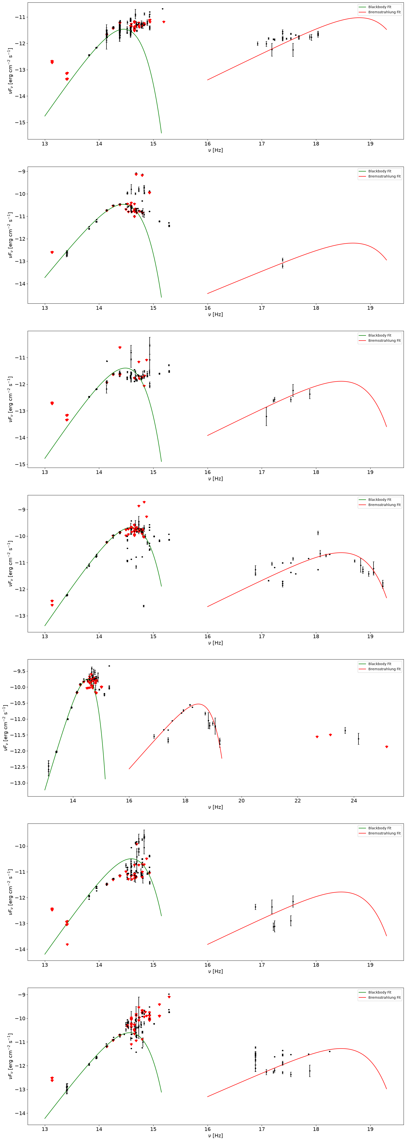
V426 Ophiuchi
Fit Values
Blackbody |  | Bremsstrahlung
T (K) | 4000 | T (K) | 1.4e8
r (cm) | 1.5e11 | r (cm) | 1.9e9
RA (hms) ~ 18:07:51.692
Dec (dms) ~ + 05:51:47.21
V_{q} ~ 13
V_{o} ~ 11
P_{o} ~ 22 d
t_{o} ~ 7 d
D ~ 190 pc
P_{orb} ~ 7 h
m_{WD} ~ (0.9 ± 0.19)M
m_{MS} ~ (0.7 ± 0.14)M
type_{MS} : K5V
T_{MS} ~ 4440 K
a ~ (2.16 ± 0.14)R
i ~ (59 ±6)°
Hessman, 1988; Kersten et al., 2025; Cusumano et al.,2010; Abdo et al., 2010; Baumgartner et al., 2013
HEASA 2026
Notes:
Fits are to show that the secondary star dominates the optical emission, along with the disc emission and possible flickering

Slide 6
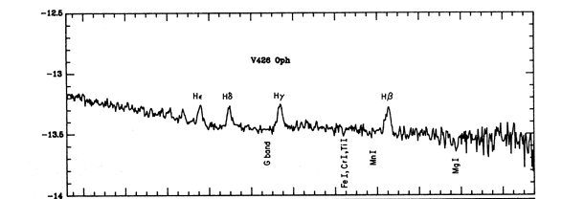
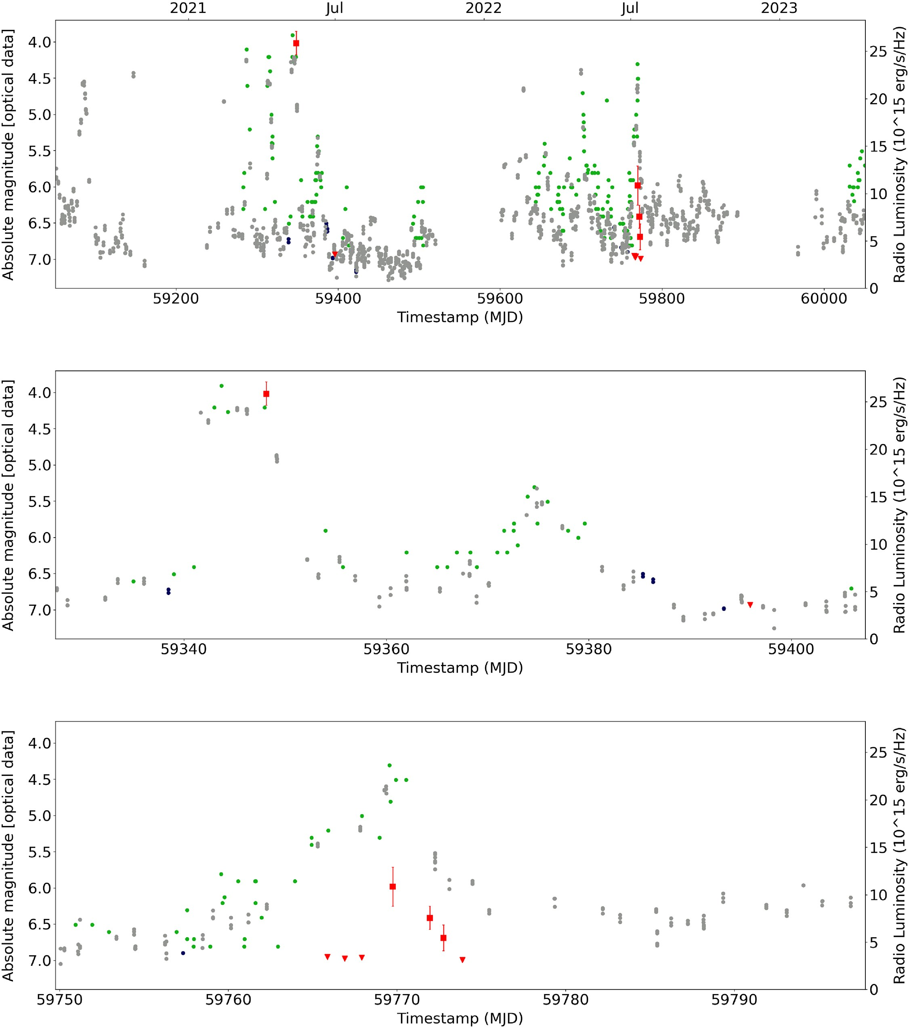

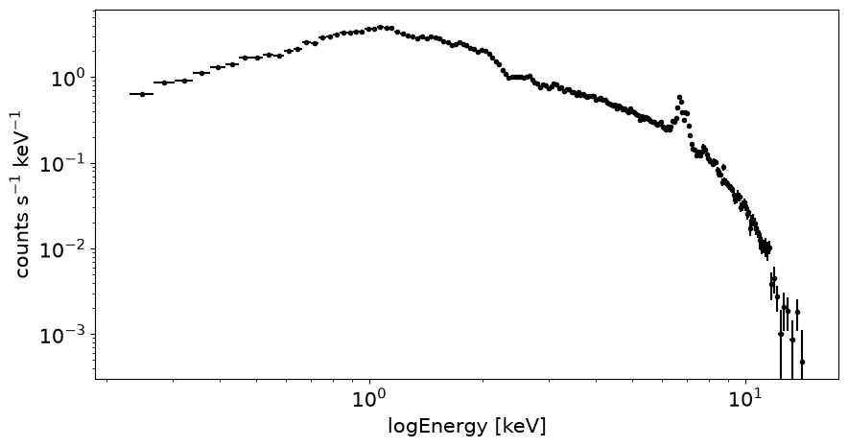
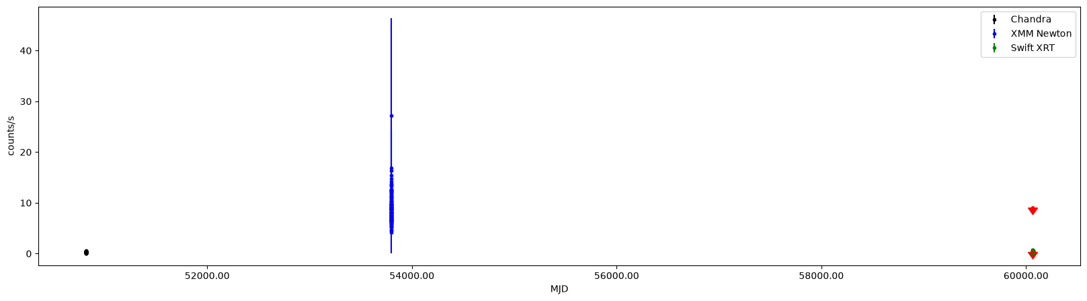
Fe Kα
|
Kersten et al., 2025; Echevarría et al., 1988
HEASA 2026

Slide 7
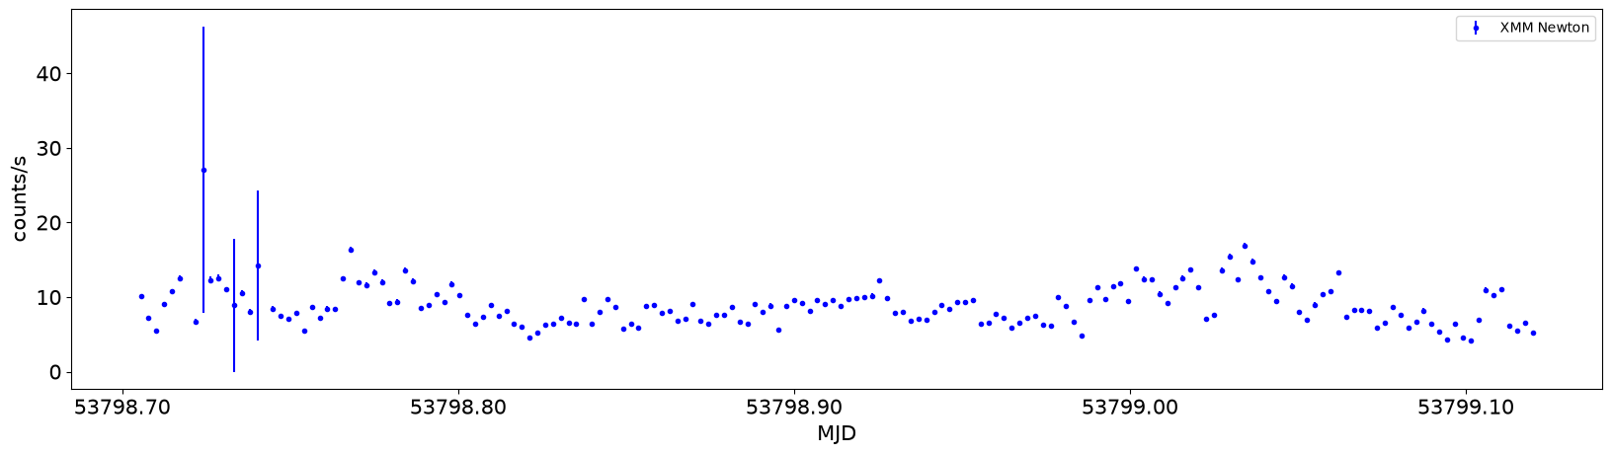
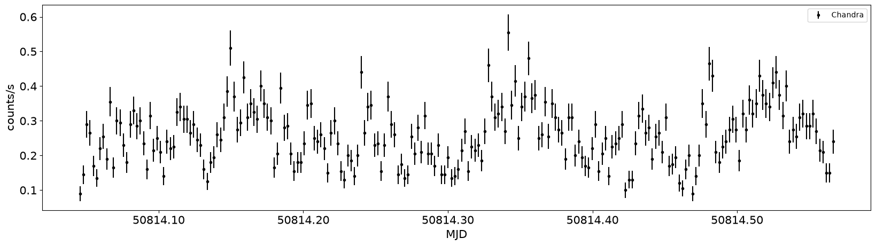
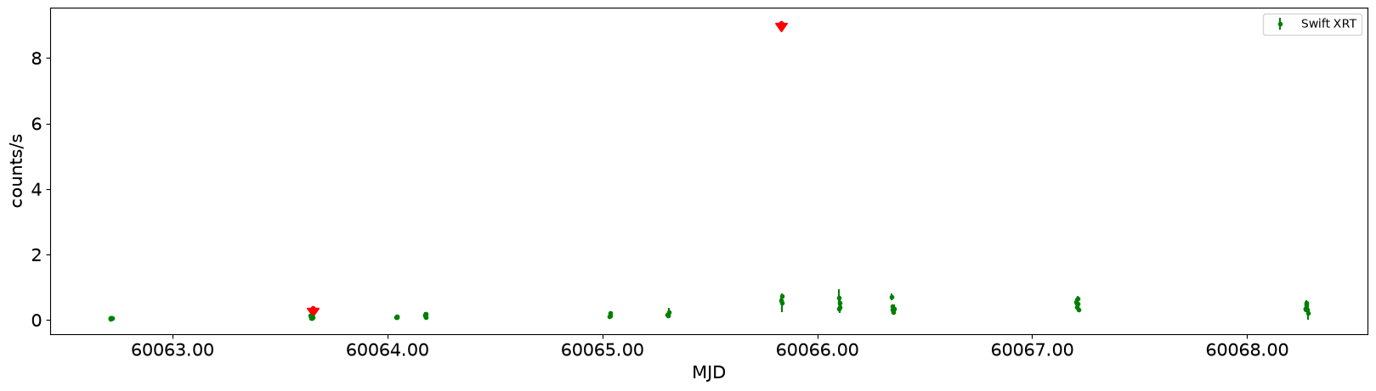
HEASA 2026

Slide 8
RU Pegasi
Fit Values
Blackbody |  | Bremsstrahlung
T (K) | 4800 | T (K) | 1.4e8
r (cm) | 1.6e11 | r (cm) | 2.3e9
RA (hms) ~ 22:14:02.545
Dec (dms) ~ + 12:42:11.33
V_{q} ~ 12
V_{o} ~ 10
P_{o} ~ 40-60 d
t_{o} ~ 15 d
D ~ 271 pc
P_{orb} ~ 9 h
m_{WD} ~ (1.06 ± 0.04)M
m_{MS} ~ (0.96 ± 0.08)M
type_{MS} : K5V
T_{MS} ~ 4440 K
a ~ (2.76 ± 0.06)R
i ~ (43 ± 5)°
Kersten et al., 2025; Wright et al., 2010; Bianchi et al., 2011; Evans et al., 2014; Voges et al., 1999; White et al., 2016; Verrecchia, et al., 2007;
White et al., 2000; Hiroi et al., 2011; Cusumano et al., 2010; Baumgartner et al., 2013
HEASA 2026

Slide 9
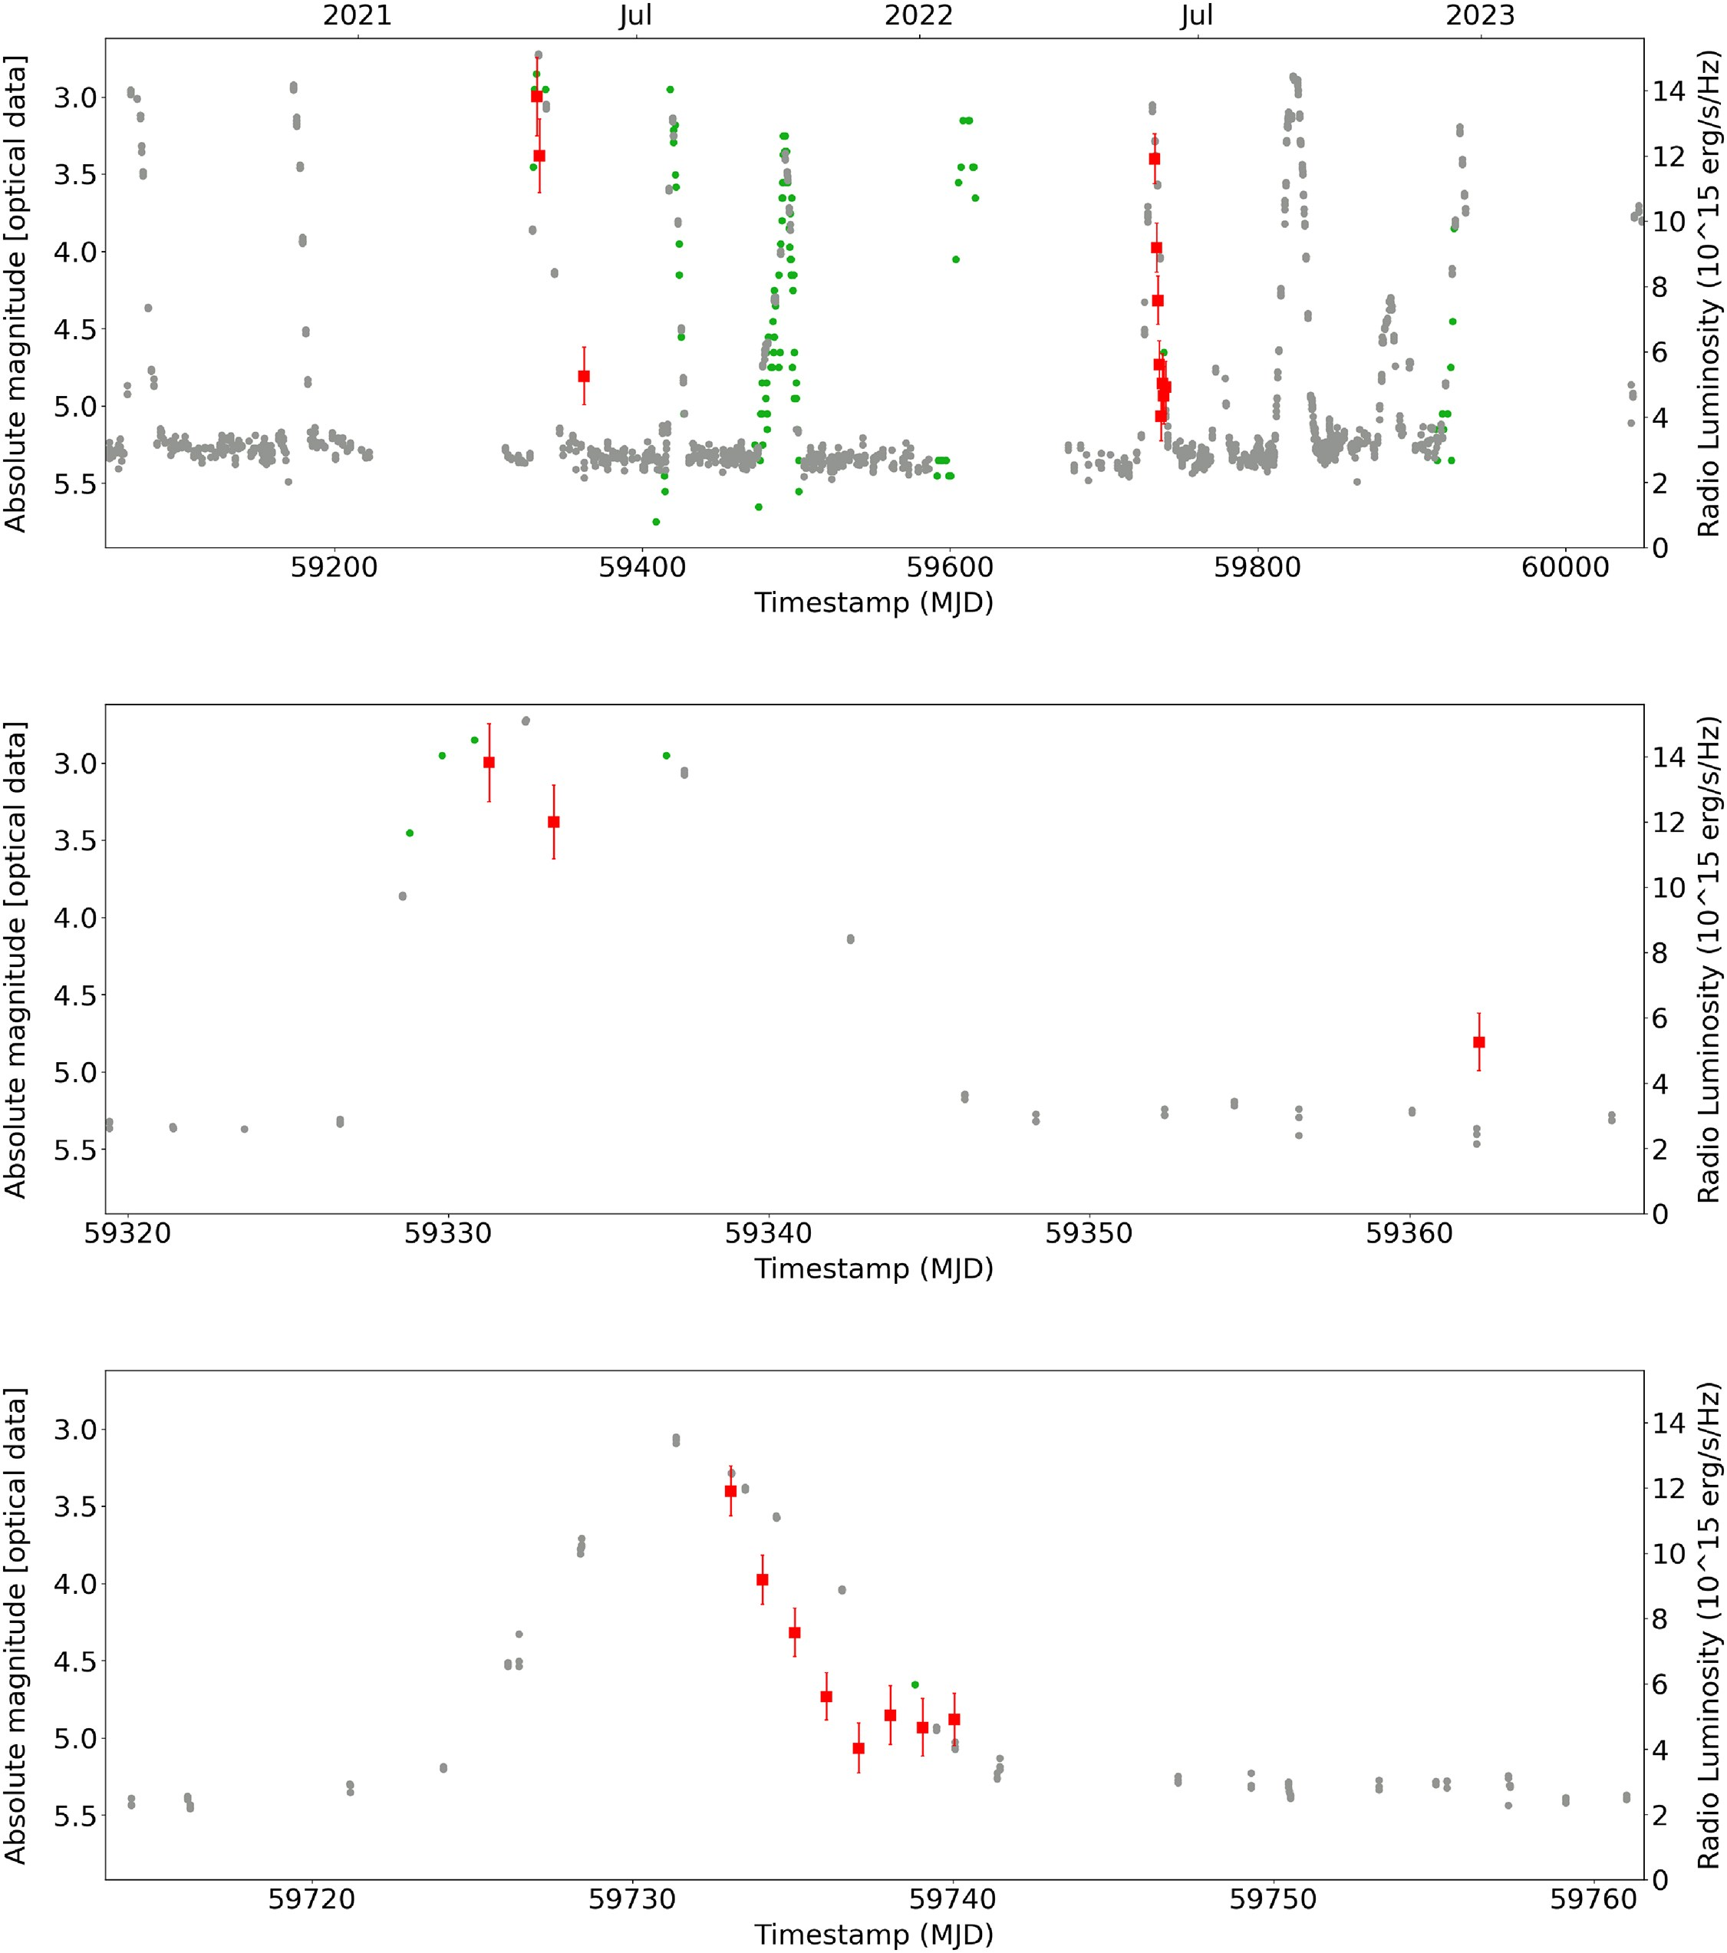
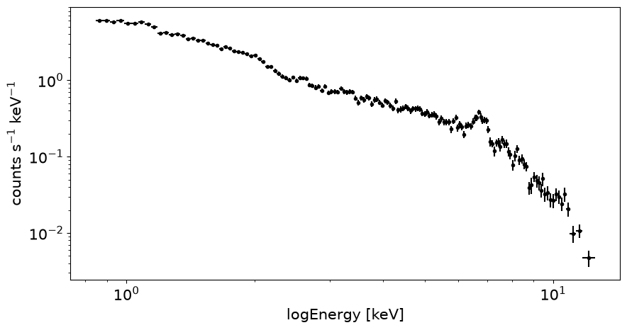
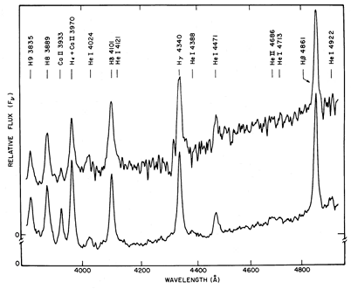
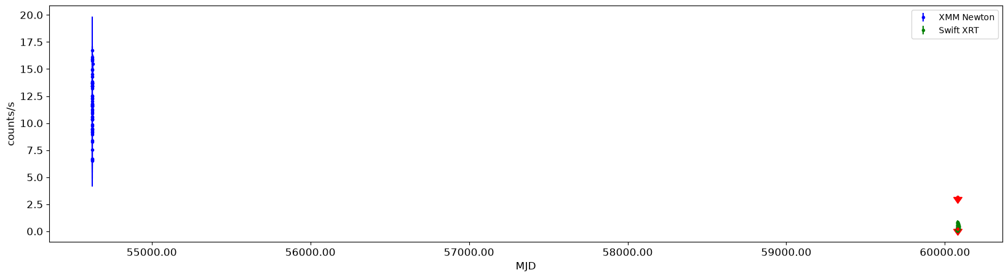
Fe Kα
|
Kersten et al., 2025; Stover, 1981
HEASA 2026

Slide 10
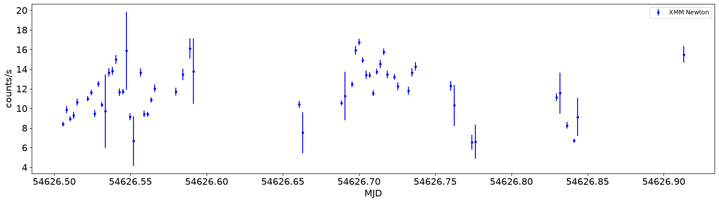
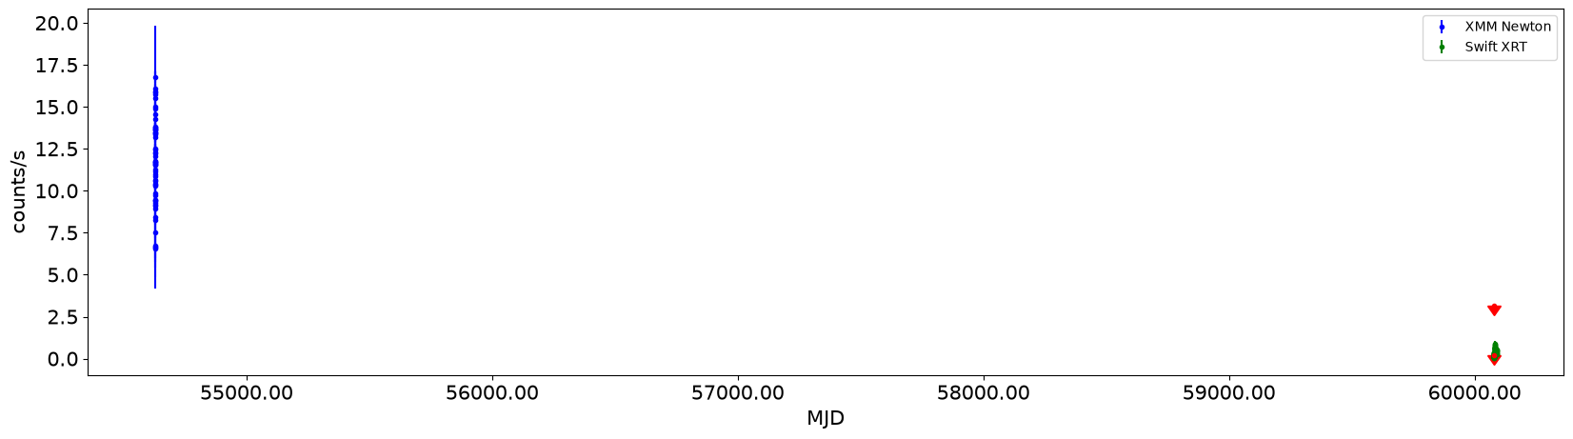
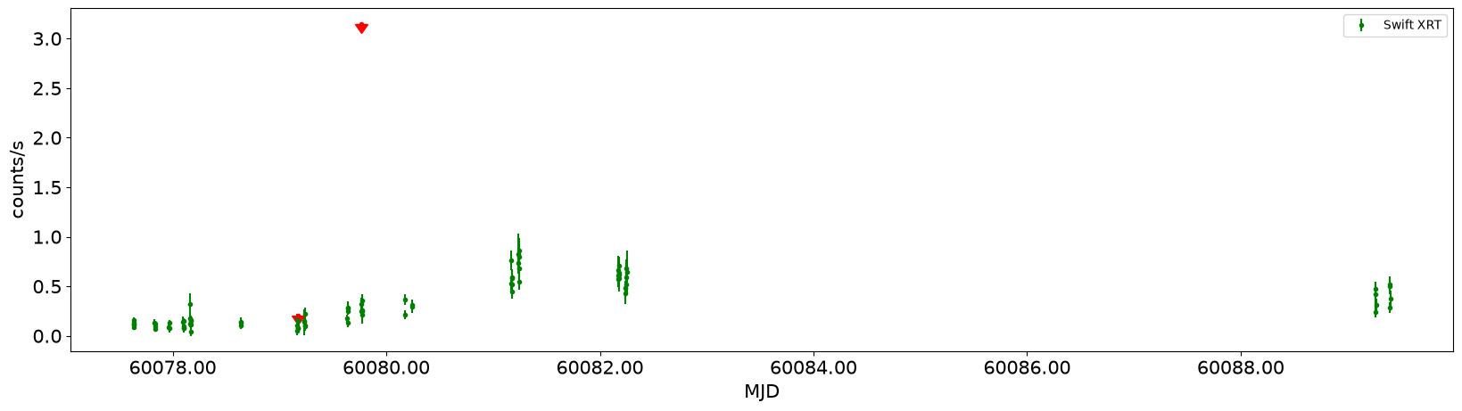
HEASA 2026

Slide 11
IP Pegasi
Fit Values
Blackbody |  | Bremsstrahlung
T (K) | 3400 | T (K) | 2.3e8
r (cm) | 6.7e10 | r (cm) | 4.1e8
RA (hms) ~ 23:23:08.467
Dec (dms) ~ + 18:24:58.67
V_{q} ~ 16
V_{o} ~ 12
P_{o} ~ 120 d
t_{o} ~ 7-10 d
D ~ 140 pc
P_{orb} ~ 3.8 h
m_{WD} ~ (1.16 ± 0.02)M
m_{MS} ~ (0.55 ± 0.02)M
type_{MS} : M4
T_{MS} ~ 3210 K
a ~ (1.472 ± 0.009)R
i ~ (83.8 ± 0.5)°
Kersten et al., 2025; Wright et al., 2010; Bianchi et al., 2011; White et al., 2000
HEASA 2026
Notes:
Mention lack of X-ray data so an estimate of what it might be was used

Slide 12
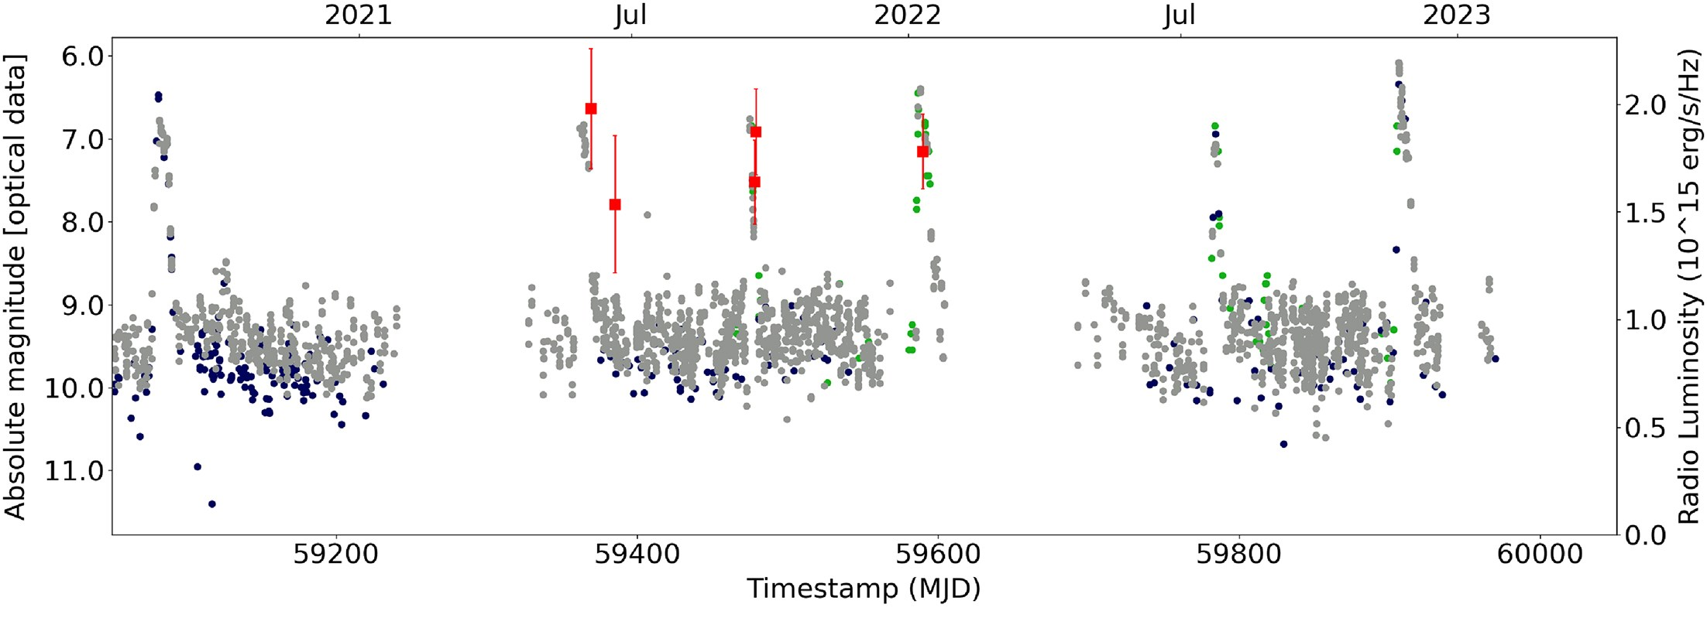
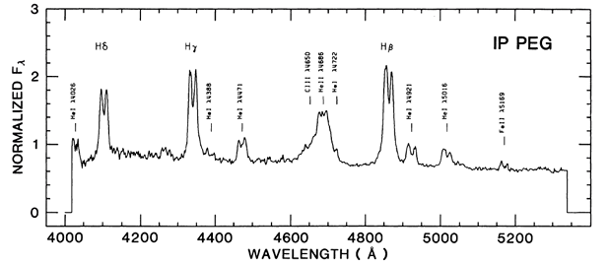
Kersten et al., 2025; Hessman, 1989
HEASA 2026

Slide 13
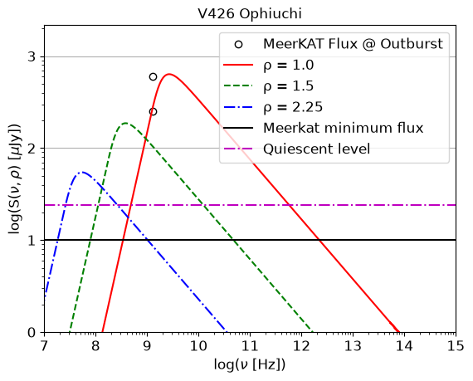
Results- V426 Ophiuchi
Parameter | Value
E₀ | 2.3 MeV
B₀ | 2.5 G
δ | 2.3
Kersten et al., 2025
HEASA 2026
Notes:
Talk about the values used to model peak flux
Mention how quiescent level is above MeerKAT limit
The blobs that are just ejected full of relativistic electrons show the data at the peak

Slide 14
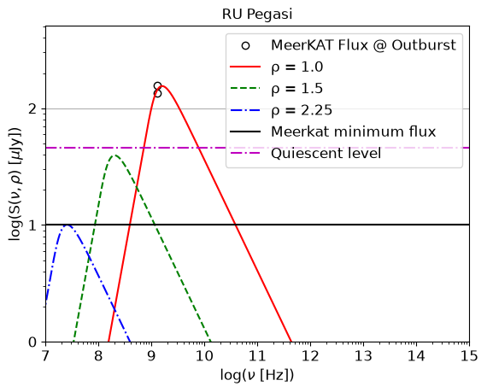
Results-RU Pegasi
Parameter | Value
E₀ | 1.4 MeV
B₀ | 2.1 G
δ | 2.9
Kersten et al., 2025
HEASA 2026
Notes:
Talk about the values used to model peak flux
Mention how quiescent level is above MeerKAT limit

Slide 15
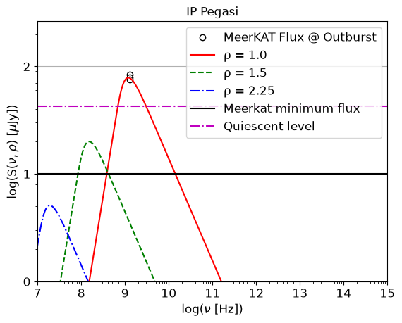
Results- IP Pegasi
Parameter | Value
E₀ | 1 MeV
B₀ | 2.15 G
δ | 2.9
Kersten et al., 2025
HEASA 2026
Notes:
Talk about the values used to model peak flux
Mention how quiescent level is above MeerKAT limit

Slide 16
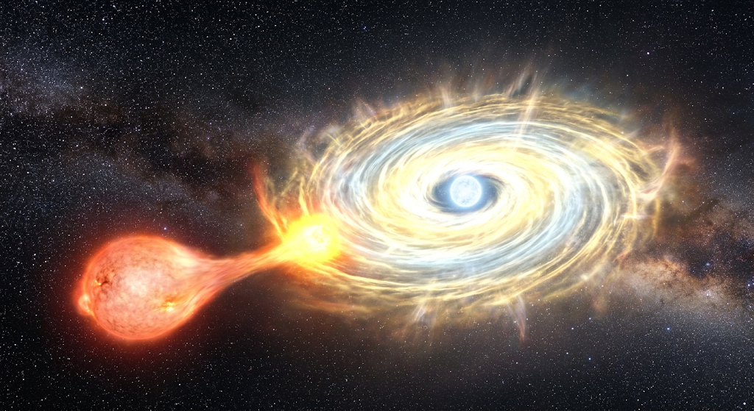
QUESTIONS?
HEASA 2026

Slide 17
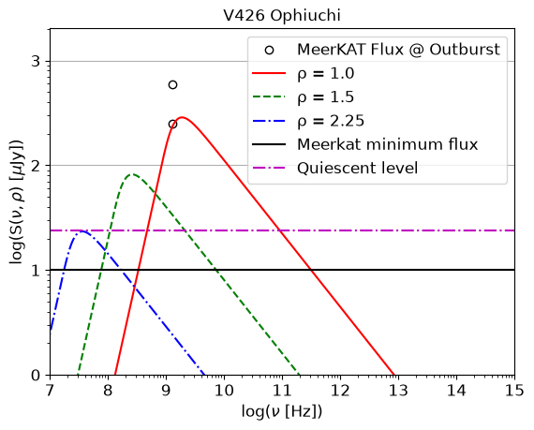
Results- V426 Ophiuchi
Parameter | Value
E₀ | 1.6 MeV
B₀ | 2.1 G
δ | 2.5
Kersten et al., 2025
HEASA 2026
Notes:
Talk about the values used to model peak flux
Mention how quiescent level is above MeerKAT limit
The blobs that are just ejected full of relativistic blobs show the data at the peak
Include additional plots with the other data points, or maybe include the other data points of each outburst on the same plot

Slide 18
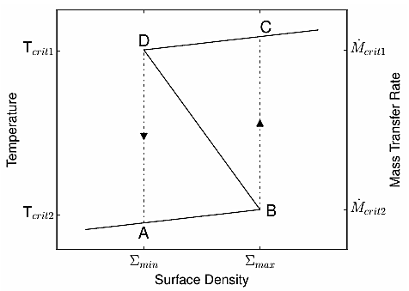
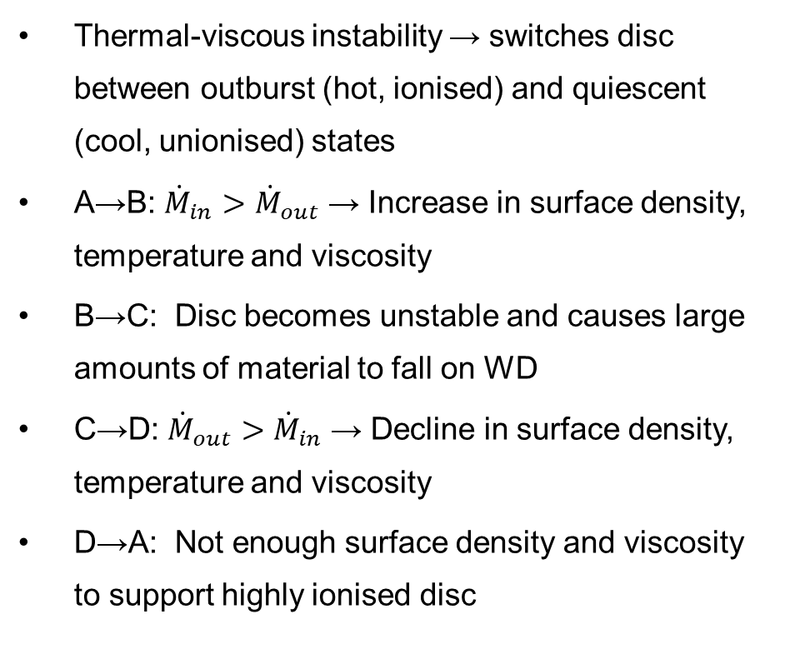
Disc Instability Model
Thermal-viscous instability → switches disc between outburst (hot, ionised) and quiescent (cool, unionised) states
A→B: ${\dot{M}}_{in}>$ ${\dot{M}}_{out}$ → Increase in surface density, temperature and viscosity
B→C: Disc becomes unstable and causes large amounts of material to fall on WD
C→D: ${\dot{M}}_{out}>$ ${\dot{M}}_{in}$ → Decline in surface density, temperature and viscosity
D→A: Not enough surface density and viscosity to support highly ionised disc
Coppejans, 2016
HEASA 2026

