Slide 1



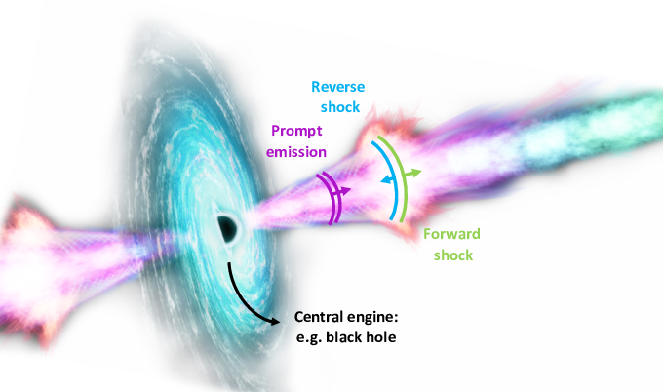
Constraining Jet Structure in Low-Luminosity Gamma-Ray Bursts
A Comparative Analysis of Jets in GRB 161219B
G. F Abbey
Postdoctoral Fellow
Collaborators
Prof. S. Razzaque: University of Johannesburg, SA (UJ)
Dr. G. Ankur: University of Johannesburg, SA (UJ)
Dr. S. P. Phiri: Copperbelt University, Zambia (CBU)
Astrophysics Research Group: Department of Physics
Copperbelt University Zambia
HEASA 2026 Conference
30th September , 2026

Slide 2
Outline
Introduction
Scientific Motivation
Data
Modelling
Results
Summary
Future Work

Slide 3
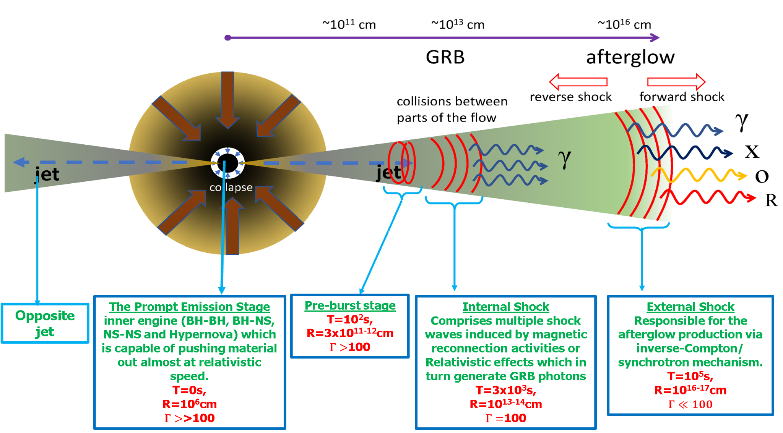
Introduction
Gamma-ray Bursts (GRBs) and Fireball Model
Figure 1: GRB Fireball model
(Knust, 2017; Pe’Er, 2015; Piran, 2005; Mészáros, Rees, & Wijers, 1999; Pe’Er, 2015; Piran, 2005).

Slide 4
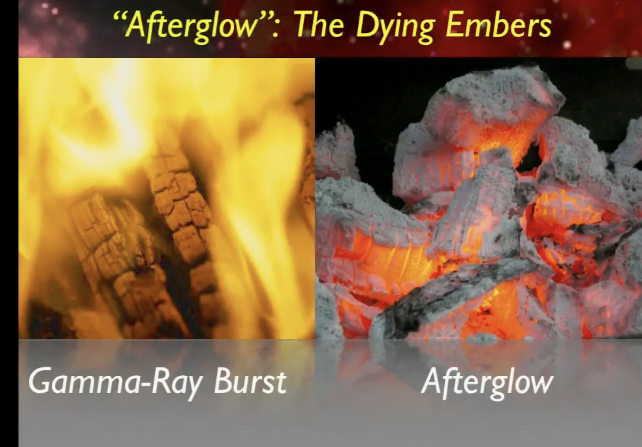
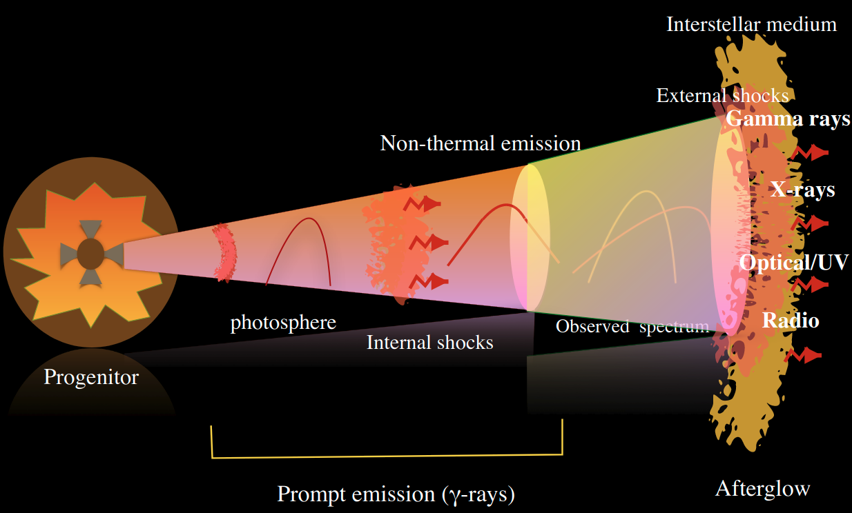
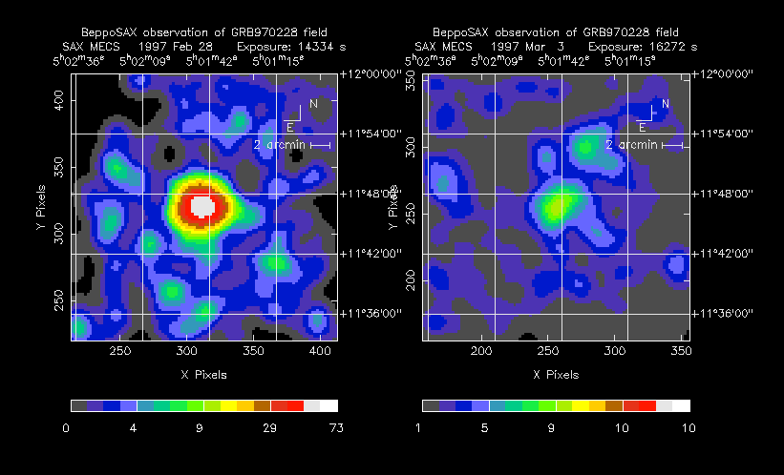
Edo Berger’s Lectures

Slide 5
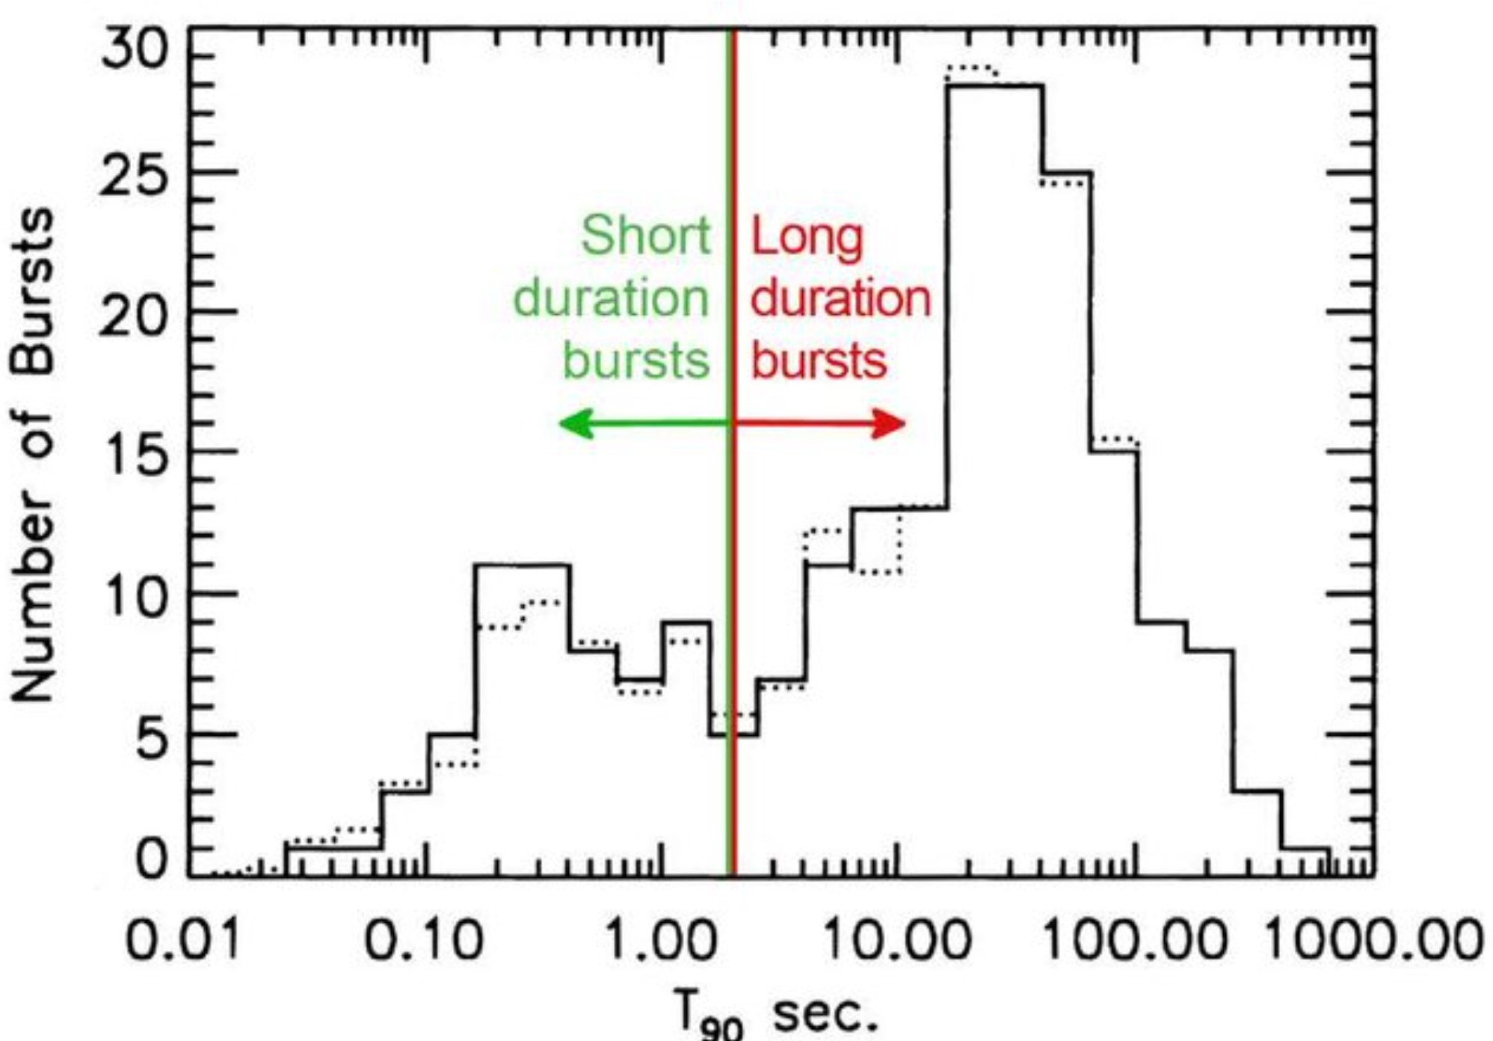
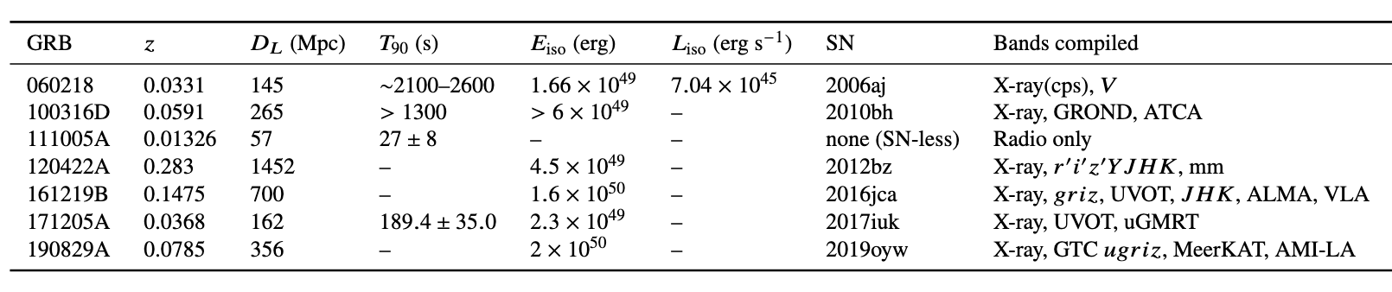
Intro. Cont…
SGRBs
LGRBs
GRB Statistics
30%
Population
Swift Observatory (XRT/UVOT):> 2,000 (3/days)
Fermi Gamma-ray Space Telescope (GBM): > 4,000 (240/year)
CGRO (BATSE): = 2,704.
Others Total~10,000+
70%
LLGRBs (<0.15%):
Are subclass of LGRBs that release much less gamma-ray energy than typical (classical) long-duration GRBs.

Slide 6
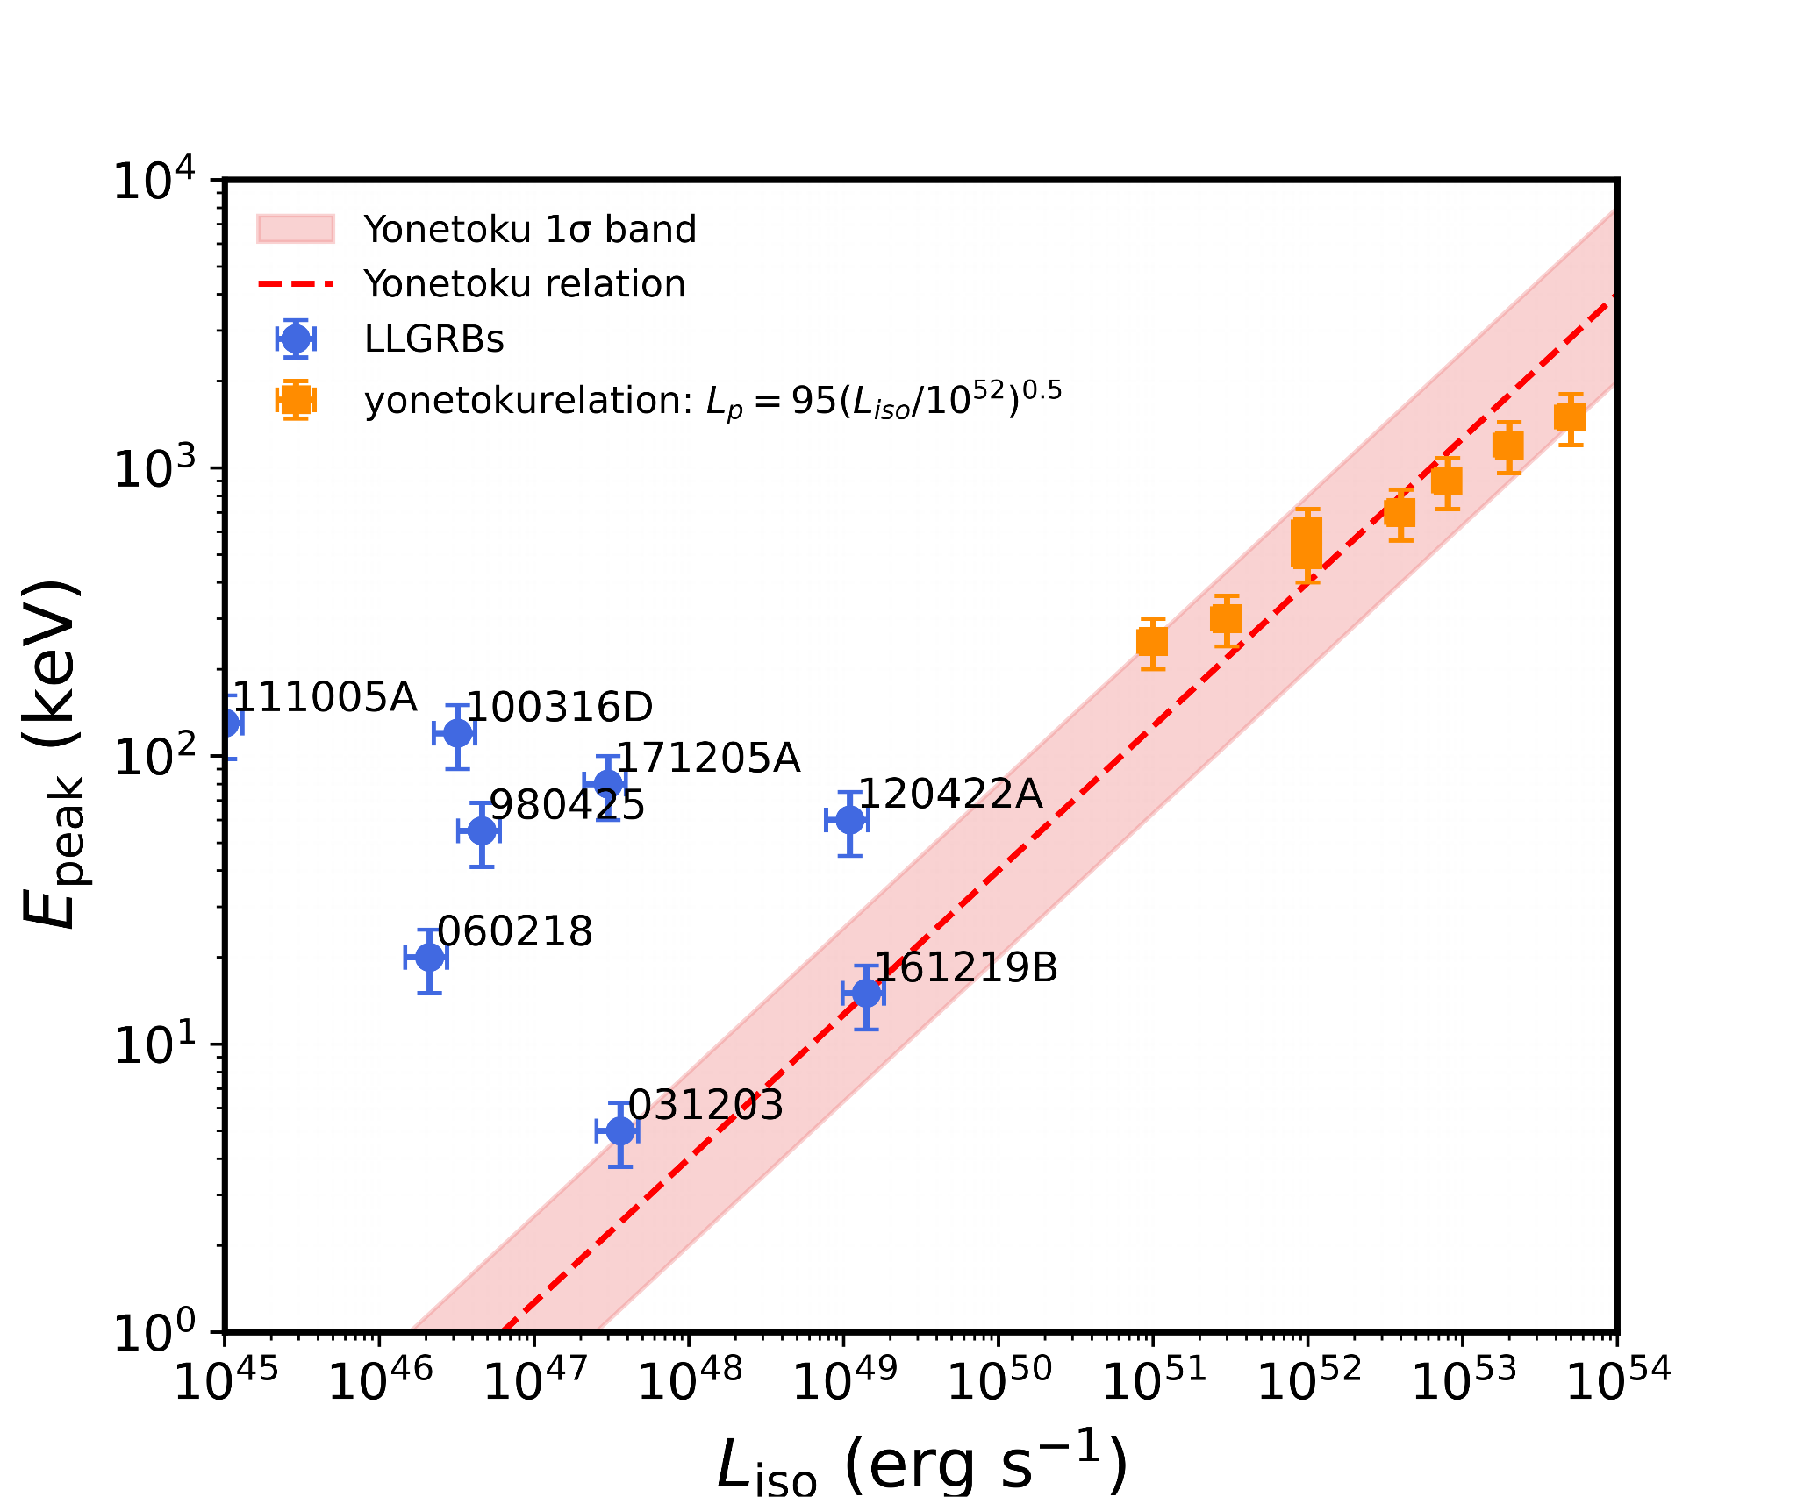
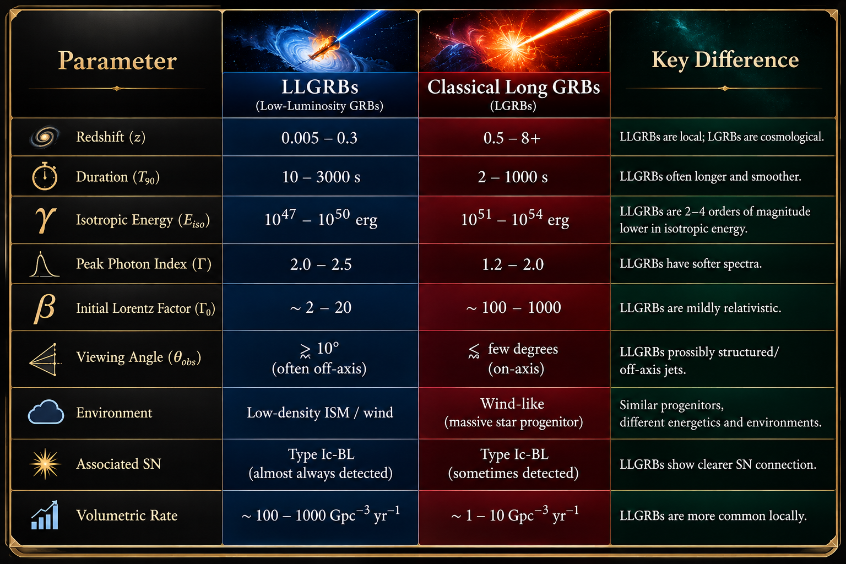
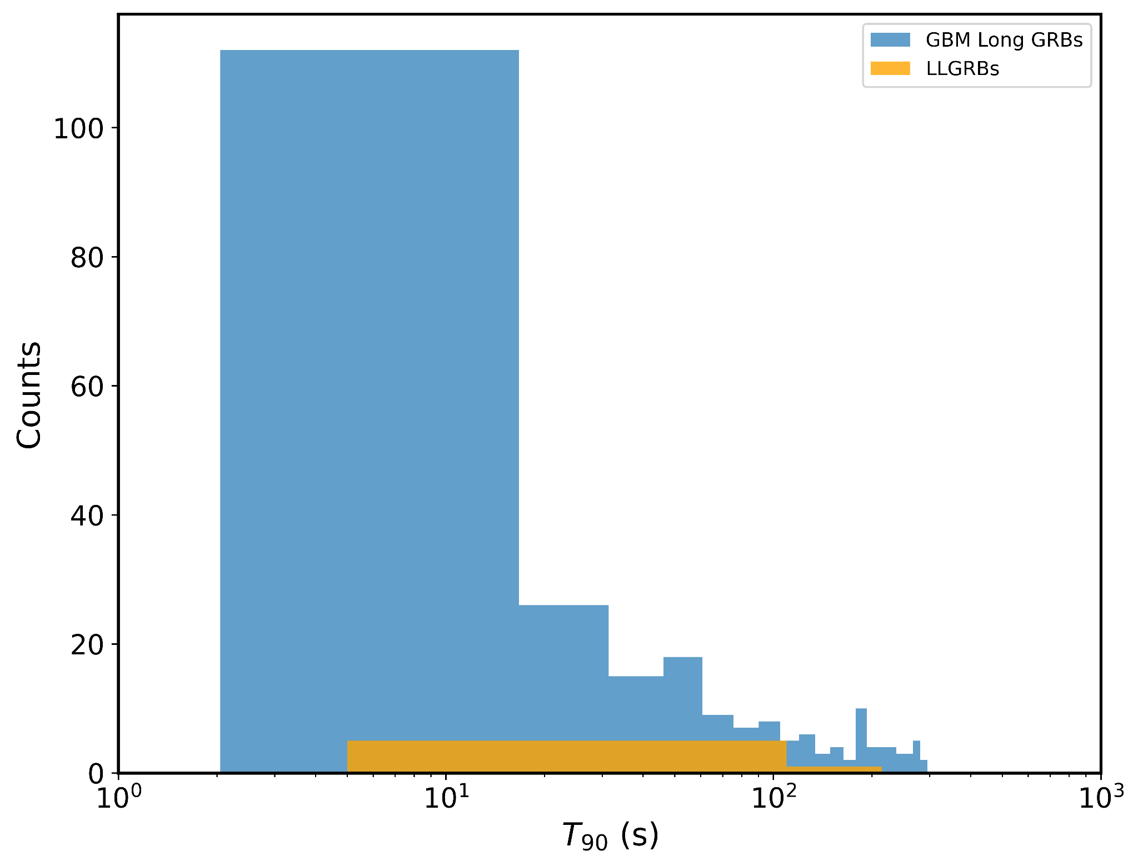
Scientific Motivation

Slide 7
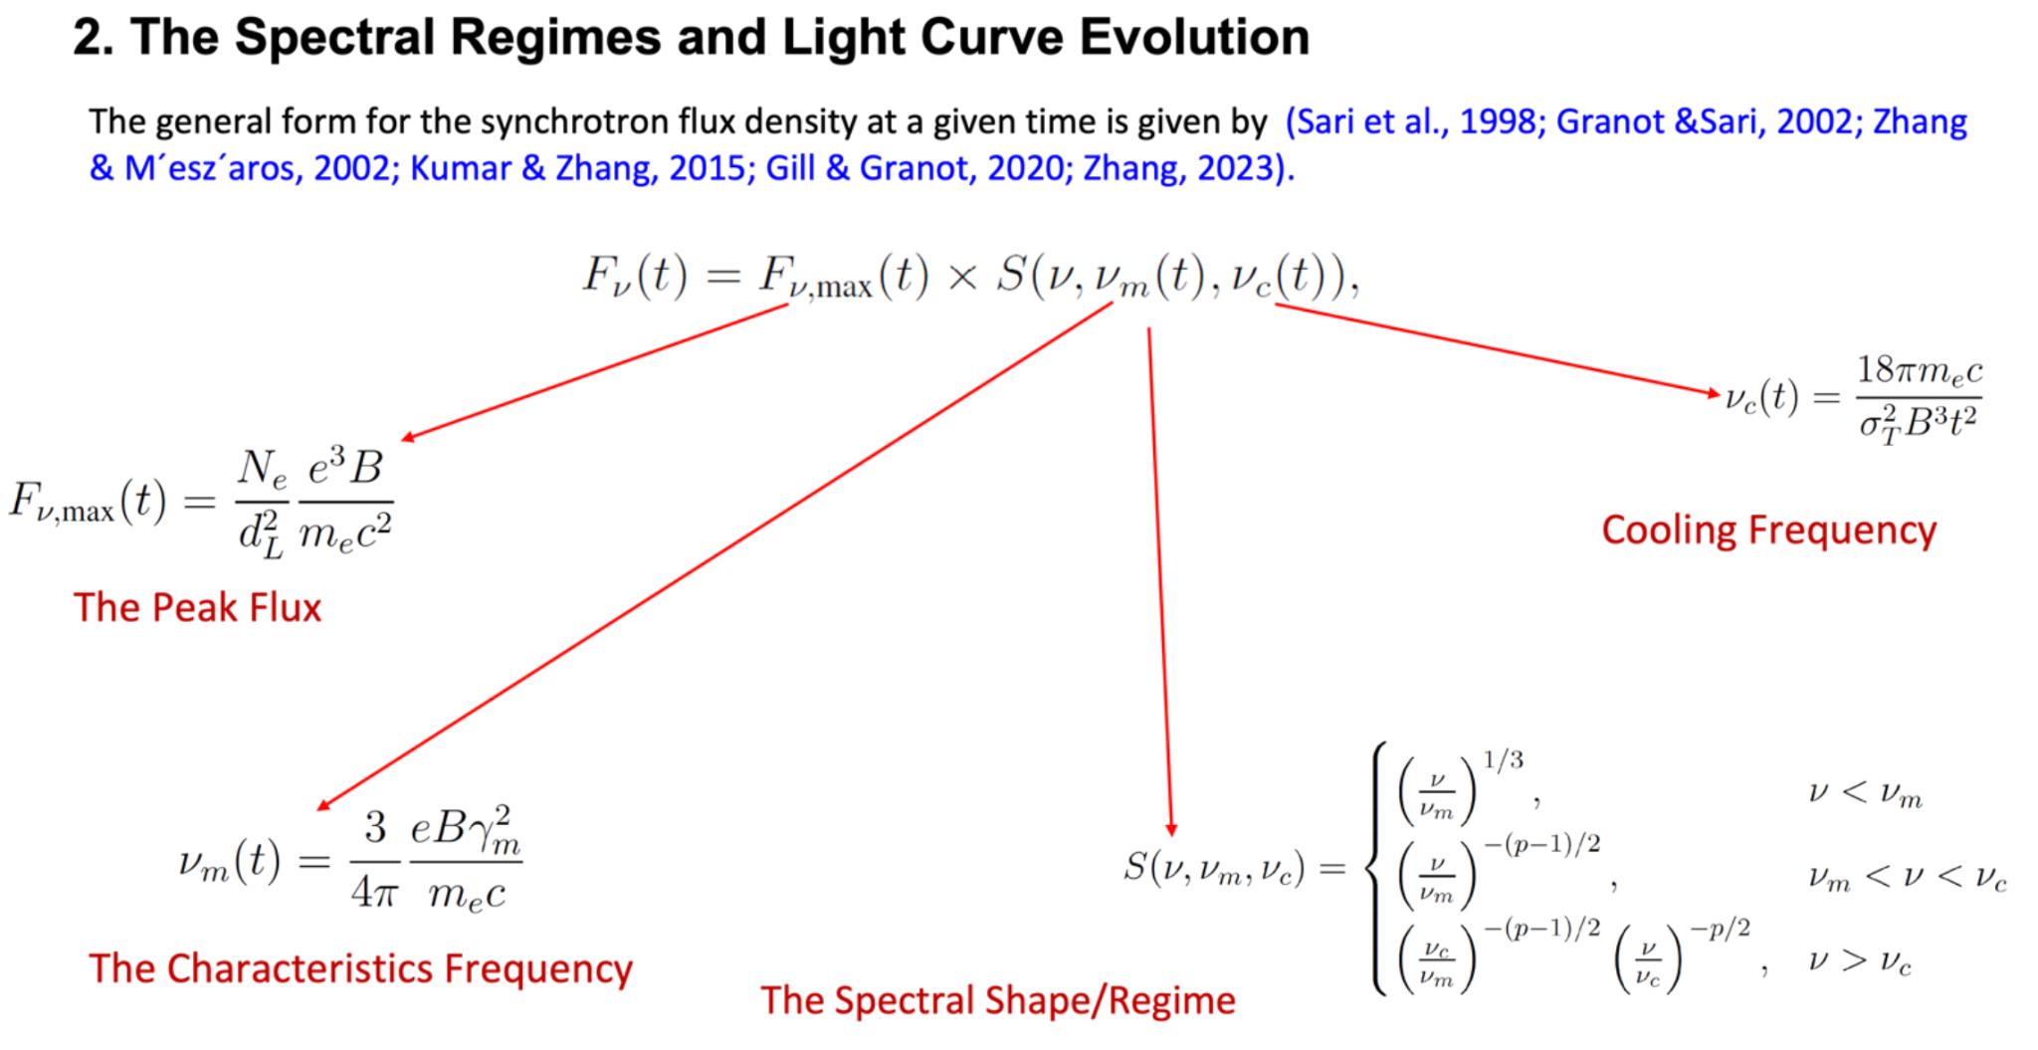
Intro. Cont…
Synchrotron Forward and Reverse Shock Framework

Slide 8
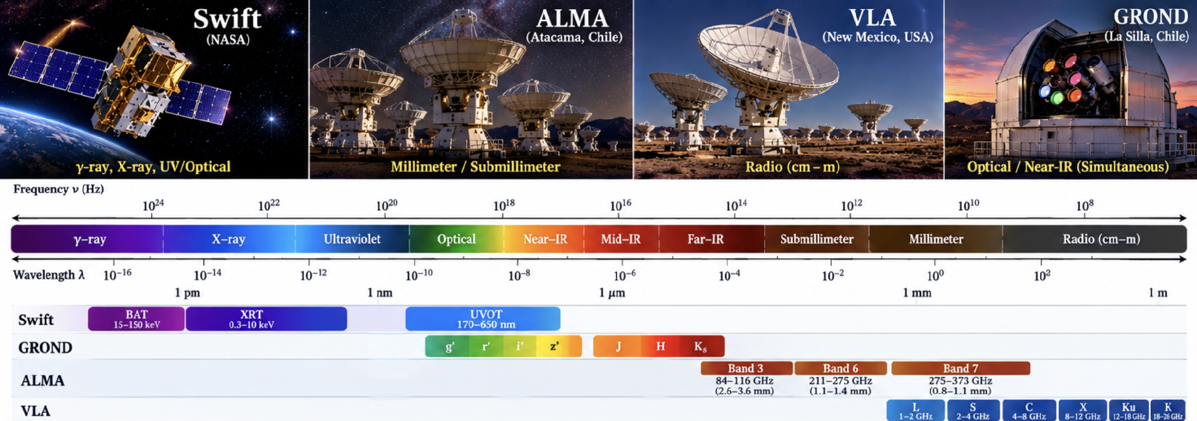
Data: Swift UVOT/XRT, Ashall et al. (2019), Cano et al. (2017), Laskar et al. (2011)
Swift
GROND
ALMA
VLA
BAT, XRT 0.3–10 keV, UVOT UV/optical
g′ r′ i′ z′ J H Ks, simultaneous
Bands 3, 6, 7 (mm/sub-mm)
L to K bands (1–26 GHz)
Notes:
Walk across the spectrum: X-ray and UV from Swift, seven simultaneous optical/NIR bands from GROND, millimetre from ALMA, centimetre radio from VLA. Each comes in a different native system and unit, which is the problem we solve.

Slide 9
Our pipeline: from raw archives to one mJy dataset
1 · Extract
2 · Clean
3 · Correct
4 · Convert
5 · Unify
UV · Opt · NIR
Magnitudes, times, errors
Galactic extinction: m − Aλ
Mag → Fν (Jy)
Jy → mJy
Swift-UVOT + GROND
X-ray
0.3–10 keV light curve + Γ
Flux → Fν at 1 keV
→ mJy
Swift-XRT
mm / Radio
Published flux densities
Dust-free: none needed
Frequencies tabulated
μJy / Jy → mJy
ALMA + VLA
Homogeneous, dereddened dataset in mJy → broadband light curves & SEDs, radio to X-ray
>1300 Data Points
6
Notes:
The key slide. Read it left to right, then top to bottom. Highlighted boxes are what distinguish this work: extinction correction of every UV/optical/NIR band, conversion from magnitudes to flux density, X-ray flux to a 1 keV flux density, and one common unit (mJy) for everything.

Slide 10
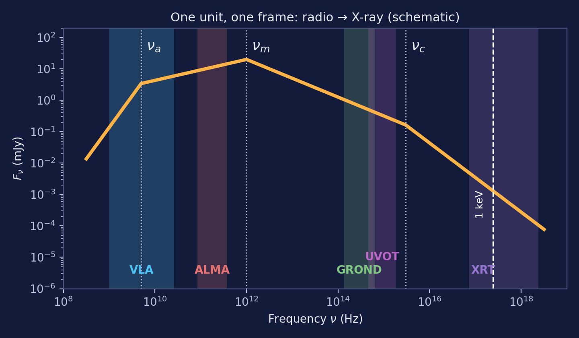

Our Strongest Point
Why mJy?
https://vegasafterglow.readthedocs.io/en/latest/index.html
8
Notes:
Headline difference. Dust dims blue light more than red, so uncorrected magnitudes give wrong colours and wrong spectral indices. We corrected every UV/optical/NIR band with filter-specific A_lambda from the extinction calculator before converting to flux. Radio and mm are unaffected by dust, which is why no correction is applied there.

Slide 11
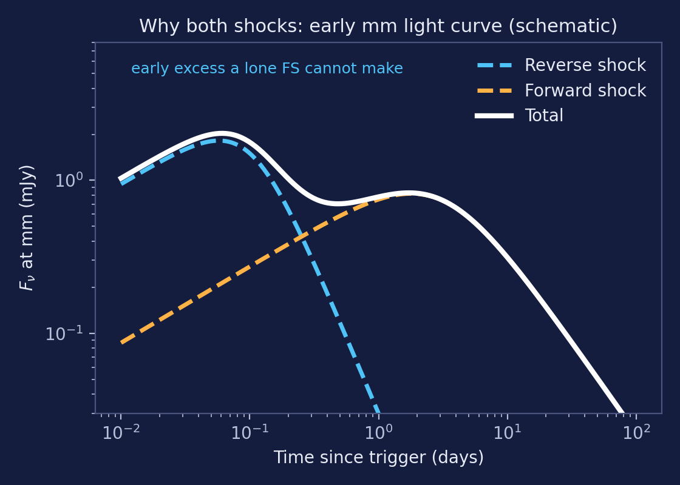
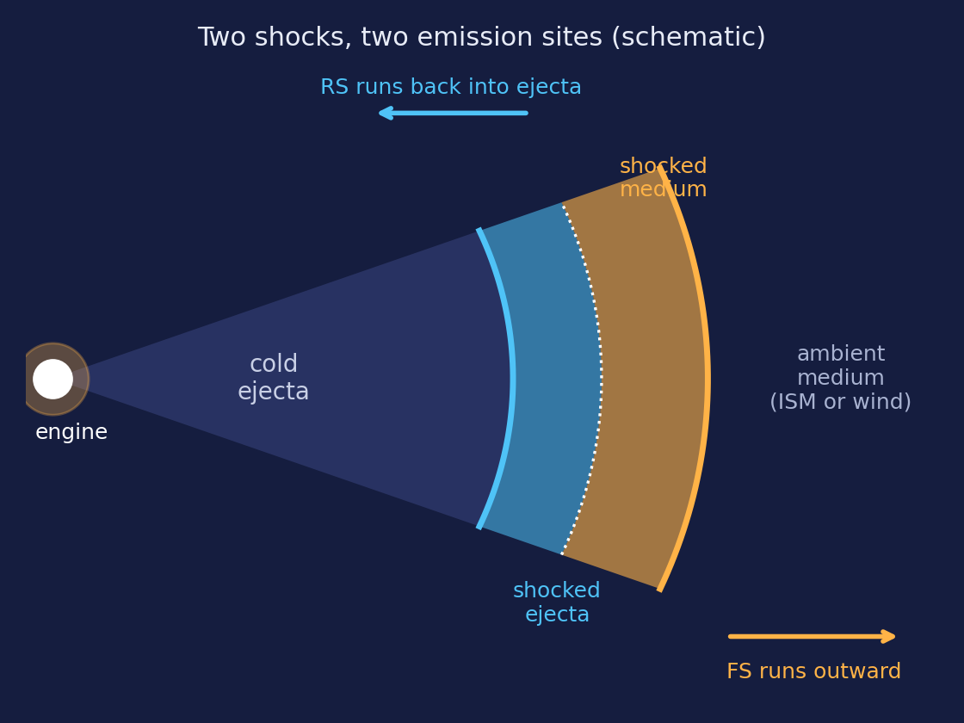
Our Justification
Our Hope
Intrinsic or off-axis
True energy budget
A fair model choice
Ejecta magnetisation
16
Notes:
Close the loop with the pipeline: model selection depends on spectral slopes, and uncorrected optical colours bias p and the cooling break, which can push a fit toward the wrong jet structure. Our extinction correction is what makes this comparison trustworthy.

Slide 12
Why this jet-model combination?
An afterglow fit has to answer two separate questions. We chose models that answer each one, then combine them.
Q1 · Angular structure
Q2 · Emission sites
How is energy spread across the jet, and where are we looking from?
Which shock makes the light we see, and when?
Top-hat
Gaussian
Power-law
Forward shock
Reverse shock
3 jet structures × (forward + reverse shock) = 3 physical models, fitted to the same dataset and compared statistically
12
Notes:
Frame the modelling as two independent questions. Q1 is about geometry across angle; Q2 is about which shock emits. Earlier work answered Q2 for this burst; we keep that and add Q1. Adjust the comparison criterion to the one we actually use (e.g. chi-square per dof, BIC).

Slide 13
What's New
Previous works vs this work
Aspect | Previous works (Cano; Ashall; Laskar) | This work
Galactic extinction | Magnitudes plotted directly | Every UV/optical/NIR band dereddened with its own Aλ
Photometric quantity | Magnitudes (AB and Vega mixed) | Flux density Fν (AB- and Vega consistent)
Units | Jy, μJy, mag, erg cm⁻² s⁻¹ | Everything in mJy
X-ray | Integrated 0.3–10 keV flux | Flux density at 1 keV
Coverage | Regime by regime | One radio-to-X-ray dataset
Jet modelling | Standard jet framework; FS + RS (Laskar) | Top-hat, Gaussian and power-law jets, each with FS + RS
17
Notes:
Summary of the contribution in one table. Pause on the extinction row: it is the difference the audience will remember.

Slide 14
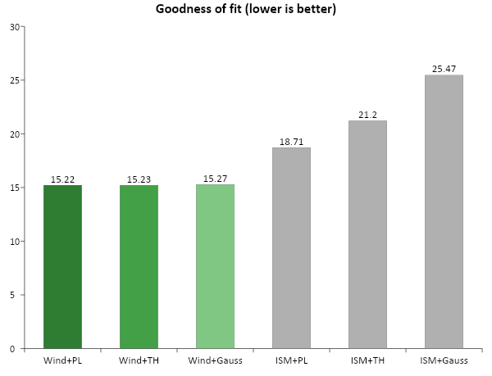
Results
Two best-fit models
Wind + Power-law jet (chi2_red = 15.22, best AIC/BIC)
Wind + Top-hat jet (chi2_red = 15.23, statistically tied)
Physical reading
161219B's afterglow strongly prefers a wind-stratified circumburst medium (n propto r^-2) -- the signature of a massive, mass-losing progenitor consistent with the associated SN 2016jca.

Slide 15
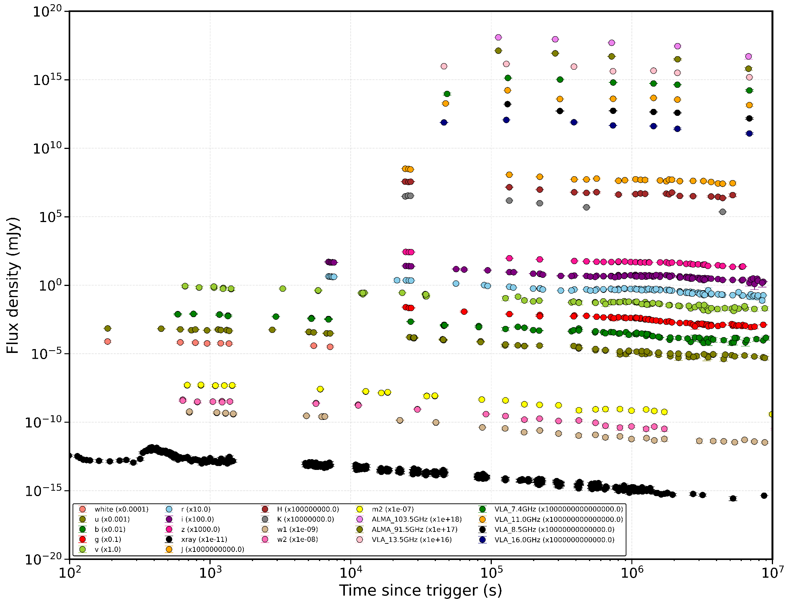
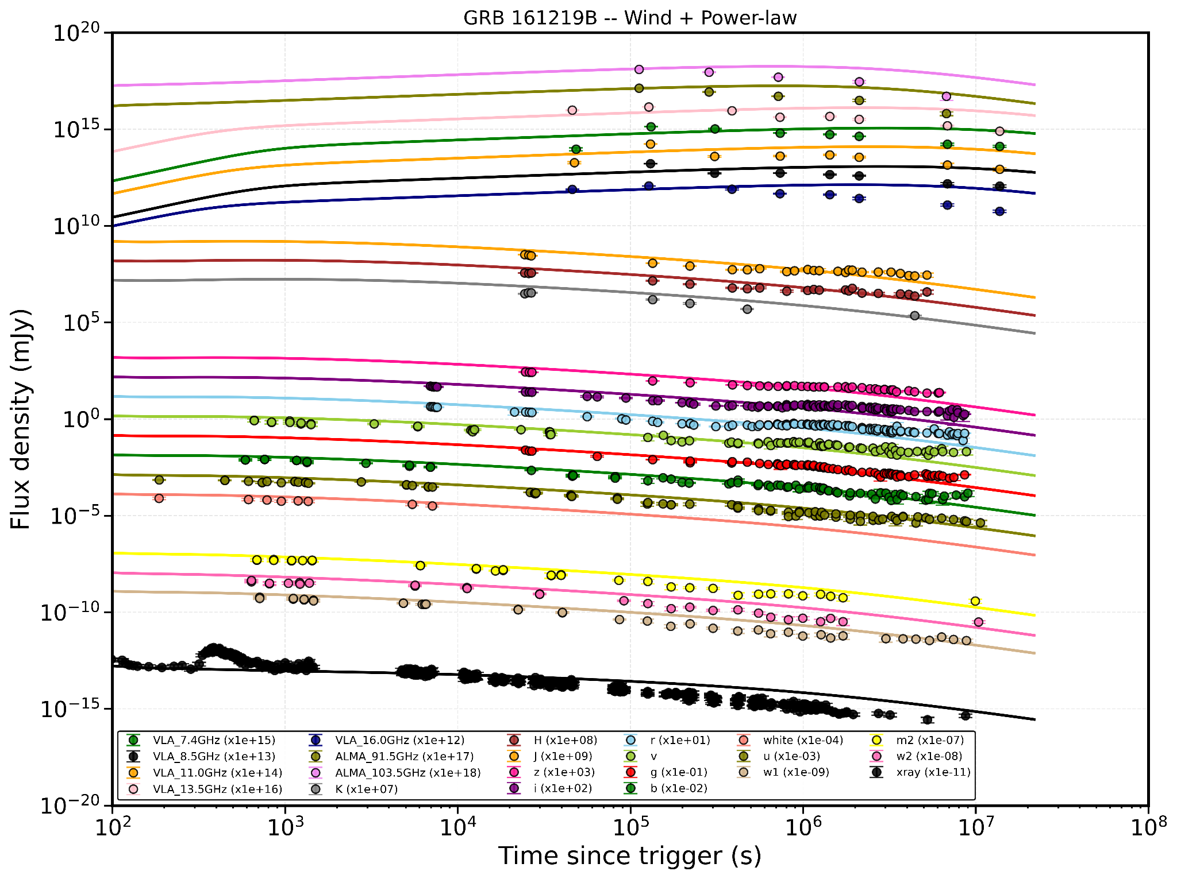
Results
Multiwavelength Light curve of 161219B:
Light Curve Fittings of 161219B:

Slide 16
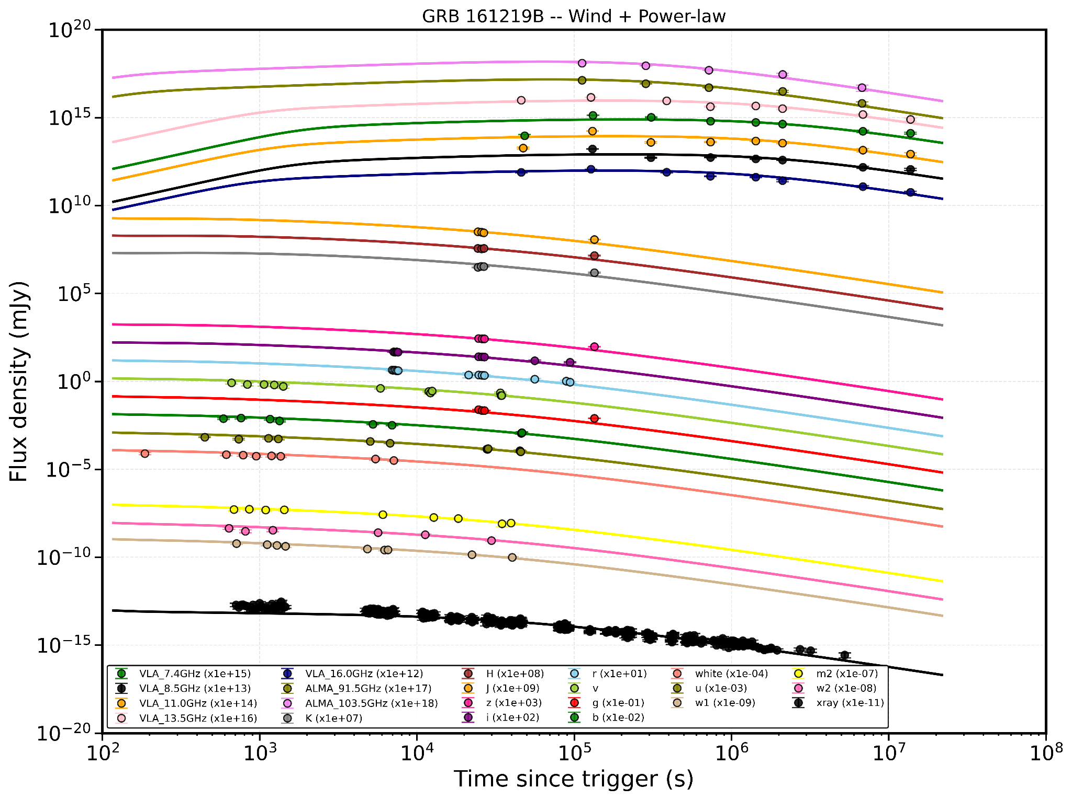
Multiwavelength Fittings:
Multiwavelength Fits with SN Data161219B:
Multiwavelength Fits without SN Data161219B:
t < 0.6 days (51,840 s): (Ashall et al.) -- forward-shock-only physics doesn't include this.
Optical/NIR, t > 5 days (432,000 s): SN 2016jca emerges here (spectroscopically confirmed by 3.73d)
Radio below 10 GHz, around t = 1.49 days: Laskar et al.

Slide 17
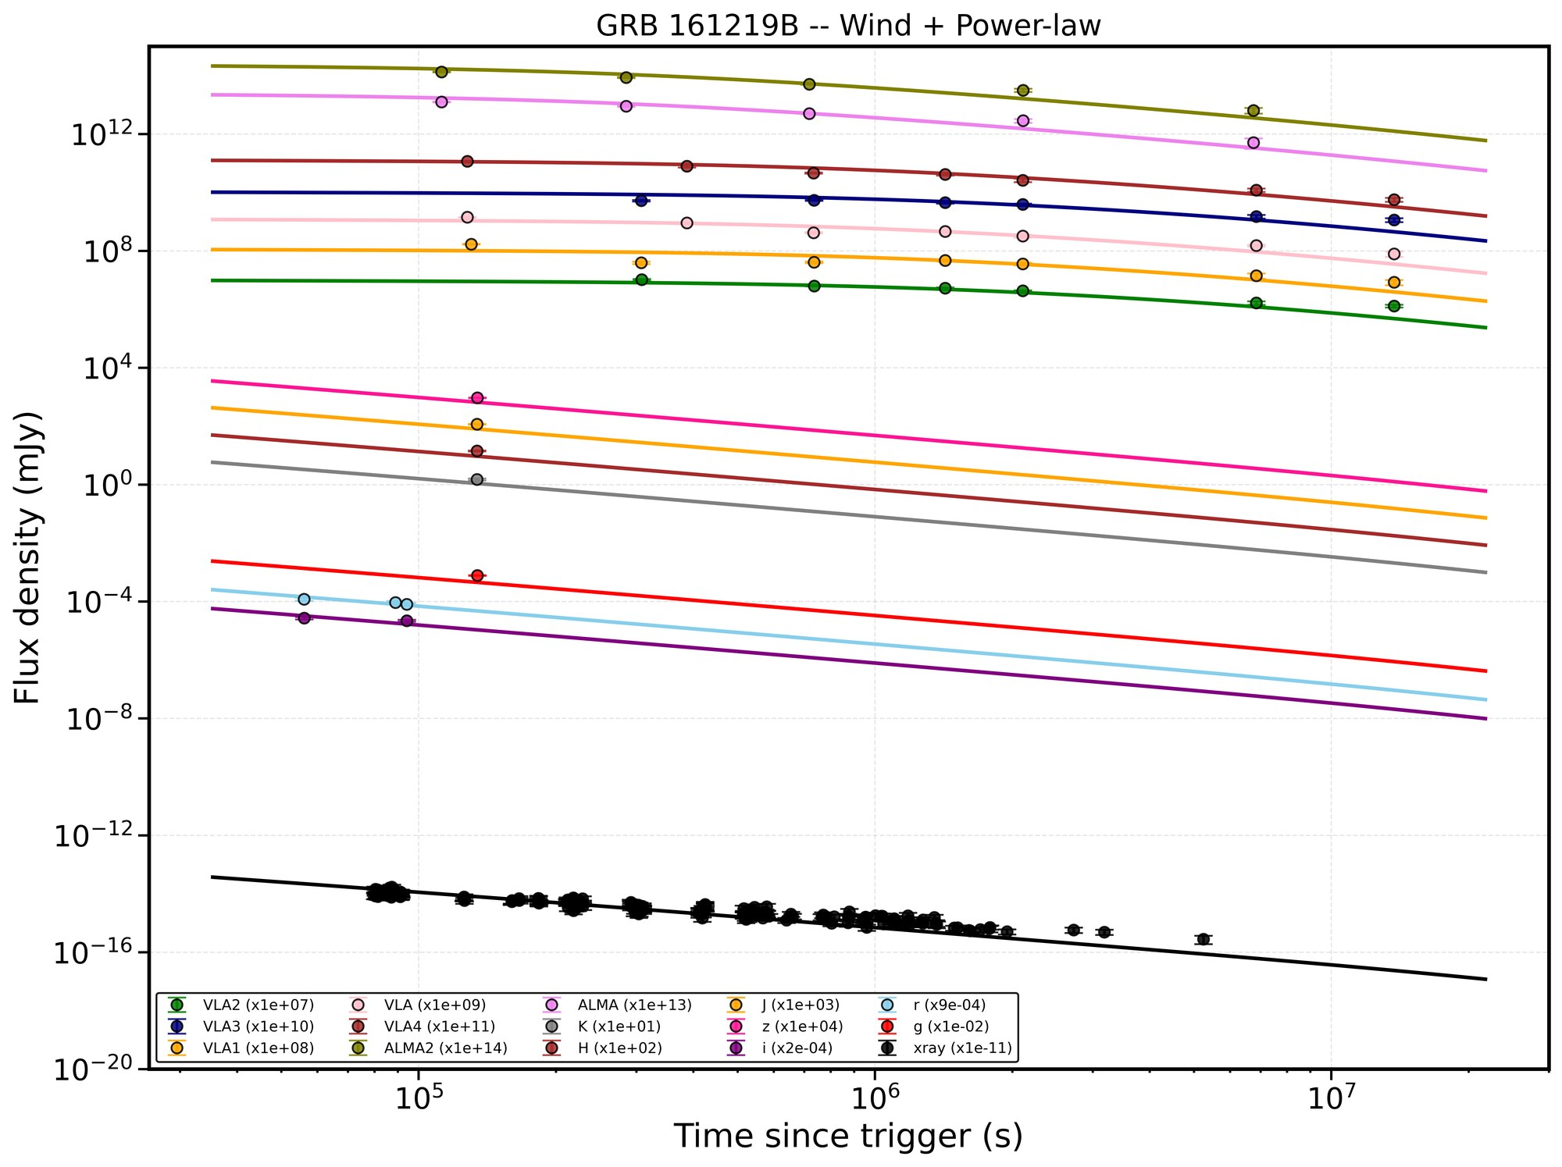
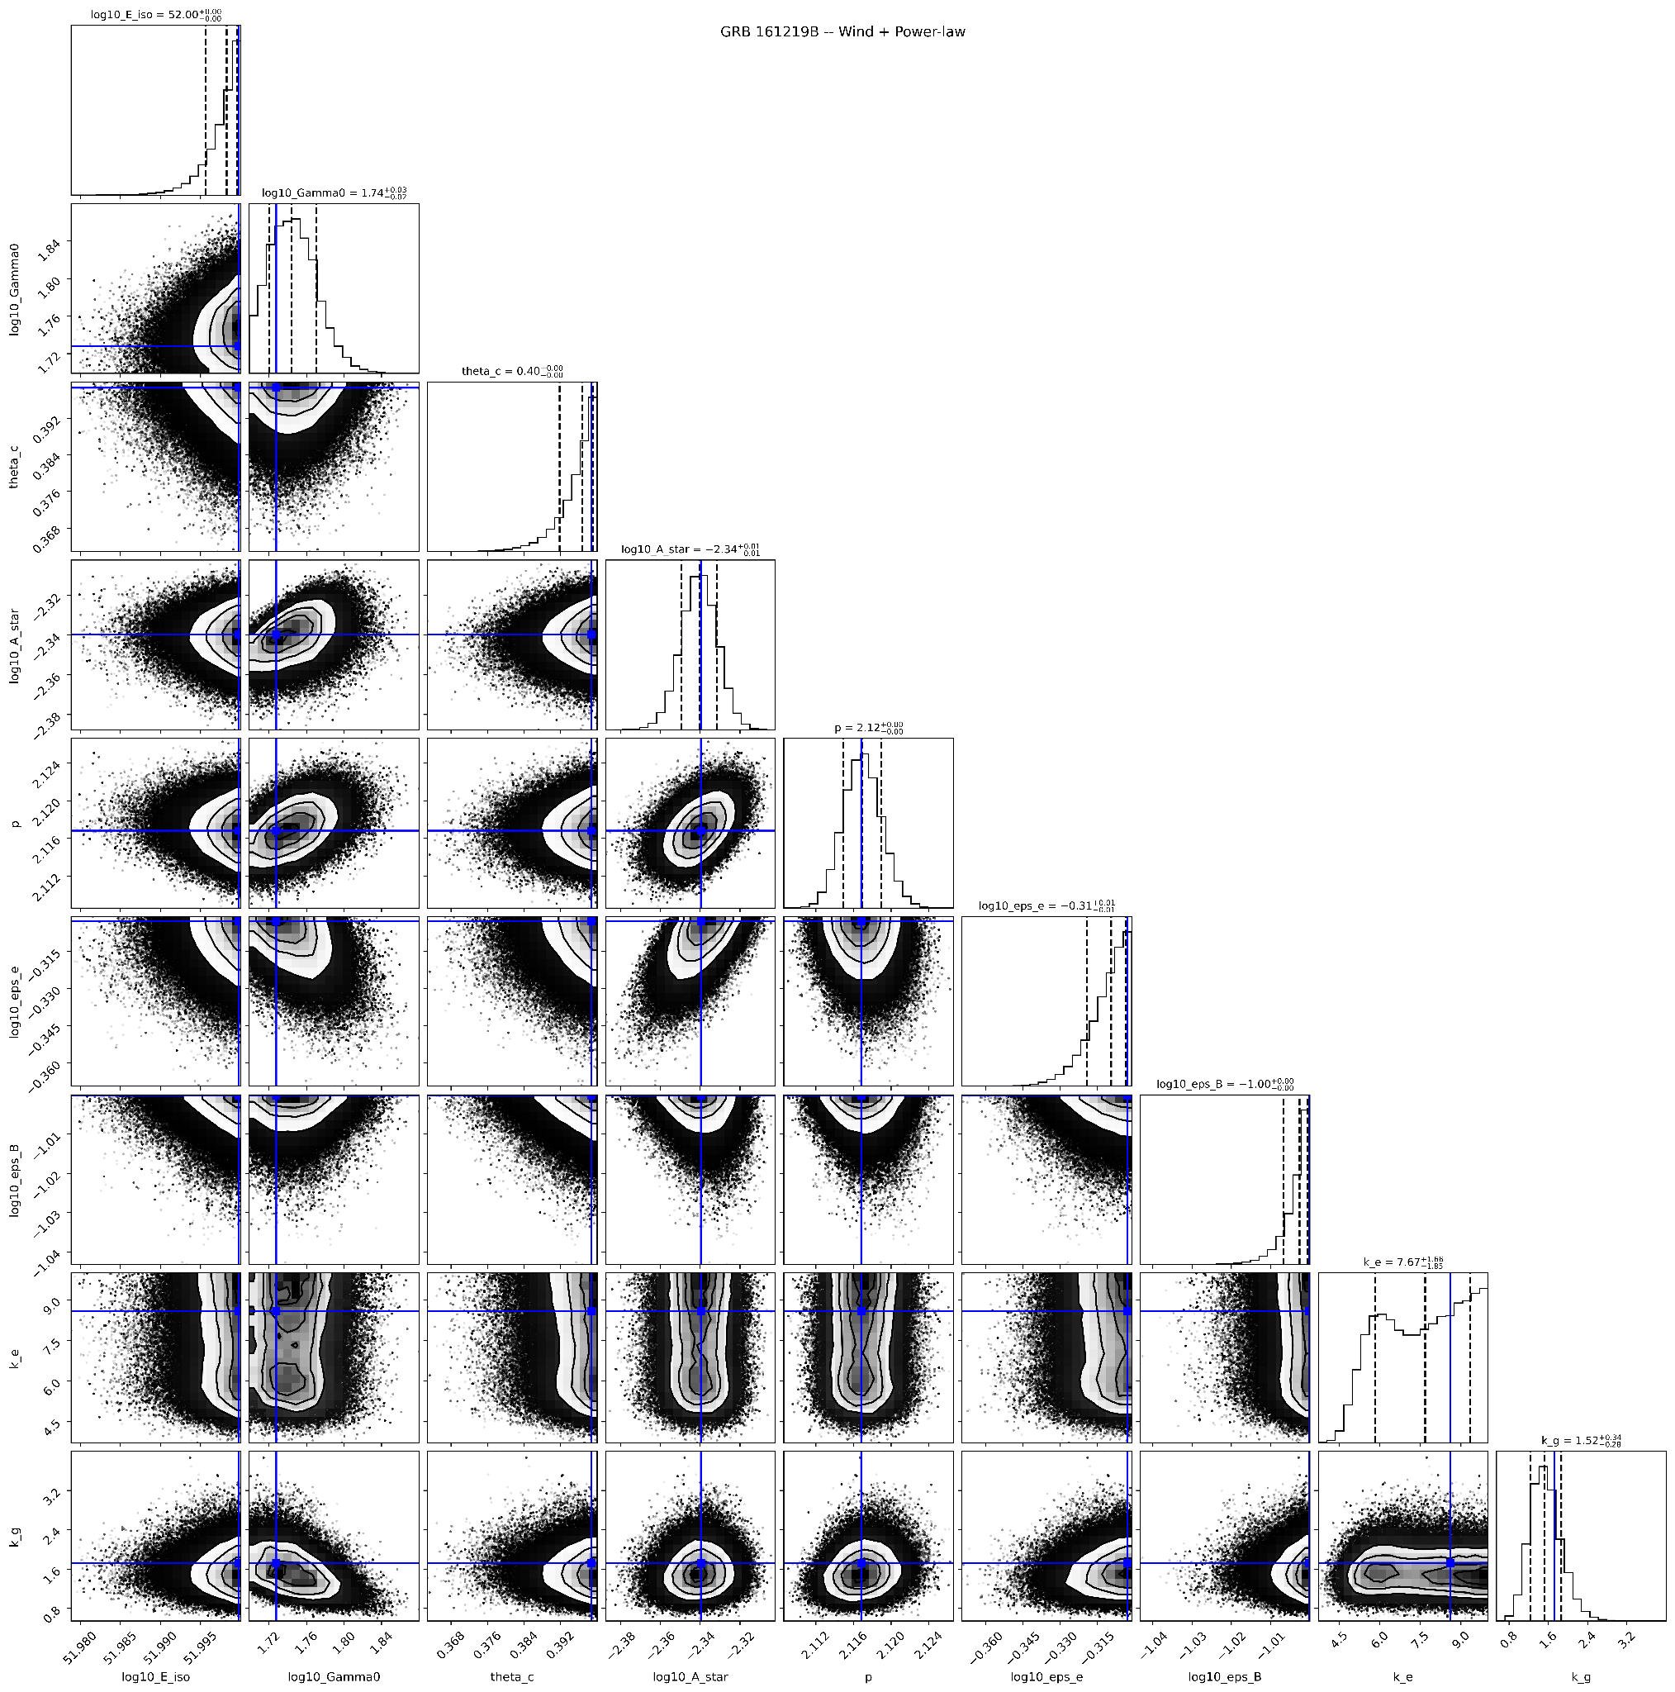
GRB 161219B — Best Fit #1: Wind + Power-law Jet
Parameter | Value
log E_iso [erg] | 51.998 (prior-bounded)
Gamma_0 | 55.5 (+3.4/-3.0)
theta_c [deg] | 22.7 (prior-bounded)
log A_star | -2.34 +/- 0.01
p | 2.117 +/- 0.002
eps_e | 0.49 +/- 0.01
eps_B | 0.0993 (prior-bounded)
chi2_red = 15.22 | AIC = 3290.5

Slide 18
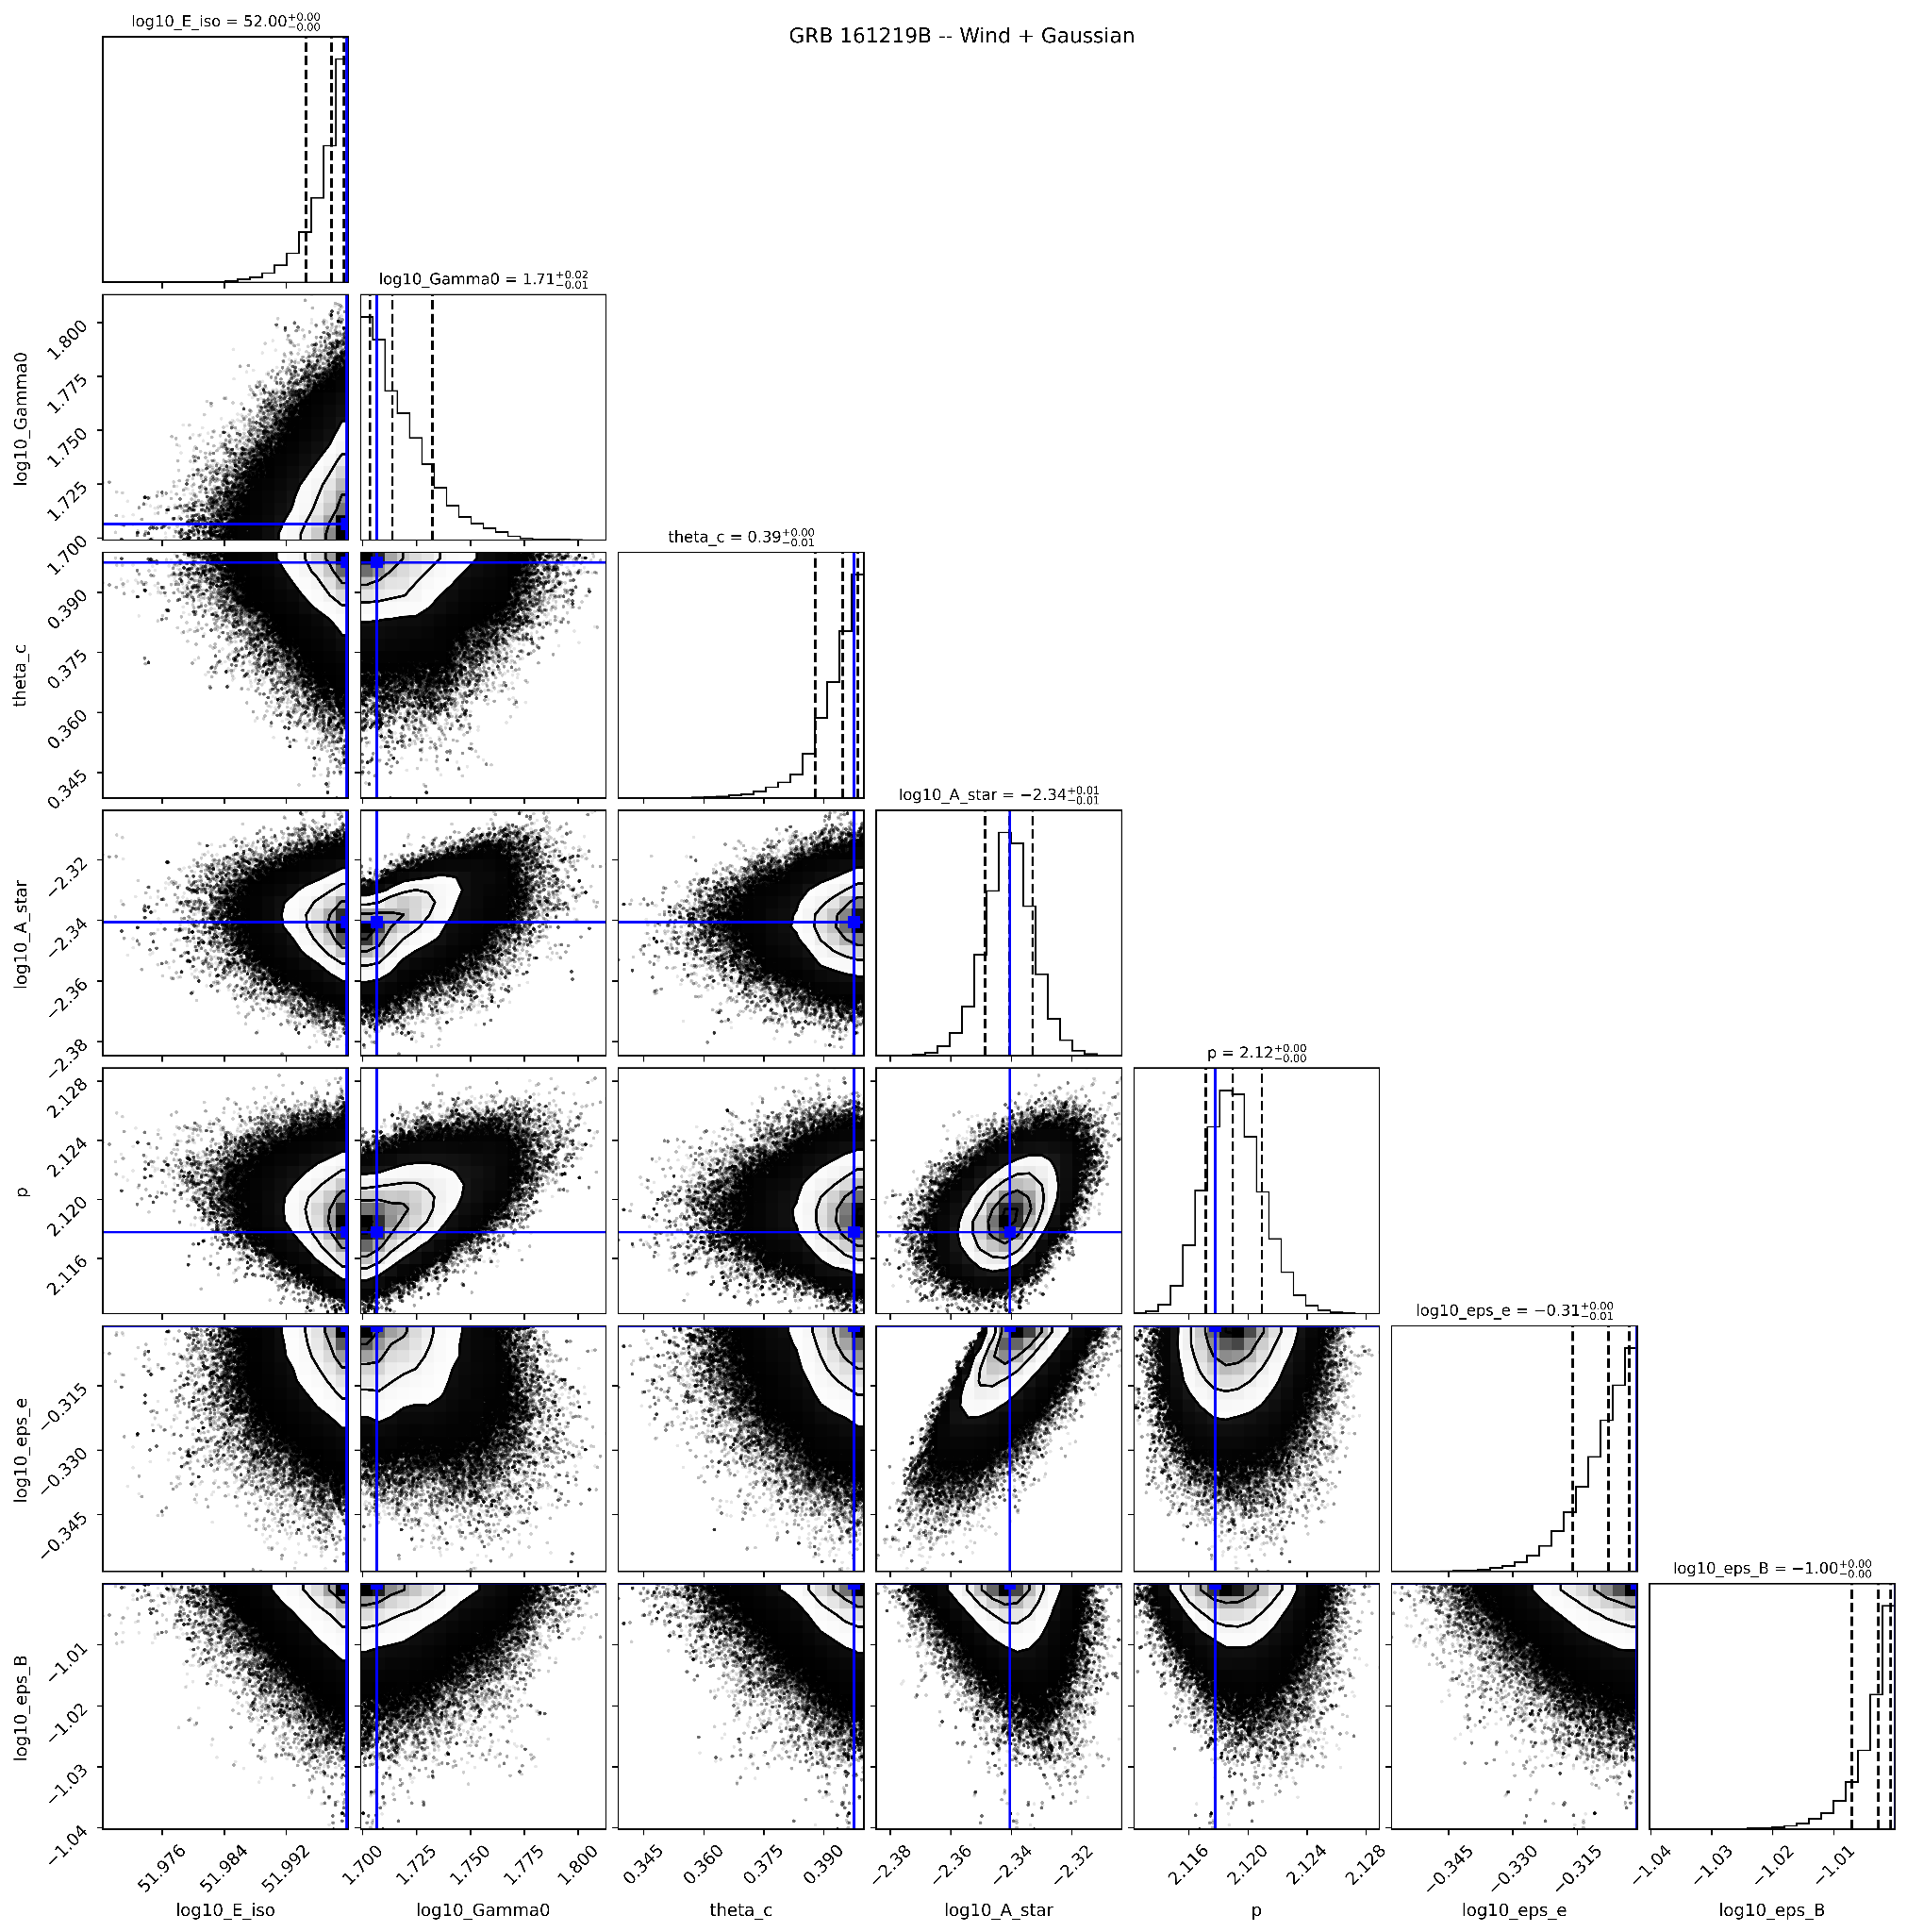
GRB 161219B — Best Fit #2: Wind + Top-hat Jet
Parameter | Value
log E_iso [erg] | 51.998 (prior-bounded)
Gamma_0 | 51.3 (+3.0/-2.8)
theta_c [deg] | 22.7 (prior-bounded)
log A_star | -2.34 +/- 0.01
p | 2.118 +/- 0.002
eps_e | 0.49 +/- 0.01
eps_B | 0.0993 (prior-bounded)
chi2_red = 15.23 | AIC = 3319.4

Slide 19
Summary of Results
161219B's afterglow strongly prefers a wind-stratified circumburst medium -- the signature of a massive, mass-losing progenitor consistent with the associated SN 2016jca.
Sharp-edged (top-hat) jet gives essentially the same physical parameters as the power-law jet -- p, eps_e, A_star and Gamma_0 all agree within established standard for LLGRBs 161219B (Ashall et al. (2019), Cano et al. (2017), Laskar et al. (2018)).
Together, Fits 1 and 2 show the robust result is: wind medium, mildly relativistic outflow (50-55), theta_c ~ 23 deg and theta_v ~ 10 degree
Spectral Indices (p = 2.12): matches standard relativistic shock acceleration theory
eps_e ~ 0.49: is close to equipartition energy -- electrons carry nearly as much energy as the magnetic field and protons combined.
Goodness of Fits (AIC/BIC) between the two best models is not large enough to prefer one jet edge-profile over the other from this dataset alone.

Slide 20
Future improvements
What we hope to improve next
Complete the model fits
Host-galaxy extinction
Run the three jet structures with FS + RS+SN on the full corrected dataset and rank them.
Constrain host dust from the corrected SED shape.
LLGRBs sample
Open dataset
Apply the same pipeline to other nearby LLGRBs–SN events for a consistent comparison.
Release the homogenised mJy tables
So others can build on them.
18
Notes:
Forward look. The pipeline is the reusable asset; this burst is the first application.

Slide 21



THANK YOU FOR LISTENING

