Slide 1



MSc Project
Revisiting Lorentz-factor constraints
in blazars and gamma-ray bursts based on Polarization – dependent γγ absorption
Denzel Mkhwanazi
Supervisor: Prof. Markus Böttcher
01/15
Notes:
Opening: State the problem in one sentence: standard γγ opacity calculations average over polarization, but the γγ cross section depends on polarization. My project asks whether retaining that information changes the inferred minimum Doppler factor δ_min for relativistic sources.

Slide 2
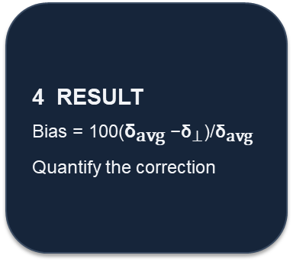
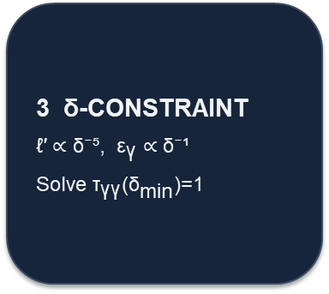
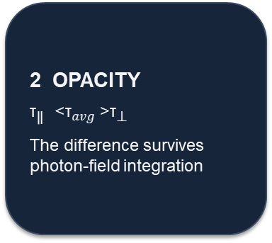
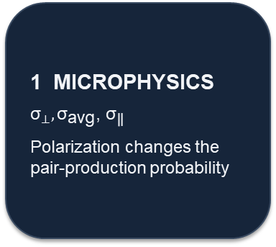
01 • INTRODUCTION
How the project connects: from polarization to ${\text{δ}}_{\text{min} }$
QUESTION • Does retaining the polarization dependence of γγ absorption change the inferred minimum Doppler factor (${\text{δ}}_{\text{min} } )$?
1 MICROPHYSICS
${\text{σ}}_{⊥},{\text{σ}}_{\text{avg}}$, ${\text{σ}}_{\text{∥}}$
Polarization changes the pair-production probability
2 OPACITY
${\text{τ}}_{\text{∥}}$ > ${\text{τ}}_{avg}$ >${\text{τ}}_{\text{⊥}}$
The difference survives photon-field integration
3 δ-CONSTRAINT
ℓ′ ∝ δ⁻⁵, ${\text{ε}}_{\text{γ}}$ ∝ δ⁻¹
Solve ${\text{τ}}_{\text{γγ}}$(${\text{δ}}_{\text{min}}$)=1
4 RESULT
Bias = 100(${\text{δ}}_{\text{avg} }$−${\text{δ}}_{\text{⊥}}$)/${\text{δ}}_{\text{avg} }$
Quantify the correction
KEY EQUATIONS: R′ = cδ${\text{t}}_{\text{var} }$/ (1+z) • L′ = Lobs/δ⁴ • ε′γ = (1+z)$E_{\text{γ}\text{,}\text{obs}}$/δ • ℓ′ ∝ δ⁻⁵ • $T_{\text{γγ}}$ (${\text{δ}}_{\text{min} }$= 1)
Story: collision → opacity → polarization → validation → δ-dependent opacity → transparency boundary → bias → source-grid result
02/15

Slide 3

Cross Section
Β = $\sqrt{1−\frac{1}{x} }$
Average
${σ^{avg}}_{ϒϒ }= \frac{3}{16}$ $σ_{T}(1−β^{2})$X {(3-$β^{4})In\left(\frac{1+β}{1−β}\right)−2β$(2-$β^{2}$)} (1)
${σ^{avg}}_{ϒϒ }$ =$\frac{{σ^{avg}}_{ϒϒ }\text{+ }{σ^{\text{⊥}}}_{ϒϒ }}{2}$ (2)
Parallel
${σ^{\text{∥}}}_{ϒϒ }= \frac{3}{16}$ $σ_{T}(1−β^{2})$X {$\frac{7−2β^{2}−β^{4}}{2}In\left(\frac{1+β}{1−β}\right)−β$(5-3$β^{2}$)} (3)
Perpendicular
${σ^{\text{⊥}}}_{ϒϒ }= \frac{3}{16}$ $σ_{T}(1−β^{2})$X {$\frac{7−2β^{2}−β^{4}}{2}In\left(\frac{1+β}{1−β}\right)−β$(3-$β^{2}$)} (4)
x ↓β ↓cross section ↓probability of γγ absorption
11/15
Notes:
Conclude in the same order as the project. First, the microscopic physics is polarization dependent. Second, the effect survives into opacity. Third, because opacity determines δmin, the inferred Doppler factor changes. In the representative grid the correction is percent-level and decreases with lower magnetic-field ordering. Finally, emphasize validation: the extension is built on a numerical implementation that reproduces the published benchmark values.

Slide 4
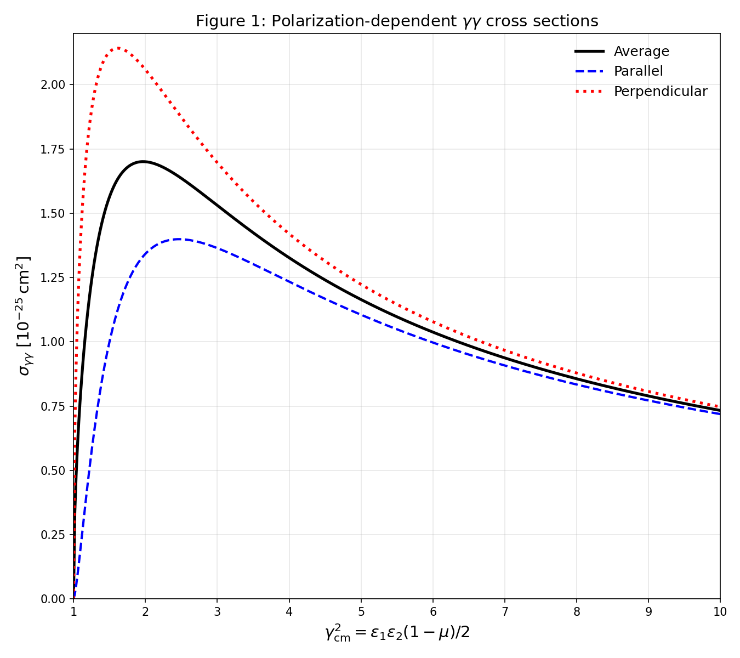

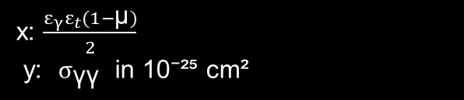
02 • MICROPHYSICS
STEP 1 — THE COLLISION: polarization changes the γγ cross section
READ THE AXES
x: $\frac{ε_{γ}ε_{t}(1−\text{μ})}{2}$
y: $σ_{\text{γγ}}$ in 10⁻²⁵ cm²
MAIN RESULT
$$σ_{\text{⊥}}\text{> }σ_{\text{avg}}>σ_{\text{∥}}$$
WHY THIS STARTS THE STORY
The two polarization states do not interact equally: in this regime, σ⊥ is larger than σavg, so the perpendicular state is more strongly absorbed.
03/15
Notes:
Figure 1 script: Start at the x-axis. x is the dimensionless center-of-momentum energy variable. Pair production requires x≥1, so the curves begin at zero at threshold. Moving right, the cross section rises rapidly, reaches a maximum, then decreases. The key comparison is vertical: the red/perpendicular curve is above the black average curve, while the blue/parallel curve is below it. Therefore σ⊥ > σavg > σ∥ over much of the plotted range. At high x the curves approach one another, so the polarization distinction becomes less pronounced. Do not say the cross section simply increases with energy—it peaks and then falls.

Slide 5

But one collision is not yet an astrophysical opacity. Does this difference survive the photon-field integration?”
Π = $\frac{\text{(}\text{α}\text{+}\text{1}\text{)}}{\text{α}+\frac{5}{3}}$ (5)
$k_{v}^{\text{⊥} }$= $\int_{0}^{∞ }{d∊}\int_{4π}{d\text{Ω}}(1−µ)$X{${σ^{\text{∥}}}_{ϒϒ }$($n^{\text{⊥}}\left[∊,\text{Ω}\right]$ $\cos^{2}$+ $n^{\text{∥}}\left[∊,\text{Ω}\right]\sin^{2})+{σ^{\text{⊥}}}_{ϒϒ }({n^{\text{⊥}}\left[∊,\text{Ω}\right] \sin^{2}+n}^{\text{∥}}\left[∊\text{Ω}\right]\sin^{2})$} (6)
$k_{v}^{\text{∥}}$= $\int_{0}^{∞ }{d∊}\int_{4π}{d\text{Ω}}(1−µ)$X{${σ^{\text{∥}}}_{ϒϒ }$($n^{\text{∥}}\left[∊,\text{Ω}\right]$ $\cos^{2}$+ $n^{\text{⊥}}\left[∊,\text{Ω}\right]\sin^{2})+{σ^{\text{⊥}}}_{ϒϒ }({n^{\text{⊥}}\left[∊,\text{Ω}\right] \sin^{2}+n}^{\text{∥}}\left[∊\text{Ω}\right]\sin^{2})$} (7)
11/15
Notes:
Conclude in the same order as the project. First, the microscopic physics is polarization dependent. Second, the effect survives into opacity. Third, because opacity determines δmin, the inferred Doppler factor changes. In the representative grid the correction is percent-level and decreases with lower magnetic-field ordering. Finally, emphasize validation: the extension is built on a numerical implementation that reproduces the published benchmark values.

Slide 6
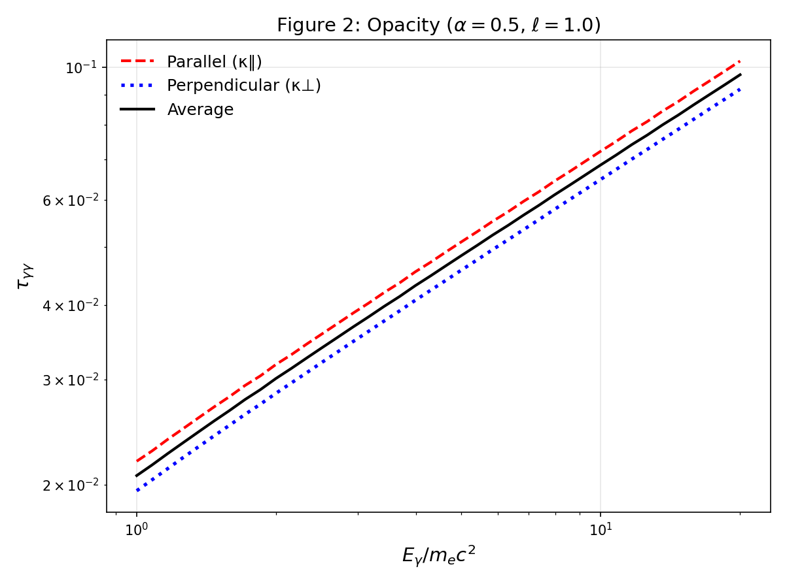
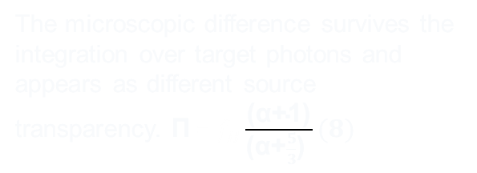

03 • MACROPHYSICS
STEP 2 — THE SOURCE: the cross-section difference becomes opacity
WHAT IS PLOTTED
τ_{γγ} versus γ-ray energy, for α=0.5 and ℓ=1.
KEY ORDERING
$T_{\text{∥}}$ > τ_{avg} > ${\text{τ}}_{\text{⊥ }}$
THE BRIDGE TO ASTROPHYSICS
The microscopic difference survives the integration over target photons and appears as different source transparency. $\text{Π}$ = $f_{B}\frac{\text{(}\text{α}\text{+}\text{1}\text{)}}{\text{(}\text{α}\text{+}\frac{5}{3}\text{) }}(8)$
If one polarization is preferentially absorbed, then the radiation that escapes should also change polarization.”
04/15
Notes:
Figure 2 script: The y-axis is optical depth τγγ. The x-axis is gamma-ray energy in units of m_e c² and is logarithmic. All three curves rise with energy in this plotted range, meaning higher-energy gamma rays experience greater absorption. The red dashed parallel curve is highest, black average is in the middle, blue dotted perpendicular is lowest. Thus τ∥ > τavg > τ⊥ for this model setup. The important conceptual step is: Figure 1 told us individual collisions have different cross sections; Figure 2 shows that after integrating over the photon field, this becomes a macroscopic difference in opacity.

Slide 7
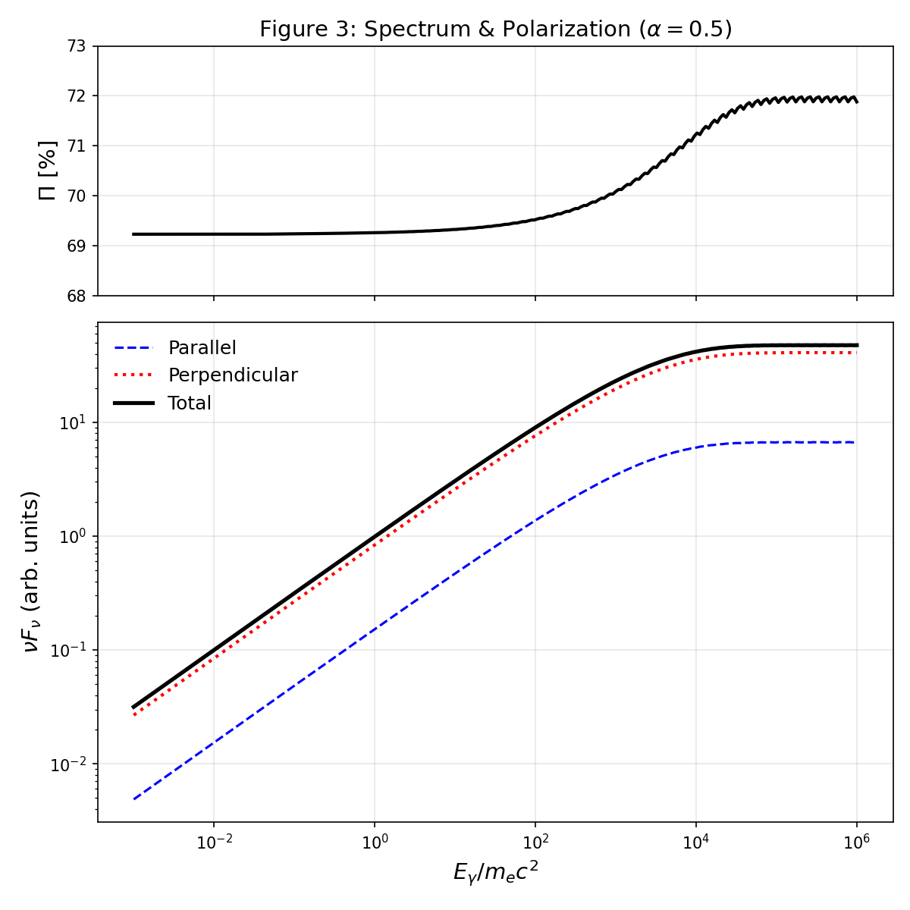
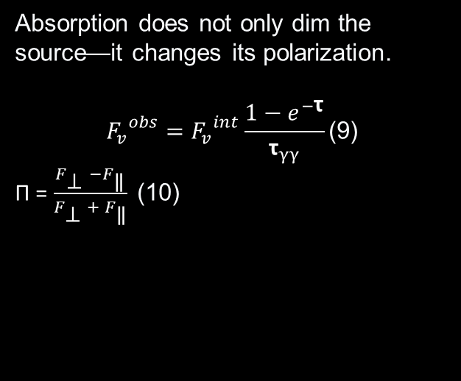
04 • RADIATIVE TRANSFER
STEP 3 — THE OBSERVABLE: selective absorption changes polarization
TOP PANEL
Observed polarization rises from ≈69.2% to ≈72% as energy increases.
BOTTOM PANEL
The parallel component is absorbed more strongly; the surviving flux becomes increasingly dominated by the perpendicular component.
THE SURPRISING CONSEQUENCE
Absorption does not only dim the source—it changes its polarization.
$${F_{v}}^{obs}={F_{v}}^{int}\frac{1−e^{−\text{τ}}}{{\text{τ}}_{γγ}}\text{(}\text{9}\text{)}$$
Π = $\frac{F_{\text{⊥} }−F_{\text{∥}}}{F_{\text{⊥} }+ F_{\text{∥}}} \text{(}\text{10}\text{)}$
Before using this machinery in a new Doppler-factor calculation, we need to check that the numerical implementation reproduces the established result.
05/15
Notes:
Figure 3 script: There are two panels. In the bottom panel, black is total flux, red dotted is perpendicular, and blue dashed is parallel. At high energies, the blue parallel component is much smaller than the perpendicular component, showing stronger selective absorption of the parallel component. In the top panel, the polarization fraction therefore rises from roughly 69.2% toward roughly 72%. Explain the mechanism: if one polarization component is removed more efficiently, the remaining radiation is more polarized. This is the observable consequence of polarization-dependent absorption.

Slide 8
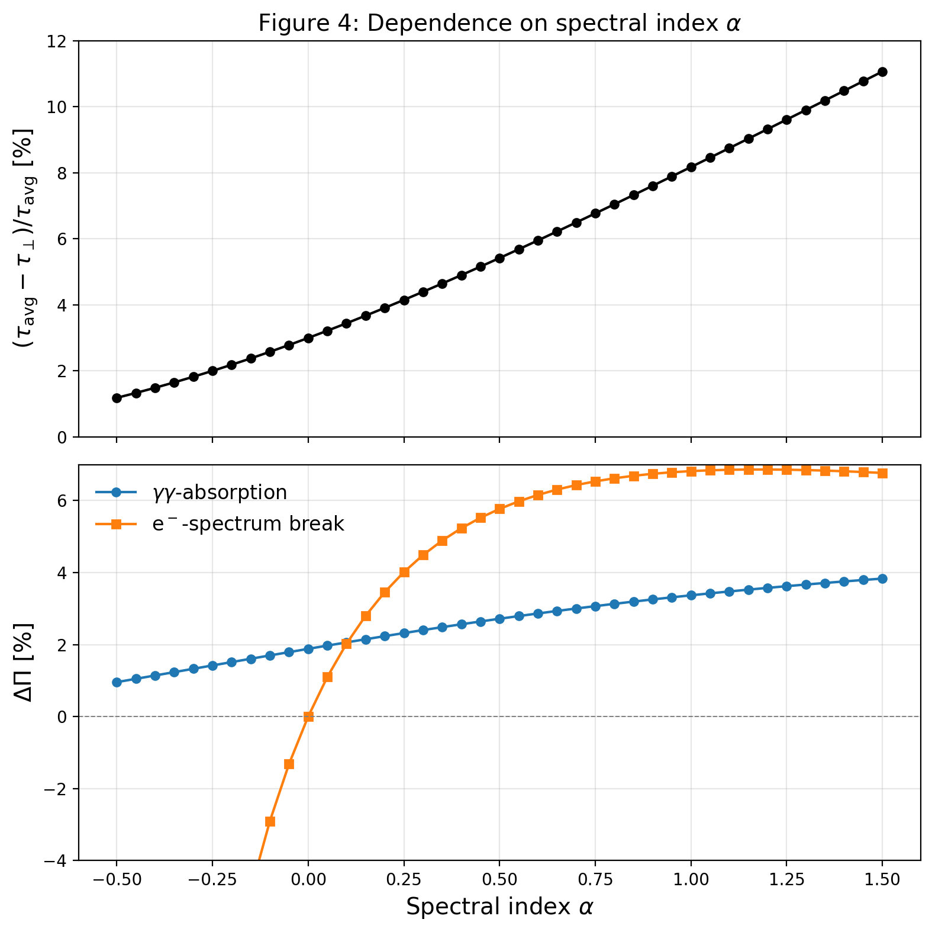
05 • CODE VALIDATION
STEP 4 — TRUST THE CALCULATION: validate before extending it
AT α = 0.5
γγ absorption: ΔΠ_{γγ} ≈ 2.72% | published ≈ 2.7%
ELECTRON-SPECTRUM BREAK
ΔΠ_{e} ≈ 5.77% | published ≈ 5.8%
A break in the gamma-ray spectrum can have two different causes. Either γγ absorption removes photons on the way out, or the electrons themselves have a break, so the source emits a steeper spectrum. In both cases the spectrum steepens by the same amount, from α = 0.5 to 1, so the spectrum alone can't tell them apart. But the polarization changes differently. For an electron break, it changes by about 5.8%. For absorption, only about 2.7%. My code gives 2.72% and 5.77%, matching the published values, so it is validated before I extend it
we can now make the opacity explicitly depend on δ
06/15
Notes:
Figure 4 script: This is a validation figure, not yet the new astrophysical result. Top panel: the relative opacity difference between average and perpendicular cases increases with spectral index α. Bottom panel: the blue γγ-absorption polarization change increases gradually with α; the orange electron-spectrum-break contribution rises more strongly and then saturates around the upper part of the plotted range. At α=0.5, my implementation gives approximately 2.72% for the γγ contribution versus about 2.7% reported by Böttcher, and approximately 5.77% versus about 5.8% for the electron-spectrum-break contribution. The scientific point is that the numerical implementation reproduces the published benchmark.

Slide 9
06 • NEW CALCULATION
STEP 5 — THE NEW QUESTION: what happens when opacity depends on δ?
This is the core extension. We convert the observed source quantities into the comoving frame using δ and redshift
SOURCE SIZE
COMOVING LUMINOSITY
COMOVING γ-RAY ENERGY
R′ = c δ t_{var} /(1+z)
L′ = L_{obs} / δ⁴
ε_{γ} = (1+z) E_{γ,obs} / δ
Therefore
ℓ′ ∝ δ⁻⁵ and ε_{γ} ∝ δ⁻¹
Higher δ → lower photon compactness + lower comoving γ-ray energy → lower τ_{γγ}
If increasing δ makes the source more transparent, there must be a boundary that defines the minimum δ.”
07/15
Notes:
Explain the extension carefully. The observed luminosity and variability time are converted into comoving quantities using δ and redshift. Because L′ scales as δ^-4 while R′ scales as δ, the compactness scales as δ^-5. The gamma-ray energy in the comoving frame scales as δ^-1. Thus increasing δ generally makes the source more transparent through two effects. This is why δ can be solved from the transparency condition.

Slide 10
07 • CONSTRAINT
STEP 6 — THE THRESHOLD: where does the gamma ray escape?
We define the minimum Doppler factor at the transparency boundary τγγ(δmin)=1. Below it the model is too opaque for the chosen gamma-ray energy; above it the source becomes progressively more transparent
τ_{γγ}(δ_{min}) = 1
τ = 1
τ > 1
τ < 1
Mostly transparent
Boundary → δ_{min}
Mostly opaque
The solver searches for the δ at which the gamma ray is just able to escape.
Now we have a conventional constraint and a polarization-dependent constraint. We need a single comparison number
08/15
Notes:
Say: I define the minimum Doppler factor at the point where optical depth equals one. Below that value the model is too opaque for the chosen gamma-ray energy; above it the source becomes progressively more transparent. Because the full opacity is a numerical integral, there is no simple closed-form δmin, so I solve τ(δ)=1 numerically using a root finder.

Slide 11
08 • BIAS
STEP 7 — THE COMPARISON: how large is the polarization correction?
Bias = 100 × (δ_{avg} − δ⊥) / δ_{avg}
CONVENTIONAL
POLARIZATION-DEPENDENT
WHAT THE NUMBER MEANS
δ_{avg} uses polarization-averaged opacity.
δ⊥ uses the perpendicular opacity.
Bias measures how much the inferred δ changes when polarization is retained.
Example: δ_{avg}=100, δ⊥=97 → Bias = 3%
The final question is how this correction behaves for representative blazars and GRBs
09/15
Notes:
Explain the sign and meaning. The conventional estimate uses the polarization-averaged opacity. The perpendicular case has lower opacity in the model, so it requires a smaller δ to reach τ=1. The bias is the fractional difference relative to δavg. For the simple example 100 and 97, the bias is 3%. It is a relative shift in the inferred constraint, not a measurement uncertainty.

Slide 12
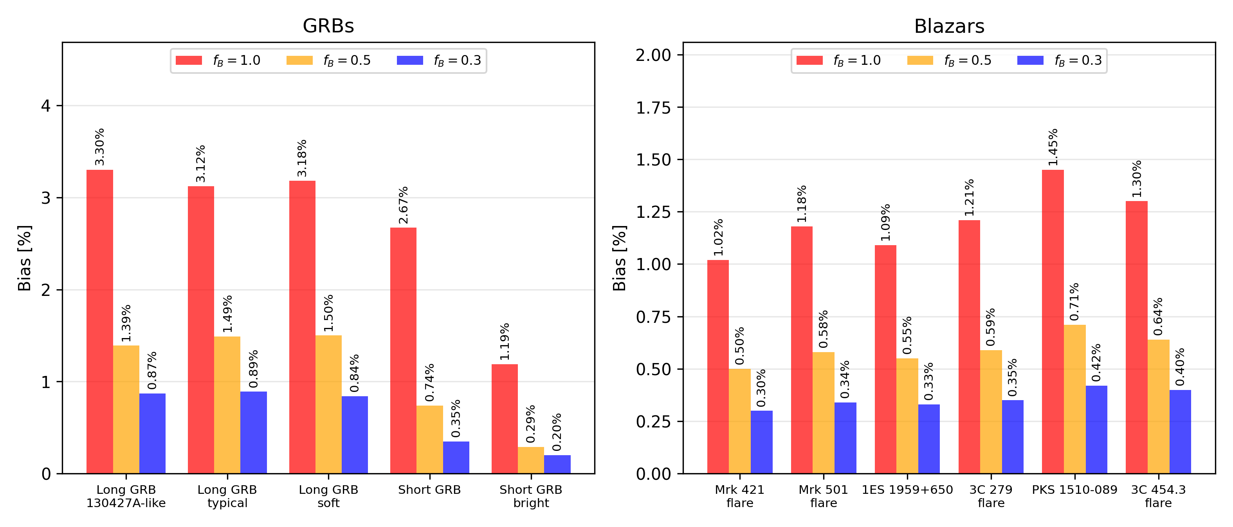
09 • RESULTS
STEP 8 — THE RESULT: the correction depends on magnetic ordering
10/15
Notes:
Figure/result script: This plot compares representative GRB cases on the left and blazar cases on the right. Each source has three bars corresponding to fB=1.0, 0.5 and 0.3. The consistent trend is that reducing fB reduces the bias. At fB=1, four of the five GRB cases lie at roughly 2.7–3.3%, while the short GRB bright case is lower at about 1.2%, inside the blazar range of roughly 1.0–1.45%. At fB=0.5 the GRB biases are roughly 0.3–1.5% and the blazar biases 0.5–0.7%; at fB=0.3 they are roughly 0.2–0.9% and 0.3–0.4%. Do not generalize this as 'all GRBs have larger bias': the short GRB bright case is a counter-example within this grid, and the values depend on the representative source parameters used. The physical interpretation: stronger magnetic ordering → larger polarization fraction → greater difference between polarization populations → larger polarization correction. These results are for the grid without the high-energy target-photon cutoff; the εcut = 1 sensitivity run is in the appendix.

Slide 13
10 • CONTRIBUTION & CONCLUSION
• we implemented and validated the polarization-dependent γγ formalism.
• we made the compactness observable-based, so τγγ becomes a function of δ.
• we solved τγγ(δ)=1 to obtain polarization-dependent δmin.
• The representative grid gives a percent-level correction that decreases as fB decreases.
• The implementation reproduces the published Böttcher benchmarks before the δ-dependent extension.
Bottom line: polarization produces a correction to the transparency constraint, not a replacement for the underlying γγ physics.
11/15
Notes:
Conclude in the same order as the project. First, the microscopic physics is polarization dependent. Second, the effect survives into opacity. Third, because opacity determines δmin, the inferred Doppler factor changes. In the representative grid the correction is percent-level and decreases with lower magnetic-field ordering. Finally, emphasize validation: the extension is built on a numerical implementation that reproduces the published benchmark values.

Slide 14
11. What’s Next
. Have a meeting with Prof after the talk
Thank you
11/15
Notes:
Conclude in the same order as the project. First, the microscopic physics is polarization dependent. Second, the effect survives into opacity. Third, because opacity determines δmin, the inferred Doppler factor changes. In the representative grid the correction is percent-level and decreases with lower magnetic-field ordering. Finally, emphasize validation: the extension is built on a numerical implementation that reproduces the published benchmark values.

Slide 15
APPENDIX
11/15
Notes:
Conclude in the same order as the project. First, the microscopic physics is polarization dependent. Second, the effect survives into opacity. Third, because opacity determines δmin, the inferred Doppler factor changes. In the representative grid the correction is percent-level and decreases with lower magnetic-field ordering. Finally, emphasize validation: the extension is built on a numerical implementation that reproduces the published benchmark values.

Slide 16
APPENDIX
Minimum Doppler factors and bias (no cutoff)
 |  |  | f_{B} = 1.0 |  | f_{B} = 0.5 |  | f_{B} = 0.3
Source | α | δ_{avg} | δ⊥ | bias [%] | δ⊥ | bias [%] | δ⊥ | bias [%]
HBL Mrk 421 flare | 0.5 | 317.9 | 314.6 | 1.02 | 316.3 | 0.50 | 316.9 | 0.30
HBL Mrk 501 flare | 0.7 | 184.0 | 181.9 | 1.18 | 183.0 | 0.58 | 183.4 | 0.34
HBL 1ES 1959+650 | 0.6 | 197.4 | 195.2 | 1.09 | 196.3 | 0.55 | 196.7 | 0.33
FSRQ 3C 279 flare | 0.8 | 1408.5 | 1391.5 | 1.21 | 1400.2 | 0.59 | 1403.6 | 0.35
FSRQ PKS 1510-089 | 1.0 | 909.2 | 896.0 | 1.45 | 902.7 | 0.71 | 905.3 | 0.42
FSRQ 3C 454.3 flare | 0.9 | 1512.2 | 1492.5 | 1.30 | 1502.5 | 0.64 | 1506.2 | 0.40
Long GRB 130427A-like | 0.5 | 6833.1 | 6607.9 | 3.30 | 6738.3 | 1.39 | 6773.7 | 0.87
Long GRB typical | 0.8 | 3892.3 | 3770.7 | 3.12 | 3834.2 | 1.49 | 3857.7 | 0.89
Long GRB soft | 1.0 | 2019.0 | 1954.7 | 3.18 | 1988.8 | 1.50 | 2002.1 | 0.84
Short GRB | 0.6 | 2543.7 | 2475.8 | 2.67 | 2524.9 | 0.74 | 2534.8 | 0.35
Short GRB bright | 0.4 | 3690.9 | 3646.9 | 1.19 | 3680.0 | 0.29 | 3683.4 | 0.20
δ_{avg} (polarization-averaged opacity) does not depend on f_{B}, so it is listed once per source. Bias = 100 (δ_{avg} − δ⊥) / δ_{avg}. α is the spectral index.
SLIDE 12/15
Notes:
Table script: each row is one representative source, for the grid without a high-energy cutoff. δavg is the minimum Doppler factor from the polarization-averaged opacity and does not depend on fB; δ⊥ is from the perpendicular opacity, shown for fB=1.0, 0.5 and 0.3, with the bias 100(δavg − δ⊥)/δavg beside each. The bias falls with fB for every source. Blazar δmin lies between about 180 and 1500; the GRB values are larger (about 2000–6800). The table is the numerical backing for slides 12–13.

Slide 17
APPENDIX
Minimum Doppler factors and bias (ε_{cut} = 1)
 |  |  | f_{B} = 1.0 |  | f_{B} = 0.5 |  | f_{B} = 0.3
Source | α | δ_{avg} | δ⊥ | bias [%] | δ⊥ | bias [%] | δ⊥ | bias [%]
HBL Mrk 421 flare | 0.5 | 317.8 | 314.6 | 1.02 | 316.2 | 0.50 | 316.8 | 0.30
HBL Mrk 501 flare | 0.7 | 184.0 | 181.8 | 1.18 | 182.9 | 0.58 | 183.4 | 0.34
HBL 1ES 1959+650 | 0.6 | 197.3 | 195.1 | 1.09 | 196.2 | 0.55 | 196.6 | 0.33
FSRQ 3C 279 flare | 0.8 | 1402.4 | 1385.0 | 1.24 | 1393.8 | 0.61 | 1397.3 | 0.36
FSRQ PKS 1510-089 | 1.0 | 904.5 | 891.5 | 1.44 | 897.9 | 0.73 | 900.6 | 0.43
FSRQ 3C 454.3 flare | 0.9 | 1487.9 | 1468.0 | 1.34 | 1478.0 | 0.66 | 1481.9 | 0.40
Long GRB 130427A-like | 0.5 | 1815.3 | 1765.5 | 2.74 | 1794.4 | 1.15 | 1804.2 | 0.61
Long GRB typical | 0.8 | 1128.9 | 1091.3 | 3.33 | 1112.8 | 1.43 | 1120.2 | 0.78
Long GRB soft | 1.0 | 597.4 | 576.4 | 3.52 | 587.4 | 1.68 | 591.0 | 1.08
Short GRB | 0.6 | 739.2 | 716.0 | 3.13 | 730.7 | 1.15 | 734.7 | 0.60
Short GRB bright | 0.4 | 1088.7 | 1055.2 | 3.07 | 1071.4 | 1.59 | 1079.1 | 0.88
δ_{avg} (polarization-averaged opacity) does not depend on f_{B}, so it is listed once per source. Bias = 100 (δ_{avg} − δ⊥) / δ_{avg}. α is the spectral index.
SLIDE 13/15
Notes:
Table script: same source grid and layout as the previous slide, but with the target-photon spectrum cut off at εcut = 1. The blazar rows are almost unchanged (δmin differs by under 2%), while the GRB δmin values fall to roughly 600–1800. The bias again falls with fB for every source; at fB=1 the GRB biases are roughly 2.7–3.5%, the largest being long GRB soft (3.52%). This is a sensitivity test on the assumed target spectrum.

Slide 18
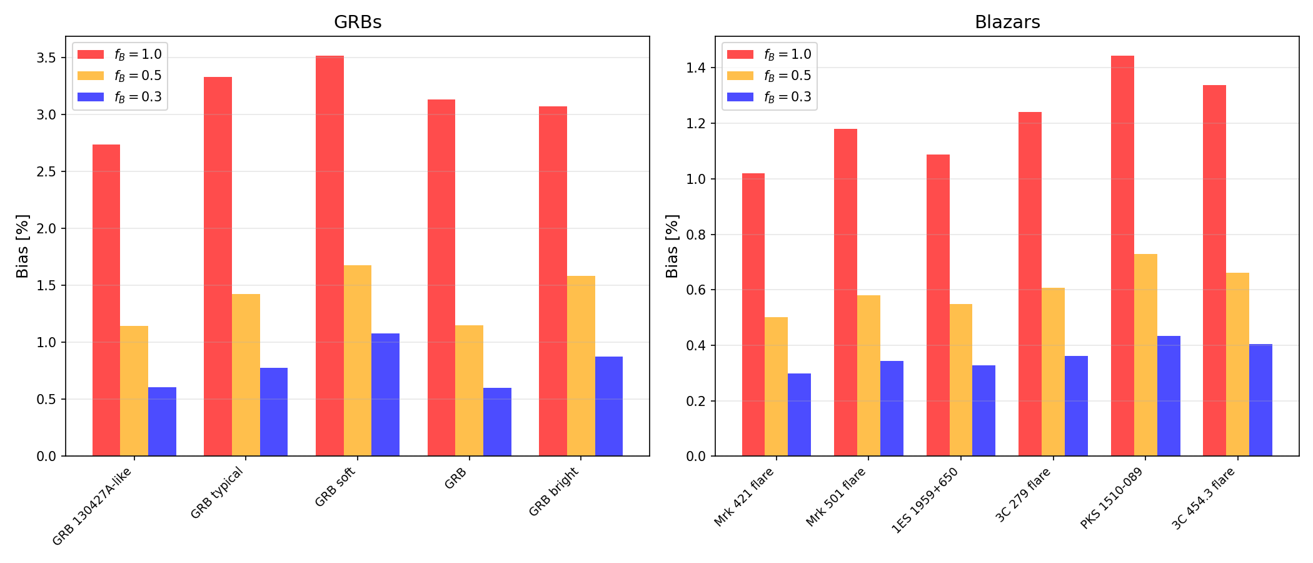
APPENDIX
Cutoff test (ε_{cut} = 1): bias by group
SLIDE 14/15
Notes:
Cutoff sensitivity run: the same source grid with the target-photon spectrum suppressed above εcut = 1 (n(εt) → n(εt) exp(−εt/εcut)). Compared with the no-cutoff grid, the GRB minimum Doppler factors drop from roughly 2000–6800 to roughly 600–1800, while the blazar values change by under 2%. This is the expected direction, since removing high-energy target photons reduces the opacity, and the effect is much larger for the GRBs than for the blazars. At fB=1 the GRB biases are roughly 2.7–3.5% (short GRB bright ~3.1%, versus ~1.2% without a cutoff) and the blazar biases roughly 1.0–1.45%. The trend that the bias decreases with fB is unchanged. This is a sensitivity test, not a claim about the real source spectrum.

Slide 19
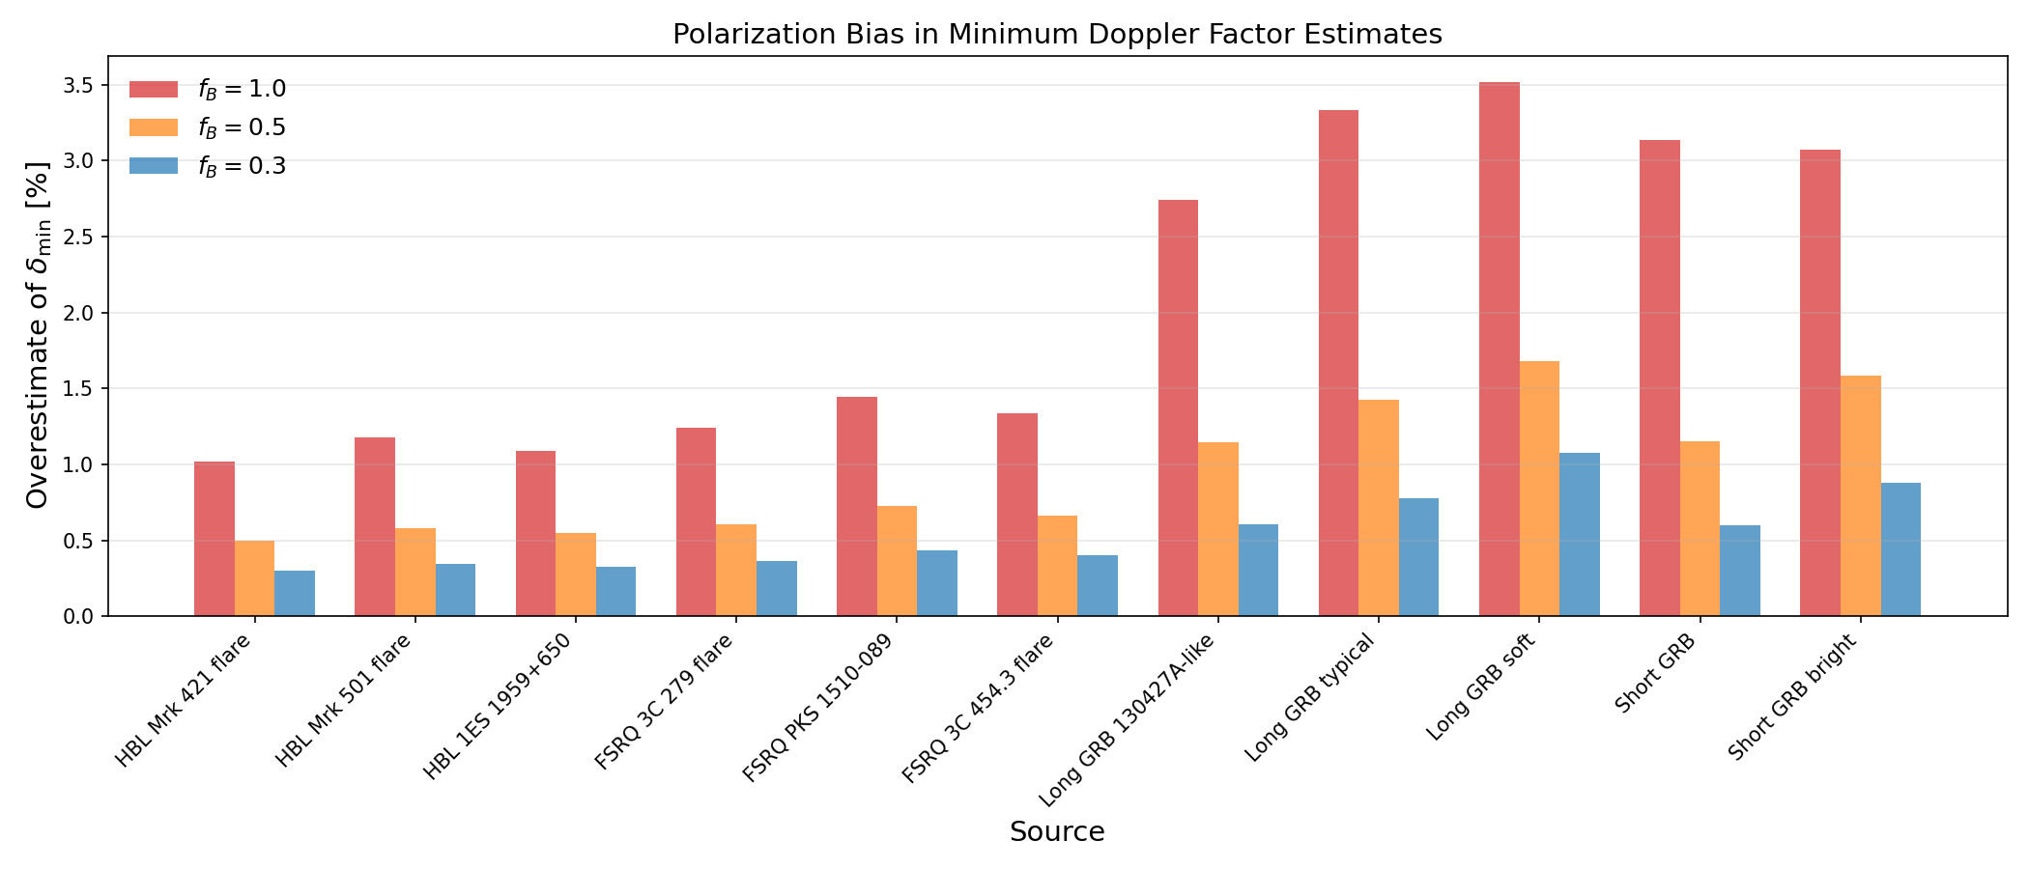
APPENDIX
Cutoff test (ε_{cut} = 1): bias by source
SLIDE 15/15
Notes:
Cutoff sensitivity run (εcut = 1), source by source. Same message as the previous slide: the bias falls with fB for every source; compared with the no-cutoff grid the GRB δmin values are lower by a factor of roughly 3.4–3.8 and the blazar values are essentially unchanged. The largest bias is long GRB soft (~3.5% at fB=1) in this run, versus long GRB 130427A-like (~3.3%) without a cutoff.

