Slide 1
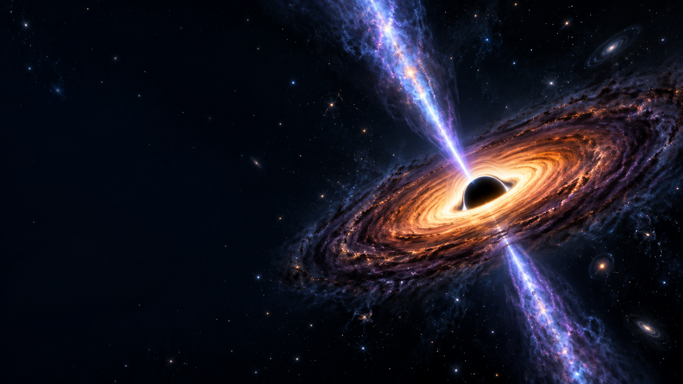



Time-Dependent Studies of Blazar Emission:
Insights from PKS 2155-304
Shruti Mukherjee | PhD Scholar
Prof. Brian Van Soelen | Prof. Markus Boettcher | Dr. Anna Luashvili
Dr. Michael Zacharias
The University of the Free State | North-West University
HEASA 2026 · 29 Sep – 2 Oct 2026
T: +27 788328857 | E: MukherjeeS@ufs.ac.za | www.ufs.ac.za

Slide 2
Outline
AGNs and Blazars
Scientific Motivation & Workflow
PKS 2155 – 304 : Multiwavelength analysis, state identification, projected modeling
Comparative view of flaring states and the quiescent state
Current Progress
Future Direction & Conclusions

Slide 3
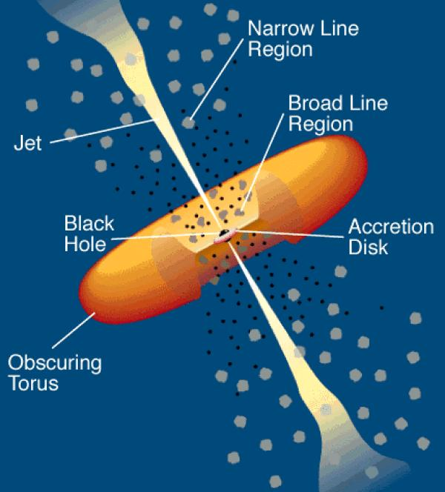
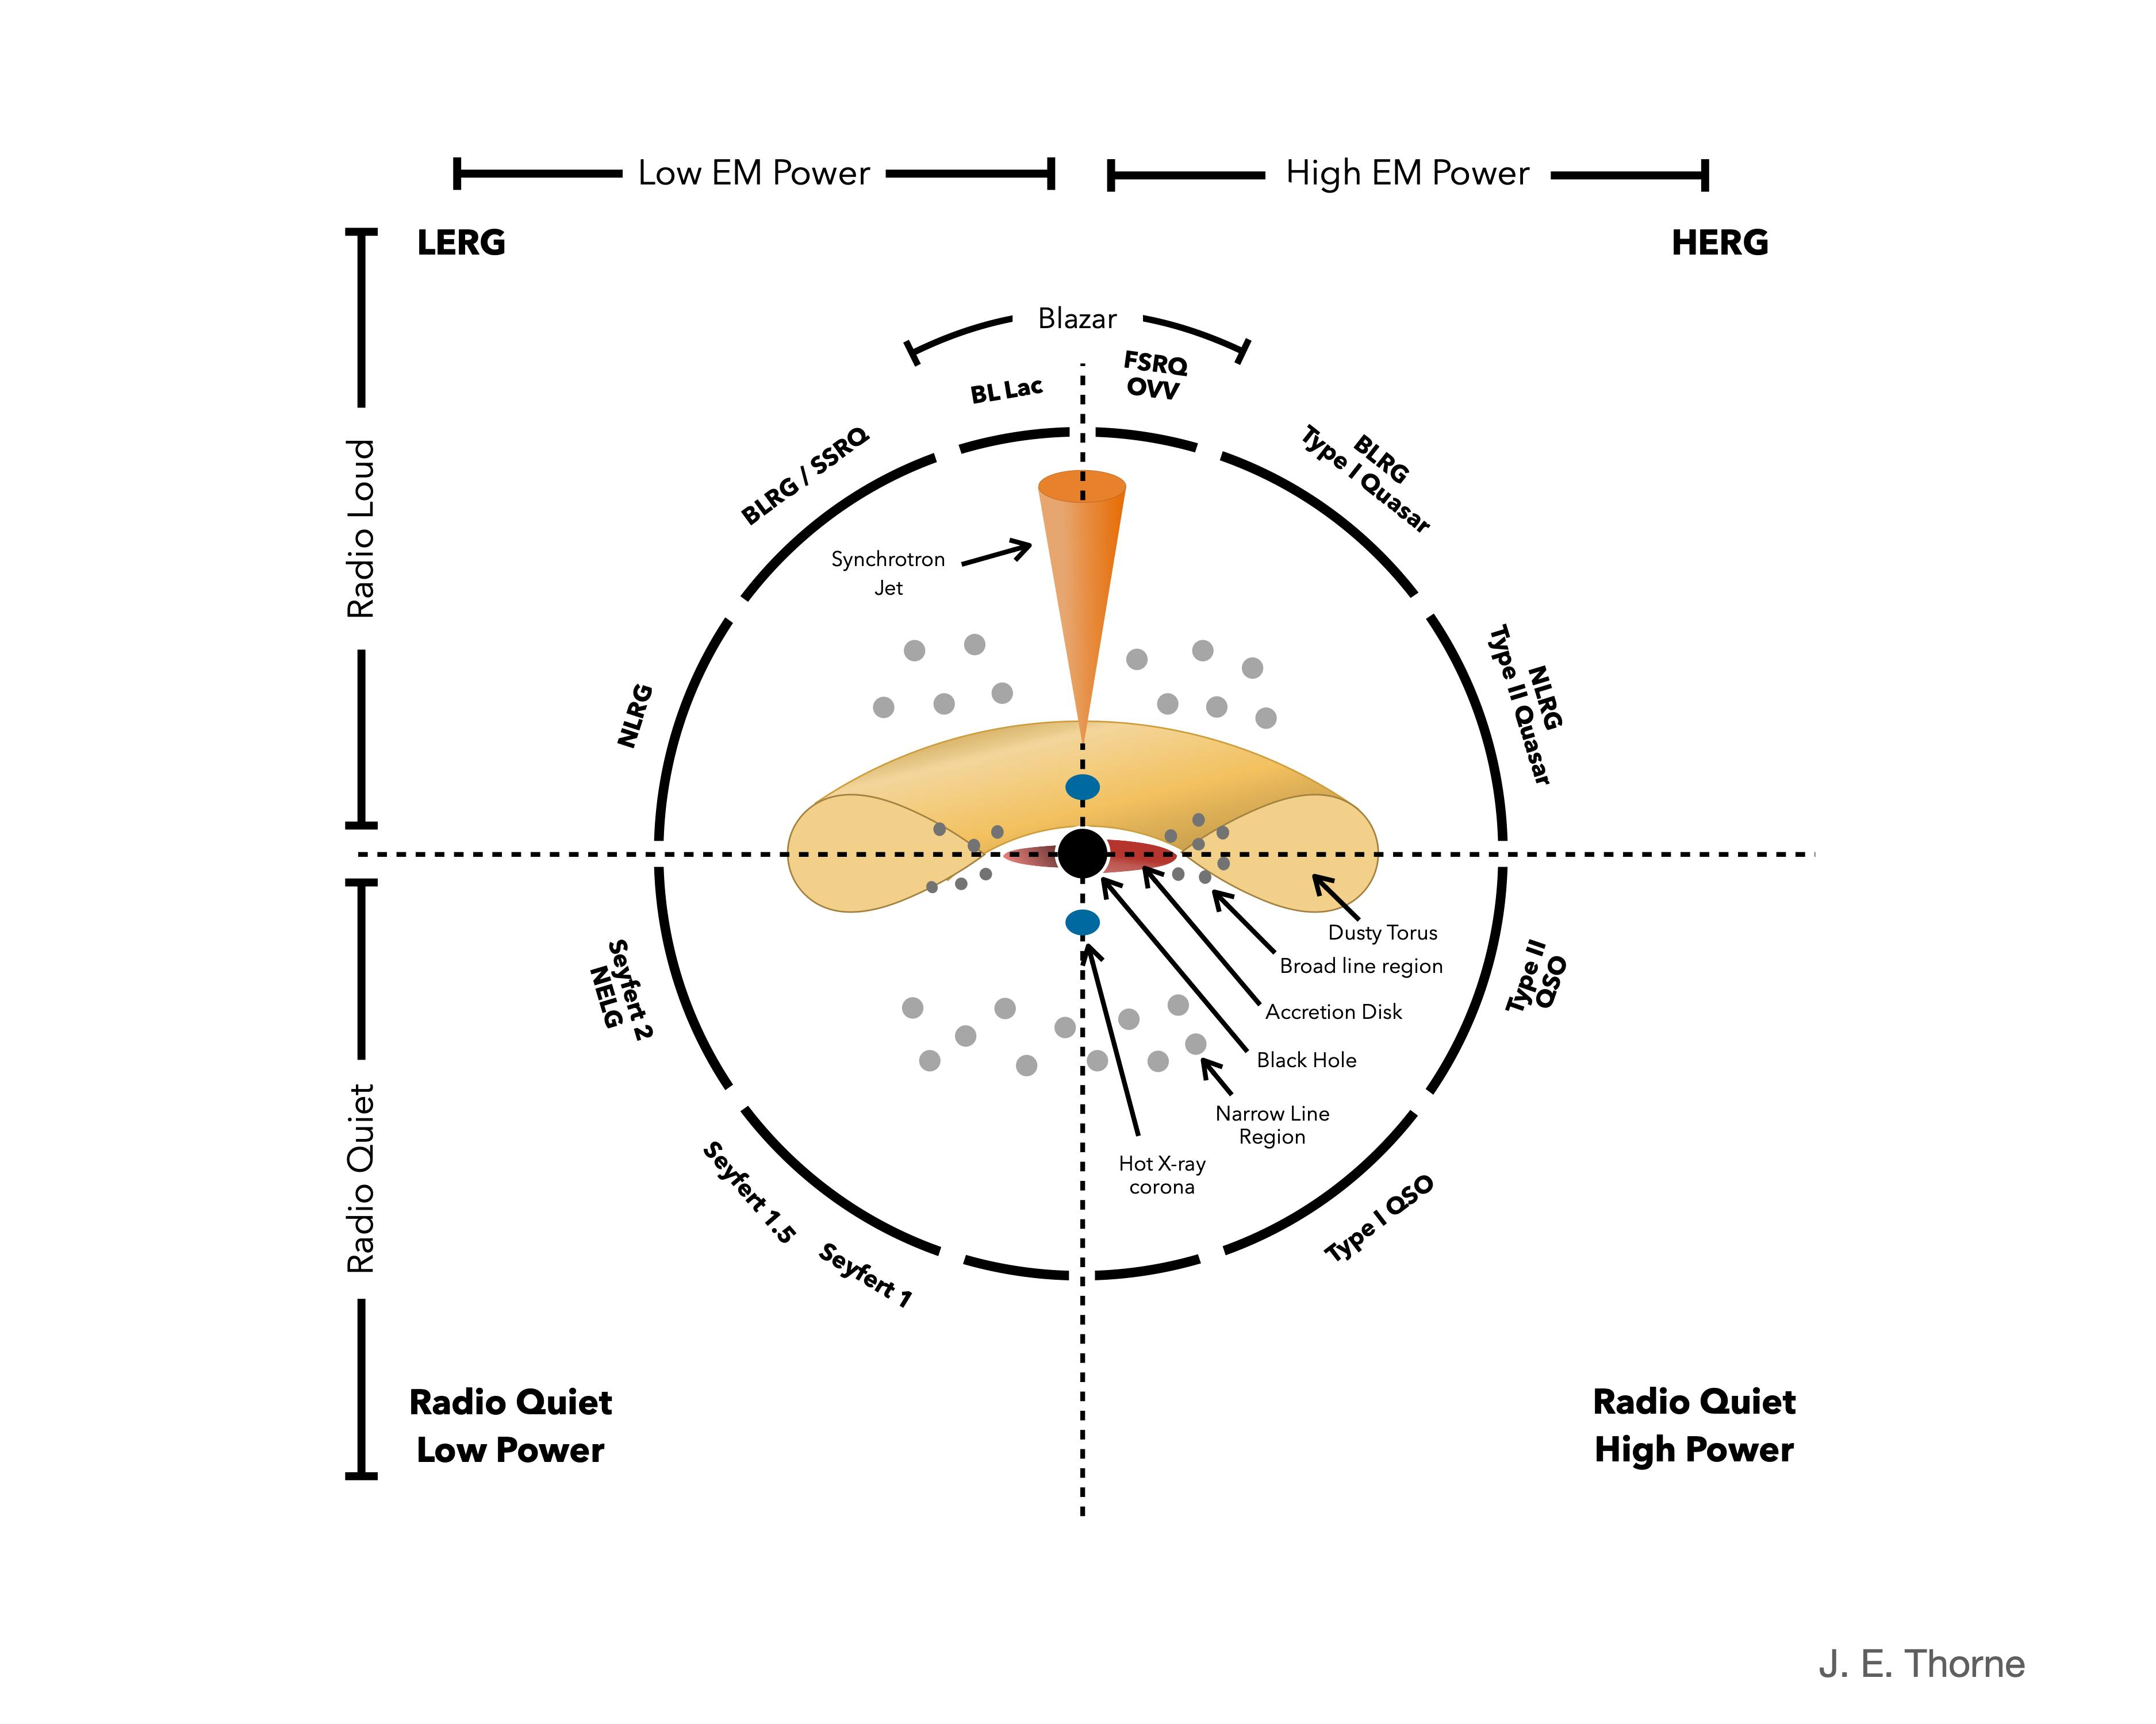
Active Galactic Nuclei (AGN)
Supermassive black hole (SMBH) + accretion disk
Broad Line Region (BLR)
Narrow Line Region (NLR)
Dusty Torus
Relativistic jets (radio-loud subset)
Blazars: jets closely aligned with the line of sight
Extreme flux variability across the electromagnetic spectrum
This work: PKS 2155-304 (BL Lac, HBL)

Slide 4
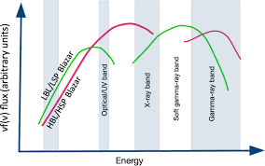
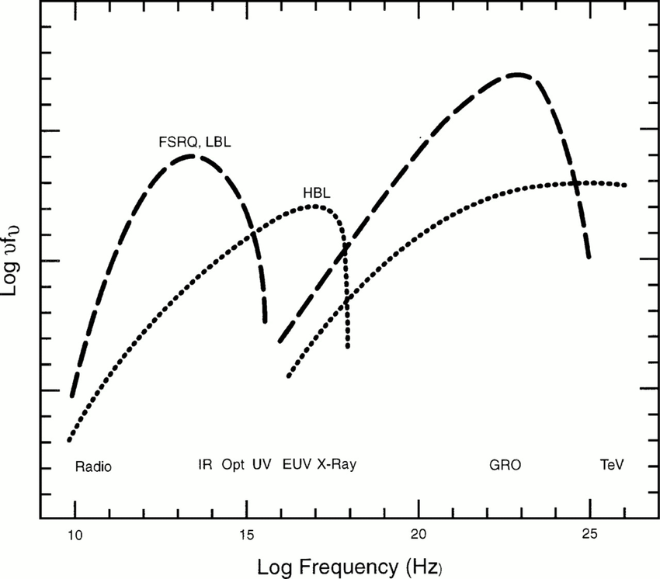
Broadband SEDs of BL Lacs & FSRQs
Synchrotron hump Radio to UV/X-ray - relativistic electrons in the jet B-field
Inverse Compton hump X-ray to γ-ray - up-scattered photons
BL Lac (HBL): Synchrotron peaks at UV/X-ray; IC dominated by SSC
FSRQ: Synchrotron peaks at radio/IR; IC dominated by EC from BLR and dust torus; broad emission lines visible

Slide 5
Why Variability Matters ?
Emission regions: Variability timescale constrains the size of the emitting region via causality: R ≲ cΔt δ/(1+z)
Particle acceleration: Flux rise times probe acceleration mechanisms: diffusive shock acceleration, magnetic reconnection
Radiative cooling: Decay timescales measure synchrotron and IC cooling rates, constraining B-field and particle energy
Jet dynamics: Correlated variability between wavebands tests the co-spatiality of emitting zones and jet structure
Multi-wavelength approach: Simultaneous coverage from γ-ray to optical breaks model degeneracies and yields unique physical parameters

Slide 6
Scientific Workflow
Multi-
wavelength
Data
Light
Curves
Bayesian
Blocks
HOP
Algorithm
Steady State
Resolved SEDs
Time-Dependent Modeling
→
→
→
→
→
Data: Fermi-LAT (γ-ray), Swift-XRT (X-ray), Swift-UVOT (UV/optical), Steward Observatory (optical), SMARTS
Bayesian Blocks: Change-point algorithm (Scargle et al. 2013) — objectively identifies flux transitions
HOP algorithm: Groups Bayesian Block states into discrete flaring and quiescent episodes by local flux topology
Time-dep. model: Kinetic equation for N(γ, t) — self-consistent SEDs and model light curves at each timestep

Slide 7
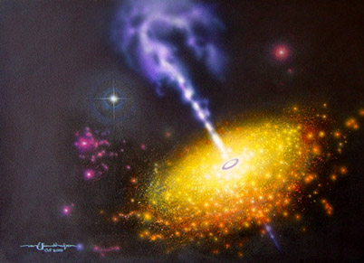
PKS 2155-304 – Source Overview
Classification: High-frequency peaked BL Lac (HBL)
Redshift: z = 0.116 (~500 Mpc)
Synchrotron peak: UV – soft X-ray
HE mechanism: Synchrotron self-Compton (SSC)
Significance: Among brightest and most variable blazars in the sky; benchmark TeV source
Dataset: Fermi-LAT, Swift-XRT, UVOT, SMARTS, Steward Observatory
Coverage: 2008 – 2018 (10 years)

Slide 8
PKS 2155-304 – MWL Lightcurves (2008-2018)
Fermi-LAT light curve of 10 days binning within the energy range of 0.1 – 300 GeV.
Swift-XRT light curve of 1000 sec binning within the energy range 0.1 – 10.0 keV.

Slide 9
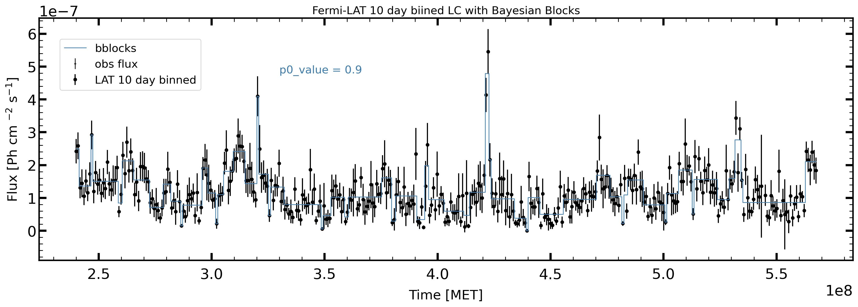
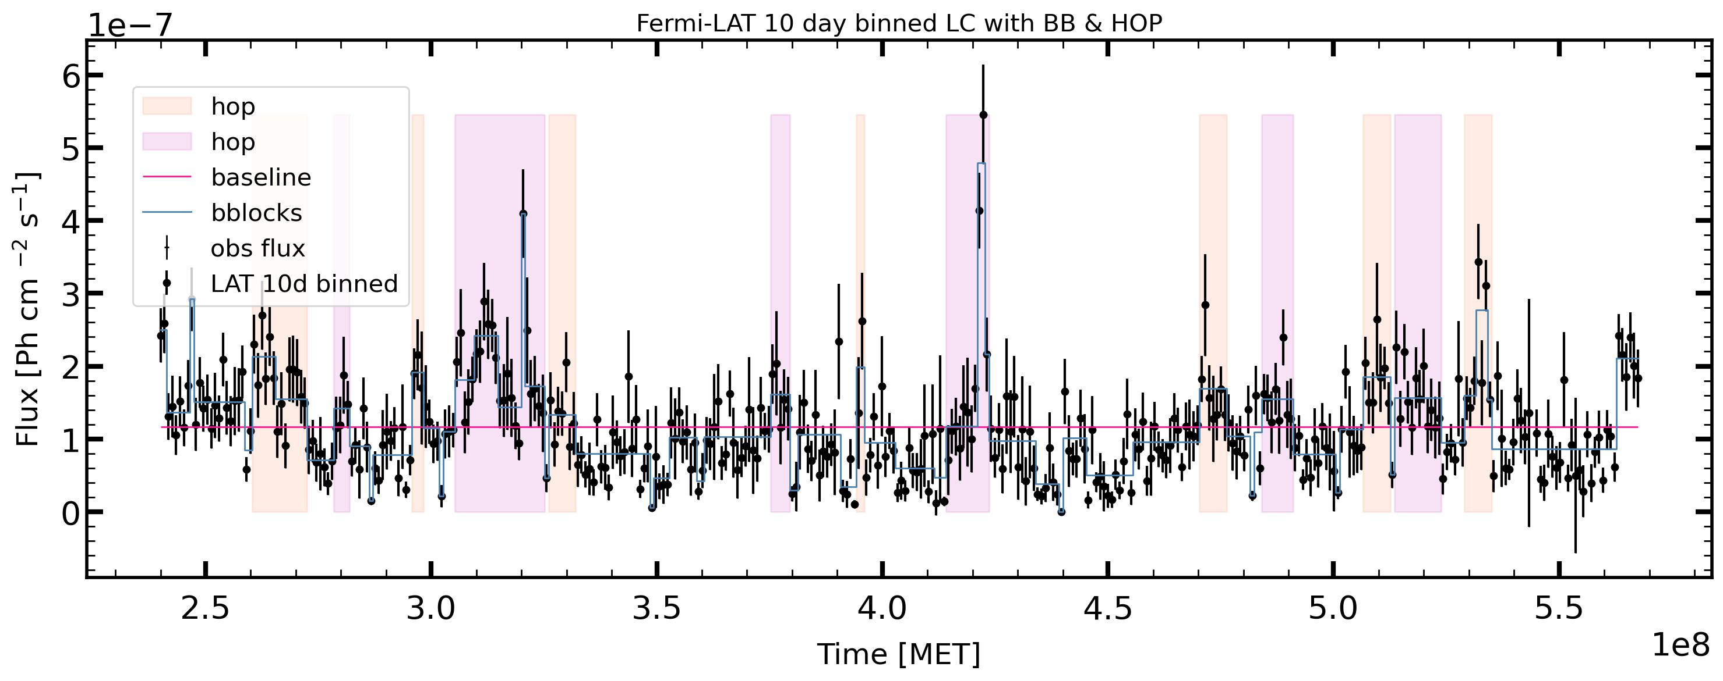
Bayesian Block & HOP Application – PKS 2155-304

Slide 10
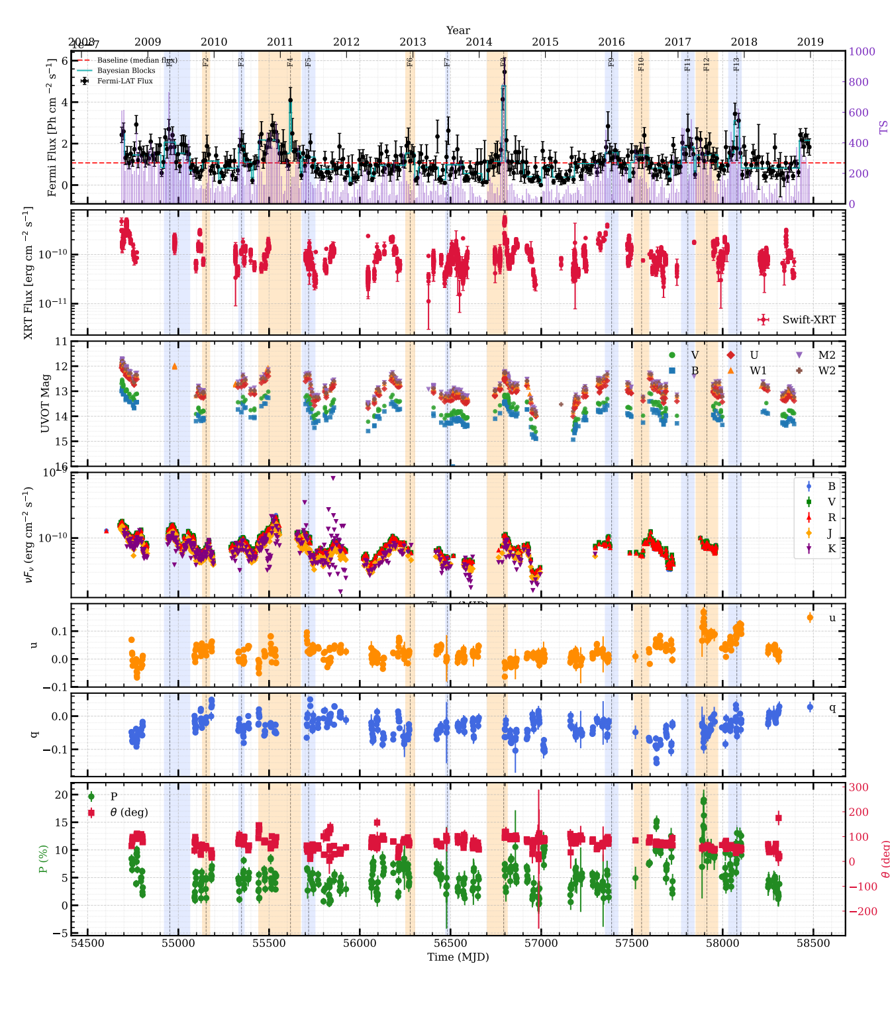
HOP Flare Identification – PKS 2155-304
• HOP algorithm groups Bayesian Block segments by local flux topology: identifies peaks and associates surrounding blocks into discrete flaring episodes.
• Output: catalogue of flaring and quiescent epochs, each with start/end MJD, peak flux, and mean flux — used to select steady-state & time-resolved SED epochs.

Slide 11
One zone Hadro-Leptonic Code (OneHaLe) ?
OneHaLe is a time-dependent, one-zone code for blazar emission; here we use its leptonic option.
A spherical emitting region contains relativistic electrons in a magnetic field and moves with bulk Lorentz factor Γ.
Electrons produce synchrotron radiation and upscatter those photons through synchrotron self-Compton (SSC) emission.
Electron inputs: γₑ,min, γₑ,max, injection index p, injection power Lₑ,inj, and acceleration/escape timescales.
Emission-region inputs: radius R, magnetic field B, Γ, and viewing angle θobs; these set the spectrum and Doppler boosting.
Variability limits the region size: R ≲ c Δt δ / (1 + z).

Slide 12
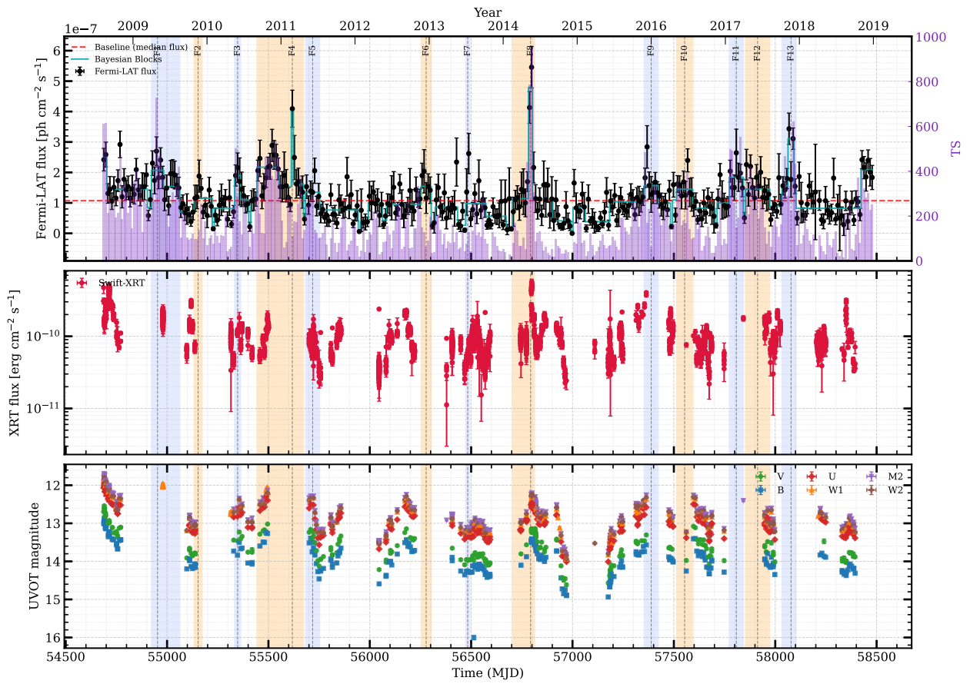
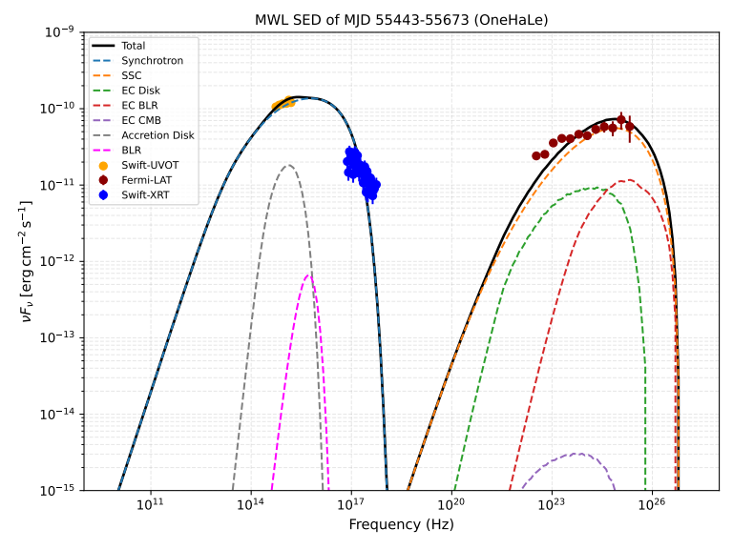
PKS 2155-304 – Steady-State SED (55443-55673)
B = 0.014 G; R = 4.80 × 10¹⁷ cm
Γ = 19.0; z = 0.116
θobs = 0.053 rad (3.01°)
γe,min = 3.00 × 10³
γe,max = 3.00 × 10⁵
P = 1.55; Le,inj = 3.00 × 10⁴¹ erg s⁻¹
tacc/tesc = 0.80; tesc = 15 R/c
MBH = 4.0 × 10⁹ M⊙
Ldisk/LEdd = 1.0 × 10⁻³
tvar ≈ 10.9 days

Slide 13
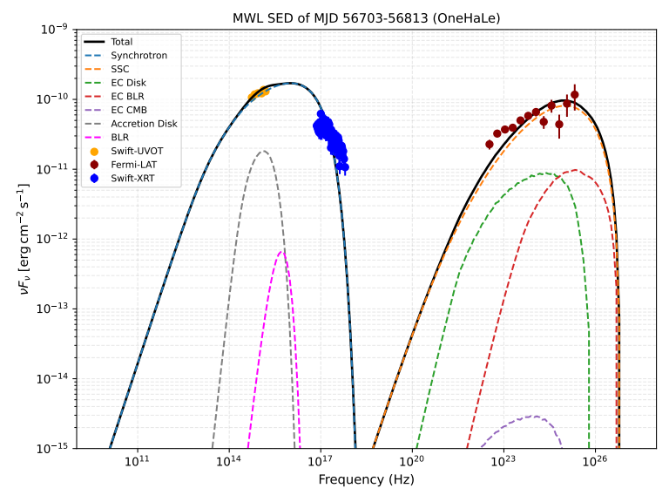
PKS 2155-304 – Steady-State SED (56703-56813)
B = 0.016 G; R = 4.00 × 10¹⁷ cm
Γ = 19.0; z = 0.116
θobs = 0.053 rad (3.01°)
γe,min = 3.00 × 10³
γe,max = 3.15 × 10⁵
P = 1.35; Le,inj = 3.65 × 10⁴¹ erg s⁻¹
tacc/tesc = 0.90; tesc = 15 R/c
MBH = 4.0 × 10⁹ M⊙
Ldisk/LEdd = 1.0 × 10⁻³
tvar ≈ 9.07 days

Slide 14
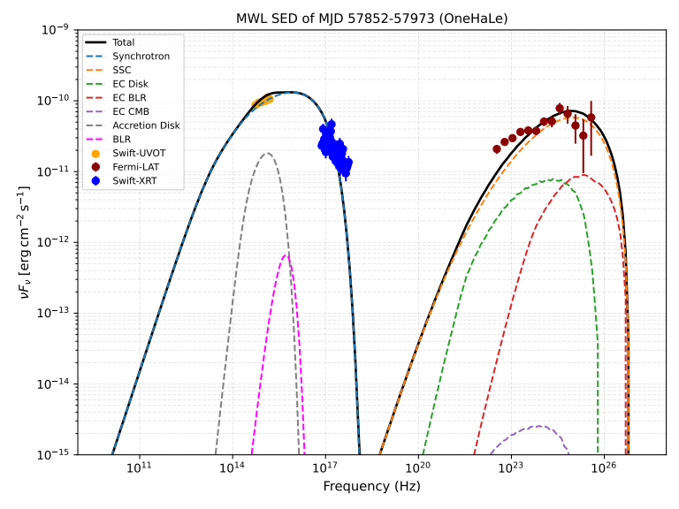
PKS 2155-304 – Steady-State SED (57852-57973)
B = 0.015 G; R = 4.00 × 10¹⁷ cm
Γ = 19.0; z = 0.116
θobs = 0.053 rad (3.01°)
γe,min = 3.00 × 10³
γe,max = 3.00 × 10⁵
P = 1.45; Le,inj = 2.85 × 10⁴¹ erg s⁻¹
tacc/tesc = 0.92; tesc = 15 R/c
MBH = 4.0 × 10⁹ M⊙
Ldisk/LEdd = 1.0 × 10⁻³
tvar ≈ 9.07 days

Slide 15
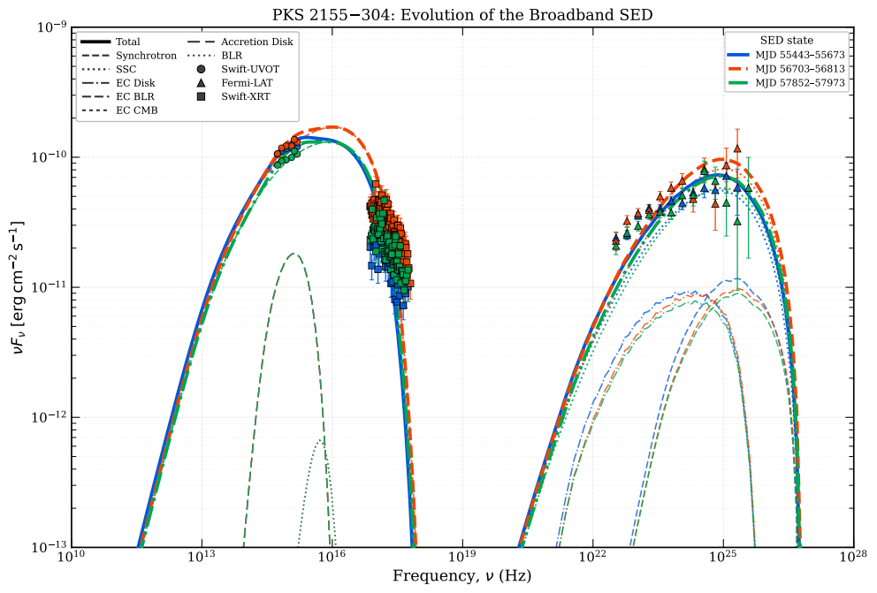
PKS 2155-304 – Steady-State SED (evolution of Fstate)

Slide 16
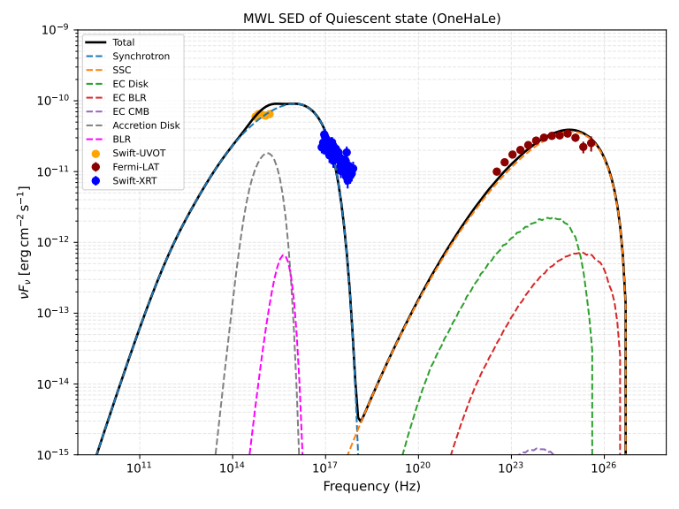
PKS 2155-304 – Steady-State SED (Q-state)
B = 0.018 G; R = 2.50 × 10¹⁷ cm
Γ = 20.0; z = 0.116
θobs = 0.05 rad (2.86°)
γe,min = 8.70 × 10²
γe,max = 2.90 × 10⁵
P = 1.35; Le,inj = 1.85 × 10⁴¹ erg s⁻¹
tacc/tesc = 1.5; tesc = 50 R/c
MBH = 4.0 × 10⁹ M⊙
Ldisk/LEdd = 1.0 × 10⁻³
tvar ≈ 5.39 days

Slide 17
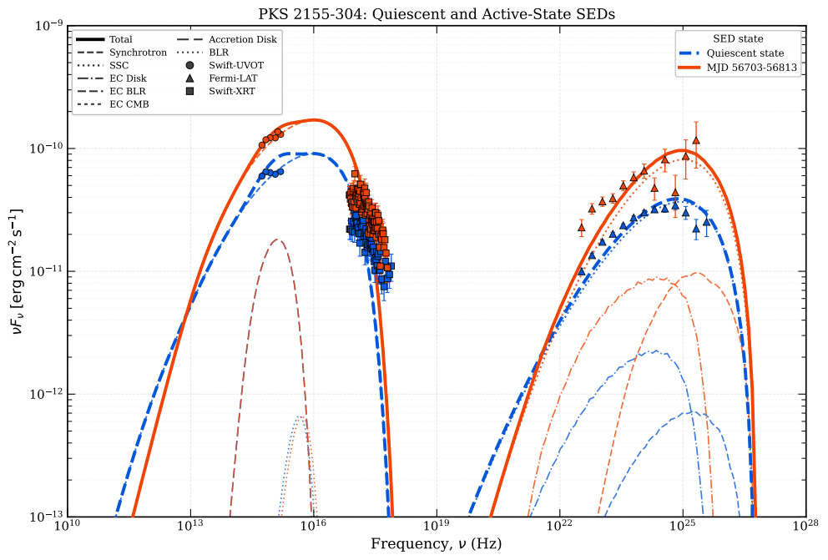
PKS 2155-304 – Steady-State SED (Fstate & Q-state)

Slide 18
PKS 2155-304 – Current Progress
✓ Multi-wavelength light curves (2008–2018)
✓ Bayesian Block analysis
✓ HOP flare identification
✓ Equilibrium SED modeled in F & Q states
⟳ Time-dependent SED + light curves modeling

Slide 19
Future Directions
CTA era: The Cherenkov Telescope Array will extend multiwavelength campaigns into the TeV band and help constrain electron cooling through rapid variability.
Population studies: Apply Bayesian Blocks, HOP, and time-dependent modeling to a blazar sample to compare the drivers of flux variability across sources.
Extending to VHE: Combine Fermi-LAT and archival H.E.S.S., MAGIC, and VERITAS data for PKS 2155-304 to constrain optical-to-TeV SEDs during flares.
Beyond one zone: Use H.E.S.S. VHE data to test a time-dependent leptonic code that couples diffusive shock acceleration with radiative transfer, especially where a one-zone SSC model cannot reproduce the TeV spectrum.

Slide 20
Conclusions
1. Multi-wavelength campaign: Ten-year (PKS 2155-304) datasets constructed from Fermi-LAT, Swift-XRT, Swift-UVOT, and Steward Observatory.
2. State identification: Bayesian Block analysis and HOP algorithm provide objective, statistically robust separation of flaring and quiescent epochs in both sources.
3. Steady-state modeling: PKS 2155-304: leptonic SED modeling across all identified states completed — EC/BLR dominates the γ-ray emission; physical parameters vary systematically between states.
4. Time-dependent modeling: Kinetic modeling (self-consistent SEDs + model light curves) underway for both sources — probing particle injection, cooling, and escape on flare timescales.

Slide 21
References
Unified Schemes for Radio-Loud Active Galactic Nuclei - arXiv:astro-ph/9506063
Modeling the emission processes in blazars – 10.1007/s10509-007-9404-0
Leptonic and Hadronic Modeling of Fermi-Detected Blazars - M. Böttcher et al 2013 ApJ 768 54
Very High Energy Gamma Rays from PKS 2155-304 - P. M. Chadwick et al 1999 ApJ 513 161
An Exceptional VHE Gamma-Ray Flare of PKS 2155-304 – Astrophys.J.664:L71-L78,2007
Characterizing the γ-ray long-term variability of PKS 2155-304 with H.E.S.S. and Fermi-LAT - https://doi.org/10.1051/0004-6361/201629419

Slide 22
Thank You
Questions & Discussion
MukherjeeS@ufs.ac.za | shruti0342@gmail.com
Fermi-LAT · Swift-XRT/UVOT · Steward Observatory Monitoring Program · SMARTS

