Slide 1

HEASA 2026

Slide 2

What is AfAS?
AfAS is an organisation of professional astronomers in Africa
AfAS is governed by a constitution
Vision: Create a globally competitive and collaborative astronomy community in Africa
Mission: To be the voice of astronomy in Africa and to contribute to addressing the challenges faced by Africa through the promotion and advancement of astronomy
AfAS is registered as an NPO (235-890 NPO) / NPC (2020/223188/08)
The secretariat is hosted by South Africa through the Department of Science and Innovation (DSI) and is based at the South African Astronomical Observatory (SAAO).
Notes:
“AfAS is the professional society for astronomers across Africa.
Our role is to connect the African astronomy community, strengthen collaboration between countries, and represent African astronomy internationally.
Our vision is to build a globally competitive and collaborative astronomy community in Africa.
Beyond scientific research, we also focus on how astronomy can contribute to education, technology development, innovation, and socio-economic growth across the continent.

Slide 3









Our Objectives
Strengthening the teaching of science, technology, engineering and mathematics in schools and the public through the use of astronomy and related fields
Using astronomy to attract African youth into Science, Technology, Engineering and Mathematics careers
Increasing the number of African astronomers as well as the number of astronomers working in Africa
Facilitating the use of existing international astronomical facilities, and, where necessary, the development of new astronomical facilities in Africa
Encouraging the use of astronomy for socio-economic development
Cultivating and supporting collaboration among countries in Africa as well as collaborations between Africa and the rest of the world
Encouraging governmental and intergovernmental (AU) investment in astronomy related activities
Inspiring and retaining underrepresented groups to study astronomy
Notes:
Our objectives focus on three major areas.
First, strengthening astronomy research and infrastructure across Africa.
Second, developing human capacity, especially attracting young people into STEM fields through astronomy.
And third, promoting collaboration both within Africa and internationally.
We also place strong emphasis on inclusion, particularly increasing participation of women and underrepresented groups in astronomy

Slide 4
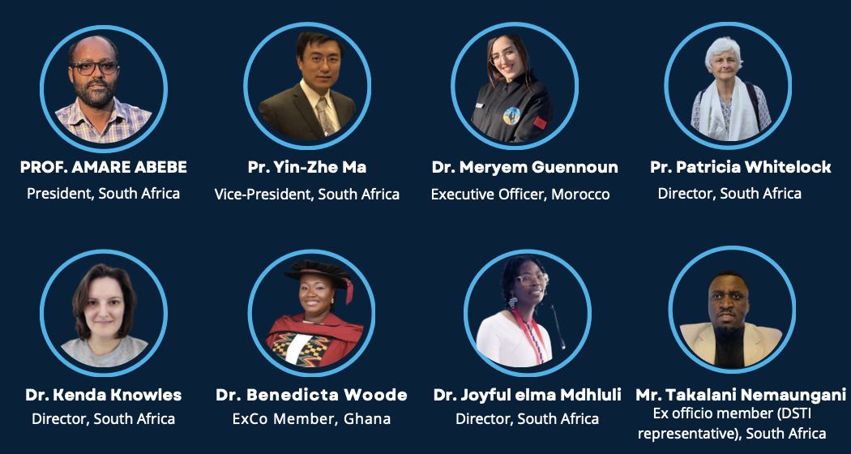
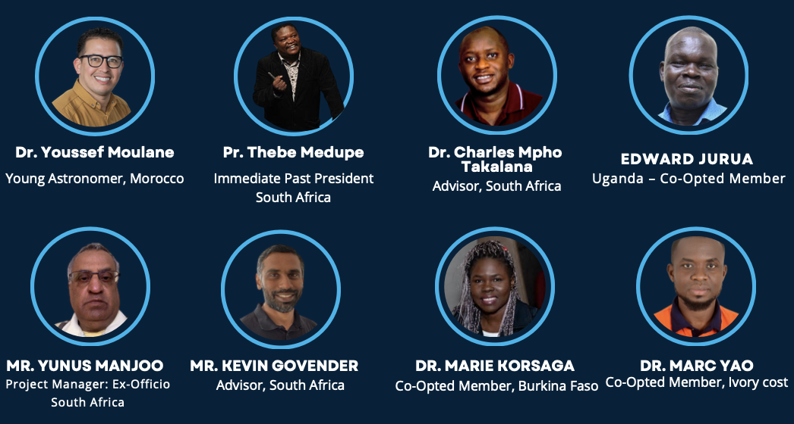
AfAS Structures: Executive Committee
Notes:
AfAS operates through an Executive Committee composed of members from different countries across Africa. This structure ensures broad continental representation and allows the Society to reflect the diversity of the African astronomy community.

Slide 5
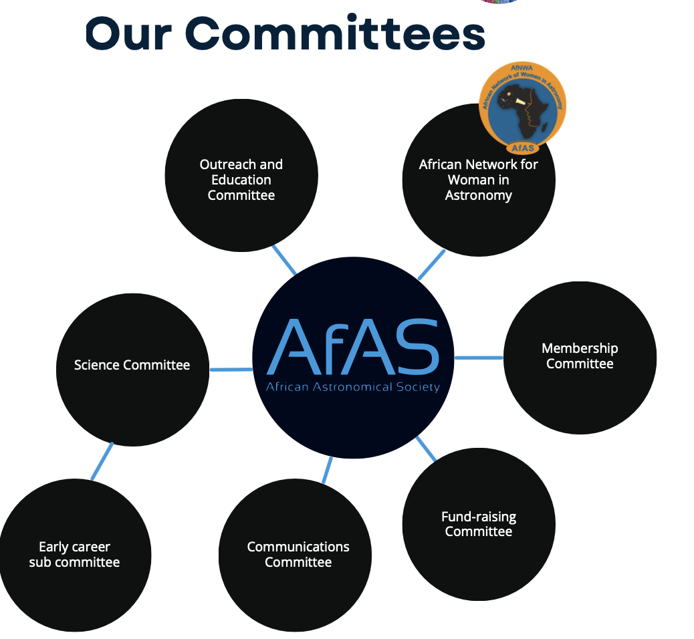


AfAS Structures: Committees
Notes:
AfAS also operates through several thematic committees covering areas such as science, outreach and education, membership, communication, and fundraising. In addition, the Society supports major initiatives and umbrella projects, including APA and AERAP.

Slide 6
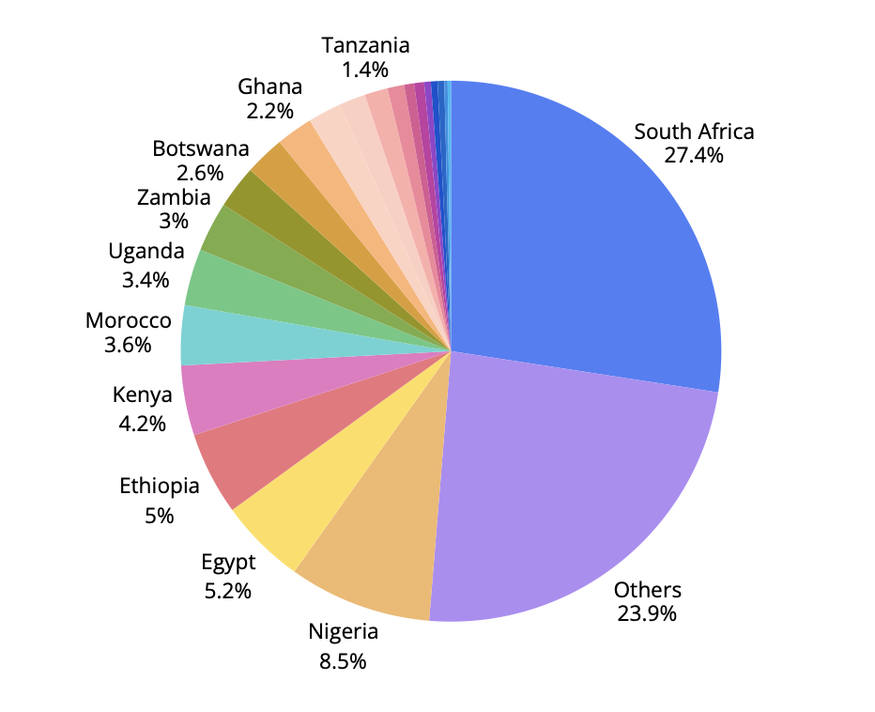
AfAS membership
Notes:
AfAS membership has grown significantly in recent years, with more than 500 members across Africa and over 120 international members. While the largest membership base is in South Africa, the Society is seeing increasing participation from countries across all regions of the continent.

Slide 7
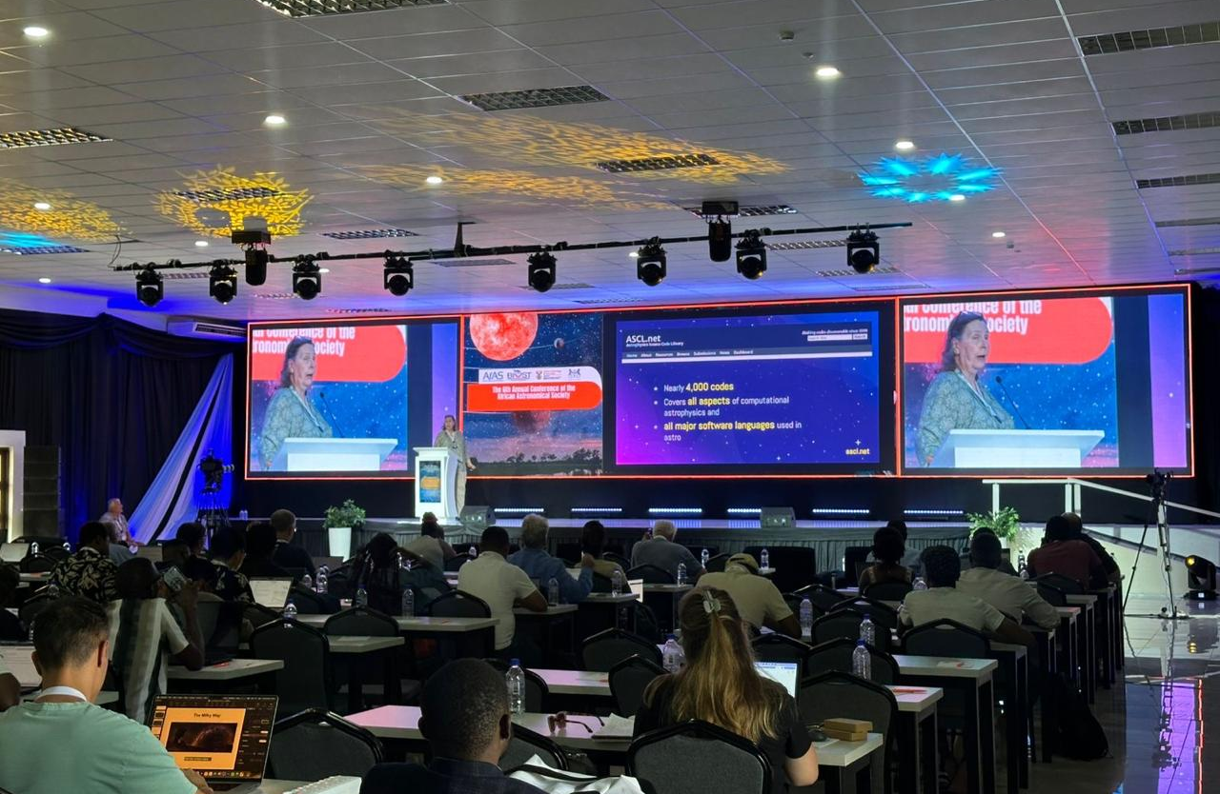
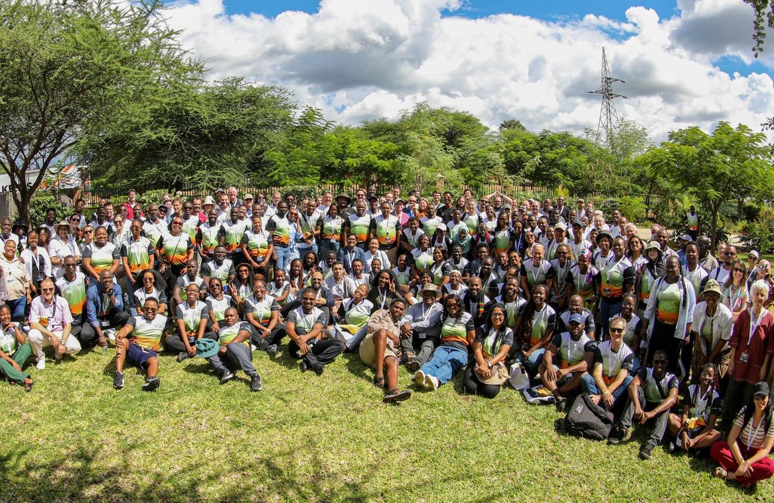
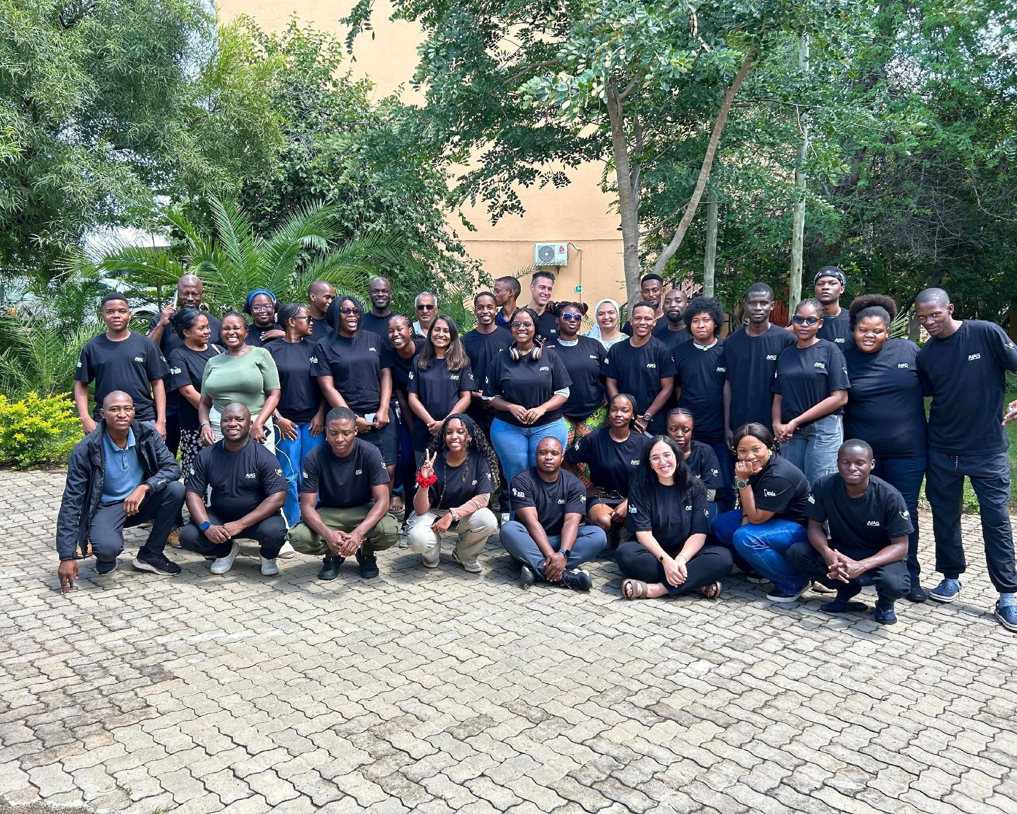
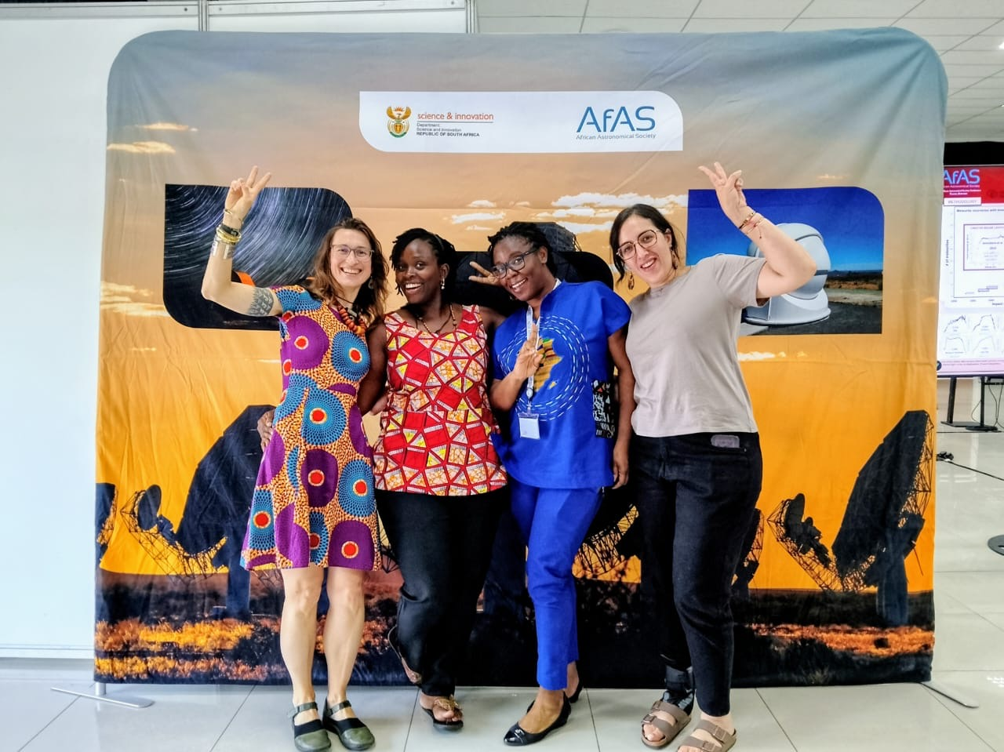
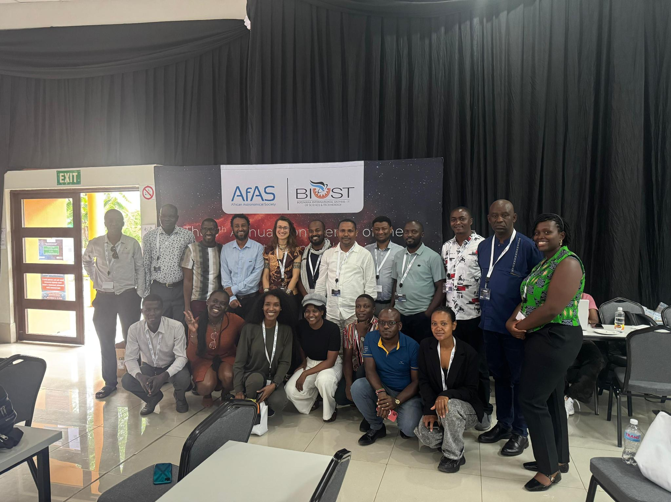
Notes:
One of AfAS’s main activities is the annual AfAS conference. This year, the conference was held in Botswana, following the 2024 edition in Morocco. The conference rotates across different African countries to promote inclusivity and continental participation, alternating between South Africa and other regions of Africa.

Slide 8

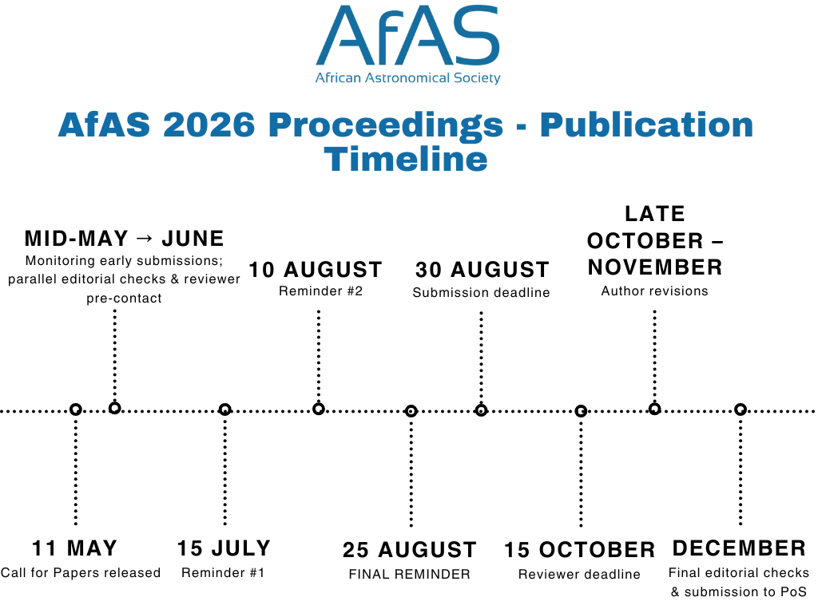
Notes:
With this year’s conference, AfAS is also launching the AfAS Conference Proceedings for the first time. This is a new initiative currently in progress, and we have just started receiving submissions.

Slide 9
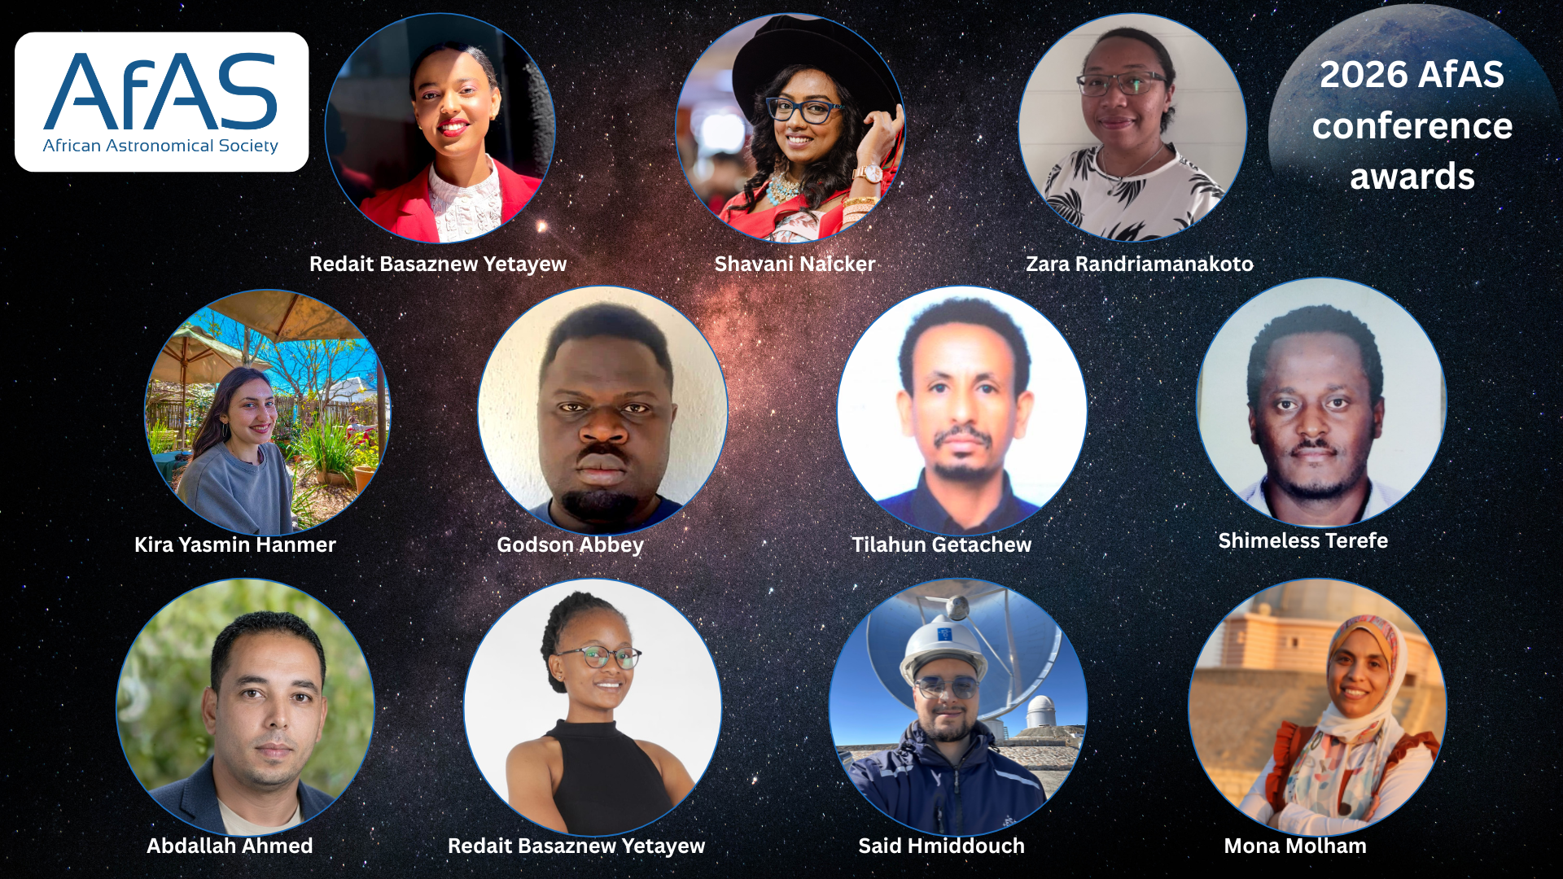
Notes:
During the conference each year, AfAS provides awards for Master’s and PhD students, seed grants for early-career researchers, and AfNWA awards. The goal is to support young scientists and encourage research excellence

Slide 10
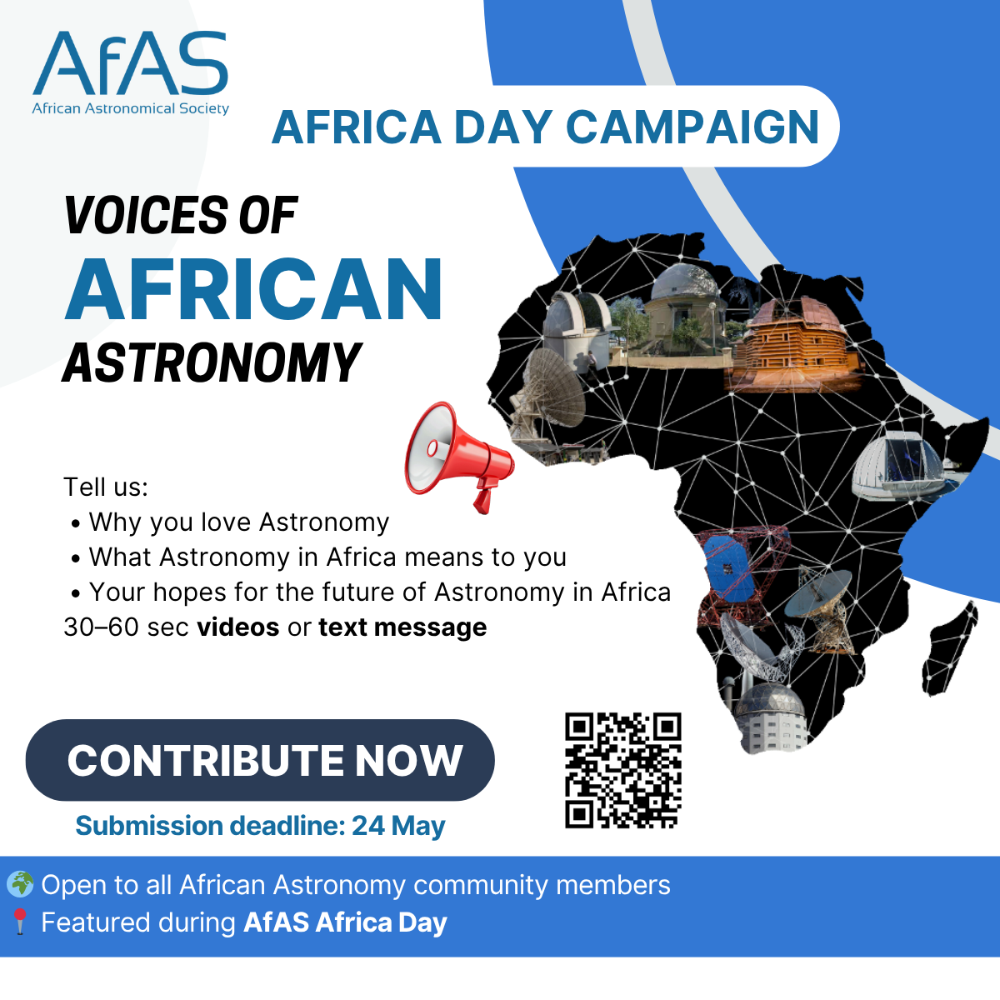
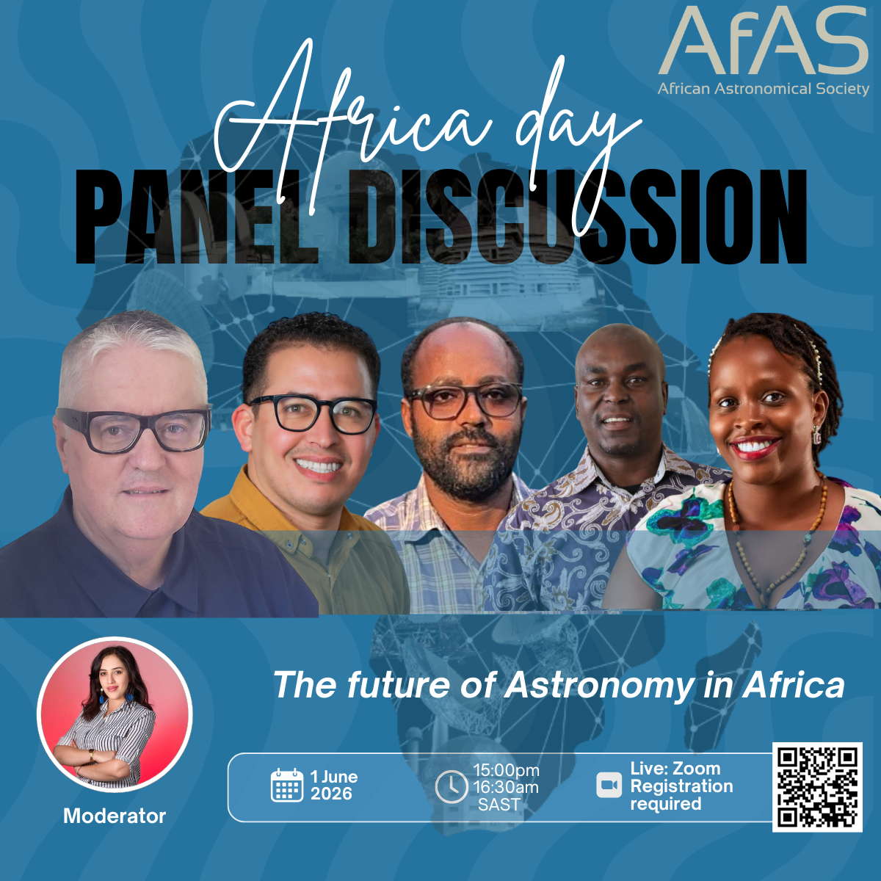
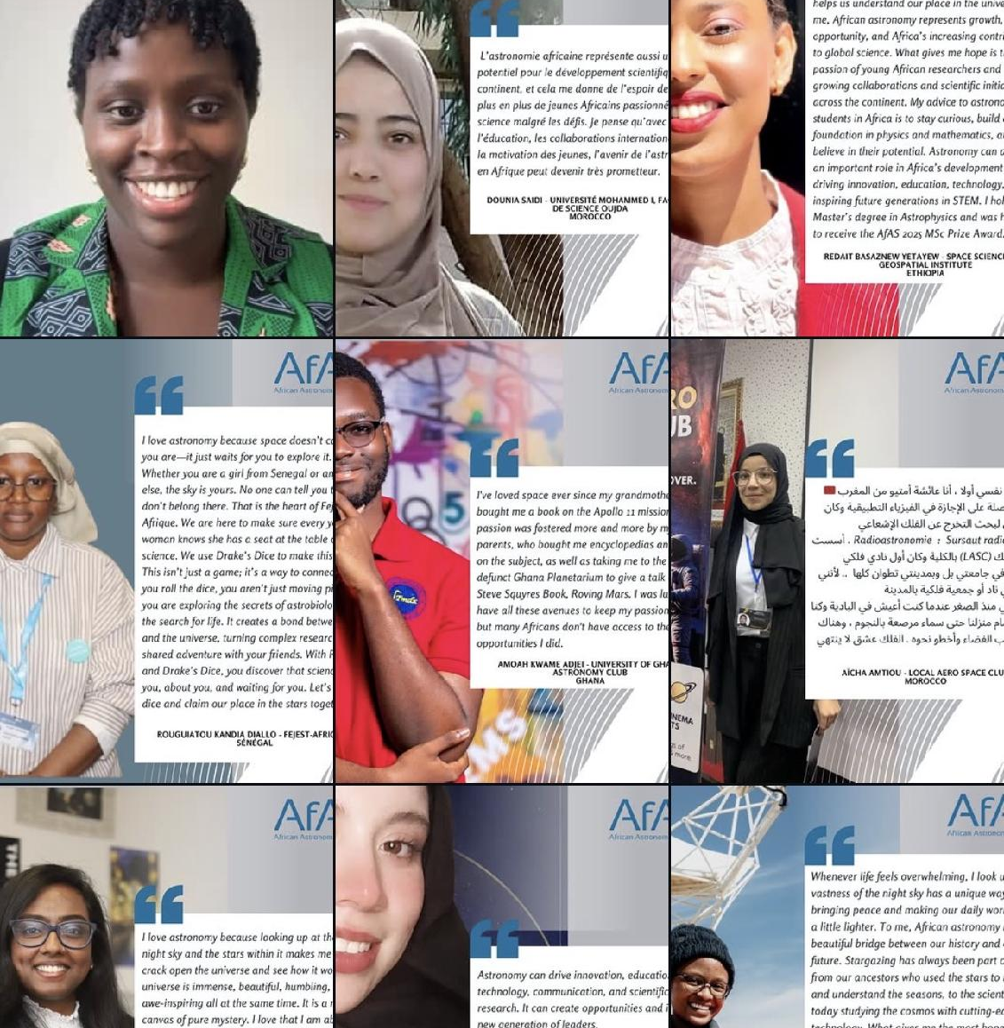
Africa Day Celebration – May2026

Slide 11
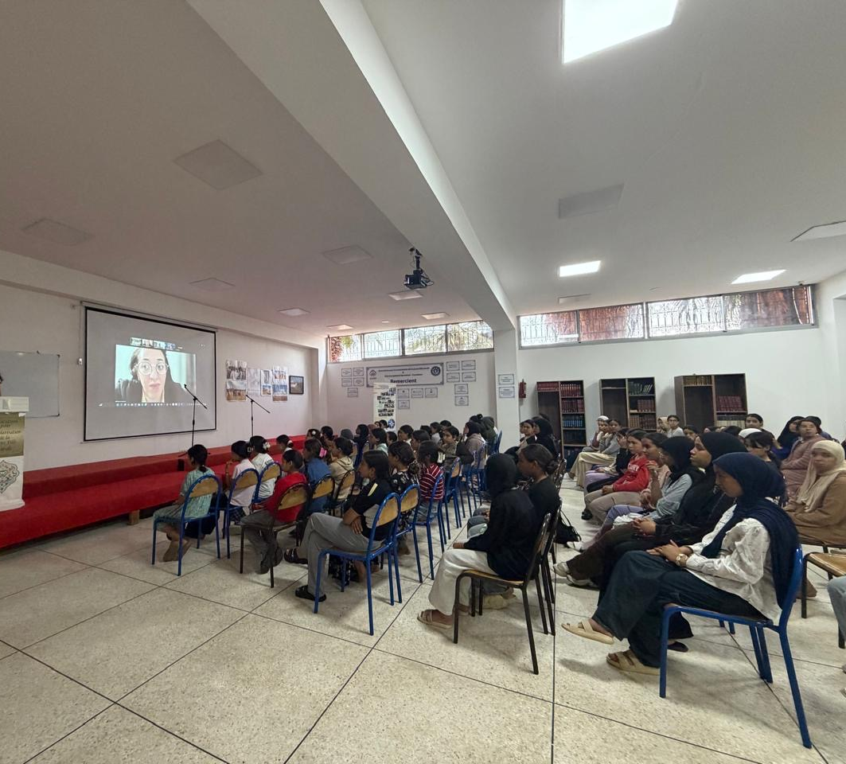
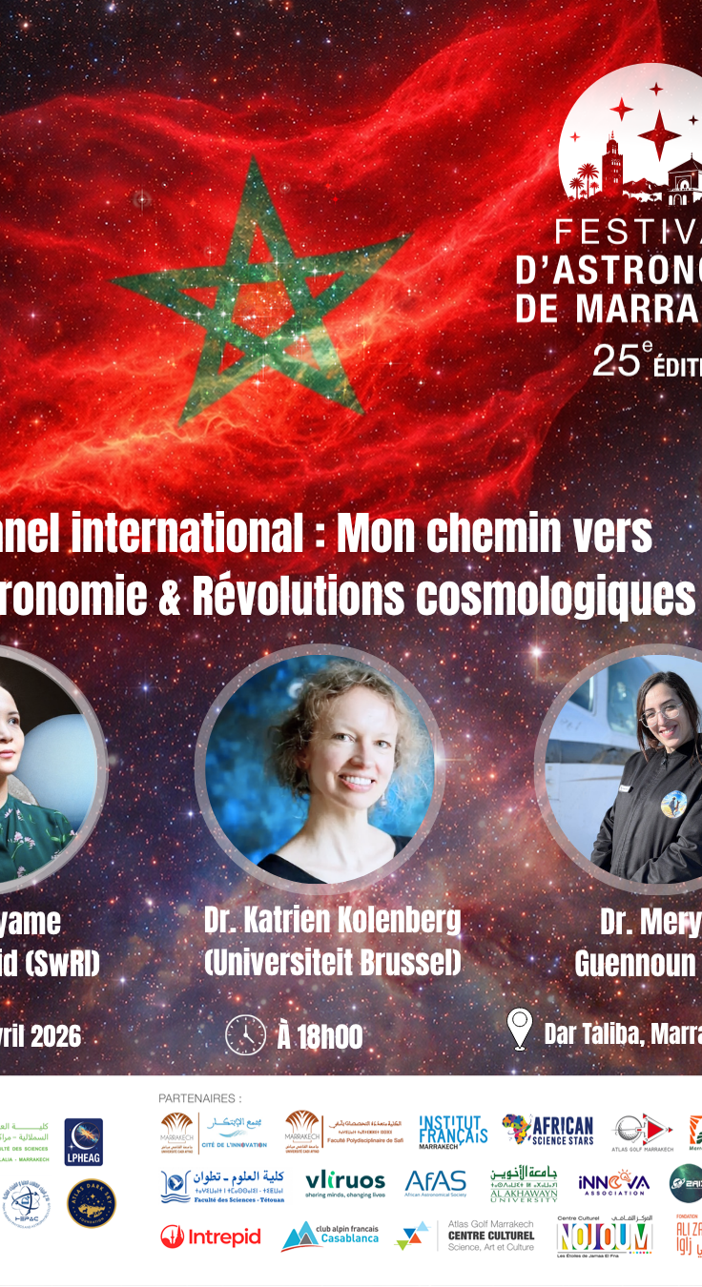
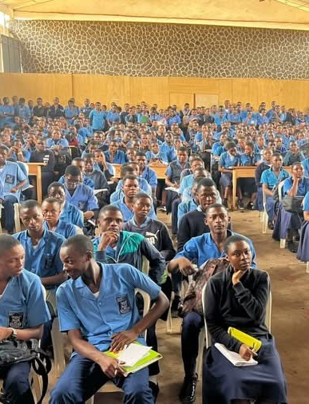
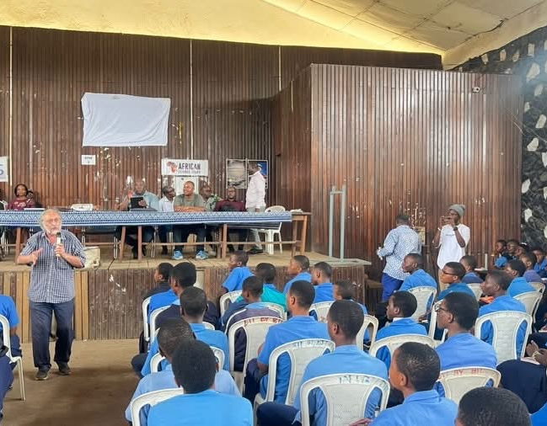

Notes:
AfAS also focuses strongly on outreach across Africa, inspiring young people to pursue careers in astronomy, science, and technology, and showing how astronomy can support education and development.

Slide 12
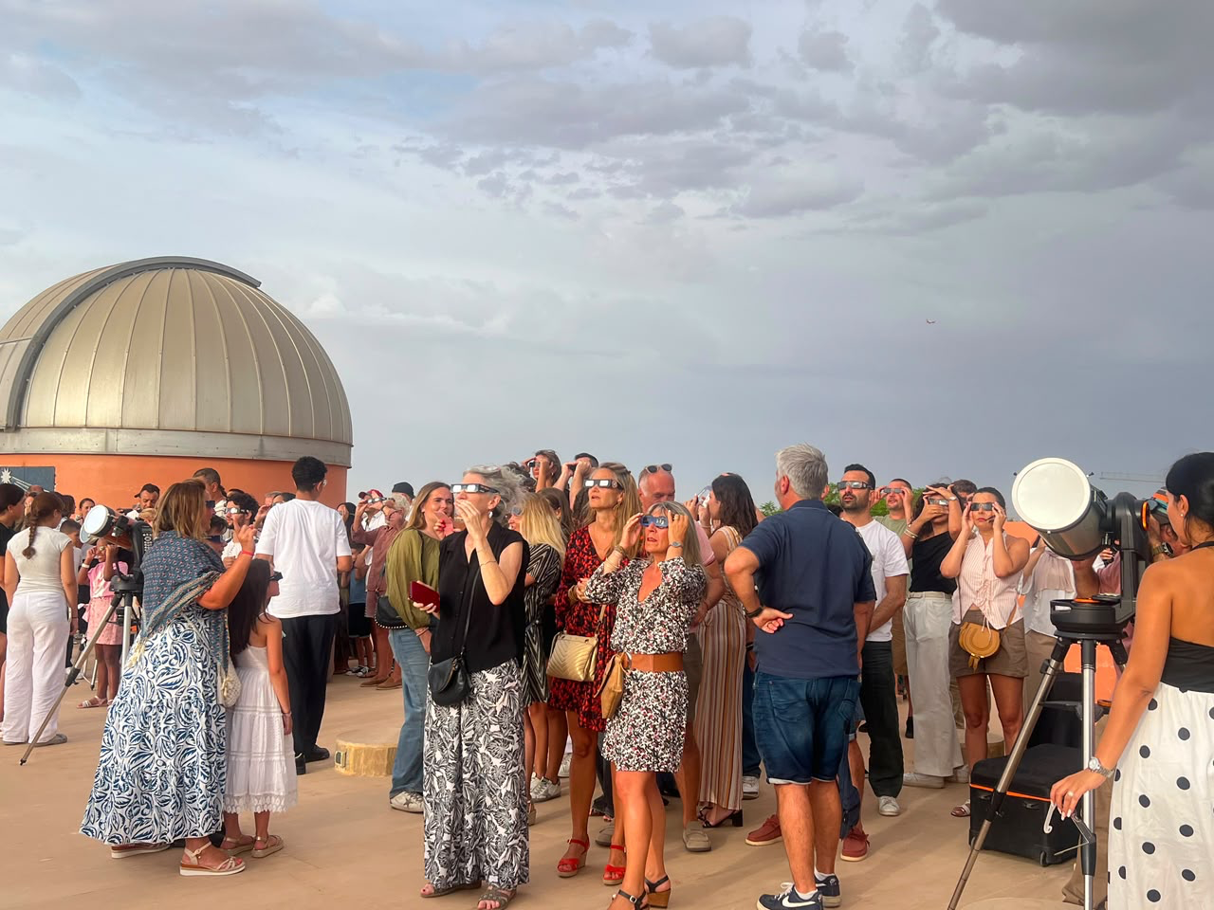
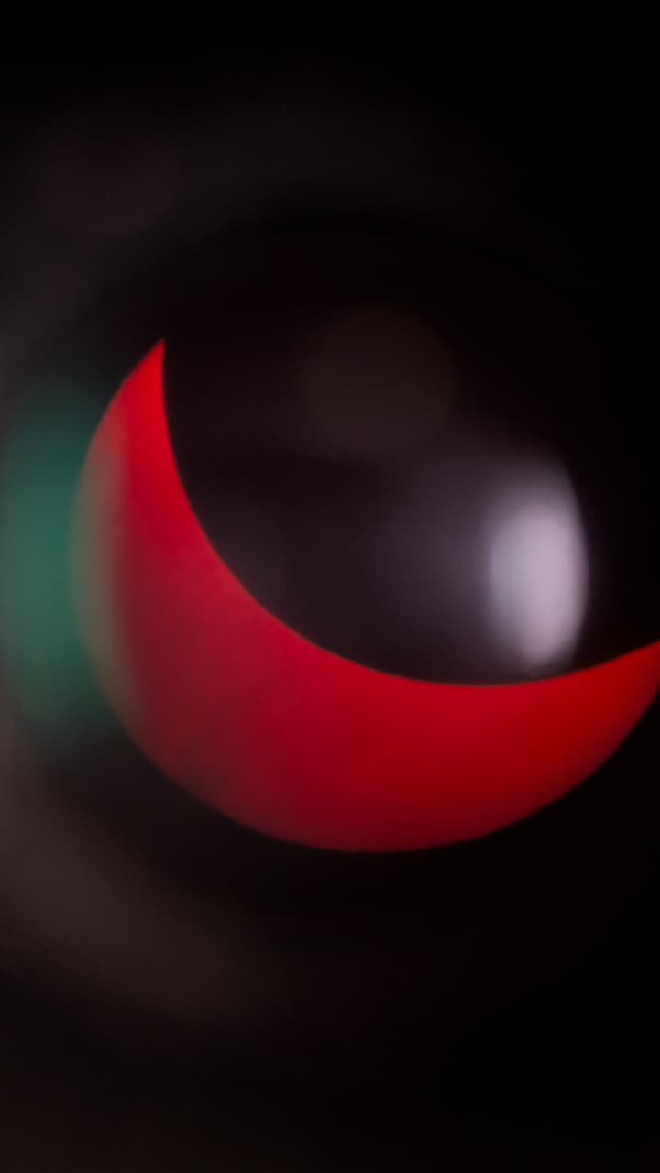
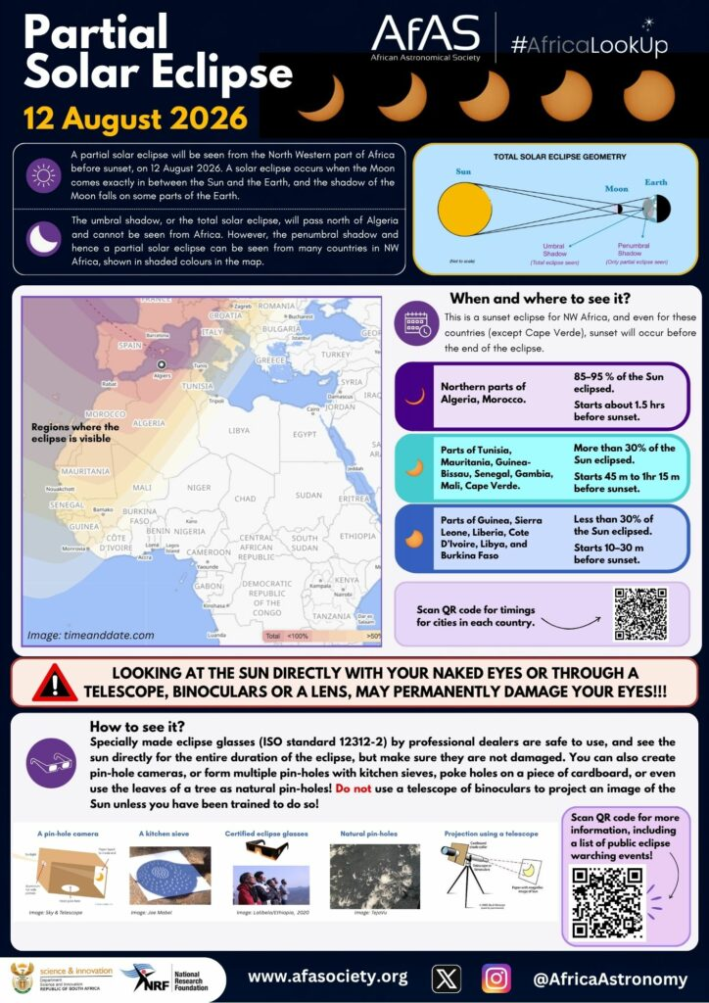
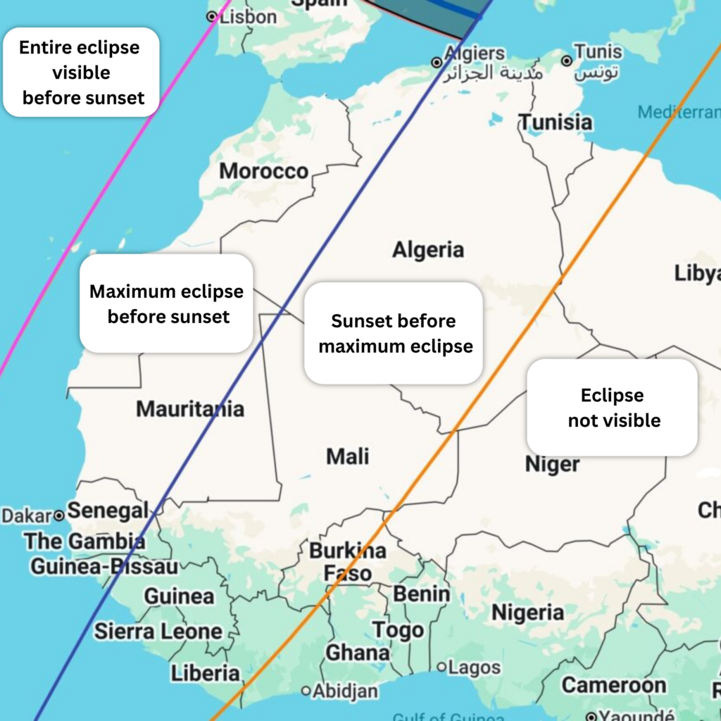
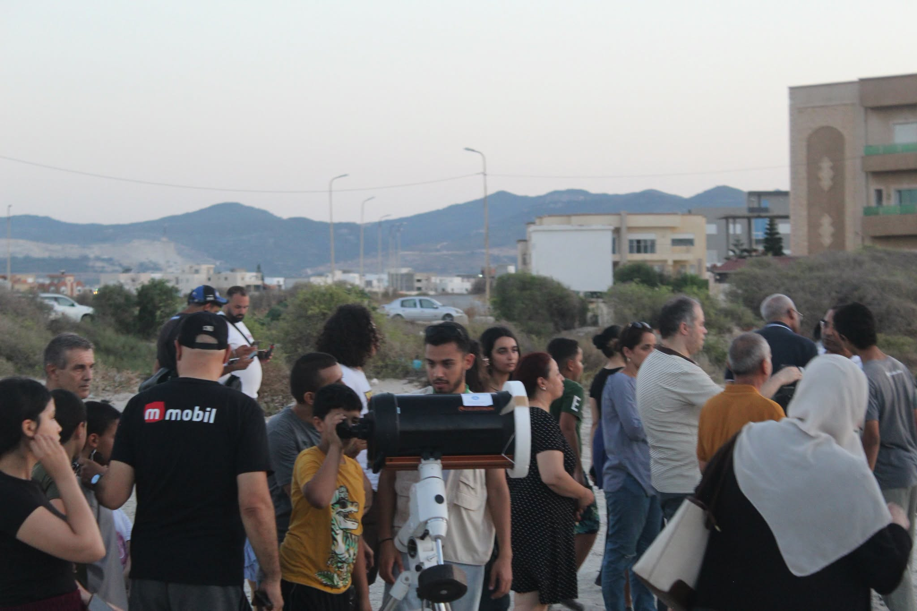
#AfricaLookUp
Notes:
12 August solar eclipse we prepared resources in English, French and Arabic, including information on visibility and timing across different African countries.
But we see this as something that could grow beyond one eclipse. We are already looking ahead to the next two solar eclipses in February and August 2027, and we would like to explore how we can make this more useful and more collaborative across Africa.
So I wanted to bring this idea here, because I’d be very interested in hearing from people who might want to contribute resources, share events, help with translation, outreach, or develop the project further with us.

Slide 13
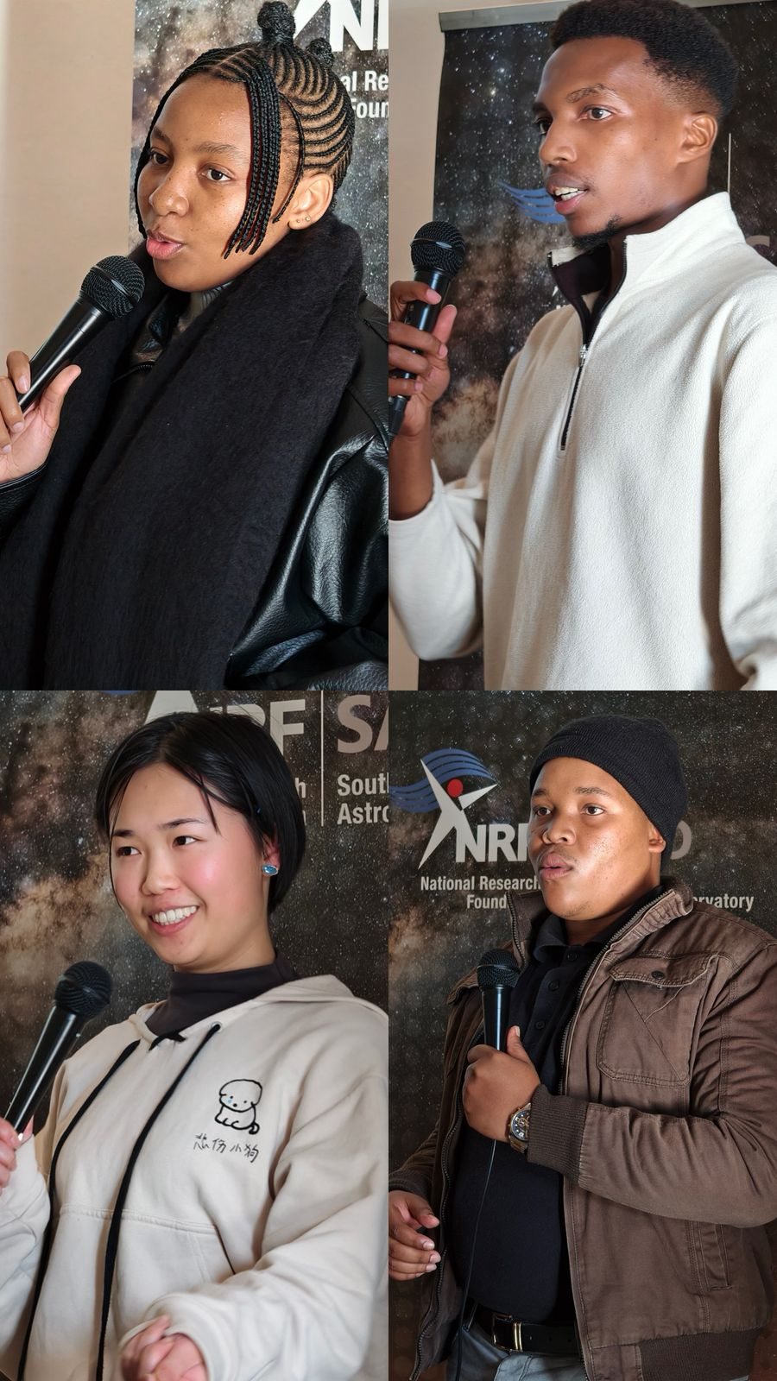
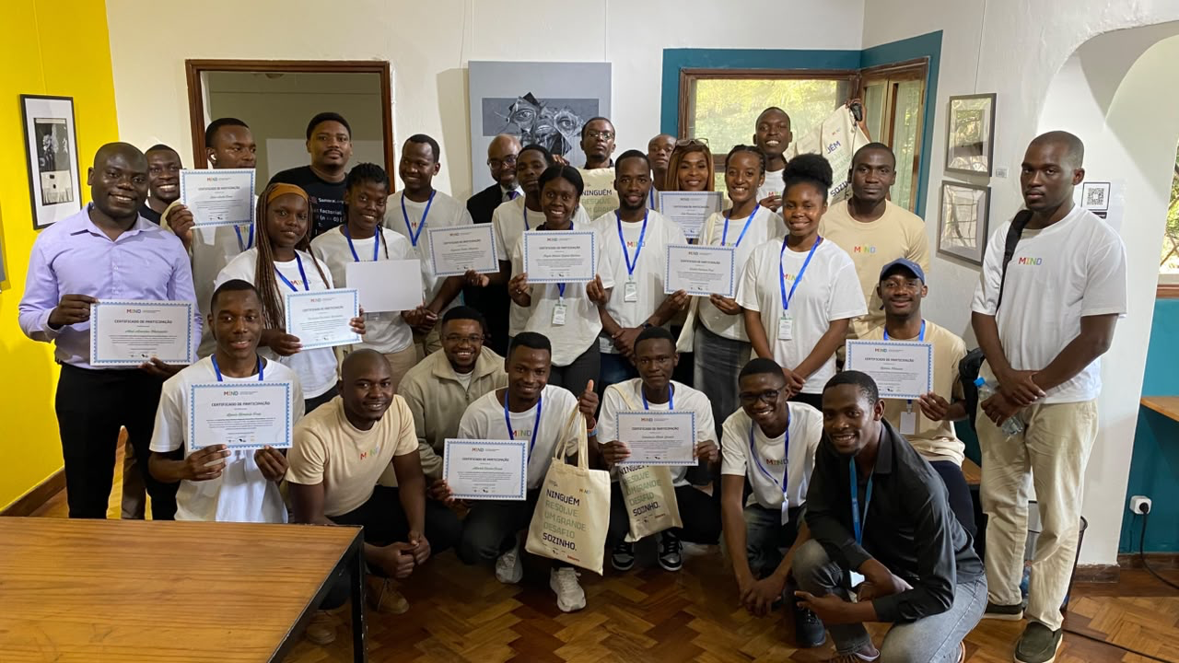
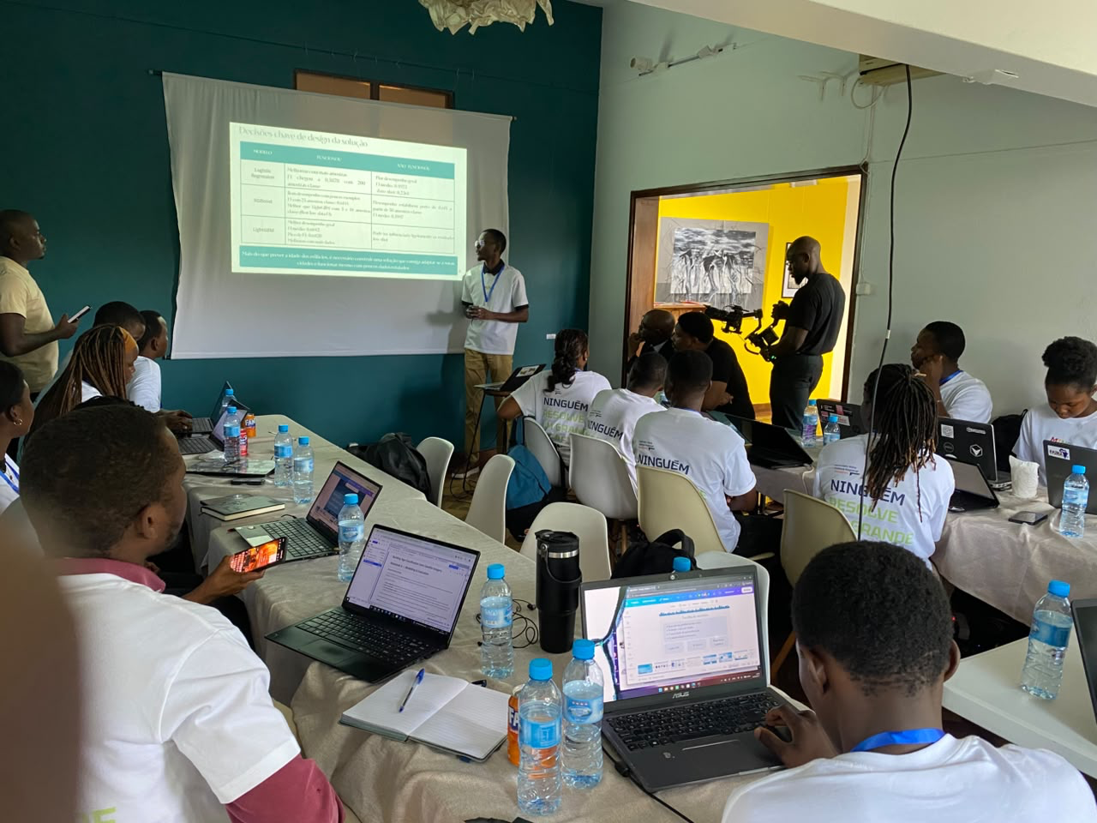


Slide 14
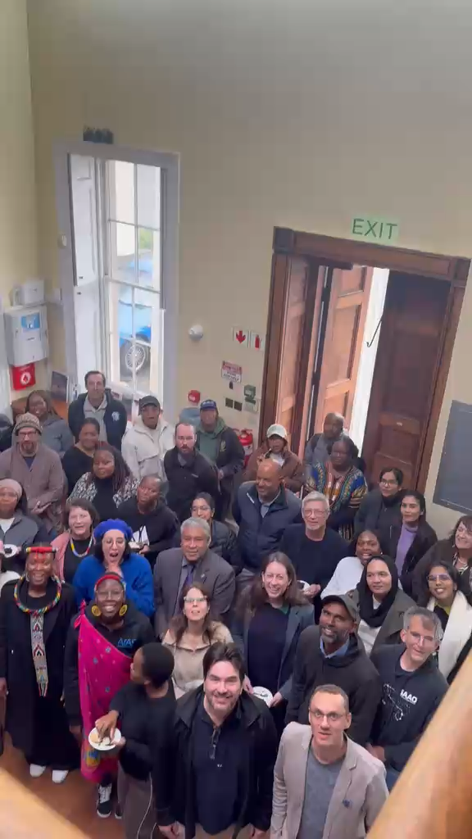

Slide 15
Thank you

