Slide 1
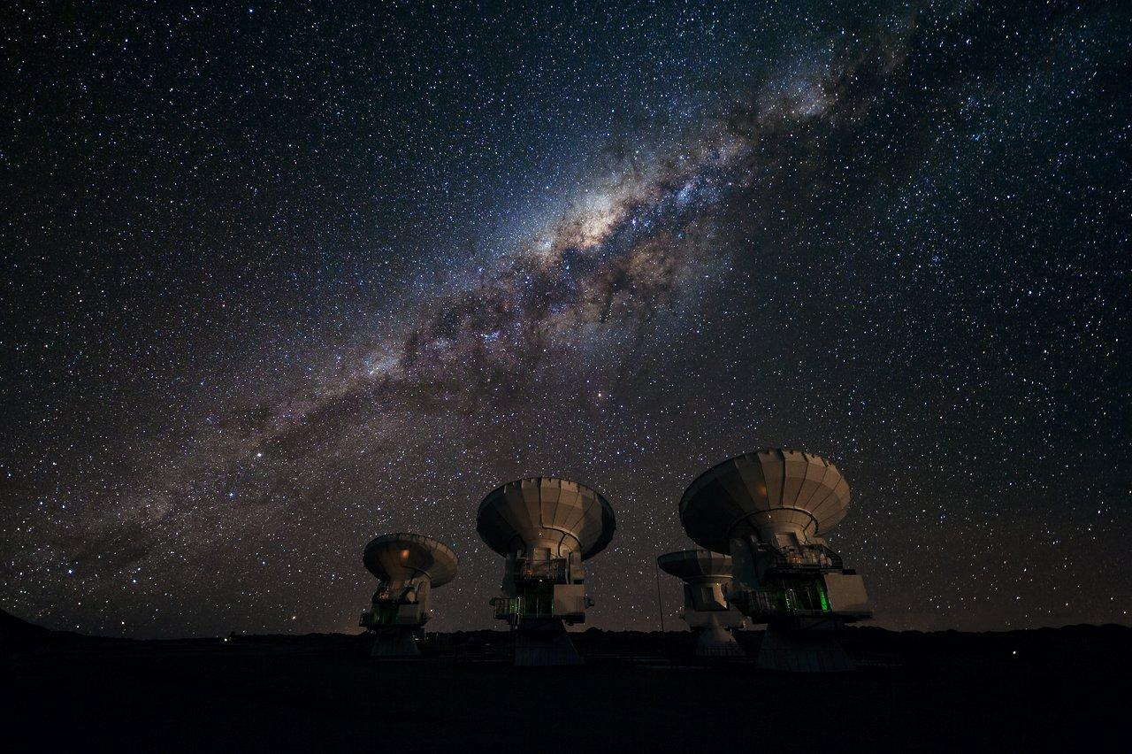




Astronomy for a Better World!
Dr Charles Takalana & Dr Joyful Mdhluli
IAU-Office of Astronomy for Development
HEASA 2026 (29 Sep - 02 Oct 2026)
Credit: ESO/José Francisco Salgado

Slide 2
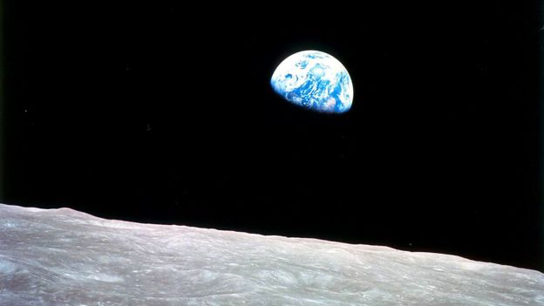
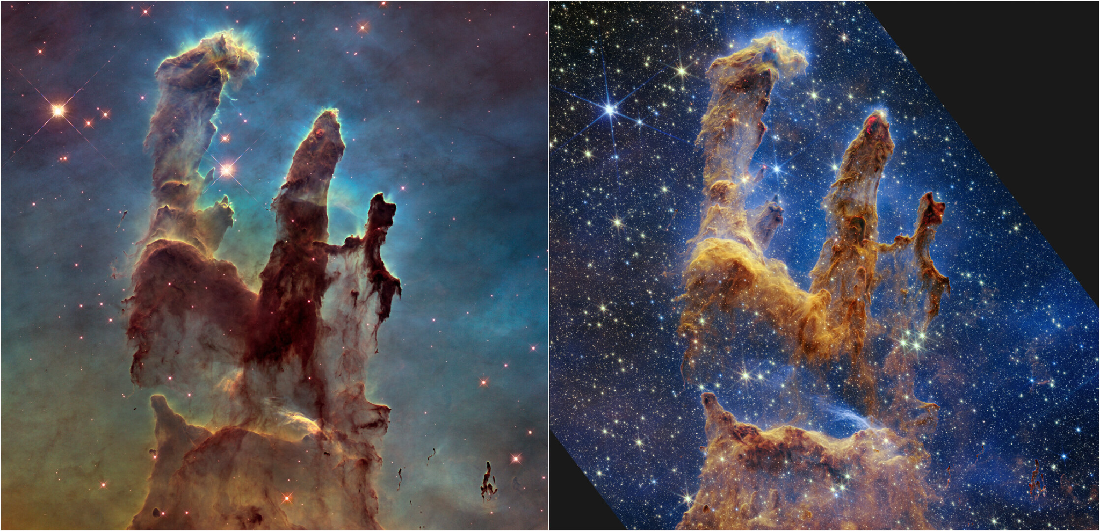
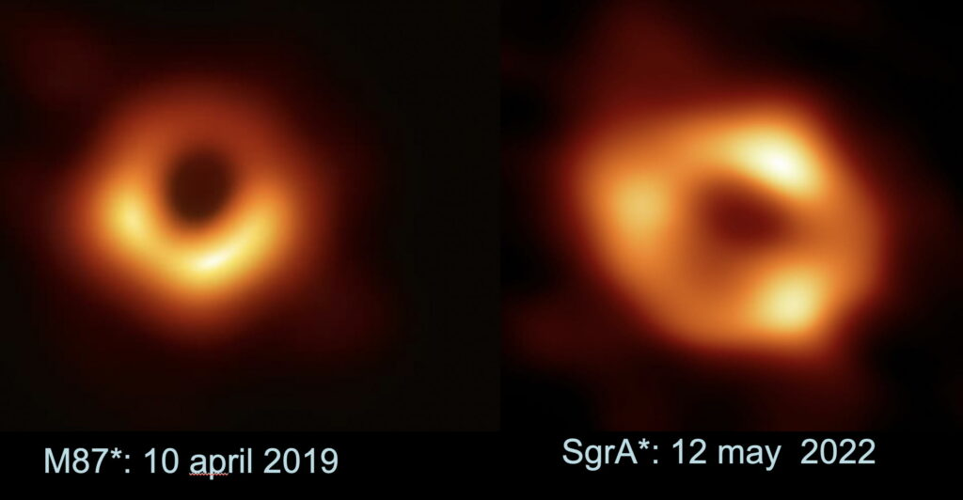
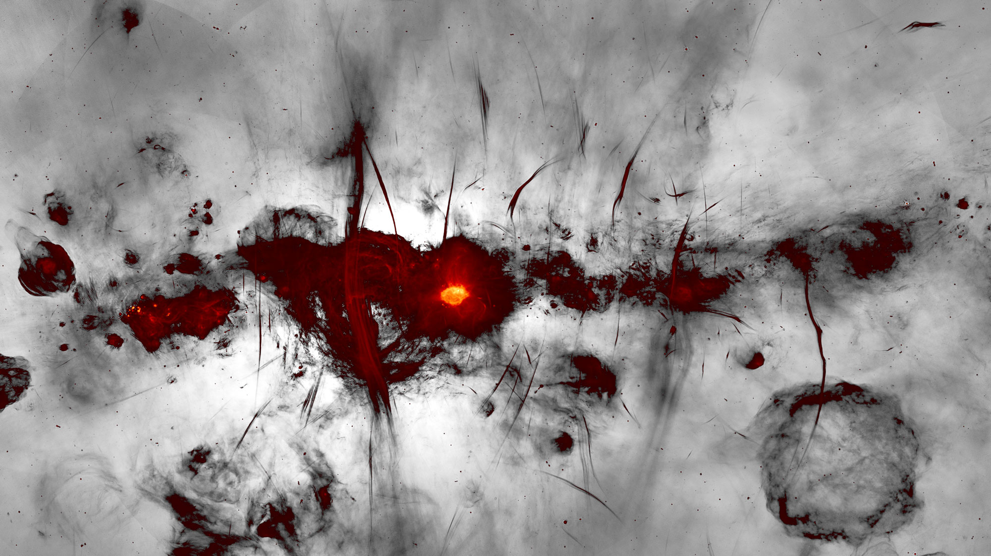
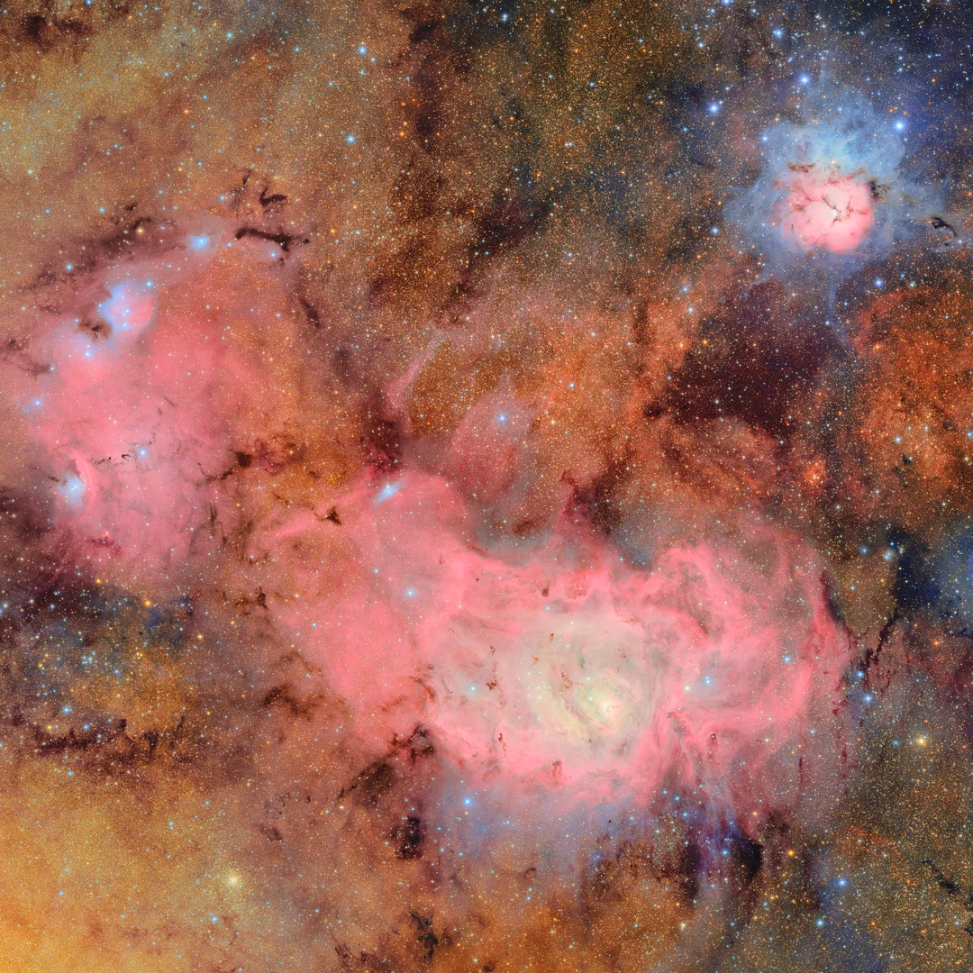
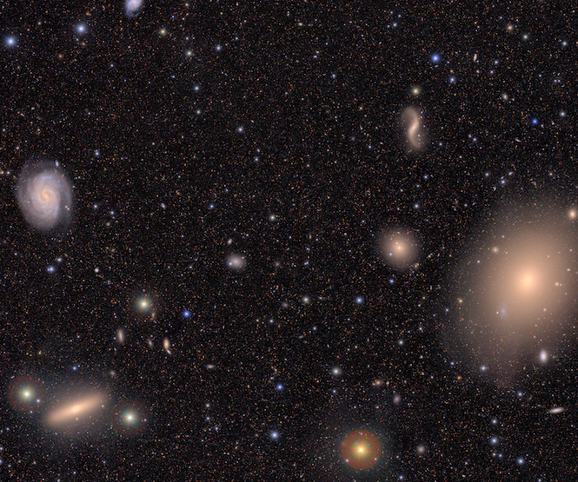

Slide 3
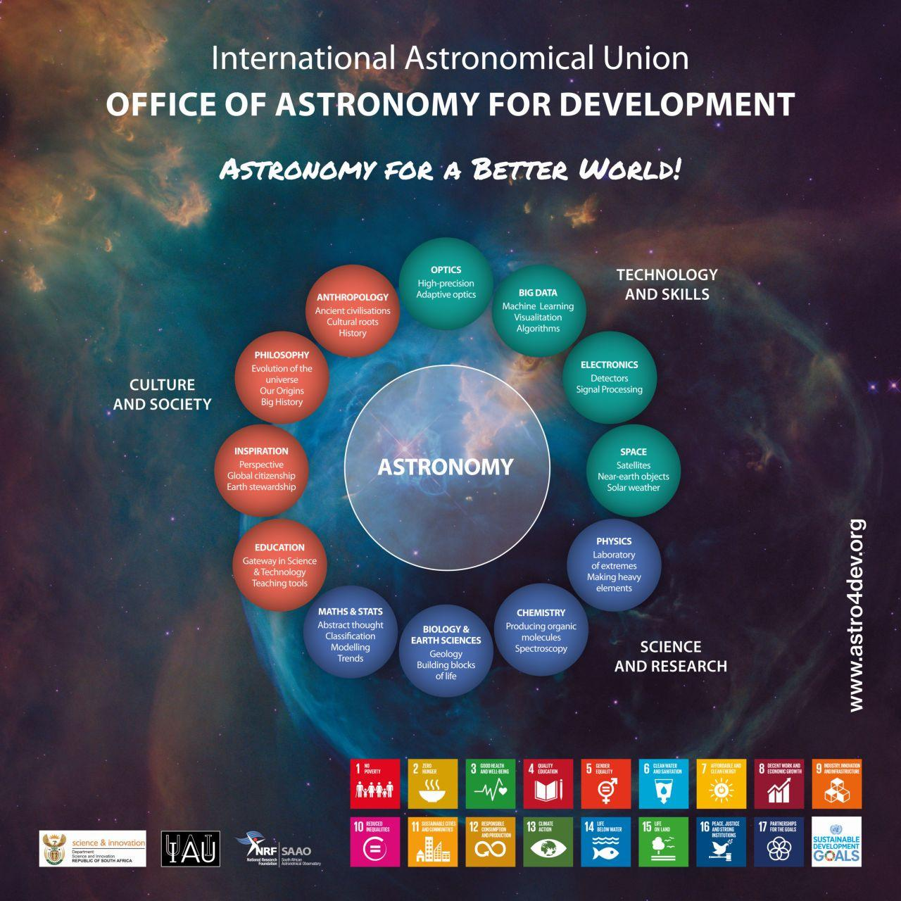
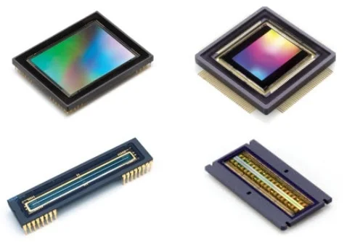
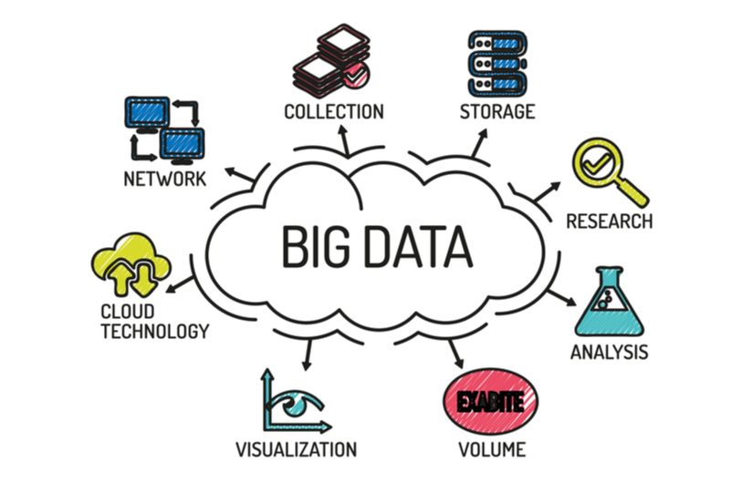


Slide 4
Over 100 years of scientific excellence
IAU
International
Astronomical Union
To promote and safeguard the science of astronomy in all its aspects including research, communication, education and development through international cooperation
Background image credit: ESO/
?’;losé Francisco Salgado

Slide 5









IAU Strategic Plan 2020-2030
GOAL
1
The IAU leads the worldwide coordination of astronomy and the fostering of communication and dissemination of astronomical knowledge among professional astronomers
GOAL
2
The IAU promotes the inclusive advancement of the field of astronomy in every country
GOAL
3
The IAU promotes the use of astronomy as a tool for development in every country
GOAL
4
The IAU engages the public in astronomy through access to astronomical information and communication of the science of astronomy
GOAL
5
The IAU stimulates the use of astronomy for teaching and education at school level

Slide 6

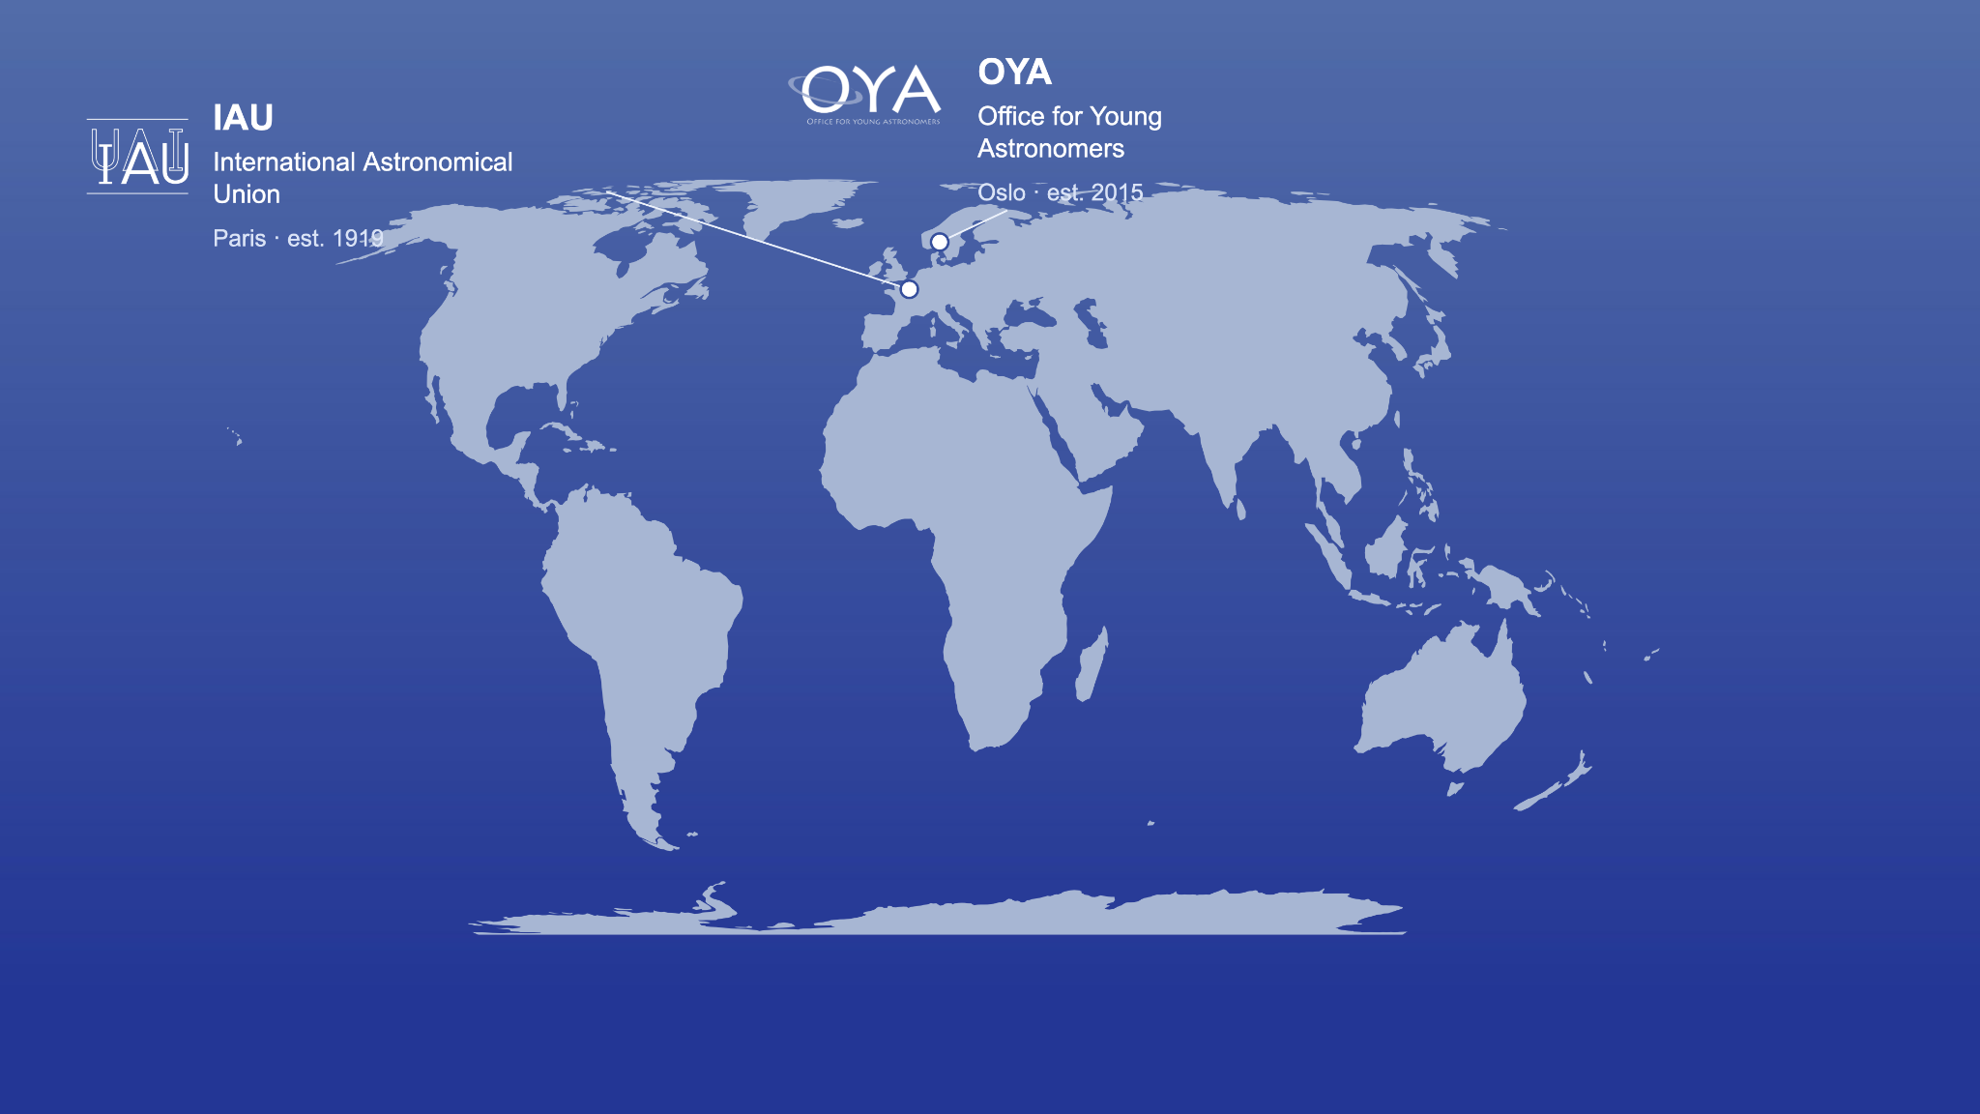
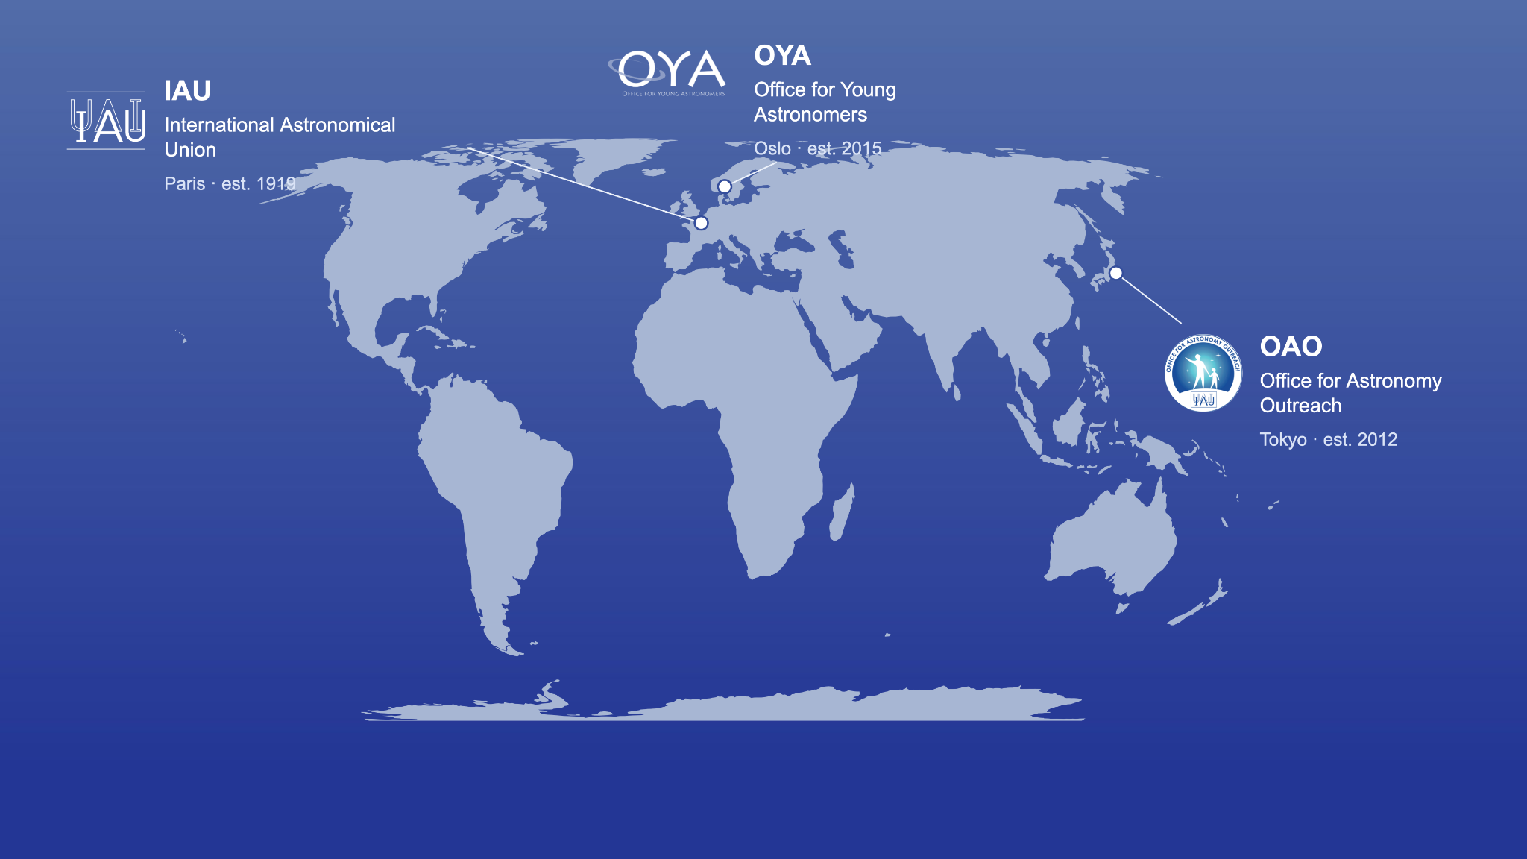
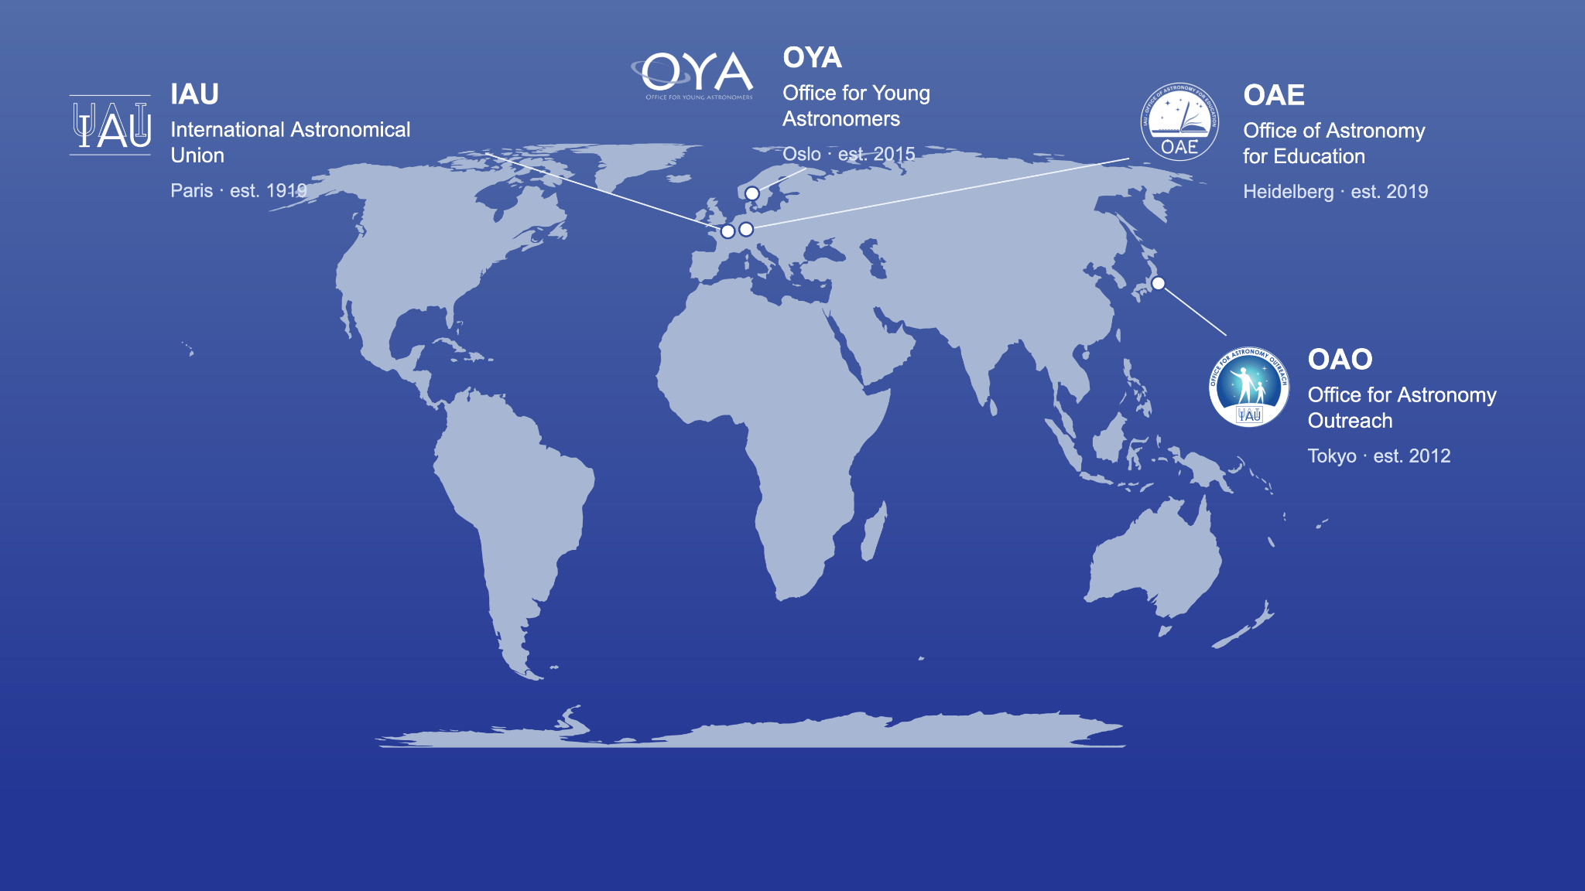
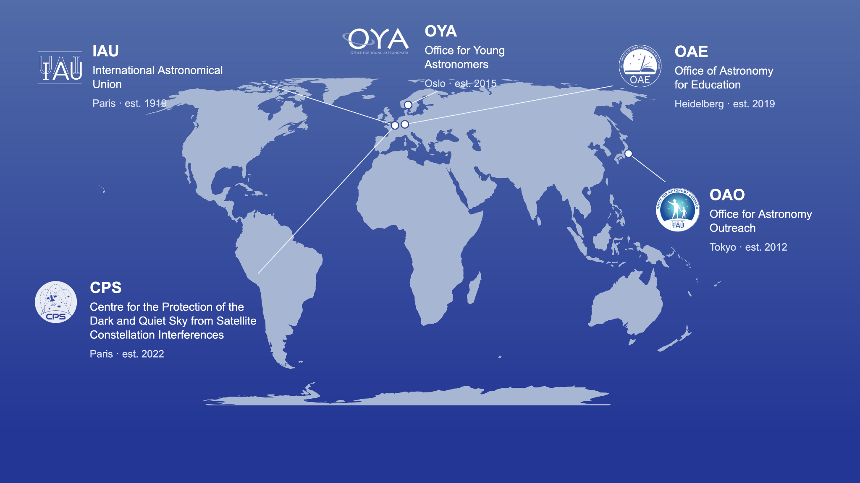
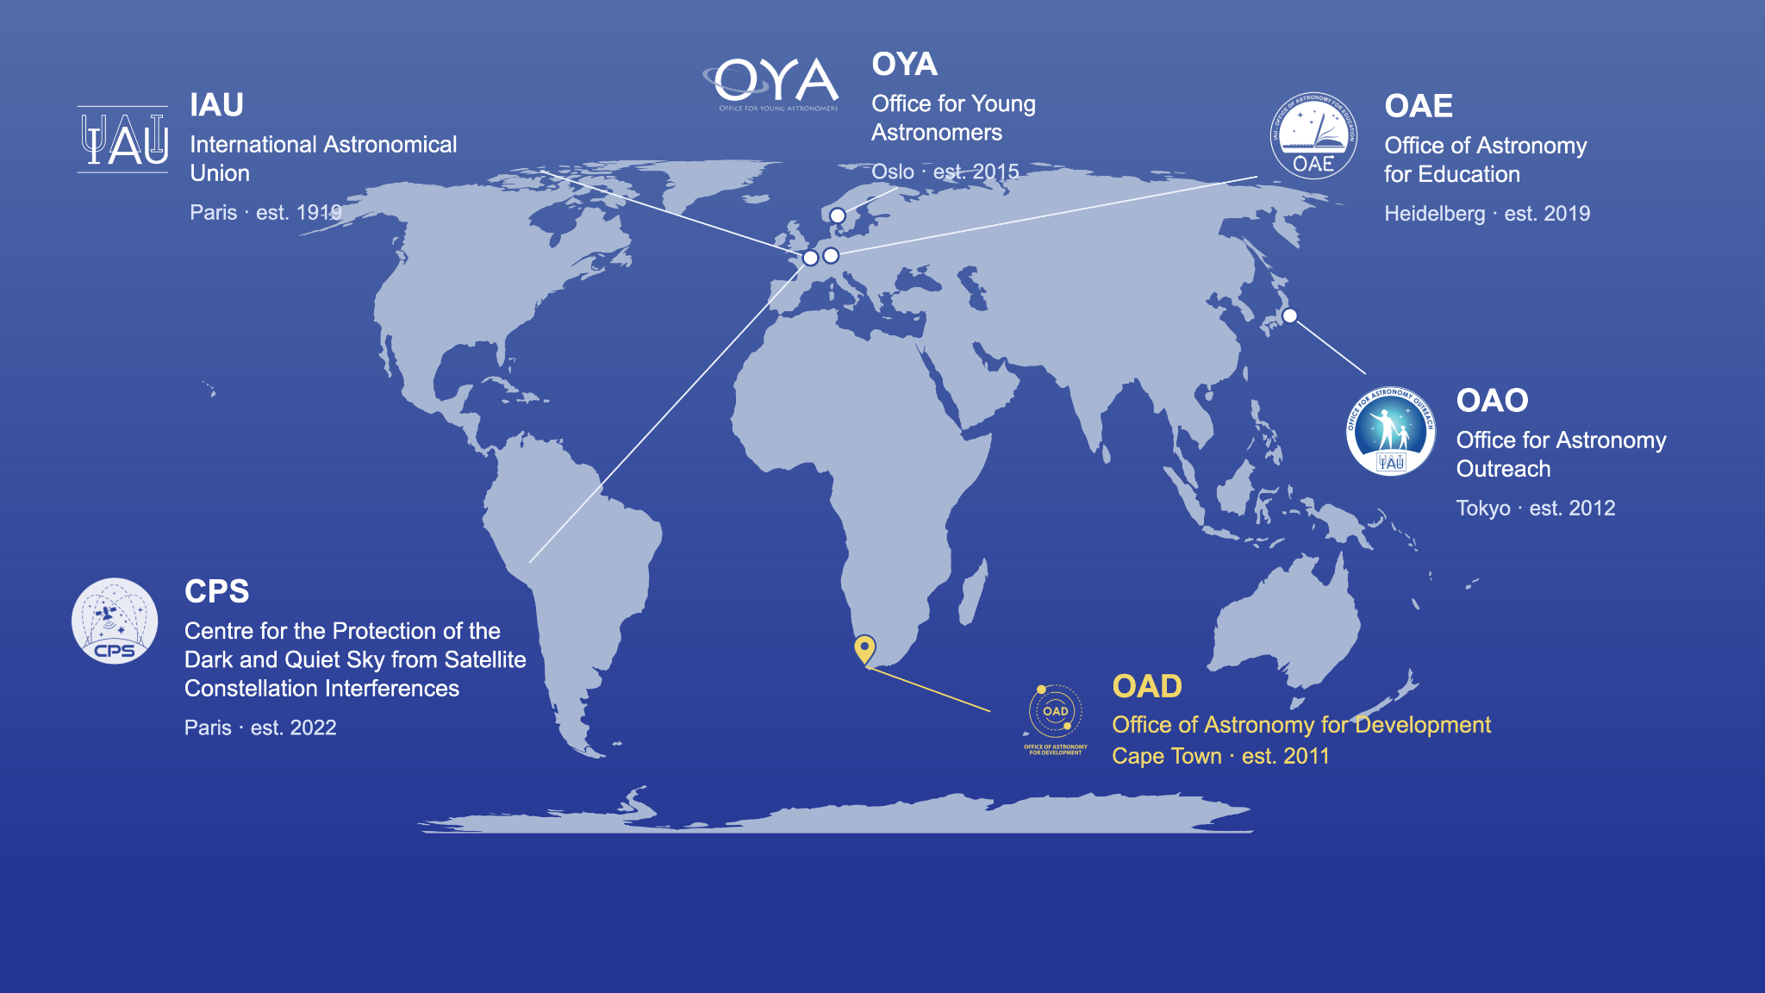

Slide 7
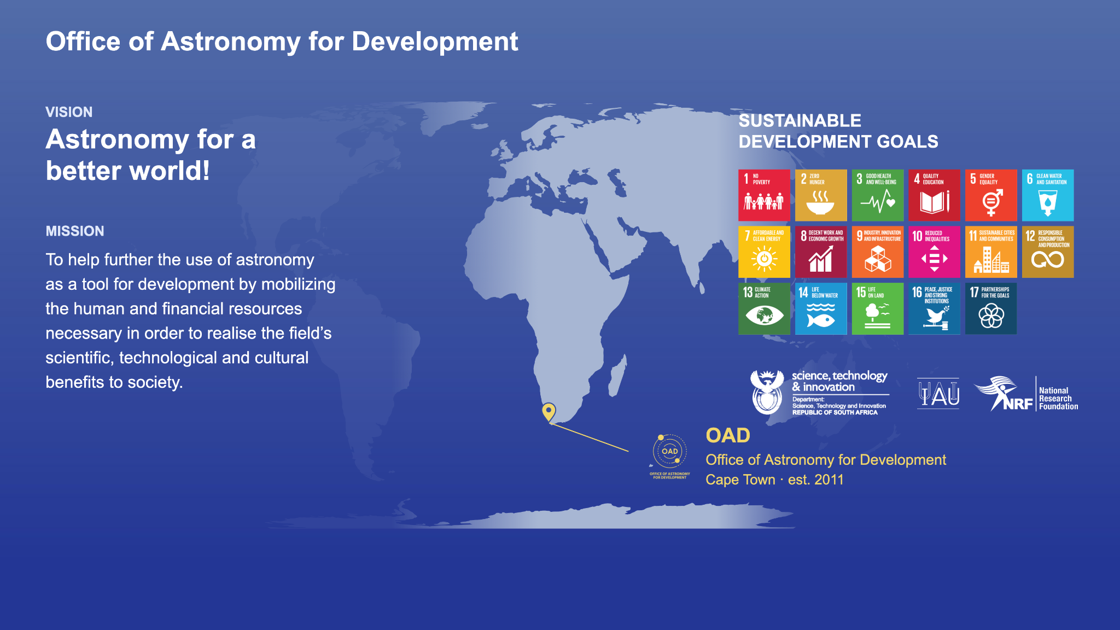




IAU Office of Astronomy for Development
Vision:
Astronomy for a better world!
Mission:
To help further the use of astronomy as a tool for development by mobilizing the human and financial resources necessary in order to realise the field's scientific, technological and cultural benefits to society.
Credit: IAU OAO
Credit: Mariano Menendez

Slide 8
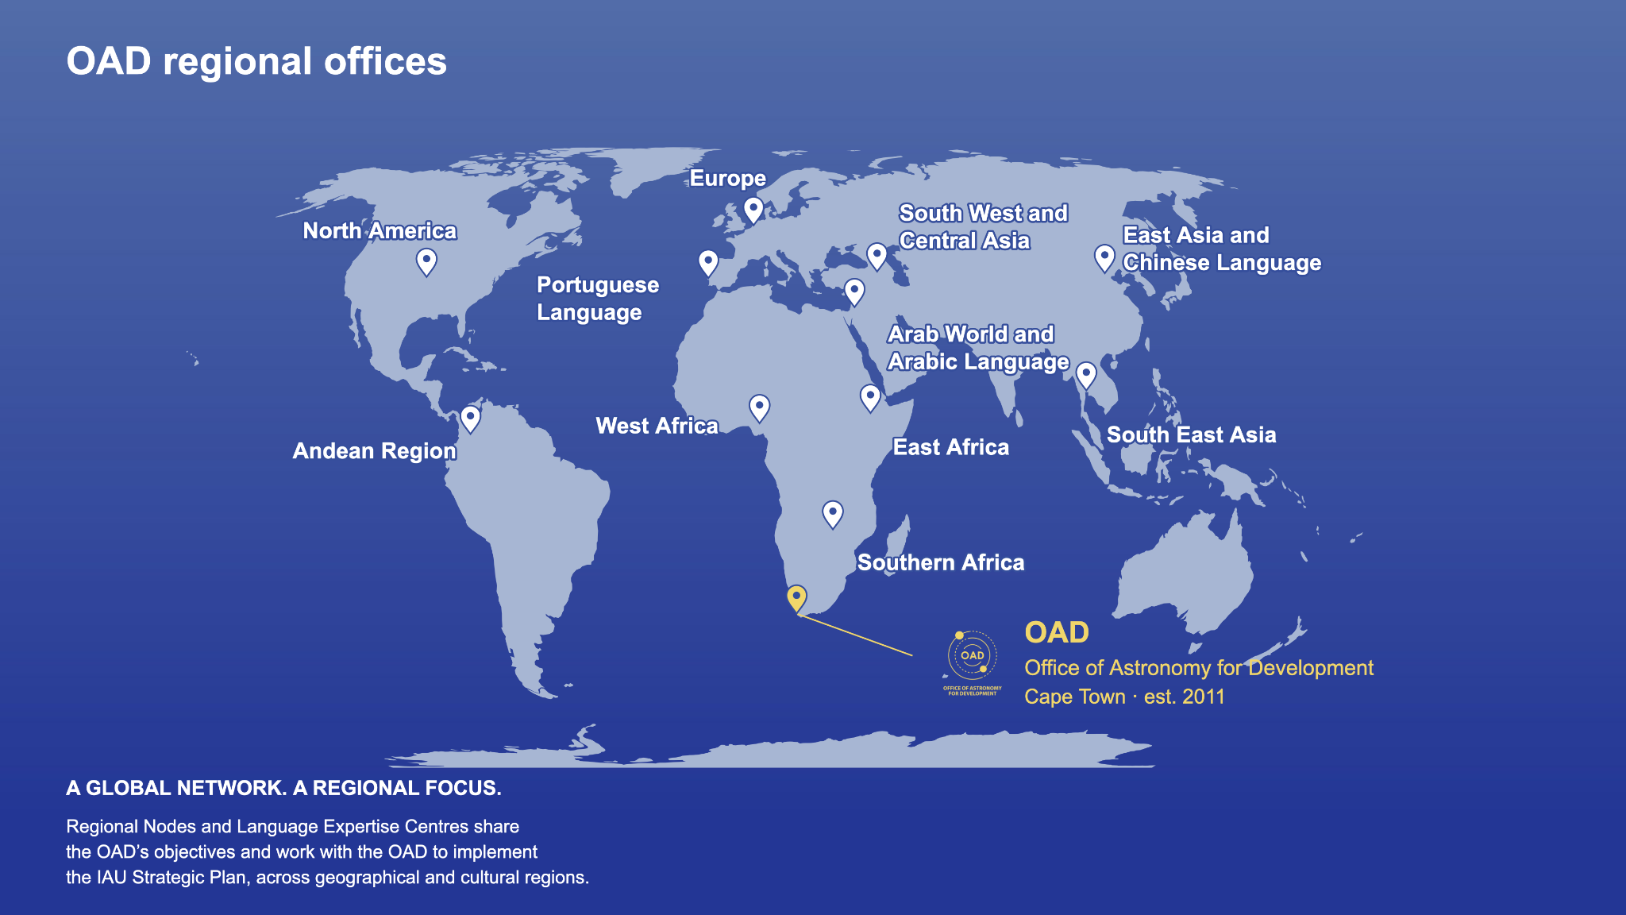
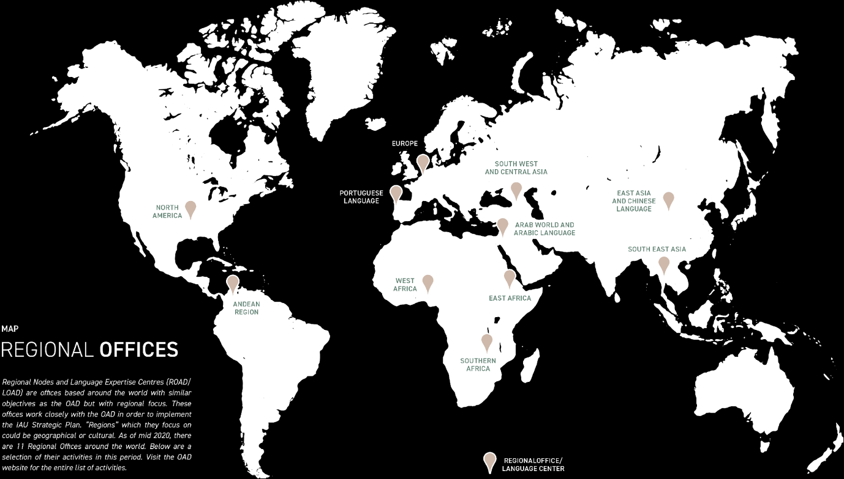
Global Reach

Slide 9
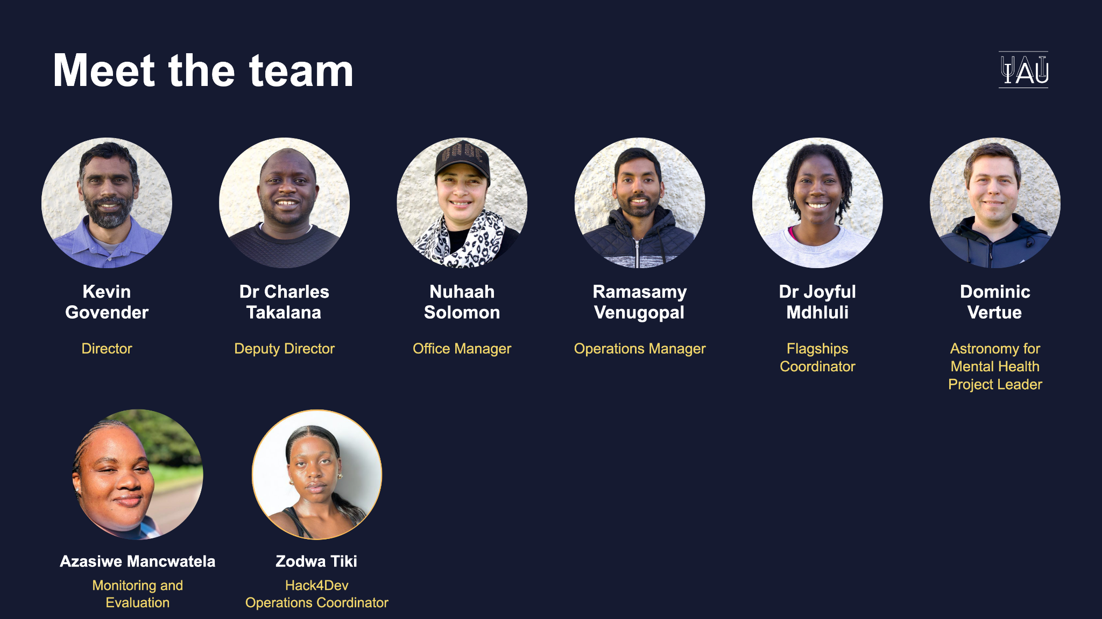
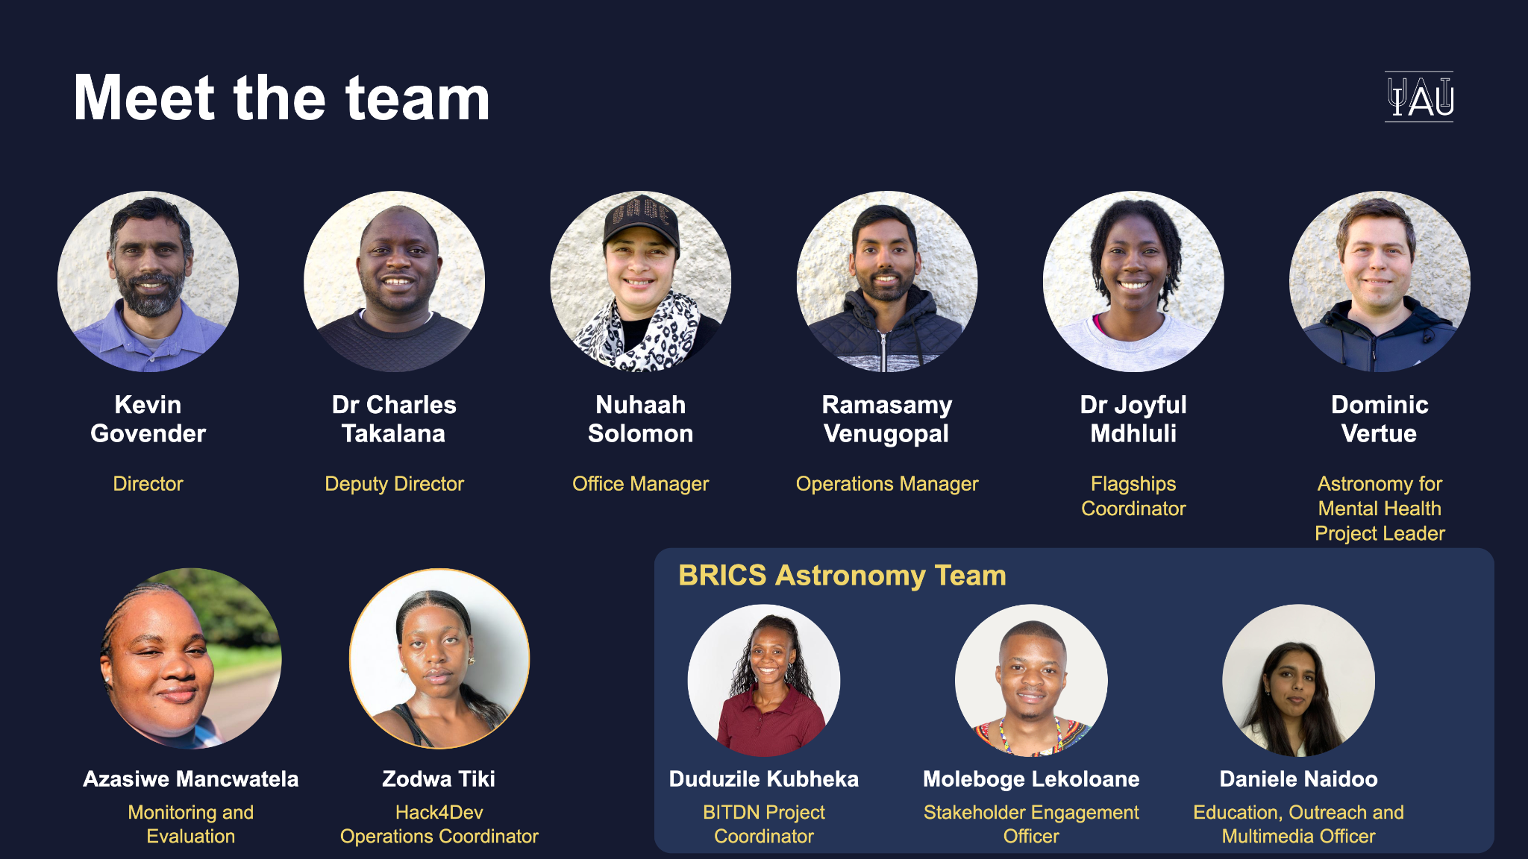
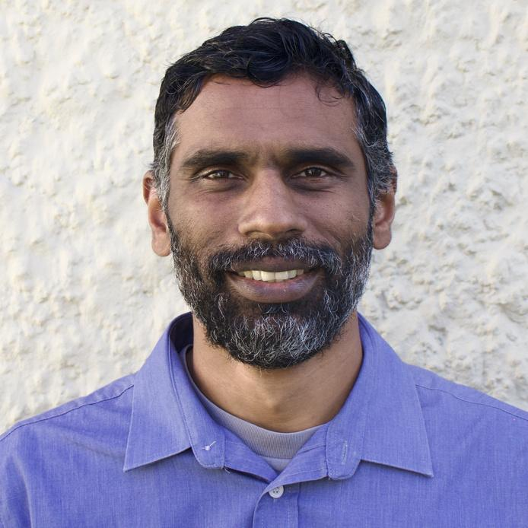
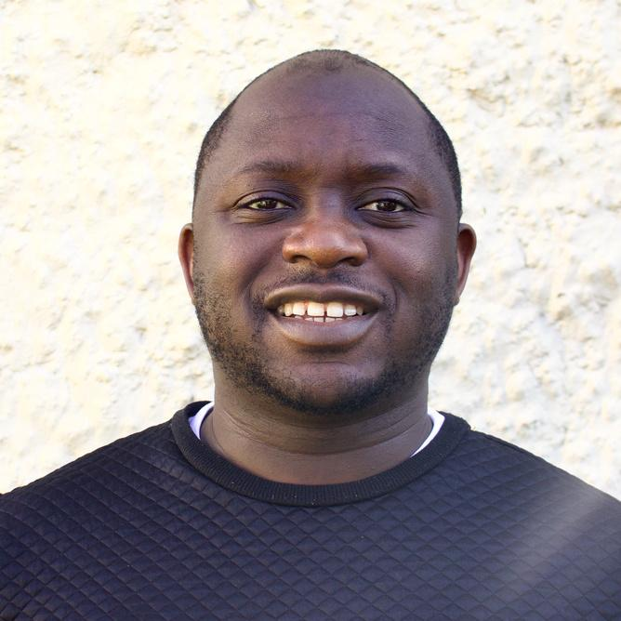
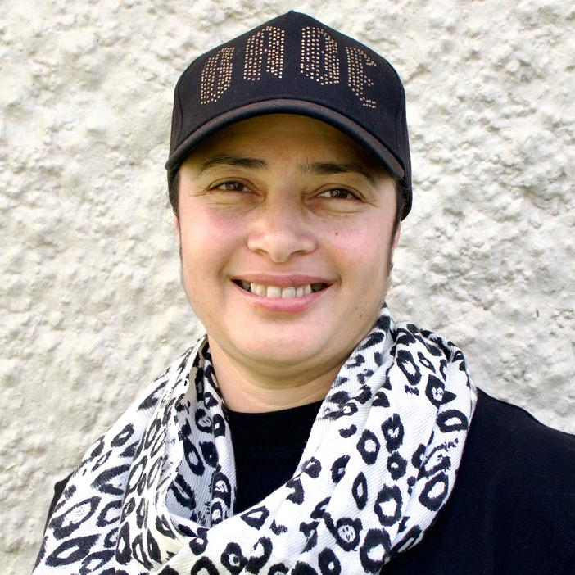
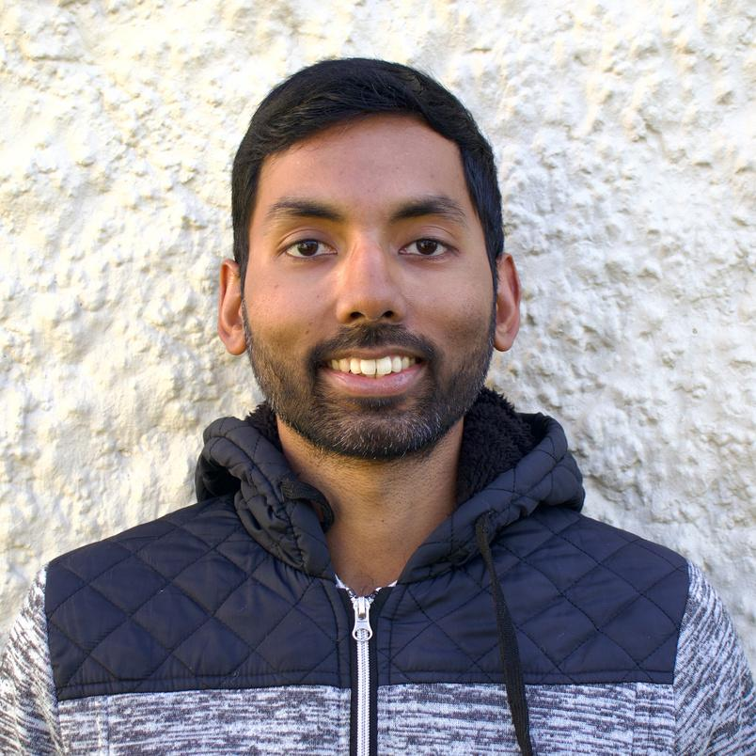
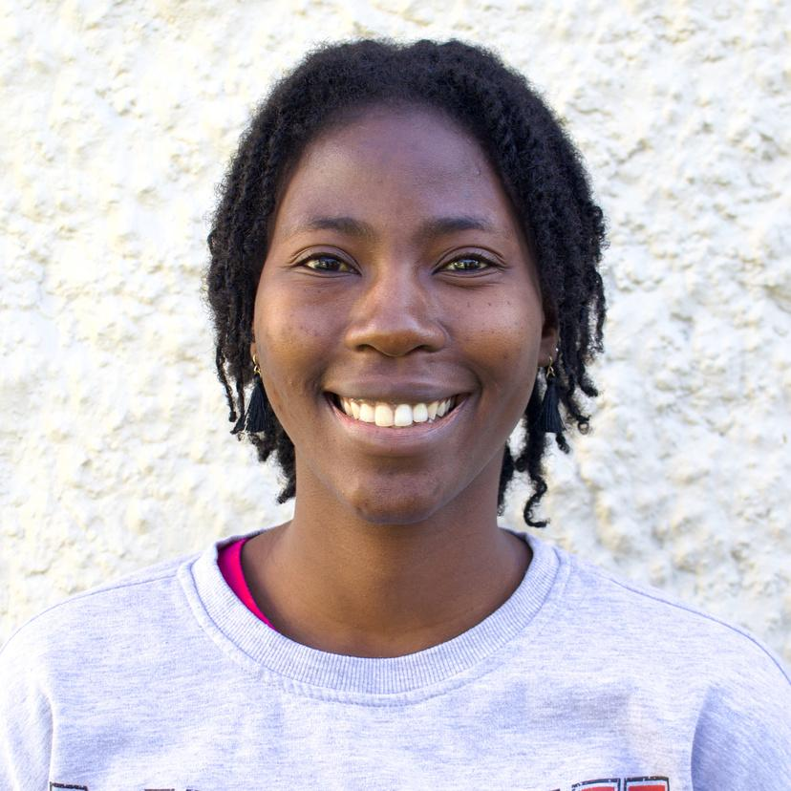
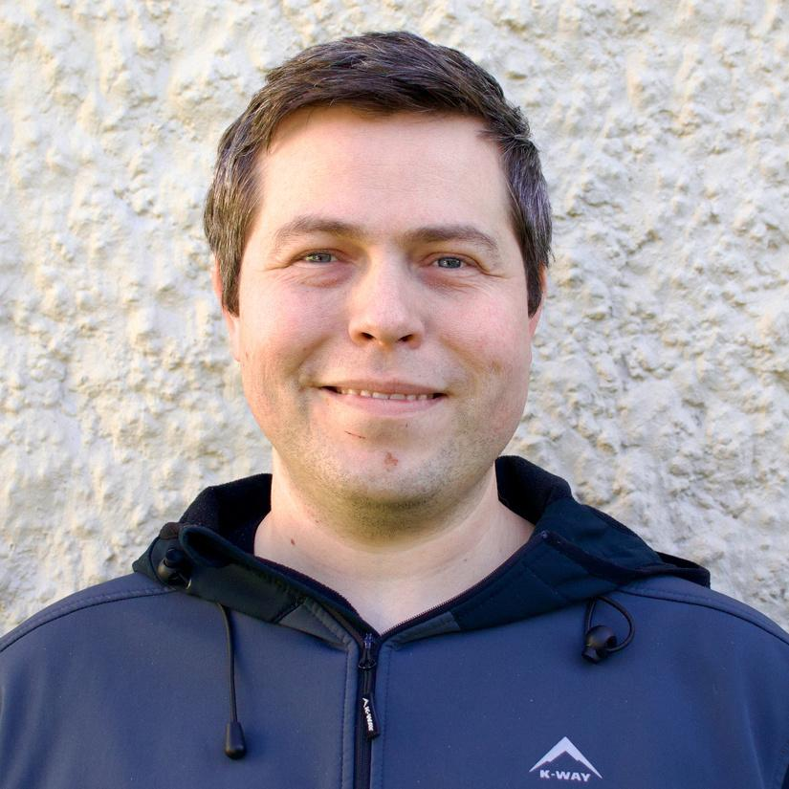
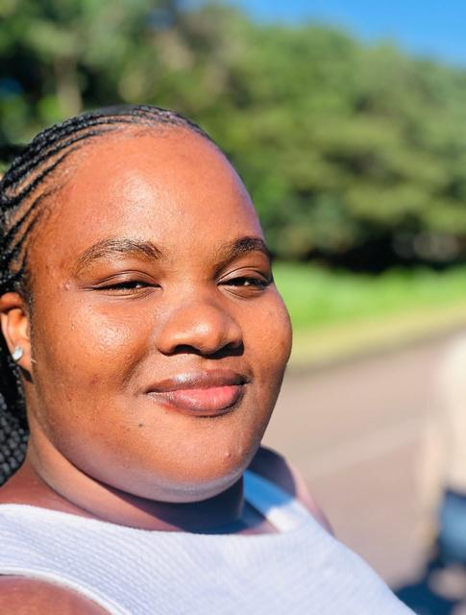
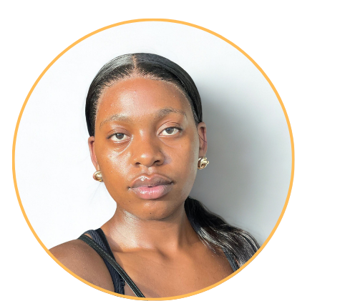
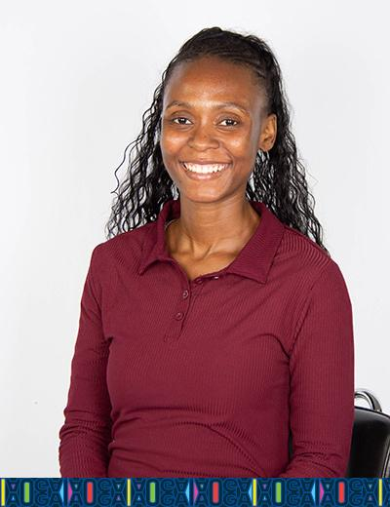
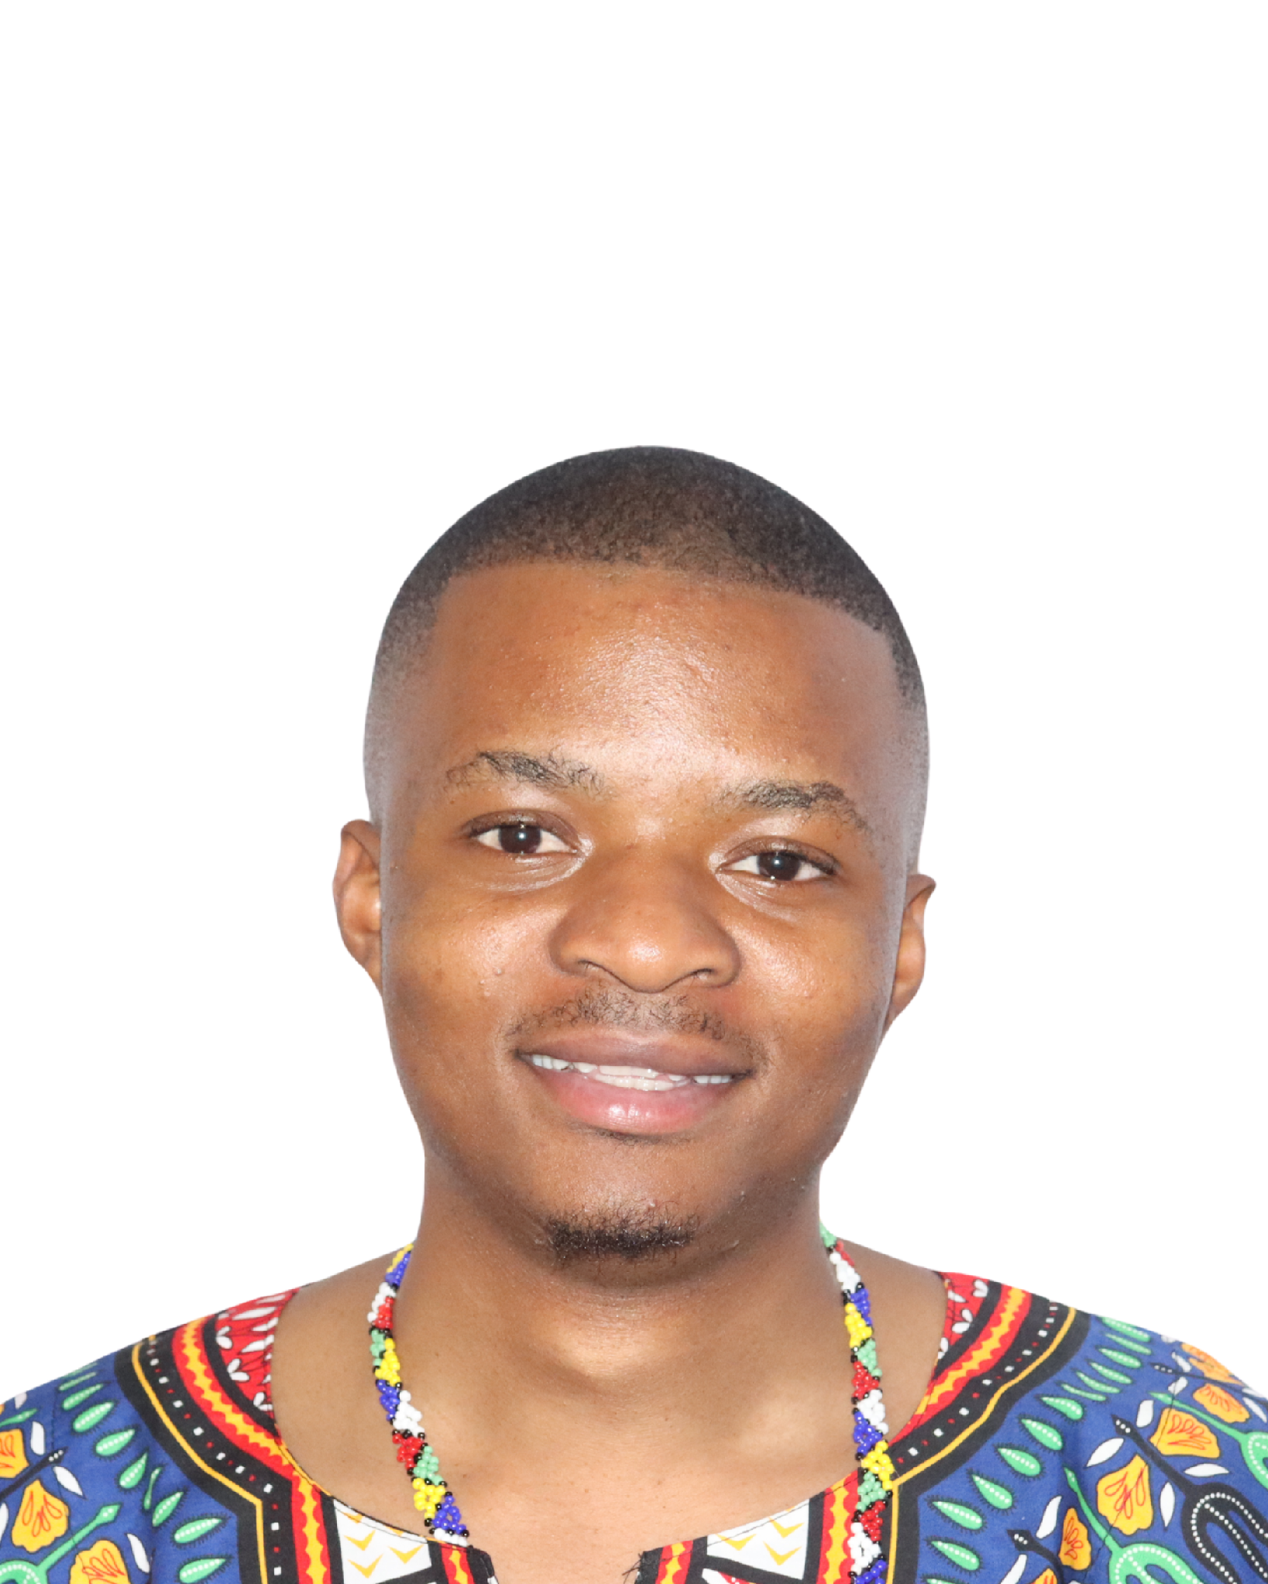
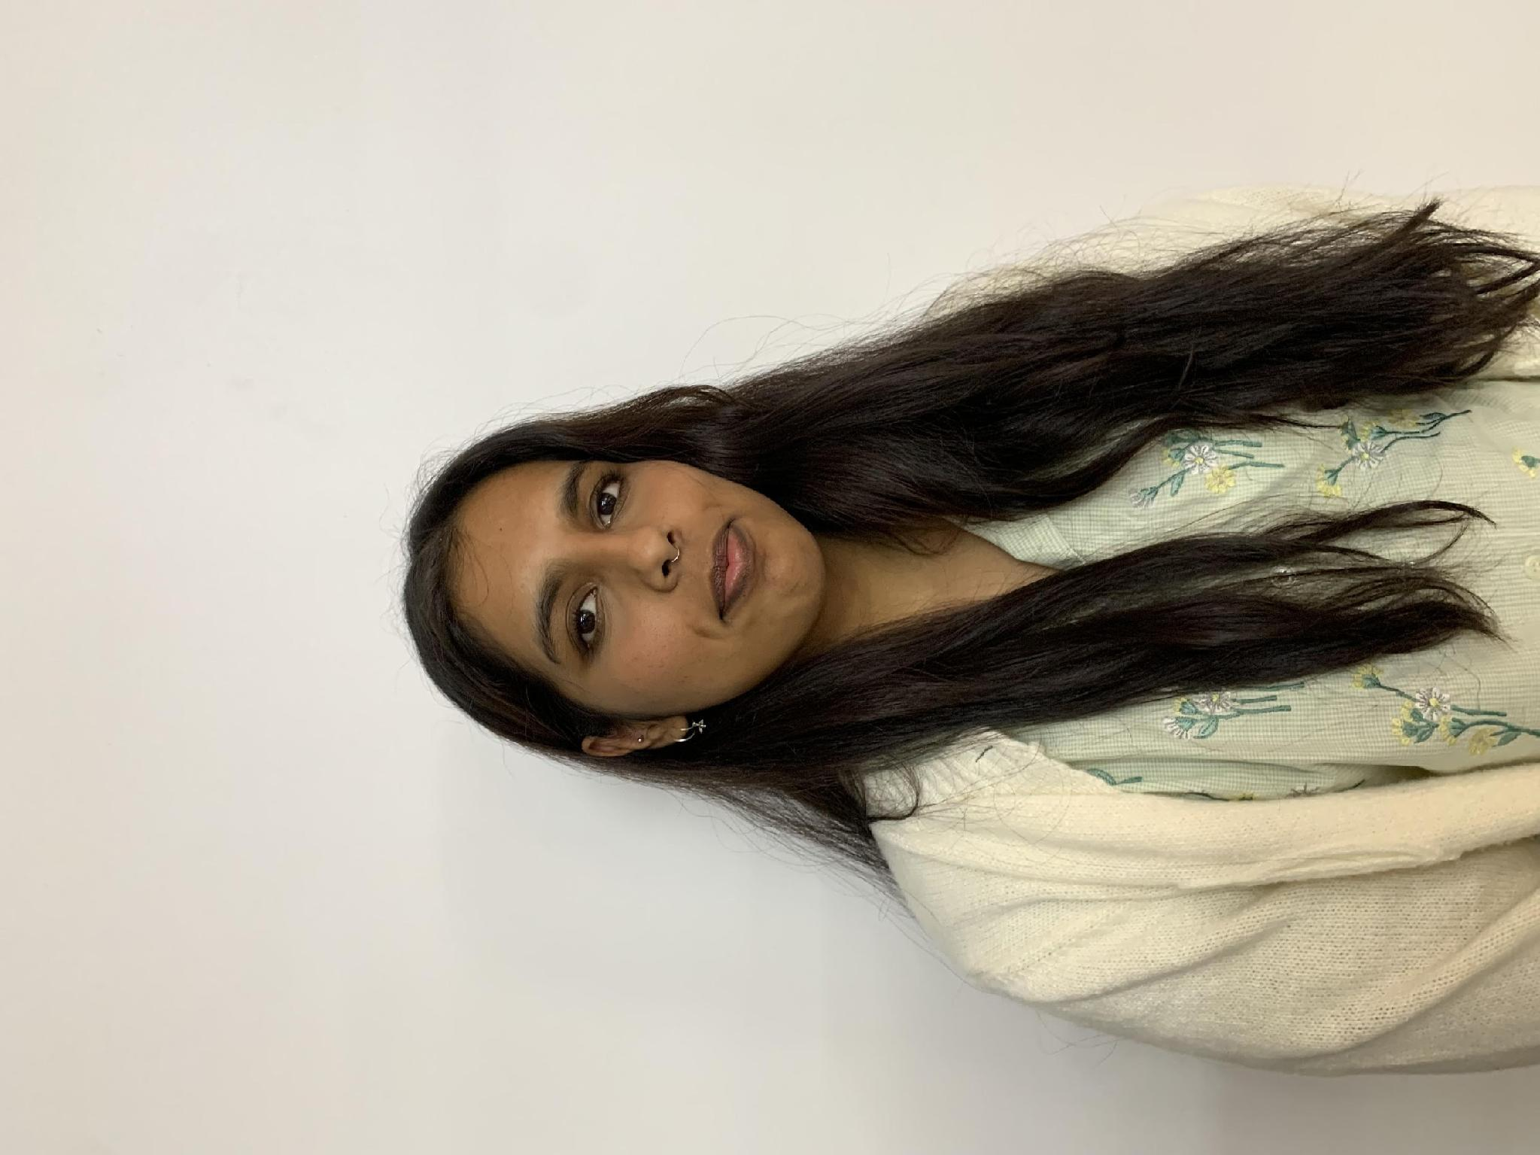
Meet Our Team
Kevin Govender
Dr Charles Takalana
Nuhaah Solomon
Ramasamy Venugopal
Dr Joyful Mdhluli
Director
Deputy Director
Office Manager
Flagships Coordinator
Operations Manager
BRICS Astronomy Team
Dominic Vertue
Azasiwe Mancwatela
Astronomy for Mental Health Project Leader
Zodwa Tiki
Monitoring and Evaluation
Hack4Dev Operations Coordinator
Duduzile Kubheka
Moleboge Lekoloane
Daniele Naidoo
BITDN Project Coordinator
Stakeholder Engagement Officer
Education, Outreach and Multimedia Officer

Slide 10
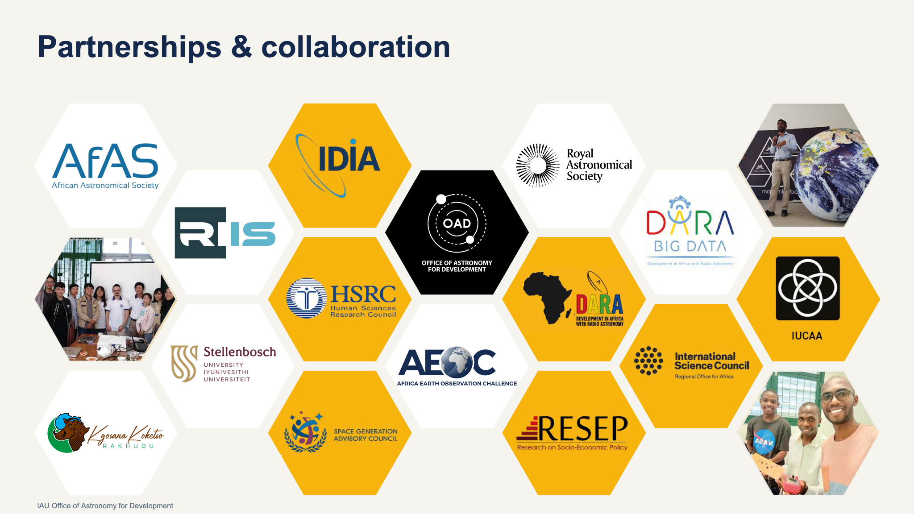






Partnerships & Collaboration
Credit: IAU OAO
Credit: Mariano Menendez

Slide 11
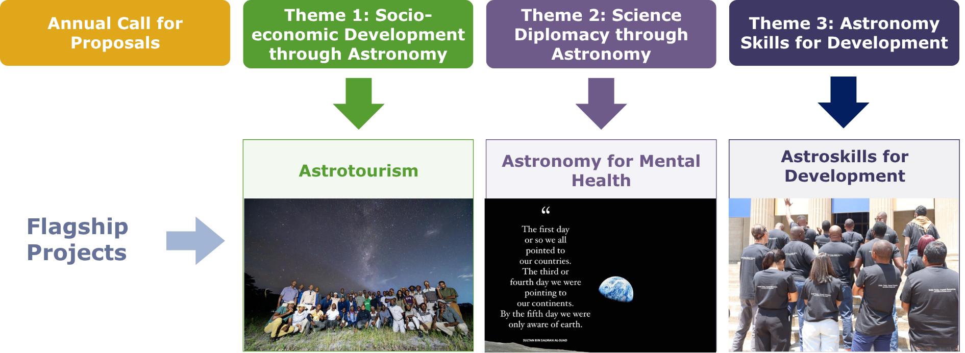
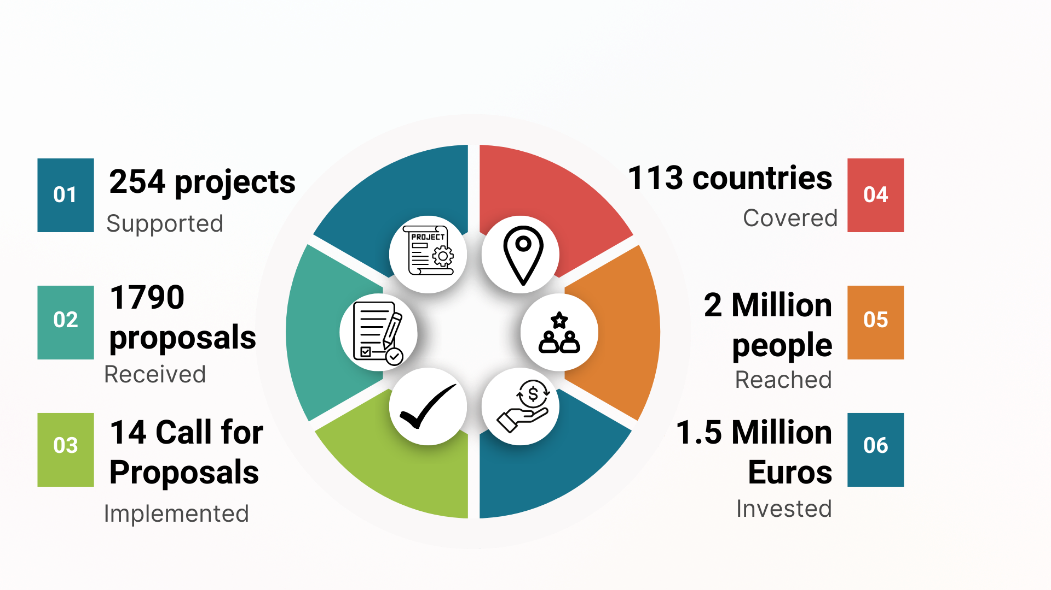
IAU-OAD Focus

Slide 12
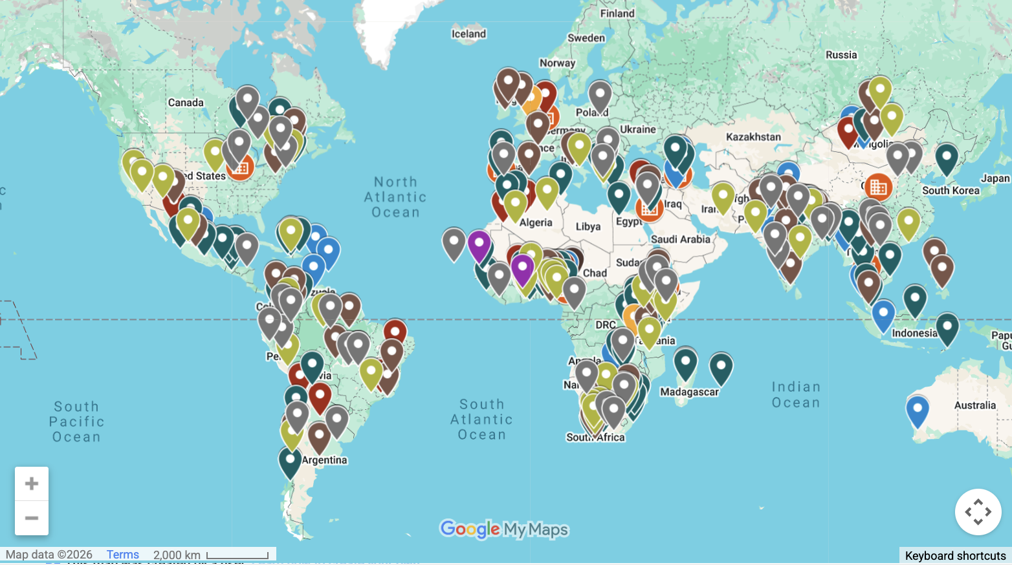

Slide 13
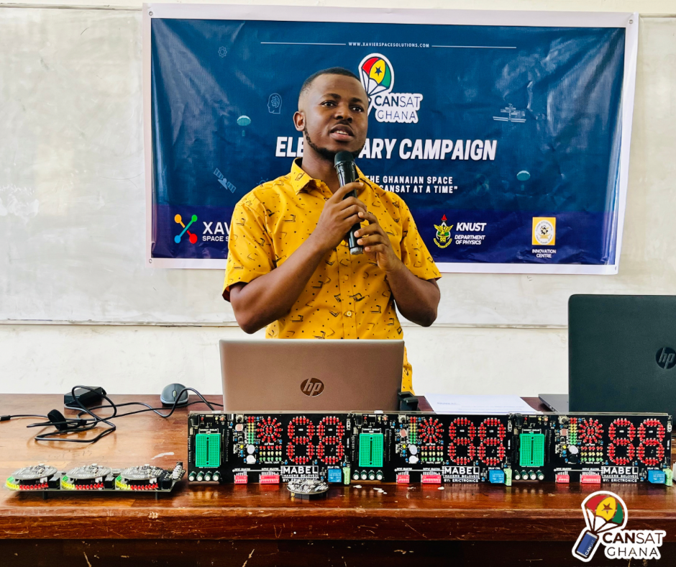
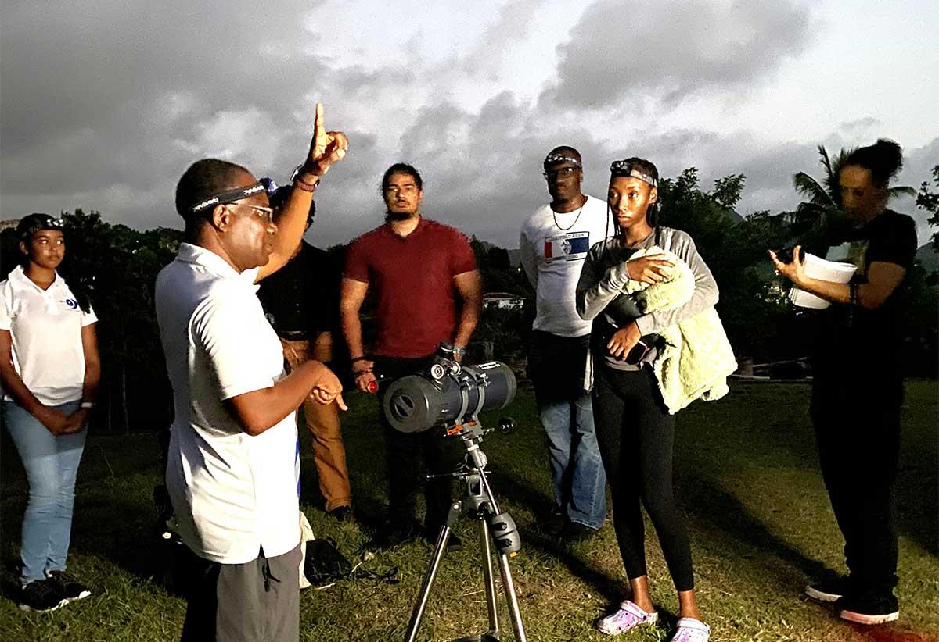
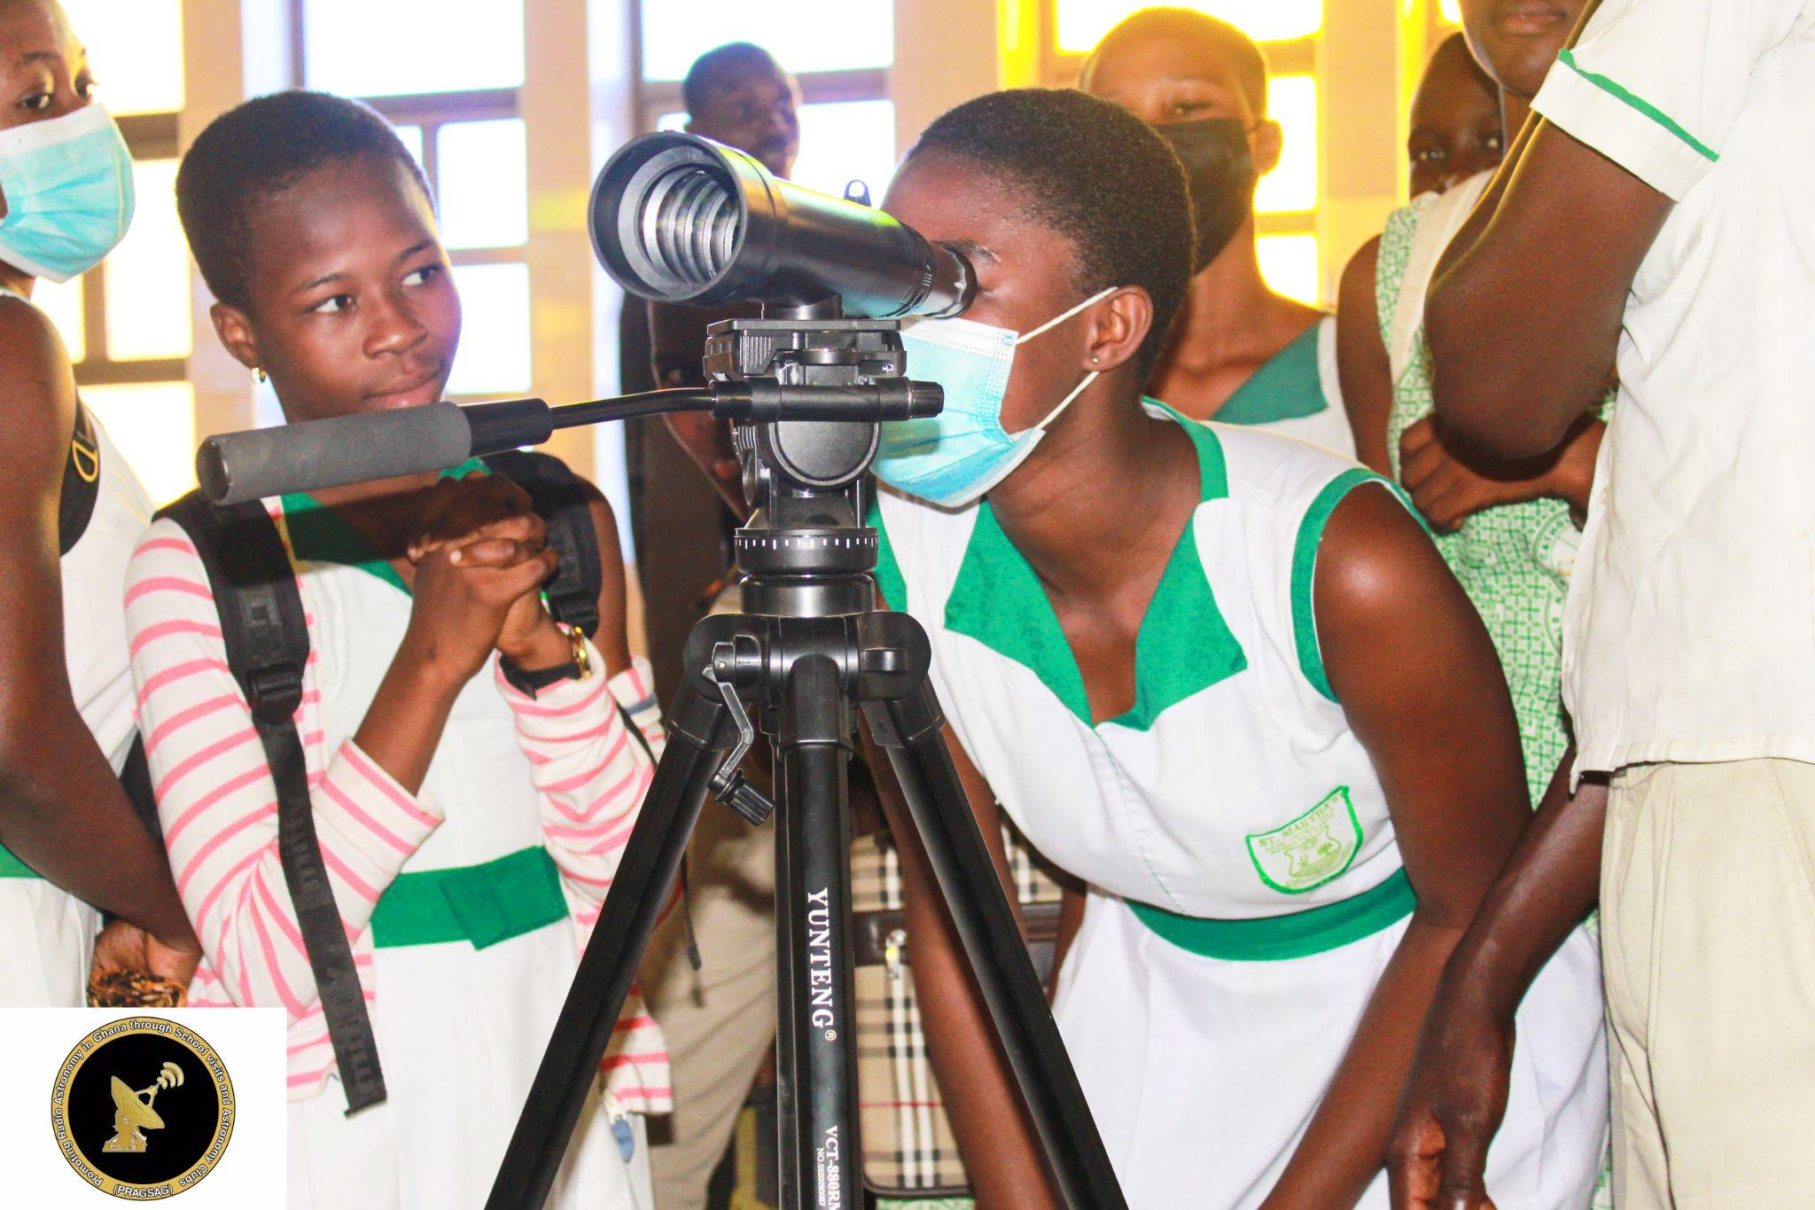
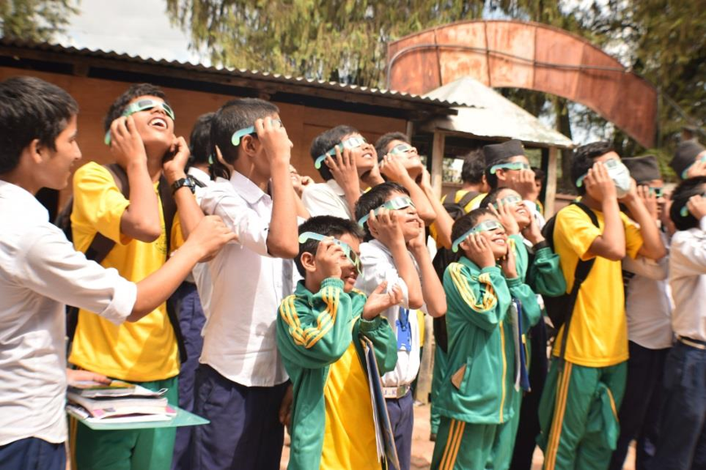

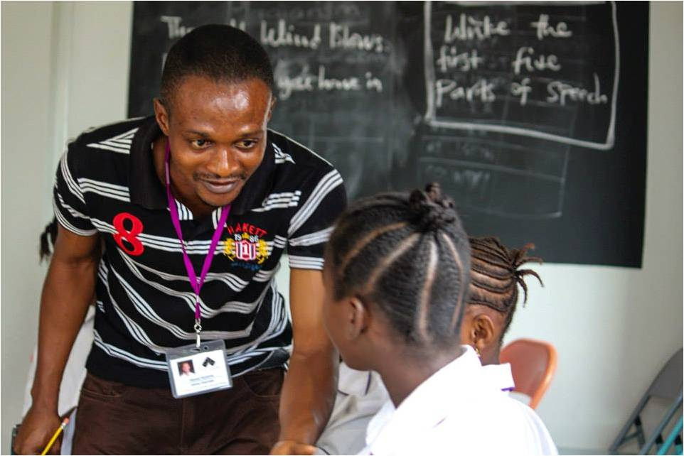



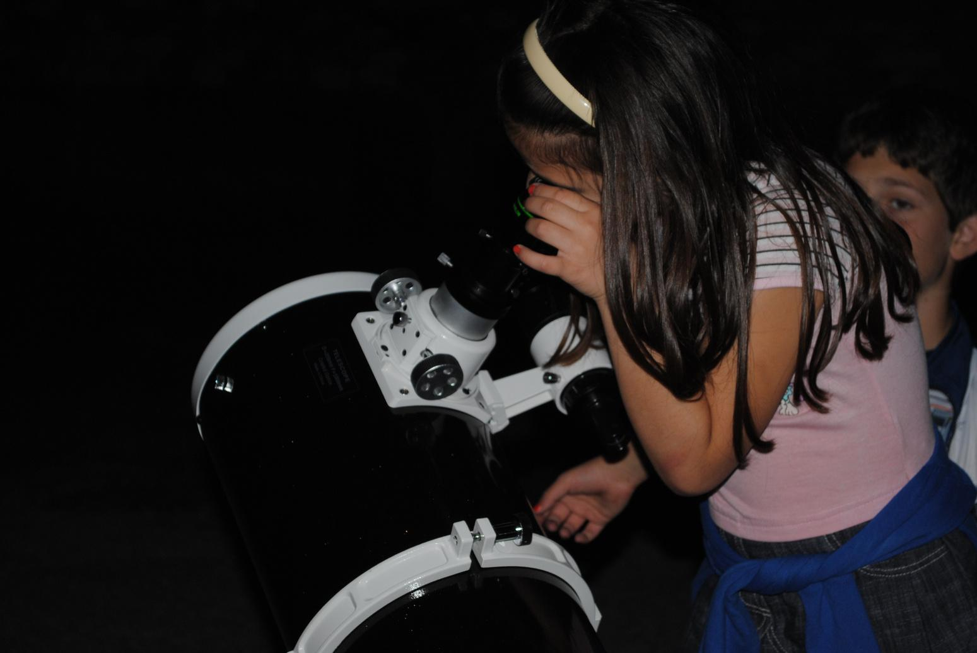
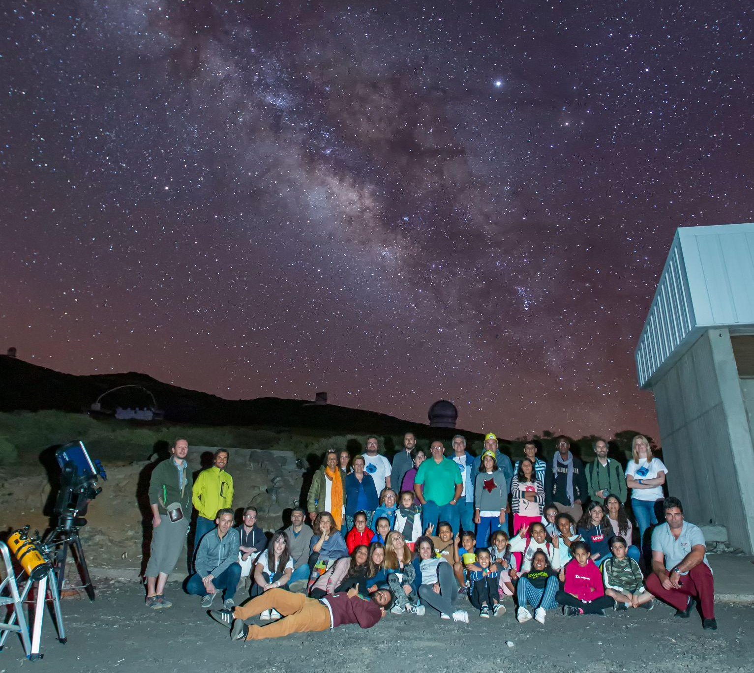



Examples of Funded Projects
Education and Training
Addressing literacy, school drop outs, science training, skills development
Access, Gender Equity, Inclusion
Expanding access to science, removing barriers, using cultural connections
Economic Development
Astrotourism training, telescope making
Credit: IAU OAO
Credit: Mariano Menendez

Slide 14
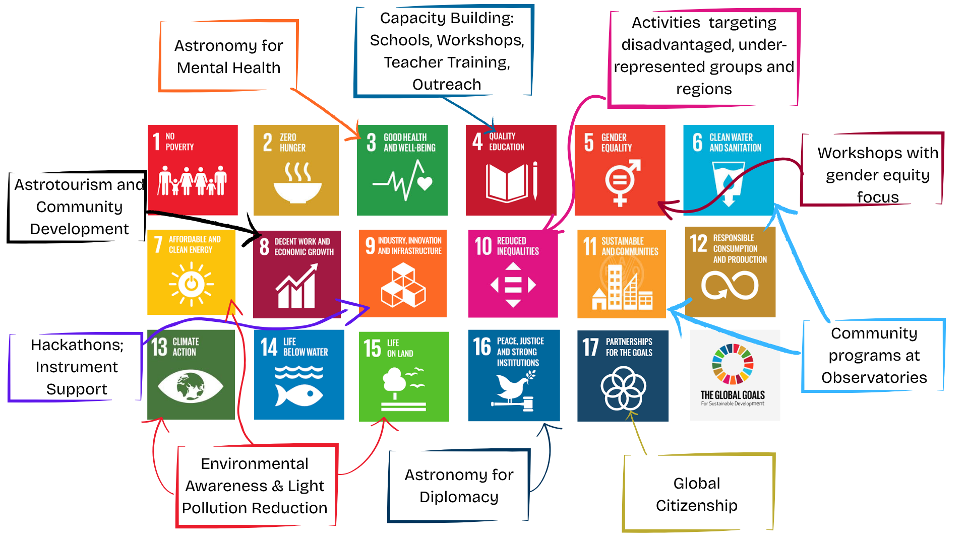
Astronomy and Society
Through our Annual Call for Proposals and Flagship projects, we have used astronomy to contribute to 13 of the 17 UN Sustainable Development Goals.
Credit: IAU OAO
Credit: Mariano Menendez

Slide 15
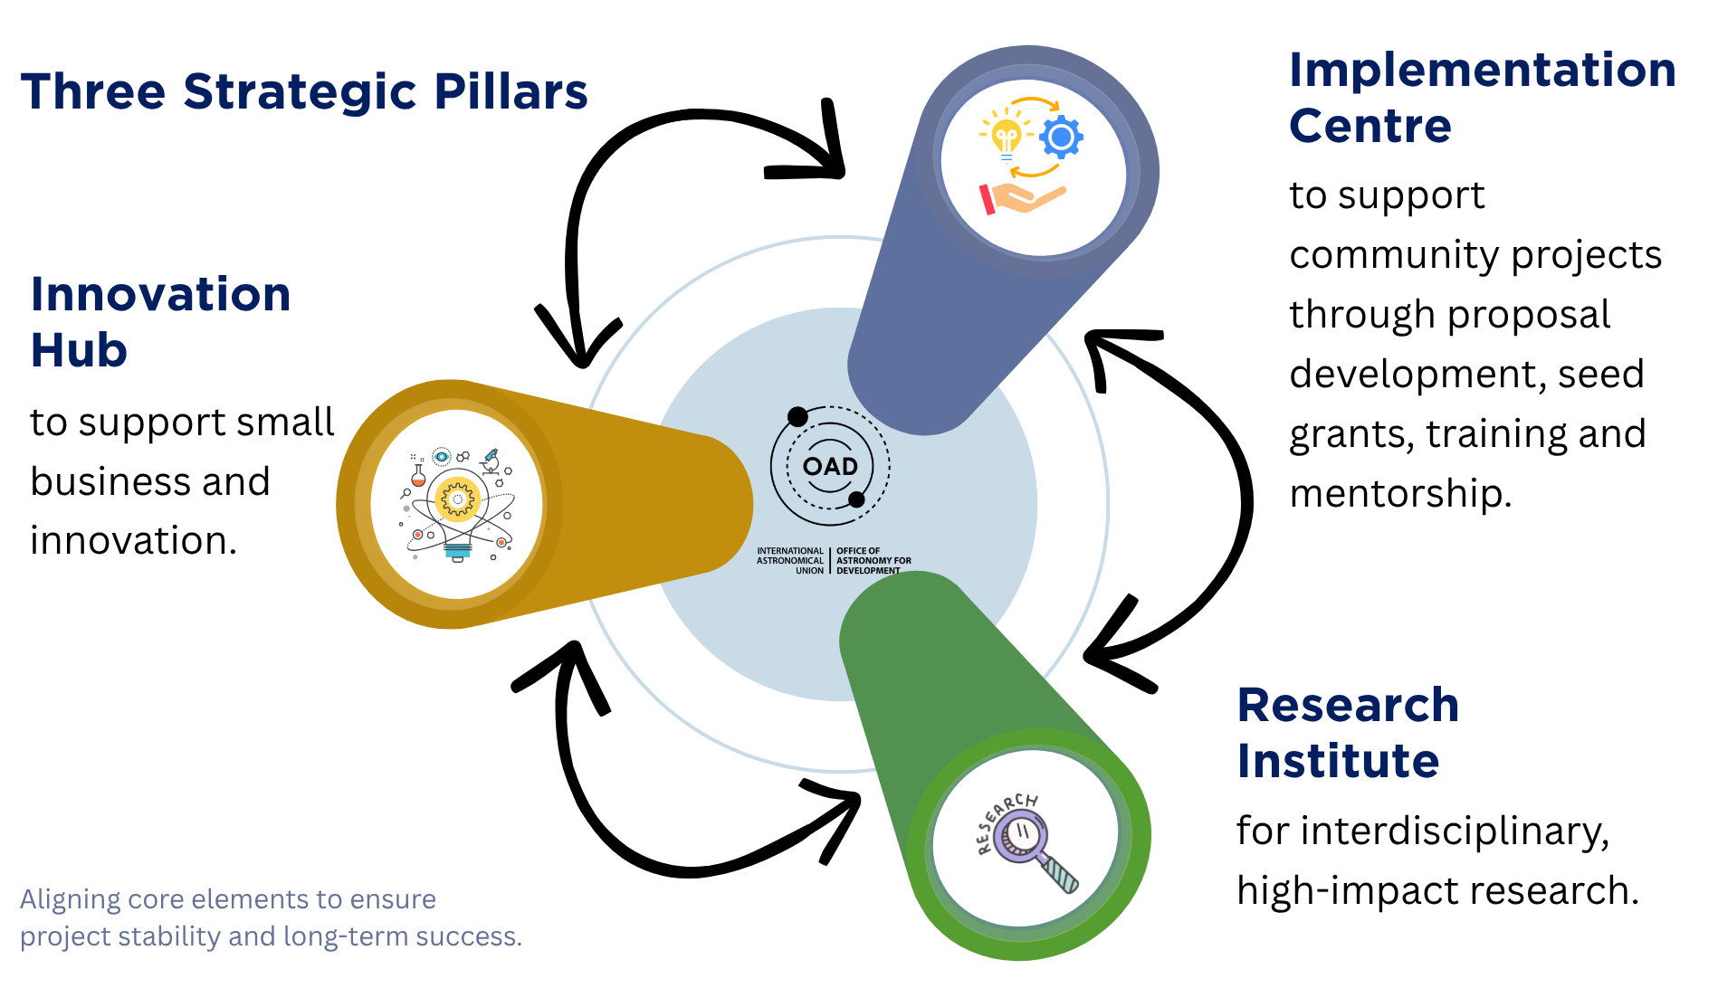
New Growth Directions
Credit: IAU OAO
Still in concept-development phase

Slide 16
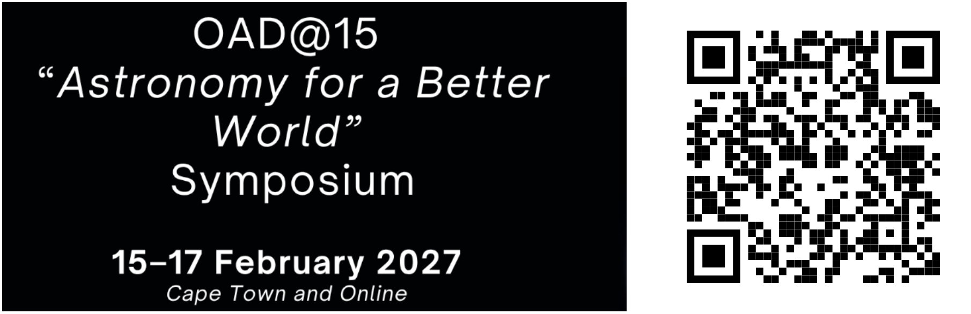
Everyone is welcome!
(Registration Open)
Thank you
joy@astro4dev.org
Credit: IAU OAO

