Slide 1
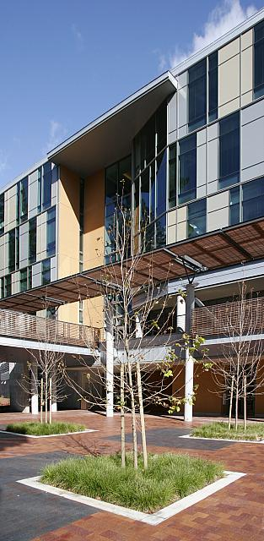

Understanding and reducing lag in amorphous selenium-tellurium photoconductors
Kaitlin Hellier
Radiological Instrumentation Laboratory
Electrical and Computer Engineering
ril.soe.ucsc.edu

Slide 2
Intrinsic lag in a-Se and a-Se:Te
Lag in a-Se is caused by VAPs and undercoordinated bonds
Doping with As addresses VAPs; Cl reduces deep trapping and undercoordination
Mid-deep traps in a-Se (~0.3-0.5 eV from band edge) main factor
Low density and energy, easily overcome at low fields
Lag reduces to <1% for fields > 6 V/um
Incorporating Te increases trap density and energy range
Switch from ring- to chain-like structure → more dangling bonds and VAPs
Lag increases significantly compared to a-Se
First Frame Lag at 20 fps
→ Need to reduce trap formation in Se-Te

Slide 3
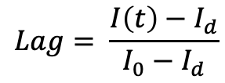
Lag in Se-Te
$$Lag= \frac{{I\left(t\right)−I}_{d}}{I_{0}−I_{d}}$$
Can evaluate lag by looking at rise and fall of signal with light exposure
We see saturation with increasing intensity, which indicates that lag is predominantly controlled by mid-deep trapping
Allows us to evaluate density of traps and lifetime as a function of field
Continuing work will fit data, and explore thermally stimulated current (TSC) to evaluate trap depth
← Increasing Intensity

Slide 4
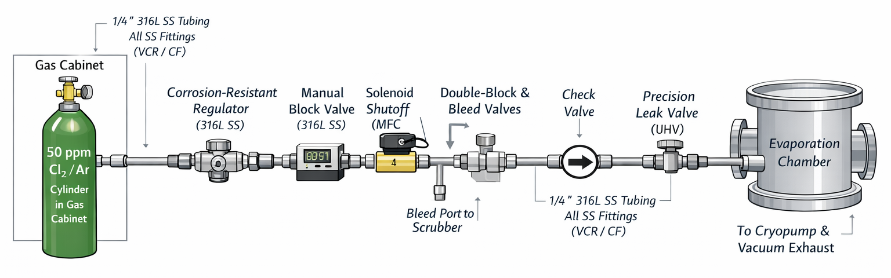
Reducing Lag in a-Se:Te
Cl
Se
Chlorine is commonly used in chalcogenides to passivate defects during and post fabrication
Goal: incorporate Cl to prevent VAP formation and complete dangling bonds
Methods:
Co-deposition: Fabricate films from two sources, stabilized a-Se (0.2% As, 10 ppm Cl) and pure Te, to add small amount of Cl, and adjust a-Se/Cl content according
Pre-alloying: Obtain pre-mixed Se-Te with 25 ppm Cl to incorporate during evaporation
Gas flow: Ar:Cl (50 ppm) gas mix added to system during fabrication through extremely low flow leak valve
Te

Slide 5
Impact of HBL on Device Lag
High conductivity of Se-Te sends detector to breakdown (Joule heating) at low bias and gives high dark current without blocking layers
Holes are the primary injector; HBL required to go to high fields
Optimal device structure requires hole collection → HBL deposited on top of Se-Te in vertical structure
Limited options to achieve high transparency and good blocking with low temperature fabrication that doesn’t damage Se-Te layer
Implementation of SiO₂ deposited by e-beam successful for achieving current and QE targets up to moderate fields; however, significant impact on lag
First Frame Lag at 20 fps
Target
→ Need to explore alternative HBLs and new deposition methods

Slide 6
Investigation of a new HBL Layer
Utilizing a thin layer of Se-Te (3 um) increases the impact of defects in the HBL and at the interface compared to traditional thicknesses
Using an insulating layer is no longer as effective, as it is easier to overblock with small changes in thickness
→ Semiconducting layers may be more effective to ensure no lag reduction
CeO₂ is commonly used with a-Se, but difficult to develop with sputtering at low temperatures
SnO₂ (spin coated nanoparticles) has been used for thin Se_{0.6}Te_{0.4} photodiodes [1]; however not tested for lag and presents risk
New sputtering system will allow deposition of both materials; will require optimization
 | Target Thickness | CBM | VBM
Se-Te | 3 um | -3.8 | -5.4
HBLs | Target Thickness | CBM | VCM | Hole Barrier (eV) | Electron Barrier (eV) | Trapping / Interface Comments | Additional Comments
SnO₂ | 5–20 nm | −4.2 | −7.8 | 2.4 | 0.4 | Oxygen vacancies → electron traps; sputter damage risk | Best balance of extraction + blocking
CeO₂ | 10–30 nm | −3.7 | −7.3 | 1.9 | 0.1 | Ce³⁺ states → trapping if oxygen-deficient | Sensitive to stoichiometry
TiO₂ | 5–15 nm | −4.1 | −7.4 | 2 | 0.3 | Known for electron trapping → lag risk | Likely worse for lag-sensitive systems
HfO₂ | 0.5–3 nm | −2.2 | −8.2 | 2.8 | 1.6 | Deep traps, fixed charge, overblocking | Not suitable as main HBL
Al₂O₃ | 0.5–2 nm | −1.2 | −8.8 | 3.4 | 2.6 | Strong blocking, deep traps | High risk of overblocking electrons
SiO₂ | 0.3–1 nm | −1.0 | −9.0 | 3.6 | 2.8 | Very insulating; tunneling-limited | Only for ultrathin passivation if needed
[1] R. Li, S. Bai, Z. Jia, X. Chen, Y. Liu, and Q. Lin, “Flexible Broadband Photodiodes Based on Amorphous Te0.4Se0.6 Thin Films,” ACS Photonics, vol. 11, no. 6, pp. 2521–2527, Jun. 2024, doi: 10.1021/acsphotonics.4c00543.

Slide 7
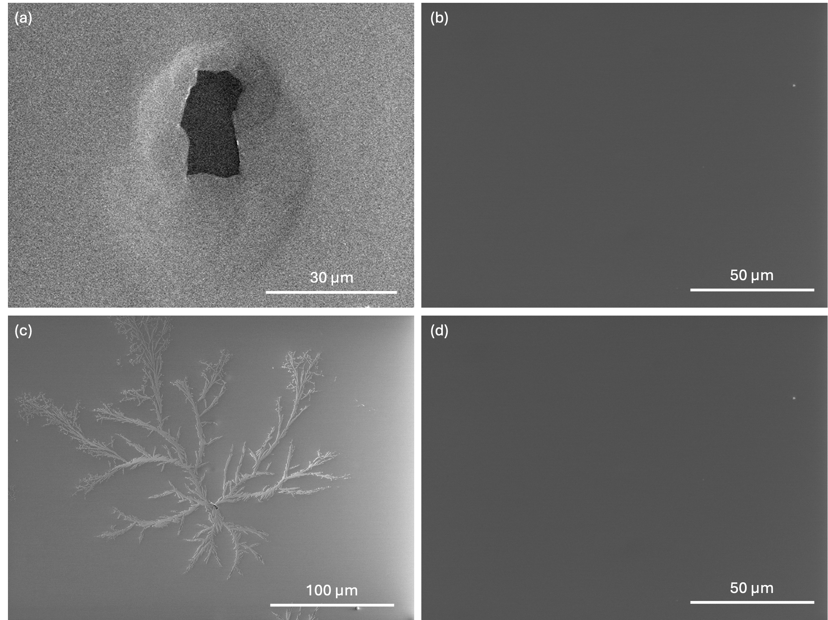
Oxidation
Batch A – 1 week
Batch B – 1 week
Study of evaporation materials with air exposure led to discovery that Te forms Te-O bonds over time → amorphous TeO_{x} at surface of pellets
This penetrates deeper into pellets over time
Use of poor-quality pellets creates poor-quality films/photodetectors
TeO_{x} formation creates nucleation point for t-Se crystallization, both in pellets and in films
TeO_{x} also increases resistances and provides additional points for trapping
Shows Te is more susceptible to oxygen exposure in Se-Te than Se in a-Se
Want to prevent air exposure or potential oxygen interaction with blocking layers, either during deposition or over time at interfaces
Batch A – 5 months
Batch B – 5 months

Slide 8
Passivation/Protection Layers
Passivation layer | Target Thickness | LUMO / CBM (eV) | HOMO / VBM (eV) | Hole Barrier (eV) | Electron Barrier (eV) | Trapping / Interface Comments | Additional Comments
Parylene-C | 5–30 nm | −2.3 | −6.8 | 1.4 | 1.5 | Very low traps; chemically inert | Best for preventing Te oxidation
Fluoropolymer (CYTOP, etc.) | 3–20 nm | ~−2.0 | ~−7.0 | ~1.6 | ~1.8 | Very inert; low trap density | Hydrophobic; good barrier layer
SiNₓ | 1–3 nm | ~−2.5 | ~−7.5 | ~2.1 | ~1.3 | Fixed charge + plasma damage risk | Good if low-damage deposition possible
AlN | 0.5–2 nm | ~−2.0 | ~−7.8 | ~2.4 | ~1.8 | Wide-gap; possible interface charge | Less mature for this application
MgF₂ / AlF₃ | 0.3–1.5 nm | ~−0.8 to −1.5 | ~−8 to −10 | >3 | >2 | Very inert; tunneling-limited | Good purely for oxidation suppression
GeOₓ | 0.3–1.0 nm | ~−3.5 | ~−7.5 | ~2.1 | ~0.3–0.5 | Known passivation with CeO₂; some trap risk | Proven in a-Se systems
HfO₂ (ultrathin) | 0.5–1.5 nm | −2.2 | −8.2 | 2.8 | 1.6 | Strong passivation; deep traps possible | Better than SiO₂ for tunneling
Al₂O₃ (ultrathin) | 0.4–1.2 nm | −1.2 | −8.8 | 3.4 | 2.6 | Strong blocking; risk of overblocking | Use thinner than HfO₂
SiO₂ (ultrathin) | 0.3–1.0 nm | −1.0 | −9.0 | 3.6 | 2.8 | Highly insulating; tunneling-limited | Only if others unavailable
HBL | Target Thickness | LUMO (eV) | HOMO (eV) | Hole Barrier (eV) | Electron Barrier (eV) | Trapping / Interface Comments | Additional Comments
PTCBI (perylene tetracarboxylic bisbenzimidazole) | 5–20 nm | ~−4.0 to −4.2 | ~−6.2 to −6.5 | 0.8–1.1 | 0.2–0.4 | Generally low trap density vs oxides; possible crystallinity; interface-sensitive; organic disorder may introduce shallow traps but fewer deep oxide traps | Demonstrated in a-Se detector literature as HBL; oxygen-free; vacuum deposition; good balance of blocking + transport
Sputtering may create plasma damage at Se-Te surface
→ Implementation of a protective layer will prevent damage
Use of oxides may create a-TeO_{x} layer at Se-Te interface
Implementation of an oxygen-free layer will prevent oxidation
Avoiding sputtering more ideal to prevent first issue, except for gentle materials
Could also investigate PTCBI as combined organic protection/HBL; however, previous results with thick devices showed high DC (Abbaszadeh 2012)

Slide 9
Next steps for reducing lag from HBLs
Investigation of PTCBI and SnO2 nanoparticles in single pixel devices
Evaporation and solution processing, easily and quickly obtainable
Quickly testable while awaiting sputtering system installation
Investigation of passivation/protection layer
Evaluation of (very thin) parylene in conjunction with SnO2 nanoparticles
Exploration of fluoropolymers and deposition on Se-Te, impact on transport
Development of SnO₂ and CeO₂ by sputtering
Optimize process conditions, film fabrication
Look for effects of plasma damage and if passivation layer required
Evaluate ability for deposition on top of Se-Te, further optimization
Further exploration of passivation layers (if required) and compatibility, with lag reduction key factor

