Slide 1
CFD Simulation of Target Cell and Gas Supply System
Siddharth Thakker
April 8th, 2026 Institute of Nuclear Physics Johannes Gutenberg University Mainz

Slide 2
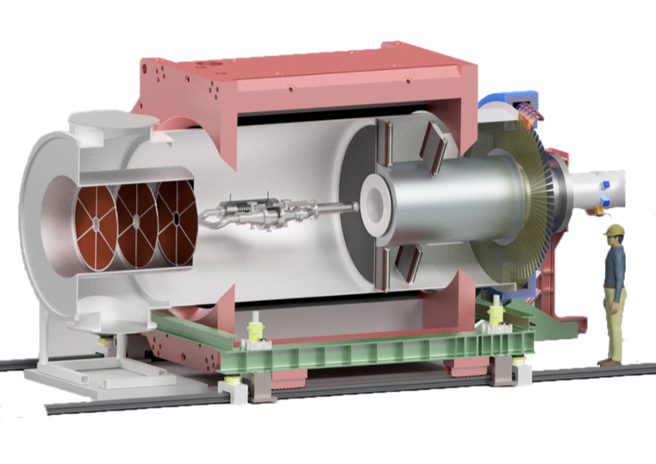
Experimental setup
Superconducting solenoid
Tracking detectors (forward scattering)
Integrating Cherenkov detector ring
Vacuum chamber
Lead Shielding
Beam
Luminosity detector
Liquid hydrogen target loop
Tracking detector (forward scattering)

Slide 3
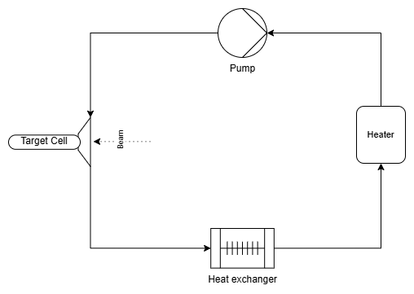
The liquid hydrogen target loop
Fig: Loop flow diagram

Slide 4
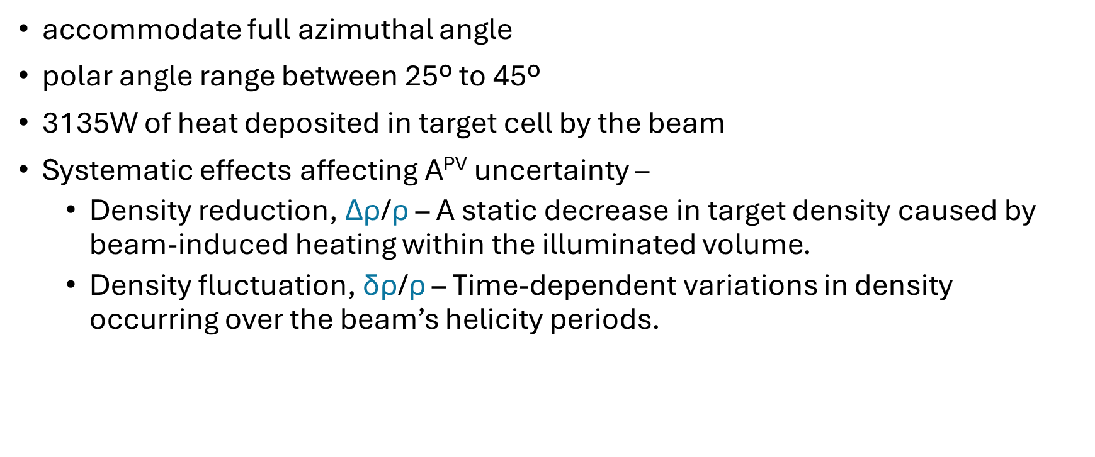
Design requirements
accommodate full azimuthal angle
polar angle range between 25º to 45º
3135W of heat deposited in target cell by the beam
Systematic effects affecting A^{PV} uncertainty –
Density reduction, ∆$\text{ρ}$/$\text{ρ}$ – A static decrease in target density caused by beam-induced heating within the illuminated volume.
Density fluctuation, δ$\text{ρ}$/$\text{ρ}$ – Time-dependent variations in density occurring over the beam’s helicity periods.

Slide 5
Target cell specifications
Pressure/temperature | 2.4bar / 20K
Cell length | 60cm
Mass flow rate | < 2kg/s
lH2 pump head | < 0.1bar
Beam area on target | 25mm²
Heat deposited | 3.1kW
Target thickness | 4.3g/cm²
lH2 ∆ρ/ρ | <2%
lH2 δρ/ρ at 1 kHz | <10ppm
Table: All design parameters for target cell

Slide 6
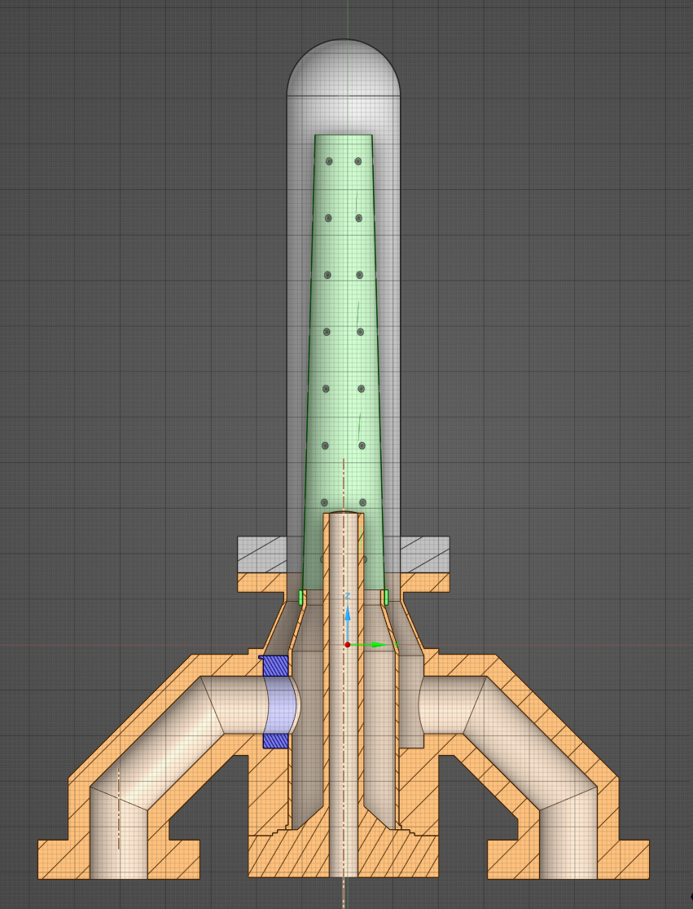
Target cell
Exit window
Hydrogen target shell
Inner cone
Fig: Target cell
with manifold
Entrance window
H2
Manifold
H2
beam

Slide 7
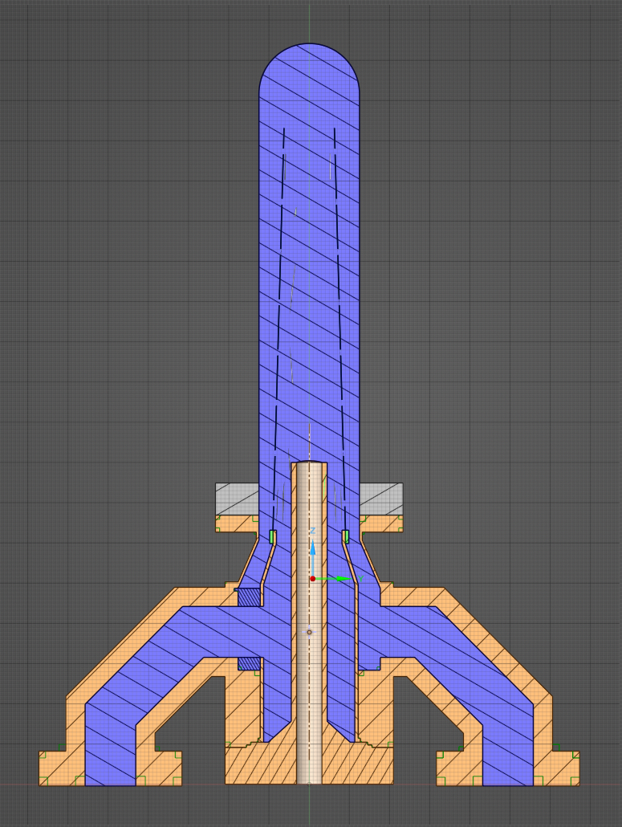
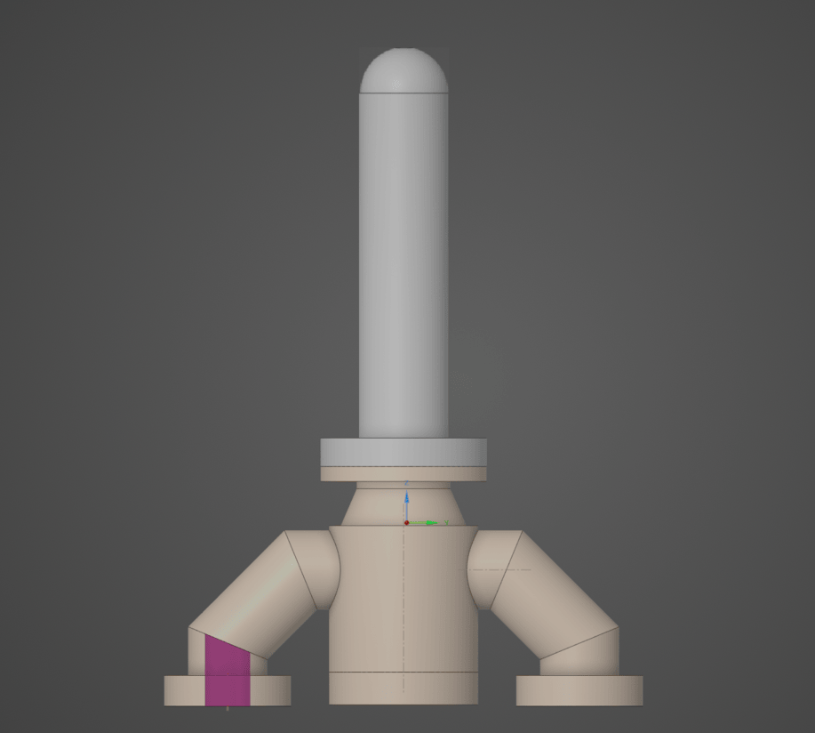
Fig: Target cell During operation
Fig: Target cell Animation of the liquid hydrogen flow

Slide 8

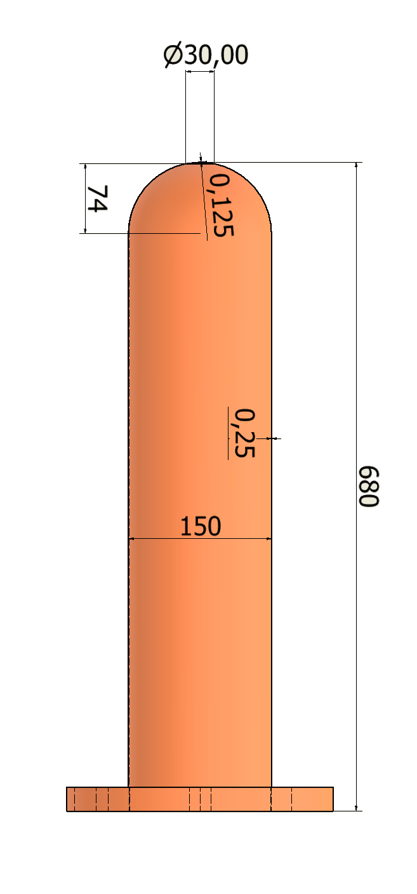
Hydrogen target shell
Beam exit
Thickness:
Hemispherical window
(in mm)

Slide 9
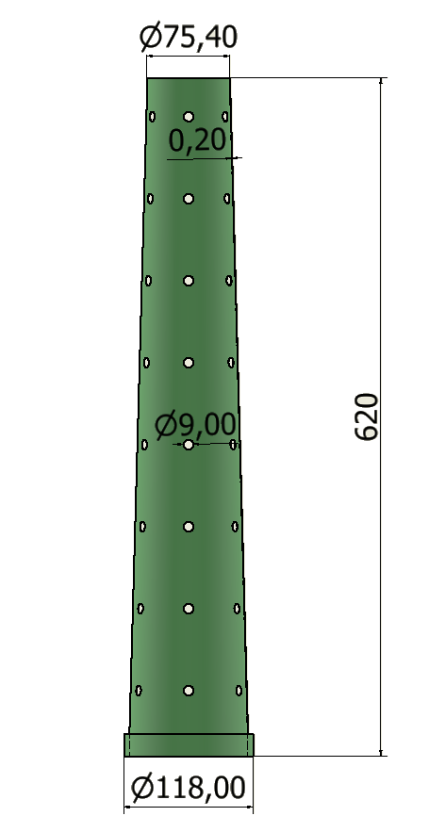

Inner Cone/ Conical Flow Diverter
Thickness:
Flow out
Holes
Flow in
(in mm)

Slide 10
CFD simulation of target cell
Target cell with its manifold
Steady state simulation
20K liquid H2
Mass flow 1.9 kg/s
Turbulence using K-epsilon viscous model
5x5mm rastered beam depositing 3.1kW

Slide 11
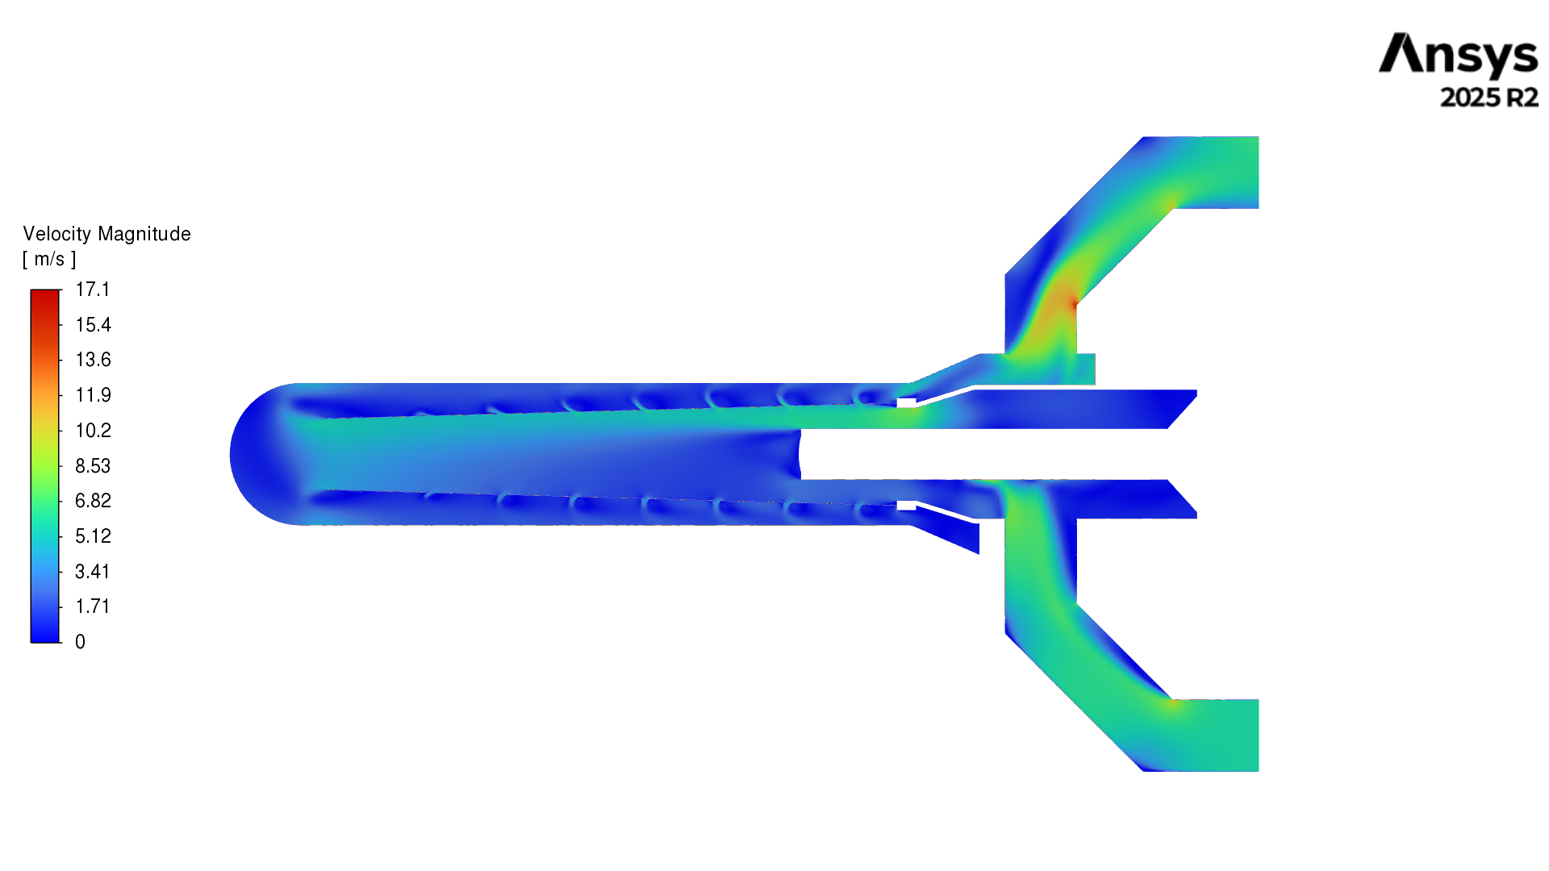
Velocity contour
Flow out
Inside the inner cone: velocity > 0.025m/s, turbulent
---------------- beam
Avg total velocity 4.9 m/s
Flow in

Slide 12
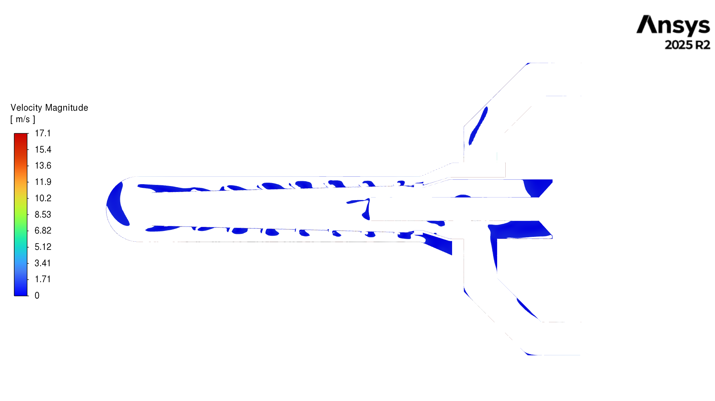
Low velocity regions with < 1m/s
Problematic regions close to windows
Flow out
---------------- beam
Flow in

Slide 13
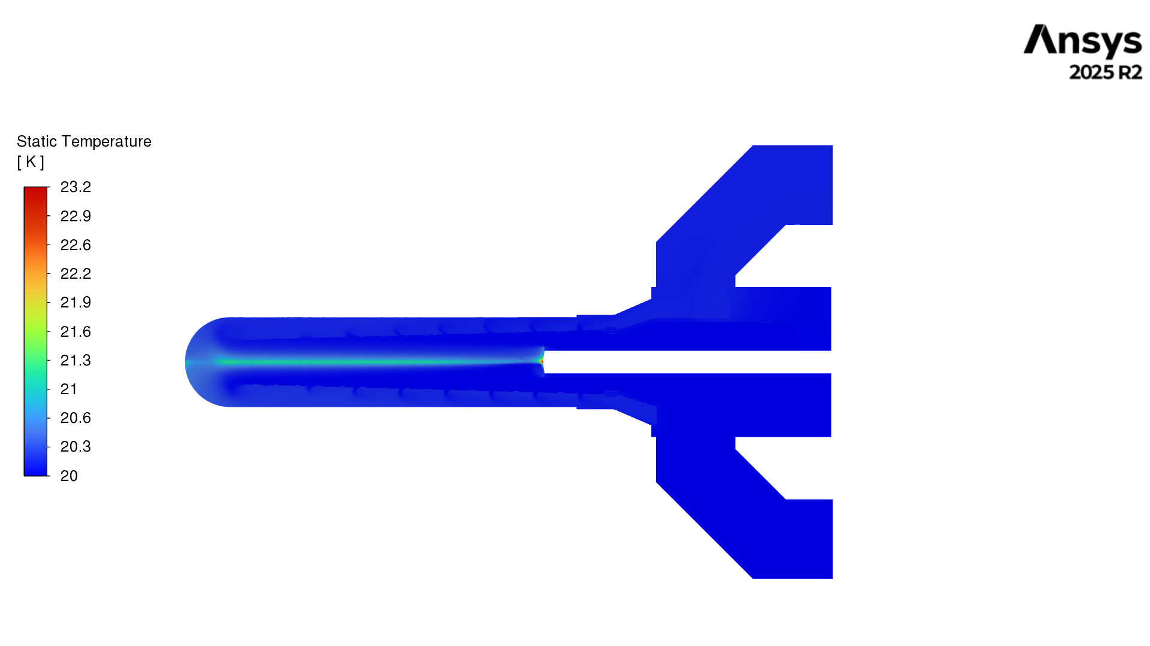
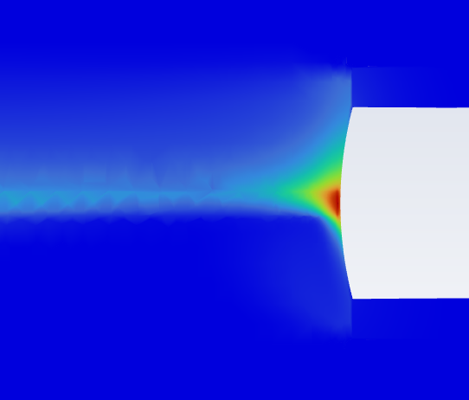
Temperature contour
Flow out
---------------- beam
lq H2 is expected
to boil at 23.2K
Flow in

Slide 14
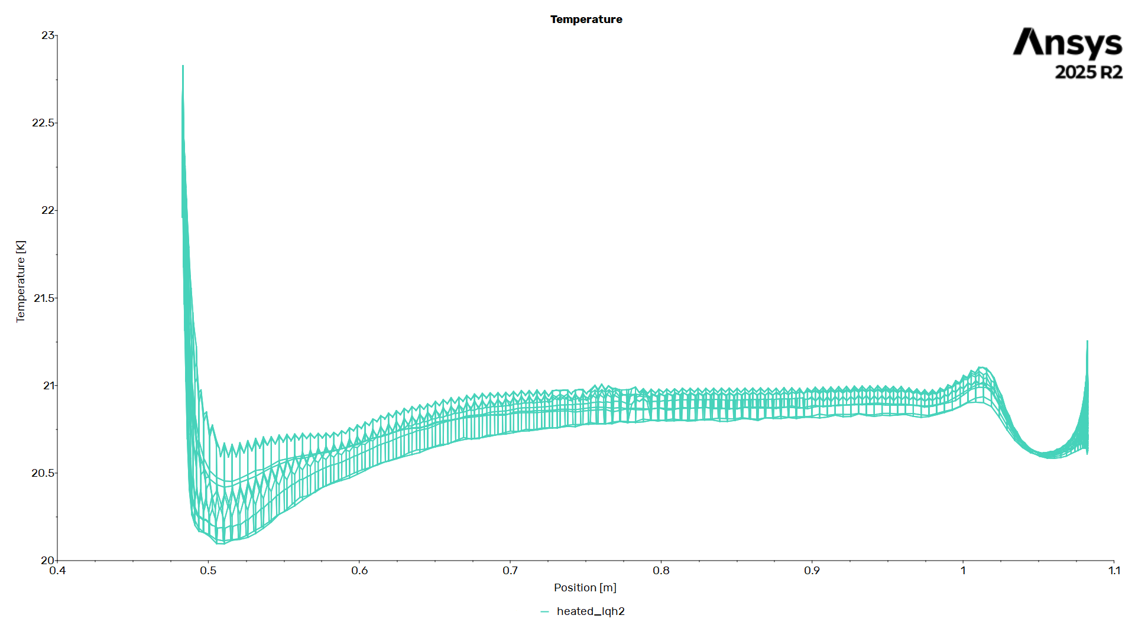
Temperature variation at the beam
Entrance window
Exit window

Slide 15
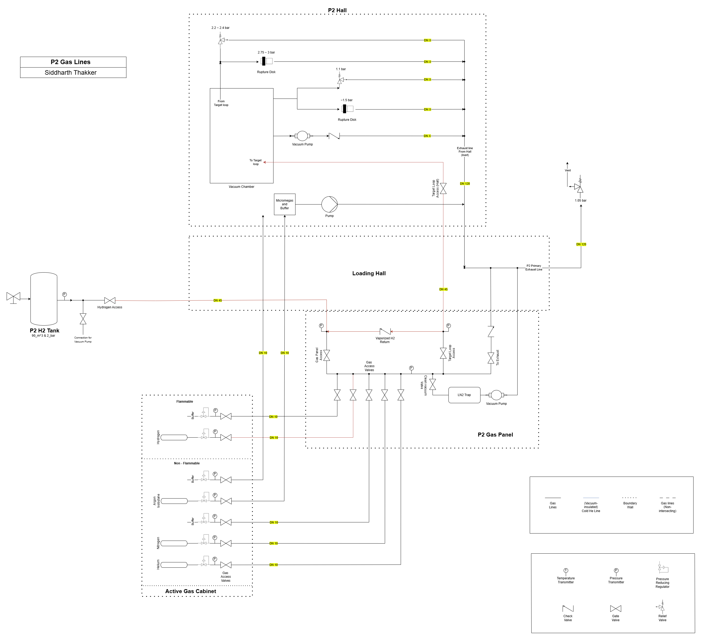
Gas supply and safety
Parts
Active gas cabinet
Gas Panel
Supply lines
Exhaust lines
Operation
Commencing – Vacuum in supply lines, inerting the exhaust lines, hydrogen supplied to the loop and cooled
During the experiment – lq H2 in the loop, exhaust lines in place
After the experiment – lq H2 slowly boils and returns to tank via check valve
Fig: P2 P&ID diagram

Slide 16
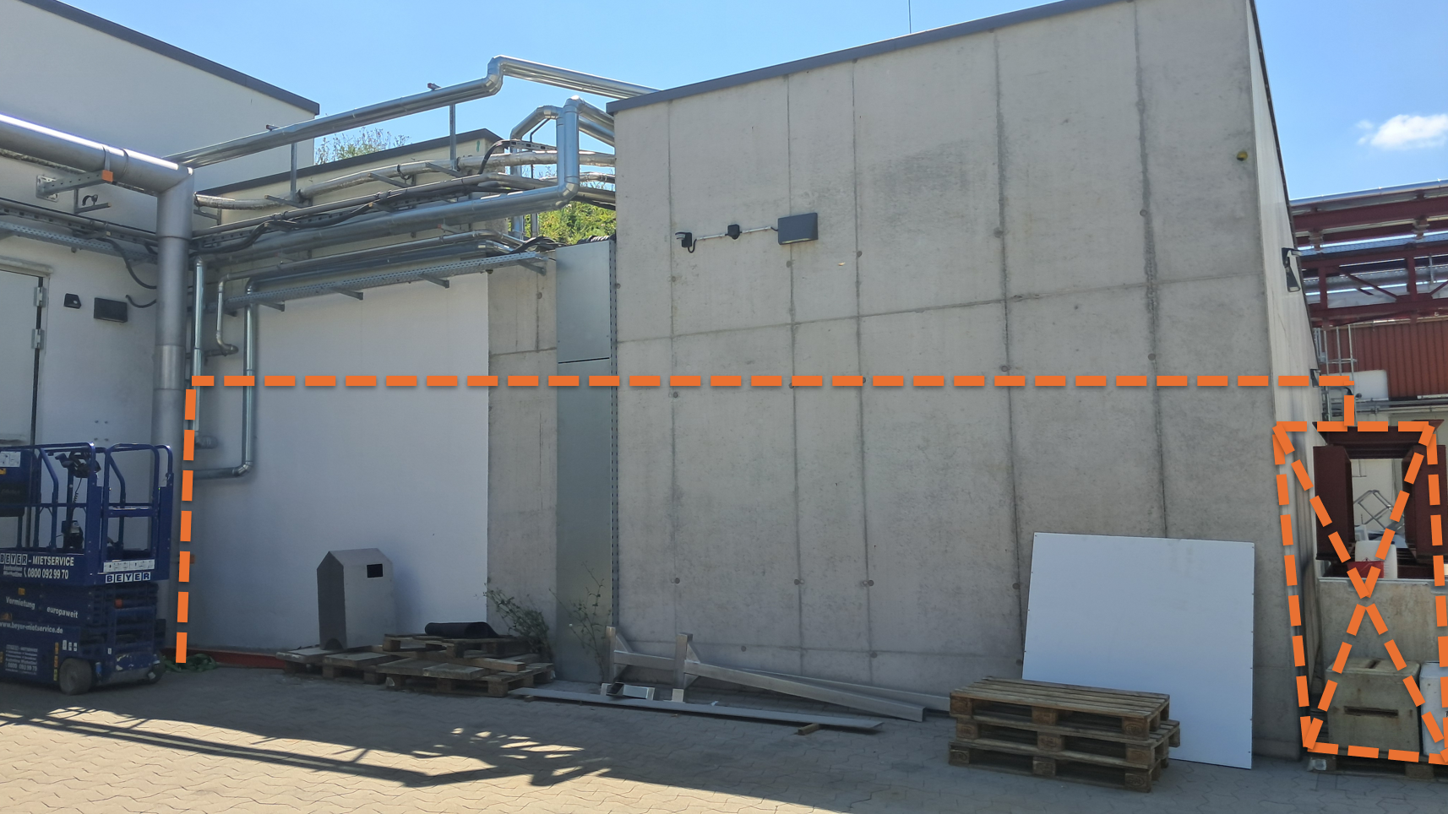
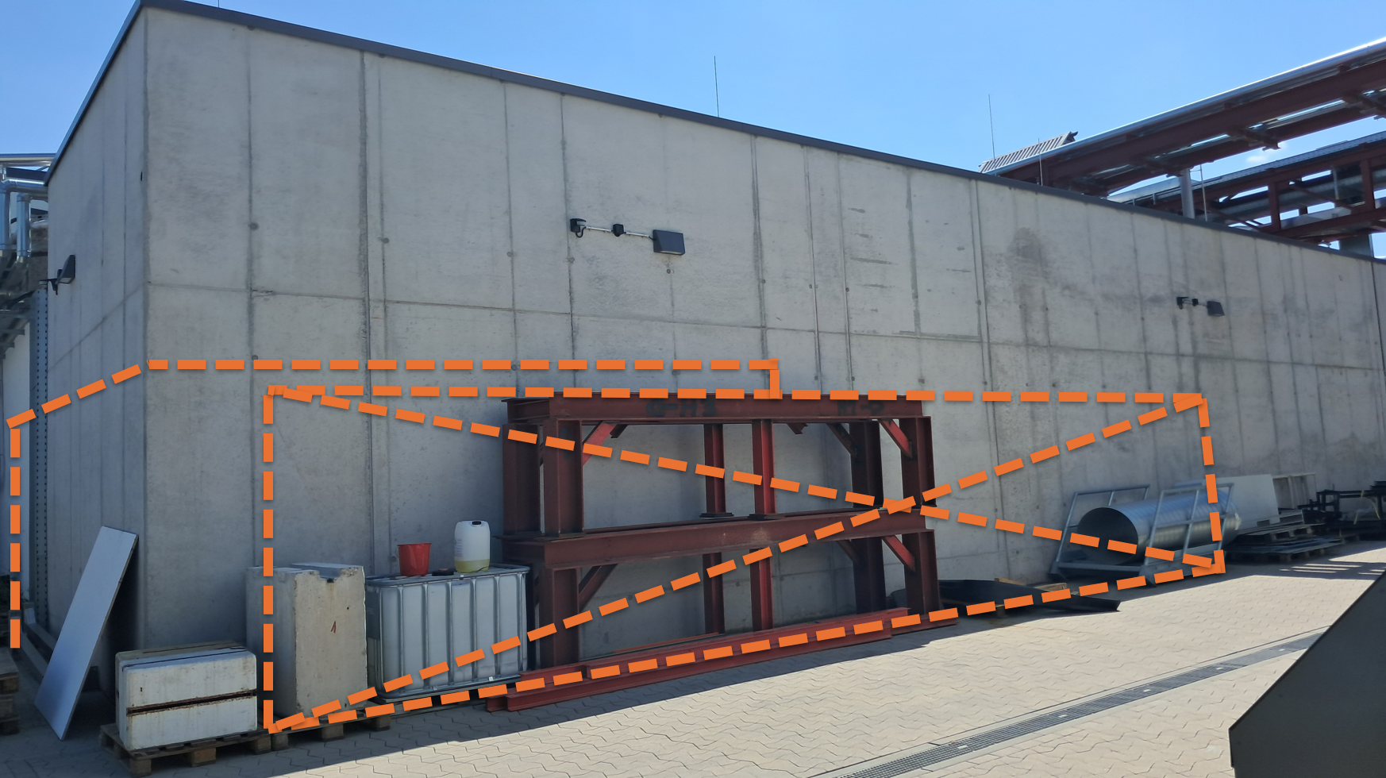
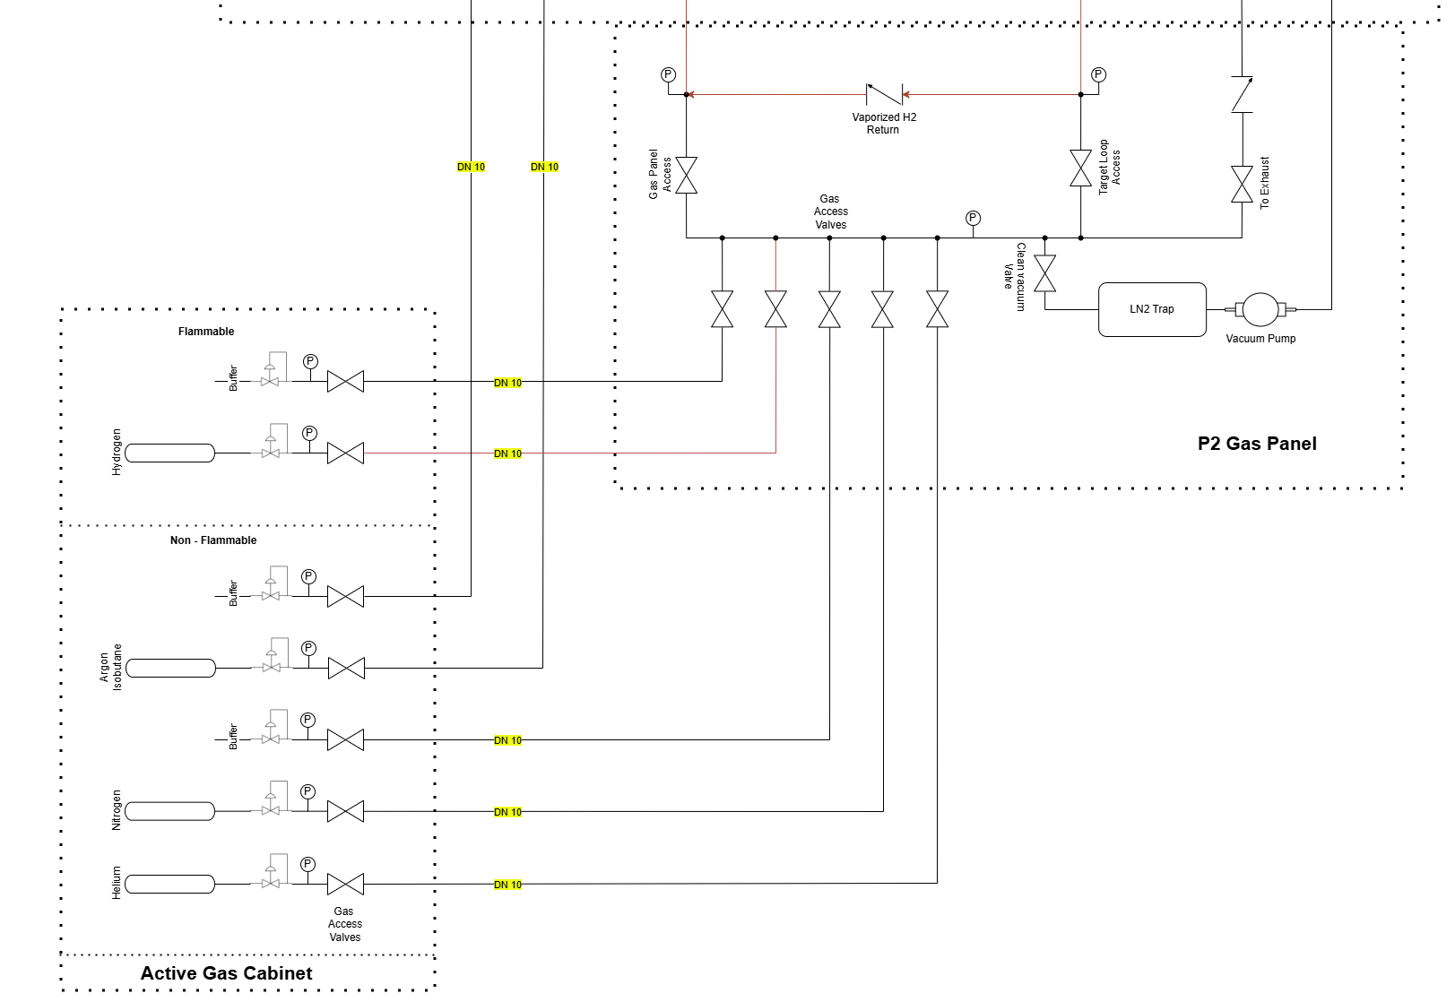
Active Gas Cabinet: Bottle connections of
Hydrogen
Helium – to test leaks
Nitrogen – to provide an inert environment in the exhaust line
Argon isobutane
Gas Panel
Active Gas Cabinet
Gas Panel
The gas panel is the main control station
Connections to/from AGC, hydrogen tank, Target loop and exhaust lines
Vacuum pump venting out to exhaust lines through LN2 trap

Slide 17
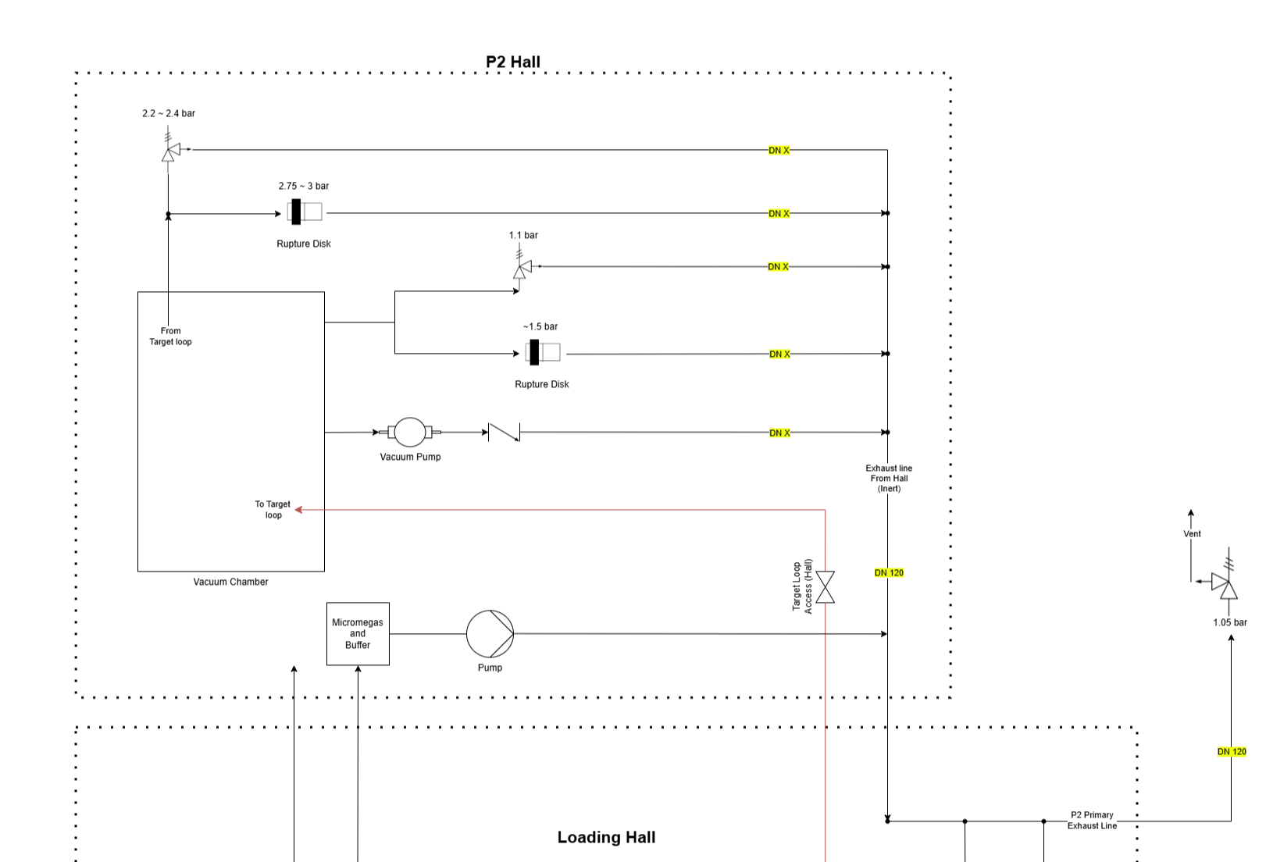
Exhaust and emergency relief
Case 1
Case 2
A primary exhaust line, where all other lines connect
Exhaust for vacuum chamber
Emergency case 1 – high pressure in the gas lines
Emergency case 2 – Explosion of the target cell

Slide 18
Summary and next steps
Lq H2 target cell design
CFD simulation of the target cell
Problem identification in the geometry
Gas supply and safety
Next steps
Advancing simulation with added multiphase and transient state
Extraction of required values of density fluctuation and reduction
Modification in the geometry to satisfy all requirements
Thank you

Slide 19
Extra slides

Slide 20
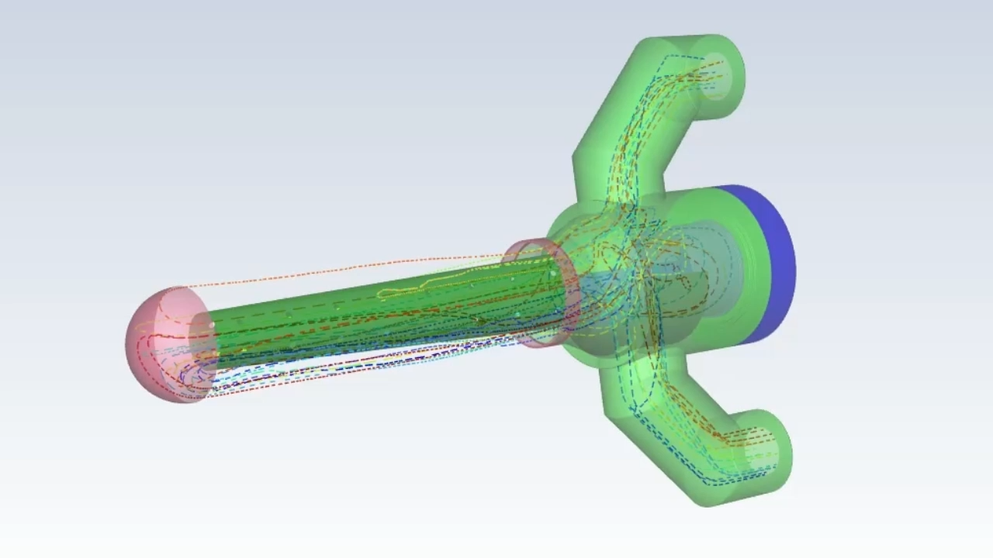
Pathlines
Flow from holes
in inner cone
Flow out
Flow turns around, goes upstream
Flow in

Slide 21
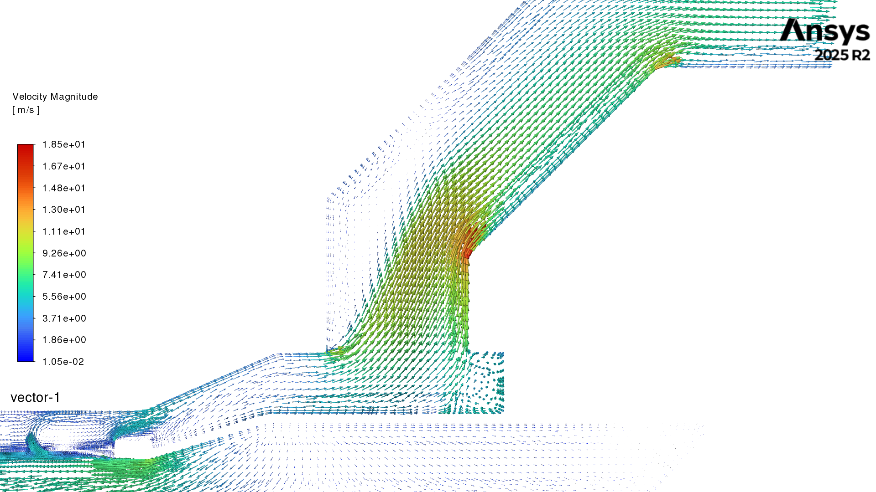
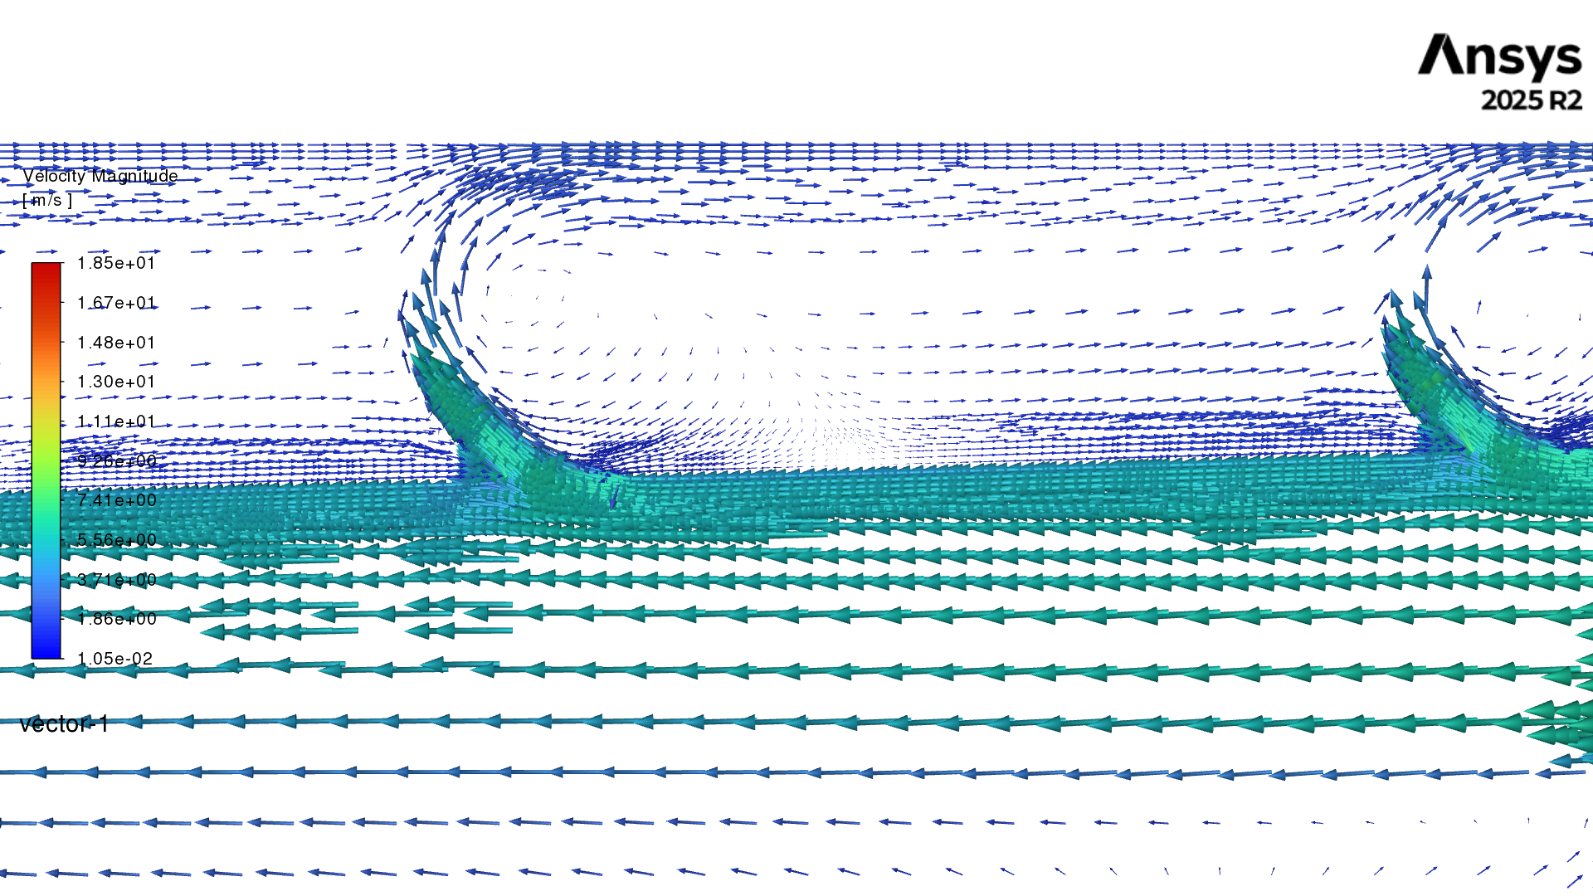
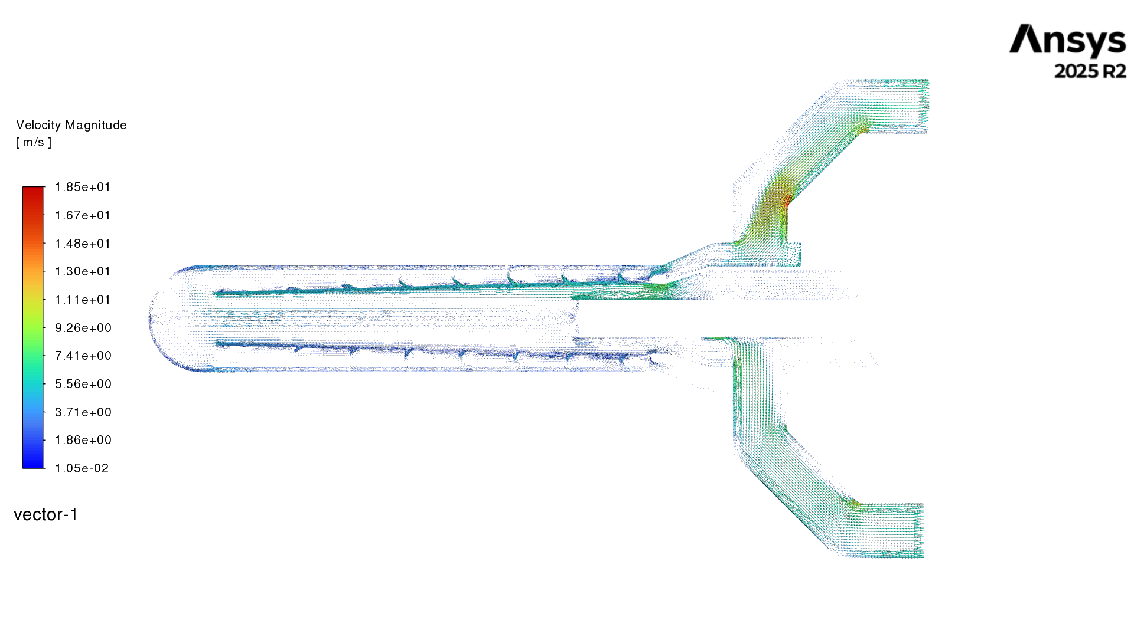

Slide 22
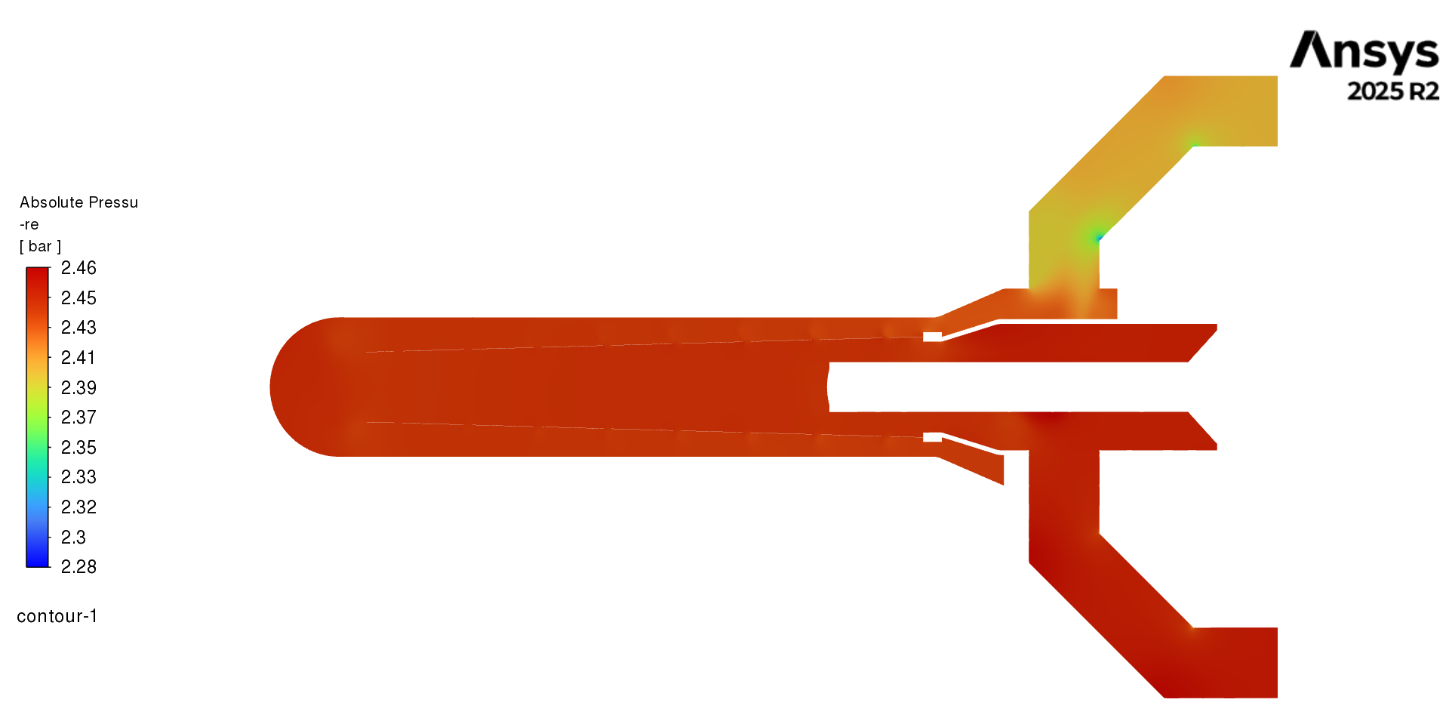

Slide 23

Heat exchanger
Used to remove the heat load from the target loop using He gas coolant
Will be modeled after the Qweak Counter flow heat exchanger with copper finned tube
The mass flow needed can be calculated:
For ex, He inlet – 10 atm and 14K, Outlet – 3 atm 20K, then 101g/s He flow is required
The HX design will be assessed with CFD
P is the total cooling power
∆H is the He enthalpy bw He inlet and outlet
$$ṁ =\text{P}\text{/}\text{∆}\text{H}$$

Slide 24
High power heater (HPH)
Used to mitigate lH2 density variations and relaxation time when the beam trips
HPH works in a feedback loop with the read-back of a temperature sensor in the Lq H2
Ensures that the target is operated at constant heat load and regulate the temperature
The qweak like heater is designed to have eight layers of Nichrome wire wrapped around crossed G10 boards.

Slide 25
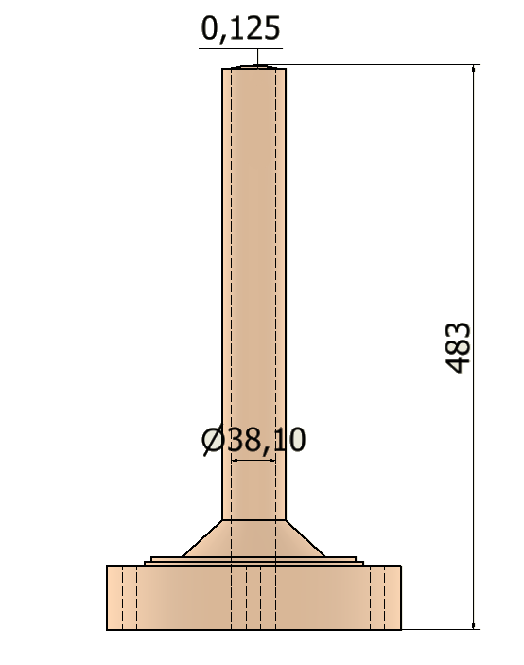

Beam guide
Thickness at entrance window:
Entrance window
(in mm)

