Slide 1
Mainz status and timeline
Cherenkov detector
Hydrogen target
Accelerator
Superconducting solenoid

Slide 2
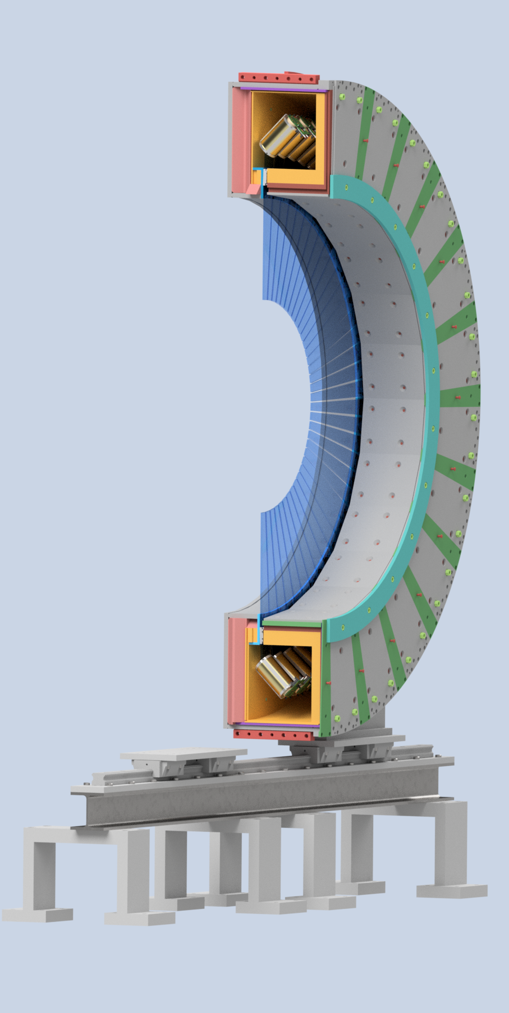
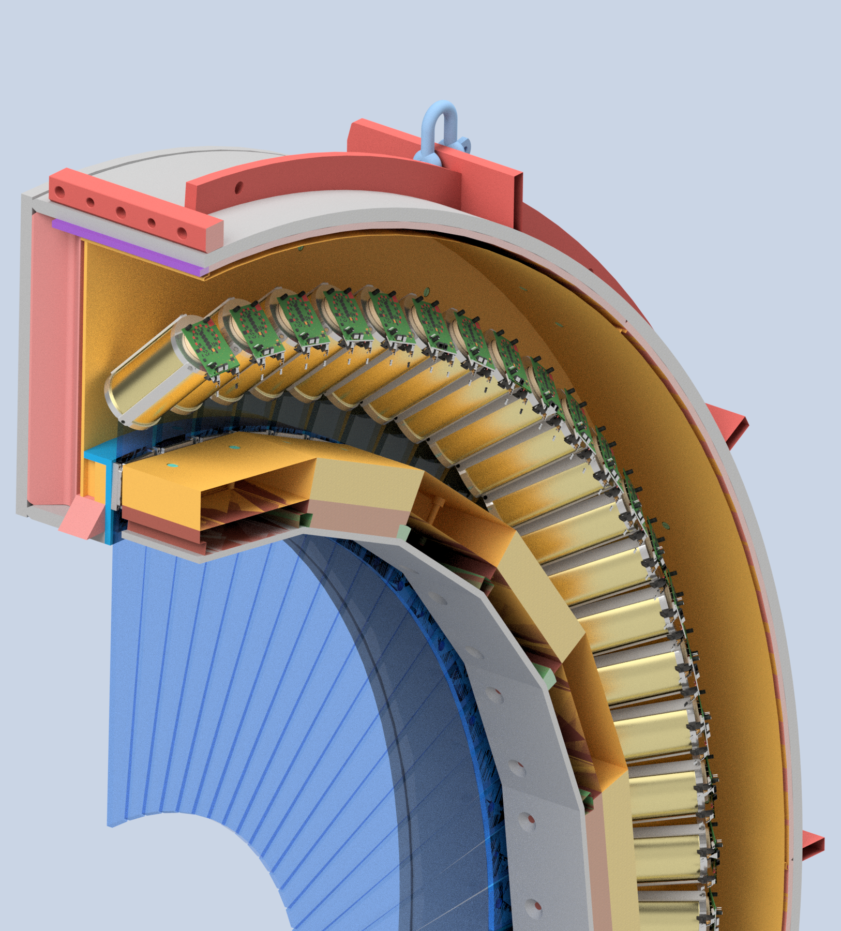
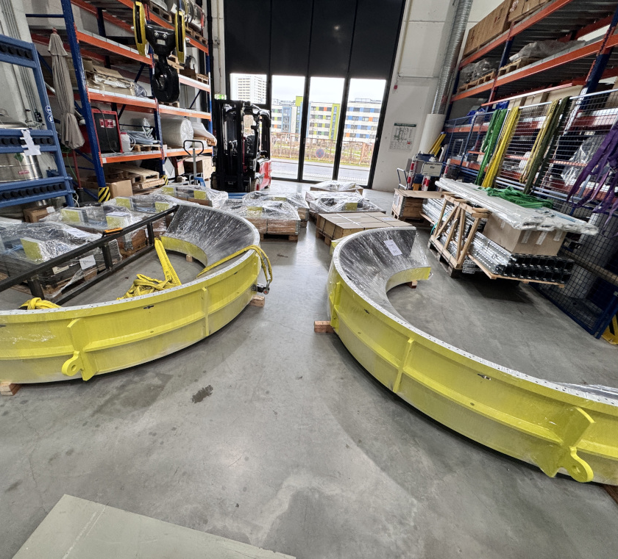
Cherenkov Detector
Support structure and housing delivered on 24. February
Received offer from Alanod for wrapping material (3.5t)
Planning of a test stand for finished detector modules started

Slide 3
Hydrogen target
Offer from NTG for a design study
Target support table
Positioning mechanism
Finalization of the explosion protection concept ongoing
CFD simulation and Geant4 simulations ongoing
See talks by Siddarth and Jayanta

Slide 4
MESA time plan
Unchanged since February meeting
First beam from MESA scheduled for June 2027 (unpolarised, 1µA)
Subsequently beam for experiments:
MAGIX: September 2027
P2: November 2027

Slide 5
MESA cryo-test
First test started 12.2.26
Ended 14.2.26 by break of burst disk on cryo-module 2
Trigger: Excessive lHe consumption exciding liquefiers intake capacity
Overpressure caused main compressor shutdown
Compressor restarted but turbines already stopped
Major design error of the helium guard on the cryo-module
Pressure relief valve with cracking pressure >1.5barG used (should be >50mbar)
Rapture of burst disk at 1.4 bar
Next cryo-test end of May

Slide 6
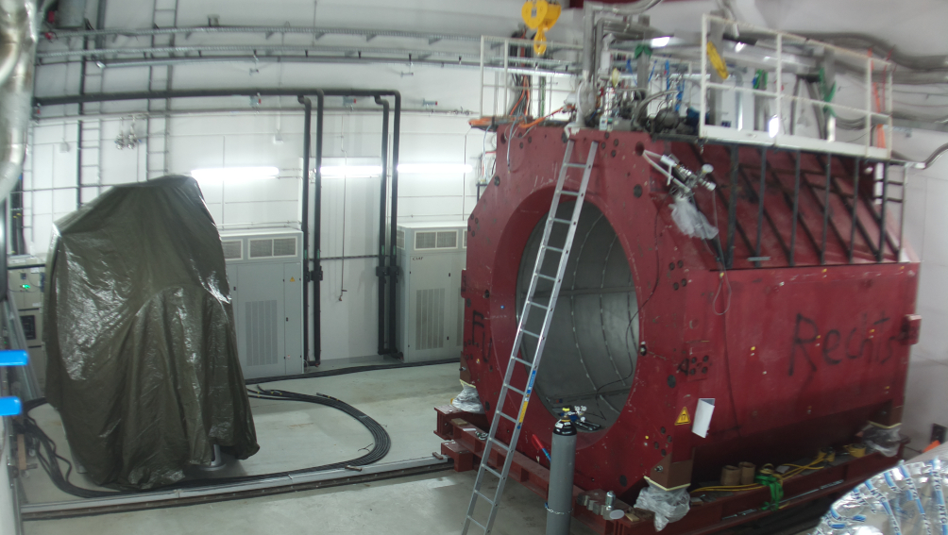
View of the P2 hall

Slide 7
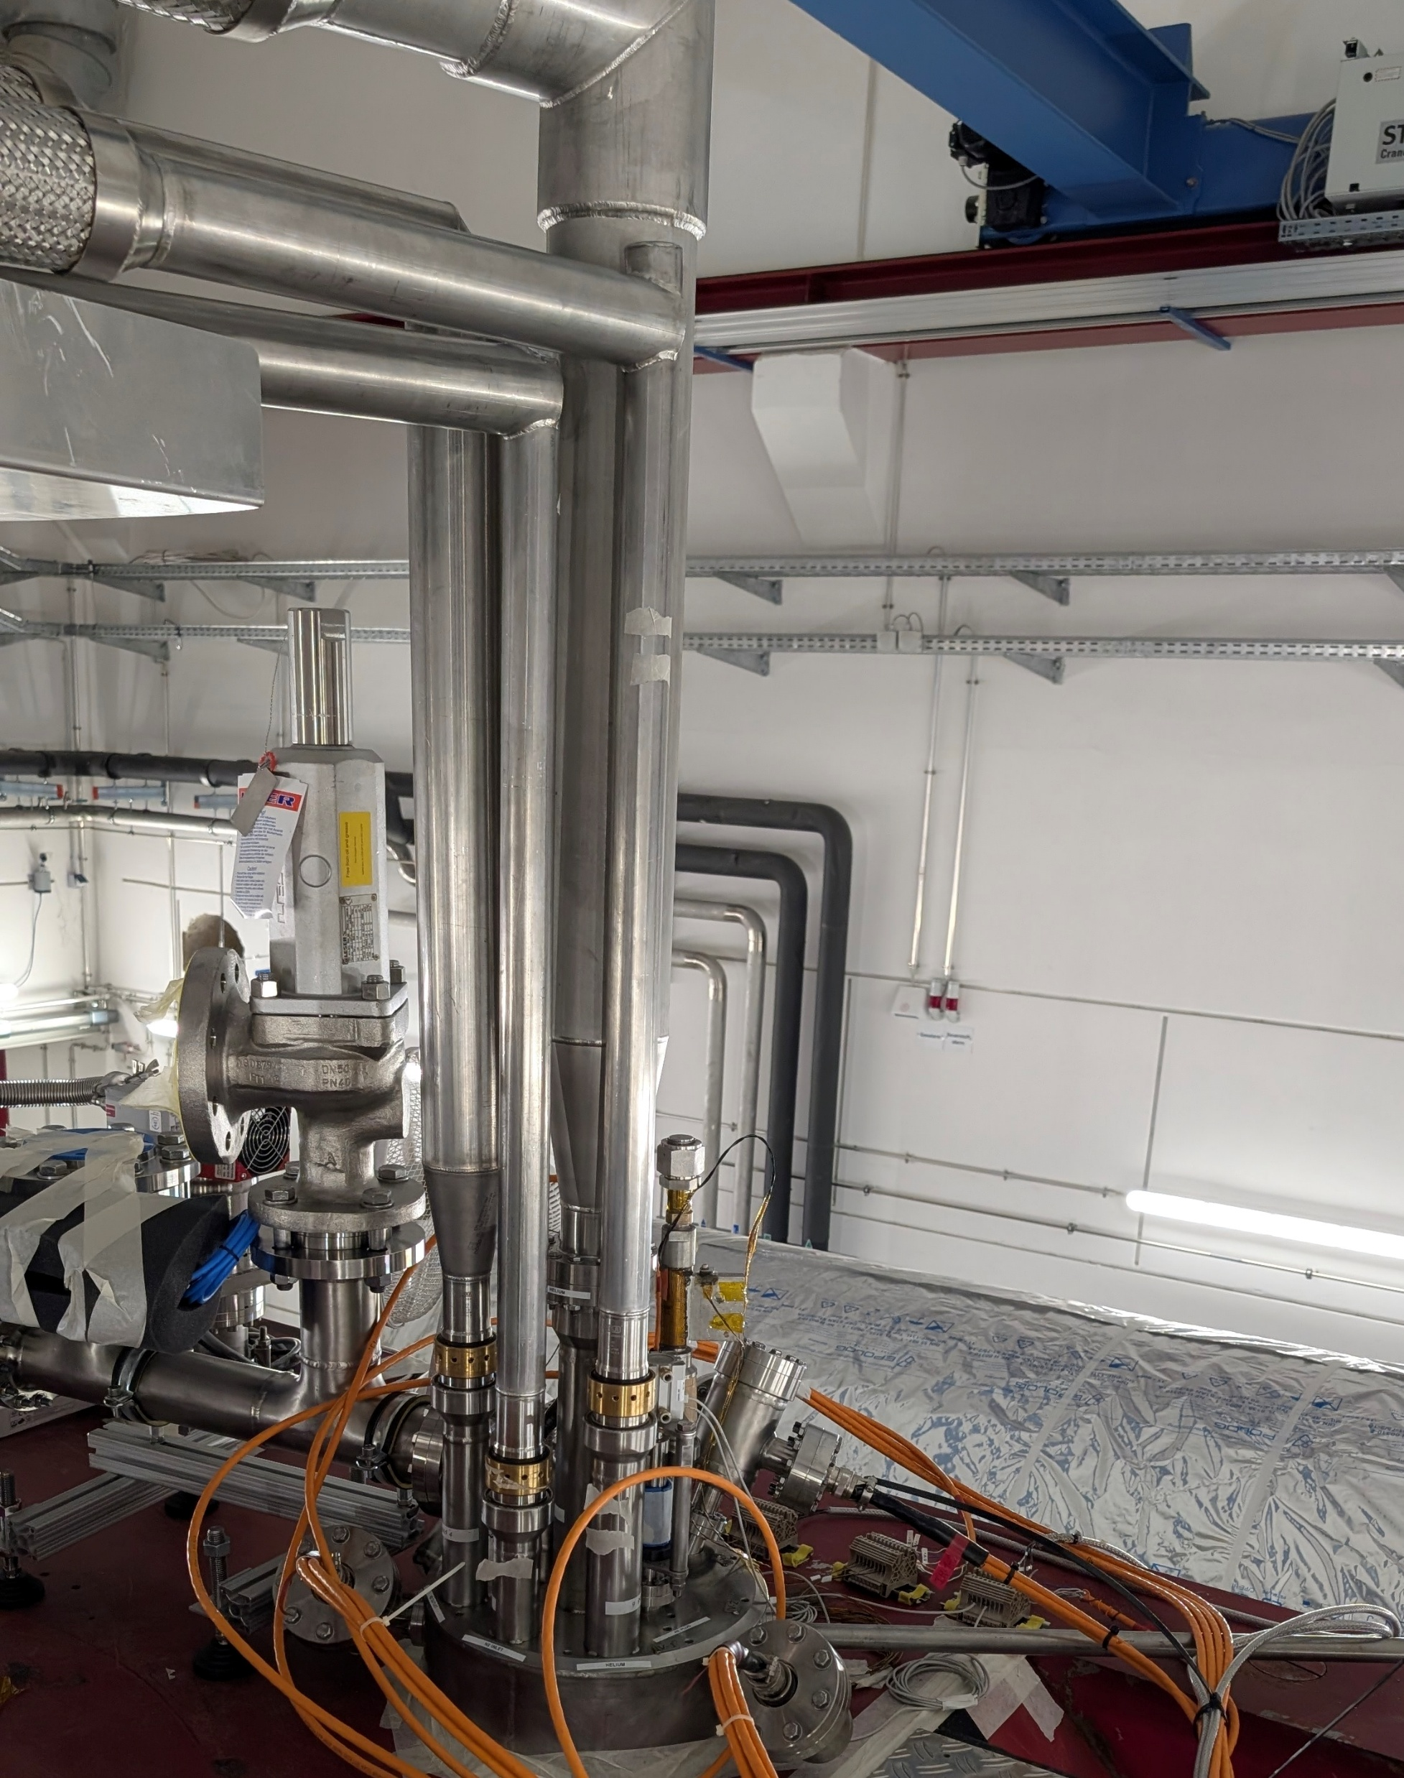
Superconducting Solenoid
All cryo-lines connected to the cryostat
Disconnected again today
Instrumentation for cool down connected and implemented in EPICS
Sigmaphi will finish connection of electrical feedthroughs starting Friday
Cool down and powering of the magnet end of May

Slide 8
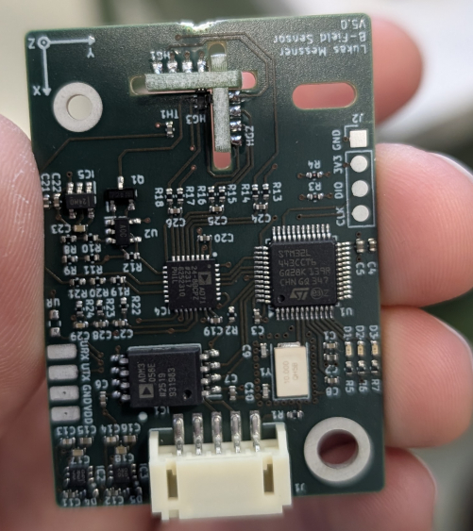
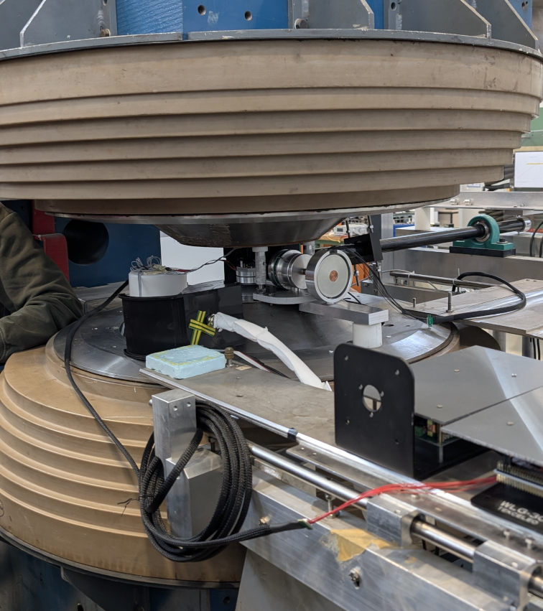
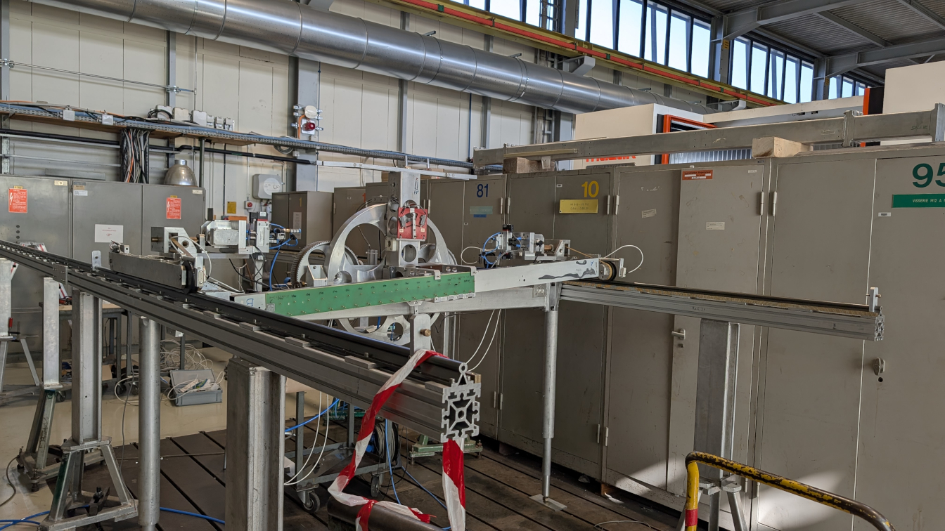
Magnetic field measurement
End March: Visit Magnet workshop at CERN
Measuring machine prepared
Minor modification to mechanics needed
Calibration of all sensors needed (Shruti will support them)
September/October 2026: Installation of the frame in P2 hall
October/November 2026: Preparations and Measurement of magnetic field

