Slide 1
What I will be talking about
Week 1: mechanical structures
  Session 1: Purpose of structures, track-based alignment, requirements for positioning and stability, loads (vibration, thermo-mechanical, etc.)
  Session 2: 1D oscillator, Miles' equation, vibration studies (base vibration and air flow), structure design examples
Week 2: Thermal management
  Session 1: Silicon systems cooling requirements, sensor temperature and runaway, prediction methods
  Session 2: Heat transfer, thermal path design, thermal conductivities of structural and interface materials, cooling technologies (air, monophase, evaporative), evaporative cooling systems (emphasis on CO2), evaporator design (incl. microchannels), prediction methods and performance verification, engineering aspects
A lot of stuff is from a review article I wrote some time ago:
  G. Viehhauser 2015 JINST 10 P09001, doi:10.1088/1748-0221/10/09/P09001
  Also has lots of references

Slide 2
Thermal Management I
Georg Viehhauser

Slide 3
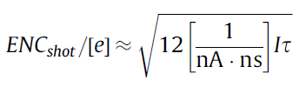
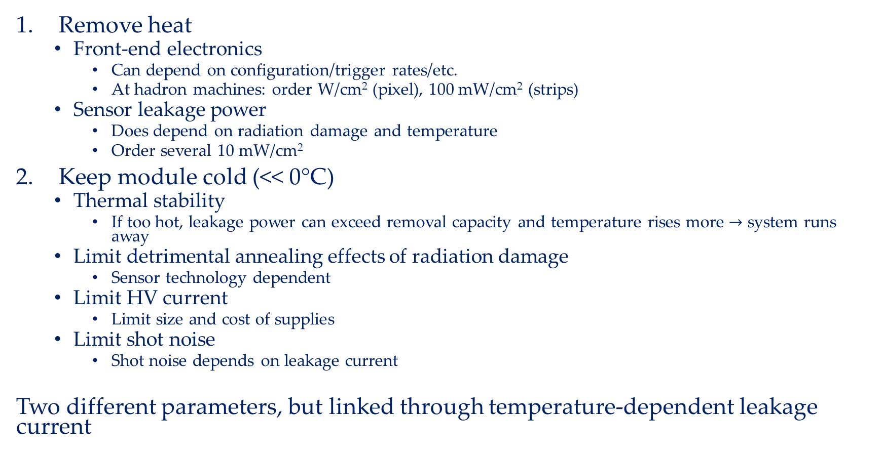
Why do we need cooling?
Remove heat
  Front-end electronics
    Can depend on configuration/trigger rates/etc.
    At hadron machines: order W/cm² (pixel), 100 mW/cm² (strips)
  Sensor leakage power
    Does depend on radiation damage and temperature
    Order several 10 mW/cm²
Keep module cold (<< 0°C)
  Thermal stability
    If too hot, leakage power can exceed removal capacity and temperature rises more $→$ system runs away
  Limit detrimental annealing effects of radiation damage
    Sensor technology dependent
  Limit HV current
    Limit size and cost of supplies
  Limit shot noise
    Shot noise depends on leakage current
Two different parameters, but linked through temperature-dependent leakage current

Slide 4
What happens if you get it wrong?
Failure to remove the heat generated can lead to thermal damage to the system
  In practice usually well protected against overheating by temperature-dependent interlocks
  Interlocks should be placed close to biggest heat sources and at locations where failure of heat removal manifests early
  Note that response times can be short (see later)
But even if you protect your system against instantaneous damage, the performance of your system can be compromised
  In practice, for regular operation the power which can be generated in the system is limited by power supplies
  Response to intolerably high currents will be reduction of bias voltage
  Ultimately, in the long run failed thermal management results in reduced SNR, up to the point where system does not provide useful data any more

Slide 5
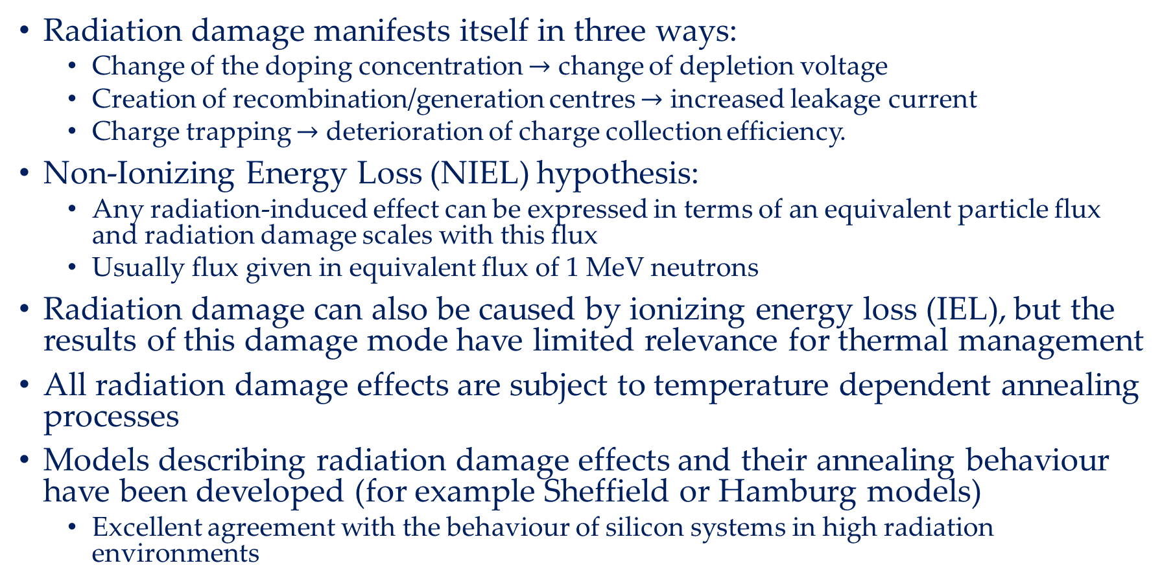
Radiation damage
Radiation damage manifests itself in three ways:
  Change of the doping concentration $→$ change of depletion voltage
  Creation of recombination/generation centres $→$ increased leakage current
  Charge trapping $→$ deterioration of charge collection efficiency.
Non-Ionizing Energy Loss (NIEL) hypothesis:
  Any radiation-induced effect can be expressed in terms of an equivalent particle flux and radiation damage scales with this flux
  Usually flux given in equivalent flux of 1 MeV neutrons
Radiation damage can also be caused by ionizing energy loss (IEL), but the results of this damage mode have limited relevance for thermal management
All radiation damage effects are subject to temperature dependent annealing processes
Models describing radiation damage effects and their annealing behaviour have been developed (for example Sheffield or Hamburg models)
  Excellent agreement with the behaviour of silicon systems in high radiation environments

Slide 6
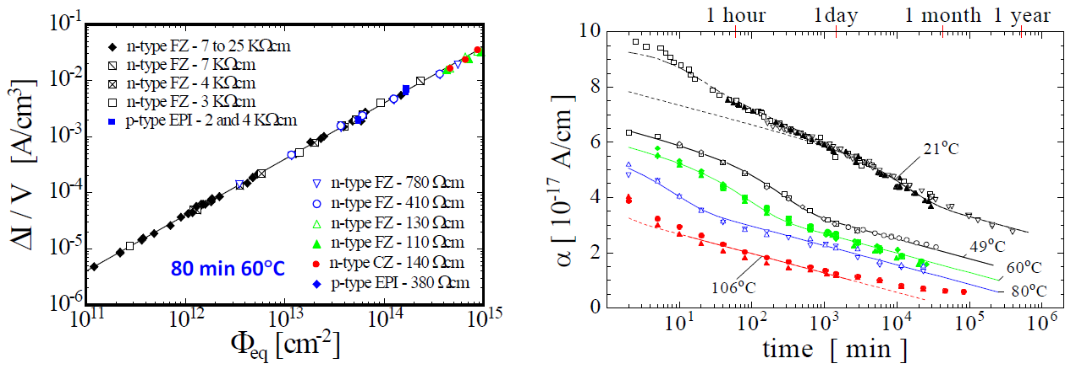
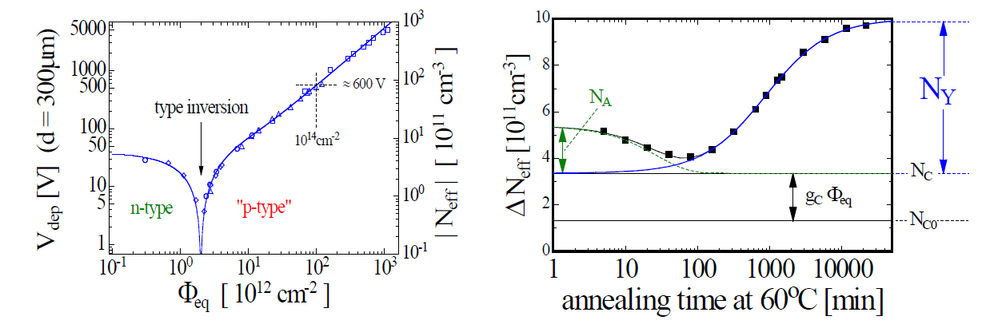
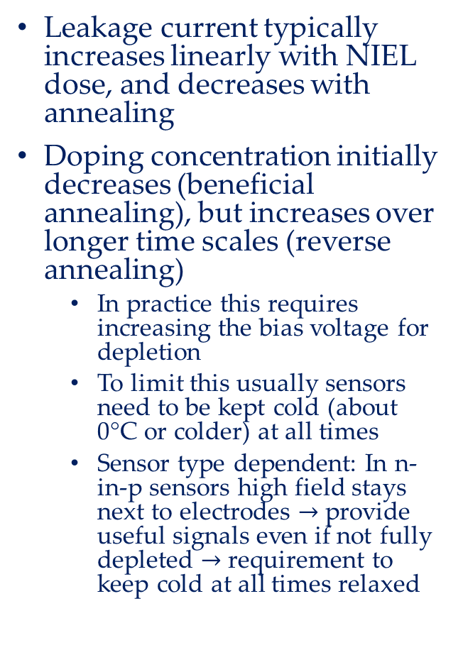
Leakage current and doping concentration vs dose and T
Leakage current typically increases linearly with NIEL dose, and decreases with annealing
Doping concentration initially decreases (beneficial annealing), but increases over longer time scales (reverse annealing)
  In practice this requires increasing the bias voltage for depletion
  To limit this usually sensors need to be kept cold (about 0°C or colder) at all times
  Sensor type dependent: In n-in-p sensors high field stays next to electrodes $→$provide useful signals even if not fully depleted $→$requirement to keep cold at all times relaxed
Dawson, I (ed.), CERN-2021-001

Slide 7

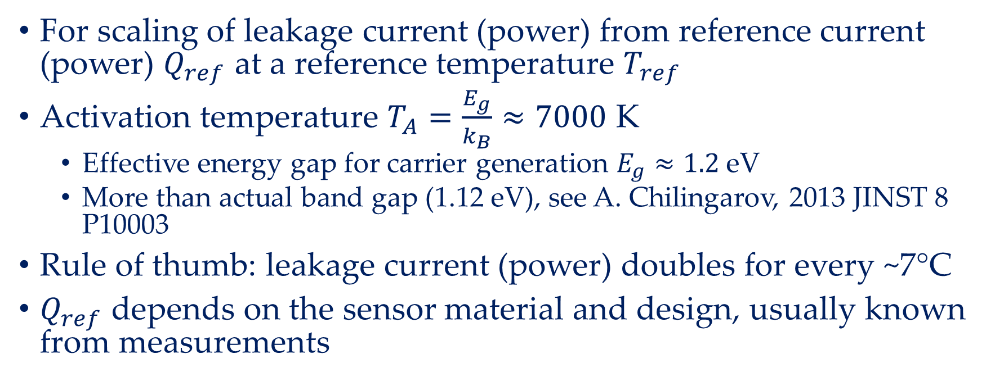
Leakage current – temperature dependence
Q here is heat generated
Q = V×I(T_{s}), assuming V constant
For scaling of leakage current (power) from reference current (power) $Q_{ref}$ at a reference temperature $T_{ref}$
Activation temperature $T_{A}=\frac{E_{g}}{k_{B}}≈7000$ K
  Effective energy gap for carrier generation $E_{g}≈1.2$ eV
  More than actual band gap (1.12 eV), see A. Chilingarov, 2013 JINST 8 P10003
Rule of thumb: leakage current (power) doubles for every ~7°C
$Q_{ref}$ depends on the sensor material and design, usually known from measurements

Slide 8
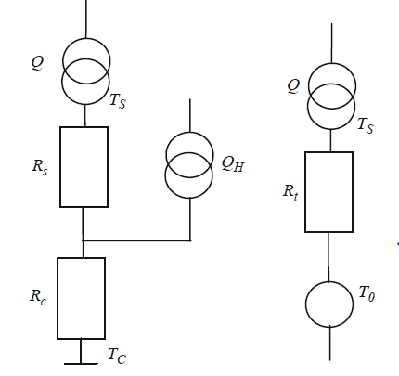
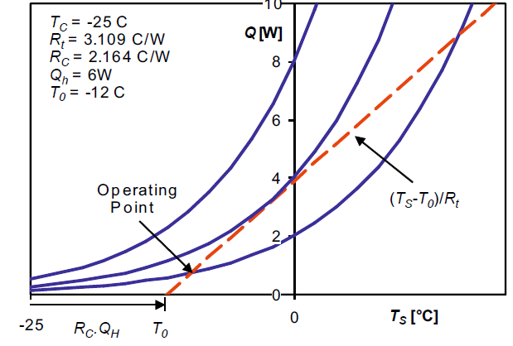
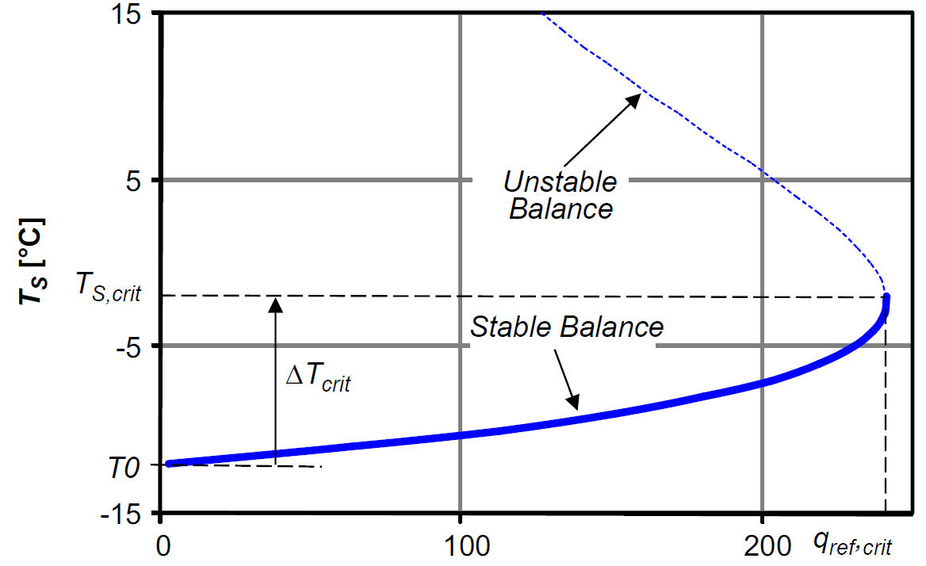
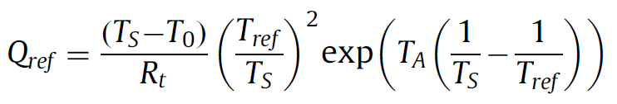
Sensor temperature and thermal stability
G. Beck, G. Viehhauser, NIM A 618 (2010) 131–138
Heat from sensor
Thevenin equivalent
Minimal model: we model the thermal behavior of a module as a linear network
Different Q_{ref}
Network eq
Heat from electronics
Sensor temperature
Curve (aka “thermal runaway curve”)
Typically plot max T_{s}
from FEA vs Q_{ref}

Slide 9
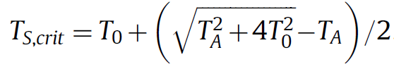

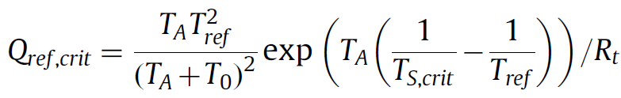
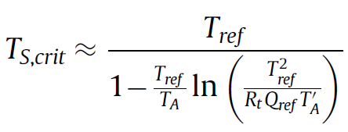
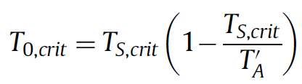


Analytic model of sensor temperature
FEA is time consuming, so use minimal model
Find values of thermal impedances from a limited number of FEA runs (need as many runs as thermal impedances in model)
Then calculate behavior over whole parameter range, and in particular the critical parameters from analytical expressions
Critical parameters for given sensor power Q_{ref}
Critical cooling temperature
with

Slide 10
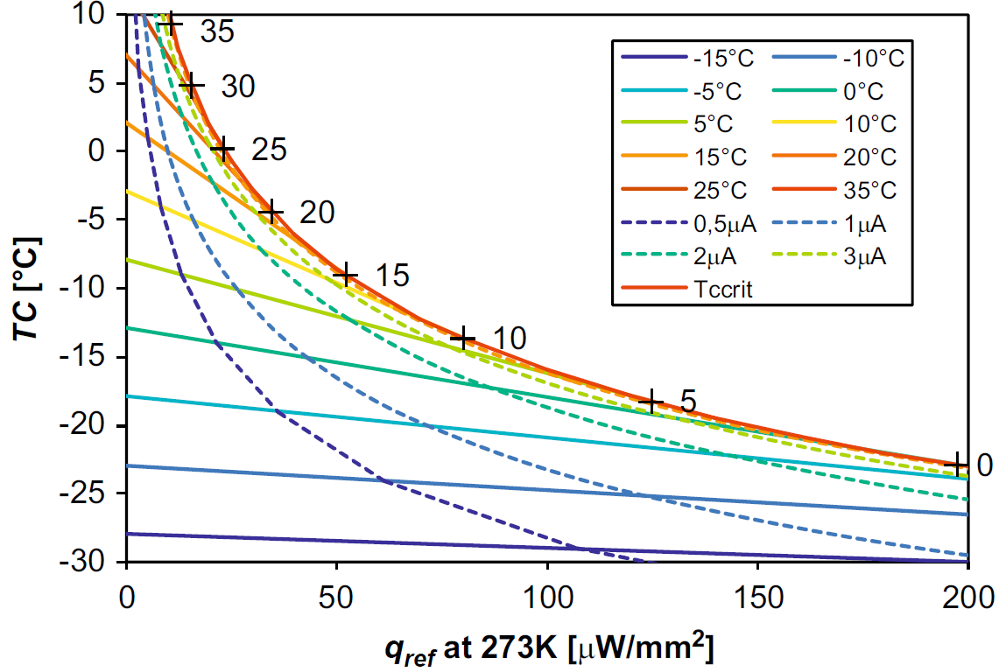
The whole picture
ATLAS Barrel SCT
Sensor T at critical limit
Sensor Isotherms
Critical boundary
Thermally stable
Lines of equal sensor current

Slide 11
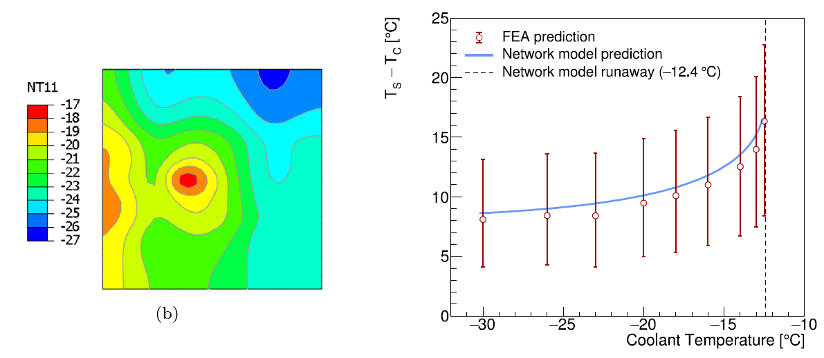
How do we get the impedances for the minimal model?
For the simple network model so far there are two resistances required (R_{c} and R_{s}), which can be extracted from two FEA runs
  Usually take Q_{ref} = 0 to get T₀ and one other small Q_{ref})
But there is one question: which sensor temperature should we take? In a 3D FEA the sensor temperature is not uniform
  Traditionally, people always plot the max sensor temperature
  However, it turns out, the best estimate of critical parameters is obtained if average sensor temperature is taken
Dashed line is T_{C,crit} from minimal model
ATLAS ITk barrel strip sensor
Error bars give range of sensor temperatures from FEA
Last datapoint is largest T_{C}, for which a stable solution was found with FEA

Slide 12
A more complex example
Beck, Brendlinger, Chen and Viehhauser, NIM A 969 (2020)164023
In the ATLAS ITk strip system we have additional non-linear temperature dependent electronics elements
  Power converters (FEAST) with varying efficiency
  Front-end chips with TID-dependent leakage currents
Temperature and generated power linked in complex way
Impossible to calculate using FEA
TID
Front-end power
Chip P
FEAST efficiency
Sensor T
Front-end T
Coolant T
Sensor P
NIEL

Slide 13
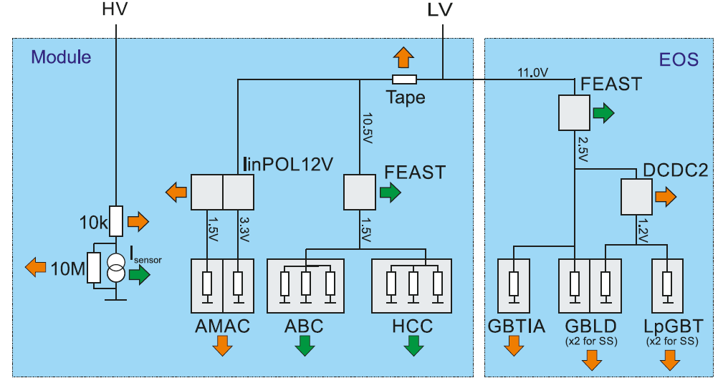
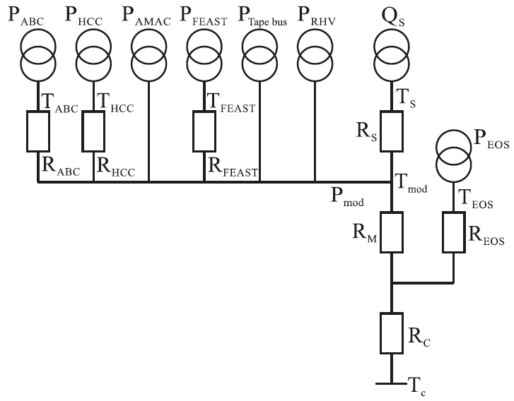
Thermo-electrical model for the ITk strips
Two connected networks, one electrical (to determine power), one thermal (to determine temperatures)
Non-linear elements have been parametrized from measurements
Thermal impedances from thermal FEA (more impedances so a more runs)
Done this for every month in the expected 14 years of operation (with realistic luminosity profile)
System of equations is not solvable analytically, but numerically using Mathematica or Python
Electrical network
Thermal network

Slide 14
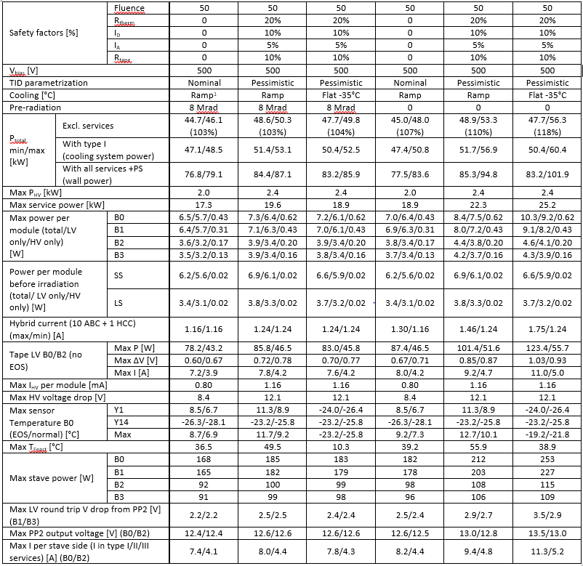
Output examples
Numerical results
Development plots
L3
L2
L1
L0

Slide 15
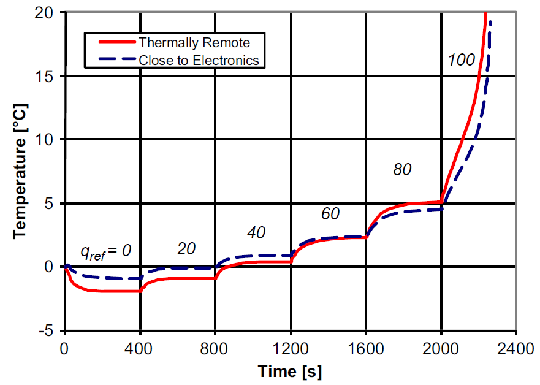
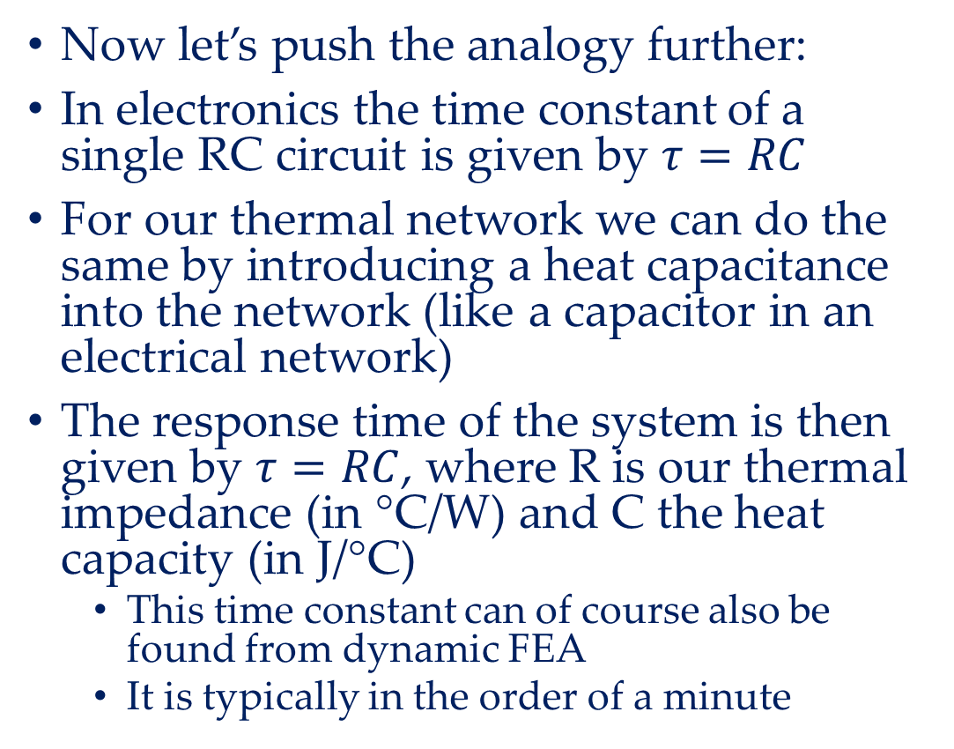
Thermal response time
Now let’s push the analogy further:
In electronics the time constant of a single RC circuit is given by $τ=RC$
For our thermal network we can do the same by introducing a heat capacitance into the network (like a capacitor in an electrical network)
The response time of the system is then given by $τ=RC$, where R is our thermal impedance (in °C/W) and C the heat capacity (in J/°C)
  This time constant can of course also be found from dynamic FEA
  It is typically in the order of a minute
Dynamic FEA of ATLAS barrel SCT module
Runaway

Slide 16
Summary
The purpose of thermal management is to
  Remove heat
  Keep temperatures low
If you get it wrong there is the possibility of instant damage
  But even if you protect against that, system performance is compromised
A key feature is sensor leakage current
  Small fraction of power to be removed, but temperature-dependent
  Increases with radiation damage
Accurate prediction of performance is time-consuming (3D FEA)
  Simple network models can facilitate understanding
Because thermal management is critical and non-trivial you need to understand your design (requirements, specifications, and safety margins)
  Wildly slapping on safety factors is not the answer
  Network models can be very useful for quick turn-around optimization

Slide 17
Thermal Management II
Heat transfer & cooling systems

Slide 18
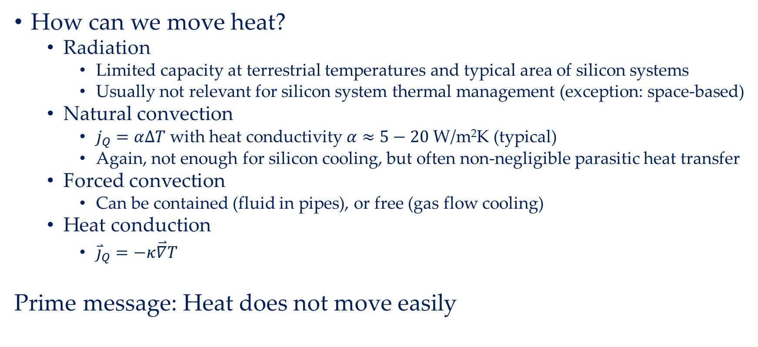
Heat transfer
How can we move heat?
  Radiation
    Limited capacity at terrestrial temperatures and typical area of silicon systems
    Usually not relevant for silicon system thermal management (exception: space-based)
  Natural convection
    $j_{Q}=α∆T$ with heat conductivity $α≈5−20$ W/m²K (typical)
    Again, not enough for silicon cooling, but often non-negligible parasitic heat transfer
  Forced convection
    Can be contained (fluid in pipes), or free (gas flow cooling)
  Heat conduction
    ${\overset{⃑}{j}}_{Q}=−κ\overset{⃑}{∇}T$
Prime message: Heat does not move easily
These are the technically relevant types of heat transfer for silicon systems

Slide 19
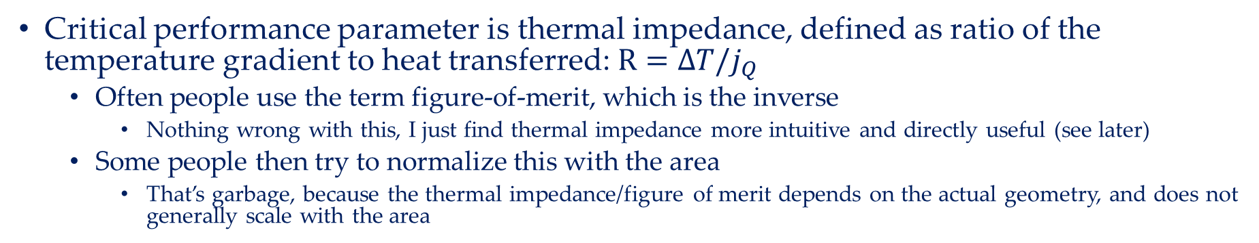
Heat conduction
Critical performance parameter is thermal impedance, defined as ratio of the temperature gradient to heat transferred: $R=∆T/j_{Q}$
  Often people use the term figure-of-merit, which is the inverse
    Nothing wrong with this, I just find thermal impedance more intuitive and directly useful (see later)
  Some people then try to normalize this with the area
    That’s garbage, because the thermal impedance/figure of merit depends on the actual geometry, and does not generally scale with the area
Structural elements often fulfil secondary role as heat conduction paths
  Thermal impedance decreases with cross-section of the heat path
  Need to reconcile low thermal impedance with minimizing the detector material causing multiple scattering
  Use of high thermal conductivity materials is mandatory
Usually some conductive path cannot be avoided: from the electronics/silicon to the local heat sink (typically cooling pipe)

Slide 20
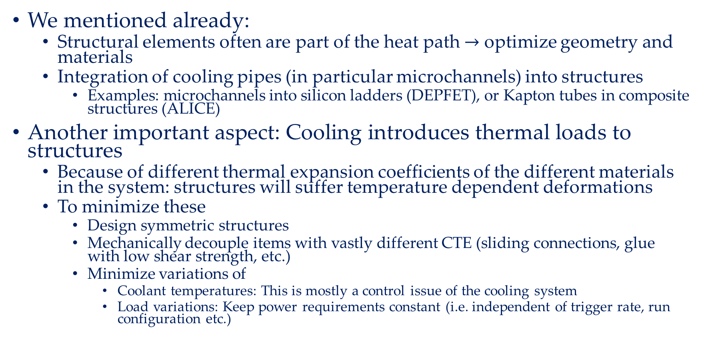
Interface to mechanics
We mentioned already:
  Structural elements often are part of the heat path $→$ optimize geometry and materials
  Integration of cooling pipes (in particular microchannels) into structures
    Examples: microchannels into silicon ladders (DEPFET), or Kapton tubes in composite structures (ALICE)
Another important aspect: Cooling introduces thermal loads to structures
  Because of different thermal expansion coefficients of the different materials in the system: structures will suffer temperature dependent deformations
  To minimize these
    Design symmetric structures
    Mechanically decouple items with vastly different CTE (sliding connections, glue with low shear strength, etc.)
    Minimize variations of
      Coolant temperatures: This is mostly a control issue of the cooling system
      Load variations: Keep power requirements constant (i.e. independent of trigger rate, run configuration etc.)

Slide 21
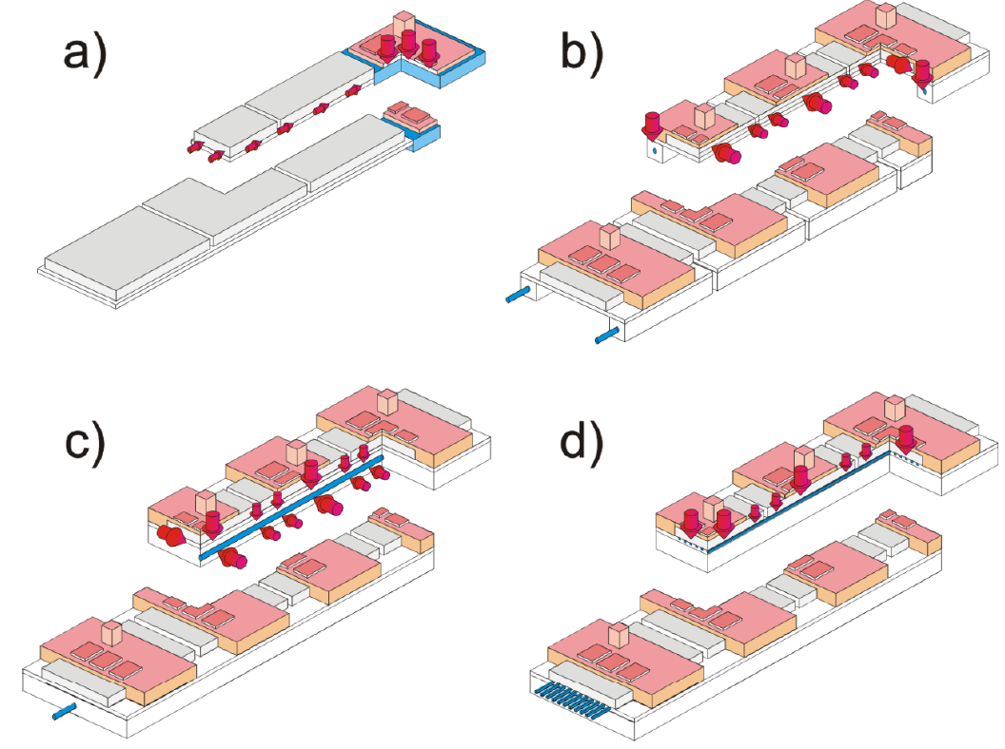
Cooling pipes and thermal path topologies
Because heat transfer by forced convection is much more capable than conduction heat path geometries tend to bring the heat sources (in particular sensors) closer and closer to the local heat sink (cooling pipe)
The natural endpoint is to incorporate the cooling channels into the silicon (sensor and/or electronics): ‘micro-channels’
  The difficulty here is how to connect the pipe segments from wafer to wafer

Slide 22
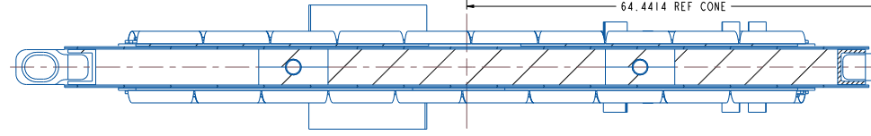
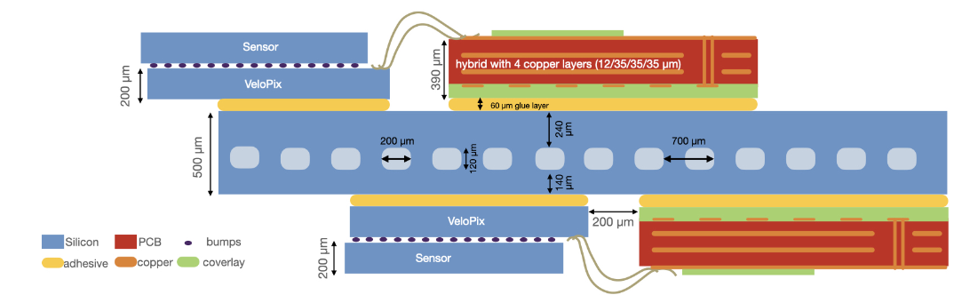
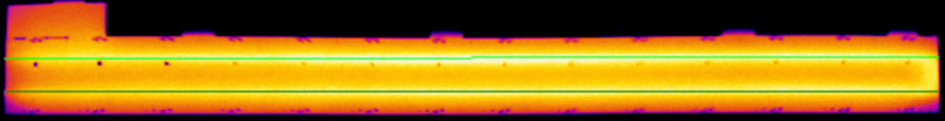
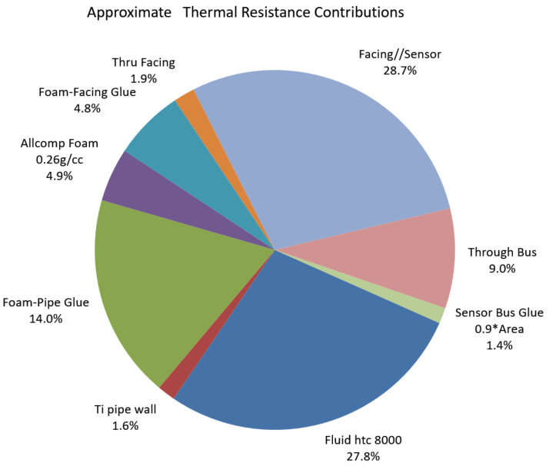
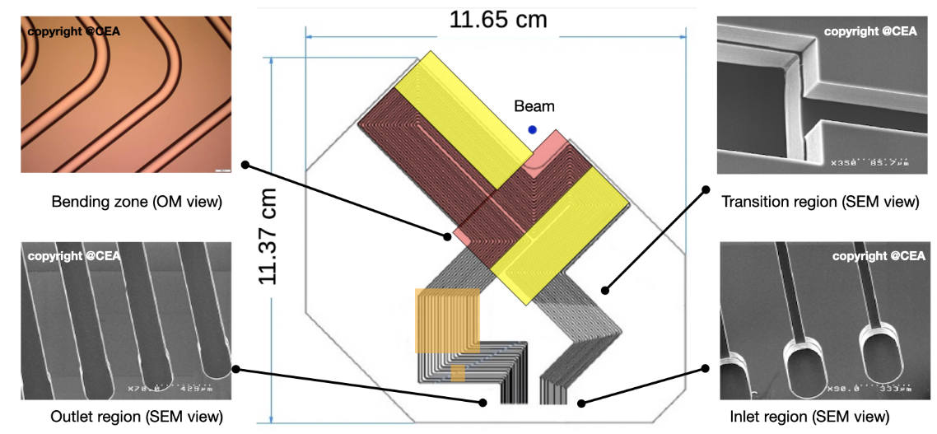
Examples:
ATLAS ITk strips
LHCb VELO upgrade
Silicon modules
Ti cooling pipe
Carbon foam
Carbon honeycomb

Slide 23
Forced convection
Best method to transport heat over large distances (> 0.1 m)
  Every large scale silicon system uses forced convection to transport heat from local heat sink at the detector to external heat sink
  Usually this means that the forced convection system is closed, but that’s not necessary, if the coolant is cheap and environmentally unproblematic
    Examples: Air cooling, evaporative CO₂ cooling with a blow-off system
Two main types:
  Monophase
    Can be liquid or gas
    Required mass flow is given by amount of heat to be removed, the acceptable temperature increase through the system and heat capacity of the coolant
  Evaporative
    Coolant to the heat source is liquid, heat is absorbed as latent heat of evaporation, and return is (partly) vapour
  (Something more exotic, but considered originally for the ATLAS SCT: binary ice)

Slide 24
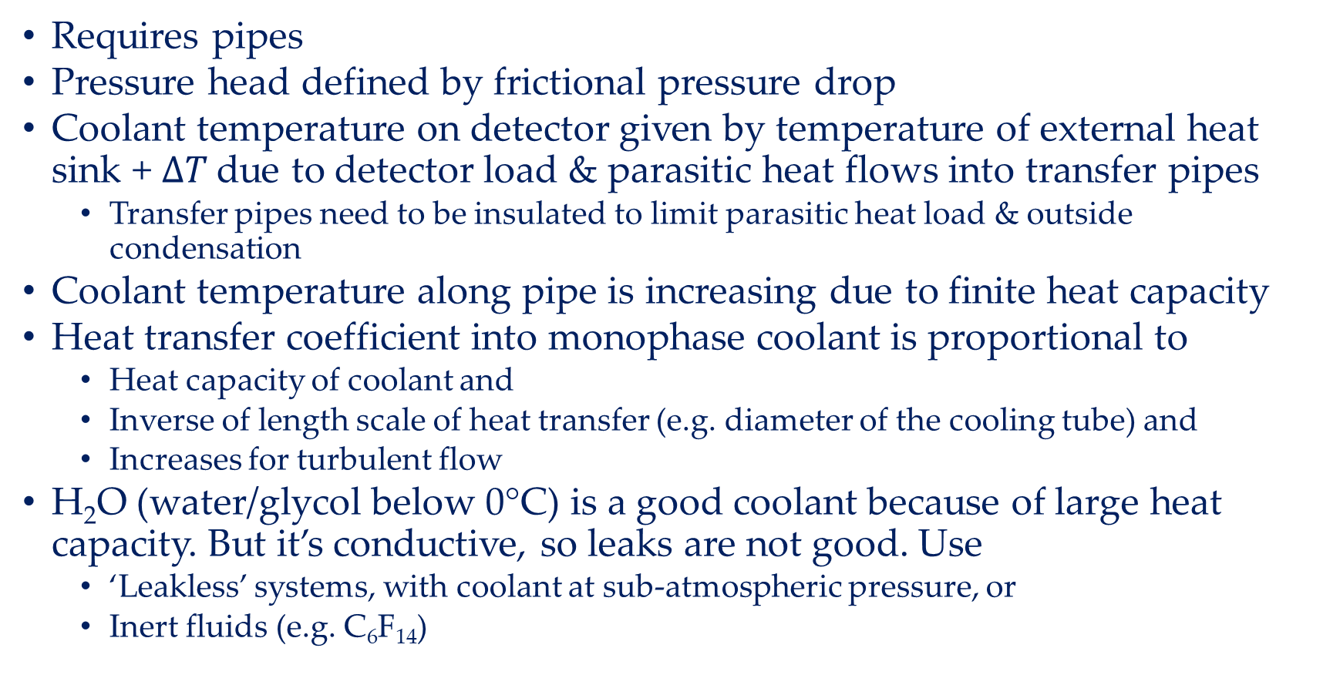
Monophase cooling: Liquids
Requires pipes
Pressure head defined by frictional pressure drop
Coolant temperature on detector given by temperature of external heat sink + $∆T$due to detector load & parasitic heat flows into transfer pipes
  Transfer pipes need to be insulated to limit parasitic heat load & outside condensation
Coolant temperature along pipe is increasing due to finite heat capacity
Heat transfer coefficient into monophase coolant is proportional to
  Heat capacity of coolant and
  Inverse of length scale of heat transfer (e.g. diameter of the cooling tube) and
  Increases for turbulent flow
H₂O (water/glycol below 0°C) is a good coolant because of large heat capacity. But it’s conductive, so leaks are not good. Use
  ‘Leakless’ systems, with coolant at sub-atmospheric pressure, or
  Inert fluids (e.g. C₆F₁₄)

Slide 25
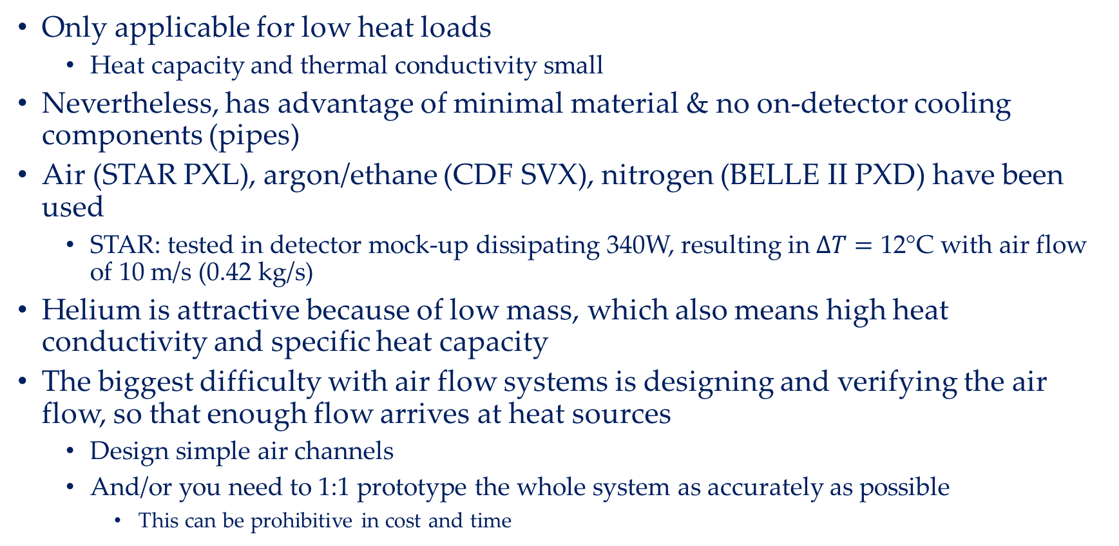
Monophase cooling: Gas
Only applicable for low heat loads
  Heat capacity and thermal conductivity small
Nevertheless, has advantage of minimal material & no on-detector cooling components (pipes)
Air (STAR PXL), argon/ethane (CDF SVX), nitrogen (BELLE II PXD) have been used
  STAR: tested in detector mock-up dissipating 340W, resulting in $∆T=\text{12}$°C with air flow of 10 m/s (0.42 kg/s)
Helium is attractive because of low mass, which also means high heat conductivity and specific heat capacity
The biggest difficulty with air flow systems is designing and verifying the air flow, so that enough flow arrives at heat sources
  Design simple air channels
  And/or you need to 1:1 prototype the whole system as accurately as possible
    This can be prohibitive in cost and time

Slide 26
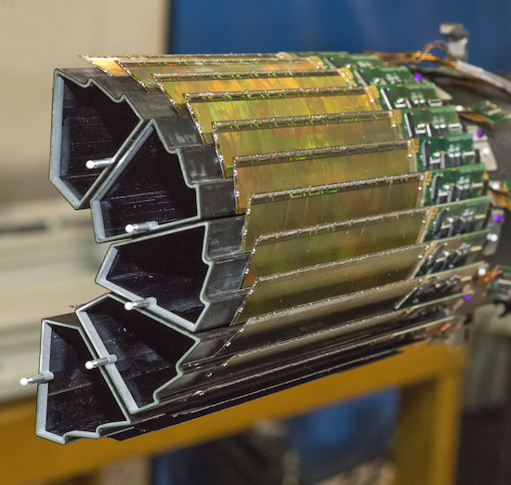
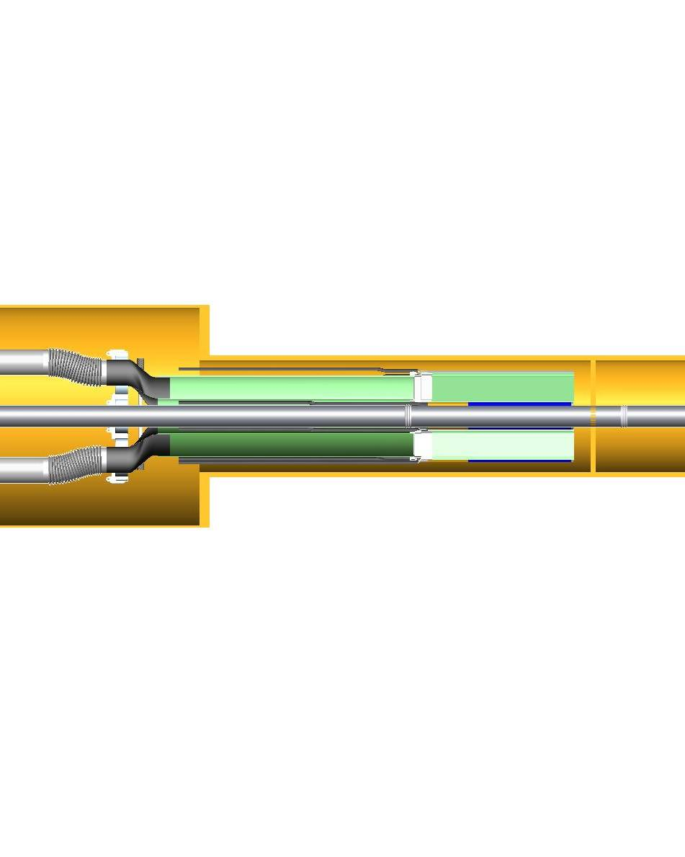
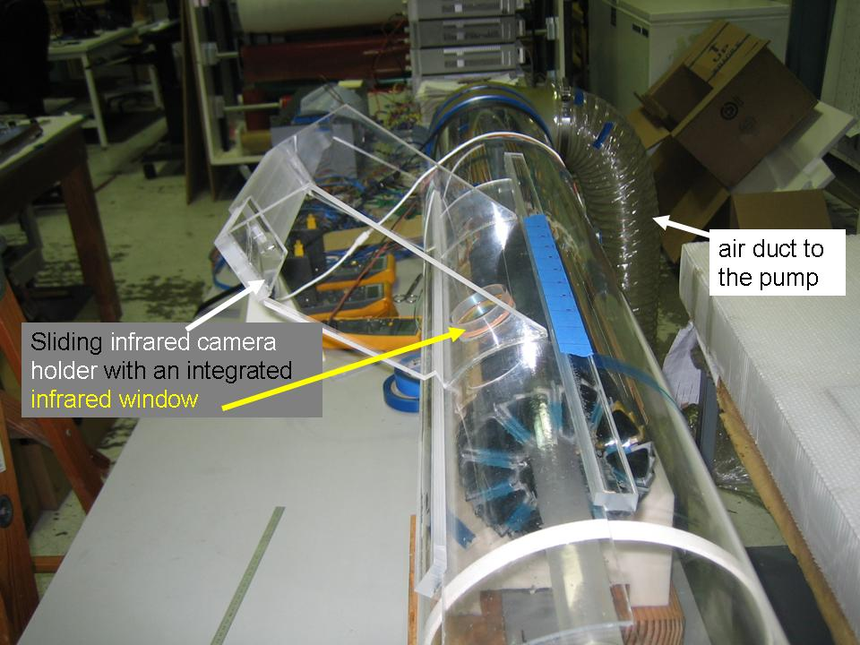
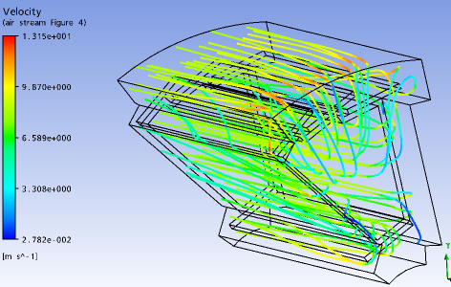
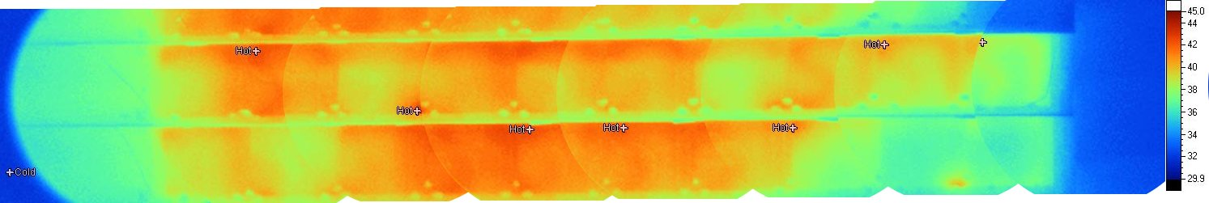
Example: STAR PXL
First vertex detector at a collider experiment based on Monolithic Active Pixel Sensor technology
350 W total Si + drivers. ΔT = 11 °C with 10.4 m/s air velocity, confirming CFD estimate
Eric Anderssen, https://indico.cern.ch/event/469996/contributions/2148211/

Slide 27
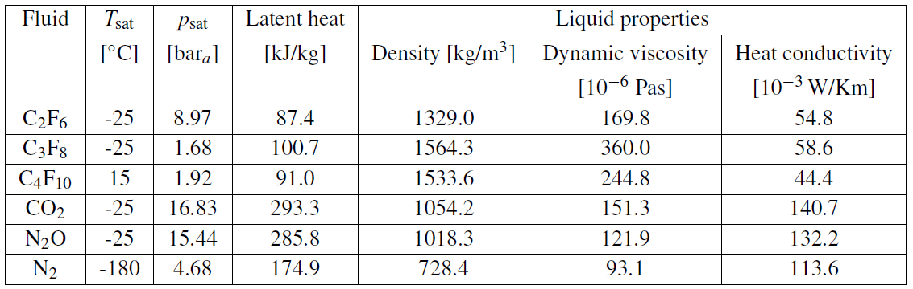
Evaporative cooling
Attractive because of large latent heat of evaporation & high heat transfer coefficient to cooling tube wall
T does not directly depend on the absorbed heat, but is given by saturation temperature corresponding to the local pressure in the pipe
  As p drops along circuit, T decreases
Usually evaporation temperature controlled by a base pressure at an external location in the fluid return (dome-loaded pressure regulator, accumulator, etc.) with offset due to on-detector and return line pressure drops
It is mandatory for such systems that on-detector and return lines are carefully designed and prototyped
Evaporative cooling fails, when too much of the liquid has evaporated (‘dry-out’)
  Typically, this happens before the liquid has evaporated completely, but when the liquid film dissociates from the tube wall, and the remaining liquid becomes, as droplets, part of the vapour flow. At that point the HTC to from the coolant to the wall drops significantly. For CO₂ this can happen at 50% liquid
GWP
12000
9000
6000
1
265
1

Slide 28
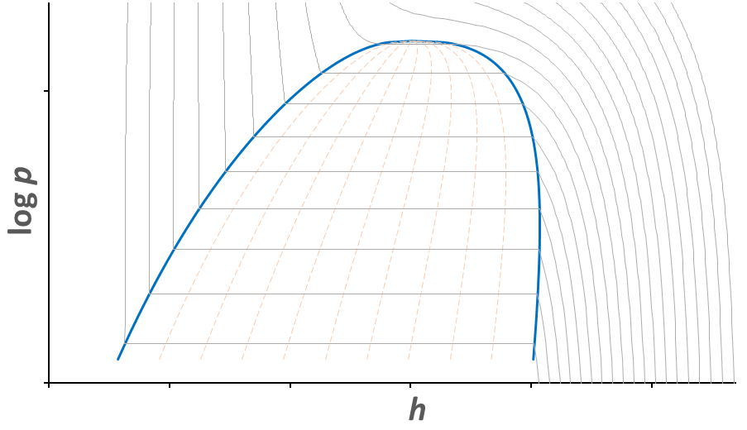

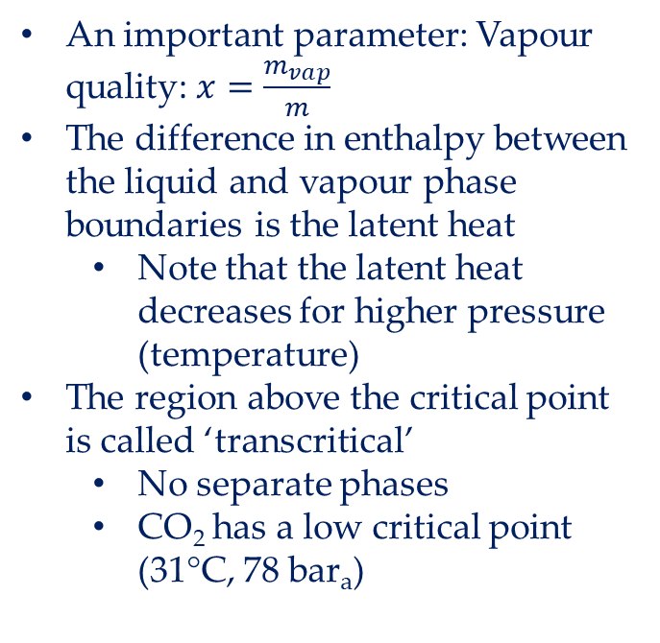
p-h Diagrams
To understand evaporative cooling circuits we often use p-h diagrams
  Flow in thermally insulated pipe is isenthalpic (Joule-Kelvin expansion) and has only pressure drop
  Heat in/out-flow changes enthalpy
Isotherms
An important parameter: Vapour quality: $x=\frac{m_{vap}}{m}$
The difference in enthalpy between the liquid and vapour phase boundaries is the latent heat
  Note that the latent heat decreases for higher pressure (temperature)
The region above the critical point is called ‘transcritical’
  No separate phases
  CO₂ has a low critical point (31°C, 78 bar_{a})
Critical point
liquid
vapour
2-phase
Phase boundary
Lines of equal $x$

Slide 29
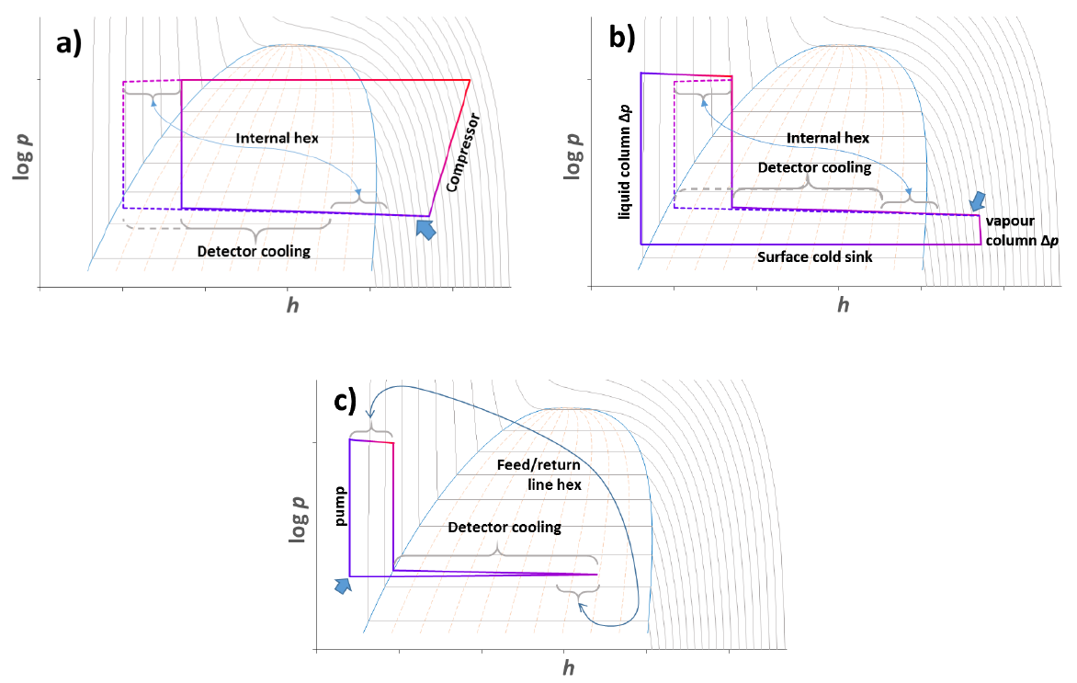
Fluid transport in evaporative systems
How can we generate pressure head to move the fluid in evaporative system?
  not shown: wicking (heat pipe)
Gravity – driven
(Thermosiphon)
Pump - driven
Compressor - driven

Slide 30
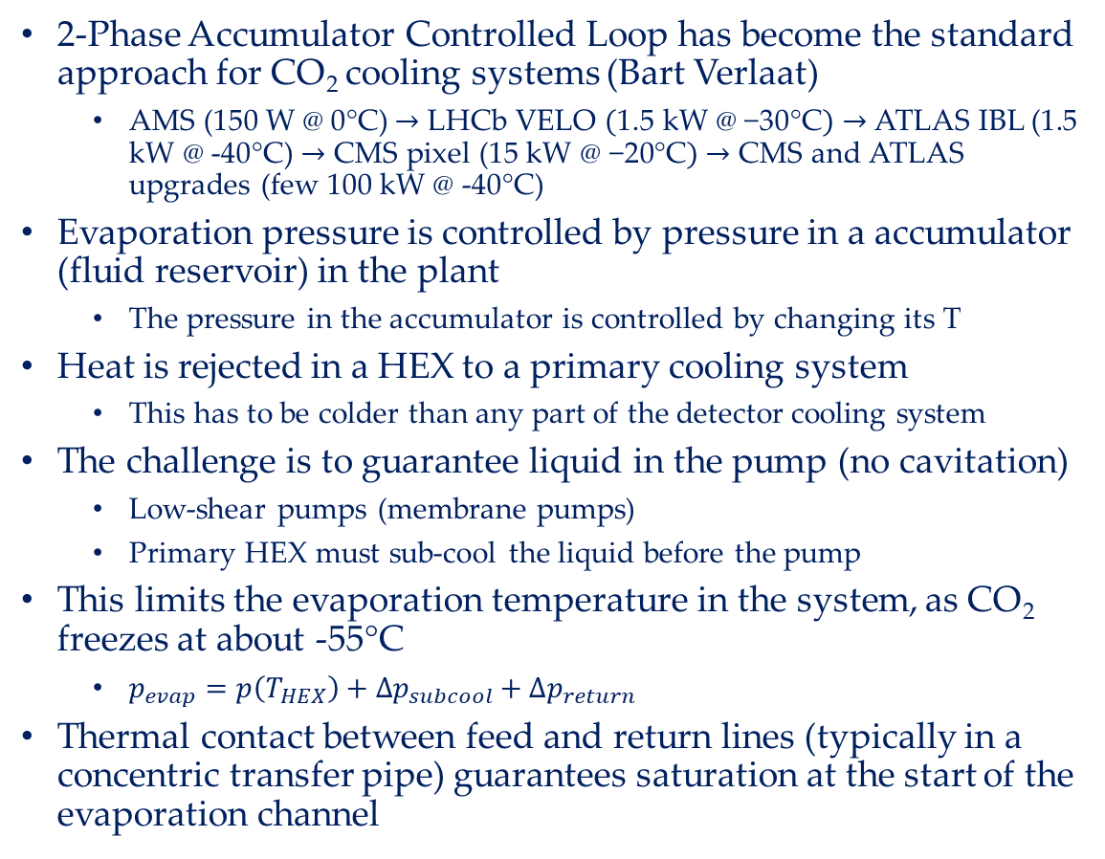
2-PACL
2-Phase Accumulator Controlled Loop has become the standard approach for CO₂ cooling systems (Bart Verlaat)
  AMS (150 W $\text{@} \text{0°}\text{C}$)$→$ LHCb VELO $(\text{1.5} \text{kW}\text{ @ −30°}\text{C})→$ ATLAS IBL (1.5 kW @ -40°C) $→$ CMS pixel (15 kW $\text{@ −}\text{2}\text{0°}\text{C})$ $→$ CMS and ATLAS upgrades (few 100 kW @ -40°C)
Evaporation pressure is controlled by pressure in a accumulator (fluid reservoir) in the plant
  The pressure in the accumulator is controlled by changing its T
Heat is rejected in a HEX to a primary cooling system
  This has to be colder than any part of the detector cooling system
The challenge is to guarantee liquid in the pump (no cavitation)
  Low-shear pumps (membrane pumps)
  Primary HEX must sub-cool the liquid before the pump
This limits the evaporation temperature in the system, as CO₂ freezes at about -55°C
  $p_{evap}=p\left(T_{HEX}\right)+∆p_{subcool}+∆p_{return}$
Thermal contact between feed and return lines (typically in a concentric transfer pipe) guarantees saturation at the start of the evaporation channel

Slide 31
Blow-off systems
If you have a supply of high-p fluid (aka gas bottle) then one can use this to feed an open cooling system
This makes sense for CO₂ as it is cheap and its loss is of no environmental concern
Cannot vent directly to atmosphere (would freeze), but fluid first needs to be boiled off and warmed up, before release to atmosphere
  Typically this is done in a water bath
The challenge is that the bottle pressure is usually fixed, and the only means of control is the back pressure
  This correlates flow and evaporation temperature
  To control separately need a parallel by-pass (with heat load)

Slide 32
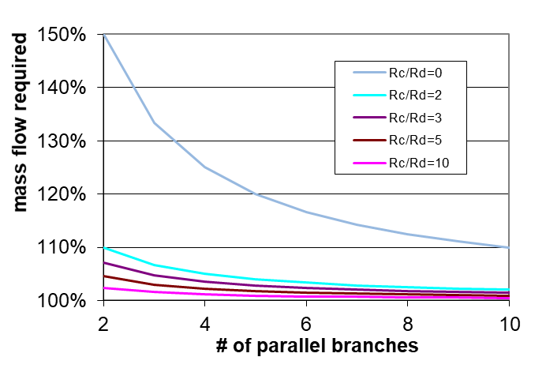
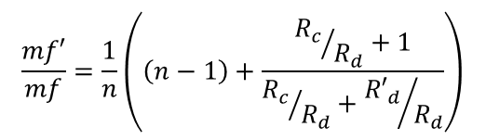
What do we need capillaries for?
Capillaries are flow restrictions
  Typically a pipe with small diameter (order mm and smaller), but can be orifice, porous plug, etc.
The biggest pressure drop in the circuit is in the capillary – why do we need it?
  The capillary defines the point where boiling starts – ideally right behind the capillary
  In systems with several parallel evaporators we need to balance the flow in the parallel branches for all cases of load variations
    Load variations result in changes of the flow resistance in the pipes associated with the detector load and the return (detector load reduction will reduce impedance)
    To always guarantee enough mass flow in all branches need to supply excess mass flow
    The excess mass flow can be reduced by adding series impedance in each branch – this is the capillary
    Typical impedance ratio R_{c}/R_{d} between 5 and 10
Illustration:
Mass flow
For R’_{d}/R_{d} =0.5
R_{c}
R_{c}
R_{c}
R_{c}
$$\frac{mf′}{mf}=\frac{1}{n}\left(\left(n−1\right)+\frac{{R_{c}}/{R_{d}}+1}{{R_{c}}/{R_{d}}+{{R′}_{d}}/{R_{d}}}\right)$$
…
R’_{d}
R_{d}
R_{d}
R_{d}
n branches

Slide 33
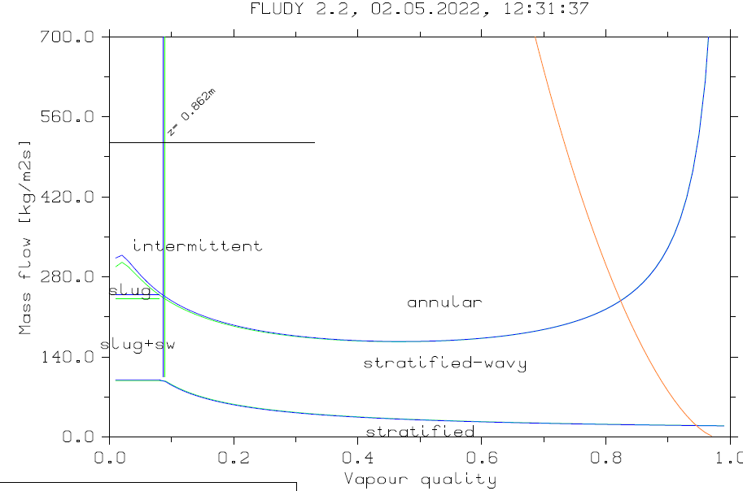
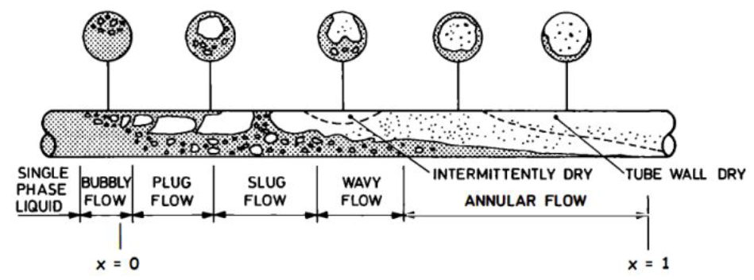
Flow regimes
Flow patterns do change along the pipe
  Affect pressure drop and HTC
Important is that liquid adheres to the wall - best HTC for annular flow
  Good heat conductivity from wall to liquid & liquid evaporates at inner boundary to vapour core
Once the liquid separates from wall (mist flow), the HTC drops significantly, and the system goes into dry-out
mist flow

Slide 34
Predicting evaporative cooling performance
We have seen the importance of pressure drop and heat transfer coefficient for the performance of an evaporative cooling system
In the design phase we would like to calculate these properties to optimize designs
A large number of semi-empirical correlations exist to calculate these parameters for a given state, none of them works 100% (see for example D. Hellenschmidt CERN-THESIS-2020-245)
  This is also because we occupy, as usual, an odd corner of phase space for fluid dynamics specialists
  These correlations are usually 1D, but interestingly 3D CFD is not better (because boundary conditions at interfaces are complicated)
Two programmes have been written, which take these correlations and calculate the performance of a complete loop
  CoBra (by Bart Verlaat and the CERN cooling group)
  FluDy (by me)
Important: All these predictive methods are only good as guidance for the design, but results can be significantly (factor of 2) off
  Always need to verify designs with actual prototype measurements (including all transfer pipes)

Slide 35
Evaporative cooling – what can go wrong?
When the system does not provide enough cooling power it will lead to dryout, the HTC at this location will drop and the outside temperature will increase
  Interlocks need to be at the place where things start to go wrong, i.e. at the end of the evaporator
On a more long-term timescale, we need to increase mass flow, this will increase evaporator & return line pressure drops
If we get evaporator & return line pressure drops wrong then we will not achieve the target evaporation on the detector
  This happened for the ATLAS ID, in the SCT we can’t reach the design evaporation temperature of -25°C (ok, because of lots of safety factors)
  The only thing which protects you from that is accurate prototyping of complete system (incl. transfer lines), there is no way to retroactively fix this by changing the plant, you need to change the pipes, which is usually impossible
    (there is one way out (if you are lucky): change your coolant…)
Capillaries are notoriously difficult to dimension, small ID variation can have large effects – capillaries need to be tuned
  If we get these wrong, then mass flows are off, and we can have issues with boiling starting at the wrong position
Finally, a high-power cooling system is a very serious piece of engineering
  You must do things properly, there are no short-cuts, or magic pieces of equipment
  Make sure you are using established, proven technologies

Slide 36
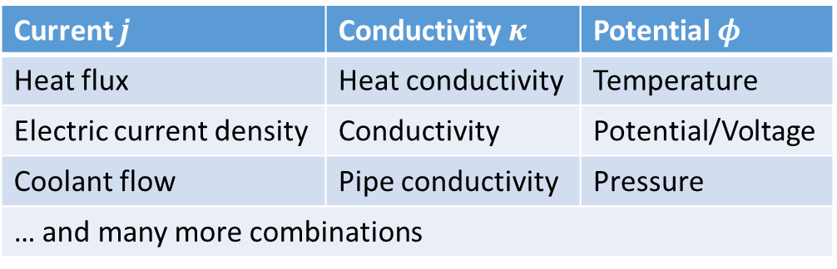
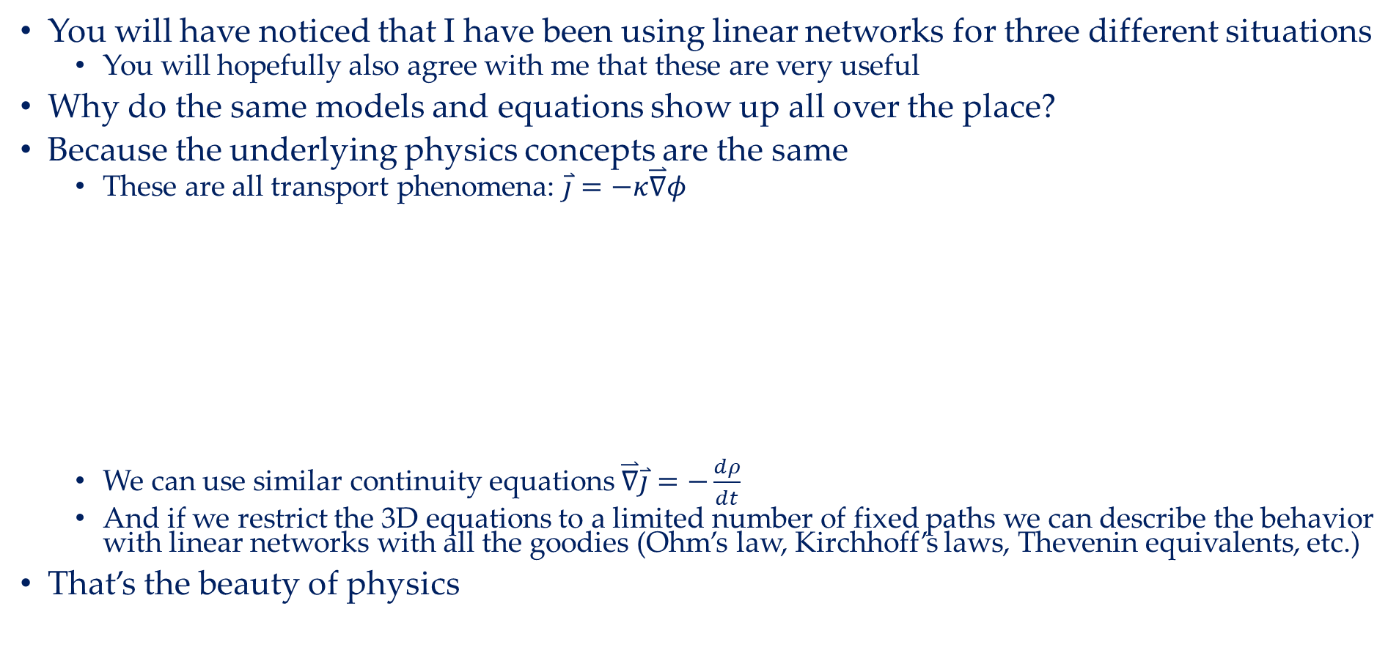
Educational excursion: Transport and linear networks
You will have noticed that I have been using linear networks for three different situations
  You will hopefully also agree with me that these are very useful
Why do the same models and equations show up all over the place?
Because the underlying physics concepts are the same
  These are all transport phenomena: $\overset{⃑}{j}=−κ\overset{⃑}{∇}φ$
  We can use similar continuity equations $\overset{⃑}{∇}\overset{⃑}{j}=−\frac{dρ}{dt}$
  And if we restrict the 3D equations to a limited number of fixed paths we can describe the behavior with linear networks with all the goodies (Ohm’s law, Kirchhoff’s laws, Thevenin equivalents, etc.)
That’s the beauty of physics
Current $j$ | Conductivity $κ$ | Potential $φ$
Heat flux | Heat conductivity | Temperature
Electric current density | Conductivity | Potential/Voltage
Coolant flow | Pipe conductivity | Pressure
… and many more combinations

Slide 37
Summary
Heat is hard to move
  Heat transfer by conduction cannot be avoided
    Reduce length of thermal path
  The most powerful heat transfer is forced convection, and here the most efficient is evaporative cooling
  Evaporative cooling is not simple – challenges are how to get the coolant around, into all parallel branches, and predict the performance, which must always be checked with prototypes
Know your thermal physics!

