Slide 1

Trigger and
Data-Acquisition: Part I
UK Advanced Instrumentation Course 2026
Andrew W. Rose, Imperial College London
awr01@imperial.ac.uk

Slide 2
Credits
These slides draw heavily from a long and distinguished heritage of slides drawing heavily from other people’s slides which drew heavily from other people’s slides, who…
  Some of these include Sioni Summers, Alessandro Thea, Alex Tapper, Dan Saunders, Georg Auzinger – thanks to them all!

Slide 3
A (slightly unapologetic) apology
My examples are heavily biased towards the LHC and CMS
  It’s where my experience is, it is what I know
The boundary between Trigger and DAQ is blurry, and I tend to err to the Trigger side
  It’s where my experience is, it is what I know

Slide 4
Science: The basics
Science is the art of knowing what to record, and when

Slide 5
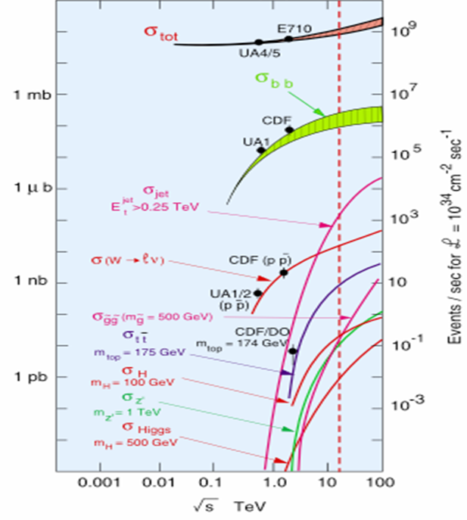
Science: The basics
Science is the art of knowing what to record, and when
With CMS & ATLAS in “discovery mode”, we care about the Higgs Boson or rarer
  Higgs Boson production is ten orders of magnitude below the total interaction rate
  That is a needle in a haystack the same mass as the
  Empire State Building
And we want statistics, a lot of statistics
Ten orders of magnitude

Slide 6
Unfortunately, Statistics requires data
The LHC’s 40MHz crossing rate and 2×10³⁴ cm⁻² s⁻¹ luminosity was chosen to provide
2 billion interactions per second
Unfortunately, 40MHz on a 70 million channel tracker produces the equivalent of 25Pbit/s of data

Slide 7
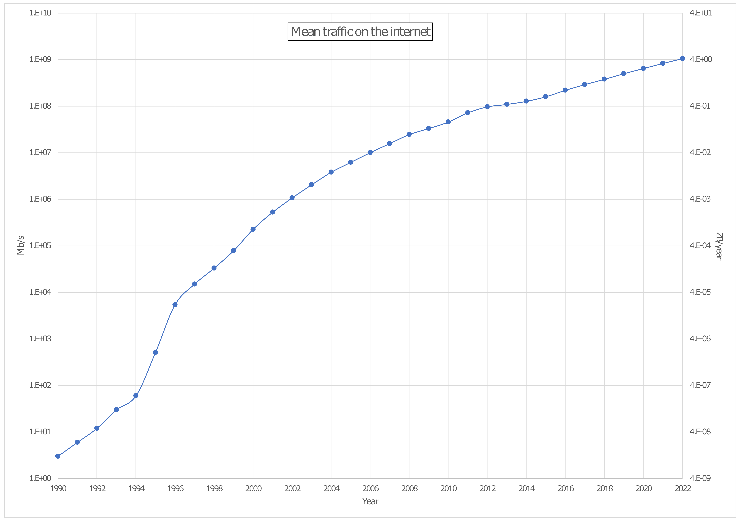
How much data???!
CMS Raw
CMS compressed
1,000,000×
Home broadband
1,000×
Home broadband
CMS tape-store
1×
Home broadband

Slide 8
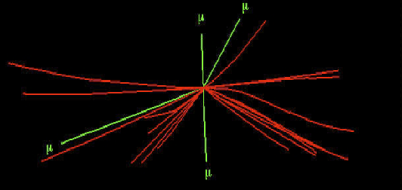
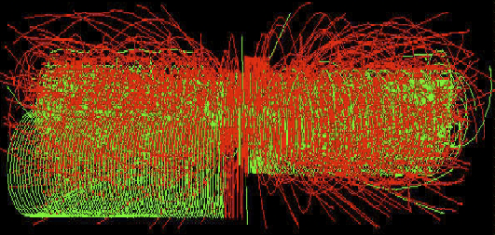
Unfortunately, Statistics requires data
The LHC’s 40MHz crossing rate and 2×10³⁴ cm⁻² s⁻¹ luminosity was chosen to provide
2 billion interactions per second
Unfortunately, 2×10³⁴ cm⁻² s⁻¹ luminosity produces ~50 times more background in your detector than signal (if there is a signal at all), making selection tricky
  And every time the LHC improves its performance, this gets worse
Higgs -> 4μ
+30 MinBias

Slide 9
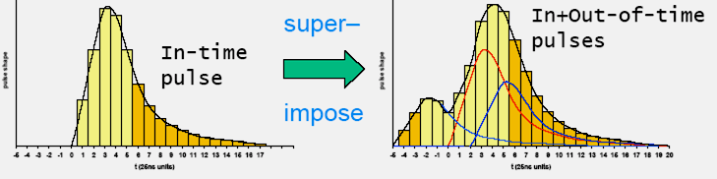
Unfortunately, Statistics requires data
And it gets worse…
  In-time pile up: Same crossing different interactions
  At LHC, new events come every 25 ns
  Out-of-time pile up: Due to events from different crossings
  Need to identify the bunch crossing that a given event comes from
Superimpose

Slide 10
Science: The basics
Enormous data rate at e.g. CMS:
40 MHz collision rate x 1-2 MB event size > 60 TB/s
  Can’t write this to tape & process it later!
Do we need to write it all to tape?
  Tiny cross sections for Higgs and new physics
Process each event, decide to accept/reject
Ten orders of magnitude

Slide 11
Science: The basics
Enormous data rate at e.g. CMS:
40 MHz collision rate x 1-2 MB event size > 60 TB/s
  Can’t write this to tape & process it later!
Do we need to write it all to tape?
  Tiny cross sections for Higgs and new physics
Process each event, decide to accept/reject
  All online - can’t go back and fix it
  Don’t screw up!
Ten orders of magnitude

Slide 12
Science: The basics
Enormous data rate at e.g. CMS:
40 MHz collision rate x 1-2 MB event size > 60 TB/s
  Can’t write this to tape & process it later!
Do we need to write it all to tape?
  Tiny cross sections for Higgs and new physics
Process each event, decide to accept/reject
  All online - can’t go back and fix it.
  Don’t screw up!
Ten orders of magnitude
  This is the art of Triggering

Slide 13
Requirements
Trigger basic requirements
  Need high efficiency for selecting processes for physics analysis
  Need large reduction of rate from unwanted high-rate processes
  Robustness is essential
  Highly flexible, to react to changing conditions
  System must be affordable

Slide 14
What’s on the (Trigger) menu today?
Historical systems
Simple triggers
Complex triggers
Modern triggers

Slide 15
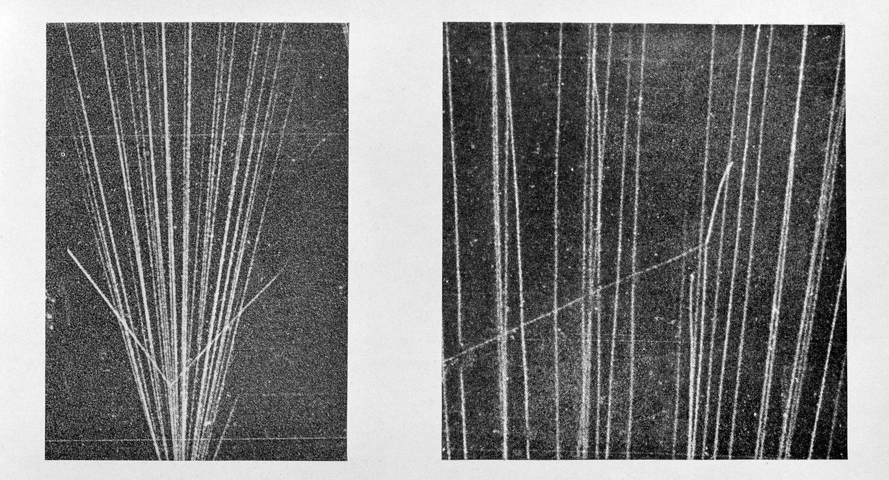
The earliest trigger
Cloud-chamber images recorded on film
Need some way to trigger the camera

Slide 16
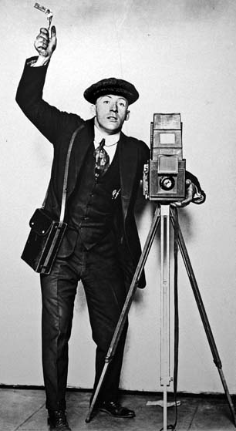
The earliest trigger
Grad student
Cloud-chamber images recorded on film
Need some way to trigger the camera
†Artist’s impression

Slide 17

The earliest trigger
Grad student
High efficiency? Nope – reflexes too slow
Large rate reduction? Better than nothing
Robustness? No – keep wanting sleep, coffee, toilet breaks, etc.
Highly flexible? Depends on the student
Affordable? Well that’s one thing in your favour, I suppose
†Artist’s impression

Slide 18


The earliest trigger
Grad student
High efficiency? Nope – reflexes too slow
Large rate reduction? Better than nothing
Robustness? No – keep wanting sleep, coffee, toilet breaks, etc.
Highly flexible? Depends on the student
Affordable? Well that’s one thing in your favour, I suppose
  Although Rutherford & Geiger did note that
  “Strong coffee with a pinch of Strychnine”
  improved an assistant’s ability
  to spot scintillation light
†Artist’s impression

Slide 19
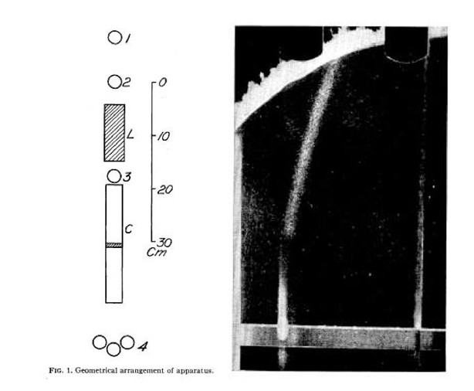
The earliest trigger
Blackett pioneered a technique to trigger the camera of cloud chambers (and got the Nobel prize for this and other work)
Just missed out on discovering the positron in 1932
Stevenson and Street used this to confirm the discovery of the muon in 1937
Trigger photo capture when Geiger counters 1,2,3, but not 4 record coincidental measurements

Slide 20
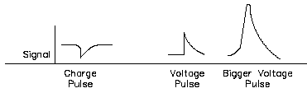
The simplest trigger systems
Source: Use the signals from the Front-End of the detectors themselves
  Binary: tracking detectors (pixels, strips)
  Analog: tracking detectors, time of flight detectors, calorimeters, …
Front-End
Pre-amplifier
Amplifier

Slide 21
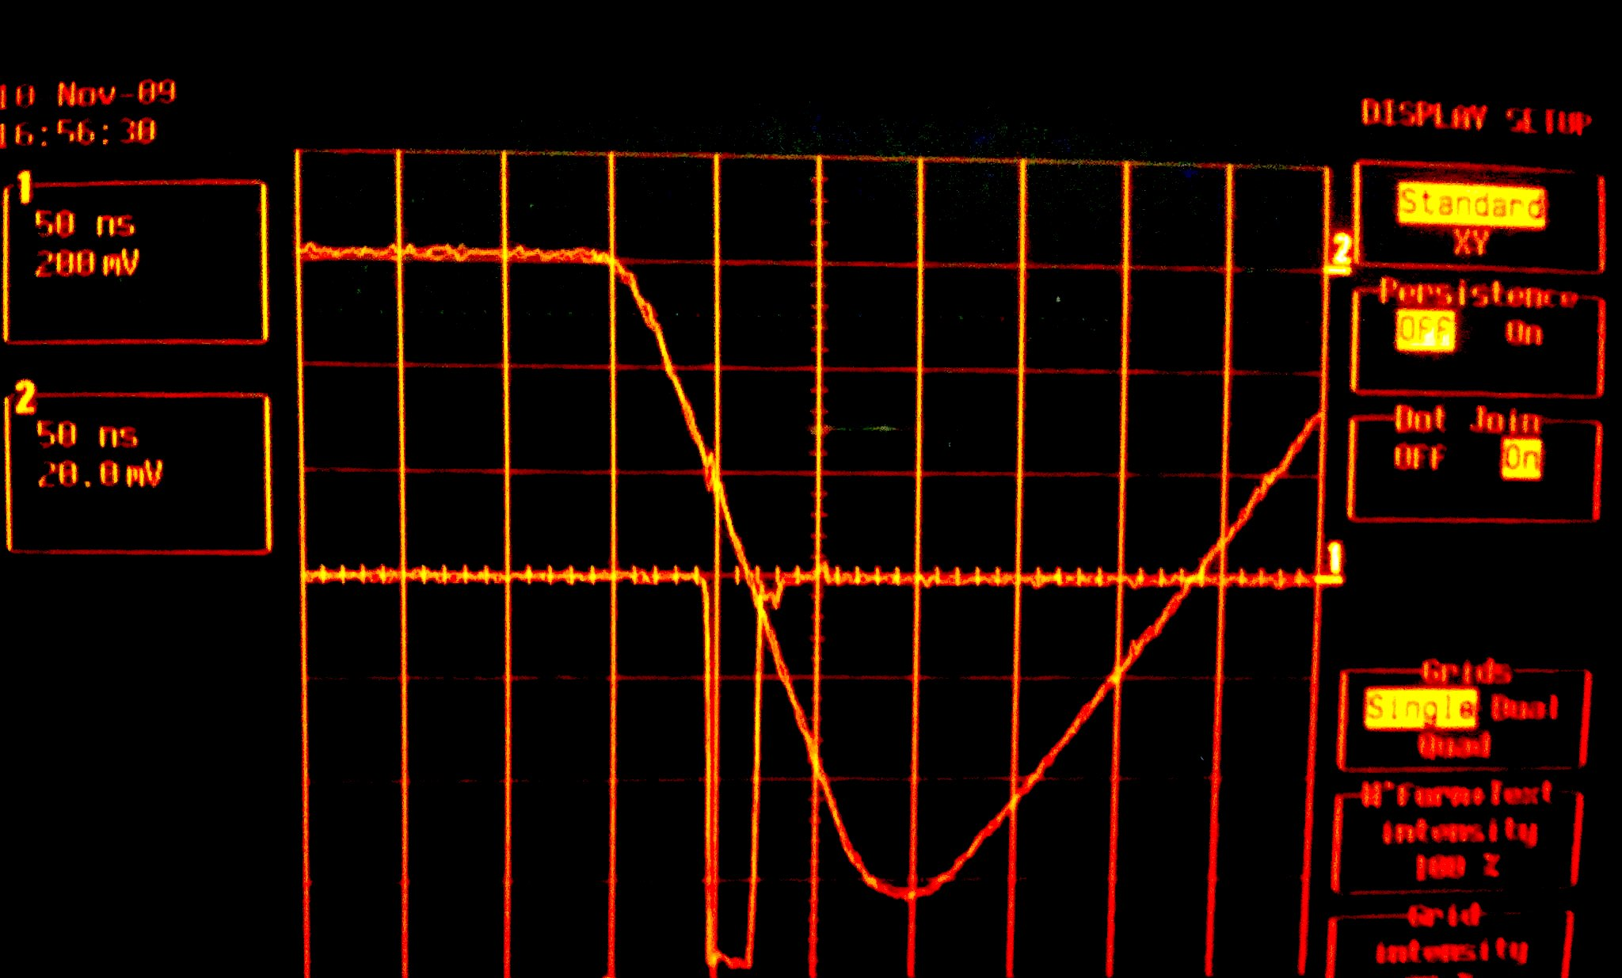

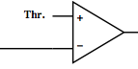
The simplest trigger systems
Source: Use the signals from the Front-End of the detectors themselves
  Binary: tracking detectors (pixels, strips)
  Analog: tracking detectors, time of flight detectors, calorimeters, …
The most trivial trigger algorithm: Signal > Threshold
  Apply the lowest possible threshold
  Identify best compromise between hit efficiency and noise rate
Accept
Source
Reject
Discriminator
Front-End
Pre-amplifier
Amplifier
Trigger signal

Slide 22
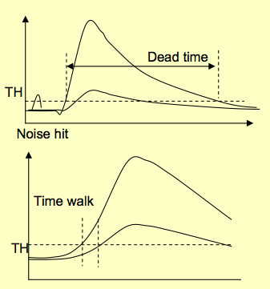


Detector signals characteristics
Pulse width
  Limits the effective hit rate
  Must be adapted to the desired trigger rate
Time walk
  The threshold-crossing time depends on the signal amplitude
  Must be minimal in good trigger systems
Time walk can be suppressed by triggering on total signal fraction
  Applicable on same-shape input signals with different amplitude
  Useful for scintillator detectors and photomultipliers
Leading edge
Trailing edge

Slide 23
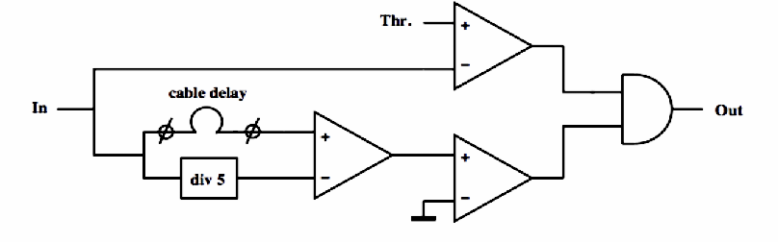

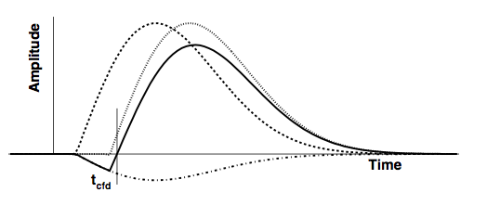
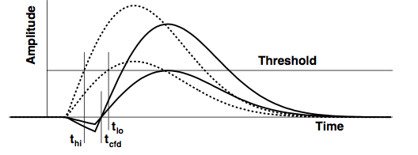


The constant fraction discriminator
Input pulse
Delayed input pulse
Attenuated inverted input
Bipolar pulse
  Attenuation + configurable delay applied before the discrimination determines tCFD
  If delay too short, the unit works as a normal discriminator since the output of the normal discriminator fires later than the CFD part
The output of the CFD fires when the bipolar pulse changes polarity
Signals with the same rising time, at a fraction f
at t = t_{cfd}

Slide 24


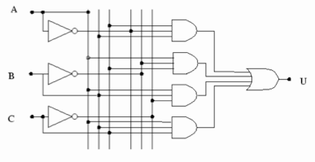
Trigger logic implementation
Once we are in the digital domain, all manipulations can be broken down to a Boolean operations
Combinatorial
  Summing, Decoders, Multiplexers,…
Sequential
  Flip-flops, Registers, Counters,…
AND
OR
NOT

Slide 25
Trigger logic implementation
Once we are in the digital domain, all manipulations can be broken down to a Boolean operations
Combinatorial
  Summing, Decoders, Multiplexers,…
Sequential
  Flip-flops, Registers, Counters,…
AND
OR
NOT
Data propagates as a wave through the logic
Operations happen at well defined times and in a well defined order

Slide 26
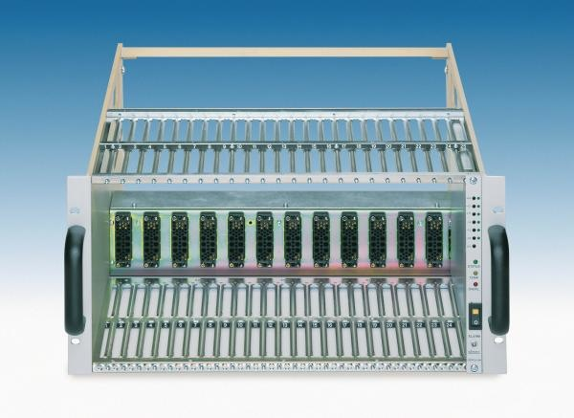
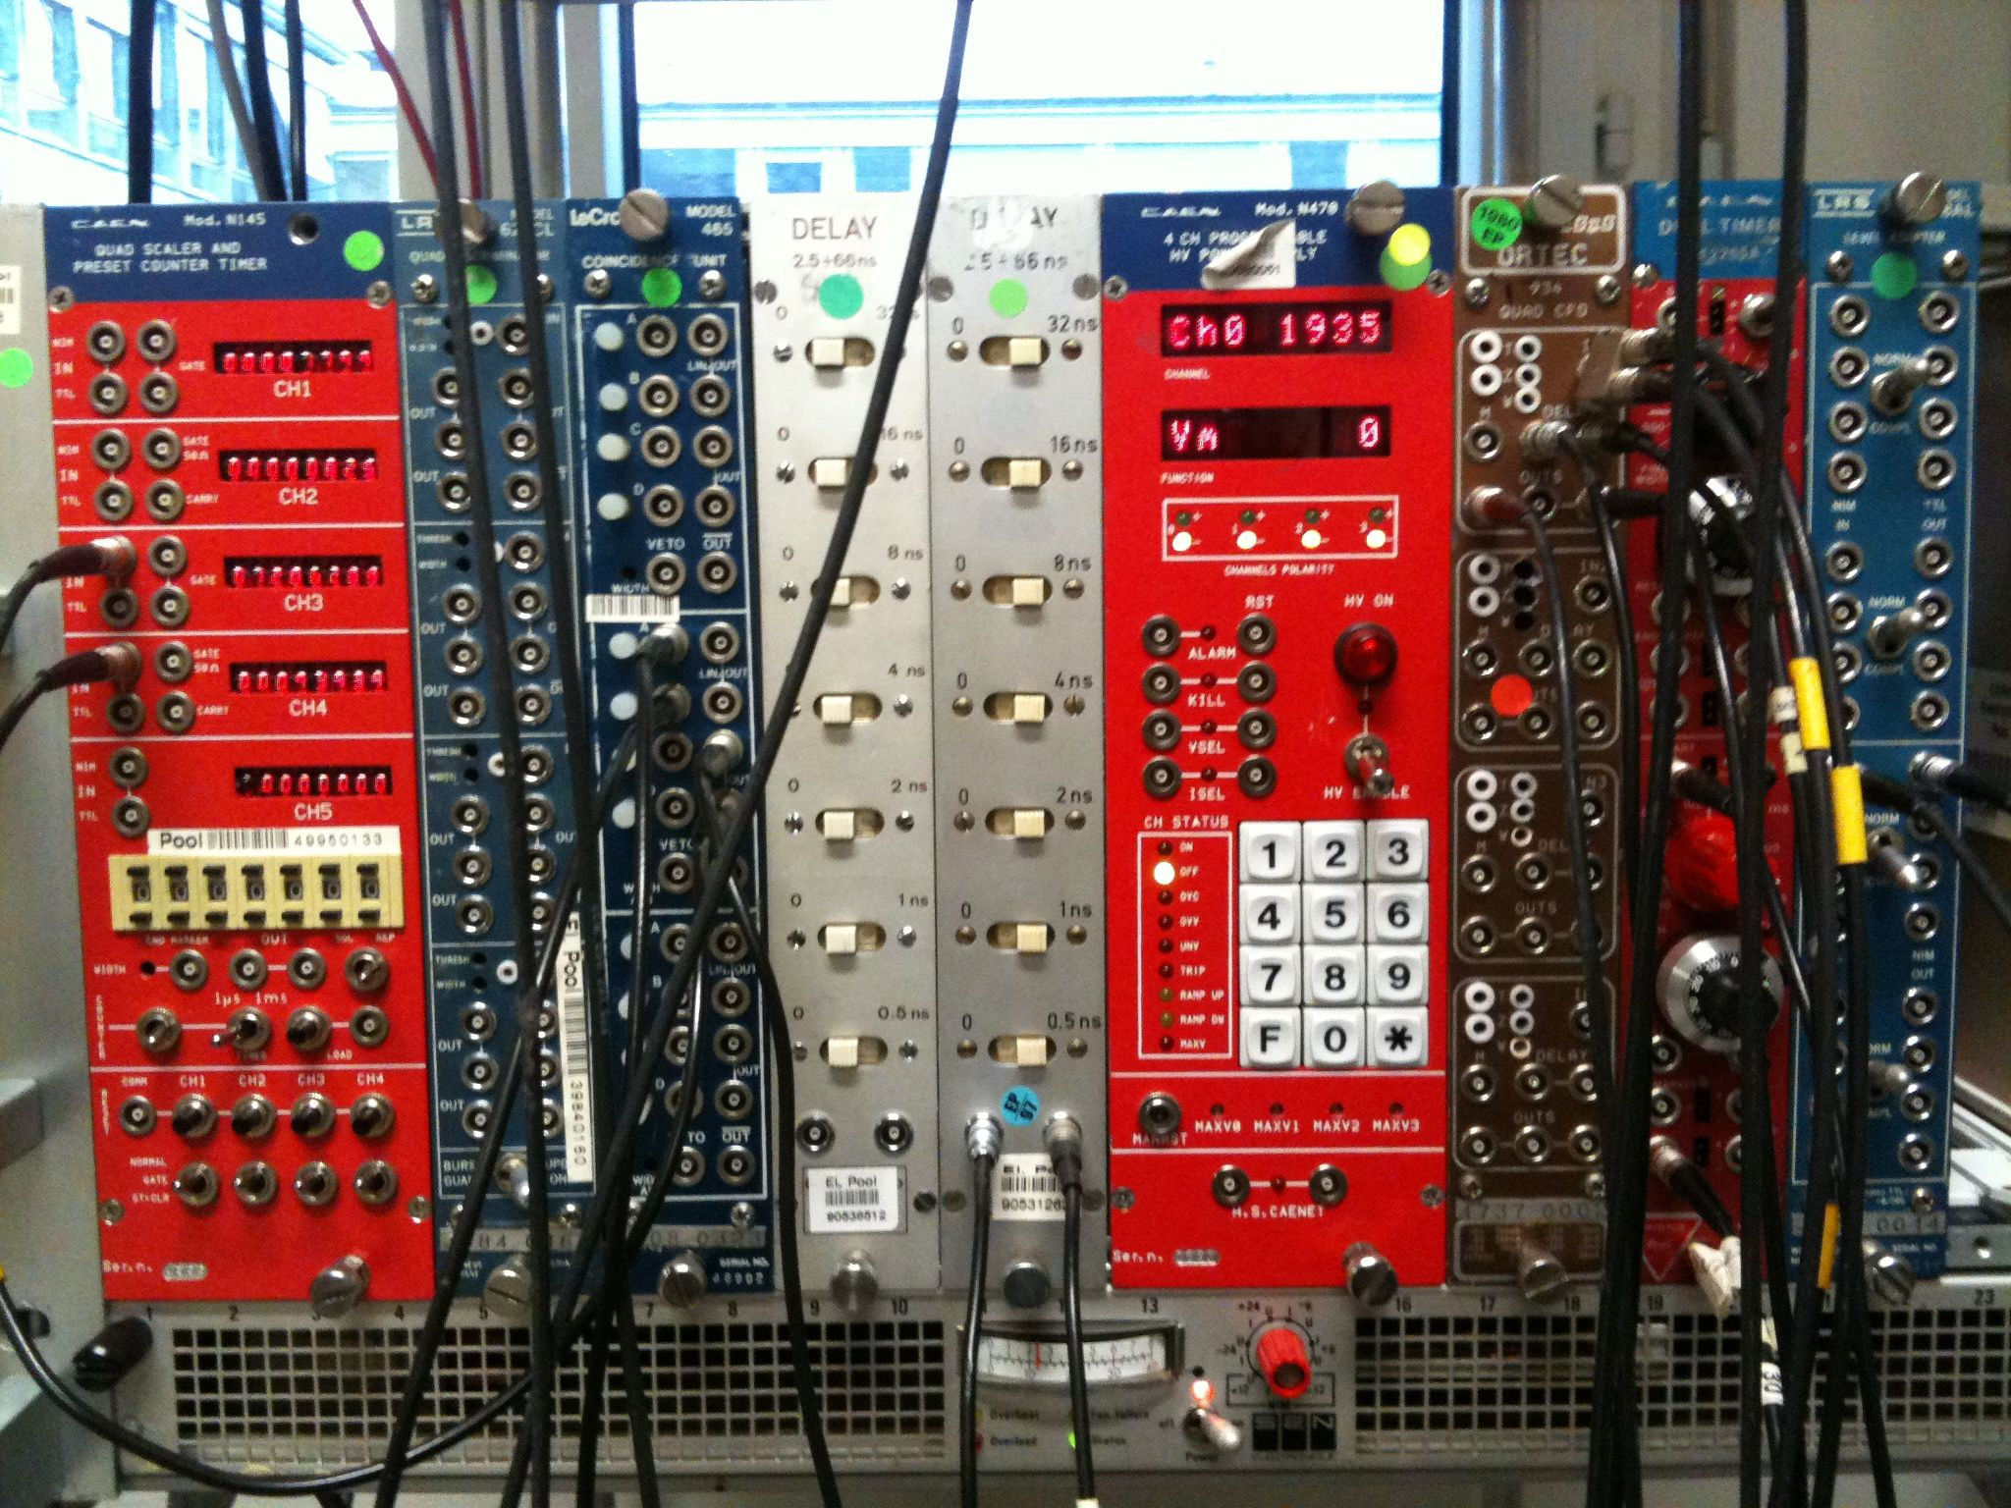

A simple trigger wants a simple system
A simple trigger system can start with a NIM crate
Common support for electronic modules
Standard impedance, connections, logic levels
  Watch out for negative voltage levels: Low = 0v, High = -0.8V

Slide 27
A simple trigger wants a simple system
Digital Logic
CFD
Threshold Discriminator
Analogue Delay

Slide 28
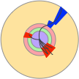
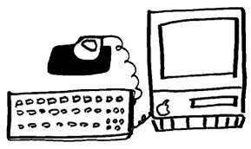
A simple trigger and DAQ system
Detector
Fast links
Trigger system
start
&
FE
busy
FE
coincidence logic
FE
DAQ system
FE
discriminators
Front-Ends
ReadOut
delays
Digitizers (ADC, TDC,….)

Slide 29
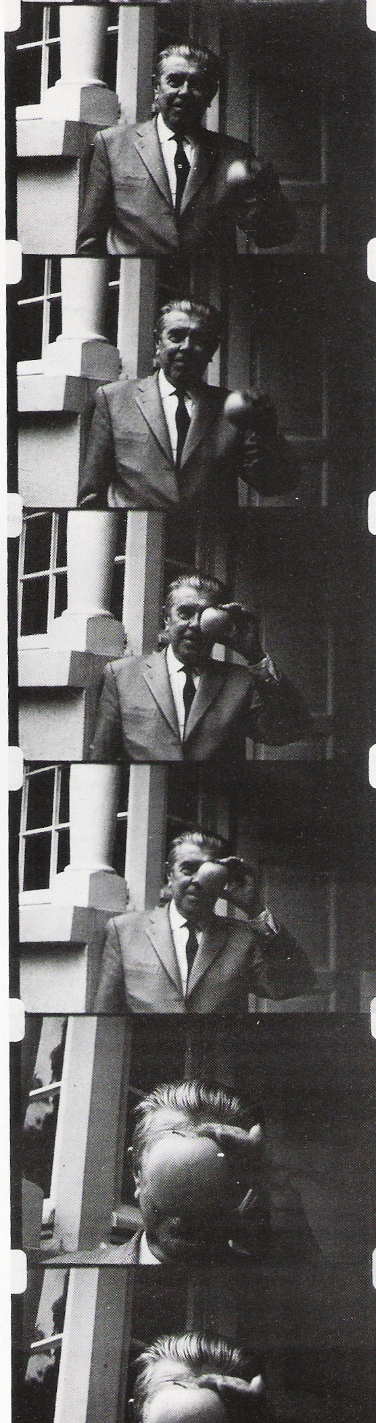
Keyword: DeadTime
The key parameter in high speed trigger systems design
  The fraction of the acquisition time when no events can be recorded.
  Typically of the order of few %
  Reduces the overall system efficiency
Arises when a given processing step takes a finite amount of time
  Readout dead-time
  Trigger dead-time
  Operational dead-time

Slide 30
Deadtime Example
Writing to disk or tape is much slow than accepting data into RAM
If you select an event and start writing it to disk, you cannot accept any more events until you finish writing, even if they are interesting

Slide 31
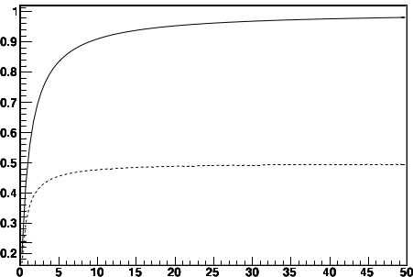

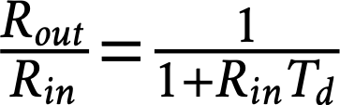

Deadtime example
For input rate “R_{in}”, Readout rate “R_{out}”, and time taken to write to disk “T_{d}”
Fraction of 1s “lost” to writing = R_{out}•T_{d}
Event output rate R_{out} = (1-R_{out}•T_{d})•R_{in}
Rout(Hz)
T_{d}=1s
  for T_{d} = 1s →max rate = 1Hz
T_{d}=2s
IRREDUCIBLE!!!
Fraction of
surviving events
R_{in}(Hz)
To achieve high efficiency ⟹

Slide 32
Deadtime
Writing to disk or tape is much slow than accepting data into RAM
If you select an event and start writing it to disk, you cannot accept any more events until you finish writing, even if they are interesting
Same principle applies to processing time
  For example, ADCs

Slide 33
A simple trigger system: Deadtime
Fast links
Trigger system
start
&
FE
busy
FE
coincidence logic
FE
FE
discriminators
Front-Ends
ReadOut
delays
Mux
ADC

Slide 34
A simple trigger system: Deadtime
Detector
Fast links
Trigger system
start
&
FE
busy
FE
coincidence logic
FE
FE
discriminators
Front-Ends
ReadOut
delays
Mux
ADC
If ADC is the critical step for deadtime, this is clearly a really bad plan

Slide 35
A simple trigger system: Parallelism
Detector
  Independent readout and trigger paths, one for each sensor element
  Digitisation and DAQ processed in parallel (as much as affordable!)
Fast links
Trigger system
start
&
FE
busy
FE
coincidence logic
FE
FE
discriminators
Front-Ends
ReadOut
delays
ADCs
Mux
Much more sensible!
Potentially much more expensive!

Slide 36
Keyword: Latency
  Latency: Time to form the trigger decision and distribute to the digitisers
Fast links
Trigger system
&
FE
FE
coincidence logic
FE
FE
discriminators
Latency
Front-Ends
ReadOut
delays
ADCs
Mux

Slide 37
A simple trigger system: Latency
  Latency: Time to form the trigger decision and distribute to the digitisers
  Signals must be delayed until the trigger decision is available
  The more complex is the selection, the longer is the latency
Fast links
Trigger system
&
FE
FE
coincidence logic
FE
FE
discriminators
Latency
Front-Ends
ReadOut
delays
ADCs
Mux

Slide 38
A simple trigger system: Latency
Fast links
Trigger system
&
FE
FE
coincidence logic
FE
FE
discriminators
Latency
Front-Ends
ReadOut
delays
ADCs
Mux
Analogue delay-lines are a bit risky, don’t you think?
Especially for more than one channel

Slide 39
A simple trigger system
Fast links
Trigger system
&
FE
FE
coincidence logic
FE
FE
discriminators
Latency
Front-Ends
ReadOut
delays
ADCs
Mux
If the ADCs are the slow part,
can we use the time more profitably?

Slide 40
A simple trigger system: Pre-trigger
  Pre-Trigger stage: very fast indicator of some minimal activity in the detector
  Used to START the digitisers, with no delay
  The complex trigger decision comes later
Fast links
Trigger system
Pre-trigger
&
start
FE
FE
coincidence logic
FE
FE
discriminators
Front-Ends
Start ADC
busy
ReadOut
ADCs
Mux
If the ADCs are the slow part,
can we use the time more profitably?

Slide 41
A simple trigger system: Pre-trigger
Fast links
Trigger system
Pre-trigger
&
start
FE
FE
coincidence logic
FE
FE
discriminators
Front-Ends
Start ADC
busy
ReadOut
ADCs
Mux
Assumes the digitization time is longer than the latency of the trigger system!
What if that is not true?

Slide 42
A simple trigger system: Pre-trigger
Fast links
Trigger system
Pre-trigger
&
start
FE
FE
coincidence logic
FE
FE
discriminators
Front-Ends
Start ADC
Data Valid
ReadOut
ADCs
Digital delay
A PIPELINE
Mux
Since each digitization takes a finite time
Can store the result of each digitization in RAM until trigger decision is made

Slide 43
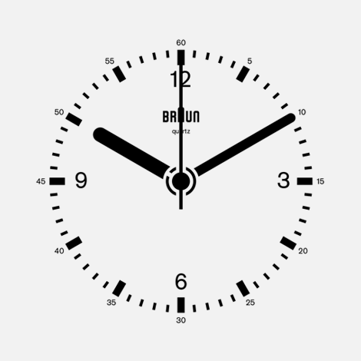
Simple trigger system: Bunched Colliders
Fast links
Trigger system
&
start
FE
FE
coincidence logic
FE
FE
discriminators
Front-Ends
ReadOut
ADCs
Digital delay
A PIPELINE
Mux
We have a master-clock – the bunch-crossings themselves!
No need for a pre-trigger

Slide 44
A Simple trigger system: Digital Triggers
Fast links
Digital Trigger system
start
FE
FE
FE
FE
Front-Ends
ADCs
ReadOut
Digital delay
A PIPELINE
Mux

Slide 45
A Simple trigger system: Digital Triggers
Fast links
Digital Trigger system
  This is the fundamental design behind all modern collider
  trigger-systems
start
FE
FE
FE
FE
Front-Ends
ADCs
ReadOut
Digital delay
A PIPELINE
Mux

Slide 46
And finally: A philosophical question
If you only see what the trigger accepts, how do you know what you have thrown away?

Slide 47
And finally: A philosophical question
If you only see what the trigger accepts, how do you know what you have thrown away?
A good trigger will also have so-called Minimum-bias or Zero-bias paths
  Zero-bias – accept a truly random sample of events (even “empty”)
  Minimum-bias – accept a random sample of crossings with collisions
Allows you to look at what your trigger tells you not to

Slide 48
What about non-collider experiments?
"Always on" detectors – "events" could occur at any time - continuous read out
  But most of the time, nothing is happening
Signals may be localised to one portion of the detector - local read out
"Events" may have very different durations - few ms to 100s seconds (e.g. supernova)
"Video" data compared to LHC experiments’ "Photo" data
Want to capture data when
something ‘interesting’ does
happen, and suppress the rest
Everything I have said about
deadtime, latency, min-bias paths,
etc. still applies!

