Slide 1

Circuits and Layouts
I
Instrumentation Training Lectures, Oxford 15/05/2026

Slide 2
Overview
Introduction, definitions
Layout and interconnects in IC technology
Transistor MOS layouts
Passive components layouts
Instrumentation Training Lectures, Oxford 15/05/2026

Slide 3
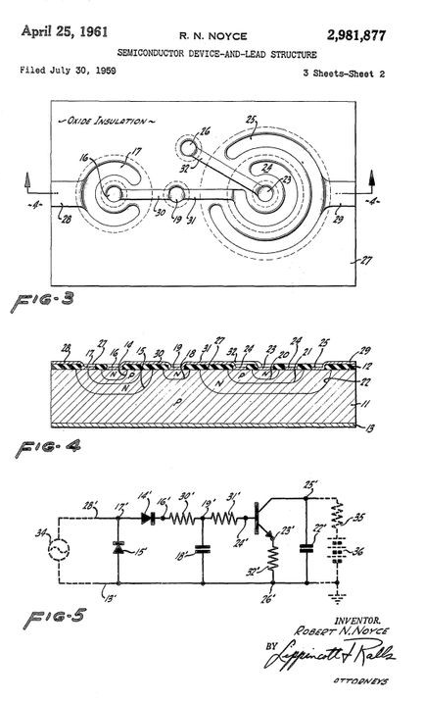
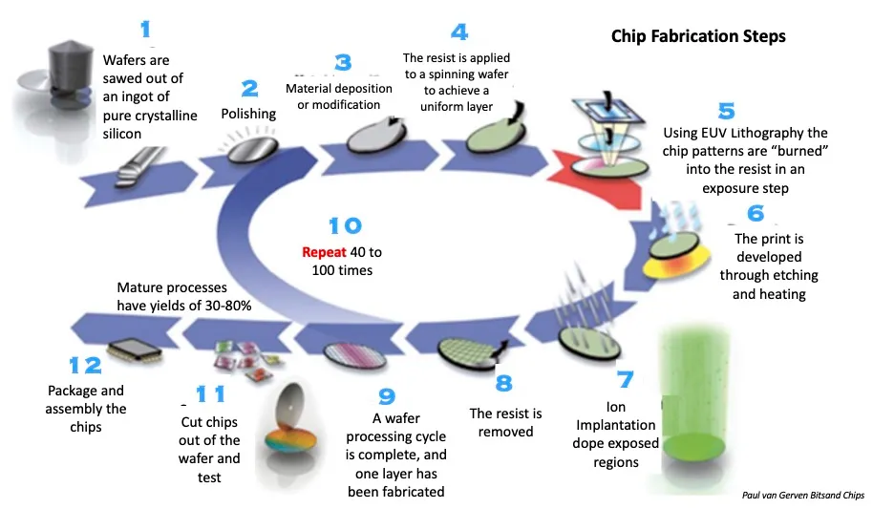
Introduction
  IC (integrated circuits) single silicon chip that includes active and passive interconnected devices to implement complex operations (analogue, digital)
  Planar technology: the processing steps are implemented in a thin layer of the surface of the chip
  Fabrication of chip is an extremely complex process, requiring several steps of atomic precision
First planar IC patent, 1961
1
Instrumentation Training Lectures, Oxford 15/05/2026

Slide 4
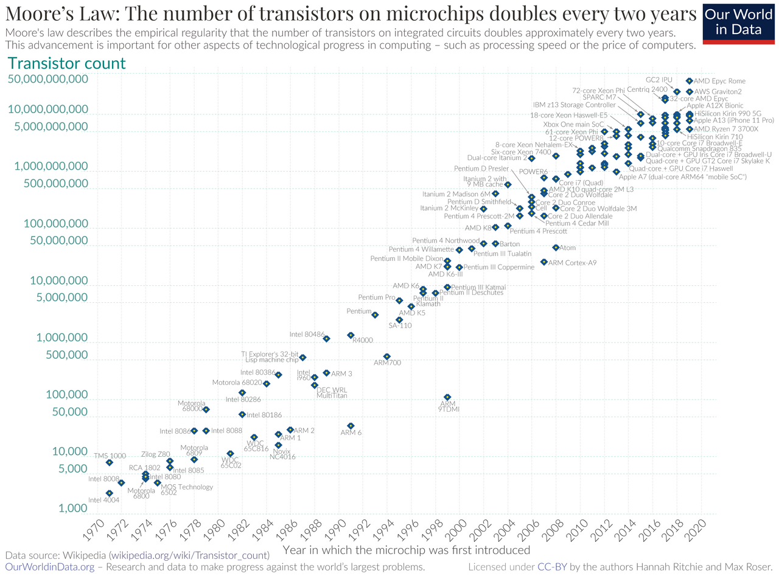
Layout and interconnects
  Device scaling leads to cost reduction and increased speed per transistor
  However, due to the high number of transistors on chip, layout optimization at chip level has become as important as transistors fabrication
  Interconnecting the devices has become the bottleneck for IC performances
Moore, G. "Cramming More Components onto Integrated Circuits," Electronics Magazine Vol. 38, No. 8 (April 19, 1965)
2
Instrumentation Training Lectures, Oxford 15/05/2026

Slide 5
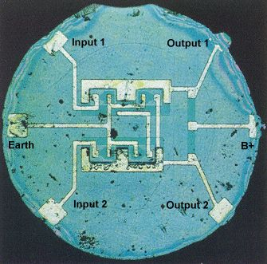
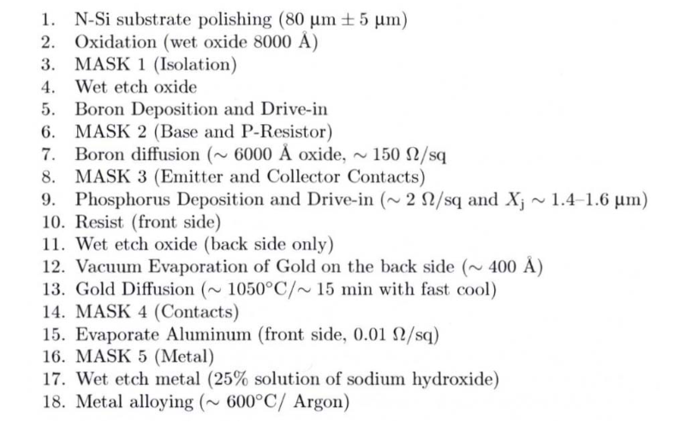
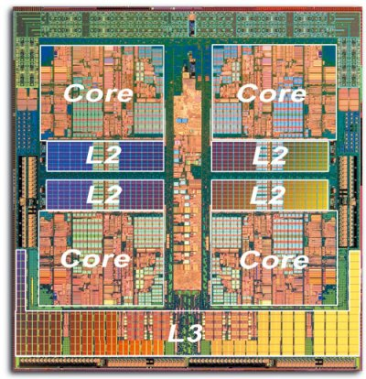
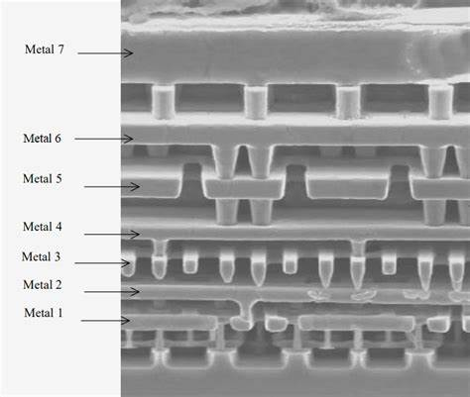
Layouts and interconnects
The processing steps involved in fabricating transistors and their immediate interconnect is called Front-End-Of-Line (FEOL)
That includes implantation, oxide growth, diffusion and first metal layer deposition
Interconnecting all the devices together with higher metals is the Back-End-Of-Line (BEOL)
As the number of transistors on chips grew, it became impossible to make all connections in a single layer
Added additional vertical levels of interconnects
Simpler IC might have a few metal layers, complex ICs exceed 10 layers
Taking into account inflation, for the same price, one can buy, in 2026, an AMD Ryzen 5 5600 CPU 6-core/12-thread "Zen 3" desktop processor (7nm) offering 3.5 GHz base clock, which has 4.15 billion transistors.
First commercial IC, Fairchild Semiconductor, 1961. A Flip-Flop
circuit , using 4 transistor. Initially sold at 120 USD.
Original Planar process flow (from Fairchild Semiconductor)
3
Instrumentation Training Lectures, Oxford 15/05/2026

Slide 6
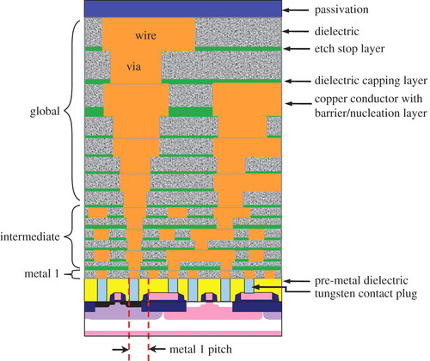
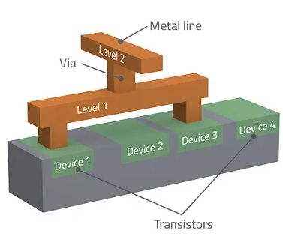
Layout and interconnects
BEOL
Various levels of interconnects are present in modern ICs:
  Metal 1, for short local interconnects
  Intermediate, to connect devices within blocks
  Global interconnects, for long, low resistivity connections, including power, grounds
Various levels are connected by vias and separated by dielectrics
FEOL
4
Instrumentation Training Lectures, Oxford 15/05/2026

Slide 7
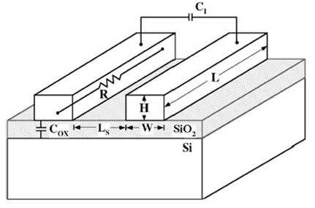





Layout and interconnects
t_{ox}
Interconnects and their layouts are of increasing importance as the feature size of circuit elements become smaller
Delay times of interconnect transmission line
$$R=ρ\frac{L}{WH}$$
$$C_{ox}=ε_{ox}ε_{o}\frac{WL}{t_{ox}}$$
$τ_{I}≅ε_{ox}ε_{o}ρ\frac{L^{2}}{WH}(\frac{W}{t_{ox}}+\frac{H}{L_{s}}$)
$$C_{I}=ε_{ox}ε_{o}\frac{HL}{L_{s}}$$
$C_{tot}≅C_{I}$+ $C_{ox}$
5
Instrumentation Training Lectures, Oxford 15/05/2026

Slide 8



Layout and interconnects
As the technology size decreases:
  W, L_{s} and H decrease
  t_{ox} decrease at ∼ the same rate as W and H i.e. by a scaling factor λ
  The distance L for local interconnect decreases as the sized of devices gets smaller (∼ λ)
  Time delay $τ_{iloc}$for local interconnect remains ∼ constant or slightly decreases
$τ_{i}≅ε_{ox}ε_{o}ρ\frac{L^{2}}{WH}(\frac{W}{t_{ox}}+\frac{H}{L_{s}}$)
$$τ_{iloc}∝ε_{ox}ε_{o}ρ\frac{λ^{2}}{λ^{2}}$$
6
Instrumentation Training Lectures, Oxford 15/05/2026

Slide 9
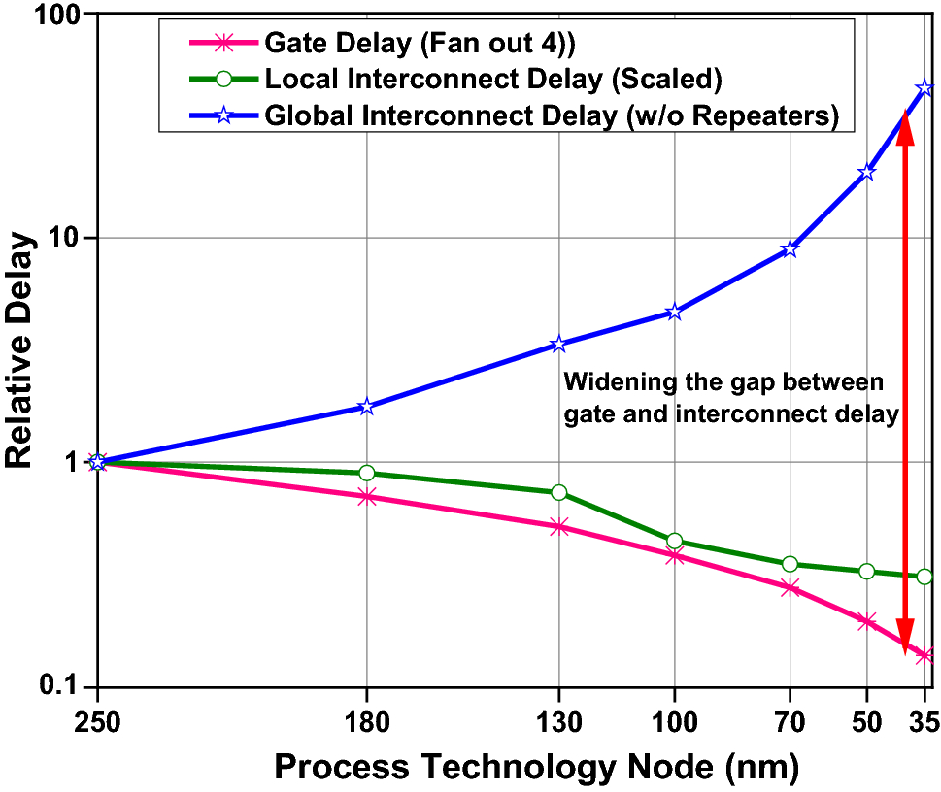


Layout and interconnects
As the technology size decreases:
  Area S of the die tends to increase
  Length of global interconnect increases √S
  Time delay $τ_{igIo}$for global interconnect tends to increase
Projected delay issues of global regular wire compared to gate delay with technology scaling
Source: A Survey of Emerging Interconnects for On-Chip Efficient Multicast and Broadcast in Many-Cores, February 2016, IEEE Circuits and Systems Magazine 16(1):58 - 72
$$τ_{igIo}≅ε_{ox}ε_{o}ρ\frac{S}{λ^{2}}$$
7
Instrumentation Training Lectures, Oxford 15/05/2026

Slide 10
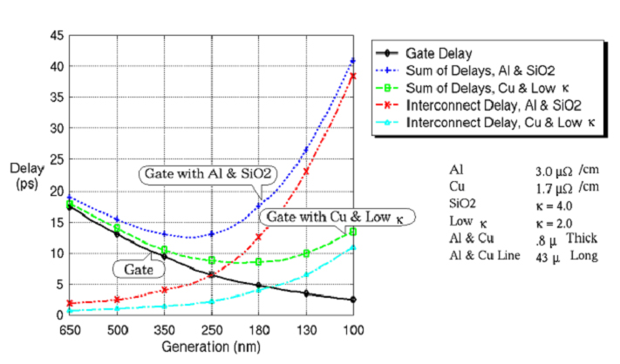


Layout and interconnects
Time delay $τ_{igIo}$for global interconnect tends to increase as the technology size decreases
Different materials can be used for the interconnect to reduce ρ and ε
The global interconnect delay vs. technology node for standard and advanced materials
source: 3D Integration Technologies – An Overview, Chanchani, R. (2009)
$$τ_{igIo}≅ε_{ox}ε_{o}ρ\frac{S}{λ^{2}}$$
8
Instrumentation Training Lectures, Oxford 15/05/2026

Slide 11
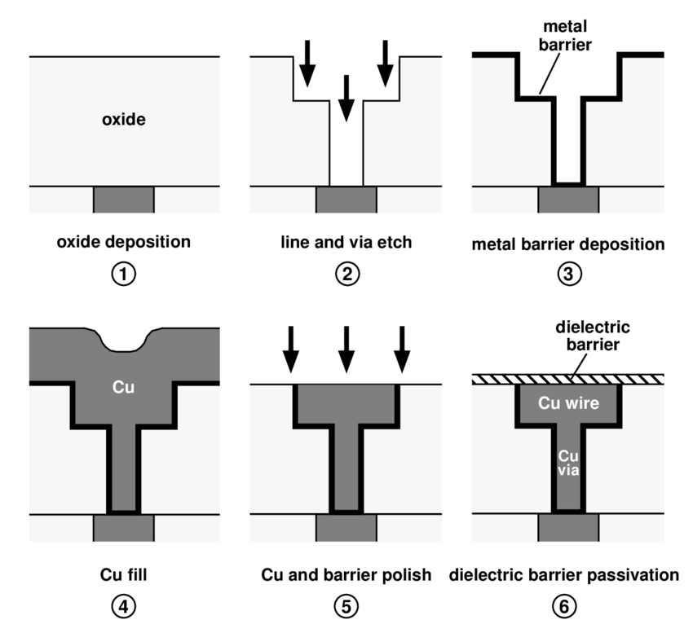
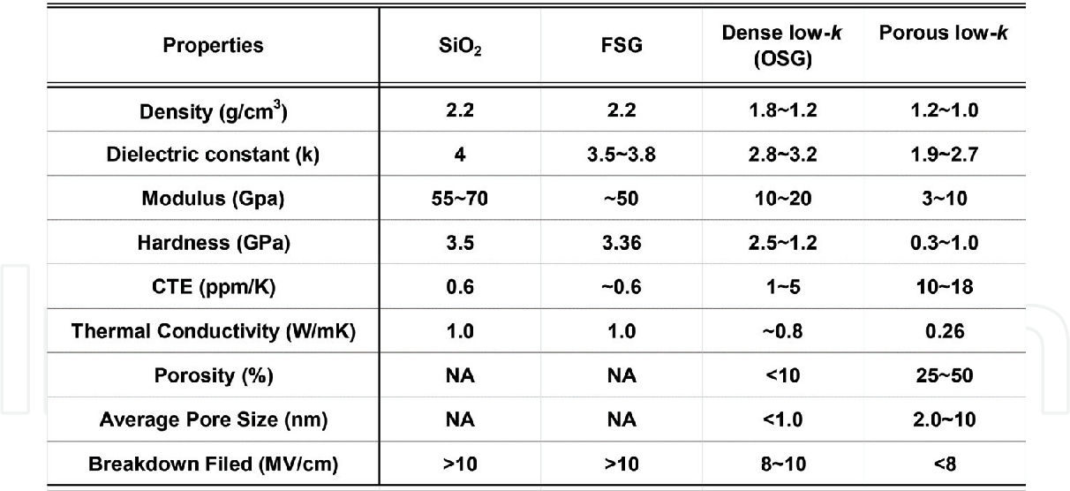
Layout and interconnects
Reducing ρ has been achieved by using Cu instead of Al (Damascene* process)
Reduce ε is more challenging: low-K dielectrics can be obtained using F-doped oxides and other dopants, but the resulting dielectric shows poorer quality
Air gaps are also used (ε =1) in some locations in <10 nm nodes
Dual Damascene process. An additional metal barrier (W) is deposited first to avoid Cu contamination of Si. Cu deposited by electroplating. CMP is needed as Cu does not plasma etch^{[1]}.
Low- dielectrics have been used for < 100 nm nodes. Reliability issues with very low k-dielectrics
*from ancient sword making technique in Damascus, Syria
^{[1]}C. K. Hu and J. M. E. Harper, Copper Interconnections and Reliability, Mater. Chem. Phys., vol. 52, p. 5-16, 1998.
9
Instrumentation Training Lectures, Oxford 15/05/2026

Slide 12
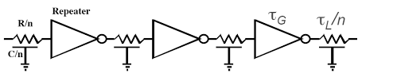
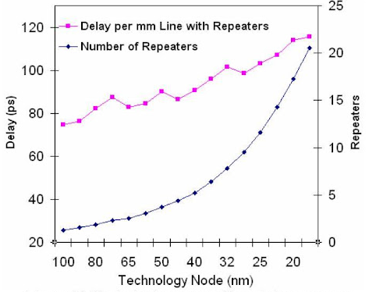

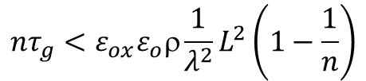
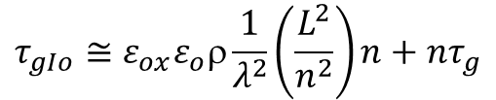

Layout and interconnects
A long interconnect line L is broken into n segments, each of length L/n
Another way to reduce the interconnect delay is to use pass transistors (or repeaters)
A long interconnect L is broken into n shorter lines, with the delay of each section reduced quadratically
A small repeaters’ delay $τ_{g}$ reduces the global delay $τ_{igIo}$
The repeater solution increases the occupied area and the power consumption
$$τ_{igIo}≅ε_{ox}ε_{o}ρ\frac{L^{2}}{λ^{2}}$$
$$τ_{gIo}≅ε_{ox}ε_{o}ρ\frac{1}{λ^{2}}\left(\frac{L^{2}}{n^{2}}\right)n+nτ_{g}$$
$${nτ}_{g}<ε_{ox}ε_{o}ρ\frac{1}{λ^{2}}L^{2}\left(1−\frac{1}{n}\right)$$
Global interconnection delay and repeaters vs. node (source: http://www.monolithic3d.com/3d-ic-edge1.html)
10
Instrumentation Training Lectures, Oxford 15/05/2026

Slide 13
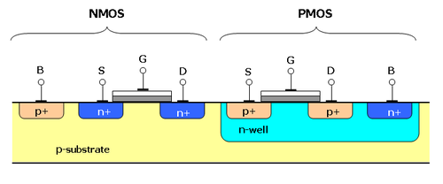
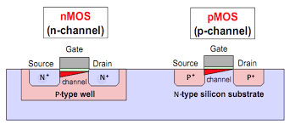
MOS transistor layout
Very often standard silicon wafers are P type and devices, including MOS transistors, are implemented in them
This stems from the fact that NMOS are intrinsically faster than PMOS (e⁻ mobility higher than h⁺ )
Fastest NMOS is obtained from high resistivity (low doping) P substrate rather than lower resistivity (higher doping) P well
11
Instrumentation Training Lectures, Oxford 15/05/2026

Slide 14

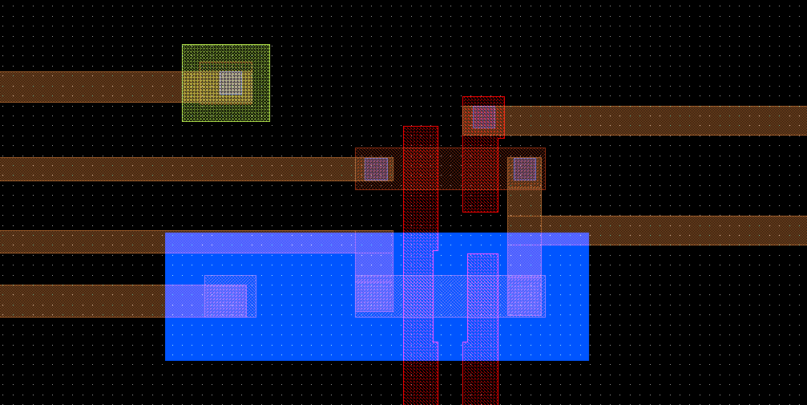


MOS transistor layout
In digital circuits, the transistors are normally designed with minimum size, to increase density of functions/storage /area
In analog circuits a large form factor β = W/L is required, to increase the transconductance g_{m}
NMOS
S
W
L
D
PMOS
NWell
GATE
12
Instrumentation Training Lectures, Oxford 15/05/2026

Slide 15
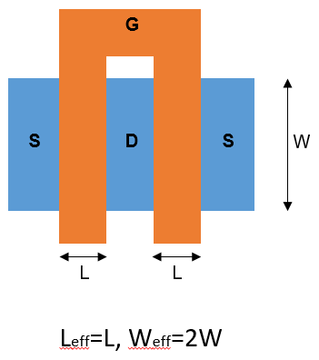
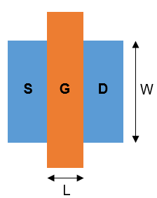
MOS transistor layout
In the layout of analog transistors the form factor is crucial as it determines g_{m} (straight structures preferable)
However, a big value of W might increase Gate resistance/capacitance
Special layout solutions in analog design:
  multi-finger structure
Single finger
Two fingers: W are summed
Capacitance x 2
Resistance /2
To first approx., RC remains the same as in single finger
13
Instrumentation Training Lectures, Oxford 15/05/2026

Slide 16
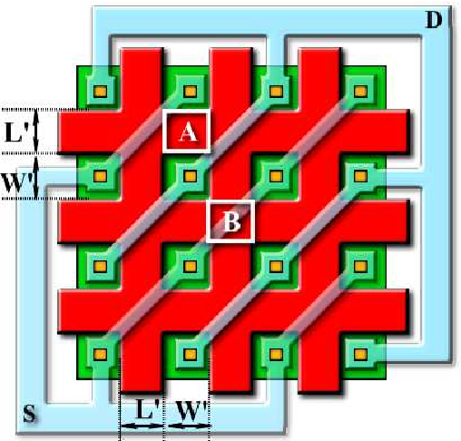



MOS transistor layout
Multi finger structures decrease the Gate resistance but increase the parasitic effects (drain-gate coupling, gate to substrate)
Special structure (Waffle structure) used for RF CMOS applications
P. Vacula 1,2, M. Husák, M. 2013
Waffle MOS channel aspect ratio calculation with Schwarz-Christoffel Transformation
14
Instrumentation Training Lectures, Oxford 15/05/2026

Slide 17
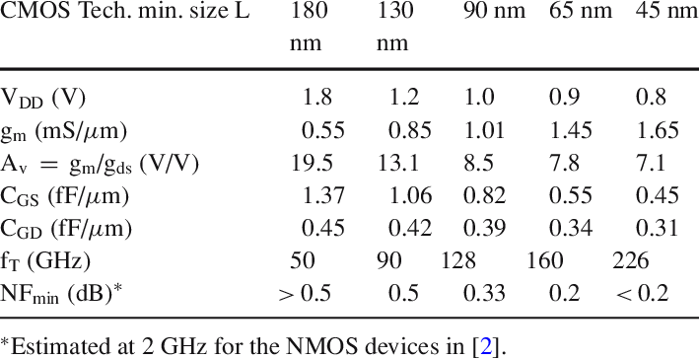
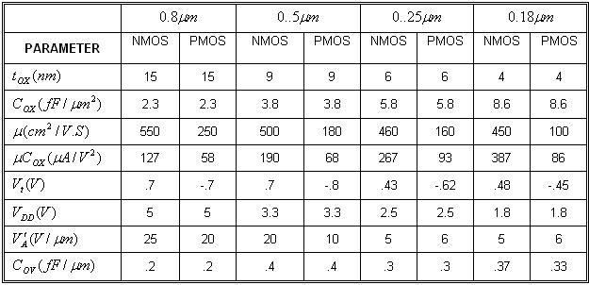
MOS transistor layout
Typical figures of CMOS process vs. size
Scaling down does not imply improvements in device characteristics of the same factor
15
Instrumentation Training Lectures, Oxford 15/05/2026

Slide 18
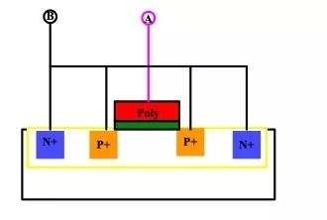
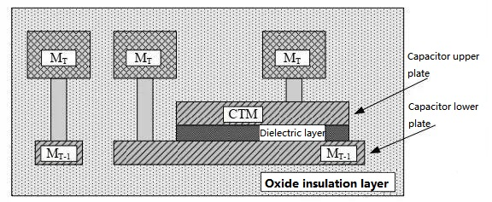
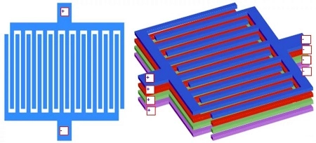
Passive components layout
MOS capacitor: capacitance values changes with voltage, small area
Integrated Capacitors are normally obtained by structures close to the silicon substrate
Three type of capacitors:
  MOS (Metal Oxide Semiconductor)
  MiM (Metal Insulator Metal)
  MoM (Metal Oxide Metal) use interdigitated capacitors formed by metal layers
MIM use different layers of metal and interposed dielectric to form a capacitor. Similar to plate capacitor, good stability but require additional masks
MOM use interdigitated capacitors formed by metal connections, placed in close proximity – preferred choice for advanced CMOS, also no additional mask required
16
Instrumentation Training Lectures, Oxford 15/05/2026

Slide 19
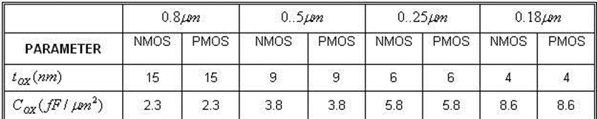
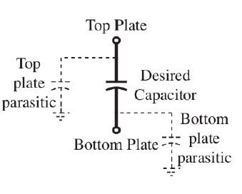



Passive components layout
$$t_{ox}=4 nm$$
$C=$8.6 fF/$μm^{2}$
Typical values of capacitance
Typical dielectric layers are SiO₂ or Si₃N₄
Use of high k materials is common in more advanced CMOS technologies
$$C=\frac{ε_{0}ε_{r}}{t_{ox}}WL$$
MIM/MOMs parasitic
$C_{t,p}=$0.1 % C
$C_{b,p}=$1 % C
17
Instrumentation Training Lectures, Oxford 15/05/2026

Slide 20
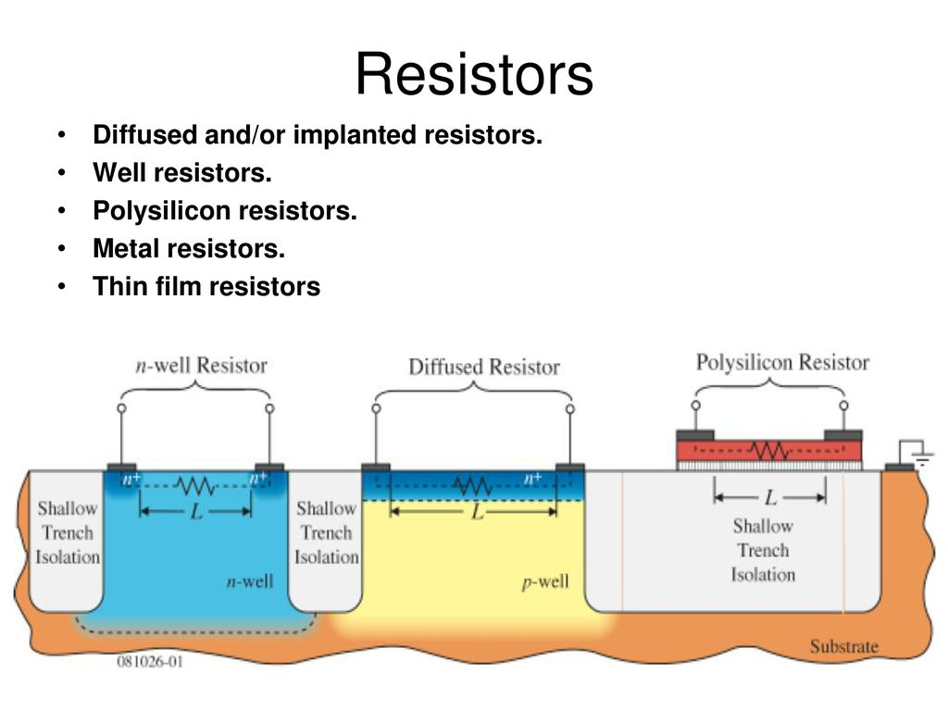



Passive components layout
Integrated Resistors are normally obtained by thin strips of resistive layers
Insulation from surrounding achieved by oxide layers or reversed biased junctions
$$Nwell: ρ_{∎}\sim 1 kΩ/∎$$
$$Poly: ρ_{∎}\sim 10 Ω/∎$$
$Metallic: ρ_{∎}\sim 0.1 Ω/∎$ $R=$ $ρ_{∎}\frac{L}{W}$
18
Instrumentation Training Lectures, Oxford 15/05/2026

Slide 21
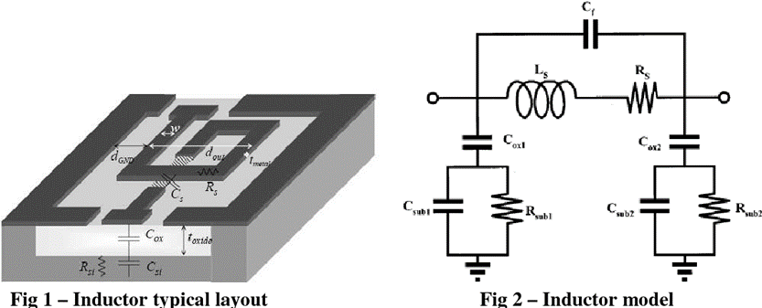
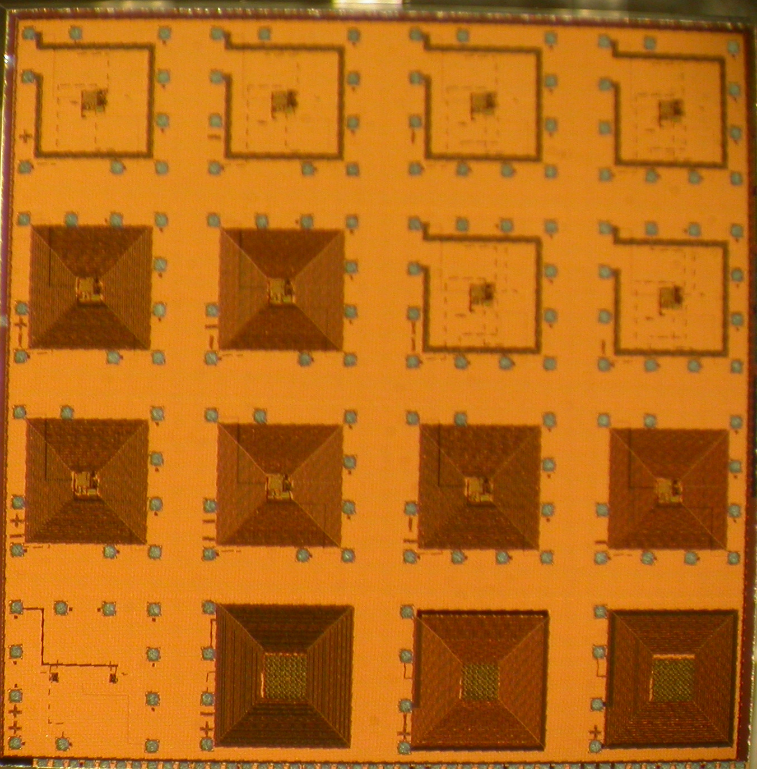
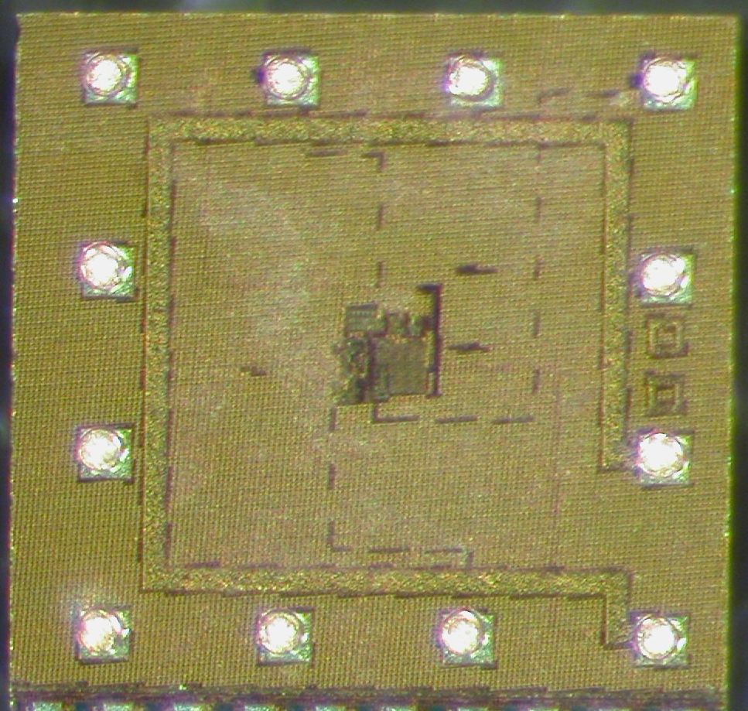
Passive components layout
Integrated Inductors are obtained by different layout of metal layers
Used in some RF CMOS applications
Yishay, Roee Ben et al. “High performance MEMS 0.18μm RF- CMOS inductors.” 2008 IEEE International Conference on Microwaves, Communications, Antennas and Electronic Systems (2008): 1-7.
E.G. Villani, et al., A monolithic 180 nm CMOS dosimeter for In Vivo Dosimetry medical application, Radiation Measurements, Volume 71, 2014, Pages 389-391, ISSN 1350-4487,https://doi.org/10.1016/j.radmeas.2014.07.007.
19
Instrumentation Training Lectures, Oxford 15/05/2026

Slide 22
Circuits and layout I
Layouts and interconnects in IC
  FEOL and BEOL different characteristics
  Interconnect delays and ways to mitigate them
Transistors layouts in IC
Passive components layouts in IC
    Thank you
    giulio.villani@stfc.ac.uk
20
Instrumentation Training Lectures, Oxford 15/05/2026

