Slide 1
UK Advanced Instrumentation Training
Circuit Design 3 & 4
Simulation LTspice 1 & 2
Dr Weida Zhang
@physics.ox.ac.uk
2022 May 10

Slide 2
Circuit Design, Noise, Grounding
Workflow
Analyze -> Block Diagram, Specs
Schematic -> Circuit topology, Constraints
Layout -> GERBER, BOM, Assembly-files
Manufacturing (fabrication, population, assembly)
Debug, Characterization -> Reports
(Revision)
Simulation

Slide 3
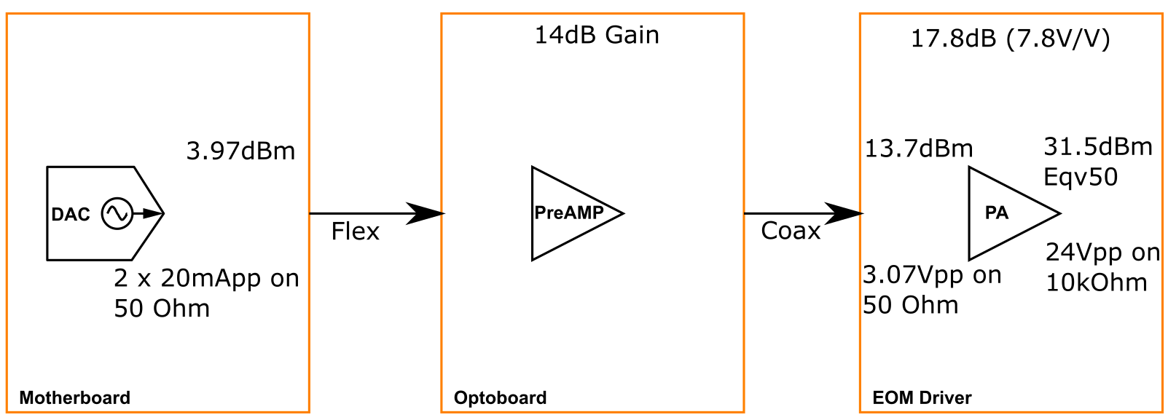
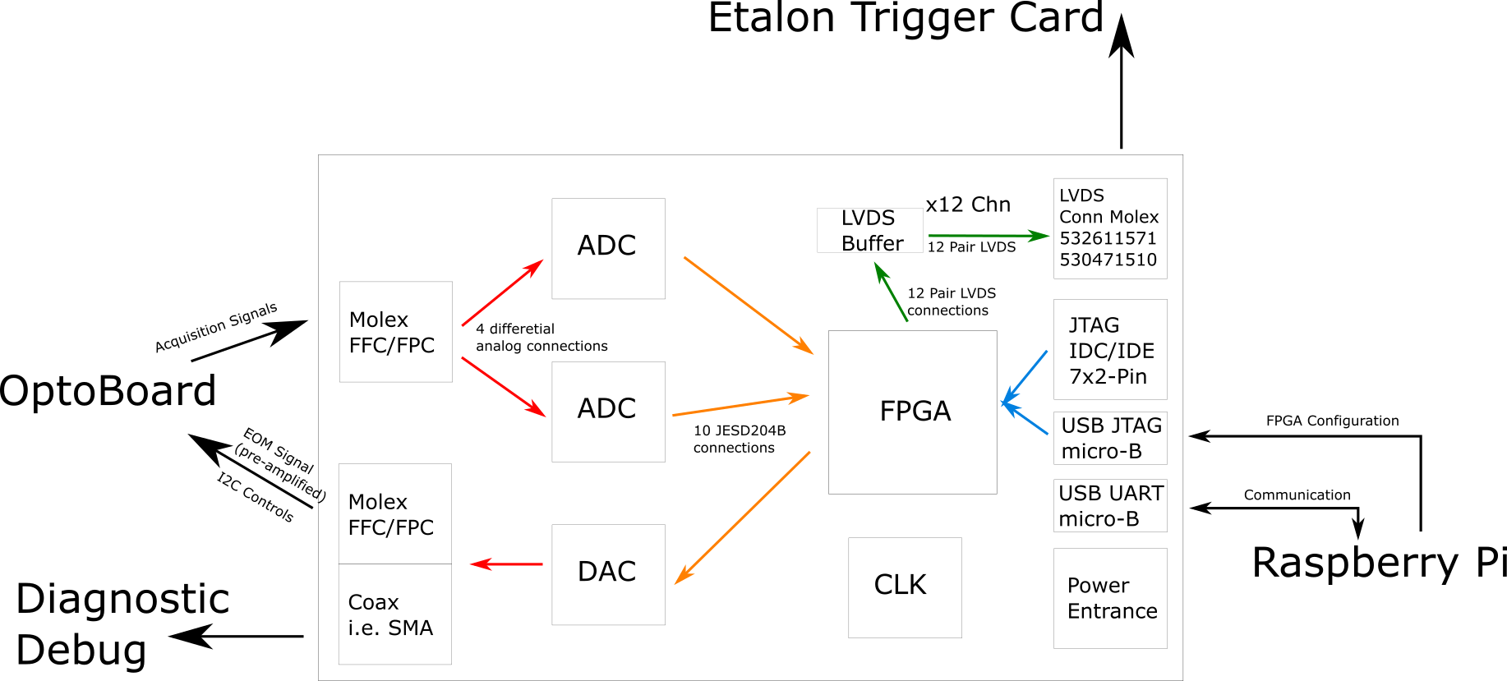
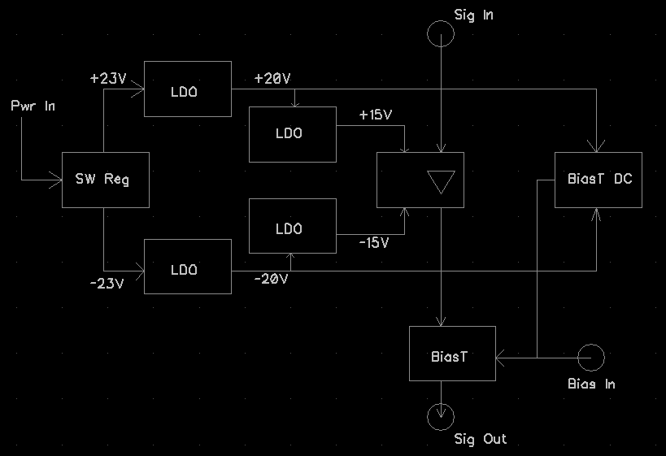
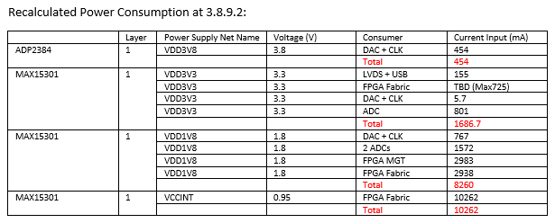
Circuit Design, Noise, Grounding
Workflow
Analyze -> Block Diagram, Specs

Slide 4
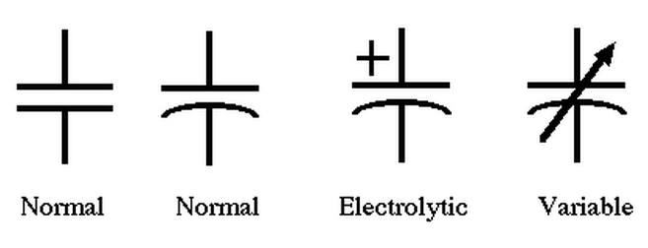
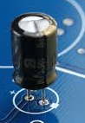
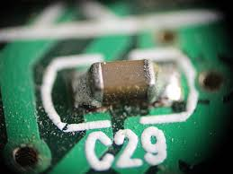
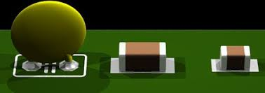
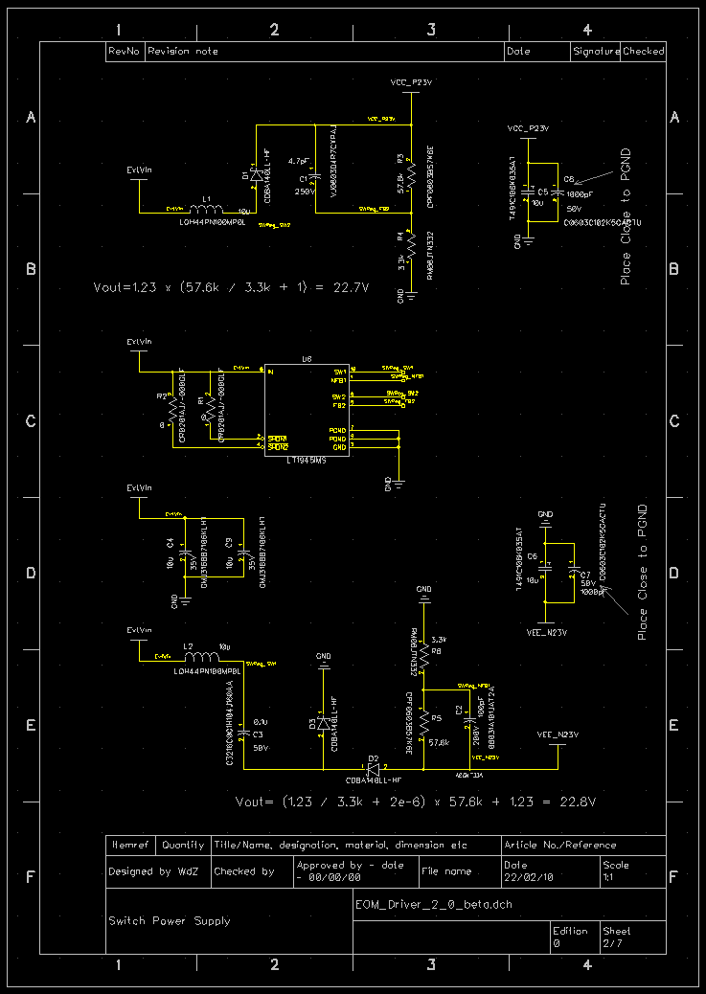
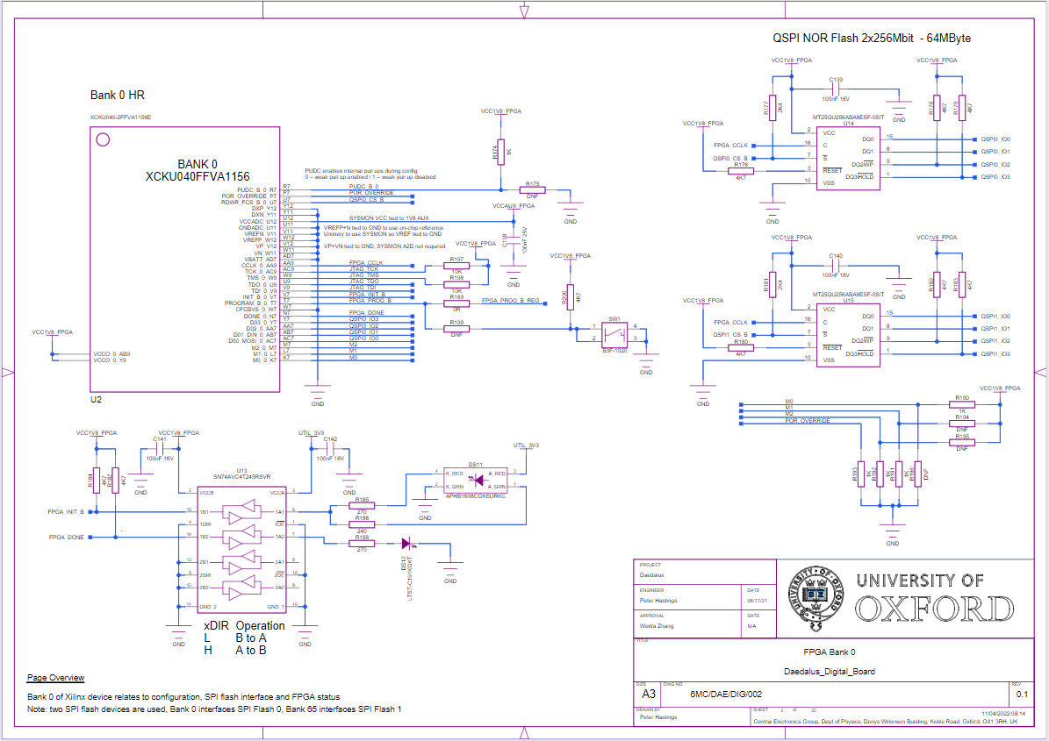
Circuit Design, Noise, Grounding
Workflow
Schematic -> Circuit topology, Constraints

Slide 5
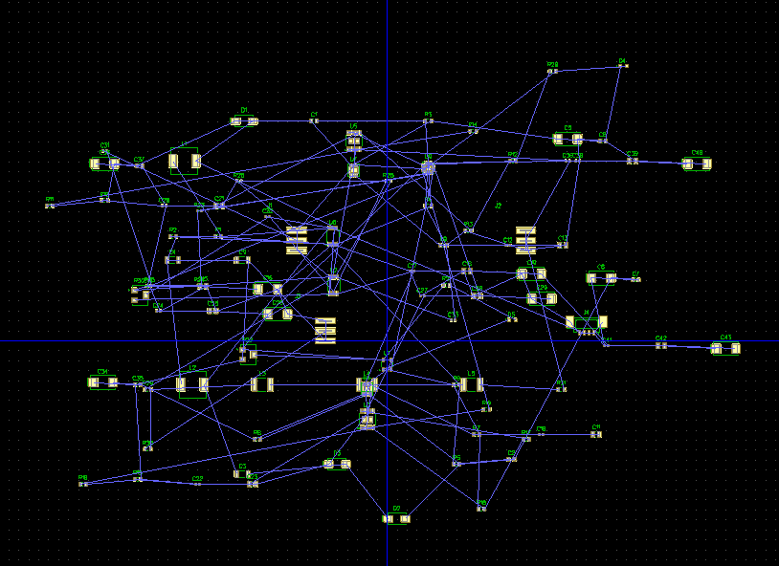
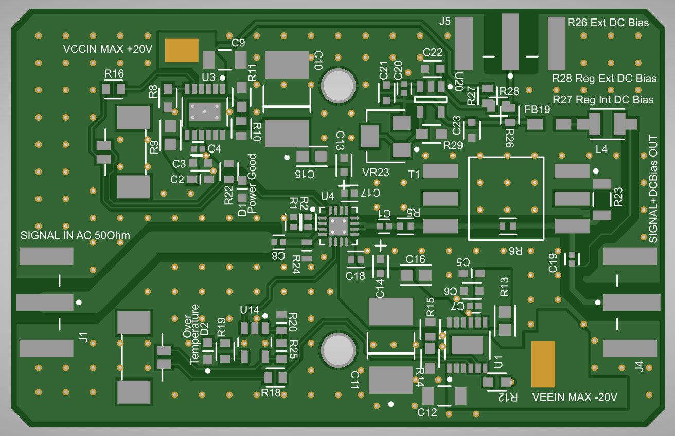
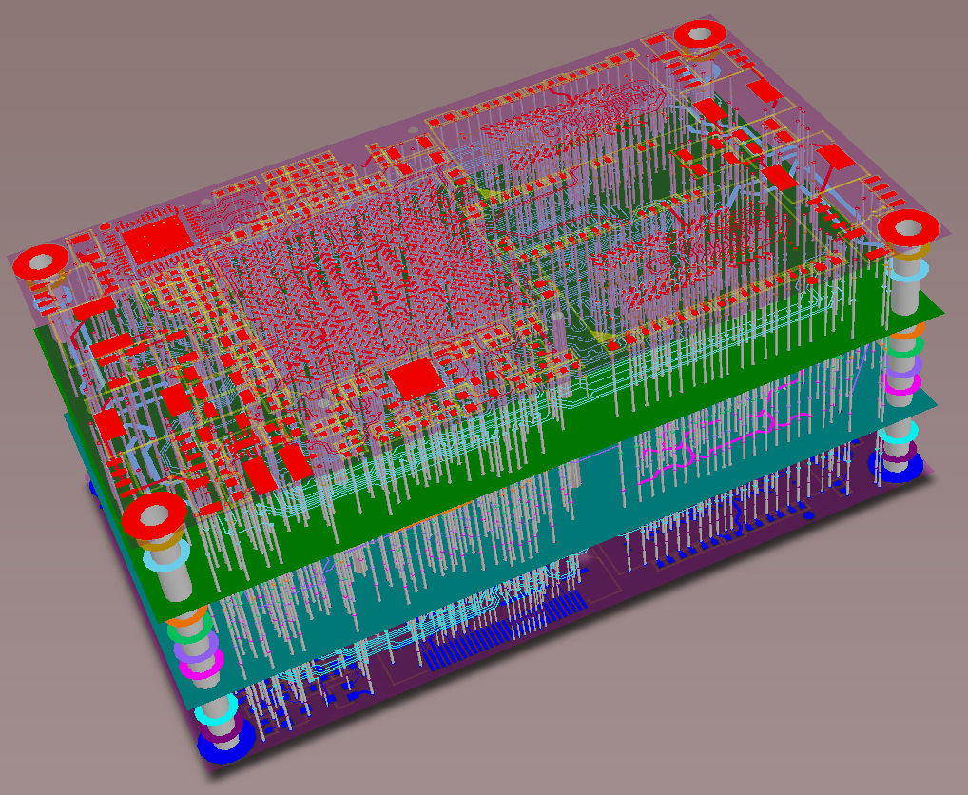
Circuit Design, Noise, Grounding
Workflow
Layout -> GERBER, BOM, Assembly-files
Source: https://www.wellpcb.com/

Slide 6
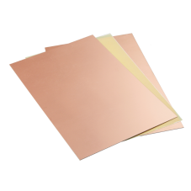
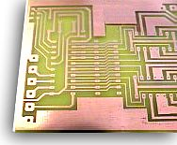
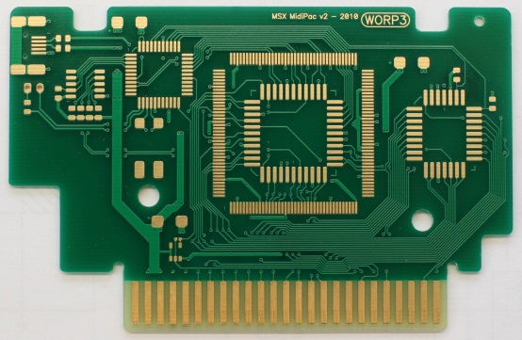
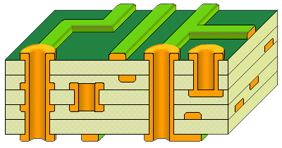
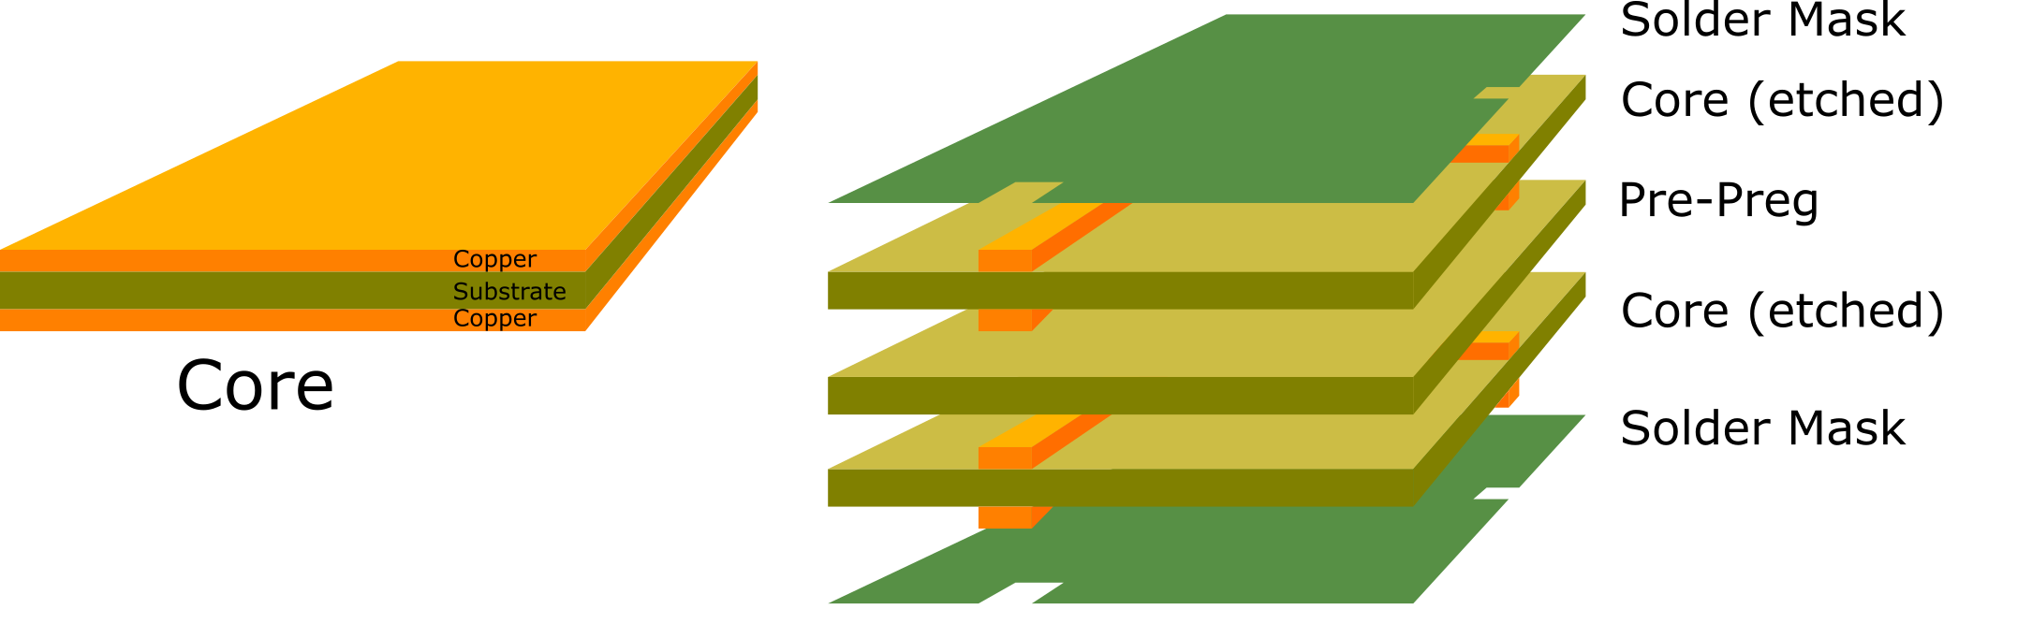
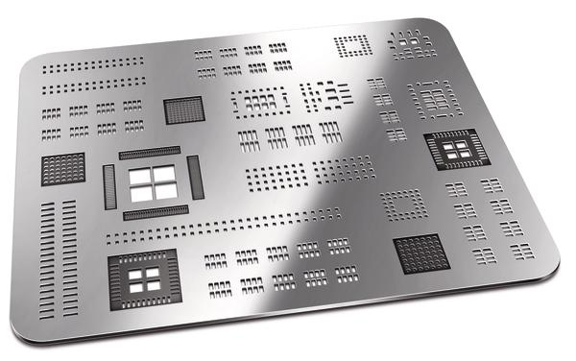
Circuit Design, Noise, Grounding
Workflow
Manufacturing (fabrication, population, assembly)

Slide 7
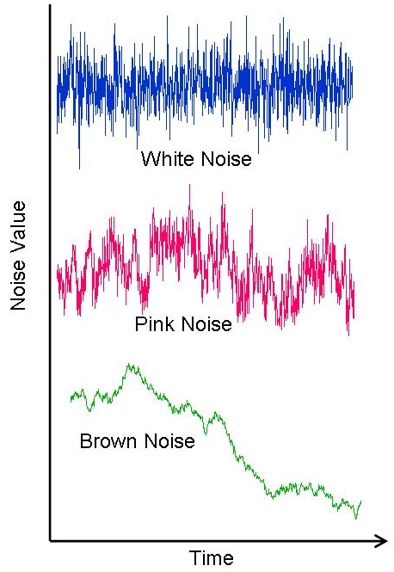
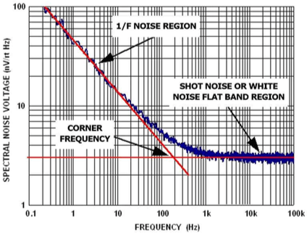
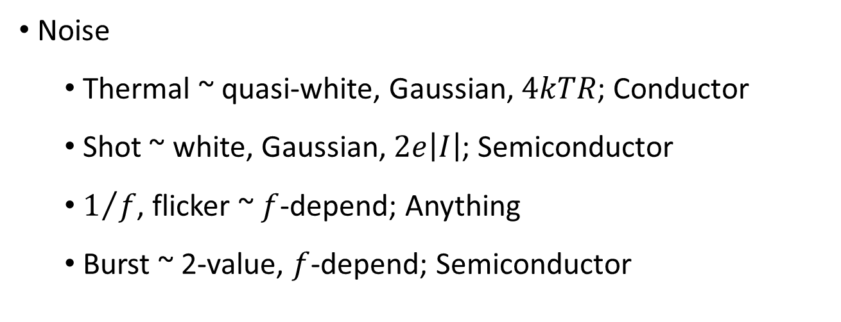
Circuit Design, Noise, Grounding
Noise
Thermal ~ quasi-white, Gaussian, $4kTR$; Conductor
Shot ~ white, Gaussian, $2e\left|I\right|$; Semiconductor
$1/f$, flicker ~ $f$-depend; Anything
Burst ~ 2-value, $f$-depend; Semiconductor

Slide 8
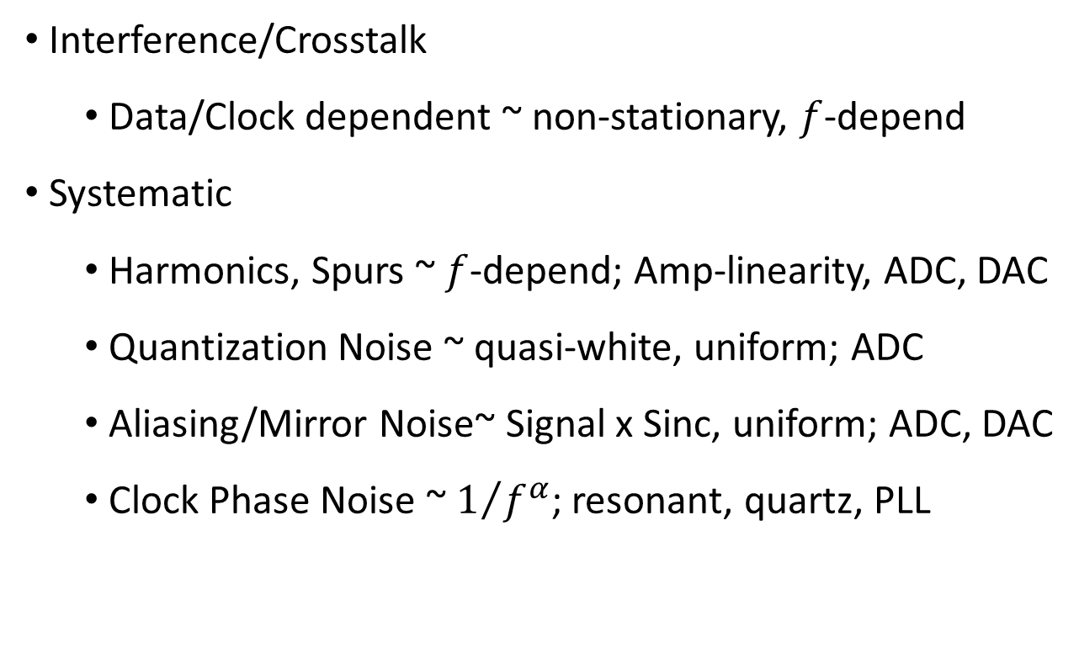
Circuit Design, Noise, Grounding
Interference/Crosstalk
Data/Clock dependent ~ non-stationary, $f$-depend
Systematic
Harmonics, Spurs ~ $f$-depend; Amp-linearity, ADC, DAC
Quantization Noise ~ quasi-white, uniform; ADC
Aliasing/Mirror Noise~ Signal x Sinc, uniform; ADC, DAC
Clock Phase Noise ~ $1/{f^{α}}$; resonant, quartz, PLL

Slide 9
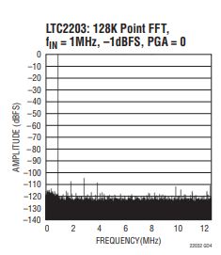
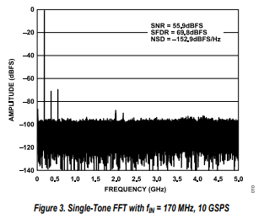
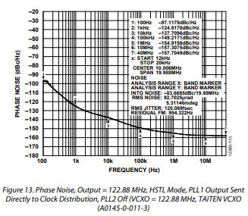
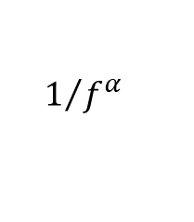
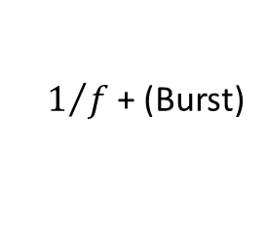
Circuit Design, Noise, Grounding
Harmonics
Spurs/Crosstalk
Thermal + Shot + Quantization
$$1/{f^{α}}$$
$1/f$+ (Burst)

Slide 10

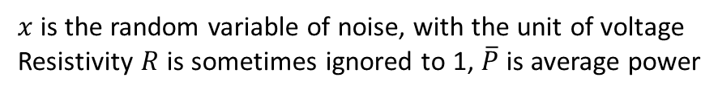
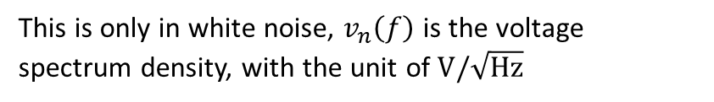
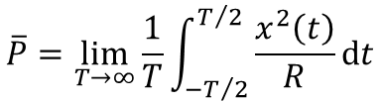
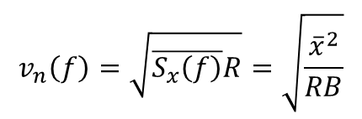
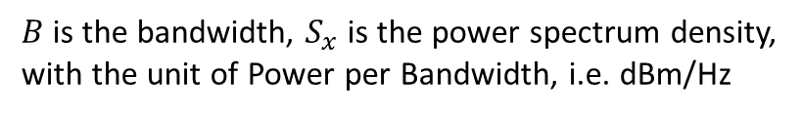

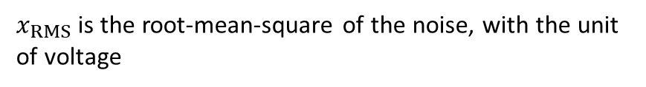
Circuit Design, Noise, Grounding
Noise
Units PSD vs PSD
$$\overline{P}=\lim_{T→∞}{\frac{1}{T}\int_{−T/2}^{T/2}{\frac{x^{2}\left(t\right)}{R}dt}}$$
$x$ is the random variable of noise, with the unit of voltage
Resistivity $R$ is sometimes ignored to 1, $\overline{P}$ is average power
$$\overline{P}=\int_{0}^{B}{S_{x}\left(f\right)df}$$
$B$ is the bandwidth, $S_{x}$ is the power spectrum density,
with the unit of Power per Bandwidth, i.e. dBm/Hz
$$x_{RMS}=\sqrt{\overline{P}R}$$
$x_{RMS}$ is the root-mean-square of the noise, with the unit of voltage
$$v_{n}\left(f\right)=\sqrt{\overline{S_{x}\left(f\right)}R}=\sqrt{\frac{{\overline{x}}^{2}}{RB}}$$
This is only in white noise, $v_{n}\left(f\right)$ is the voltage spectrum density, with the unit of $V/\sqrt{Hz}$

Slide 11
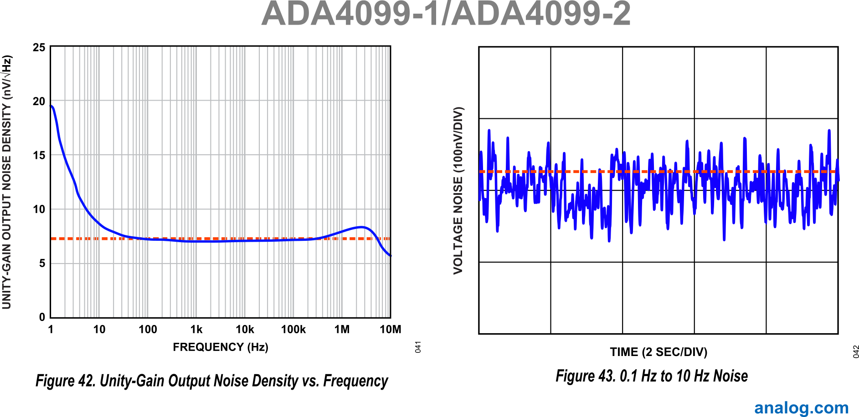
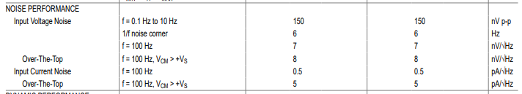


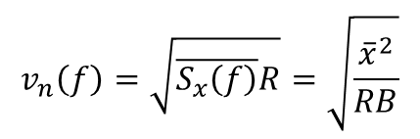


Circuit Design, Noise, Grounding
Noise
Conversion
0dBm = 0.632V_{PP} = 0.233 V_{RMS}
Quantify and Comparison
$$x_{RMS}$$
$$v_{n}\left(f\right)$$
$v_{n}$ as a number gives floor
$x_{RMS}$ at low frequency tells flicker
$$x_{RMS}=\sqrt{\overline{P}R}$$
$$v_{n}\left(f\right)=\sqrt{\overline{S_{x}\left(f\right)}R}=\sqrt{\frac{{\overline{x}}^{2}}{RB}}$$

Slide 12
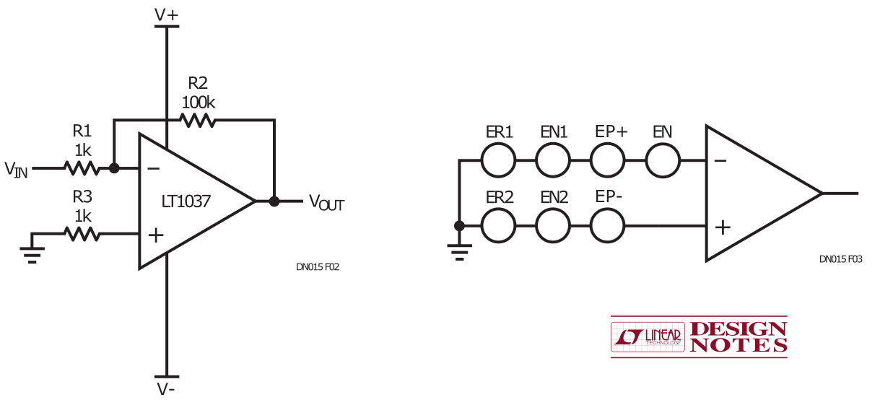
Circuit Design, Noise, Grounding
Noise
Paths
Signal Input
Resistive Components
Semiconductor Devices
Non-Linear (not LTI)
Power Supplies
Indirect Coupling

Slide 13
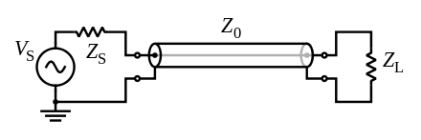
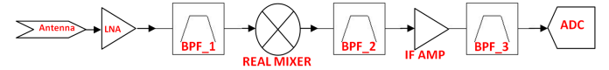
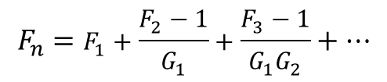
Circuit Design, Noise, Grounding
Noise
Paths
Signal Input
Antenna, transducer -> matching network
Previous Stage of Amps -> termination
Source: Texas Instruments
$$F_{n}=F_{1}+\frac{F_{2}−1}{G_{1}}+\frac{F_{3}−1}{G_{1}G_{2}}+…$$

Slide 14
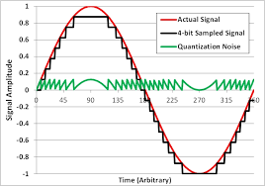
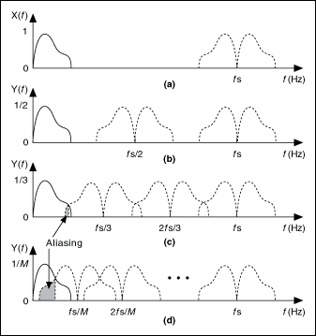
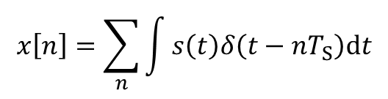
Circuit Design, Noise, Grounding
Noise
Paths
Signal Input
ADC
Quantization ENOB
Aliasing
$$x\left[n\right]=\sum_{n}{\int{s\left(t\right)δ\left(t−nT_{S}\right)dt}}$$

Slide 15
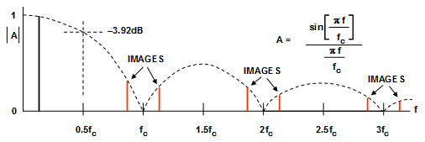
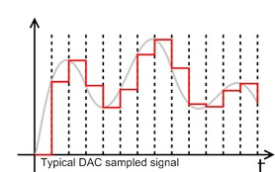
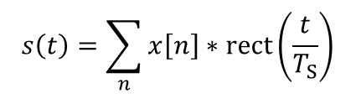
Circuit Design, Noise, Grounding
Noise
Paths
Signal Input
DAC
Quantization ENOB
Mirror/Image
$$s\left(t\right)=\sum_{n}{x\left[n\right]∗rect\left(\frac{t}{T_{S}}\right)}$$

Slide 16
Circuit Design, Noise, Grounding
Noise
Paths
Resistive Components
Semiconductor Devices

Slide 17
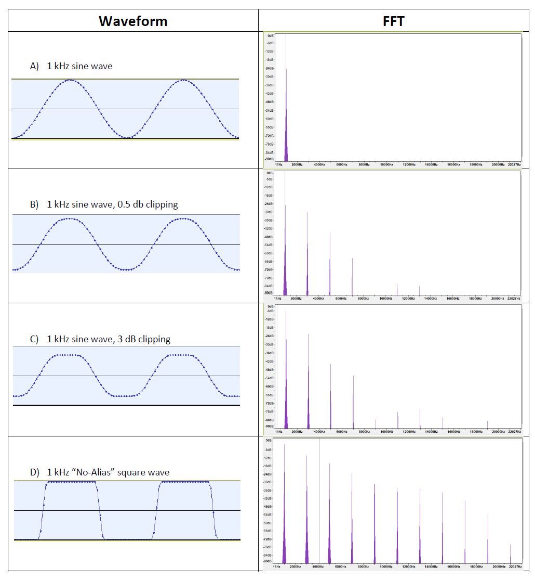
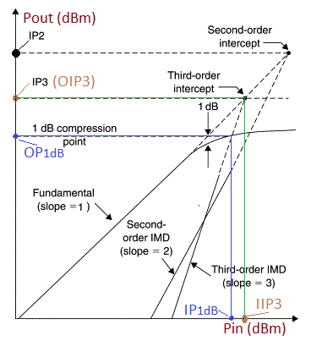
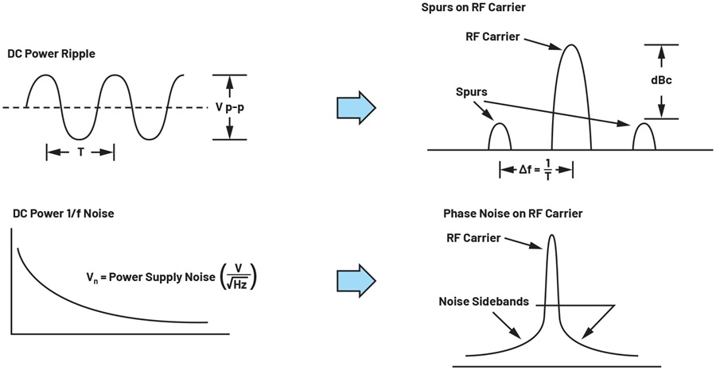
Circuit Design, Noise, Grounding
Noise
Paths
Non-Linear (not LTI)

Slide 18

Circuit Design, Noise, Grounding
Noise
Paths
Power Supplies
Indirect Coupling
Power integrity

Slide 19



Circuit Design, Noise, Grounding
Noise
Paths
Power Supplies
Indirect Coupling

Slide 20

Circuit Design, Noise, Grounding
Grounding
weida.zhang@physics.ox.ac.uk

Slide 21










Circuit Design, Noise, Grounding
Circuit Design SW Packages
OrCAD/Allegro
30th May 1500 & 2nd Jun 1100 by Dr Daniel Weatherill

Slide 22













Circuit Design, Amplifier, Clock
Transmission Line Theory

Slide 23

Circuit Design, Amplifier, Clock
Signal Integrity
Designing and Maintaining Trace Structure
Termination
Source: Keysight

Slide 24



Circuit Design, Amplifier, Clock
Scattering Parameter (S-Parameter)

Slide 25




Circuit Design, Amplifier, Clock
Scattering Parameter (S-Parameter)

Slide 26




Circuit Design, Amplifier, Clock
Matching Network
$$S_{22}$$
$$S_{11}$$
Source: SiLabs

Slide 27

Circuit Design, Amplifier, Clock
Simulation of Amplifier Design
S12
S12

Slide 28


Circuit Design, Amplifier, Clock
Clock Jitter/Phase noise in Digital System/Comms

Slide 29

Circuit Design, Amplifier, Clock
Clock Jitter/Phase noise in DAQ

Slide 30


Circuit Design, Amplifier, Clock
Clock Jitter/Phase noise
Source: NIST

Slide 31


Circuit Design, Amplifier, Clock
Phase Locked Loop

Slide 32







Circuit Design, Amplifier, Clock
How to read datasheet
weida.zhang@physics.ox.ac.uk

Slide 33


Simulation - LTspice
Schematic Level
Layout Level
Structural model – SPICE
Behavioral model – IBIS
Scattering model – S-parameter

Slide 34




Simulation - LTspice
ADS by Keysight
Electronics Desktop by Ansys
LTspice by Analog Devices
Qucs (under GPL license)

Slide 35




Simulation - LTspice
Transient
AC
DC Sweep
Noise

Slide 36

Simulation - LTspice
Layout Level - SIwave

Slide 37

Simulation - LTspice
Transient
AC
Noise
Simulation – Qucs – Match Circuit

