Slide 1
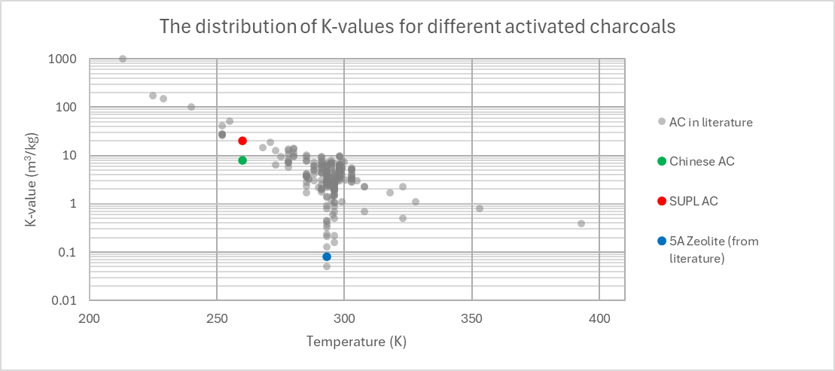
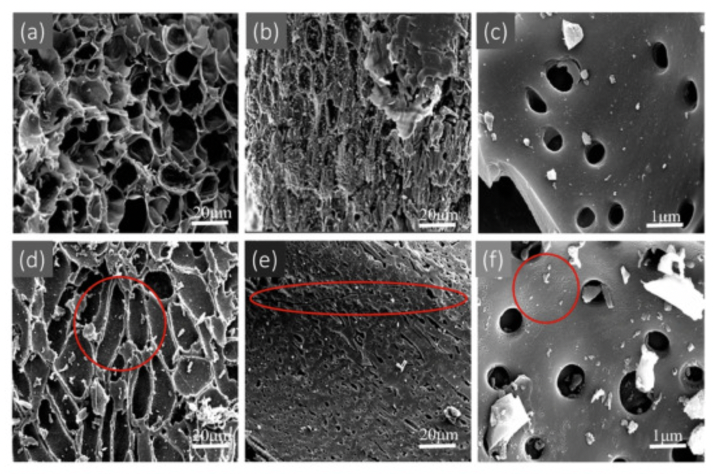

Characterising Adsorbents
K constant, K$=\frac{τ∅}{m}$
Ratio of adsorbed radon to radon present in the air
Depends on the material
Pore size (near 0.5 µm)
Chemical composition
And experimental parameters
Temperature, pressure, relative humidity etc.
Our candidates
AC from China : K ≈ 8 m³/kg
AC from SUPL : K ≈ 20 m³/kg
5Å zeolite : tbd

