Slide 1
CYGNUS-Oz
ANU Weekly
8th April 2026

Slide 2
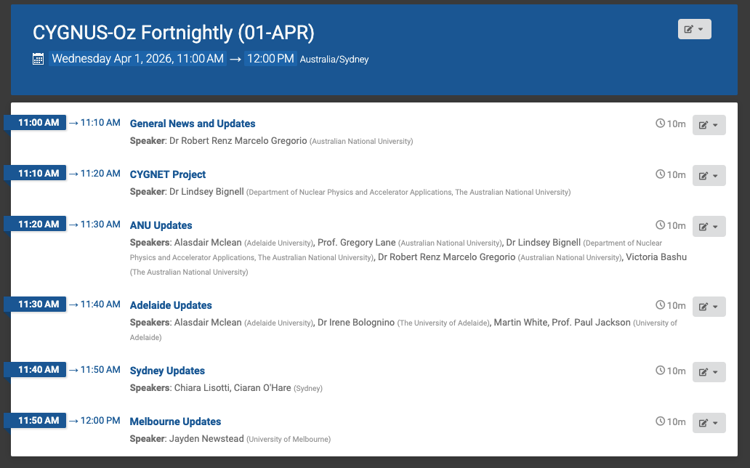
CYGNUS-Oz Fortnightly
  CYGNUS-Oz Weds 11 am (Canberra time )
  Alternate Wednesdays
    Technical Meeting (ANU)
    Institutional Updates

Slide 3
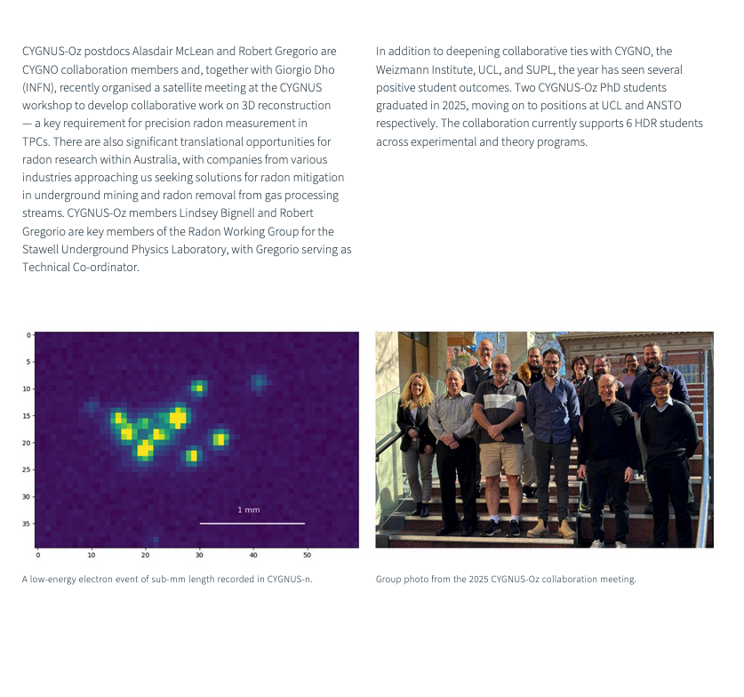
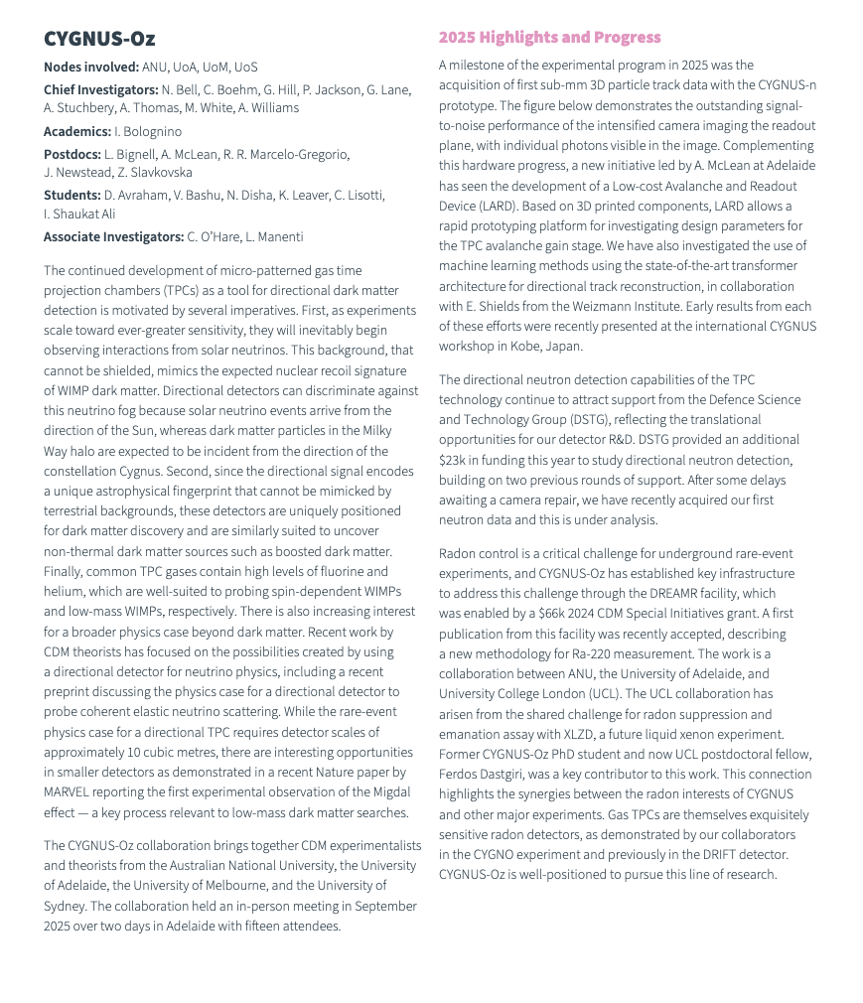
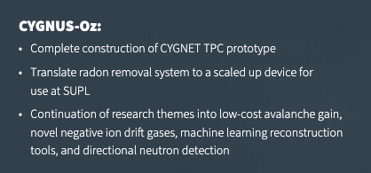
General News and Upcoming Events
  Centre publishes 2025 Annual Report – Great Work Everyone! ☺

Slide 4
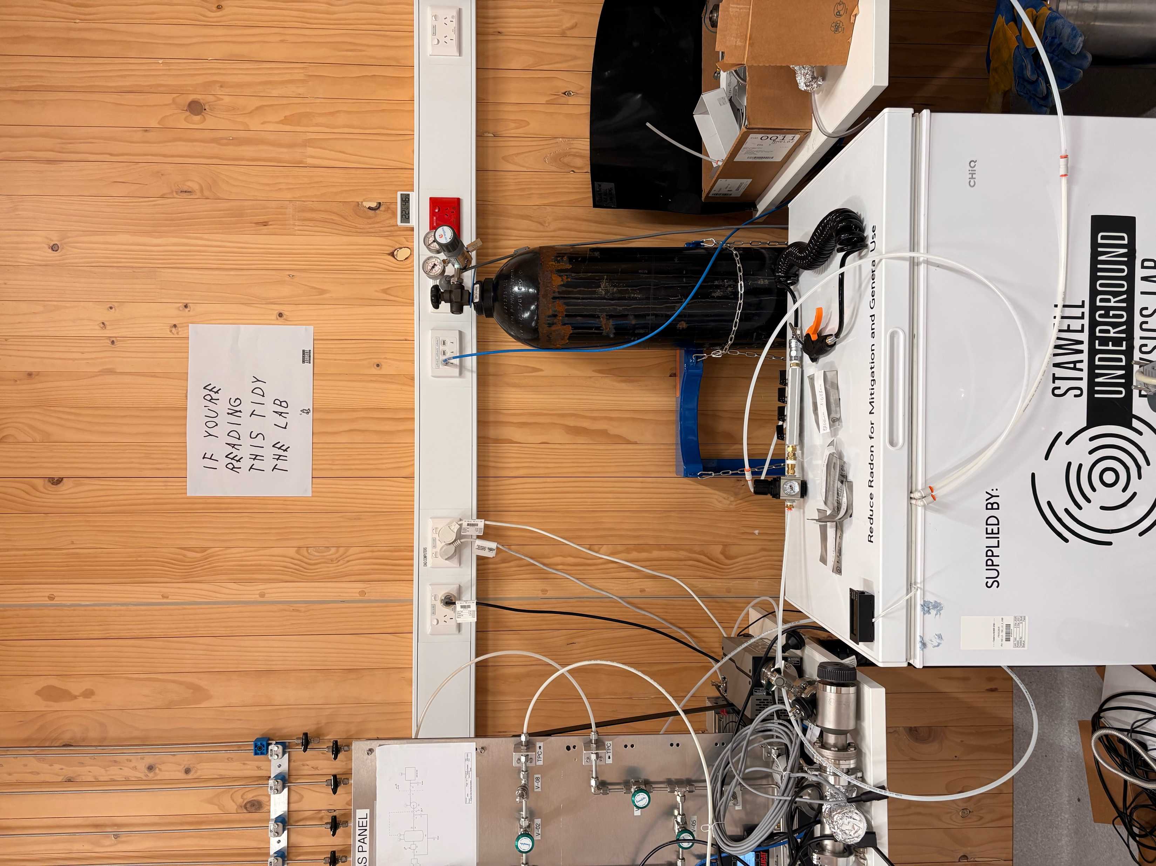
General News and Upcoming Events
  Lab Admin:
    Please return the tools
    Don’t leave anything on top of the SUPL Freezer
  Lab resources
    Communicate
      Use whiteboard (Name, test in progress, test end…)
      OR Write a note
    If in doubt:
      Vacuum Scroll Pump – Ask Victoria/Daniel
      RAD8 – Ask Kai/Shijie
      RAD7 – Ask Lauz/Natasha

Slide 5
General News and Upcoming Events
  Resuming ANU Journal Club (10th April)
    Yiyi Recommendation:
      The assay of soil carbon with naturally occurring cosmic ray neutrons (R. McTaggart)
    Fridays 15:00 @ NPAA Dining area OR Zoom link
  Rob Away (9th-17th April)
    Panda-X and CJPL Underground Lab
    Ali to Chair CYGNUS-Oz Institutional updates
  Group Axe throwing @Maniax: 1st May
    20% discount (Thanks Daniel)
    RSVP by 22nd April (Contact Daniel/Victoria)
  Identification of Dark Matter Conference (Zaragoza): 1st -5th June
  CDM 2026 ECR and Annual Workshop (Perth): 16th -21st November

Slide 6
Publication Plan
  Published ✅
  Direct in-chamber radon-220 (thoron) emanation measurements for rare-event physics experiments
    R.R. Marcelo Gregorio et al 2026 JINST 21 P03027
  In progress ⏳
  High Negative Ion Gain MMThGEM-Micromegas Detector for Directional Dark Matter Searches
    Submitted to JINST( arXiv: 2602.12658) – A. G. Mclean – In Review ⏳
  LARD (Low-Cost Amplification Readout Devices): A Rapid Prototyping Platform
    A. G. Mclean - Writing
  Negative ion formation in pure CF4 via dissociative electron attachment
    L.J. Bignell – Writing
  Improving accuracy of in-gas radon assay electrostatic detectors and application to He, CF4 and SF6 for directional dark matter experiments
    R.R Marcelo Gregorio – Repeating tests at ANU
  Planned 🤔
  Using LARD Platform for optimising [insert here] for directional dark matter searches
    V.U. Bashu
  Improving sensitivity in DRIFT data with modern ML architecture
    E. Shield (CERN)
  Suppression of radon emanation from surfaces in the Stawell Underground Physics Laboratory (SUPL)
    R.R Marcelo Gregorio – Technical Report/Note

Slide 7
AGENDA
Detector Development
CYGNUS-N/CYGNET
Adelaide Updates
LARD Group Updates
Track Reconstruction
Machine Learning
CYGNO Tasks
Radon Group

Slide 8
CYGNUS-Oz
Radon Group

Slide 9
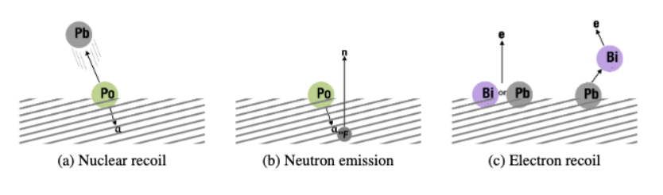
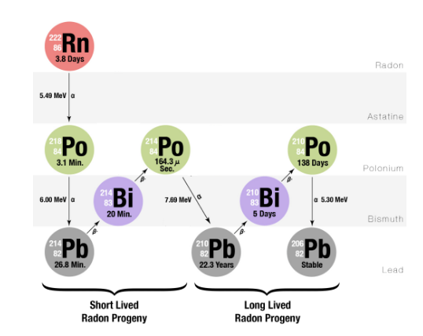
CYGNUS-Oz Radon Group Overview
Origin of Radon Contamination
Radon-induced Backgrounds
Intrinsic material emanation
Ambient radon plate out (long lived)
Radon Decay Chain
Radon Strategies
Radon Detection and Mitigation
Radon Event Tagging (Analysis/Simulation)

Slide 10
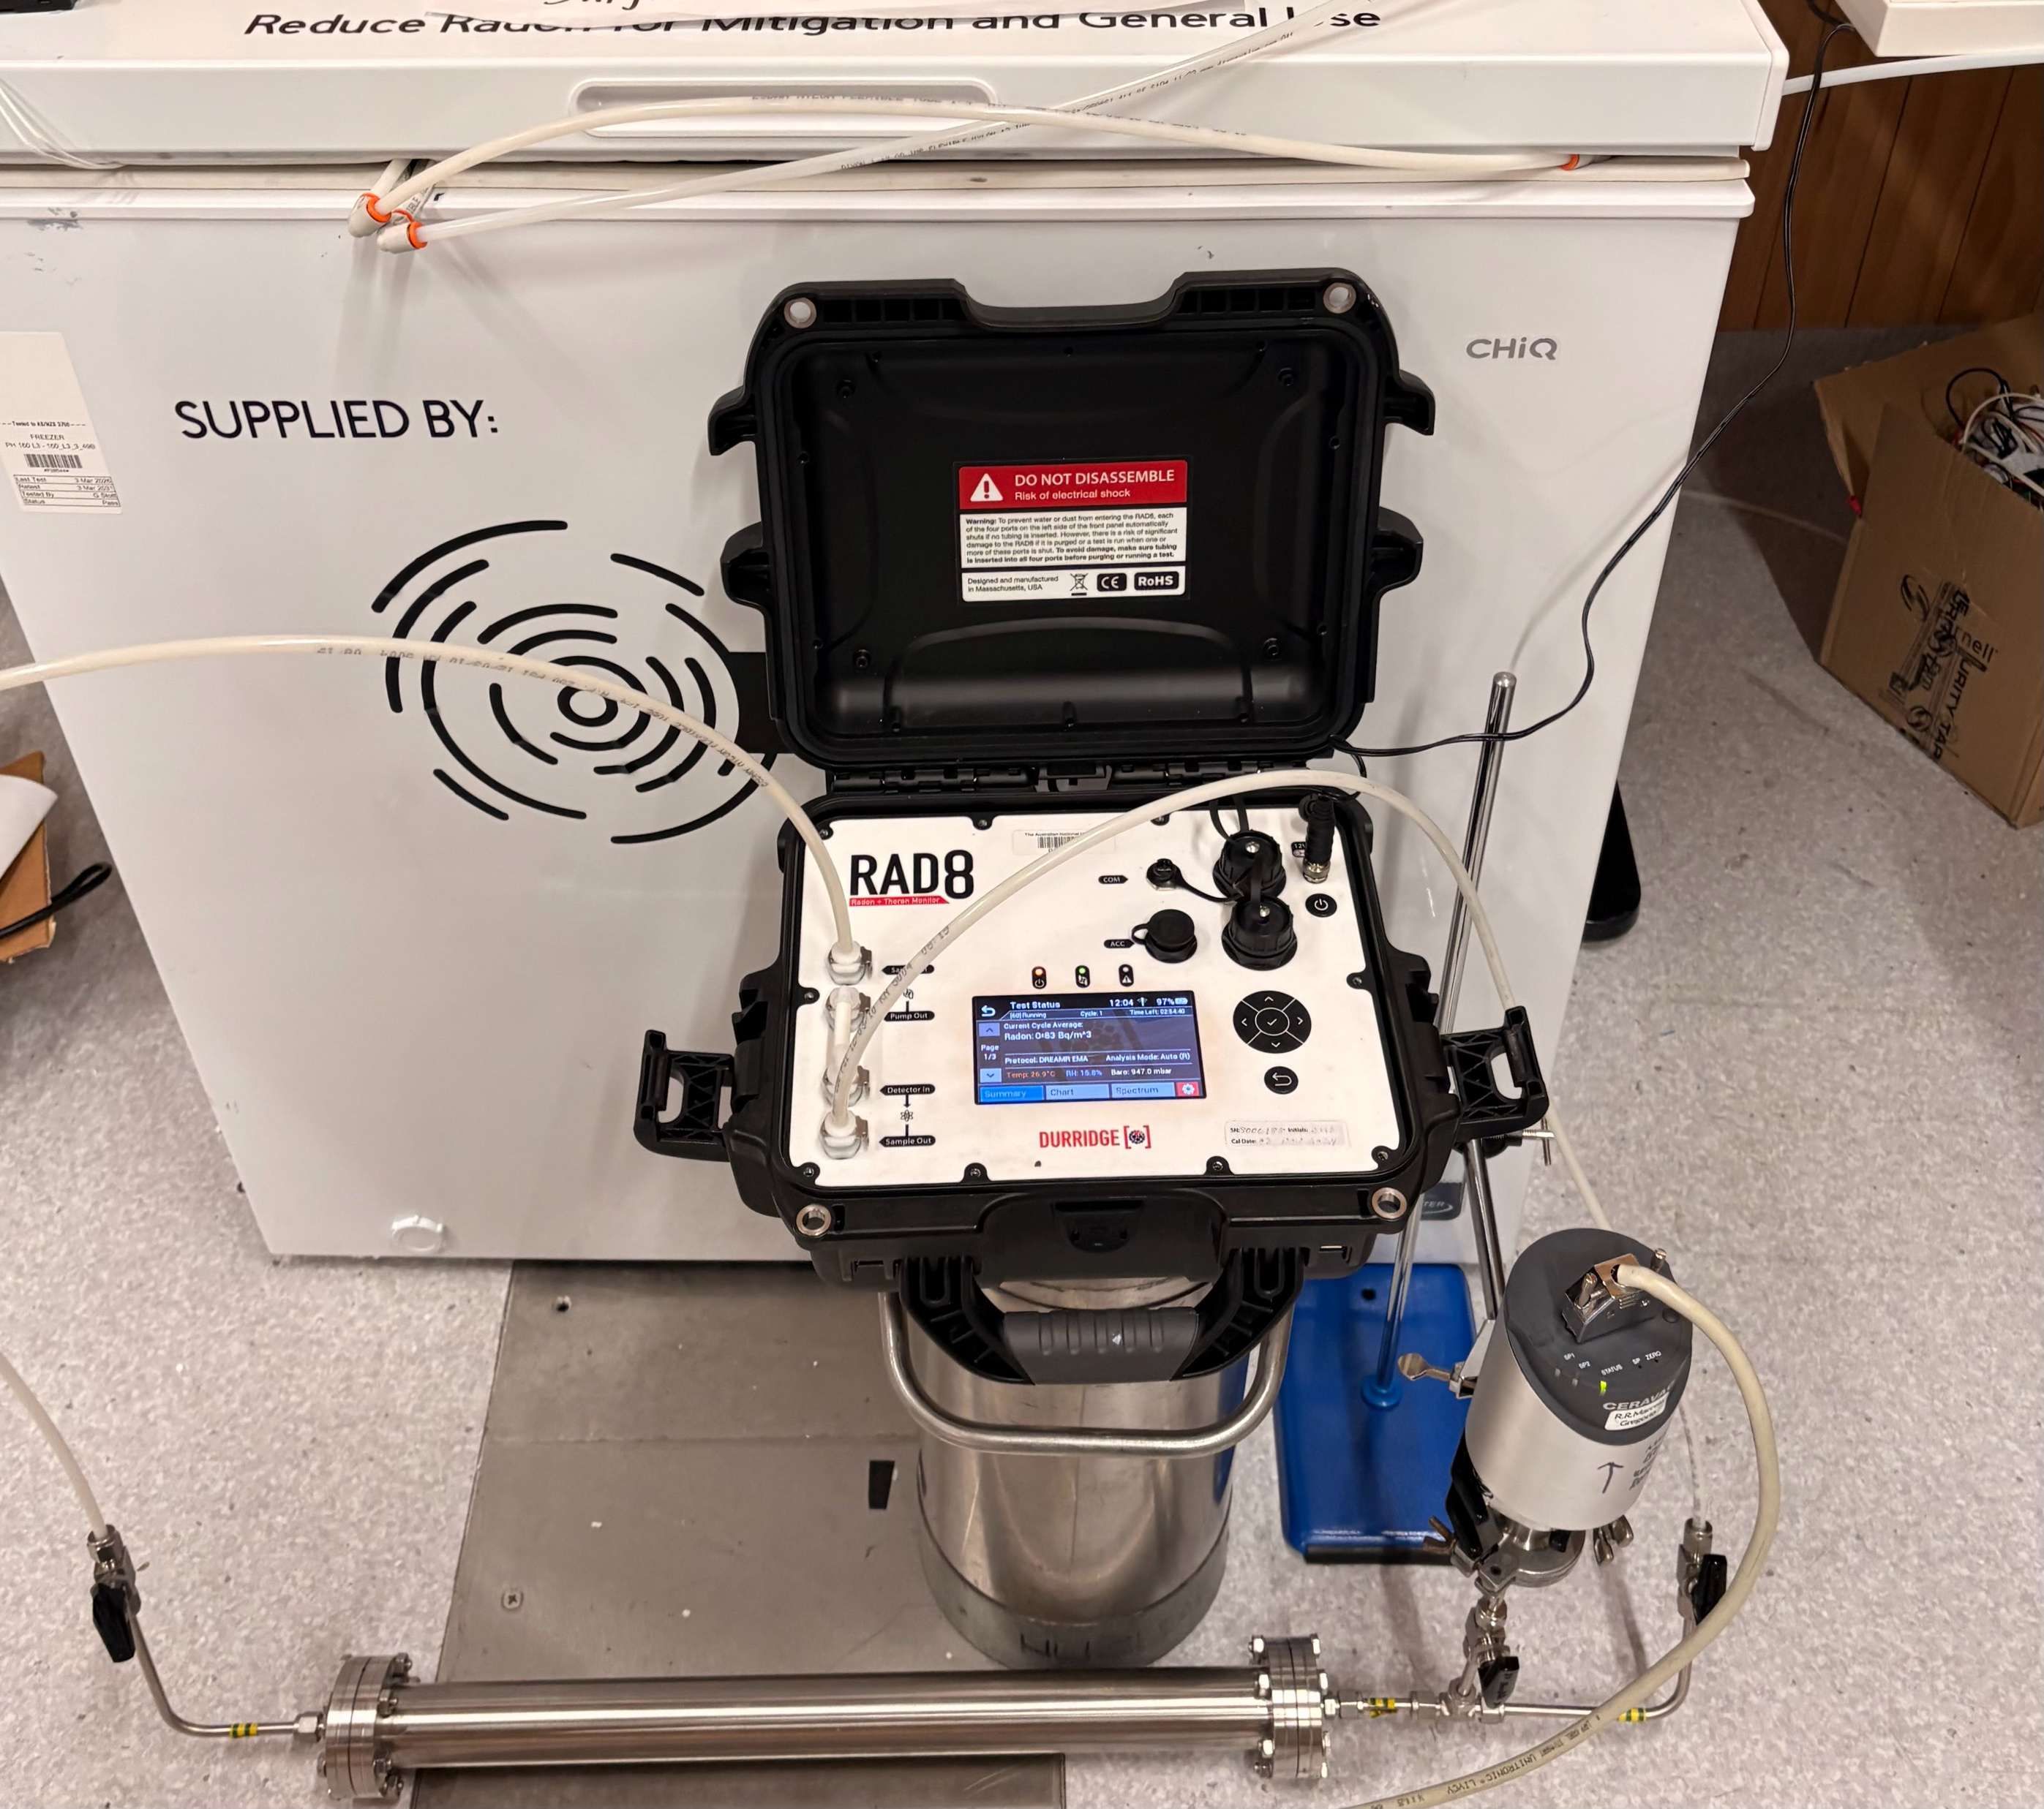
General Radon Updates
  Next Generation Radon Filtration Materials
  Prof. Stuart Batten has kindly agreed to synthesise and send MOFs samples for characterising
  Ordered Japanese 8 Ag-FER-B (Silver Zeolite MS)
  DREAMR Radon Emanation Facility
  Baseline test underway with 0.6L ‘Emanation Vessel’
  C.f. RAD7 Sheffield 3.5L setup – 0.63 ± 0.08 atoms/min

Slide 11
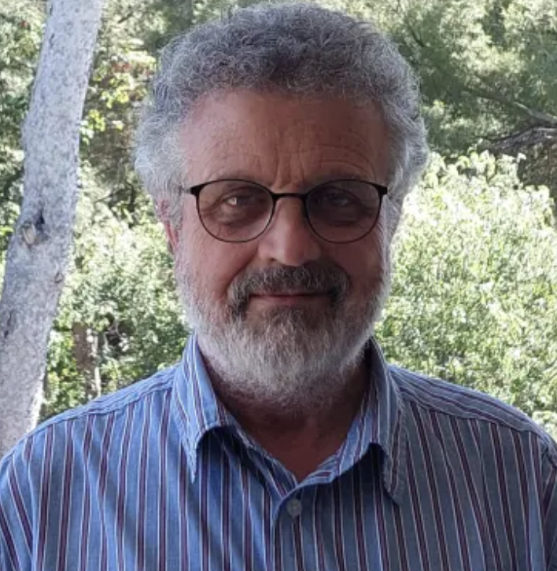

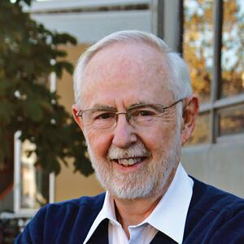

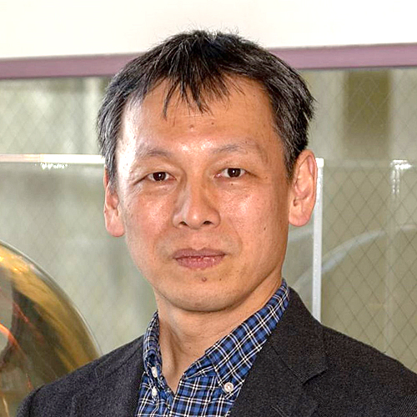
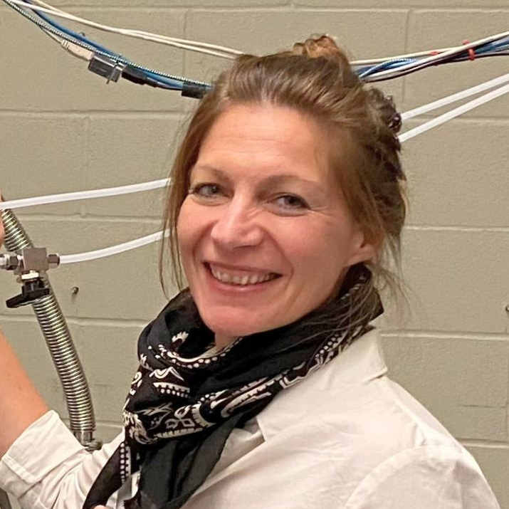
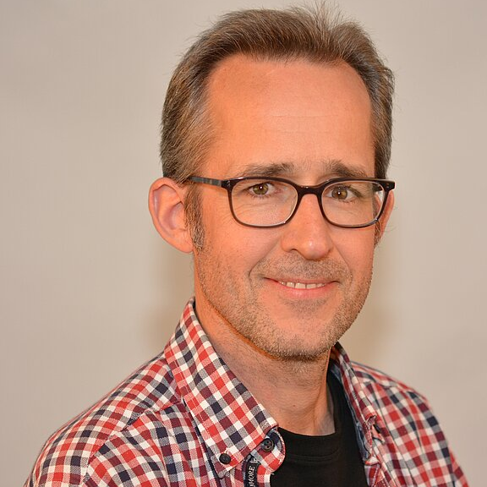

International Radon Network for Low Background Experiments
Representatives:
DM Experiments
NDBD Experiments
Underground Laboratories
Scientific Facilities
Prof Jose Bustos
CPPM
Dr. Robert Renz Marcelo Gregorio
ANU
Confirmed Letters of Support
And more…
E/Prof Arthur McDonald
SNOLAB
Physics Nobel Prize (2015)
Prof Yue Meng
SJTU
Prof Yasuo Takeuchi
Kobe University
A/Prof Marie-Cécile Piro
University of Alberta
Dr. Hardy Simgen
MPIK
Dr. Monica Sisti
INFN Milano

Slide 12
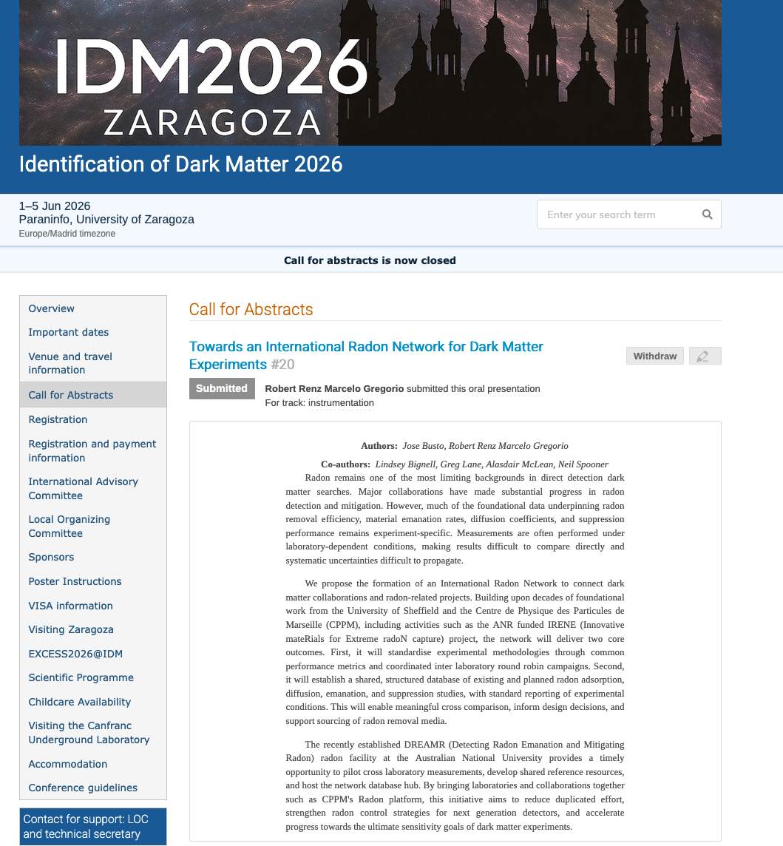
International Radon Network Objectives:
  Standardise methodologies and performance metrics for radon filtration*
  Create a shared international database for radon adsorption, diffusion, emanation, and suppression data
  Accelerate progress towards the ultimate sensitivity goals of dark matter experiments through coordinated international effort
*DREAMR facility at ANU to pilot cross-laboratory measurements and shared reference resources
Discussion:
How to deliver in practice?
Other objectives…

Slide 13
SUPL Radon Mitigation Project
See Slides
  K. Davies, L. Truong*
Radon Emanation Facility
Baseline test in progress
Next: Temp, Pressure
  S. Yuan
Radon in Different Gases Project
Looking for vacuum vessel
  N. Disha
Radon Electroplating Project
  L. Bechteler-Weickhardt
Moved setup to target prep lab
Radon Event Tagging for CYGNO
* Research project completed

Slide 14
Back Up

Slide 15
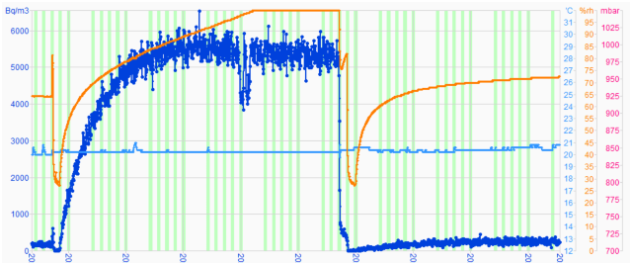
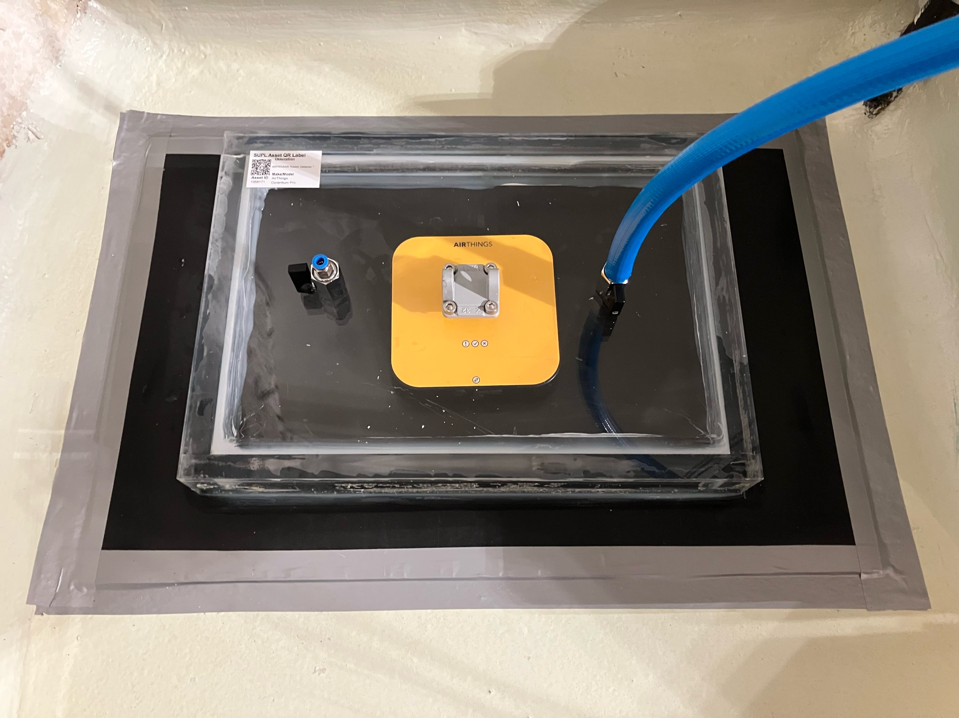
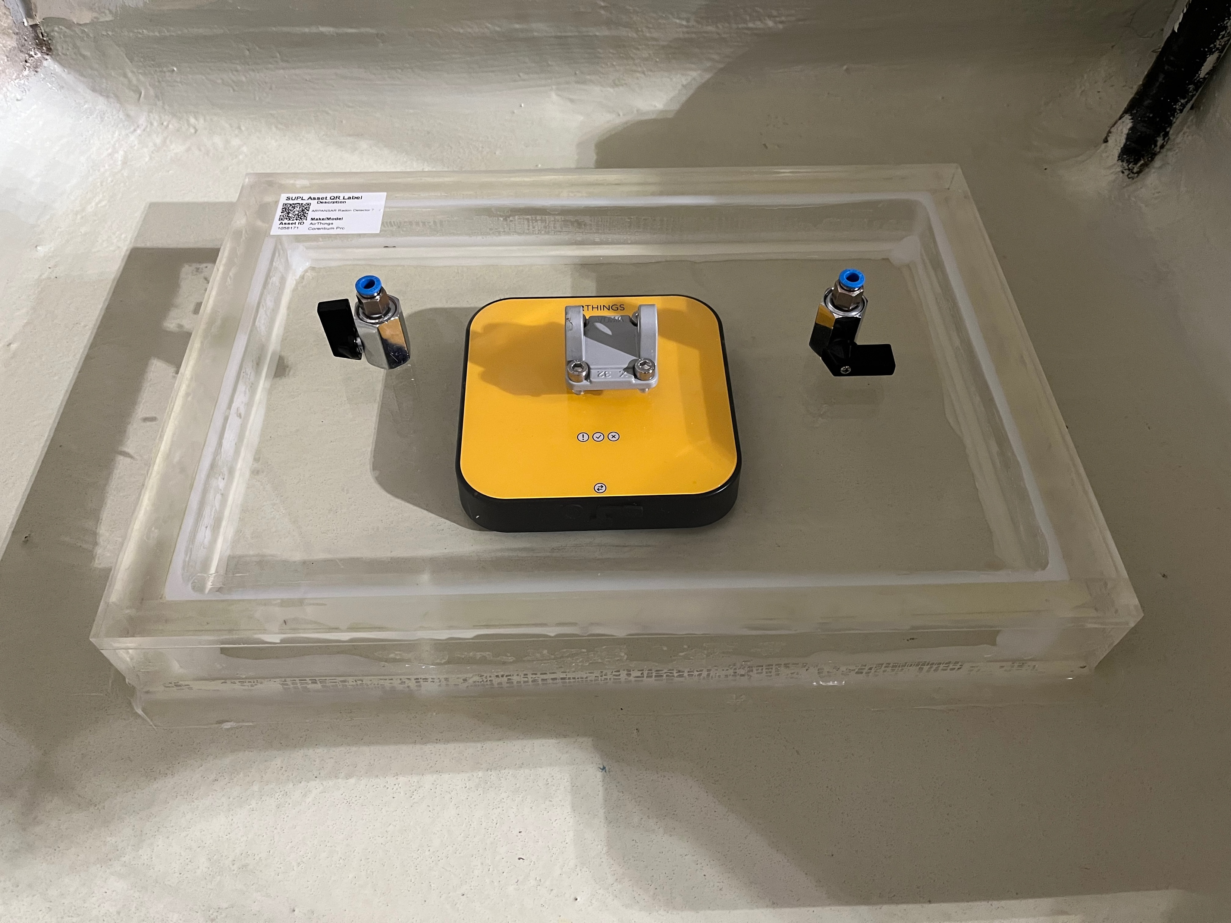
SUPL Project
Updates
Radon mitigation at Stawell Underground Physics Laboratory
Prevention of entry with barriers
Dilution with ventilation
Filtration with radon capturing materials (Linda Talk Feb 18th)
Floor emanation (With barrier)
~250 Bq/m3
Floor emanation (no barrier)
~6000 Bq/m3

Slide 16
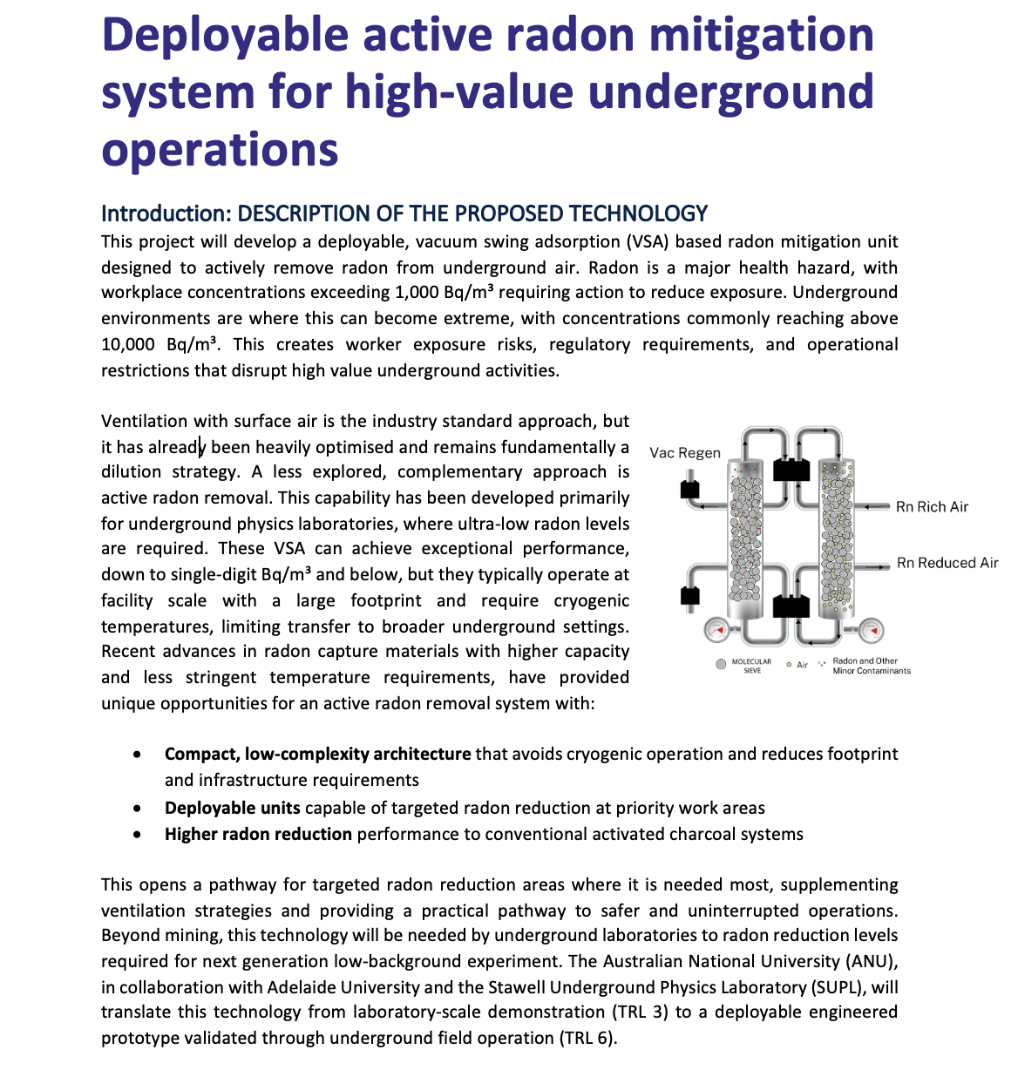
Vacuum Swing Adsorption (VSA) Project

Slide 17
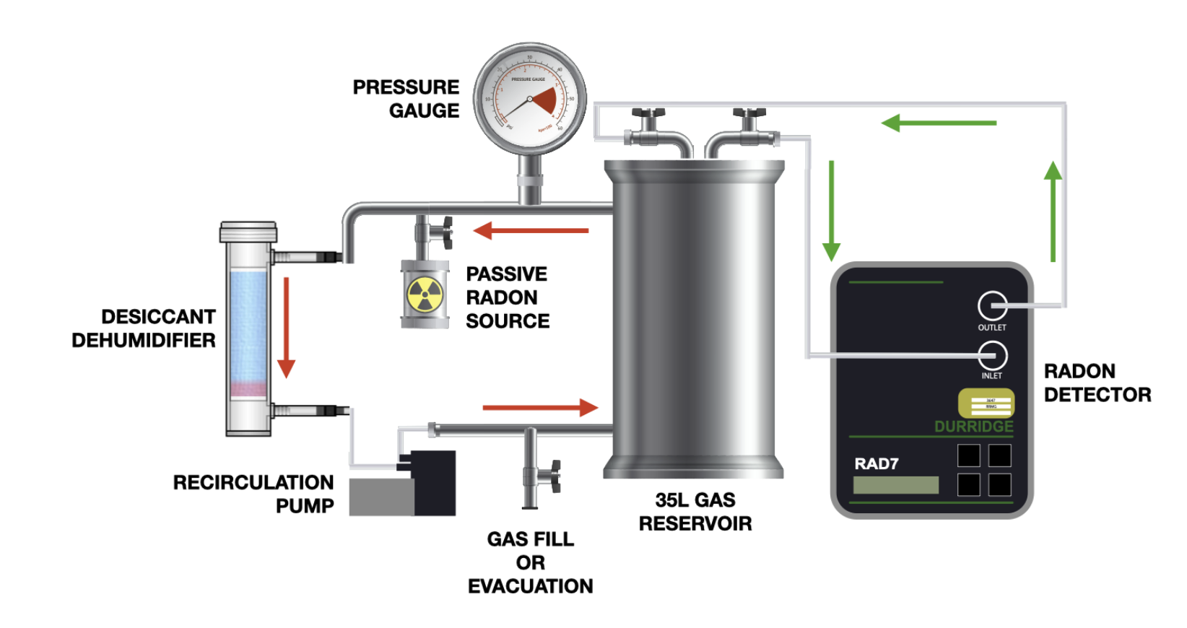
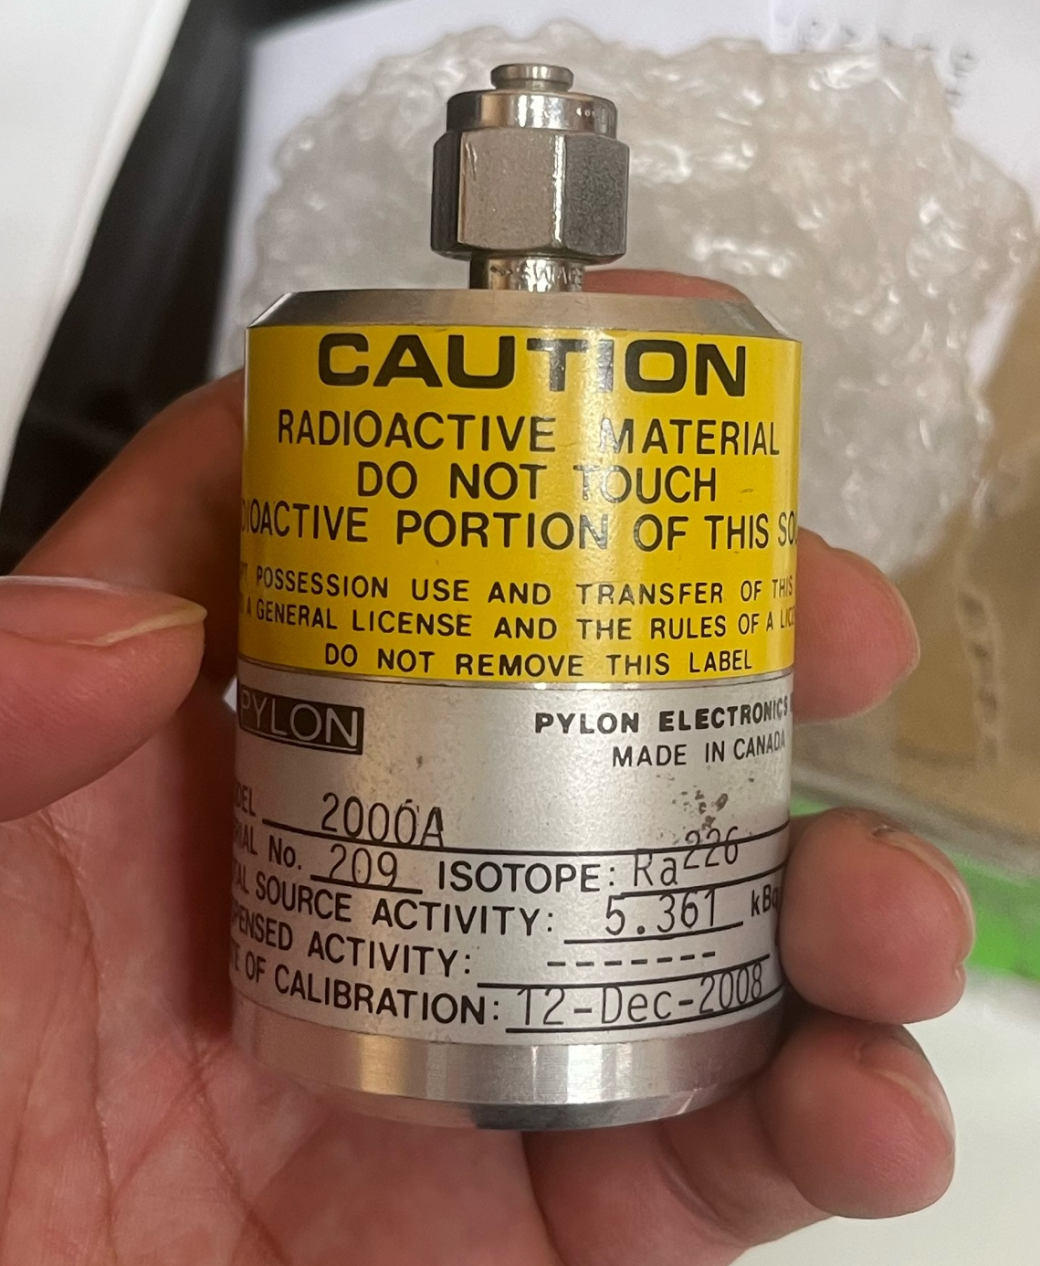
Radon in Different Gases
Updates
  Original setup take 6 weeks for one measurement
  Flow-though radon source method reducing measurement time to ~ 5 days
  Natasha is working on making a flow through source with uranium sand
    Challenges with pressure buildup
    Consulted Dr Michaela Froehlich about Inert solutions
      → Explore different ratios (beads : sand)
      → Different size beads
Original setup
5.6 kBq passive radon source has arrived

Slide 18
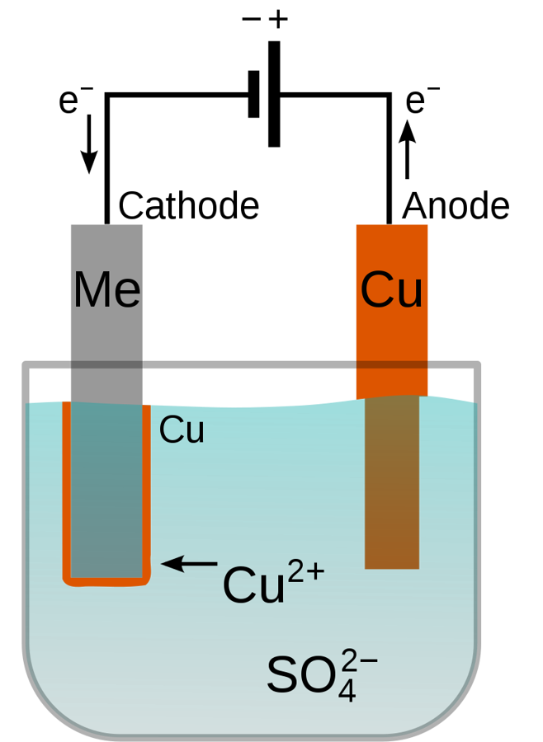
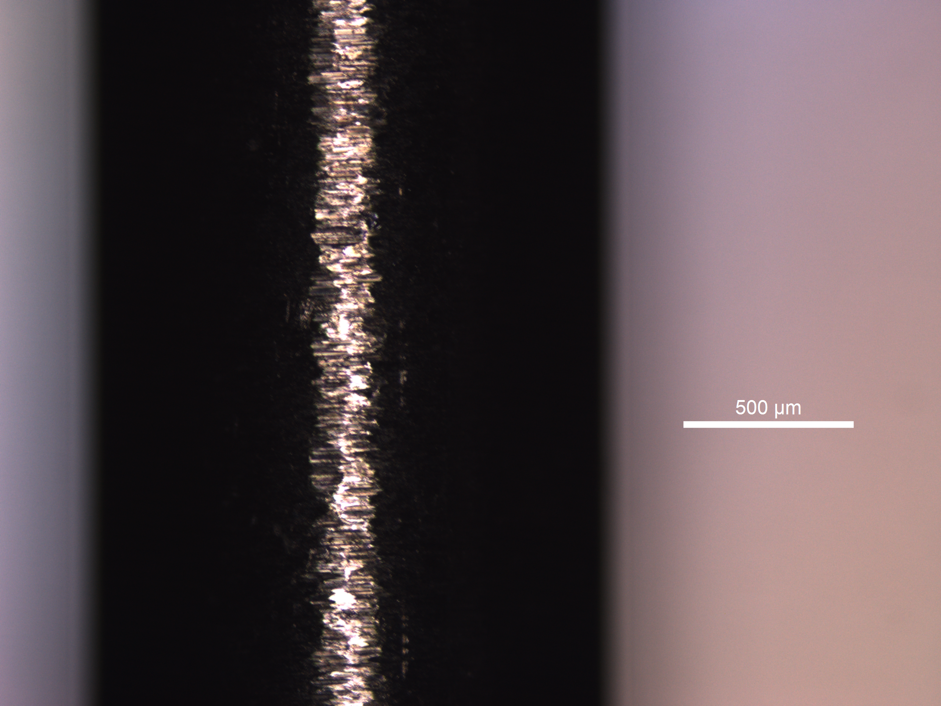
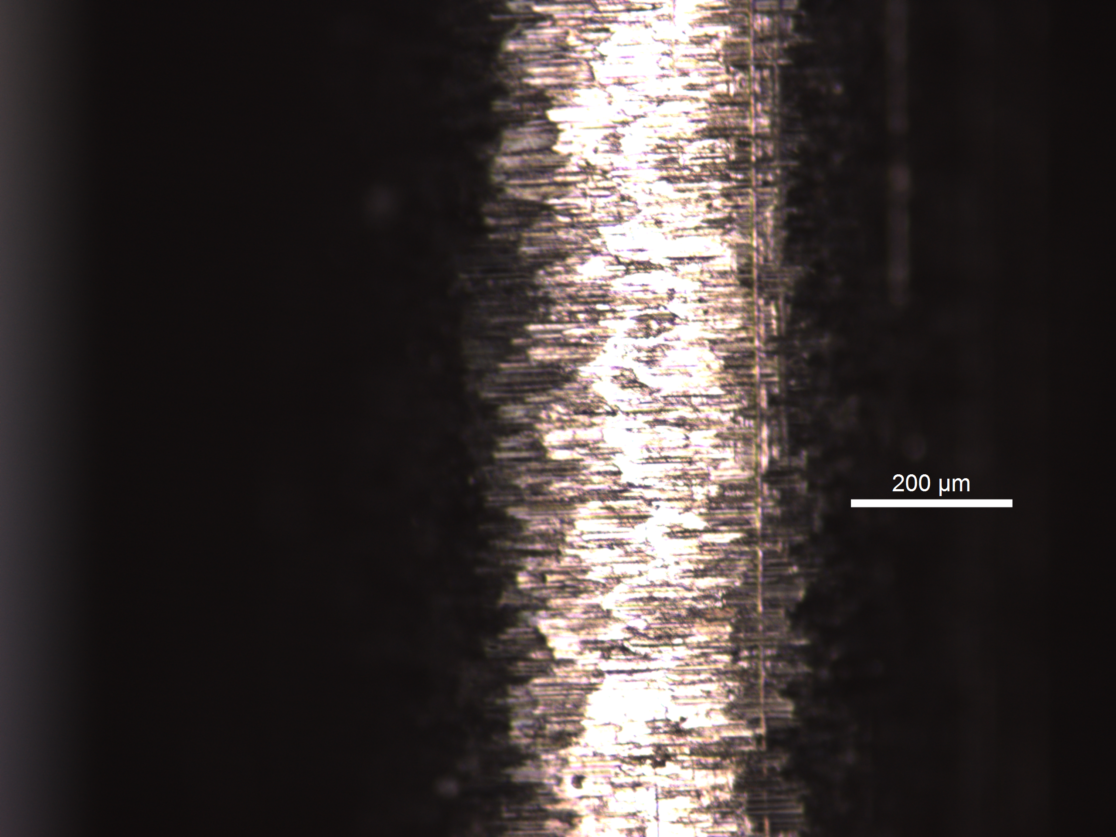
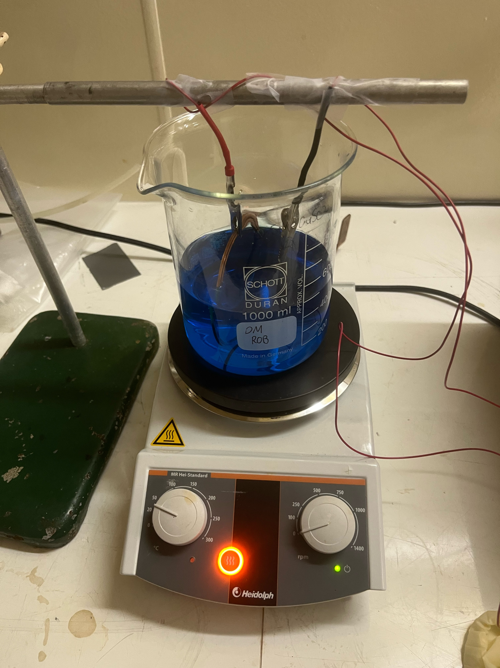
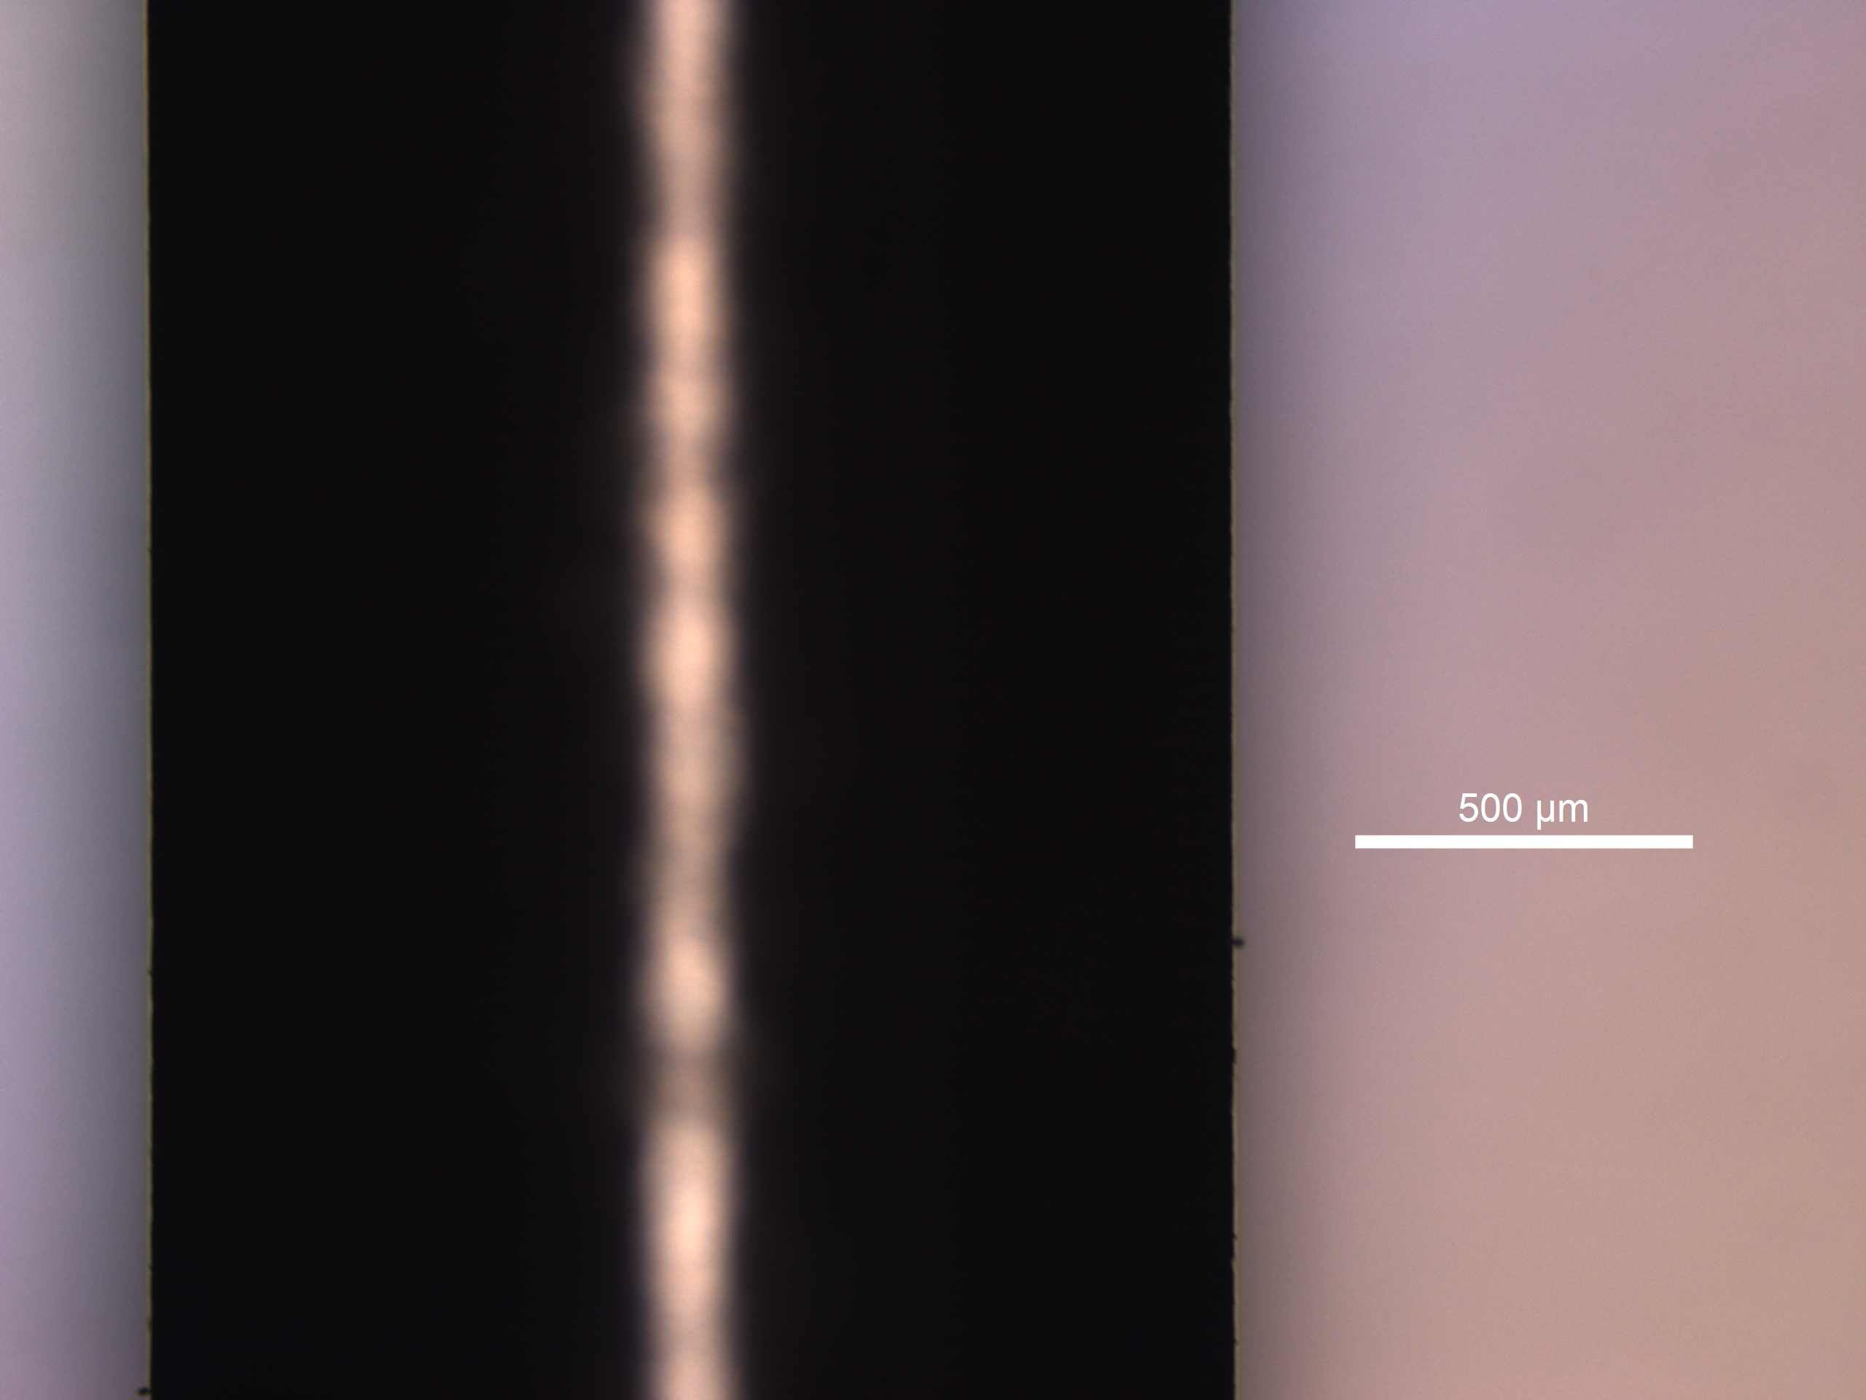
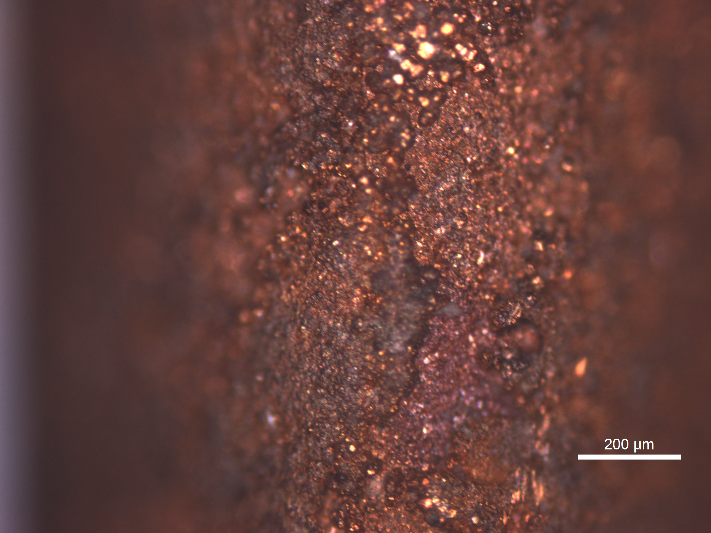
Electroplating Project
Copper Platting Setup Ready in ‘Pb Plating lab’
Leica Stellaris 8 @John Carver Building
²²⁰Rn_{Ema}
Thickness/Quality
Incoming student: - Laurent Bechteler-Weickhardt

Slide 19
Electroplating Project Updates
²²⁰Rn_{Ema}
Thickness/Quality
Focus middle
Focus edge

Slide 20
Electroplating Project Updates
²²⁰Rn_{Ema}
Thickness/Quality

Slide 21
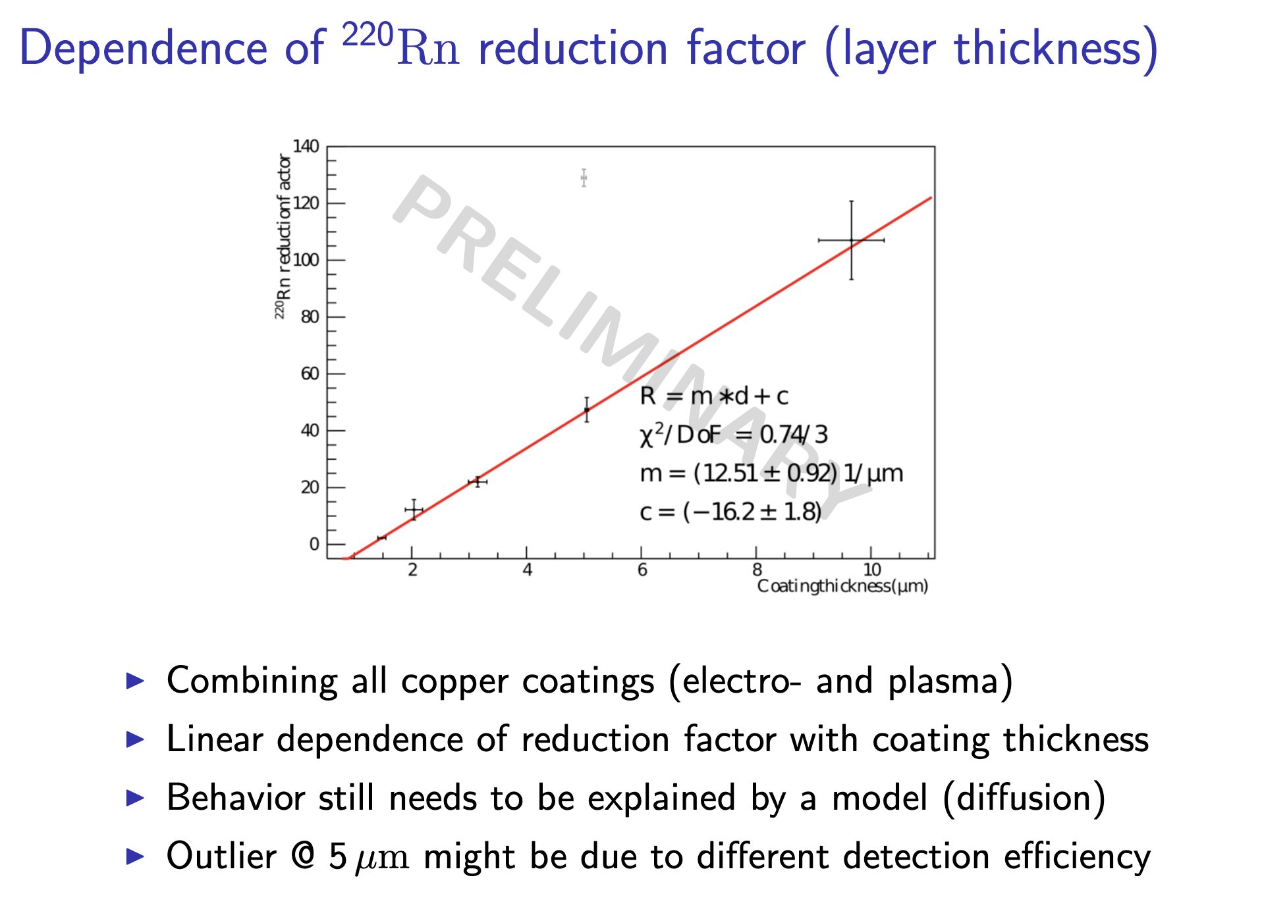
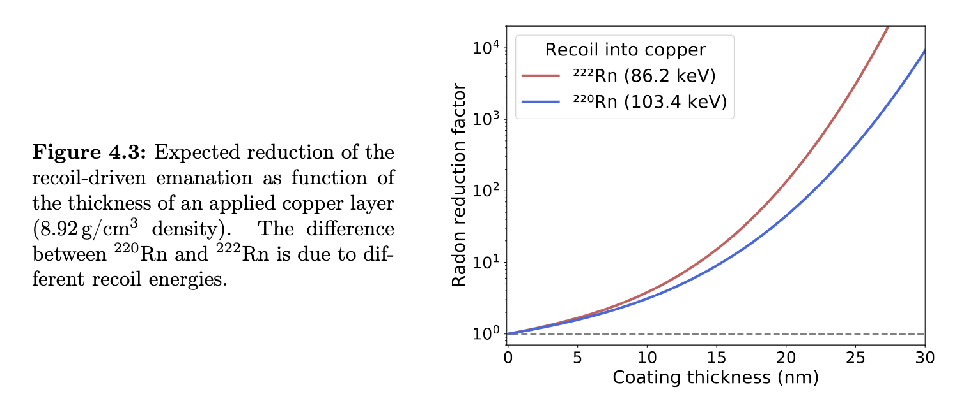
Copper Plating Literature Review
From 222Rn measurements in XENONnT and HeXe to radon mitigation in future liquid xenon experiments (PhD Thesis University of Heidelberg, 2022 Florian Jörg)
Simulation SRIM Simulation
Coating thickness of 10um reduction factor x 100

