Slide 1
FCC-ee Muon Detector R&D (FY2026)
Scintillator + Drift tube tracker (report today)
µRWELL
Bing Zhou
April 3, 2026
FCC-ee L2L3 meeting

Slide 2
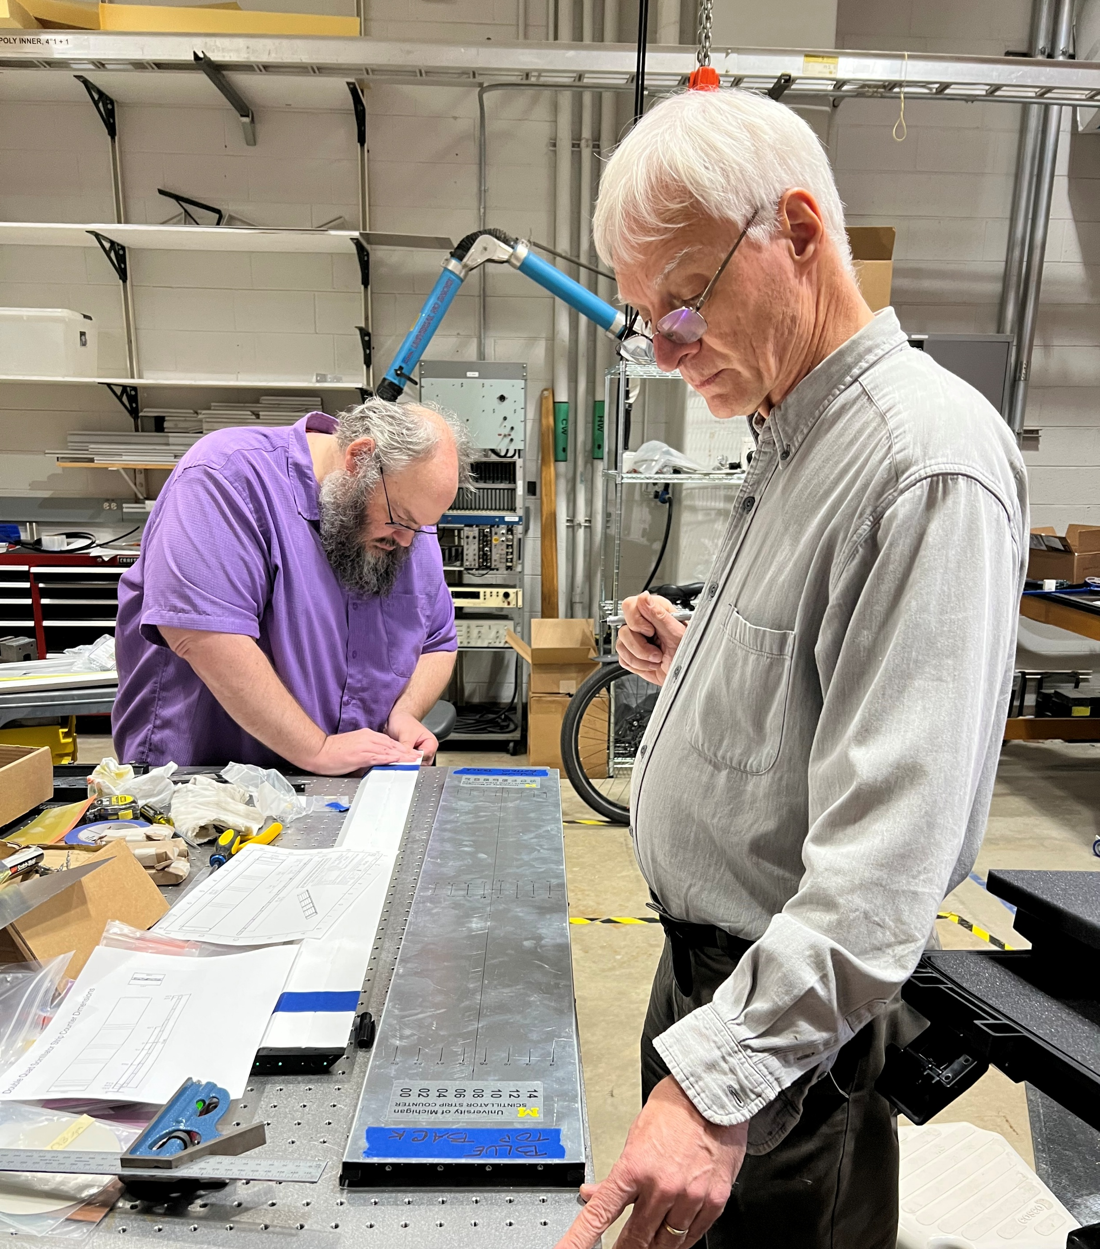
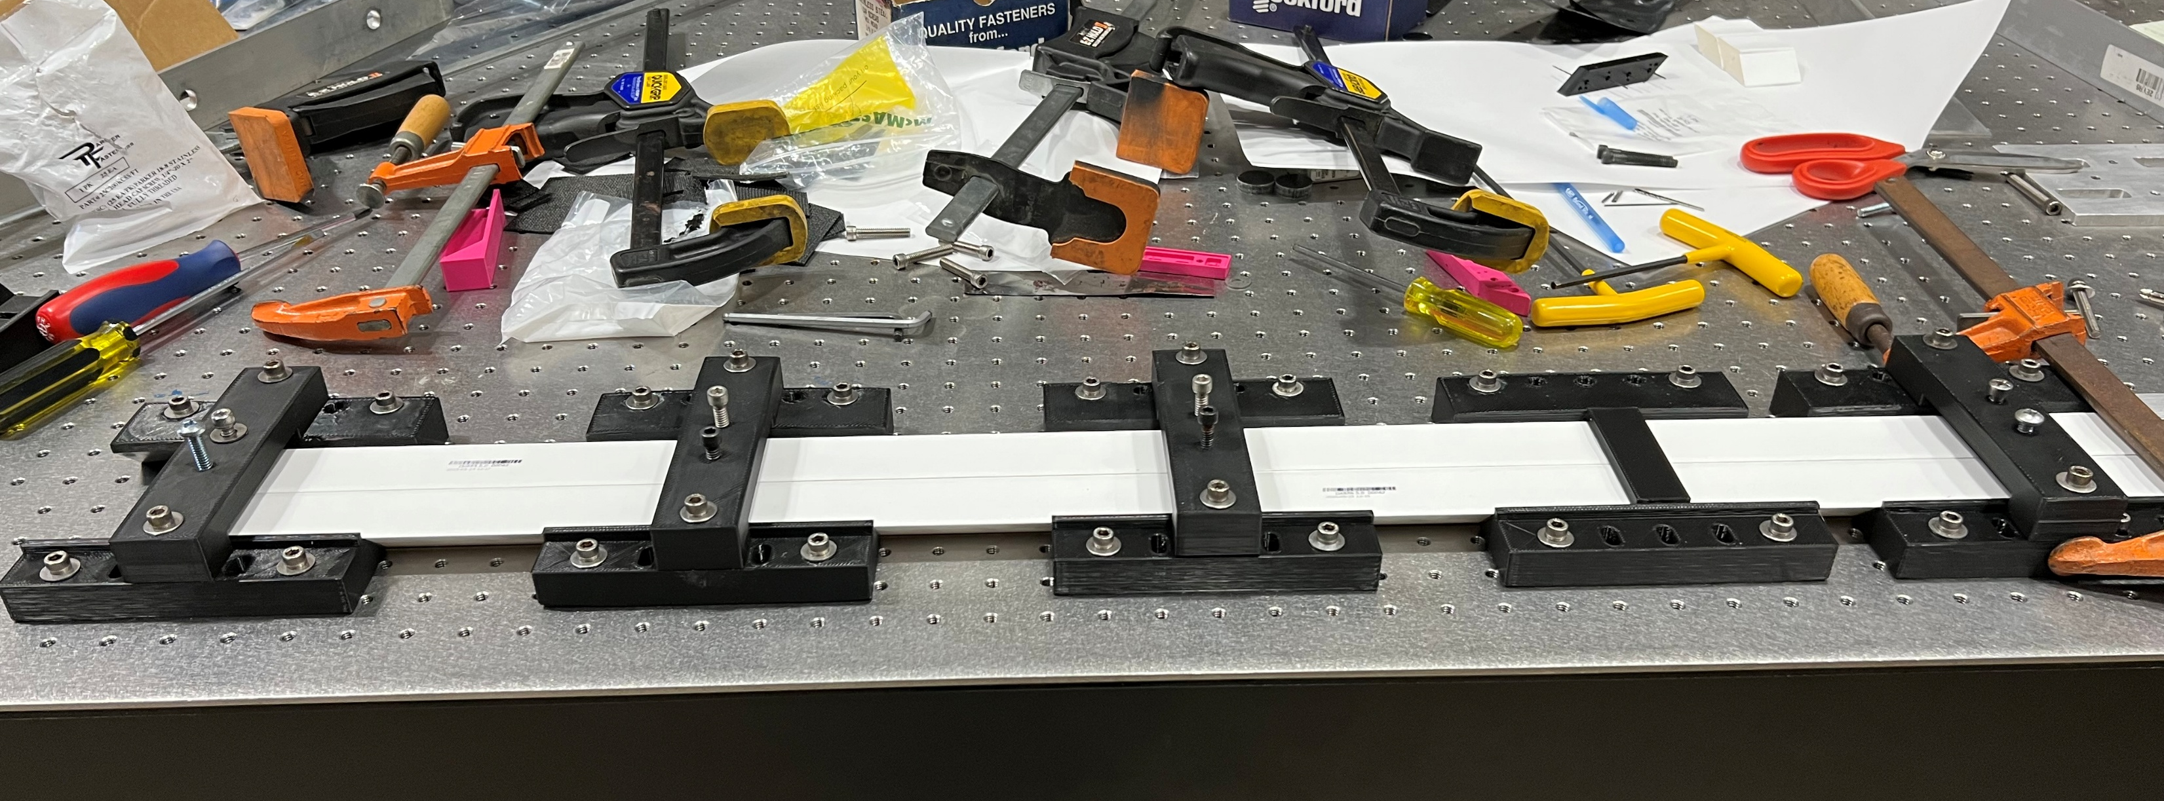
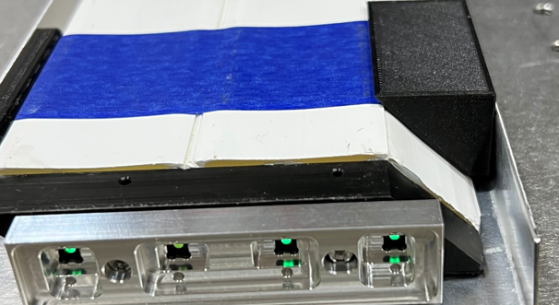
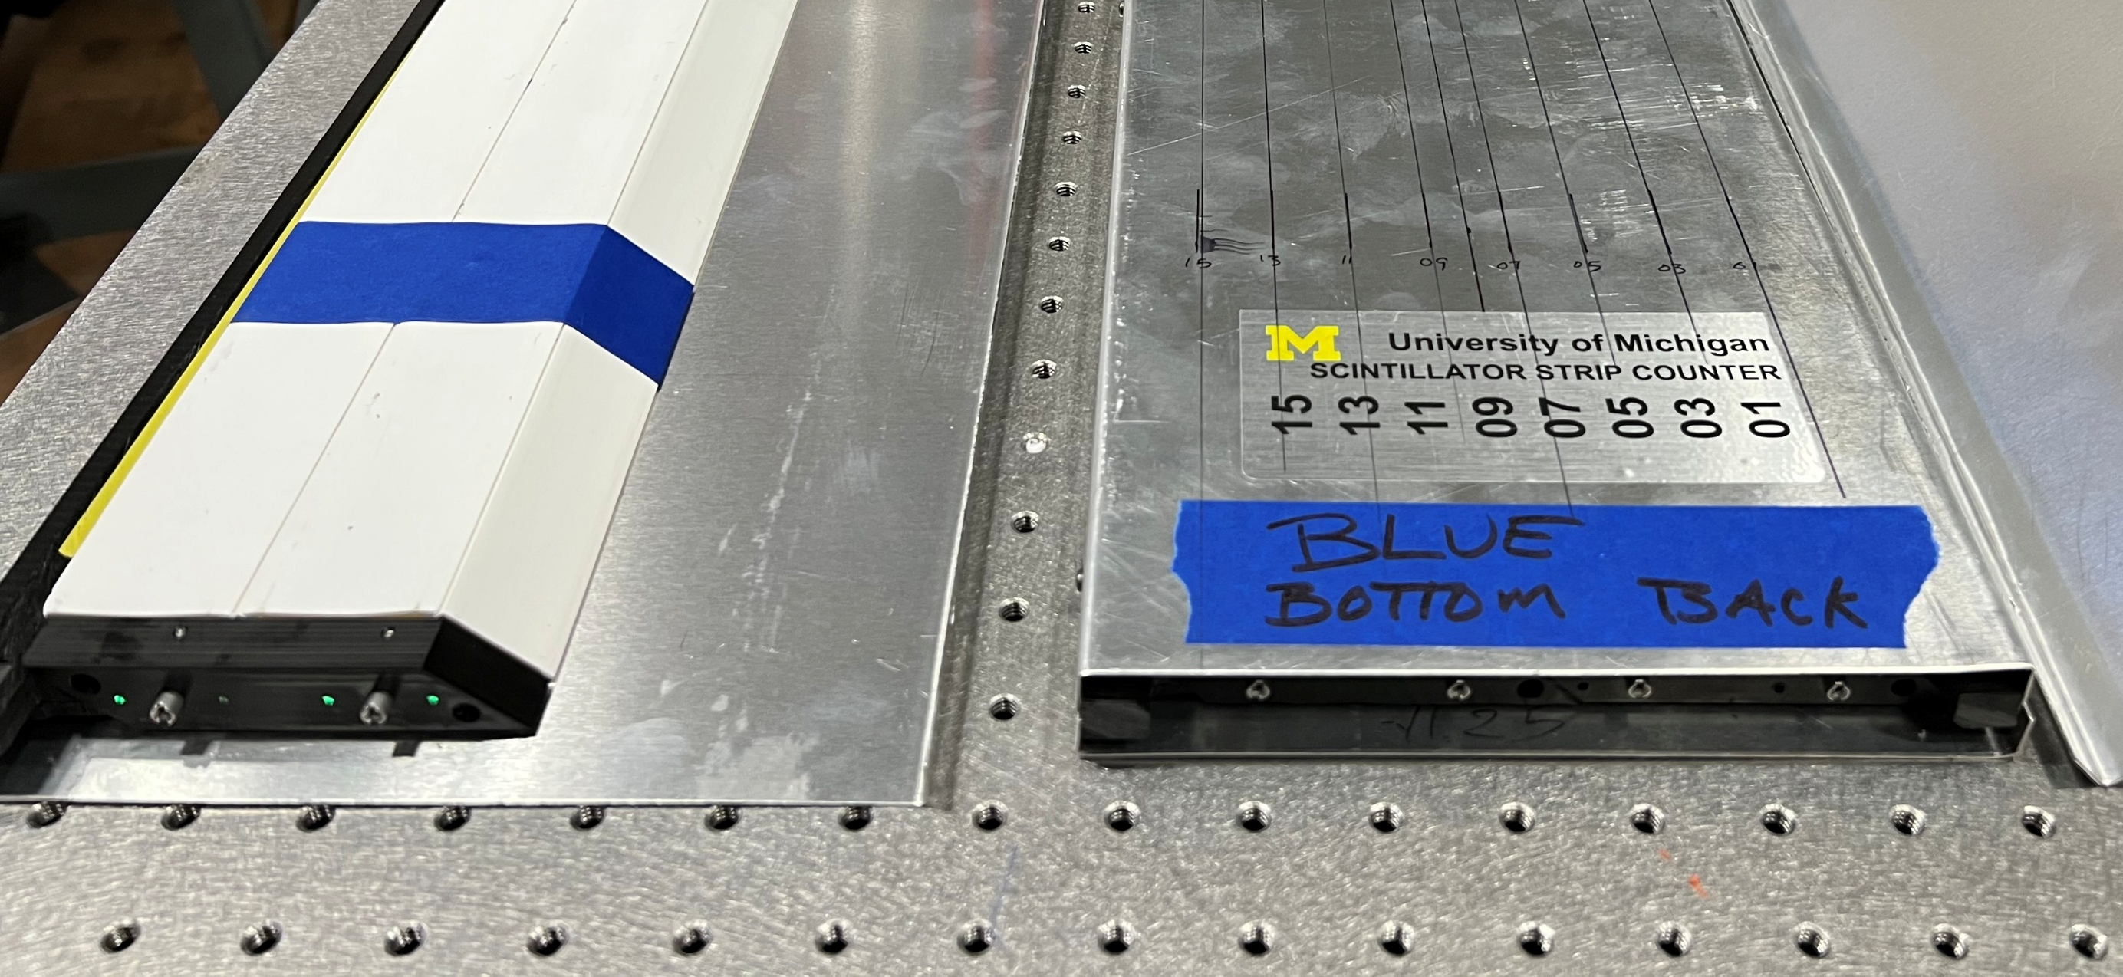
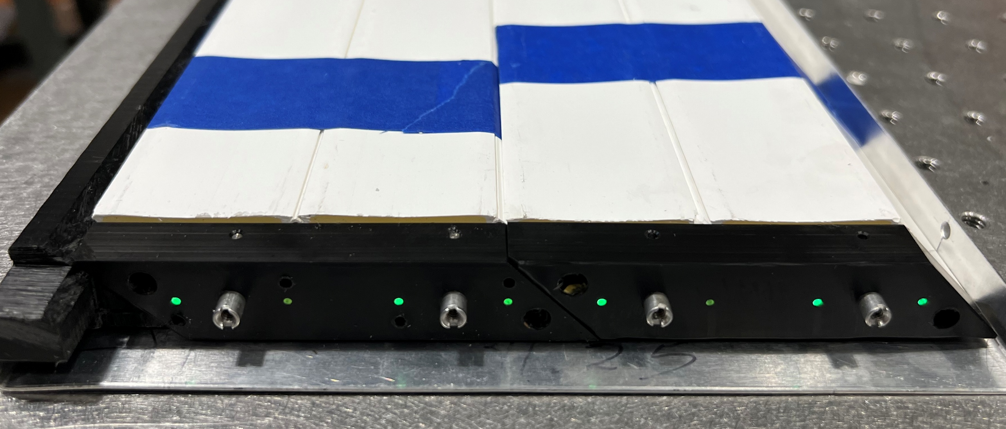
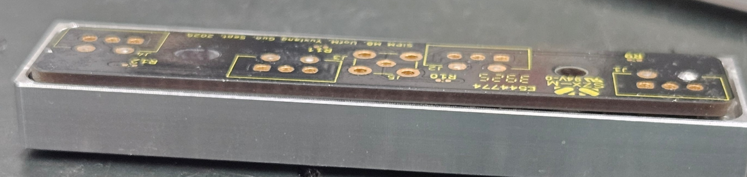
Scintillator Strip Prototype Module Construction at Michigan
Received 20 triangular strips (4cm base, 2cm height) from Alan Bross
and Jim Freeman (arXiv:2202.08184)
Received samples of YS-2M and YS-4M 1.5mm diameter fibers from Kuraray
Purchased 35 Hamamatsu S13360-3075PE SiPMs
Constructed five quad-counters, including the fiber holder, SiMP holder, and FE boards, assembled into two modules with two quad-counters each, + a spare, following the Fermilab procedure closely
Readout from both ends of the modules for a total 32 readout channels
Quad-counter assembly
SiPM holder attachment
Module assembly (two quad-counters)
Front-end Electronics Board
Module assembly into the external Al box

Slide 3
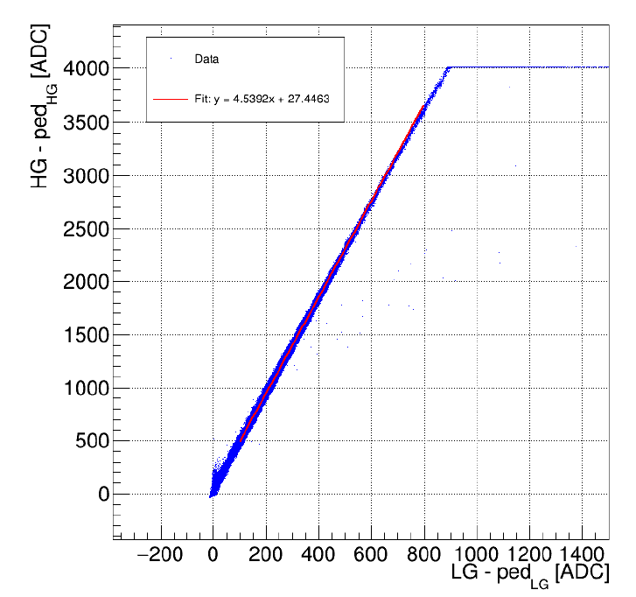
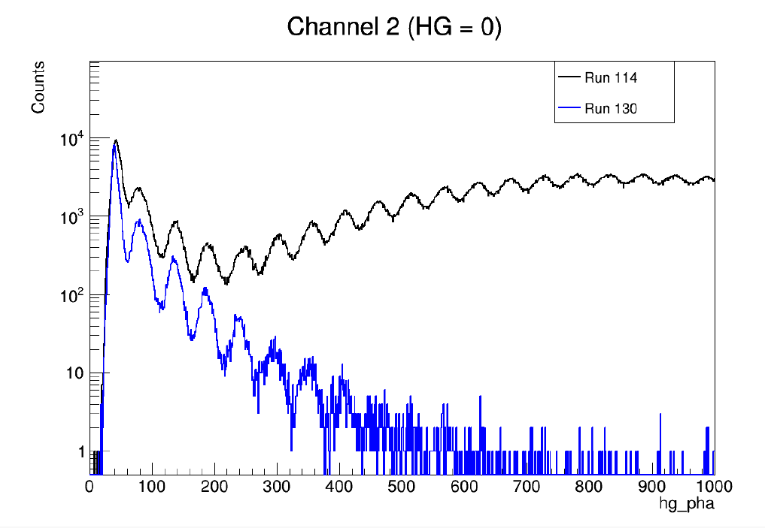
Cosmic Ray Studies at Michigan
CAEN module with 32-channel Citiroc ASIC, with both high and low gain readouts
Cross calibrate the low-gain readout
Calibrate using single PE peaks in the high gain readout
High gain readout
Channel with cosmic hit
Channel without cosmic hit
Low gain readout

Slide 4
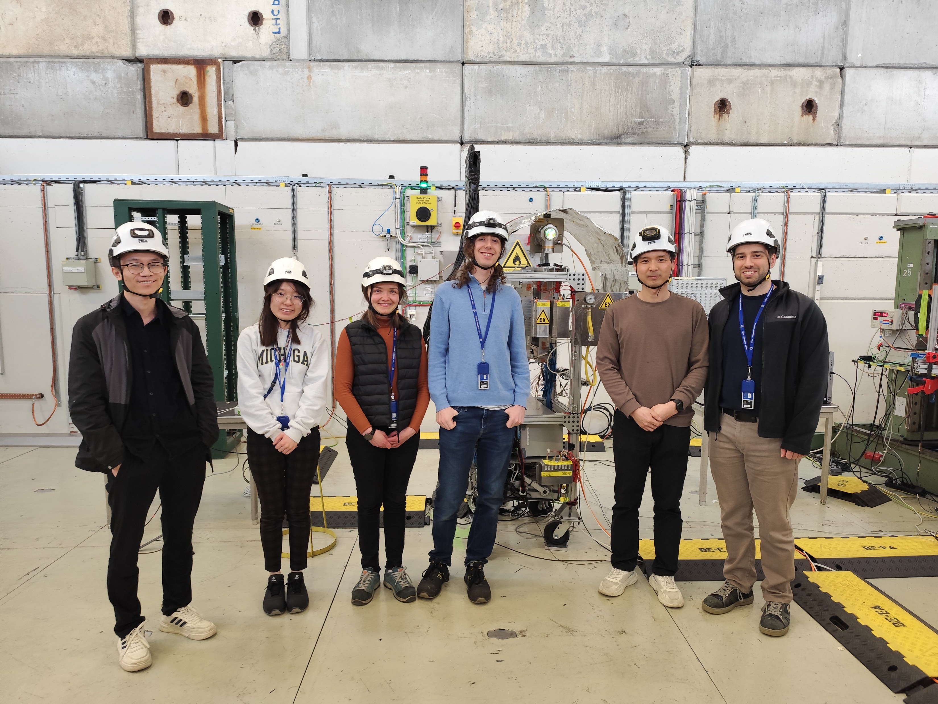
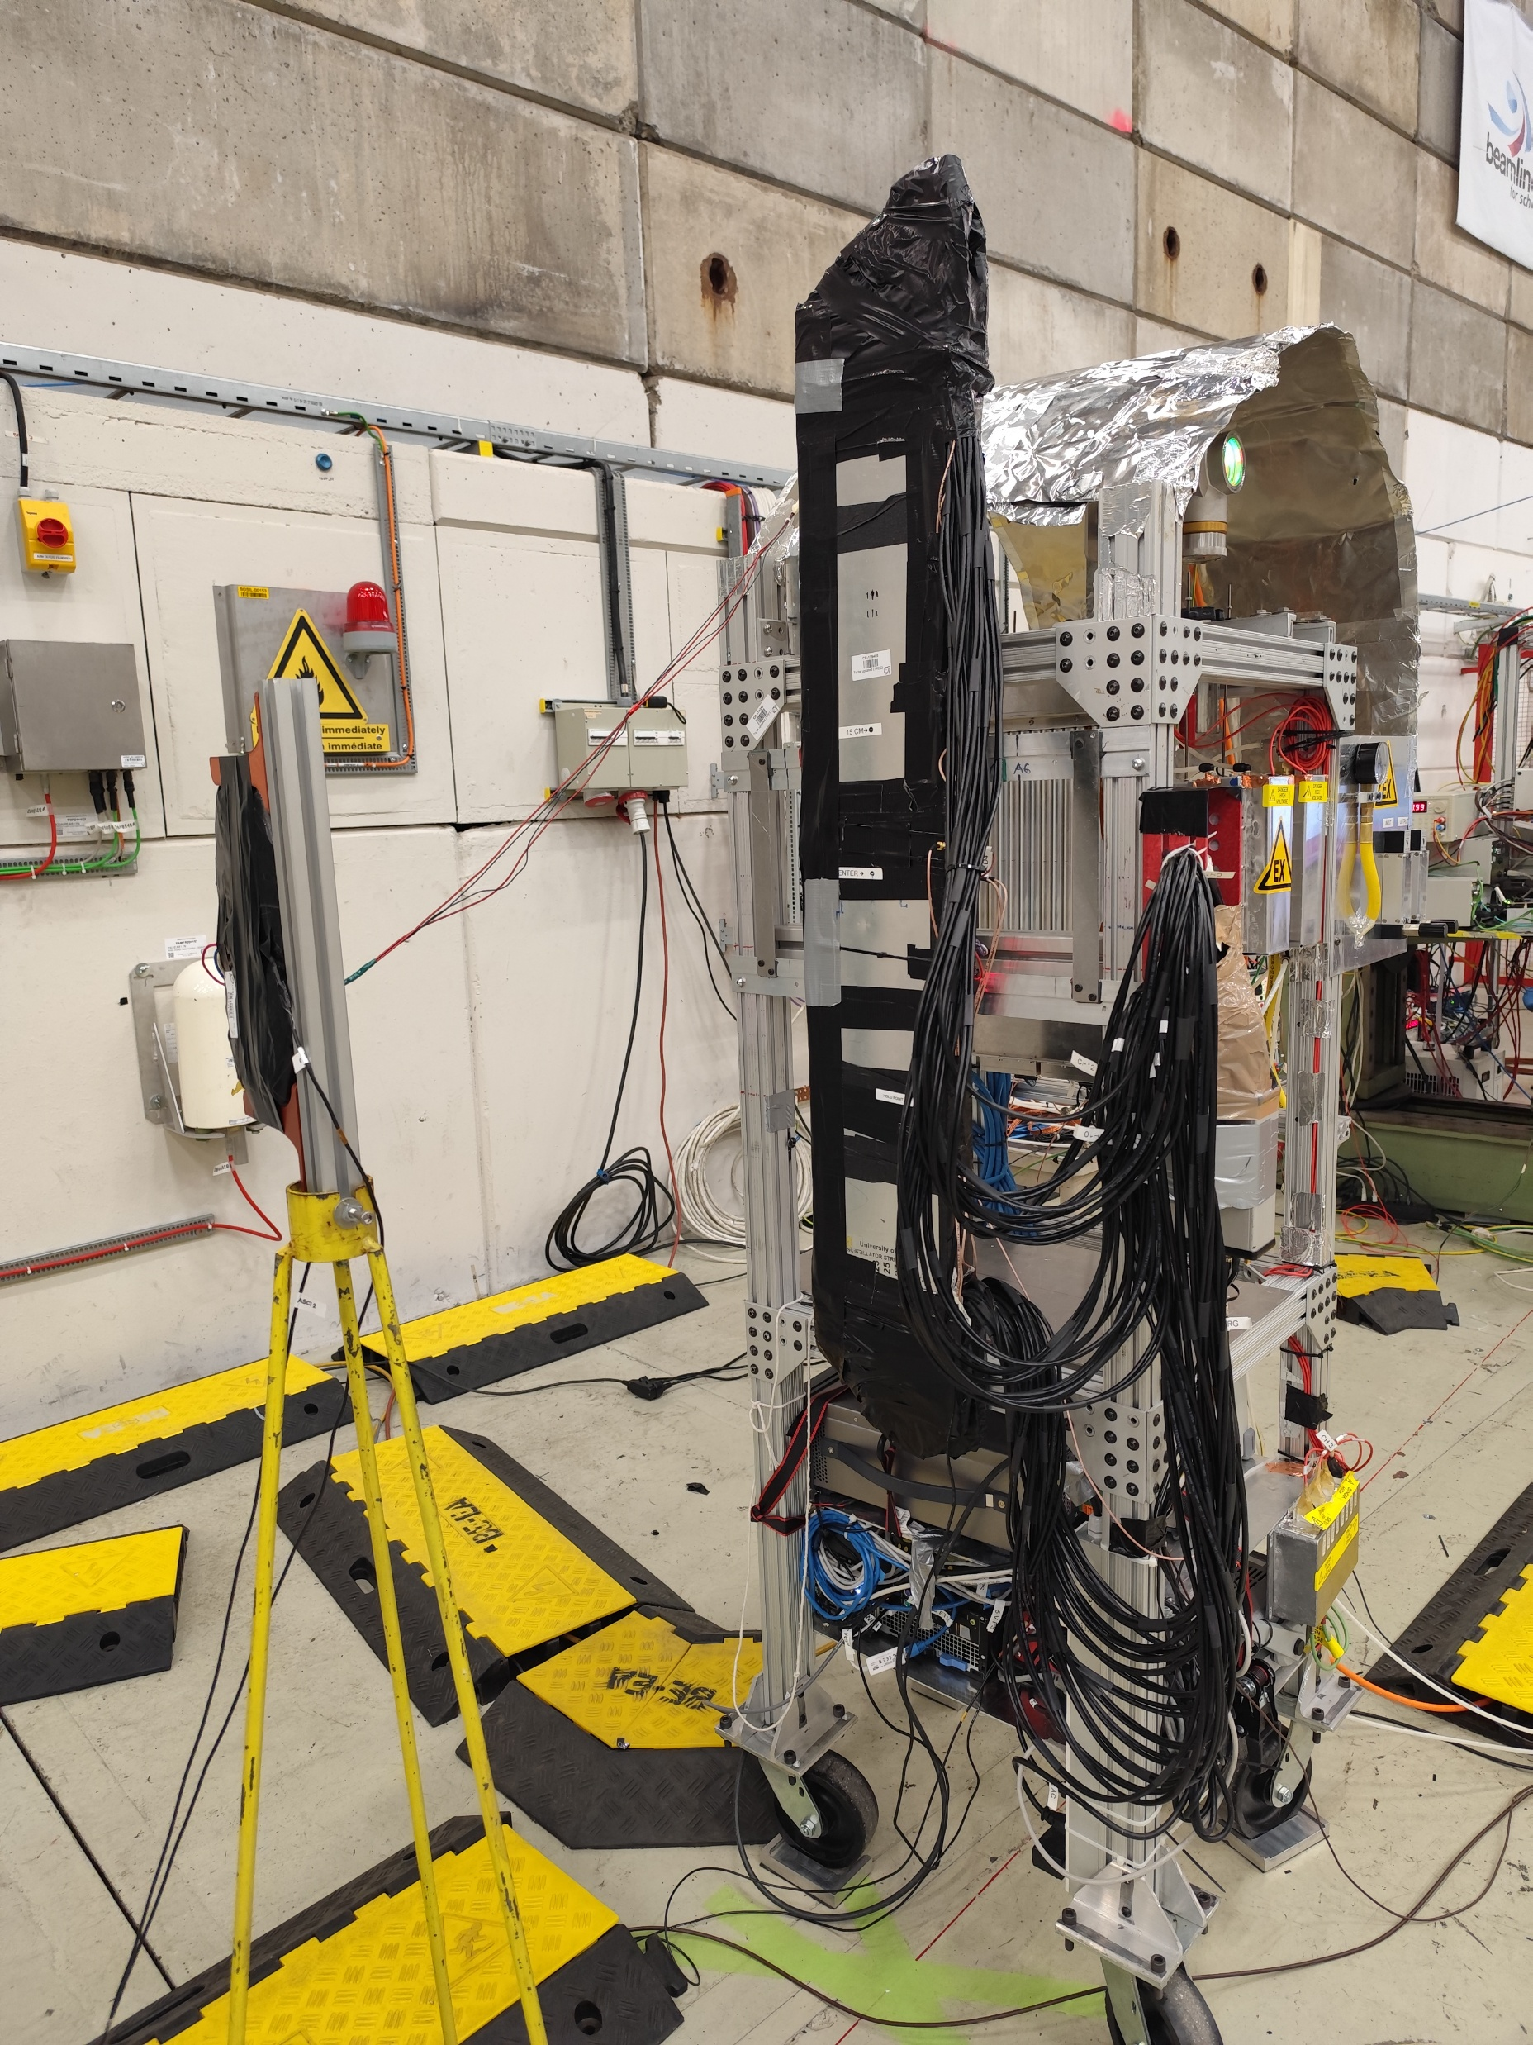
Tests with beams at CERN (11/12 – 20/2025), (3/18 – 4/6/2026)
conjunction of the straw tracker test
UM postdoc and students to carry out the test beam tests
Scintillator modules, readout in both ends
4 sMDT chambers
~100 cm
A5
4 cm
D1
D2
D0
A1
D3
D4
Top
0 2 4 6 8 10 12 14
B1
B2
A3
B3
B4
Bottom
E0
E1
B0
A0
15 13 11 9 7 5 3 1
4 cm
A4
18 cm
E2
E3
C1
C2
C0
A2
C3
C4
A6
6 cm
6 cm
Center
~3 cm
15-18 cm
15-18 cm
15-18 cm
15-18 cm

Slide 5
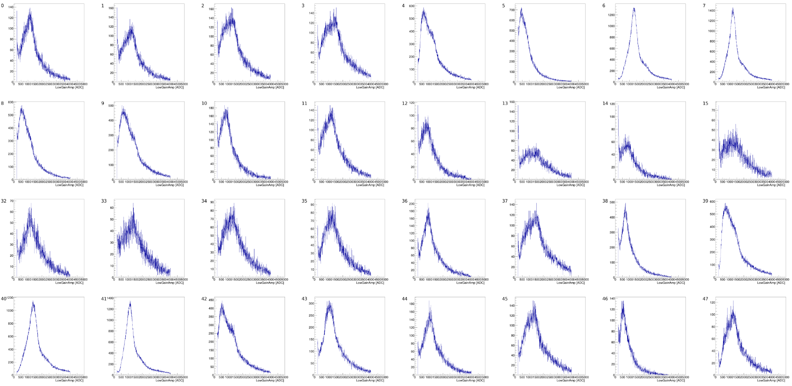
Raw ADC Spectra from Low Gain Readouts
From all 32 channels
Strips illuminated
by the beam
Blue module
Yellow module

Slide 6
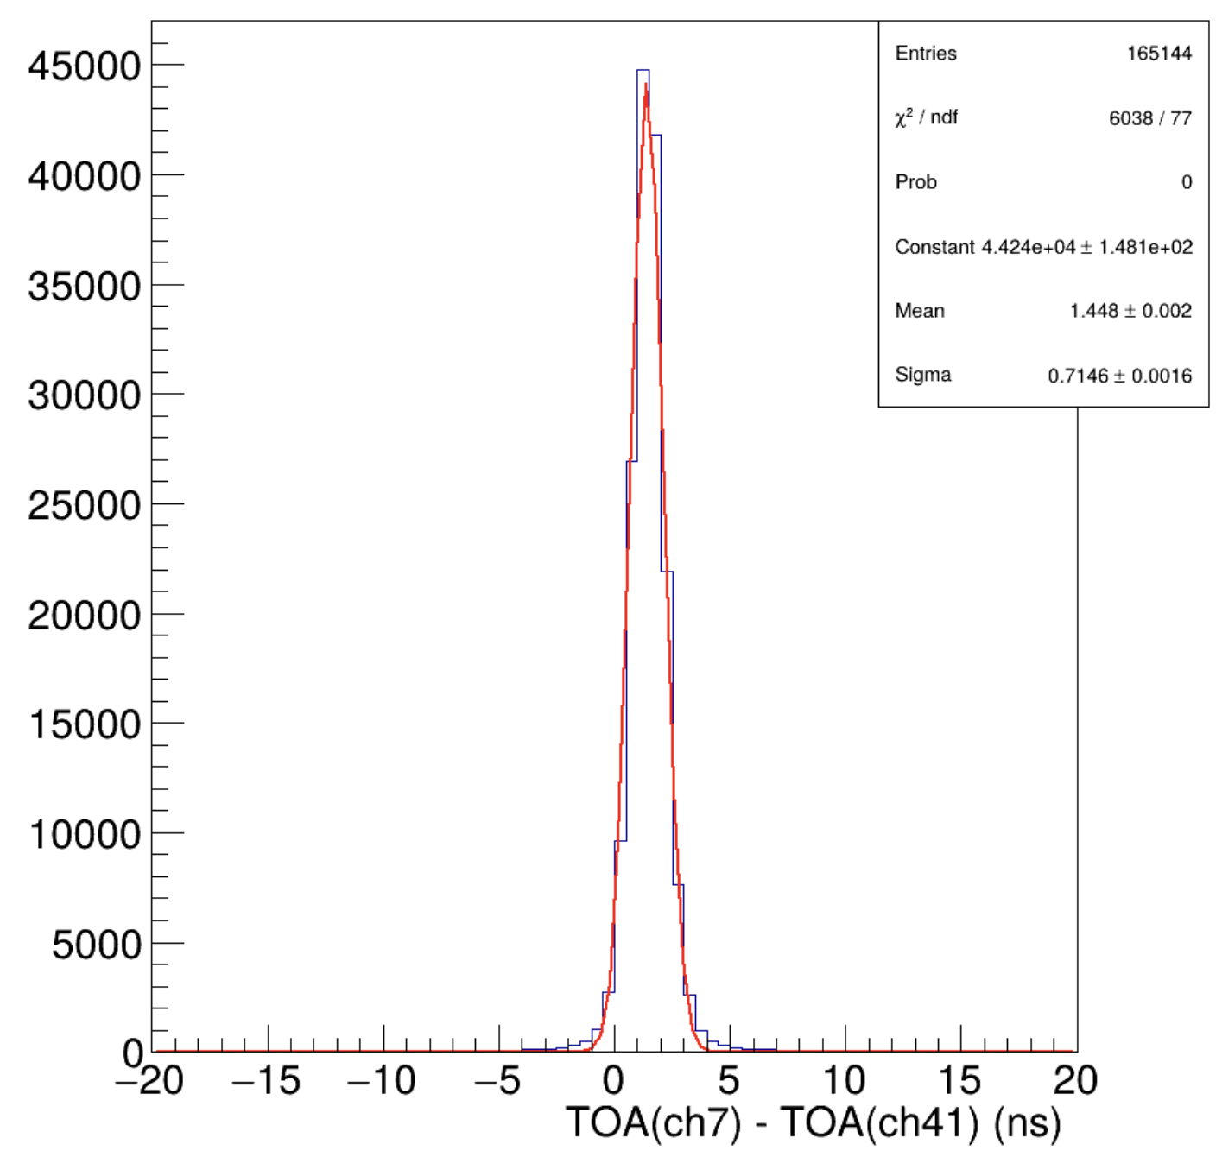
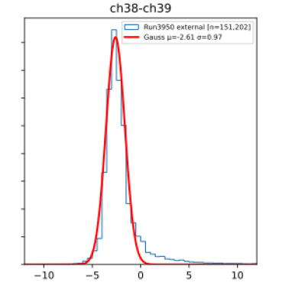
A First Look at the Time Information
Time difference between the two ends
of the same strip
Time difference between the two modules
L
t₁
t₂
t₁
t₂
z
beam
Blue module
Yellow module
Should be able to measure the z-position along
the strip from the time information to a few cm.

Slide 7
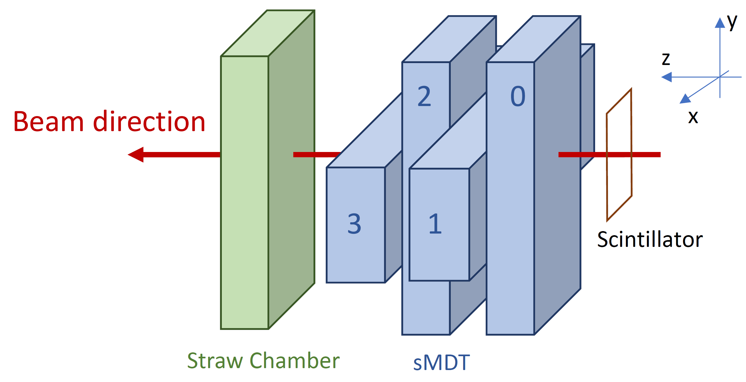
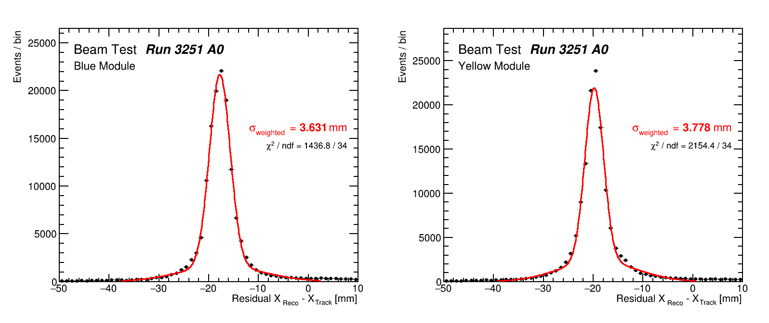
A First Look at the Position Measurement
Four sMDT chambers provide accurate tracking information,
Improve the position measurement from charge sharing
Q₂
Q₁
Expected ~2 mm or better
position resolution!
Very preliminary, without calibrations and corrections

