Slide 1
Cryogenic ODMR Chiral Microscope
Hadware Meeting
01/04/2026

Slide 2
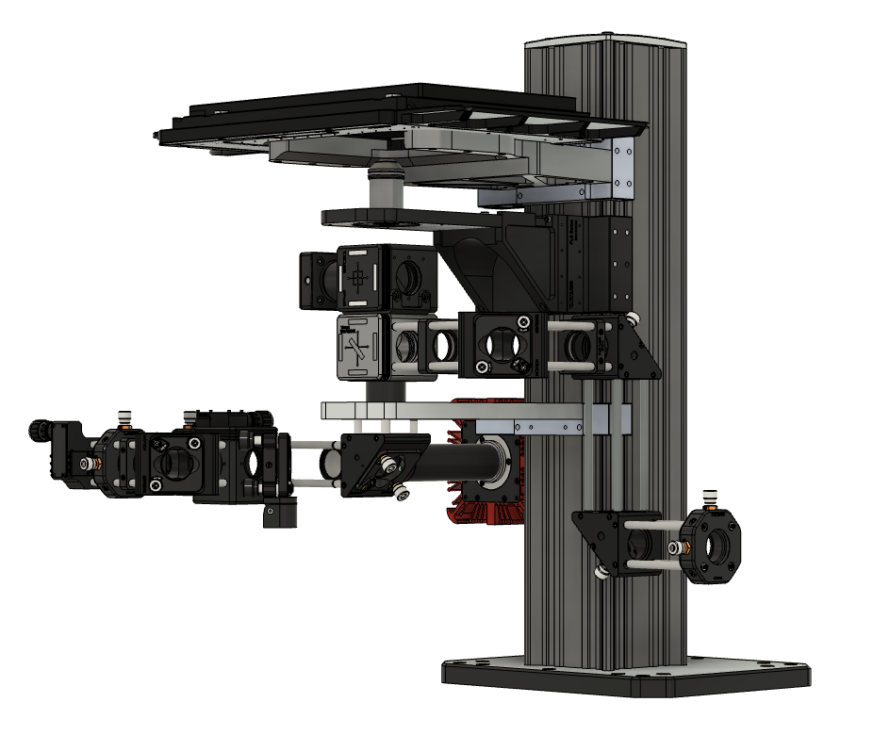
Microscope
Wide Field
Confocal
CPL Analysis

Slide 3
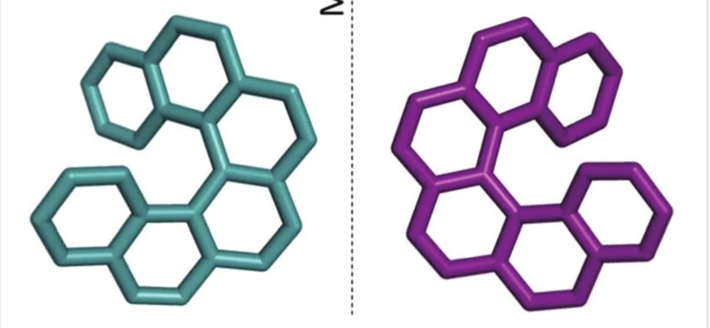
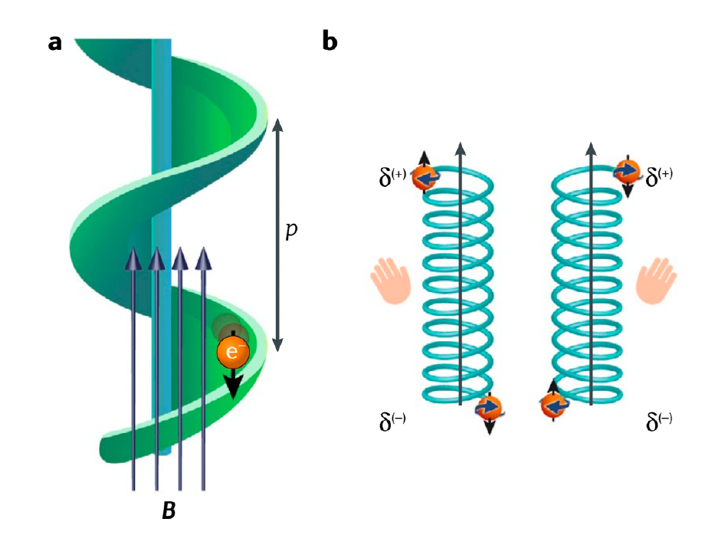
Chiral Molecule Analysis
Helical molecule can act as a spin filter
Electron moving through a chiral molecular bridge, the helical geometry couples the electron’s motion to its spin
One spin orientation is transmitted more efficiently than the other
Helicene

Slide 4
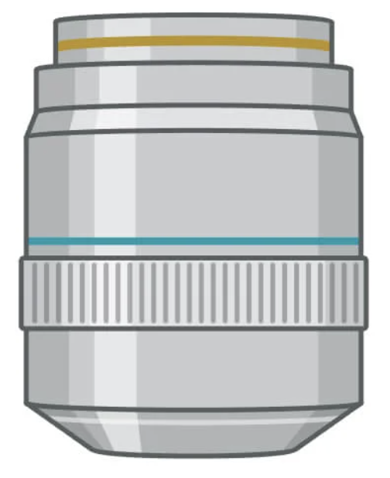

Chiral Microscope Setup
XY
Z
L1
LP
BS
L2
QWP
Aligning Camera
DM
L3
Fluorescence is collected using confocal microscopy
QWP converts RCP/LCP to two orthogonal linear polarized states
F
L4
EMCCD
QWP
L5
L6
BS
LP
L7
https://www.nature.com/articles/s41467-022-28220-z
LP
L8

Slide 5
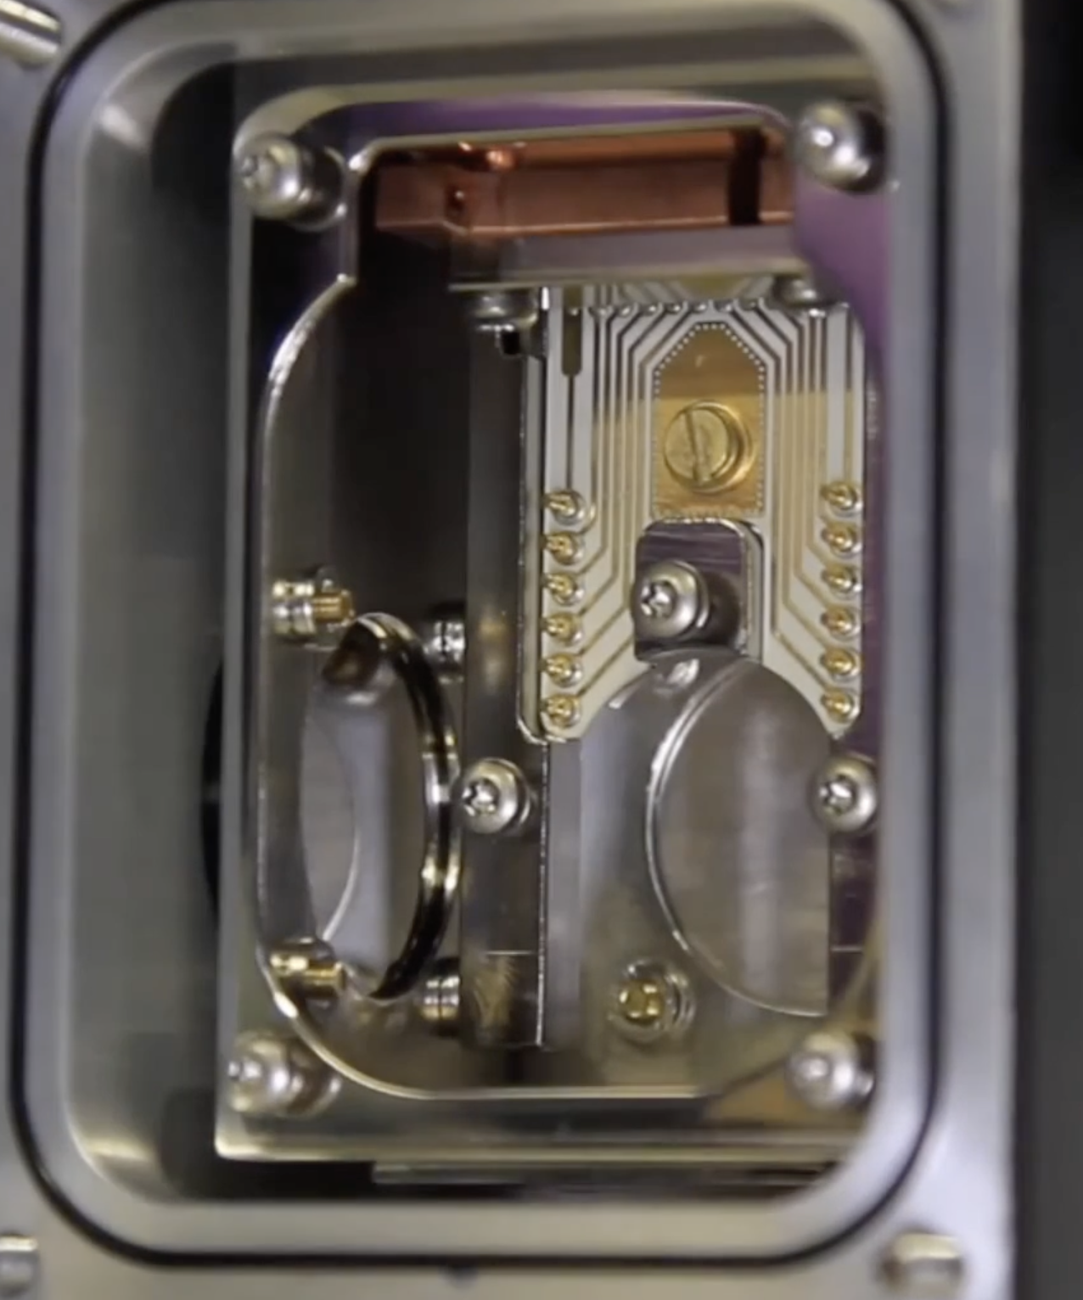
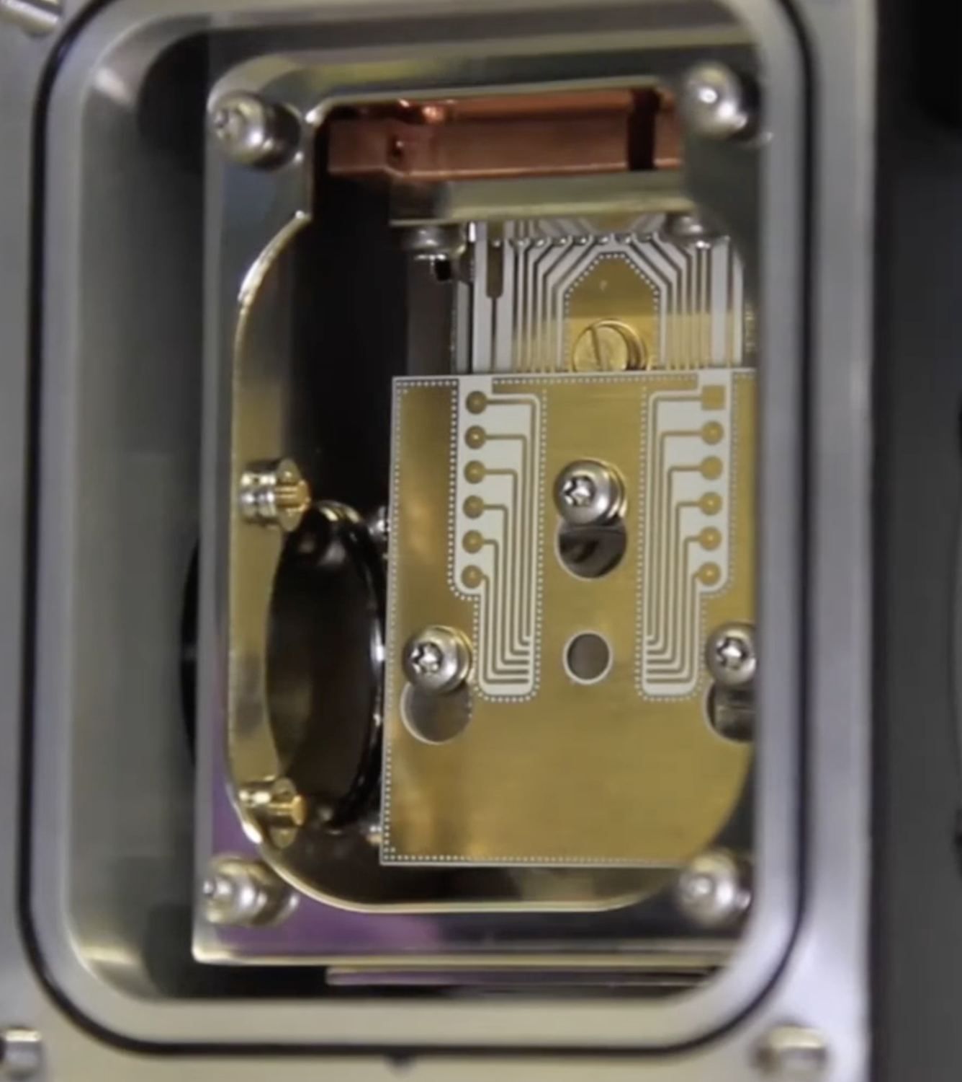
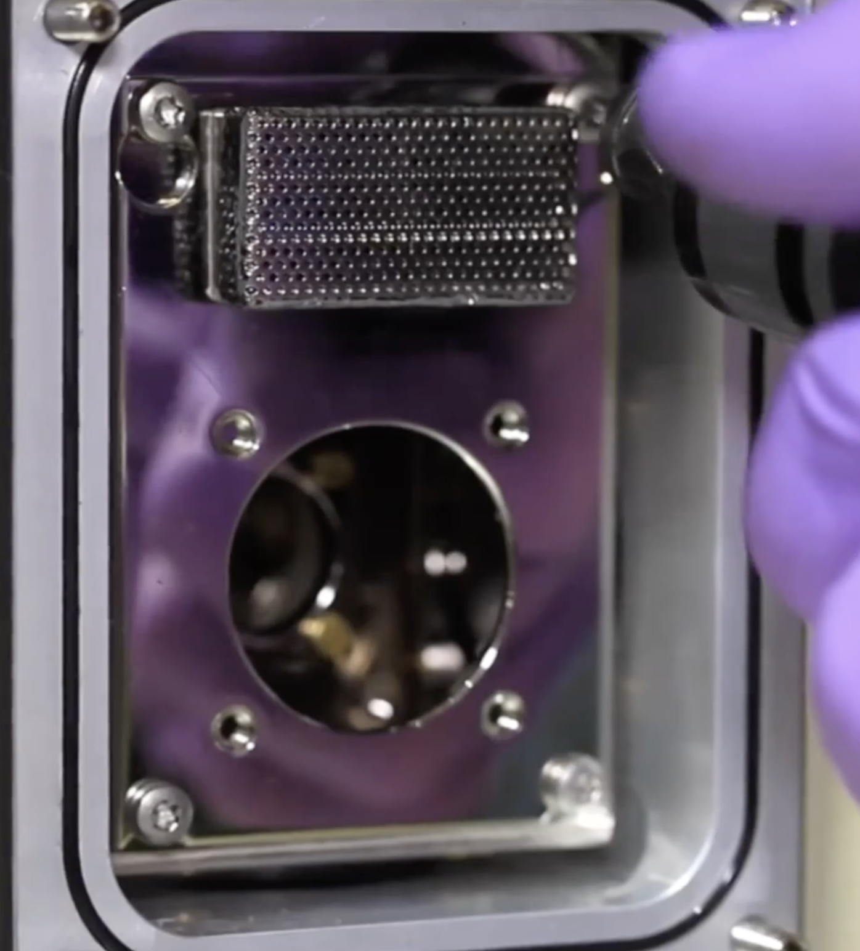
Cryostat Modification
To do single emitter imaging we need an objective with minimum NA 0.8 which has a WD ~ 1mm
Sample holder
Radiation shield
Sample holder connected hermetically to the cold head

Slide 6
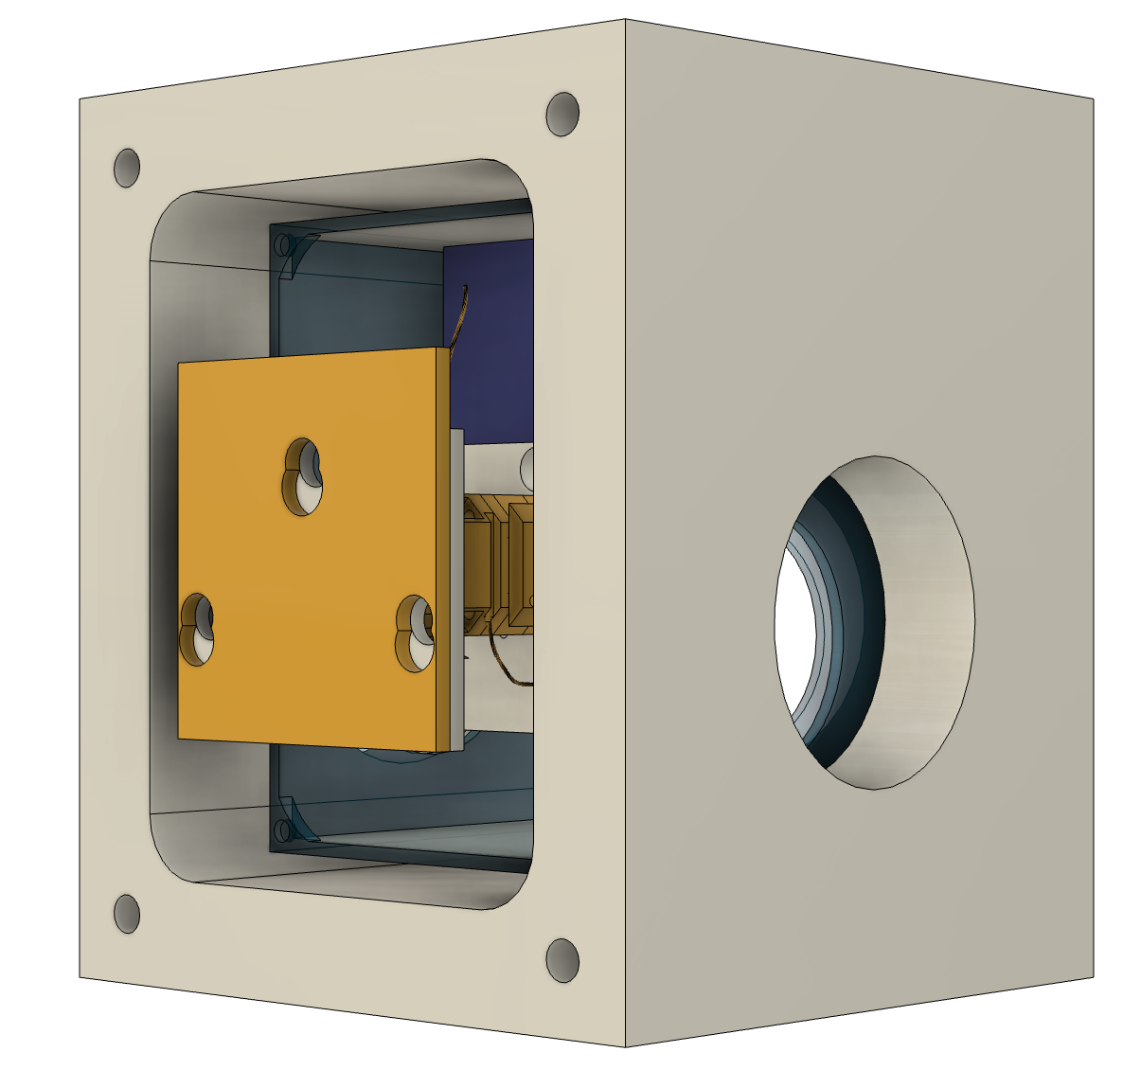
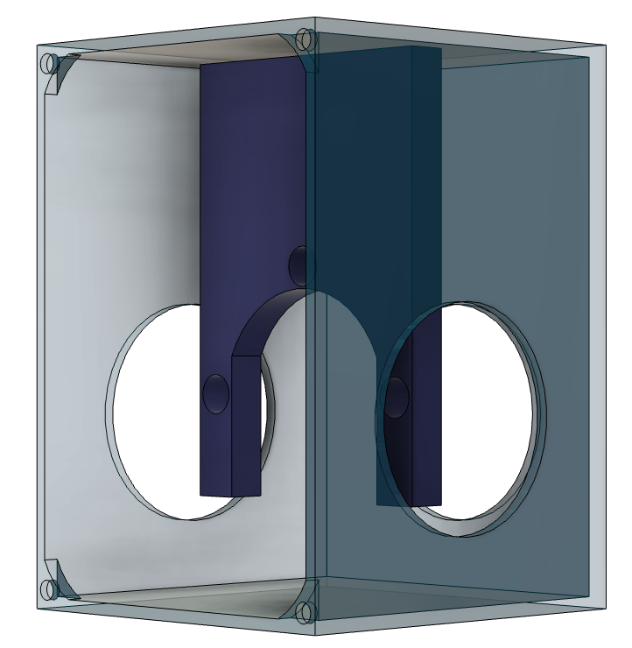
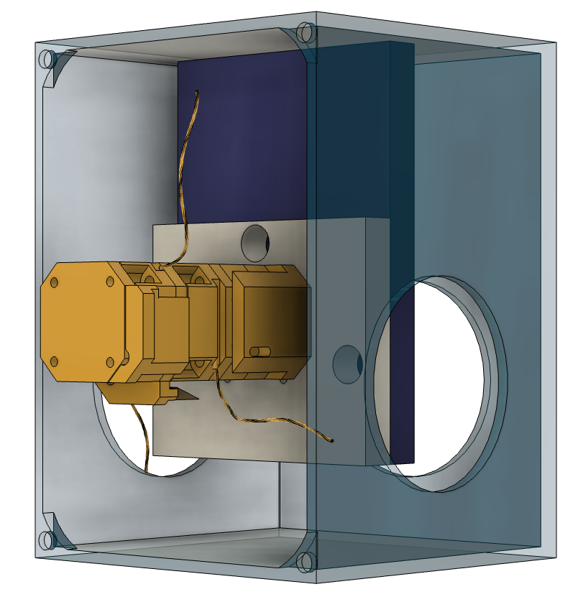
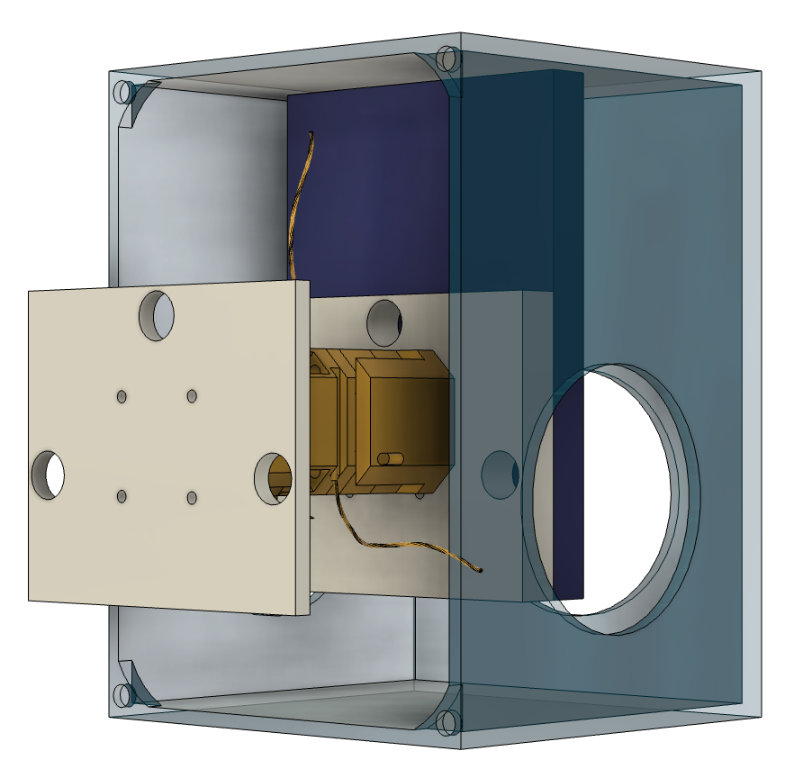
Cryostat Modification
Cold head
XYZ stages
Sample holder mount
Sample holder

Slide 7
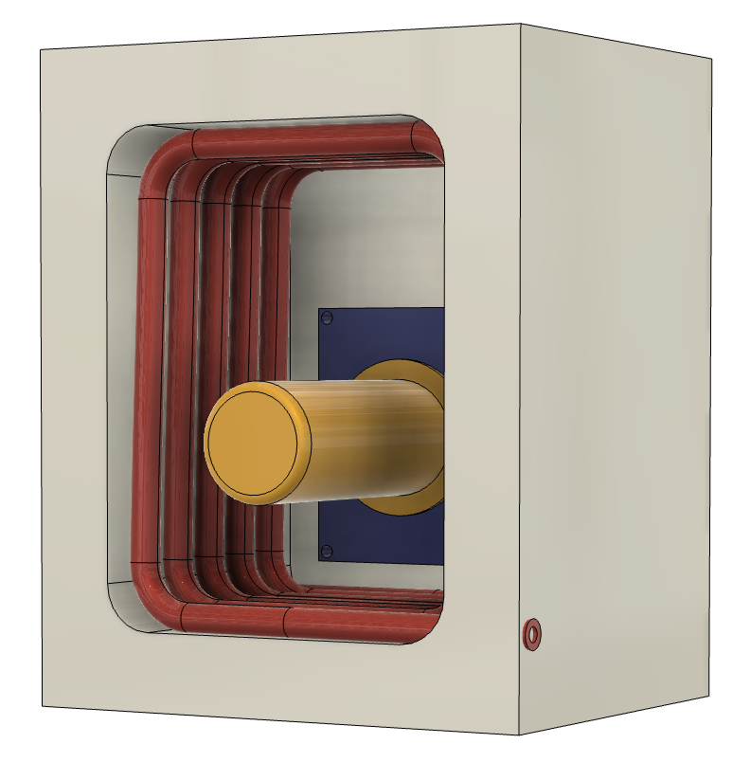
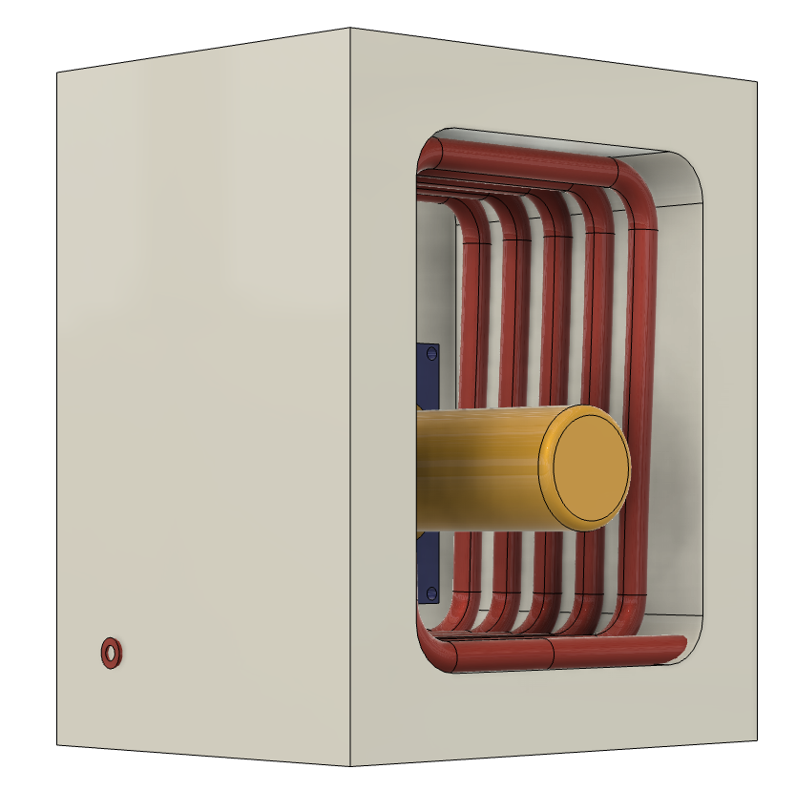
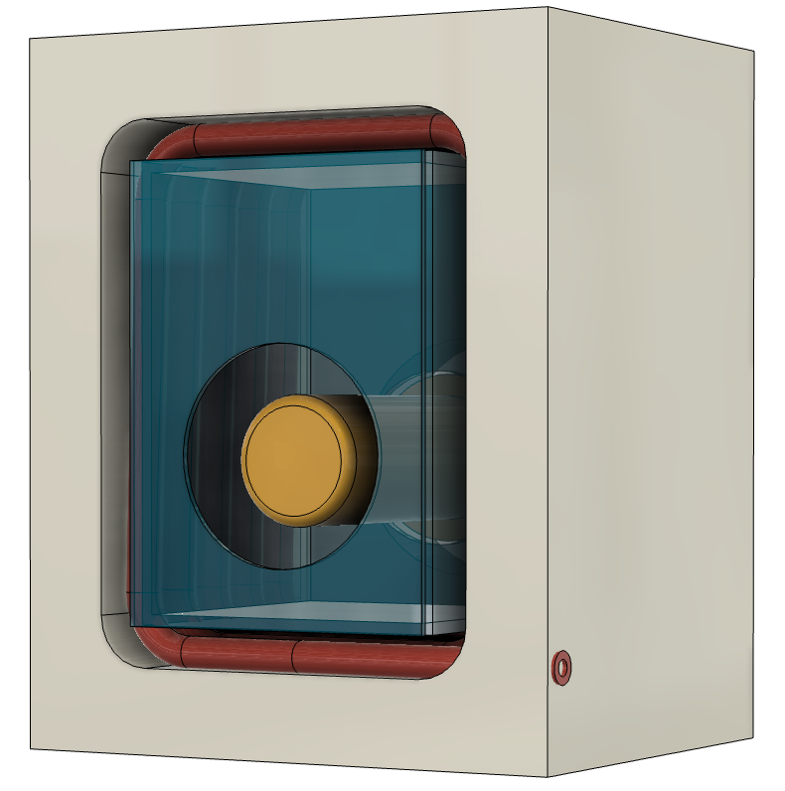
Cryostat Extension
Radiation Shield
LN In
LN Out

