Slide 1
FCC-ee Optics Evaluation
Options, Challenges & Outcome
2 April 2026 / US HFCC
S. Kostoglou, G. Roy, F. Zimmermann, C. Carli
on behalf of the FCC-ee Layout & Optics Design Working Group

Slide 2
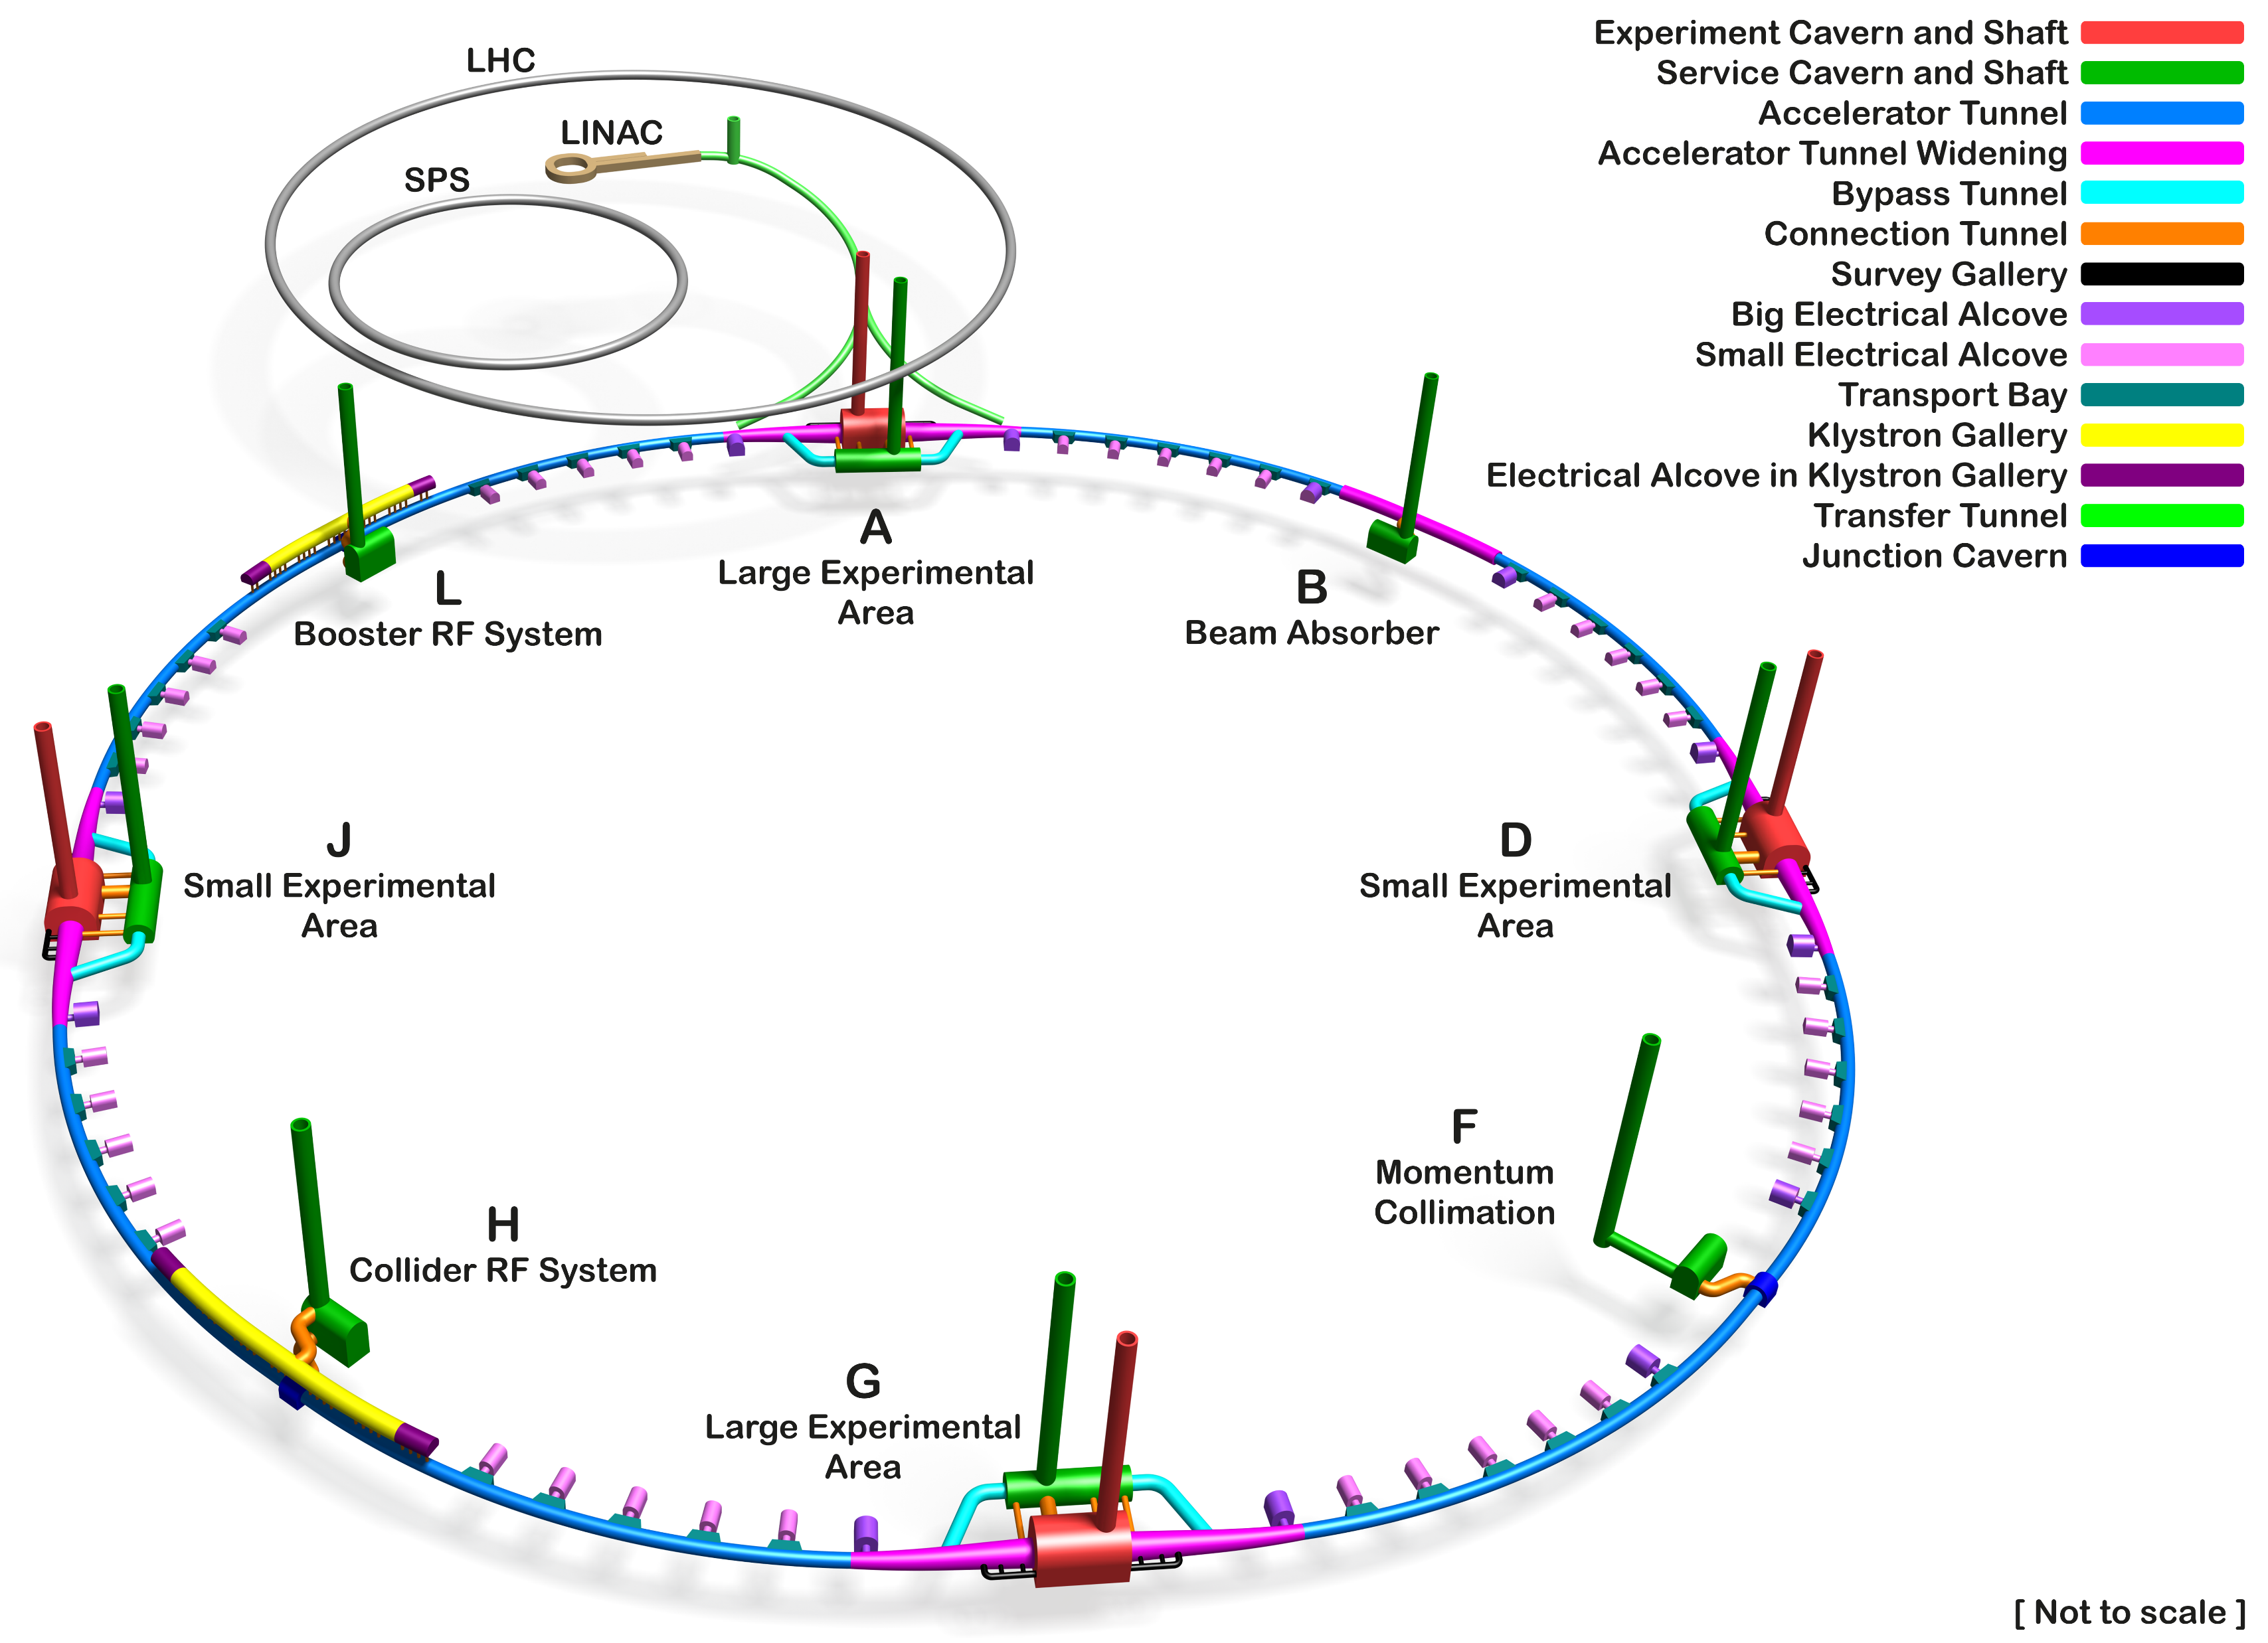
FCC-ee timeline
Feasibility Study concluded in 2025, assessing FCC technical, geological and financial feasibility
In 2026, European Strategy outcome placed
HL-LHC & FCC-ee as first and second highest priorities
FCC is now entering Reference Design Phase
Possible CERN Council decision by 2028
Technical Design Report foreseen to be completed by 2033
Courtesy A. Navascues Cornago

Slide 3
Introduction
FCC-ee Collider lattice is the basis for many technical studies & system designs
The choice of baseline optics extends beyond beam dynamics, performance & luminosity reach
Selecting baseline optics is on the critical path towards a coherent and cost-effective TDR
Two optics options
  Global Hybrid Correction (GHC) by K. Oide, developed over more than 10 years: high-level of maturity, building on KEKB/SuperKEKB experience, hybrid chromaticity correction and strongly relying on lattice super-periodicity
  Local Chromaticity Correction (LCC) by P. Raimondi since 2023: newer modular concept, local chromaticity correction in both planes, common layout across energies

Slide 4
Comparison framework
Comparison principles
  Written report prepared by multiple groups (> 80 contributors)
  Evaluation by independent external review panel
  Recommendation transmitted to FCC study management for a decision
Multi-parametric comparison across wide range of evaluation criteria
  Beam physics/performance: Dynamic Aperture, Momentum Acceptance, lifetime, beam-beam effects, collimation, impedance, top-up injection
  Hardware/Infrastructure: Magnets, Power Converters, RF, BI, MDI, Radiation shielding
  Operational aspects: optics tuning and tolerances, switching between energy points, polarisation and energy calibration, availability
Challenges
  Short timescale
  Uneven maturity or investment of studies between the two optics
  Results distributed across multiple teams and tools, requiring careful consistency checks
  Where data were missing, expert judgment was used and clearly stated in the report

Slide 5
Review Panel
21-23 January 2026 at CERN
Panel members
  Philip Bambade (IJCLab)
  Riccardo Bartolini (DESY), Chairperson
  Alain Blondel (U Geneva)
  Paul Collier (CERN)
  Catia Milardi (INFN-LNF)
  Sergei Nagaitsev (BNL)
  John Seeman (SLAC)
  Ye Zou (USTC)
  Haruyo Koiso (KEK – on Zoom)
Mandate
  Assess methodology, assumptions and comparison criteria
  Review performance potential, hardware / infrastructure implications and operational considerations
  Identify gaps, uncertainties and issues requiring clarification
  Provide a recommendation on the preferred optics option
  Propose follow-up actions in the short and longer term

Slide 6
Optics options: Main differences
 | GHC | LCC
Chromaticity correction | Global horizontal chromaticity correction in the arcs + local vertical correction near the IP | Local chromaticity correction in both planes in the Final Focus
Arc concept | FODO arcs with many non-interleaved sextupole pairs in –I transformations. Preserving –I condition is essential. Twin aperture dipoles and quadrupoles, QF for one beam corresponds to QD for the other, constrained to have the same length and strength, hence equal phase advances | Repetitive 5-cell FODO structure with only 4 sextupole families in 4 nested pairs. Achromatic and anharmonic lattice. Higher dipole filling factor, twin-aperture quadrupoles powered separately for the two beams
Technical insertions | Identical / universal technical straight sections, with strong dependence on superperiodicity. | Specialized straight sections for injection, collimation, RF using transparency conditions
Final focus | Simpler IR: Crab-waist included in the Y CCS (virtual crab sextupoles) | More elaborate FF: dedicated X and Y CCS, dedicated crab sextupoles, additional higher-order magnets for tuning
Switching between energy modes | Different magnet layout ai different energies: long 90°/90° FODO cell at Z and W, short (half length) 90°/90° FODO a ttbar | Common layout across energies, with phase-advance changes

Slide 7
Impact of Collider optics on overall design
Collider optics is not only a beam-dynamics choice
  It has major implications for layout, CE, hardware, integration, operation & cost
Booster & Collider layout are coupled
  Booster layout must follow repetitive Collider arc structure
  Booster location relative to the experiments (inside vs outside) feeds into tunnel size & CE
  Common infrastructure (tunnel, experimental caverns..) that serves both FCC-ee & FCC-hh
GHC and LCC Final Focus are different
  Different available space near the IP → BS dump location, first dipole-IP distance, SR levels → affect detector background & environment
Optics in technical insertions are contrained by functionality and overall design of collider (tunes, path lengths)
  Flexibility I placement of functionality (Injection, Collimation, Dump, RF) is part of the overall facility optimisation

Slide 8
Impact of Collider optics on overall design
Both beamlines (e+, e-) must be defined explicitly, 2 machines per Collider optics
  Some sections are different for the two beams, cannot be obtained by simple mirroring
RF needs and SR losses per turn are optics-dependent
  Different dipole filling factors, different levels of SR
  Different RF requirements feed into infrastructure, cost and performance reach
Switching between energy points
  LCC keeps common layout across energies (except RF insertion), simplifying energy transitions
  GHC requires different layout in arcs and RF between energy points → different powering solutions to ensure smooth transitions, additional powering circuits, less operational flexibility
Optics differences propagate into many systems. Keeping both optics options became unsustainable for the Reference Design Phase

Slide 9
Optics comparison: The highlights

Slide 10
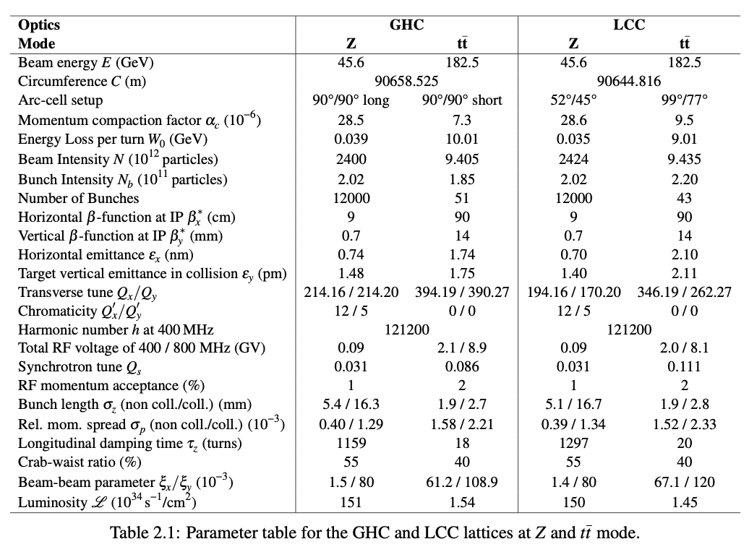
Comparison parameters
X. Buffat, M. Jebramcik, I. Karpov,
K. Oide, P. Raimondi, K. Skoufaris
Preliminary set of beam & machine parameters
used as basis for the comparison

Slide 11
Comparison parameters
X. Buffat, M. Jebramcik, I. Karpov,
K. Oide, P. Raimondi, K. Skoufaris
Beam current set by 50 MW SR
power per beam for GHC
  10% less radiation power for LCC for the same beam current
ε_{y}=ε_{x}/1000 after optics corrections
ξ_{y}=0.08 at Z, 0.12 at ttbar per IP
N_{b}≤12000 from e-cloud
Q_{y} from tracking simulations
Q_{x} between synchro-betatron sidebands
V_{RF}(Z)=90 MV for beam loading and depolarization constraints

Slide 12
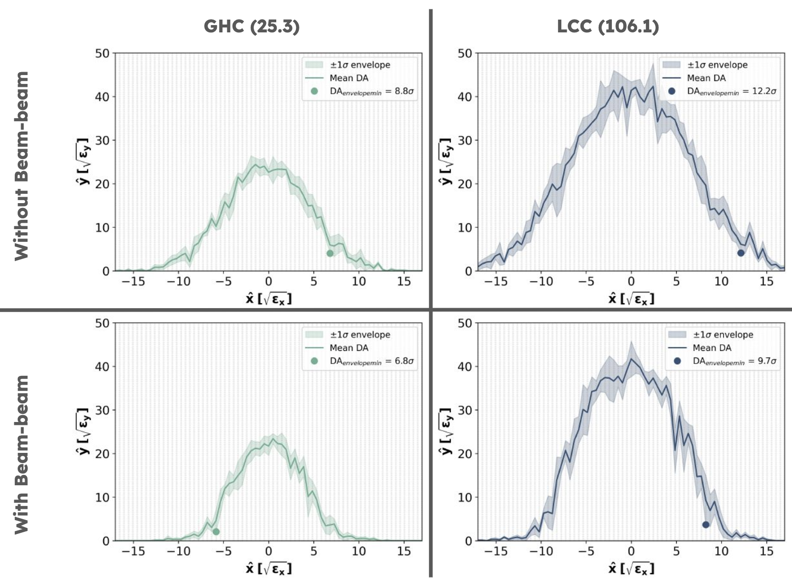
Dynamic Aperture & Momentum Acceptance
DA at Z pole
DA & MA comparison including SR effects, cases without beam-beam or with weak-strong
beam-beam and beamstrahlung (BS)
Overall, LCC shows a higher DA and MA for Z
  Tune scans: larger stable tune space with acceptable lifetime & lower vertical emittance
  for LCC
At ttbar, both optics suffer from a significant luminosity degradation (20-30%) at nominal beam–beam parameter, requiring further studies
  GHC degradation related to loss of superperiodicity
  LCC degradation related to strong BB effects, larger emittances and resonance crossing
K. Skoufaris, X. Buffat, M. Jebramcik

Slide 13
Magnets: Differences in Arc layout
J. Bauche, I. Garcia Aguirrebeitia-Sanchez, A. Vorozhtsov, L. von Freeden
Main dipoles
Length
  LCC: ~30m dipoles, split in 3 units of ~10m
  GHC: ~24m dipoles, split in 2 units of ~12m
Field: Slightly lower field for LCC (5%)
Quantity: 17% more in LCC to support & align
Design: Identical magnet cross-section
Powering: -2.5% busbar lengths in LCC
Main quadrupoles
Length
  LCC: 1.86 m QD, 2.89 m QF
  GHC: 2.7 m QF and QD
Field: Much lower for LCC
Quantity: 24% less in LCC
Design:
  LCC: Twin aperture but separate powering of each aperture
  GHC: Coupled twin aperture with opposite polarities for the two beams

Slide 14
Magnets: Differences in Arc layout
J. Bauche, I. Garcia Aguirrebeitia-Sanchez, A. Vorozhtsov, L. von Freeden
Main sextupoles
Length
  LCC: 0.52 m SD, 0.3 m SF
  GHC: 1.3 m SF and SD (double for Zh & ttbar)
Quantity: 27% less in LCC
Design: Similar magnet cross-section
Powering:
  GHC: Many independently powered sextupole pairs
  LCC: Fewer sextupole families / circuits in the arcs
Overall
Quadruople and Sextupoles arc magnets are the most complex and costly to manufacture
LCC shows clear potential for magnet CAPEX savings thanks to its shorter Quadrupoles and Sextupole arc magnets
Preliminary estimate for total arc-magnet CAPEX: about 17% lower for LCC than for GHC
Manufacturing is expected to be easier for LCC, especially because the sextupoles are much smaller and less numerous

Slide 15
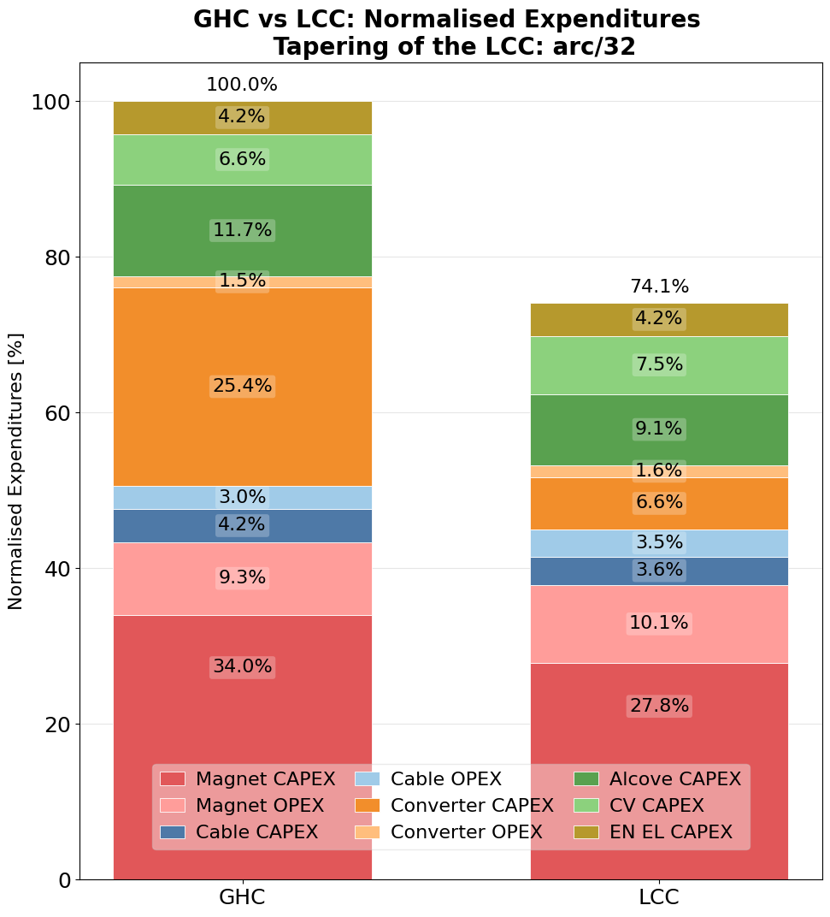
Global system optimization
D. Aguglia, N. Pinillos Zamorano,
A. Rankovic, S. Pittet
Subsystems cannot be optimized independently.
Local choice in one subsystem propagates to many others
System optimisation objective is to minimize total cost (CAPEX & OPEX), while respecting some constraints
Comparison performed on Collider arcs only, including magnets, power converters, cabling, electrical equipment, cooling & ventilation, alcoves..
LCC gives substantially lower cost than GHC
  Main contributor are the power converters
  In LCC, sextupole powering is centralized in the big alcoves, which reduces the number of converters
  GHC needs more converters to support energy-stage transitions with fixed magnet layout

Slide 16
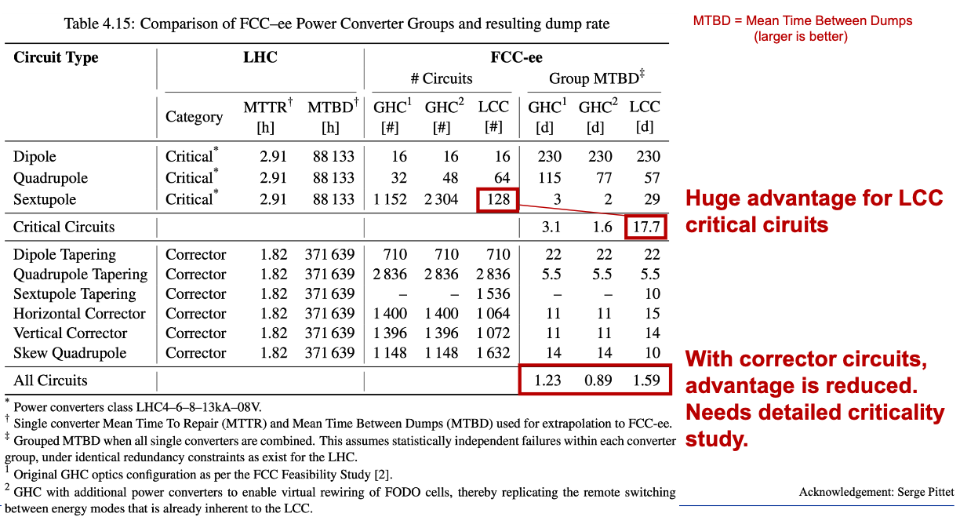
Machine availability
J. Heron, J. Uythoven, D. Domange
Availability is driven mainly
by failure rate & repair duration
The dominant optics-dependent factor is the power converter configuration
LCC has a clear availability advantage due to sextupole powering: Fewer critical sextupole circuits means larger MTBD, fewer dumps, better availability

Slide 17



RF system
I. Karpov, O. Brunner, K. Canderan,
W. Hofle, V. Parma, F. Peauger, D. Sittard
$$Z$$
&
$$WW$$
e⁻ beam
33 400 MHz CMs
33 400 MHz CMs
e⁺ beam
Horizontal crossing
+ vertical separation
33 400 MHz CMs
33 400 MHz CMs
$$ZH$$
EM separator
EM separator
33 400 MHz CMs
102 800 MHz CMs
33 400 MHz CMs
$$t\overline{t}$$
Identical number of 400 MHz SRF modules for Z, WW, Zh
Separate per beam for Z (with Reverse Phase Operation) and WW, common to both for Zh
Additional 800 MHz modules, common to both beams, for ttbar
Vertically separated beam pipes to avoid long-range beam-beam effects
Electromagnetic separators and dipoles to steer back to arc trajectories

Slide 18
RF system
I. Karpov, O. Brunner, K. Canderan,
W. Hofle, V. Parma, F. Peauger, D. Sittard
$$Z$$
&
$$WW$$
e⁻ beam
33 400 MHz CMs
33 400 MHz CMs
e⁺ beam
Horizontal crossing
+ vertical separation
33 400 MHz CMs
33 400 MHz CMs
$$ZH$$
EM separator
EM separator
33 400 MHz CMs
102 800 MHz CMs
33 400 MHz CMs
$$t\overline{t}$$
LCC has about 10% lower SR energy loss per turn than GHC. Lower RF voltage needs, fewer cavities, beneficial for integration of cryomodules
Beam parameters in the comparison were chosen to maintain 50 MW SR power per beam for GHC. Under this assumption, same total beam current assumed for both optics but lower RF voltage requirements at ttbar for LCC

Slide 19
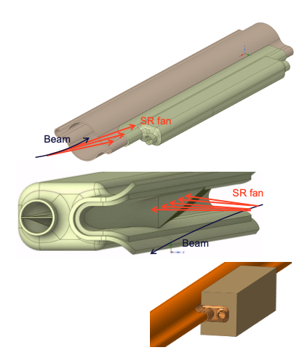
Synchrotron Radiation Absorbers
B. Humann, A. Lechner, M. Ady, C. Garion, V. Giovinco, M. Morrone, P. Krkotic et al
SRAs integrated into vacuum chamber winglets to intercept SR
  Placed only in dipoles
  Spaced so that no direct photons from the beam hit the downstream chamber wall
Placement is driven by dipole spacing and dipole-free regions
  GHC: Longer short straight sections, longer dipole-free regions &
  non-uniform dipole pattern (short and long dipoles) make shadowing more difficult. Some absorbers must protrude into the chamber
  aperture to maintain full shadowing
  LCC: more uniform, long-drift shadowing problem is avoided
Overall, the LCC layout is more favorable for SR absorber integration: fewer absorbers, more uniform placement and no absorber intrusion into nominal aperture

Slide 20
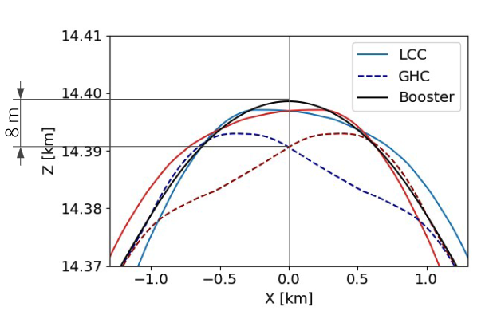
Machine Detector Interface
M. Boscolo, G. Broggi, G. Nigrelli, F. Palla, F. Van der Veken
MDI includes the experimental cavern & the interplay with the final-focus matching section (~1 km from the IP on each side)
Same high-level parameters: L*=2.4 m, 30 mrad crossing angle, SR masks at exits of final doublet (QC1, QC2) quadrupoles
  Similar QC1 lengths & gradients, -30% QC2 gradient in LCC, potentially allowing normal-conducting magnet design
No show-stopper MDI issue for either optics, but different tunnel footprint, cavern integration, SR levels & beam intercepting device layout
  LCC places dipoles in the cavern (possibility to move them away under discussion), GHC does not
  GHC uses reverse bends, LCC does not, but SR only on one side of tunnel
  Beams start separating at different locations for the two optics
  BS dump location differs: ~500 m downstream in GHC, likely closer in LCC but requires further assessment

Slide 21
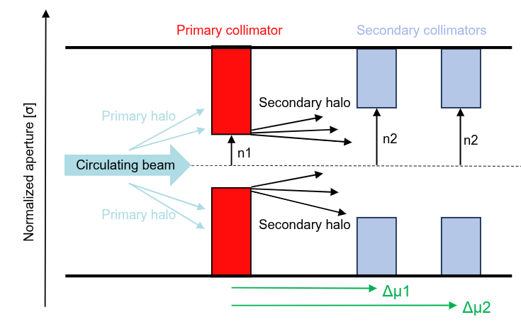
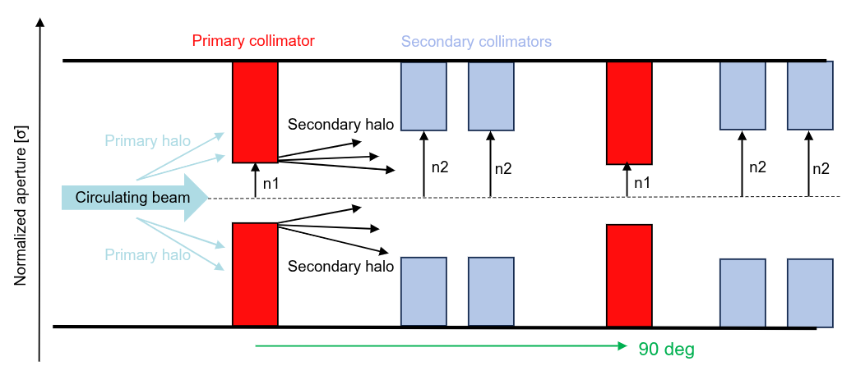
Collimation/Impedance
G. Broggi, A. Bessenay, R. Bruce, S. Redaelli, F. Van der Veken
C. Zannini, D. Gibellieri, M. Migliorati
GHC
Two-stage collimation (primary & secondary) for both optics
GHC is contrained by the universal technical insertion & superperiodicity requirements, limited freedom to optimize
LCC has more flexibility:
  Higher β-functions, wider collimation gap
  → beneficial for impedance
  Double-phase collimation (primary collimators with
  90° phase advance) can be implemented naturally:
  Significantly improves suppression of fast losses,
  protects against hierarchy breakage, improves background
  Collimation insertion has essentially zero dispersion: off-momentum collimation requires another dedicated region and is not yet fully defined / optimized
Overall, LCC is favored for betatron collimation & impedance
LCC

Slide 22
Optics comparison: The outcome

Slide 23
Outcome of the review
The panel acknowledged that parallel development of GHC and LCC is unsustainable
Both lattice strategies were judged to be clearly defined
GHC was recognized as the FCC-ee historical backbone. LCC was recognized as building on that foundation
Recommendation: adopt LCC as the new FCC-ee optics baseline
Main reasons:
  Modular approach & greater insertion flexibility, enabled by transparency conditions
  Common layout across all operating energies
  Superior DA and MA
  Lower SR loss per turn, either reduced RF needs or higher luminosity at fixed RF power
  Fewer sextupole families, significantly reduced number of power converters and cost

Slide 24
Outcome of the review
The panel also stressed that many areas require more systematic & in-depth analysis
Several near-term and longer-term studies were identified
  Consistent use of tools across simulations
  Field quality, tolerances and misalignments. Robustness against realistic machine imperfections
  Correctors strategy and performance
  Integrated simulations including beam-beam and collective effects
  Top-up injection efficiency
  Understanding luminosity loss at ttbar in LCC
  Collimation optimization in LCC, including momentum collimation
  Interplay between Booster and Collider fields
Panel also emphasized that the two optics were compared at the same total beam current, not at the same SR power and that these comparison assumptions should be revisited

Slide 25
Study decision following optics review
LCC becomes the new reference optics for all ongoing studies
It will be used in particular for:
  the short-term follow-up actions identified by the review panel
  deriving specifications for hardware
  analysing the implications for infrastructure, technical systems and the entire project
Goal: confirm LCC as the new baseline optics after FCC Week 2026
By end of 2026: update all relevant specifications & requirements

Slide 26
Next steps
By FCC Week 2026
  Make optics available at all energy points
  First reference table of beam & machine parameters
  Studies of all groups with LCC as common reference for FCC Week 2026
By end of 2026
  Consolidate layout for CE studies (Booster placement, tunnel widening in insertions,
  beam separations)
  Reference to surface & FCC-hh compatibility
  Consolidate hardware: magnet specifications, circuits & power converter specifications
  Consolidate collimation, injection/dumps, RF, solenoid compensation
Reference Design Phase
  Fully consolidated design, supported by realistic simulations including most important beam dynamics effects & refine equipment specifications
  Continue optimizations of performance & integrated luminosity

Slide 27
Summary
The optics comparison required a very large effort from many teams, across many technical areas, in a very short timescale
LCC was recommended, it offers real advantages in performance and cost.
The collaboration is now focusing on consolidating it into a coherent design. Target is to confirm the new baseline optics after FCC Week 2026
Our goal now is to keep the momentum, maintain a strong flow of information across groups and help align the work plan for the Reference Design Phase
The next phase is extremely challenging as many aspects now couple optics, hardware, integration, CE, MDI, RF, collimation, vacuum, operation, machine protection..
The key objective is to make all of these studies converge into a coherent and technically feasible design

Slide 28
Thank you for your attention.
2 April 2026 / US HFCC
28

Slide 29
Comparison parameters
X. Buffat, M. Jebramcik, I. Karpov,
K. Oide, P. Raimondi, K. Skoufaris
GHC
LCC

