Slide 1


Fundamental Physics at the MeV scale in Australia
https://arxiv.org/abs/2302.13281
Martin Sevior¹⁾, Lindsey Bignell^{2,3)}, Irene Bolognino^{4,3)}, Catalina Curceanu⁵⁾ , Tibor Kibédi²⁾, Alasdair McLean^{4,3)}, Adam Steinberg¹⁾, Andrew Stuchbery²⁾, Martin White⁴⁾
(+Nic. Jackson, Connor Rush, Adrian Babic – Melbourne M.Sc. Students,
Michael Baker, Andrea Thamm (U. Mass.))
¹⁾ School of Physics, University of Melbourne
²⁾Department of Nuclear Physics and Accelerator Applications, Australian National University
³⁾ARC Centre of Excellence for Dark Matter Particle Physics
⁴⁾Adelaide University
⁵⁾INFN (Frascati)

Slide 2
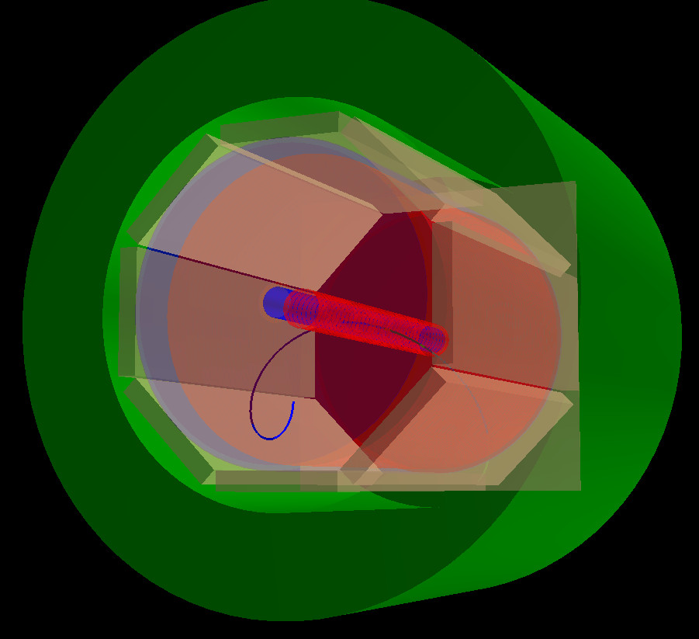
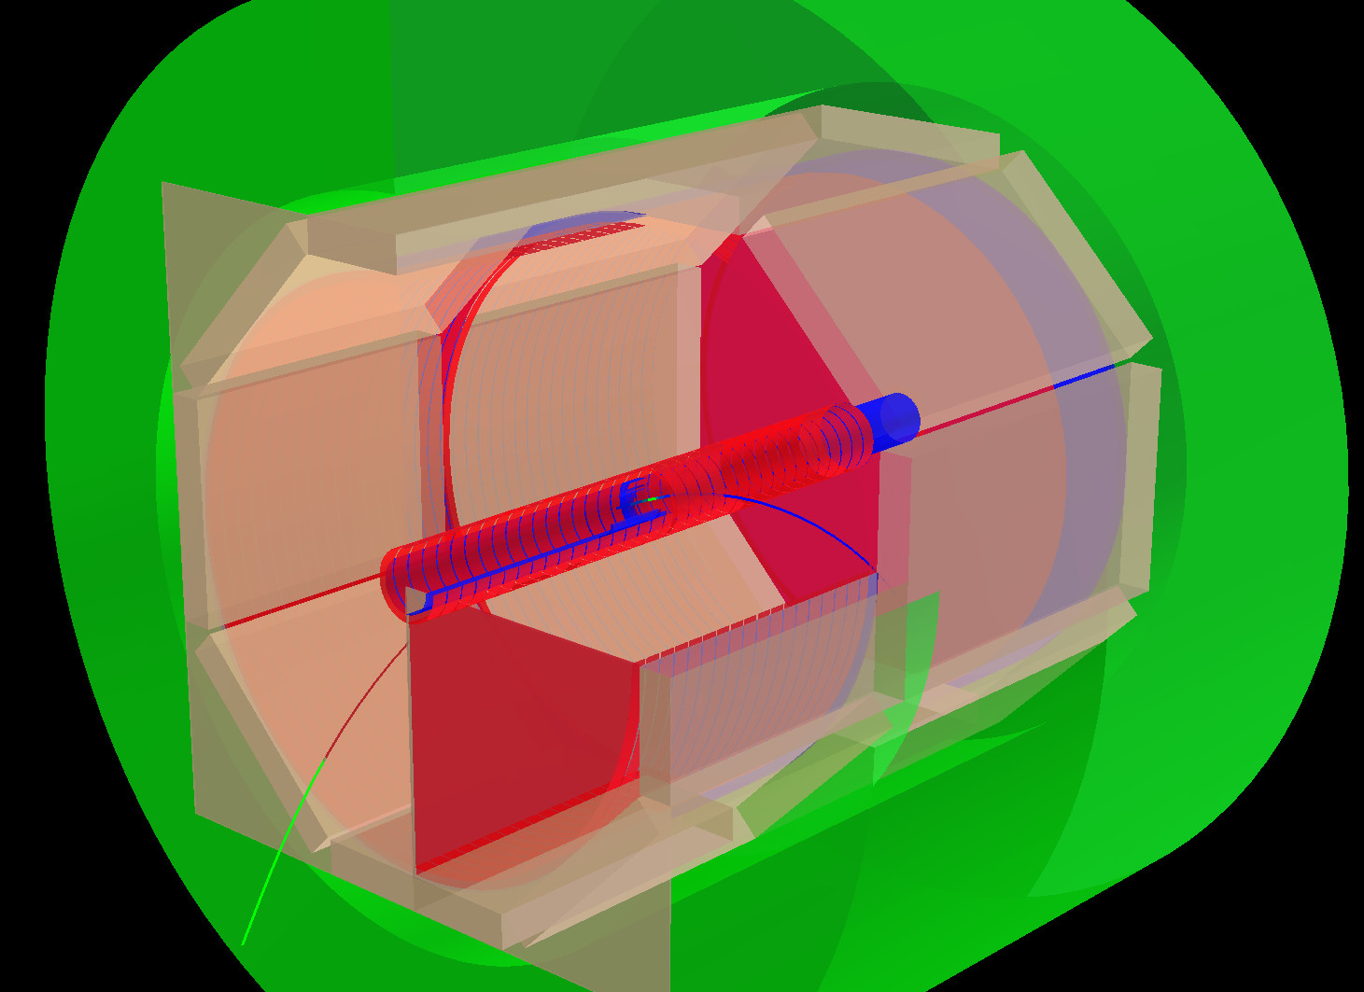
Beamline Instrument for MeV-scale particle and nuclear Physics (BLIMP)
Pelletron (Melbourne), 14 UD (ANU)
Iron Yoke (Electromagnet)
Trigger scintillators
Proton beam
Beam Pipe
Electric Field Cage

Slide 3
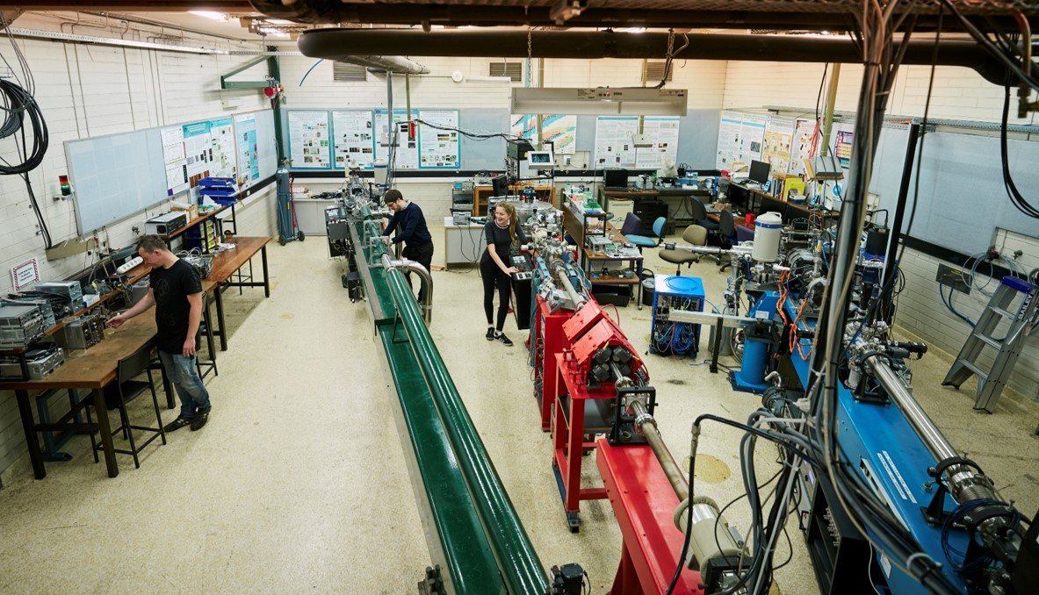
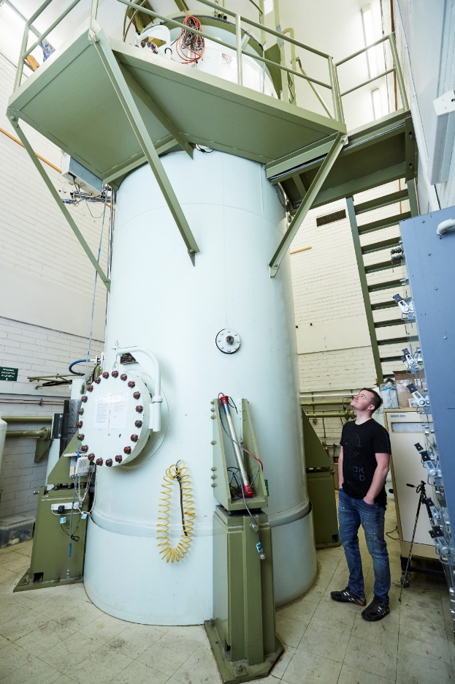
New Physics in the MeV regime?
Theoretical studies and experimental anomalies motivate a high-precision Time Projection Chamber for the Pelletron 5 MV accelerator at unimelb
Also enables qualitatively new Nuclear Physics experiments not previous possible
Employs advanced detector technology developed for HEP
The key: high resolution studies of electron-positron pairs from p + ^{Z}X →^{Z+1}Y + (e⁺e⁻) reactions:
To start: p + ⁷Li →⁸Be + (e⁺e⁻)
The Pelletron accelerator laboratory, University of Melbourne

Slide 4
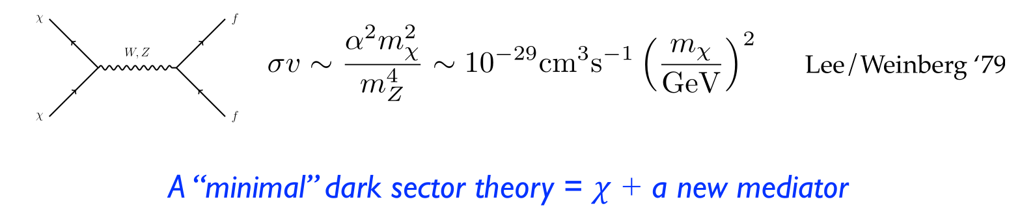
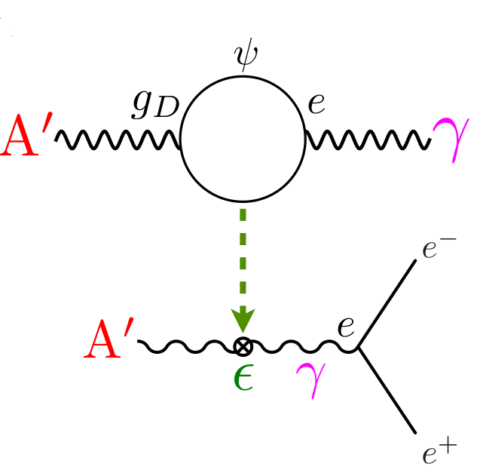
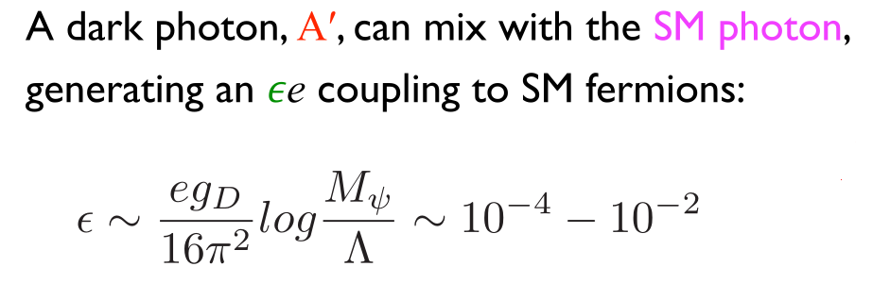
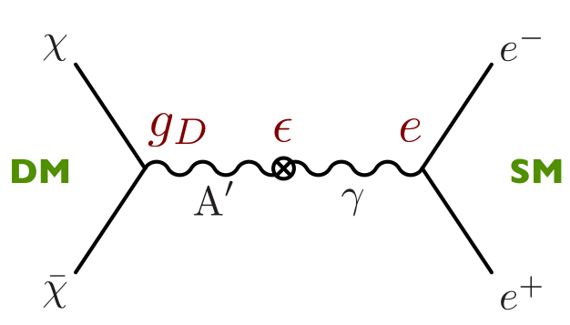

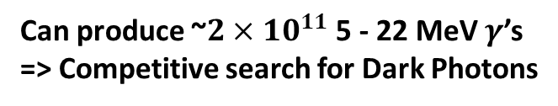

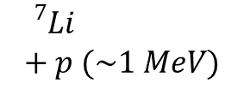
Particle Physics Motivation – “Dark Sector”
Dark Matter => New Physics
MeV-GeV thermal relic DM requires new, comparably light mediators to achieve required annihilation cross-section for Thermal freeze-out.
Lee & Weinberg 77
A’
ε.q
$$∝ε^{2}$$
$${}_{}^{7}{Li}+p (\sim 1 MeV)$$
A’
e⁺
ε.e
~18.5 MeV
e⁻
$${}_{}^{8}{Be}$$
(Tim Nelson, SLACMass, Feb 2020)
Can produce ~$2×{10}^{11}$ 5 - 22 MeV $γ$’s
=> Competitive search for Dark Photons

Slide 5
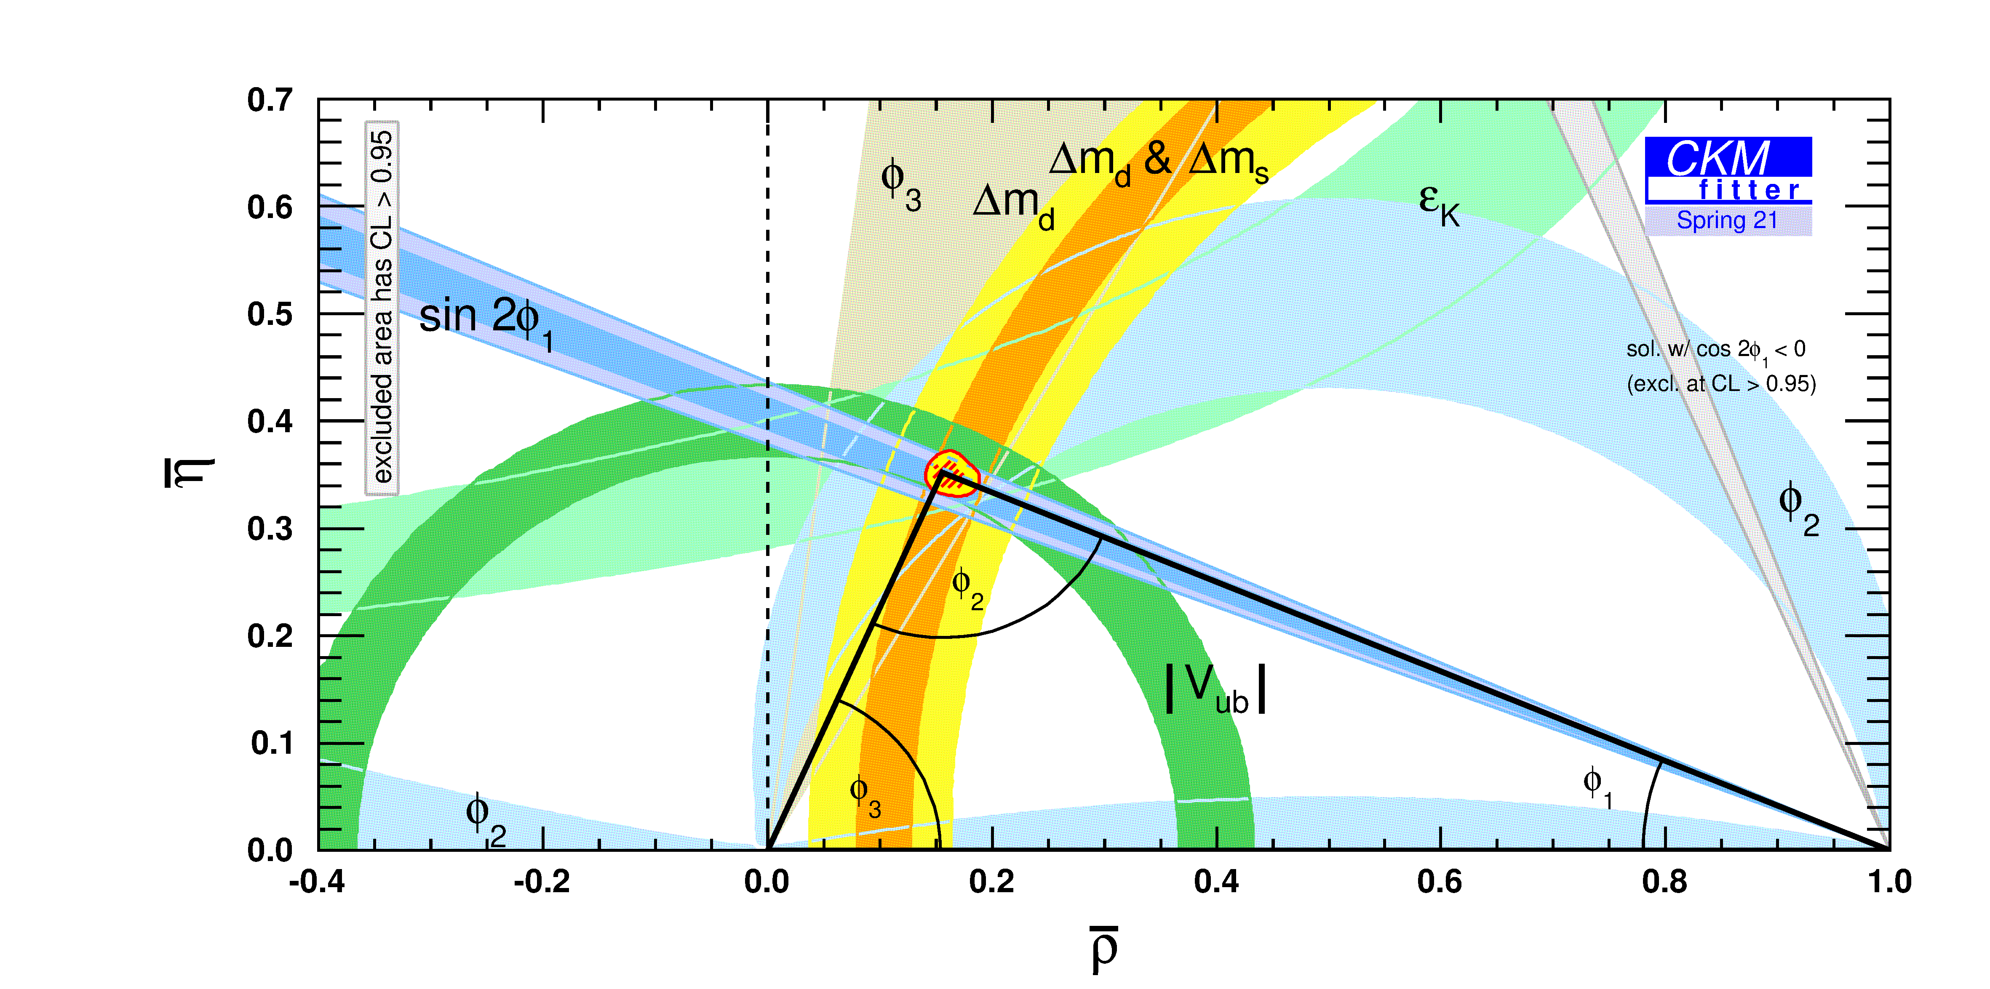
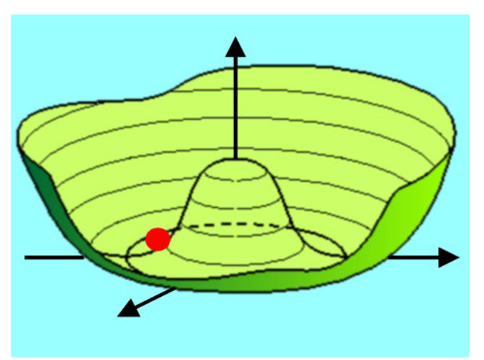
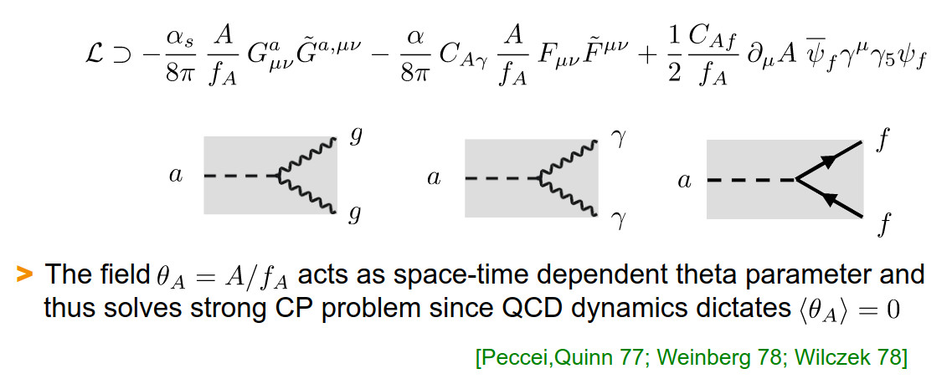
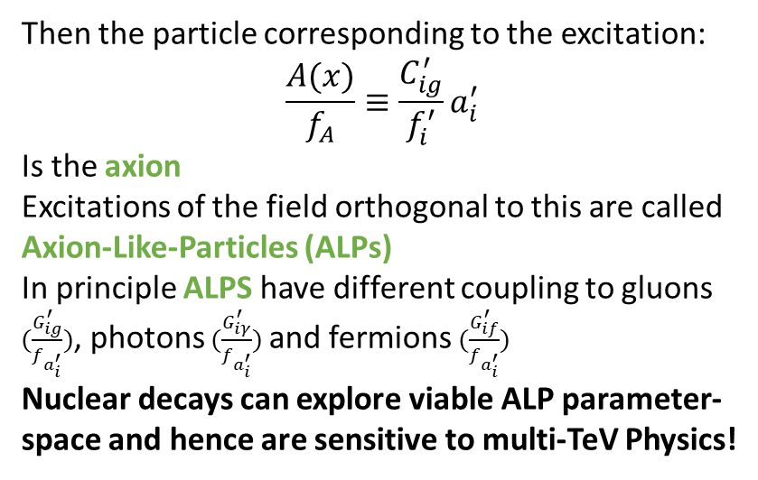
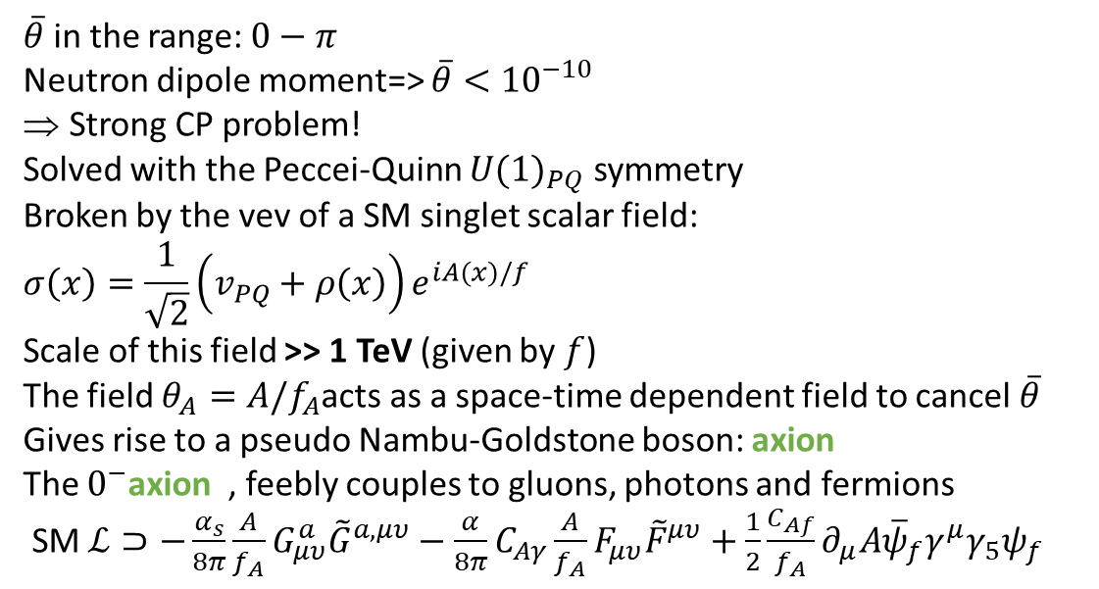


Axion Like Particles (ALPs)
Axion Like Particles (ALPs) arise from additional global symmetries:
Global lepton number symmetry: Majoron
[Chikashige et al. 78; Gelmini &Roncadelli 81]
Global family symmetry: Familon
[Wiczek 82; Berezhiani & Kholpov 90]
Quantum Gravity
[Bauer, Neubert, Renner, Schnubel, Thamm 22]
QCD $ℒ$ has a CP-violating angle similar to the CKM matrix
$$ℒ⊂\overline{θ}\frac{α_{s}}{8π}G_{a}^{μυ}{\tilde{G}}_{a,μυ}$$
$\overline{θ}$ in the range: $0−π$
Neutron dipole moment=> $\overline{θ}<{10}^{−10}$
Strong CP problem!
Solved with the Peccei-Quinn ${U(1)}_{PQ}$ symmetry
Broken by the vev of a SM singlet scalar field:
$$σ\left(x\right)=\frac{1}{\sqrt{2}}\left(v_{PQ}+ρ\left(x\right)\right)e^{iA(x)/f}$$
Scale of this field >> 1 TeV (given by $f$)
The field $θ_{A}=A/f_{A}$acts as a space-time dependent field to cancel $\overline{θ}$
Gives rise to a pseudo Nambu-Goldstone boson: axion
The $0^{−}$axion , feebly couples to gluons, photons and fermions
SM $ℒ⊃−\frac{α_{s}}{8π}\frac{A}{f_{A}}G_{μυ}^{a}{\tilde{G}}^{a,μυ}−$ $\frac{α}{8π}C_{Aγ}\frac{A}{f_{A}}F_{μυ}^{}{\tilde{F}}^{μυ}+\frac{1}{2}\frac{C_{Af}}{f_{A}}∂_{μ}A{\overline{ψ}}_{f}γ^{μ}γ_{5}ψ_{f}$
$ℒ⊃−\frac{α_{s}}{8π}\frac{G_{ig}^{′}}{f_{a_{i}^{′}}}{a_{i}^{′}G}_{μυ}^{b}{\tilde{G}}^{b,μυ}−$ $\frac{α}{8π}\frac{G_{iγ}^{′}}{f_{a_{i}^{′}}}a_{i}^{′}F_{μυ}^{}{\tilde{F}}^{μυ}+\frac{1}{2}\frac{G_{if}^{′}}{f_{a_{i}^{′}}}∂_{μ}a_{i}^{′}{\overline{ψ}}_{f}γ^{μ}γ_{5}ψ_{f}$
Then the particle corresponding to the excitation:
$$\frac{A(x)}{f_{A}}≡\frac{C_{ig}^{′}}{f_{i}^{′}}a_{i}^{′}$$
Is the axion
Excitations of the field orthogonal to this are called
Axion-Like-Particles (ALPs)
In principle ALPS have different coupling to gluons $(\frac{G_{ig}^{′}}{f_{a_{i}^{′}}})$, photons $(\frac{G_{iγ}^{′}}{f_{a_{i}^{′}}})$and fermions $(\frac{G_{if}^{′}}{f_{a_{i}^{′}}})$
Nuclear decays can explore viable ALP parameter-space and hence are sensitive to multi-TeV Physics!
[Powell 16, Ringwald 16,Peccei&Quinn77;Weinberg 78; Wiczek 78]

Slide 6
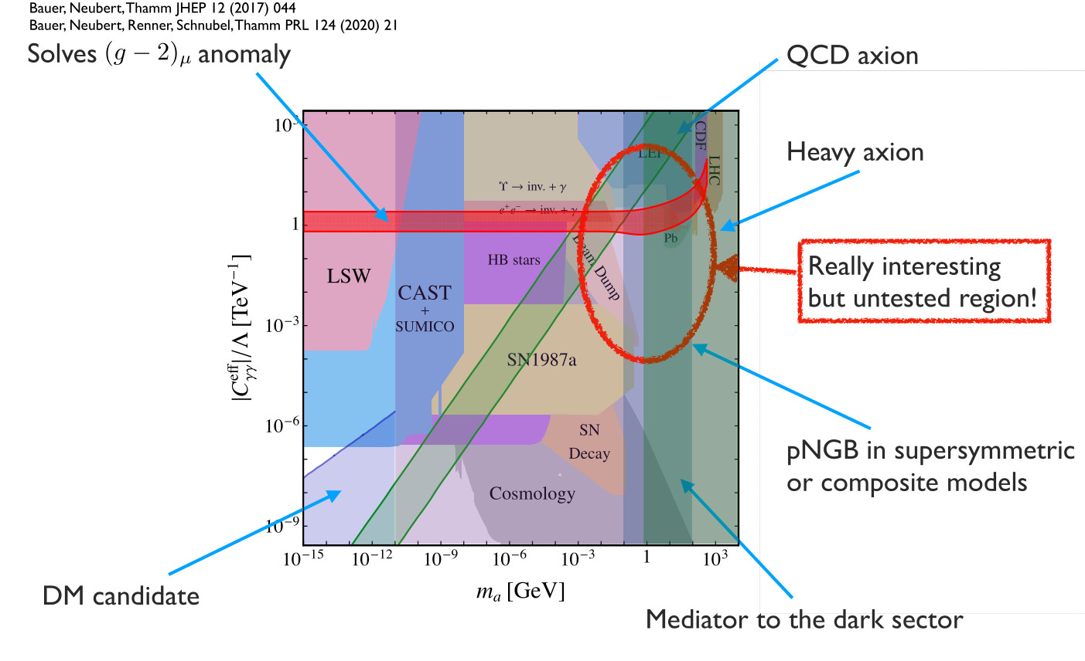
ALP mass to gamma-coupling parameter-space

Slide 7
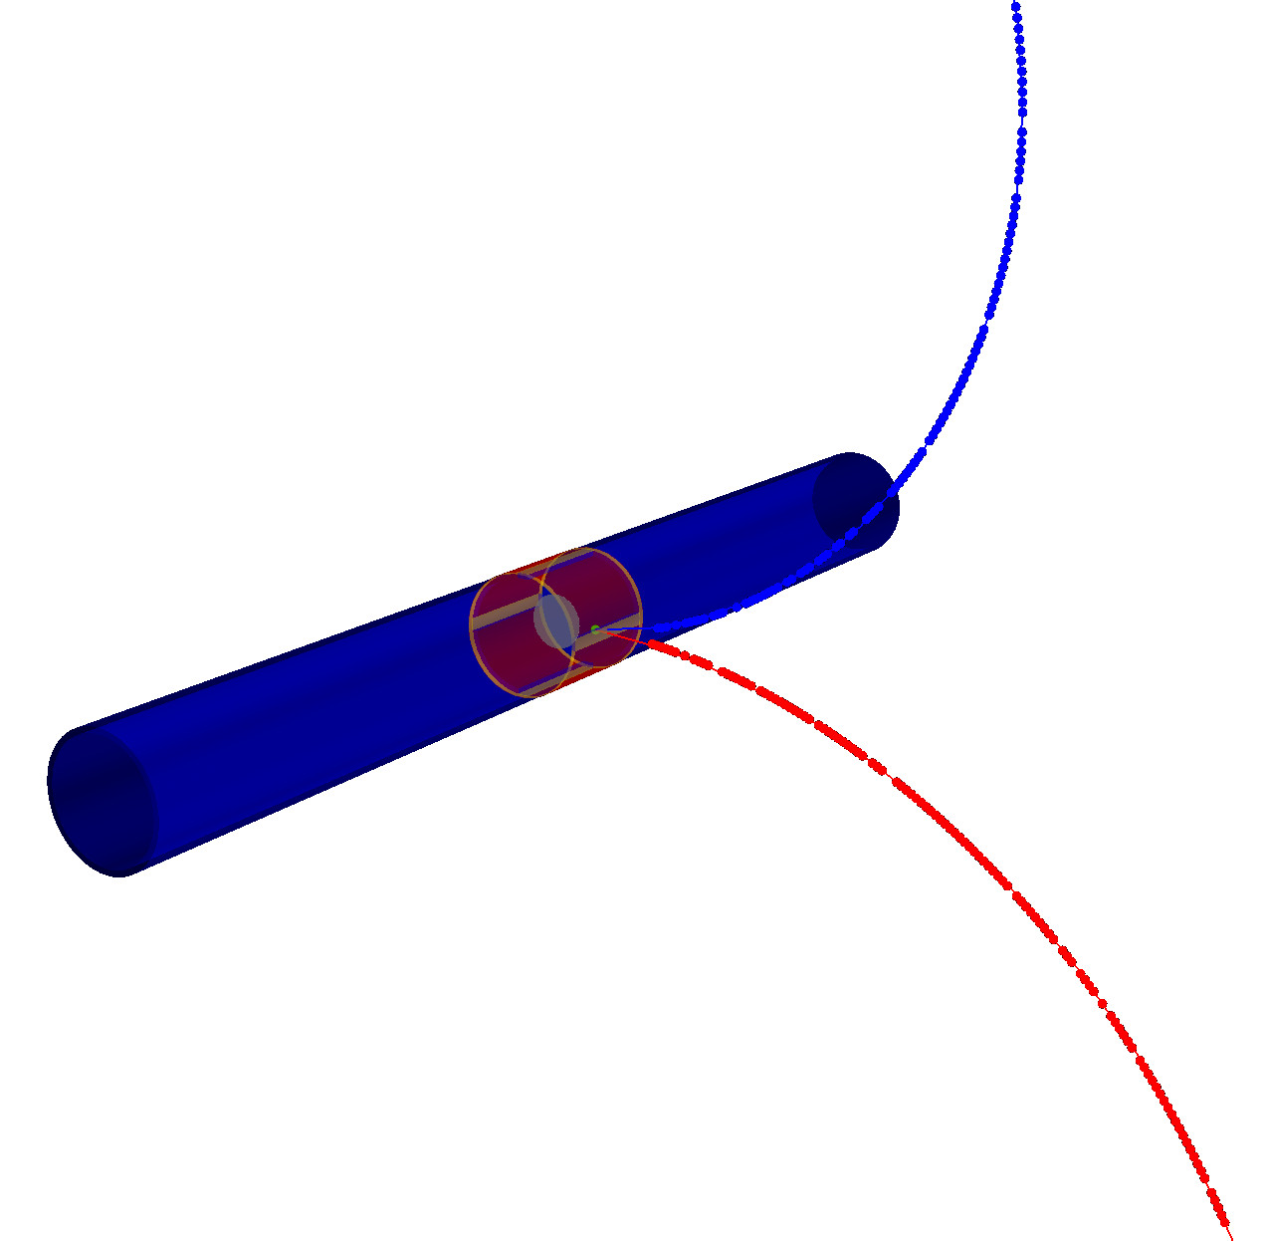
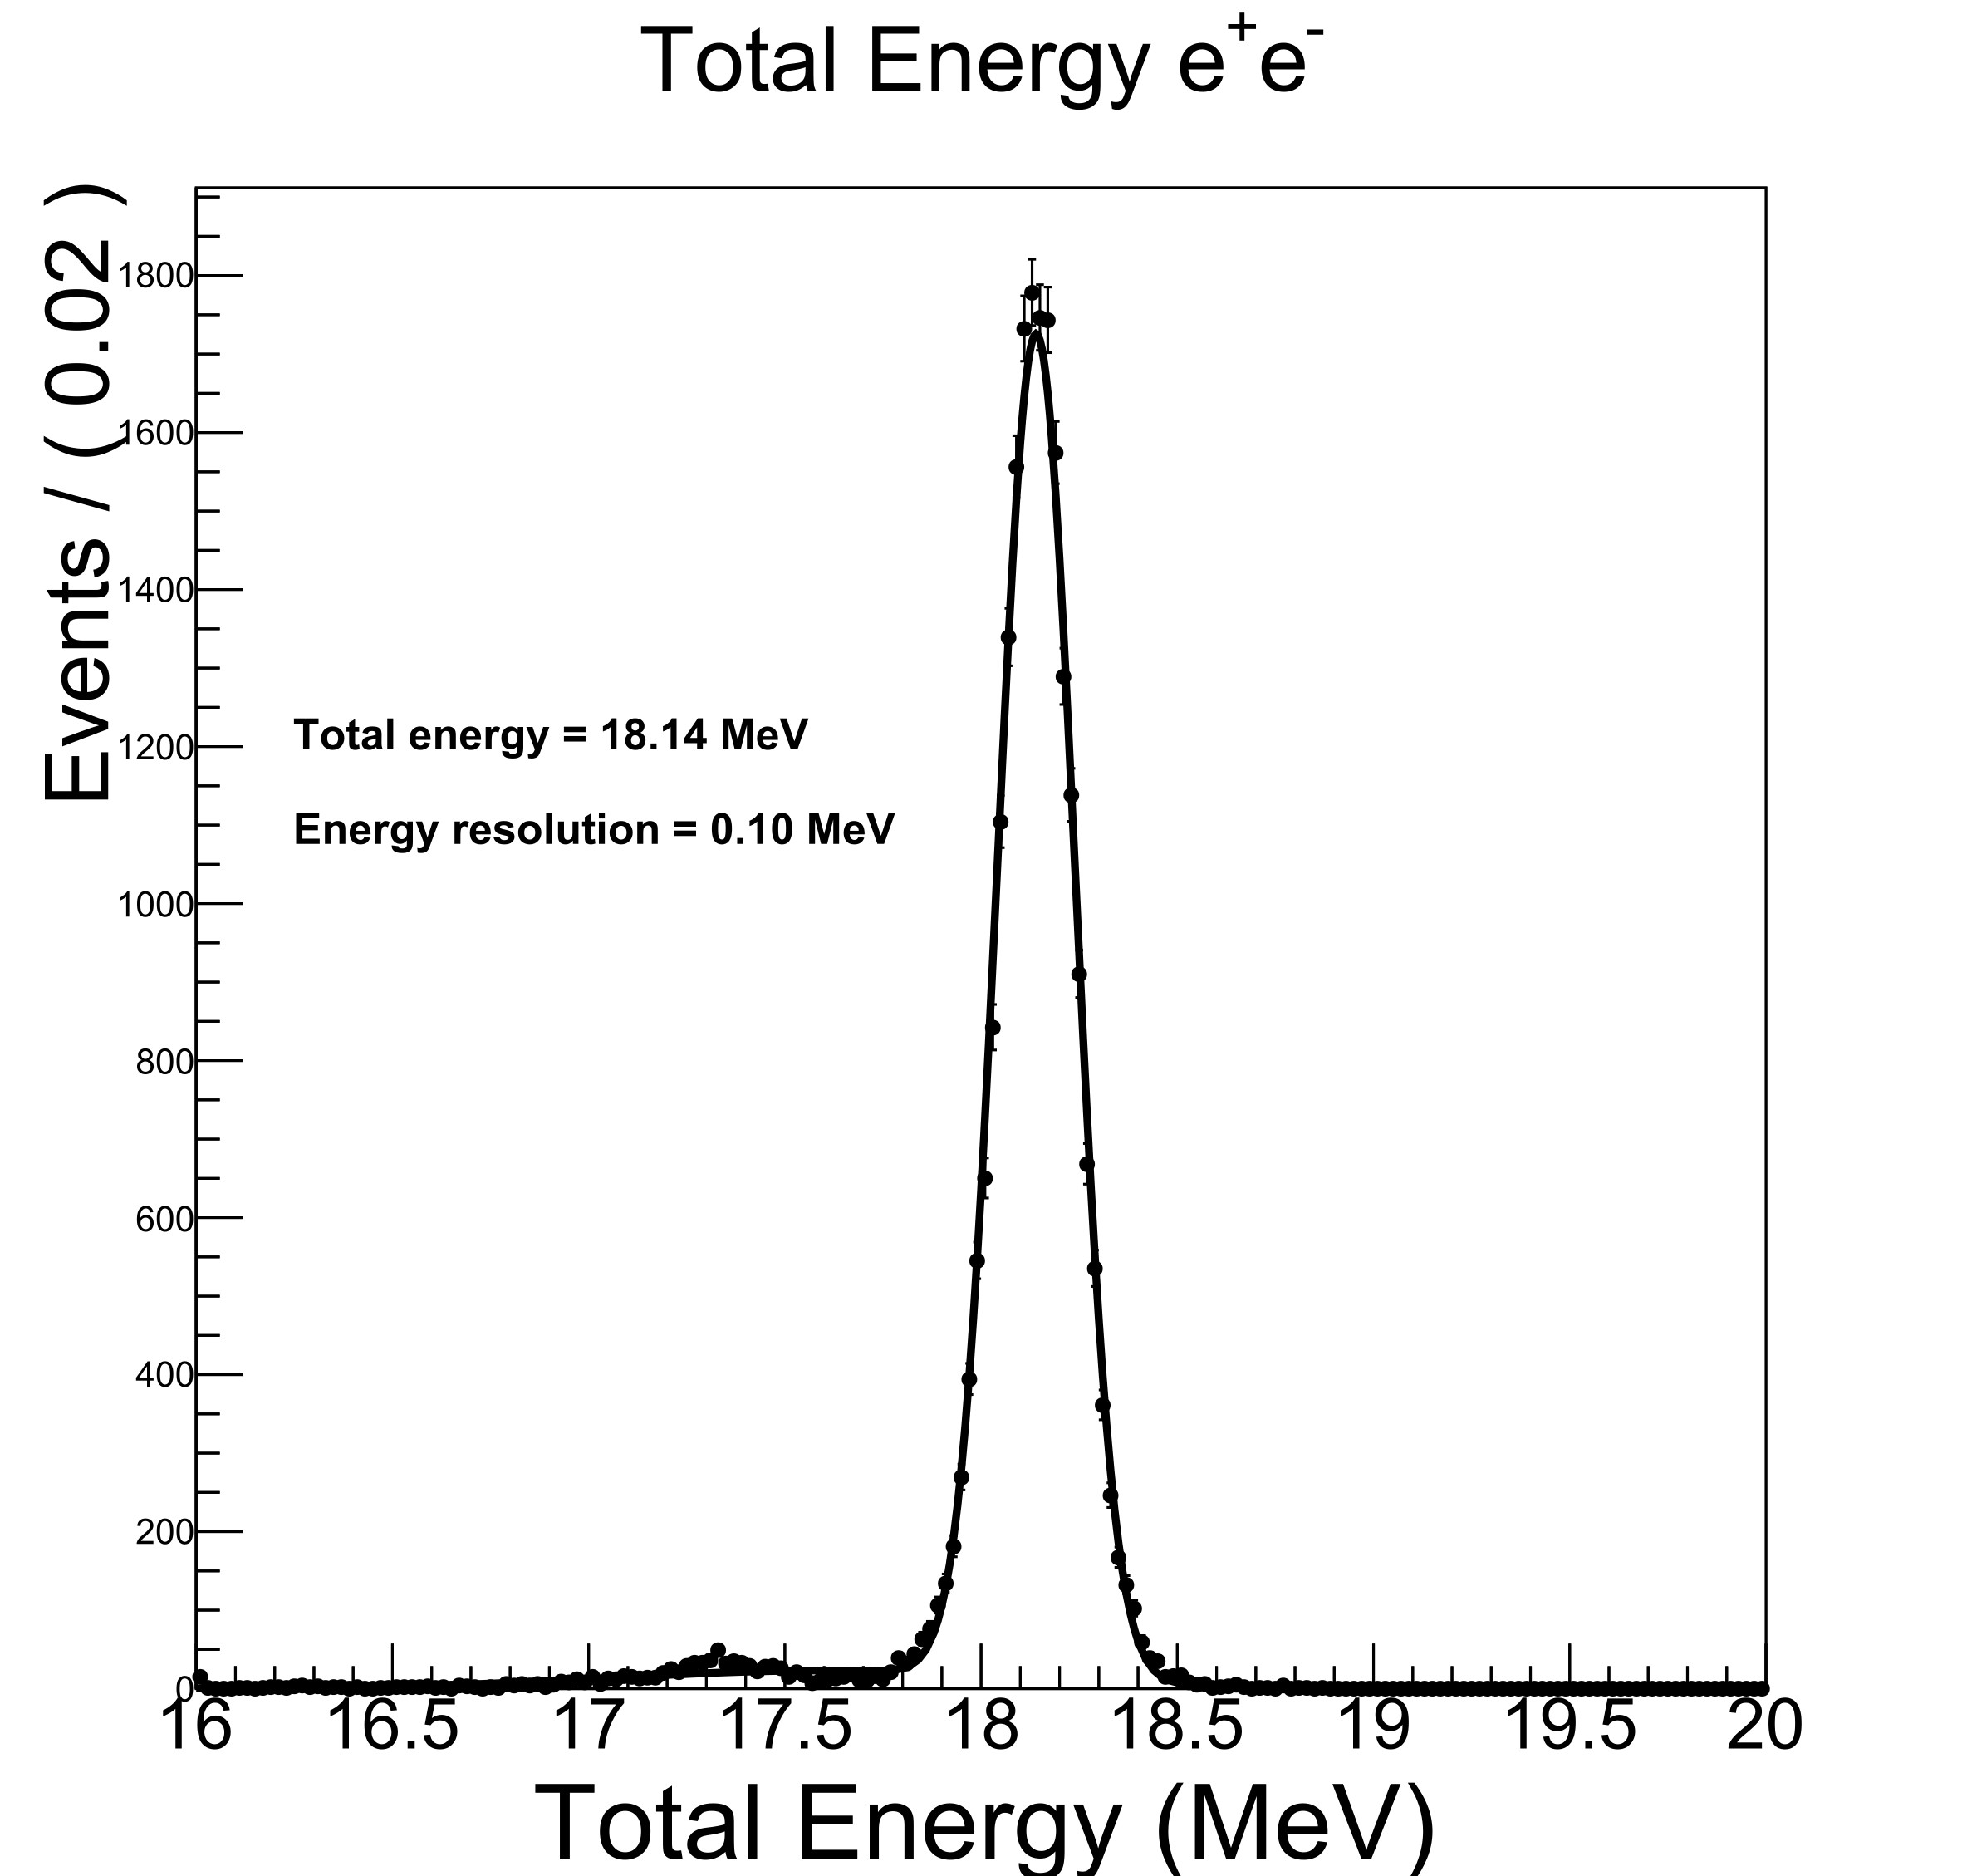

Pauli Exclusion Principle (PEP) violation
Requires “fresh” fermions. Possible in Quantum Gravity.
Tests Physics at the Planck scale.
Phys. Rev. Lett. 129, 131301 (2022)
Acta Phys.Polon.Supp. 17 (2024) 1, 1-A6
External gamma conversion
~ 5% efficiency in TPC
$${}_{}^{12}C$$
Incident Proton
~2 MeV
~20 MeV Gamma
PEP excluded state

Slide 8
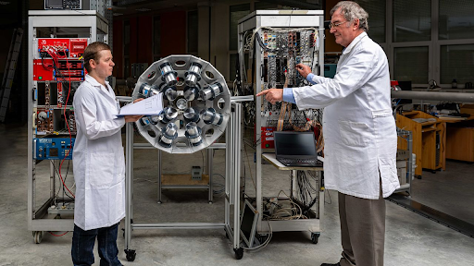
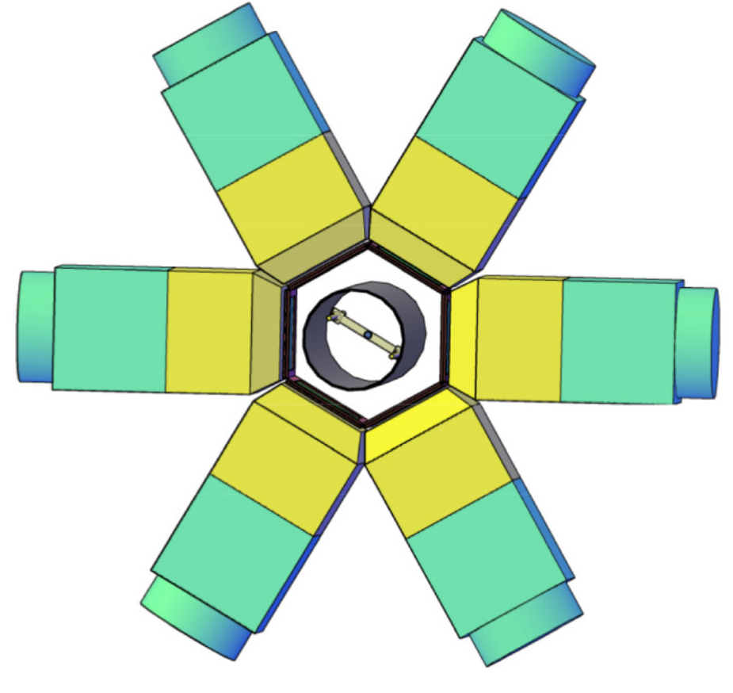
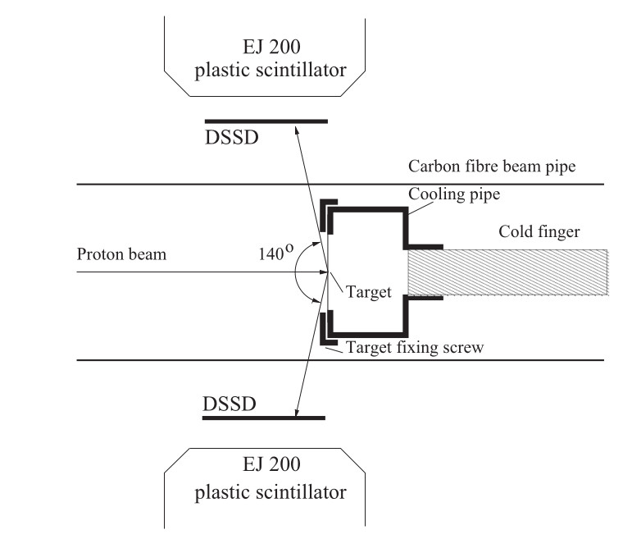
Particle Physics Motivation - Experiment
Well motivated theories for the existence of feebly interacting fundamental boson at the MeV scale.
ATOMKI group have found evidence for this at ~17 MeV invariant mass, the “X17”

Slide 9

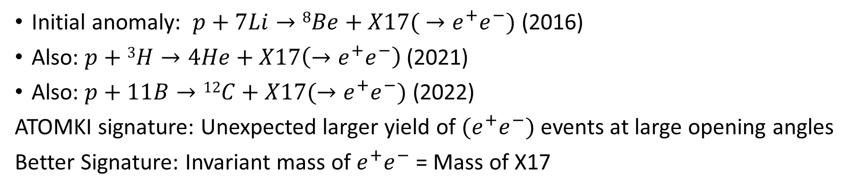

X17
Initial anomaly: $p+7Li→8Be+X17( →e^{+}e^{−})$ (2016)
Also: $p+$ $3H→4He+X17\left(→e^{+}e^{−}\right)$ (2021)
Also: $p+11B→12C+X17(→e^{+}e^{−})$ (2022)
ATOMKI signature: Unexpected larger yield of $(e^{+}e^{−})$ events at large opening angles
Better Signature: Invariant mass of $e^{+}e^{−}$ = Mass of X17
An opportunity to do fundamental Physics research on the Pelletron
$${}_{}^{7}{Li}+p (\sim 1 MeV)$$
~18.5 MeV
17 MeV (X17)
$${}_{}^{8}{Be}$$

Slide 10

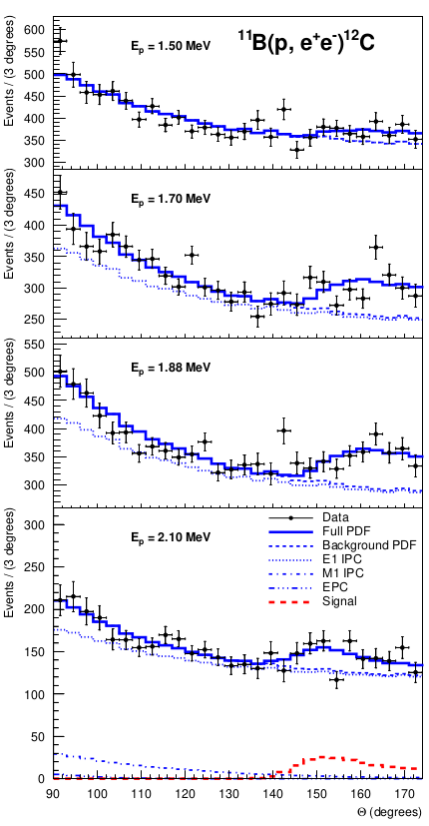
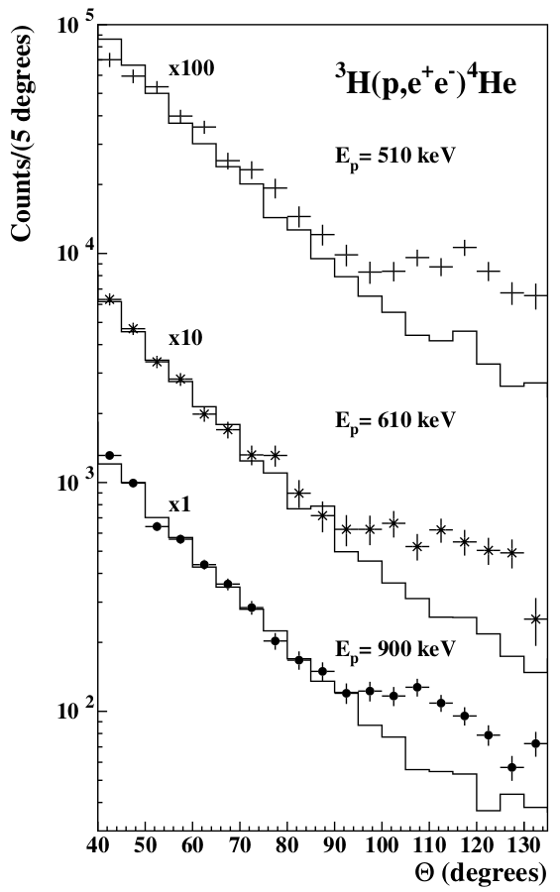
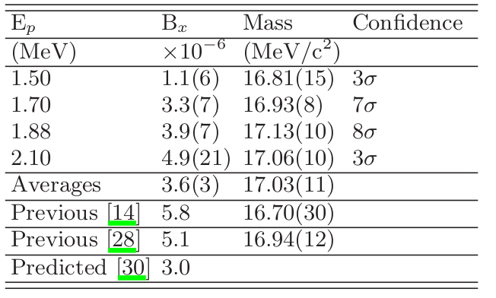
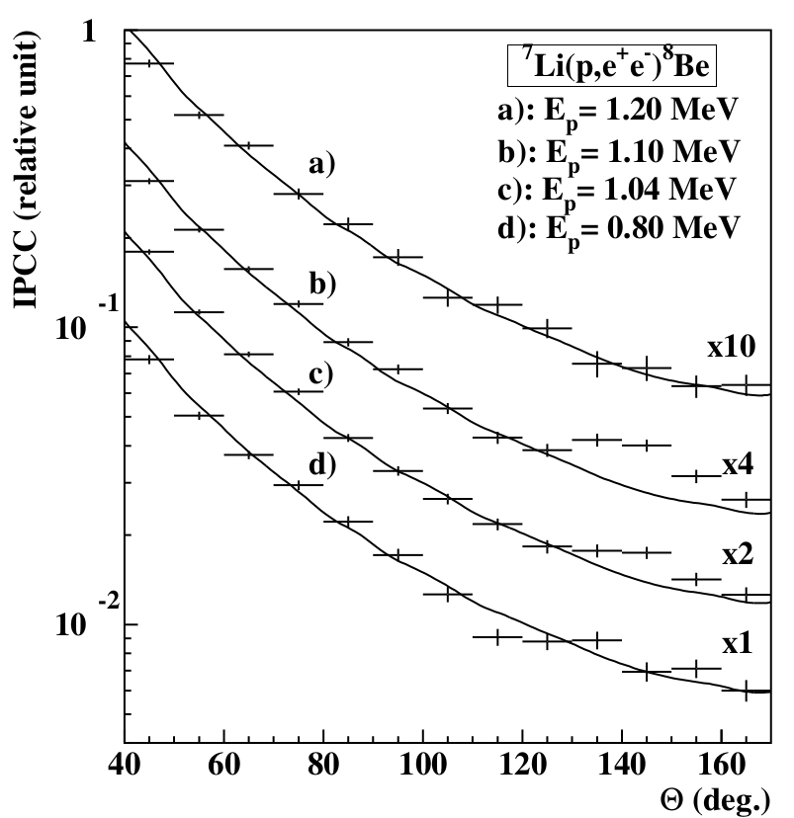
X17 particle
detectors
2016 observation¹
p + ⁷Li→⁸Be + e⁺e⁻
2021²: p + ³H→⁴He + e⁺e⁻
2022³: p + ¹¹B→¹²C + e⁺e⁻
e⁺e⁻ pairs
Θ
Nuclear
target
proton beam
1: arxiv 1504.01527, ,(PRL 116, 04215, (2016))
2: arxiv 2104.10075, (PRC 104,044003, (2021))
3: arxiv 2209.10795, (PRC 106, L061601 (2022))

Slide 11
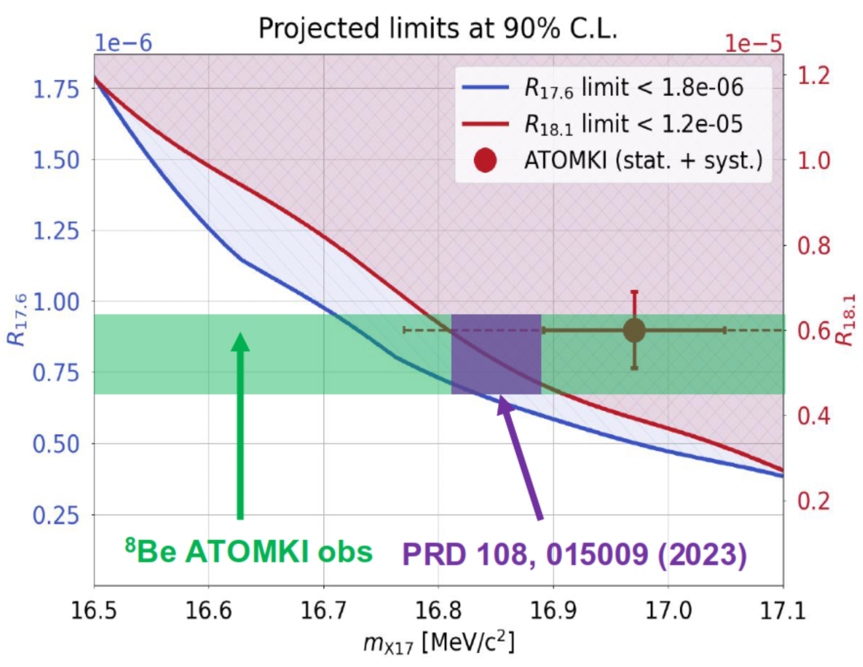
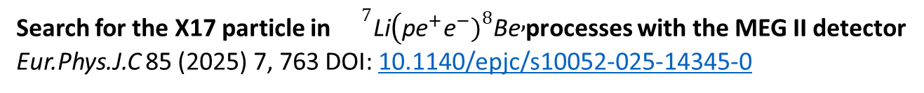
Recent Results -MEG-II
Search for the X17 particle in ${}^{7}\text{Li}(\text{p}{\text{e}}^{+}{\text{e}}^{−}{\left.)\right.}^{8}\text{Be},$processes with the MEG II detector
Eur.Phys.J.C 85 (2025) 7, 763 DOI: 10.1140/epjc/s10052-025-14345-0
Measurement on Li7 target to reproduce Be8 ATOMKI result, no signal found
ULs on BR(⁸Be*→ ⁸Be ee, anomaly)/BR(⁸Be* → ⁸Be γ) for 17.6, 18.1 MeV transitions
The MEG-II result remains compatible
[Barducci, et al. ,HEP 04 (2025) 035] with the ATOMKI combination MX = 16.85(4) MeV
[Denton, Gehrlein PRD108, 015009 (2023)]

Slide 12
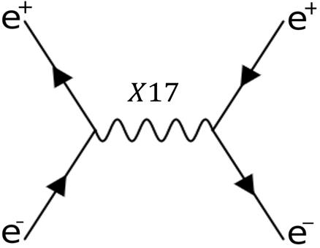
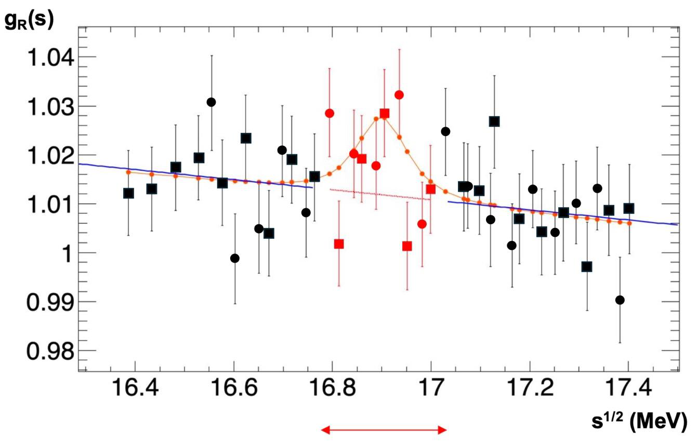
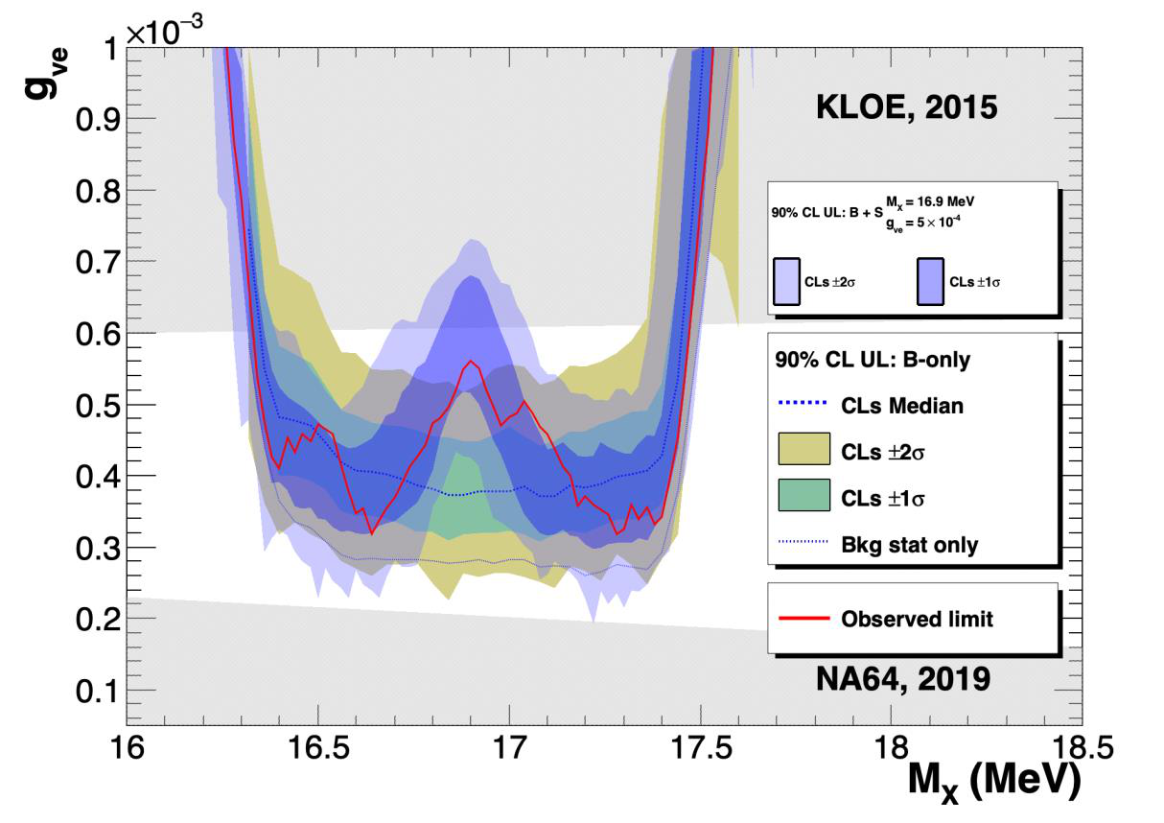
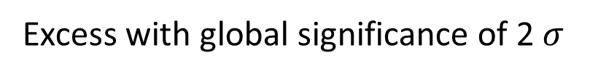
Recent Results - PADME
arxiv:2505.24979
J. High Energ. Phys. 2025, 7 (2025)
PADME Search for a resonance on a thin target
At PADME, X17 produced through resonant annihilation in thin target: Scan around E(e+) ~ 283 MeV
Excess with global significance of 2 $σ$

Slide 13
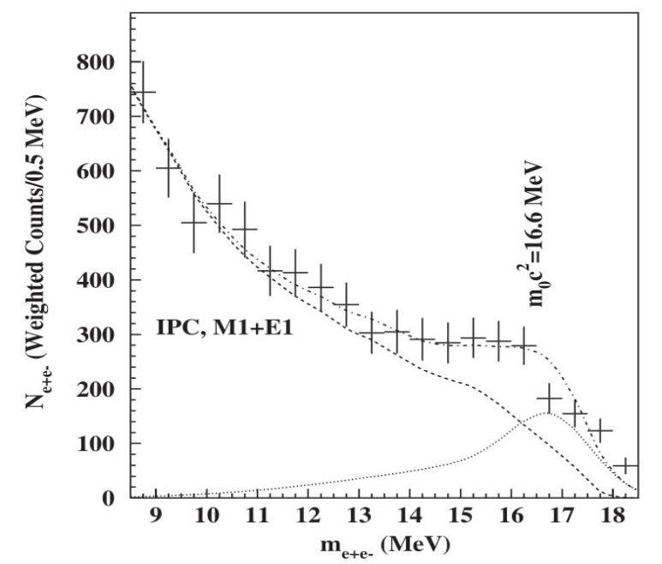
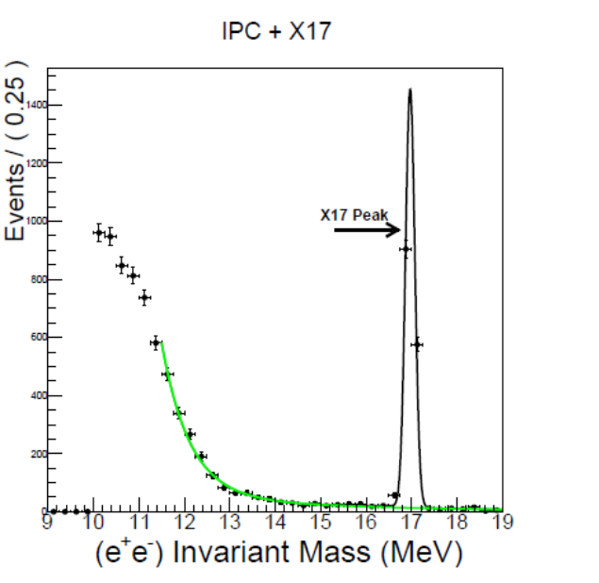
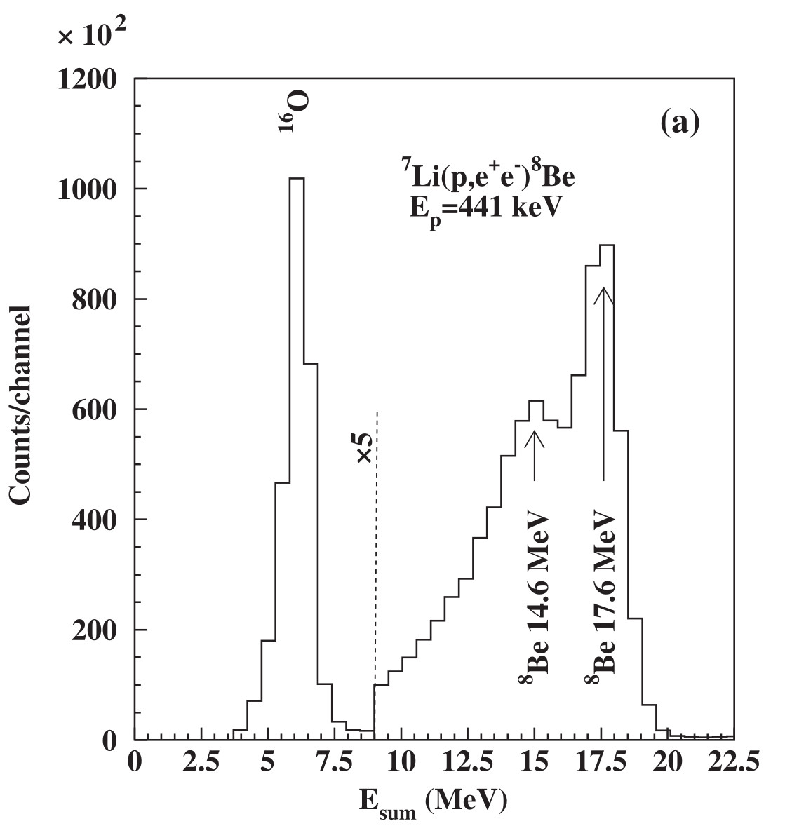
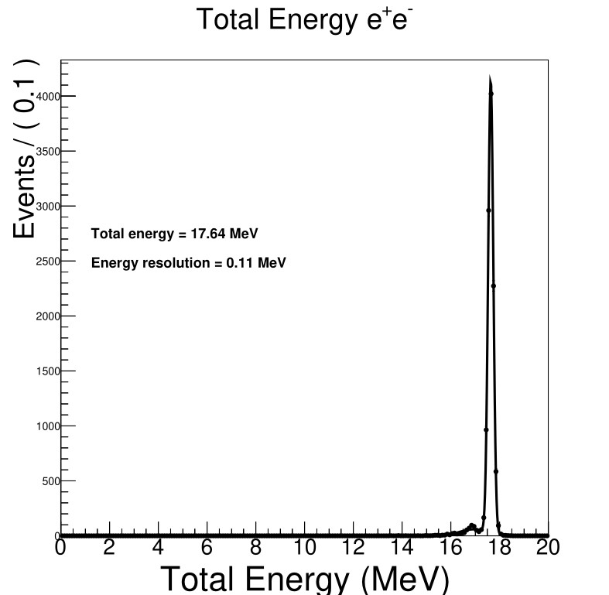



New Physics may exist at MeV- scale
Observable via “$X→e^{+}e^{−}$” using Melbourne Pelletron
We plan to build a Time Projection Chamber (TPC) and perform far higher precision experiments on the Pelletron
$e^{+}e^{−}$Invariant Mass
$e^{+}e^{−}$Invariant Mass
ATOMKI Energy Sum resolution ~1.5 MeV
TPC Energy Sum resolution 0.1 MeV
X17
Our expectation from TPC
If the X17 exists
ATOMKI X17 result
For p + ⁷Li→⁸Be + e⁺e⁻

Slide 14
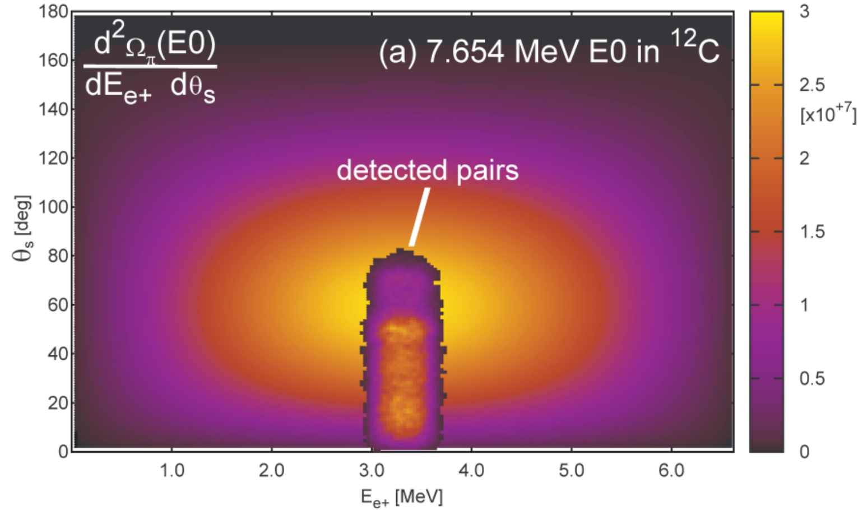
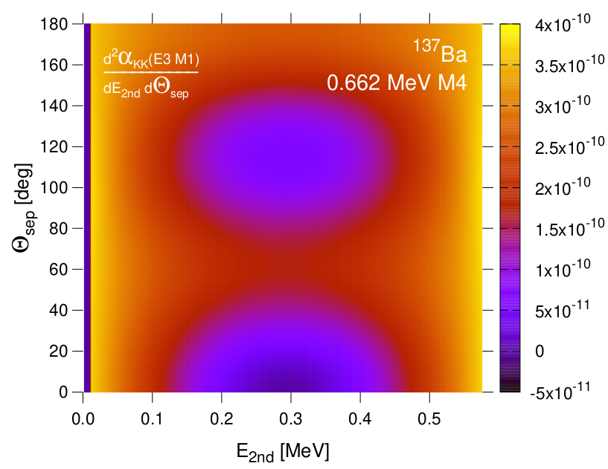
Applications in Nuclear Physics
World-first double-differential IPC cross-section measurements
e⁺e⁻ pairs
Nuclear target
proton beam
Also, large acceptance enables investigation of multi-particle final states
Unobserved 2-quantum nuclear processes¹:
Double internal pair conversion (4th order EM process e.g. ¹³⁷Ba (K-K, K-L, L-L)
Both are qualitatively new Nuclear Physics investigations
¹Waltz et al. Nature,526:406 (2015)

Slide 15
BLIMP is a Time Projection Chamber
Iron Yoke (Electromagnet)
Trigger scintillators
Proton beam
Beam Pipe
Electric Field Cage

Slide 16
Design of BLIMP
Conceptual design using EVE package in ROOT
Simulate electric fields inside the TPC and micromegas with COMSOL
Simulate Gas based detectors with HEP software GARFIELD
Simulate passage of primary electrons through TPC with Geant4
Record space-point hits with the expected resolution
Employ Genfit2 to reconstruct Particle trajectories
Employ RAVE to reconstruct interaction
Employ ROOT EVE for event display and visually validate reconstruction
Employ ROOT roofit to determine signal in the presence of background
Development of TPC and MPGD expertise at Melbourne, Adelaide and ANU

Slide 17
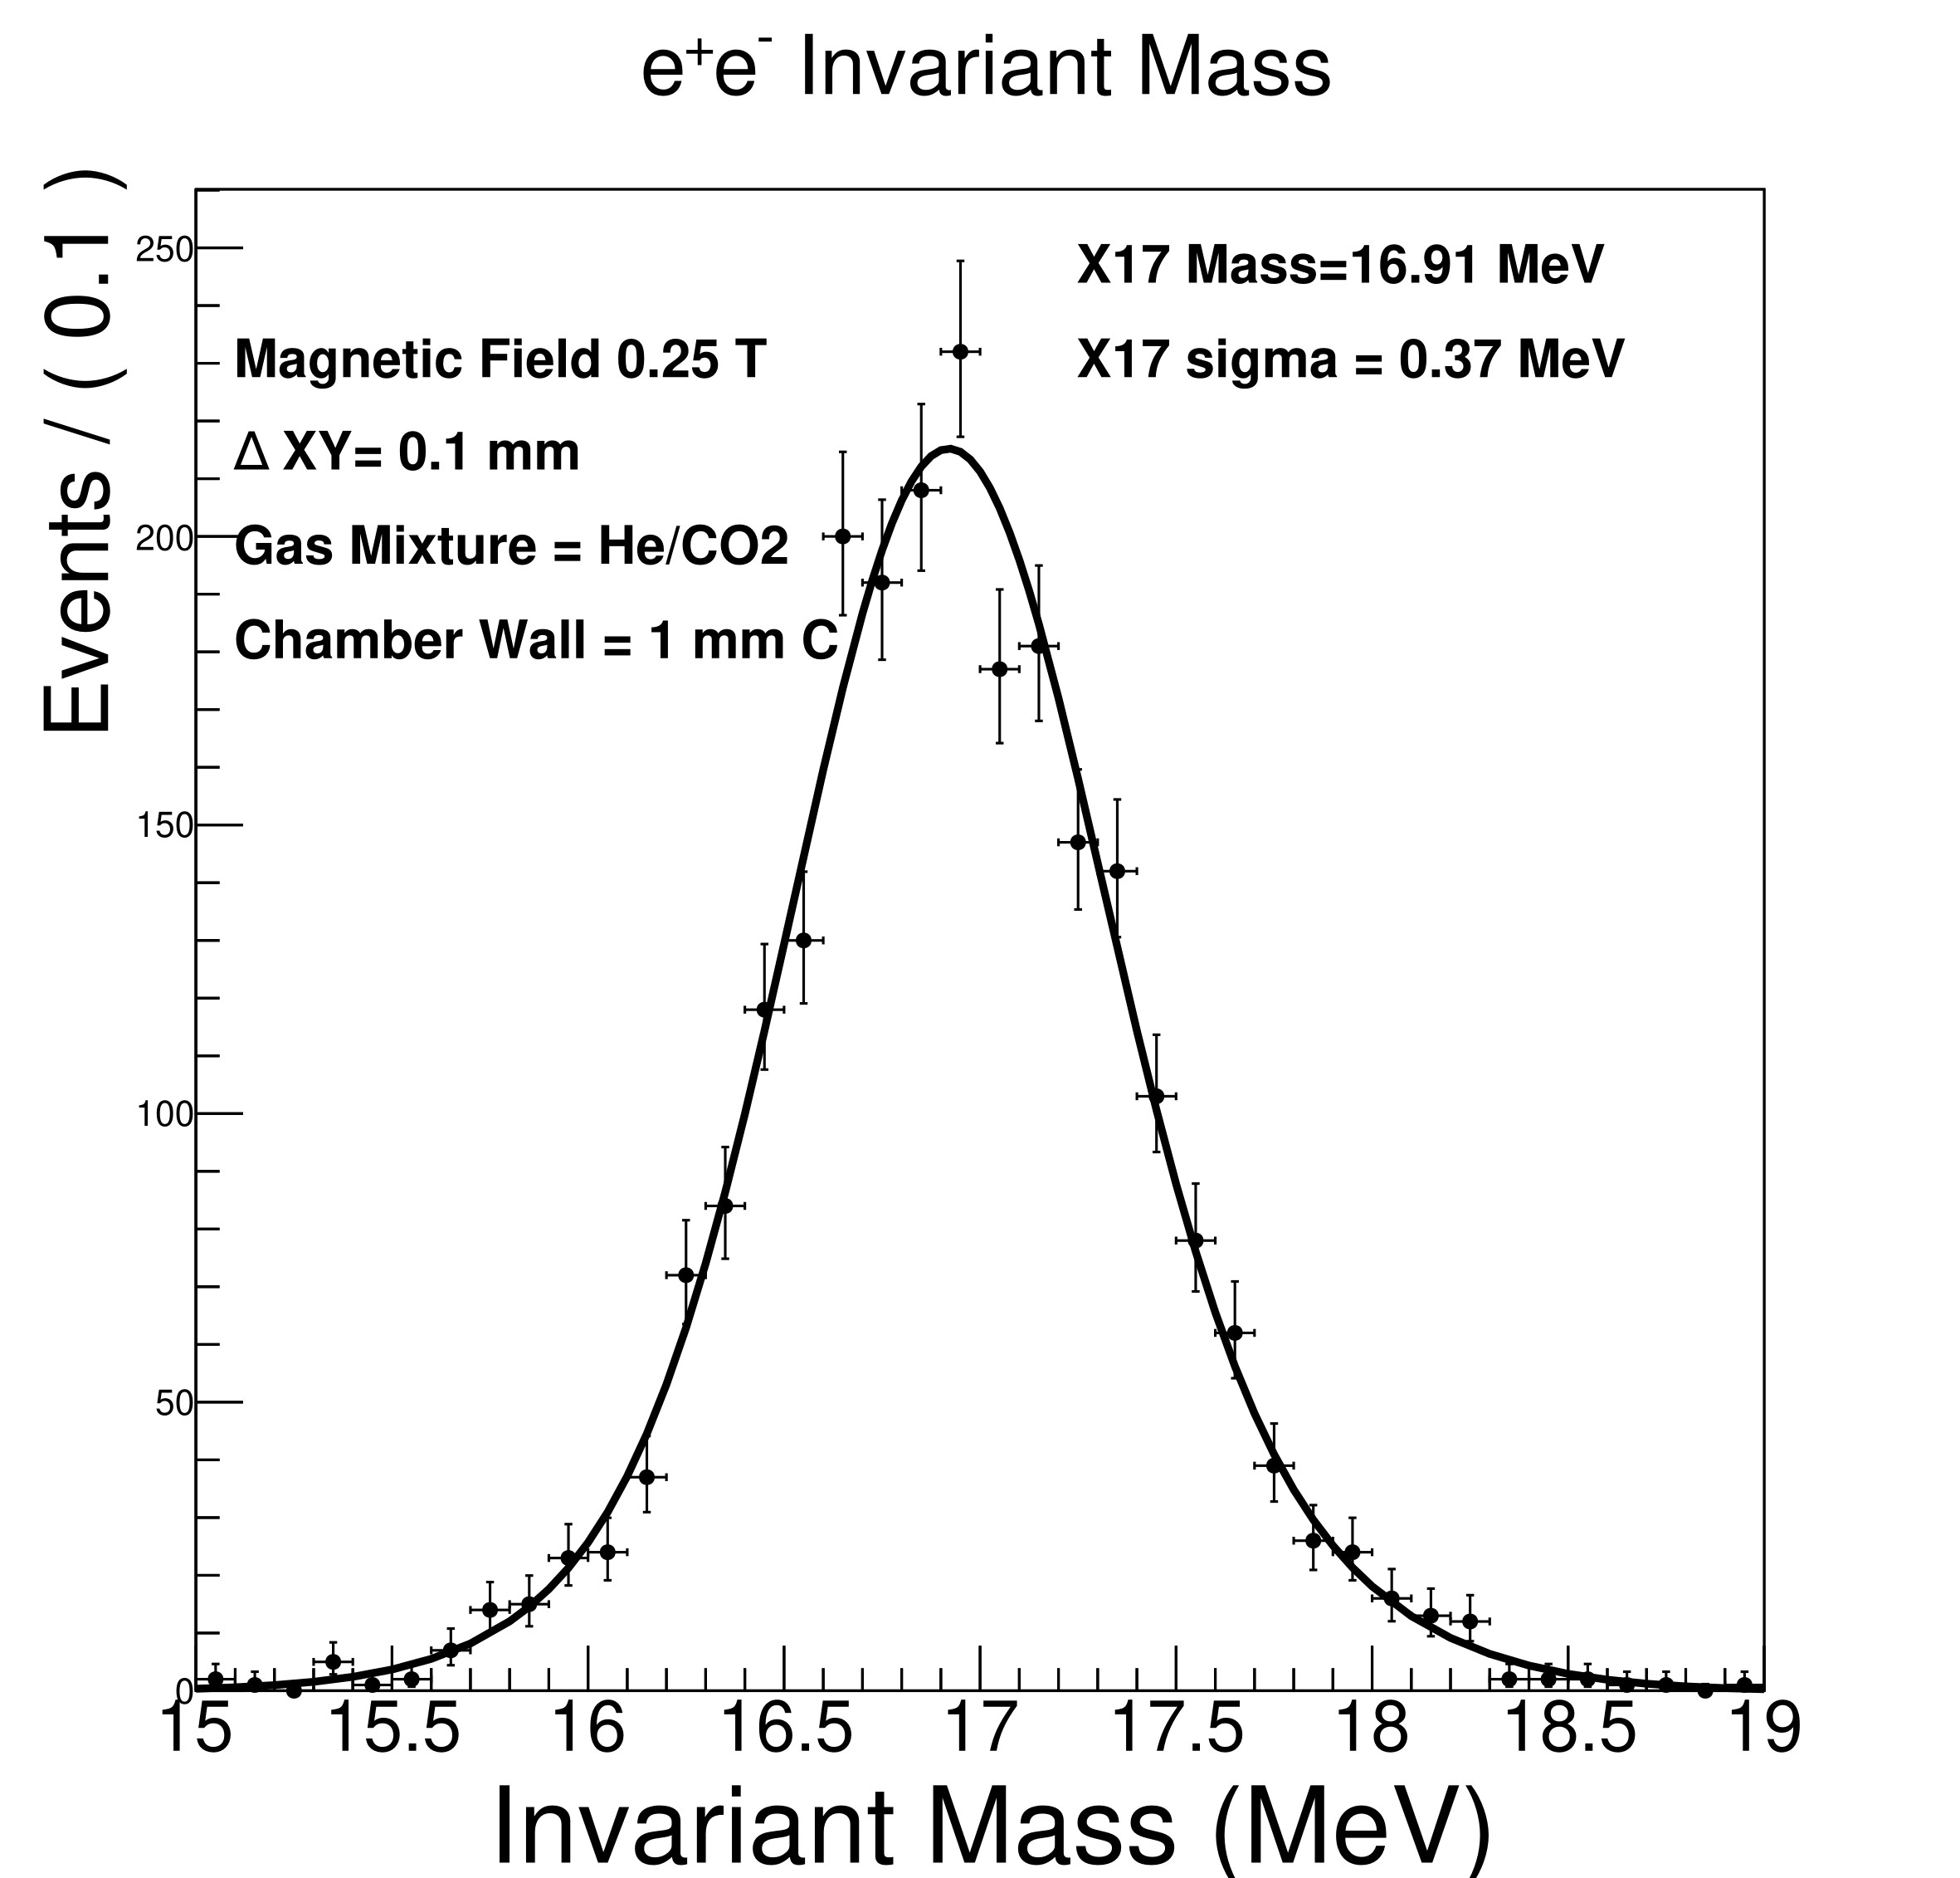
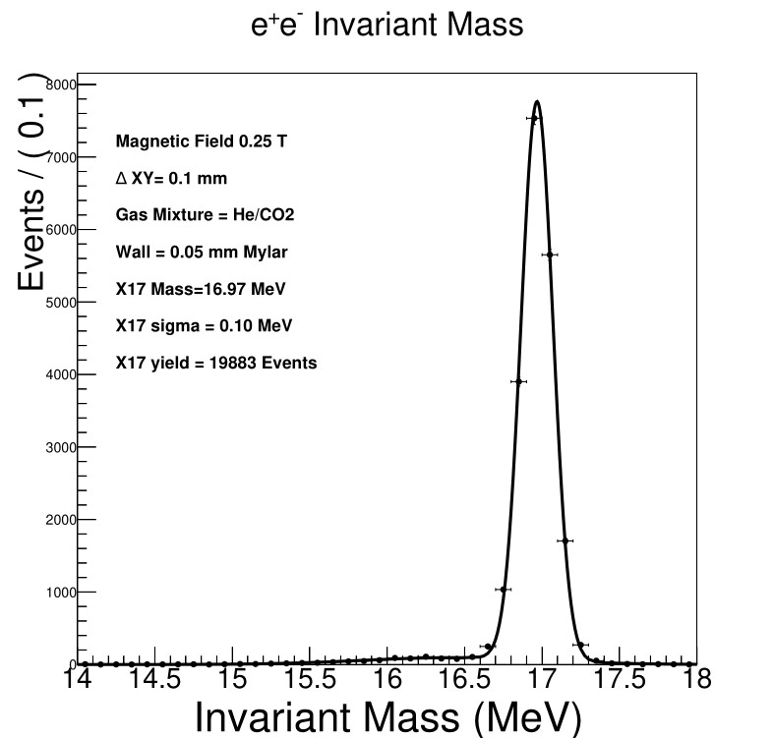
Geant4 + Genfit2 + RAVE
Made numerous simulations.
Assumed single-electron identification and 100 µm resolution in x-y, 1 mm in z
Gas 90:10 He / CO₂ + thin Target chamber => very good invariant mass resolution
σ = 0.37 MeV
Thin-walled Target Chamber is key
1 mm
Carbon
(ATOMKI)
50 µm
Mylar
σ = 0.1 MeV

Slide 18
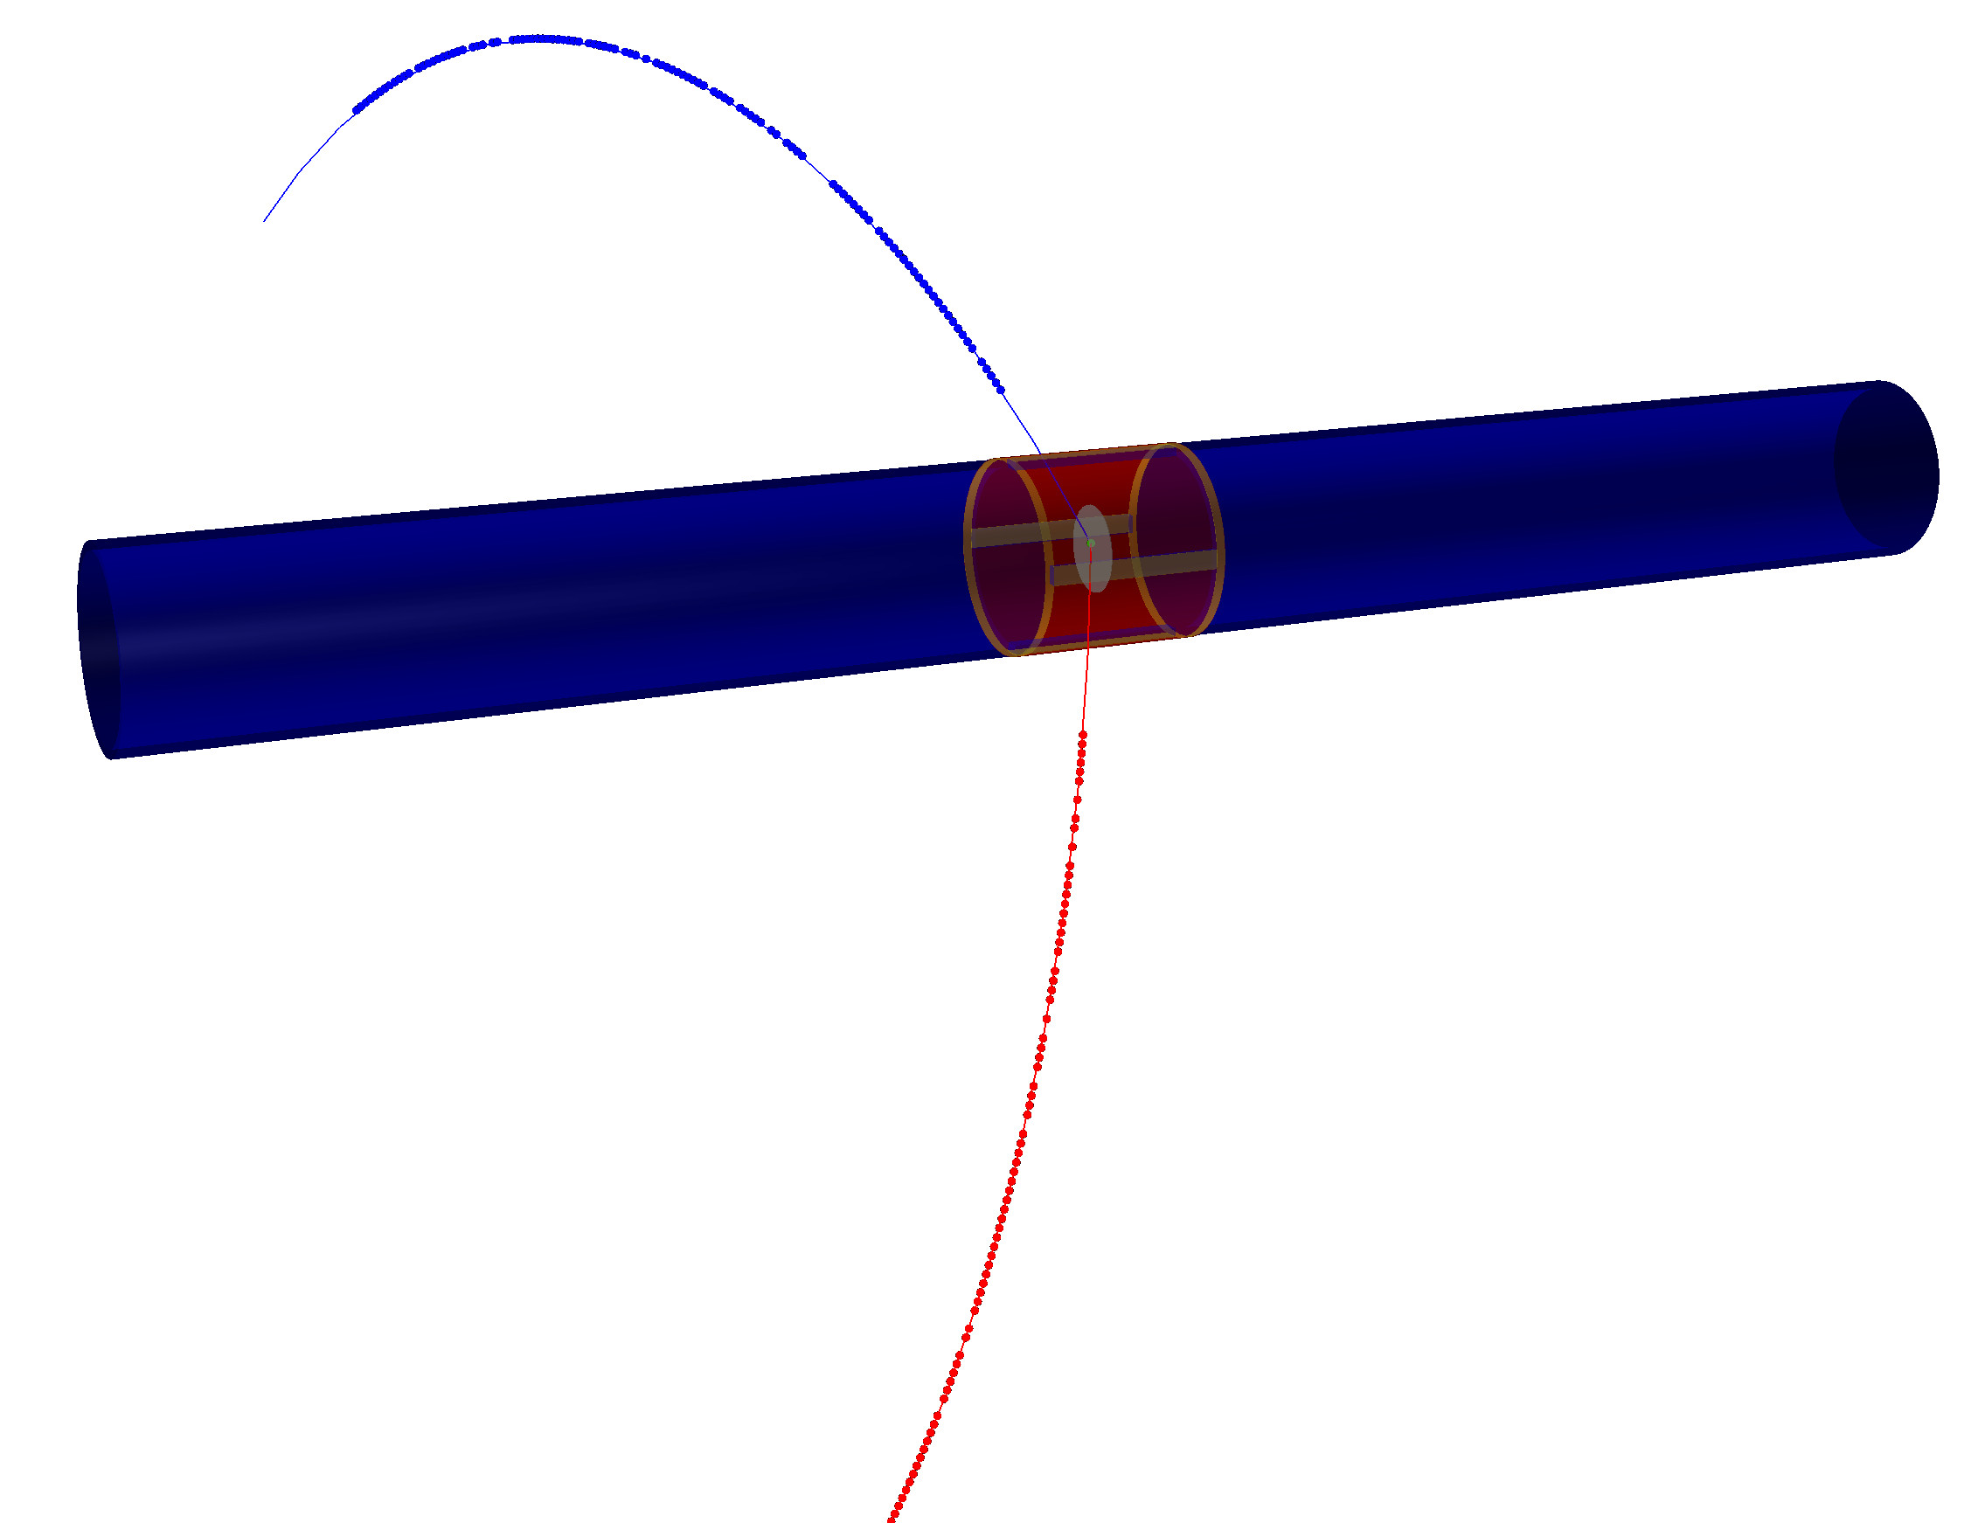
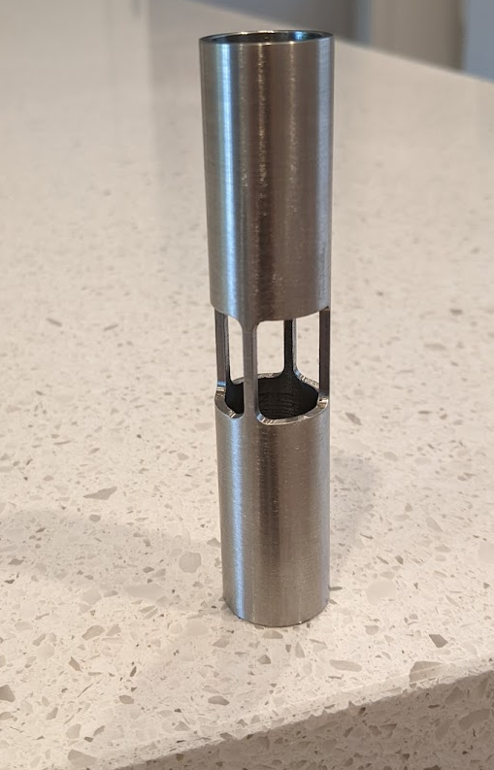
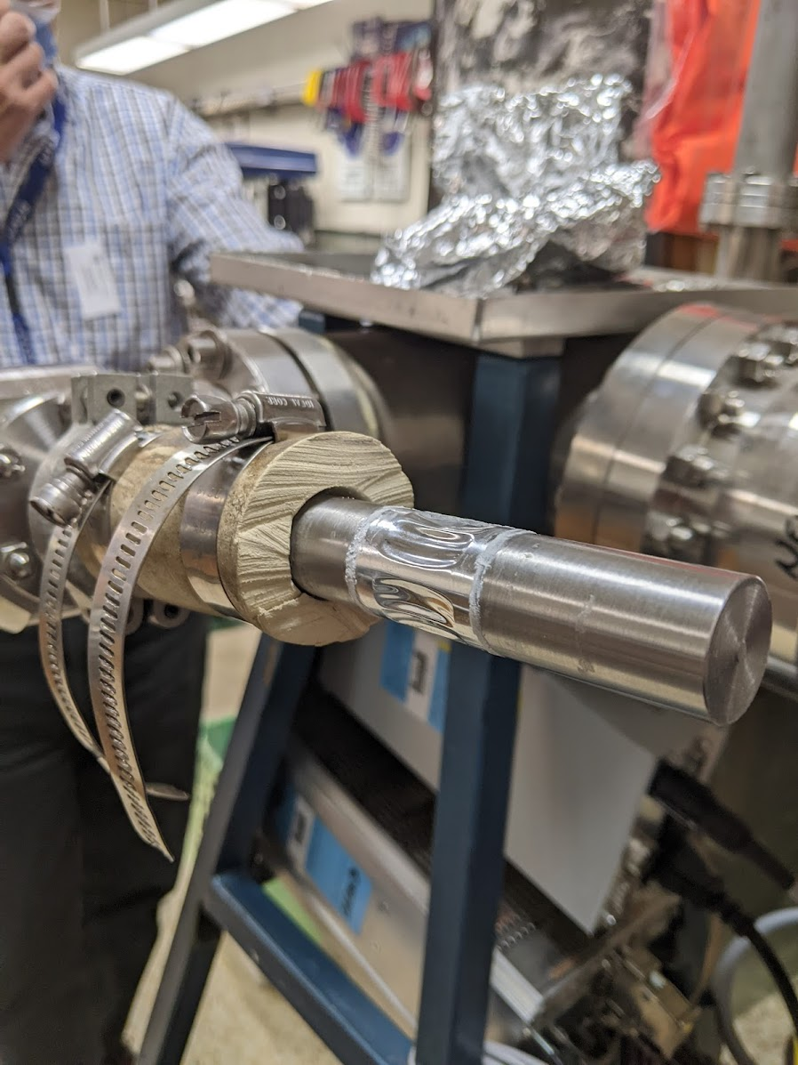
Prototype BLIMP Target Chamber
Best Invariant Mass Resolution requires very thin vacuum wall
Shear strength of Mylar foil (15 kg/mm²) implies 50 micron thick foil has a factor of 20 safety under vacuum

Slide 19
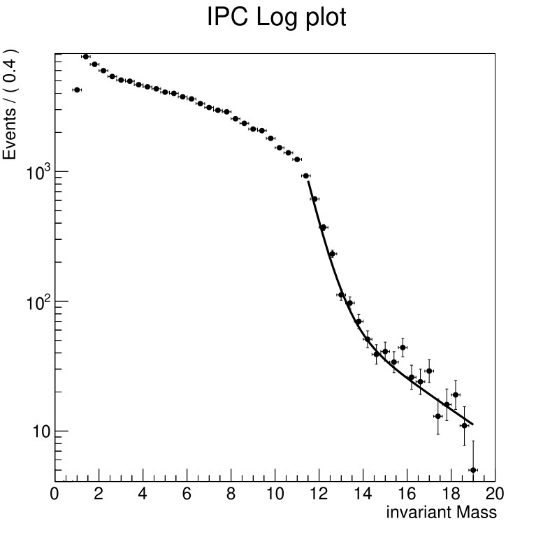
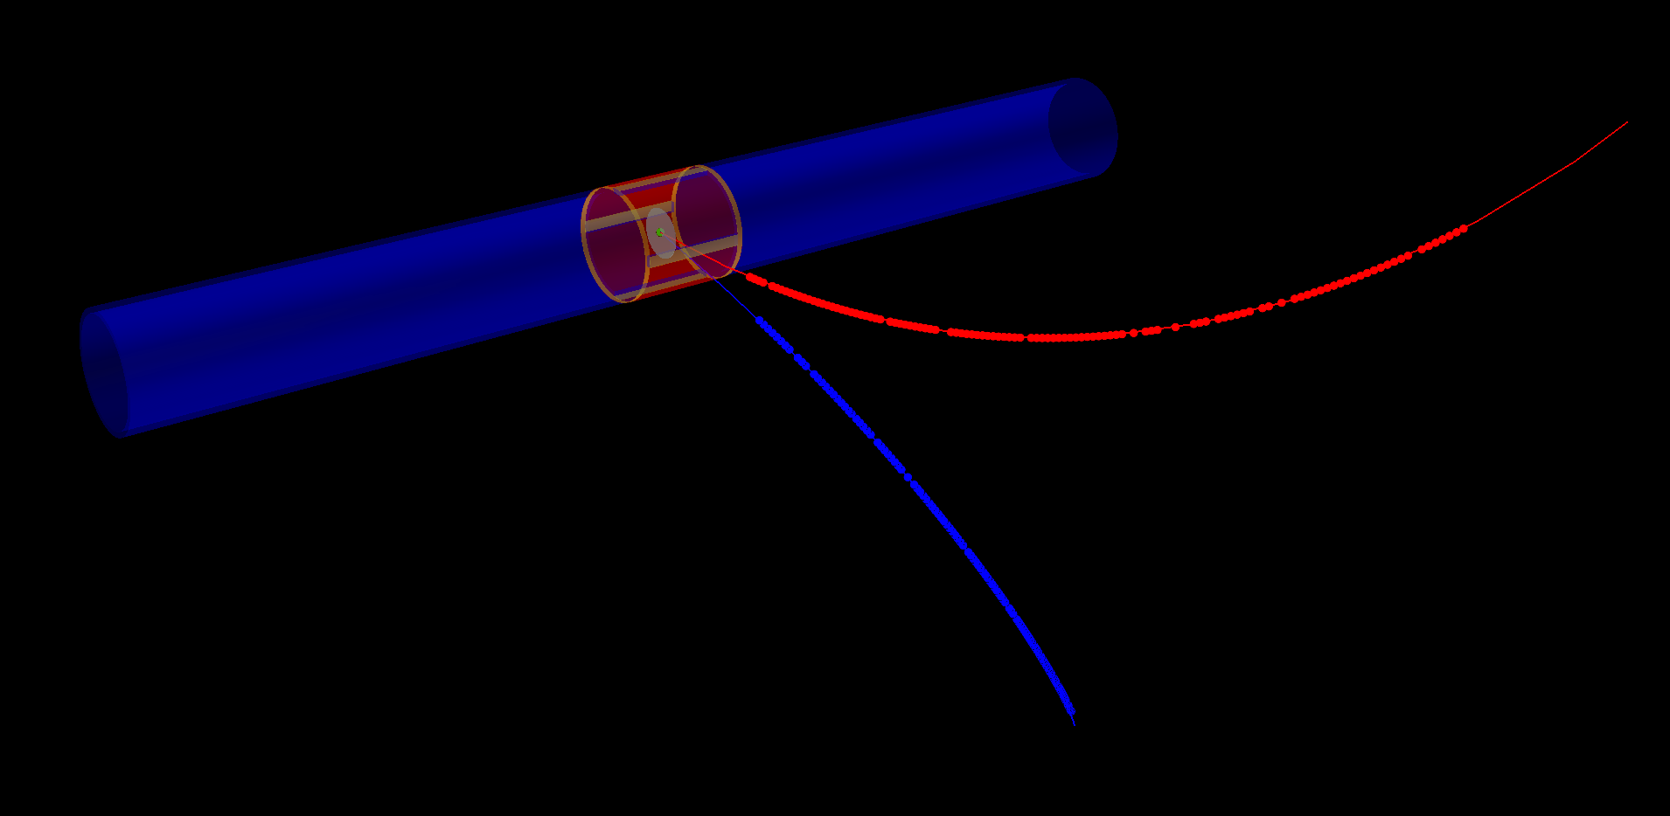
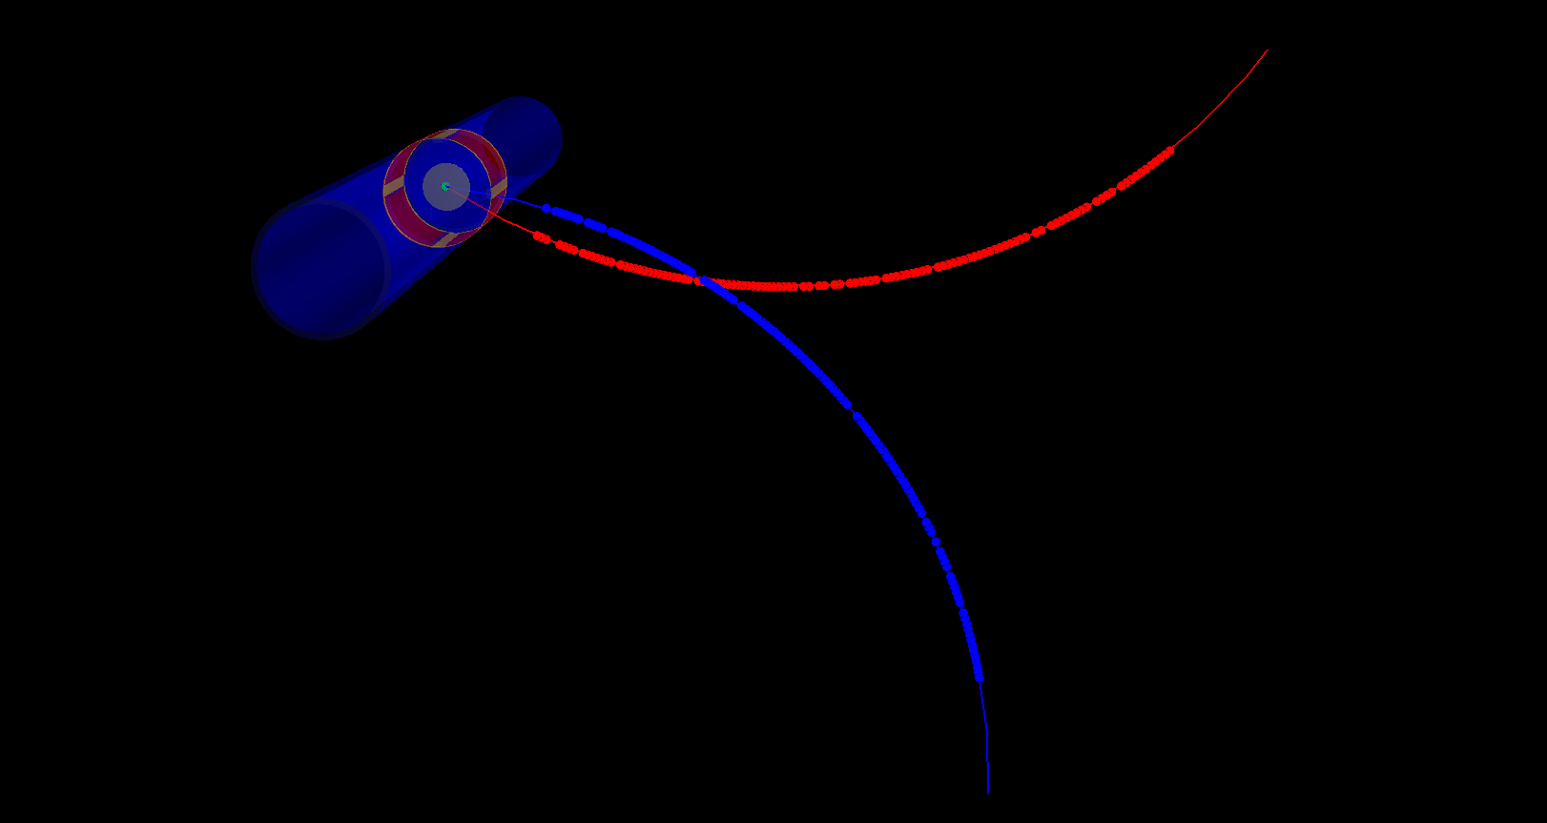
Internal Conversion Background (IPC)
Irreducible background comes from Nuclear Internal Conversion
$${}_{4}^{8}{{Be}^{∗}}→{{}_{4 }^{8}{Be}+γ}^{∗}→e^{+}e^{−}$$
Peaks at low invariant mass
Simulated with Born-approximation
Full GEANT4 Simulation + genfit2 + RAVE reconstruction with realistic TPC hits (~130 )
Black line is an ansatz fit

Slide 20
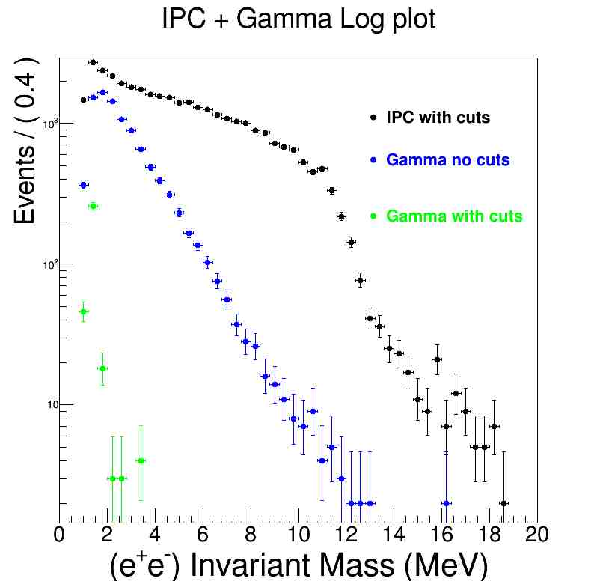
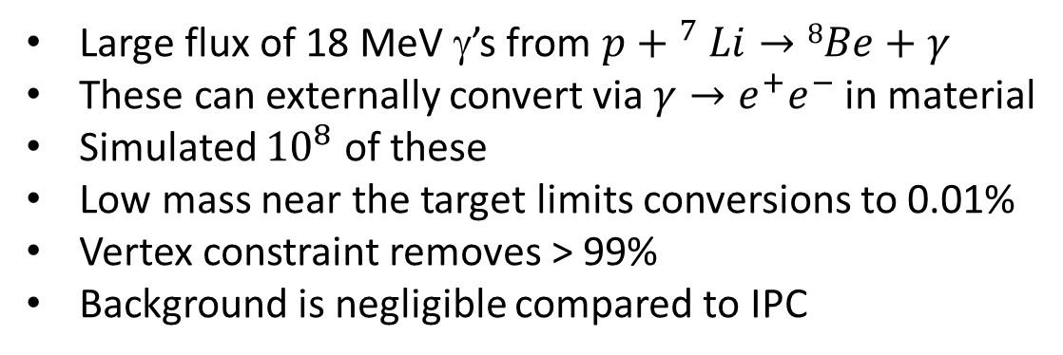
External Gamma conversion
Large flux of 18 MeV γ’s from $p{+ }^{7}Li→8Be+γ$
These can externally convert via $γ→e^{+}e^{−}$ in material
Simulated ${10}^{8}$ of these
Low mass near the target limits conversions to 0.01%
Vertex constraint removes > 99%
Background is negligible compared to IPC

Slide 21
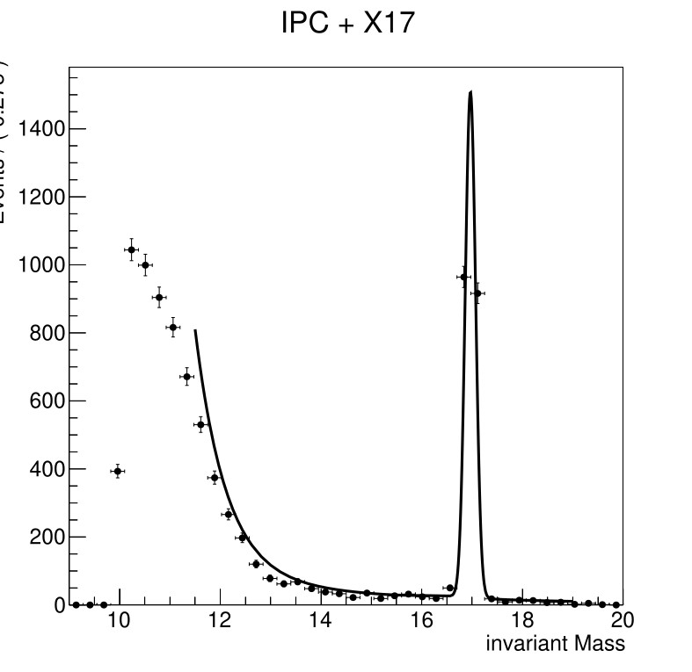
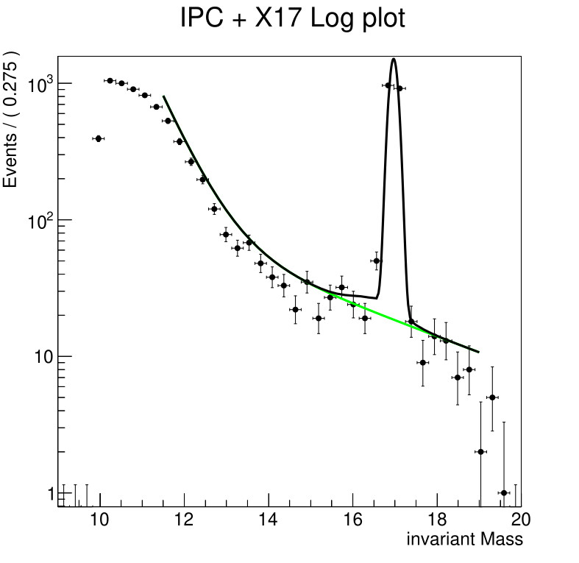


X17 + IPC background
Full simulation and reconstruction of IPC+X17 with 50 µm Mylar vacuum wall
4 Day run on Pelletron. 1µA proton beam, 10¹⁹ /cm² ⁷Li target
Quantify sensitivity as a function of BR relative to $p+{}_{}^{7}Li→{}_{}^{8}{Be}+γ$
ATOMKI found X17 with BR ~$6×{10}^{−6} (p,γ)$ at 6 σ
X17 BR= $6×{10}^{−6} (p,γ)$
1908 +- 45 events
42 σ significance

Slide 22




Spin and Parity of X17
Should we find the X17, we can also determine its spin and parity via an angular analysis
1⁻
Polarization
1⁺
0⁻
$$θ_{X}$$

Slide 23



X17 Upper limit from BLIMP
10⁻⁵
ATOMKI, $\frac{{}_{}^{8}Be^{∗}→^{8}Be+X}{{}_{}^{8}Be^{∗}→^{8}Be+γ}$
Exclude X17 by over 2 orders of magnitude!
Upper Limit for X boson production
10⁻⁶
90% UL BR
TPC, $\frac{{}_{}^{8}Be^{∗}→^{8}Be+X}{{}_{}^{8}Be^{∗}→^{8}Be+γ}$
Excluded
10⁻⁷
10⁻⁸

Slide 24






No X17 signal => Can run at 4.5 MeV, Beam $2μA$, Target $2×{10}^{20} Li cm^{−2}$, 30 - day run =>$2×{10}^{11} γ$’s
(NA48 had $1.4×{10}^{9} π^{0}$ data sample) Bump-hunt in Invariant-mass spectrum
World-best exclusion for prompt, weakly coupled bosons in 5 - 22 MeV range
NA48 - Huge background at 5- 22 MeV
IPC Background peaks at 1.1 MeV
Choose reaction for optimized X mass range
17.2
19.8
11.6
5.2
1.9
90% Upper limits on BR($\frac{{}_{}^{8}{{Be}^{∗}}→Be+X(e^{+}e^{−})}{{}_{}^{8}{{Be}^{∗}}→Be+ γ}$)

Slide 25




Dark Photon and ALP limits from BR($\frac{{}_{}^{8}{{Be}^{∗}}→Be+X(e^{+}e^{−})}{{}_{}^{8}{{Be}^{∗}}→Be+ γ}$)
Feng et al. (PRL 117, 071803 (2016))
$$\frac{{}_{}^{8}{{Be}^{∗}}→Be+X(e^{+}e^{−})}{{}_{}^{8}{{Be}^{∗}}→Be+ γ}=ε^{2}\frac{P_{X}^{3}}{P_{γ}^{3}}$$
TPC
World-best ALP limit in this range
(Probing Multi-TeV scale on the Pelletron)
World-best dark Photon in 10 -20 MeV

Slide 26



Instrumentation Experience
MicroPattern Gas Detector and TPC detector development at ANU, Adelaide and Melbourne
All three are members of DRD1 Collaboration (based in CERN)
Adelaide and ANU in Cygnus
DM Discovery in the Neutrino “Fog”

Slide 27




Melbourne (N. Jackson, C. Rush, A. Babic M.Sc.)
Local Micromegas Design
Cathode
Gas Spacer
Anode
⁵⁵Fe measured response
⁵⁵Fe simulations

Slide 28



Adelaide
Multi-stage Gas Gain for negative Ion detection (Directional DM)
Capability for single-electron sensitivity
A.G. McLean et al 2026 JINST 21 P07047

Slide 29




ANU
²⁴¹Am Source
Optical Readout of TPC
PMT Timing
X-Y plane event
X-Z plane Event

Slide 30
Conclusions
BLIMP can exclude the X17 with > 2 orders of magnitude in an identical nuclear system
Unique facility – world-leading probe of dark photon/ALP physics, PEP violations. Others?
Significant first measurements for fundamental Nuclear Physics
Significant Instrumentation effort to support BLIMP
ARC LIEF 2027 bid in place….
New collaborators welcome!
More details in our arxiv paper: https://arxiv.org/abs/2302.13281

Slide 31
Backup

Slide 32
X17 particle
detectors
2016 observation¹
p + ⁷Li→⁸Be + e⁺e⁻
2021²: p + ³H→⁴He + e⁺e⁻
2022³: p + ¹¹B→¹²C + e⁺e⁻
e⁺e⁻ pairs
Θ
Nuclear
target
proton beam
1: arxiv 1504.01527,(PRL 116, 04215, (2016))

Slide 33
X17 particle
detectors
2016 observation¹
p + ⁷Li→⁸Be + e⁺e⁻
2021²: p + ³H→⁴He + e⁺e⁻
2022³: p + ¹¹B→¹²C + e⁺e⁻
e⁺e⁻ pairs
Θ
Nuclear
target
proton beam
1: arxiv 1504.01527, ,(PRL 116, 04215, (2016))
2: arxiv 2104.10075, (PRC 104,044003, (2021))

Slide 34


TPC side view
Ionization electrons
Drift with velocity v
Scintillators
z = v×t
15 KV
e⁺
0V
Ionization electron
Magnetic Field
0 V
Record (x,y,t)
120 μm
Electric Field
+800 V
Proton Beam
PCB
Readout strips on PCB
Electric Field
Magnetic Field
e⁻
+800 V
Micromegas wire mesh

Slide 35

COMSOL electric field simulation of Field Cage
3D geometry
2D geometry with axial symmetry
Employed in COMSOL

Slide 36



COMSOL electric field simulation of Field Cage
Default Electric field
radial Component
Optimized Electric field
radial Component
Default Electric field
Z Component
Default: 9 mm rings placed 1 mm apart
Optimized: 4.5 mm rings placed 0.5 mm apart
Initial upstream ring 1 mm downstream of cathode disk

Slide 37







Garfield Simulation of electron release and drift
Ionization electrons drift to detector at z=19 cm
Correlation in
Radial position
Uncorrected Resolution
100 μm resolution
Corrected Resolution
Primary MeV-scale $e^{+}(e^{−})$ at z=0
Corrected
Around 100 electrons per track released via ionization.
10 μm resolution

Slide 38

Garfield simulation of drift velocity
Dispersion of drift velocity is ~ 0.6%
Gives rise to a z-resolution of ~ 1mm

Slide 39


COMSOL + Garfield simulation of micromegas
0 V
120 μm
+800 V
PCB
Electrons are directed through the mesh and enter the amplification region

Slide 40




Garfield simulation of Micromegas amplification
800 V over ~ 100 microns provides ~ 10⁴ gas gain
Induces pulses of around 5 pC on readout strips
mesh
Electron avalanche providing gas gain

Slide 41

LHC VMM ASICs + Scalable Readout System
Readout strips with VMM ASICs
Programmable gain
Test charge input
Records channel number, analogue charge, Time with 1 ns resolution and 64 µ-sec dynamic range
~fC pulses from strips in the range for VMM

Slide 42

Projected x-y resolution ~ 100 microns
Design will work to provide 100 micron spatial resolution in (x,y)

Slide 43
Geant 4 Simulations
As charged particles propagate through matter interact causing:
  “Multiple” small angle scattering causing direction change
  Energy loss as they transfer energy to the medium
  Ionization liberating electrons
Have set up a Geant 4 simulation of the TPC
Final direction
Initial direction
Accurate determination of the Invariant mass of the e+ e- pair requires a precise measurement of the magnitude and direction of the charged particles
Accurate simulation of multiple scattering required.
Minimize the effect.
Low Density, Low Z material

Slide 44

Genfit2 + RAVE
Developed reconstruction software using “genfit2” HEP software library to reconstruct tracks
Developed vertex reconstruction software using “RAVE” HEP software library to project tracks to a common vertex

Slide 45


Target Chamber
Prototype Target Chamber
Mylar foil on stainless steel pipe, nicely holds vacuum.
Reached 1.1×10⁻⁵ Torr (limited by outgassing in the connector)

Slide 46



X17 + IPC background (2)
4 day run
X17 BR= $6×{10}^{−7}(p,γ)$
201 +- 16 events
12 σ significance

Slide 47




X17 + IPC background (3)
Plenty of head-room statistically!
Can increase beam current to 2 µA
Target Thickness to $2×{10}^{19} atoms/cm^{2}$
Run time to 40 days
Gives a factor of 40 increase in statistics!
4 day run
X17 BR= $6×{10}^{−8}(p,γ)$
27 +- 8 events
3.3 σ significance

Slide 48

Data rates
Comes from Thick-target bump hunt search + exclusion
Run at 4.5 MeV, Beam $2μA$, Target $2×{10}^{20} Li cm^{−2}$
Cross Section for $p+{}_{}^{7}Li→{}_{}^{8}{Be}+γ$ = 30 µb
N(γ)/sec = $3×{10}^{−29}×2×{10}^{20}×1.25×{10}^{13}=7.5×{10}^{4} s^{−1}$
Approx 0.01% gamma’s convert = 7.5 events/sec
IPC rate = $3.5×{10}^{−3}×7.5×{10}^{4}×0.5=131$events/sec
12 Kbytes/event $1.2×{10}^{4}×140=1.7$megabytes/sec
145 GB/day
4.5 TB for 30-day run
Well within the capacities of the unimelb Spartan HPC

Slide 49

Comparison to LHCb for generic dark photon
TPC

Slide 50



Search for the X17 at University of Montreal
Openning angle measurement of $e^{+}e^{−}$ pairs from $p+^{7}Li→^{8}Be+(e^{+}e^{−})$
arXiv:2211.11900v1

