Slide 1
Dark photon in BSM physics and dark matter searches
Xuan-Gong Wang
ARC Centre of Excellence for Dark Matter Particle Physics
CSSM, Adelaide University, Australia
Workshop on Fundamental Problems in Subatomic Physics
Cairns, Australia, Sep. 23-27, 2026

Slide 2
Outline
Dark photon hypothesis
Dark photon in BSM physics
Dark photon in dark matter searches
Summary

Slide 3
Dark photon hypothesis

Slide 4
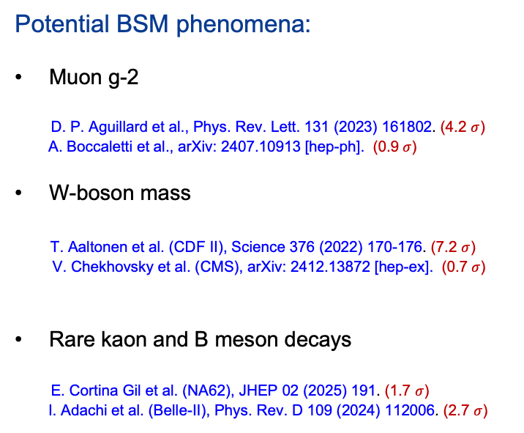
Standard Model
SU(3)_{C} X SU(2)_{L} X U(1)_{Y}
Incomplete:
Neutrino mass and oscillation
Dark Matter
Potential BSM phenomena:
Muon g-2
D. P. Aguillard et al., Phys. Rev. Lett. 131 (2023) 161802. (4.2 $σ$)
A. Boccaletti et al., arXiv: 2407.10913 [hep-ph]. (0.9$σ$)
W-boson mass
T. Aaltonen et al. (CDF II), Science 376 (2022) 170-176. (7.2 $σ$)
V. Chekhovsky et al. (CMS), arXiv: 2412.13872 [hep-ex]. (0.7$σ$)
Rare kaon and B meson decays
E. Cortina Gil et al. (NA62), JHEP 02 (2025) 191. (1.7 $σ$)
I. Adachi et al. (Belle-II), Phys. Rev. D 109 (2024) 112006. (2.7 $σ$)

Slide 5
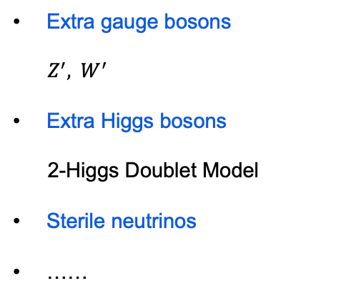
BSM
Extra gauge bosons
$Z^{′}, { W}^{′}$
Extra Higgs bosons
2-Higgs Doublet Model
Sterile neutrinos
……

Slide 6
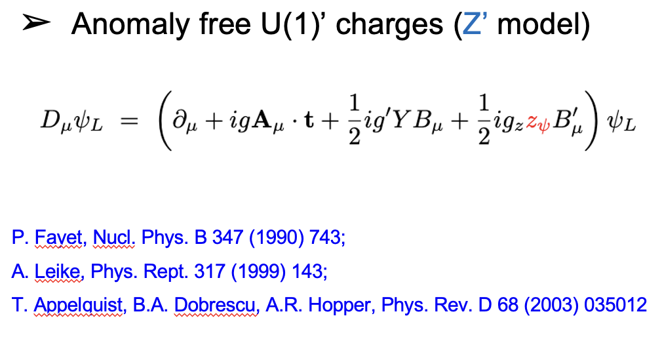
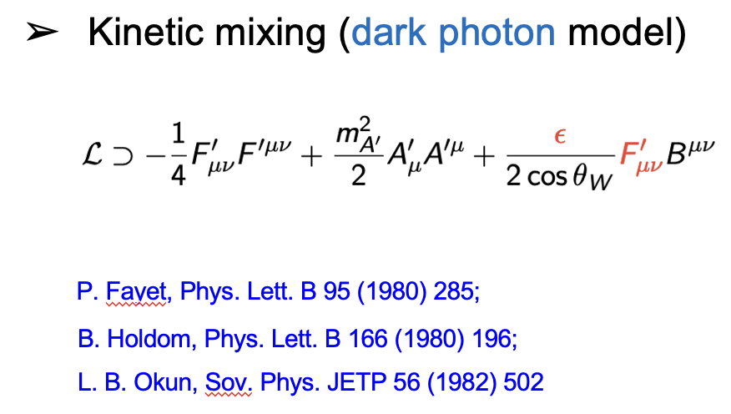
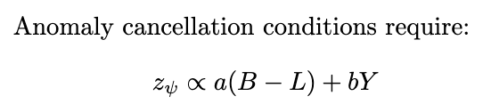
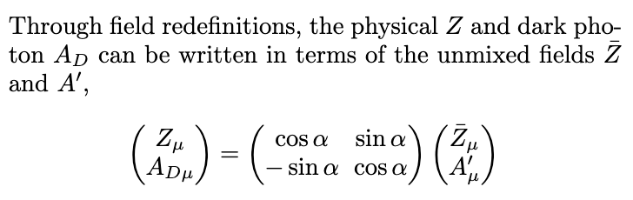
Extra U(1)’

Slide 7
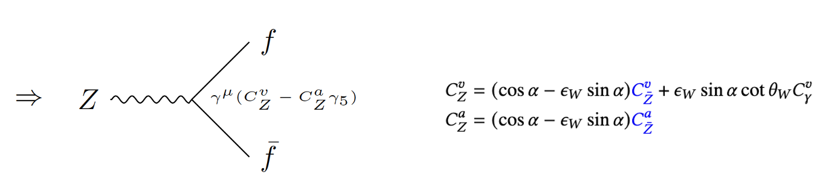
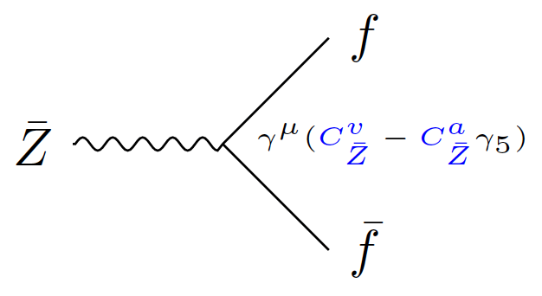
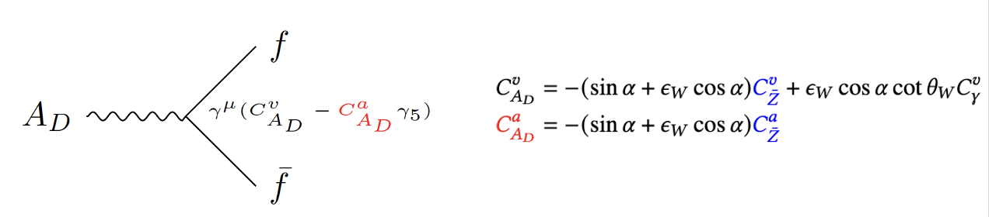
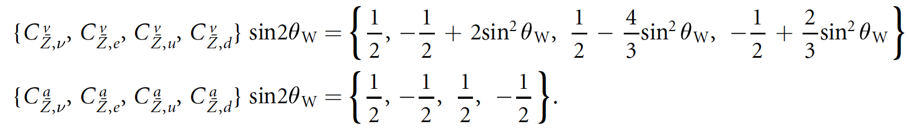
Dark Photon
SM weak couplings
It is more like a dark Z

Slide 8
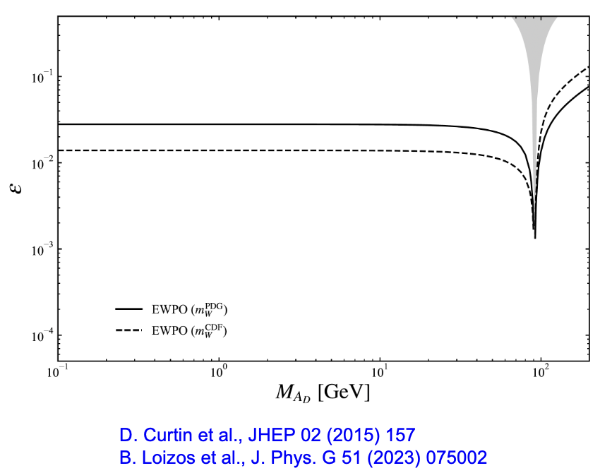
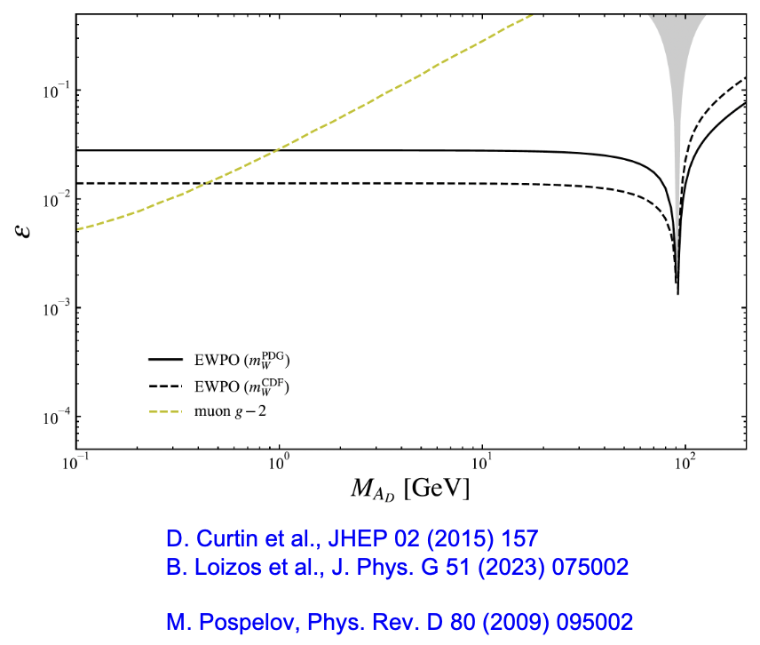
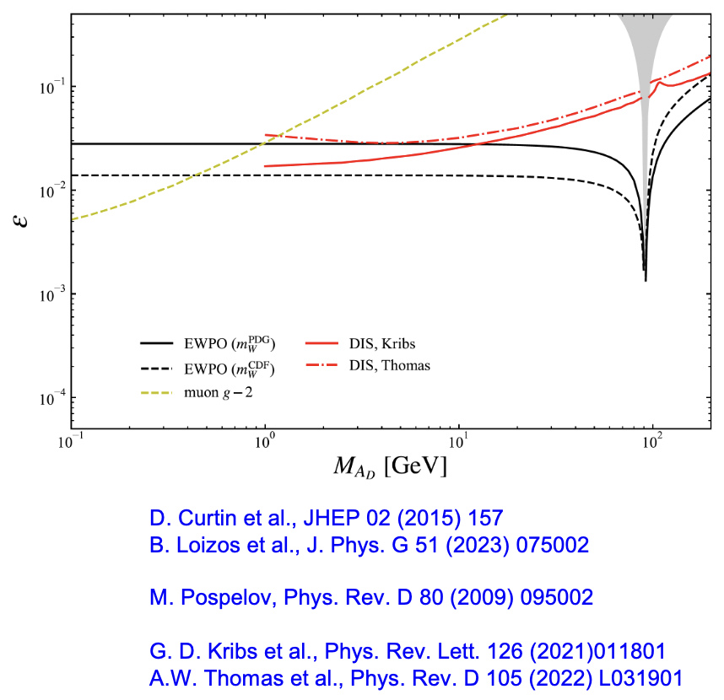
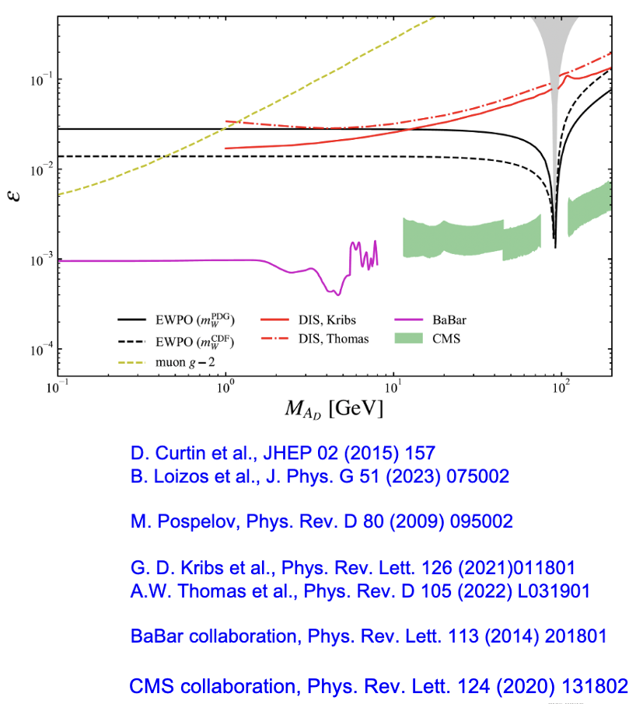
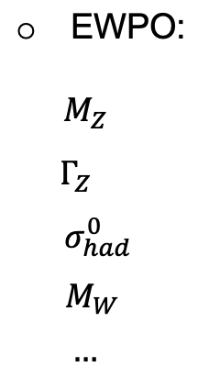
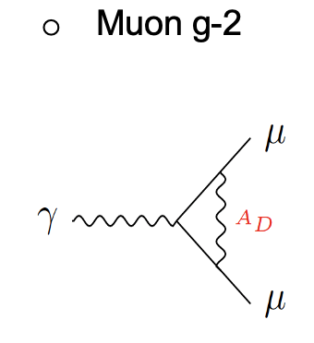
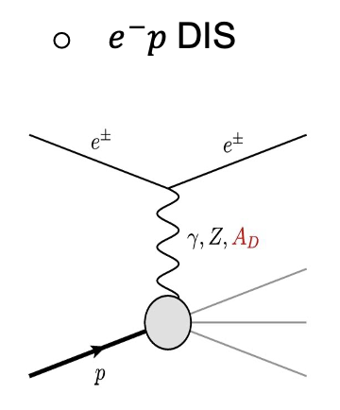
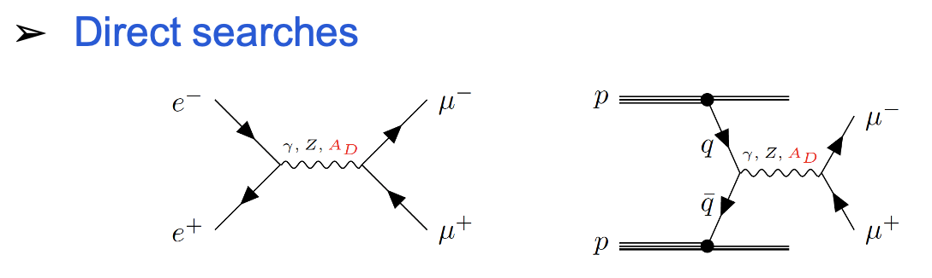
Indirect constraints
No signal of Narrow resonance

Slide 9

II.A Dark photon in global QCD analysis

Slide 10
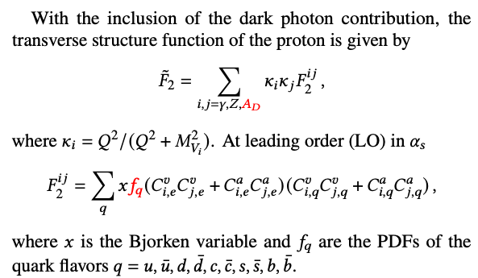
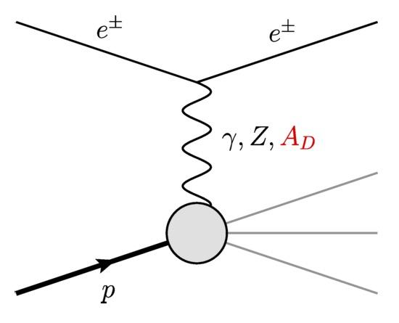

Slide 11

Jefferson Lab Angular Moment (JAM) framework
Jefferson Lab Angular Momentum (JAM) collaboration, Phys. Rev. D 104 (2021) 074031
PDFs at initial scale $Q_{0}^{2}=m_{c}^{2}$
$f\left(x,Q_{0}^{2}\right)=N x^{α} {(1−x)}^{β} (1+γ \sqrt{x}+ η x)$
Monte Carlo techniques + state-of-the-art uncertainty quantifications
NLO + missing higher order uncertainties
NNPDF collaboration, Eur. Phys. J. C 79 (2019) 931
42 parameters = 30 (free nucleon PDFs) + 6 (higher twist) + 6 (nuclear PDFs)

Slide 12
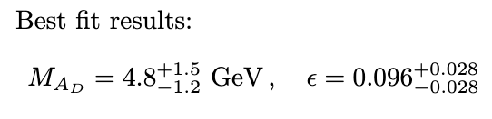
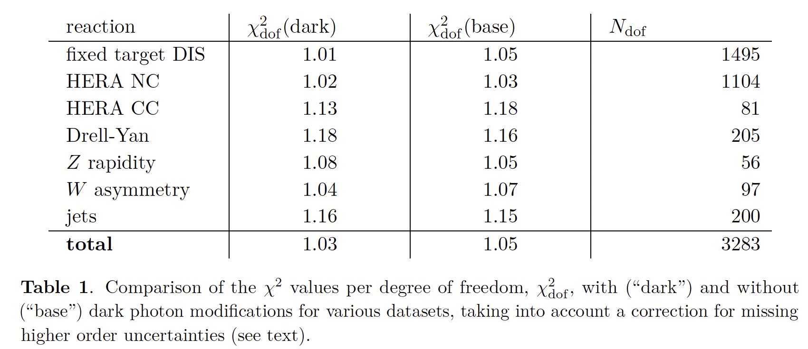
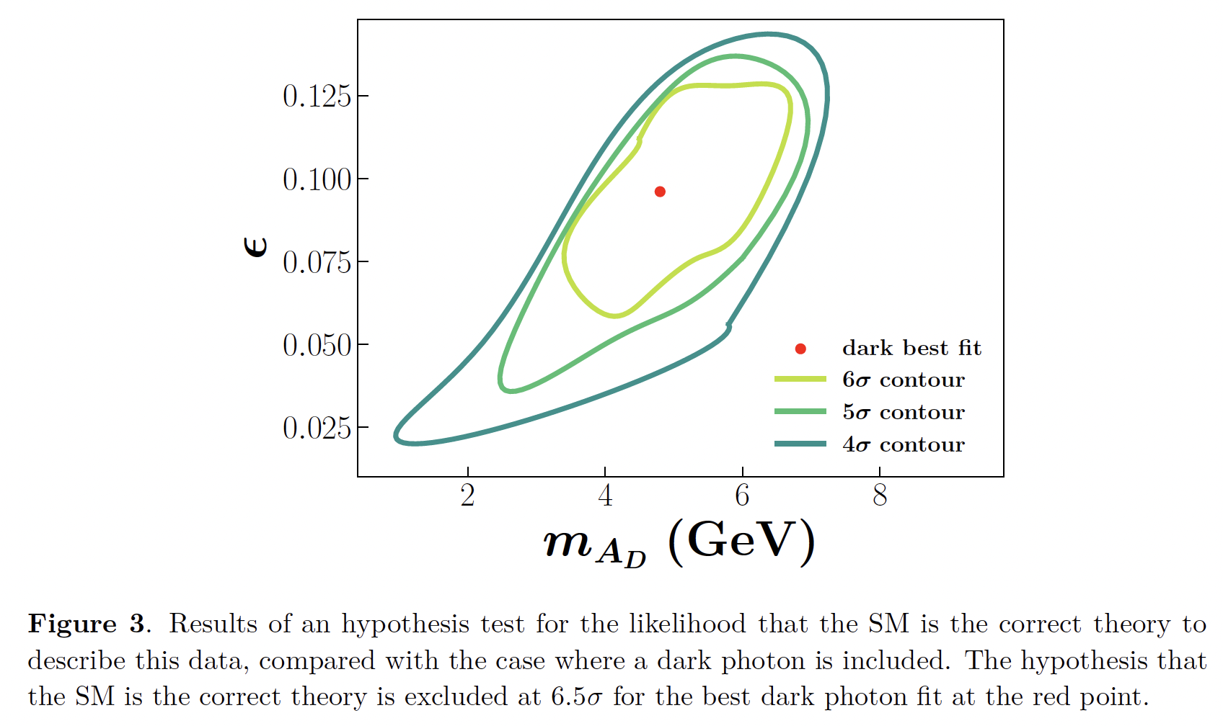
Best fit
Nicholas Hunt-Smith, et al., JHEP 09 (2023) 096

Slide 13
Coincidence?
Universal feature for new gauge bosons?
Why no signal in direct experimental searches?

Slide 14
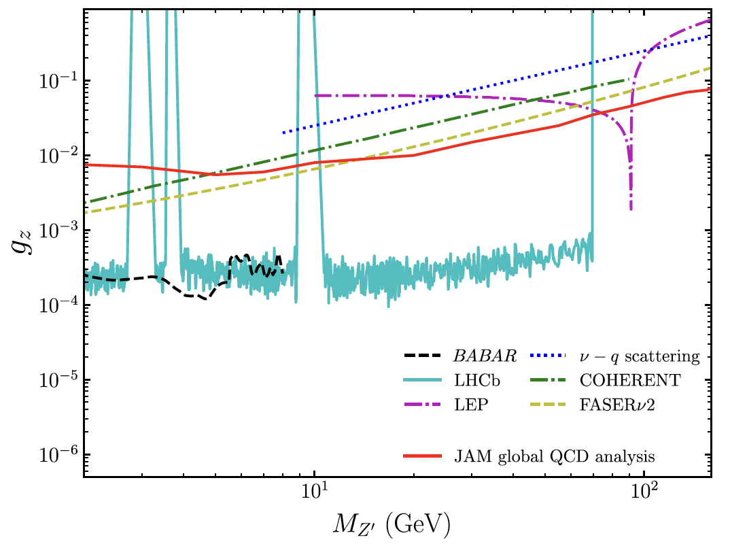
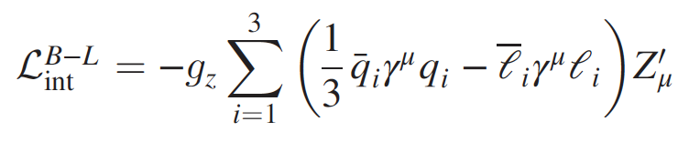
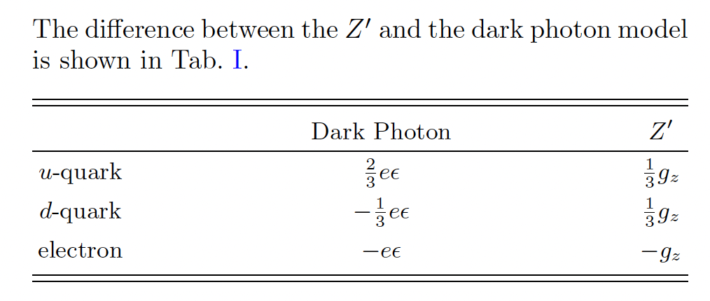

B-L Z’ model
X.G. Wang et al., Phys. Rev. D 111 (2025) 015019
DIS: t-channel
Direct search: s-channel (model dependent)
No improvement in $χ^{2}$ when Z’ is included

Slide 15
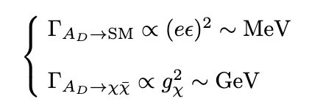
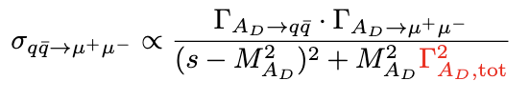
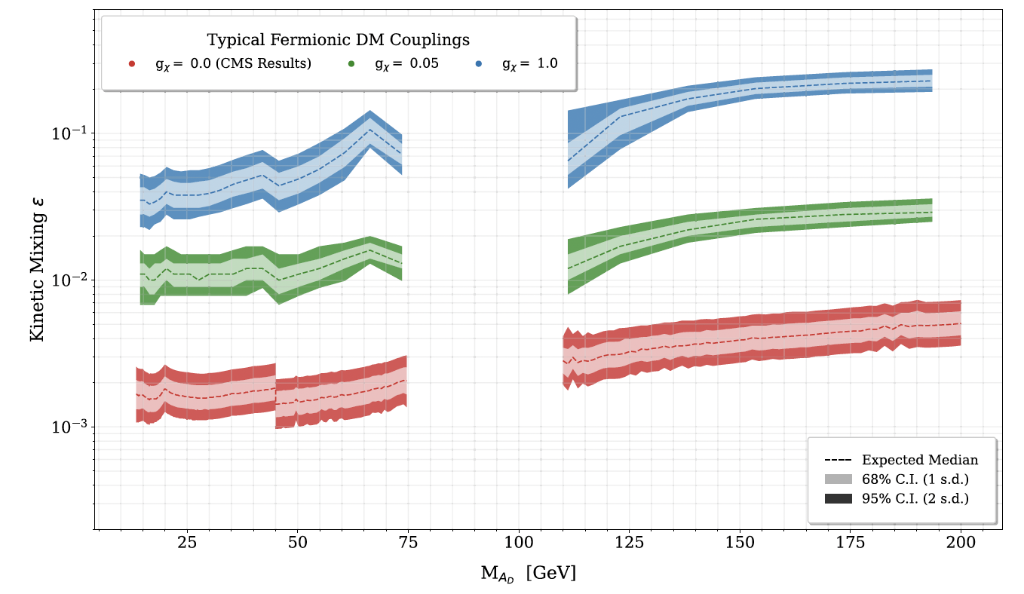
Revisit direct searches
J. Felix, A.W. Thomas, X.G. Wang, Phys. Rev. D 112 (2025) 035011
What a dark photon signal looks like?
narrow peak .vs. flat bump?

Slide 16
II.B Parity-violating electron scattering (PVES)

Slide 17
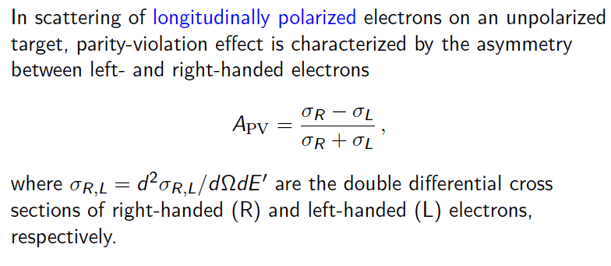
PVES

Slide 18
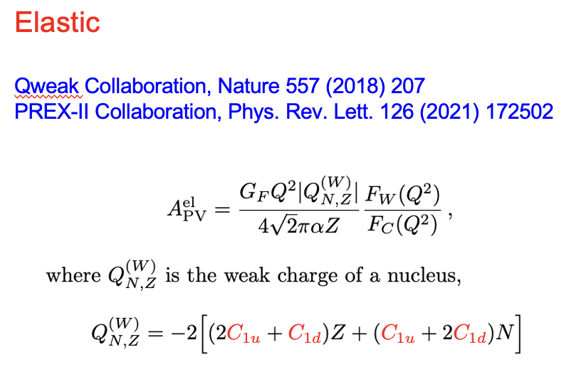
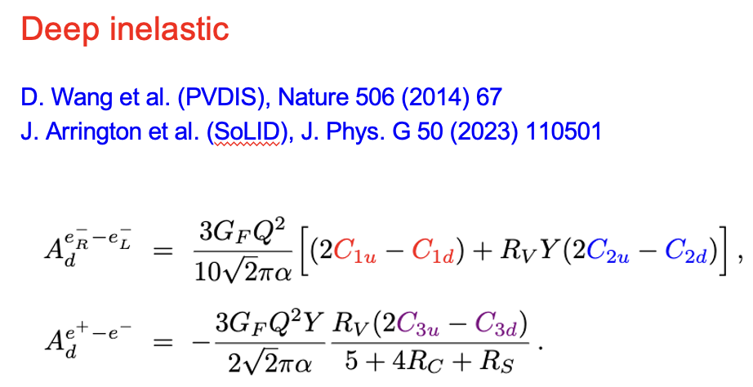
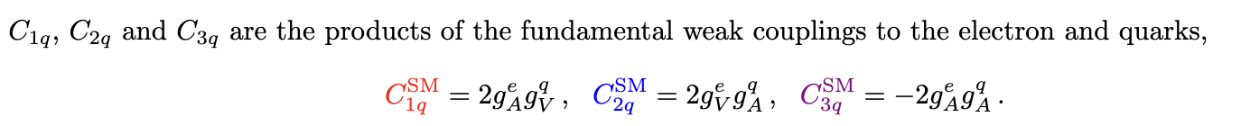
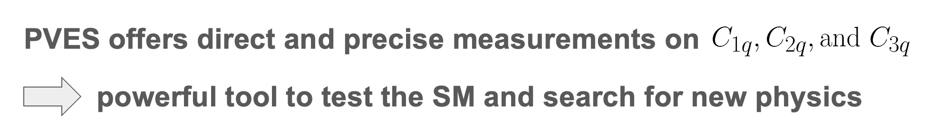
Why PVES?

Slide 19
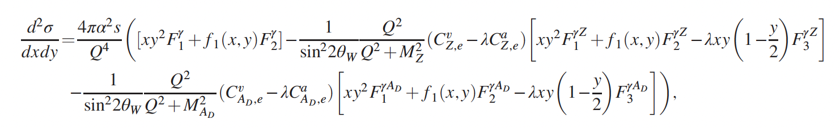
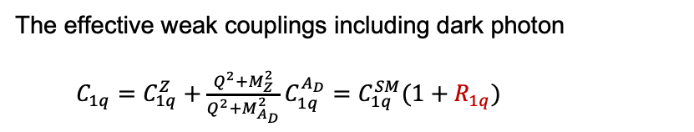
Including dark photon
A.W. Thomas, X.G. Wang, A.G. Williams, Phys. Rev. Lett. 129 (2022) 011807
where $λ=+1\left(−1\right)$ represents right-handed (left-handed) electron helicity
The effective weak couplings including dark photon
$C_{1q}=C_{1q}^{Z}+\frac{Q^{2}+M_{Z}^{2}}{Q^{2}+M_{A_{D}}^{2}}C_{1q}^{A_{D}}=C_{1q}^{SM}(1+R_{1q})$

Slide 20
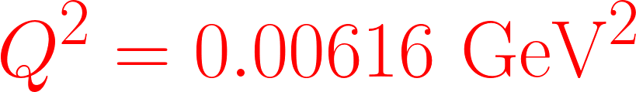
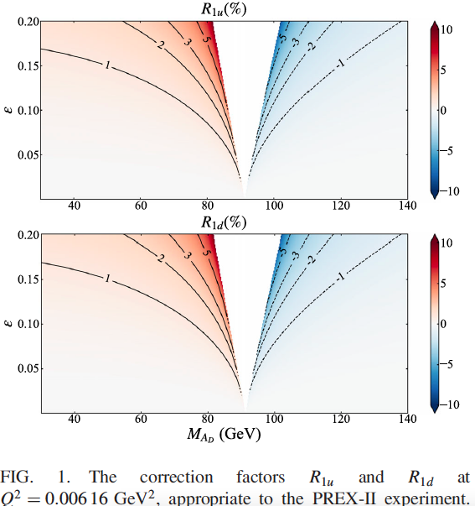
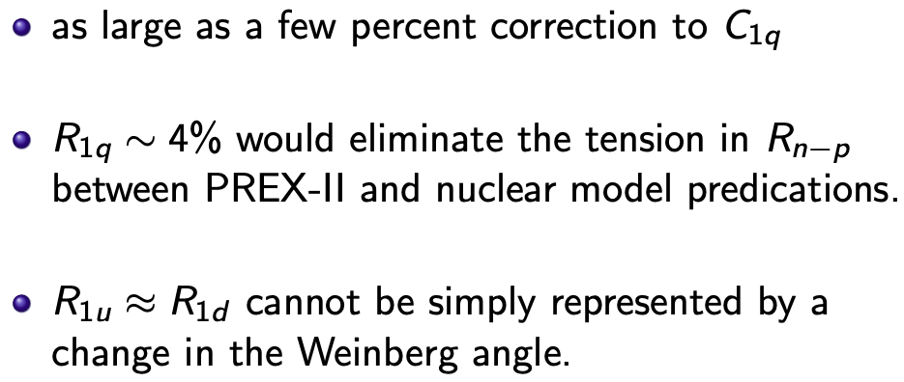

Slide 21
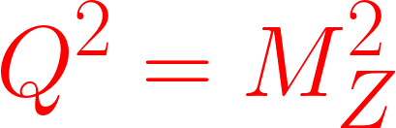
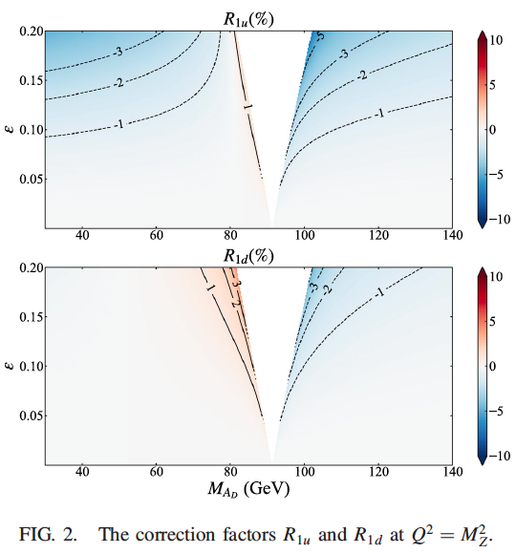
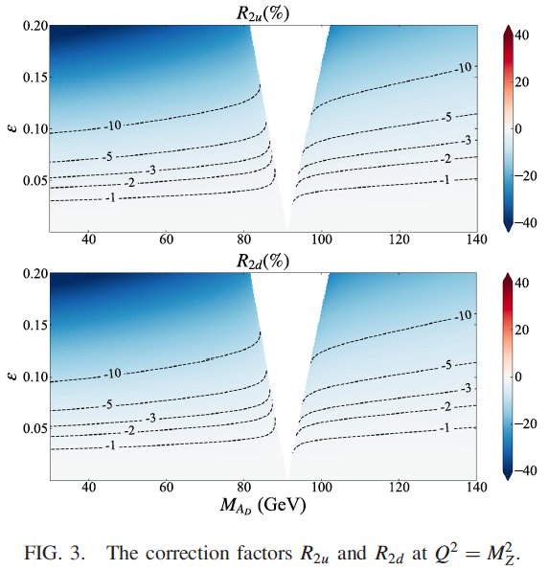
Large effect (10%) on valence PDFs from HERA

Slide 22
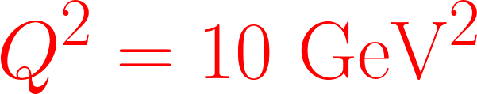
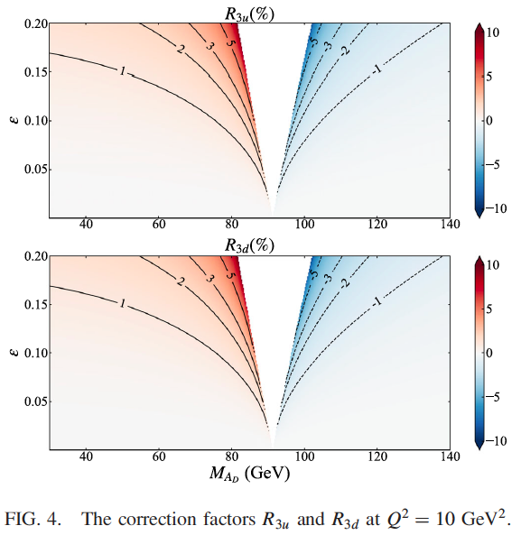
as large as 5% deviations from the SM expectations, were a dark photon to exist
Searching for the dark photon at SoLID, P2 and MOLLER
J. Arrington et al. (SoLID), J. Phys. G 50 (2023) 110501
D. Becker et al. (P2), Eur. Phys. J. A 54 (2018) 208
J. Benesch et al. (MOLLER), arXiv: 1411.4088

Slide 23
III. Dark photon in dark matter searches

Slide 24
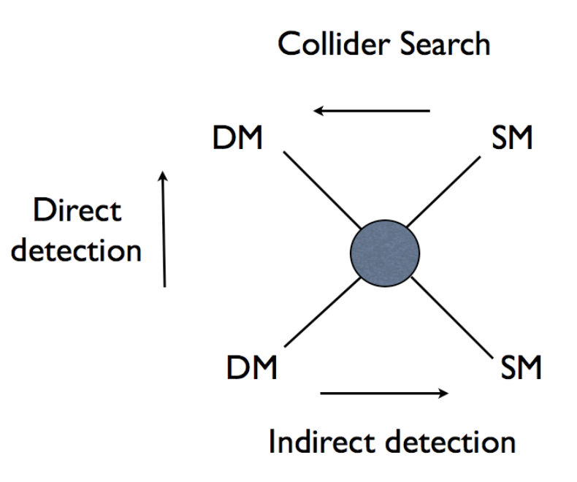
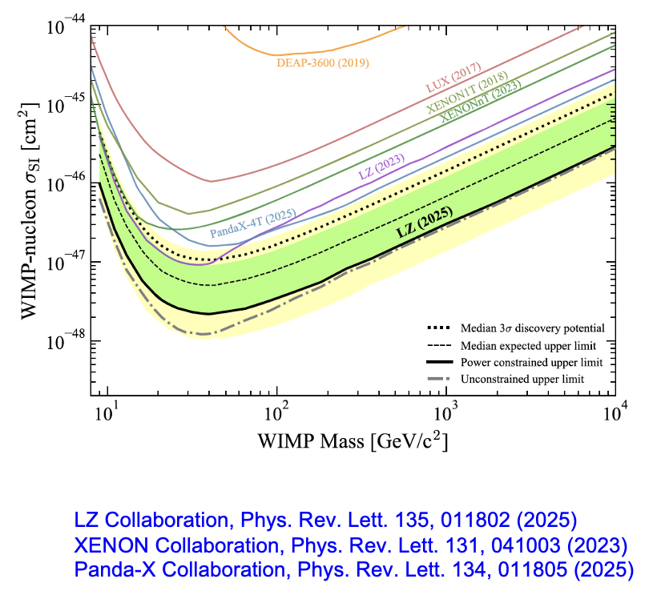
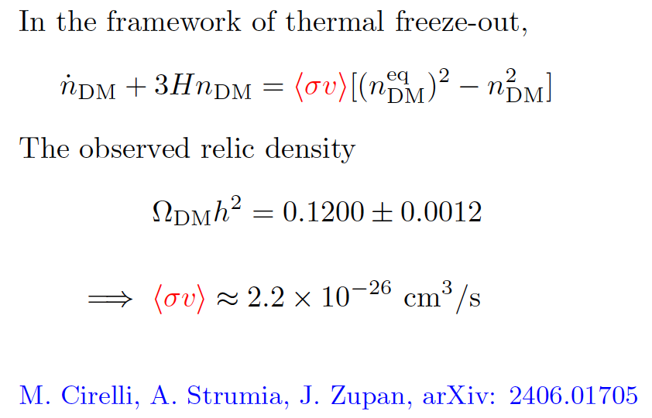
DM Constraints

Slide 25
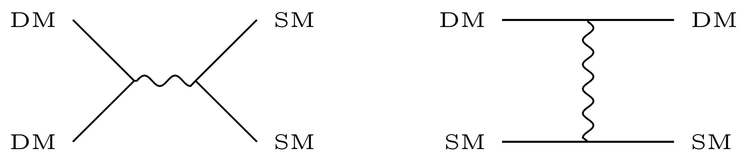


Dark portal
$$A^{′}$$
Resonance enhancement: $2 m_{DM} ≈ M_{med}$
E. Izaguirre et al., Phys. Rev. Lett. 115, 251301 (2015);
J. L. Feng, J. Smoinsky, Phys. Rev. D 96, 095022 (2017);
G. Krnjaic, arXiv: 2505.04626;
D. Alonso-Gonzalez et al., arXiv: 2507.11376

Slide 26
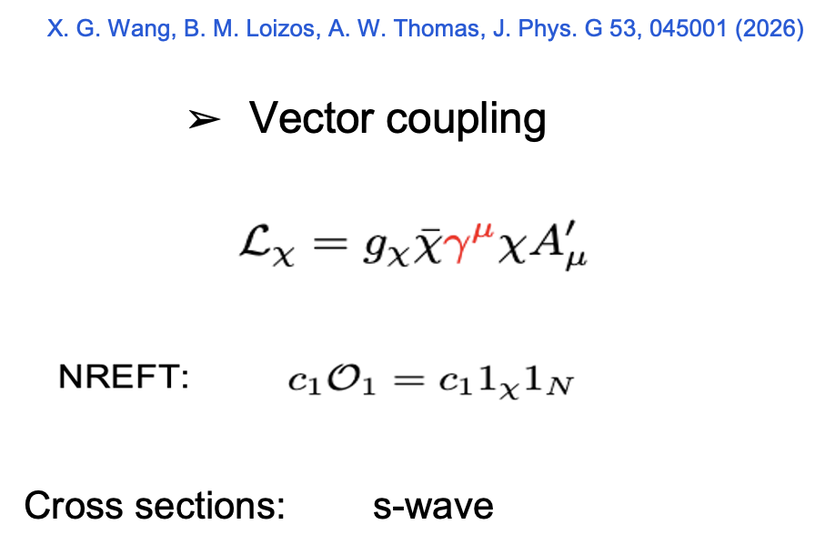
Dark photon portal
Whether a dark photon portal can satisfy all existing constraints from dark matter relic density, direct/indirect detection, and collider searches?

Slide 27

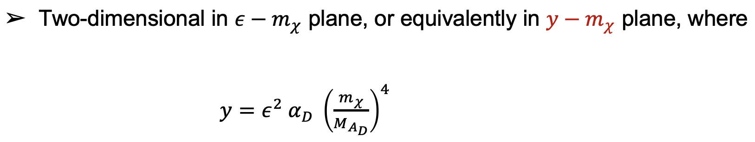
Parameter space

Slide 28




Vector coupling
Lower limits on y from relic density
The corresponding $σ_{χp}^{SI}$
Ruled out

Slide 29

Not enough

Slide 30

Very limited regions are allowed!

Slide 31

Axial-Vector coupling

Slide 32

EWPO: No Direct Detection: Yes

Slide 33

Fine!

Slide 34

Great!

Slide 35





LZ high-energy nuclear recoil event
Pengxuan Zhu, Giovani Garcia, XGW, A. W. Thomas, M. White, 2609.09015
LZ Collaboration, 2609.02823
One candidate event consistent with a nuclear recoil at:
${ E}_{nr}=248 ±{23}_{stat} ±{23}_{sys}$ keV

Slide 36
IV. Summary

Slide 37
Dark photon in BSM physics
Dark photon in dark matter searches
Global QCD analysis: indirect evidence of its existence
Parity-violating electron scattering: ~ 5% corrections (SoLID)
Vector coupling: tightly constrained
Axial coupling: the allowed region is much broader
Inelastic DM + dark photon: LZ high energy nuclear recoil event

Slide 38








Adelaide University
Anthony Thomas
Anthony Williams
Martin White
Nicholas Hunt-Smith
Bill Loizos
Jake Felix
Jefferson Lab
Thanks!
Wally Melnitchouk
Nobuo Sato

