Slide 1
From prompt to paper A quick look at arXiv:2603.20179 [hep-ex]
Dietrich Liko

Slide 2
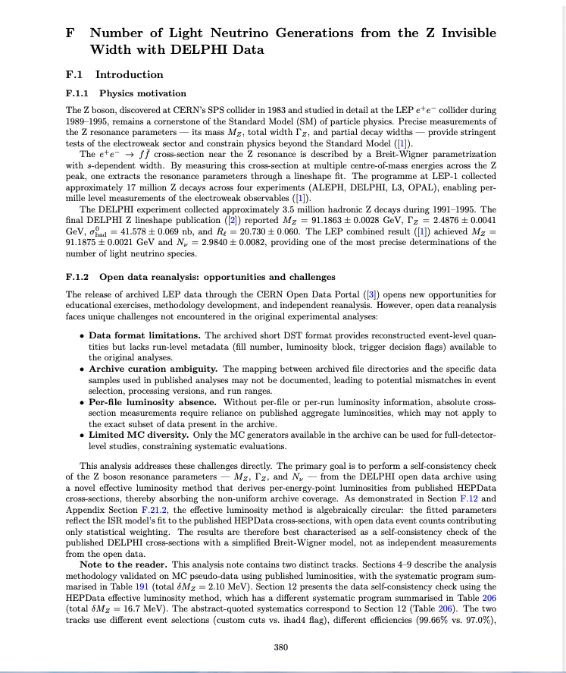
The claim
“Large language model-based AI agents are now able to autonomously execute substantial portions of a high energy physics (HEP) analysis pipeline with minimal expert-curated input.”
Measure the number of light neu-
trino generations from the Z invis-
ible width
5h15
DELPHI Experiment Example

Slide 3
How did they do it ?
Claude Code — the agentic runtime (not just the model — the CLI that can execute code, read files, iterate)
Claude Opus 4 — Anthropic’s most advanced model
JFC Framework — the methodology + conventions + orchestration layer
SciTreeRAG — the literature retrieval system
CERN Opendata – CMS/Aleph/DELPHI
Pure Python - uproot/awkward/pyhf/mplhep

Slide 4
Outline
RAG concepts
SciTreeRAG
Concepts of agentic programming
The JFC multi-agent framework
The agent zoo
The DELPHI analysis

Slide 5
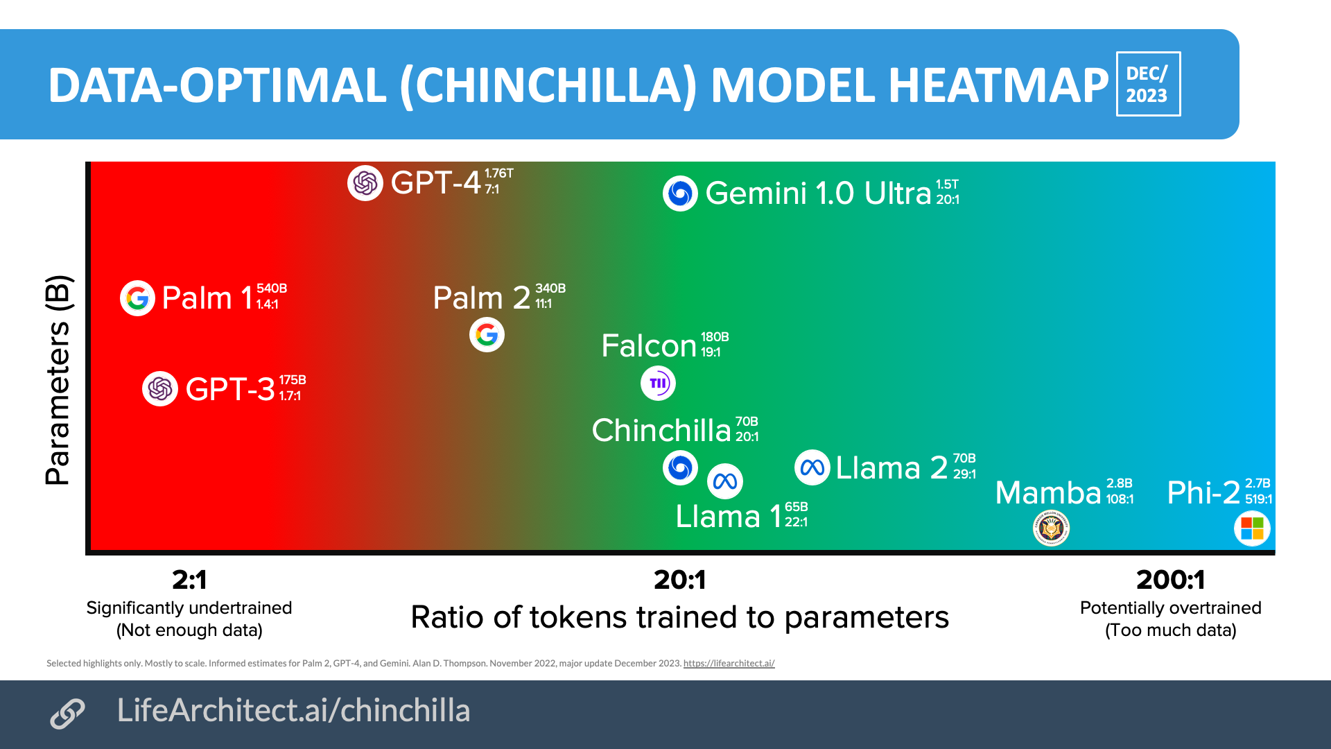
Chincilla Scaling Law (2022)
For compute-optimal training, a model requires 20 tokens per 1 parameter.
Modern models (like Llama 3) intentionally break this law by over-training (e.g., 2,000 tokens per parameter) to make smaller models more capable and cheaper to deploy.
A 1 T parameter model (1TB) trained on 45T tokens (approx. 40TB of text) represents a 40:1 lossy compression of its training data.
Original reference: Hoffmann et al. (2022) | arXiv:2203.15556

Slide 6
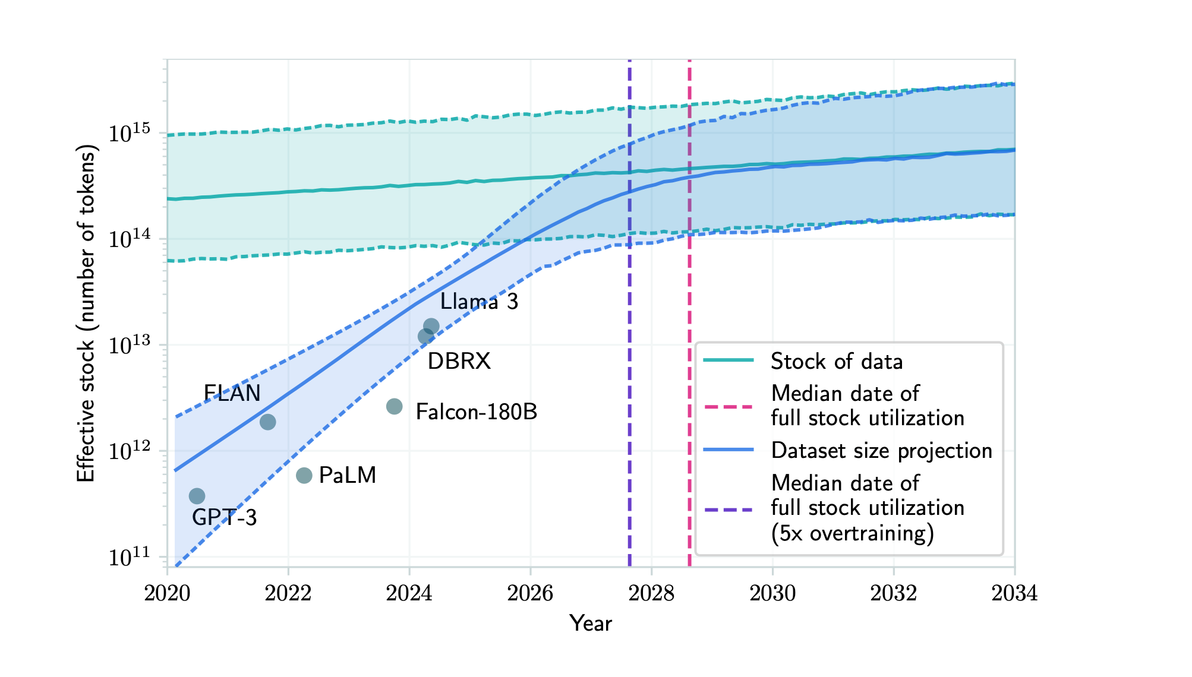
In parenthesis: Will we run out of data ?
Data Category | Total Raw Stock (Tokens) | Effective Stock (Filtered/Deduped) | Context / Comparison
Public Web | ~100 T | ~30 – 50 T | The "messy" internet; requires massive filtering.
All Published Books | ~4 – 8 T | ~4 T | High quality, but finite and legally complex.
Scientific Papers | ~1 – 2 T | ~1 T | Dense, high-reasoning data.
Code (GitHub, etc.) | ~3 – 6 T | ~3 T | Critical for logic and math performance.
Total High-Quality Text | — | ~9 – 30 T | The "Data Wall" threshold.
Total Human Text Stock | ~300 T | ~100 – 200 T | Includes low-quality social media, logs, etc.
Villalobos et al. (2022) | arXiv:2211.04325

Slide 7
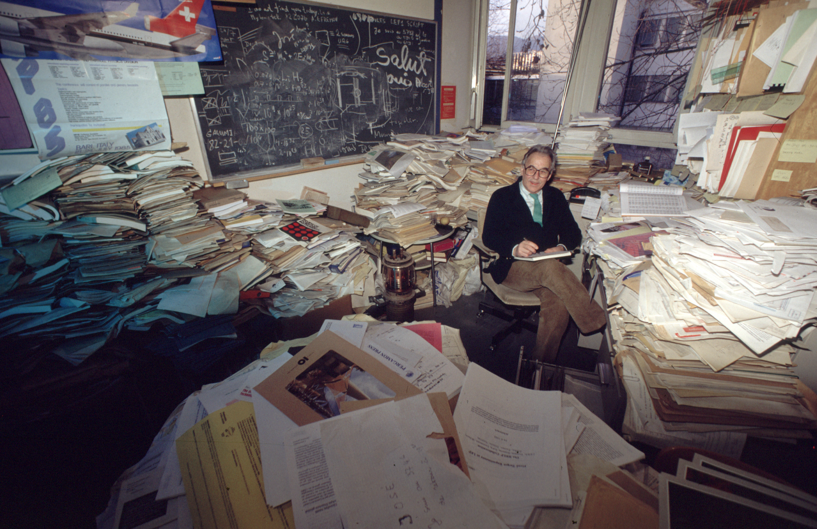
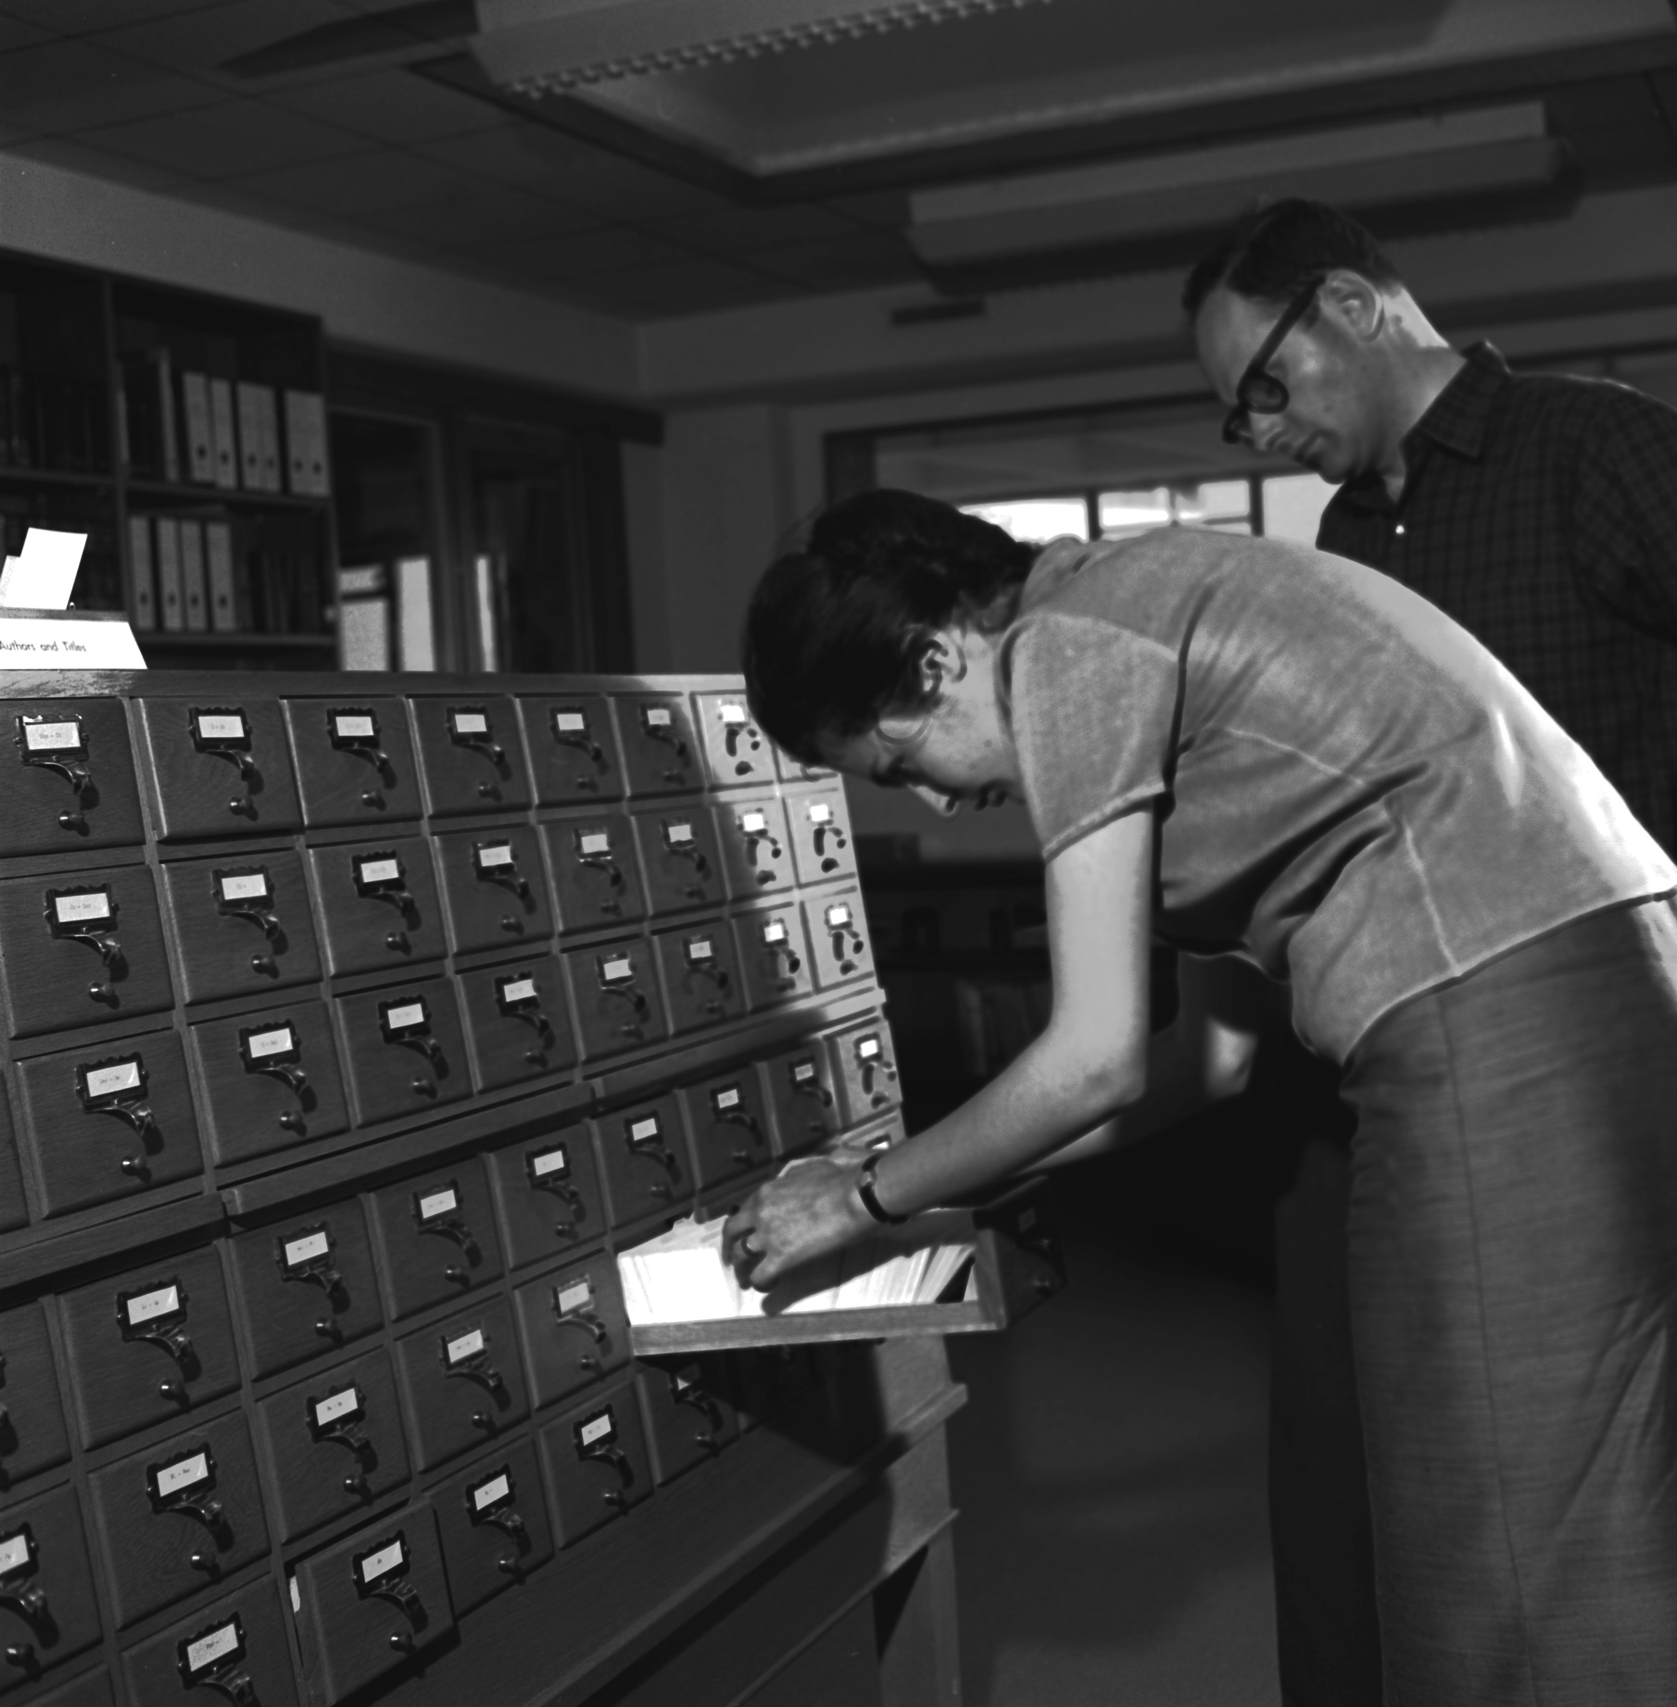
What is Retrival Augmented Generation (RAG)
Picture from the TH divison (2000)
Picture from the CERN Library (1963)
Well read, quotes all numbers from his head
Checks all the numbers and concepts in literature
Original publication: Lewis et al. (2020) | arXiv:2005.11401

Slide 8
What is Vector Search ?
Chunking: Text is cut into chunks
Embedding: An AI model converts the text into a numerical array (vector)
Mapping: Data with similar meaning are close in the vector space
Retrival: The system then finds the nearest neighbour to a question using a distance measure

Slide 9
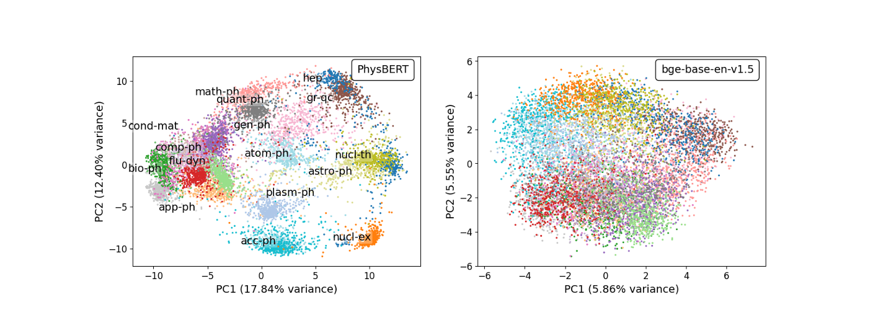
RAG Challenges for Scientific Text
Phase | Challange | Impact
Chunking | Structural Integrety | Standard breaks paragraph, equations, tables, link to figures
Embedding | Domain Semantics | Domain specific jargon
Graph | Complex Causality | Knowledge Graph complements vector search
Visualisation of the embedding space
for PhysBert and more general model
Hellert at al. (2024) | arXiv:2408.09574

Slide 10
SciTreeRag used for the paper
PhD thesis James C. McGreivy, http://hdl.handle.net/1721.1/164602
Papers are considered to be trees by structure.
It allows to retrieve not only chunks, but the context around
A study on implementing a Knowledge Graph was less sucessfull
Hu, Y., et al. (2024) | arXiv:2408.06830.

Slide 11
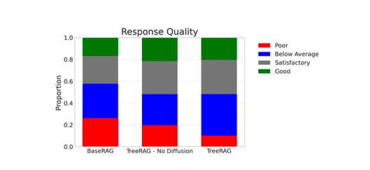
Retrieval-Augmented Generation Assessment
A RAG system has to be tested to see its usefulness – a RAGAS
Its accuracy has to be a quantifiable number
Input are questions, context and reference answers
Scoring done by a LLM (Usually GPT-4 or Claude)
Significant improvement, but hard to tell what effect that has on the overall performance
of the system

Slide 12
Additional information available to the agents
MCP Servers — Anthropic's standard protocol for giving LLMs structured access to external tools and services. Unlike generic web search, each MCP server provides the agent with explicit instructions on how to query its specific API — making retrieval more targeted and efficient.
arXiv articles
INSPIRE-HEP
HEPData

Slide 13
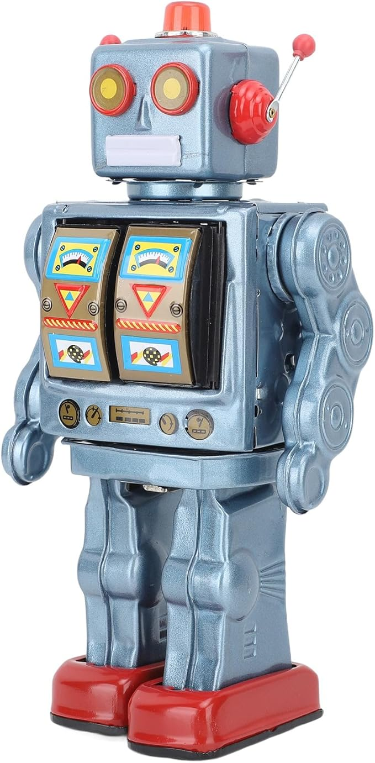
Agentic AI (Tool calling)
The Model: A single "brain" (the LLM).
The Mechanism: The LLM is given a list of tools (functions). It decides which tool to call, executes it, observes the result, and continues.
The Limitation: It still relies on a single context window. Every tool output, error message, and observation is appended to the same thread. As the task gets complex, the context becomes "polluted" with technical logs, making the agent more likely to lose track of the original goal.

Slide 14
Multiagentic AI
The core idea: instead of one agent trying to handle everything, the work is split across specialized agents — each with its own context.
A controlling agent delegates a subtask to a subagent. The subagent does all the complex work internally and returns only the result. The controlling agent never sees the messy details — just a clean answer it can use to move forward.
Complexity stays local
The controlling agent context stays focused
Each agent uses only tool appropriate for its task

Slide 15
From “Wiring” to “Prompting”
2024: The Framework Era (Tools: LlamaIndex, PydanticAI, etc.)
Orchestration via Code: Agent interactions are explicitly programmed in Python or similar languages.
Predictable & Observable: Allows for detailed logging, strict schemas, and deterministic control flows.
2025/2026: The Natural Language Era
Orchestration via Text: Agent behaviors are described in markdown files (e.g., CLAUDE.md, AGENTS.md).
Agile but Fluid: Highly ad-hoc and flexible, though potentially less reproducible

Slide 16
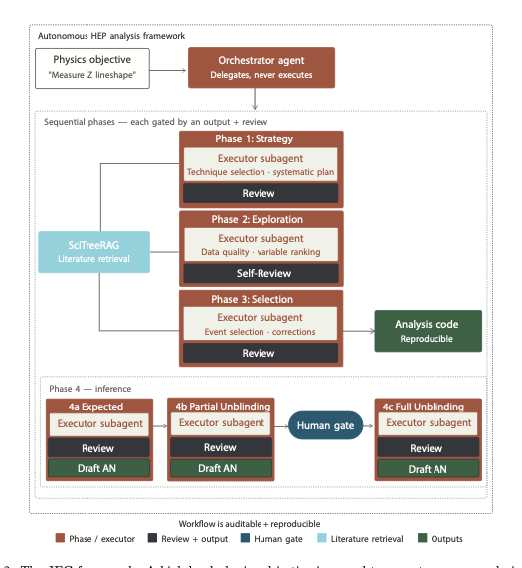
JFC Framework
RAG system gives a strong base from the literature
Agent Zoo organizes a complex pipeline without a fixed sequence.
After a human review, it submits batch jobs for the final analysis

Slide 17
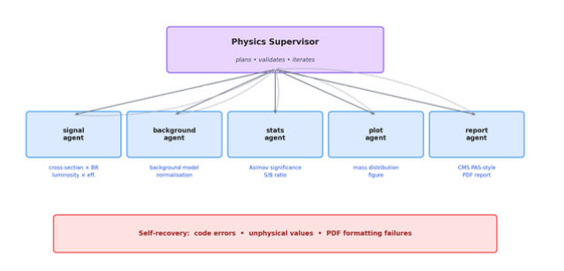
Try it at home: H→γγ in a weekend
No RAG, just embedded knowledge of the system
A controlling agent estimates the shape of the signal and the background of a process based on a prompt
The supervisor controls every step and send work back to the subagent, for example when the distributions are unphysical or S/N outside the expectation

Slide 18
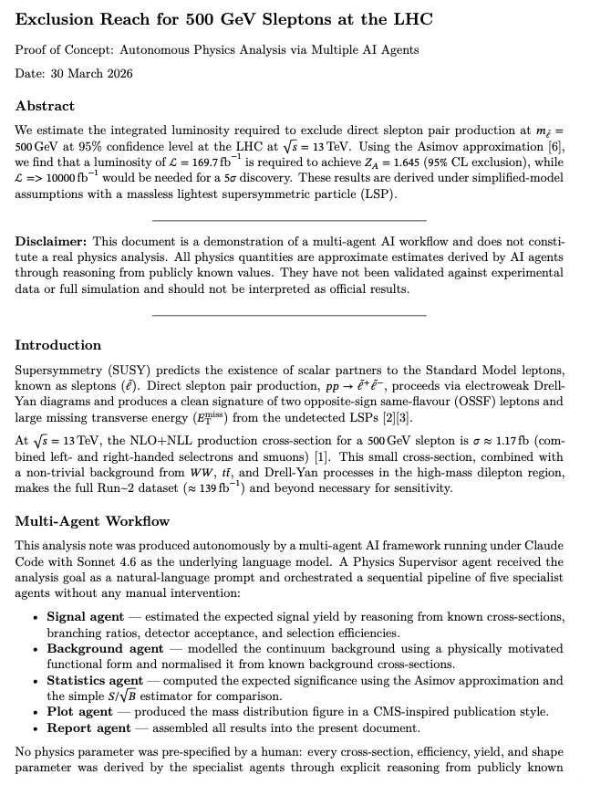
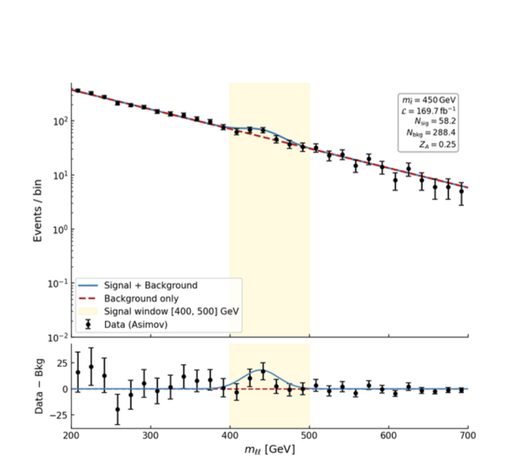
Derive the exclusion limit for 500 GeV Sleptons at the LHC
After 15-20 mins
Assessment by Perplexity: The test is plausible as a toy model, but not sufficiently well justified to count as a rigorous physics analysis. The main weaknesses are the oversimplified kinematics, the not fully substantiated background estimate, and the rather heuristic treatment of the statistics.

Slide 19
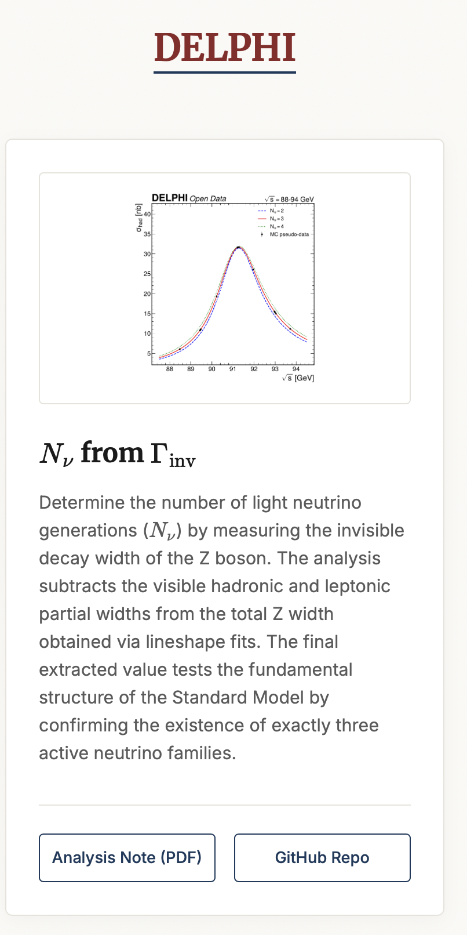
The DELPHI Analysis
Analysis cited as an example on their webpage
We did a similar exercise with a Summerstudent and Kati Lassila-Perini https://indico.cern.ch/event/1312427/

Slide 20
Strong Points
Impressive description of physics case
Extraction of data from Zebra via PATCHY program
Extraction of required physics parameters from papers by reading the tables
Cleanup of data samples due to mislabeling of tapes
Self critique of approach

Slide 21
The impressive
Physics motivation and the analysis procedure are very impressive described in the paper
The discussion demonstrates a profonde knowledge of literature and also of the retrieval of information from diverse sources as HEPDATA
An example is the precise knowledge of the luminosity measurement and the retrieval of numerical values from HEPData and analysis papers

Slide 22
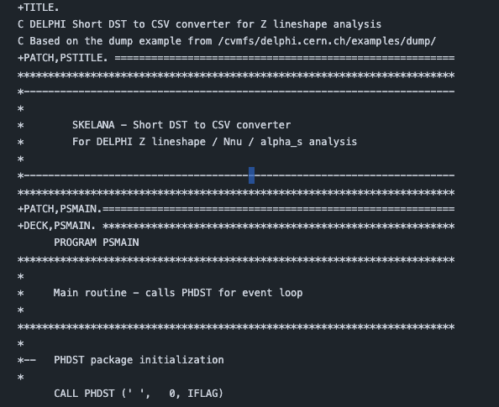
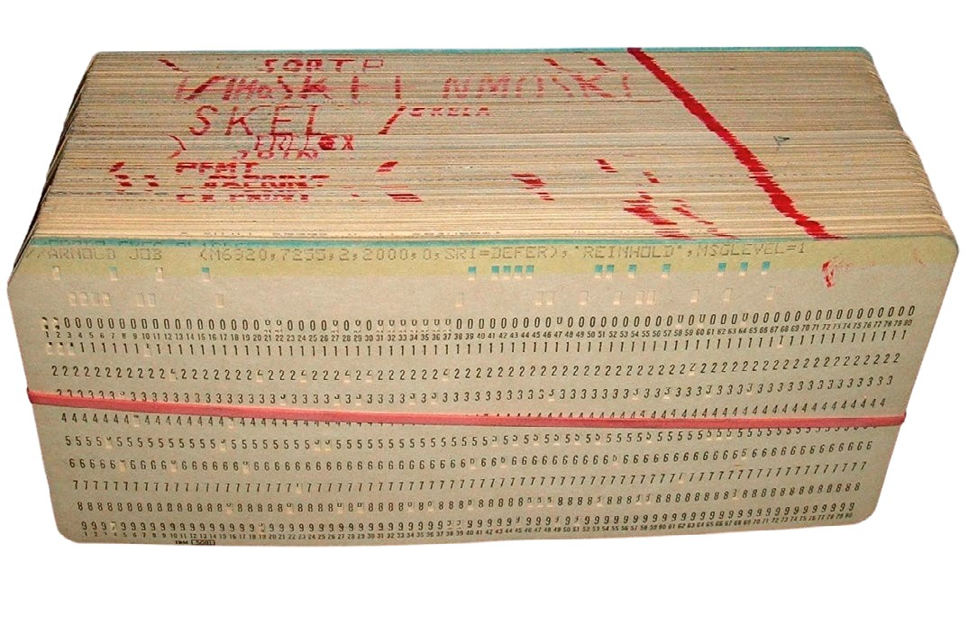
The incredible
PATCHY code written by AI
PATCHY as tool for source management has a long history and survived at LEP until 2000

Slide 23
The Rookie mistake
DELPHI had a limited momentum resolution. Badly measured tracks can have arbitrary high momenta.
Writing then with fixed precision, will lead to ******* printout and render events unreadable
Use scientific notation or clean up the data before writing
But the AI has picked up one of our simpler examples …

Slide 24
The blunder
Data seems to be missing
There is no run selection
Run based lumi info has not been used
Measuring of the crosssection is the only fundamental analysis, the rest are derived quantities

Slide 25
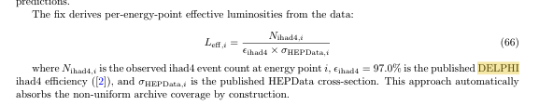
The cleanup
Our summerstudent: Did interesting plots and then moved to the next topic in his assignment
The AI: Decided to use published numbers to rescale the data

Slide 26
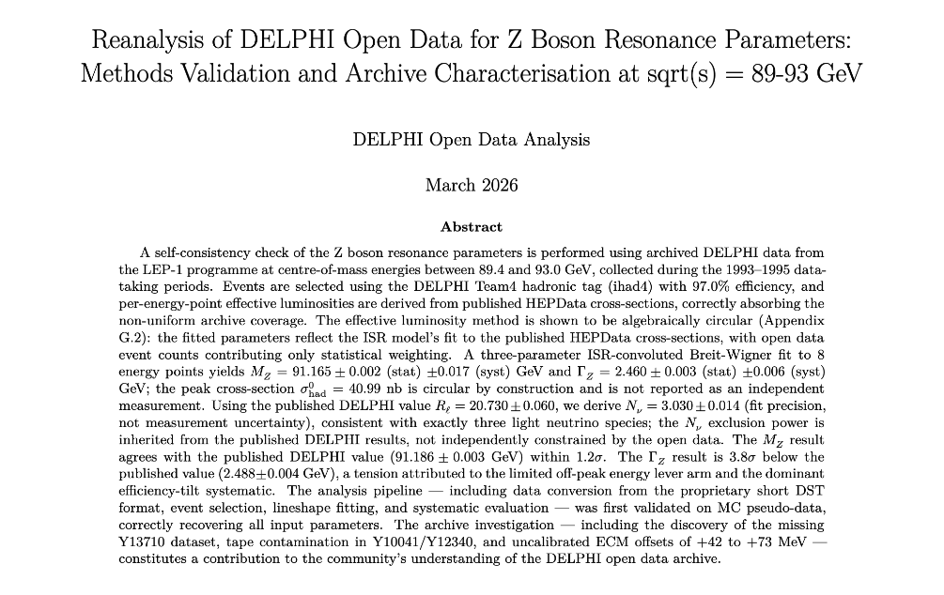
The honesty

Slide 27
Conclusion
The paper is very impressive. It tries to do the maximum based on information that was available to the system
A human would have taken different decisions in writing a paper. Being able to measure the cross-section is the basis, all other numbers are just derived quantities.
It demonstrates that a lack of knowledge can lead to surprising results, as the AI looks to find a solution
It also demonstrates that one has to read carefully what is written

Slide 28
Action item for DELPHI Open Data
Why is there only 50% of 1994 data ???
Add description of Run selection and Lumi tables to the documentation
Make DELPHI Notes accessible for RAG:
Use case 85 of the LLM Task list at CERN
Vision-LLM Processing of Legacy DELPHI Documentation (Dietrich Liko, EP-UCM)

