Slide 1
CYGNUS-Oz Fortnightly
01 April 2026

Slide 2
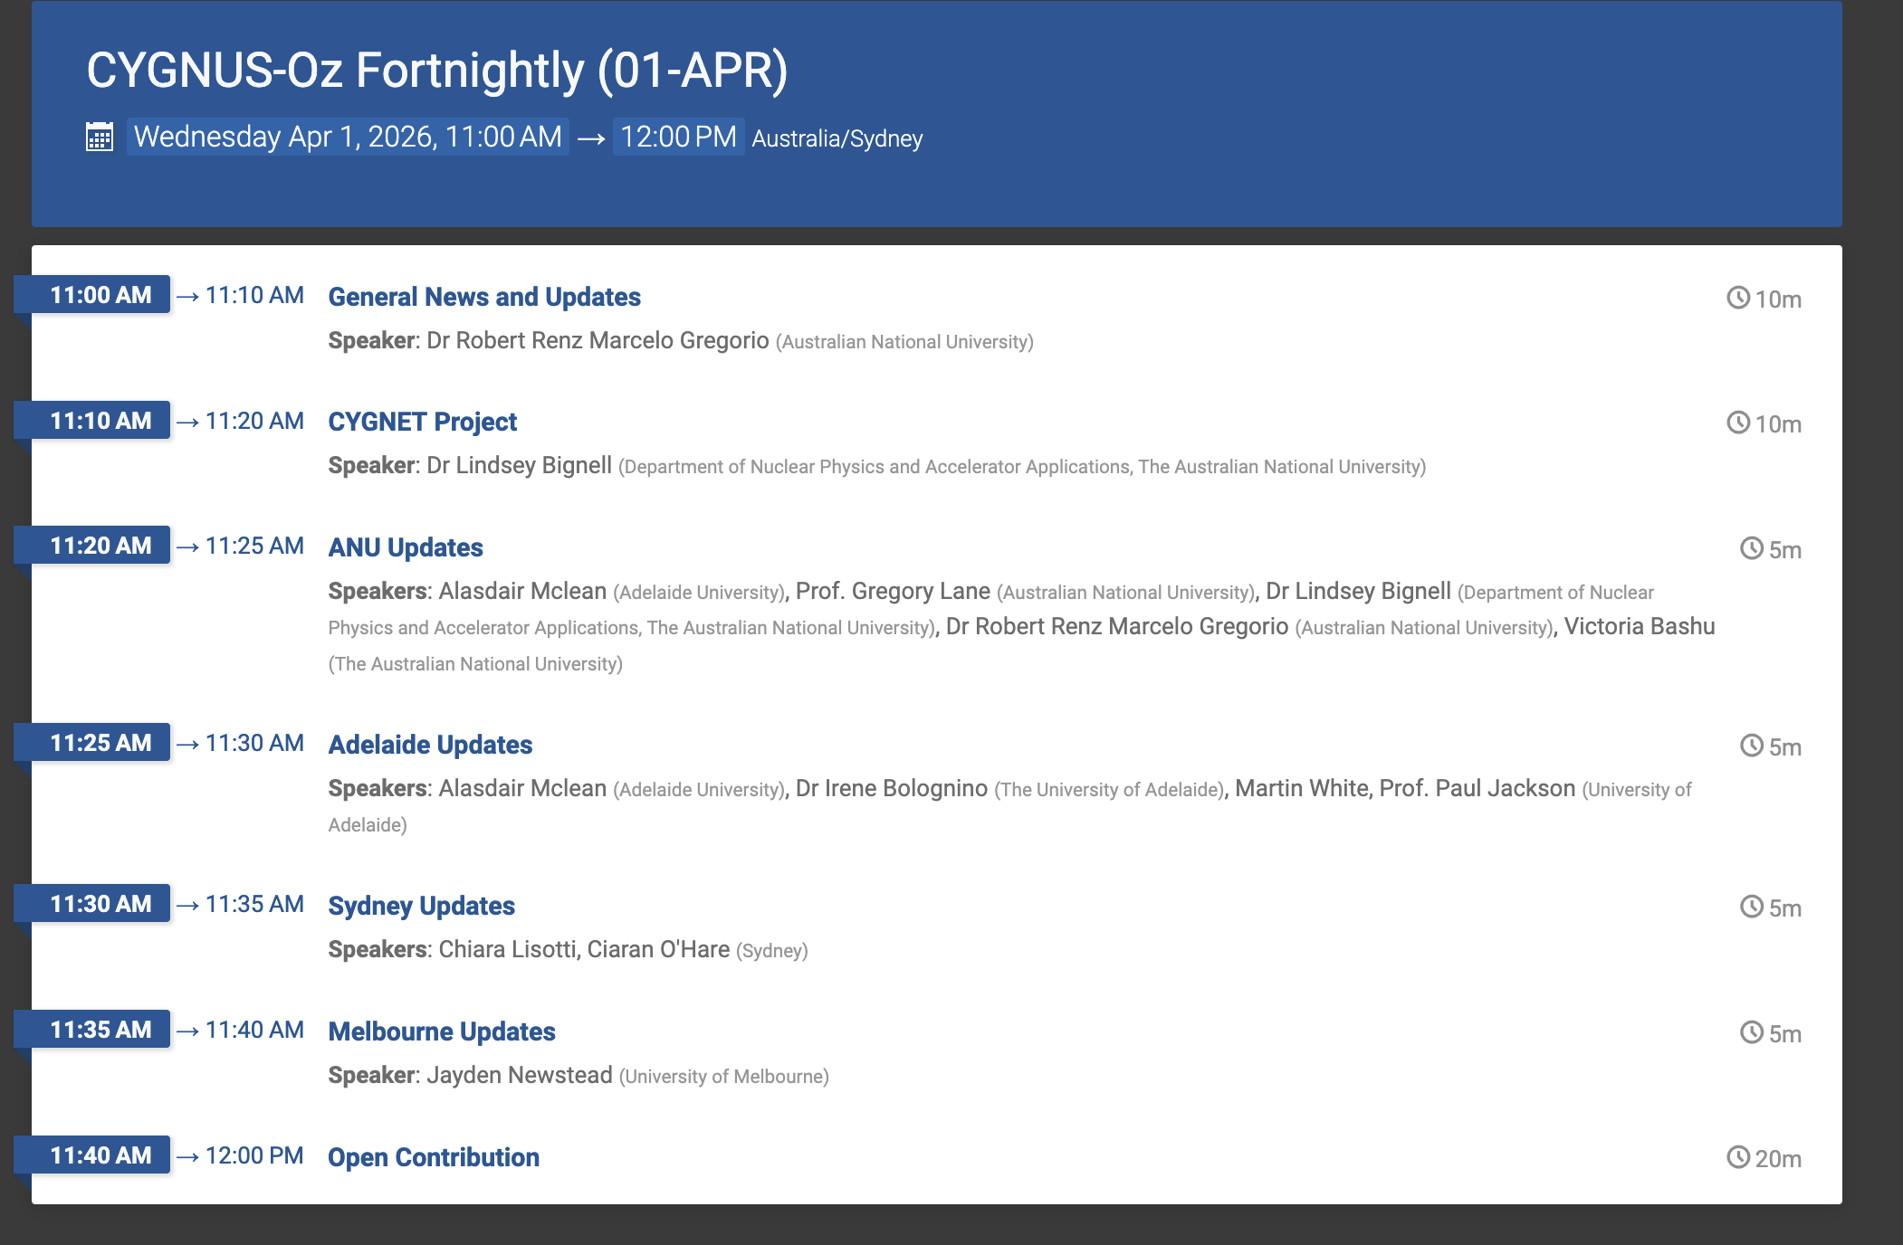
CYGNUS-Oz Fortnightly
CYGNUS-Oz Wednesday 11 am (Canberra time)
https://indico.global/event/17460/

Slide 3
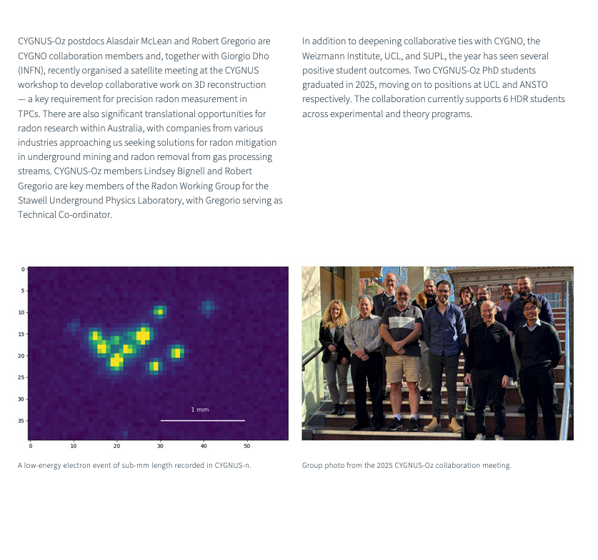
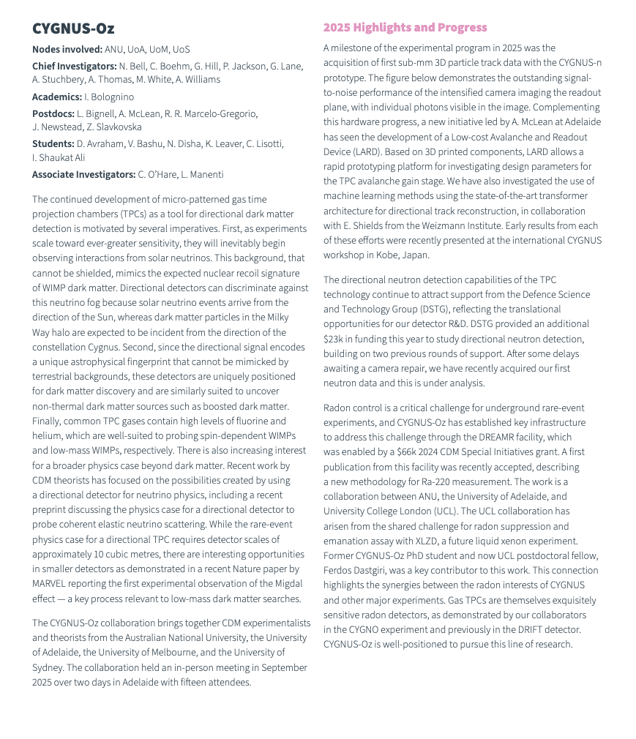
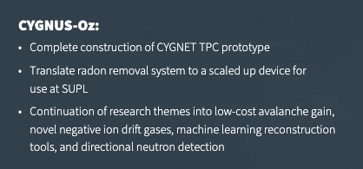
General News and Upcoming Events
Centre publishes 2025 Annual Report – Great Work Everyone! ☺

Slide 4
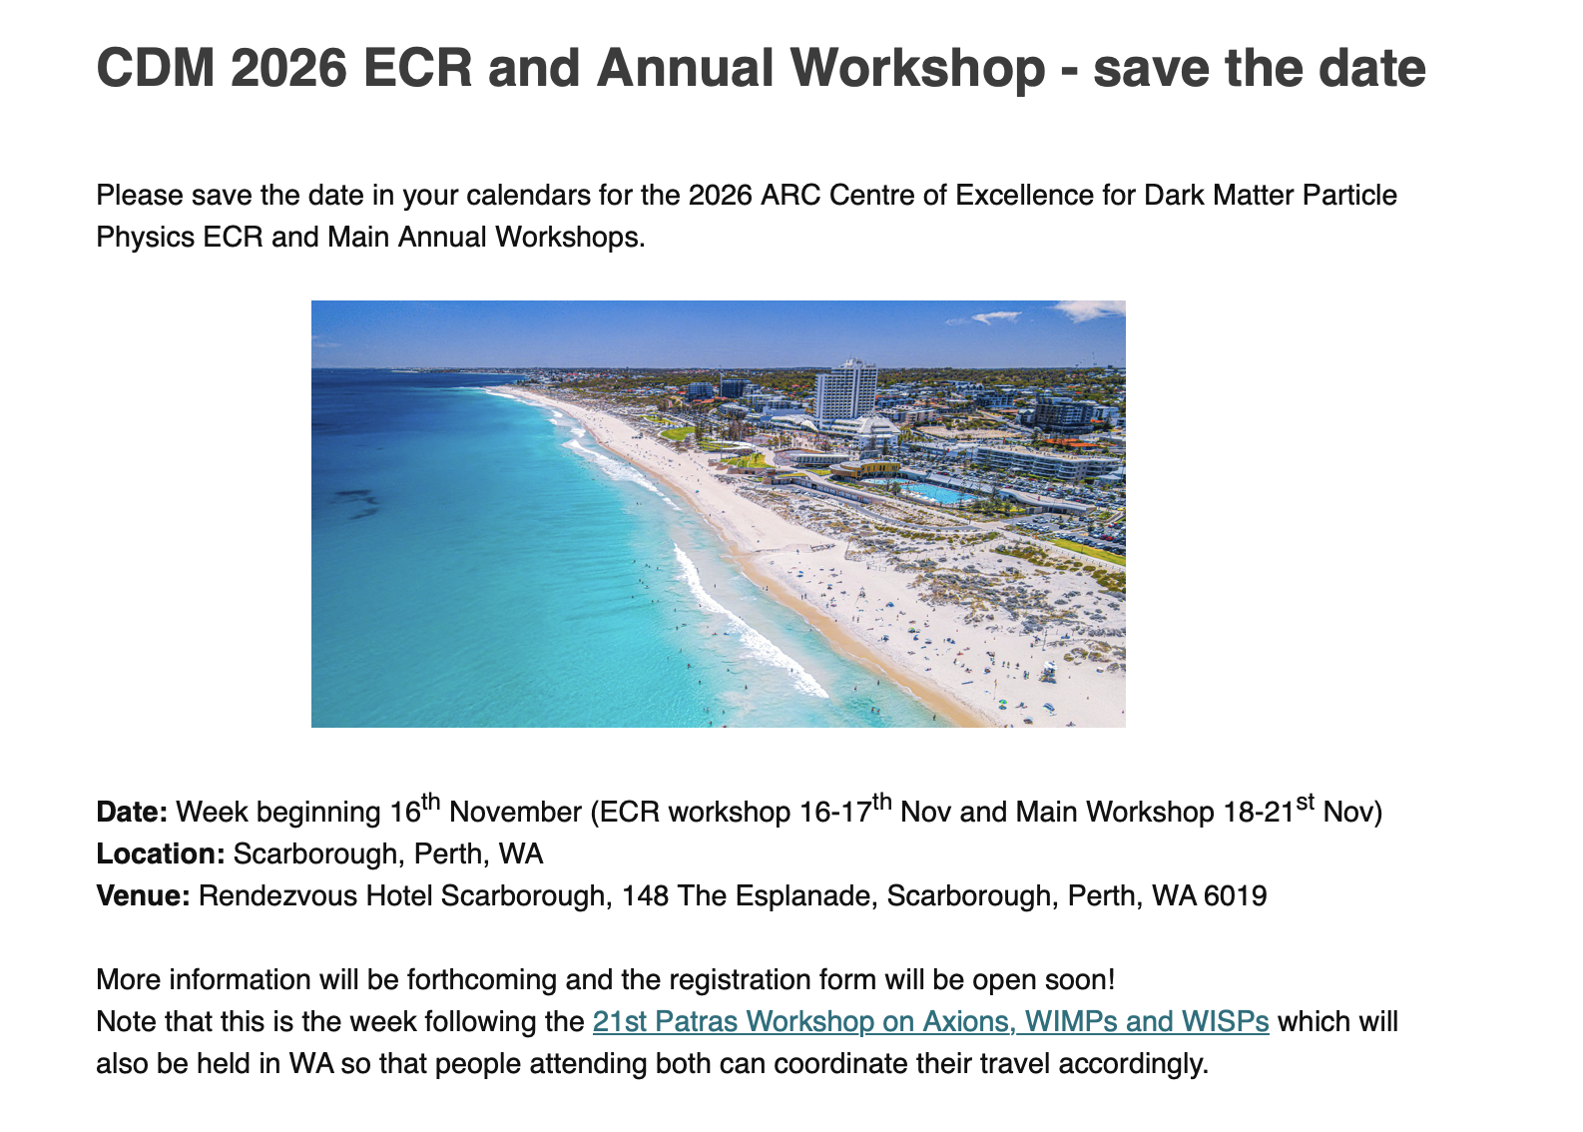
General News and Upcoming Events

Slide 5
CYGNUS & CYGNOz Workshop
9th edition of the international CYGNUS Workshop on Directional Recoil Detection 🇯🇵
Mon 23rd 09:40- Chiara (An overview of CYGNUS’ reach for dark matter and neutrino searches )
Mon 23rd 14:25 - Lindsey (Negative ion formation in pure CF4 via dissociative electron attachment)
Tue 24th 09:30 – Rob (Direct in-chamber radon-220 (thoron) emanation measurements for directional dark matter experiments)
Tue 24th 11:05 - Ali (Micromesh structures for Charge Amplification and Readout in Negative Ion Gases)
Wed 25th 09:40 - Eddie (Machine Learning methods for Directional Recoil Detection reconstruction at CYGNUS-Oz)
CYGNO x CYGNUS-Oz Workshop 2026 (Feb 26)

Slide 6
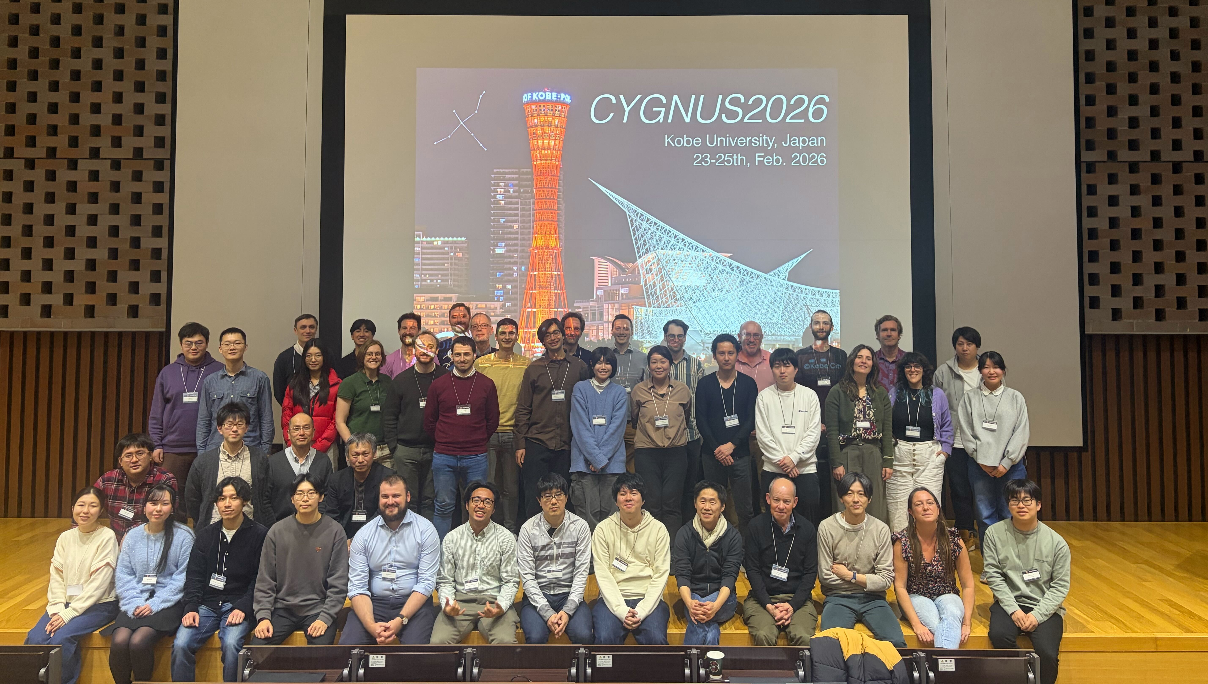
CYGNUS Conference
https://indico.global/event/15704/timetable

Slide 7
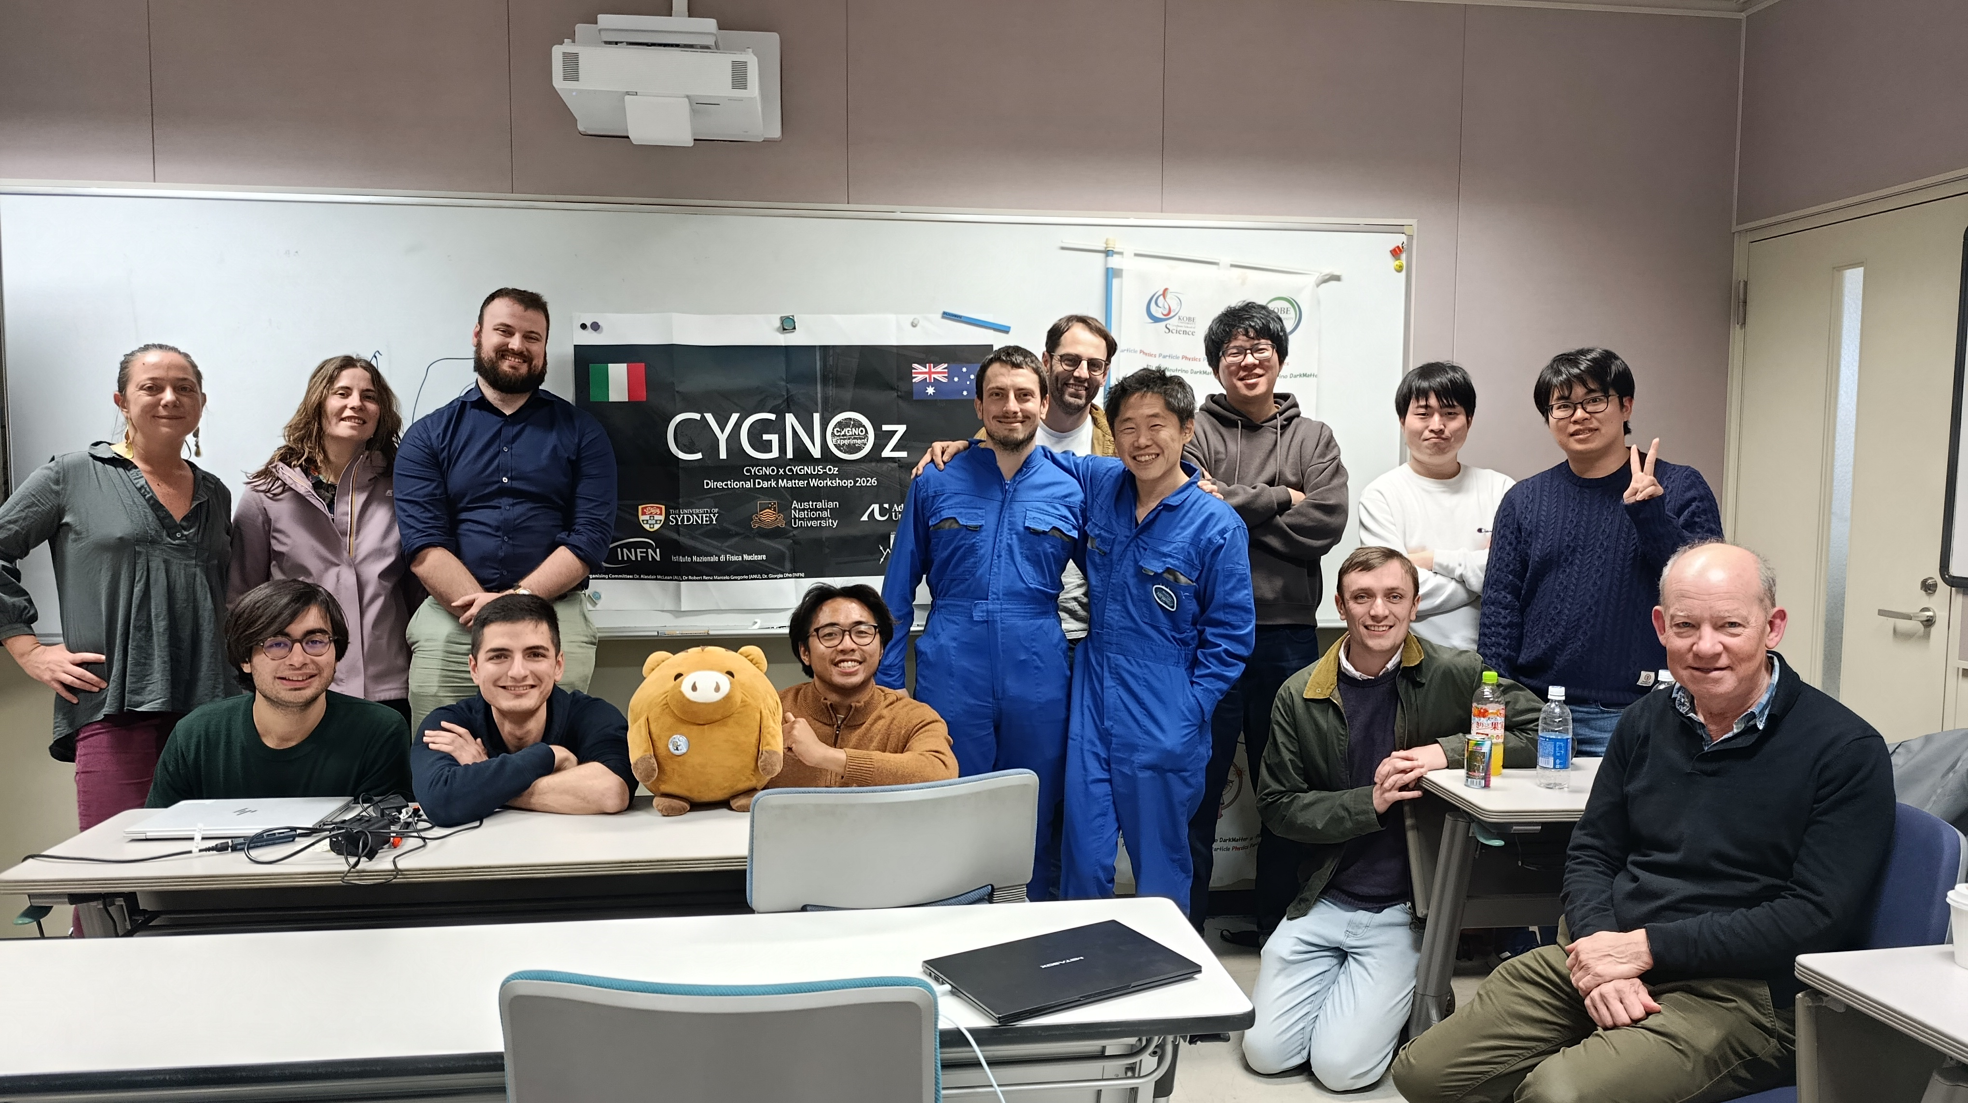
CYGNOz Workshop

Slide 8
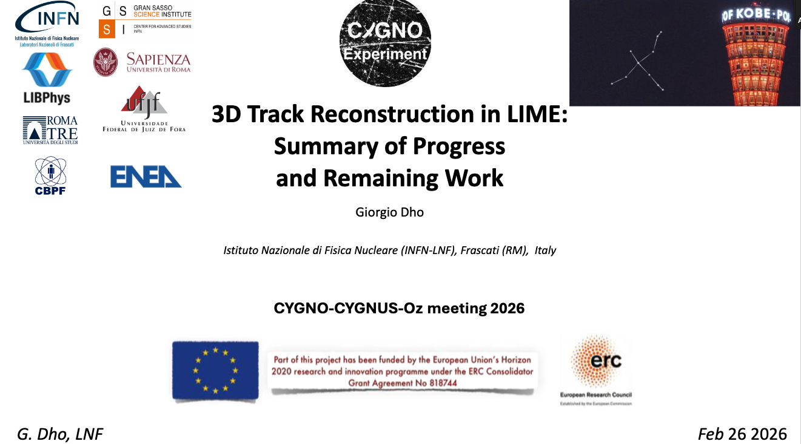
CYGNO Open tasks
https://indico.global/event/16685/contributions/144684/attachments/67241/130327/3D_Dho.pdf

Slide 9
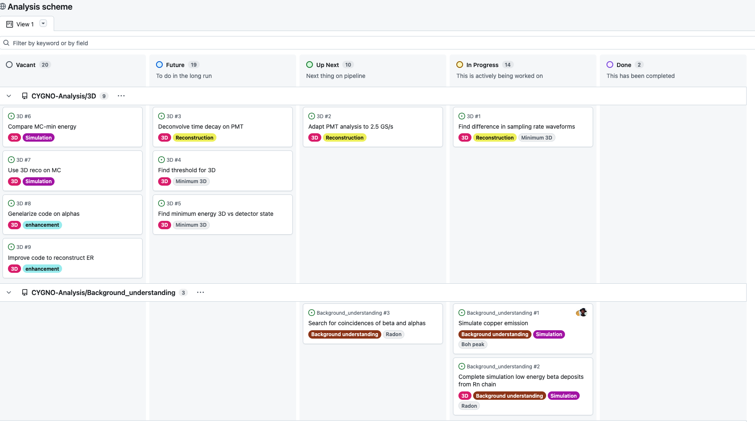
CYGNO Open tasks
https://github.com/orgs/CYGNO-Analysis/projects/1

Slide 10
AGENDA
CYGNET TPC Prototype
ANU Updates
Adelaide Updates
Sydney Updates
Melbourne Updates
Open Contribution

Slide 11
ANU Updates
Detector Development
Radon research
SUPL Radon Mitigation Project
Radon Emanation Facility
Radon Electroplating Project
Radon Event Tagging for CYGNO
Machine Learning for 3D Track Reconstruction
Led by Eddie Shield (CERN/Weizmann)
Application of Modern ML Architecture
Investigating super resolution for CYGNUS-Oz

Slide 12
AGENDA
CYGNET TPC Prototype ✅
ANU Updates ✅
Adelaide Updates
Sydney Updates
Melbourne Updates
Open Contribution

Slide 13
Open Contribution

