Slide 1
CYGNUS-Oz ANU Weekly
25 March 2026

Slide 2
General News
https://indico.global/event/17459/
Admin for new students:
Please create an indico profile!
CYGNUS-Oz ML Track reconstruction meetings
Fortnightly ML Tuesday 18:00 (Canberra time)
ANU CYGNUS-Oz Weekly to merge with CYGNUS-Oz Meeting
Wednesday 11:00 (Canberra time)

Slide 3
Upcoming Events
Greg Away 17th -25th March
Rob @ Panda-X and CJPL Underground Lab: 9th-17th April
Focus talk (TBC)

Slide 4
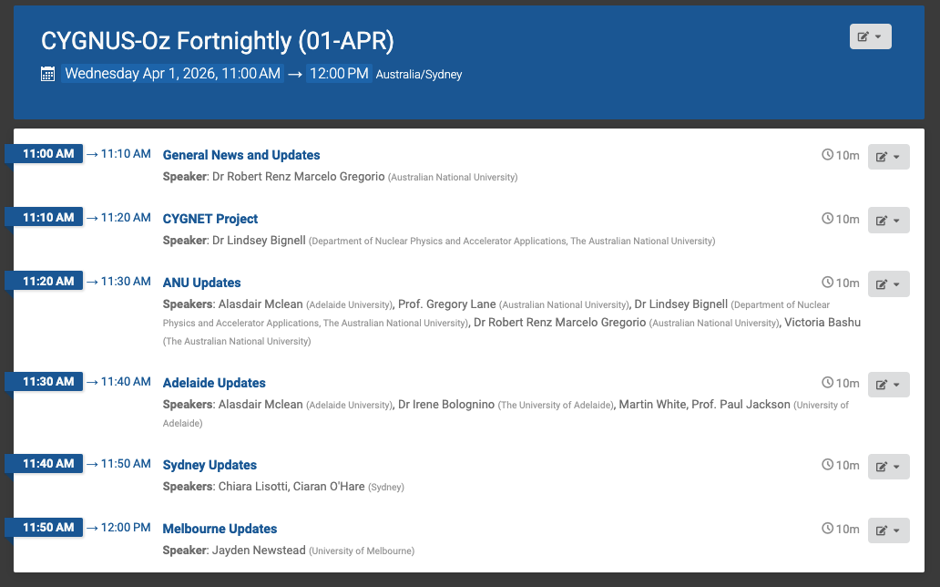
CYGNUS-Oz Fortnightly
CYGNUS-Oz Weds 11 am (Canberra time )
Alternate Wednesdays
Technical Meeting (ANU)
Institutional Updates
Agenda OK?

Slide 5
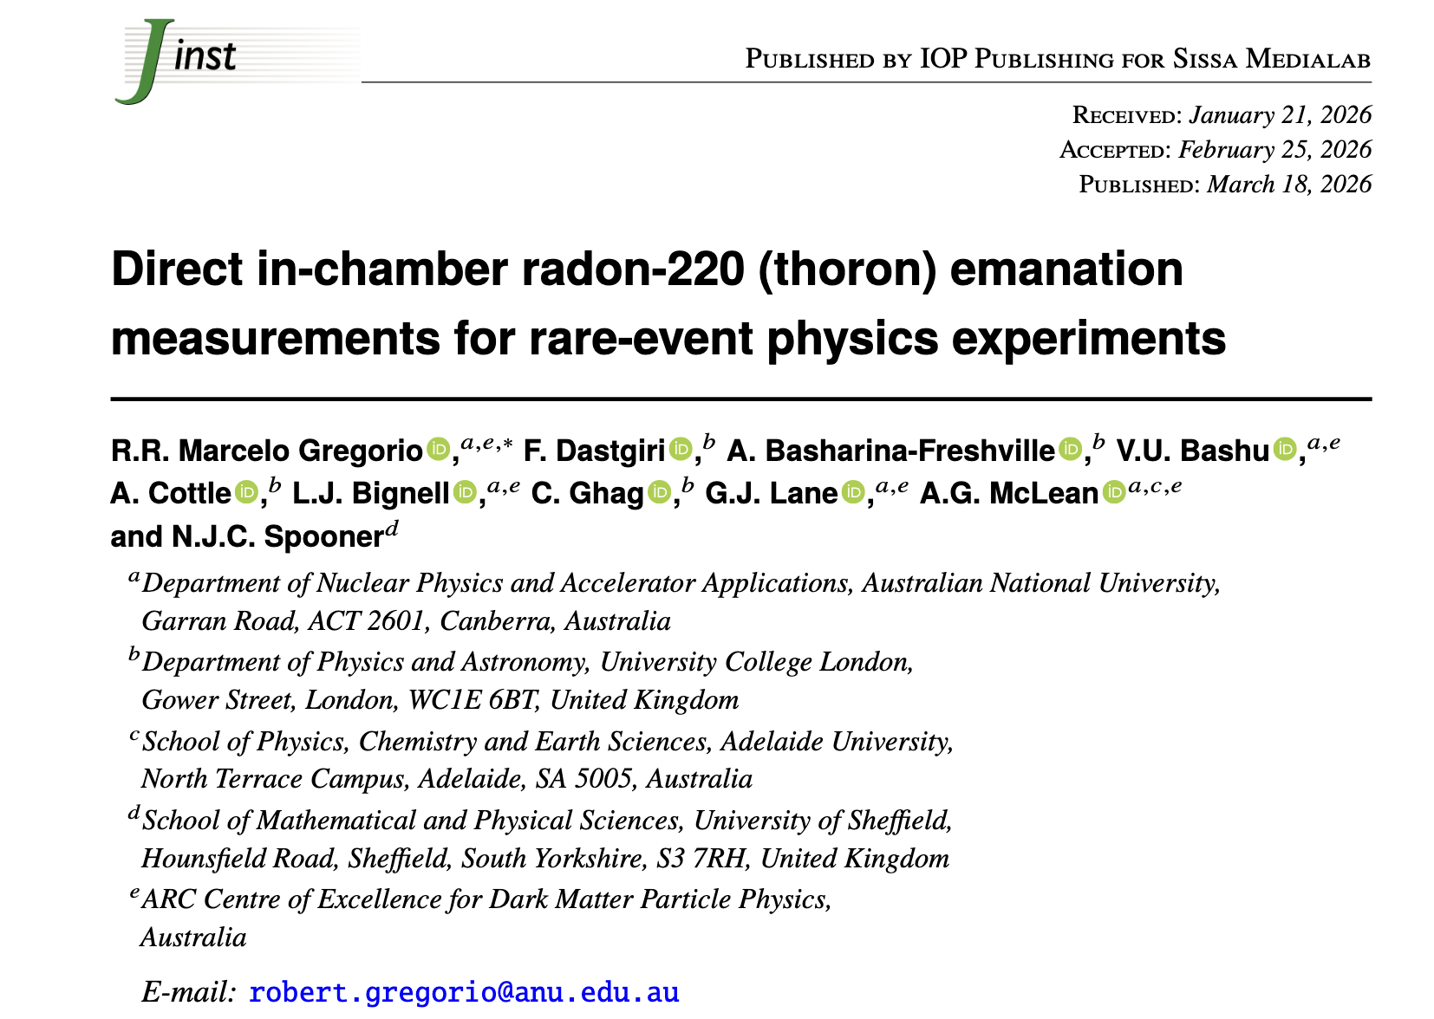
Publication Plan
In progress
Direct in-chamber radon-220 (thoron) emanation measurements for rare-event physics experiments
R.R. Marcelo Gregorio et al 2026 JINST 21 P03027 ✅
High Negative Ion Gain MMThGEM-Micromegas Detector for Directional Dark Matter Searches
Submitted to JINST( arXiv: 2602.12658) – A. G. Mclean
LARD (Low-Cost Amplification Readout Devices): A Rapid Prototyping Platform
A. G. Mclean - Writing
Negative ion formation in pure CF4 via dissociative electron attachment
L.J. Bignell – Writing
Improving accuracy of in-gas radon assay electrostatic detectors and application to He, CF4 and SF6 for directional dark matter experiments
R.R Marcelo Gregorio – Repeating tests at ANU
Planned
Using LARD Platform for optimising [insert here] for directional dark matter searches
V.U. Bashu
Improving sensitivity in DRIFT data with modern ML architecture
E. Shield (CERN)

Slide 6
Publication Plan
In progress
Direct in-chamber radon-220 (thoron) emanation measurements for rare-event physics experiments
R.R. Marcelo Gregorio et al 2026 JINST 21 P03027 ✅
High Negative Ion Gain MMThGEM-Micromegas Detector for Directional Dark Matter Searches
Submitted to JINST( arXiv: 2602.12658) – A. G. Mclean
LARD (Low-Cost Amplification Readout Devices): A Rapid Prototyping Platform
A. G. Mclean - Writing
Negative ion formation in pure CF4 via dissociative electron attachment
L.J. Bignell – Writing
Improving accuracy of in-gas radon assay electrostatic detectors and application to He, CF4 and SF6 for directional dark matter experiments
R.R Marcelo Gregorio – Repeating tests at ANU
Planned
Using LARD Platform for optimising [insert here] for directional dark matter searches
V.U. Bashu
Improving sensitivity in DRIFT data with modern ML architecture
E. Shield (CERN)
Radon emanation measurement for low-background experiments: methodologies, facilities, and future directions
R.R Marcelo Gregorio - Review Paper

Slide 7
AGENDA
Detector Development
CYGNUS-N/CYGNET
Adelaide Updates
LARD Group Updates
Track Reconstruction
Machine Learning
CYGNO Tasks
Radon Group

Slide 8
CYGNUS-Oz Radon Group

Slide 9
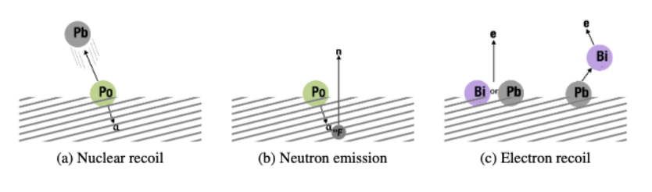
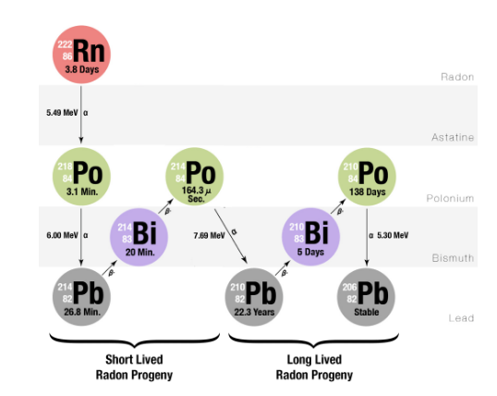
CYGNUS-Oz Radon Group Overview
Origin of Radon Contamination
Radon-induced backgrounds
Intrinsic material emanation
Ambient radon plate out (long lived)
Radon Decay Chain
Radon Strategies
Radon Detection and Mitigation
Radon Event Tagging (Analysis/Simulation)

Slide 10
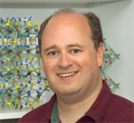
General Radon Updates
Adelaide CYGNUS-UK Equipment
~2 kg of 5A Molecular sieves
Vacuum Filtration Column (~2 kg Capacity)
Expression of Interest for synthesising radon capturing filters
Connected by Prof Anthony Philips (QMUL)
Wider Radon activities in Adelaide University
Radiobiology (A/Prof Anthony Hooker)
Prof. Stuart Batten*
(MONASH)
*Supervised by Nobel Prize winner Richard Robson (2025) MOFs

Slide 11
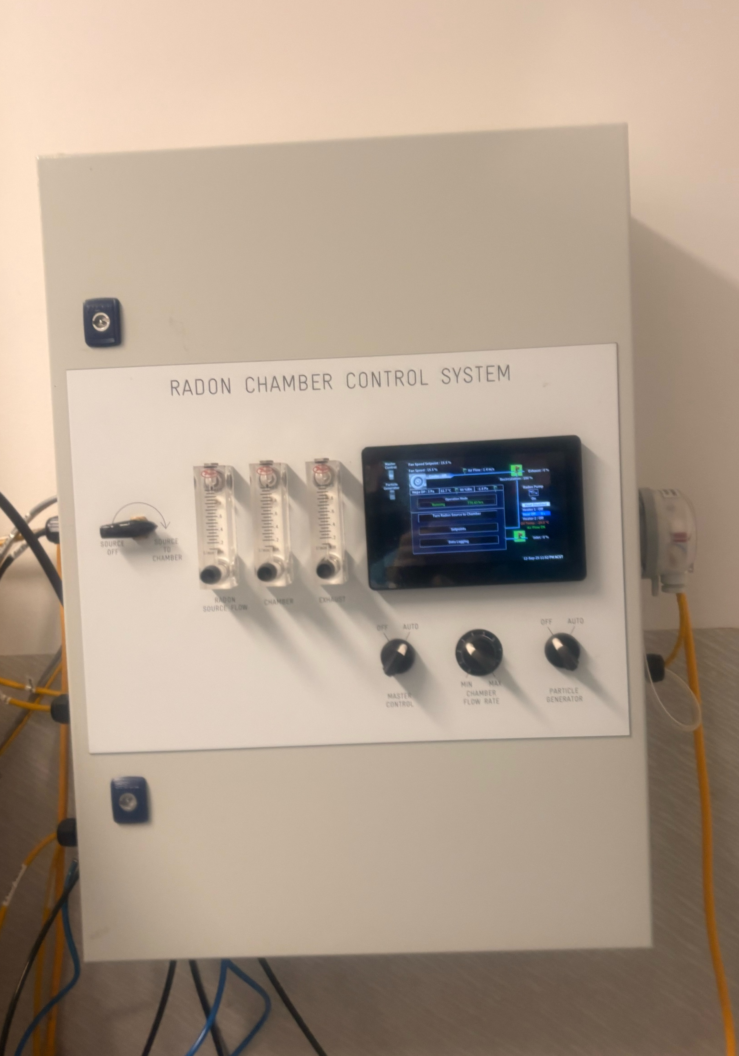
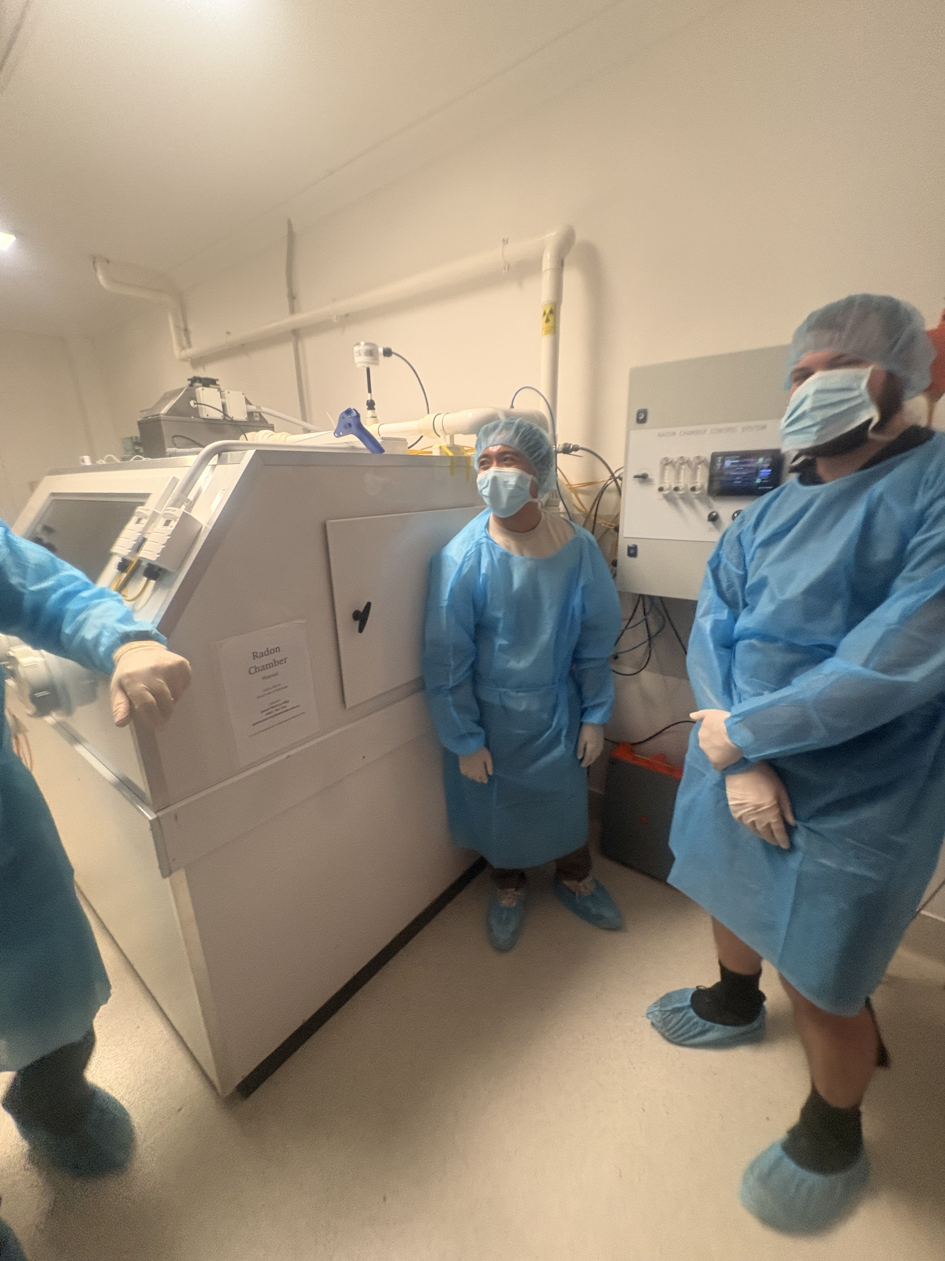
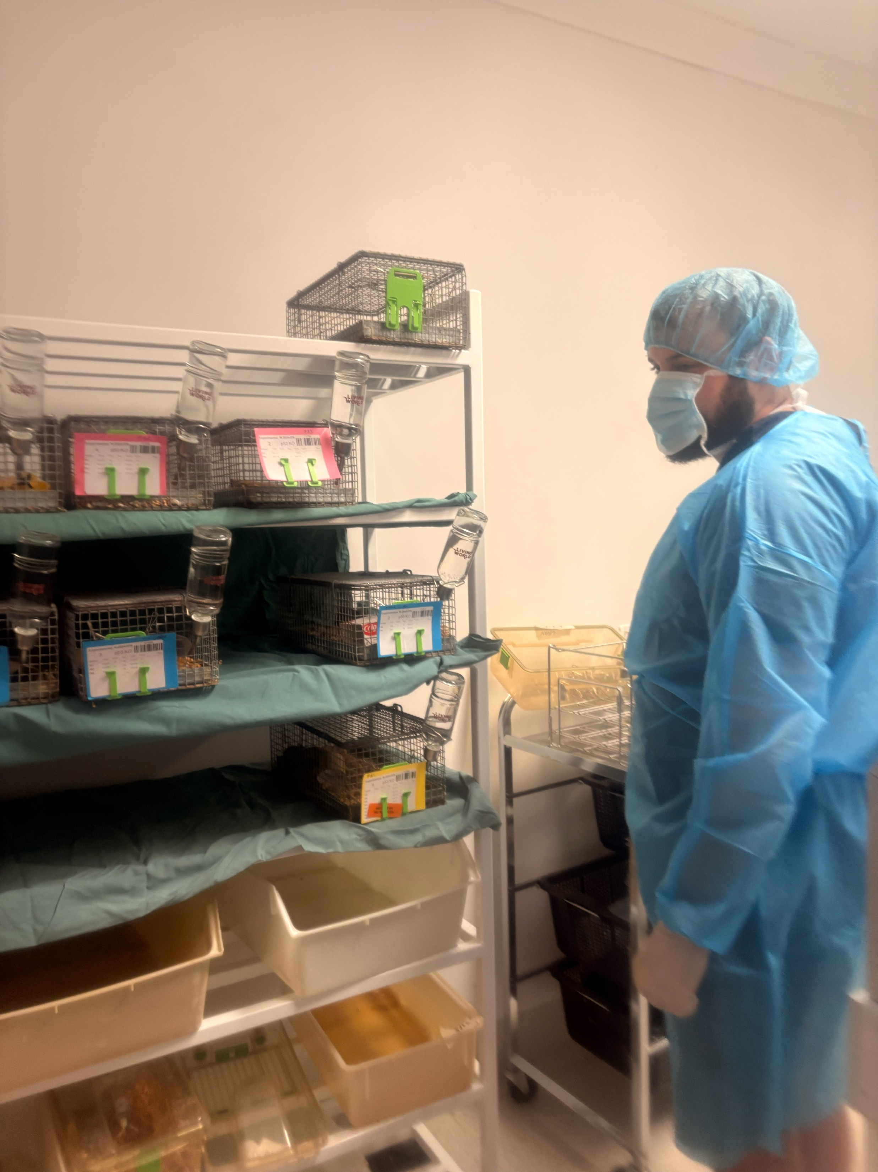
Radon Radiobiology

Slide 12
SUPL Radon Mitigation Project
K. Davies, L. Truong*
Radon Emanation Facility
S. Yuan
Radon in Different Gases Project
N. Disha
Radon Electroplating Project
L. Bechteler-Weickhardt
Radon Event Tagging for CYGNO
* Research project completed

Slide 13
Back Up

Slide 14
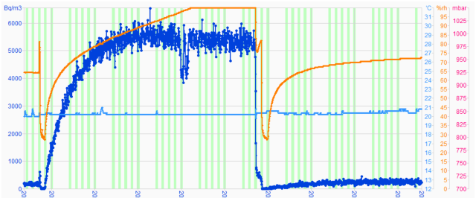
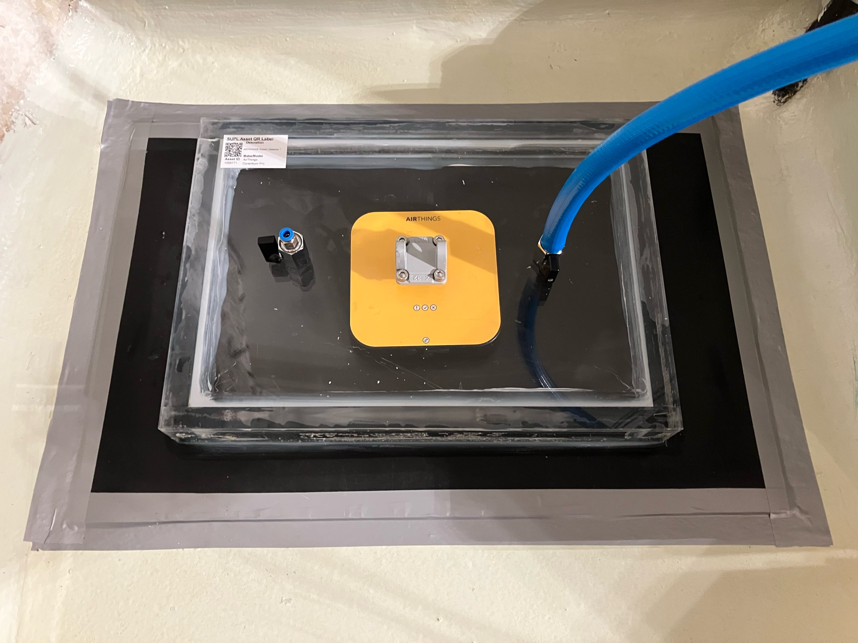
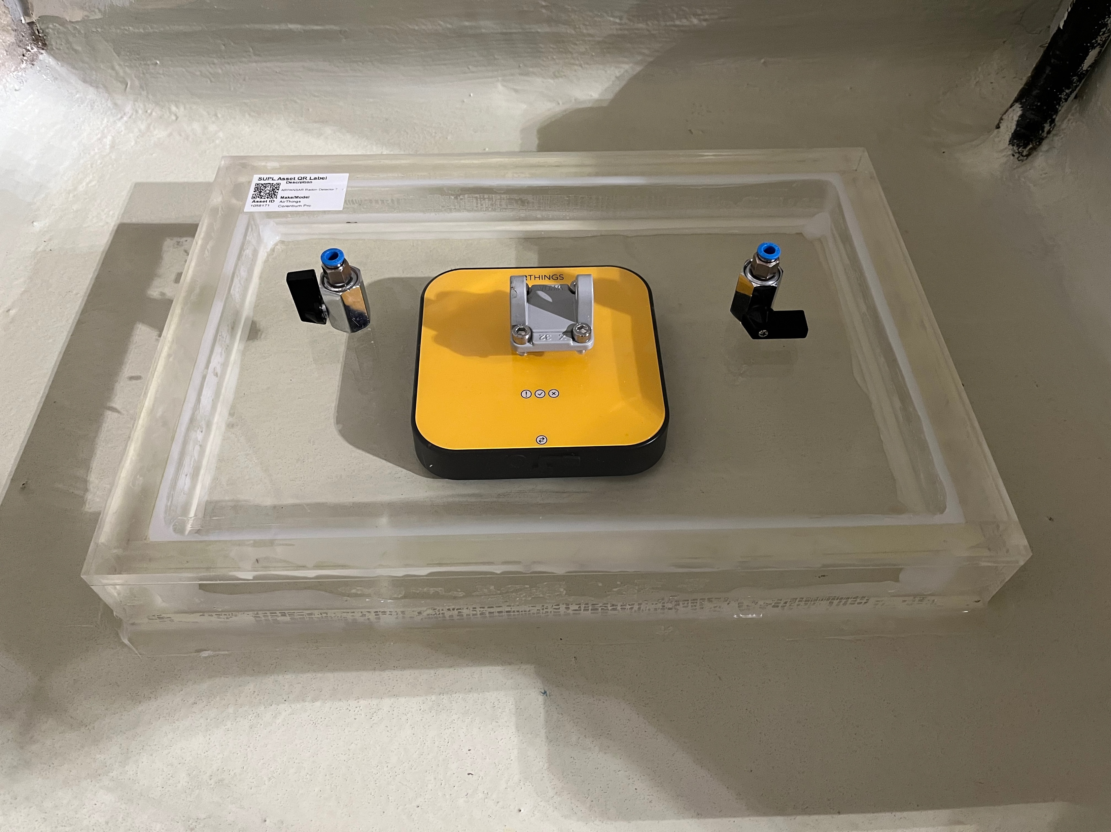
SUPL Project Updates
Radon mitigation at Stawell Underground Physics Laboratory
Prevention of entry with barriers
Dilution with ventilation
Filtration with radon capturing materials (Linda Talk Feb 18th)
Floor emanation (With barrier)
~250 Bq/m3
Floor emanation (no barrier)
~6000 Bq/m3

Slide 15
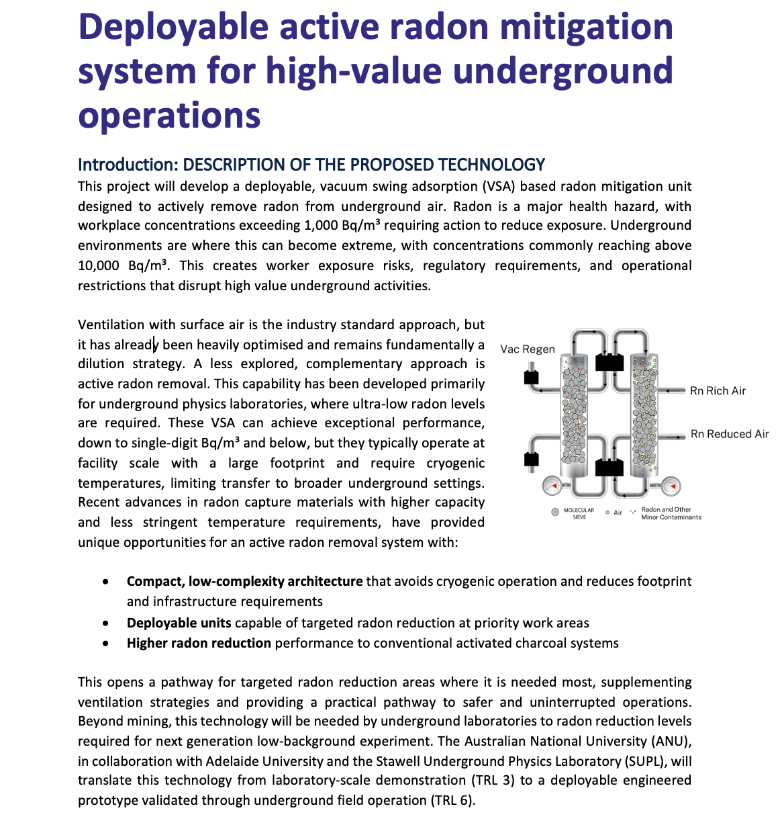
Vacuum Swing Adsorption (VSA) Project

Slide 16
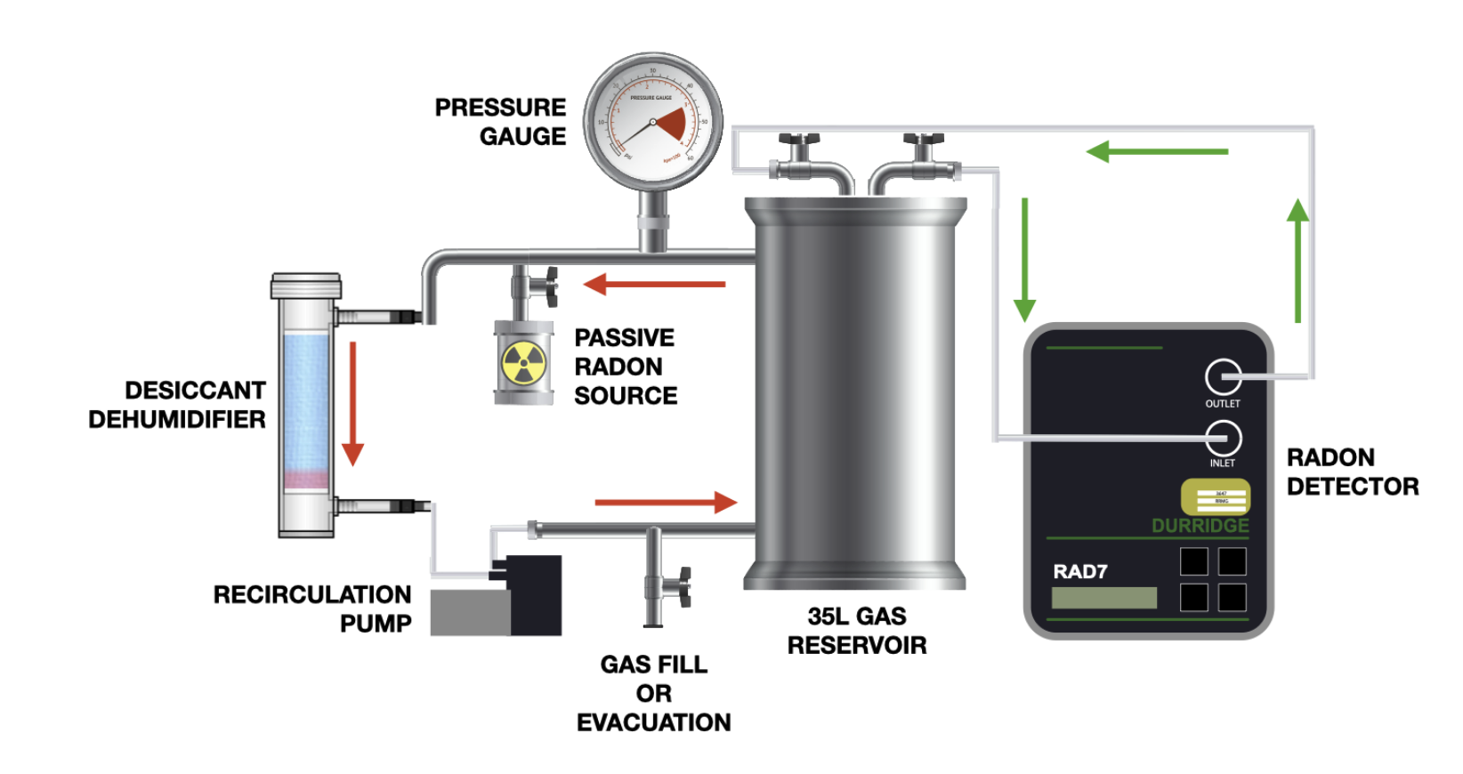
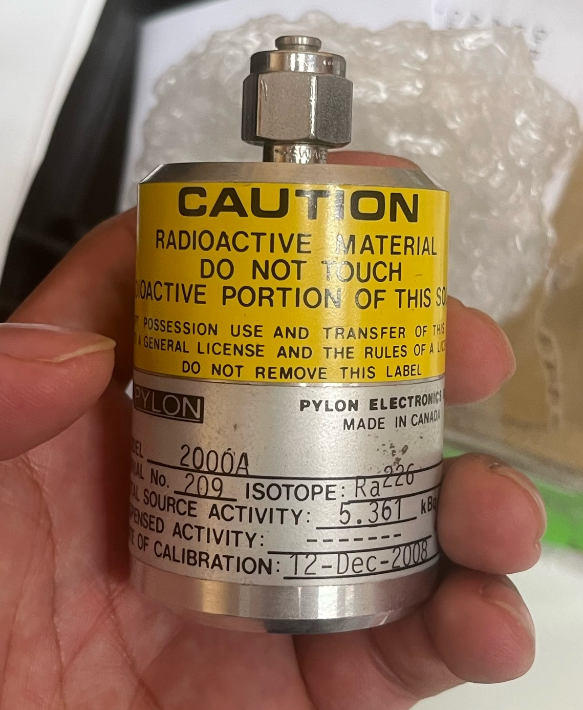
Radon in Different Gases Updates
Original setup take 6 weeks for one measurement
Flow-though radon source method reducing measurement time to ~ 5 days
Natasha is working on making a flow through source with uranium sand
Challenges with pressure buildup
Consulted Dr Michaela Froehlich about Inert solutions
→ Explore different ratios (beads : sand)
→ Different size beads
Original setup
5.6 kBq passive radon source has arrived

Slide 17
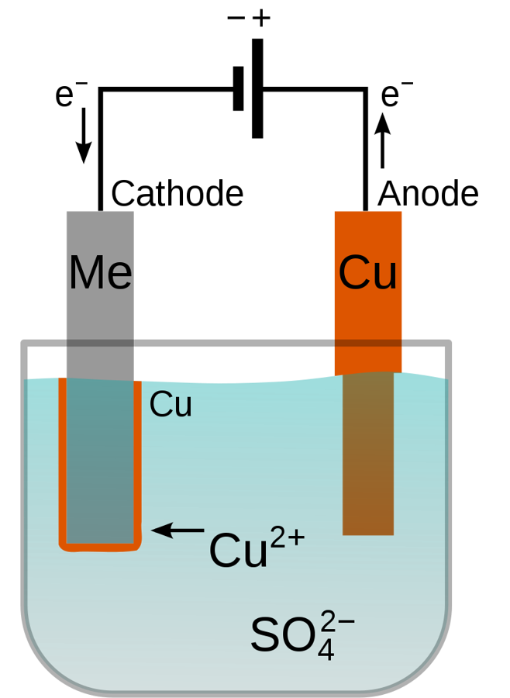
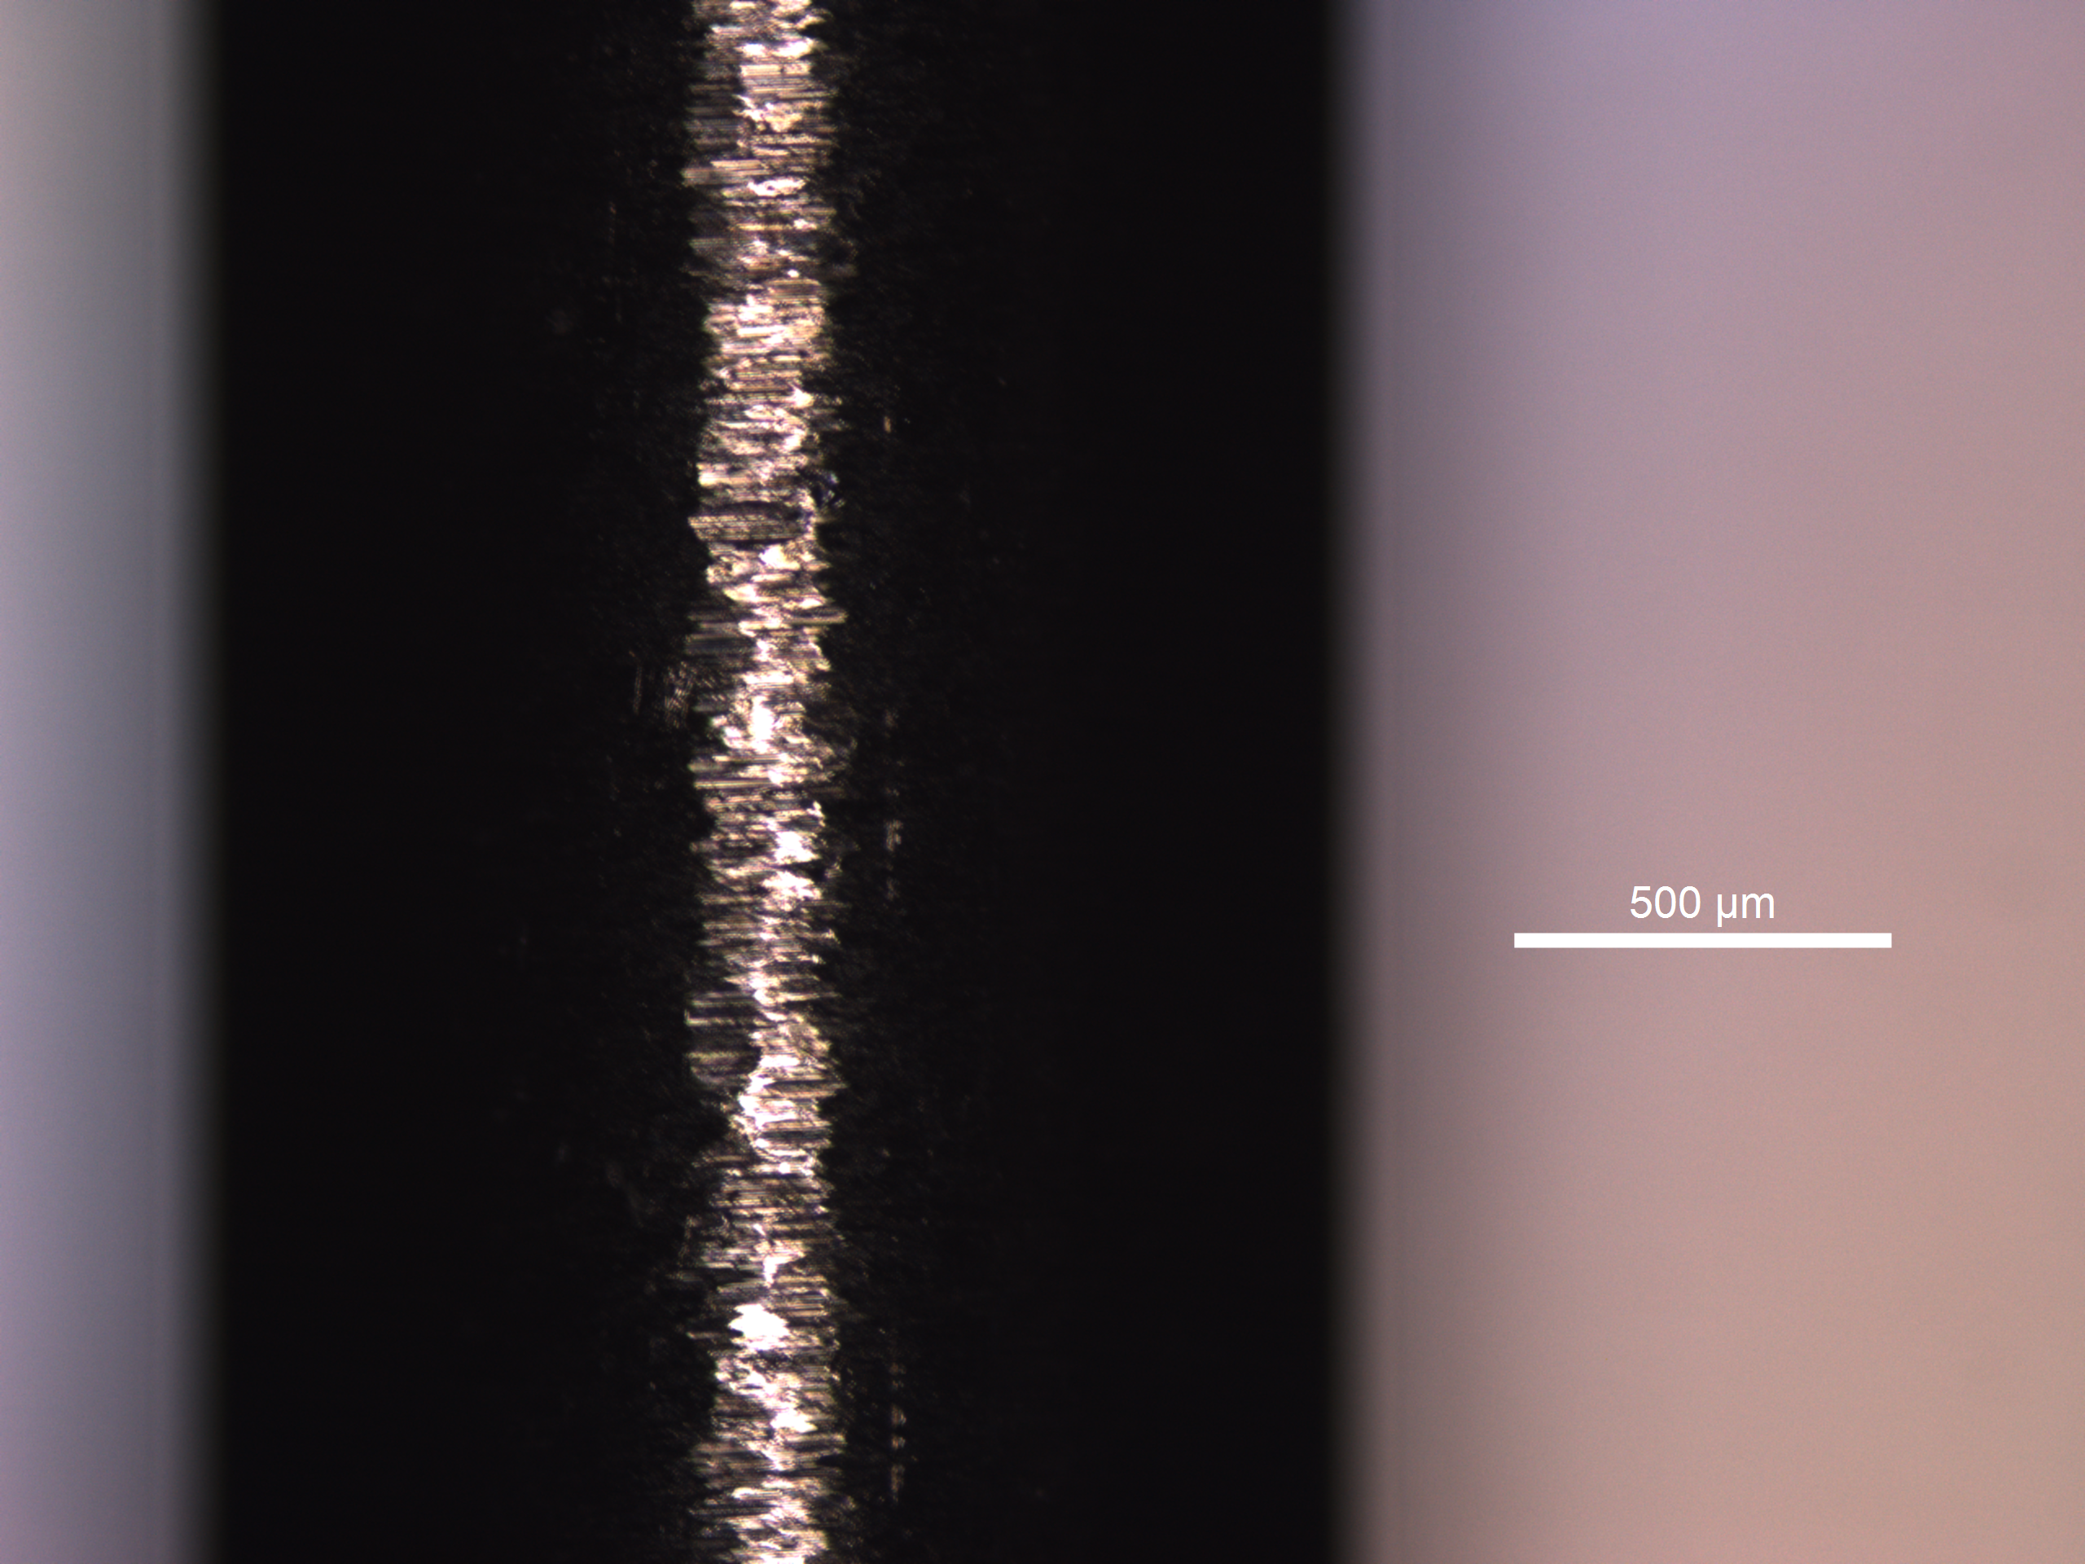
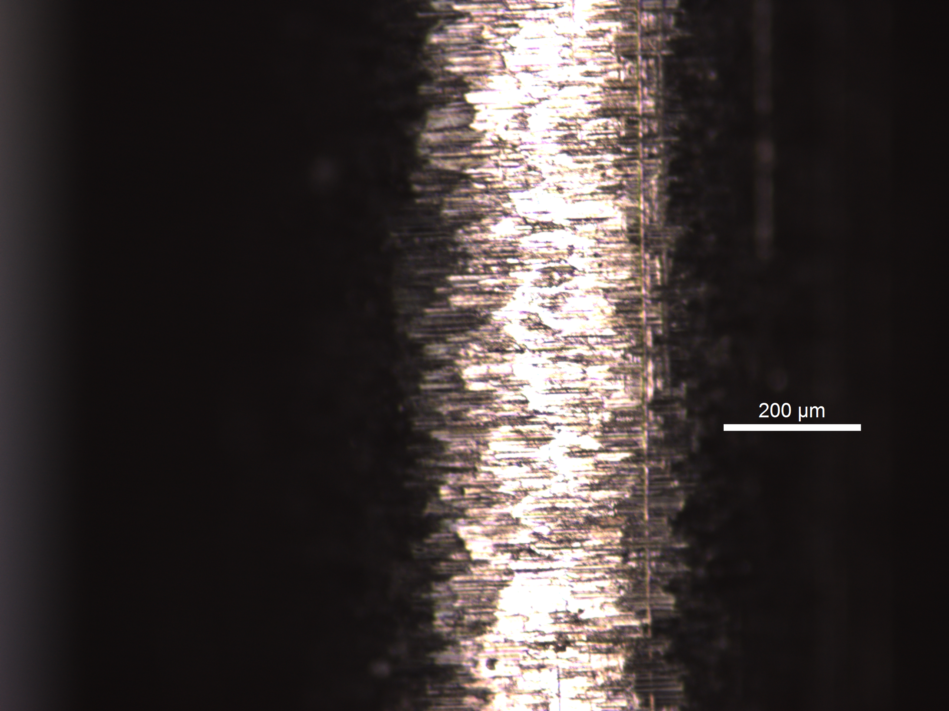
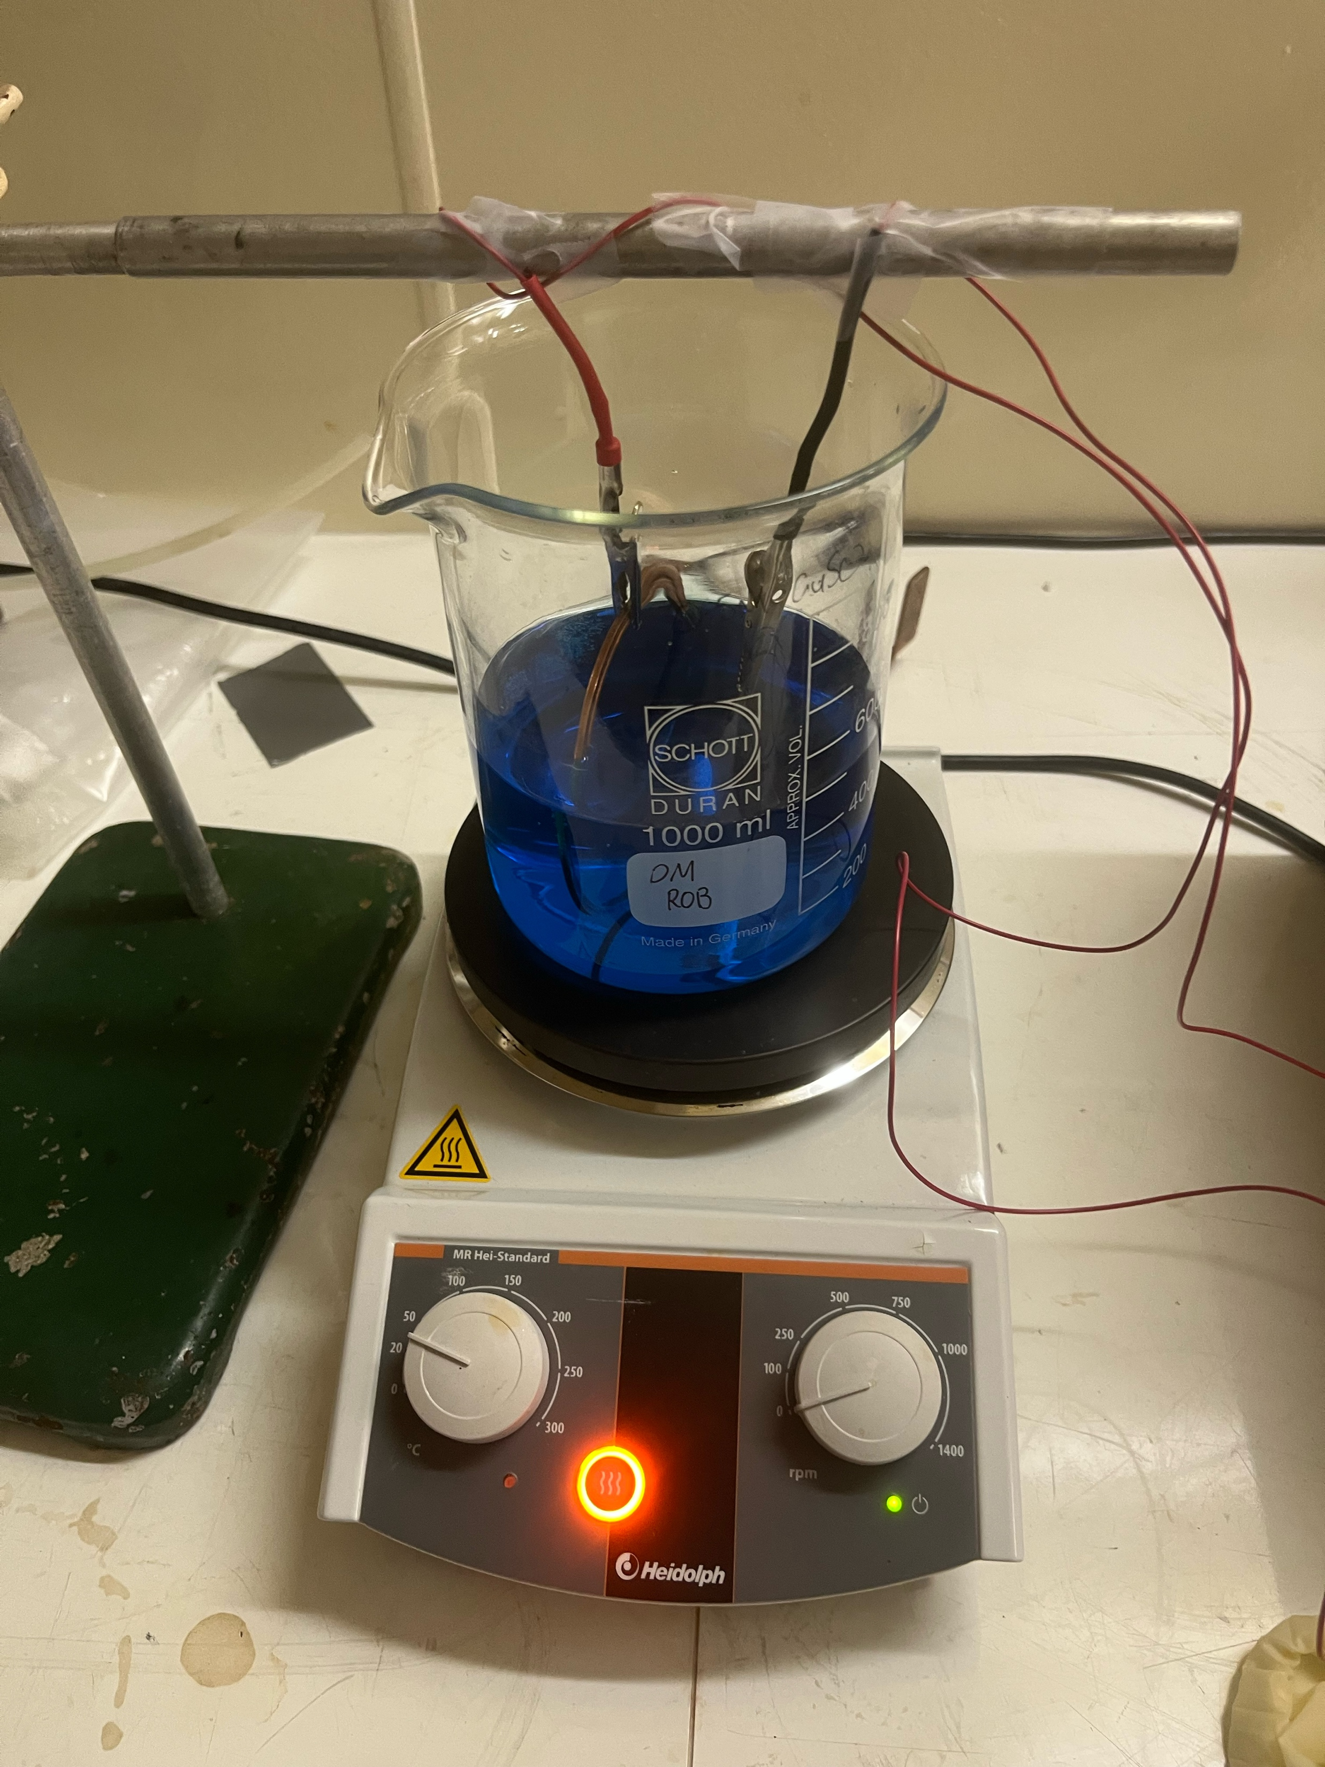
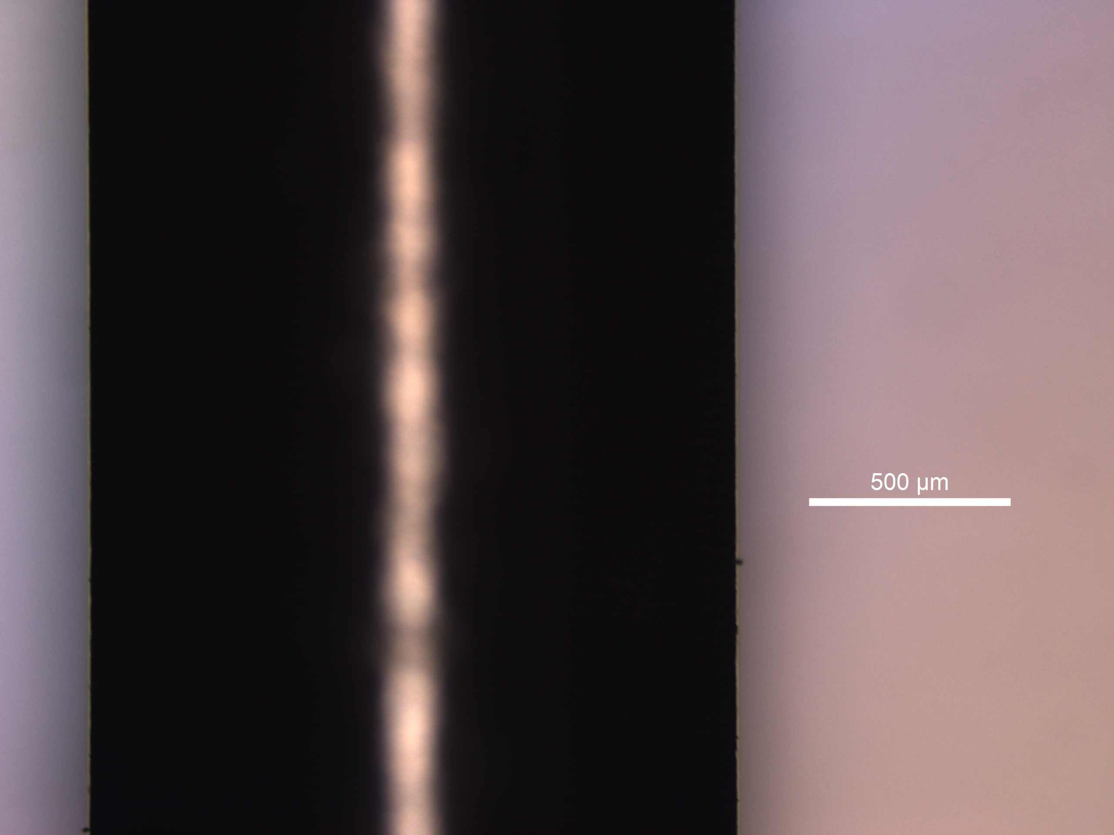
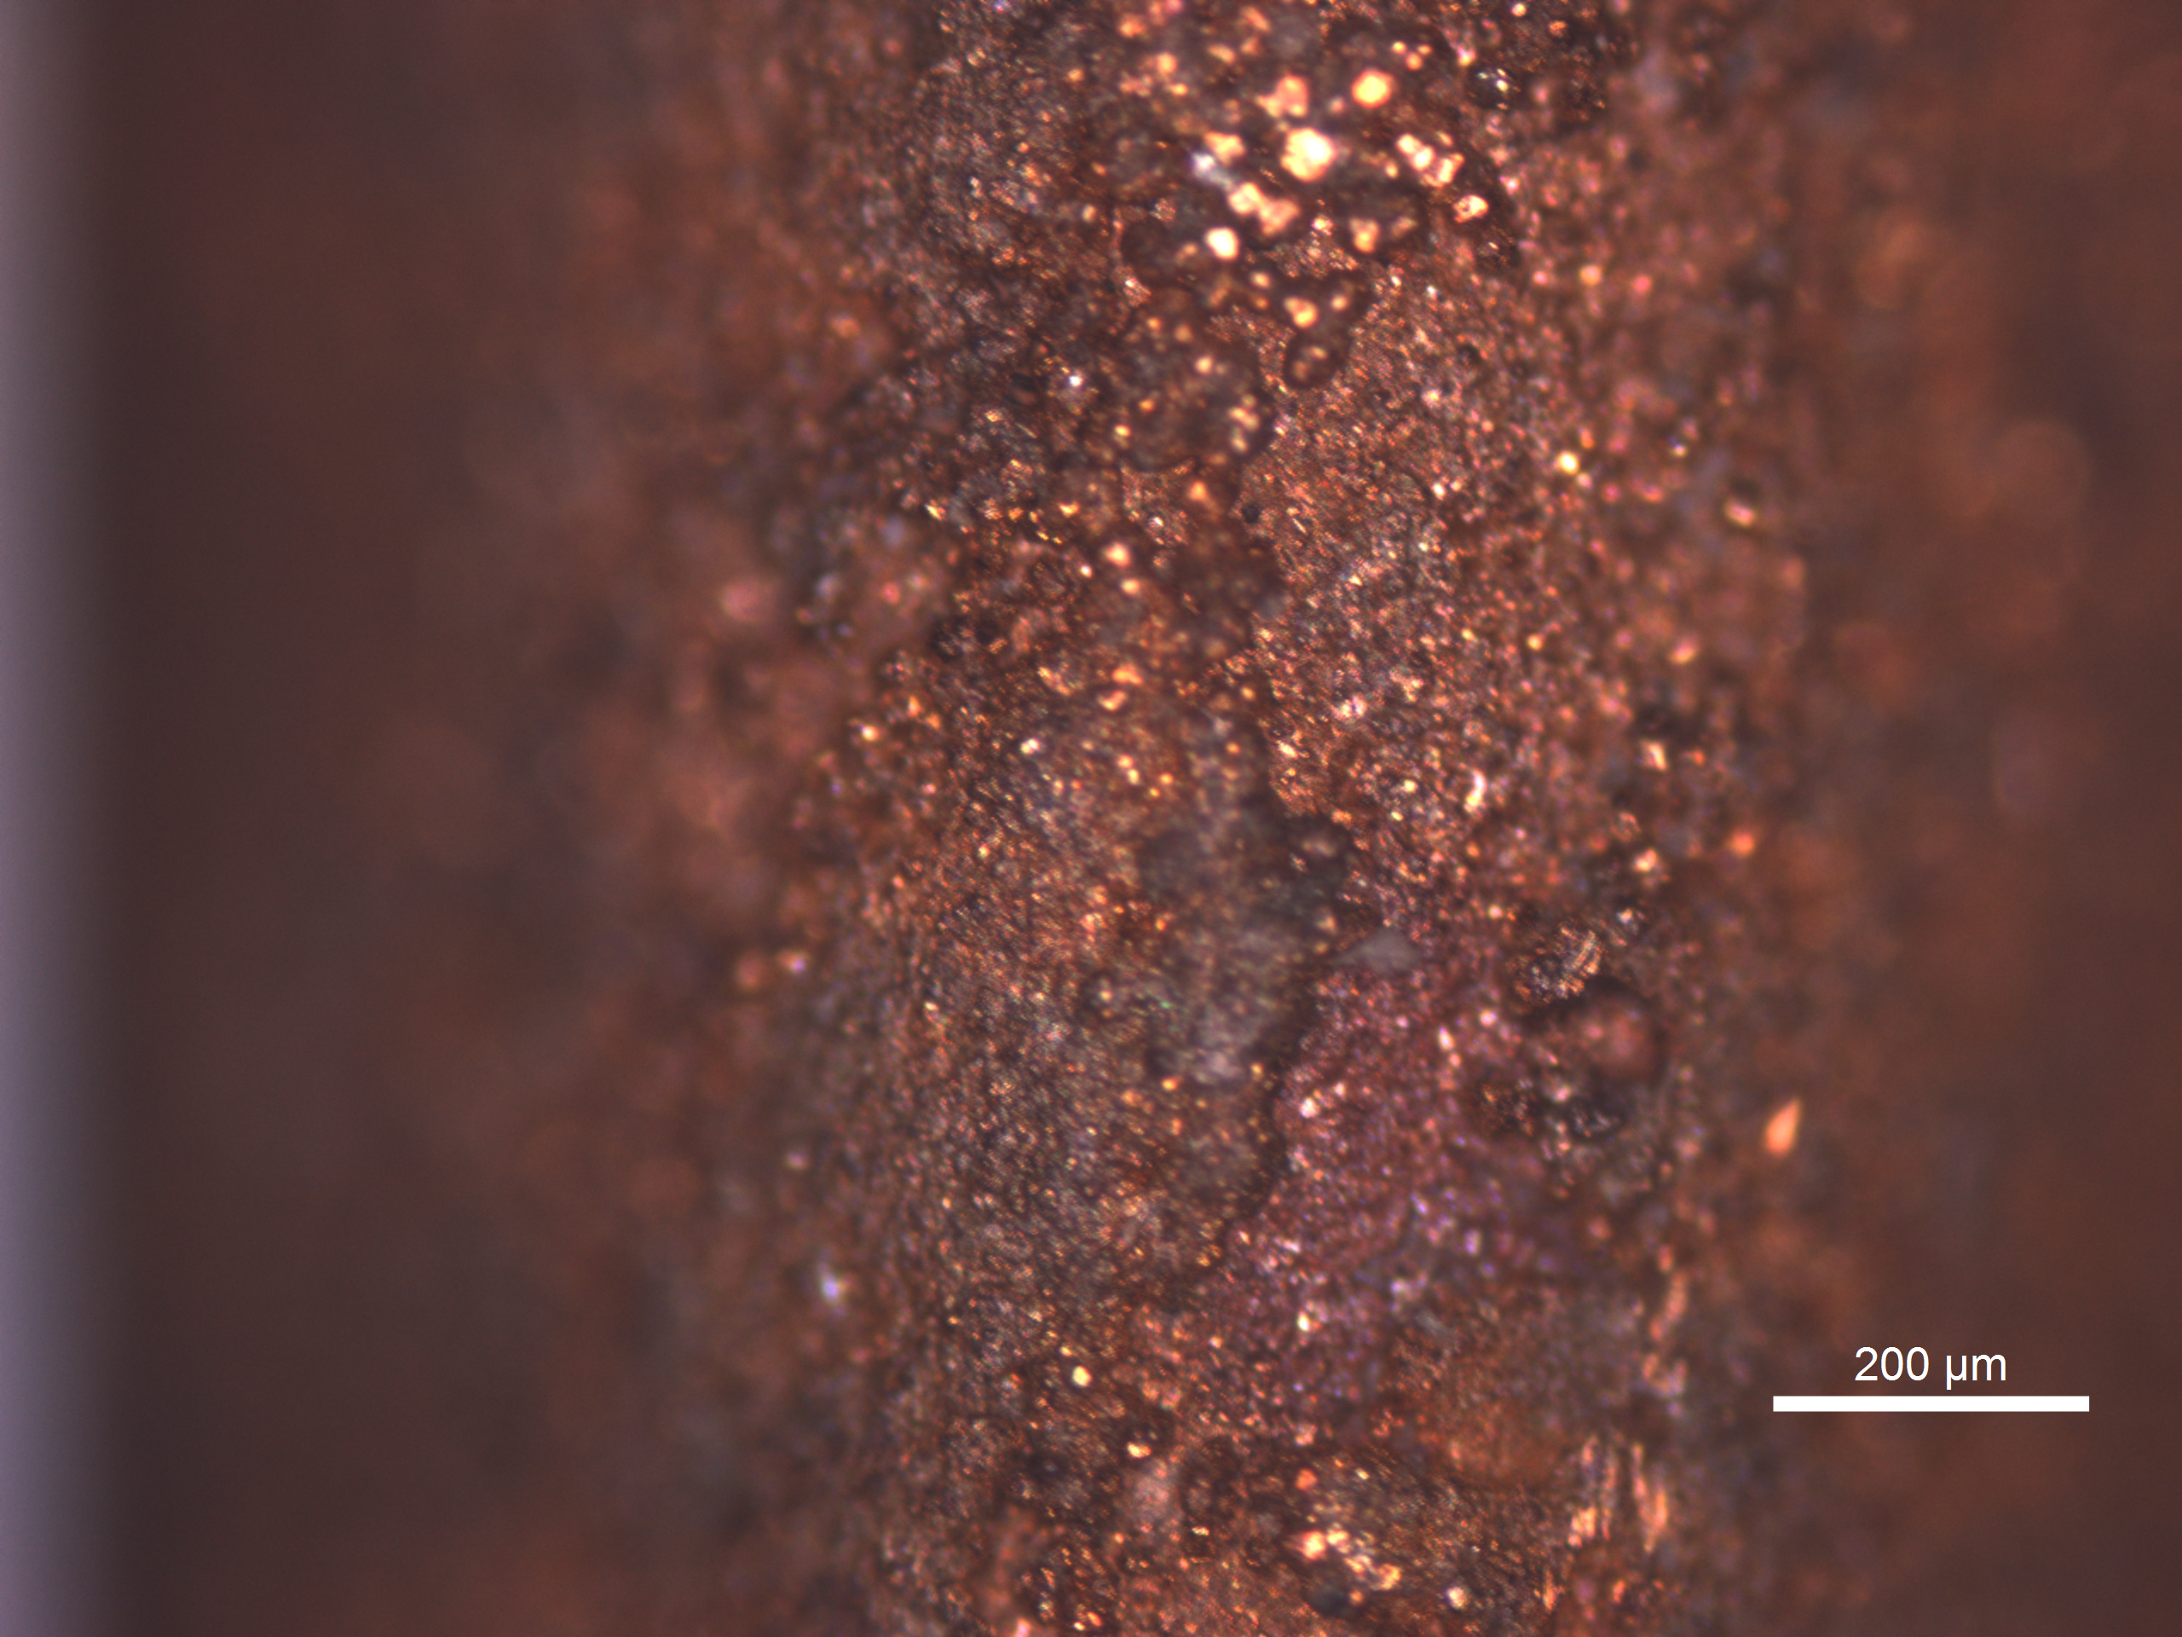
Electroplating Project
Copper Platting Setup Ready in ‘Pb Plating lab’
Leica Stellaris 8 @John Carver Building
²²⁰Rn_{Ema}
Thickness/Quality
Incoming student: - Laurent Bechteler-Weickhardt

Slide 18
Electroplating Project Updates
²²⁰Rn_{Ema}
Thickness/Quality
Focus middle
Focus edge

Slide 19
Electroplating Project Updates
²²⁰Rn_{Ema}
Thickness/Quality

Slide 20
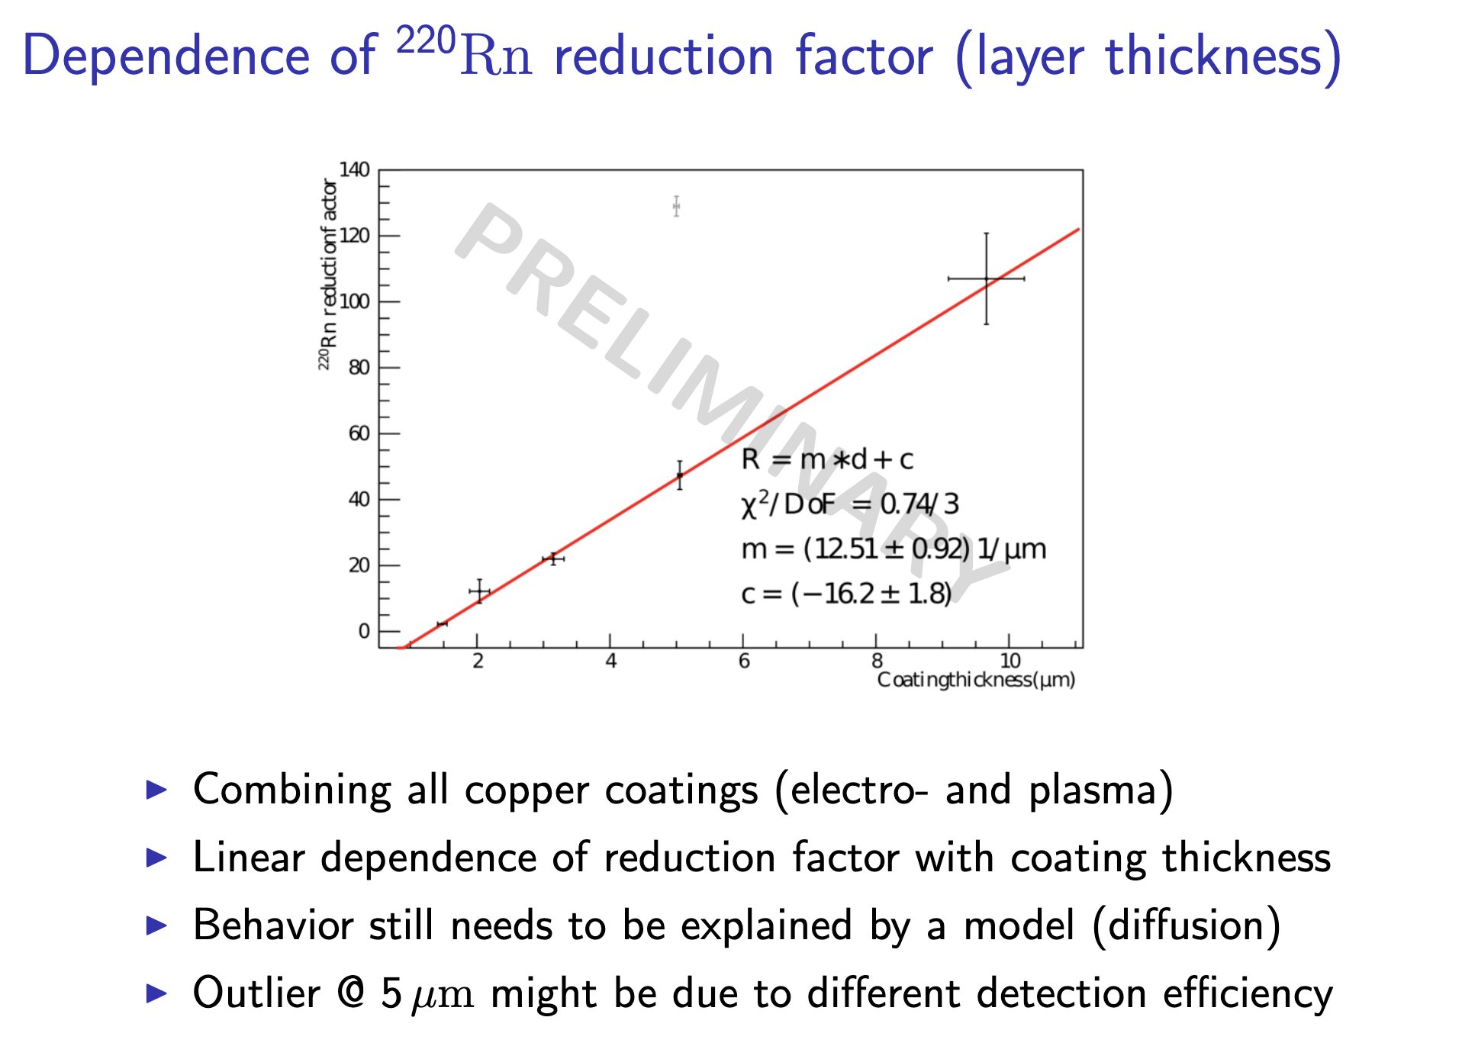
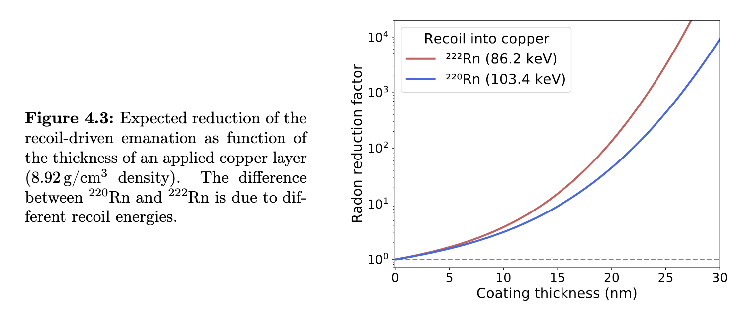
Copper Plating Literature Review
From 222Rn measurements in XENONnT and HeXe to radon mitigation in future liquid xenon experiments (PhD Thesis University of Heidelberg, 2022 Florian Jörg)
Simulation SRIM Simulation
Coating thickness of 10um reduction factor x 100

