Slide 1


Supernova Neutrino
Sino-Thai International Summer School on HighEnergy Physics and Astrophysics
Apimook Watcharangkool
National Astronomical Research Institute of Thailand

Slide 2
OUTLINE
Beyond SM
Multi-messenger
Core collapse supernova
Standing Accretion Shock Instability (SASI)
MSW effect
Detector simulation
What else can we add to simulation?
Summary

Slide 3

Beyond Standard Model Physics
“Detectable” beyond SM physics
Neutrino physics
  CP-violation (CP-phase from oscillation parameter)
  Normal/inverse Hirachy
  Dirac vs Majorana (double beta decay)
UV theory – sterile neutrino
  See-saw mechanisms type I, II, III require new fundamental particles
  Theory with extra dimension also produce more particle
Dark matter
  WIMP produce neutrino

Slide 4
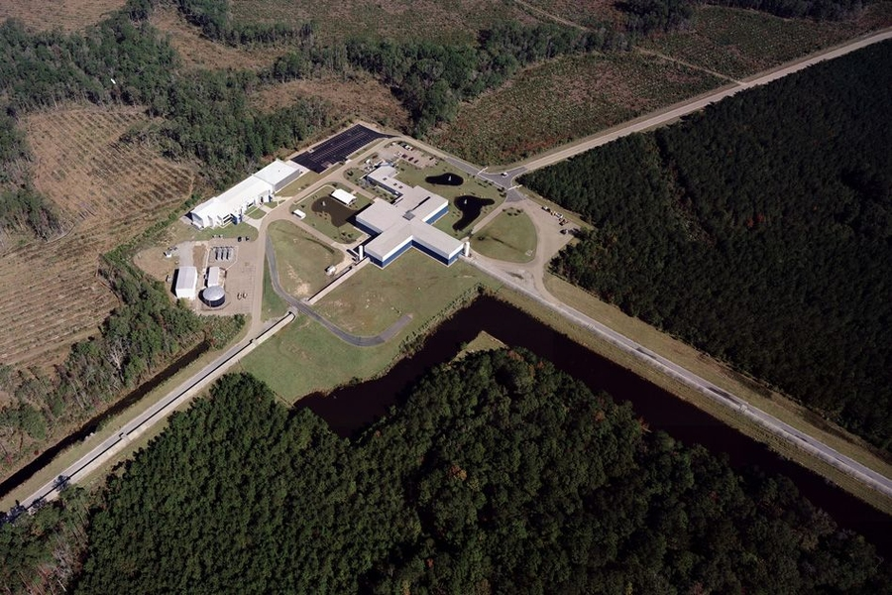
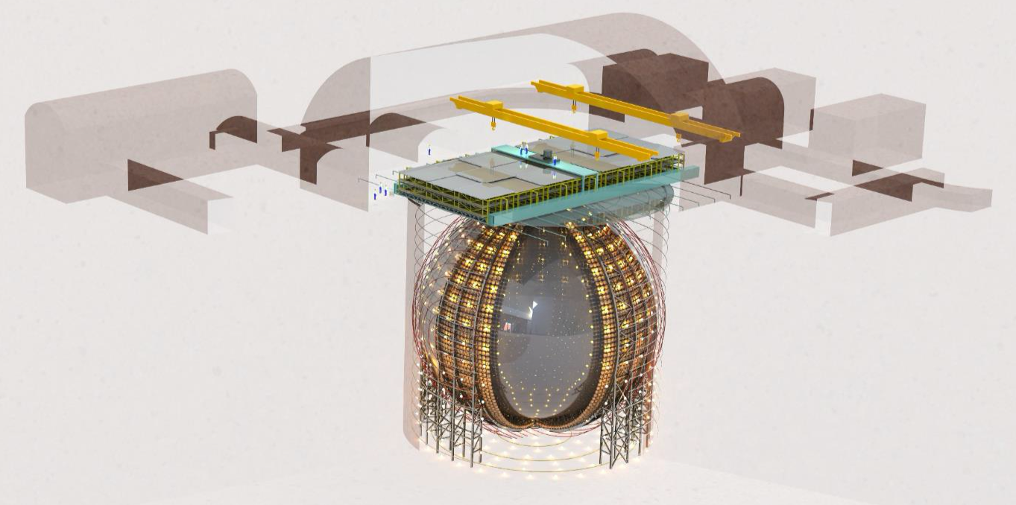



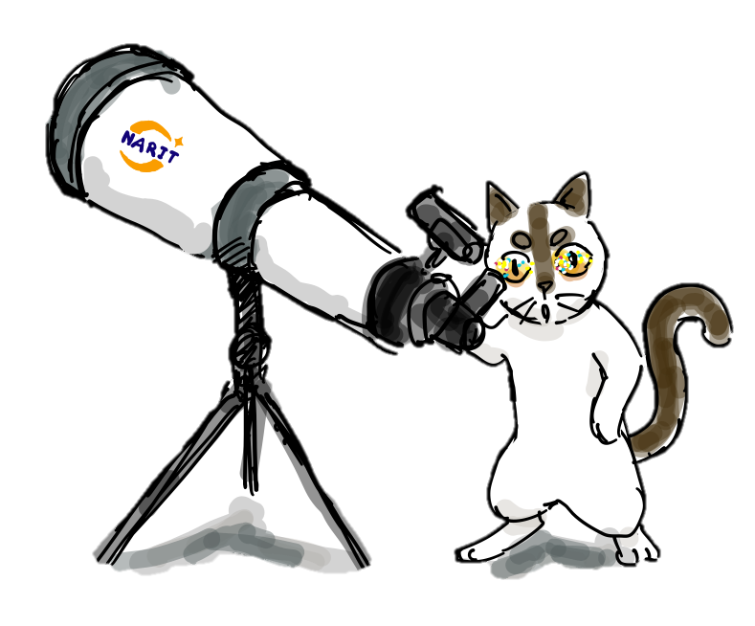

Multi-messenger detection
LIGO
Current detectable frequency range
10 Hz – 10kHz
Jiangmen underground neutrino observatory (JUNO)
Neutrino energy keV - GeV
The team working on this project

Slide 5
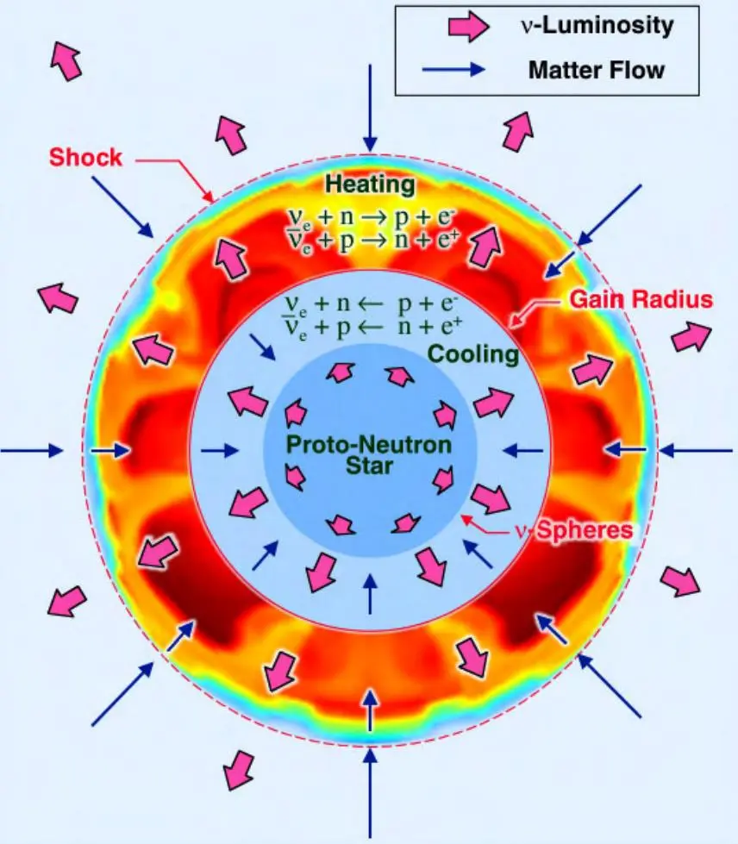
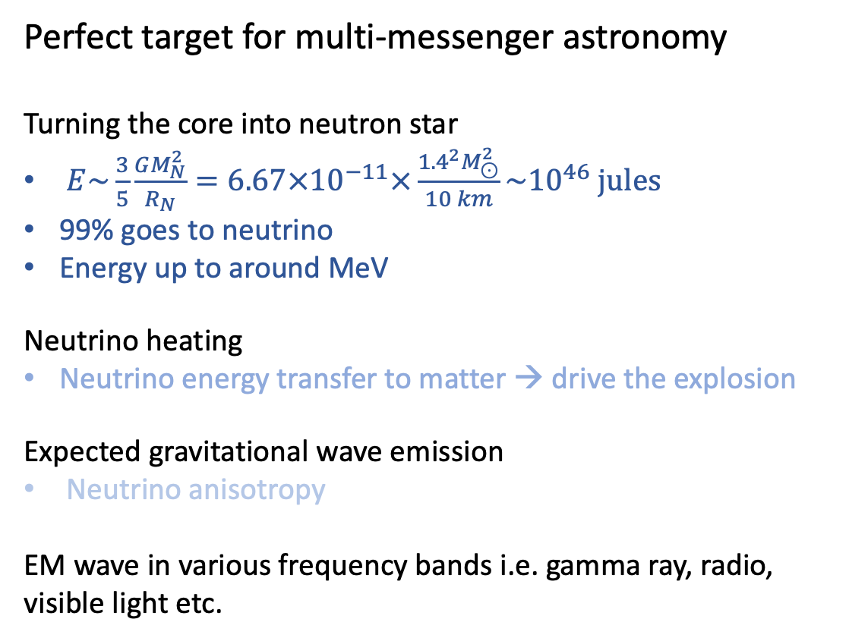
Core Collapse Supernova
Perfect target for multi-messenger astronomy
Turning the core into neutron star
$E\sim \frac{3}{5}\frac{GM_{N}^{2}}{R_{N}}=6.67×{10}^{−11}×\frac{{1.4}^{2}M_{⊙}^{2}}{10 km}\sim {10}^{46} jules$
99% goes to neutrino
Energy up to around MeV
Neutrino heating
Neutrino energy transfer to matter → drive the explosion
Expected gravitational wave emission
Neutrino anisotropy
EM wave in various frequency bands i.e. gamma ray, radio, visible light etc.

Slide 6
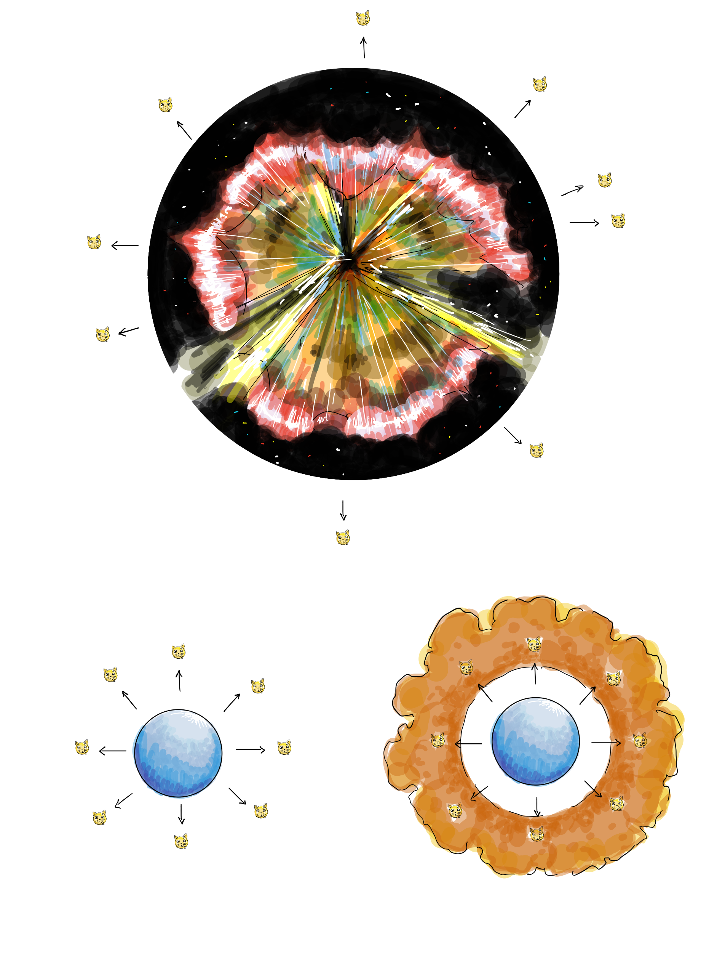
The explosion processes
Neutronisation
proto-neutron star (PNS) cooling
Produce gianormous amount of neutrino from electron capture
Emission is spherical symmetric due to intense gravitational force acting on PNS
Accretion
Infalling matter stalling building up shock wave
IBD and other processes, heating up the matter
Leads to violent explosion
Cooling
Single-flavour luminosity decay over time

Slide 7
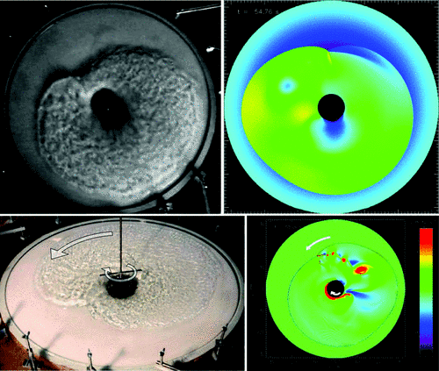
Standing Accretion Shock Instability (SASI)
Hydrodynamics instability that is the key to SN explosion
The infalling gas’s speed is a lot faster than the speed of sound
Create shock waves
For standing spherical accretion shock, there is instability
Relatively small perturbation can drive the instability
Neutrino heating (neutrino transport)
explosion
Phys. Rev. Lett. 108, 051103 (2012)

Slide 8
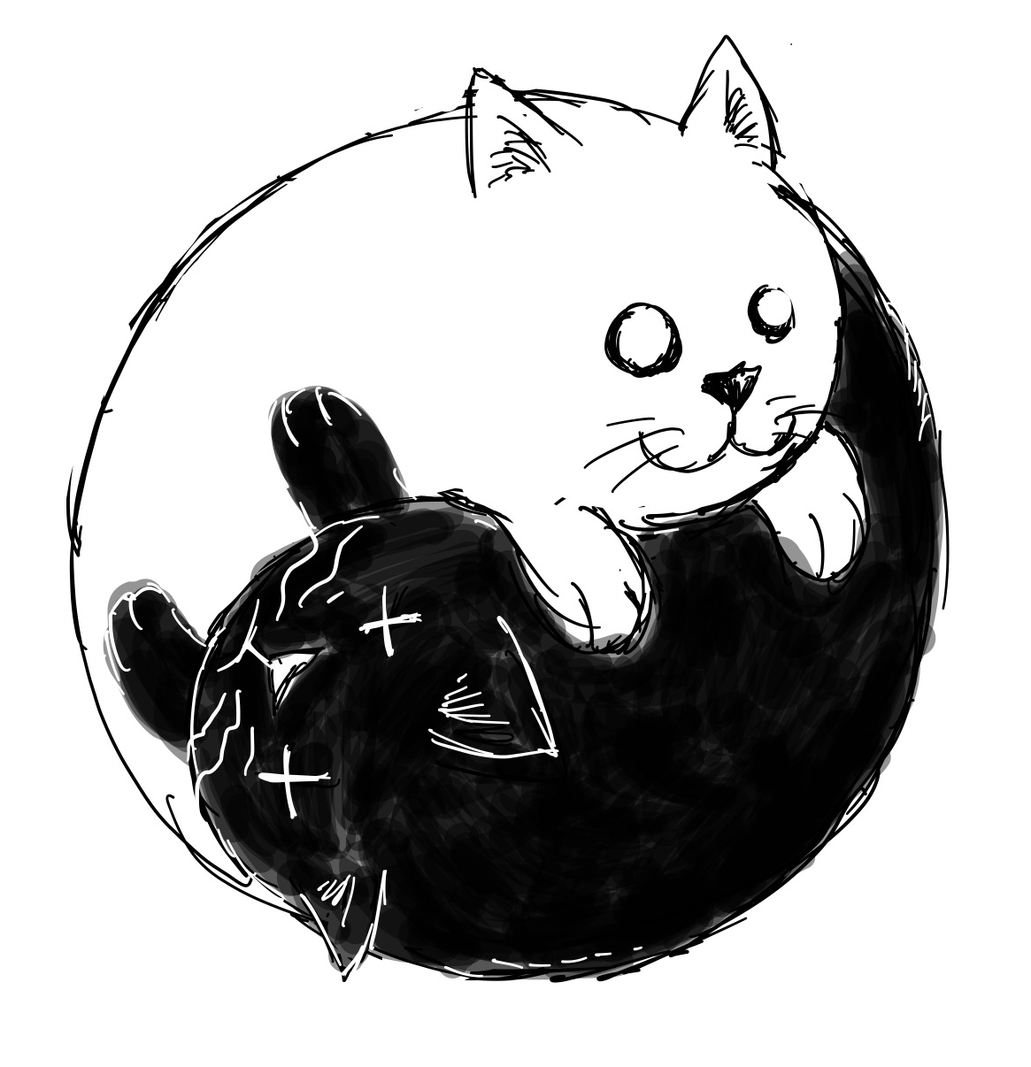
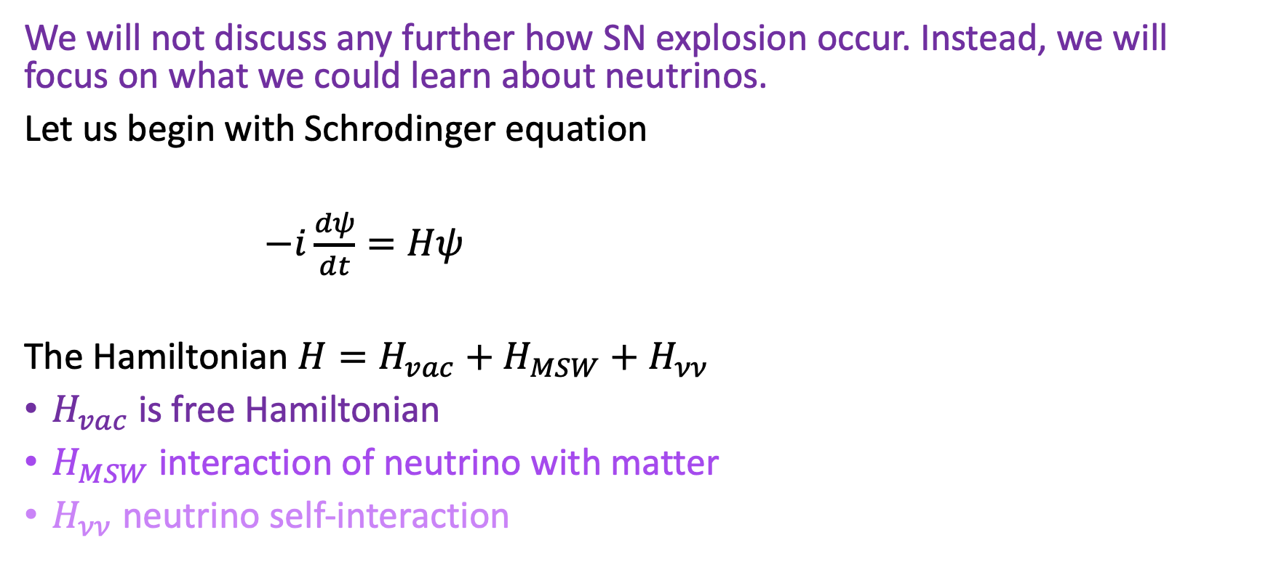
Neutrino Dynamics
We will not discuss any further how SN explosion occur. Instead, we will focus on what we could learn about neutrinos.
Let us begin with Schrodinger equation
$−i\frac{dψ}{dt}=Hψ$
The Hamiltonian $H=H_{vac}+H_{MSW}+H_{νν}$
$H_{vac}$ is free Hamiltonian
$H_{MSW}$ interaction of neutrino with matter
$H_{νν}$ neutrino self-interaction

Slide 9
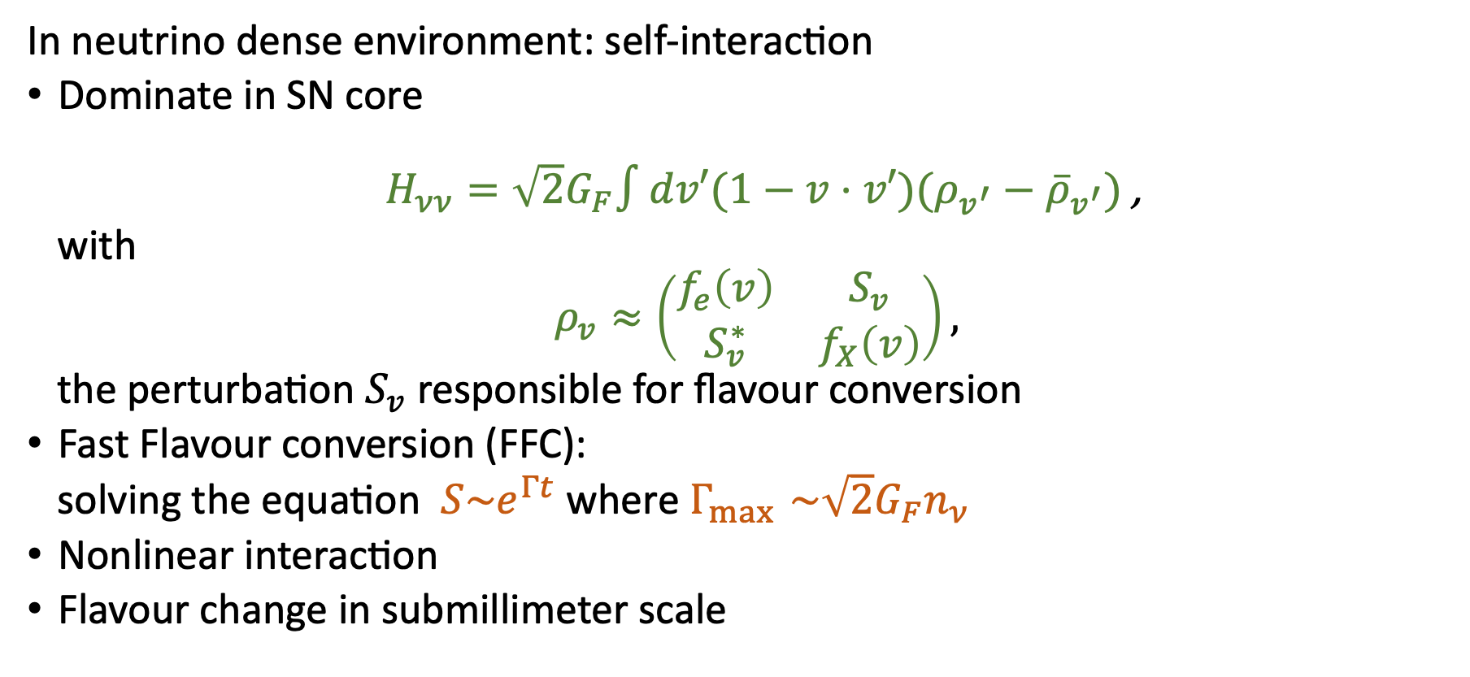
Fast Flavour Conversion
In neutrino dense environment: self-interaction
Dominate in SN core
$H_{νν}=\sqrt{2}G_{F}∫dv′(1−v⋅v′)(ρ_{v^{′}}−{\overline{ρ}}_{v^{′}})$ ,
with
$ρ_{v}≈\left(\begin{matrix}f_{e}\left(v\right) & S_{v} \\ S_{v}^{∗} & f_{X}\left(v\right)\end{matrix}\right),$
the perturbation $S_{v}$ responsible for flavour conversion
Fast Flavour conversion (FFC):
solving the equation $S\sim e^{Γt}$ where $Γ_{\max{ }}\sim \sqrt{2}G_{F}n_{ν}$
Nonlinear interaction
Flavour change in submillimeter scale

Slide 10

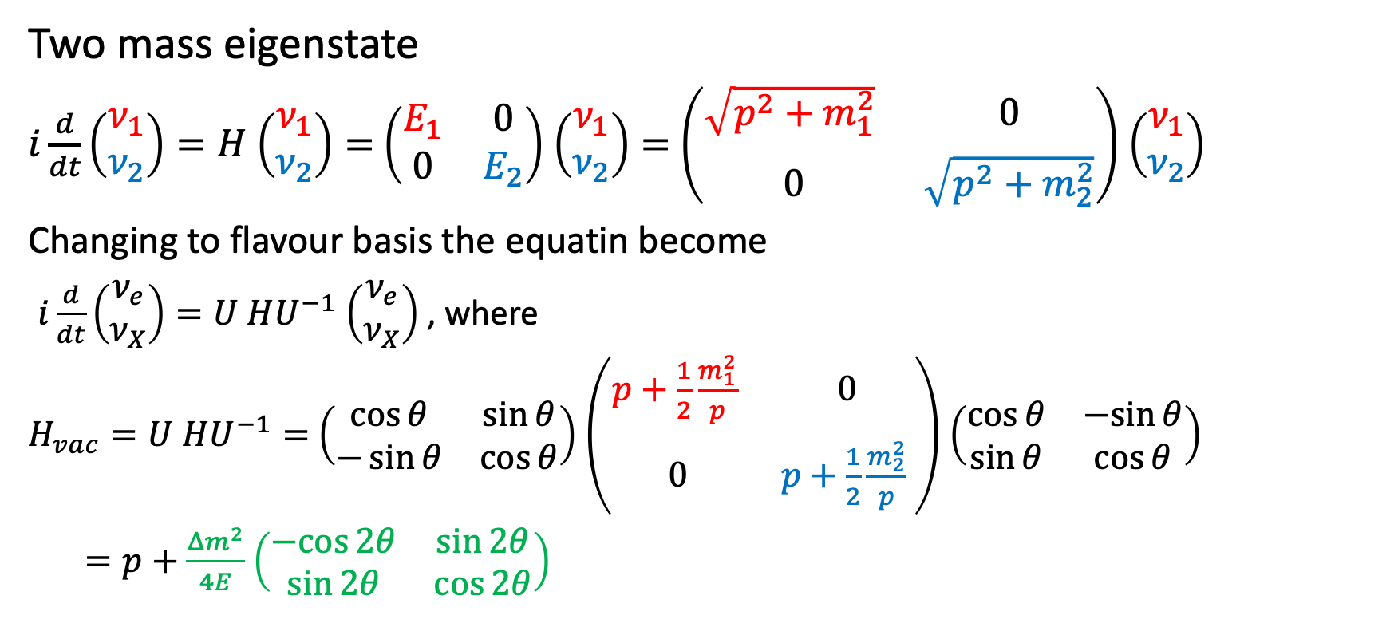
Neutrino Oscillation
Two mass eigenstate
$i\frac{d}{dt}\left(\begin{matrix}ν_{1} \\ ν_{2}\end{matrix}\right)=H$ $\left(\begin{matrix}ν_{1} \\ ν_{2}\end{matrix}\right)=$ $\left(\begin{matrix}E_{1} & 0 \\ 0 & E_{2}\end{matrix}\right)$ $\left(\begin{matrix}ν_{1} \\ ν_{2}\end{matrix}\right)=$ $\left(\begin{matrix}{\sqrt{p^{2}+m_{1}^{2}}}_{ } & 0 \\ 0 & \sqrt{p^{2}+m_{2}^{2}}\end{matrix}\right)$ $\left(\begin{matrix}ν_{1} \\ ν_{2}\end{matrix}\right)$
Changing to flavour basis the equatin become
$i\frac{d}{dt}\left(\begin{matrix}ν_{e} \\ ν_{X}\end{matrix}\right)=U^{ }HU^{−1}$ $\left(\begin{matrix}ν_{e} \\ ν_{X}\end{matrix}\right)$ , where
${H_{vac}=U}^{ }HU^{−1}=$ $\left(\begin{matrix}\cos{θ} & \sin{θ} \\ −\sin{θ} & \cos{θ}\end{matrix}\right)$ $\left(\begin{matrix}{p+\frac{1}{2}\frac{m_{1}^{2}}{p}}_{ } & 0 \\ 0 & {p+\frac{1}{2}\frac{m_{2}^{2}}{p}}_{ }\end{matrix}\right)$ $\left(\begin{matrix}\cos{θ} & −sin{θ} \\ \sin{θ} & \cos{θ}\end{matrix}\right)$
$=p+$ $\frac{Δm^{2}}{4E}$ $\left(\begin{matrix}−cos{2θ} & \sin{2θ} \\ \sin{2θ} & \cos{2θ}\end{matrix}\right)$

Slide 11
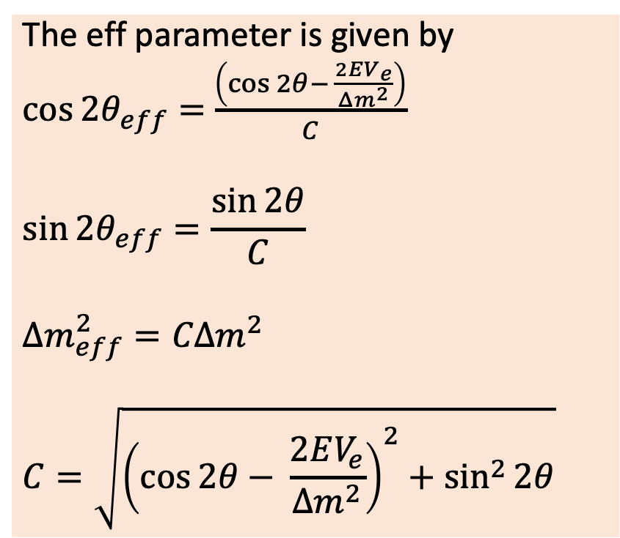
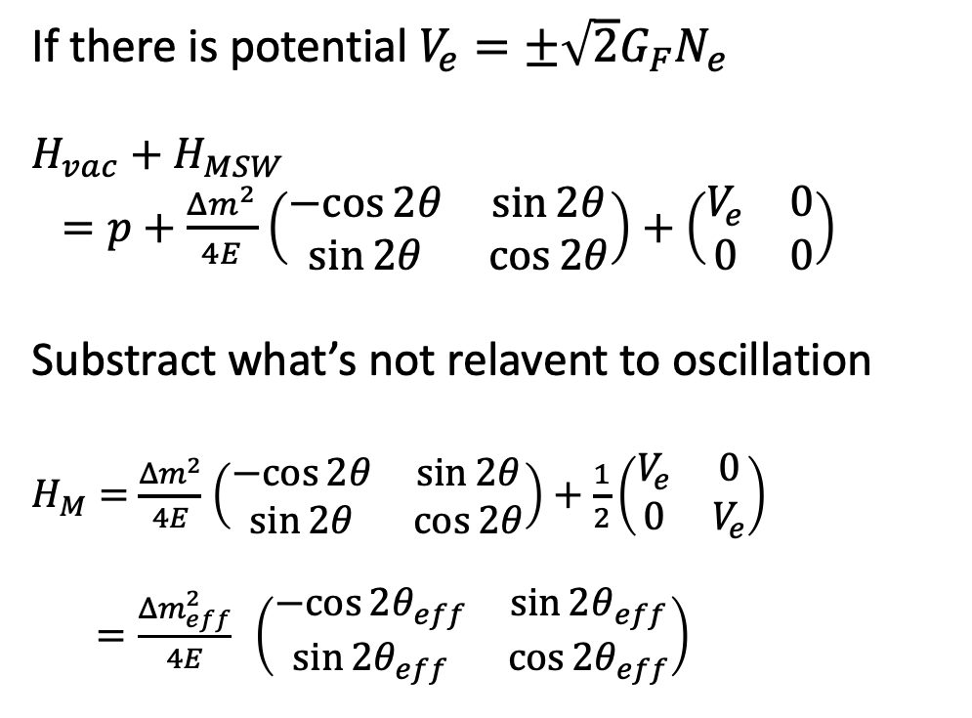
Neutrino Oscillation in Matter
If there is potential $V_{e}=±\sqrt{2}G_{F}N_{e}$
$$H_{vac}+H_{MSW}$$
$=p+$ $\frac{Δm^{2}}{4E}$ $\left(\begin{matrix}−cos{2θ} & \sin{2θ} \\ \sin{2θ} & \cos{2θ}\end{matrix}\right)+\left(\begin{matrix}V_{e} & 0 \\ 0 & 0\end{matrix}\right)$
Substract what’s not relavent to oscillation
$H_{M}=$ $\frac{Δm^{2}}{4E}$ $\left(\begin{matrix}−cos{2θ} & \sin{2θ} \\ \sin{2θ} & \cos{2θ}\end{matrix}\right)+\frac{1}{2}\left(\begin{matrix}V_{e} & 0 \\ 0 & V_{e}\end{matrix}\right)$
$=\frac{Δm_{eff}^{2}}{4E} \left(\begin{matrix}−cos{2θ_{eff}} & {\sin{2θ}}_{eff} \\ \sin{2θ_{eff}} & \cos{2θ_{eff}}\end{matrix}\right)$
The eff parameter is given by
$\cos{2θ_{eff}=}$ $\frac{\left(\cos{2θ− }\frac{2EV_{e}}{Δm^{2}}\right)}{C}$
$$\sin{2θ_{eff}=\frac{\sin{2θ}}{C} }$$
$$Δm_{eff}^{2}=CΔm^{2}$$
$$C=\sqrt{{\left(\cos{2θ− }\frac{2EV_{e}}{Δm^{2}}\right)}^{2}+\sin^{2}{2θ}}$$
Resonance

Slide 12
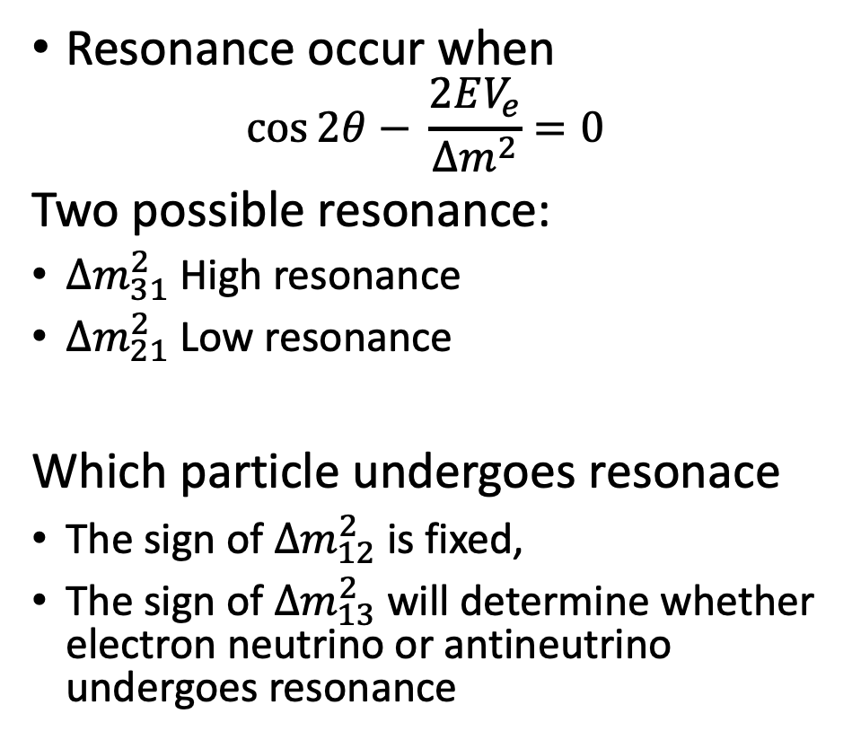
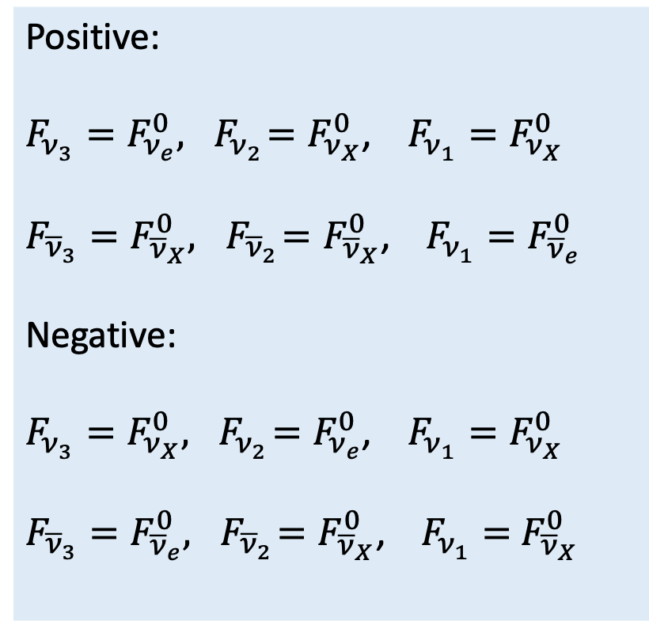
High and Low resonace
Resonance occur when
$$\cos{2θ− }\frac{2EV_{e}}{Δm^{2}}=0$$
Two possible resonance:
$Δm_{31}^{2}$ High resonance
$Δm_{21}^{2}$ Low resonance
Which particle undergoes resonace
The sign of $Δm_{12}^{2}$ is fixed,
The sign of $Δm_{13}^{2}$ will determine whether electron neutrino or antineutrino undergoes resonance
Positive:
$F_{ν_{3}}=F_{ν_{e}}^{0},{ F}_{ν_{2}}=F_{ν_{X}}^{0}$, $F_{ν_{1}}=F_{ν_{X}}^{0}$
$F_{{\overline{ν}}_{3}}=F_{{\overline{ν}}_{X}}^{0},{ F}_{{\overline{ν}}_{2}}=F_{{\overline{ν}}_{X}}^{0}$, $F_{ν_{1}}=F_{{\overline{ν}}_{e}}^{0}$
Negative:
$F_{ν_{3}}=F_{ν_{X}}^{0},{ F}_{ν_{2}}=F_{ν_{e}}^{0}$, $F_{ν_{1}}=F_{ν_{X}}^{0}$
$F_{{\overline{ν}}_{3}}=F_{{\overline{ν}}_{e}}^{0},{ F}_{{\overline{ν}}_{2}}=F_{{\overline{ν}}_{X}}^{0}$, $F_{ν_{1}}=$ $F_{{\overline{ν}}_{X}}^{0}$

Slide 13
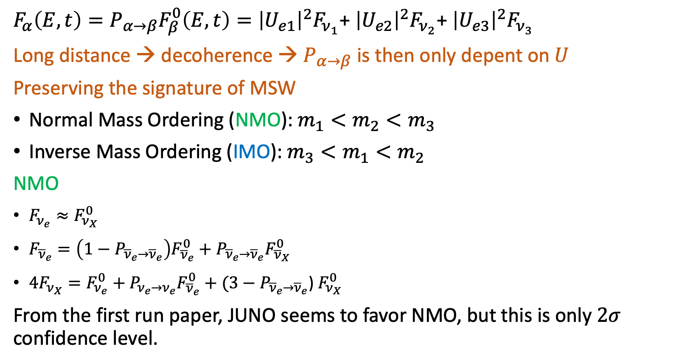

NMO and IMO
$F_{α}\left(E,t\right)=P_{α→β}F_{β}^{0}\left(E,t\right)={\left|U_{e1}\right|}^{2}F_{ν_{1}}$+ ${\left|U_{e2}\right|}^{2}F_{ν_{2}}$+ ${\left|U_{e3}\right|}^{2}F_{ν_{3}}$
Long distance → decoherence → $P_{α→β}$ is then only depent on $U$
Preserving the signature of MSW
Normal Mass Ordering (NMO): $m_{1}<m_{2}<m_{3}$
Inverse Mass Ordering (IMO): $m_{3}<m_{1}<m_{2}$
NMO
$F_{ν_{e}}≈F_{ν_{X}}^{0}$
$F_{{\overline{ν}}_{e}}=\left(1−P_{{\overline{ν}}_{e}→{\overline{ν}}_{e}}\right)F_{{\overline{ν}}_{e}}^{0}+$ $P_{{\overline{ν}}_{e}→{\overline{ν}}_{e}}F_{{\overline{ν}}_{X}}^{0}$
${4F}_{ν_{X}}=F_{ν_{e}}^{0}+P_{ν_{e}→ν_{e}}F_{{\overline{ν}}_{e}}^{0}+(3−P_{{\overline{ν}}_{e}→{\overline{ν}}_{e}}$) $F_{ν_{X}}^{0}$
From the first run paper, JUNO seems to favor NMO, but this is only $2σ$ confidence level.
IMO
$F_{ν_{e}}=P_{ν_{e}→ν_{e}}F_{ν_{e}}^{0}+ \left(1−P_{ν_{e}→ν_{e}}\right)F_{ν_{X}}^{0}$
$F_{{\overline{ν}}_{e}}≈F_{{\overline{ν}}_{X}}^{0}$
${4F}_{ν_{X}}=(1−P_{ν_{e}→ν_{e}})F_{ν_{e}}^{0}+F_{{\overline{ν}}_{e}}^{0}+(2+P_{ν_{e}→ν_{e}})$ $F_{ν_{X}}^{0}$

Slide 14
Supernova modeling
Both Pre-SN and SN event are very hard to simulate. It requires powerful computing power. JUNO software does not generate these event, but use the generated data existing in the literature to simulate detector signal.
Simulated neutrino flux/energy from models
JUNO SN generator
Pre-SN
Provide info of late state stellar evolution.
Start emitting neutrino days before SN explosion
Three different models are in used
  Guo: pair process
  Kato: pair process + weak interaction
  Patton: pair + beta process
SN model
Garching model (MPA)
no neutrino anisotropy
Nakazato model
Fornax (Princeton group)
Signal in detector
The model in blue text already in used by JUNO
Include it into the framework:
neutrino anisotropy which produce gravitational wave

Slide 15
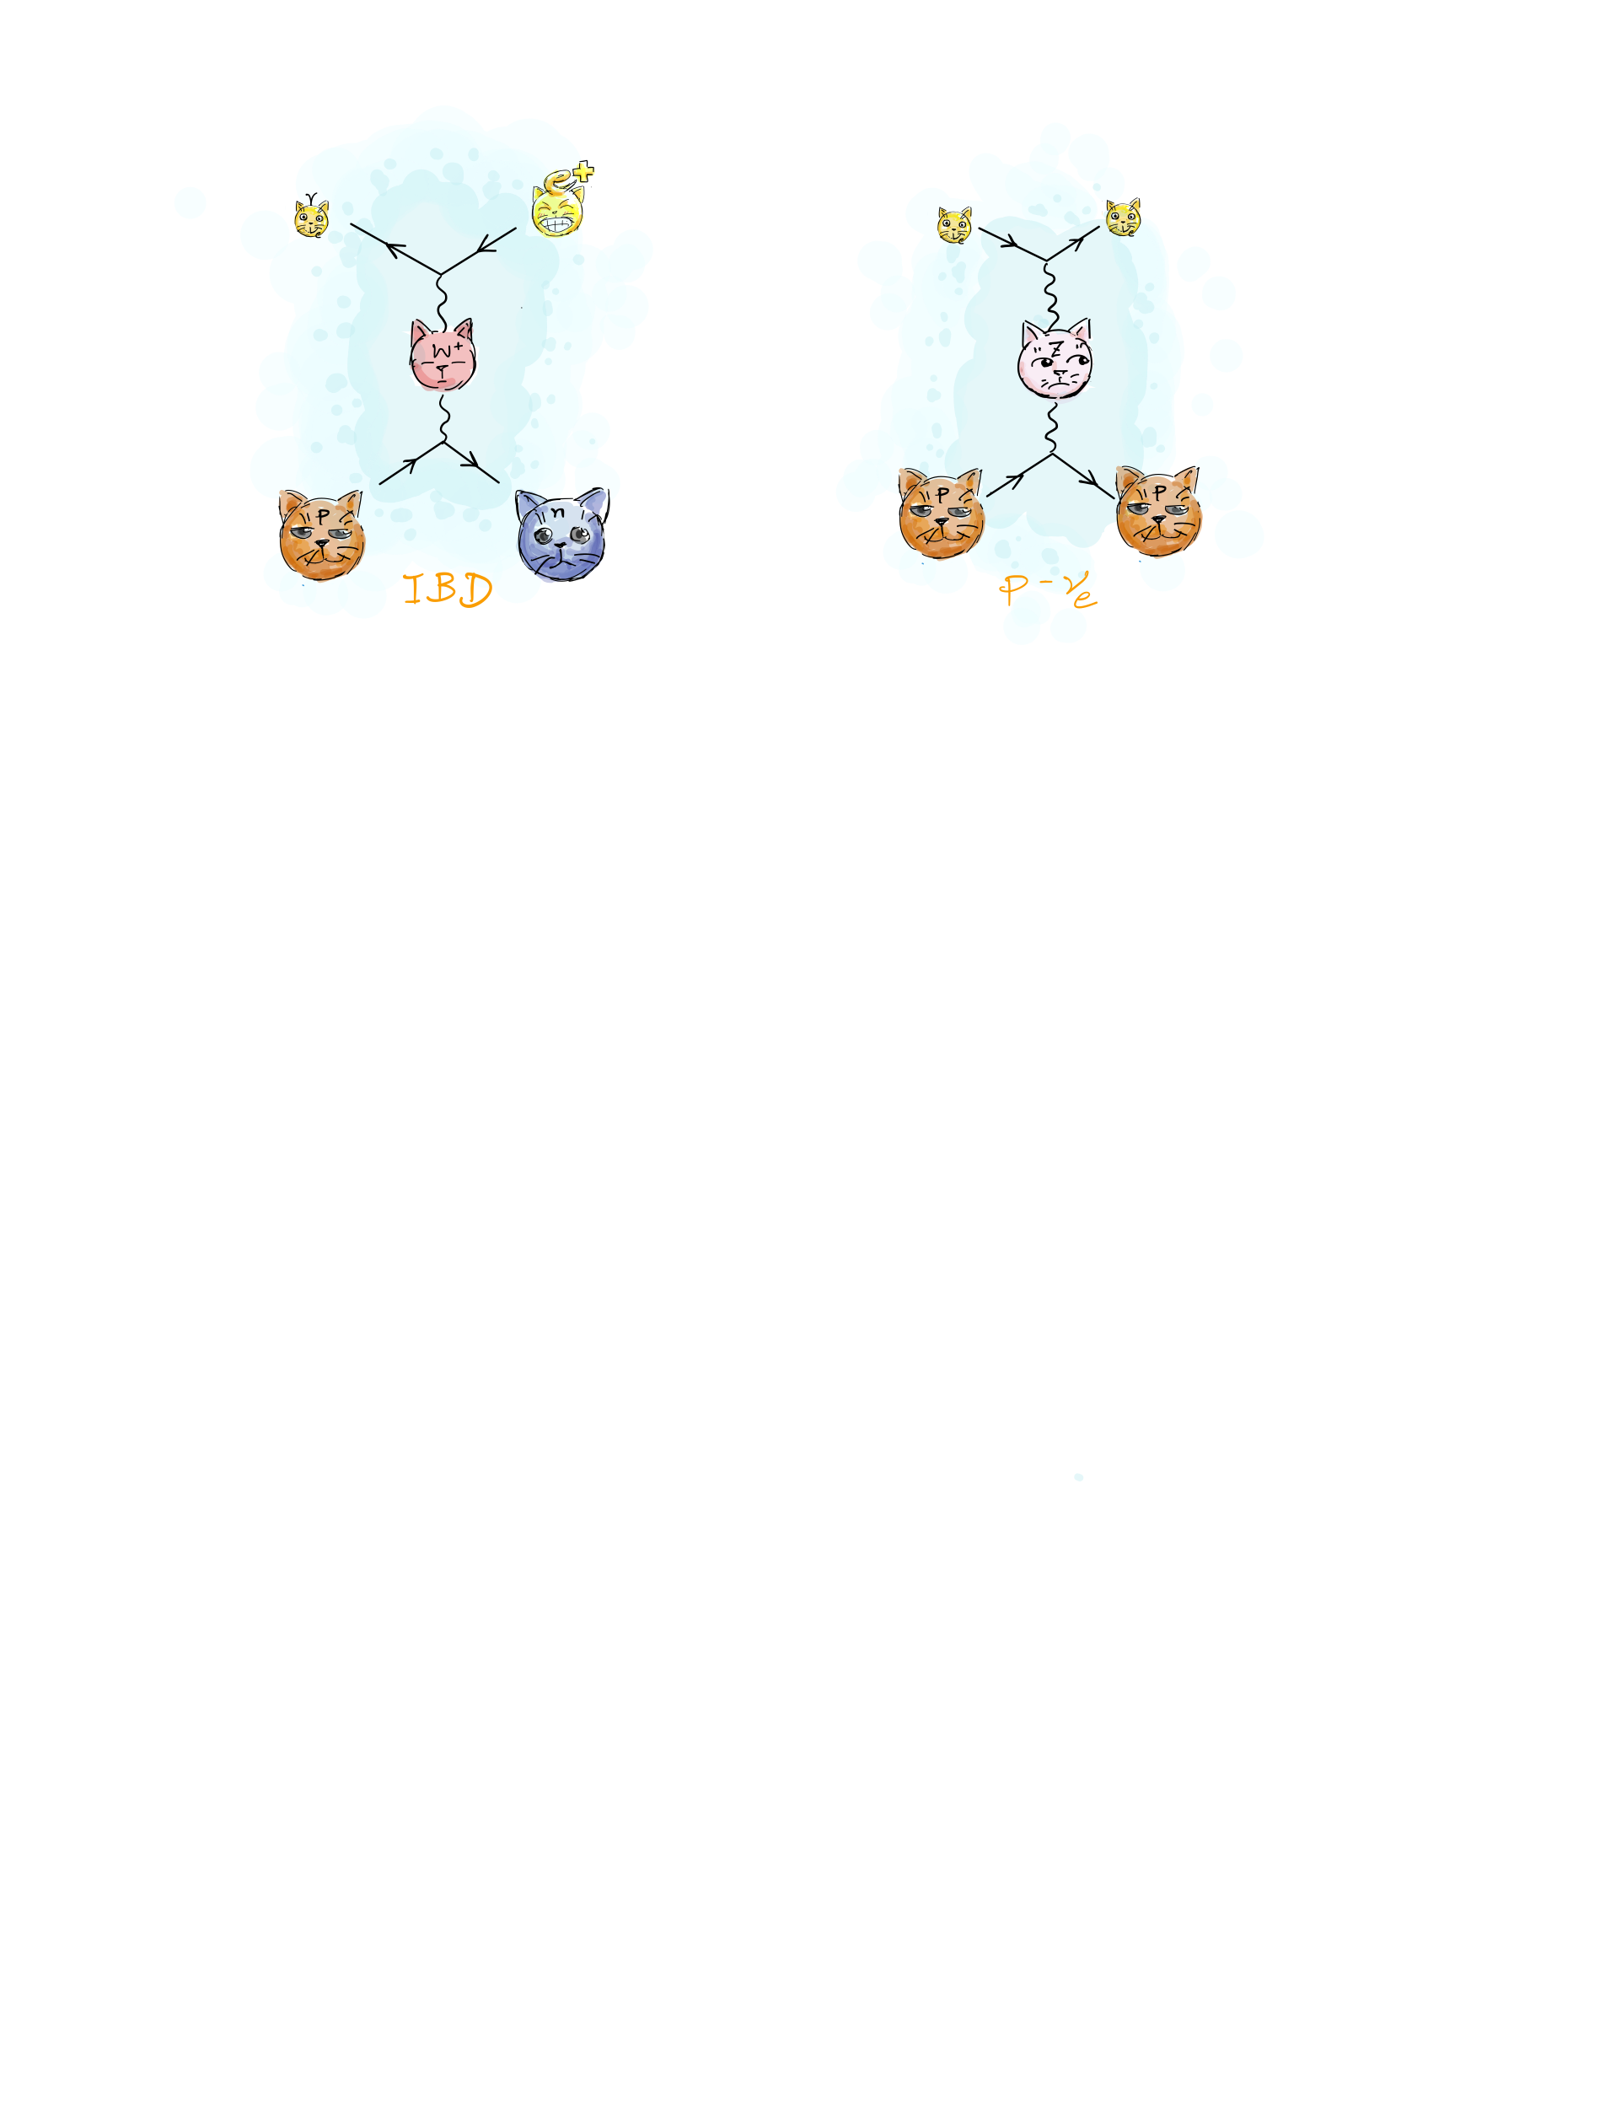
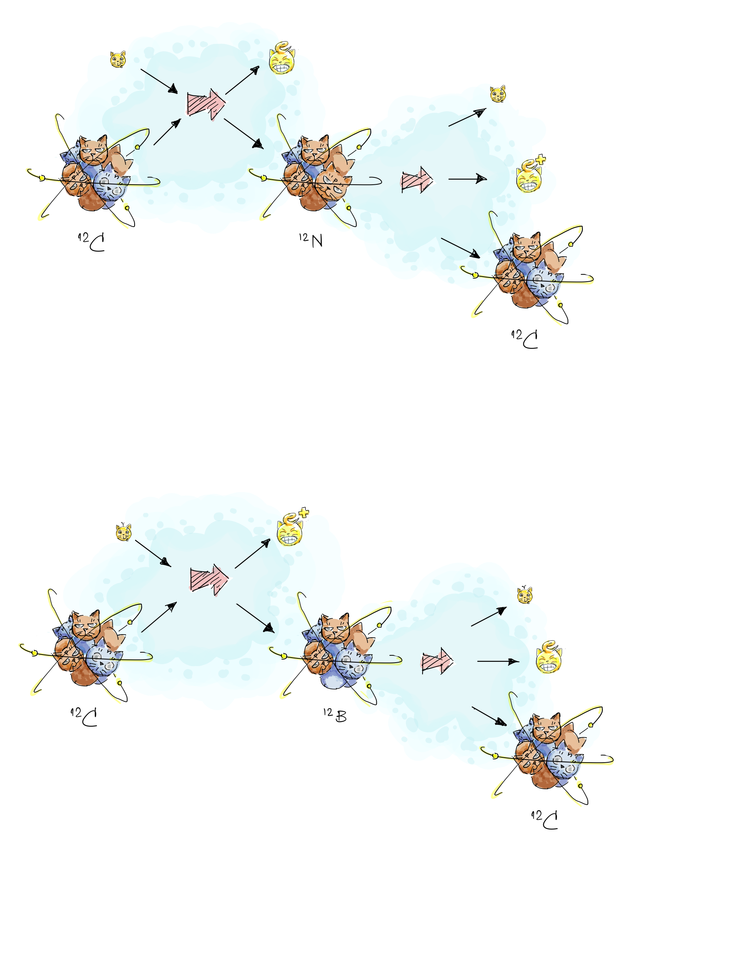
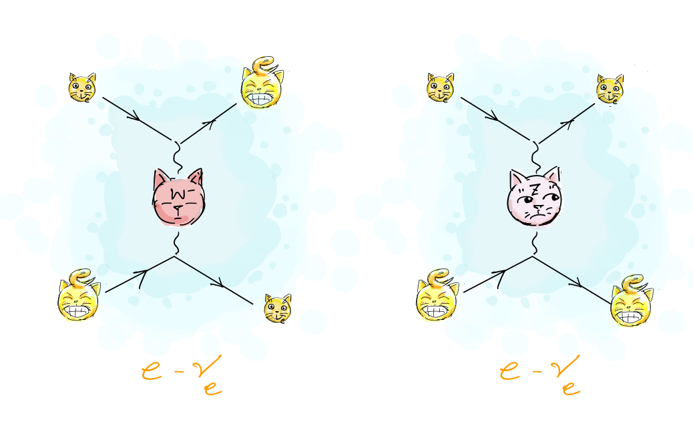
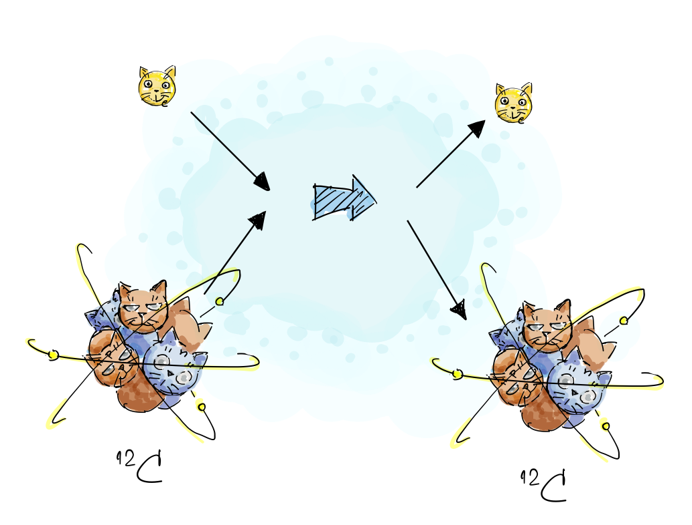
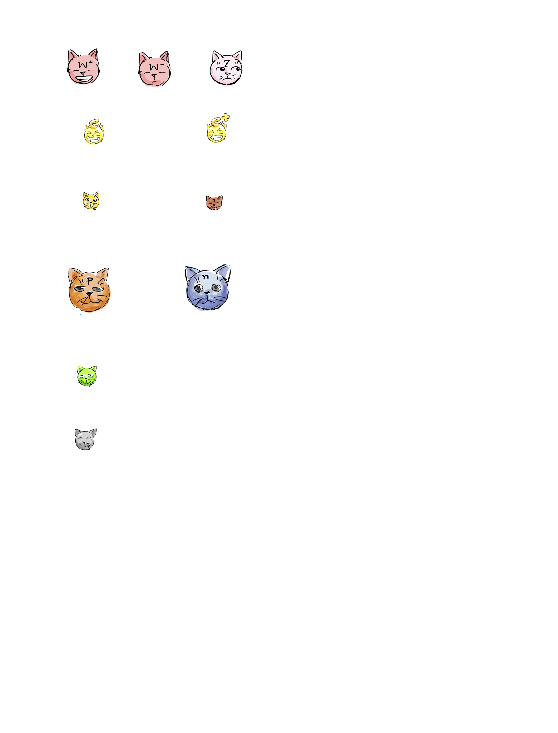
Expected signal in detector
+
Inverse beta decay
Charge current (CC) interaction
with carbon-12
Neutrino – proton elastic scattering (pES)
Neutrino – electron elastic scattering (eES)
Neutral current (NC) interaction
with carbon-12 (any neutrino)

Slide 16
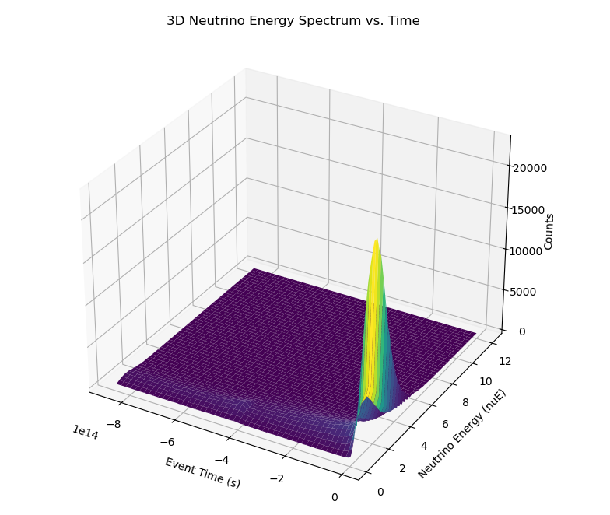
Detector simulation for JUNO: pre-SN
Why interested in pre-SN
Alert system
To effectively provide an alert → MM trigger
Clustering of neutrino signal
Simulated pre-SN
10 days before SN explosion
Counts vs time and energy
Normal & inverted hierarchy (NH, IH)
Note that this is a simulated plot. In reality this plot has to be reconstructed from detector data.
Pre-SN 3D plot:
counts vs time, energy

Slide 17
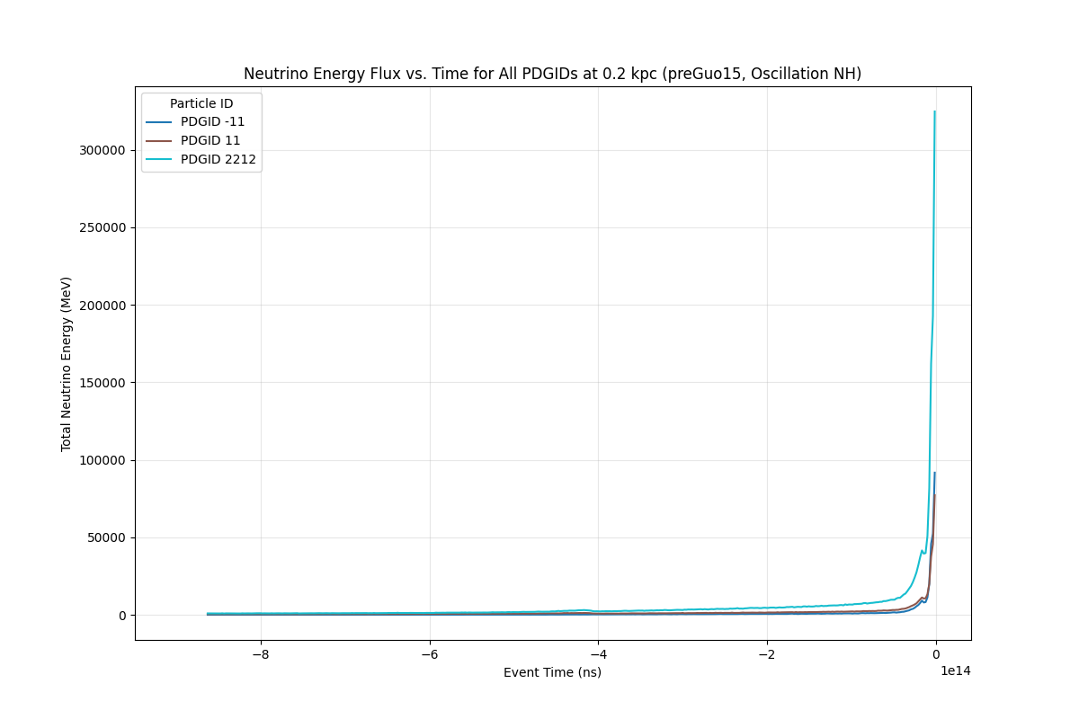
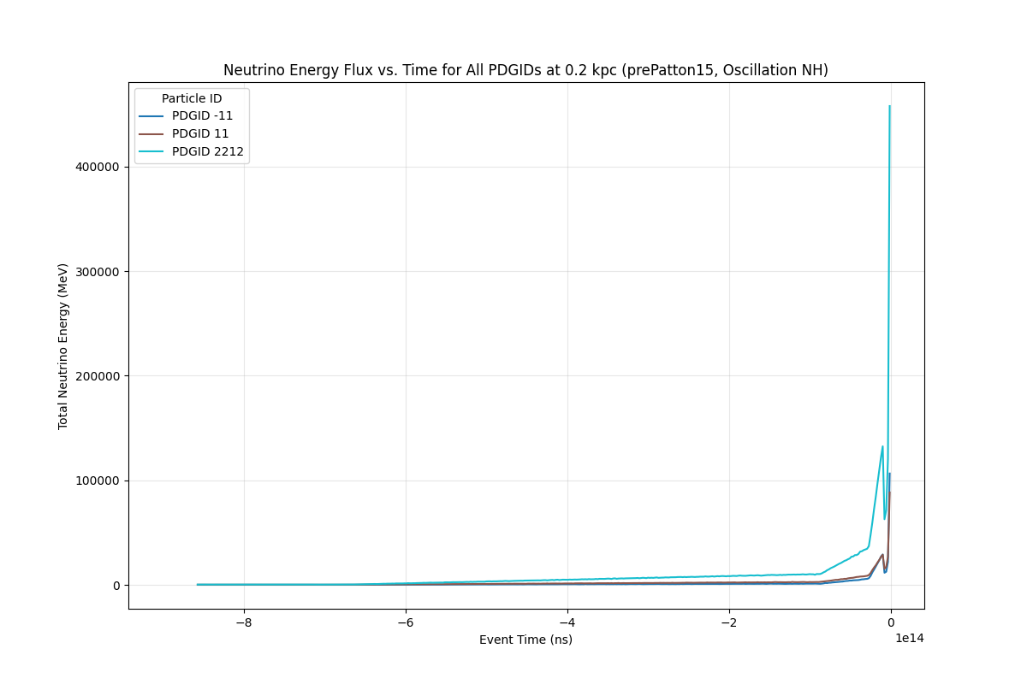
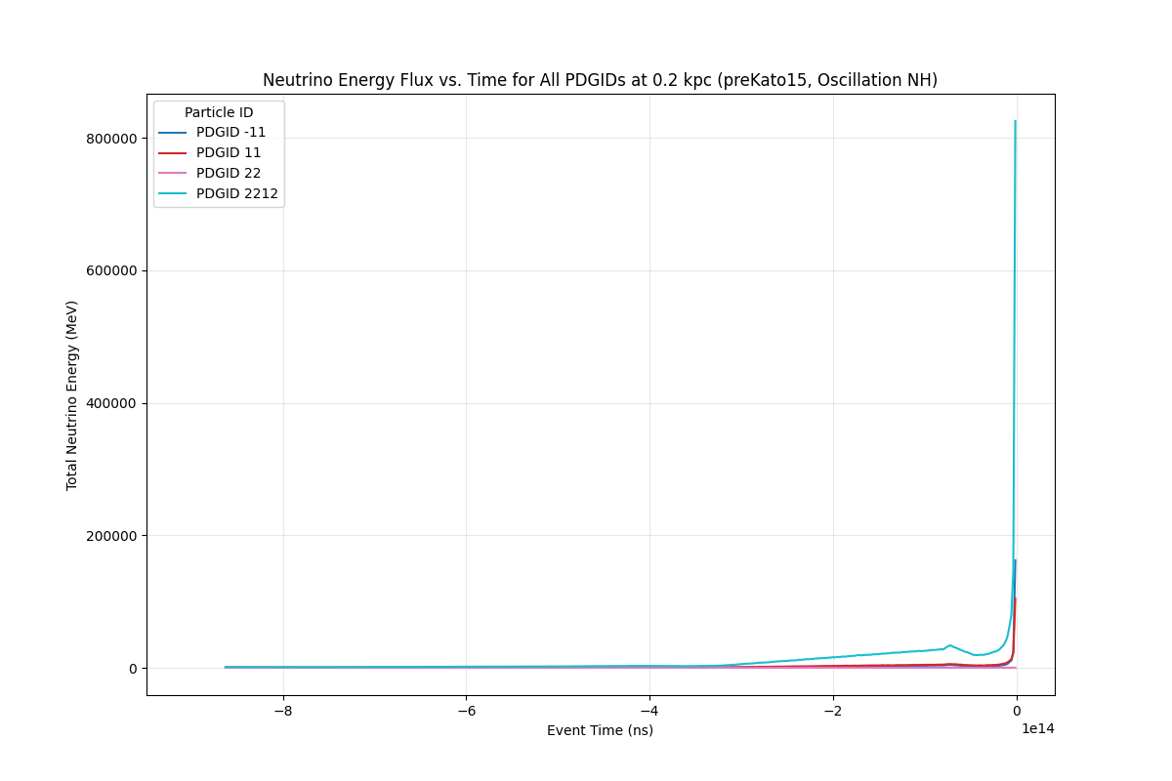
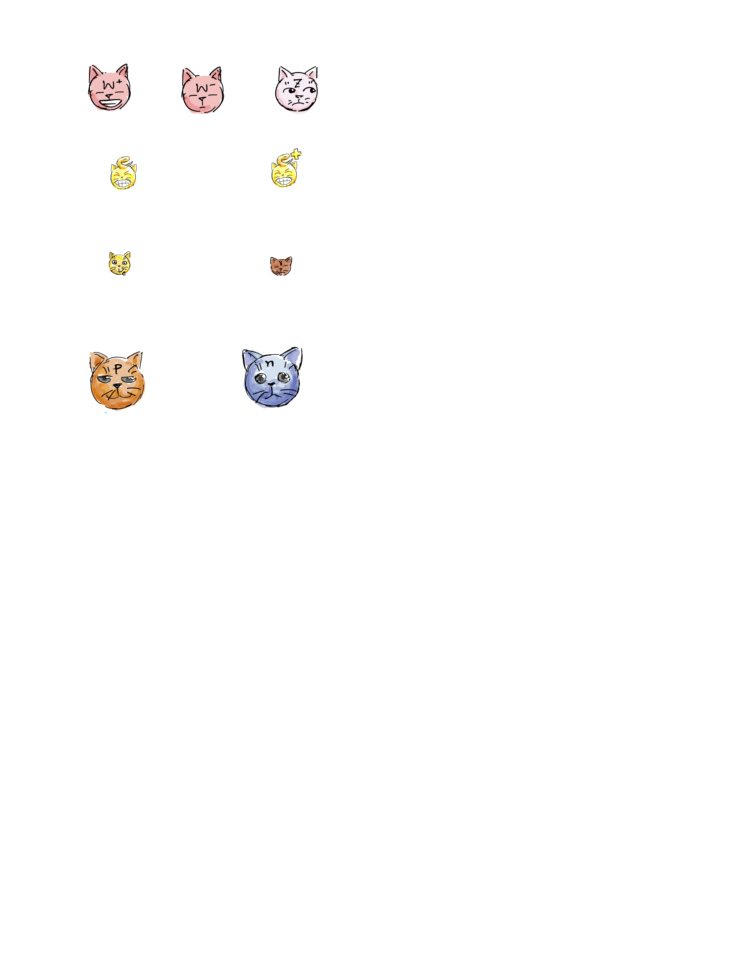
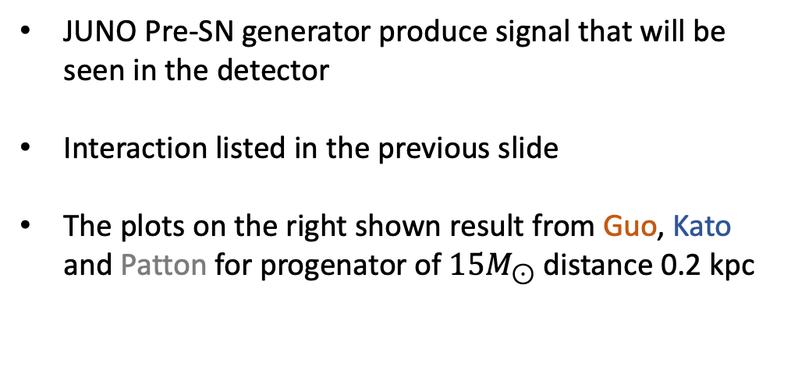
Detector simulation: Pre-SN
JUNO Pre-SN generator produce signal that will be seen in the detector
Interaction listed in the previous slide
The plots on the right shown result from Guo, Kato and Patton for progenator of ${15M}_{⊙}$ distance 0.2 kpc
Guo model
Particle ID:
electron (11)
positron (-11)
photon (22)
proton (2212)
Patton model
Kato model

Slide 18
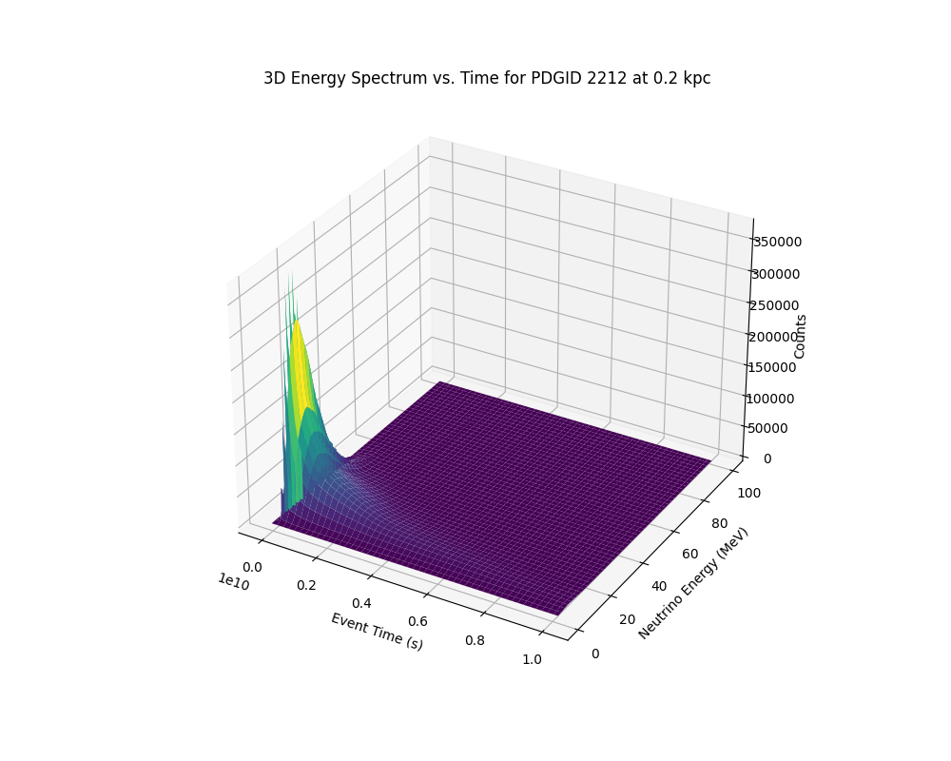
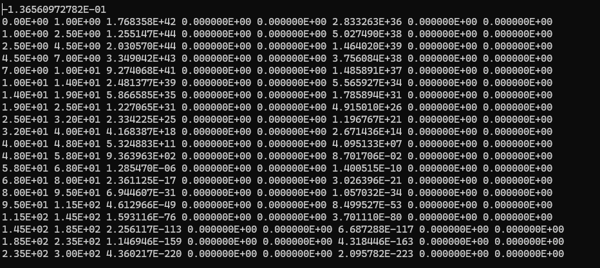
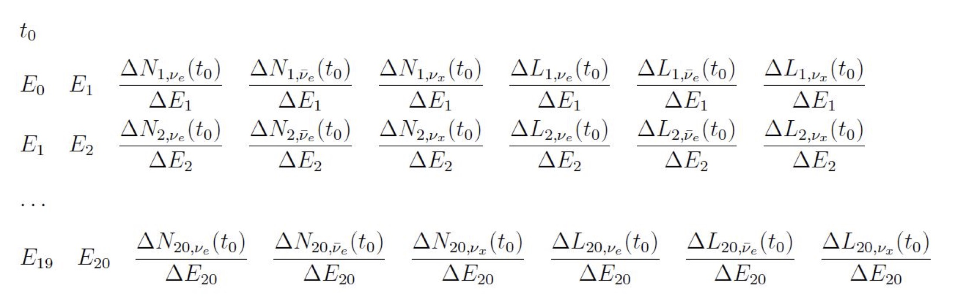
Detector simulation for JUNO: SN
Data format
Garching model SN 3D plot:
Conts vs time, energy

Slide 19
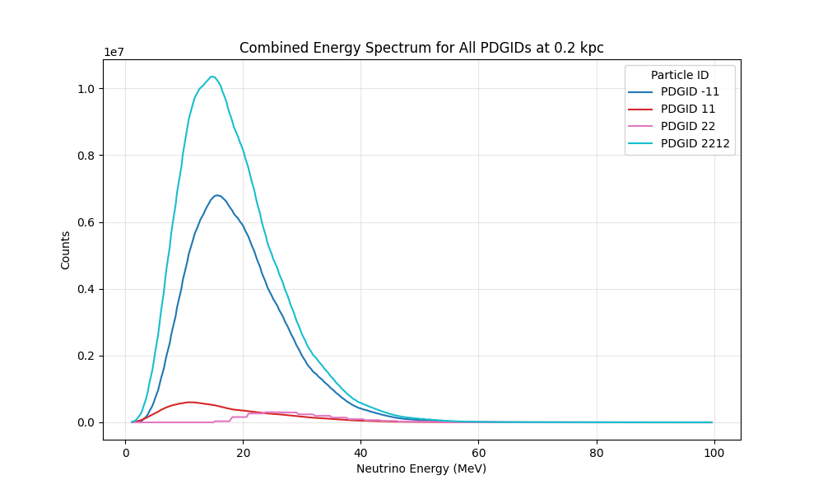
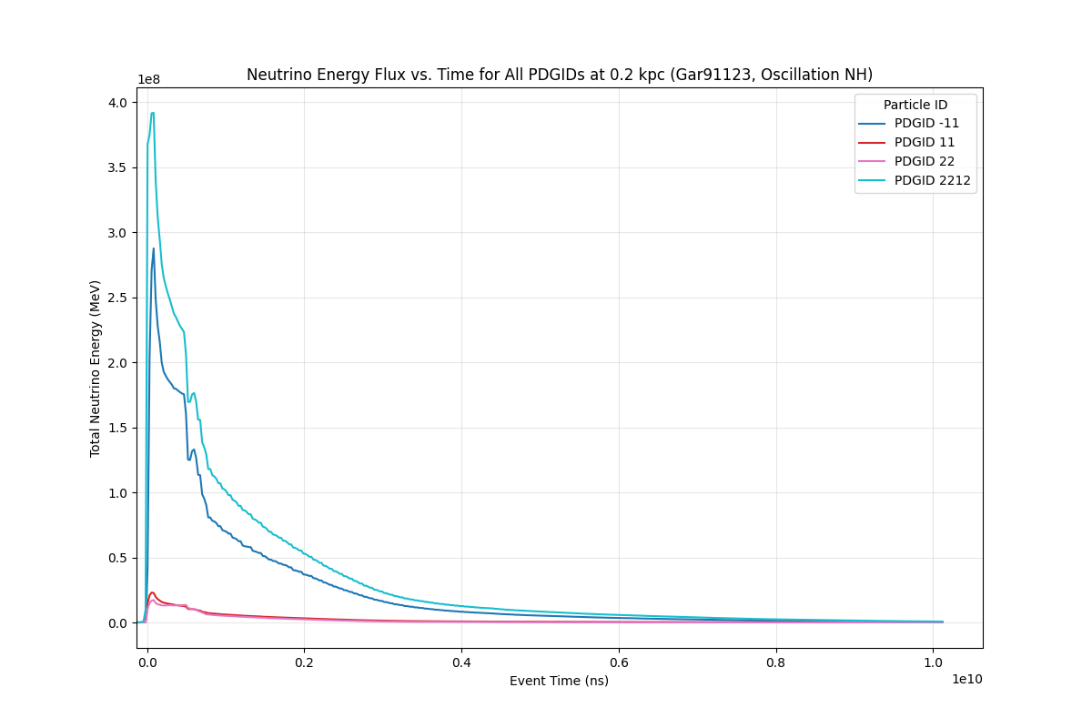
Detector simulation: SN
JUNO SN generator produce signal that will be seen in the detector
Interaction listed in the previous slide
The plots on the right shown result from Garching Model
Energy spectrum of each particle
Most of neutrino interactions result in IBD, and pES.
NC is good for detect other neutrino species
NH and IH yield different distributions
Particle ID:
electron (11)
positron (-11)
photon (22)
proton (2212)
Total energy vs time for

Slide 20
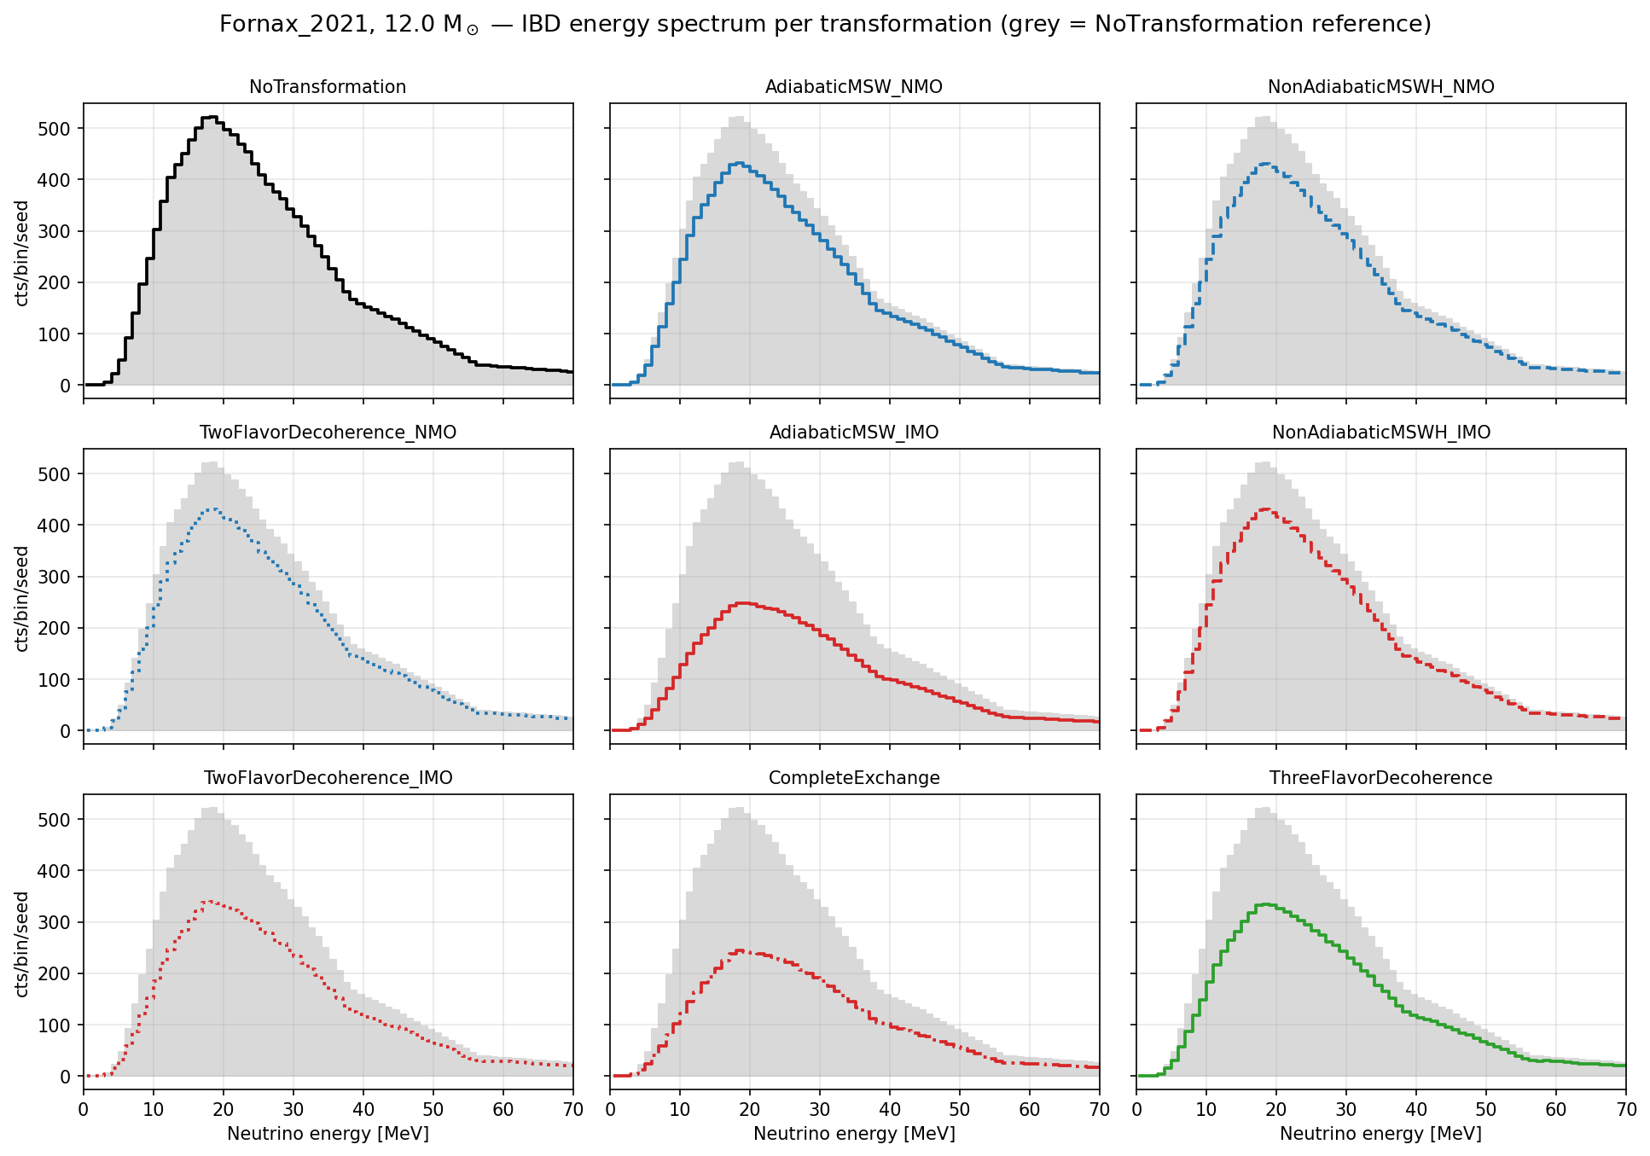
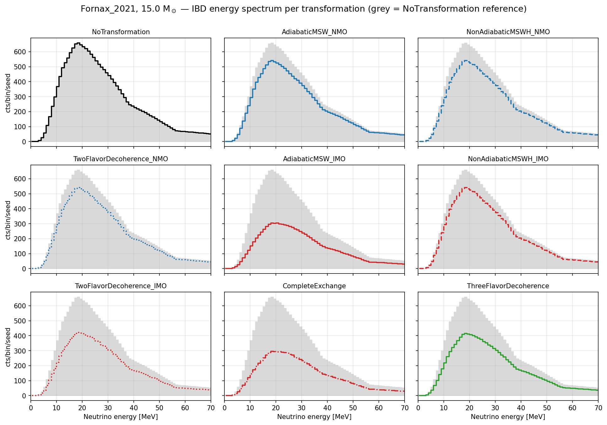
SNEWPY
Include many models: FORNAX, Nakazato, Bolling etc.

Slide 21
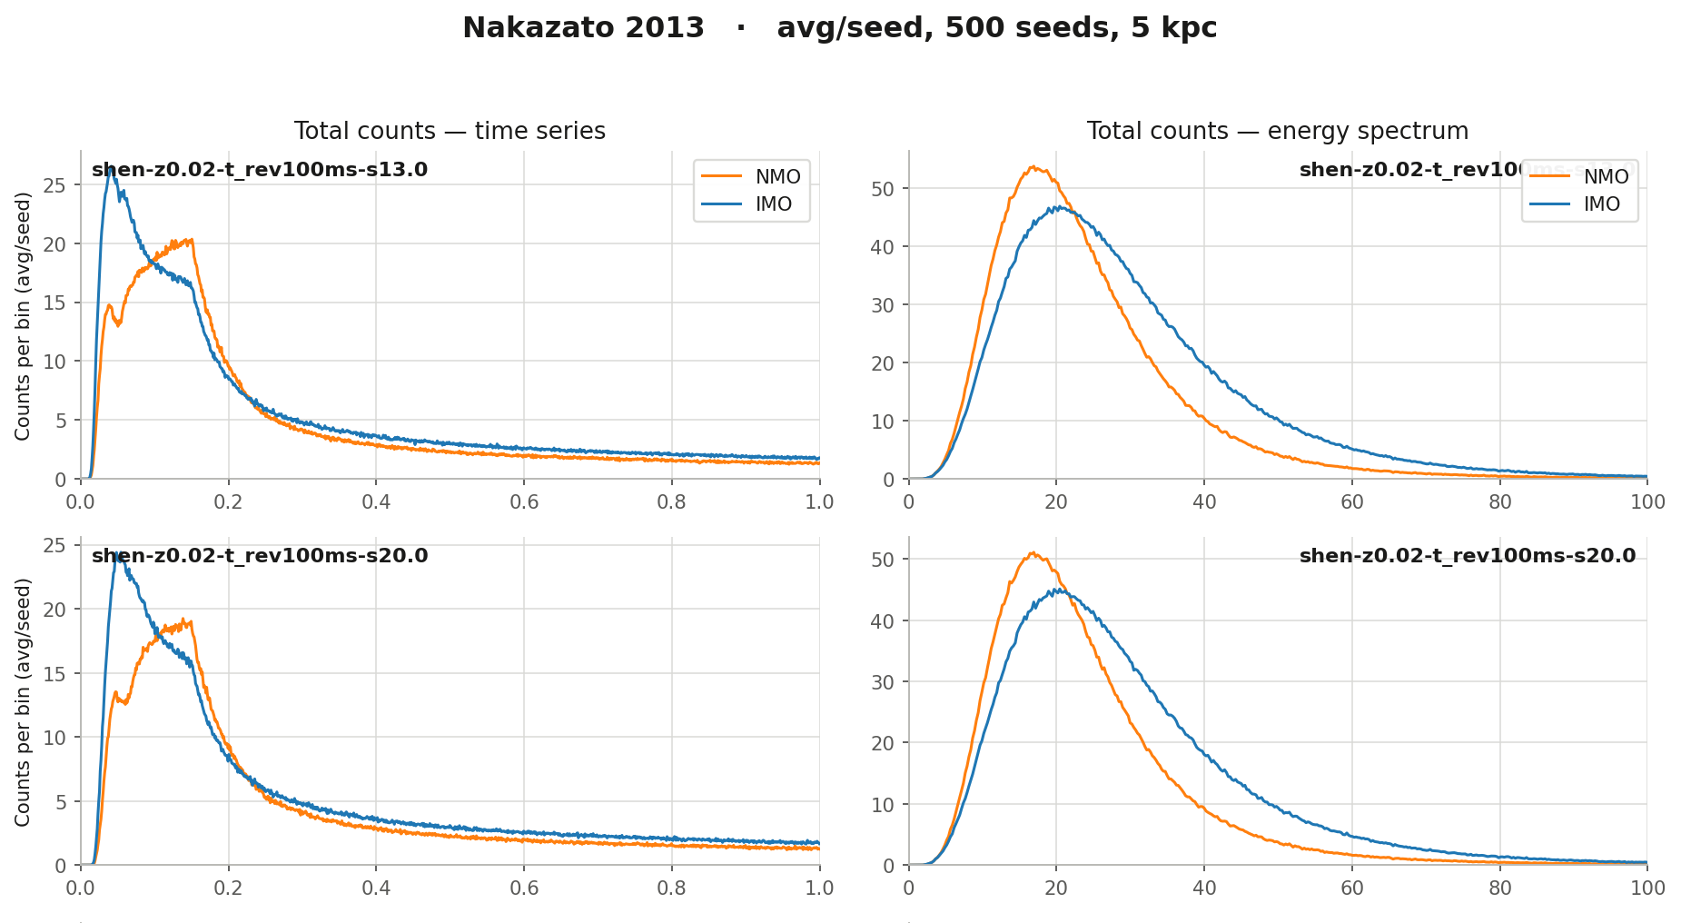
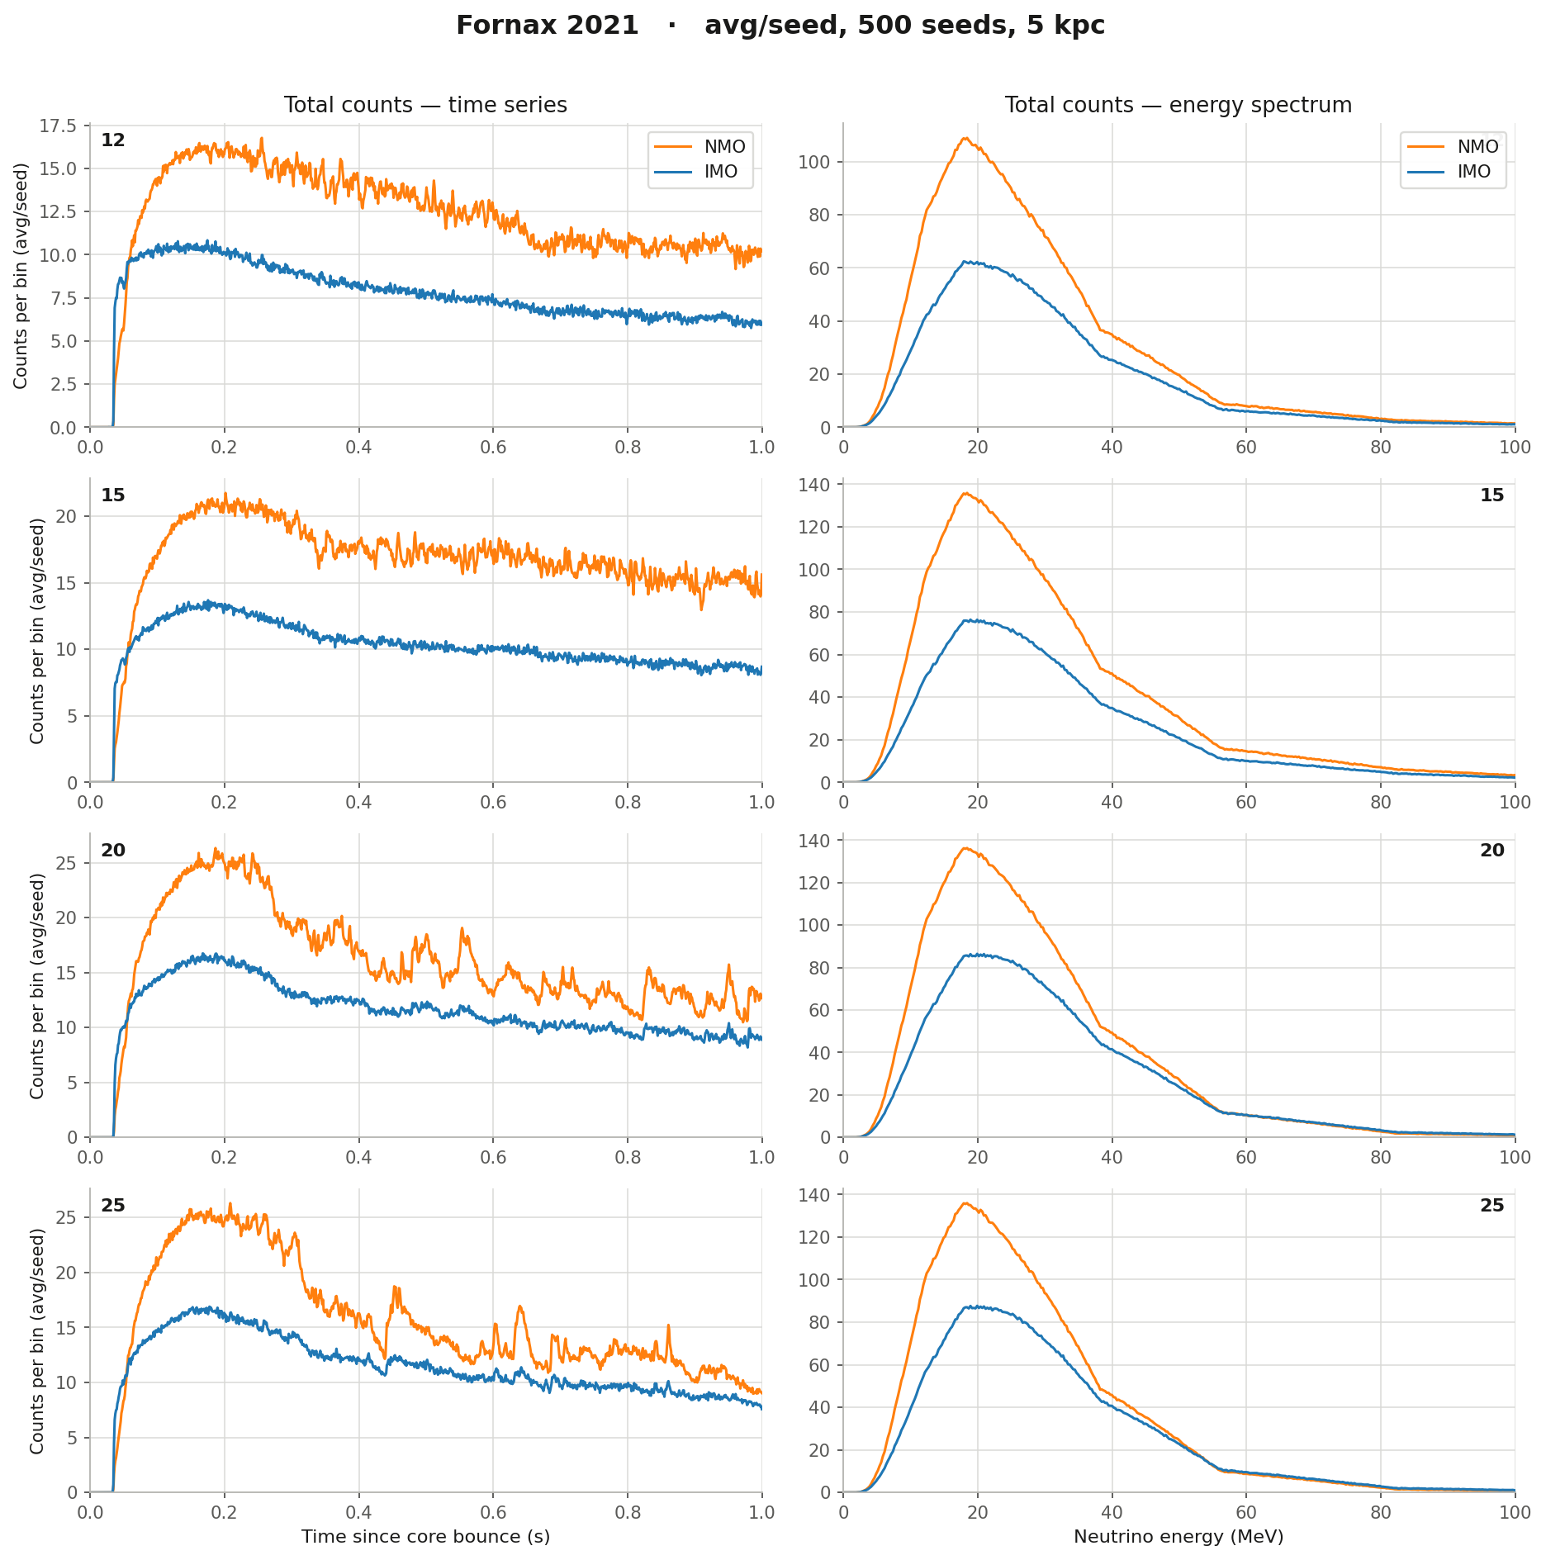
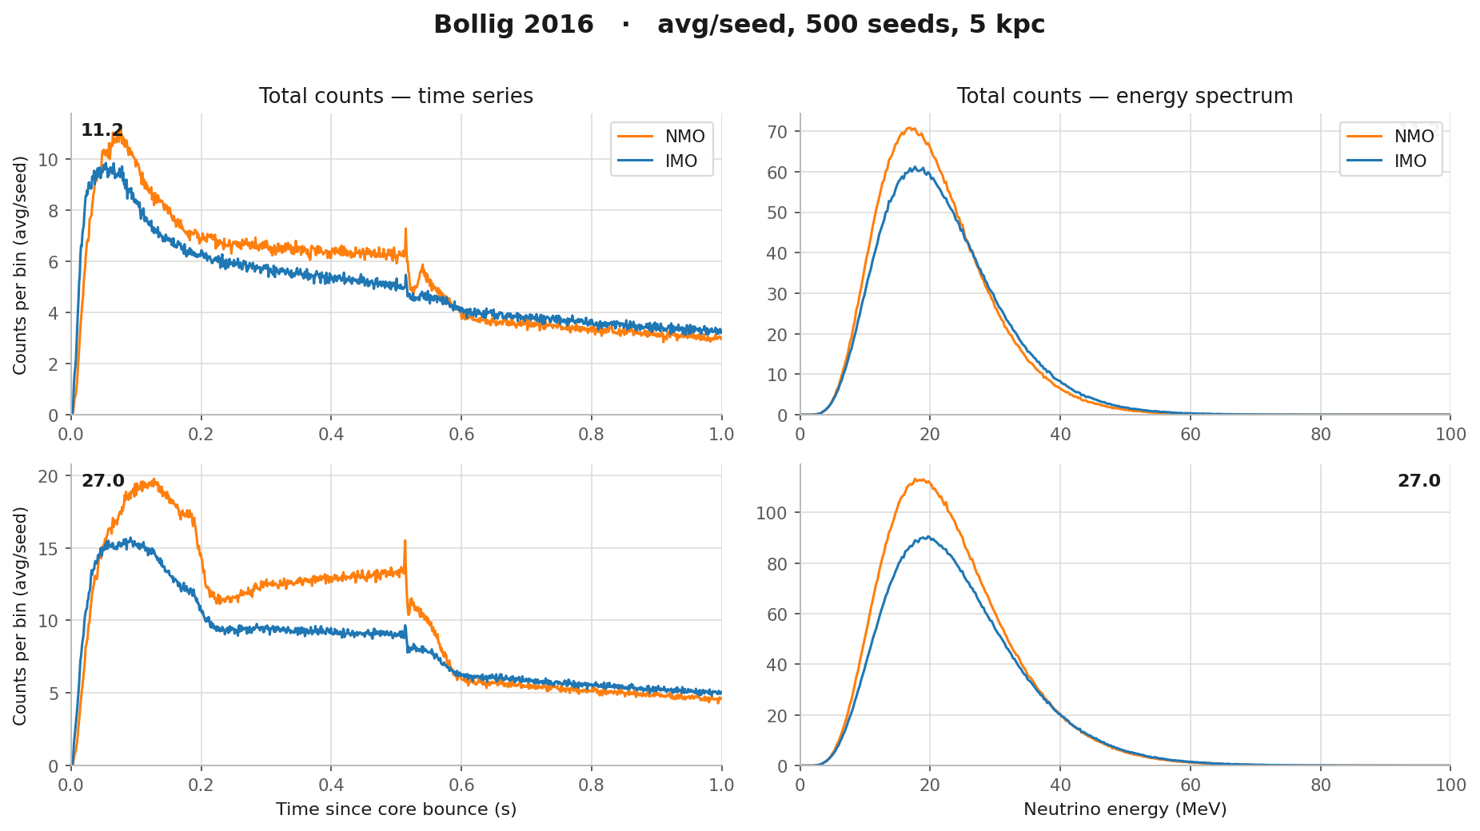
NMO vs IMO in different models

Slide 22
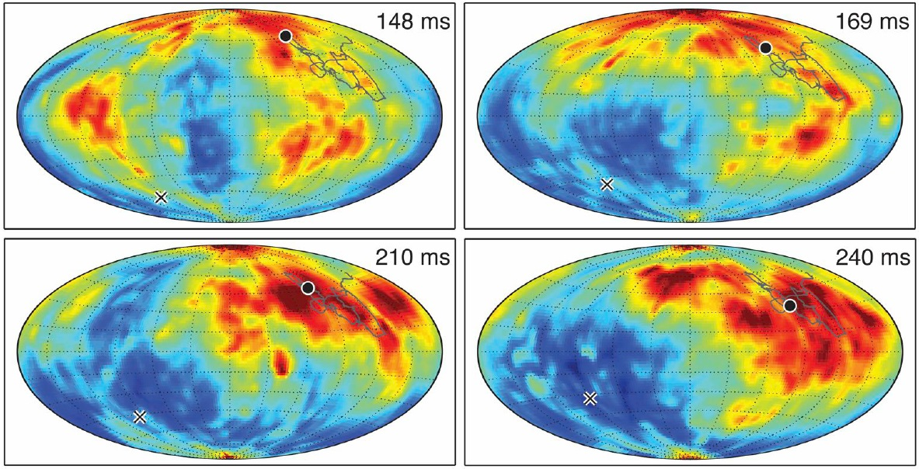
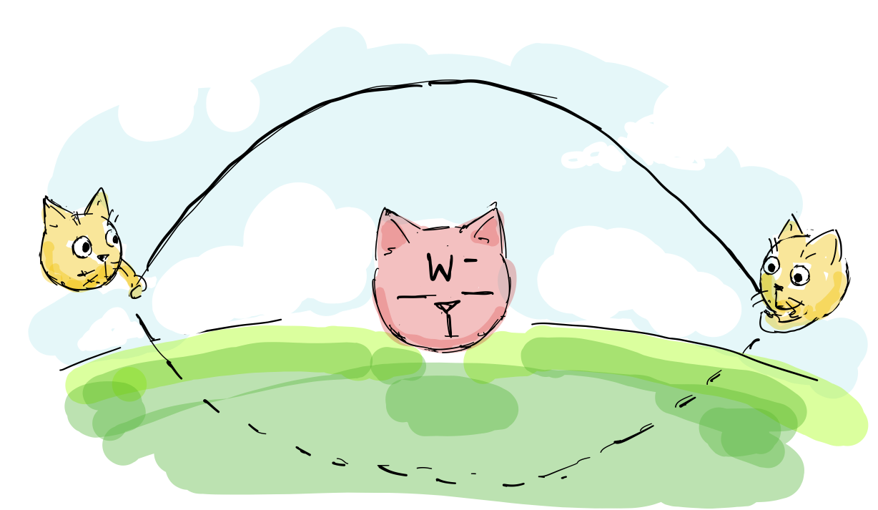
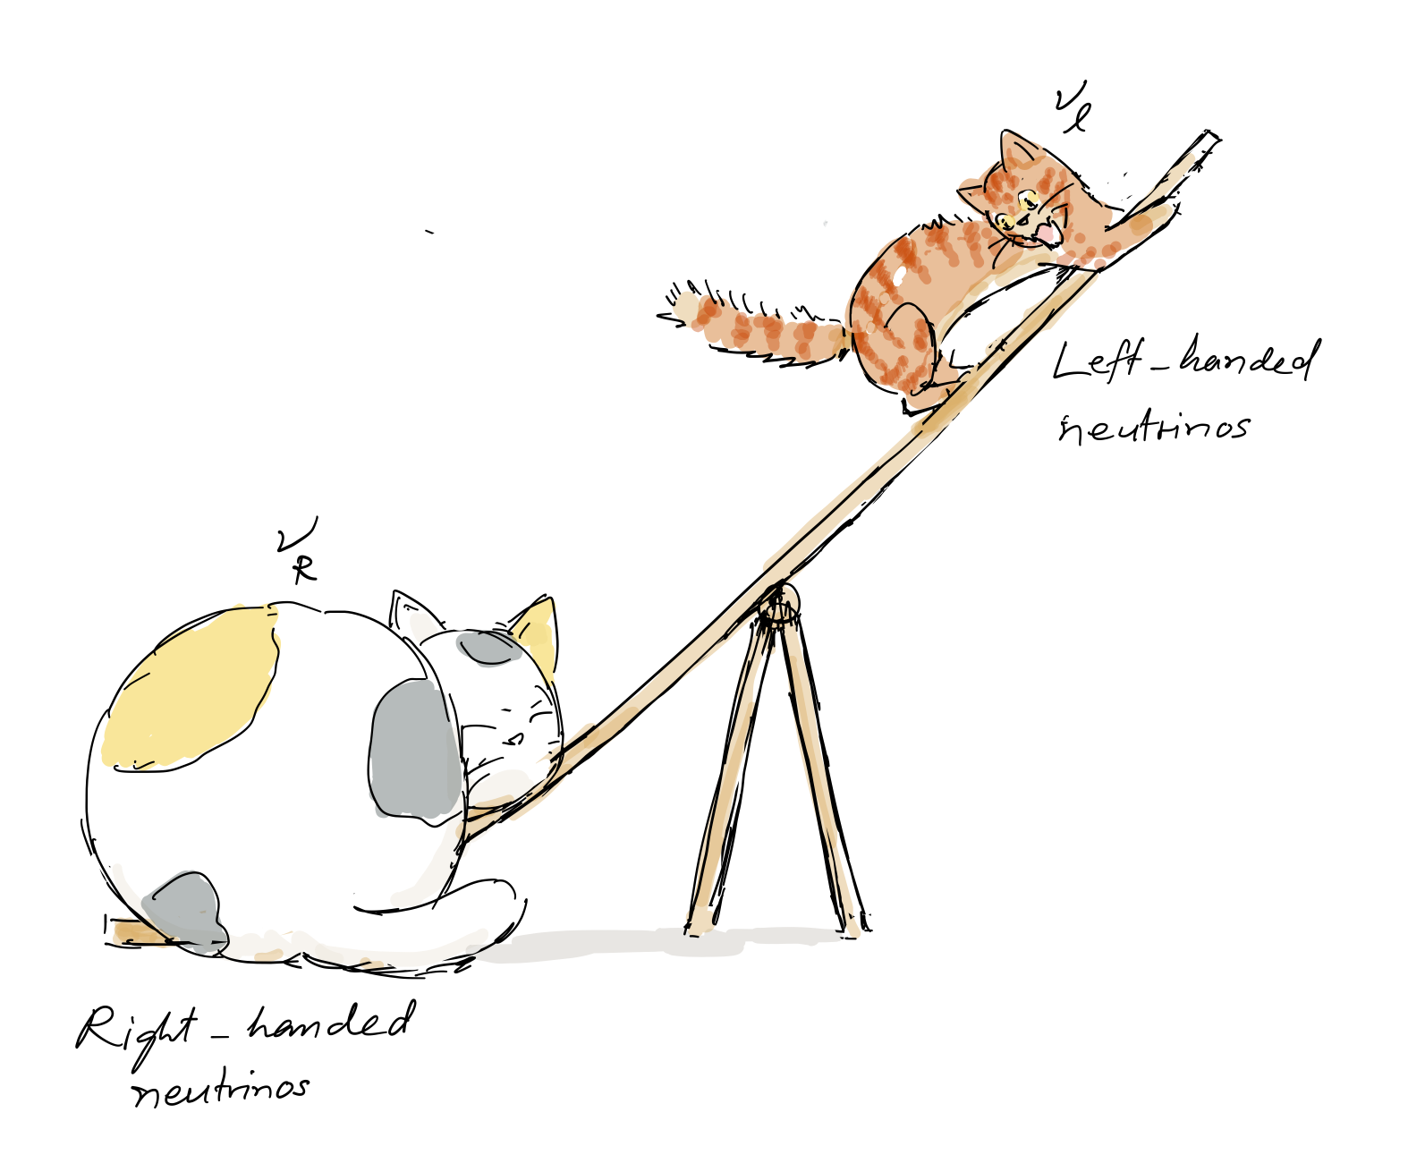
What else can we add to simulation?
Neutrino anisotropy
FORNAX 2025 version but not the
current one available in SNEWPY
Loop corrections
Adding correction to
classical theory
Contribution from sterile neutrinos
Including a heavier particle –> more
interaction at loop level
[Irene Tamborra et al. et 2014]

Slide 23
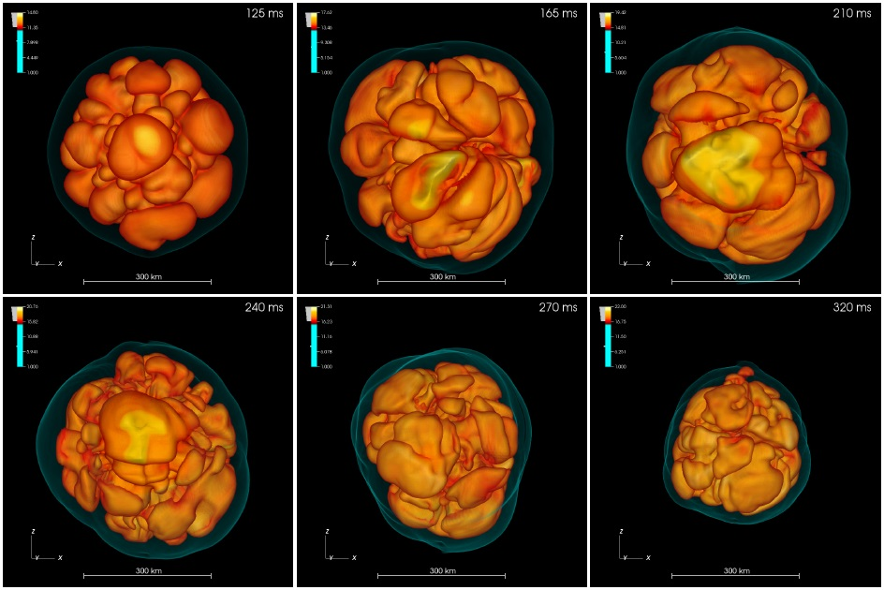
Anisotropy
Neutrino transport
Neutron star is spherically symmetric
Neutrino – matter → anisotropy
Neutrino anisotropy
Anisotropy from SASI activity
Lepton-number emission self-sustained asymmetry (LESA)
Updating SNEWPY
JUNO SN generator?
Anisotropy → Gravitational
Simulation of boiling matter around newly form neutron star [Irene Tamborra et al. et 2014]

Slide 24
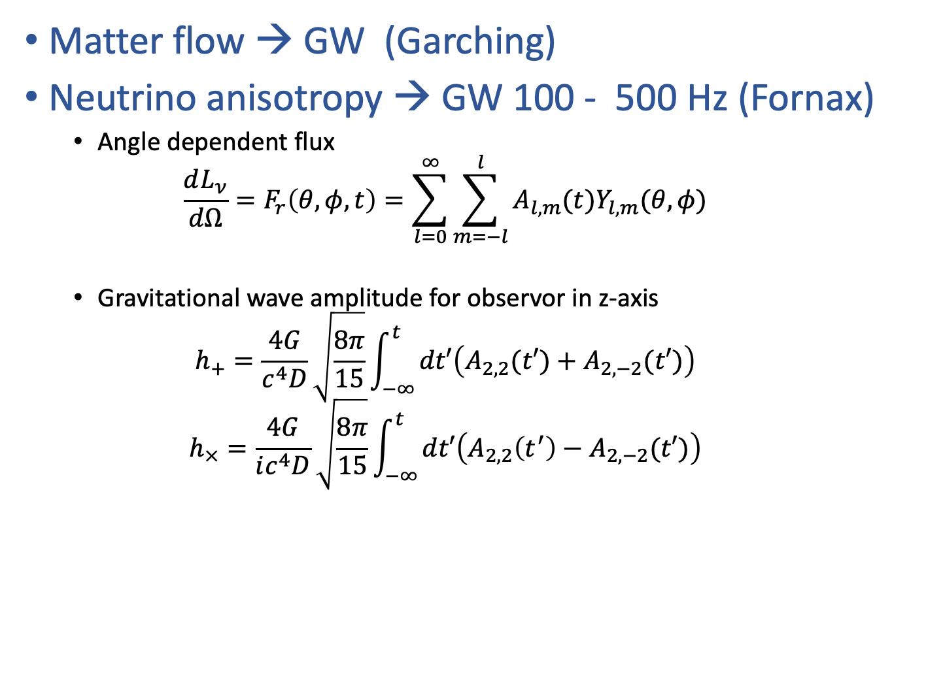
Gravitational wave driven by supernova
Matter flow → GW (Garching)
Neutrino anisotropy → GW 100 - 500 Hz (Fornax)
  Angle dependent flux
  $${\frac{dL_{ν}}{dΩ}=F}_{r}\left(θ,φ, t\right)=\sum_{l=0}^{∞}{\sum_{m=−l}^{l}{A_{l,m}(t)Y_{l,m}(θ,φ)}}$$
  Gravitational wave amplitude for observor in z-axis
  $$h_{+}=\frac{4G}{c^{4}D}\sqrt{\frac{8π}{15}}\int_{−∞ }^{t}{dt′\left(A_{2,2}(t′)+A_{2,−2}(t′)\right)}$$
  $$h_{×}=\frac{4G}{ic^{4}D}\sqrt{\frac{8π}{15}}\int_{−∞ }^{t}{dt′\left(A_{2,2}\left(t^{′}\right)−A_{2,−2}(t′)\right)}$$
If we detect GW during the explosion we know that neutrino emission is not spherical symmetric!
We can study the source of anisotropy which should originate from neutrino interaction with matter around the neutron star

Slide 25
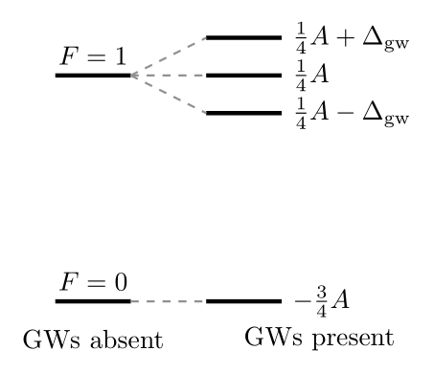
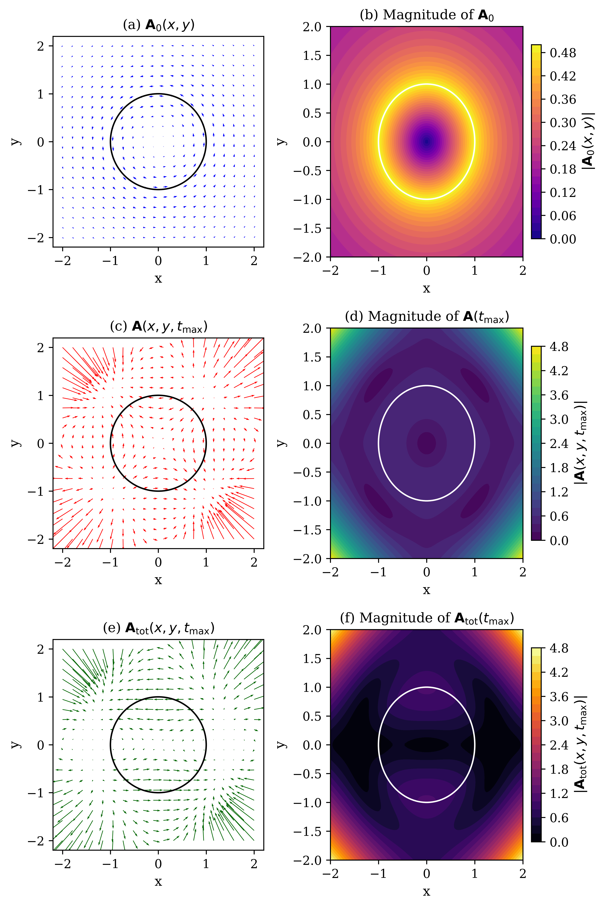
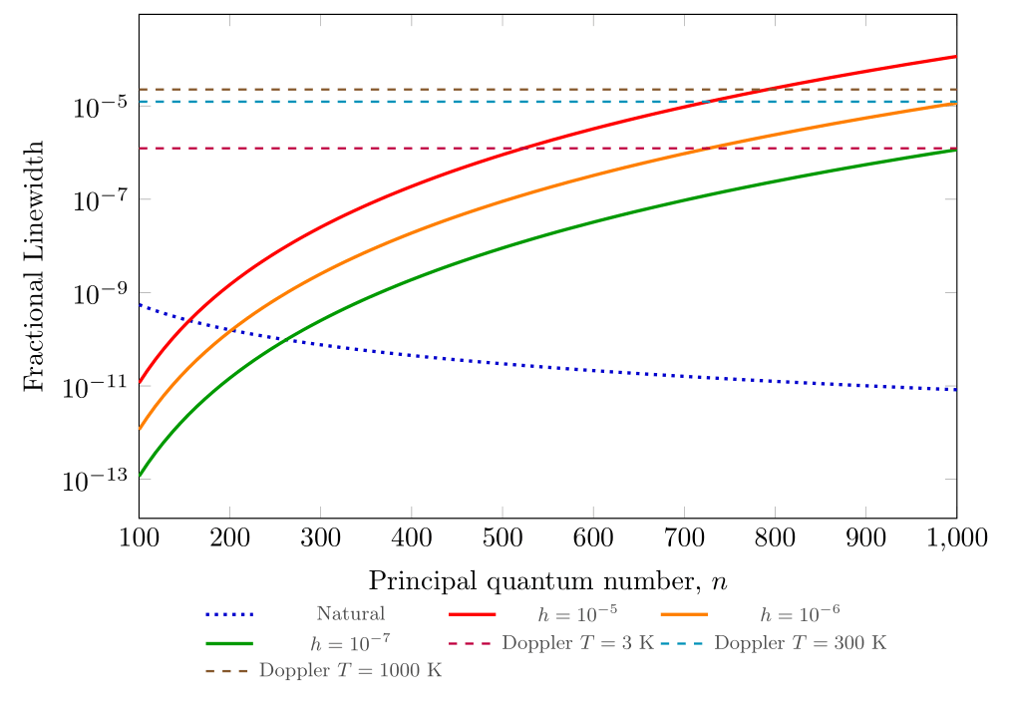
Gravitational waves effect on quantum systems
We are exploring GW interaction with systems that produces quantum effects e.g. Spectral broadening, Aharonov-Bohm effect
Goal → alternative GW detection
GW – Spectral broadening in Rydberg atoms
GW – Geometric phase of fermions
GW – Rydberg EIT

Slide 26
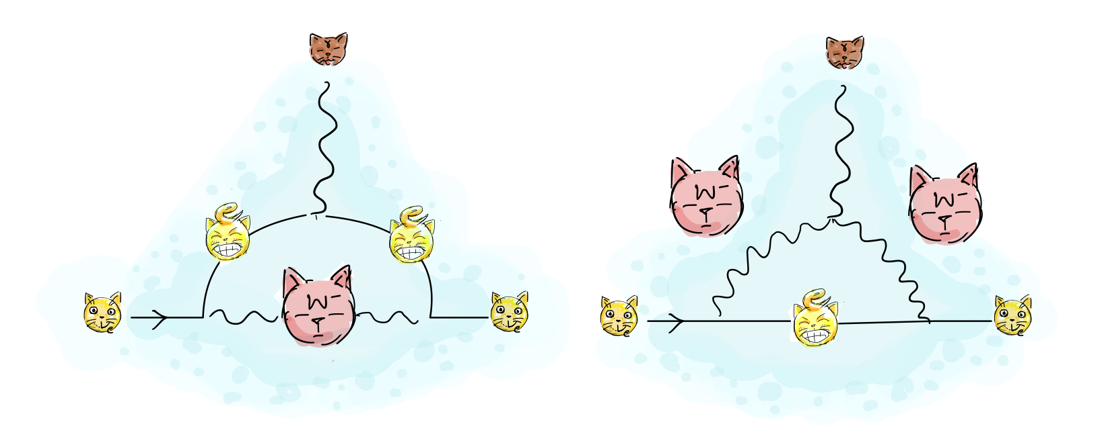
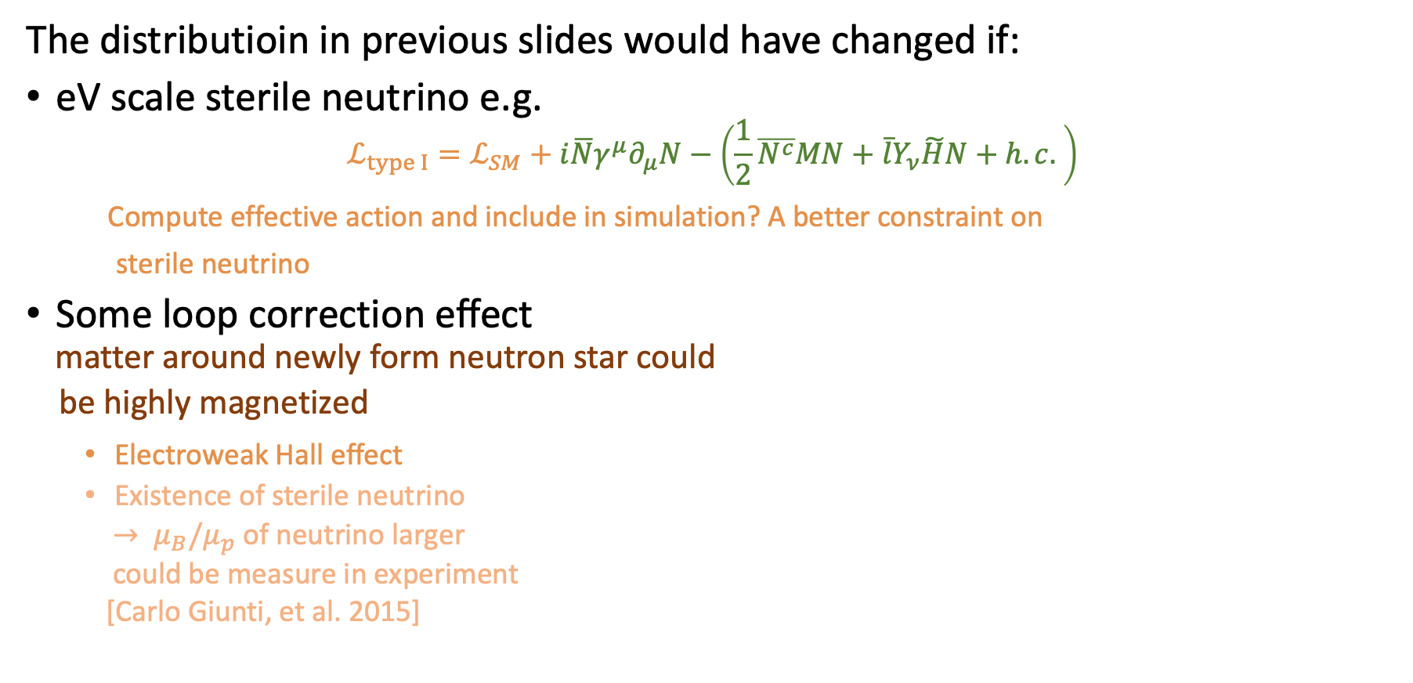
Loop correction & Sterile neutrino
The distributioin in previous slides would have changed if:
eV scale sterile neutrino e.g.
$$ℒ_{type I}=ℒ_{SM}+i\overline{N}γ^{μ}∂_{μ}N−\left(\frac{1}{2}\overline{N^{c}}MN+\overline{l}Y_{ν}\tilde{H}N+h.c. \right)$$
Compute effective action and include in simulation? A better constraint on
sterile neutrino
Some loop correction effect
matter around newly form neutron star could
be highly magnetized
  Electroweak Hall effect
  Existence of sterile neutrino
  $→ μ_{B}/μ_{p}$ of neutrino larger
  could be measure in experiment
  [Carlo Giunti, et al. 2015]

Slide 27
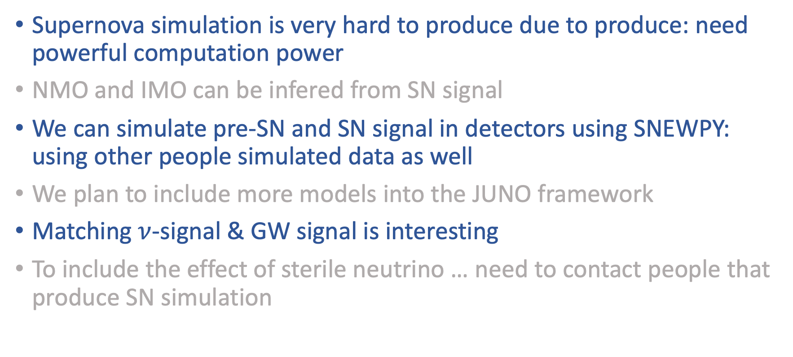
Summary
Supernova simulation is very hard to produce due to produce: need powerful computation power
NMO and IMO can be infered from SN signal
We can simulate pre-SN and SN signal in detectors using SNEWPY: using other people simulated data as well
We plan to include more models into the JUNO framework
Matching $ν$-signal & GW signal is interesting
To include the effect of sterile neutrino … need to contact people that produce SN simulation

Slide 28
Reference
JUNO collaboration, “JUNO physics and detector,” Prog. Part. Nucl. Phys. Vol. 123, 103927 (2022)
Irene Tamborra et al., “Self-sustained asymmetry of lepton-number emission: a new phenomenon during the supernova shock-accretion phase in three dimensions,” ApJ, Vol. 792 96 (2014)
Carlo Giunti et al., “Neutrino electromagnetic interactions: a window to new physics,” Rev. Mod. Phys. Vol. 87, 513 (2015)
John M. Blondin et al., “Stability of Standing Accretion Shocks, With an Eye Toward Core Collapse Supernovae,” Astrophys.J. 584, 971-980 (2003)
Thierry Foglizzo et al. , “Shallow Water Analogue of the Standing Accretion Shock Instability: Experimental Demonstration and a Two-Dimensional Model,” Phys. Rev. Lett. 108, 051103 (2012)
Data archive: https://wwwmpa.mpa-garching.mpg.de/
ccsnarchive/archive.html

Slide 29
Q&A

