Slide 1





Analysis of Ω_{b}– → Ξ_{c}⁺K–π– at LHCb
using Run 3 data
Dhruvanshu Parmar, Mikhail Mikhasenko, Marian Stahl
Ruhr-Universität Bochum
DPG Frühjahrstagung, 2026
18 March 2026

Slide 2
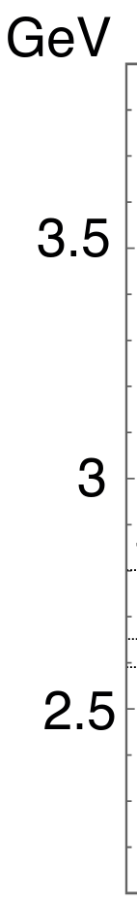
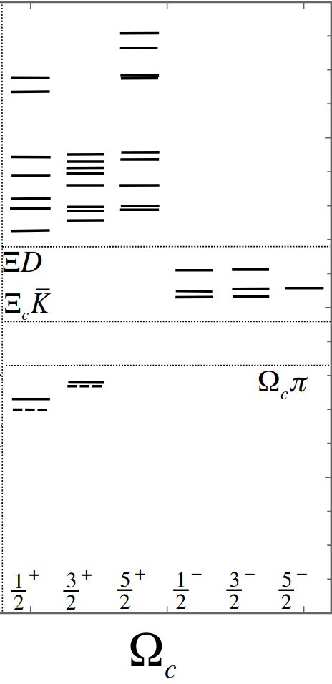
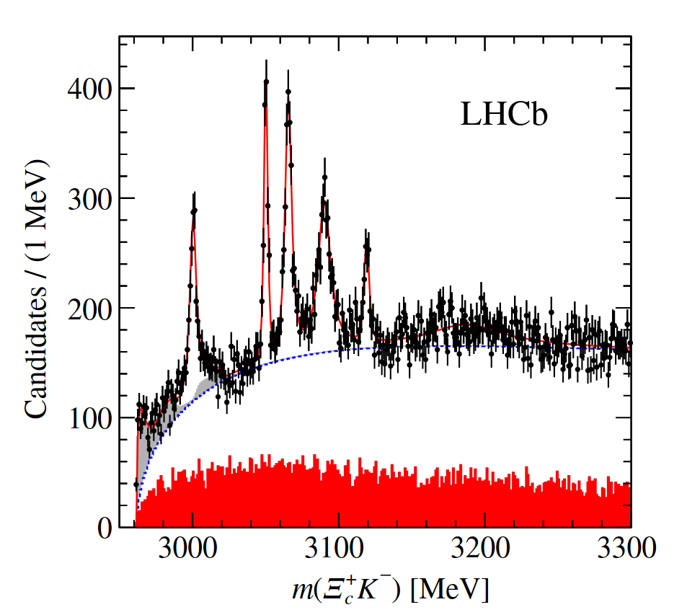

Physics motivation
[PhysRevD.92.114029]
Five new narrow Ω_{c}⁰ states in prompt production observed by the LHCb collaboration [Phys. Rev. Lett. 118 (2017) 182001].
Same states observed in decay Ω_{b}– → Ξ_{c}⁺(→ p K– π⁺) K– π– [PhysRevD.104.L091102].
Best suited for analysis to study spin and parity.
Aim for precise measurements of quantum numbers with Run 3 data.
[Phys. Rev. Lett. 118 (2017) 182001]

Slide 3
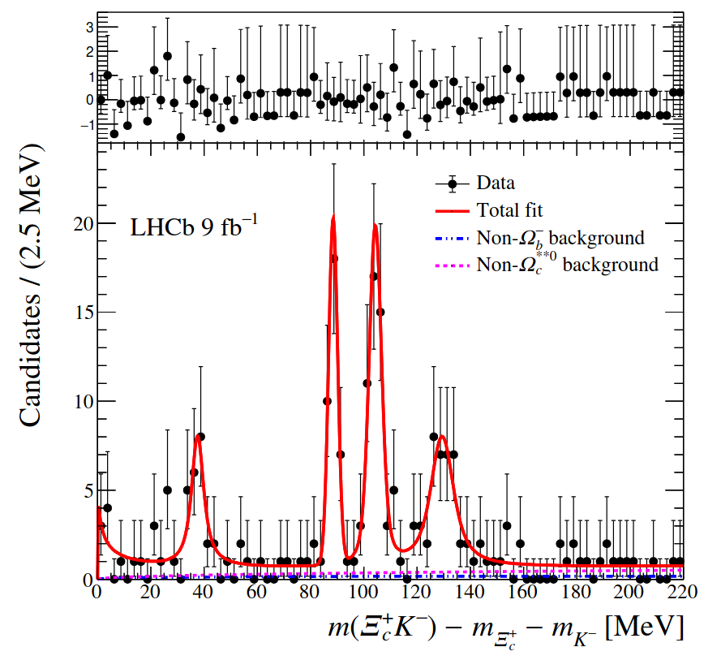
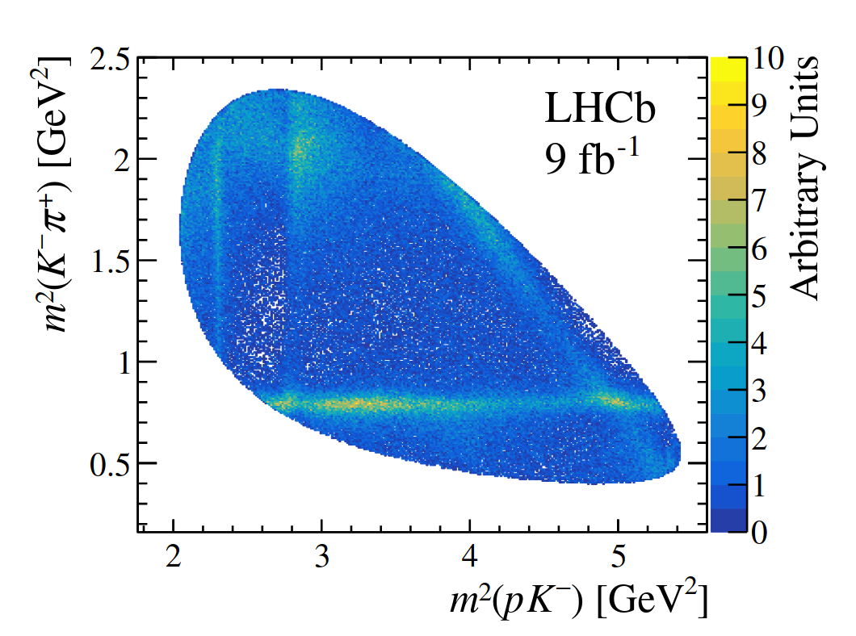
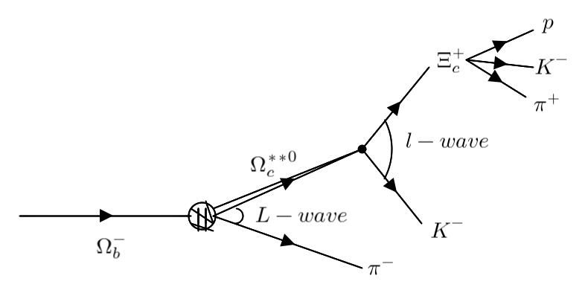
Analysis goals
Spectroscopy of charm hadrons
Studying excited states of Ω_{c}⁰.
Measure mass, widths and fit fractions.
Spin properties
Studying sensitivity of helicity amplitudes on polarization of Ξ_{c}⁺ decay products.
Include established amplitude models for Ξ_{c}⁺ →p K– π⁺ .
[PhysRevD.104.L091102]
Ξ_{c}⁺ →p K– π⁺
[LHCB-PAPER-2024-034-001]

Slide 4
Full selection of events
Multivariate selection
Post Multivariate selection
Da
t
a
Readyyy!
Ξ_{c}⁺
BDT
Score
ok
Ω_{b}– BDT
Score
ok
Cloned tracks?
Any multiple candidates?
Preselection
Ok
No
No
Score
Not ok
Score
Not ok
Yes
Yes
Not ok
Discard

Slide 5
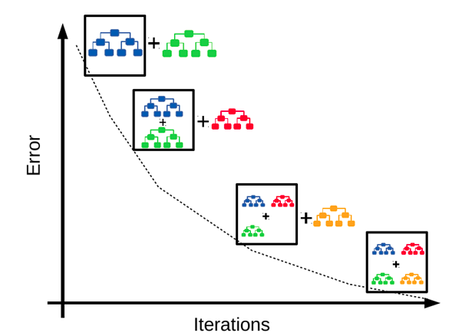
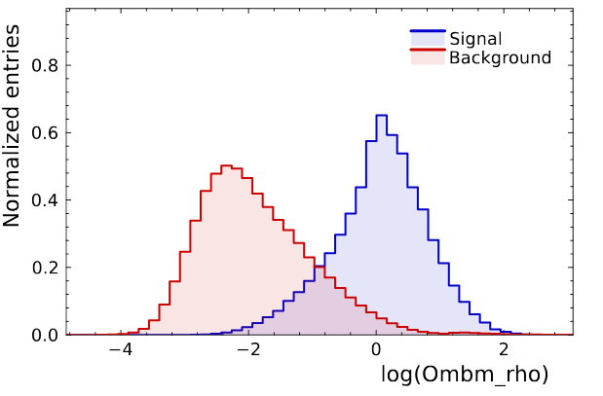
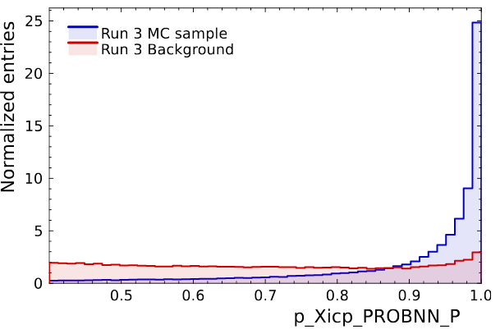
Multivariate selection using GBDTs
Decision trees (DTs) use simple decision rules from data features to make inferences.
Gradient boosting is combining such ‘weaker’ trees for improved performance.
For this analysis:
Ξ_{c}⁺ BDT for Ξ_{c}⁺ → pK–π⁺ decays.
Ω_{b}– BDT Ω_{b}– → Ξ_{c}⁺K–π– decays.
The features for training can be categorized into 3 parts:
Geometrical features (Radial distance, IPCHI2).
PID features (PROBNNs,PID).
Kinematic features (pT,mass).
Image source
Signal
Background

Slide 6
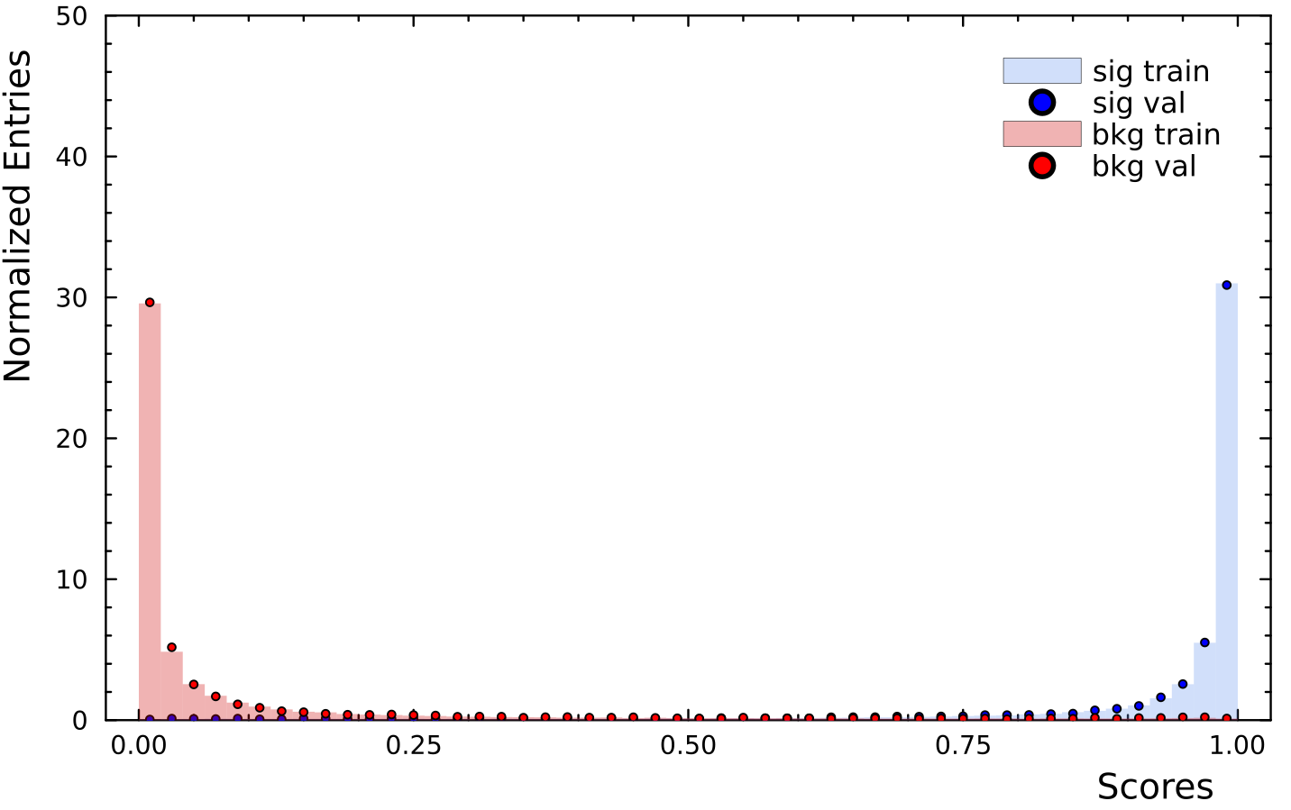
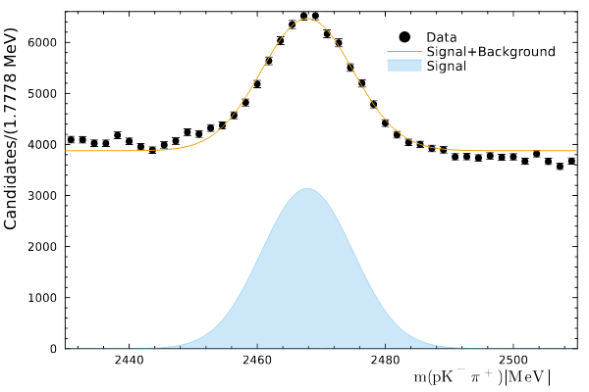
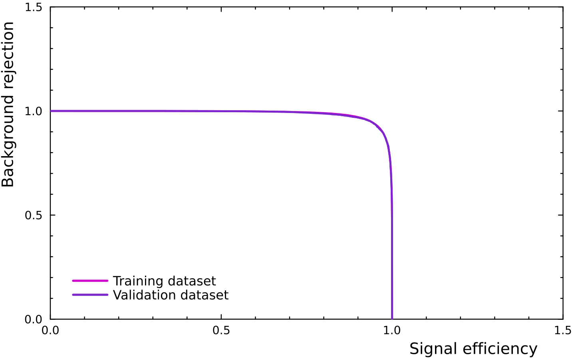
Ξ_{c}⁺ BDT performance
BDT performance is good
Nice separation of signal and background.
No visible traces of overfitting.
Apply conditions for sufficient Ξ_{c}⁺ candidates
Ξ_{c}⁺ BDT score > 0.1 .
Select candidates in 2σ window around Ξ_{c}⁺ mass peak.
Ξ_{c}⁺ BDT score as input feature for Ω_{b}– BDT.

Slide 7

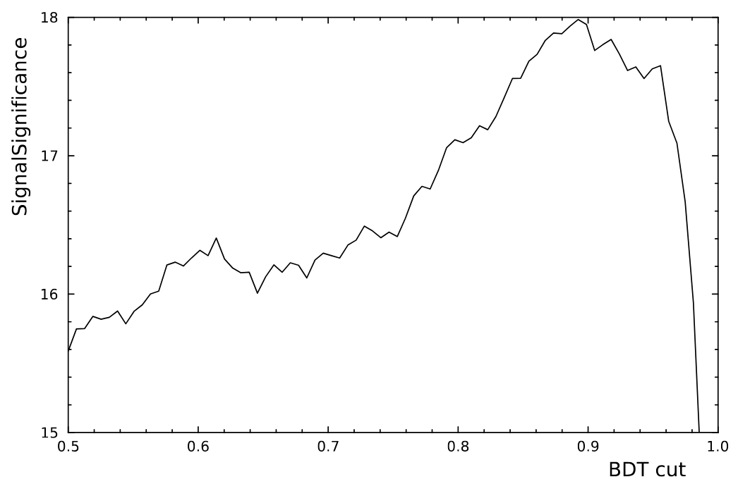
Optimization of Ω_{b}– BDT
Procedure :
Scan through a range of BDT scores.
Select events with scores larger than this set value (BDT cut).
Evaluate signal (S) and background (B) yields in a fixed 2σ interval around Ω_{b}– mass.
Ξ_{c}⁺ BDT do not need to be optimized
For systematics :)

Slide 8
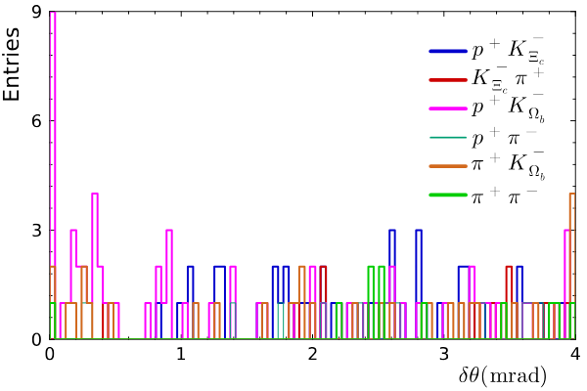
Cloned tracks and multiple candidates
Cloned tracks are removed if two-track combinations have opening angles (δθ) less than 1 mrad.
Multiple candidates are removed by selecting candidate with highest BDT score.
Year | Pre-BDT | Ξ_{c}⁺ BDT | Optimized Ω_{b}– BDT | Remove cloned tracks | Remove multiple candidates
2024 | 22,739,305 | 1,048,882 | 1976 | 1784 | 1739
2025 | 114,942,557 | 3,996,614 | 2906 | 2488 | 2438

Slide 9
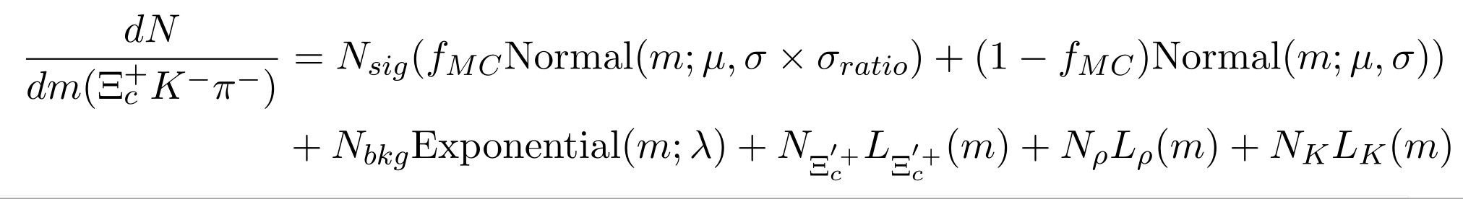
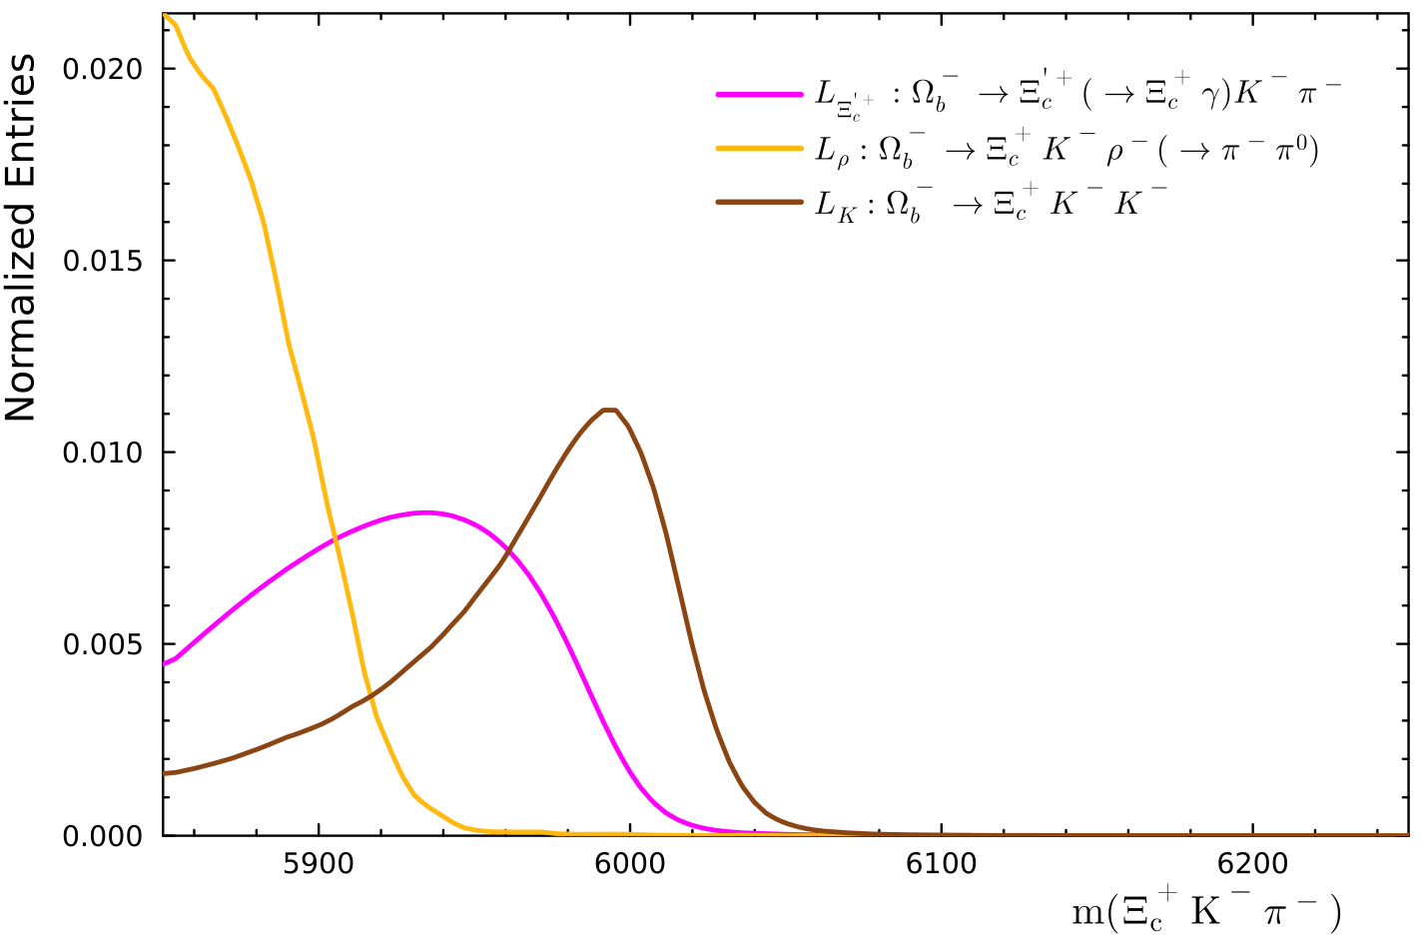
Fit model for the Ξ_{c}⁺K–π– mass spectrum
The complete model can be written as:
Parameters f_{MC} and σ_{ratio} fixed from MC, rest all parameters are floated.
‘L’ are different lineshapes for feed-down backgrounds.
Modeled using simulated data from RapidSim.
All components normalized to fit range.

Slide 10
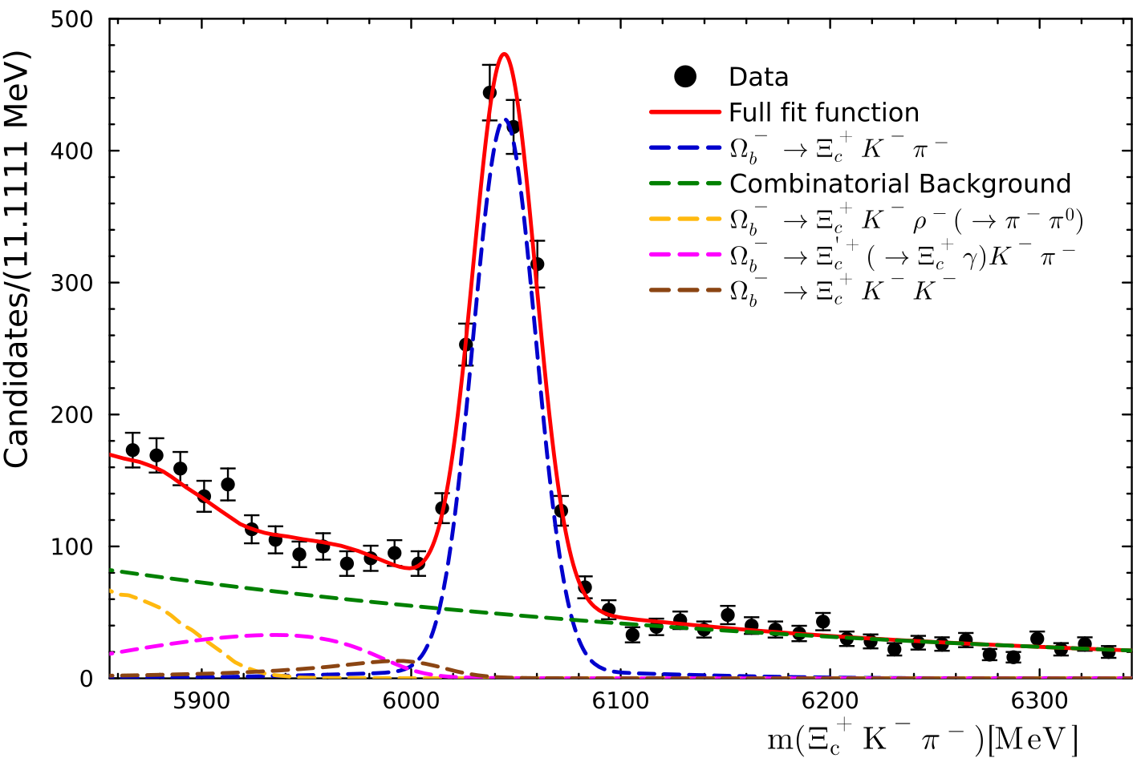
Ξ_{c}⁺K–π– mass spectrum
An extended negative log likelihood (extended-nll) fit is performed in the fit range of (5850,6350) MeV.
Signal yield per luminosity is roughly 2.5x more compared to Run 2.
Preliminary
μ | 6044.52 ± 0.75 MeV
σ | 74.48 ± 3.45 MeV
λ | 0.0027 ± 0.0003 MeV^{–1}
N_{sig} | 1464.22 ± 65.78
N_{bkg} | 1982.5 ± 79.03
N_{Ξ’} | 343.45 ± 104.8
N⍴ | 281.73 ± 58.63
N_{K} | 105.06 ± 79.75
LHCb sample | Signal Yield | Signal Yield per fb^{–1}
Run 1 (3 fb^{–1}) | 44 ± 5 | 15 ± 2
Run 2 (6 fb^{–1}) | 199 ± 13 | 33 ± 2
Run 1 + Run 2 (9 fb^{–1}) | 240 ± 17 | 27 ± 1
Run 3 (~ 17.8 fb^{–1}) | 1464 ± 66 | 82 ± 4

Slide 11
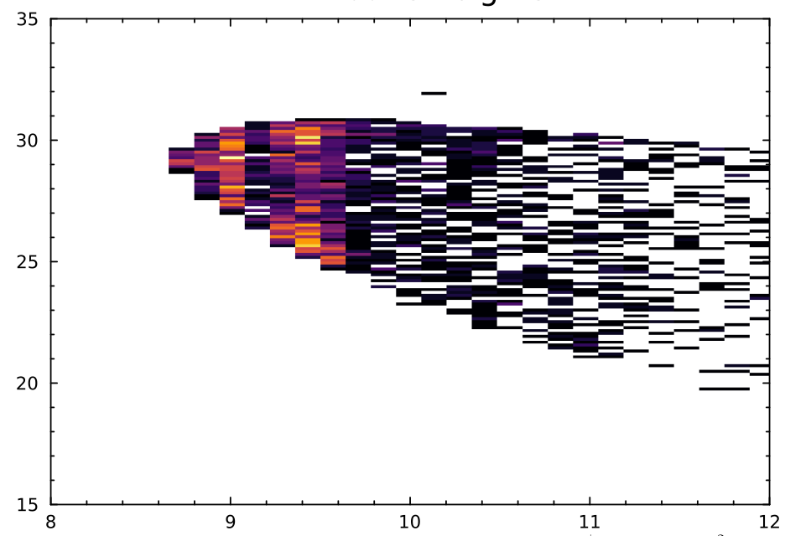
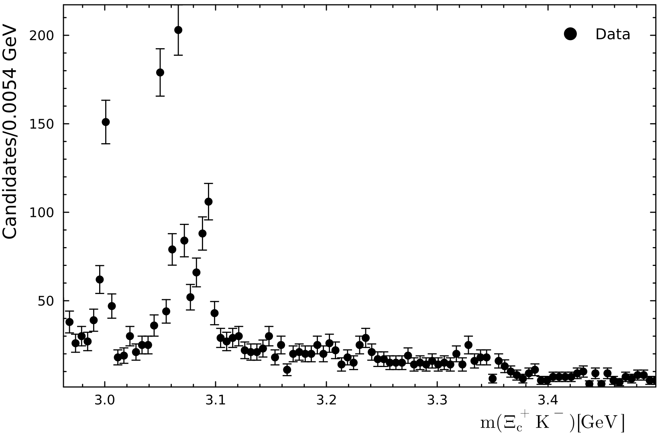
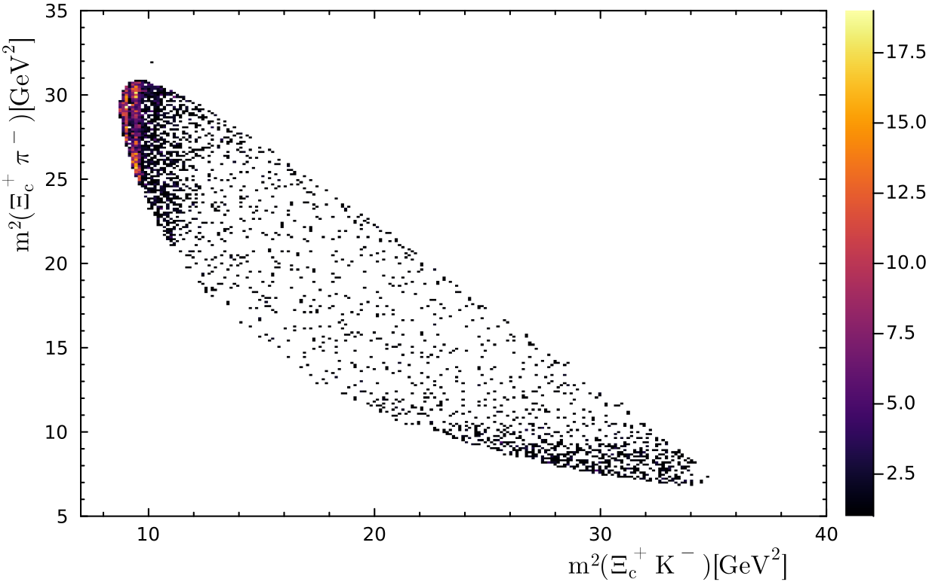
Ξ_{c}⁺K– spectrum
All excited Ω_{c}⁰ resonances appear in a small region of the spectrum:
Observed resonances incomplete set of quantum numbers.
Unexplained peaking structures that ‘maybe’ are resonances.
The Ξ_{c}⁺K– threshold enhancement considered for study.

Slide 12
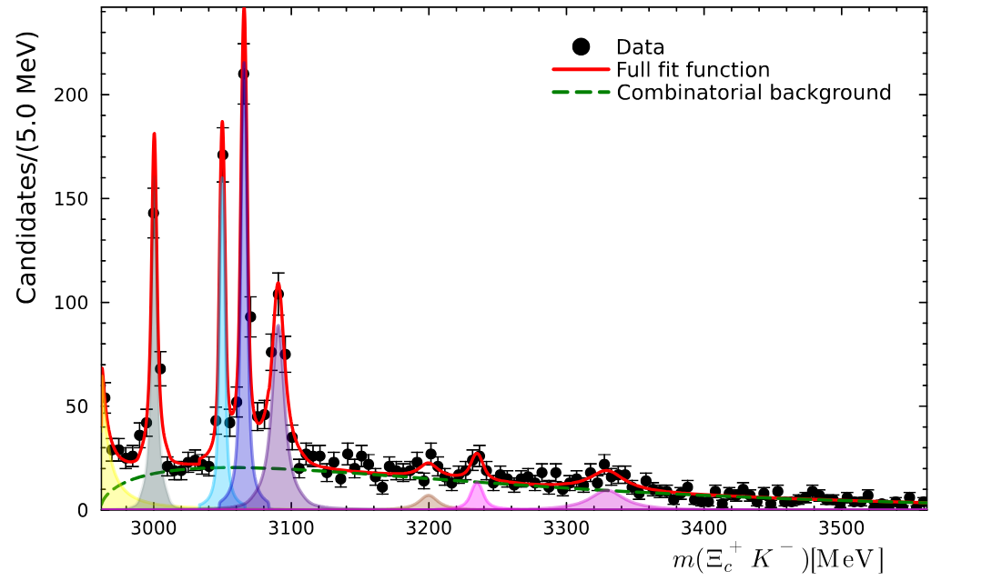


Fitting Ξ_{c}⁺K– spectrum … not so pretty!
Run1 + Run2
Ω_{c}(3050)
[PhysRevD.104.L091102]
Ω_{c}(3065)
Ω_{c}(3000)
Ω_{c}(3090)
To fit spectrum :
Resonance peaks : Relativistic Breit Wigner (RBW) ⊗ Resolution.
Combinatorial background : Exponential x Phase space function.
Extremely narrow peaks dominated by resolution.
Resolution model is to be investigated.

Slide 13
Fitting Ξ_{c}⁺K– spectrum … not so pretty!
Run1 + Run2
Ω_{c}(3050)
[PhysRevD.104.L091102]
Ω_{c}(3065)
Ω_{c}(3000)
Ω_{c}(3090)
To fit spectrum :
Resonance peaks : Relativistic Breit Wigner (RBW) ⊗ Resolution.
Combinatorial background : Exponential x Phase space function.
Extremely narrow peaks dominated by resolution.
Resolution model is to be investigated.
To be continued …

Slide 14
Summary and next steps
Run 3 data looks promising for studying Ω_{b}– → Ξ_{c}⁺K–π– process to study excited states of Ω_{c}⁰ .
Data is now clean enough with background substantially reduced after careful multivariate selection and removal of unwanted events.
Ξ_{c}⁺K–π– spectrum is understood well.
Resonances in the Ξ_{c}⁺K– spectra are under study, promising to measure J^{P} of these states with high fidelity.

Slide 15
BACKUP

Slide 16
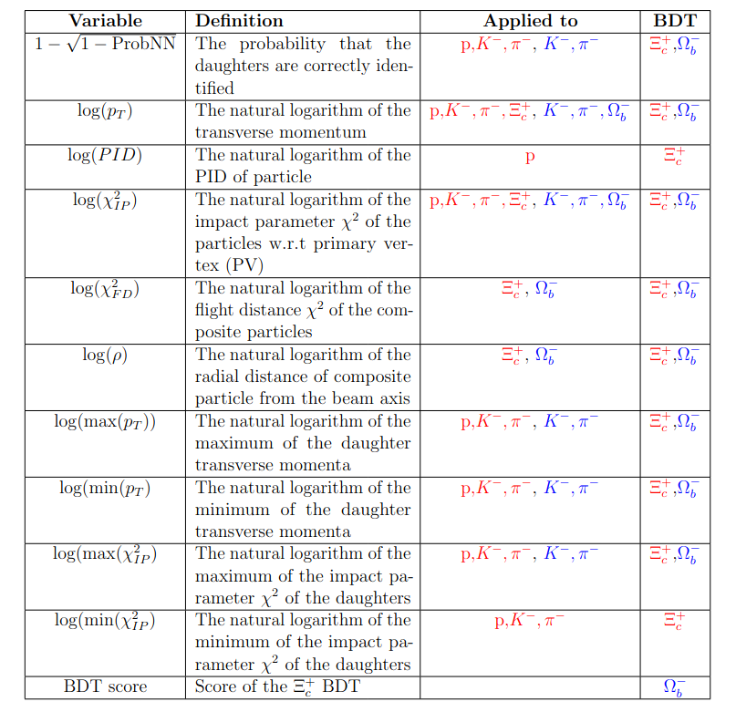
Discriminating variables for BDTs

Slide 17
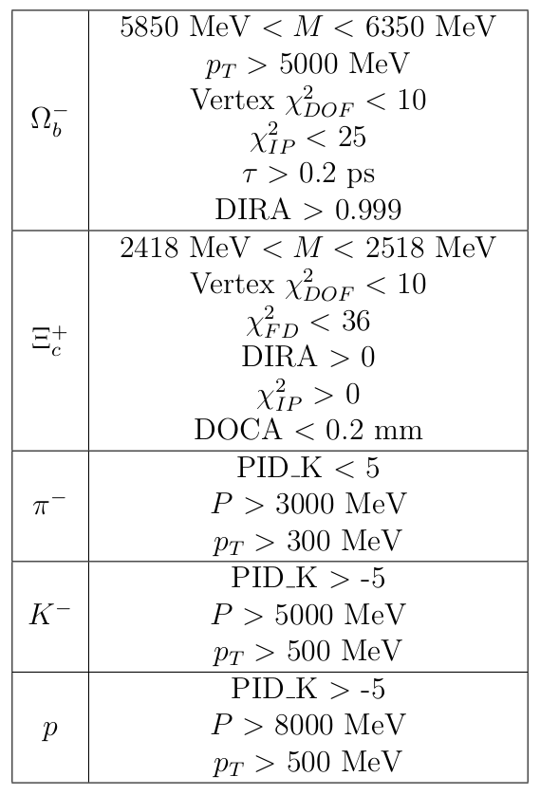
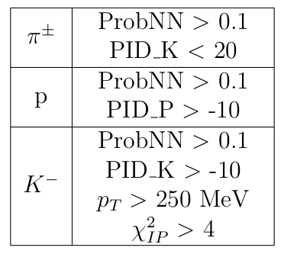
Data
Data from 2024 and 2025 (partial) of Run 3 as tabulated below.
Pre-selection for data done at trigger level and ntuple generation level are tabulated below.
Following cuts were applied to the generated ntuples:
log(Xicp_rho) > -2
p_Xicp_PROBNN_P > 0.4
log(Minimum_IPCHI2_XicDau) > 2.0
Selection criteria at trigger level
Data block | Luminosity (fb^{–1})
Sprucing24c2a | 3.192
Sprucing24c3a | 2.087
Sprucing24c4a | 1.146
Sprucing25c1 | 2.018
Sprucing25c2 | ~4.282
Sprucing25c3 | ~2.676
Sprucing25c4 | 2.407
Selection criteria while making ntuples

Slide 18
Multivariate selection statistics
For training the models
2024 MC is used for signal events
Sidebands from 2024 data are used for background
(2508,2518) MeV for Xicp_BDT
(6250,6350) MeV for Ombm_BDT
 | Training Set | Validation Set
Xicp_BDT | Signal : 105240 Background : 87349 | Signal : 11694 Background : 9707
Ombm_BDT | Signal : 13337 Background : 13337 | Signal : 1483 Background : 1482

Slide 19
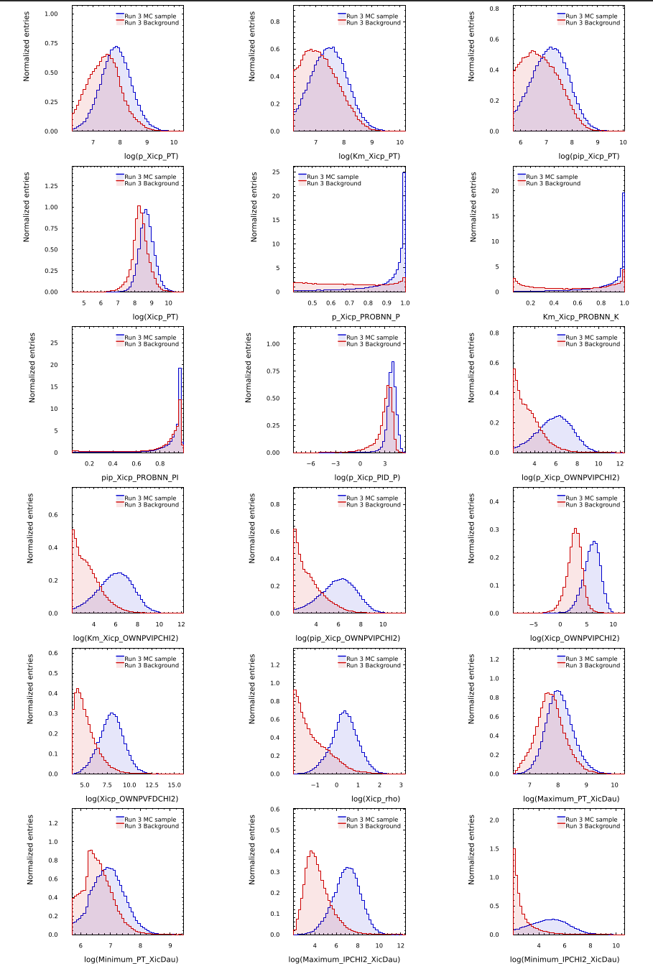
Xicp_BDT features
Feature importance:
log(Maximum_IPCHI2_XicDau)
log(Xicp_OWNPVIPCHI2)
log(Minimum_IPCHI2_XicDau)
log(Xicp_rho)
p_Xicp_PROBNN_P
Km_Xicp_PROBNN_K
log(p_Xicp_PID_P)
log(Xicp_OWNPVFDCHI2)
log(p_Xicp_PT)
log(Minimum_PT_XicDau)
log(pip_Xicp_PT)
log(pip_Xicp_OWNPVIPCHI2)
log(Xicp_PT)
pip_Xicp_PROBNN_PI
log(Maximum_PT_XicDau)
log(Km_Xicp_PT)
log(Km_Xicp_OWNPVIPCHI2)
log(p_Xicp_OWNPVIPCHI2)

Slide 20
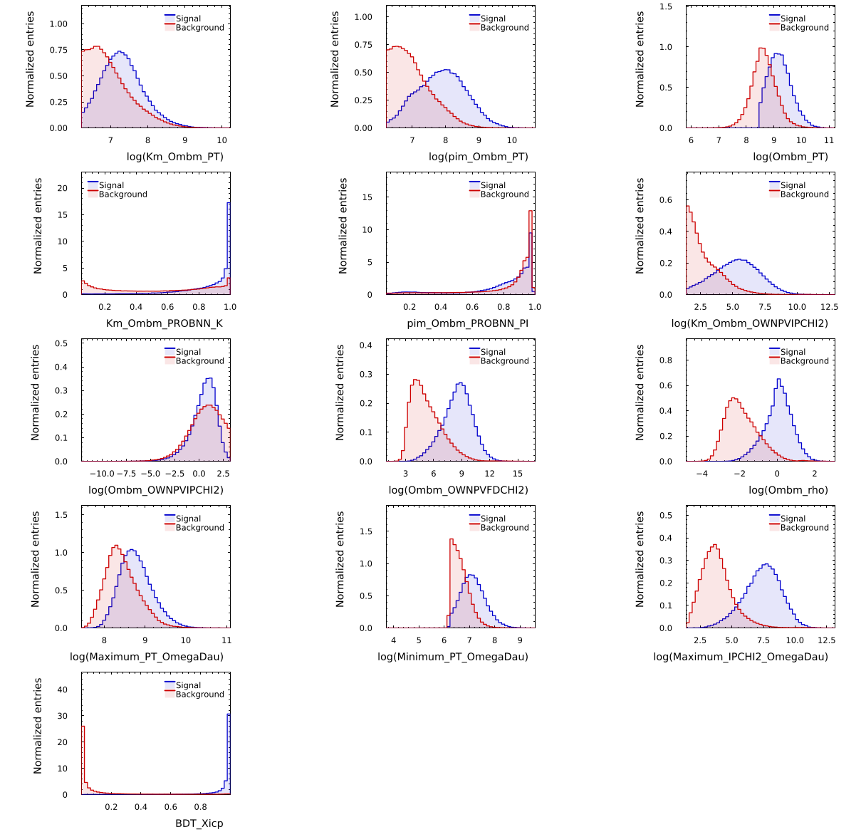
Ombm_BDT features
Feature importance
BDT_Xicp (Xicp_BDT score)
log(Maximum_IPCHI2_OmegaDau)
log(Minimum_PT_OmegaDau)
log(Ombm_rho)
Km_Ombm_PROBNN_K
log(Ombm_PT)
log(Ombm_OWNPVIPCHI2)
log(pim_Ombm_PT)
log(Km_Ombm_OWNPVIPCHI2)
log(Ombm_OWNPVFDCHI2)
log(Km_Ombm_PT)
log(Maximum_PT_OmegaDau)
pim_Ombm_PROBNN_PI

Slide 21
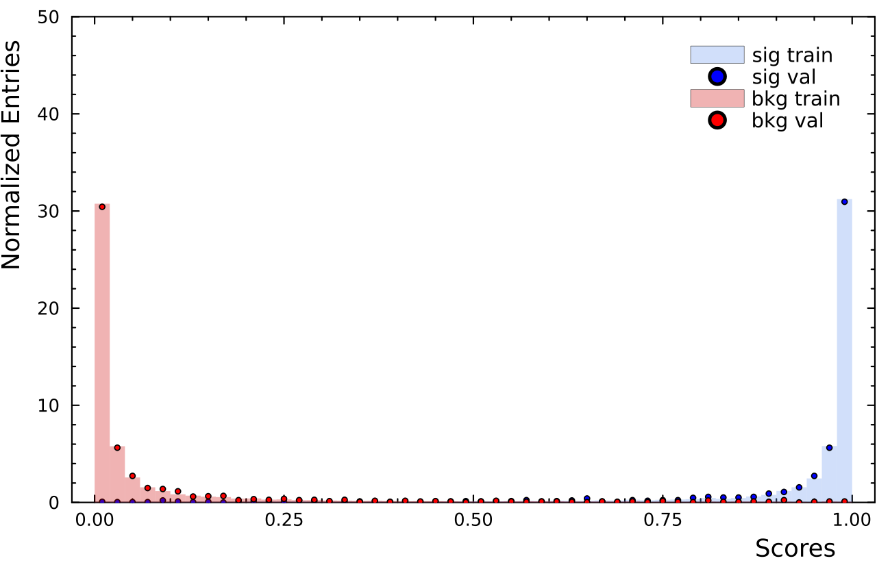
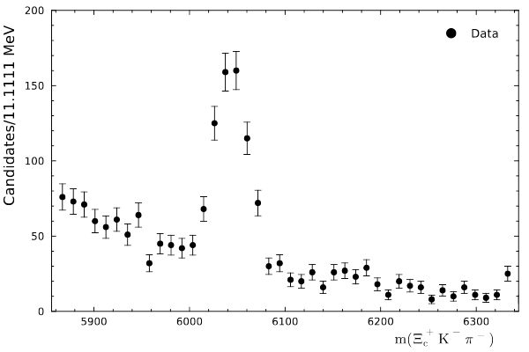
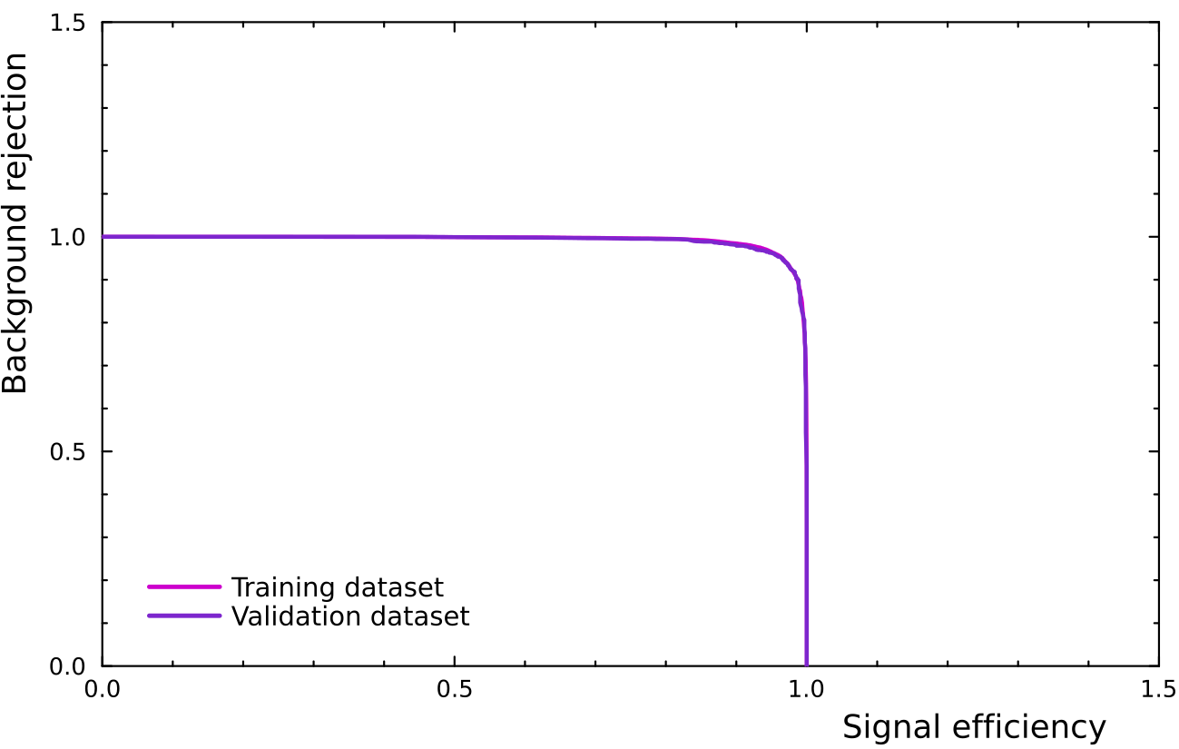
Ω_{b}– BDT performance
BDT performance is good just like in Ξ_{c}⁺ BDT
Quite reduced background for high scores
Ω_{b}– signal distinctly visible at expected PDG value
Ombm_BDT score > 0.9

Slide 22
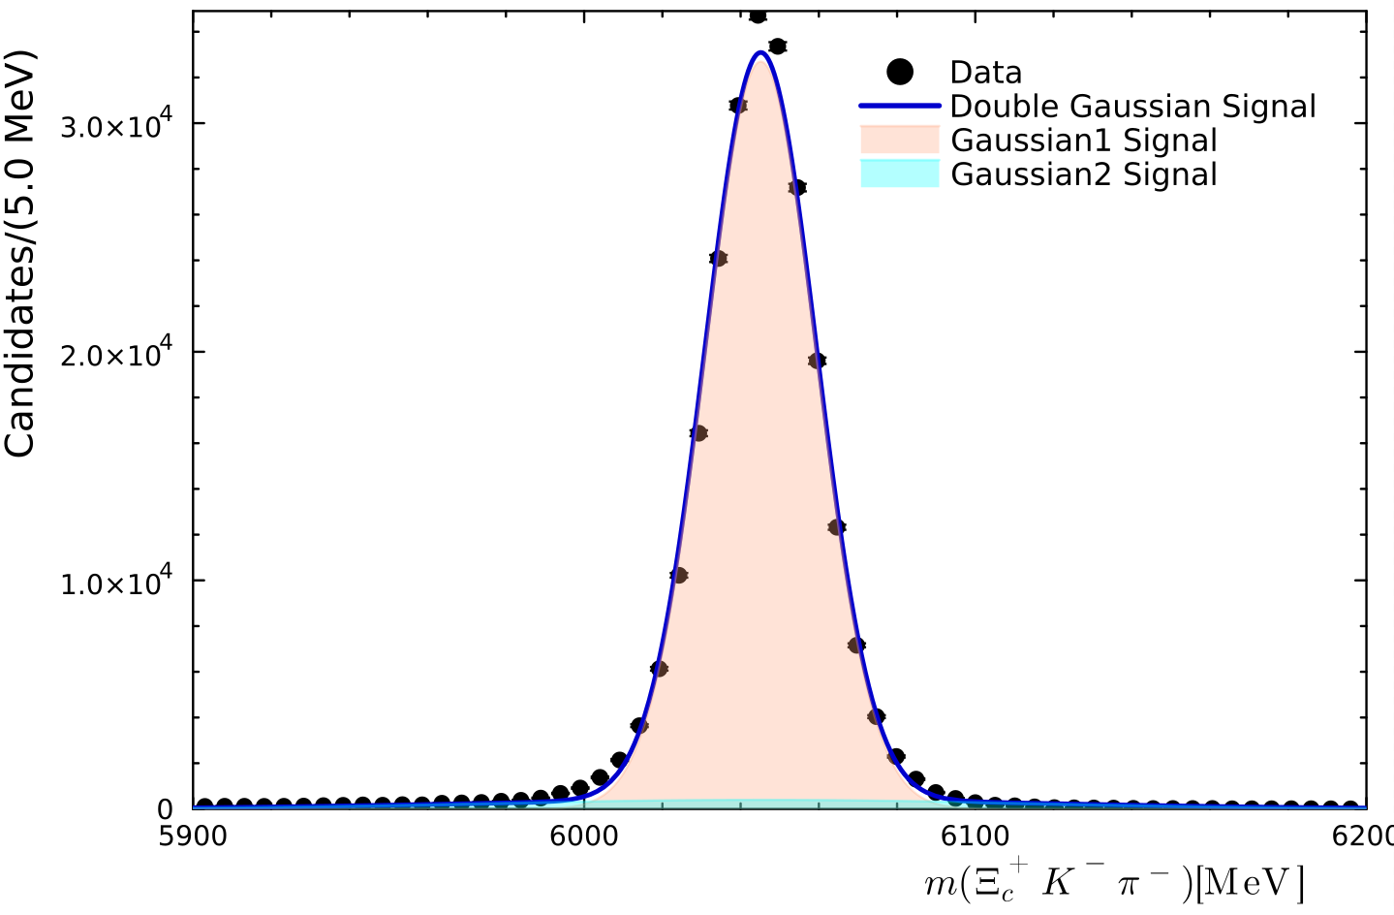


Fit model for the Ξ_{c}⁺K–π– mass spectrum
The fit model to describe the Ξ_{c}⁺K–π– spectra comprises of three components:
Double Gaussian signal model with ratio of widths and fit fraction fixed from MC.
Exponential function for the combinatorial background
Lineshapes for feed-down backgrounds.
The double gaussian fit for Ξ_{c}⁺K–π– spectra is shown for MC. From fit data, we get
Fit fraction (f_{MC}) = 0.94
Effective width (σ_{MC}) = 22.11 MeV
σ_{ratio} = σ₁/σ₂ = 0.19
μ | 6045.15 ± 0.04 MeV
σ₁ | 14.23 ± 0.04 MeV
N₁ | 230935.10 ± 719.49
σ₂ | 71.76 ± 0.81 MeV
N₂ | 14225.70 ± 288.81

Slide 23
Cloned tracks and multiple candidates
After multivariate selection, further cleaning of data is done.
Cloned tracks are looked for using δθ distributions.
δθ is the angle measured between two tracks using their momenta.
Tracks with very small δθ are more prone to be ‘cloned’.
Remove these events if δθ < 1 mrad
For multiple candidates,
Define UniqueID = EventNumber + 10⁹xRunNumber
Events with same UniqueID are counted as multiple
candidates.
From this set, select events with highest Ombm BDT score.

Slide 24
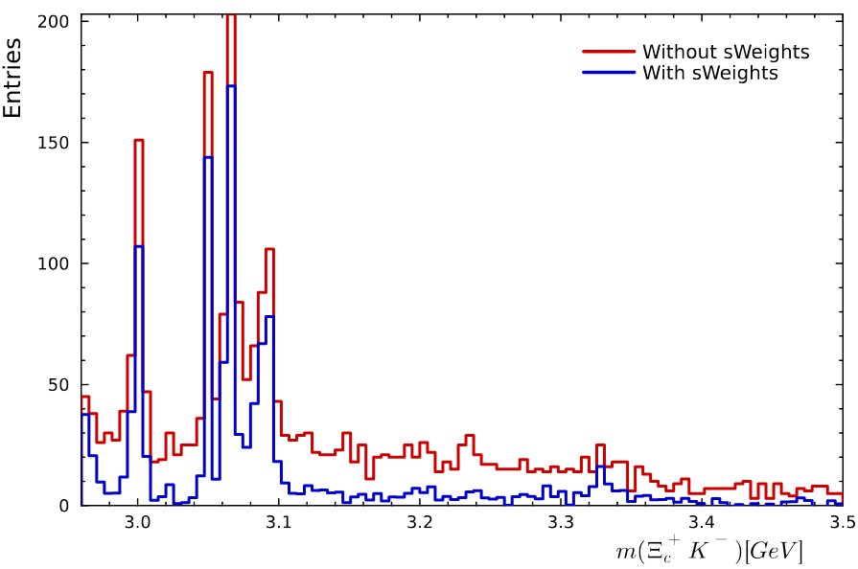
Ξ_{c}⁺K– spectrum

Slide 25
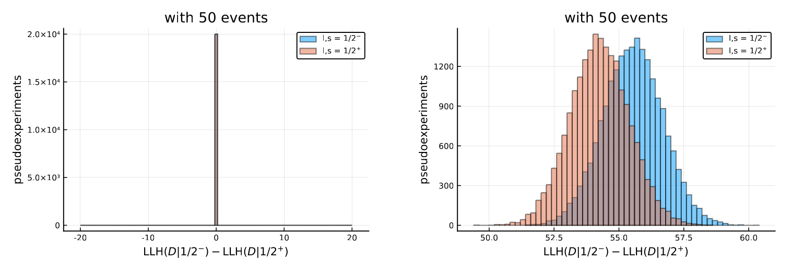
Analysis goals
[LHCB-PAPER-2024-034-001]

