Slide 1
CYGNUS-Oz
ANU Weekly
18 March 2026

Slide 2
General News
  https://indico.global/event/17413/
  Admin for new students:
  DM Lab induction after meeting
  Please create an indico profile
  Welcome for lunch at 12:00 (NPAA benches)
  CYGNUS-Oz Adelaide Lab stuff
  LARD prototypes, DM0 Fe-55 Source, Only gas needed…
  CYGNUS-OZ ML Track reconstruction meetings
  Weekly Tuesday 18:00 (Canberra time)

Slide 3
Upcoming Events
  Rob @ CYGNUS-Oz Adelaide: 17th – 24th March
  Greg Away: 18th March – 25th May
  ANU CYGNUS-Oz Weekly to merge with CYGNUS-Oz Meeting
    Adelaide University, University of Sydney and University of Melbourne
    Date and time TBC
  Focus talk TBC

Slide 4
Publication Plan
  In progress
  Direct in-chamber radon-220 (thoron) emanation measurements for rare-event physics experiments
    ✅ ACCEPTED for Publication JINST( arXiv:2601.12622) – R.R. Marcelo Gregorio 🎉
  High Negative Ion Gain MMThGEM-Micromegas Detector for Directional Dark Matter Searches
    Submitted to JINST( arXiv: 2602.12658) – A. G. Mclean
  Negative ion formation in pure CF4 via dissociative electron attachment
  Improving accuracy of in-gas radon assay electrostatic detectors and application to He, CF4 and SF6 for directional dark matter experiments
    Awaiting N2/Air radon measurement
  Planned
  Improving sensitivity in DRIFT data with modern ML architecture
    Eddie Shield (CERN)
  LARD: Low-Cost Amplification Readout Devices (LARD)
    Awaiting data analysis

Slide 5
AGENDA
CYGNUS-N/CYGNET Detector Development
LARD Group Updates
Adelaide Lab Update
ML Track Reconstruction & CYGNO Tasks Updates
CYGNUS-Oz Radon Group

Slide 6
CYGNUS-Oz
Radon Group

Slide 7
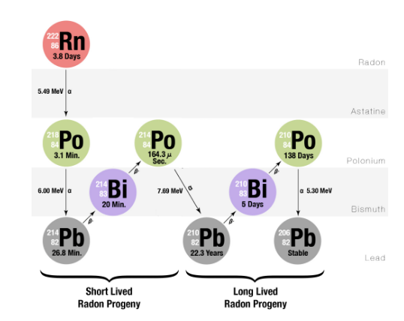
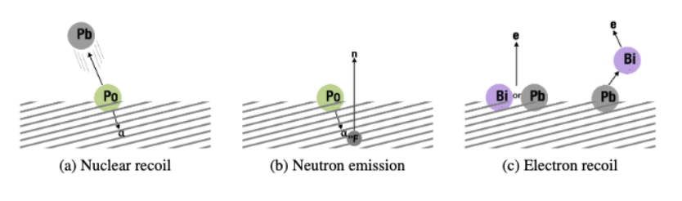
CYGNUS-Oz Radon Group Overview
Radon Decay Chain
Radon-induced backgrounds
Radon Strategies
Radon Detection and Mitigation
Radon Event Tagging (Analysis/Simulation)

Slide 8
SUPL Radon Mitigation Project
  K. Davies, L. Truong*
* Research project completed

Slide 9
Radon Concentration Line
  S. Yuan

Slide 10
Radon in Different Gases Project
  N. Disha

Slide 11
Radon Electroplating Project
  L. Bechteler-Weickhardt

Slide 12
Back Up

Slide 13

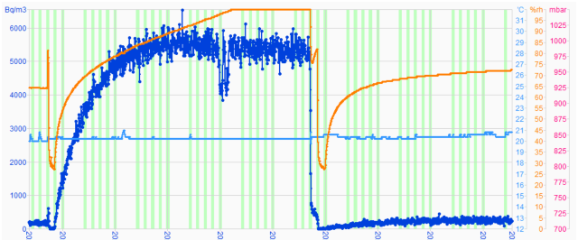
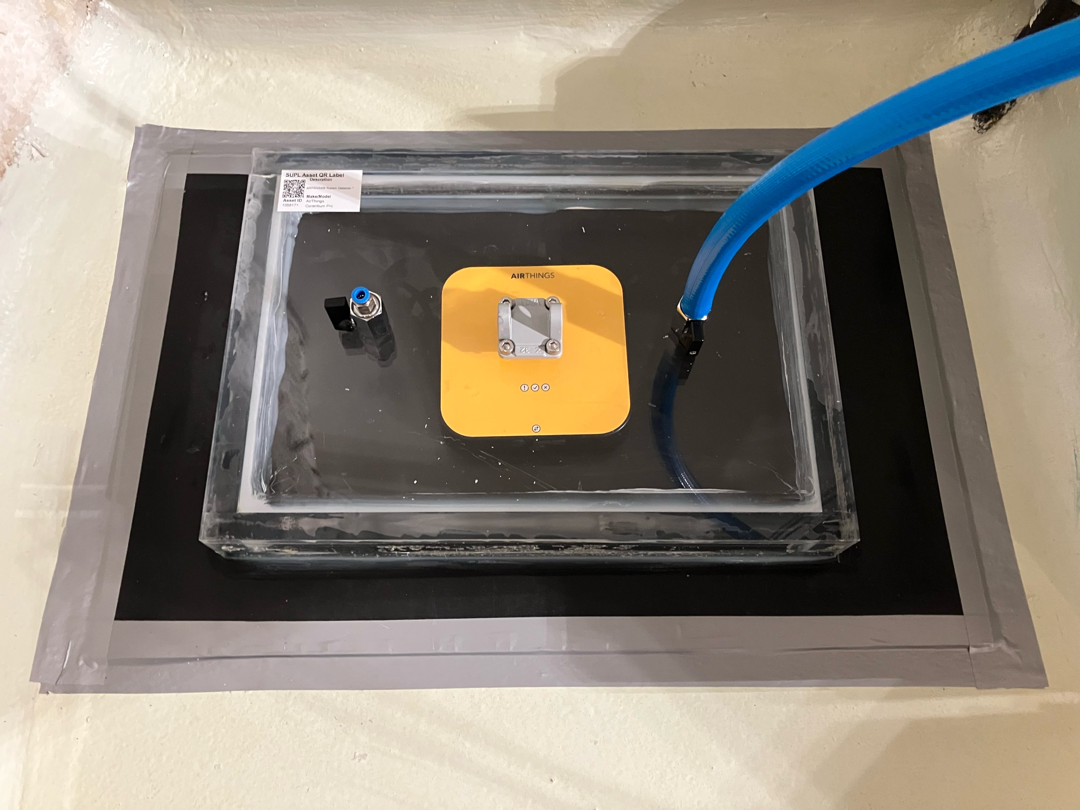
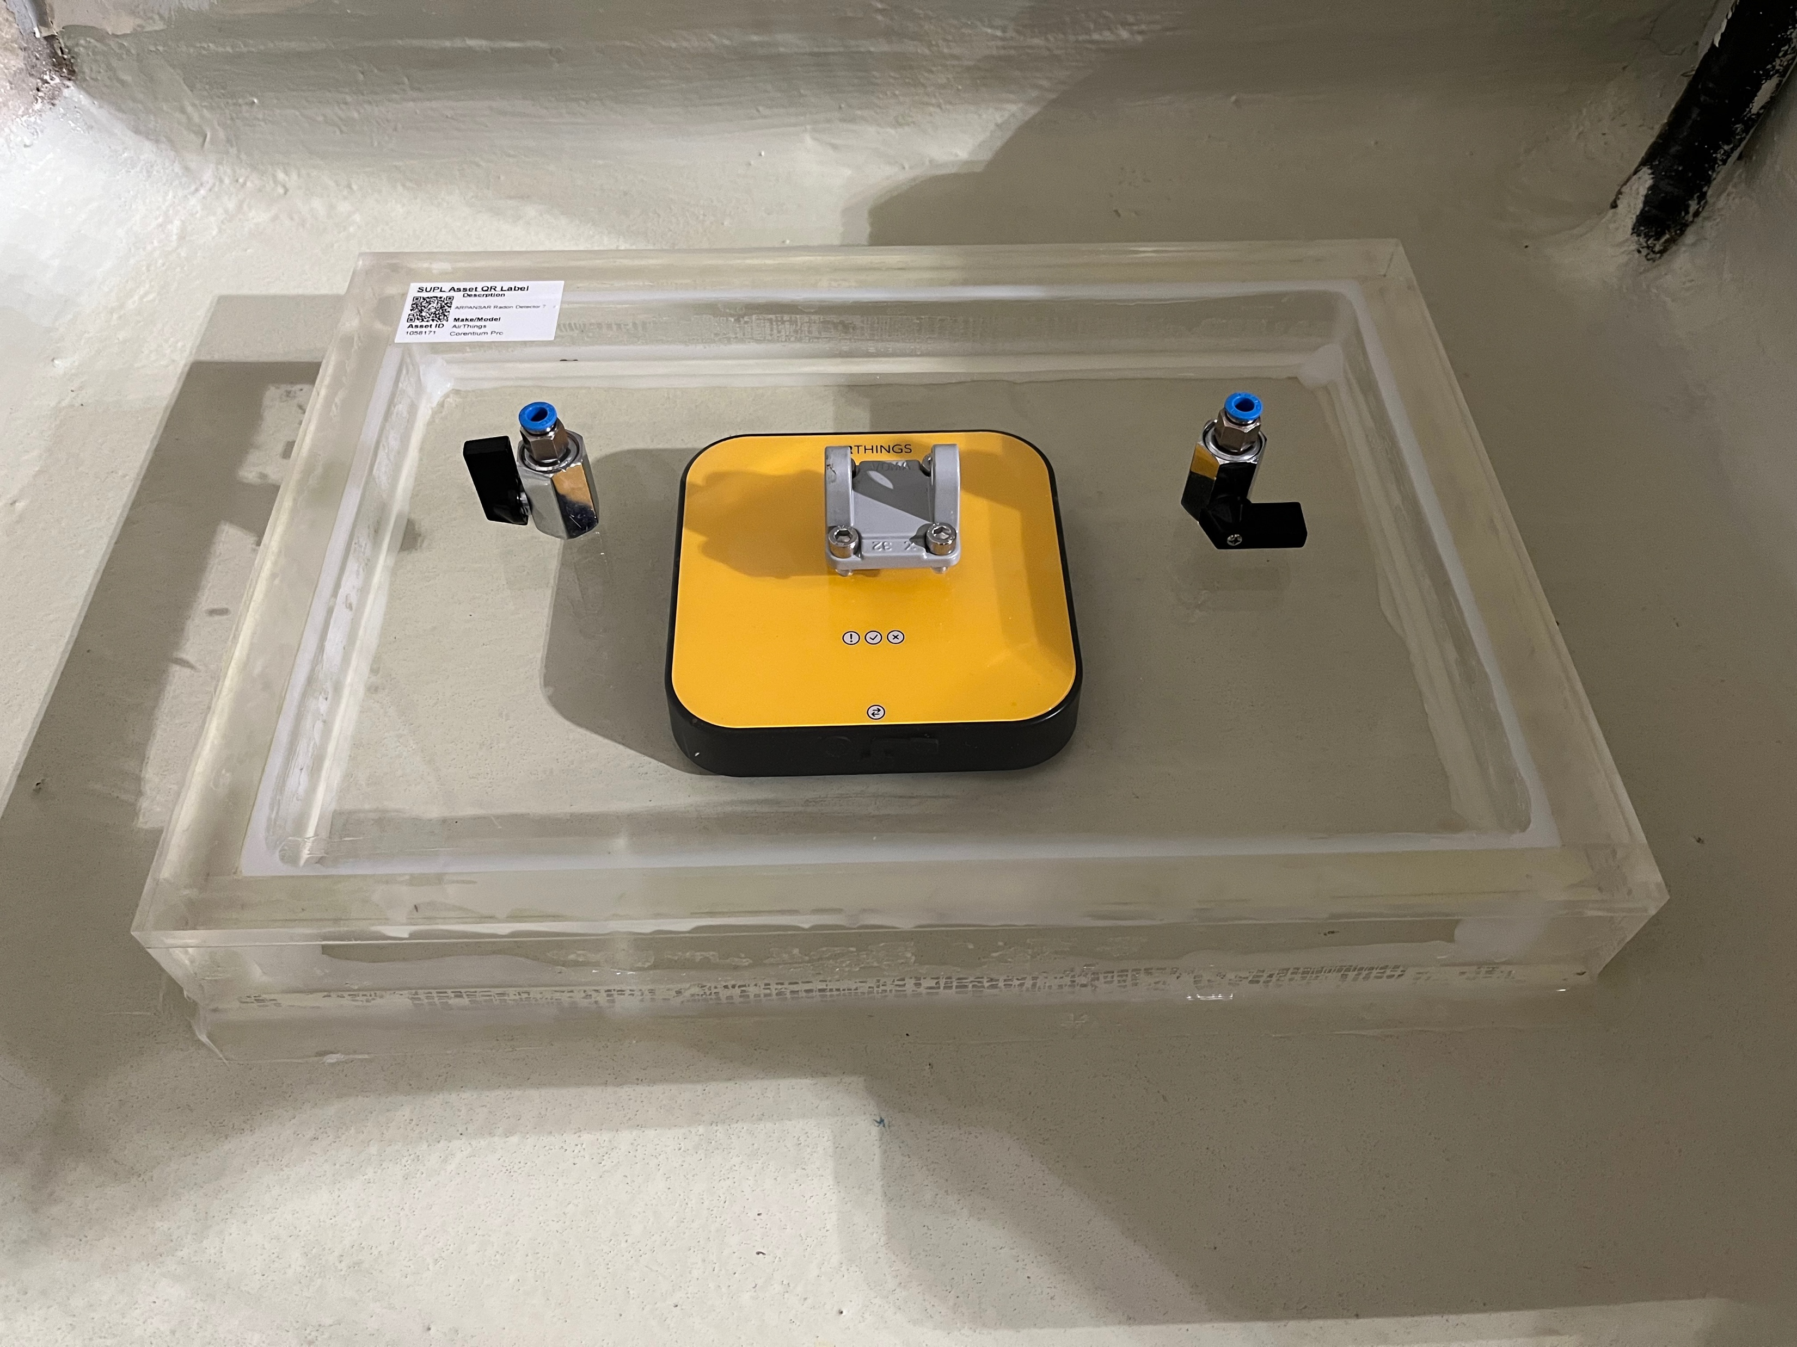
SUPL Project
Updates
Radon mitigation at Stawell Underground Physics Laboratory
Prevention of entry with barriers
Dilution with ventilation
Filtration with radon capturing materials (Linda Talk Feb 18th)
Floor emanation (With barrier)
~250 Bq/m3
Floor emanation (no barrier)
~6000 Bq/m3

Slide 14
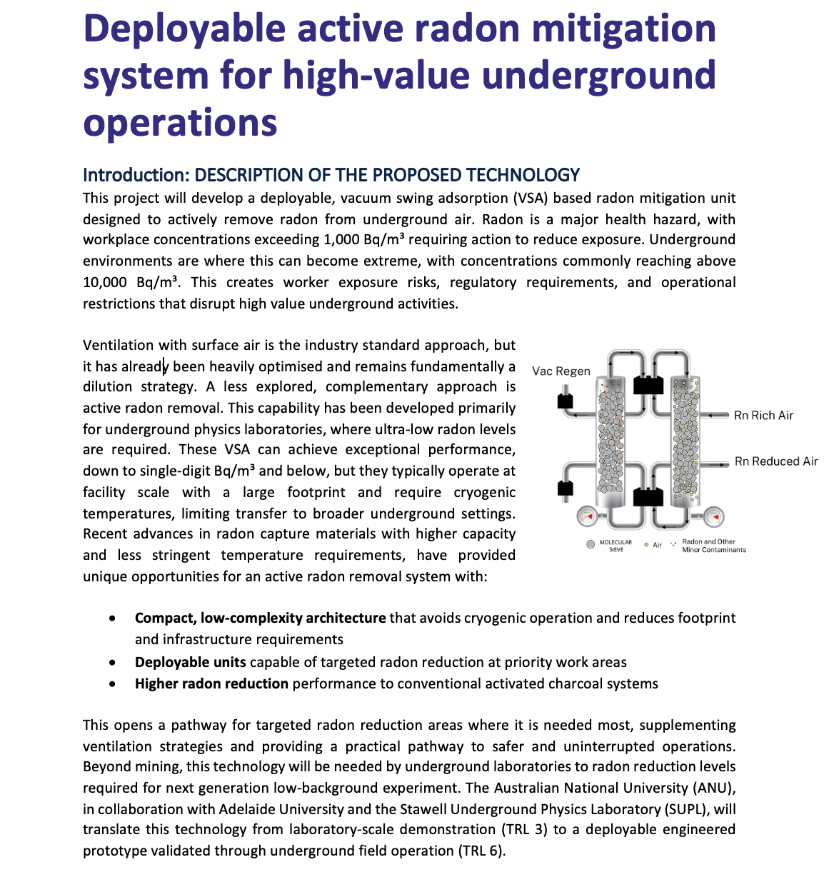
Vacuum Swing Adsorption (VSA) Project

Slide 15
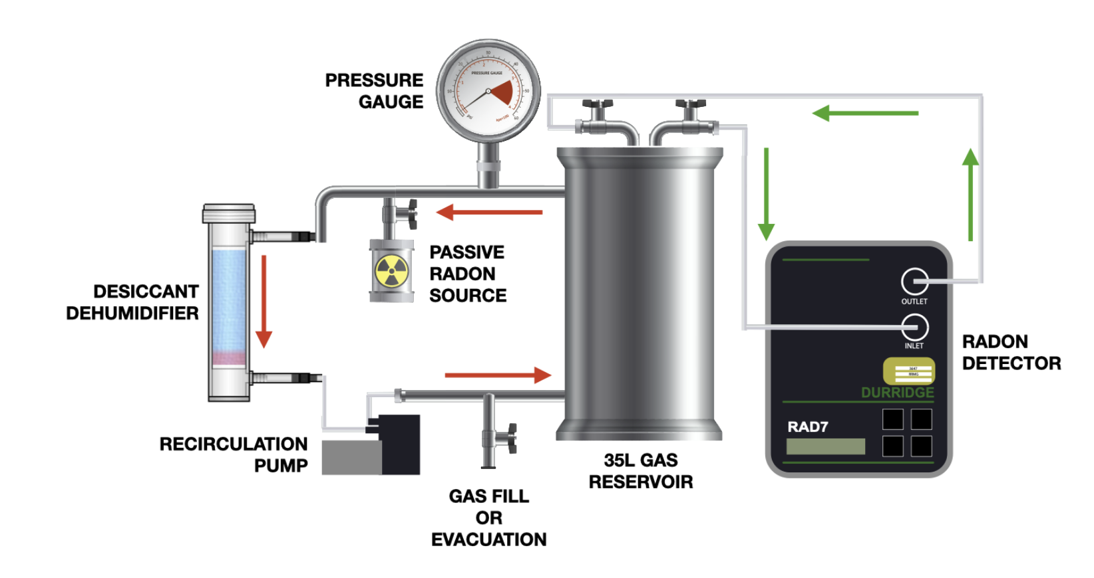
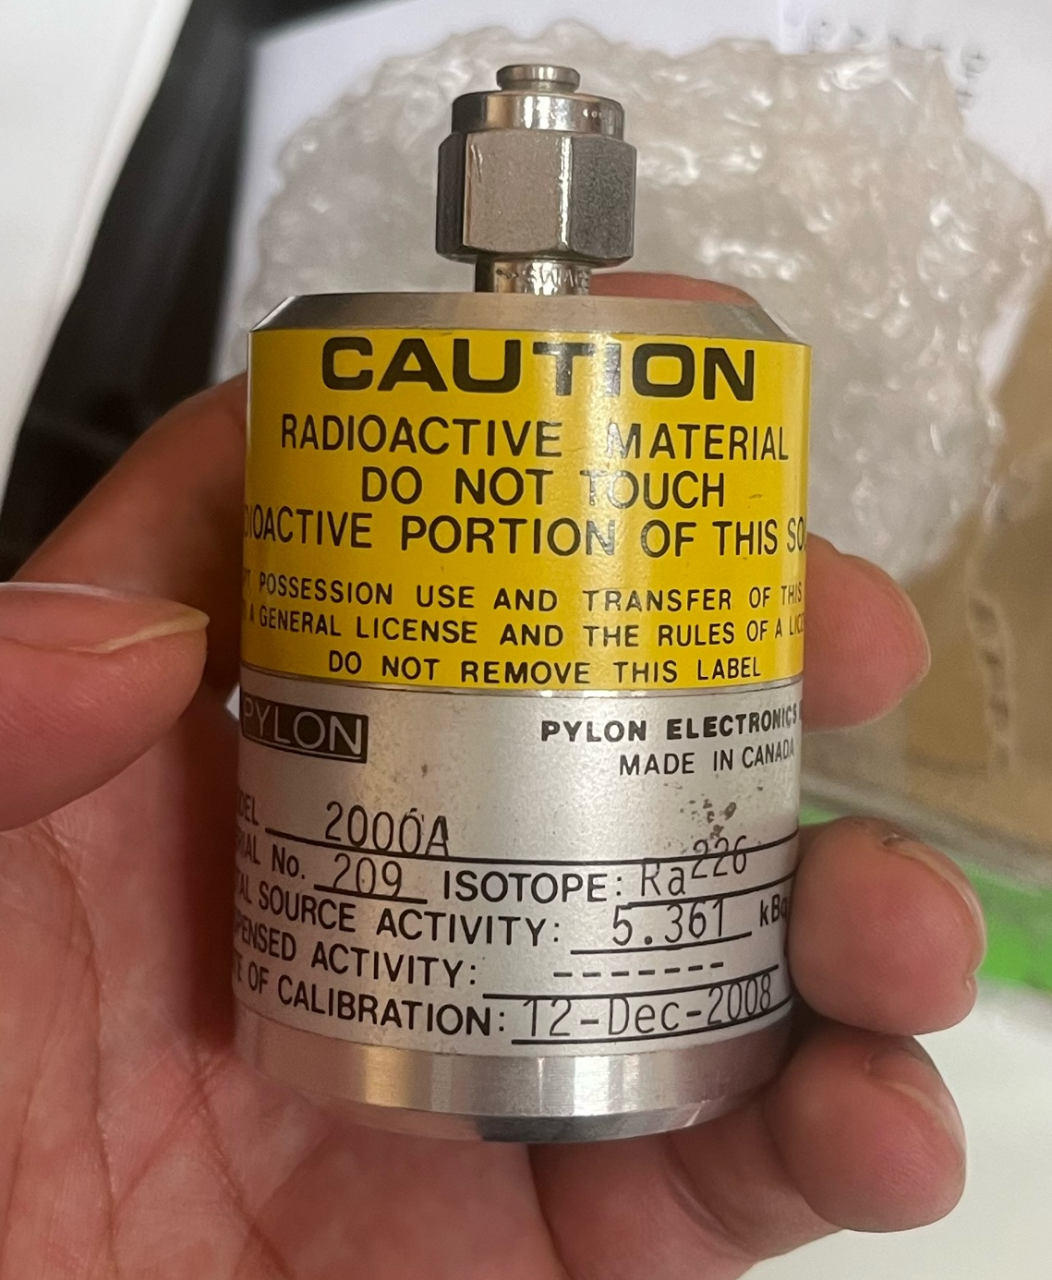
Radon in Different Gases
Updates
  Original setup take 6 weeks for one measurement
  Flow-though radon source method reducing measurement time to ~ 5 days
  Natasha is working on making a flow through source with uranium sand
    Challenges with pressure buildup
    Consulted Dr Michaela Froehlich about Inert solutions
      → Explore different ratios (beads : sand)
      → Different size beads
Original setup
5.6 kBq passive radon source has arrived

Slide 16
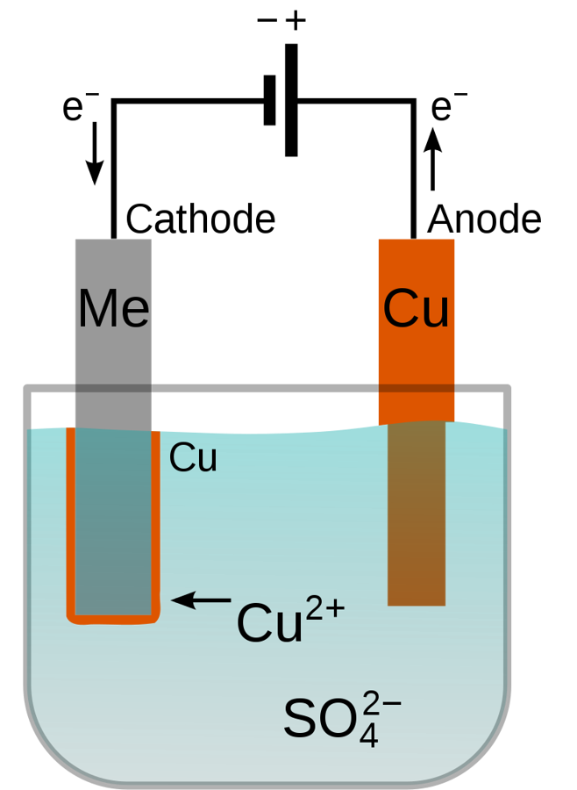
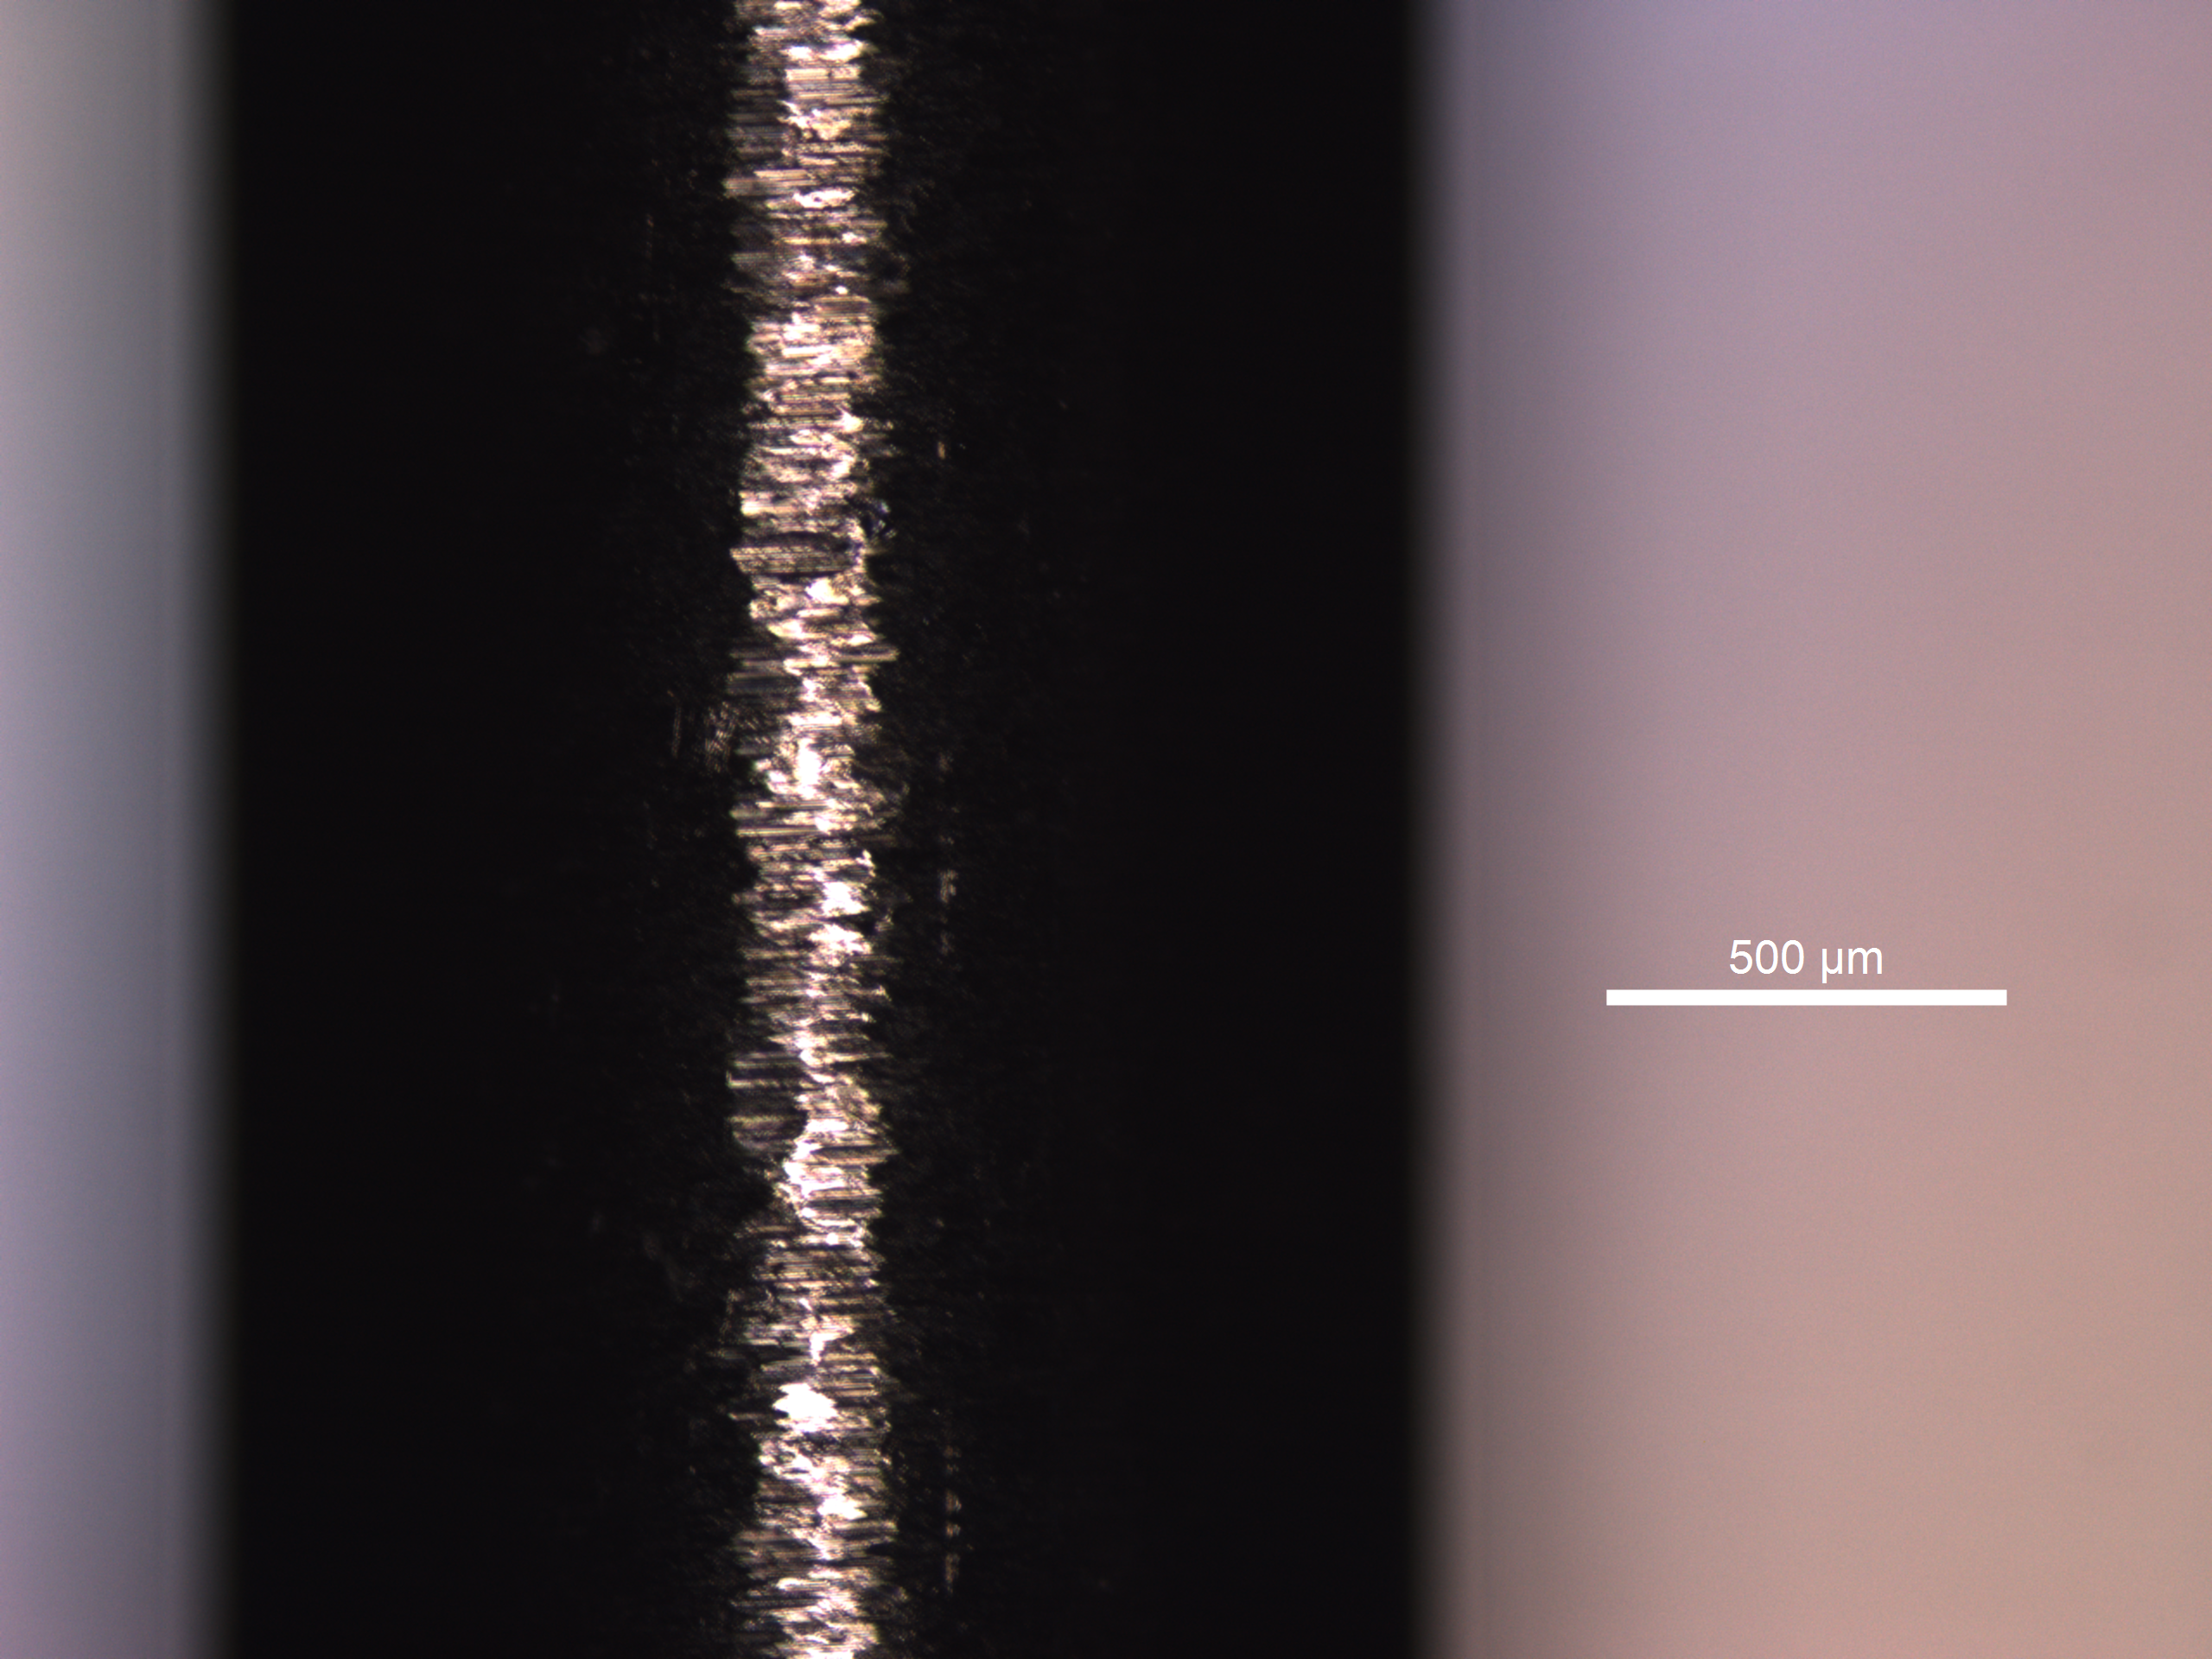
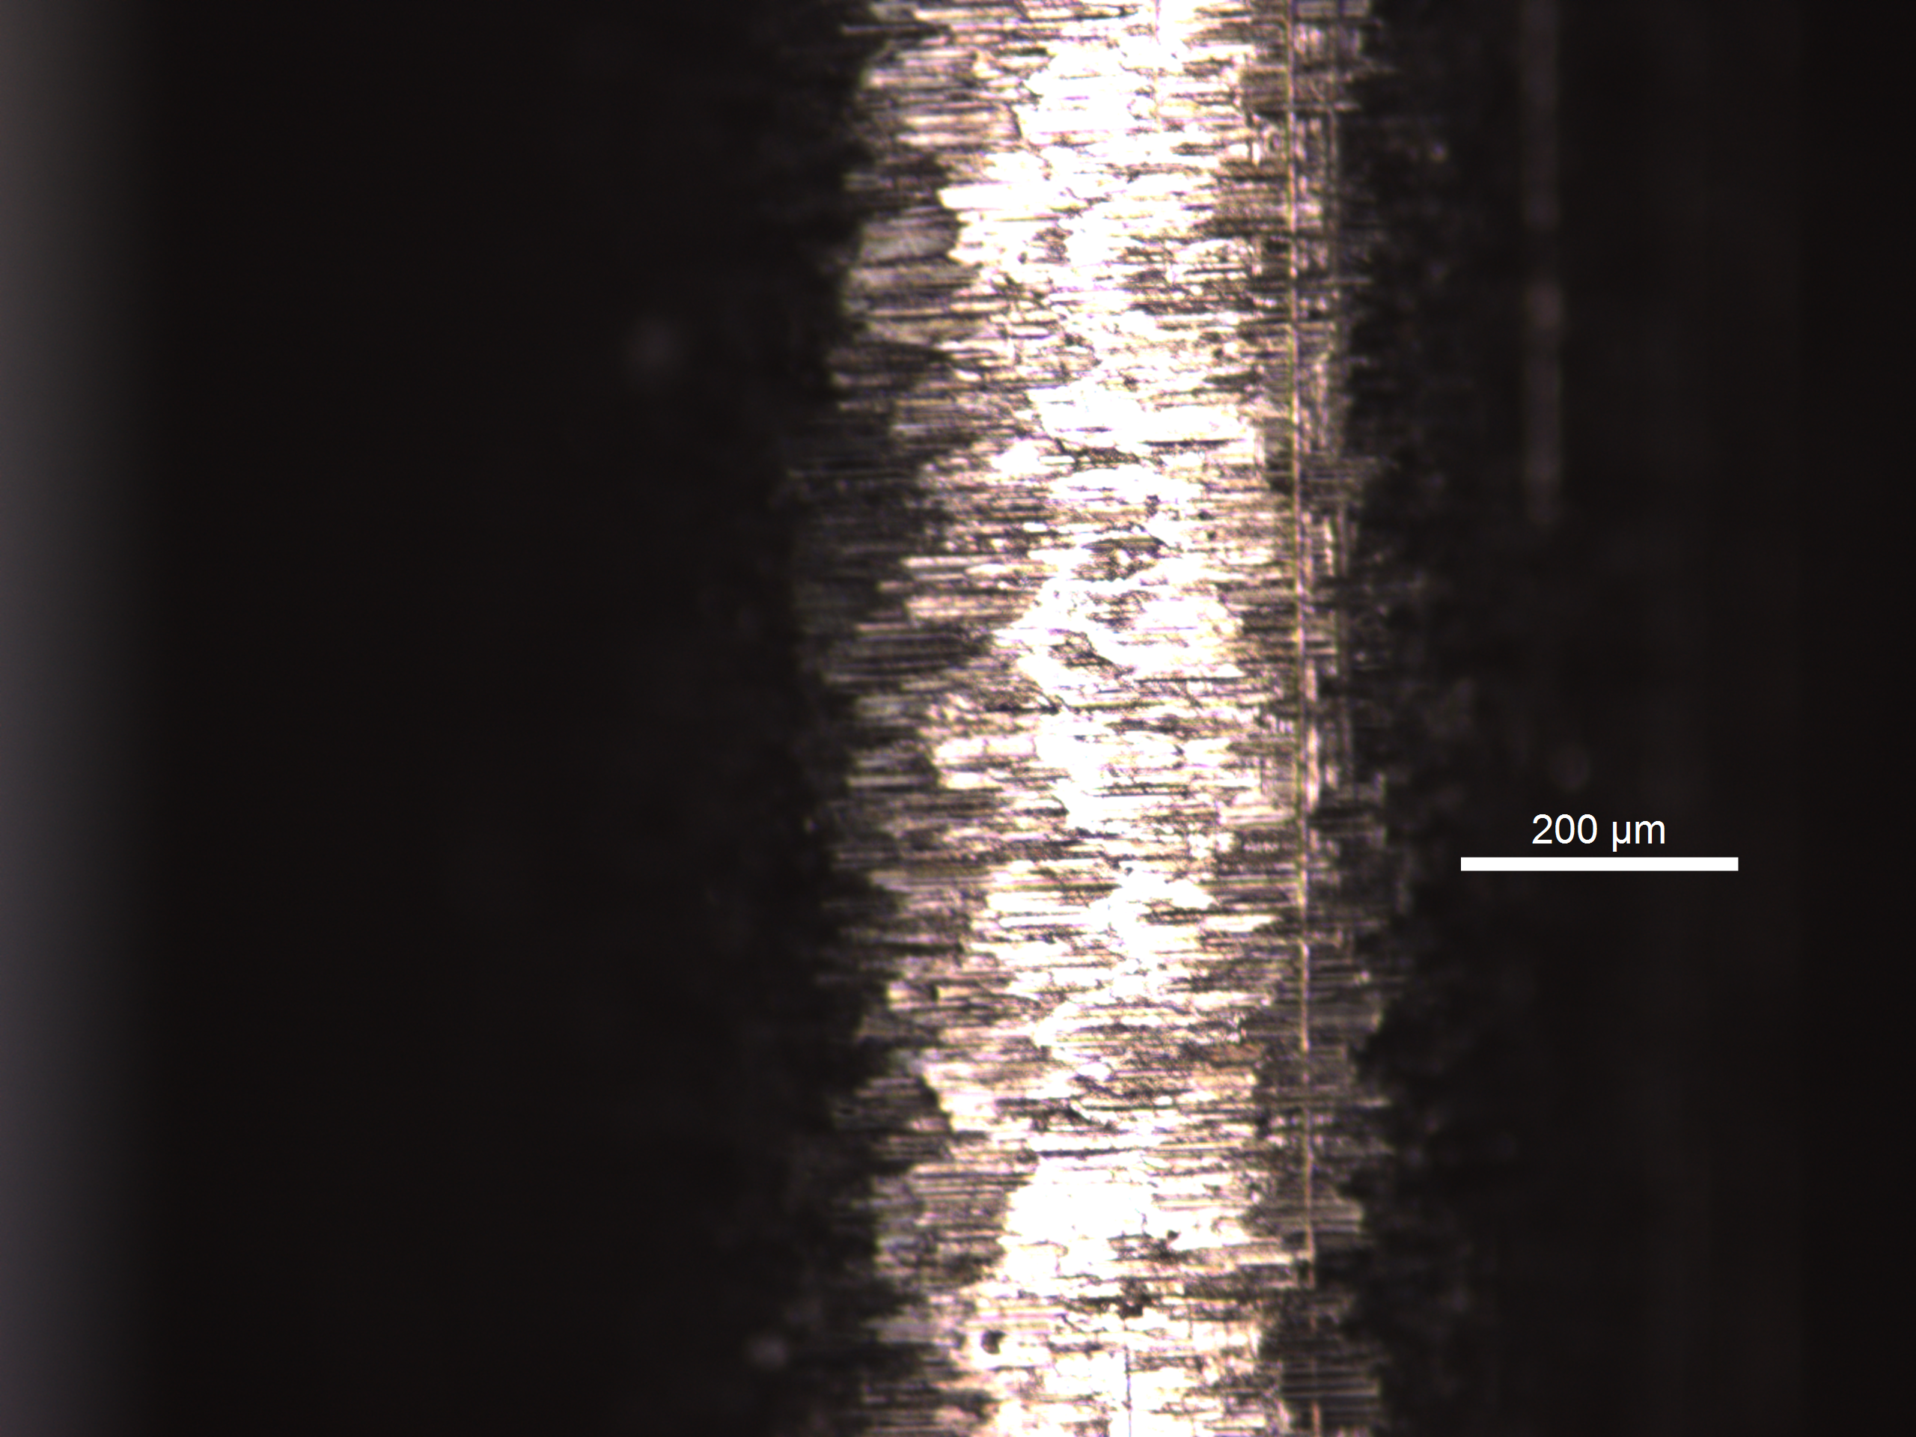
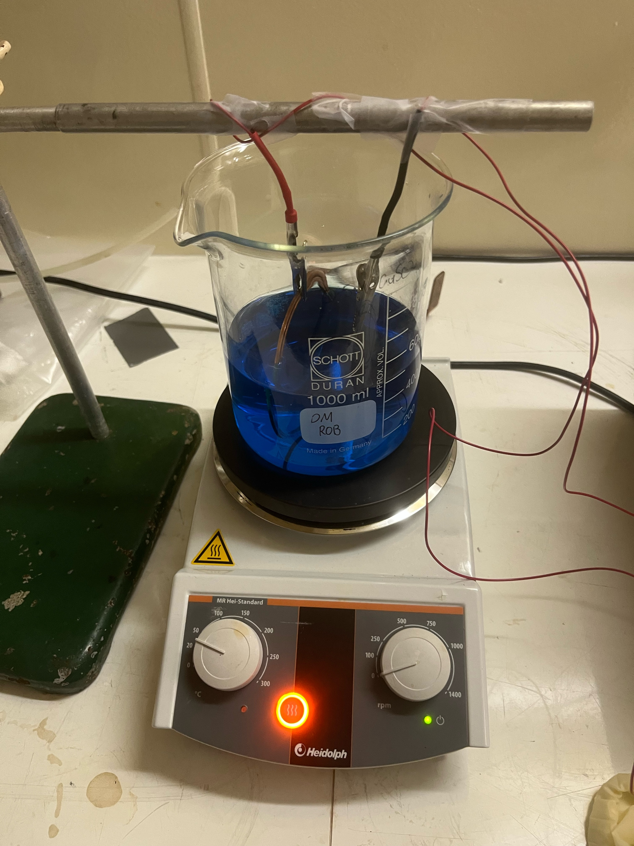
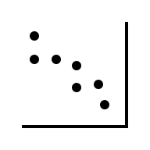
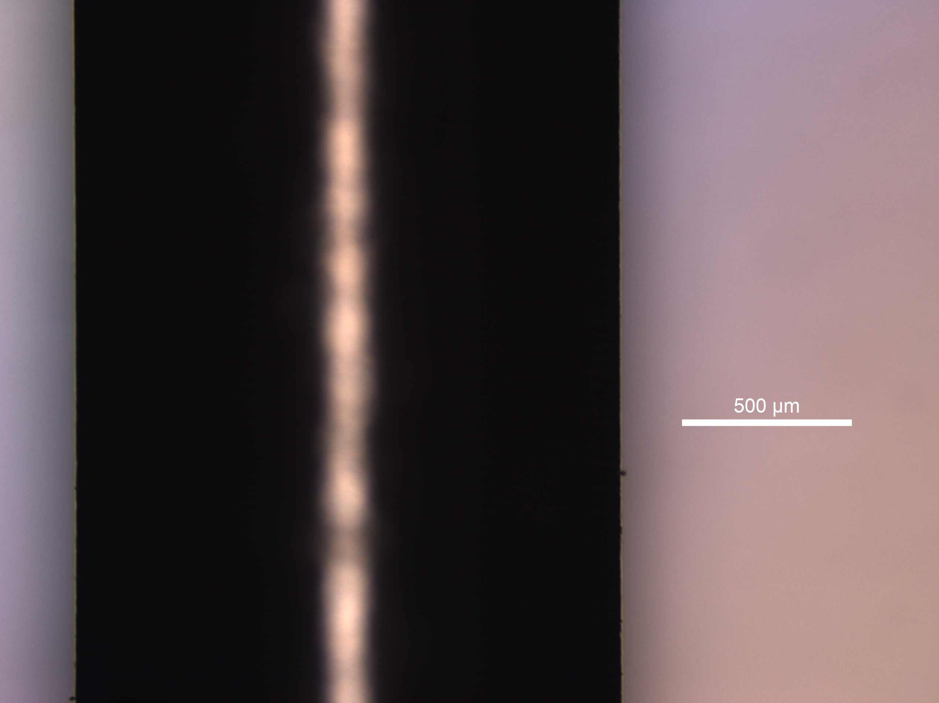
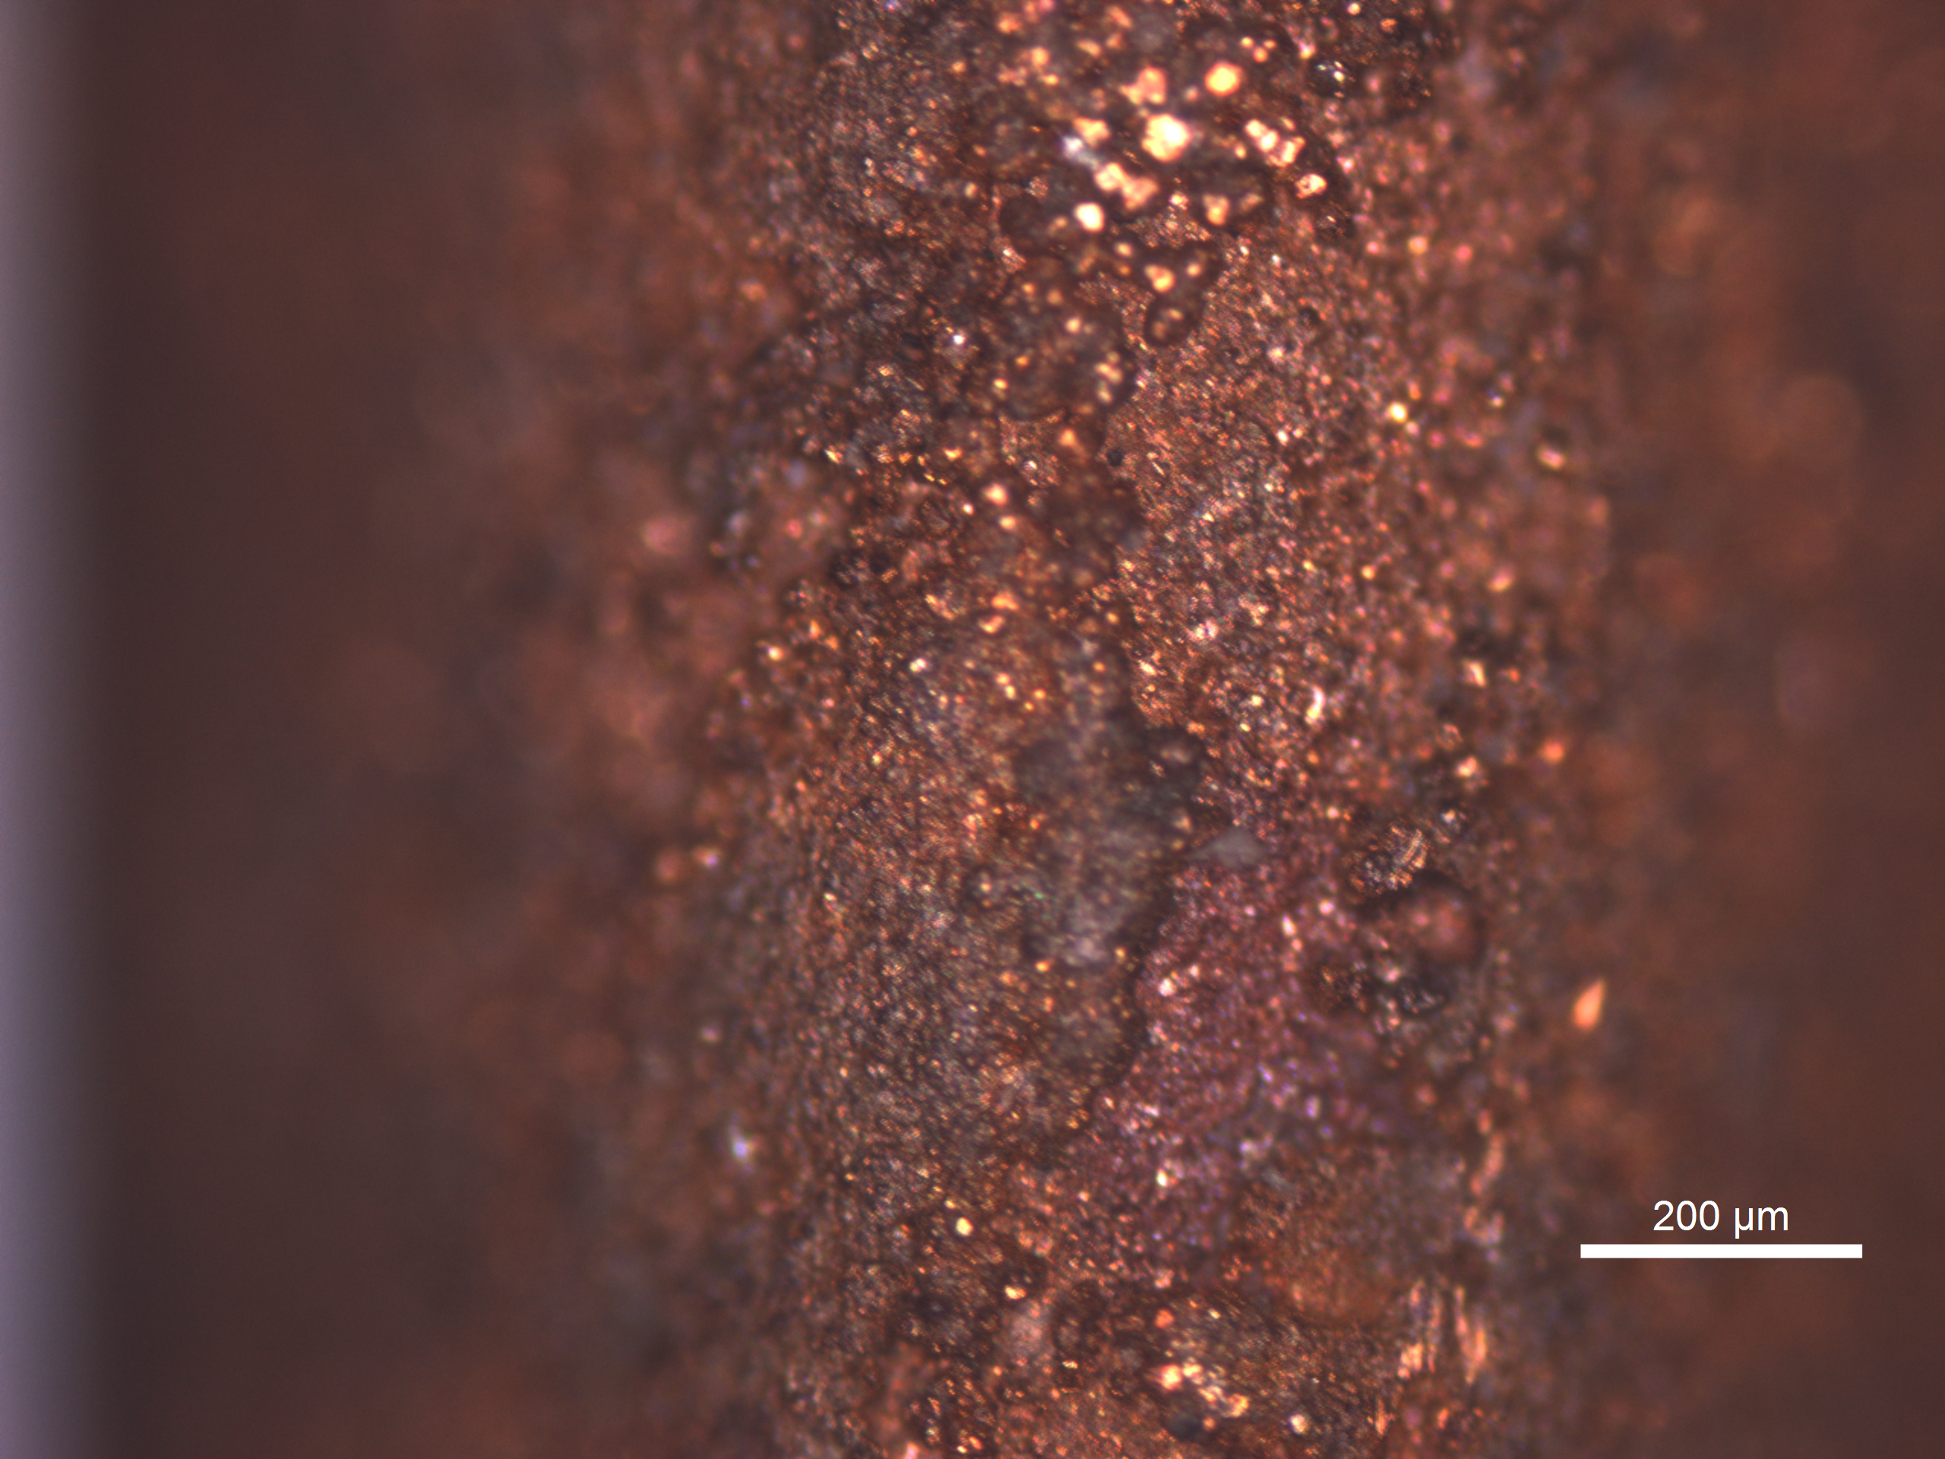
Electroplating Project
Copper Platting Setup Ready in ‘Pb Plating lab’
Leica Stellaris 8 @John Carver Building
²²⁰Rn_{Ema}
Thickness/Quality
Incoming student: - Laurent Bechteler-Weickhardt

Slide 17
Electroplating Project Updates
²²⁰Rn_{Ema}
Thickness/Quality
Focus middle
Focus edge

Slide 18
Electroplating Project Updates
²²⁰Rn_{Ema}
Thickness/Quality

Slide 19
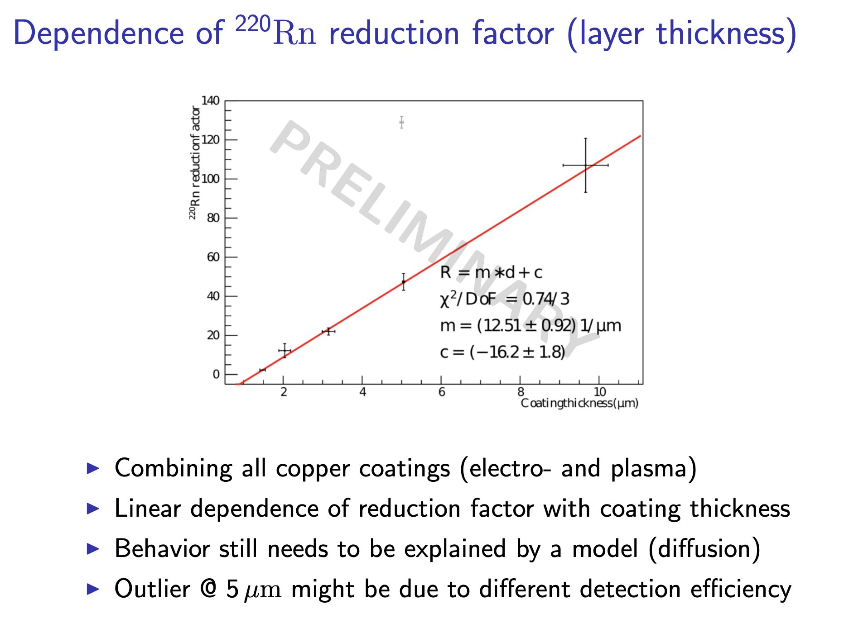
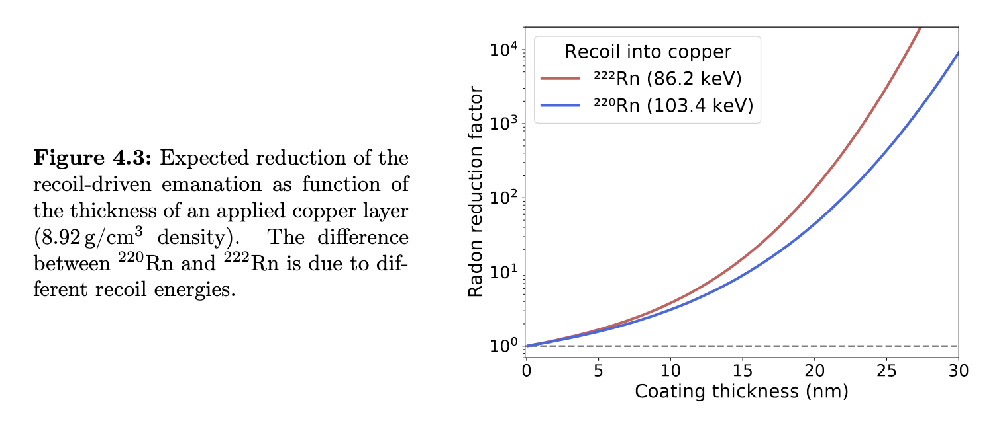
Copper Plating Literature Review
From 222Rn measurements in XENONnT and HeXe to radon mitigation in future liquid xenon experiments (PhD Thesis University of Heidelberg, 2022 Florian Jörg)
Simulation SRIM Simulation
Coating thickness of 10um reduction factor x 100

