Slide 1
Accelerator ambassador updates
Mitko Oldfield

Slide 2
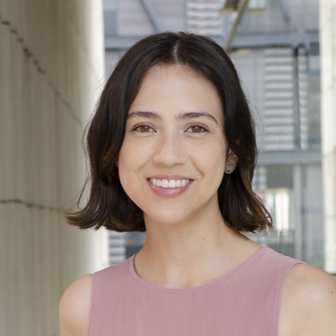
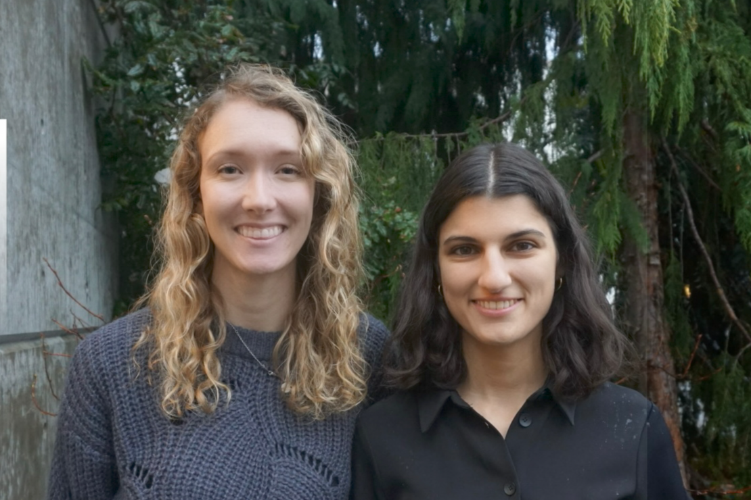
AMBASSADOR PROGRESS
Maria (Historias Sincotronicas):
Has recorded content at multiple sites (incl. CERN)
Has been put in contact with Latin American women in physics
Meeting Wed 29th April
Jade & Olivia (Particles that Heal: Discovery Day):
Have contacted four organisations that do excursions
Have multiple activity designs – will implement 4 on the day
Have met required number of volunteers for the day
Volunteers will help with design delivery
Meeting Wed 29th April

Slide 3
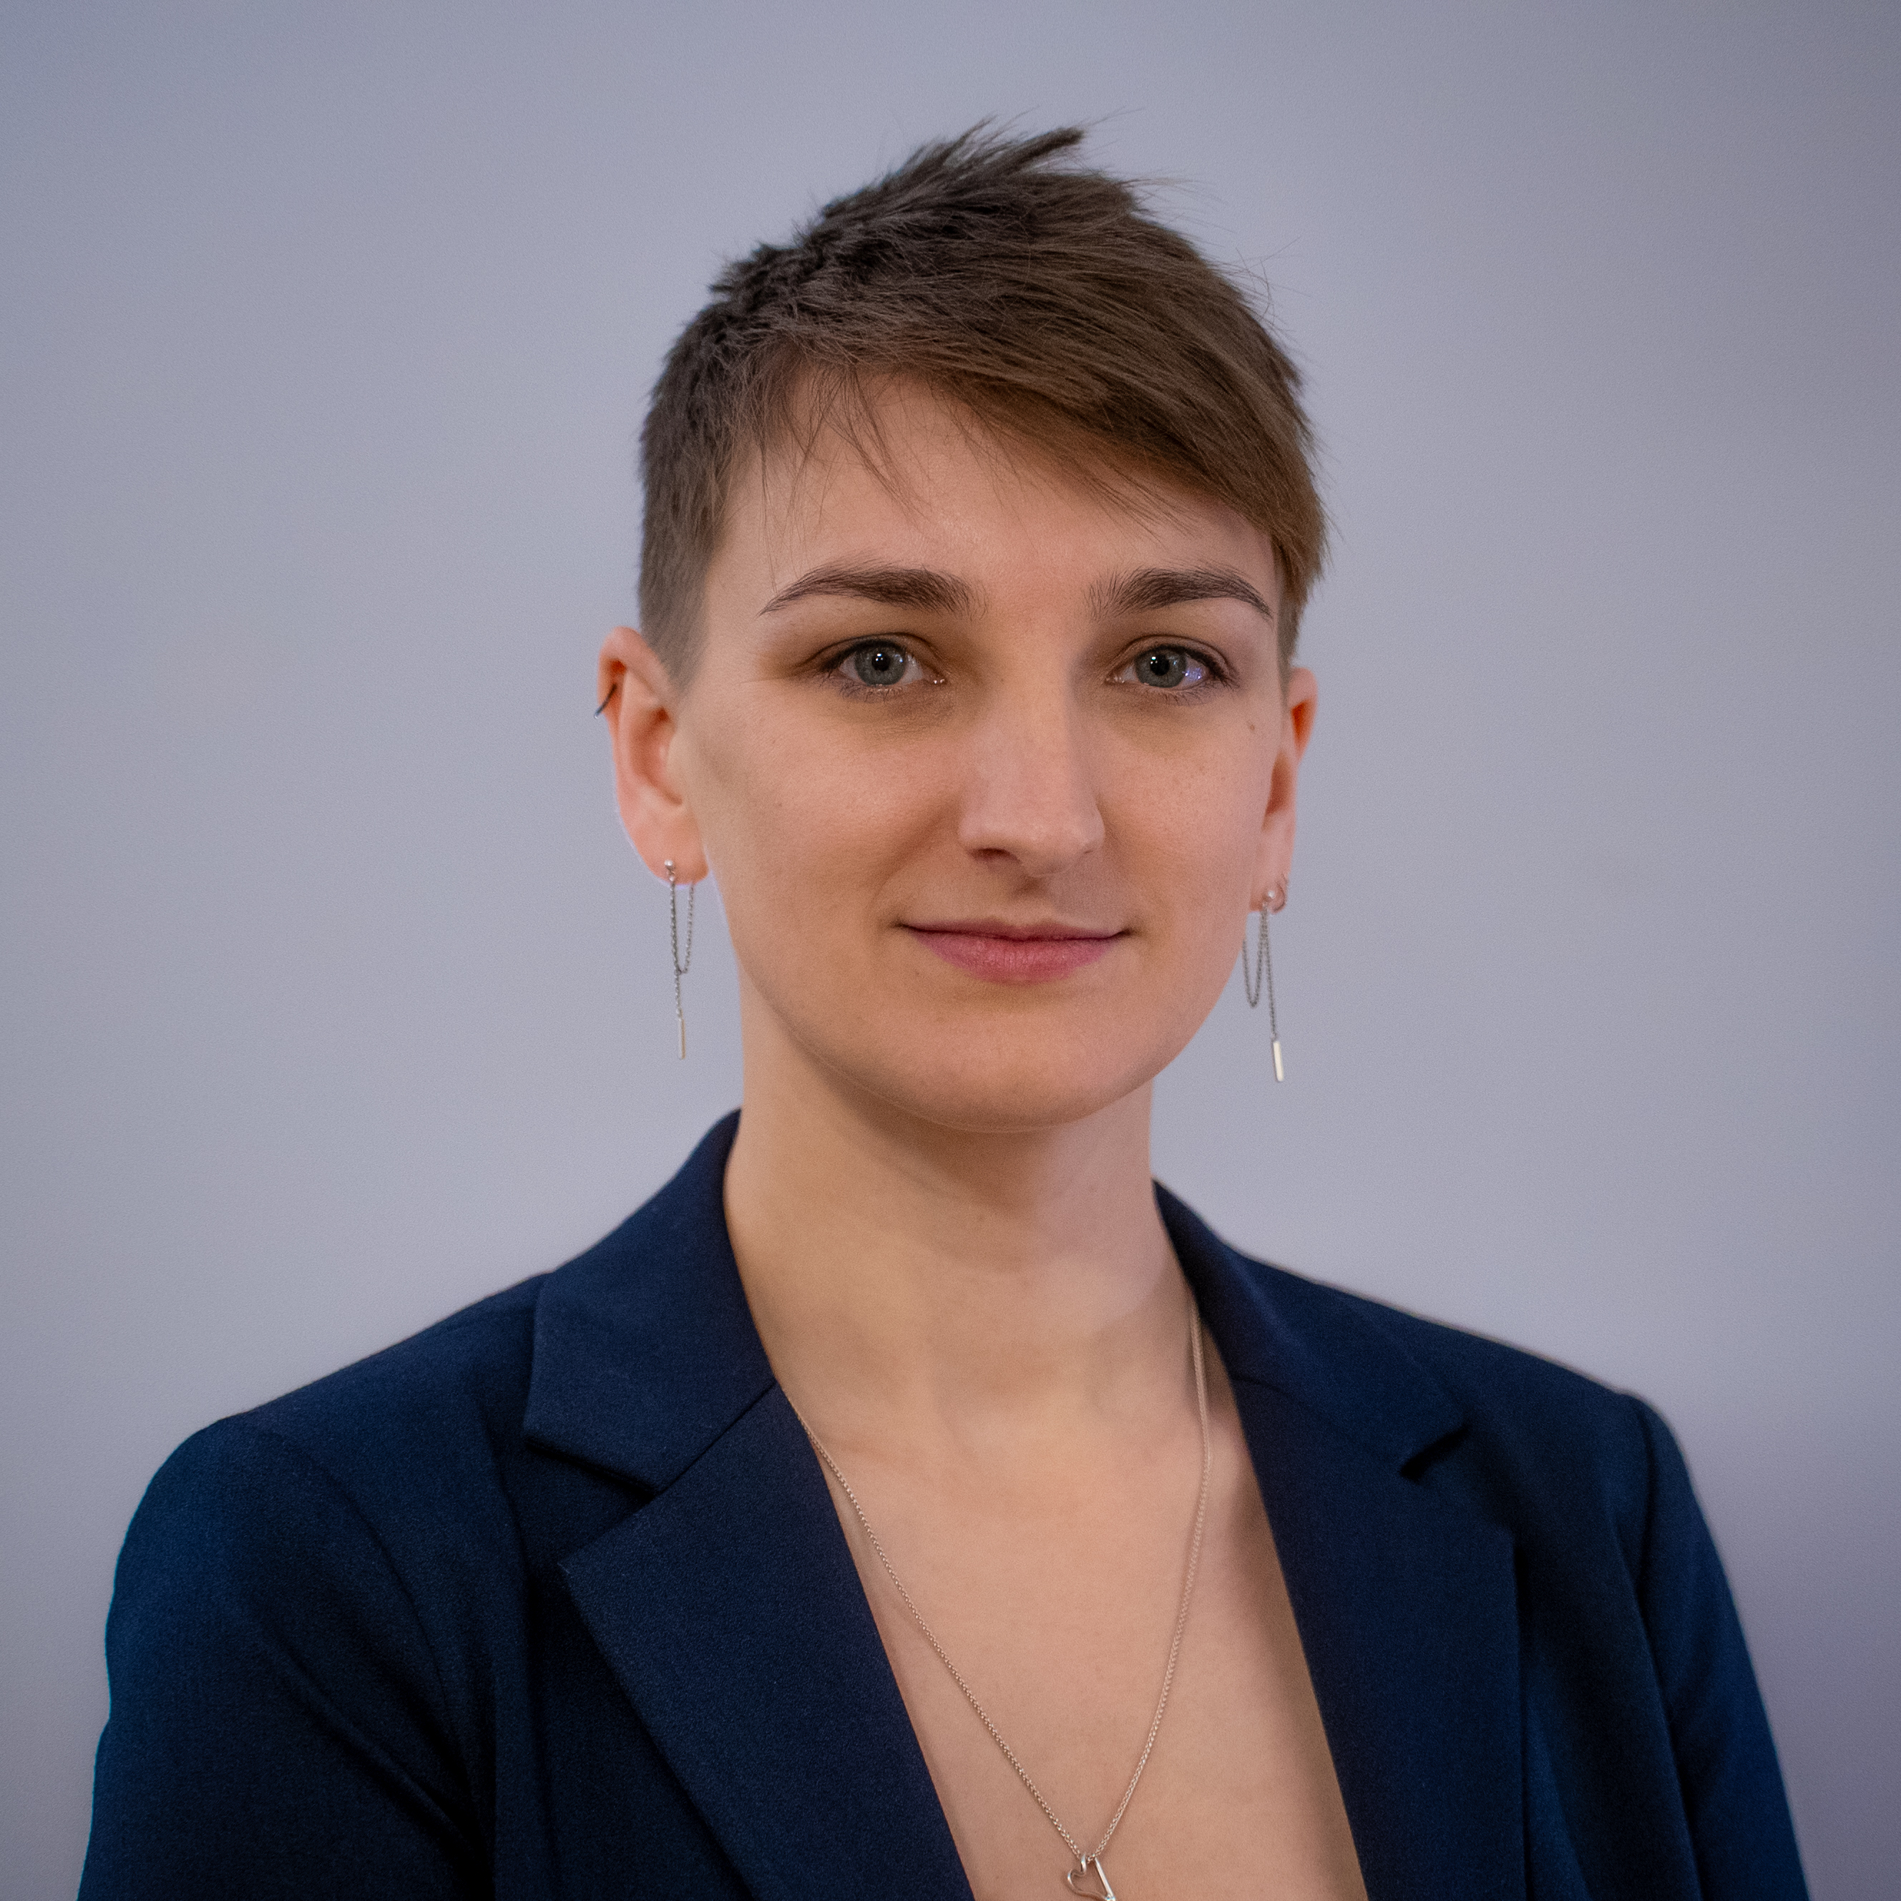
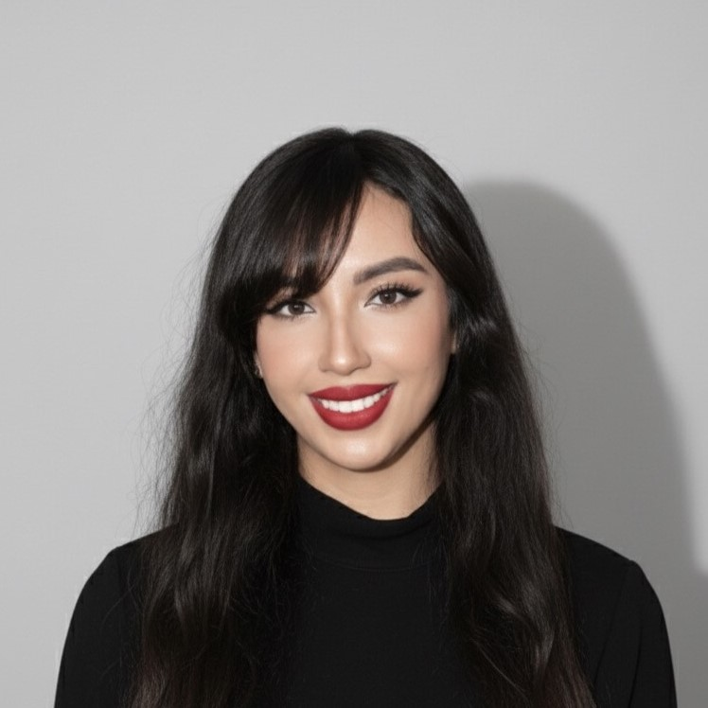
AMBASSADOR PROGRESS
Hannah (Accelerating Sustainability):
Has continued to develop slides for multiples audiences
In contact with several schools
Working with Oxford comms officer to help delivery
Meeting Wed 29th April
Sanae (Accelerator Futures: From Africa to the World):
Has spoken to Morocco and Calabria about collaboration
Will travel to Kenya July 5th to 19th
Requires IUPAP merch
Meeting Wed 29th April

Slide 4
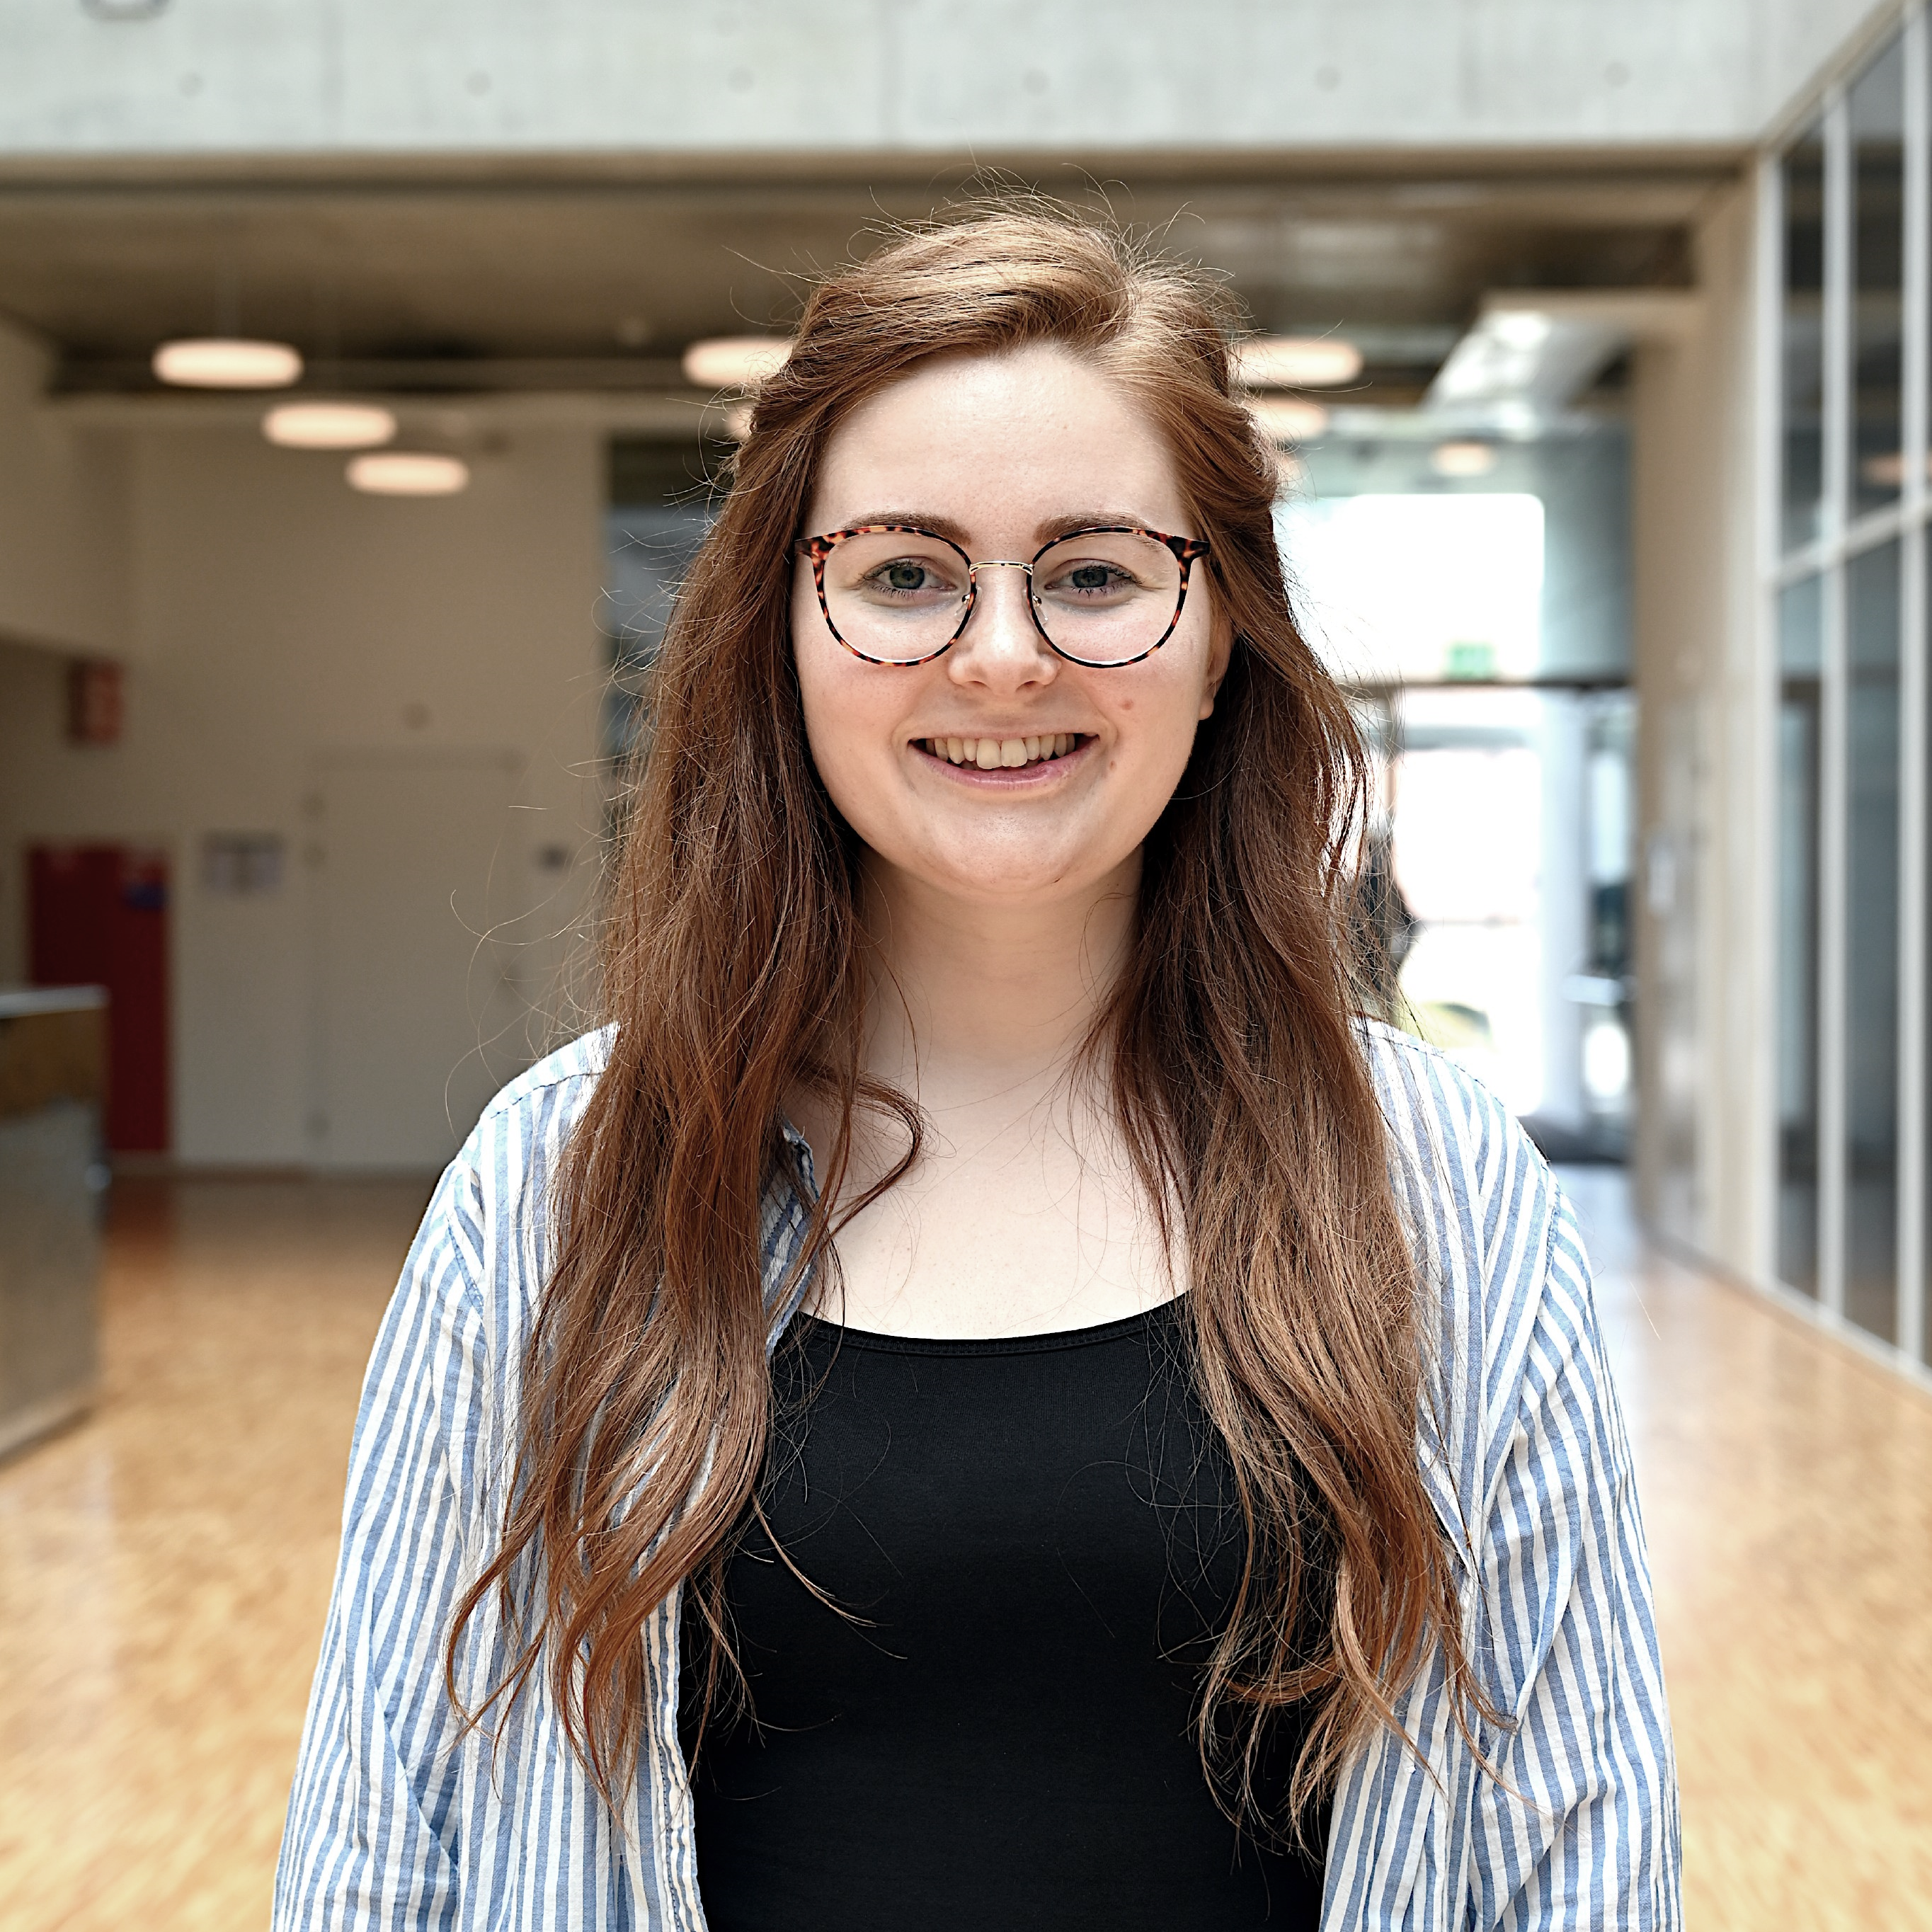
AMBASSADOR PROGRESS
Annabella (Behind the Beamlines):
Reaching out to contacts for podcast
Will make three episodes, with possibility for extension
Meeting Wed 29th April

Slide 5


SCIENCE COMMUNICATION WORKSHOP
Sokoto/Nigeria
Melbourne Australia
France
Milan Italy
Geneva
Tartu/ Estonia
India
Melbourne/Australia
chicago, IL
Indonesia
Darmstadt, Germany
India
Lund, Sweden
Lund, Sweden
Montreal, Canada
Sweden
Kénitra/Morocco
Italy
Hamburg/Germany
France
Geneva
Syracuse, USA
sweden
Jordan
Brazil
UK
Canada
Date changed from late April to early May Unforeseen circumstances led to date change
27-person sign-up so far 16 countries, 5 continents
Multiple scientific backgrounds
85% heard through LinkedIn, 15% through friends

Slide 6
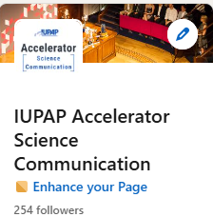
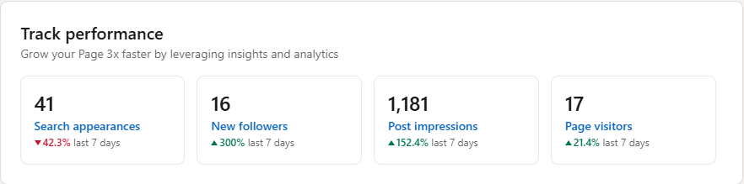
ACCELERATOR SCIENCE COMMUNICATION LINKEDIN
Suggestions for scheduled posts or shared content?
May upload individual 3-minute ambassador intro videos
Will upload project progress later into projects

